Slide 1
Research, Values & Corn-cept Video

Slide 2
Introduction

Slide 3
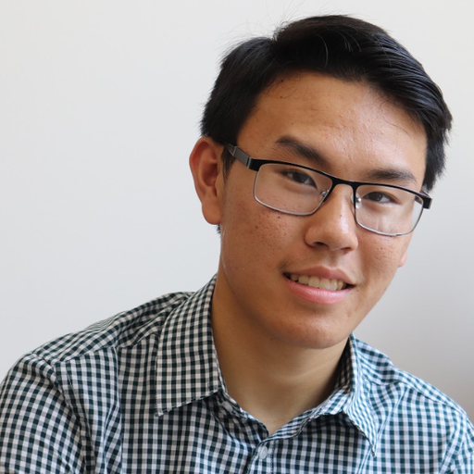
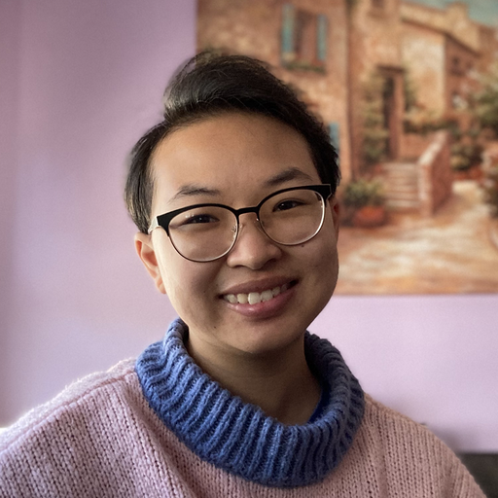
Meet the Team: Foodies!
Andy H. ’23
Dax D. ’22
Star D.
’23
Kyle N.
’23

Slide 4
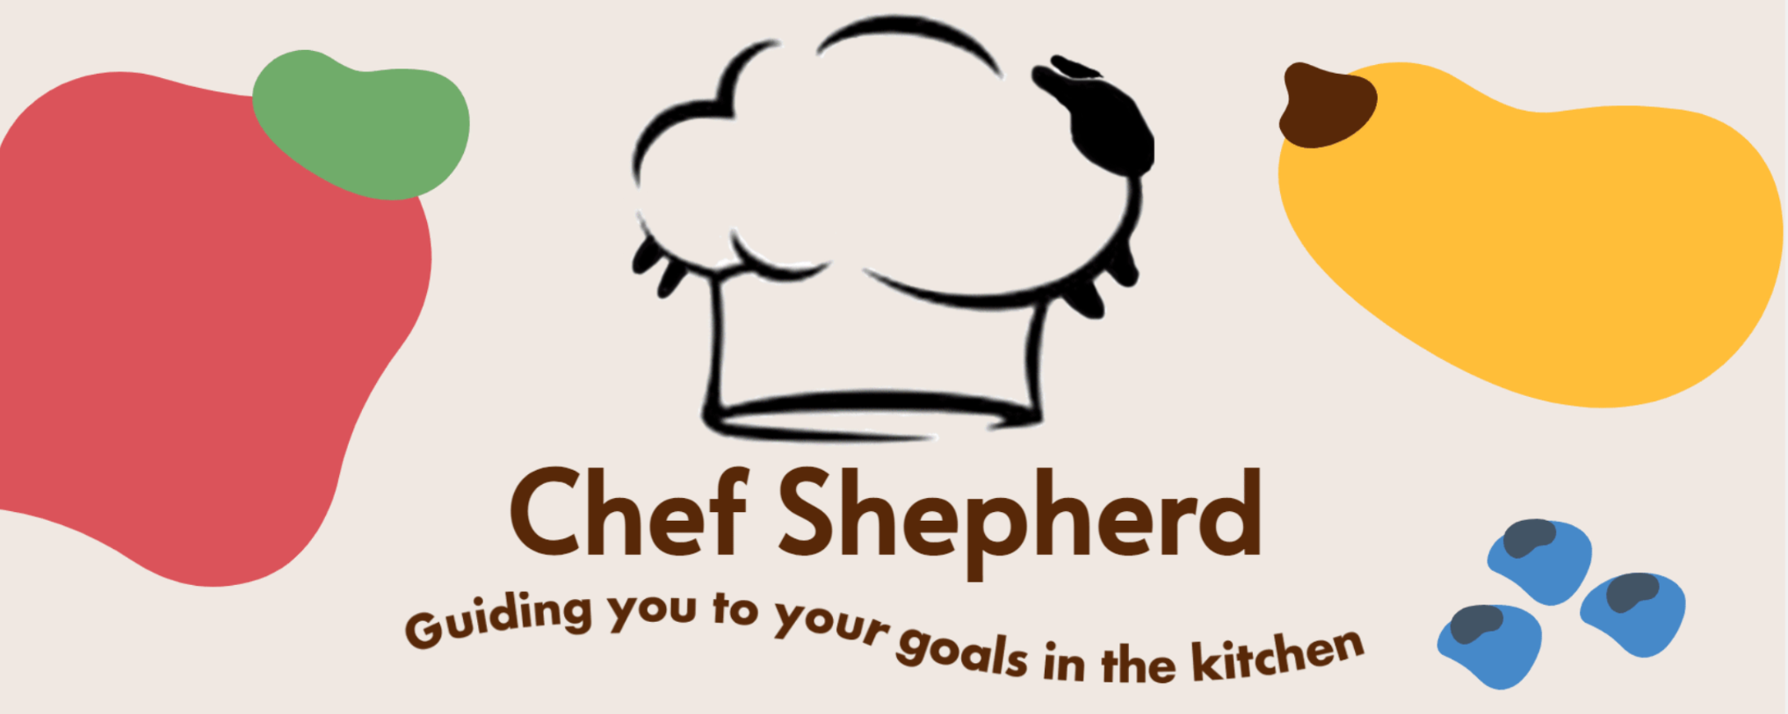
Notes:
The value proposition should concisely convey what customers get out of your product in a short phrase (e.g., stripe.com “Payment infrastructure for the Internet”, evernote: “Remember everything!”).

Slide 5
How might we help people manage uncertainty safely in the kitchen?
An app where you
put in your diet limitations, and it tracks and warns
you as you add things to a
recipe if you’re close to your
limits but otherwise lets
you explore / A cooking companion app that watches as you cook and gives you safety suggestions as you modify the recipe
Notes:
We went from this problem and solution proposal to… (next slide)

Slide 6
Problem/Solution Overview
Regardless of their cooking ability, people may have uncertainty about the recipes they are making - whether that be understanding nutritional value, making modifications, or simply learning techniques. Chef Shepherd is a personalized cooking companion who is meant to advise you based on your needs while also being good company in the kitchen.
Notes:
Your problem/solution overview should be a concise statement (1-3 sentences) of the problem you are tackling and a brief synopsis of your proposed solution.

Slide 7
Market Research

Slide 8
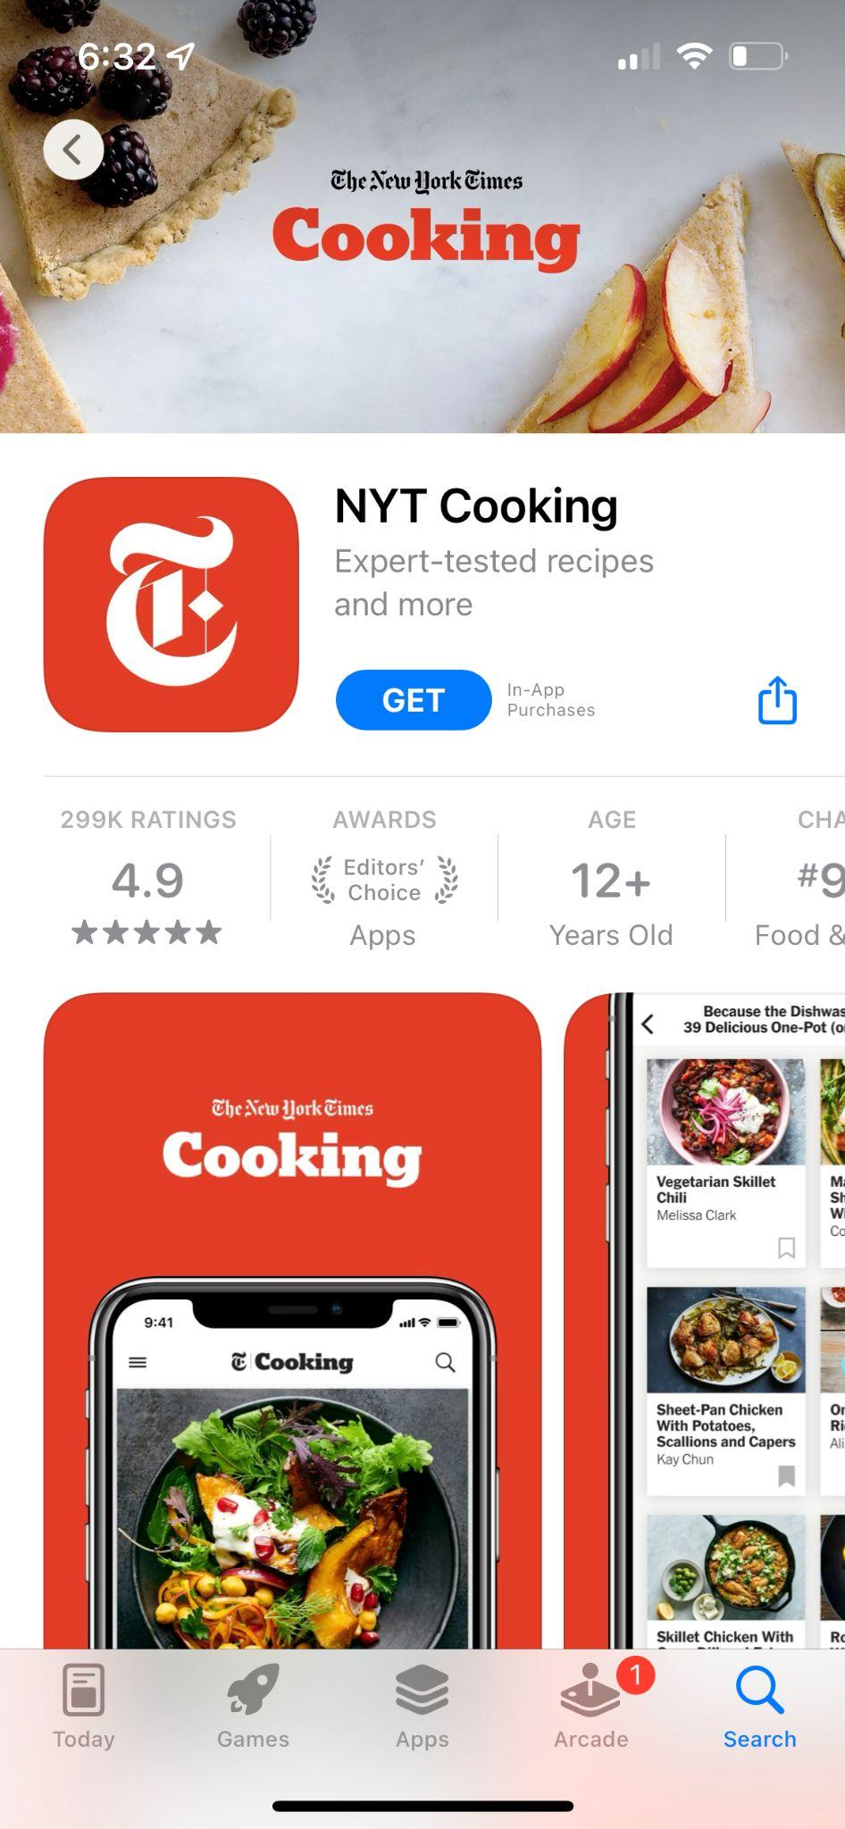
NYT Cooking
4.9 stars - Editors’ choice in the App Store
20,000 expert-tested recipes, curated collection from editors
Search recipes based on meal type, dietary restrictions, cuisine, timing, etc.
Save your recipes and create a grocery list
Techniques for novices and professionals, personalized recommendations
Get advice from home cooks about ingredient swaps (forum)
Notes:
Notes from our research: NYT Cooking
4.9 starts - editors’ choice - 12+
View curated collections from our editors
Very niche dishes I’m sure
Database of 20000 recipes
Search recipes by meal type, diet, cuisine, and more
Vegetarian, vegan, healthy, Times Classics
For one, for two, main course, side dish
weekday, quick, easy
Access thousands of expert-tested recipes
Limits to expert tested recipes
Cook easy-to-follow recipes, every time
Save and organize your favorite recipes
Create your own grocery list
Always-on app screen!
Techniques and tips for novices and experienced home cooks
Personalized recommendations
Get advice from home cooks on ingredient swaps
Price: $4.99 monthly, $39.99 annually
Very credible because everyone knows the NYT

Slide 9
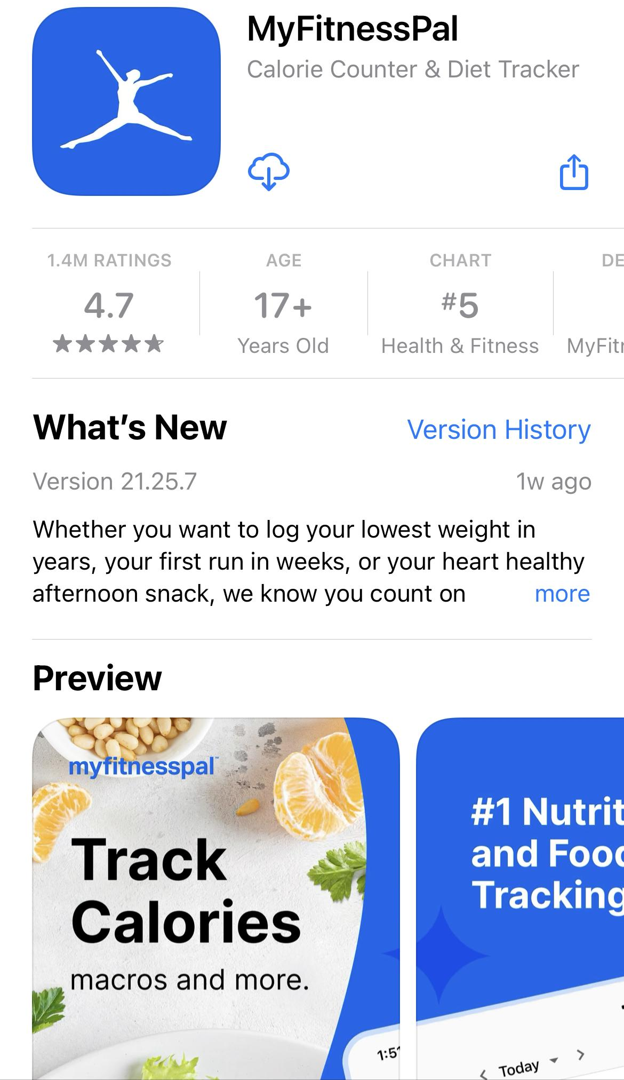
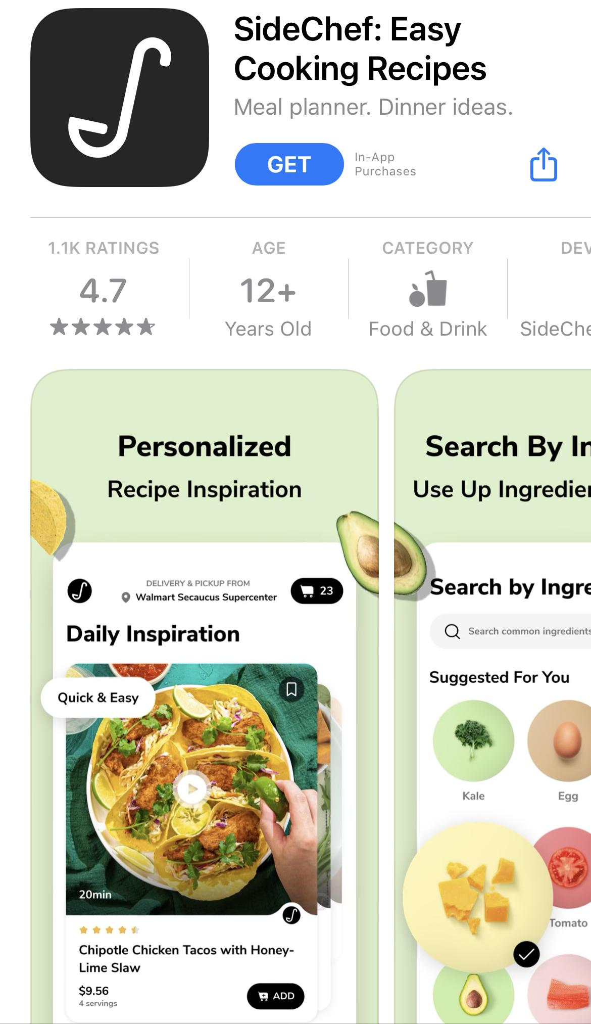
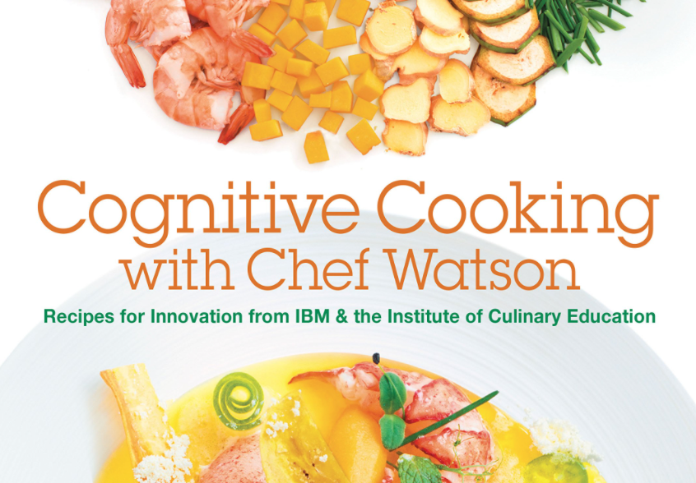
Other products we looked into…

Slide 10
What didn’t work?
How existing solutions differ from our solution?
What did work?
Solutions focused on large diet categories rather than individual dietary needs (e.g. pescatarian, keto, vegan)
Some solutions aren’t considerate of novices (e.g. NYT cooking recipes are complex)
Many existing solutions use static recipes, unable to be adapted as you modify a recipe while cooking
Not all solutions were concerned with nutrition, only completing the recipe
Their solutions did not offer feedback on cooking
User-friendly, sleek interfaces are attractive
Data-driven / AI – MFP uses a large database of foods, NYT uses a large recipe base
Personalizable with respect to individual nutrition goals and taste preferences, since everyone eats differently

Slide 11
What makes our solution different?
Freedom to deviate from the recipe as you cook
Companionship/emotional support
Parasocial relationship
Enhanced specificity with dietary restrictions
Live feedback as you cook

Slide 12
Tasks
Notes:
Together, they should capture the core value prop of your product and address the problem you’re tackling. Label them as simple, medium, and complex.

Slide 13
Simple
I want to cook a recipe with a social companion to keep me company.
I want live feedback on how well I’m cooking while I make a recipe.
Moderate
I want to make personalizations while cooking a recipe while still being secure in meeting my nutrition goals and taste preferences.
Complex
I want to make a meal without a recipe (maybe with a general idea), while still being secure in meeting my nutrition goals and taste preferences.
I want a long-term parasocial relationship with my cooking companion.

Slide 14
Values in Design

Slide 15
We are designing a Cooking Companion with the guiding values of health, inclusion, wellness.
Notes:
include a statement about the values embedded in the project

Slide 16
How do we encode these values?
Chef Shepherd promotes health by helping people cook meals that meet their individual nutrition goals. We promote inclusion by recognizing that everyone eats uniquely and therefore can customize Chef Shepherd to their diet category (omnivore, vegan, pescatarian, etc.) and specific needs (sodium, sugar, etc.). We also recognize that wellbeing is holistic and extends beyond nutrition. Therefore, we promote wellness more generally, via nutrition but also via the social companionship that Chef Shepherd offers.
Notes:
how you intend to encode these values.

Slide 17
Conflicting Values
Health may conflict with wellness since we take health to mean nutritional health, while wellness is a more holistic term for a person’s overall well-being. It might be appropriate for a person to occasionally cook meals that would be considered unhealthy if it contributes to their wellbeing (Ex. 1).
Health might also contradict inclusion. It is difficult for a truly inclusive cooking app to adopt universal standards for what is “healthy” for all people. Health needs vary, and if we want to include all users, we have to take special care to consider what we promote as “healthy” or “unhealthy” to our users.
Notes:
Example 1: What if, for example, a person wants to make a meal that impresses their friends and family (wellness) but in the process might sacrifice taste for nutrition (health)? (In fact, this example comes directly from one of our needfinding interviews.)

Slide 18
How do we address conflicting values?
We will address the health-wellness conflict by committing to never prevent users from making an “unhealthy” decision since we recognize that Chef Shepherd cannot know the context of a person’s food decisions in the context of their overall wellbeing. Instead, we will adopt language that suggests that foods may be unhealthier, and encourages users to reconsider rather than force users to change.

Slide 19
How do we address conflicting values?
We will address the health-inclusion conflict by committing to make fine-grained decisions about what we promote as healthy or unhealthy for a person. As much as possible, we will learn on user-provided data about what is considered healthy in regards to their specific needs. This puts users in the driver’s seat when it comes to the health/inclusion contradiction. If possible, Chef Shepherd will work together with users to develop this data by providing educational tips while users input their health standards so that users are making well-informed health decisions.

Slide 20
Video Storyboard
Notes:
: Storyboard up to three different scenes (corresponding to your 3-5 tasks above). Make sure to focus on how you would prepare and organize them for your filming (i.e., angles, zoom level, actors, dialog/narration/captions)

Slide 21
Notes:
Maybe making food a social activity would ease Julia’s embarrassment
Daniel derived a lot of value from sharing his food and culture with others as well as learning about others’ cultures through their food

Slide 23
Video

Slide 25
Thanks!

