Slide 1
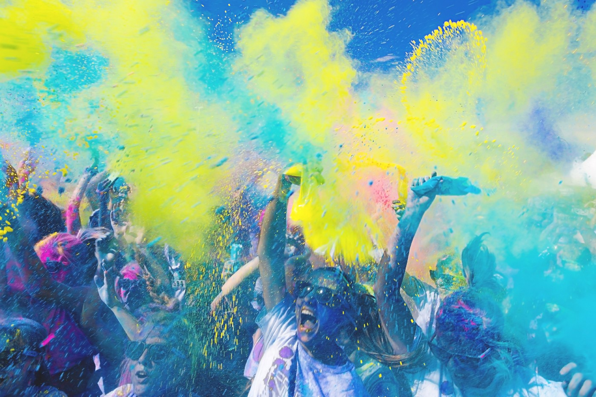
Entourage
Connecting artists and fans through music NFTs

Slide 2
Overview
1
Exploring Designs
2
Low-Fi Prototype
3
Usability Testing & Results

Slide 3
Entourage
Our goal is to enhance the music consumption experience of music listeners through music NFTs campaigns released by musicians, with ownership providing fan status, exclusive content, and community engagement with other fans.

Slide 4
1
Exploring Designs

Slide 5





Our Selection
Phone
Desktop
Wearables
Map-based Focus
Voice Assistant

Slide 6
Our Selection
Phone
Desktop
Wearables
Map-based Focus
Voice Assistant

Slide 7
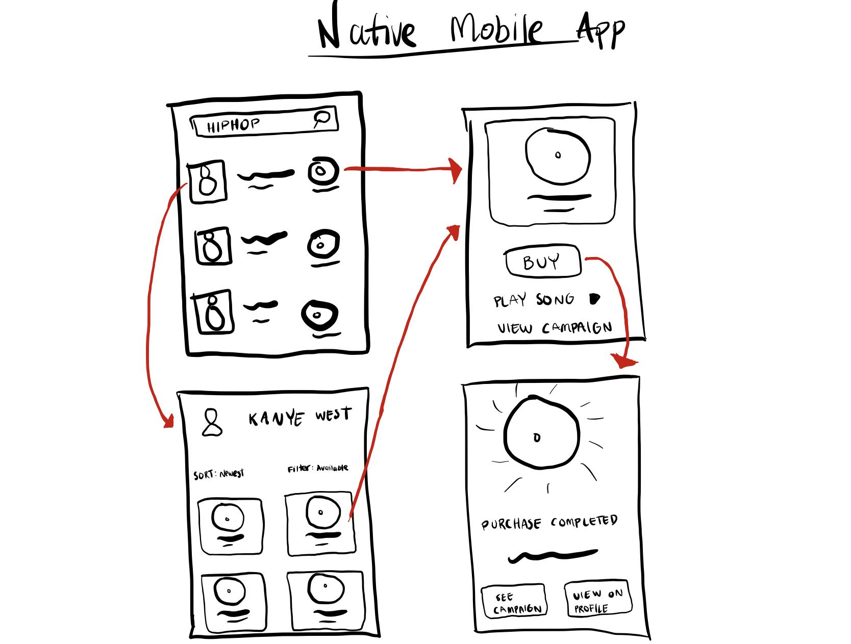
Phone Storyboard
Phone

Slide 8
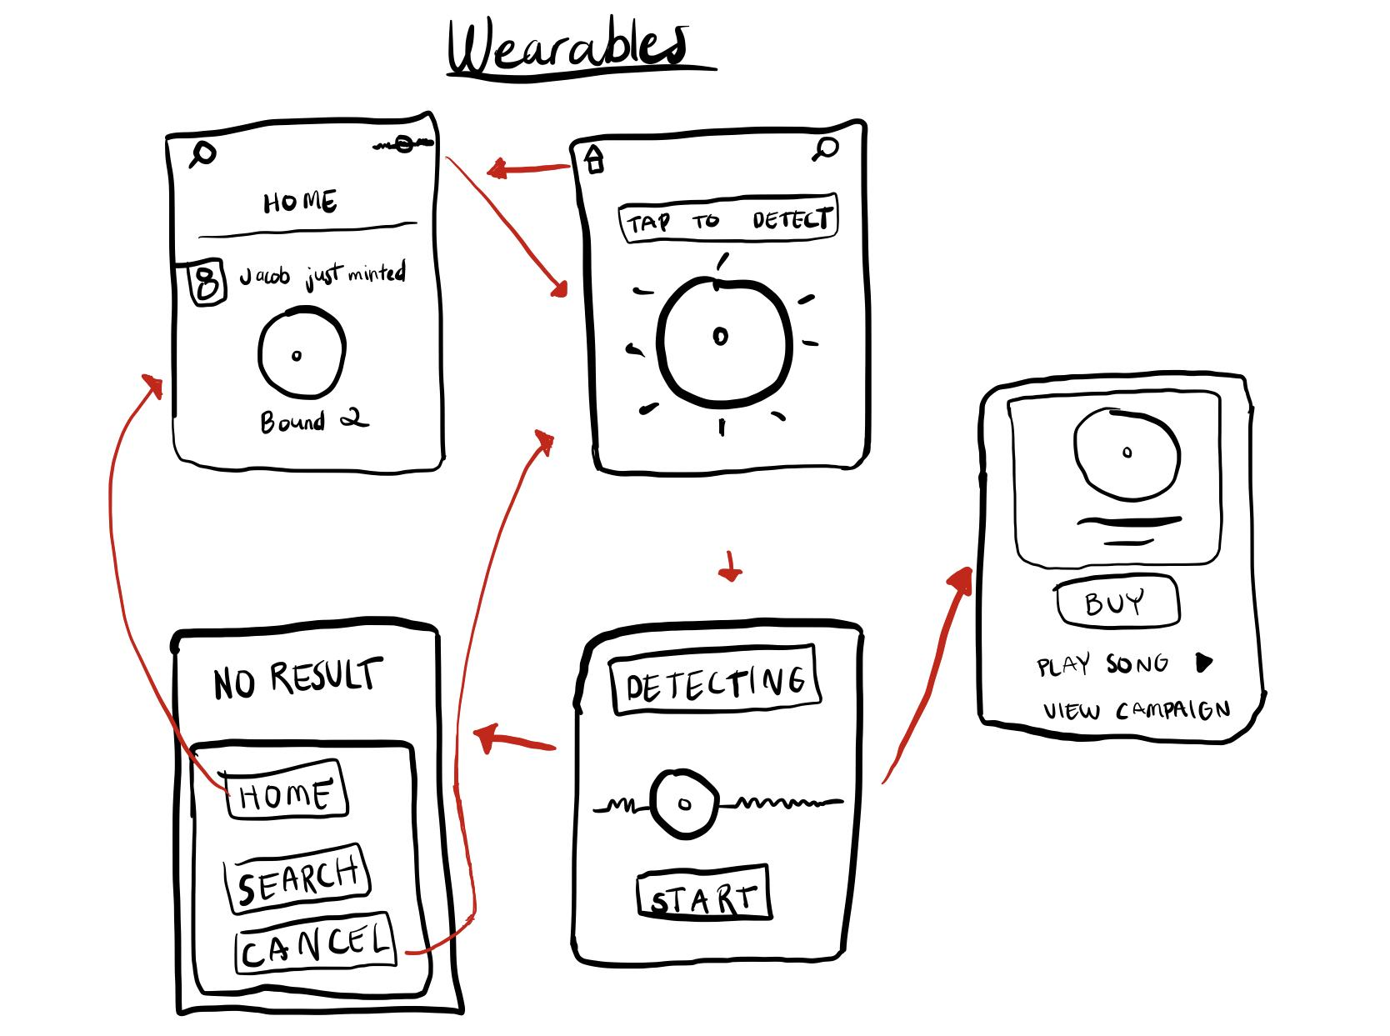
Wearables Storyboard
Wearables

Slide 9
Selected Interface
Phone

Slide 10
2
Low-Fi Prototype

Slide 11
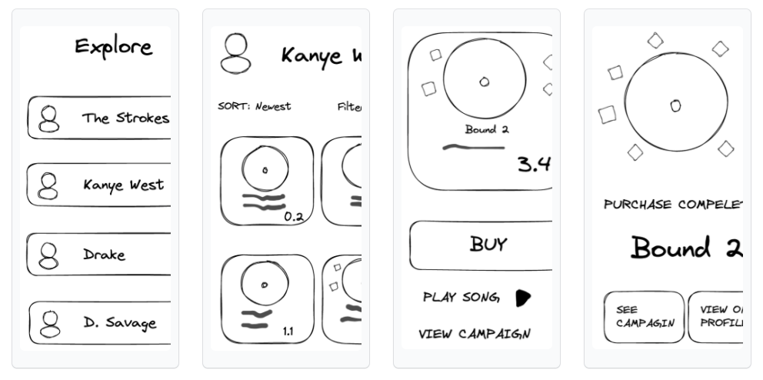
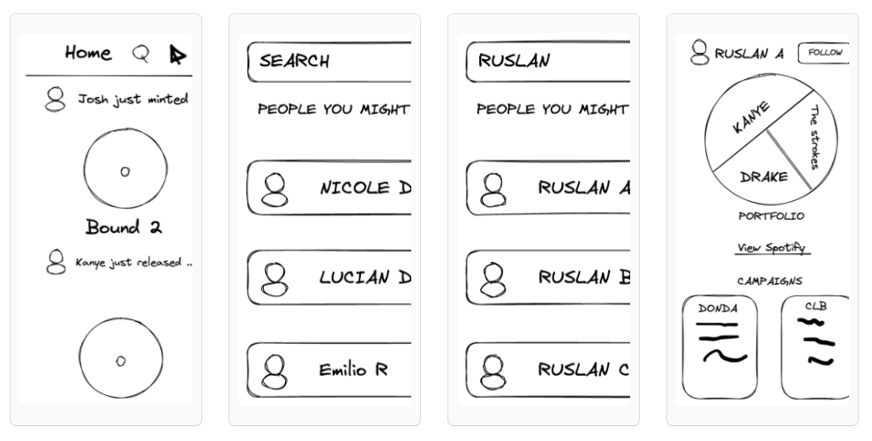
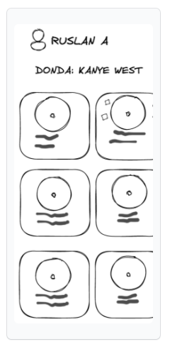
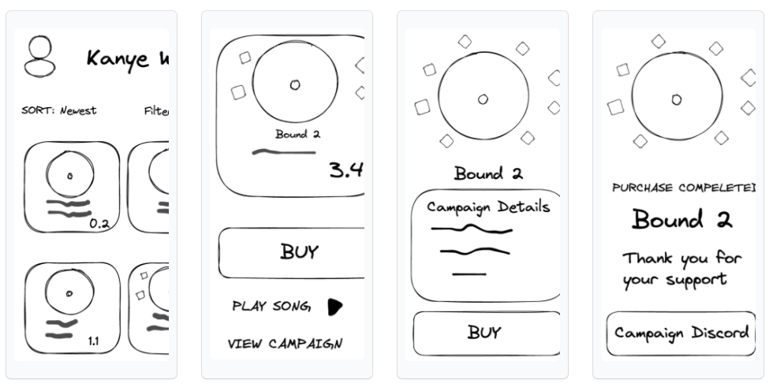
Prototype Structure
BUY
FOLLOW
CONNECT

Slide 12
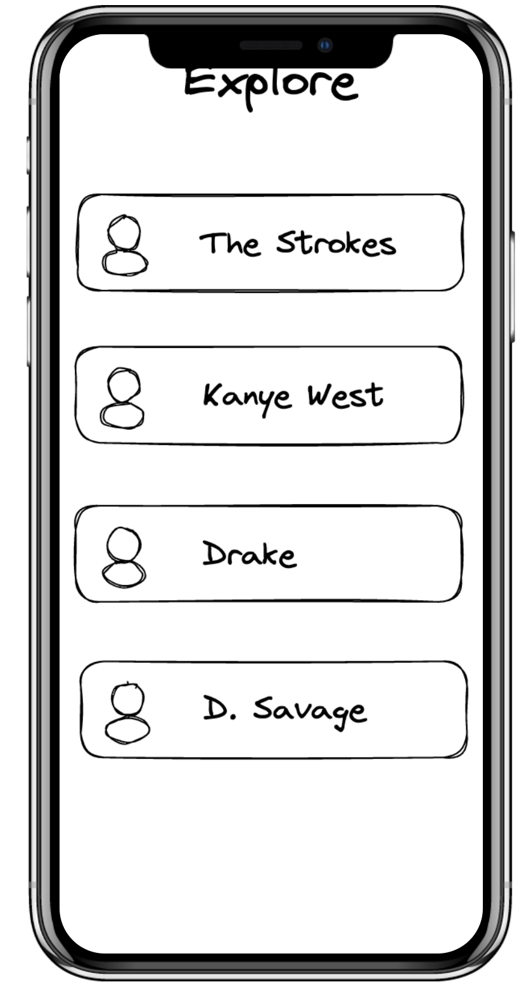
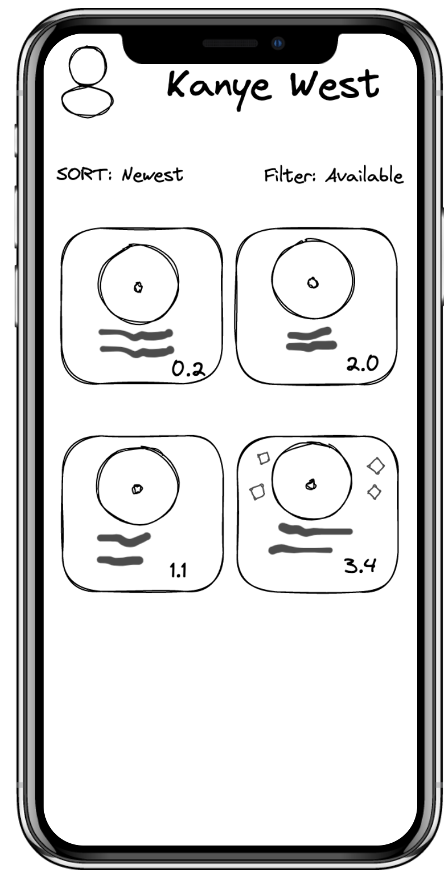
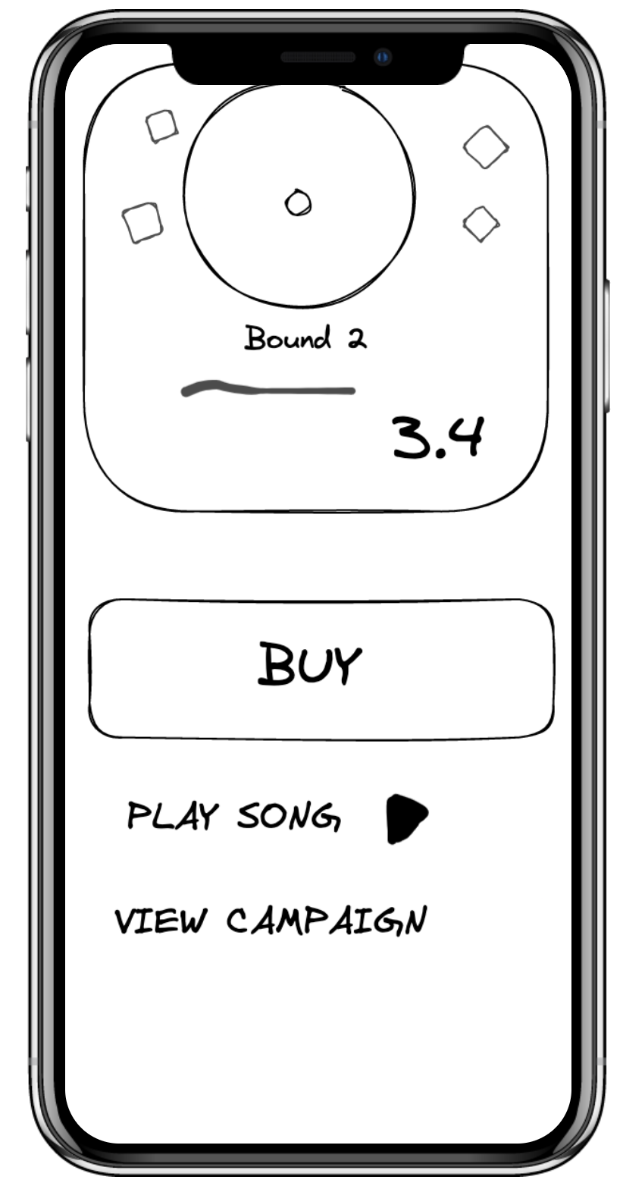
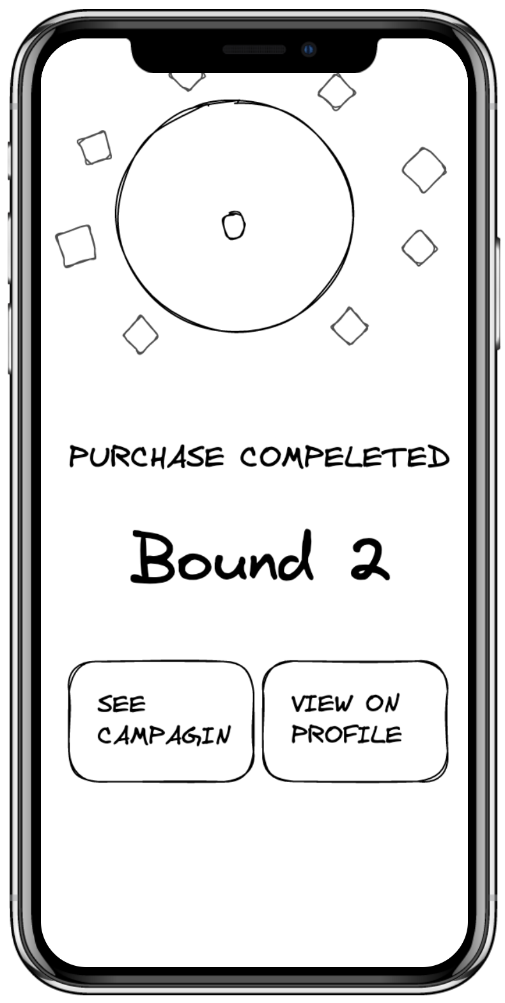
Task
1
Simple Task: Purchase a music NFT

Slide 13
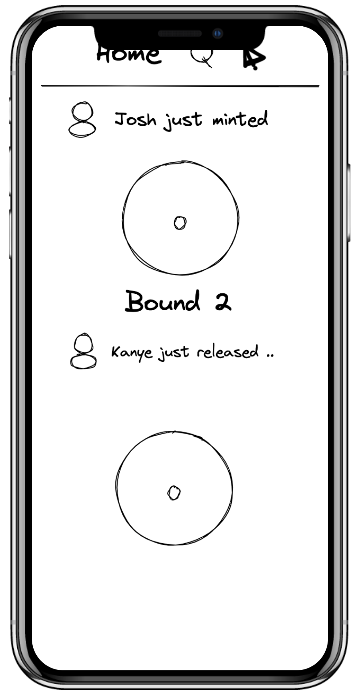
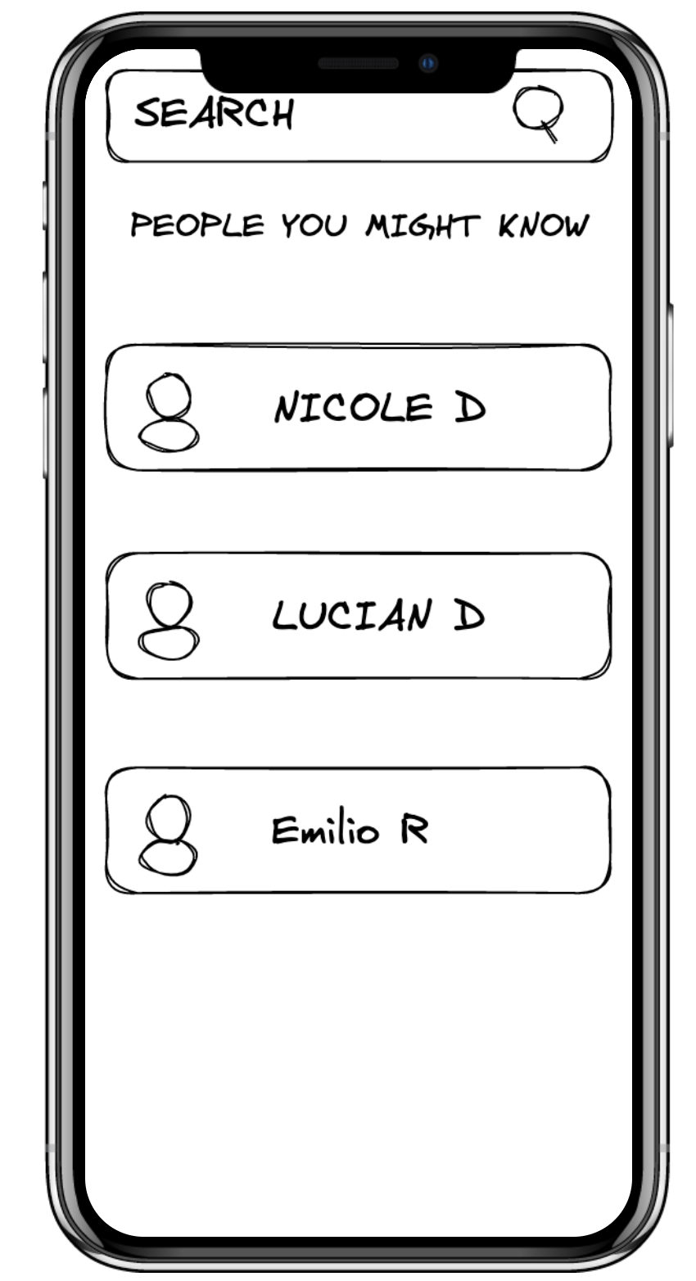
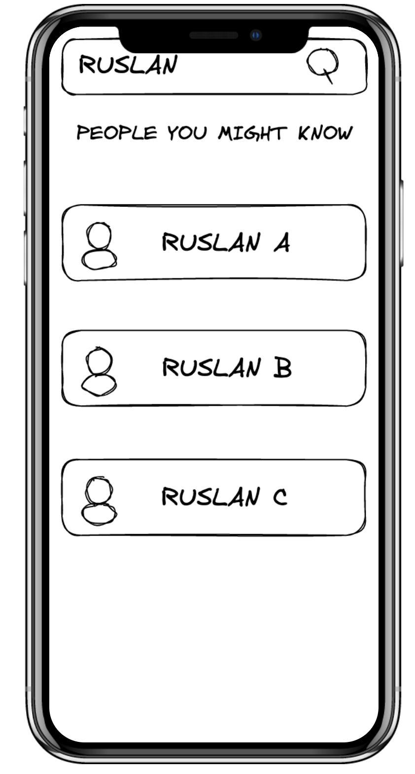
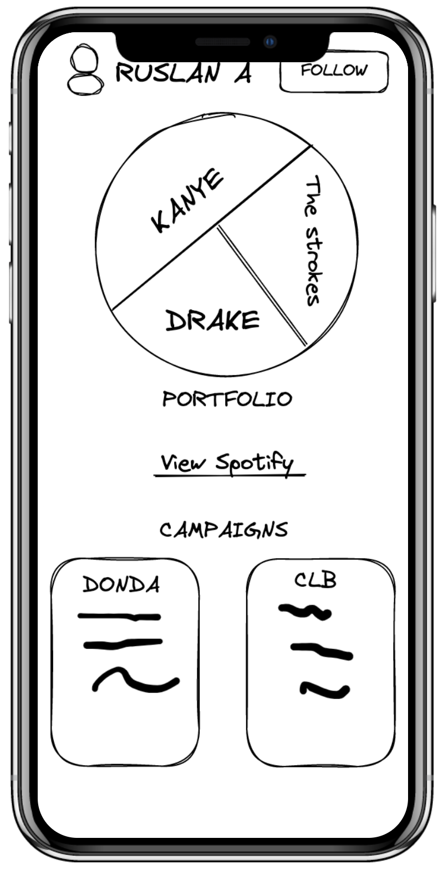
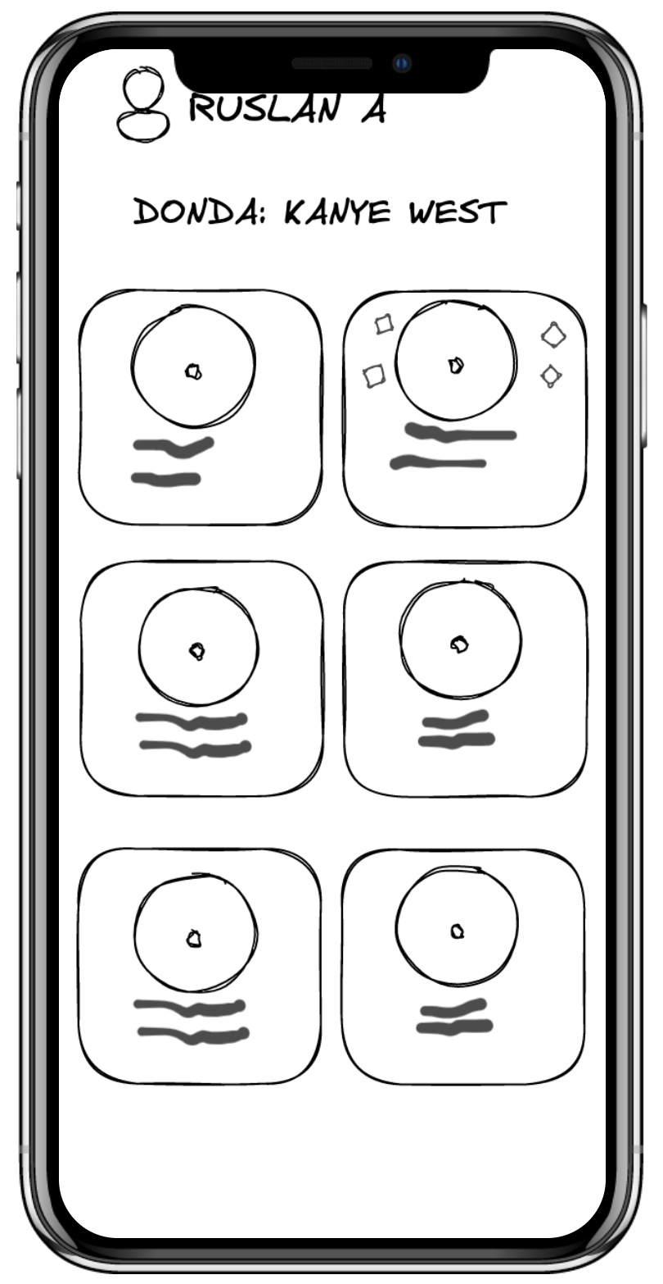
Task
2
Moderate Task: Search & follow friends to view their music NFT portfolio

Slide 14
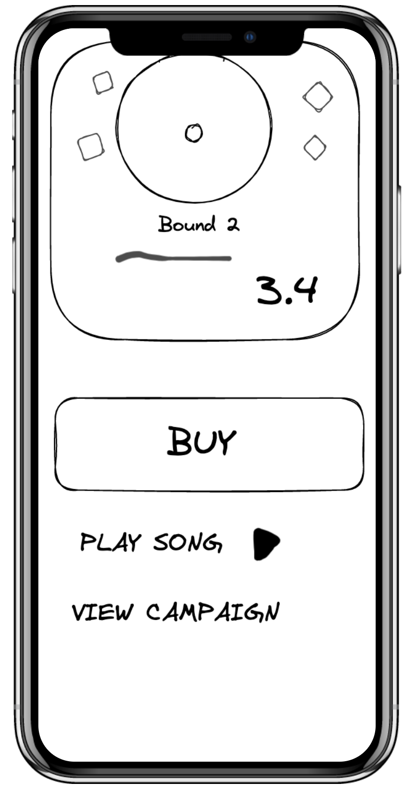
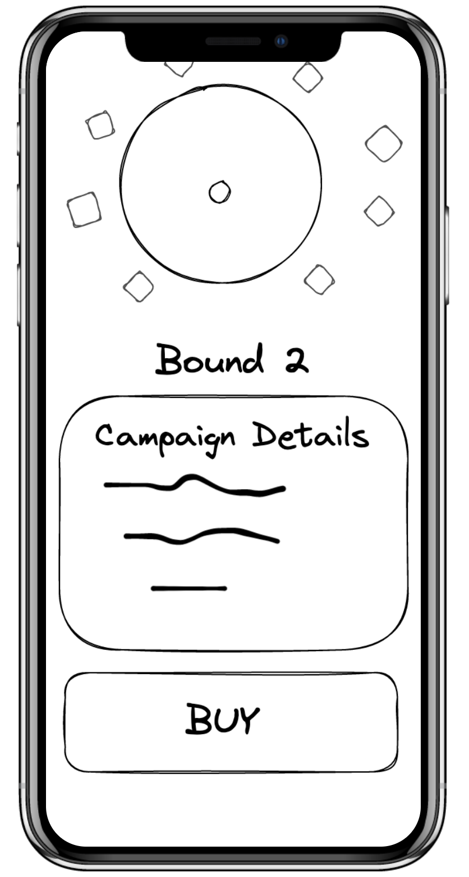
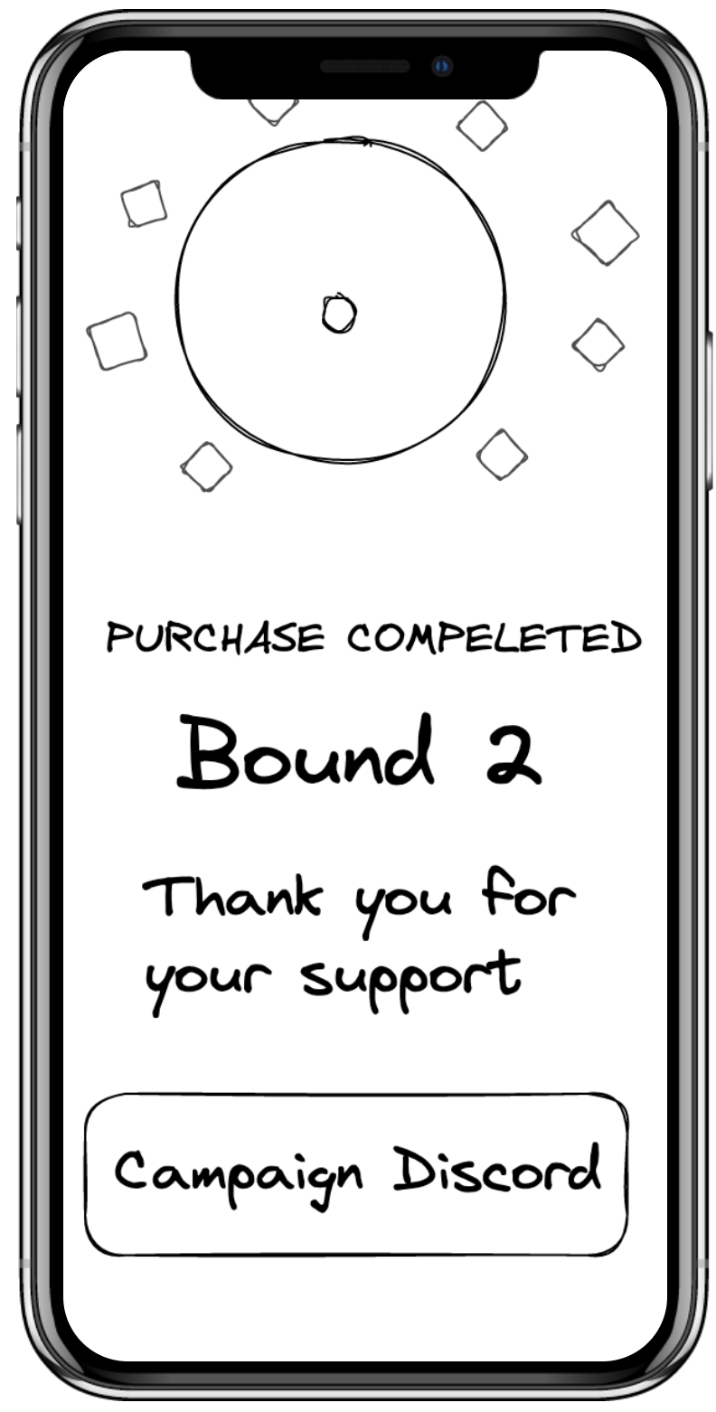
Task
3
Complex Task: Join a campaign/event

Slide 15
3
Usability Testing
&
Analysis

Slide 16
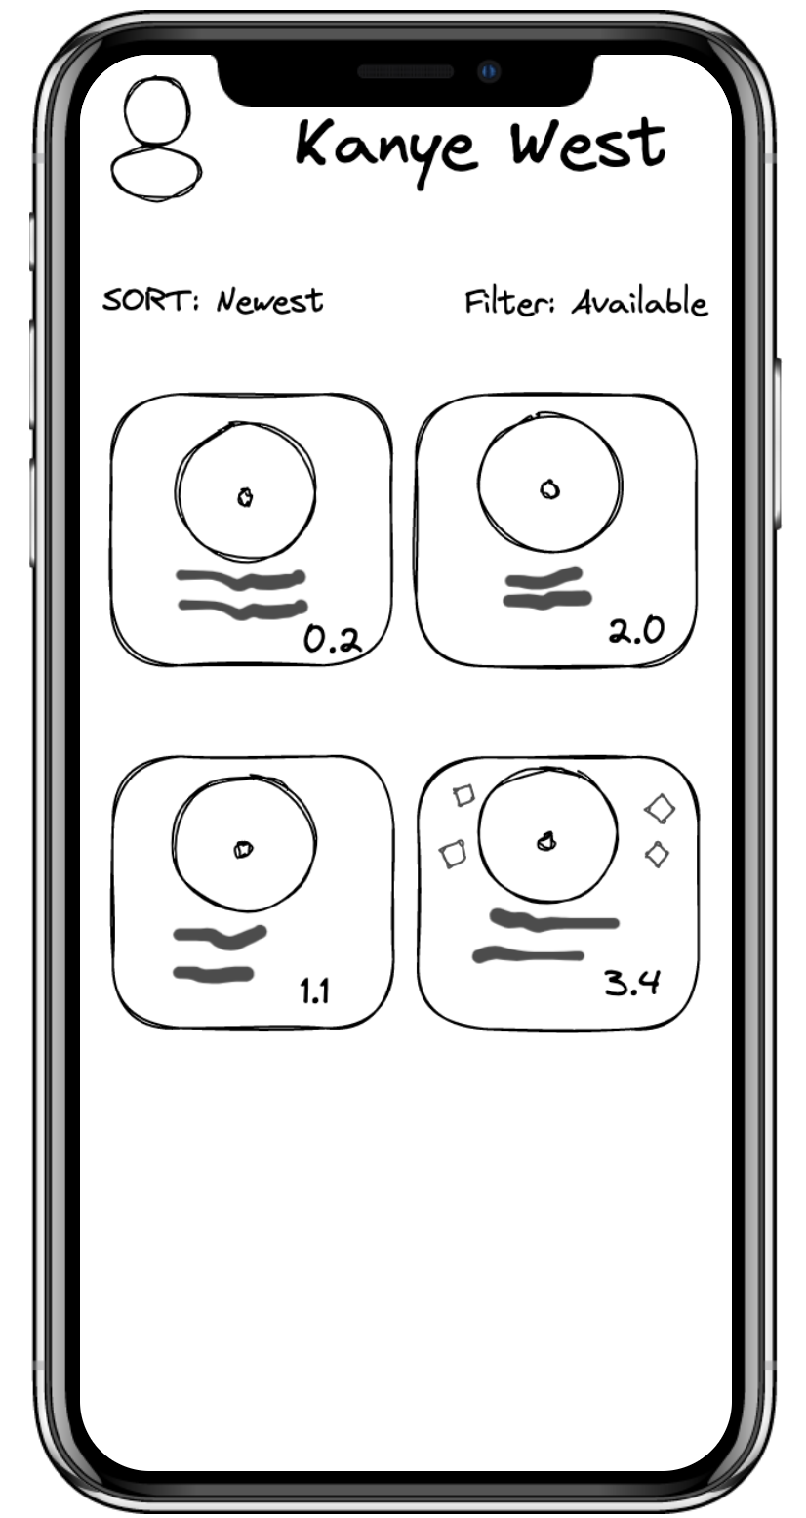
Experimental Method
Zoom Call (Participants Shared Screen)
Leveraged Sketches & Marvel POP
Completed 3 Tasks
No Compensation

Slide 17



Participants
Participant #1
Participant #2
Participant #3
Influencer
25 y/o
Business student
21 y/o
Student
21 y/o
Notes:
Alahji

Slide 18
Breakdown
Participants shared screen a & completed the tasks, one by one
Participants gave feedback on experience
Gave overview of Marvel demo
Notes:
Alahji

Slide 19


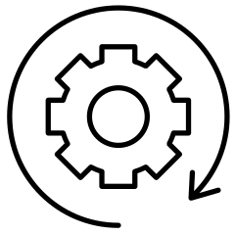
Results
SUCCESSES
Searching for other users on platform was easy
Liked being able to see other people’s NFT collection
Process to purchase music NFTs was straightforward

Slide 20

Results
“I really like that you can use the search feature instead of having to just scroll endlessly to find what you’re looking for.”
Participant #2
Business student
21 y/o

Slide 21
Results
“It’s cool that you can see other people’s NFT portfolios.”
Participant #3
Student
21 y/o

Slide 22


Results
FAILURES
Confusion with pie chart
UI for purchasing NFT is crowded

Slide 23
Results
“I do not like the pie chart. It is confusing. What is it for?”
Participant #1
Influencer
25 y/o

Slide 24
Results
“UI is a bit crowded when buying an NFT.”
Participant #3
Student
21 y/o

Slide 25
UI Change
1
Clarify
2
Simplify
Redesign the pie chart so that users can easily tell how to access their NFT collection
Remove additional features on page such as “play song” and “view campaign” to highlight the purchasing process

Slide 26
SUMMARY
1
Simplify UI
2
Clarify Concept

