Slide 1

Entourage
Peer-to-peer music NFT marketplace to support your favorite musicians

Slide 2
Problem
1
Lack of verifying that you’re a superfan
2
Lack of community in the music NFT space
3
Lack of familiarity with NFTs

Slide 3
Solution
A social investing platform allowing superfans to bond over buying and selling music NFTs to support their favorite musicians and join exclusive communities

Slide 4
Market Research: Part I
 | ENTOURAGE | SOUND.XYZ | ROYAL
Social investing
Buy and sell limited music NFTs
Access to exclusive events hosted by musician
Verified superfan status
✔
✔
✔
✔
✔
✔
✔

Slide 5
Market Research: Part II
Unlike our competitors, Entourage have not neglected the social aspect of music. We are building communities & fostering relationships through music NFTs, allowing users to connect with each other and discover new artists

Slide 6
Tasks
Simple Task
Mint NFTs to financially support your favorite musicians, verify that you’re a superfan status
01
Moderate Task
Follow other users and see each other’s music NFT collection
02
03
Complex Task
Join campaigns and exclusive events hosted by your favorite musicians

Slide 7
Values in Design
At the heart of our design values are transparency, security and inclusion. While our goal is to introduce more people to the music NFT space, an artifact that arises is exclusion (which stems from NFT artists creating exclusive communities). We aim to combat that by encouraging the creation of more communities to allow users to find a home on our platform.

Slide 8
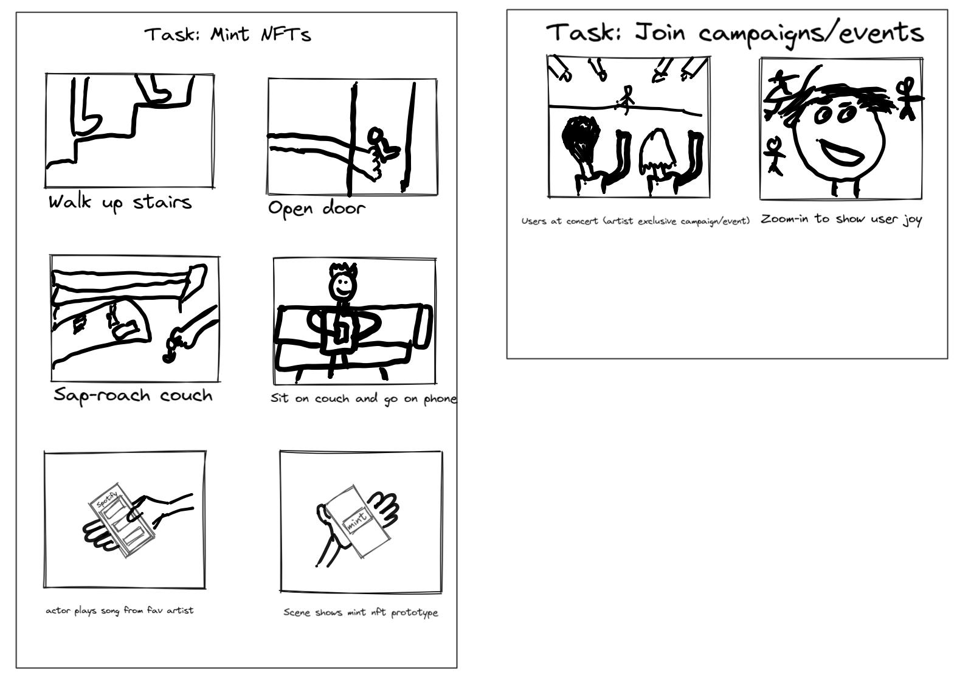
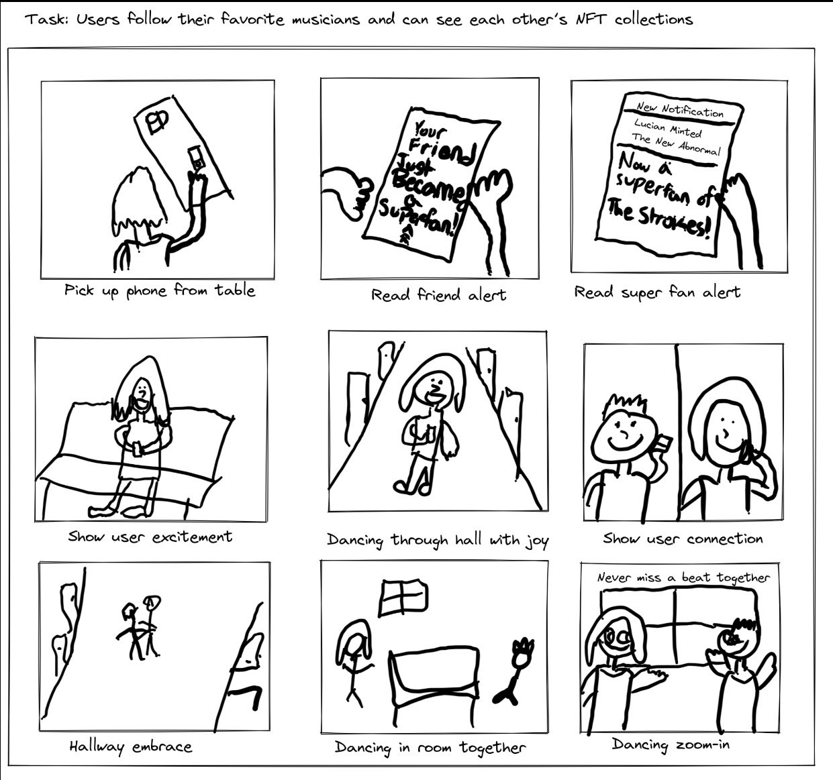
Our Storyboard

Slide 9
Thank You :)

