Slide 1
Team 3

Slide 2
Art and Digital Media:
1
Problem Domain → Digital Assets/Collectibles

Slide 3
Introductions
Emilio
Stanford ‘24 Mathematics/CS Orlando, FL
Ruslan
Stanford ‘23 Computer Science Palestine
Alahji
Stanford ‘23 Computer Science Atlanta, GA
Nick
Stanford ‘23 Computer Science Danville, CA

Slide 4
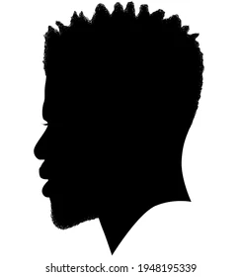


Our Participants
Jimmy
Stanford
CS
Mountain View, CA
John
Georgia Tech
Business
Atlanta, GA
Jennifer
UF
Engineering
Orlando, FL

Slide 5
Knowledge
Jimmy
Jennifer
Fondness
John

Slide 6
Guiding Questions
How do you expose yourself to digital media?
How do you share digital content you enjoy?
What do you value about digital assets?
What sorts of digital assets have you interacted with?

Slide 7
Results

Slide 8
Jimmy
“I judge anyone who spends more than double digits on digital assets”
Worked on in-game transactions, has a distaste for digital assets
“I don’t have the disposable dignity for NFTs”

Slide 9
John
“I currently view NFTs and cryptocurrency as a business opportunity and nothing else.”
Avid gamer, interest in digital collectables and cryptocurrency

Slide 10
Jennifer
“I am a person who does not like to print files. I like the convenience of having everything stored on my devices. If something can be stored digitally, what is the need of owning them physically?”
Business owner; an environmentalist and a proponent of being sustainable

Slide 11

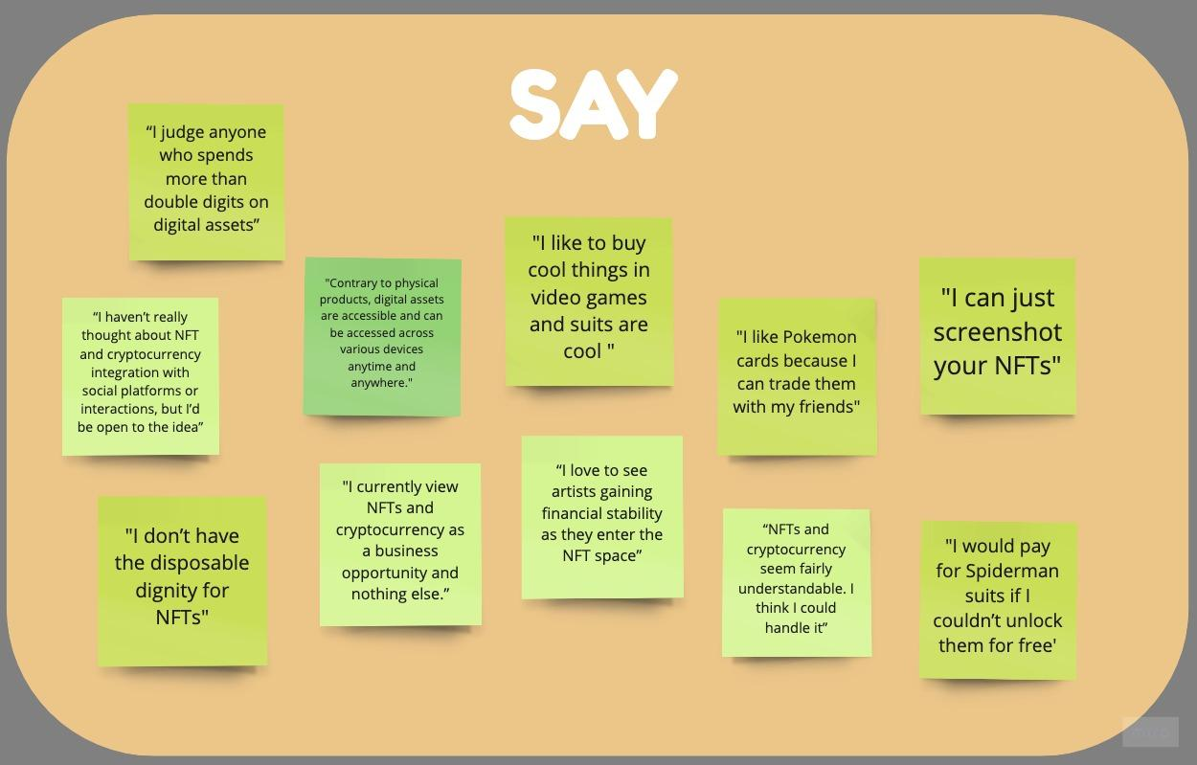
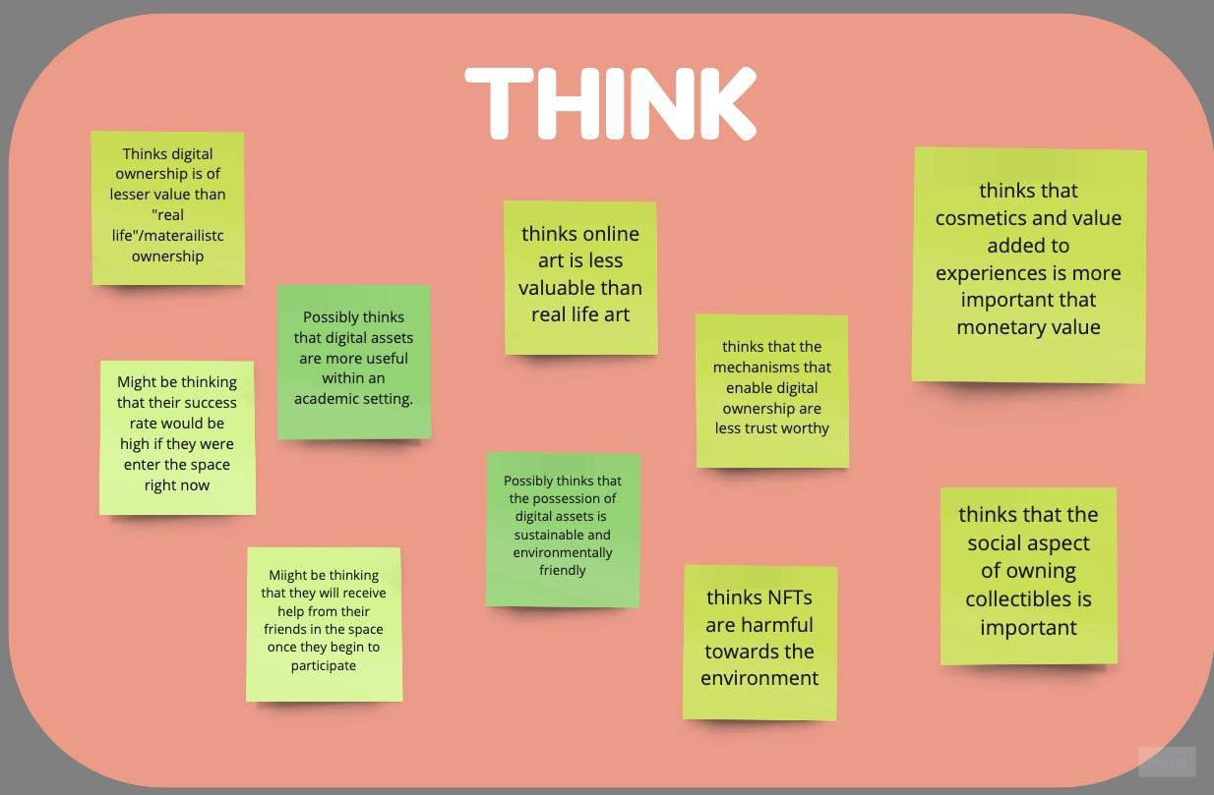
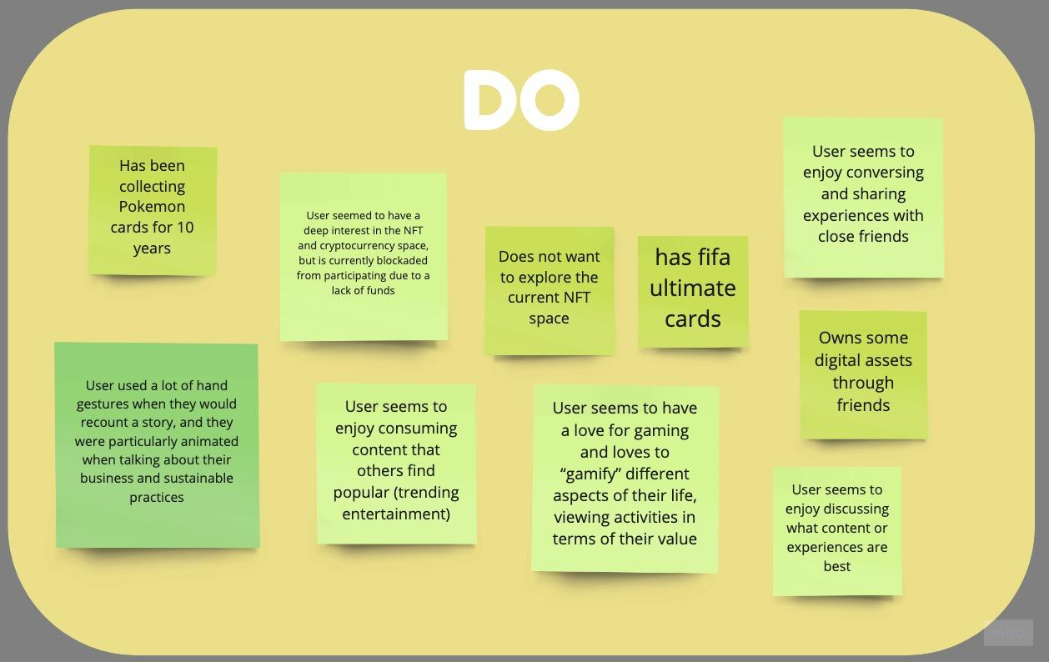
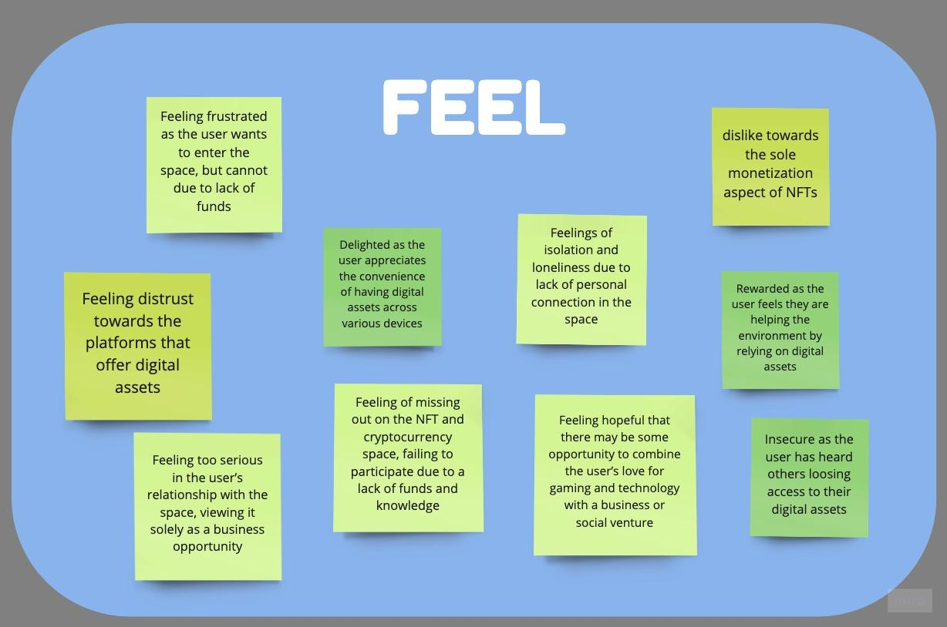

Slide 12
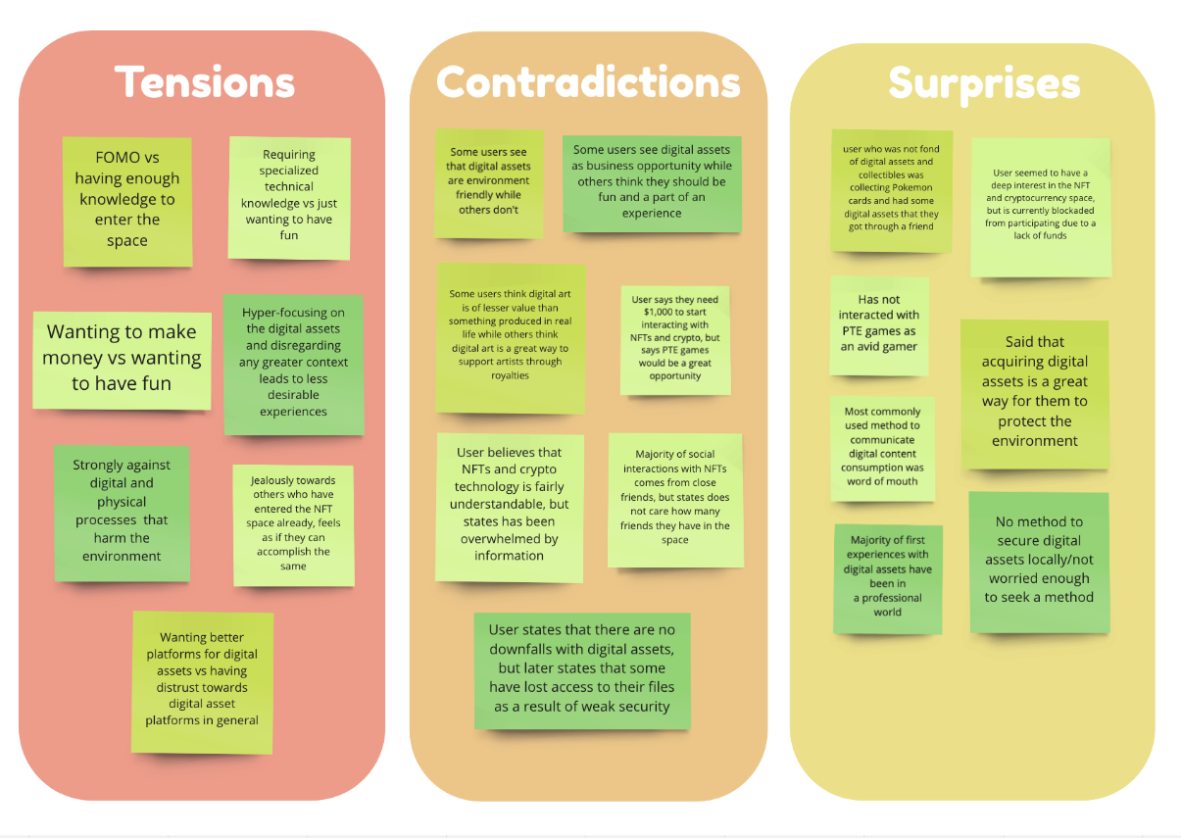
Tensions, Contradictions, Surprises
Tensions
Contradictions
Surprises

Slide 13
Initial Insights/Potential Needs
Potential Need #1
Method to share
digital collectables
Potential Need #2
Break monetary
barriers to entry
Security and trust with digital assets
Potential Need #3
Functionality and fun integration
Potential Need #4

Slide 14
Summary
:D
We talked to our participants about their experiences with digital assets
Price, knowledge and trust were a common concern when engaging with digital assets/collectables
These experiences came in different forms

Slide 15
Thanks!
Any questions?
Remember to like, comment, and subscribe!

