Slide 1
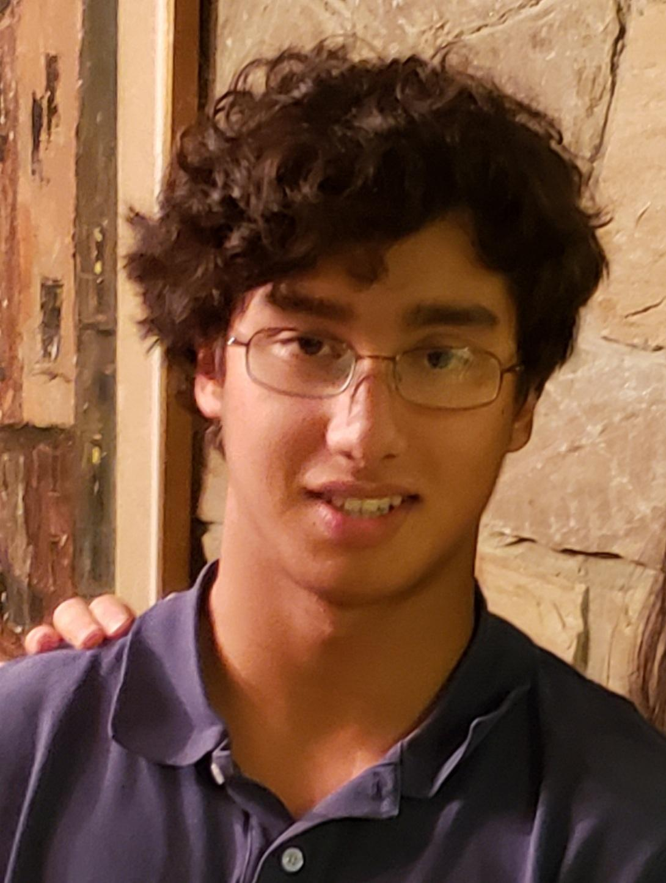
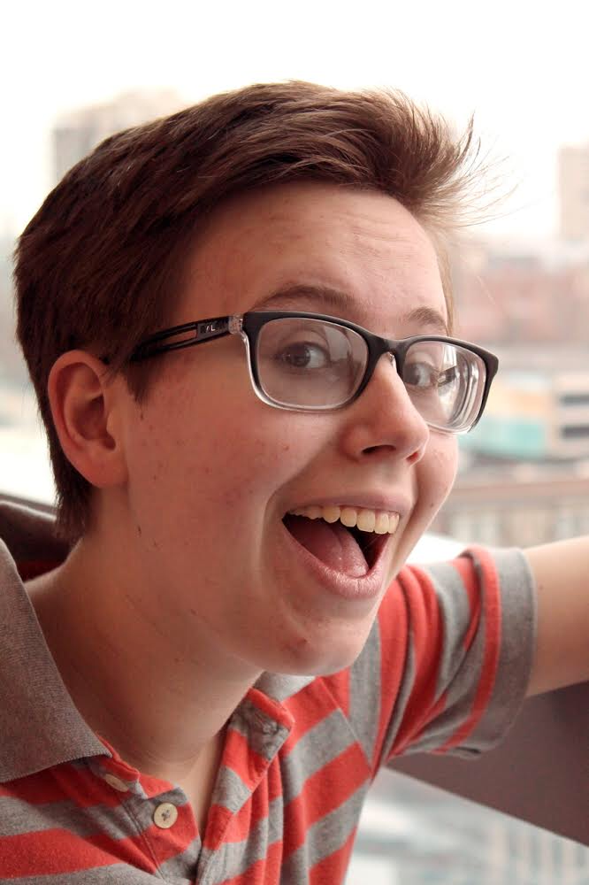
Steven. G. O.
Annie N.
Cyrus D.
Brighten your community — together!
Midway Milestone Presentation

Slide 2
Problem & Solution
Problem:
Seniors who live in care homes often struggle to find community.
Diverse Abilities
+
Inconsistent Energy Levels
=
Difficult to connect
Solution:
Group residents of complementary ability and energy levels
Assign a task that serves an overall community goal.

Slide 3
Overview
HE Results
Revised Design
Hi-Fi Status
Hi-Fi Demo
Summary

Slide 4
Heuristic Evaluation Overview
13 Violations Severity 3-4 | 9 Changes
17 Violations Severity 1-2 | 9 Changes
4 Violations | H2 Match Between System and Real World
3 Violations | H1, H3, H4, H6, H11

Slide 5
Simple Task Violations
H3 User Control and Freedom
Severity 4
Users can make an error when checking in
H2 Match Between System and Real World
Severity 3
Order of directions doesn’t match up to real life
H8 Aesthetic and Minimalist Design
Severity 3
Unclear when the user is done or must do another task
H1 Visibility of System Status &
H2 Match Between System and Real World
Severity 4
No info given on where and when to meet

Slide 6
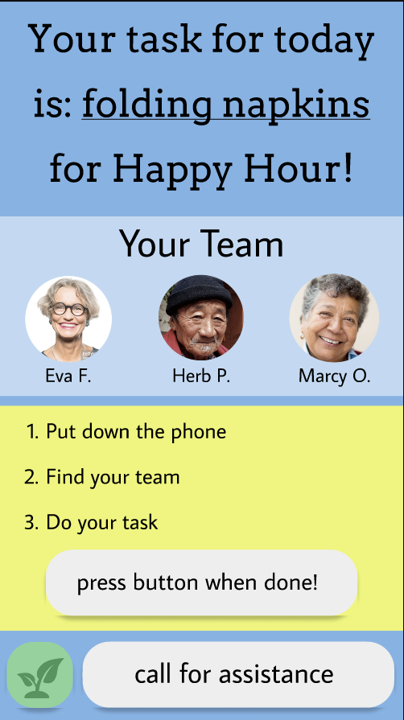
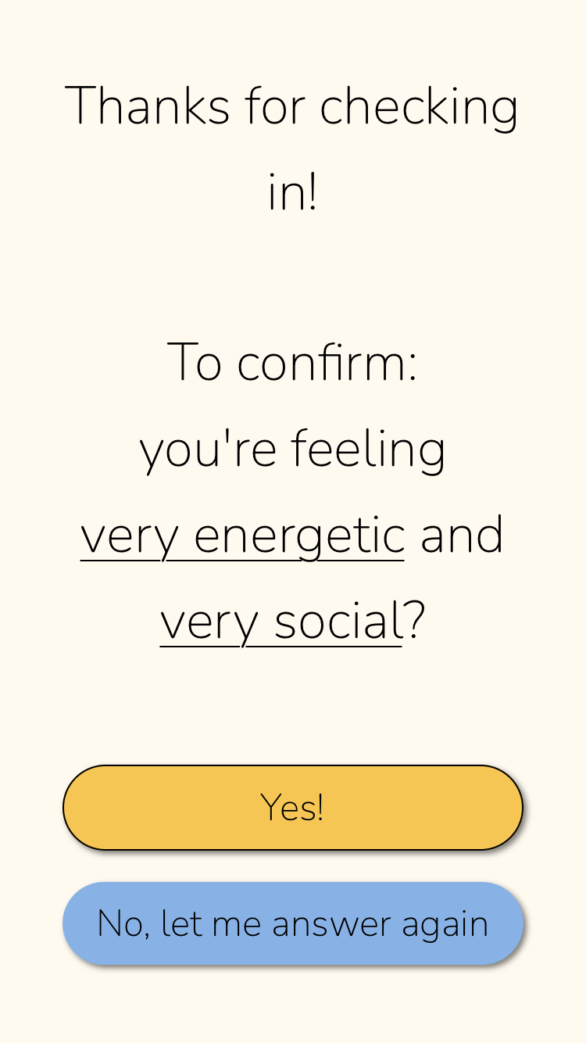
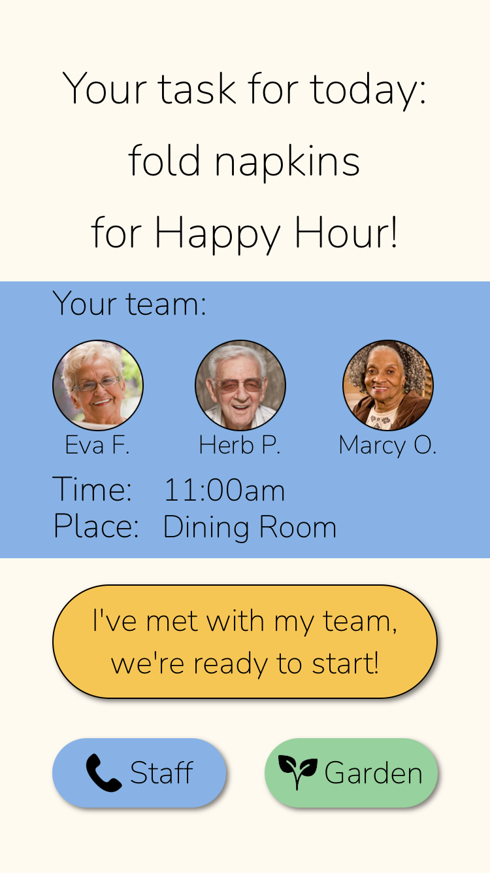
Simple Task Revisions
Order of directions
Info for where and when to meet
Check-in with error prevention

Slide 7
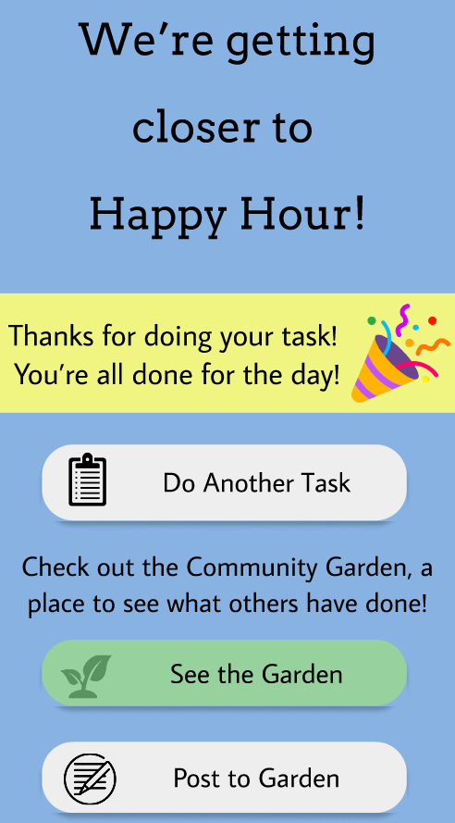
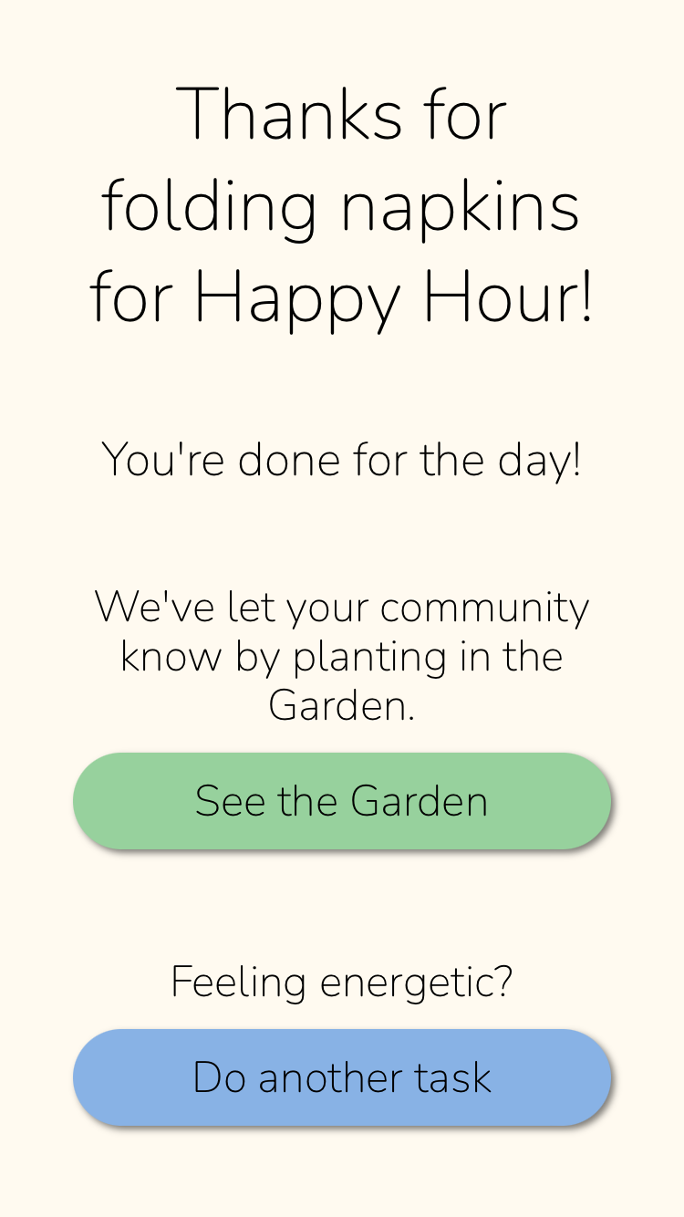
Simple Task Revisions
Order of directions
Placement of “Do another task”
More efficient → Fewer button taps → Fewer errors
More robust → Clearer UI → User does not get lost

Slide 8
Moderate Task Violations
H3 User Control and Freedom
Severity 4
There is no way to get out of the call for help screen

Slide 9
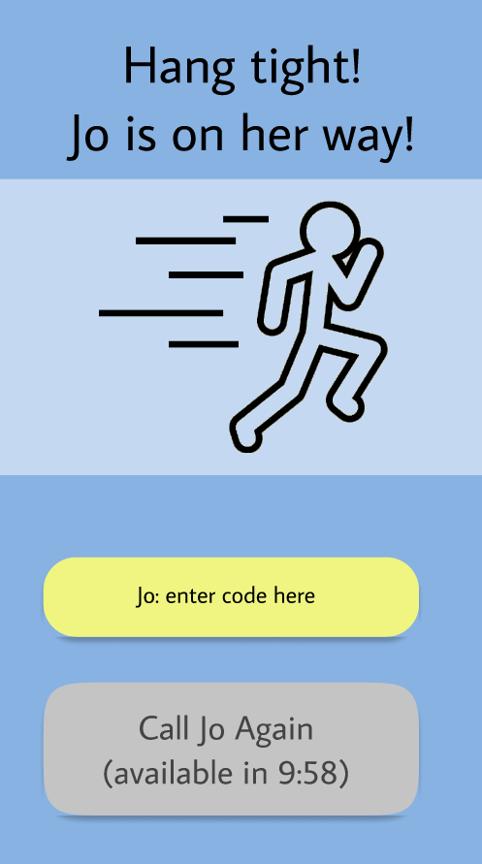
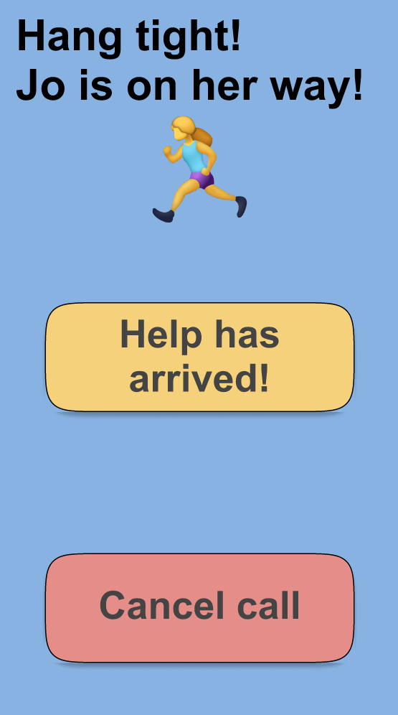
Moderate Task Revisions
Cancel call
No unlock code
User has more freedom

Slide 10
Complex Task Violations
H6 Recognition not Recall
Severity 3
Users are not clear when they are, or that they can post to the garden
H2 Match Between System and Real World
Severity 4
What do the plant icons mean?
H11 Accessibility
Severity 4
Text and icons are too small

Slide 11
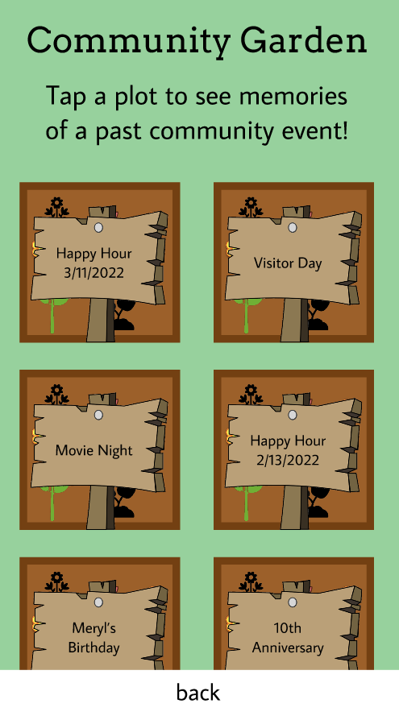
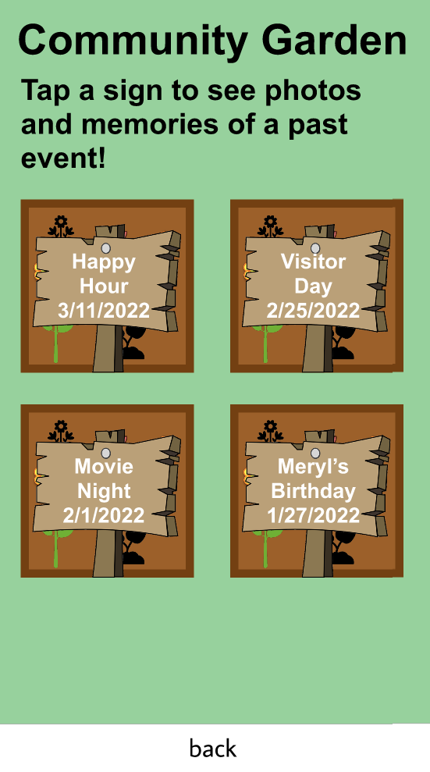
Complex Task Revisions
Clarify what the page is
Bigger text
Increased contrast

Slide 12
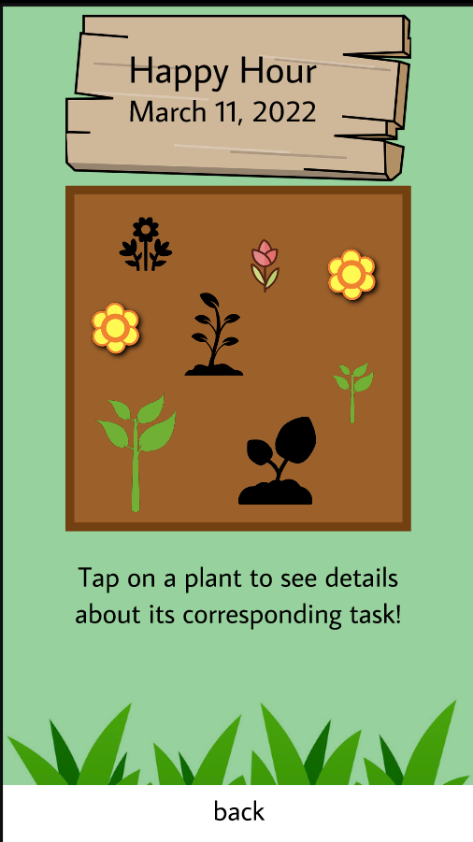
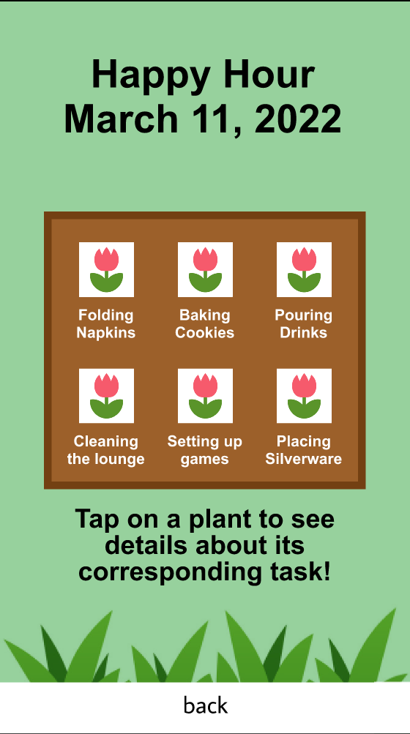
Complex Task Revisions
Grid style
Increased readability
Distinguish plants by text

Slide 13
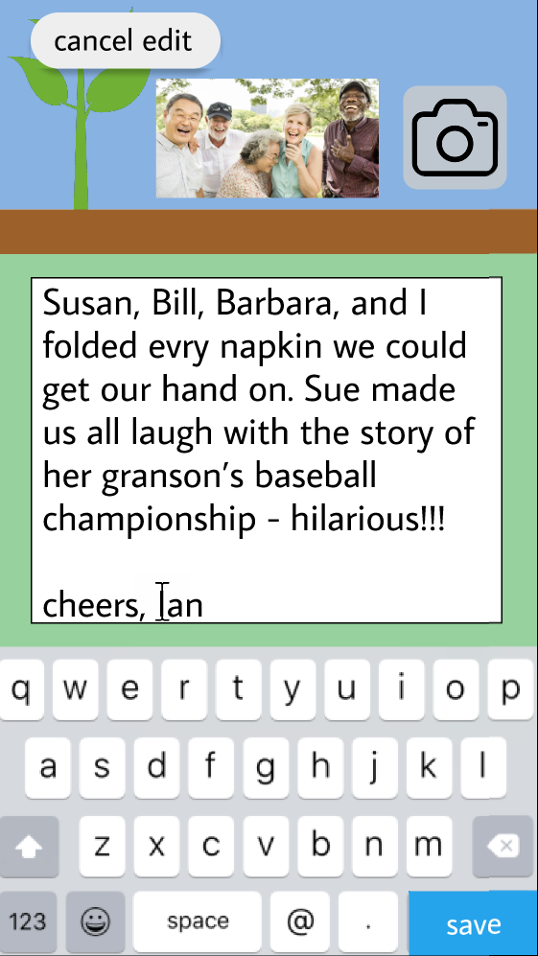
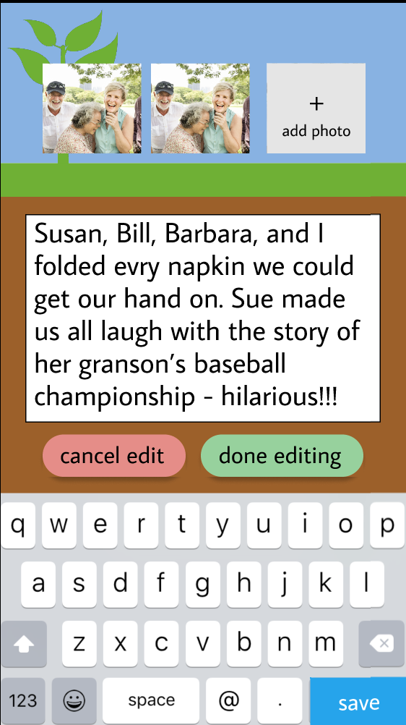
Complex Task Revisions
Clarify when you are editing a post
Add new photos
Descriptive buttons
Color contrast to focus attention

Slide 14
Implementation Tools
Figma
GitHub
ReactNative
Firebase

Slide 15
Implemented Features
Check-in
Task Confirmation
Help Screens
(Task 2)
Task Main
Task “Hub”
Notes:
Check in flow
Task main
Task confirmation
The Hub
The help flow

Slide 16
Unimplemented Features
Help Screens Style
Garden Screens
Overlay pop up for info button
Fix font boldness with custom
font
Standardize button
style
Implement user post in
Garden
Notes:
Styling of help flow
Styling of garden flow
Overlay pop up for info button

Slide 17
Plan to Finish
Help Screens
(Task 2, style)
Garden Screens
(Task 3)
Focus on UI details
(font, standardizing design)
Notes:
Styling of help flow
Styling of garden flow
Overlay pop up for info button

Slide 18
Wizard of Oz & Hardcoded Data
Wizard of Oz:
Task Assignment Algorithm
Calling for help from a real staff member
Hardcoded Data:
User + Task Database
Assigned staff member
Notes:
Hardcoded
Hardcoded user data: the staff/care home would be inputting this information into the database
Staff member generated for task assistance is hardcoded
Wizard of Oz
Algorithm for assigning tasks
The call for help would ping the staff to come and help

Slide 19
Problems & Issues
Making
clean &nd Standardized Design
U.I.

Slide 20
Live Demo!!!!

Slide 21
Summary
18
1/3
1
Major Changes Based on the Heuristic Evaluation
Tasks Fully implemented
Week Left

