Slide 1
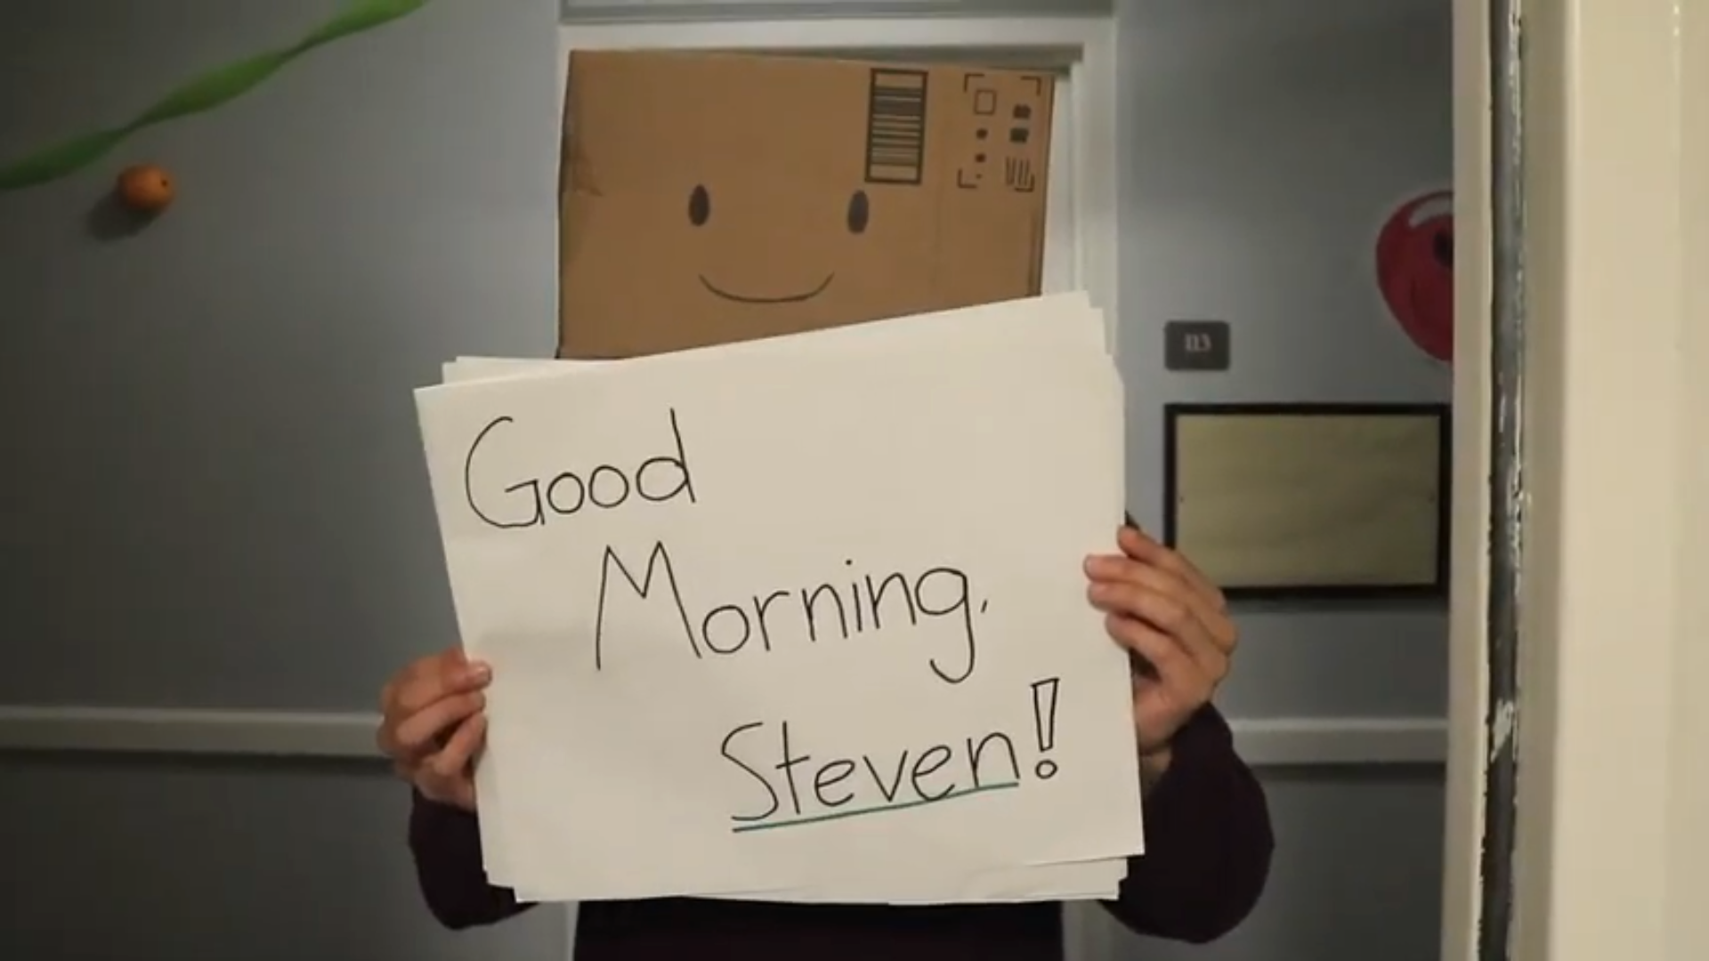
SeniorCircle
Brighten your community — together!
Annie N.
Cyrus D.
Steven O.

Slide 2
Mission & Values
Mission Statement
Value Proposition
Building community in care homes through teamwork!
Community
Agency
Collaboration

Slide 3
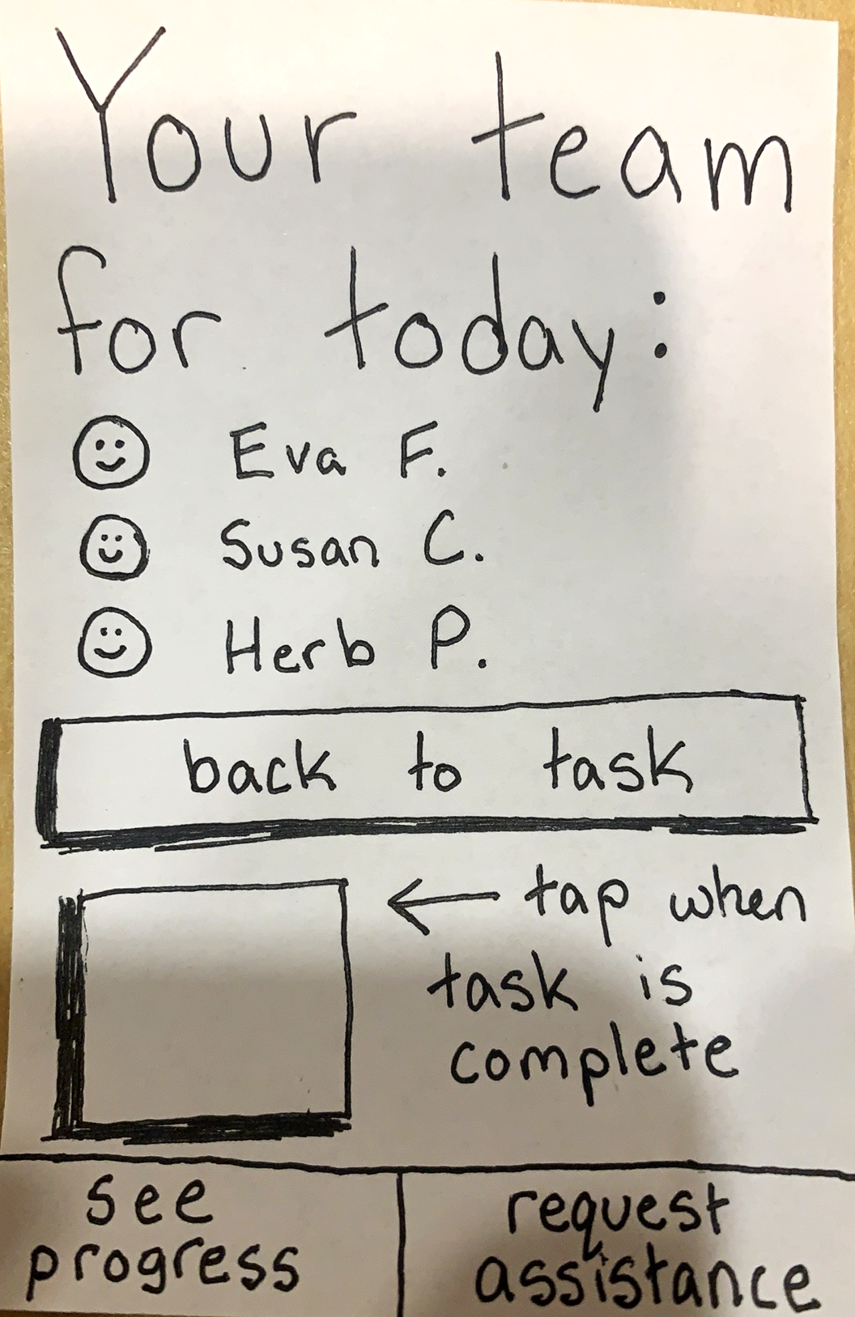
Design Selection & Rationale
Mobile App
Practicality (common and portable)
Can leverage existing accessibility technology
Guidelines for designing for our target demographic already exist

Slide 4
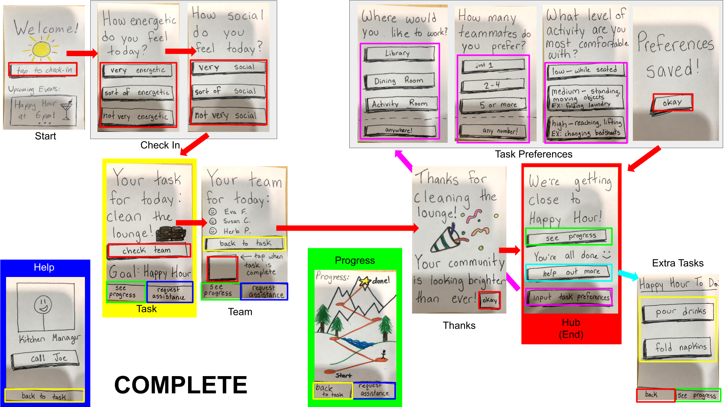

Slide 5
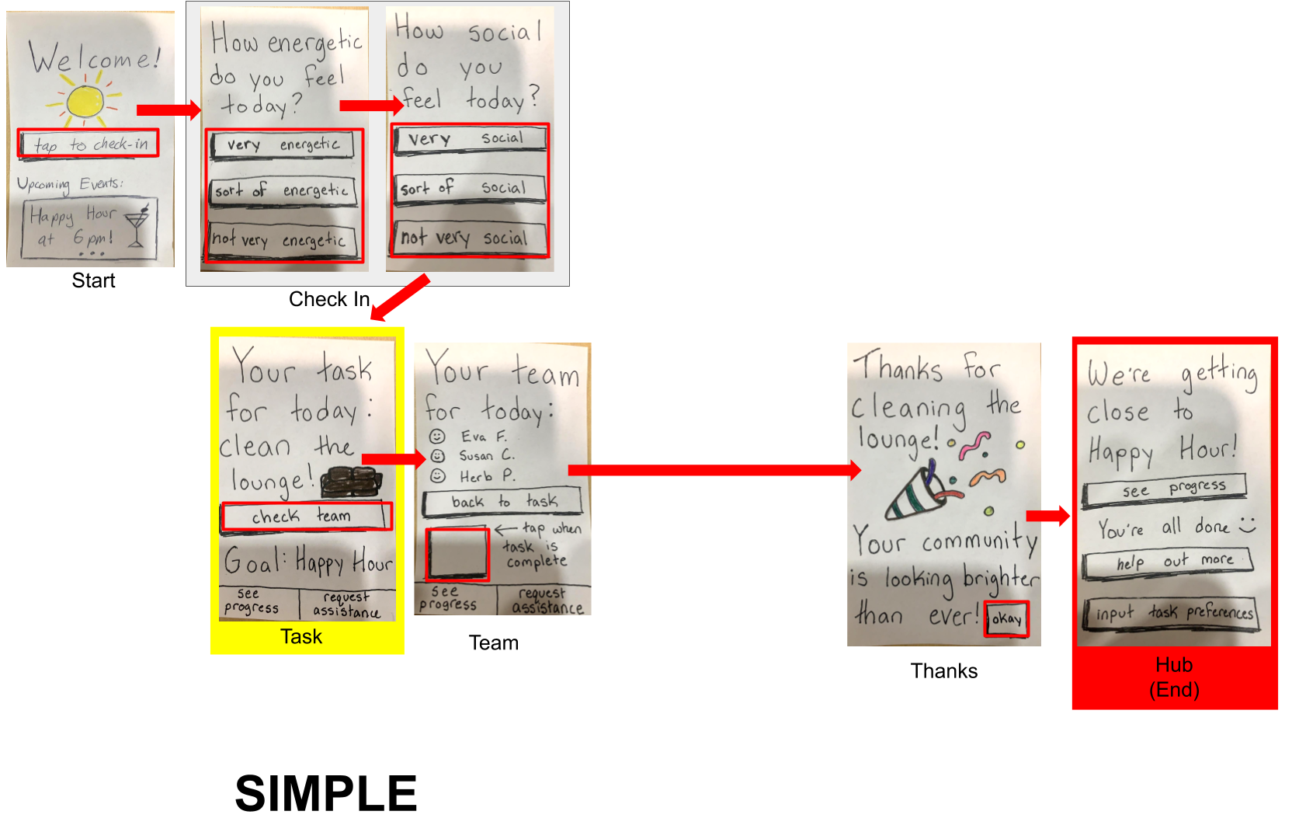

Slide 7
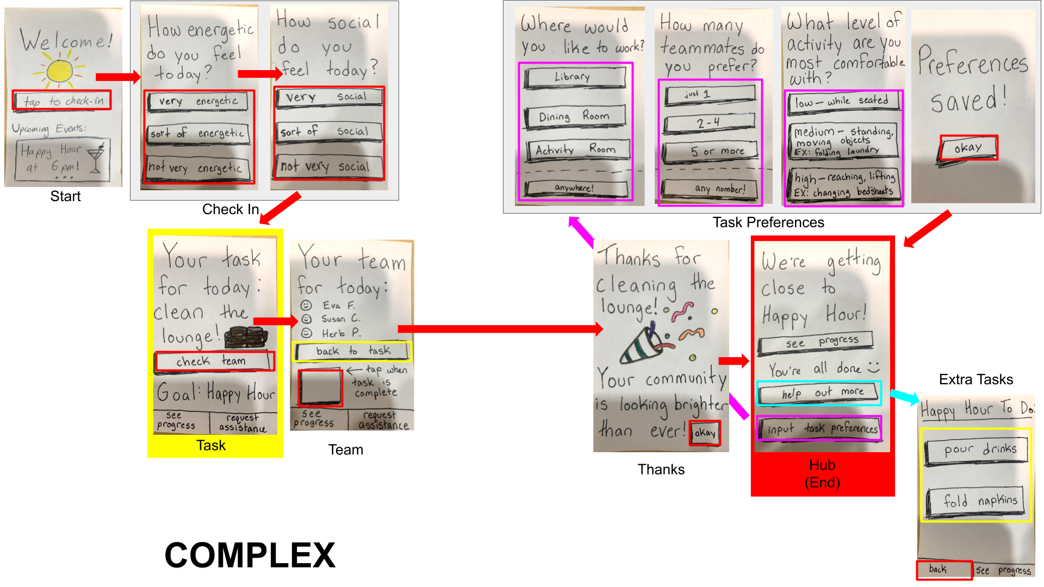

Slide 8
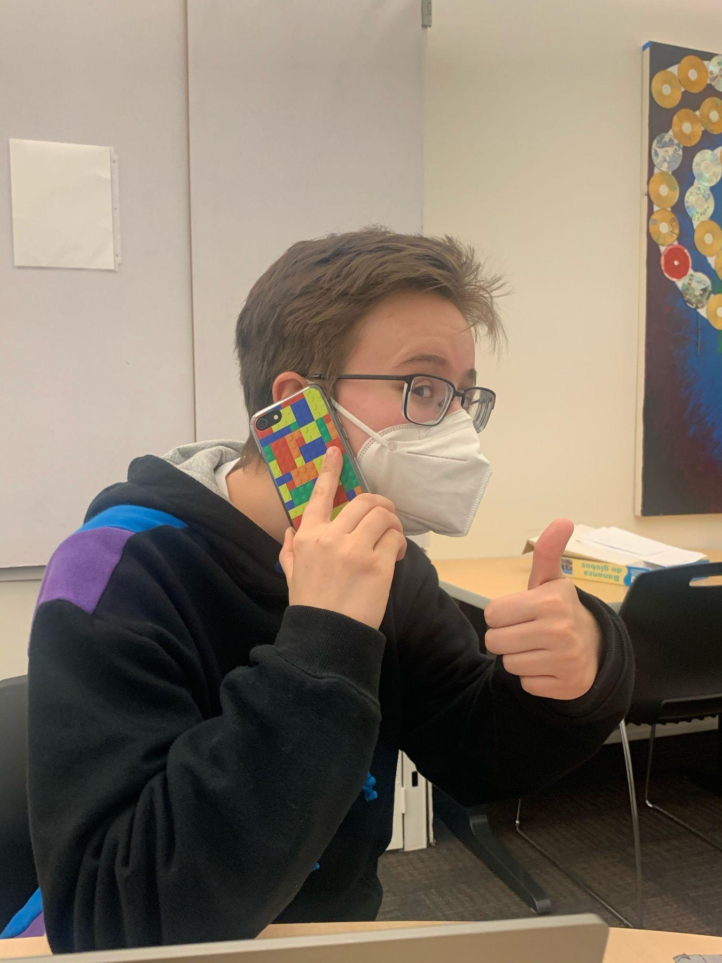
Experimental Method
Conducted via Zoom, prototype on participant phone
Asked about experiences with care homes
Informed of the scenario via story
Identify task
Call for assistance (M)
Mark task complete (S)
Input preferences (C2)
Choose additional task (C1)

Slide 9
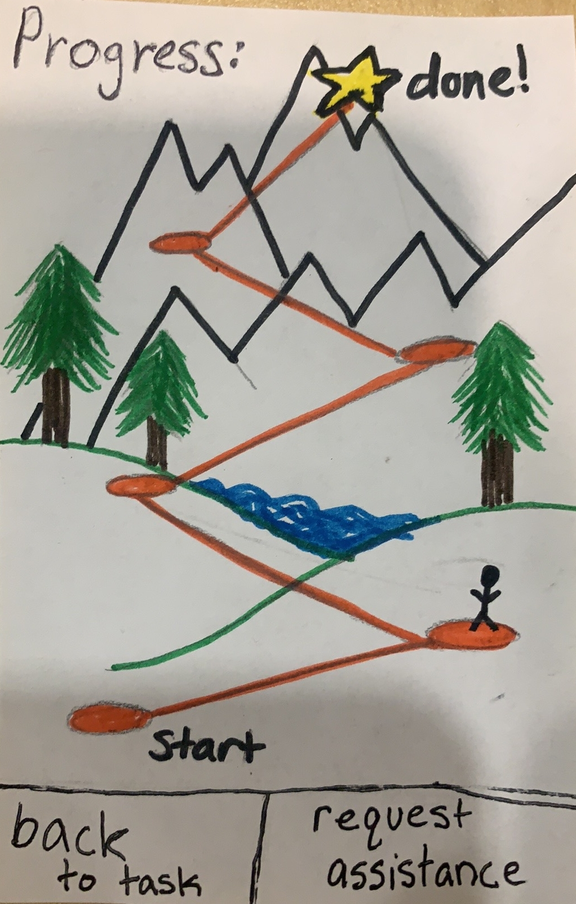
Experimental Results
Is this a video game?
I don’t feel like I’ve accomplished anything…
Why haven’t I moved?
Progress screen was confusing
Notes:
Sense of being involved, service, overall feel better

Slide 10
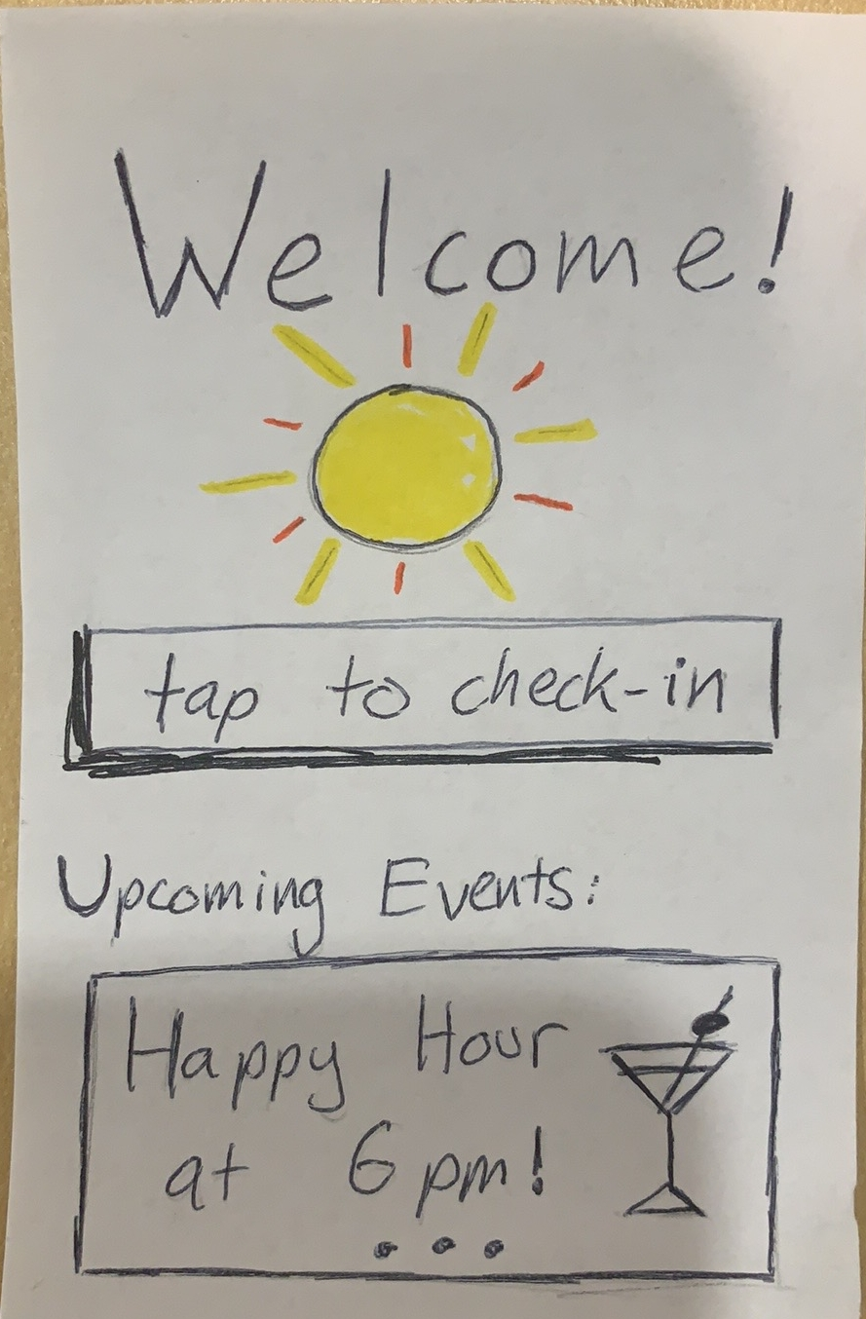
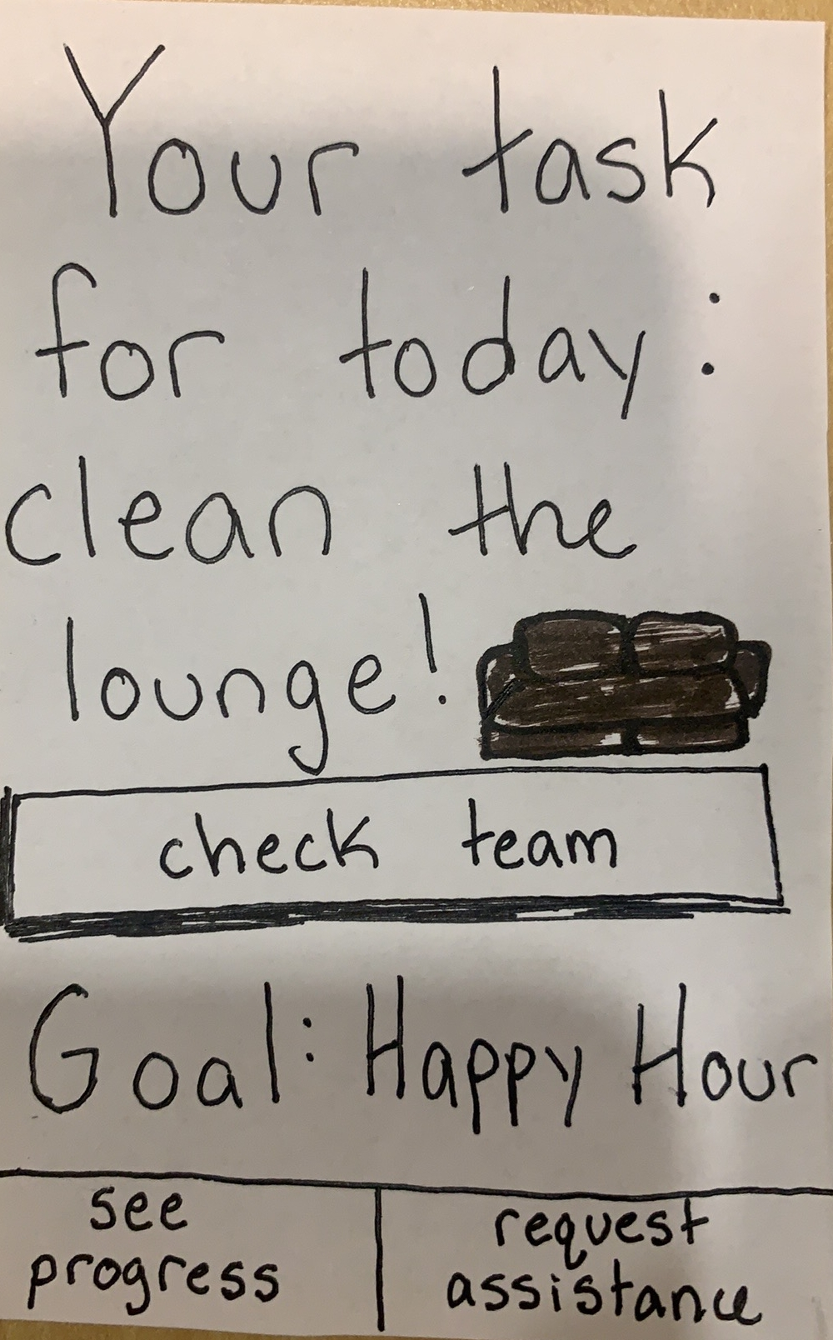
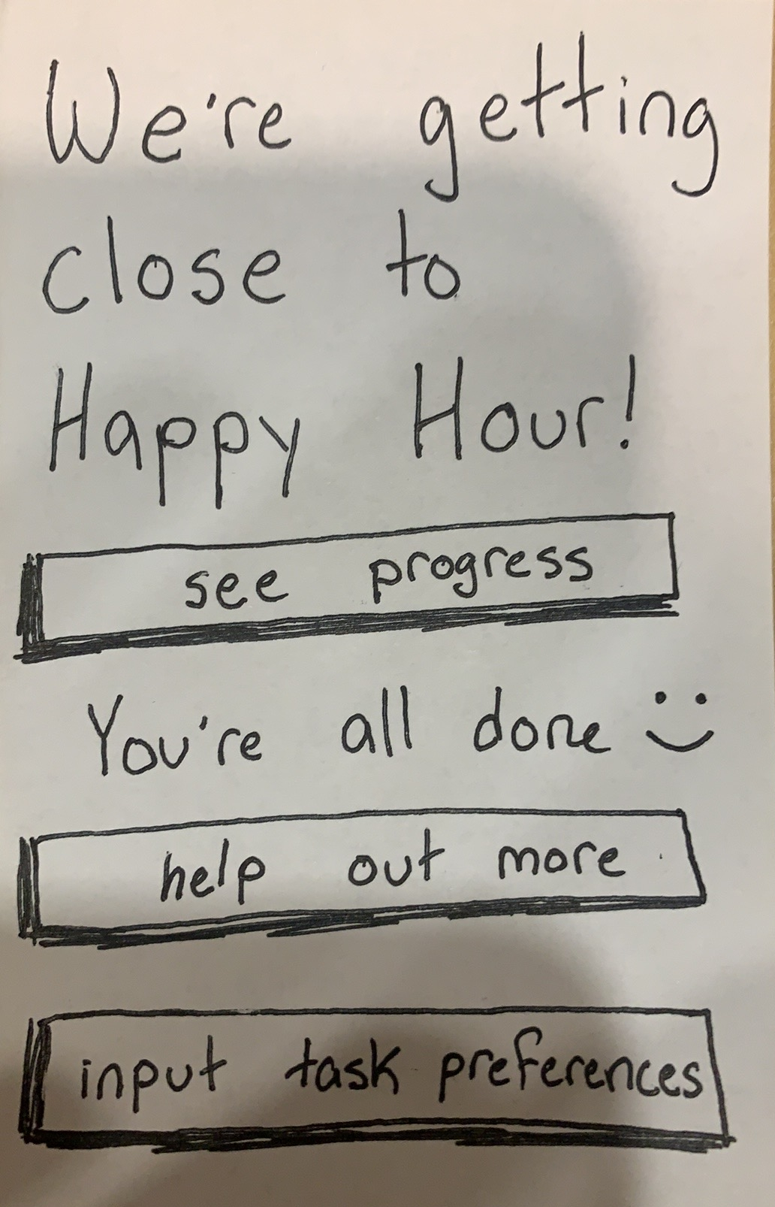
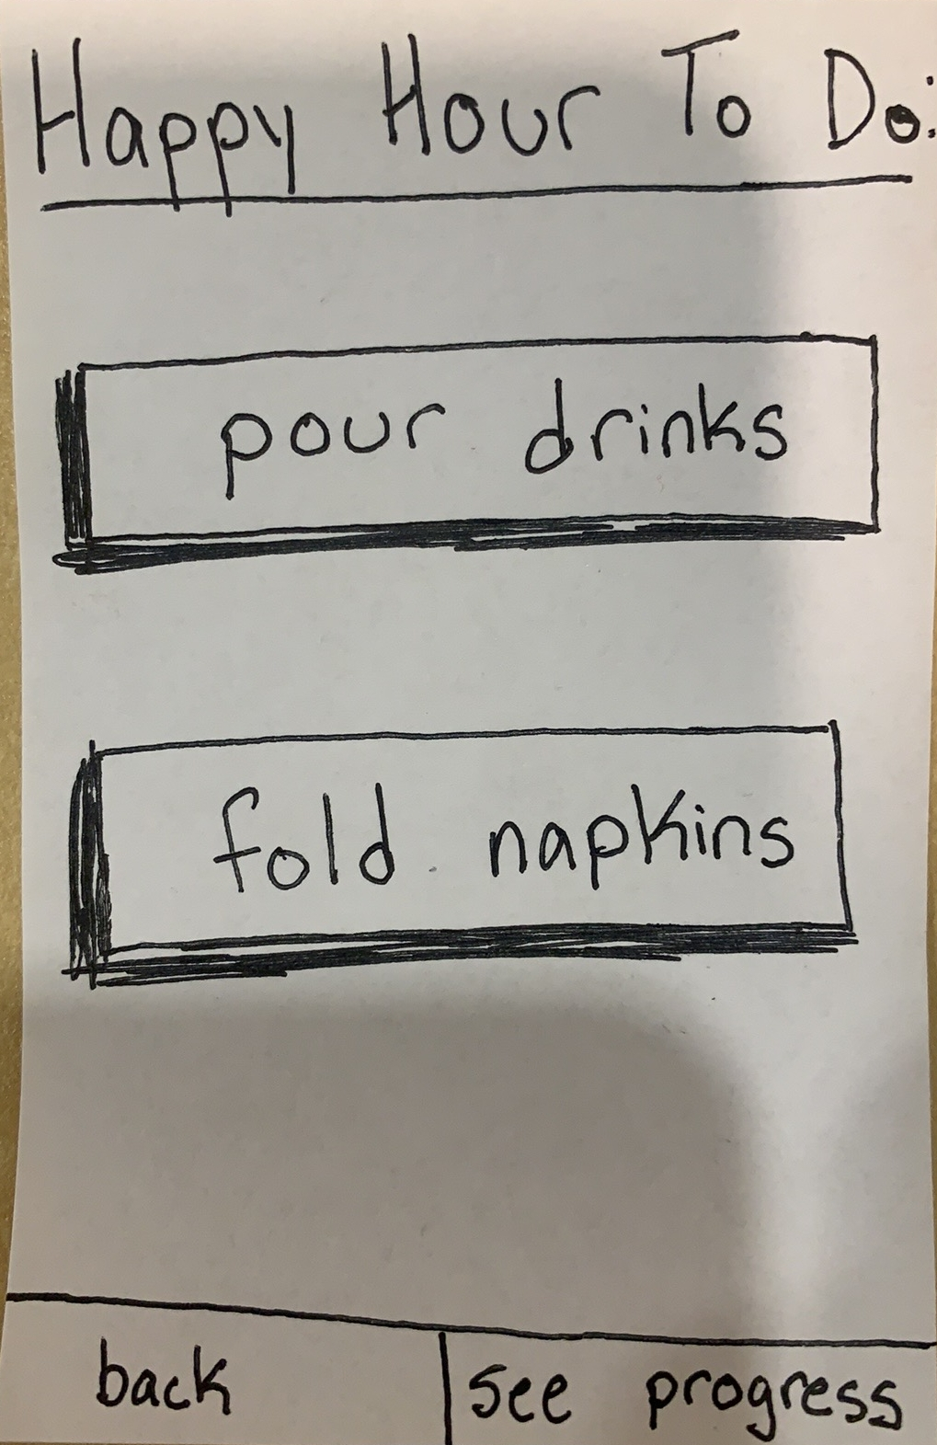
Experimental Results
Overarching goal was unclear
Notes:
Sense of being involved, service, overall feel better

Slide 11
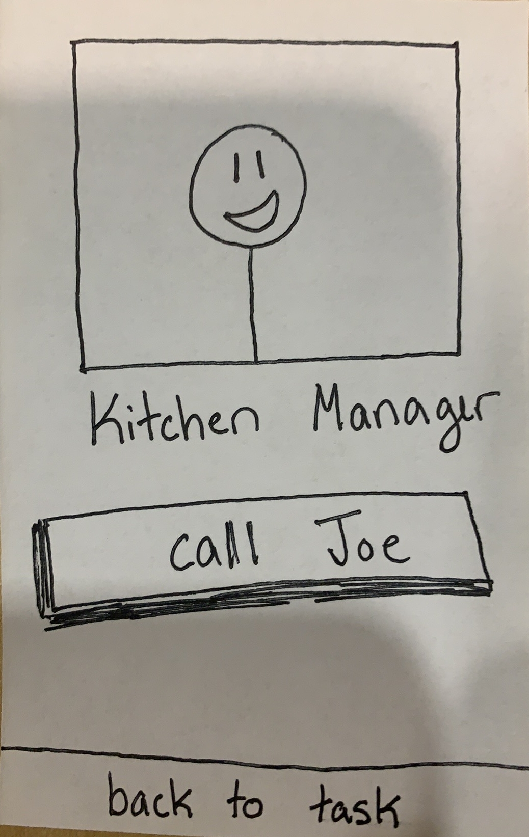
Experimental Results
I couldn’t screw it up for long!
Too many dead ends, not enough choices [for advanced user]
*silence*
[task completed]
Linearity is good!
Notes:
Sense of being involved, service, overall feel better

Slide 12
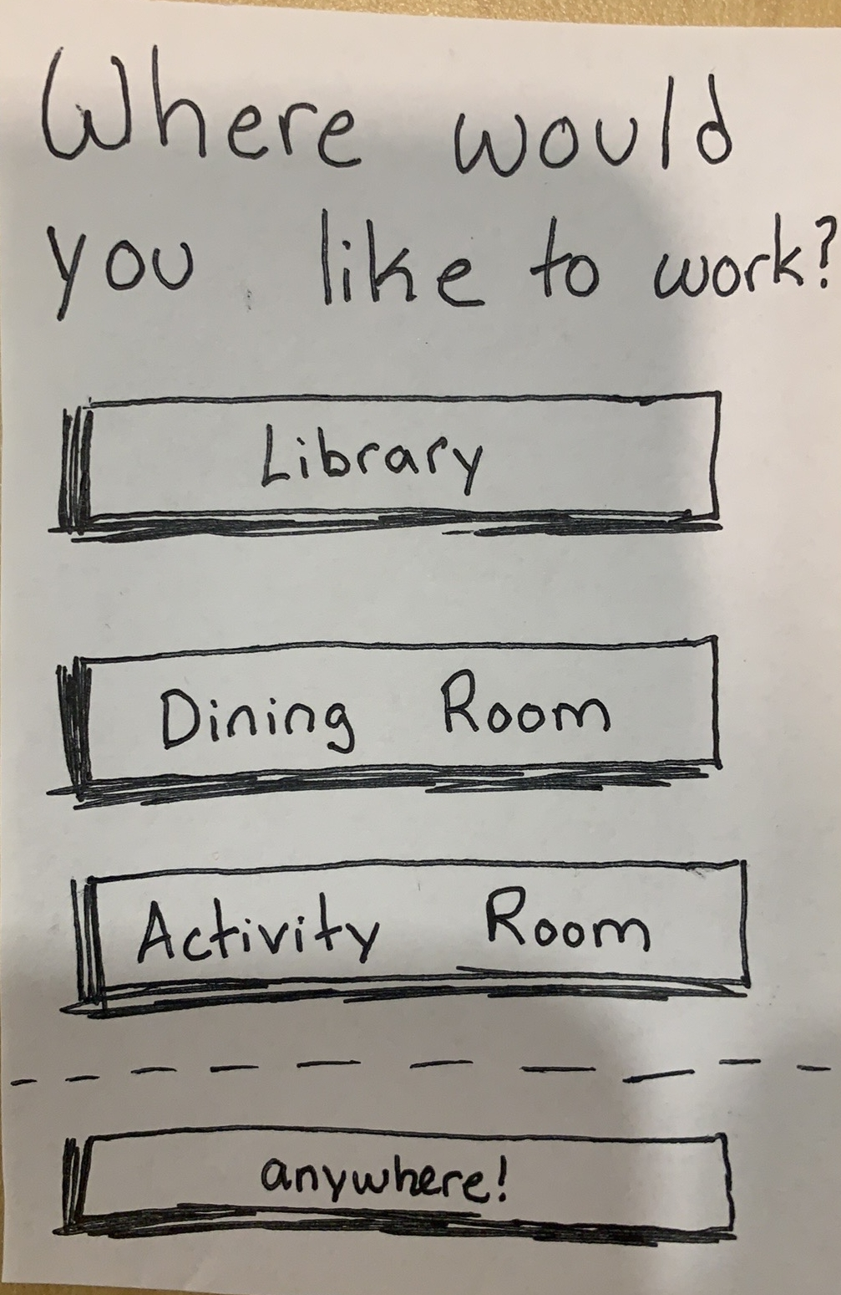
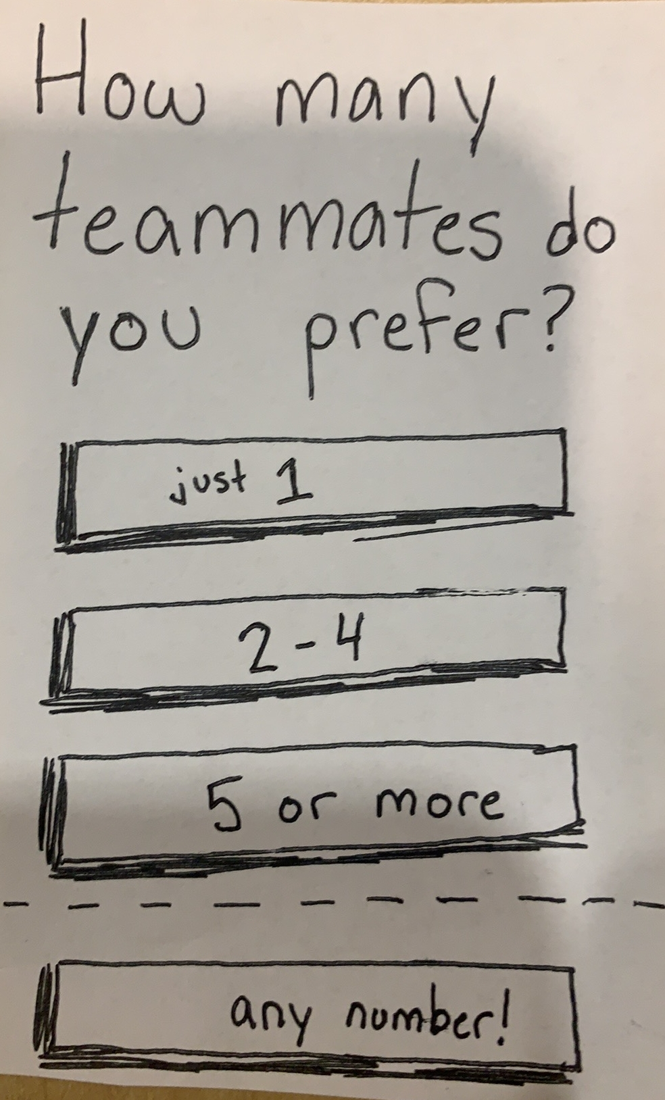
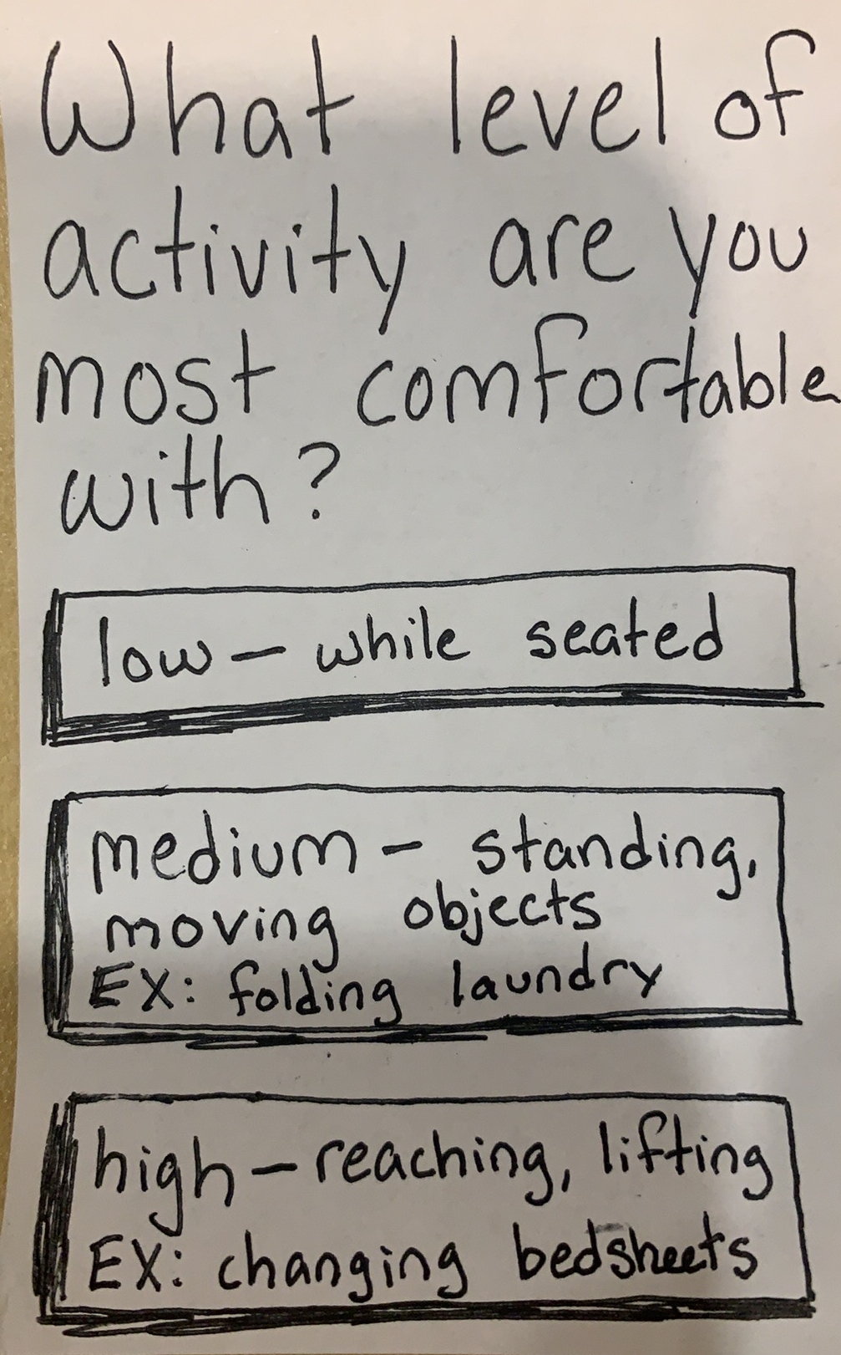
Experimental Results
Want direction
Notes:
Sense of being involved, service, overall feel better

Slide 13
Experimental Results
Me:
You passed!
Me:
It’s almost time for Happy Hour, and —
Subject:
Man, I love this!
Subject:
Good, I need a drink.
Responded well to positive vibes
Notes:
Sense of being involved, service, overall feel better

Slide 14
Suggested UI Changes:
More Guidance
Make primary button very obvious
Prompt when to do things IRL
User manual?

Slide 15
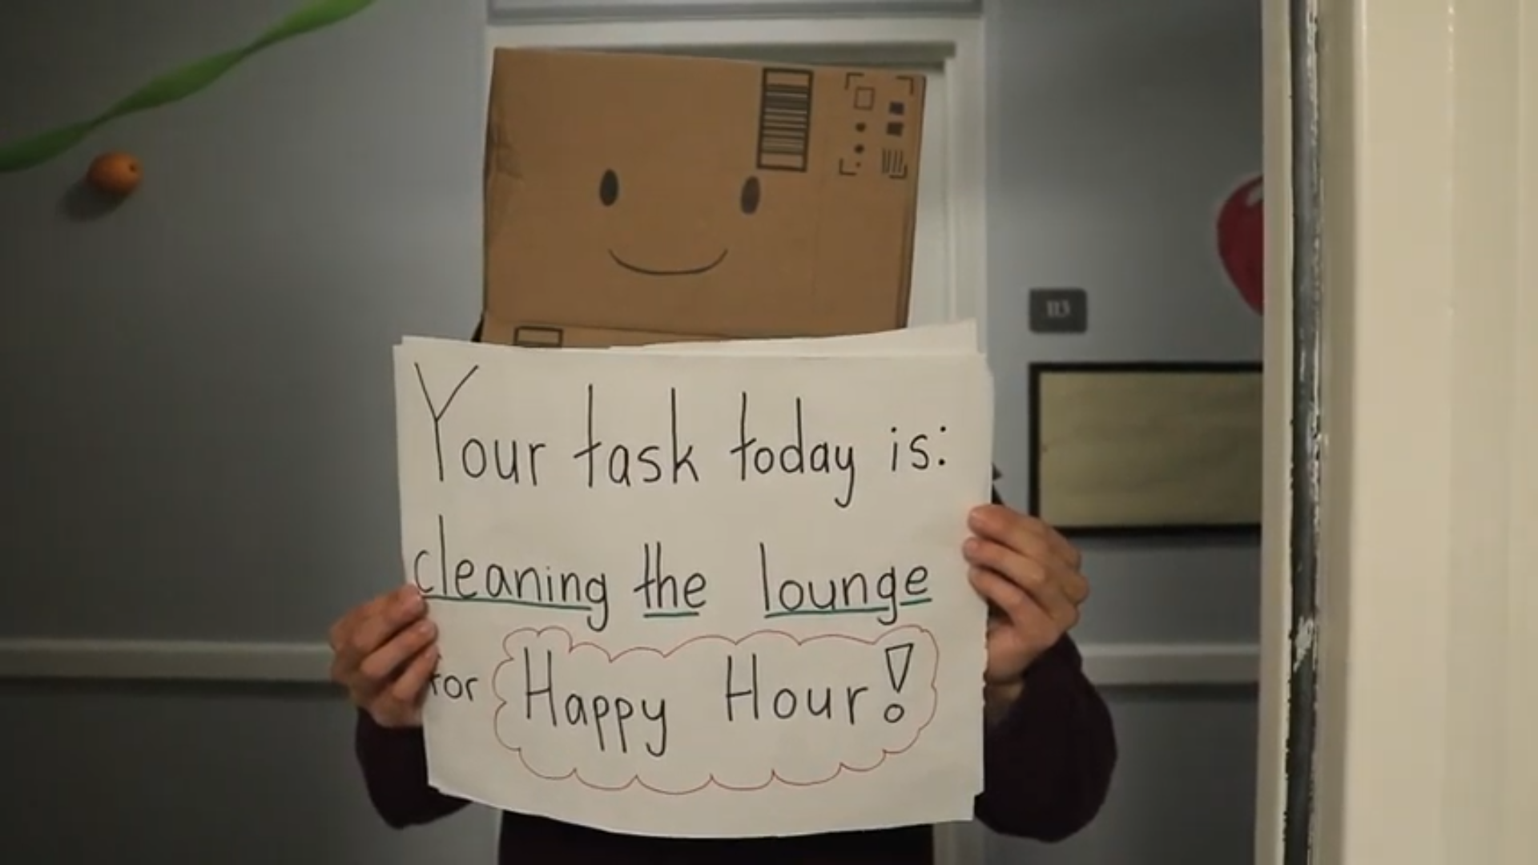
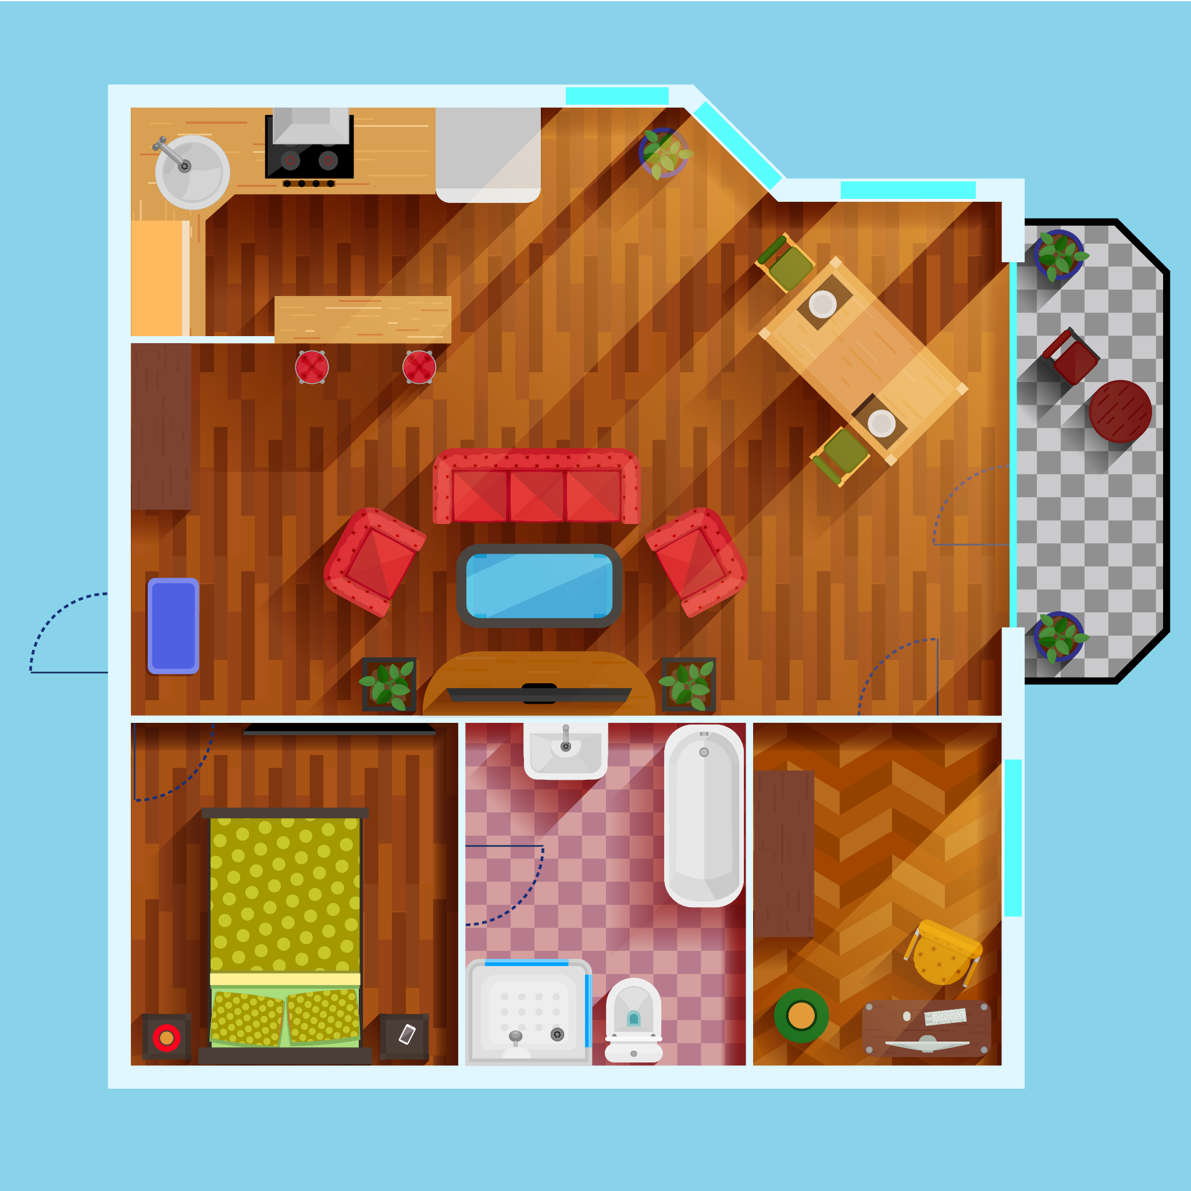
Suggested UI Changes:
More Explanations
Progress screen…
Emphasis on common goal
Tutorial?
“Prep for Happy Hour is 75% complete!”

Slide 16
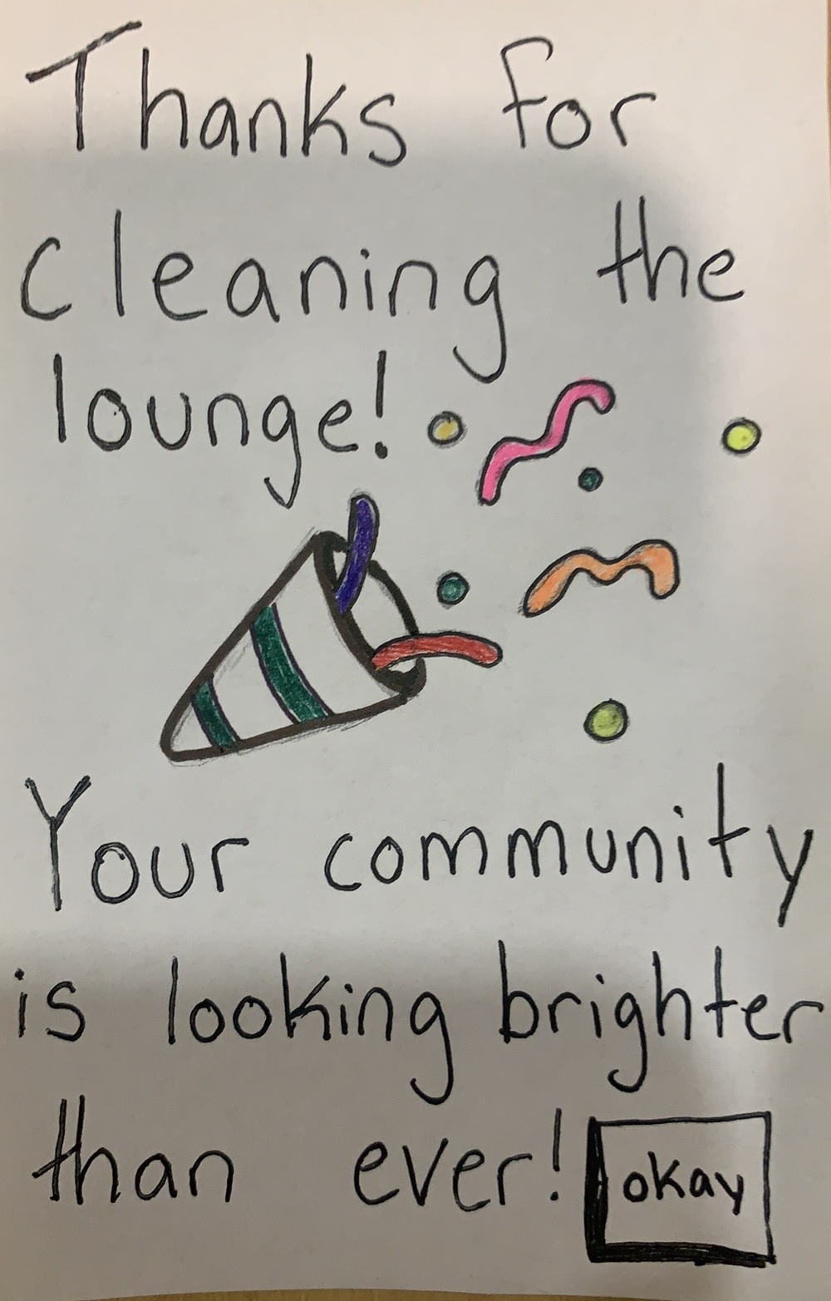
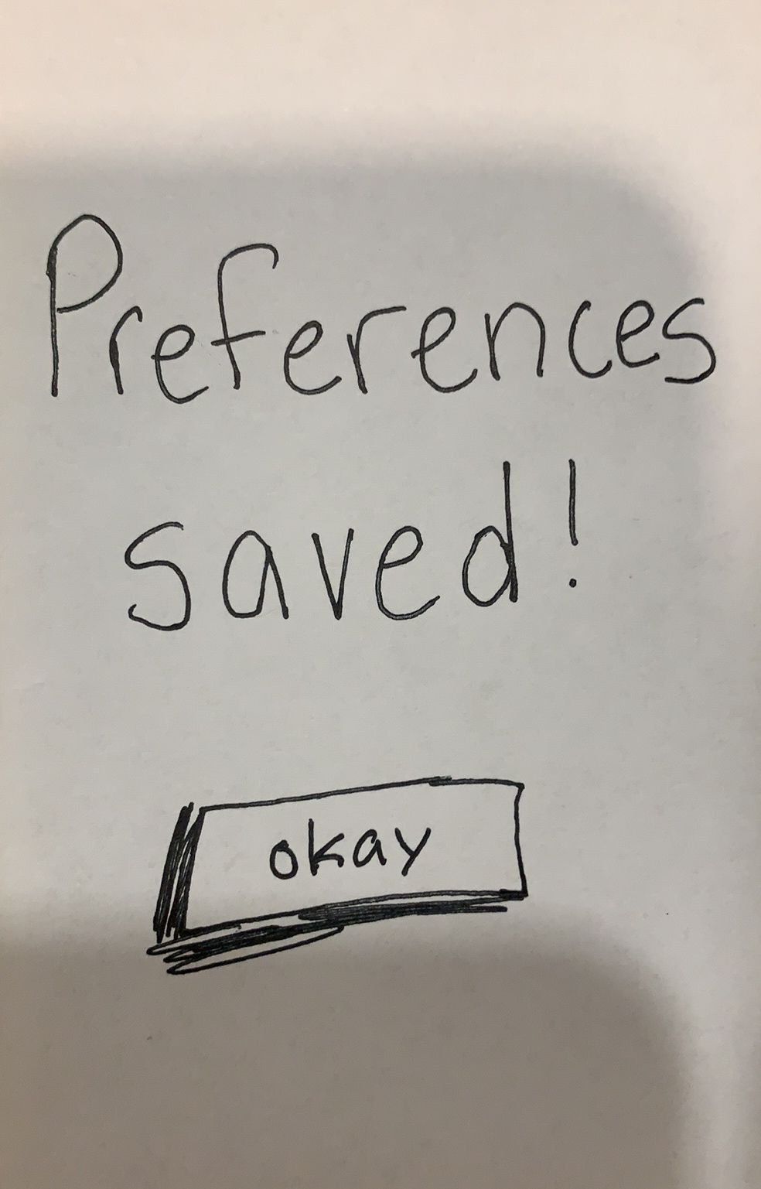
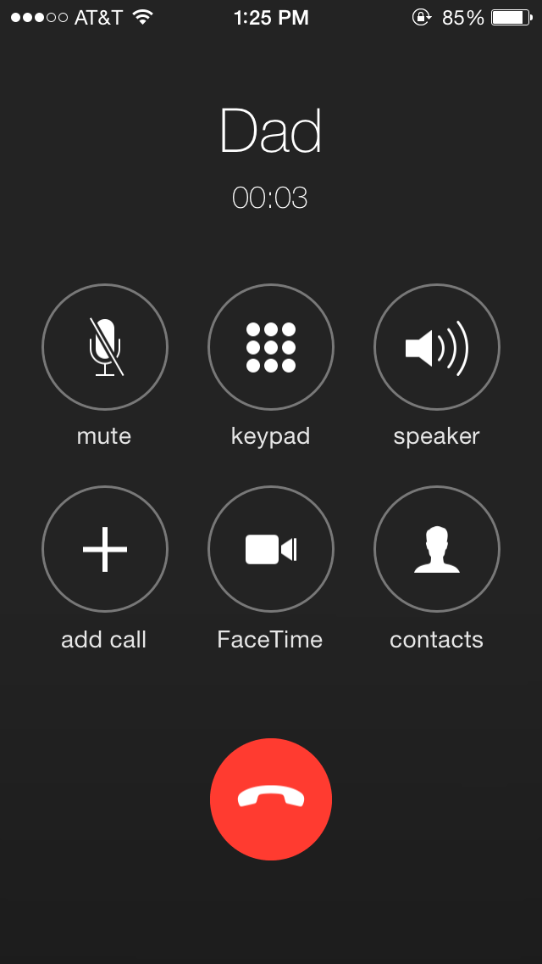
Suggested UI Changes:
Positive Reinforcement
Celebrate successes
Affirm that actions have been taken
Encourage exploration?

Slide 17
Summary
SeniorCircle
Instincts took us in the right direction, but not far enough — more to do
Small details can have big effects
Aim to overemphasize
Guide more transparently
Brighten your community — together!

