Slide 1
NEEDFINDING
By Delali, Carolina, and Katherine

Slide 2
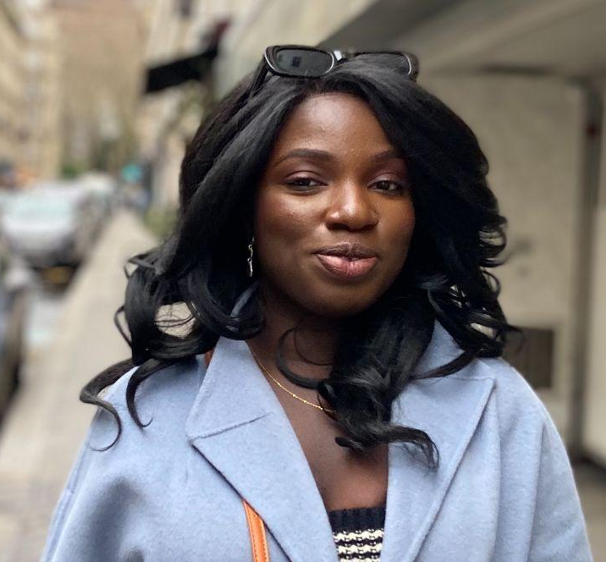
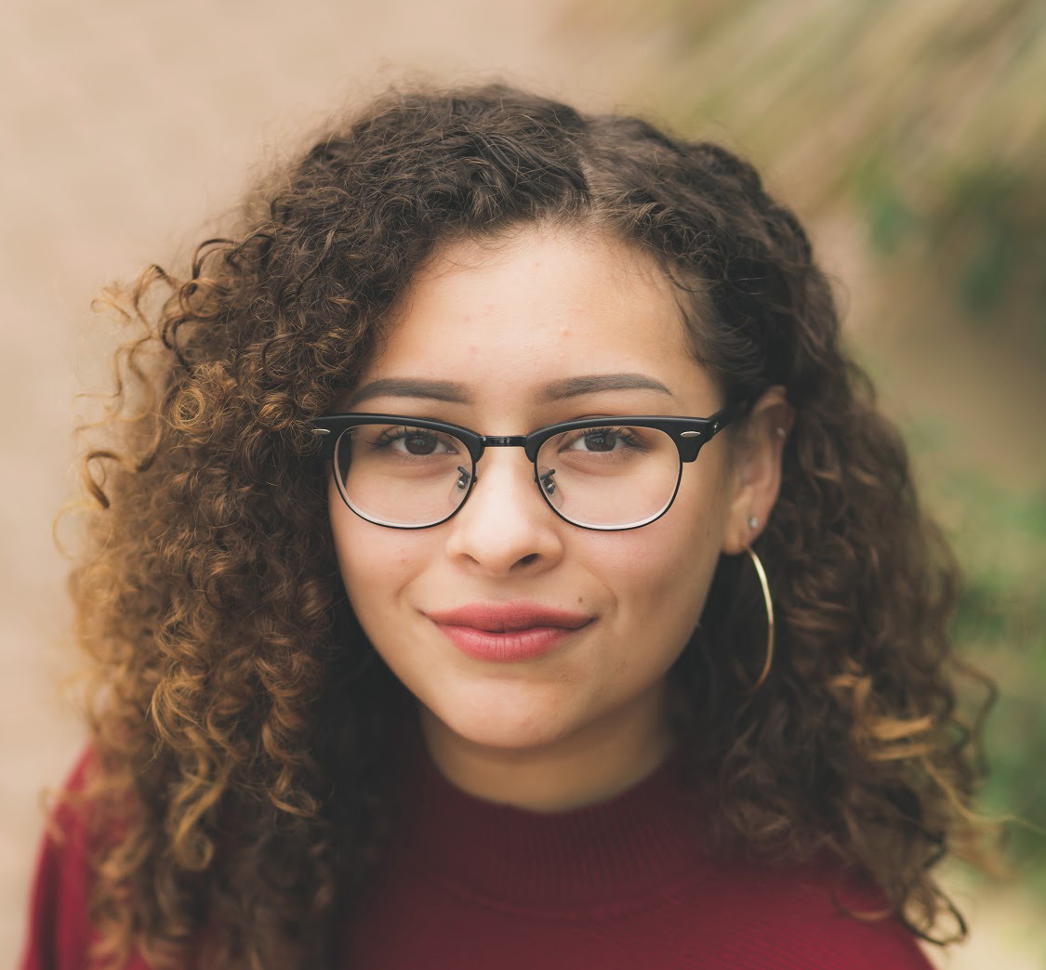
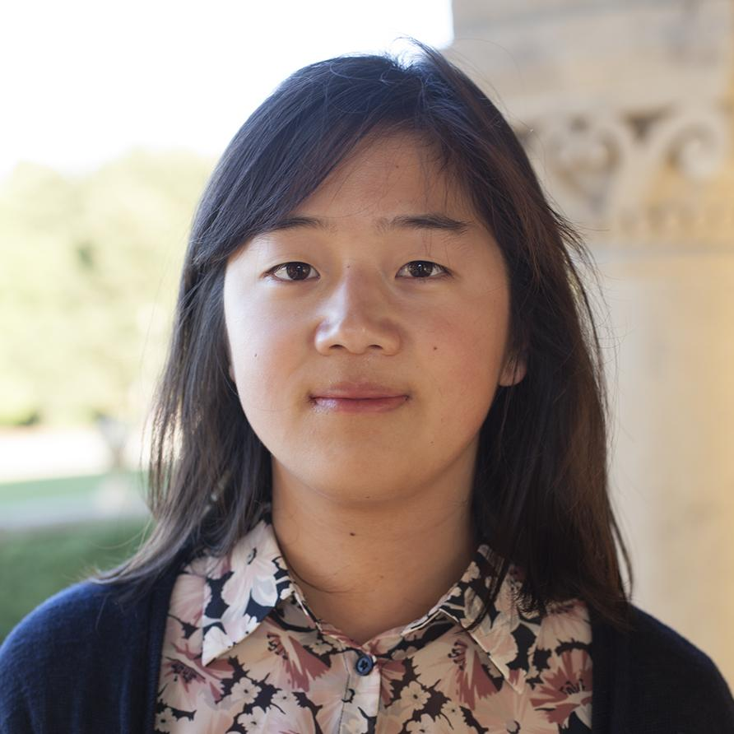
TEAM MEMBERS
Delali Azamati CS
Senior
Carolina Borbon SymSys
Junior
Katherine Liu CS
Senior

Slide 3
1.
NEEDFINDING
METHODOLOGY
Details on our participants

Slide 4
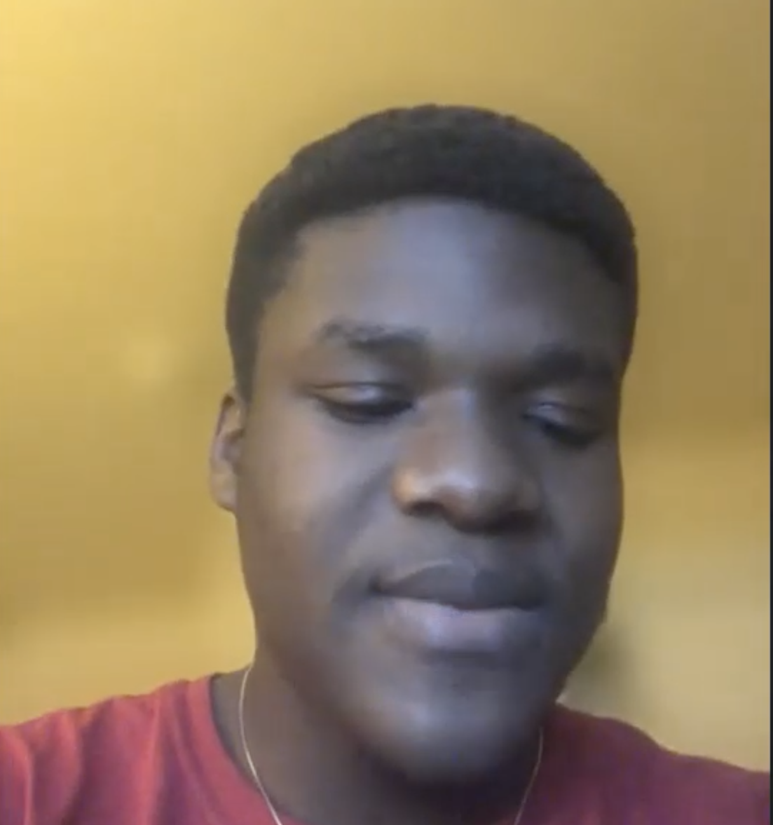

Participant Overview
Participant 1
Newly Immigrated Student
Spent 22 years in Togo
Participant Overview
Notes:
Who: our first participant is Delali’s cousin who recently immigrated to the US from Togo
Why chosen: so we could explore the strives of being a new immigrant, student, not advanced english speaker, student
What did you ask?
1. What is your experience like coming to the US?
2. What was the process of learning English then actually speaking it with native speakers like? Any surprises?
Experience traveling in the us?
5. What has been the biggest struggle you anticipated/ and did not anticipate? What has come naturally for you?

Slide 5
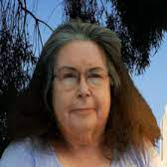
Participant Overview
Participant 1
Newly Immigrated Student
Spent 22 years in Togo
Participant Overview
Participant 2
(extreme user)
Lifelong wheelchair user
Director of OAE
Notes:
Who: our second participant is a lifelong wheelchair user, and she works as the Director of the Office of Accessible Education.
Why chosen: she has lifelong experience with disability, specifically impaired mobility. Through her work she also has extended institutional knowledge, and has supported many students that come through the OAE office.
How they were recruited: we reached out to her through email. She had been a guest speaker at one of Carolina’s classes the fall of 2020.
What did you ask? We asked about her personal experiences with disabilities, got some personal stories. We also talked about her work with college students with disabilities, and she spoke to some of the biggest challenges she sees when navigating through an institution

Slide 6

Participant Overview
Participant 1
Newly Immigrated Student
Spent 22 years in Togo
Participant Overview
Participant 2
(extreme user)
Lifelong wheelchair user
Director of OAE
Participant 3
ADHD
Formerly undocumented immigrant
Notes:
Who: our third participant is a 27-year old artist who works as a comics colorist. They have ADHD, and they are a formerly undocumented immigrant.
Why chosen: Katherine is mutuals with our third participant on Twitter, where they often openly talk about their experiences with ADHD and being undocumented. We wanted to make sure we found both people with visible and invisible disabilities, and having ADHD and being undocumented are both something that you may not necessarily know about a person at first glance.
How they were recruited: Since this person already seemed open to talking about their experiences, Katherine casually asked them on Discord if they were willing to have a call.
What did you ask?
We asked to explain how ADHD affects their life and for some specific examples of times that ADHD got in the way of them doing their job. We asked how they eventually came over that roadblock and how they manage their ADHD.
We asked about the hardships of being undocumented, and also whether they are as open about having ADHD and being undocumented in real life as they are online.

Slide 7

Participant Overview
Participant 1
Newly Immigrated Student
Spent 22 years in Togo
Participant Overview
Participant 2
(extreme user)
Lifelong wheelchair user
Director of OAE
Participant 3
ADHD
Formerly undocumented immigrant
Participant 4
Hard of hearing
Hearing aid user
Notes:
Who: our fourth participant is Katherine’s friend who is hard of hearing. She is a recent Stanford alum and now is working a software engineering job.
Why chosen: She has a disability that could be visible or invisible and has had it all her life.
Where they were interviewed: For this interview, we actually did not call her, but we typed our questions to her and she typed back. She expressed that she was more comfortable answering questions this way rather than calling.
What did you ask?
Asked about how hearing loss affects her daily life and what she wished hearing people would know about being hard of hearing
Asked about the kinds of tools shes uses to be able to participate in meetings now at work vs. the kinds of tools she used when she was a student at Stanford, and what worked or didn’t work about each.

Slide 8
2.
INTERVIEW RESULTS

Slide 9
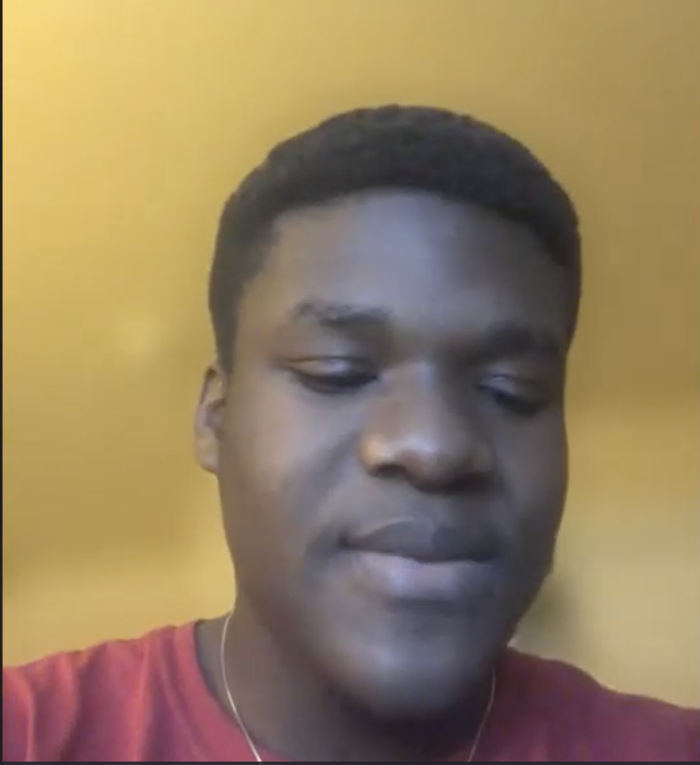
Interviewee
1
Results
“Here, you know, I'm kind of alone.”
“Everybody, ...is in his own house …can't go out and be greeting people like …in Togo”
Notes:
Discussion of results, pictures, quotes, and surprises you gleaned from your interviews (include images).
Theme
-isolation
-lack of community; individualistic culture
-trouble acclimating to new culture
Surprise
-institutionalized kindness
-no longer says hi to stangers
-emphasis on understanding in US education system
everybody, ...is in his own house w/ his own family, you can't go out and be greeting people like we used to do in Africa or Togo you know.

Slide 10
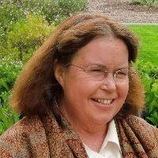

Interviewee 2
I encounter people who are trying to do diversity work: they include people of color, people of different gender orientations. There’s a list, right? People with disabilities should always be on that list. It shouldn’t take someone like me to remind them.
Notes:
Discussion of results, pictures, quotes, and surprises you gleaned from your interviews (include images).

Slide 11
Interviewee 3
Results
People hear
executive dysfunction and think we need more options and time. But the more options, the harder it is to choose.
With sensory issues, I can only drink oat milk, but it’s expensive.
People think we don’t pay taxes and get government benefits. But the help that is available is hidden.
Notes:
Executive function is the ability to put tasks together in your mind and get the drive to perform them. People hear about executive DYSfunction and think we just need more options and more time. But the more options we’re given, the harder it is to choose. And if people say “take your time,” it’s probably never going to get done.

Slide 12
Interviewee 3
Results
People hear
executive dysfunction and think we need more options and time. But the more options, the harder it is to choose.
With sensory issues, I can only drink oat milk, but it’s expensive.
People think we don’t pay taxes and get government benefits. But the help that is available is hidden.
Notes:
I’m lactose intolerant, and with the sensory issues from ADHD, I can only drink oat milk because I can tolerate the texture, but it’s expensive.

Slide 13
Interviewee 3
Results
People hear
executive dysfunction and think we need more options and time. But the more options, the harder it is to choose.
With sensory issues, I can only drink oat milk, but it’s expensive.
People think we don’t pay taxes and get government benefits. But the help that is available is hidden.
Notes:
There’s this erroneous idea that undocumented immigrants have more resources than we do. People think we come here and don’t pay taxes and get government benefits. But the help that is available is hidden. There’s not as much theft of resources as the media says there is.

Slide 14

Interviewee 4
Results
It wasn't too difficult to hand it to the professor, but getting it back would be hard. I have to arrive early to hand the mic to the professor.
The microphone that Stanford’s OAE provides to HoH students.
(Not the exact microphone, but the closest image we could find.)
Notes:
We gained some interesting insights about the microphone that Stanford’s OAE provides that HoH students can hand to their professors so that they can hear the professors better during class.
“It wasn't too difficult to hand it to the professor, but getting it back would be hard. Either I wait in a long line of students who want to ask the professor something OR I forget that I gave the the microphone until I'm halfway across the campus. I have to arrive to class a few minutes early to hand the mic to the professor.”

Slide 15
Interviewee 4
Results
It costs almost $2k, and it's really inconvenient to carry around.
The microphone that Stanford’s OAE provides to HoH students.
(Not the exact microphone, but the closest image we could find.)
Notes:
When asked why she didn’t buy a microphone like that for her own personal use, she said, “It costs almost $2k, and it’s really inconvenient to carry around. It's too large to fit in a pocket. I definitely don't want to lose or break it. The other person needs to hold it to speak into it.”
So even if even if a mic like that was affordable, she still wouldn't get it because of the inconvenience.

Slide 16
3.
ANALYSIS
Notes:
Some analysis notes
Things I noticed
-pedro was comfortable initiating conversation when it was dire or when greeting someone
-was less comfortable w/ conversation when he was directly called on or when he wanted to share more complex thoughts and emotions

Slide 17
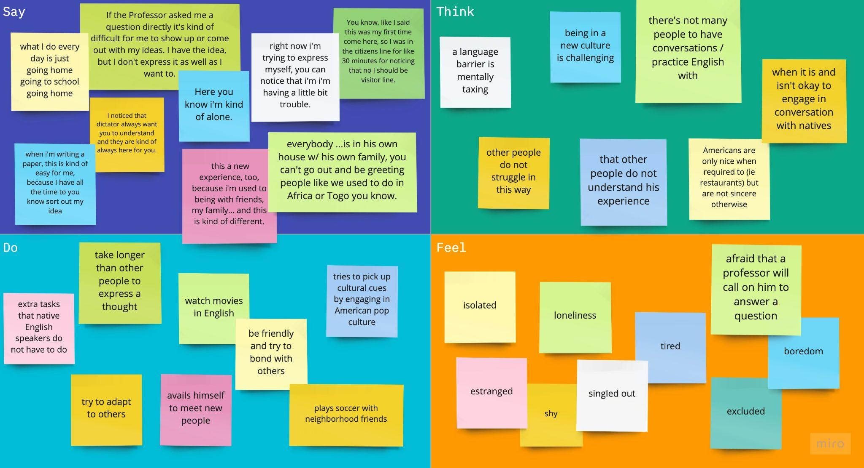

Slide 18
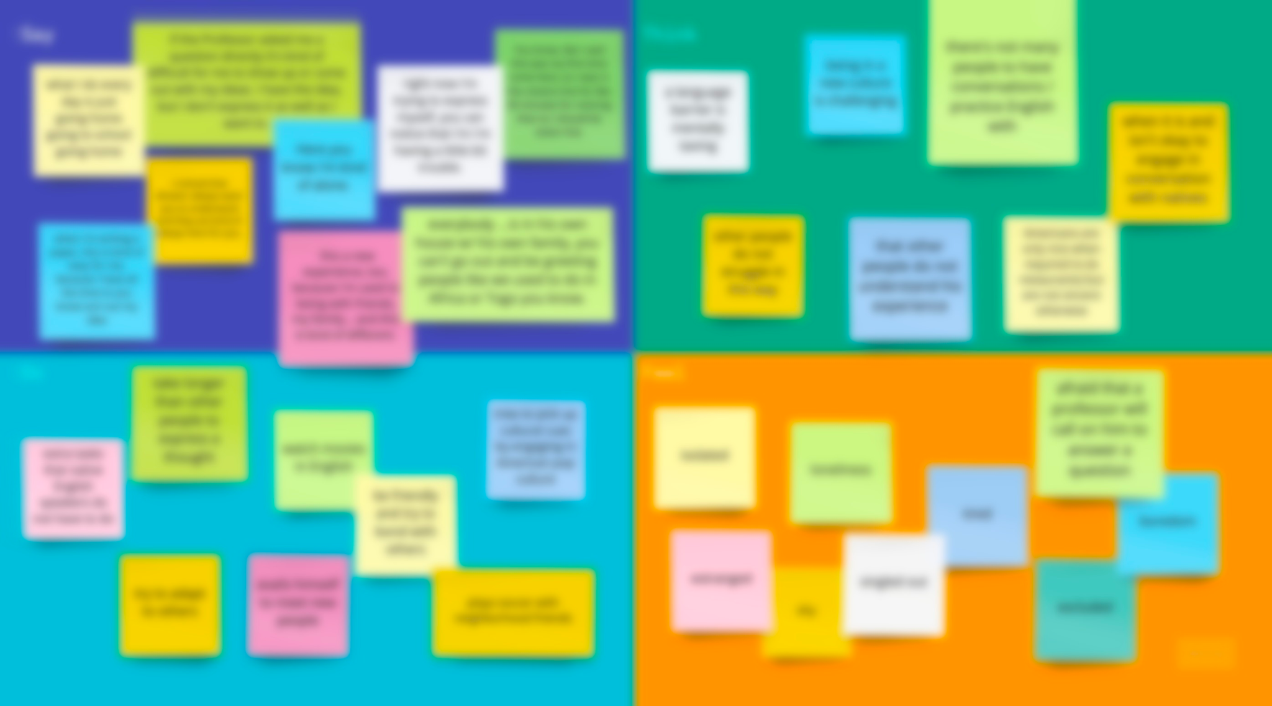


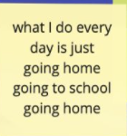
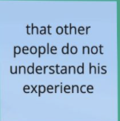


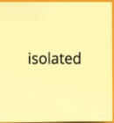

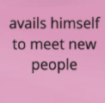
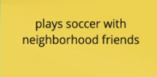
Notes:
People don’t understand his experience as one often thinks (his family included) coming to the US is like coming to the land of milk and honey, you have so many opportunities and life is just that much better and colorful

Slide 19
Insights and Needs: Interviewee 1
Insight: There is this strong desire to be a part of American society but Pedro lacks the ability to initiate these experiences
Need: for a gradual integration into this new society/ culture that does not leave Pedro feeling isolated
Notes:
Inferences, conclusions, or questions you might have about your results ○ Initial assessment of “needs” and “insights”
Lacks ability to initiate bc foreigner

Slide 20
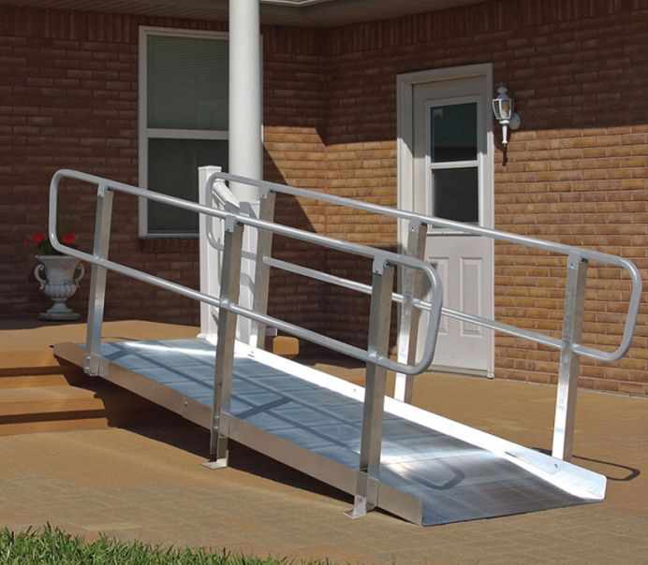

INSIGHTS FROM EXTREME USER: two major challenges
“Hassle factor”
Attitudinal
Notes:
Teri divides the challenges of having a disability into two major categories: the hassle factor and attitudinal challenges.
What is the hassle factor? “for every disability, there are extra things that you constantly have to think about. You can’t always be spontaneous. For example if your friend says “let’s go to this place and all have pizza.” You have to think, “is it accessible?” Maybe there’s a step at the door, or maybe inside the tables are so close together that you can’t sit with your friends. It’s just a hassle and takes up extra energy that you could be using for things you want to do.”
What do we mean by attitudinal challenges? “ We still have a long way to go for everyone to understand and accept that they are surrounded by people with disabilities whose needs are different from theirs. For example, if a student with a learning disability gets extended time on an exam, that doesn’t mean that they are getting an advantage. They are getting extra time to be on the same playing level as other students. “

Slide 21
Insights and Needs: Interviewee 3
People without ADHD misunderstanding what
life is like with ADHD
For people to learn to stop “babying” people with ADHD
Undocumented immigrants
don’t know about available resources, or know but are too scared to use them
A way for undocumented immigrants to learn about the help that they can get safely
Notes:
Left side: insights
Right side: needs

Slide 22
Insights: Interviewee 4
The solutions that the OAE thinks is most helpful for students with disabilities are still surprisingly inconvenient to use.

Slide 23
SUMMARY
Feelings of exclusion
Mental work
Extra tasks the rest of the population does not do
Accessibility is expensive
General population being uneducated about disability
Notes:
Some analysis notes
Things I noticed
-pedro was comfortable initiating conversation when it was dire or when greeting someone
-was less comfortable w/ conversation when he was directly called on or when he wanted to share more complex thoughts and emotions

Slide 24
Feedback?
Notes:
Some analysis notes
Things I noticed
-pedro was comfortable initiating conversation when it was dire or when greeting someone
-was less comfortable w/ conversation when he was directly called on or when he wanted to share more complex thoughts and emotions

Slide 25
EXTRA GRAPHICS

Slide 26
SlidesCarnival icons are editable shapes.
This means that you can:
Resize them without losing quality.
Change line color, width and style.
Isn’t that nice? :)
Examples:

Slide 27
DIAGRAMS AND INFOGRAPHICS

