Slide 1


Learning language in community
Delali A, Carolina B, Katherine L
Notes:
Chatty: Learning language in community
Today I’ll go over our selected interface, our lo-fi prototype and the task flows in it, our testing methodology, the results of our testing, and next steps.

Slide 2
To create comfortable spaces and fruitful connections for language learners at all levels of language ability.
Notes:
Mission statement
To create comfortable spaces and fruitful connections for language learners at all levels of language ability.

Slide 3
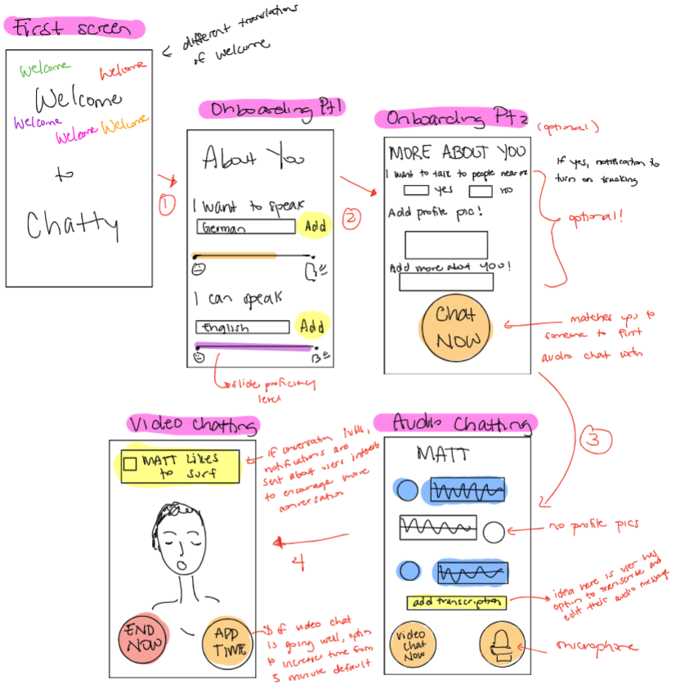
Selected Interface & Rationale
“Omegle meets Hinge”
Video chatting/voice messaging hybrid app
Focus on the CHAT NOW button brings user attention to speaking with other users
Video chatting interface is easy to use and resembles other video chatting apps; familiar
Notes:
Selected Interface & Rationale
We went for a video chatting/voice messaging hybrid app.
We chose this because we decided the most important thing is for users to practice Speaking, and we think that video chatting is what will set us apart from other language apps in the market.
We also chose this interface because the video chatting interface is familiar.

Slide 4
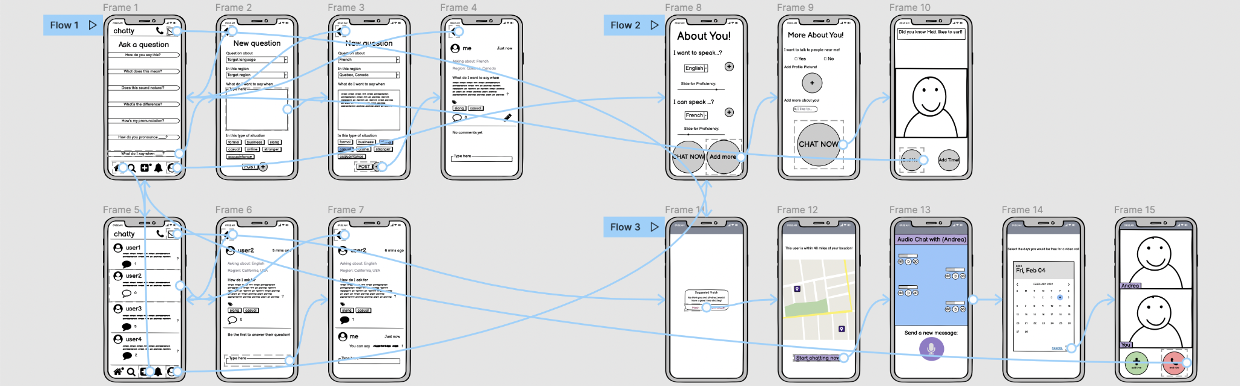
Lo-fi Prototype
Notes:
Here’s the high-level structure of our lo-fi prototype.
There are two distinct parts. The left side is the forum, which is what most language-learning apps have. The right side is the video chatting function, which is unique to Chatty.

Slide 5
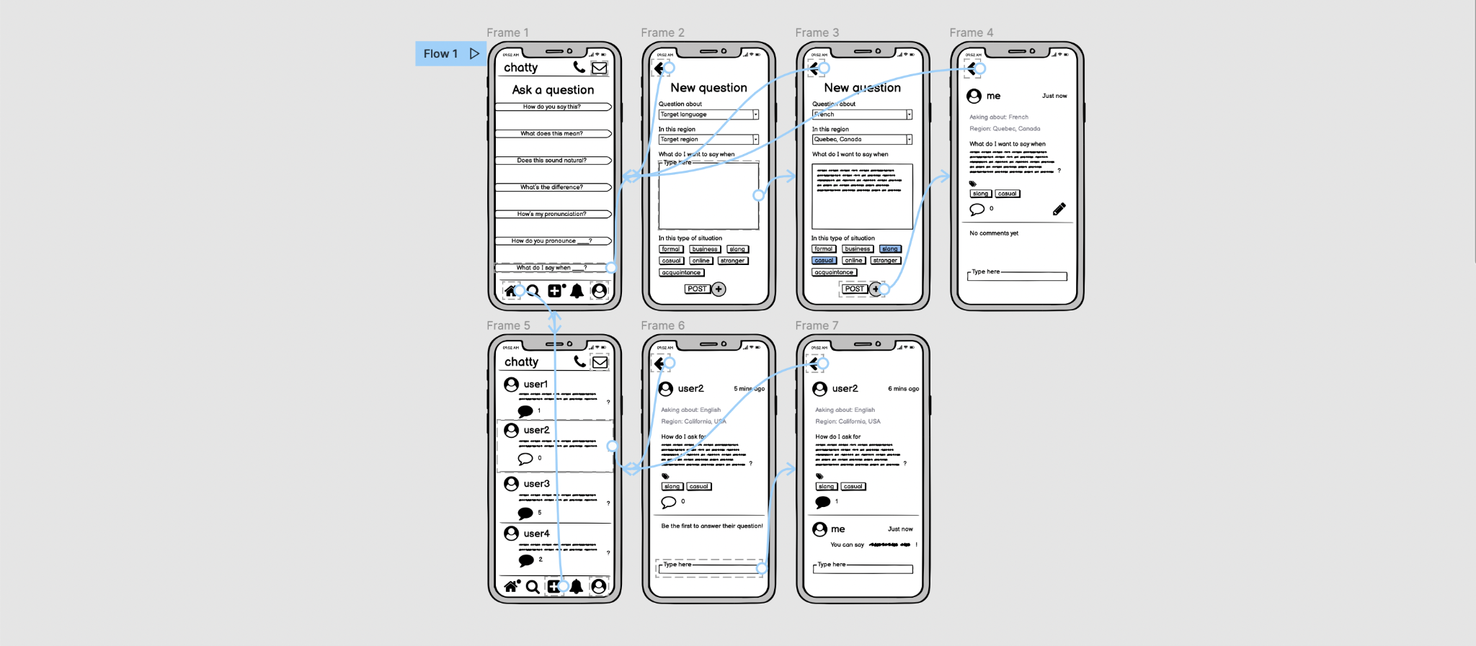
Simple Task
Ask how to say something in French.
Answer a French speaker’s question about English.
Notes:
Our simple task involves the forum where users can ask and answer questions.
We told our users to
Ask how to say something in French.
and
Answer a French speaker’s question about English.
When users ask questions, they can can indicate what language in what region they are asking about. The prototype shows a question about French in Quebec, Canada.
Users can also add tags to indicate what kind of situation they want to speak in. Some examples of situations are formal, casual, and online.

Slide 6
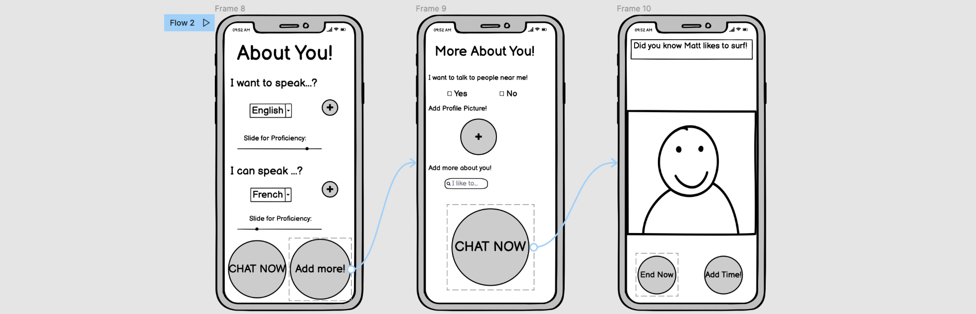
Moderate Task
Have a short video conversation with someone who speaks your target language about one of your interests.
Notes:
Our moderate task is a topic-specific conversation. We envisioned this a 10-minute meeting with a stranger, kind of like speed-dating. Here, users talk can about each others’ interests or whatever else is in the prompt.

Slide 7
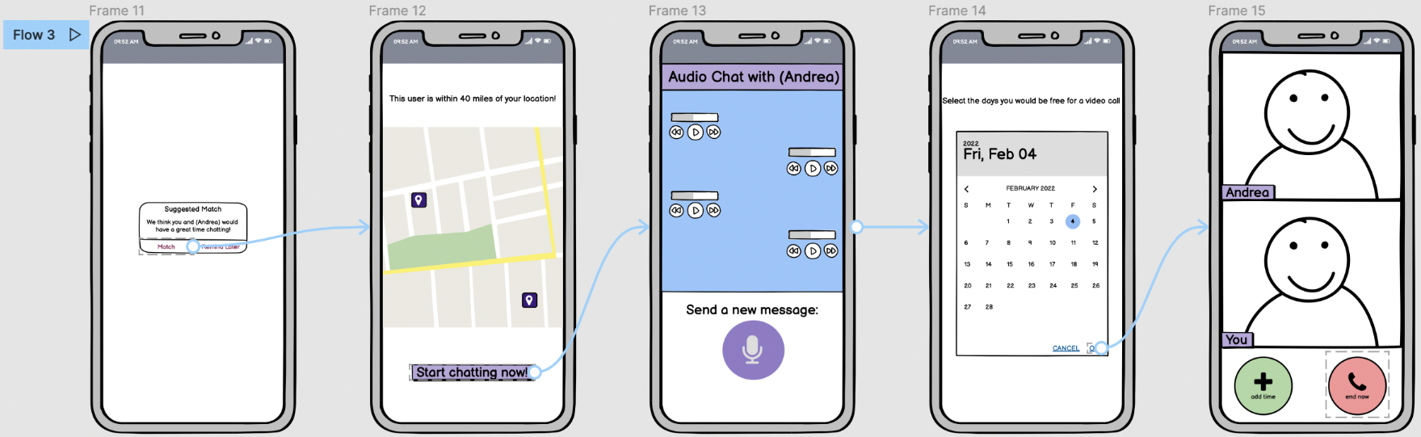
Complex Task
Build a relationship with someone who speaks your target language.
Notes:
Our complex task is to build a deeper relationship with someone who speaks your target language. We envisioned this as a bunch of messages first to get to know the other person, then scheduling a call, and finally having that call. This call isn’t like the moderate task since users aren’t limited to 10 minutes, and they can talk about whatever.

Slide 8
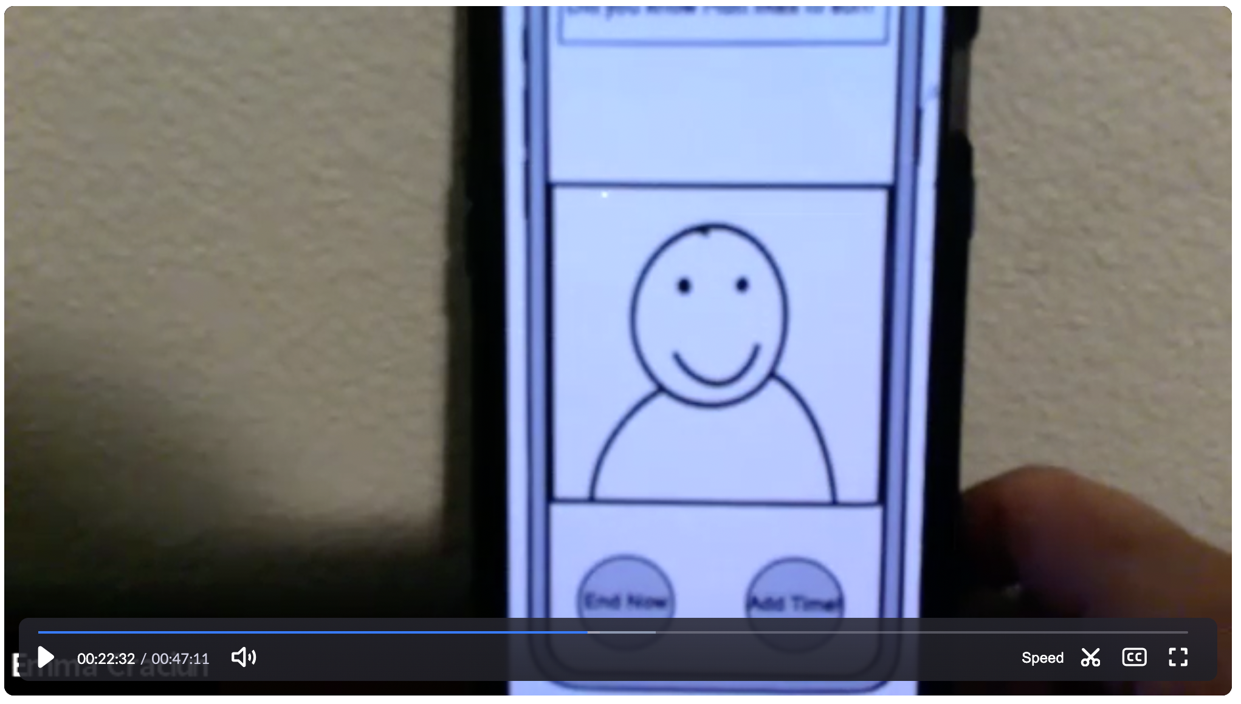
Testing
Methodology
Participants:
Friends
Beginner/intermediate language learners
Usability goals:
Flexibility
Engaging
Test measures:
Whether users can complete tasks without outside help
Whether users verbally indicate enjoyment
Participant opens Figma prototype on phone and “hugs” laptop over Zoom
Notes:
Our three participants were our friends who were beginner and intermediate language learners. only one was a stanford student.
Since all of our participants were remote, we sent them our Figma prototype and asked them to view it on their phone. We called them via Zoom and asked them to “hug” their laptop, with their webcam facing their hands, so that we could see their actions as they navigated through our prototype.
Usability goals:
Flexiblility: We want users to be able to figure out multiple ways to do tasks.
Engaging: We want users to enjoy using the app and look forward to using it again.
To test these goals, we looked for
Whether users can complete tasks without outside help
Whether users verbally indicate enjoyment while using the app

Slide 9
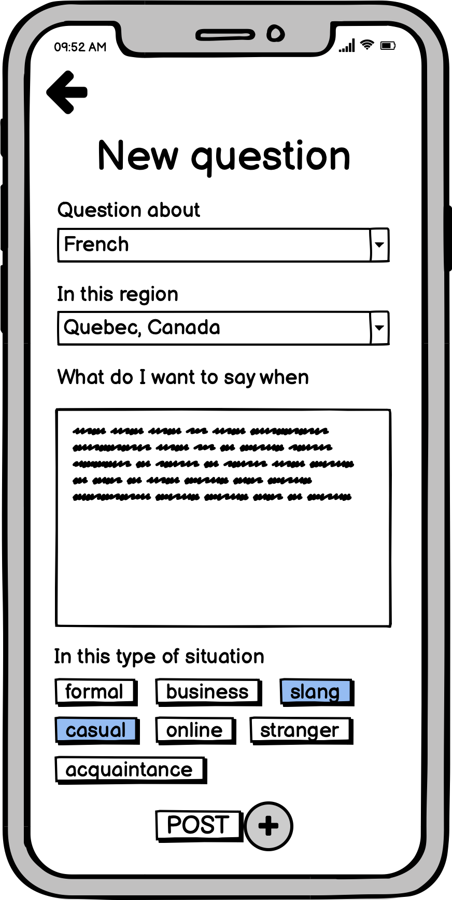
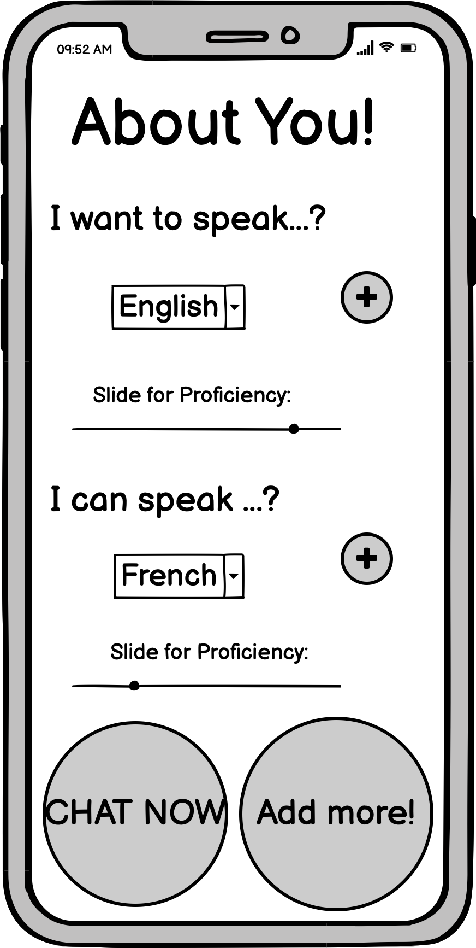
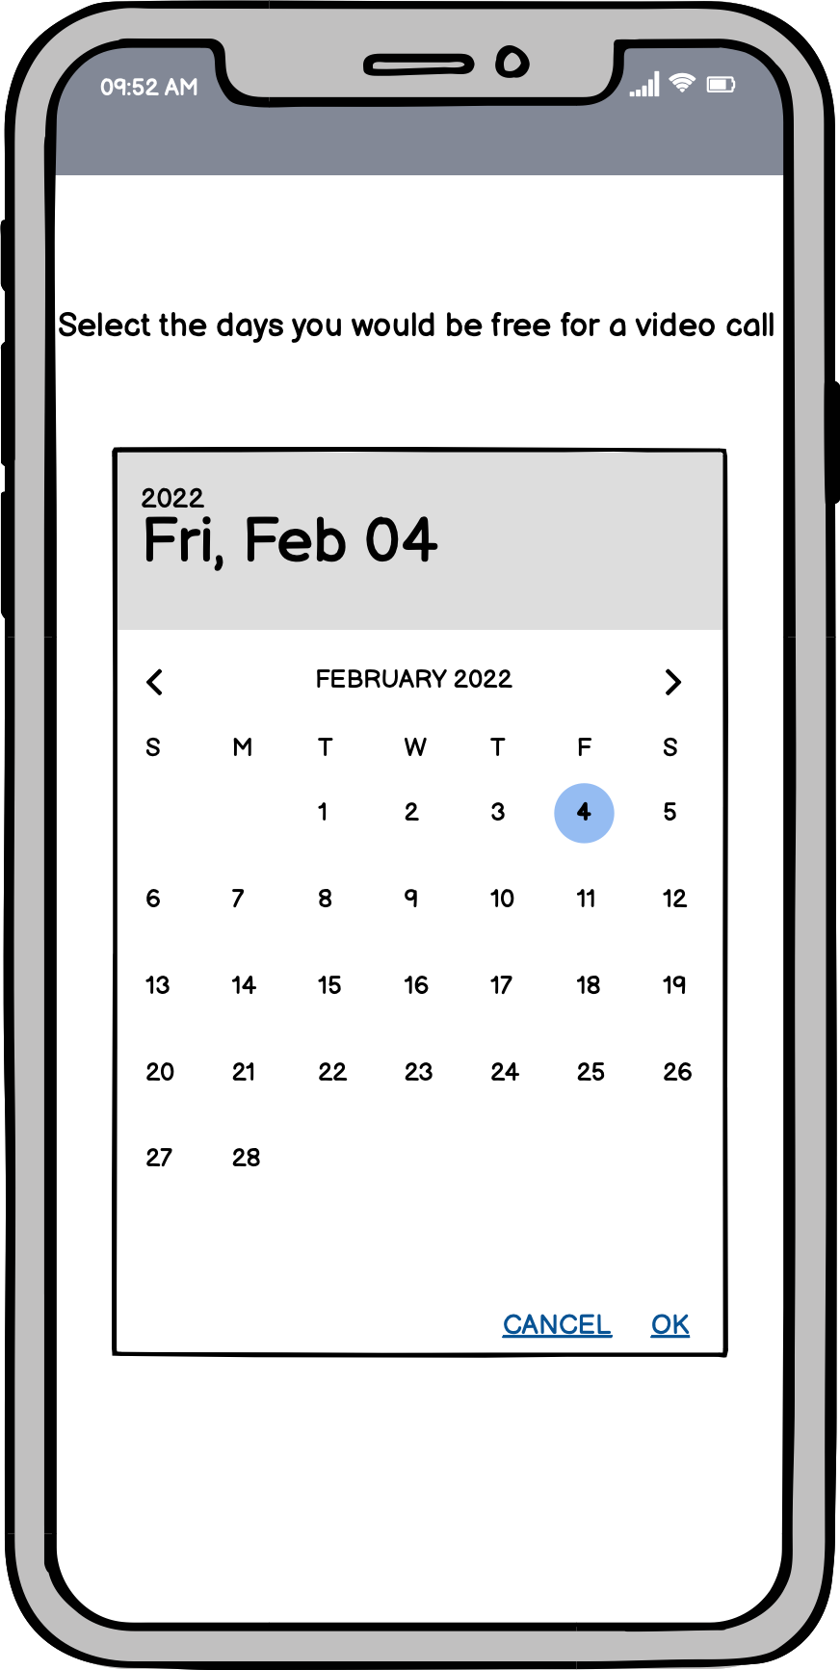
Results: Positive
Users liked app’s purpose!
Liked ability to ask region-specific questions, since different regions use same language differently
Liked scheduling a call
Liked the sliding scale for indicating proficiency in a language
Notes:
Positive results
Users liked app’s purpose!
They liked the ability to ask region-specific questions, since different regions can use same language differently
They liked the ability to schedule a call.
They liked the sliding scale for indicating proficiency in a language.

Slide 10
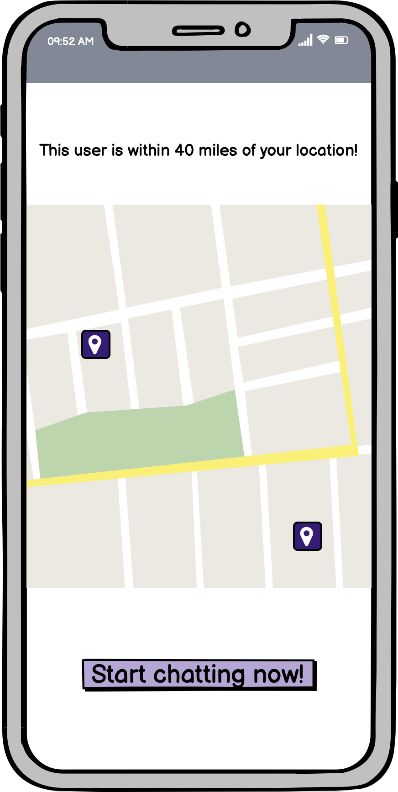
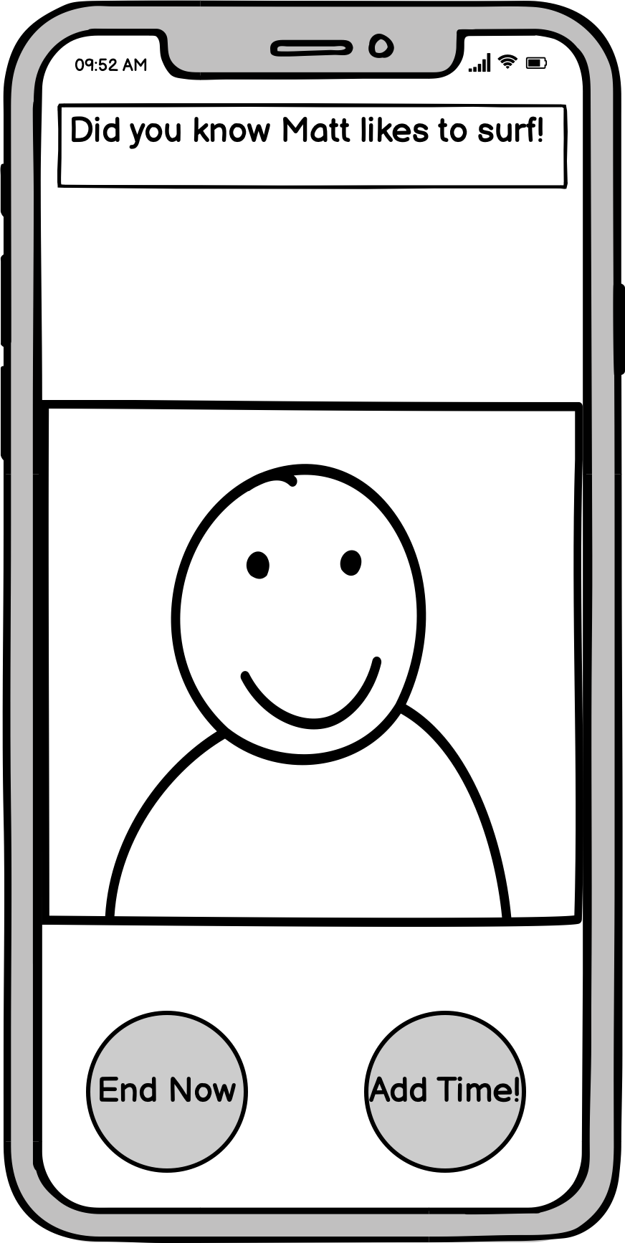
Results: Negative
Confused with the labels on some buttons
User 2 didn’t like another user having her location, even if approximate
Users didn’t like immediate jump into call, wished there was way to preview and cancel
Notes:
Results: Negative
Confused with the labels on some buttons, like the tags when asking new questions
User 2 didn’t like the idea of another user having her location, even if it was only a 5 mile radius approximation.
Users didn’t like that you immediately jumped into a call with your matched person. They wished there was a way to preview them and cancel if needed.

Slide 11



Suggested UI Changes
Timer to know how much time is left in the moderate task video call before deciding to click the “Add Time” button.
An option to write a journal entry after each call to record anything learned while it’s still fresh.
Preview of the conversation partner and an option to cancel before the video call started.
Notes:
Suggested UI changes
Add a timer to know how much time is left in the moderate task video call.
Add an option to write a journal entry after each call to record anything learned while it’s still fresh in the mind. This would be especially helpful for the short calls.
Give a preview of the conversation partner and an option to cancel before the video call started, both to avoid an uncomfortable interaction and to spare the other user’s feelings by not disconnecting mid-call.

Slide 12


Summary
Usability goals met?
Engaging: all users excited by prototype, interested in purpose and novel aspects
Flexibility: could separate some buttons with combined functionality into 2 different buttons, also reduces confusion
Notes:
In summary:
Our goal of Engagement was met. All users were excited by the prototype, and were interested in Chatty’s purpose and its novel aspects such as the video calling function. They liked the emphasis on speaking, as opposed to writing, since this is what sets Chatty apart from other language-learning apps.
Our goal of Flexibility was not met. Users really only had one way to do things. In the future, we could separate some buttons with combined functionality into two different buttons. For example, we could show 2 separate buttons for messaging and video, instead of one “CHAT NOW” button, which is vague and users don’t know what it means.

Slide 13
Summary
Usability goals met?
Next steps
Engaging: all users excited by prototype, interested in purpose and novel aspects
Focus more on user safety
Add screen to preview match and cancel video call before it happens
Consider removing map feature
Flexibility: could separate some buttons with combined functionality into 2 different buttons, also reduces confusion
Notes:
Next steps:
Focus more on user safety. We can do this by
Adding a screen to preview your match and cancel video call before it happens
Consider removing the map feature

Slide 14
Thank you!
Any questions?

