Slide 1
Visual Information Design
February 2, 2022
* Based on slides by Luke Vink, Scott Klemmer, and James Landay
Notes:
Broke 45 min in for 20 min team break
3 minutes over (cut some slides in interestingness still to fit & reduce bullets on dynamic movement & metaphor)

Slide 2

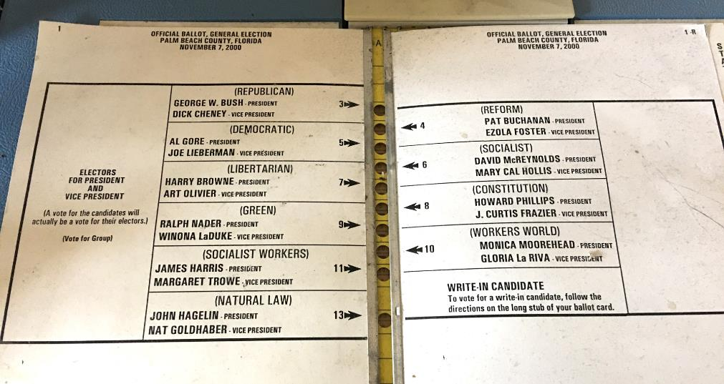
Hall of Fame or Shame?
Palm Beach, Florida
Ballot 2000
Notes:
Maybe one of the most impactful visual designs of all time
Any idea what it is?
https://tamaractalk.com/wp-content/uploads/2016/11/Butterfly-ballot.jpg

Slide 3

Hall of Shame!
Palm Beach, Florida
Ballot 2000
Eye drawn to the wrong holes
If only 1% error rate, can still change a close election
Notes:
Follow the line with your eye above Democratic?
How might we redesign this ballot to still have the same holes down the middle of the page?

Slide 4
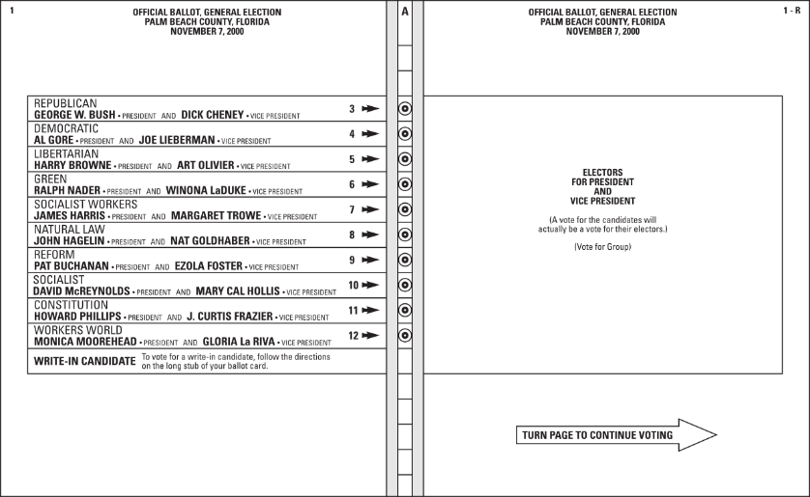
One Possible Redesign
William Lid­well, Kritina Holden, and Jill But­ler Uni­ver­sal Prin­ci­ples of De­sign

Slide 5
Visual Information Design
February 2, 2022
* Based on slides by Luke Vink, Scott Klemmer, and James Landay
Notes:
Today, we will talk about visual information design, which is one of the key topics to know to make a user experience work after you have figured out WHAT it should do. Visual design helps you improve the HOW to do it.

Slide 6
Outline
Good Form
  visual hierarchy, layout, proximity, small multiples & space
Team Break
Good Form (cont.)
  grids, typography & icons
Color
“Interesting Design”
Intro to Design Patterns & Design Systems
Notes:
In particular, we will discuss form, color, and that what we refer to as “interesting design”– design that engages the viewer.

Slide 7
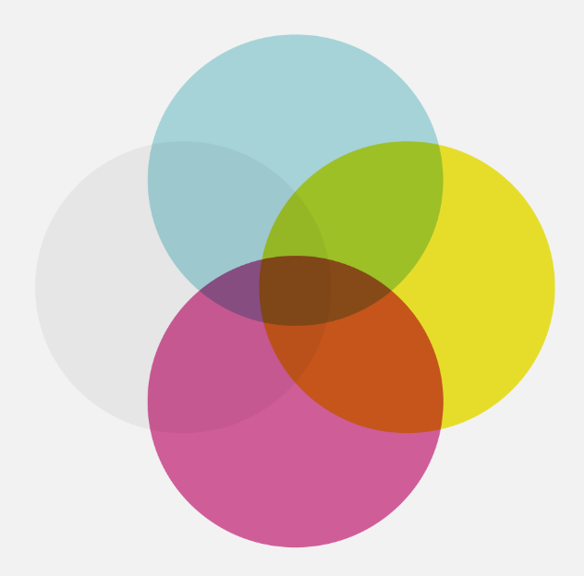
relevant
meaningful
new
interestingness
proof of
concept
experiment
ugly
truth
consistency
honesty
accuracy
How well does it communicate?
easiness
usefulness
usability
fit
How well does it work?
integrity
successful
visual
design
function
useless
rubbish
boring
eye candy
sketch
form
Based on David McCandless
beauty
structure
appearance
http://www.informationisbeautiful.net
Notes:
This graphic illustrates what should be balanced to achieve a design that can convey useful information to its observers by creating desire in the information itself.
This middle part (integrity and function) refers to the information itself, whether the data is accurate (remember the apple maps example) or useful and usable (all of your needfinding and your prototyping and testing).
[ADVANCE]
Arguably you are all becoming experienced at this – making your design work well.
So today I’m going to focus on the other two – how to achieve designs that successfully allow the user to perform such functions without having to force themselves to do so.
That is, we will focus on the form and the interestingness.
[ADVANCE]
So that your design communicates well.

Slide 8
The Art of Balance
Promotion & demotion of important objects
First Question for any design
What are the most important things?
Information should be prioritized based on its importance to the user
Notes:
I’ve mentioned several times before that good design is about balance – visual design is no exception.
Information should be prioritized based on its importance or relationship to other information:
color, size, position and the other things we have discussed are methods to suggest this.
If we look at objects on a scale of importance, we can decide best how to use those techniques.
Scott Klemmer’s video gave you good examples of how Typography, Layout, and Color give you a good idea of visual hierarchy
The key question to ask: What are the most important things? Prioritize those.

Slide 9
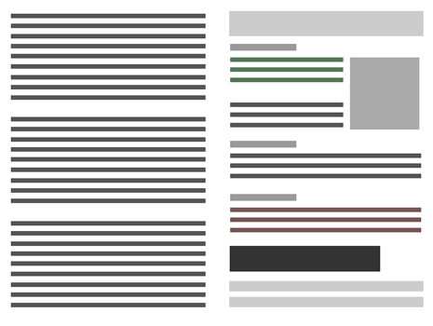
Visual Hierarchy and Reading Order
Weak visual hierarchies
provide little or no guidance on what is important.
Strong visual hierarchies
guide visual & logical progression by showing what is important.
Strong visual hierarchies create a sense of order and balance
Notes:
Strong visual hierarchies can guide people to look where you want, in the order you want them to.
If you don't have this hierarchy, they don't know where to go with their eyes
[ADVANCE]
A strong visual hierarchy creates a sense of order and balance. (see Luke Wrobleski: lukew.com)

Slide 10

Gestalt Principles of Perception Group Information
Notes:
These are all the same shape, but you know which go together by the proximity, the similarity in colors, and the empty space between the red and the yellow.
The principles of Gestalt Principles of Perception (or Gestalt psychology) are based on the humans’ ability to perceive and generate visual forms.
We will talk more about the perceptual system in a later lecture that underlies these principles.

Slide 11


Gestalt Principles of Perception Group Information
Proximity Similarity Continuation Closure
Elements close together
Similarity of shape, size, or color
Aligned along a line or curve
Individual elements form a single object
Notes:
Here are 4 of those principles that you will often use in design. (image from Luke Wrobelski at lukew.com)

Slide 12
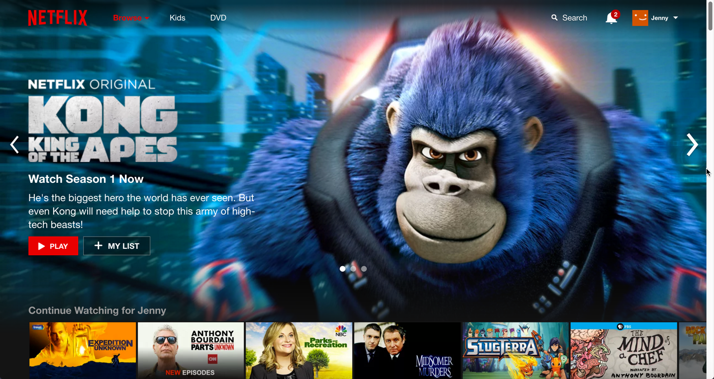
Notes:
what’s the reading order? how is it achieved?
Remember the idea of a First Read
What object is your eye drawn to first?
Second?
Third?
Why?

Slide 13
The First Read: Reading order pillars
size
color
layout
spacing
style
source: http://thenextweb.com/dd/2015/04/30/the-5-pillars-of-visual-hierarchy-in-web-design/#gref
Notes:
what’s the reading order? how is it achieved?
These are essentially some of the gestalt principles in another form

Slide 14
Using Proximity to Indicate Relationships
Gestalt Psychology in information design
Information blocks should be grouped together if related, but unrelated elements should be located at some distance from each other.
Notes:
One of the six Gestalt Principles, “The Proximity principle” is probably the one most often used in information design.
We can use proximity to describe how elements are related to each other.
Simple:
related->near.
Unrelated->far.

Slide 15
Using Proximity to Indicate Relationships
Notes:
As we divide a blank space into a layout, we can prioritize a group’s importance by just its size. As with any hierarchy, our eyes are drawn towards the largest sized objects and eventually down to the smaller. In many cases it’s a good idea to prioritize the placement of these in that order as well.

Slide 16
Using Proximity to Indicate Relationships
Notes:
Two groups of two

Slide 17
Using Proximity to Indicate Relationships
Notes:
Positioning can here be more powerful than color, fonts or any other arguably "obvious” methods of suggesting importance and relatedness. A good layout can remove the need for other confusing and intruding elements such as labels or popups.

Slide 18
Using Proximity to Indicate Relationships
Notes:
If I want to make sure these are subgroups, I might add more space
Or show more relationships among each pair of small ones?
[ADVANCE]

Slide 19
Using Proximity to Indicate Relationships
Notes:
Remove space.
Even without color, we can tell these elements are grouped simply by where they are positioned and how similar they are to each other.

Slide 20
Using Proximity to Indicate Relationships
Add color last and only if necessary. Start with position, size, space, & grayscale/luminance.
Notes:
Add color last and only if necessary (start with position, size, space, and then grayscale or luminance)
Only make things different when you are trying to call attention to the difference… THIS IS VERY IMPORTANT for example…

Slide 21
Small Multiples
Economy of line
Similarities enable us to notice differences
IMAGE REMOVED
Images from Edward Tufte’s Envisioning Information
Notes:
Japanese book for children on t-shirt colors that match
The shirts are all the same. The only difference is the colors! The difference that matters here.
[ADVANCE]
Person holding semaphores to guide in a plane to the gate.
The person is gray… just enough to tell us there is a person. The important thing is that they are holding lights and what they are doing with the lights (the important information is bright – red & yellow)

Slide 22


International Women’s Day
S M A L L M U L T I P L E S
Echeverria, Heriberto 1971
March 8 - International Women’s Day
Diaz, Estela 1974
March 8 - International Women’s Day
Revolucion!: Cuban Poster Art by Lincoln Cushing
http://www.amazon.com/Revolucion-Cuban-Poster-Lincoln-Cushing/dp/0811835820
Notes:
Small multiples convey the important information:
What do you think these two posters are trying to convey about Women in Cuban society?
multi-racial society & everyone is included (same exact form – the only data is the different colors!)
A woman can be anything she wants! Everyone is included. (The woman is the same – but different professions.)

Slide 23
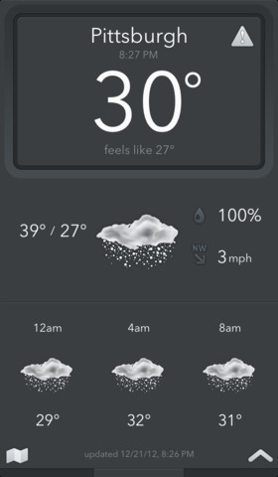
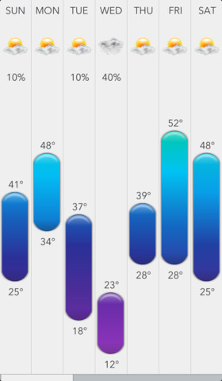
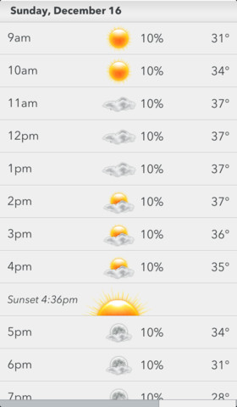
Proximity & Small Multiples in Use
Today Weather
iOS App
Notes:
These elements are grouped together really well using spacing/proximity
[ADVANCE to see groups]

Slide 24
Proximity & Small Multiples in Use
Today Weather
iOS App
Notes:
The interface also uses Small Multiples (repetition) of colors and imagery to make groups even more identifiable.

Slide 25
Proximity & Small Multiples in Use
Today Weather
iOS App
Notes:
The viewers can SEE that these are the most important – no one has to tell us. This means the design of this information is successful. If we look deeper we can see a good balance of layout where size is the biggest indicator of importance, followed by color.

Slide 26
Using Blank / White Space as an Object
White space can be used to suggest importance or prestige
The more space around a group, the more valuable it should be for the user
Think of whitespace as an “element” – consider its position
Notes:
Treat blank space as an object. This is a good way to avoid clutter. Designs with a lot of white space suggest the information within is more important: read: Apple. As mentioned before, the more objects you have, the less relevant they may be.

Slide 27
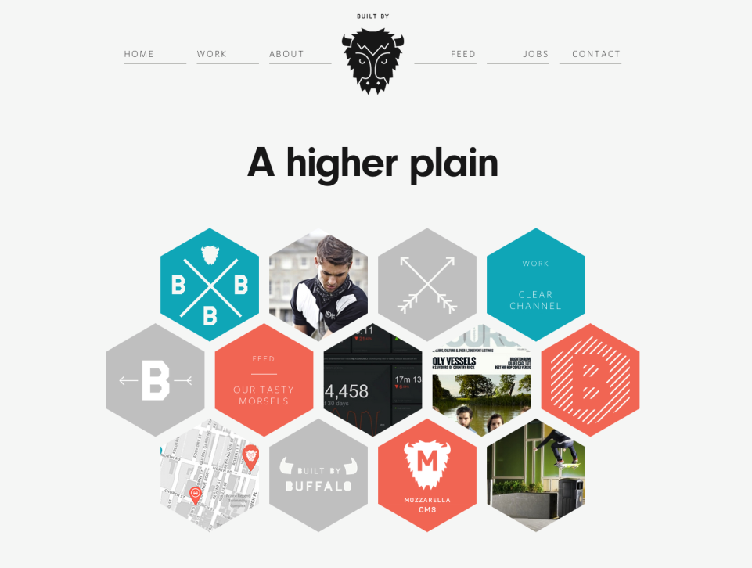
http://builtbybuffalo.com/
White Space = Value
Notes:
Web design provides good examples of the proximity rule where good layouts will organize related items into groups such as seen here with the menu and project elements grouped together.

Slide 28
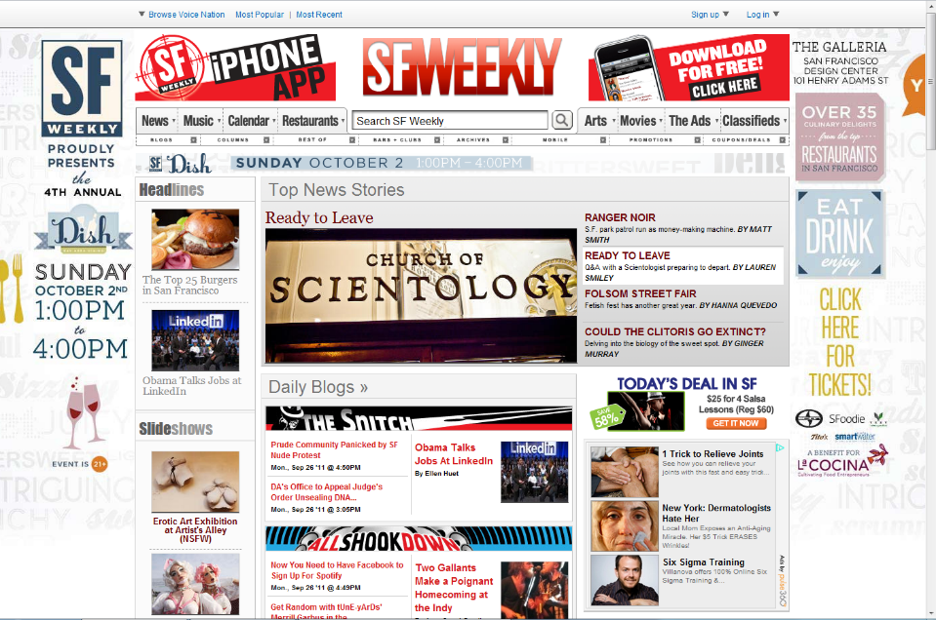
What Are The Important Things Here?
Notes:
We often sacrifice proximity to fit more things in a page. Mistaken idea that the more we offer, the more people will find the need for our solution.

Slide 29
Administrivia
Grading on Assignment #4 – Concept Video
  Will report & return tonight (sorry for delay)
Web site
  we are starting to look for them – midway check is soon
  problem getting a web site up, talk to your CA
Fill out studio team survey in studio this week
CS 194H
  follow-on to CS147
  not offered this Spring (be back next year I hope)

Slide 30
TEAM break
(FINISH LOW-fi Prototype OR SLIDES)
Notes:
team break 30 minutes
Broke 34 minutes in
If get here anywhere past 40 min, subtract 5 min from break for each 5 min behind

Slide 31
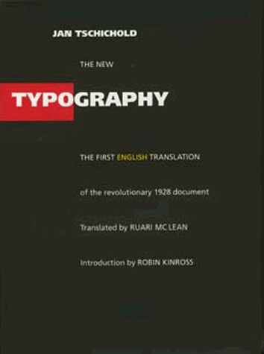
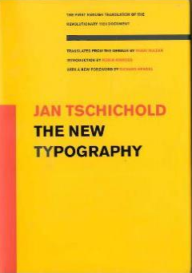
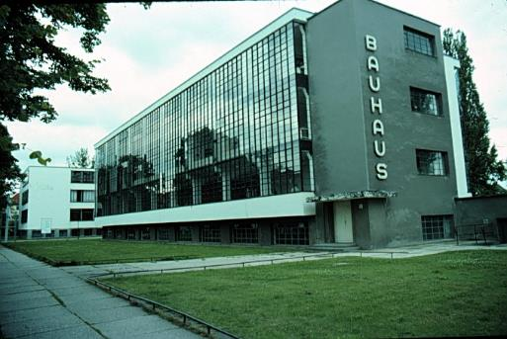
Jan Tschichold’s Revolution
Champion of Modernist Typography
Die Neue Typographie Berlin, 1928
Bauhaus school
Dessau, 1925-26
Notes:
Graphic design as we know it today started with the Bauhaus
(CHEE-HOLD) was the lead graphic designer in the Bahuaus and pioneered modernist design principles.

Slide 32
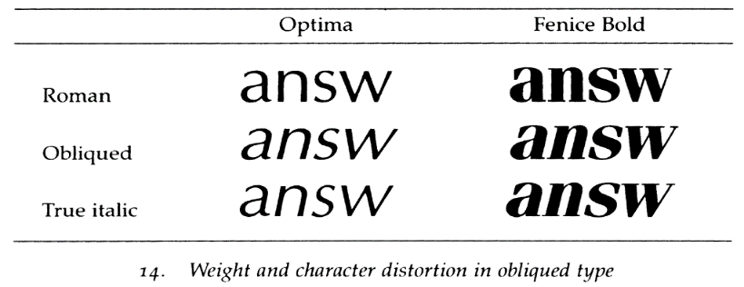
Type Classifications
Typeface (Arial) vs Font (Arial Bold)
Serifs: Structural details in letters that (may) help the reader connect them
Sans Serif
Serif
Notes:
Simple place to start is the difference between Sans Serif and Serif typefaces
Until 1900, all type faces were Serif type faces. Most modernist are Sans Serif,
Both are useful, depends on what you are trying to use them for.
German type faces were original straight up and the Italians had a slant to it. At some point in the 18th & 19th century, people figured out they could make 2 versions of the same typeface and use the difference to convey information.
Oblique is bad. That is the automatically transformed typeface you get if you don’t own the Italic version.

Slide 33
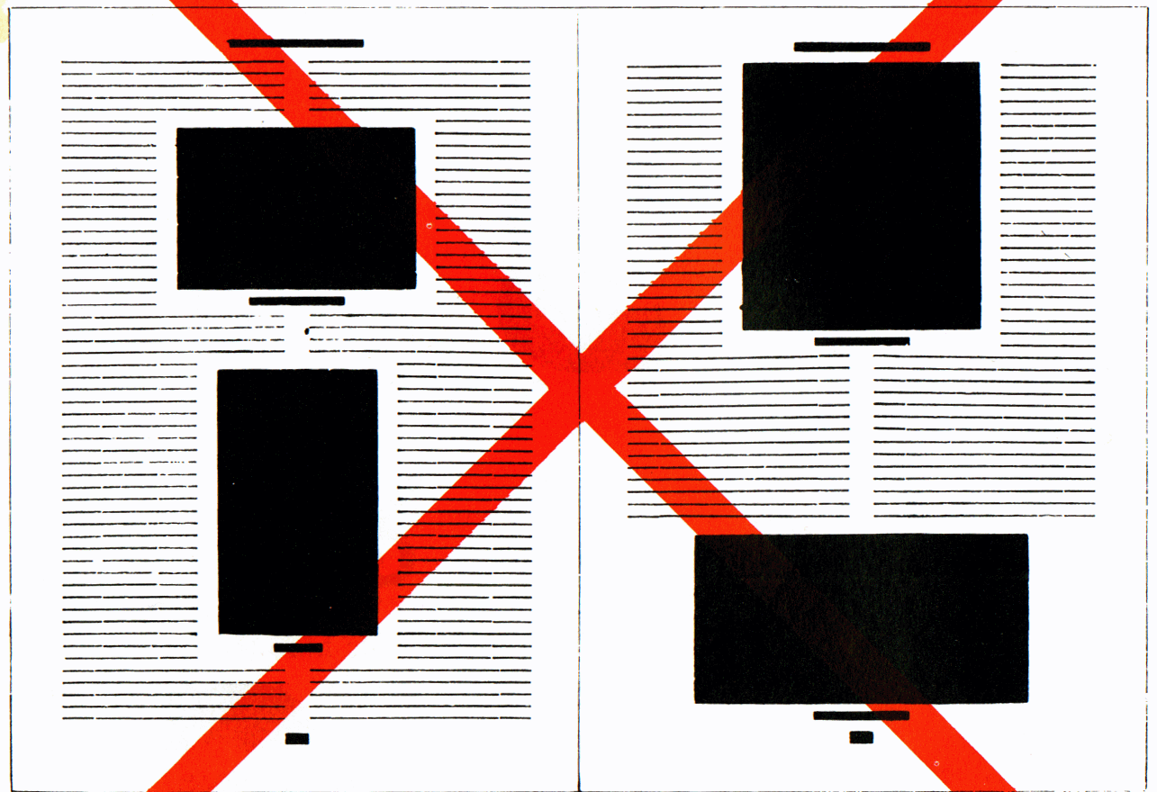
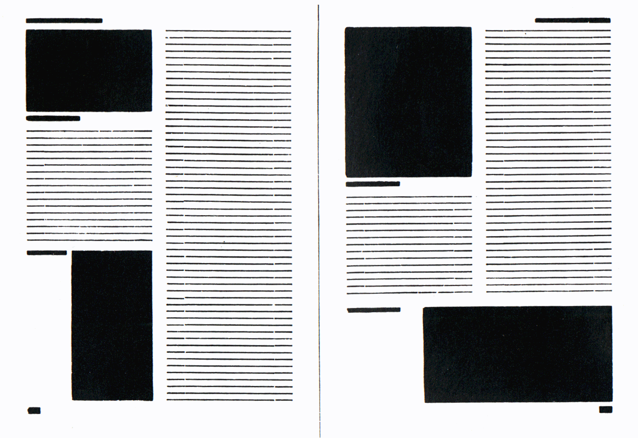
Asymmetric Typography
J A N T S C H I C H O L D
How blocks used to be arranged in magazines. Schematic, thoughtless centering of blocks
(= ugly).
The same blocks, correctly arranged in the same type-area. Constructive, meaningful, and economical
(= beautiful).
Notes:
Main tenant of modernist design
In books before the Bauhaus, everything was centered.
Harder to read.
[ADVANCE]
Asymmetric: 1) feels more dynamic (energy to the type), 2) don’t have difficult to read narrow columns around the figures.

Slide 34
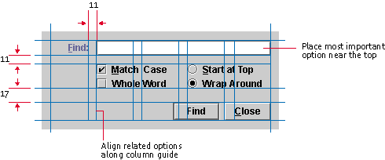
Grid Systems
A key pattern for implementing rationality, modernism, asymmetry
Note that no elements are “centered”
Java Look and Feel Design Guidelines
Notes:
One take-away on how to design a lot of information on a page, a grid system is a good place to start.
Using the grid gives you consistency and if you use someone else's grid, you get to take advantage of professional designed system.
Find is easy to see since it is in a column all by itself.
Space is consistent between the buttons.
Things that are similar are closer (i.e., radio buttons).
Bigger space to the buttons at the bottom – they are different.

Slide 35
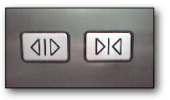

Iconography:
Differences that Make a Difference
www.jensondesign.com/1+1=3.pdf
Notes:
Left has same symbols. Only flipped.
How might you do it better?
[ADVANCE]
Right has greater iconic differences. Also size and color.
Radical change? ...Get rid of the close button entirely.
There are lots of great online sources of icons (e.g., the noun project). Use them.

Slide 36
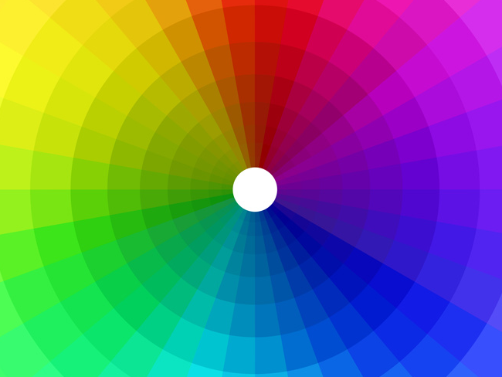
Color
Notes:
Color is often difficult to get right. It plays a major role in stimulating a person’s reaction or attitude which may vary from individual to individual and yet across cultures, colors have different meanings.

Slide 37
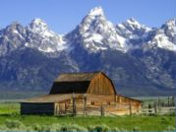
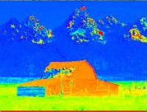
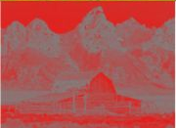
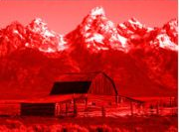
Color Definitions (digital)
Hue is gradation of color (i.e., name: “yellow”)
Saturation is purity of the hue (vividness)
  how much gray
Luminance is the brightness in an image
Photo Hue Saturation Luminance

Slide 38
Color: Edward Tufte – by hue
IMAGE REMOVED
Notes:
While it is certainly true that hues have a physical order via their wavelength, and that every kindergartener knows the rainbow ordering, our visual system has a very difficult time treating hue in an ordered way. As we see in this image, it is clear that each area is *different*, but none of the areas have an intuitive relationship between each other.
This is supposed to convey height above sea level.
Where is above ground? Where is below? What’s the highest point? These questions are hard to answer.
This is how most computer scientist would design a map.

Slide 39
Color: Edward Tufte – by luminance
IMAGE REMOVED
Notes:
Color sets that vary primarily by luminance are much easier for us to order. This image uses two color sets: browns for above ground, blues for below. The questions I mentioned before are now much easier to answer. The much more muted colors also make it much easier to read the text information.
[Eastern Sea, not Japan Sea]
Cartographers have been doing this for 2000 years.
The key is to know: under water or not under water? Then, how far for each case? Our perception system can’t use hue for how much! But, we can use intensity. As I go deeper, the color gets darker. Intensity is a great axis for presenting quantitative info.

Slide 40
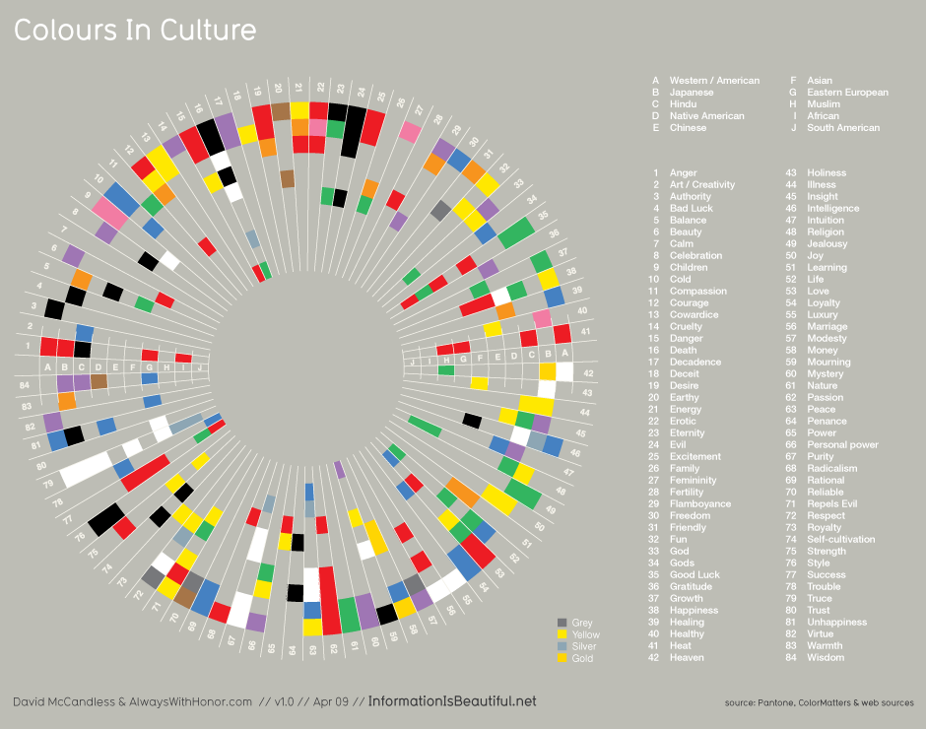
Notes:
This is a diagram of what colors mean for different cultures again from Dave McCandless’ Information is Beautiful.
key to note is the set of colors & their order in each slice differ!

Slide 41
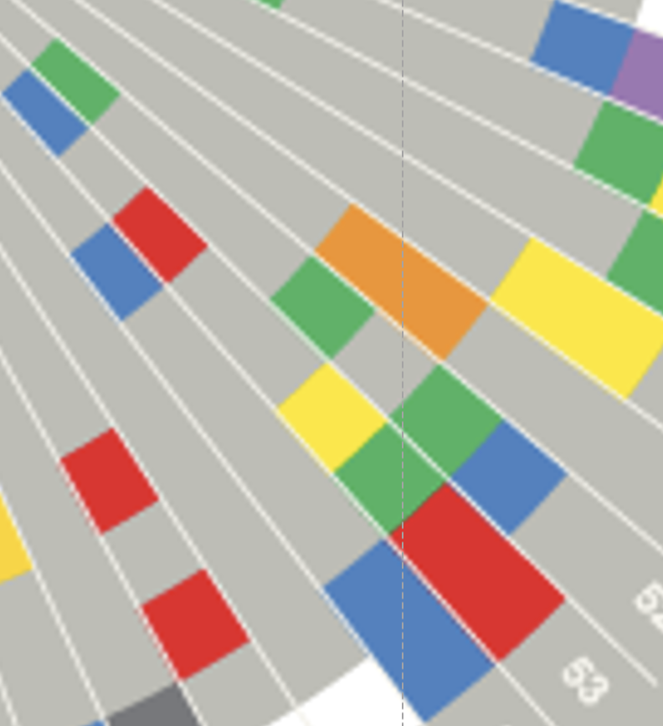
Notes:
Just zooming in on slice 53 (which stands for Love), you can see 4 different colors in different cultures.

Slide 42
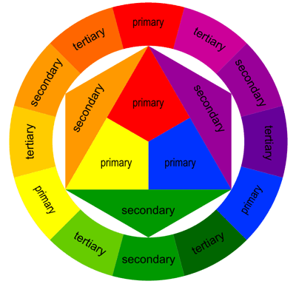
The Basics of the Color Wheel
WARM
COOL
Notes:
There is one thing that is similar across cultures with color at its most basic level. We can separate color into “warm” and
[ADVANCE]
“cool” colors which have a very similar emotional response to all people as the theory is based on our innate understanding of the natural world.

Slide 43
Color Harmonies
“A pleasing arrangement of parts, whether it be music, poetry, color, or an ice cream sundae.”
Notes:
Which brings up a related topic: Color Harmonies
What is a harmony?
[ADVANCE]
So color harmonies are pleasing combinations of colors.
This is important when you are using more than 1 color (though I caution you to be very conservative here and minimize how much color you use).

Slide 44

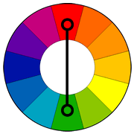
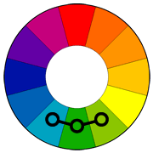
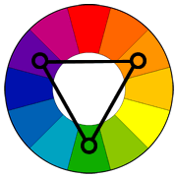
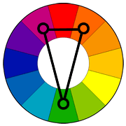
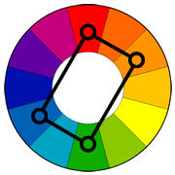
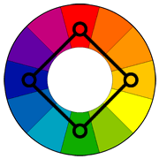
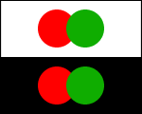
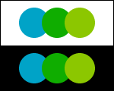
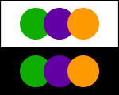
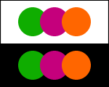
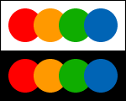
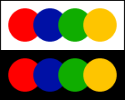

Using Appropriate Color “Harmonies”
Beginners should use these
Complementary
Analogous
Triad
Split
Complementary
Rectangle
(Tetradic)
Square
Notes:
So how do we pick the right colors?
While my suggestion for beginners is to stick to one color or “monochrome” palettes, there is the odd occasion where information must have multiple colors to be distinguishable, such as in graphs. In these cases, Color harmonies are particularly useful. They involve picking a primary color and using a color wheel to determine the best colors to go along with it. The names connote either the direction across the color wheel or the shape made by drawing a line between the combination of colors.
[ADVANCE]
For beginners, I strongly suggest using these two (analogous and split-complimentary) as they are hard to get wrong and tend to work with lots of designs.
see: http://www.tigercolor.com/color-lab/color-theory/color-harmonies.htm

Slide 45
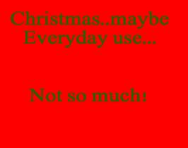
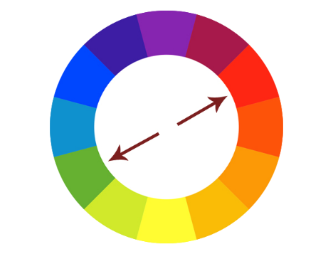
Complimentary
Hard on the eyes
Not so good for text
This color scheme must be managed well so it is not jarring. Bad with Text!!
Notes:
Let’s talk about some of them. Complimentary colors provide extreme contrast. This high contrast creates a vibrant look especially when used at full saturation.
Complementary colors are tricky to use in large doses but work well when you want something to stand out.
[ADVANCE]
Complementary colors are really bad for text.
Complementary colors are pairs of colors which, when combined, cancel each other out. This means that when combined, they produce a grey-scale color like white or black. When placed next to each other, they create the strongest contrast for those particular two colors.
In a few lectures when we talk about the physics behind vision and color you will understand more on why it is especially hard on our eyes, particularly for reading.

Slide 46
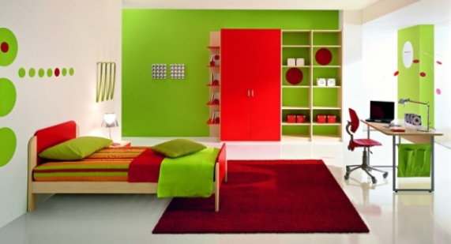
Complimentary (e.g., Children’s Bedroom)
Notes:
We often use complimentary colors in children’s products and services. The high contrast makes things easier to distinguish though it makes it hard to discern what is actually important.

Slide 47
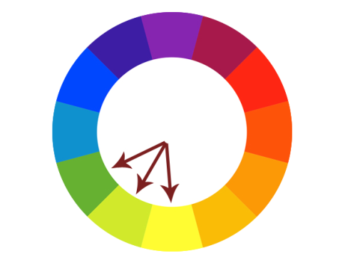
Analogous
Always easy on the eyes,
this type of color scheme
always looks “natural”
Notes:
Analogous colors tend to relate closely to what we find in nature and thus are easiest on the eyes. Visual designs using these colors are always pleasant to look at yet have enough difference in color to be distinguishable in terms of priority.

Slide 48

Analogous (e.g., Beyond Oil)
Notes:
BP, who propose that they are a company beyond oil choose an analogous scheme as it invokes nature. The mixture of green and yellow here, not to mention its flower like shape, is comforting and rather powerfully suggests an oil company cares about the environment. [whether you believe that or not is up to you]

Slide 49
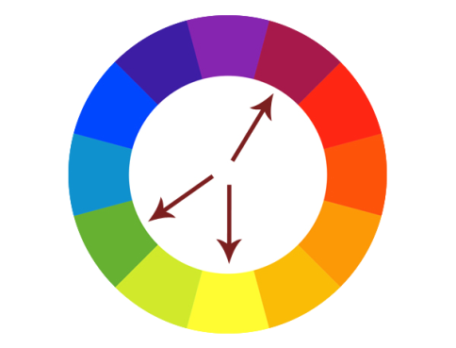
Split Complimentary
Often a good choice for beginners, because it is difficult to mess up.
Notes:
Split complimentary colors are often used when the elements of a design have a stronger need for distinction. This color scheme has the same strong visual contrast as the complementary color scheme, but has less tension.

Slide 50
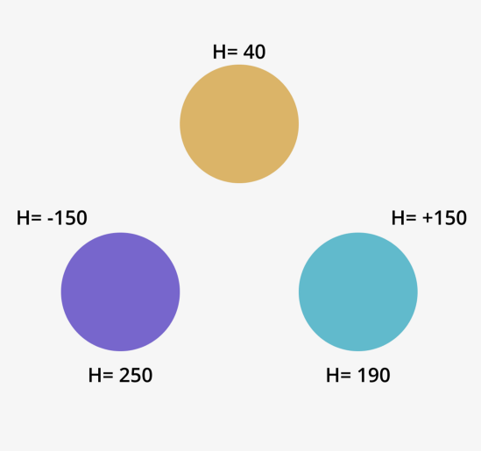
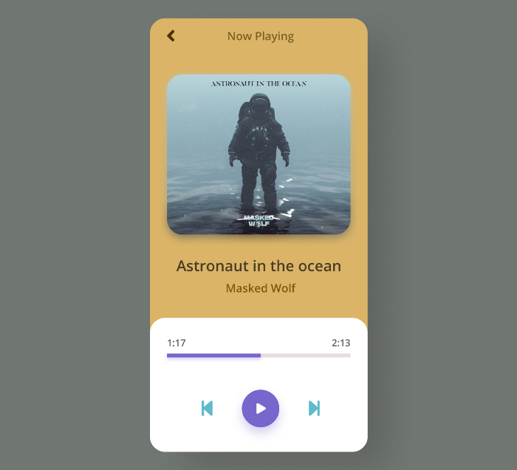
Split Complimentary
https://uxplanet.org/how-to-use-a-split-complementary-color-scheme-in-design-a6c3f1e22644
Notes:
Here is a UI example of split complementary.
The trick is to pick a base color for the Hue and then subtract 150 and add 150 to get the complementary colors in the HSB color space.

Slide 51
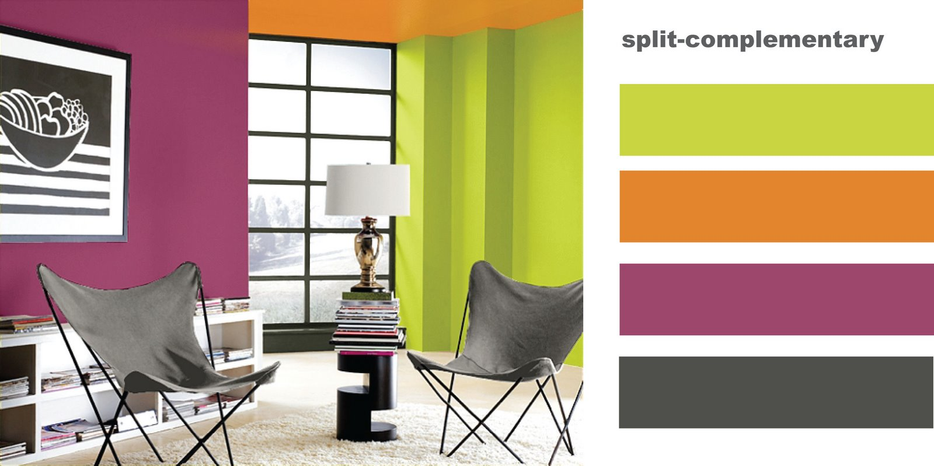
EG Split Complimentary

Slide 52
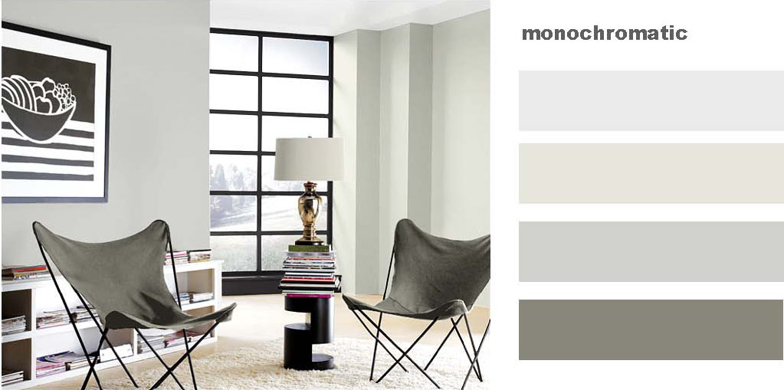
Notes:
Regardless of what color you are going to use, its always best to begin designs in gray scale

Slide 53
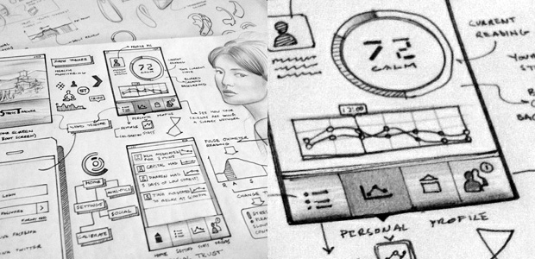
Start with Greyscale
… then accent or enhance with color
Notes:
The high contrast of greyscale allows you to really focus on getting the best layout and hierarchy of elements to then be accented or enhanced with color.

Slide 54
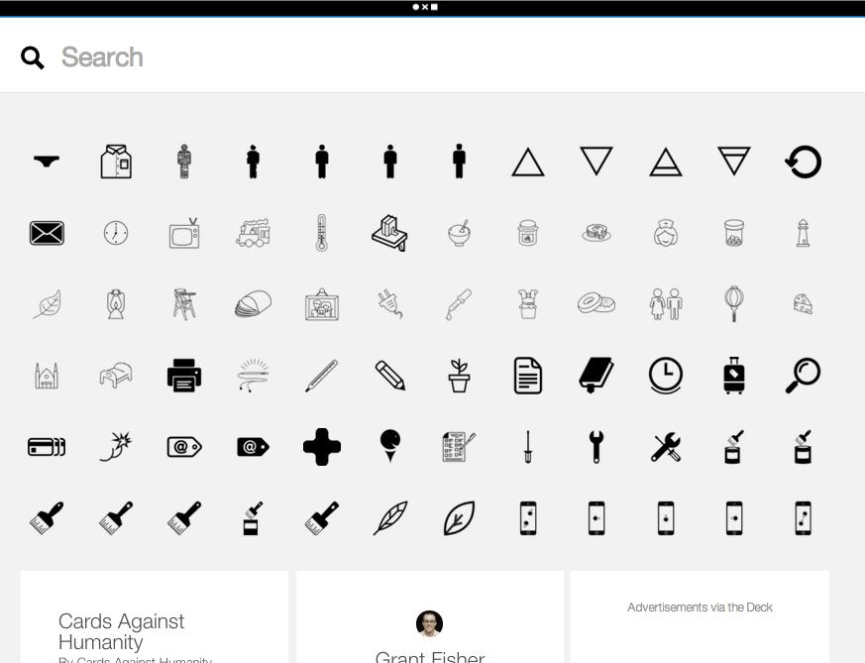
Notes:
The noun project is a very good example of an interface without any color. Here, the layout design and discovery is done so well that color is not needed at all to navigate. In fact this web interface feels to me better than many others using color
Also has good use of SMALL MULTIPLES

Slide 55
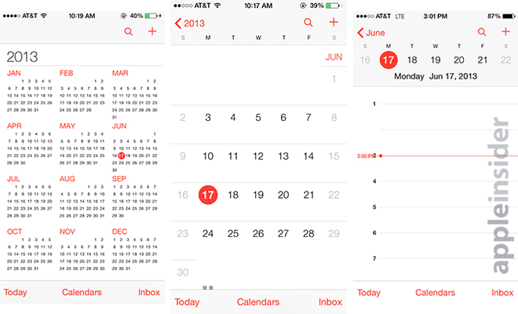
Action + Passive Colors
Notes:
A recent trend in design, most noticeable in things like Windows Phone and iOS is the use of the isolation effect. In this example, color harmonies are near irrelevant. These types of designs are so focused in their layouts that color is only used to describe an element that is “actionable”. It turns out that more often than not, this results in a user experience that is very easy to understand.

Slide 56


Poor Use of Color
Notes:
This is an example of poor color use. The colors don’t match to any particular task or function and as a result, it is near impossible to figure out what to do – and the consequence being a horrible user experience perhaps more hindering than any functionality.

Slide 57


Redesigned to Use 3 Actionable Colors plus a text color → 4 total colors
Notes:
Luke’s goal was to pick a color harmony that was relaxing while only ever using 3 colors. Anything that is colored is actionable (tappable or important). Anything grey is a “passive” color and requires the user to explore this information. The green, blue, and purple here are ANALOGOUS colors
A good color palette should comprise one dominant color, one standard color (used primarily for text, such as black or grey), and two accent colors.

Slide 58


Action/Appears often
Immediate/Important
Special/Appears rarely
Analogous
Notes:
ANALOGOUS
He sort of cheated over a bit more to get that light purple. He’s mainly using the 2 colors here plus the text (and the white background). Though you saw one bit of the green for a special situation he wanted to highlight.
It always a bit more complex because you have different luminance, etc. that changes the appearance of these pure colors.

Slide 59

Tools that help with color selection
http://colorschemedesigner.com/
http://color.adobe.com/
http://www.colourlovers.com
←https://colors.dopely.top/ (new one – I really like it!)
Notes:
These tools are useful for both exploration of colors and for figuring out harmonies. Tools like photoshop, illustrator and most interface design tools also include built-in tools for choosing color harmonies.

Slide 60
Mood Boards – Team Exercise (10 min)
Start thinking about what images represent your solution space, and what colors & icons you want to use for medium-fi
Don’t forget to pick primary and secondary colors!
Copy this slide deck to your team folder (also posted in Slack)
  https://bit.ly/mood-board-22
Notes:
10 min exercise started at 100 min (leaving 10 minutes to finish class)

Slide 61
Exit Ticket
https://bit.ly/cs147-2022wi-exit5-172

Slide 62
Visual Design that is
Interesting
[the wow factor]
Notes:
This is perhaps the most difficult thing to achieve. It’s very easy to use templates for data graphs, websites and applications – and for the most part they do very well. The following techniques for most are difficult to do right, but when done well create interest in your users.

Slide 63
Unconventional Layouts
Hard to get right & easy to overdo!
Try new shapes
  circular charts
  hexagonal objects
Like all visual design techniques (color, etc) – restrict unconventional layouts to the most important information

Slide 64


Wilfred Castillo: Tide Prediction: http://www.wilfredcastillo.com/Tide-Prediction
Notes:
For example, Wilfred Castillo’s Tide Prediction
http://www.wilfredcastillo.com/Tide-Prediction
Shows how the high tides and low tides relate to the moon’s phases (full moon and new moon are when they are strongest – aligned with the sun)
[ADVANCE] Here it is a bit more zoomed in so you can see these relationships.

Slide 65


Partly Cloudy
iOS App
Notes:
Here is another weather app I tried. Reminiscent of the tide chart…
No longer available that had a very interesting visual design.

Slide 66



Weather
(play the weather)
iOS App
Notes:
Here is another weather app. This designer has a entire set of apps (weather, rulers, etc.) that are meant to be interesting and fun. Unconventional layouts and animation/interaction.

Slide 67
Dynamic Movement
Hard to get right & easy to overdo!
Animation is best used to connect information & create “flow”
Like size, color & unusual shapes, animation draws attention to the eye & suggests importance
Notes:
Having information change dynamically has taken off and again, is difficult to do correctly. The best way for me to consider animation is to only use it to connect an input to a display of the information the input is modifying.
This connects to a usability principle that will be discussed in a few lectures when we talk about “Heuristic Evaluation” where information that adapts instantly gratifies the user that the system is working for them, not against them.

Slide 68
Metaphors (using the real world to describe info)
Hard to get right & easy to overdo!
Very useful to provide meaning and connect information to logic
The more direct or specific a metaphor, the more contextually relevant it is to a generation or time
Notes:
Metaphors are perhaps one of the hardest “interesting techniques” to get right. In information graphics, metaphors are very useful however in interfaces they can often cause more confusion than success.

Slide 69

Metaphors
Notes:
This shows changes in global emissions of CO2 and uses the metaphor of clouds of smoke coming out of a factory
[ADVANCE]
http://awesome.good.is/transparency/web/0911/globalemissions/flat.html

Slide 70
The best designs balance the techniques you have seen
and
The less techniques used,
the easier it is to balance them
Notes:
What we have discussed so far in this lecture may seem like an overwhelming number of techniques that designers use all the time.
This is how it should seem – Overwhelming. It is exactly the way customers will feel if they see too many being used at once.
Again, we are brought back to the number one skill – Balance.
The hardest part is knowing what to remove and the only way to really get a good feel for these techniques is to practice with them repetitively.

Slide 71
Overwhelming Use of Different Techniques
Notes:
This is overwhelming because there is so much going on.
[ADVANCE]

Slide 72
In other words,
Keep it Focused

Slide 73
relevant
meaningful
new
interestingness
proof of
concept
experiment
ugly
truth
consistency
honesty
accuracy
successful
visual
design
easiness
usefulness
usability
fit
integrity
useless
rubbish
function
boring
eye candy
sketch
form
Based on David McCandless
beauty
structure
appearance
http://www.informationisbeautiful.net
Notes:
Remember McCandless's info graphic on this.
Interestingness and form along with the familiar integrity and function.

Slide 74

Form
Interestingness
Integrity
Function
Notes:
One last example that I like
Daisy disk for mac
[ADVANCE]
The interesting form of the layout of your files in a circle and how much space they each take.
[ADVANCE]
The function of showing you the total amount of space for each directory in this list
[ADVANCE]
The integrity to make sure the numbers in the list at right add up to what is displayed in the center and what the system also tells you.
[ADVANCE]
And the interestingness of the circular layout for the information.
[ADVANCE]
All 4 of these aspects work well in this application to make it fun, engaging, and usable.

Slide 75

Design = Solutions
Design is about finding solutions
Unfortunately, designers often reinvent
    Hard to know how things were done before
    Why things were done a certain way
    How to reuse solutions
Notes:
What are these design patterns all about?
Design is about finding solutions

Slide 76

Design Patterns
Communicate common design problems & solutions
  First used in architecture [Alexander]

Slide 77
Using Design Patterns
Not too general and not too specific
  use a solution “a million times over, without ever doing it the same way twice”
Design patterns are a shared language
  for “building and planning towns, neighborhoods, houses, gardens, & rooms.”

Slide 78
A Web of Design Patterns
(8) Mosaic of Subcultures
Cities
& Towns
(31) Promenade
(33) Night Life
(90) Beer Hall
Local
Gatherings
(95) Building Complex
(179) Alcoves
(181) The Fire
Interiors
Notes:
See it as a graph that is interconnected.
Ex. beer hall is part of a night life…
Ex. beer hall needs spaces for groups to be alone… alcoves or the fire

Slide 79

Web Design Patterns
Also used in UI design
Communicate design problems
& solutions
  how to create navigation bars
  for finding relevant content…
  how to create a shopping cart
  that supports check out…
  how to make e-commerce sites where people return & buy…
Notes:
Also used in UI design.
I co-authored this book on Web design patterns
Like Alexander’s patterns, these design patterns can happen at many different levels

Slide 80


NAVIGATION BAR (K2)
Problem: Customers need a structured, organized way of finding the most important parts of your Web site
Notes:
Here is one of the simplest one.
The key is the patterns give tradeoffs in their description so that your design implementation may be totally different than a million others. But the things we know how to do you don’t need to spend design time figuring it out. AND your customers can figure your design out easily because they have SEEN IT BEFORE.

Slide 81
NAVIGATION BAR (K2)
Solution diagram
  captures essence on how to solve problem
Link to home
First-level navigation
Second-level navigation
Notes:
Here is the sketch for that design pattern that abstracts it to its essence.
Design patterns can be used across industries (we see the pattern for a “shopping cart” all over) or in particular verticals where it makes sense.
Companies have created pattern libraries to reuse across all applications they produce.
This led to a related idea. Design Systems

Slide 82
Design Systems
Def. A collection of repeatable components & standards for using them
  style guide or pattern library is often the starting point
  design system adds the why & how to use them together
  also includes mood/branding for company/product
Workshop on Design Systems this Saturday at 1PM
Notes:
Here is the sketch for that design pattern that abstracts it to its essence.
Design patterns can be used across industries (we see the pattern for a “shopping cart” all over) or in particular verticals where it makes sense.
Companies have created pattern libraries to reuse across all applications they produce.
This led to a related idea. Design Systems

Slide 83

Design Systems
https://blog.bitsrc.io/how-we-build-our-design-system-15713a1f1833
Notes:
Here is an example, but it will also contain text for explain how and when to use it.
You will start on one in Studio this week.

Slide 84
Summary
Start with context – what is the nature of the information?
What is the most important?
Design first in grayscale to focus on hierarchy
Small changes help us see key differences
  e.g., small multiples
Avoid clutter, focus on the essence of your tasks
Use color properly – not for ordering!
Only use 1-2 colors at a time (beyond background & text color), unless absolutely necessary

Slide 85
Further Reading
Kevin Mullet and Darrell Sano,
Designing Visual Interfaces
Edward Tufte’s books and course
Robin Williams,
The Non-Designer’s Design Book
Typography
  Jan Tschichold, The New Typography
  Robert Bringhurst,
  The Elements of Typographic Style
  http://www.adobe.com/type/
Typography on the web
  http://www.pemberley.com/janeinfo/latin1.html
  http://www.microsoft.com/typography/

Slide 86
Next Time
Mon
  Designing the Future: Early & Future Visions of HCI
  Read
    As We May Think by Vannevar Bush
    Tools For Thought Ch 9 (Engelbart Demo)
    Listen to: Of Mice and Men (99% Invisible podcast)
Studio on Friday
  present low-fi prototype/user study results – key things learned
  work on sketching out new designs
Hybrid Lecture next week if numbers keep dropping

