Slide 1
Unovate:
Un-Dominate Your Health
Osose Ewaleifoh, Ulo Freitas, Anne Li, Yousif Mohsen

Slide 2
Roadmap
Our Team and Domain
Methodology
Introduction
Needfinding
1
2
Process and Surprises
Key Insights
Interview Results
Analysis
3
4
Summary and next steps!
Looking Ahead
5

Slide 3
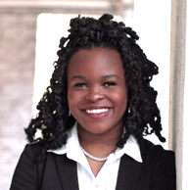
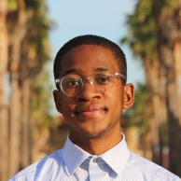
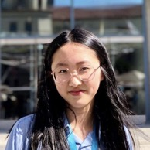
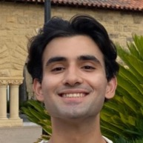
Meet the Unovation Nation!
Osose Ewaleifoh
Junior
Computer Science
she/her
Ulo Freitas
Junior
Computer Science
he/him
Anne Li
Junior
Symbolic Systems
she/her
Yousif Mohsen
Junior
Computer Science
he/him

Slide 4
Our Interest
“Un-dominating your health”
Facilitating Access to Treatment
Unequating Our Health to Performance Metrics/Apps
Improving Education about Health
Notes:
As a group we brainstormed four problem areas we were interested in: redesigning fitness, health, music communities, focus apps/methods, and corporate communication methods. From there, we all had common alignment and interest in exploring the idea of undominating health. From there we brainstormed within that general theme, what specific interests we could be interested in exploring from exploring how to address the inaccessiblity and improve education about treatment and resources (e.g., colonscopies, cervical cancer screenings). However the current focus that we’ve been interested in pushing further is the relationship between our health (mental, physical, emotional) and health apps or metrics.

Slide 5
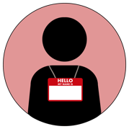
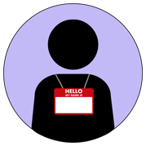




Our Participants
P173546
P108075
P191274
P567292
24 y/o
Pre-law student
Mid-40s, husband and father, Senior Manager
60 y/o, Professor of Media Technology in Ilmenau, Germany
2 years post-undergrad,
Process Engineer
: Extreme User
: Average User
Notes:
We spoke to seven individuals, all of whom come from a range of backgrounds. We spoke to two current college students, three recent college graduates (two of whom are now working in industry and one who is applying for law school), and two adults who have decades of experience in their fields (a Senior Manager at Blackberry and a professor of Media Technology at the Ilmenau University of Technology in Ilmenau, Germany).
We met the majority of our participants in public settings. We met and conducted our interviews with participants 173546 and 217556 of our participants in a public library in San Jose (Dr. Martin Luther King, Jr. Library). We met participants 368277, 563754, and 567292 in public downtown area nearby the campus of San Jose State University. Particiapnt 191274 was met and interviewed on Stanford’s campus as he was visiting his colleagues and had a period of free time in his schedule. For these six participants, we conducted impromptu interviews as their schedules were flexible and they expressed interest in participating in the interview in the moment.
We had prior communication with participant 108075 and were able to meet him outside of his home in Palo Alto.
Each of the seven participants had varying relationships with using health technology, but all shared a common interest in being more mindful about their health and wellbeing. Each participant also added vital perspectives based on their own experience, whether it be challenges that they experienced in relation to health (eg. P173546) as well as their use or lack of use health media tools. As a group, we wanted to be as intentional as possible about speaking to a diverse set of people (e.g., age-wise, background-wise) to learn as much as possible.
In terms of respect and compensation, we did not have the financial resources to pay all of our participants, however we compensated them in various ways to match their needs. For two participants, we purchased them boba drinks from a nearby restaurant to thank them for their time. We provided transportation for one participant as she felt unsafe commuting back home in the dark. All in all, we provided a safe, inviting environment for our participants, especially those who voiced sensitive topics, so this looked like verbally expressing our gratitude of them to feel comfortable sharing their stories with us.

Slide 6


Our Participants
P563754
P368277
P217556
Third-year undergraduate student studying Digital Media Art
3 years post-undergrad, Employee Safety Program Manager
19 y/o, third-year undergraduate student studying Biology
: Extreme User
: Average User
Notes:
See previous slide speaker notes for complete information about our participants

Slide 7
Extreme Users
P368277
P191274
Personal Trainer’s Daughter
Professor of Tech working with Doctors in Germany
P173546
Diabetes, History with Eating Disorder
Notes:
Our extreme users varied in terms of technical experience setting them apart from typical users. Professor of tech (P191274) is well versed in health technology through his work and research, and represents a different country’s perspective. Participant with diabetes, and eating disorders (P173546) has had significant adverse experiences with health and wellness. On the other hand, a personal trainers daughter (P368277) is well versed in health and views health as a huge positive in their life.

Slide 8
Extreme Users
Health Education
P368277
P191274
Non-Technical
P563754
P108075
P567292
Technical
P217556
P173546
Health Education
Notes:
P19274 (Professor of Tech) is an extreme user in that he is a professor of technology in Germany, and thus, he has extensive knowledge in the realm of wearable technology for health use. He works directly with doctors and is EXTREMELY well versed in health technology, and thus health education including macros, heart rate, cholesterol, etc. P368277 (Personal Trainer Daughter) is extreme is that their mother is a personal trainer, and they mention having health education VERY early on in their life, and always being confident in their relationship with food and making healthy food decisions. Though, they say aside from an apple watch, they had no idea about different gadgets and technical methods to track health. P173546 (Diabetes participant with an ED history) is extreme is that they have diabetes, and a past eating disorder which has led them to believe that they don’t know anything about making healthy food choices and what being healthy should look like. They’ve used calorie tracking apps, blood sugar monitoring devices, and apps like apple health to track exercise, so they’re versed in health apps through experience with them, but not necessarily to the level of a professor.

Slide 9
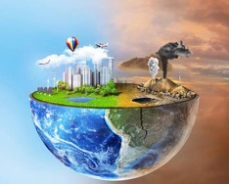
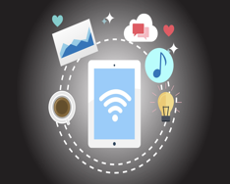
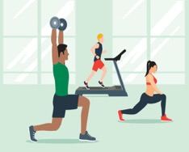
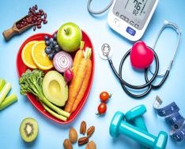
Interview Scope
Notes:
Participants were asked questions to inquire about their relationships with health by being posed with questions about their thoughts and relationships towards food, exercise, whether they used any digital media when it came to health, and questions to probe how their environment may influence their relationship with health.

Slide 10
Interviews
Participant | Interviewer | Note-Taker
P173546 | Yousif | Osose
P217556 | Anne | Ulo
P563754 | Ulo | Anne
P567292 | Yousif | Osose
P368277 | Yousif | Osose
P108075 | Anne | Ulo
P191274 | Osose | Yousif
Notes:
We conducted our interviews strategically. From our initial interview, we found out that we’d interviewed with an extreme user, despite that not being our initial intent. This participant had an eating disorder and diabetes, and from their interview, we were curious how the typical user’s experience with health is. After getting multiple more average user perspectives, we saw that there was a gap in those we surveyed. No one had a strongly positive experience with health, thus our next interview was with another extreme user – a personal trainer’s daughter who had an amazing relationship with health. Following her interview, we wanted to get someone who had a more neutral view of health. Then, we noticed that all of our participants had an average interaction with technology, and so we wondered what someone who studies health technology could offer in terms of health insights, and thus we ended with that user as our final interview. From that interview, we noticed we need another expert for the non-technical, but health education side, like a food scientist or registered dietitian. We also noticed from our interviews, that when it came to fitness, everyone was introduced to health and body image very early on, so interviewing a younger audience is also on our plate.

Slide 11
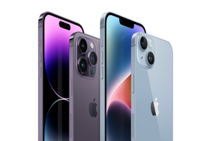
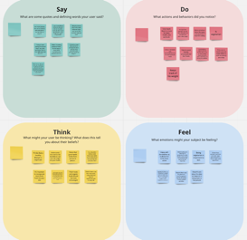
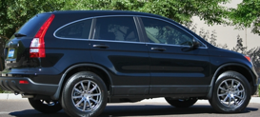


Capturing the Interviews
Notes:
We utilized empathy maps to unpack every interview and help gather insights. All interviews were transcribed using Otter, and videos were recorded on our iphones. Miro was used to brainstorm together virtually when in-person meetings weren’t possible, and to brainstorm ideas. The honda CRV took us everywhere :)

Slide 12
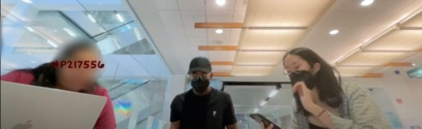
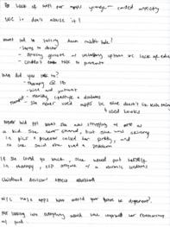
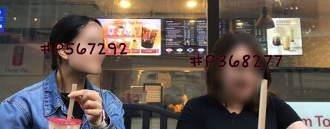
Artifacts from Interviews
Notes:
Throughout the interview process we made sure to create a comforting and supportive environment for our participants where they felt safe to speak honestly and candidly about experiences that are very close to their hearts.
At every stage of the needfinding process, we were intentional about going above beyond to humanize our participants, from listening to their experiences to making sure to compensate them for them time. One individual we interviewed, didn’t have a way to get home, so we drove them home. Some other participants were really craving boba, so we bought them boba tea. After the interview was over we converse amicably with our participants and we wished them well.

Slide 13
Empathize
2) Listen
3) Commiserate
4) Compensate
Notes:
See last slide for speaker notes.

Slide 14
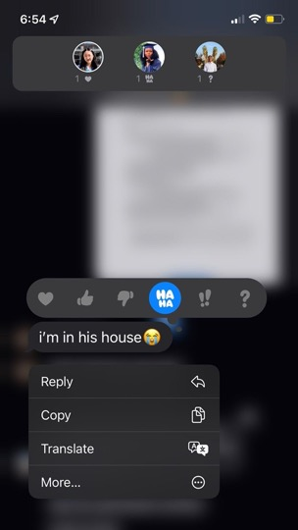
Notes:
In fact, one of our group members went as far as to meet the entire family of a participant. 😭

Slide 15
INTERVIEW RESULTS

Slide 16








What key things were said?
“I did have an eating disorder when I was younger. So, I did have a somewhat complicated relationship with food. But those apps did stress me out. When I would like look at like how much carbs something was like, I was like, okay, and on top of that, I have to give myself insulin which does kind of [make you] gain weight. So the more carbs, the more insulin, [and] the more weight I gained.”
P173546
“I think the apps have been personally good in my opinion, just because like it tells me how much I've burned rather than like me having to like go into the internet and actually looking up, like how much did I lose doing this? So like it tells me and then I really like the part where like it tells you how many steps you do each day. So like it really tells me, in reality, how much I’ve burned.”
P217556
“I always think that like the comparison is unfair. And then, you shouldn't be compared to other people; you should be compared to yourself. I almost think that there should be like how you have a credit score, like you should have a health score like, like everyone's health means something different. Every person's health is different.”
P567292
“So, I feel like the fitness part of like, Instagram that I'm on is a lot more about like, building your body rather than like shrinking it. Or like being like smaller, I guess.”
P563754
Notes:
The amount of text here is intentional. We know that audio is an unorthodox medium to present, so we included subtitles because we wanted the slide to be accessible.

Slide 17
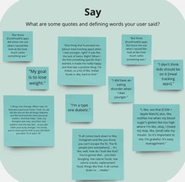
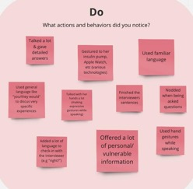
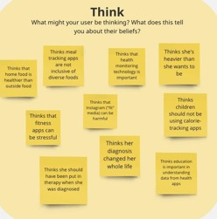
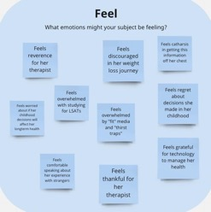
P173546
Empathy Map Analysis

Slide 18


Slide 19


Slide 20
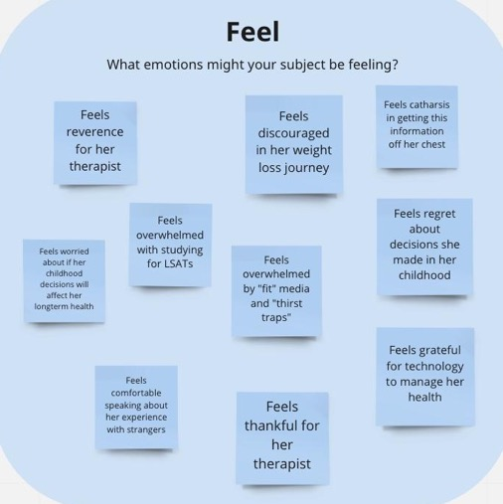

Slide 21
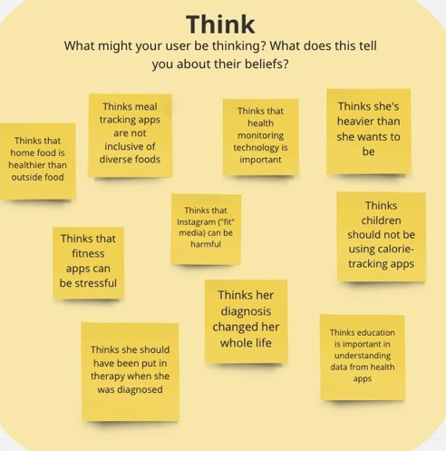

Slide 22



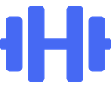

What key sentiments were shared?
Notes:
Just from those audio snippets and that empathy map we’ve been able to isolate some particularly important points. Participants expressed needing more education on health and nutrition information and what their data (caloric intake) means. Especially, those who used meal tracking apps as children, and now regret that experience because they were uneducated about the meaning of the data they were receiving.
Participants expressed concern over being compared to others, as well as the negative effects of “fit” media.
Meanwhile some of these same participants shared a thankfulness for uplifting fitness communities that can be found, like GymTok for example (where the emphasis is on getting stronger, and not on fitting into a certain image).
The biggest needs among all participants was convenience and personalization (personal reflection). Think back to that interview snippet where our participant stresses the need for a unique, personalized health metric.
Lastly, convenience when it comes to health and fitness is something everyone more of of. And some participants even claimed they would be more than willing to share personal data for convenience. Now, this is just the surface; let’s delve deeper into some other key insights and learnings we gleaned from these interviews.

Slide 23

Insights & Learnings
Notes:
BUDGET. One of our key insights is that budget shapes people’s diets. For example, participants would choose the least expensive food options at the grocery store. One also picked grocery stores that were convenient for their commute. From this, we derive one of our key learnings: healthy eating habits should be accessible regardless of budget.
Money icon by Icons8

Slide 24

Insights & Learnings
Notes:
ETHNIC FOOD REPRESENTATION. Another key insight is that ethnic foods are not well-represented on nutrition apps and in discussions of nutrition in general, which leads us to our learning that ethnic food should be better represented in nutrition-related contexts.
Money icon by Icons8
Globe icon by Icons8

Slide 25

Insights & Learnings
Notes:
MEDICAL CONDITIONS. One of our insights is that nutrition tech could be helpful for those managing medical conditions like diabetes. Therefore, one of our key learnings is that we should strive to keep the parts of nutrition tech that are helpful for those people.
Money icon by Icons8
Globe icon by Icons8
Medical History icon by Icons8

Slide 26

Insights & Learnings
Notes:
MOTIVATION. We find that nutrition and diet apps often encourage comparison to other people and rely on extrinsic motivators (for example, they focus purely on aesthetics or calories, which is not medically helpful). Our resulting learning is that nutrition and diet apps should encourage intrinsic motivation and provide a welcoming environment for self-improvement.
Money icon by Icons8
Globe icon by Icons8
Medical History icon by Icons8
compare icon by Icons8

Slide 27

Insights & Learnings
Notes:
KNOWLEDGE. Another of our insights is that food and nutrition knowledge is often inaccessible or hard-to-understand. From this, we learn that food and nutrition knowledge needs to be more readily available and understandable.
Money icon by Icons8
Globe icon by Icons8
Medical History icon by Icons8
compare icon by Icons8
Brain icon by Icons8

Slide 28

Insights & Learnings
Notes:
CONVENIENCE. Finally, we find that some participants wanted more automatic and personalized health tracking, which they believed would be more convenient and helpful. Our final learning is that more automatic and personalized health tech should be an option that can be chosen with well-informed consent. Our overall learnings from all of these insights are that nutritional health should be uplifting, inclusive and medically informed.
Money icon by Icons8
Globe icon by Icons8
Medical History icon by Icons8
compare icon by Icons8
Brain icon by Icons8
Gears icon by Icons8

Slide 29
GAME CHANGER

Slide 30
What’s Next?
Dietitian
Teen girl
Pain points
Market research
Notes:
Finally, I want to go over our next steps. We plan to interview a dietitian in order to get a subject matter expert’s input. We also plan to interview someone who is a teen girl, since that is the demographic most commonly negatively affected by nutrition tech. We plan to identify prominent problems, and conduct market research to evaluate existing solutions to those problems.
Health, wellness, and fitness are complex and deeply important topics. However, our personal experiences and circumstances, make conversations and needs surrounding these diverse and nuanced for each and everyone us. Health is complicated. Our team wants ease the ease the stress of others, promote self-reflection, and most importantly, help others undominate their health.

Slide 31
Appendix

Slide 32
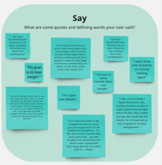
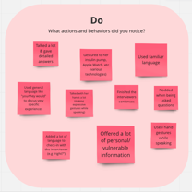
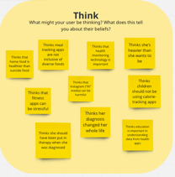
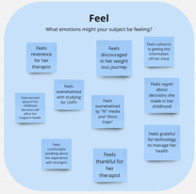
P173546

Slide 33
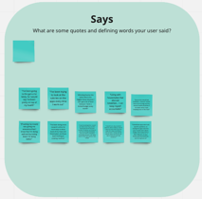
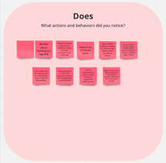
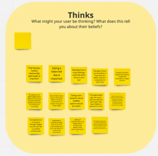
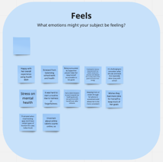
P217556

Slide 34
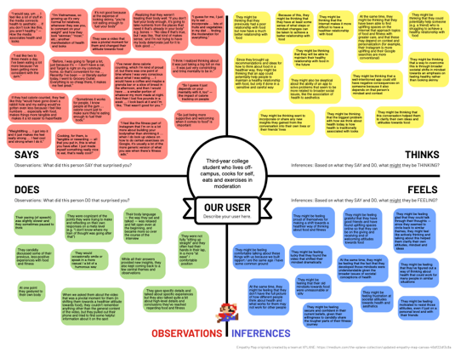
P563754

Slide 35
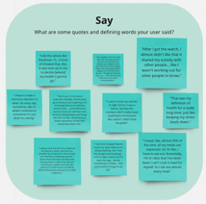
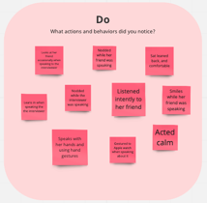
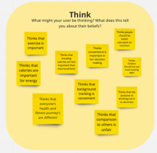
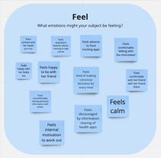
P567292

Slide 36
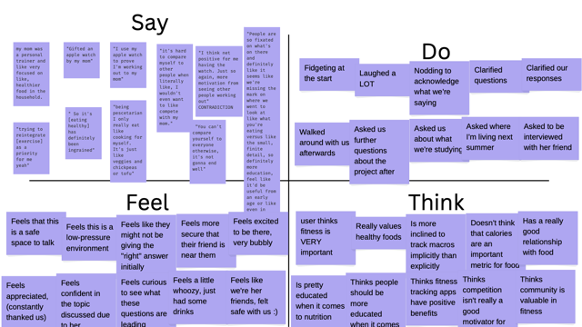
P368277

Slide 37
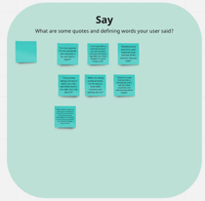
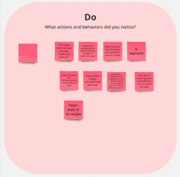
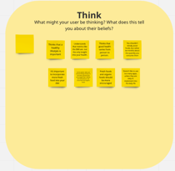
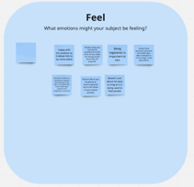
P108075

Slide 38
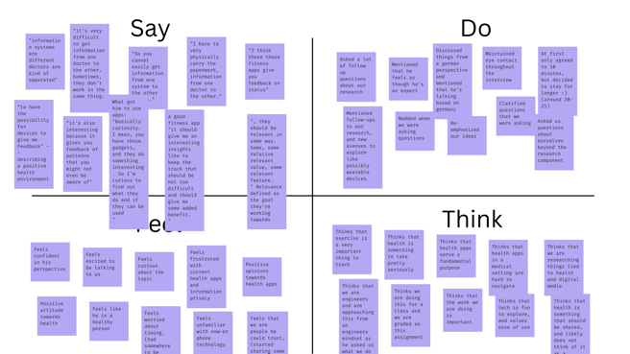
P191274

