Slide 1


Pear
Pear
Osose Ewaleifoh · Ulo Freitas
Yousif Mohsen · Anne Li

Slide 2

One Size Fits NONE:
Your Health. Your Way.
Notes:
We landed on Pear as we want it to still communicate something related to food due to the heavy food-centric emphasis of our health app. Our app focuses on viewing food as a source of reflection, and a foundation to build up your health, thus a food-name was top priority for us. Furthermore, our app’s most distinguishing feature is the ability to form “health/food” based communities from people in your background, and PAIRING you with volunteers, that are hosting events or leading chats about what it means to be healthy. You’re defining your own relationship with food, and being PAIRED with people along the journey – Pear was the perfect name :)

Slide 3
Problem/Solution Overview
Problem
The definition of being healthy has a heavy western bias which prioritizes performance metrics and numerical representations of nutrition, which alienates people beyond the western sphere.
Solution
We’re proposing an ever-expanding, individualized, definition of health that prioritizes the way food makes you feel, and connects you with a community with those from similar backgrounds to navigate your health journey together.

Slide 4


Market Analysis
Categories | Our App | Finch | MyFitnessPal | Apple Health | Reddit
Reflective
Inclusive
Has Social Component
Individualized
Focused on Keeping Up With Health
Wow Factor
Notes:
Individualized: My experience as a user is different from any other user’s experience
Comfort: The user is able to find safety in using this app, and does not feel a sense of fear/unease with use.

Slide 5




Market Analysis
Reflective
Not Inclusive
Inclusive
Not Reflective
Key
Pear
Reddit
MyFitnessPal
Apple Health
Finch

Slide 6
Embedded Values
Values | Encoding | Conflicts
Reflection | Meal mood tracker | With Efficiency: Tiered system of reflection, level I, II and III based on time available
Inclusion | Communities driven by diverse volunteer backgrounds | None
Health | Ever-expanding, originally undefined definition of health — built around the user | None
Wellbeing | Connects user to resources to support mental and physical health | None
Efficiency | Three main screens, each with defined objective | With Reflection: Tiered system of reflection, level I, II and III based on time available
Notes:
Values embedded in the project and how you intend to encode them b. Are there conflicting values? If so, how are you addressing such conflicts?

Slide 7

Simple Task
Quick Pop-up
Three moods
Quick categorization
Monthly Log
Interface on Home Screen
Reflect on meals through mood tracker

Slide 8
Moderate Task
Complete activities
Not conventionally “health-related”
Improve feeling / well-being
User searches, completes stuff offline
Building up multiple definitions of health

Slide 9

Complex Task
Requires volunteer recruitment
Double-ended:
  Volunteer interface
  Event-seeker interface
Constant Updates/Changes
Training Required
Safety Moderation
“Connect with volunteer-led events around you”

Slide 10
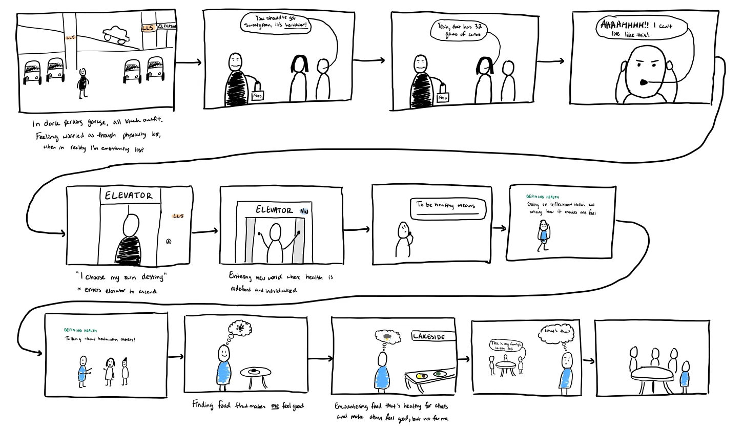
Video Storyboard
Notes:
For high quality PDF of this storyboard, please see the appendix

Slide 11
Youtube Link
https://youtu.be/mhkJXaY2yK0

Slide 12
Appendix
Link to high quality PDF of storyboard

