Slide 1
Peekaboo!
Check in with loved ones — while having fun!
—
CS147 Fall 2022
Jason, Derek, Karson, Winston

Slide 2
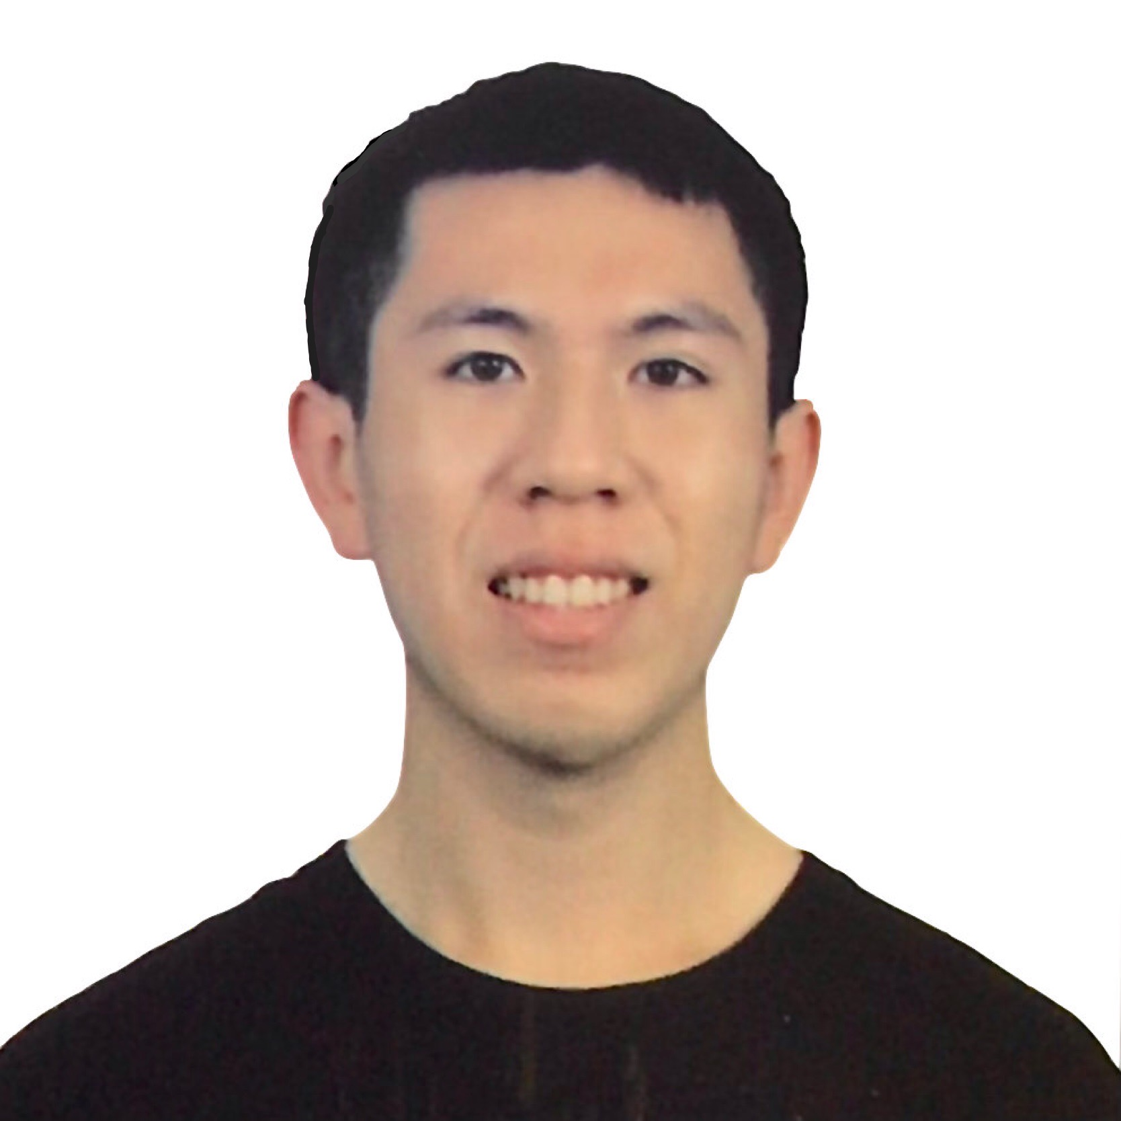
Team Presentation
Jason Lin Sophomore
CS, HCI
Derek Hwang Coterm
CS, HCI
Karson Lippert Senior
CS, HCI
Winston Shum Senior
Econ

Slide 3
Problem
Solution
People cannot check up on others in an easy manner without being intrusive.
Instantly share updates to all family/close friends through a simple check-in, photos, or fun in-app activities.

Slide 4
Value Proposition
Quickly and easily send updates to family and close friends for a simple check in
‹#›

Slide 5
Outline of Presentation
Heuristic Evaluation Results
All UI and Product Revisions
Prototype Implementation Status
Demo of Prototype (so far)

Slide 6
1.
Heuristic Evaluation Results
Analyzing design errors…

Slide 7
High-Level Summary of Results
Most Violated Heuristics
H4: Consistency & Standards: 22
H3: User Control: 8
H7: Efficiency of Use: 7
3. H11: Accessible: 7
Severity Violation Totals
Severity 0-2 Violation #: 50
Severity 3-4 Violation #: 17
Total Severity Violations: 67

Slide 8
High-Level Summary of Results
Inconsistencies in fonts, grid misalignments, and small text/buttons
Three tabs to check in and hard to navigate other parts of the app

Slide 9
High-Level Summary of Results

Slide 10
Sev 3-4 Details
Need to be able to change feed to view a different group
Navigation bar adjustments
More group customization options and preferences

Slide 11
Sev 3-4 Details
Change feed view and navigation bar changes
Manage your own groups and groups you were added to
Remove yourself from groups and edit viewing preferences

Slide 12
2.
All UI and Product Revisions
Looking at design changes…

Slide 13
Before and After Shots
Navigation bar changes
Location removal
Single check in page

Slide 14
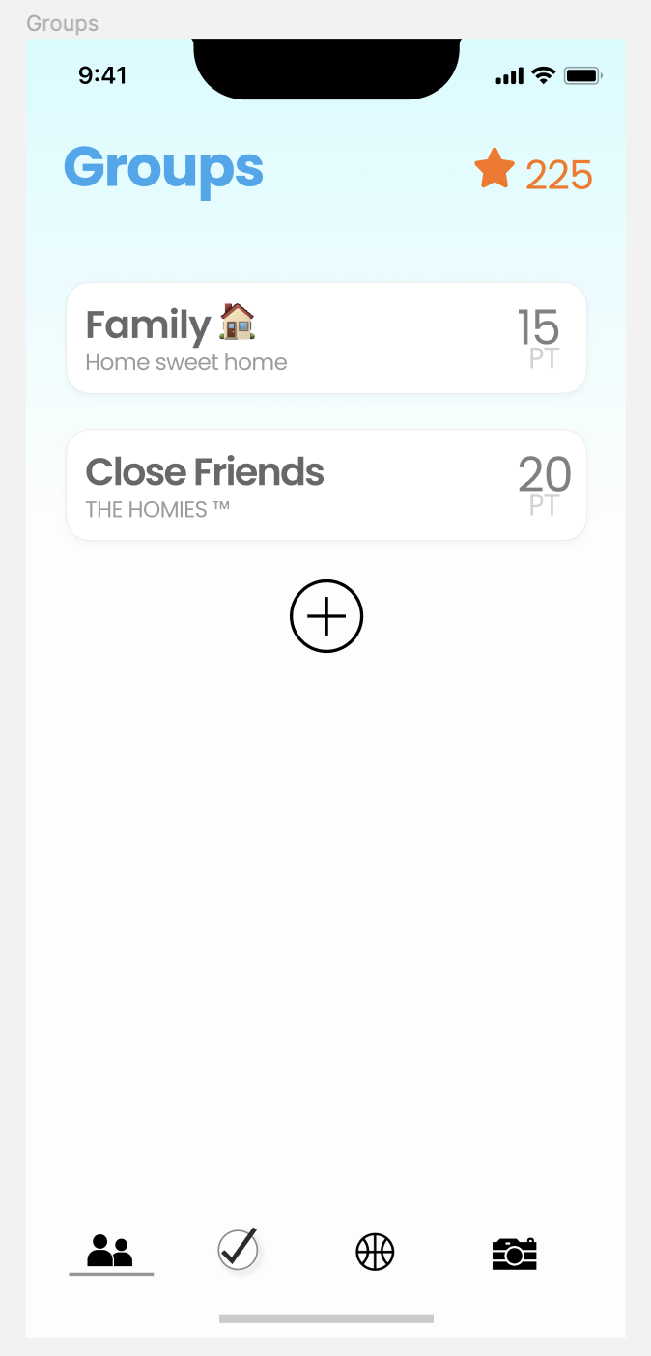
Before and After Shots
Manage your own groups
Manage groups you were added to

Slide 15
Before and After Shots
Edit viewing preferences
Remove yourself from groups

Slide 16
Before and After Shots
Profile icon added to navbar
Last check in time
Recent check in sneak peak
List of all groups

Slide 17
3.
Prototype Implementation Status
Checking implementation progress…

Slide 18
Framework/Tools Being Used
Expo CLI
Supabase (check-in and groups data)

Slide 19
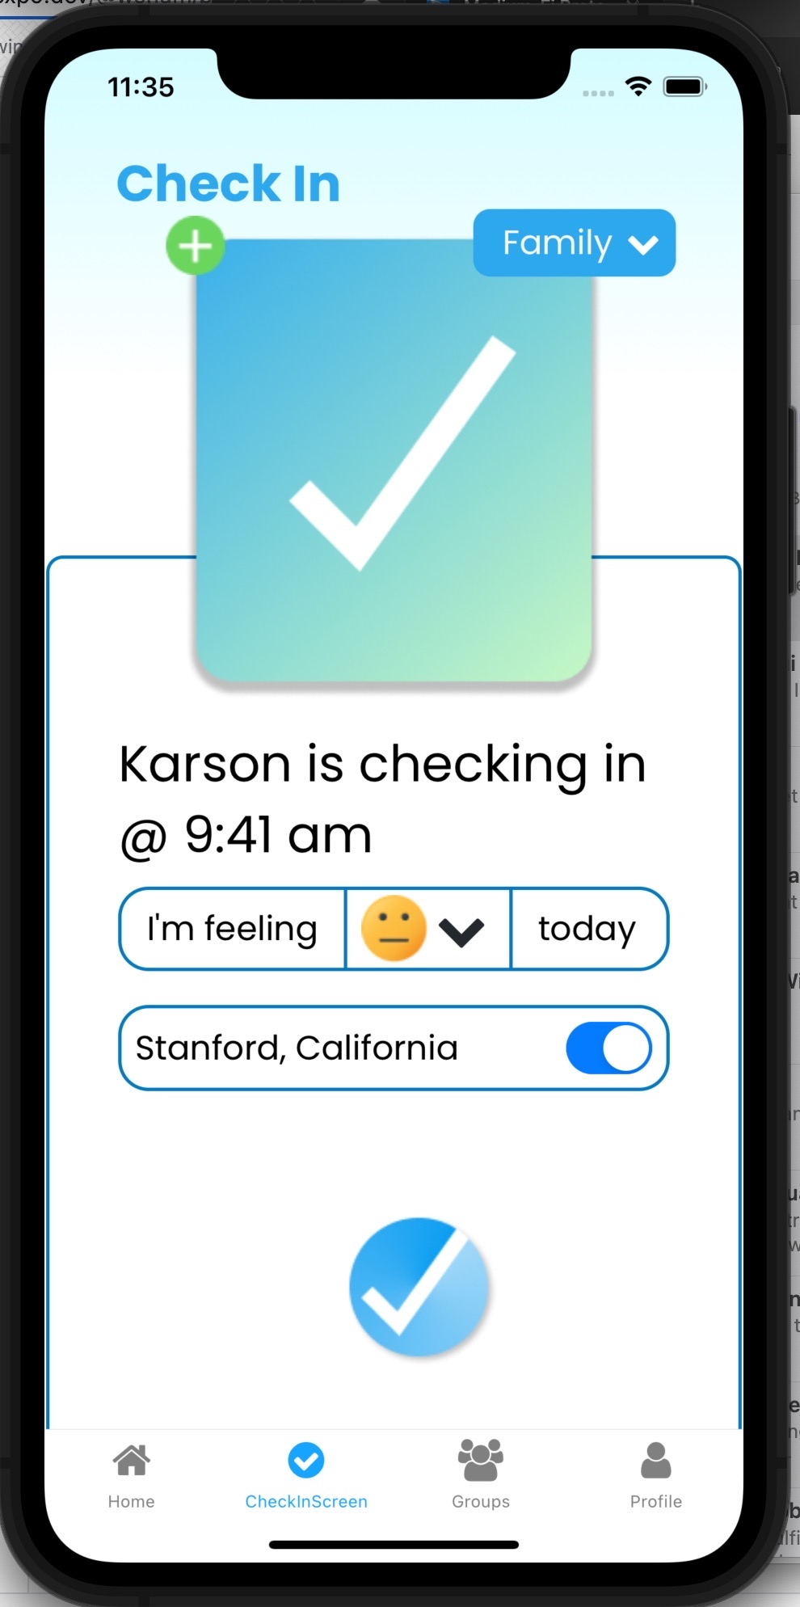
Implemented Features
Default Check-In
Group selector
Mood selector
Location switch (On and Off)

Slide 20
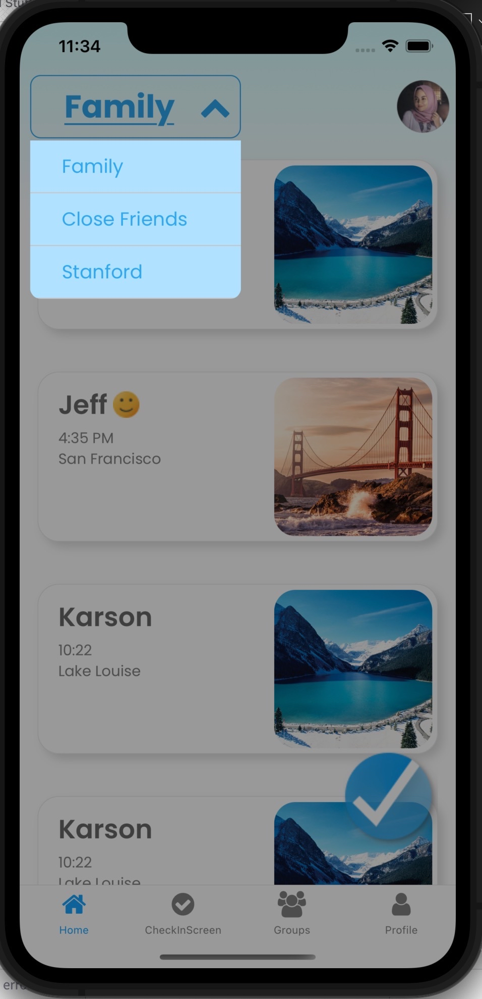
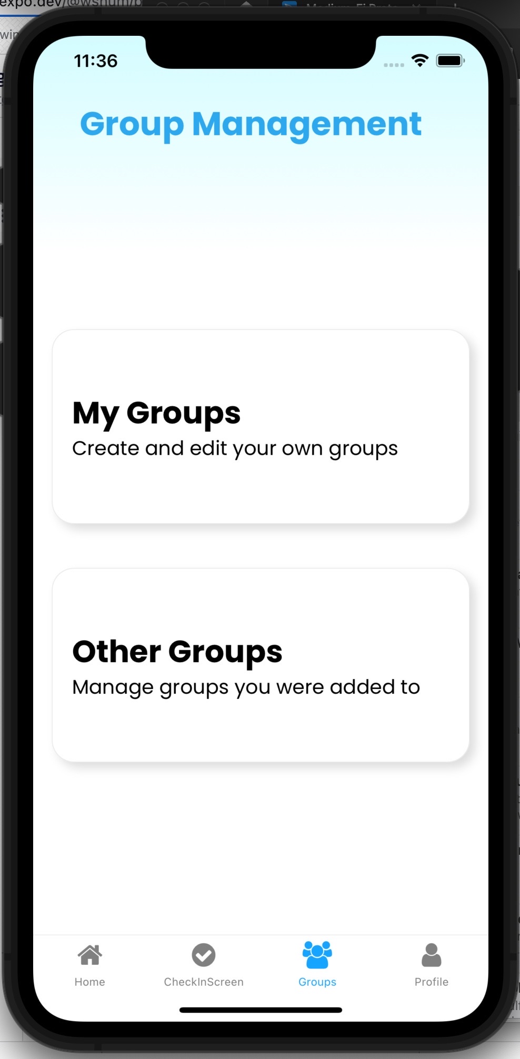
Implemented Features
Profile Page
Navigation Bar
Groups dropdown (feed page)
Viewing your groups and other groups
Creating New Groups Task Flow
Check-In Details Screen

Slide 21
Unimplemented Features & Plans to Finish
Create custom activity and activity check-in
Photo check-in
Complete updates in next few days, then polish everything

Slide 22
Wizard of Oz Techniques
Feed screen automatically updates new check-in from the user
App automatically stores check-in and groups data

Slide 23
Hard-coded Aspects
Photos used in check-in
Emojis used for Moods
Name, Time, and Location of individual check-ins
Profile and other user information
Activities check-in information

Slide 24
Issues/Questions
Unsure about how to make new check-ins upload to the top of feed screen

Slide 25
4.
Demo of Prototype
Current prototype implementation…

Slide 26
THANKS!
Any questions?
Figma Link

