Slide 1
Peekaboo!
—
CS147 Fall 2022
Jason, Derek, Karson, Winston

Slide 2
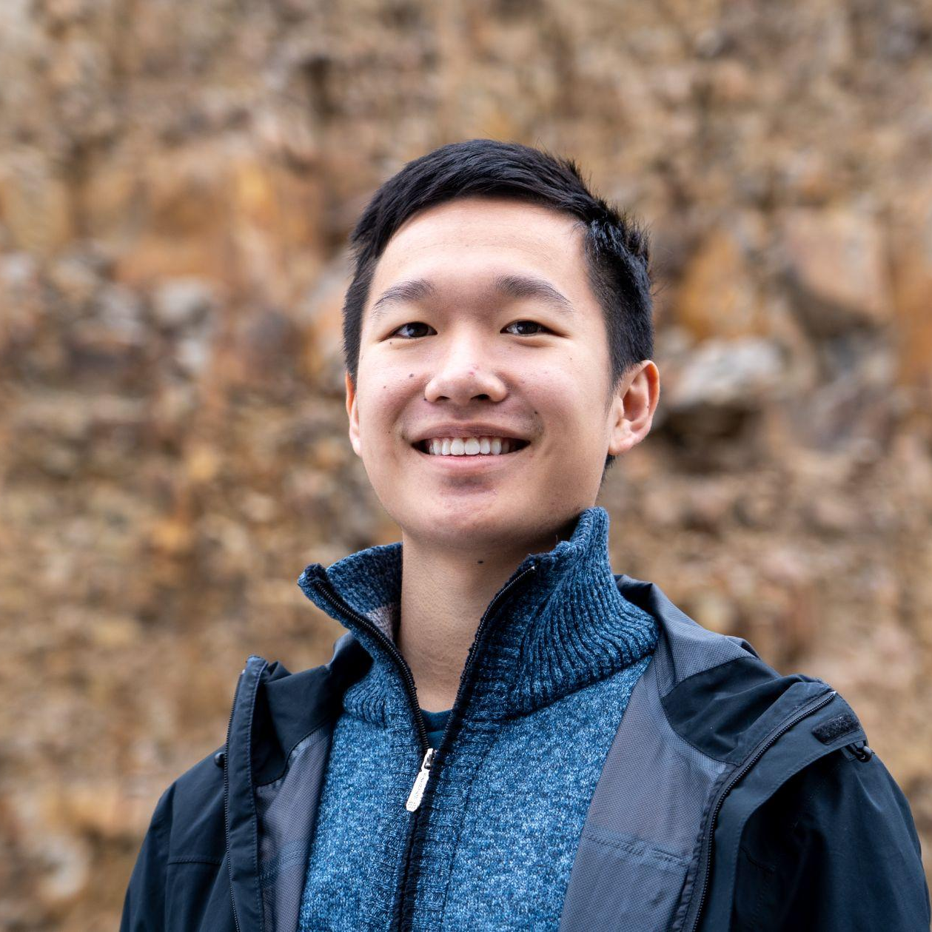
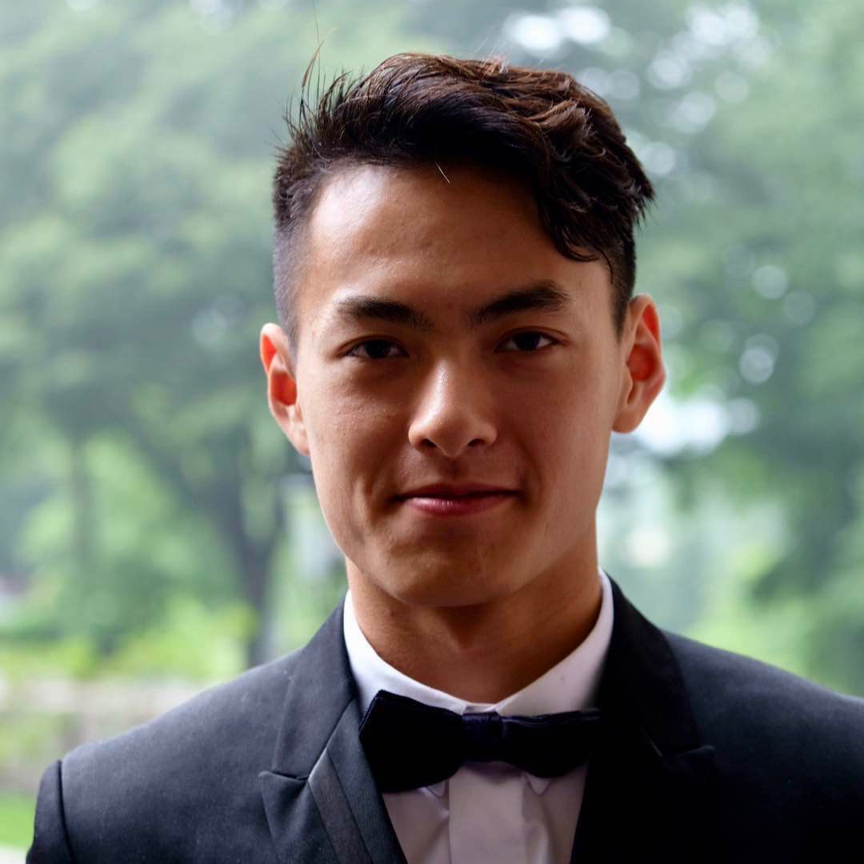
Team Presentation
Jason Lin Sophomore
Likes to juggle, jog, joggle (both at same time); make motorized couches
Derek Hwang Coterm
Went to undergrad in the rather more picturesque land of San Diego
Karson Lippert Senior
Likes In n Out
Winston Shum Senior
Knows great travelers!

Slide 3
Name Selection Process
Brainstorming one or two word names
Looking at existing names of similar products
Chose Peekaboo to illustrate the main function of our application

Slide 4
Value Proposition
Snap and share photos with family and close friends for a simple check in
* Display photos of close ones on a widget to simply and easily check in on them
* Collect tokens and badges to customize photos with stickers, effects, frames, and more
* Indirectly sending family/friends a quick update with a photo that displays on their widget

Slide 5
Problem/Solution
Overview

Slide 6
Problem
Solution
People want to check up on others in an easy manner without being intrusive
Take a picture and upload to instantly share to all family/close friends to see via a widget

Slide 7
Market Research
Details

Slide 8
Facebook
Open app and view photos of friends (algorithm might cause clutter)
Filter so only friends can view your content and/or can filter profanity
Can leave comments and likes, but messaging is on a different app
No clear way to start immediate conversation

Slide 9
Instagram
Open app and view photos from friends and suggested accounts
Filter sensitive content with “more”, “less”, or “standard”
Can leave comments, likes, and send direct messages
Can start immediate conversation with individuals or groups

Slide 10
iMessage
Open app to text and send photos/videos
Option to filter unknown senders into a separate list
Messaging someone is quick and easy (main purpose of the app)
Easy to add multiple people to conversations and pin top people/groups

Slide 11
Google Photos
Stores photos and can create photo albums to share with others
Can filter content to group photos by faces
Sometimes syncing and storage issues, but non-intrusive
No clear communication option other than sharing photos/videos

Slide 12
Peekaboo
Simply take a picture and share, allowing family/friends to view
App has a widget which quickly and easily displays what was shared
Non-intrusive way of sharing images and checking in
Some features are custom groups and photo customization

Slide 13
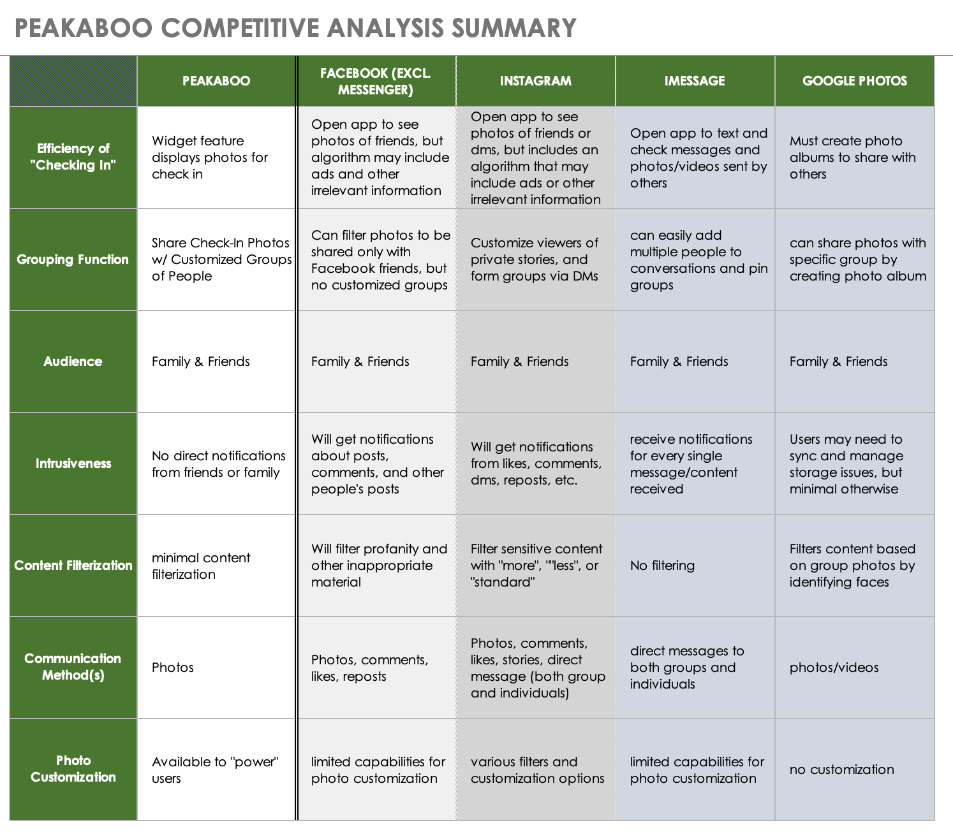

Slide 14
Values in Design

Slide 15
Efficiency
Safety
The app is easy to pick up and use so required actions are clear and simple
Users should not be put in harm when using the app

Slide 16
Equity
Inclusion
All users will be treated the same meaning no preferential treatment of data
All users will be included and if there is a benefit all users will have access
Privacy
All users’ data will be protected and not stored without permission

Slide 17
Conflicting Values?
There could be a concern between privacy and efficiency if we need to store additional data to provide a more efficient product
In the likely case that we use location data, privacy and safety could conflict

Slide 18
Tasks

Slide 19
Simple Tasks
The majority of users on the app will be uploading and sharing photos with others
Viewing shared photos - users want to see photos that have been shared with them seamlessly, as a widget

Slide 20
Moderate Tasks
Communicate safety: Users want to send location information with a photo
Sharing different photos to different people: Sharing visual documentation of your life conflicts with safety and privacy, so users want to control where their photos are displayed and who sees them

Slide 21
Complex Task
Collect tokens: our power users want another element to the app that excites them. Tokens can be used to personalize photos (stickers, effects, frames, etc)

Slide 22
Video Storyboards

Slide 25
Concept Video Link
https://www.youtube.com/watch?v=2pl2wSO9haU

Slide 26
THANKS!
Any questions?

