Slide 1
Travel and Relationships:
POV, HMW, Exp Prototypes.
—
CS147 Fall 2022
Jason, Derek, Karson, Winston
Notes:
Slide template from SlidesCarnival

Slide 2
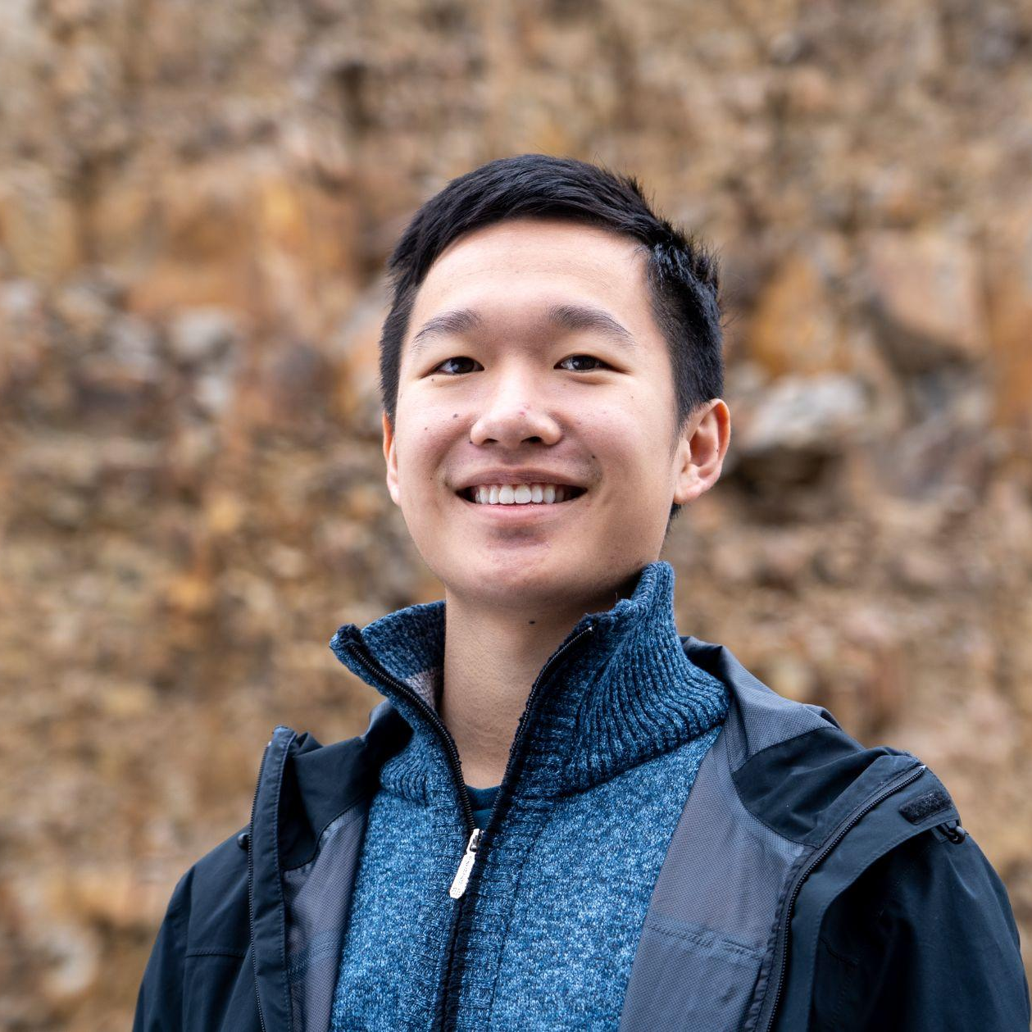
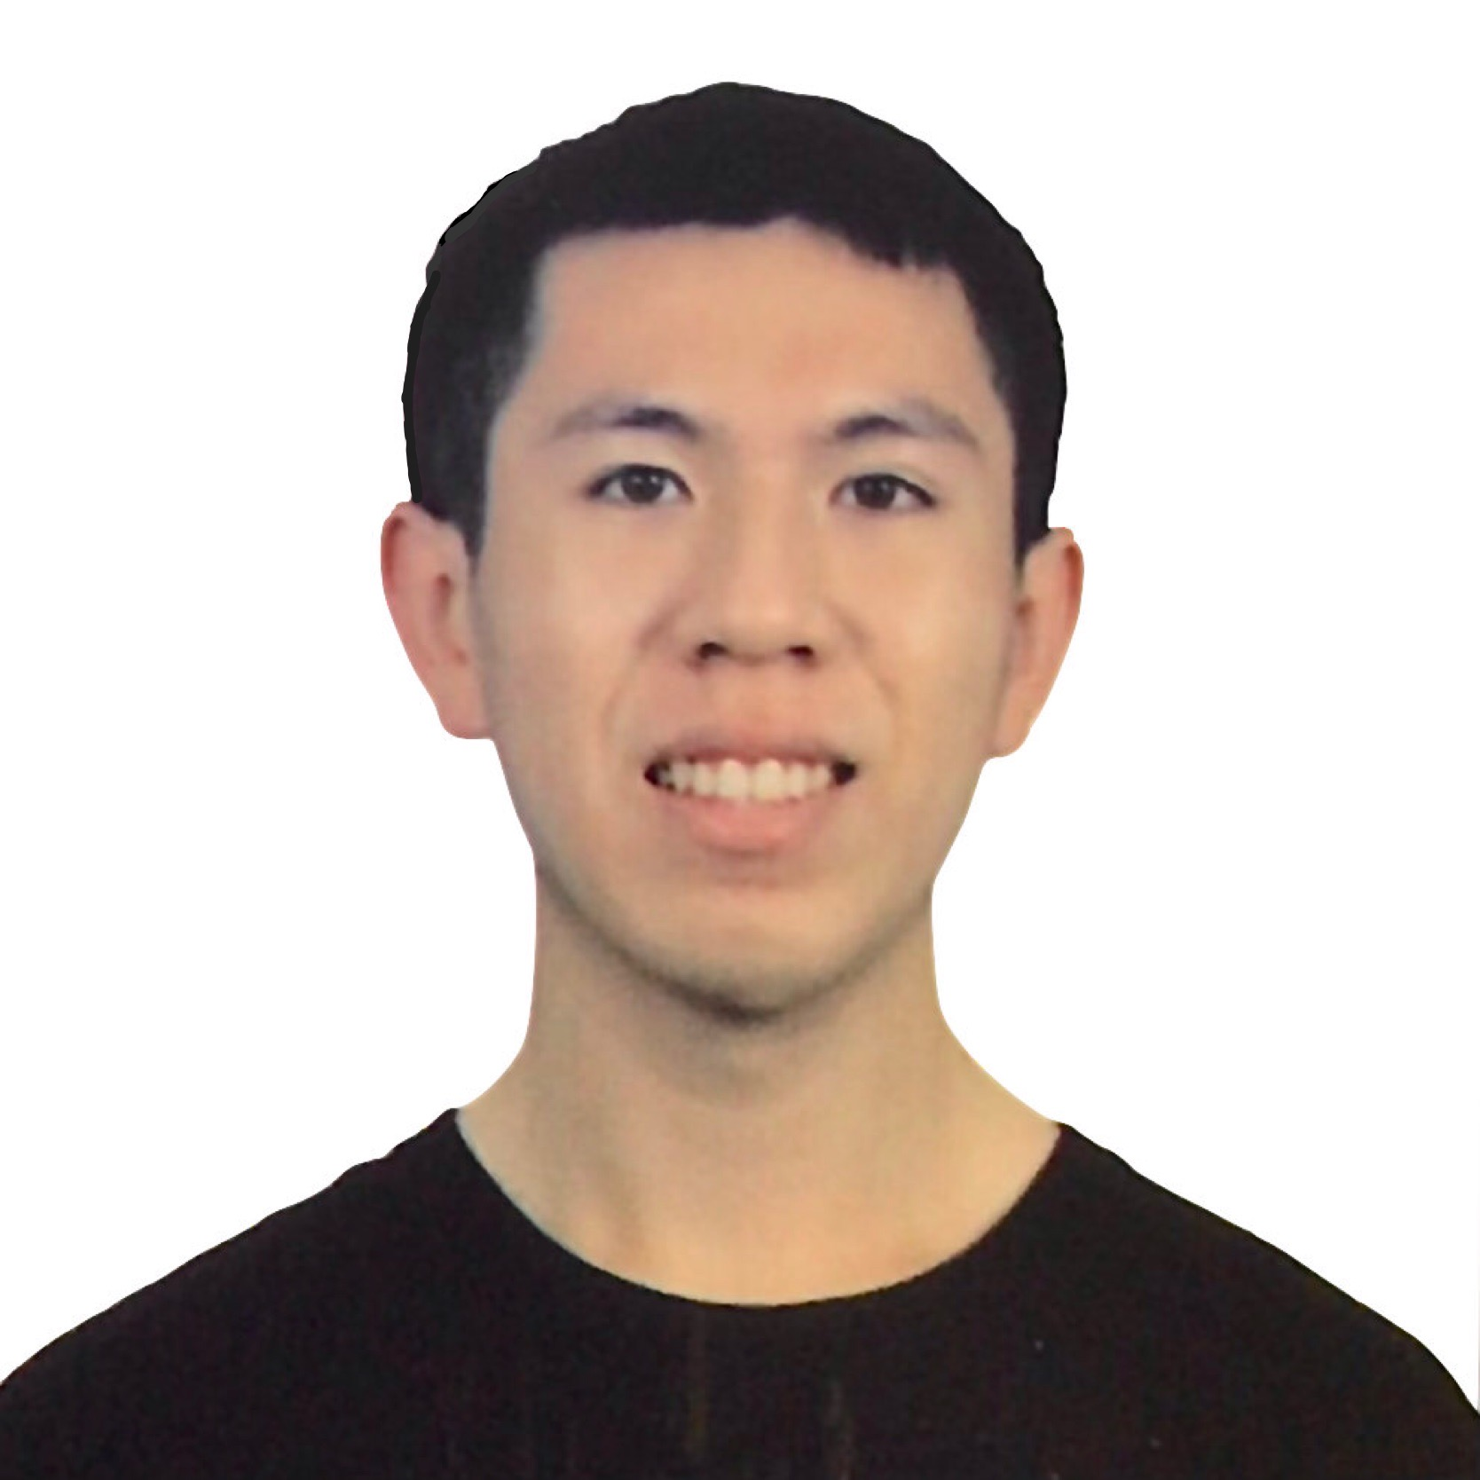
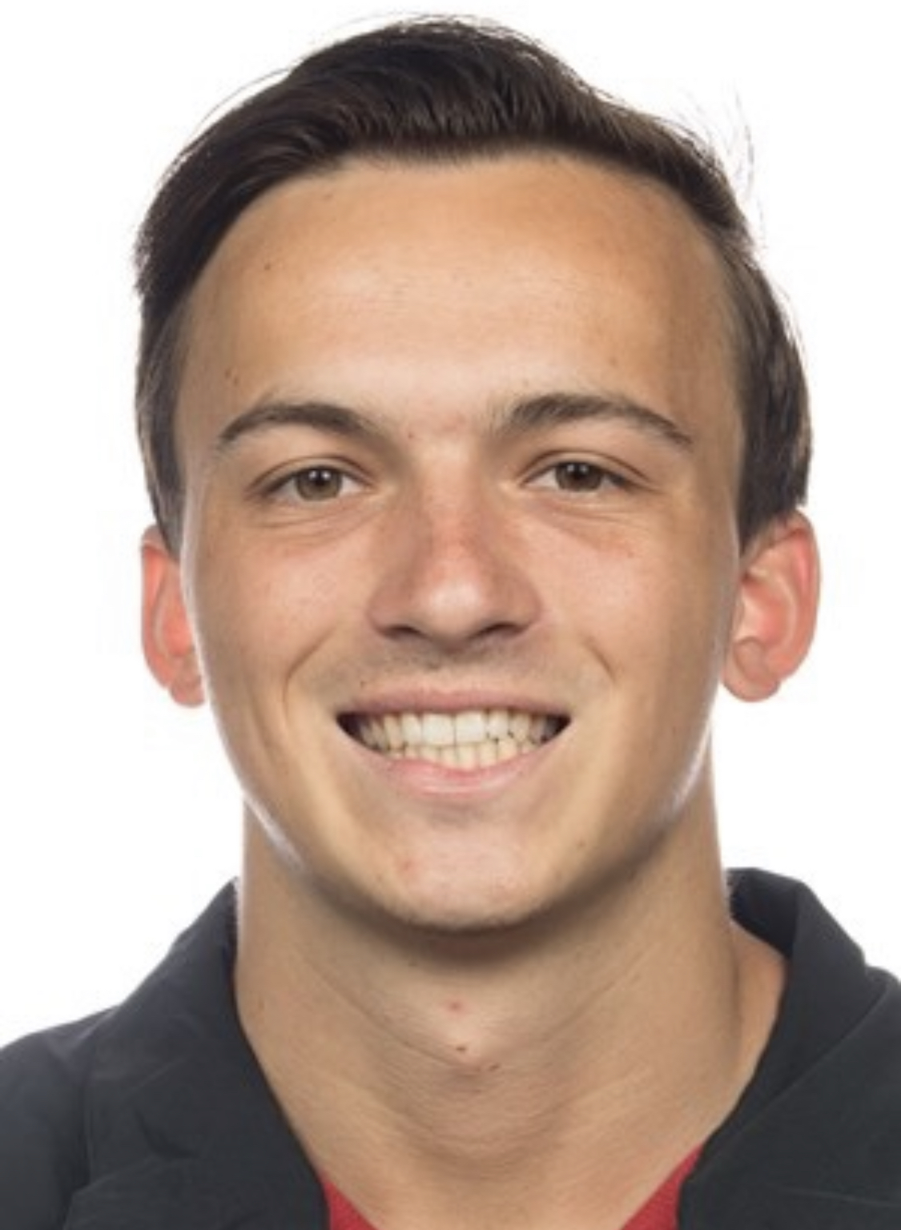
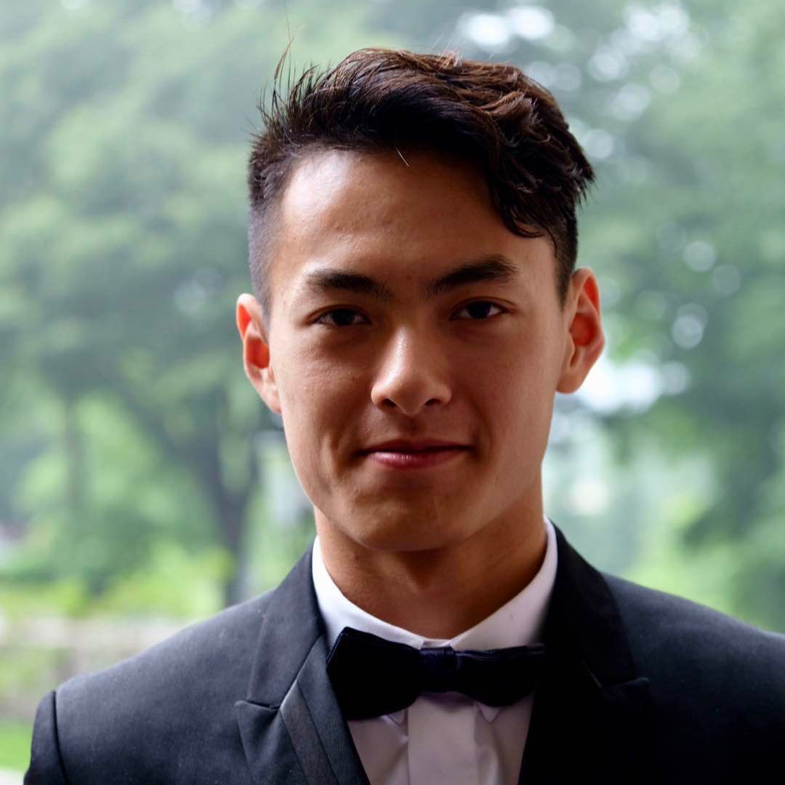
Team Presentation
Jason Lin Sophomore
Declared HCI 1 week and 1 day ago
Likes to juggle, jog, joggle (both at same time); make motorized couches
Derek Hwang Coterm
Went to undergrad in the rather more picturesque land of San Diego
Karson Lippert Senior
Currently in
Out of quarantine. 😊
Winston Shum Senior
Knows great travelers!

Slide 3
Problem Domain.
Travel and Relationships.
What has travel looked like before and around COVID-19?
How do we create and maintain relationships while traveling?

Slide 4
Problem Domain.
Travel and Relationships.
How do people check in? In what ways?
How do travellers create meaningful connections with the local people?

Slide 5
1.
Additional Needfinding
How can we gain further insights?

Slide 6
New Perspectives
What does a frequent business traveler experience?
How do people at home feel?

Slide 7
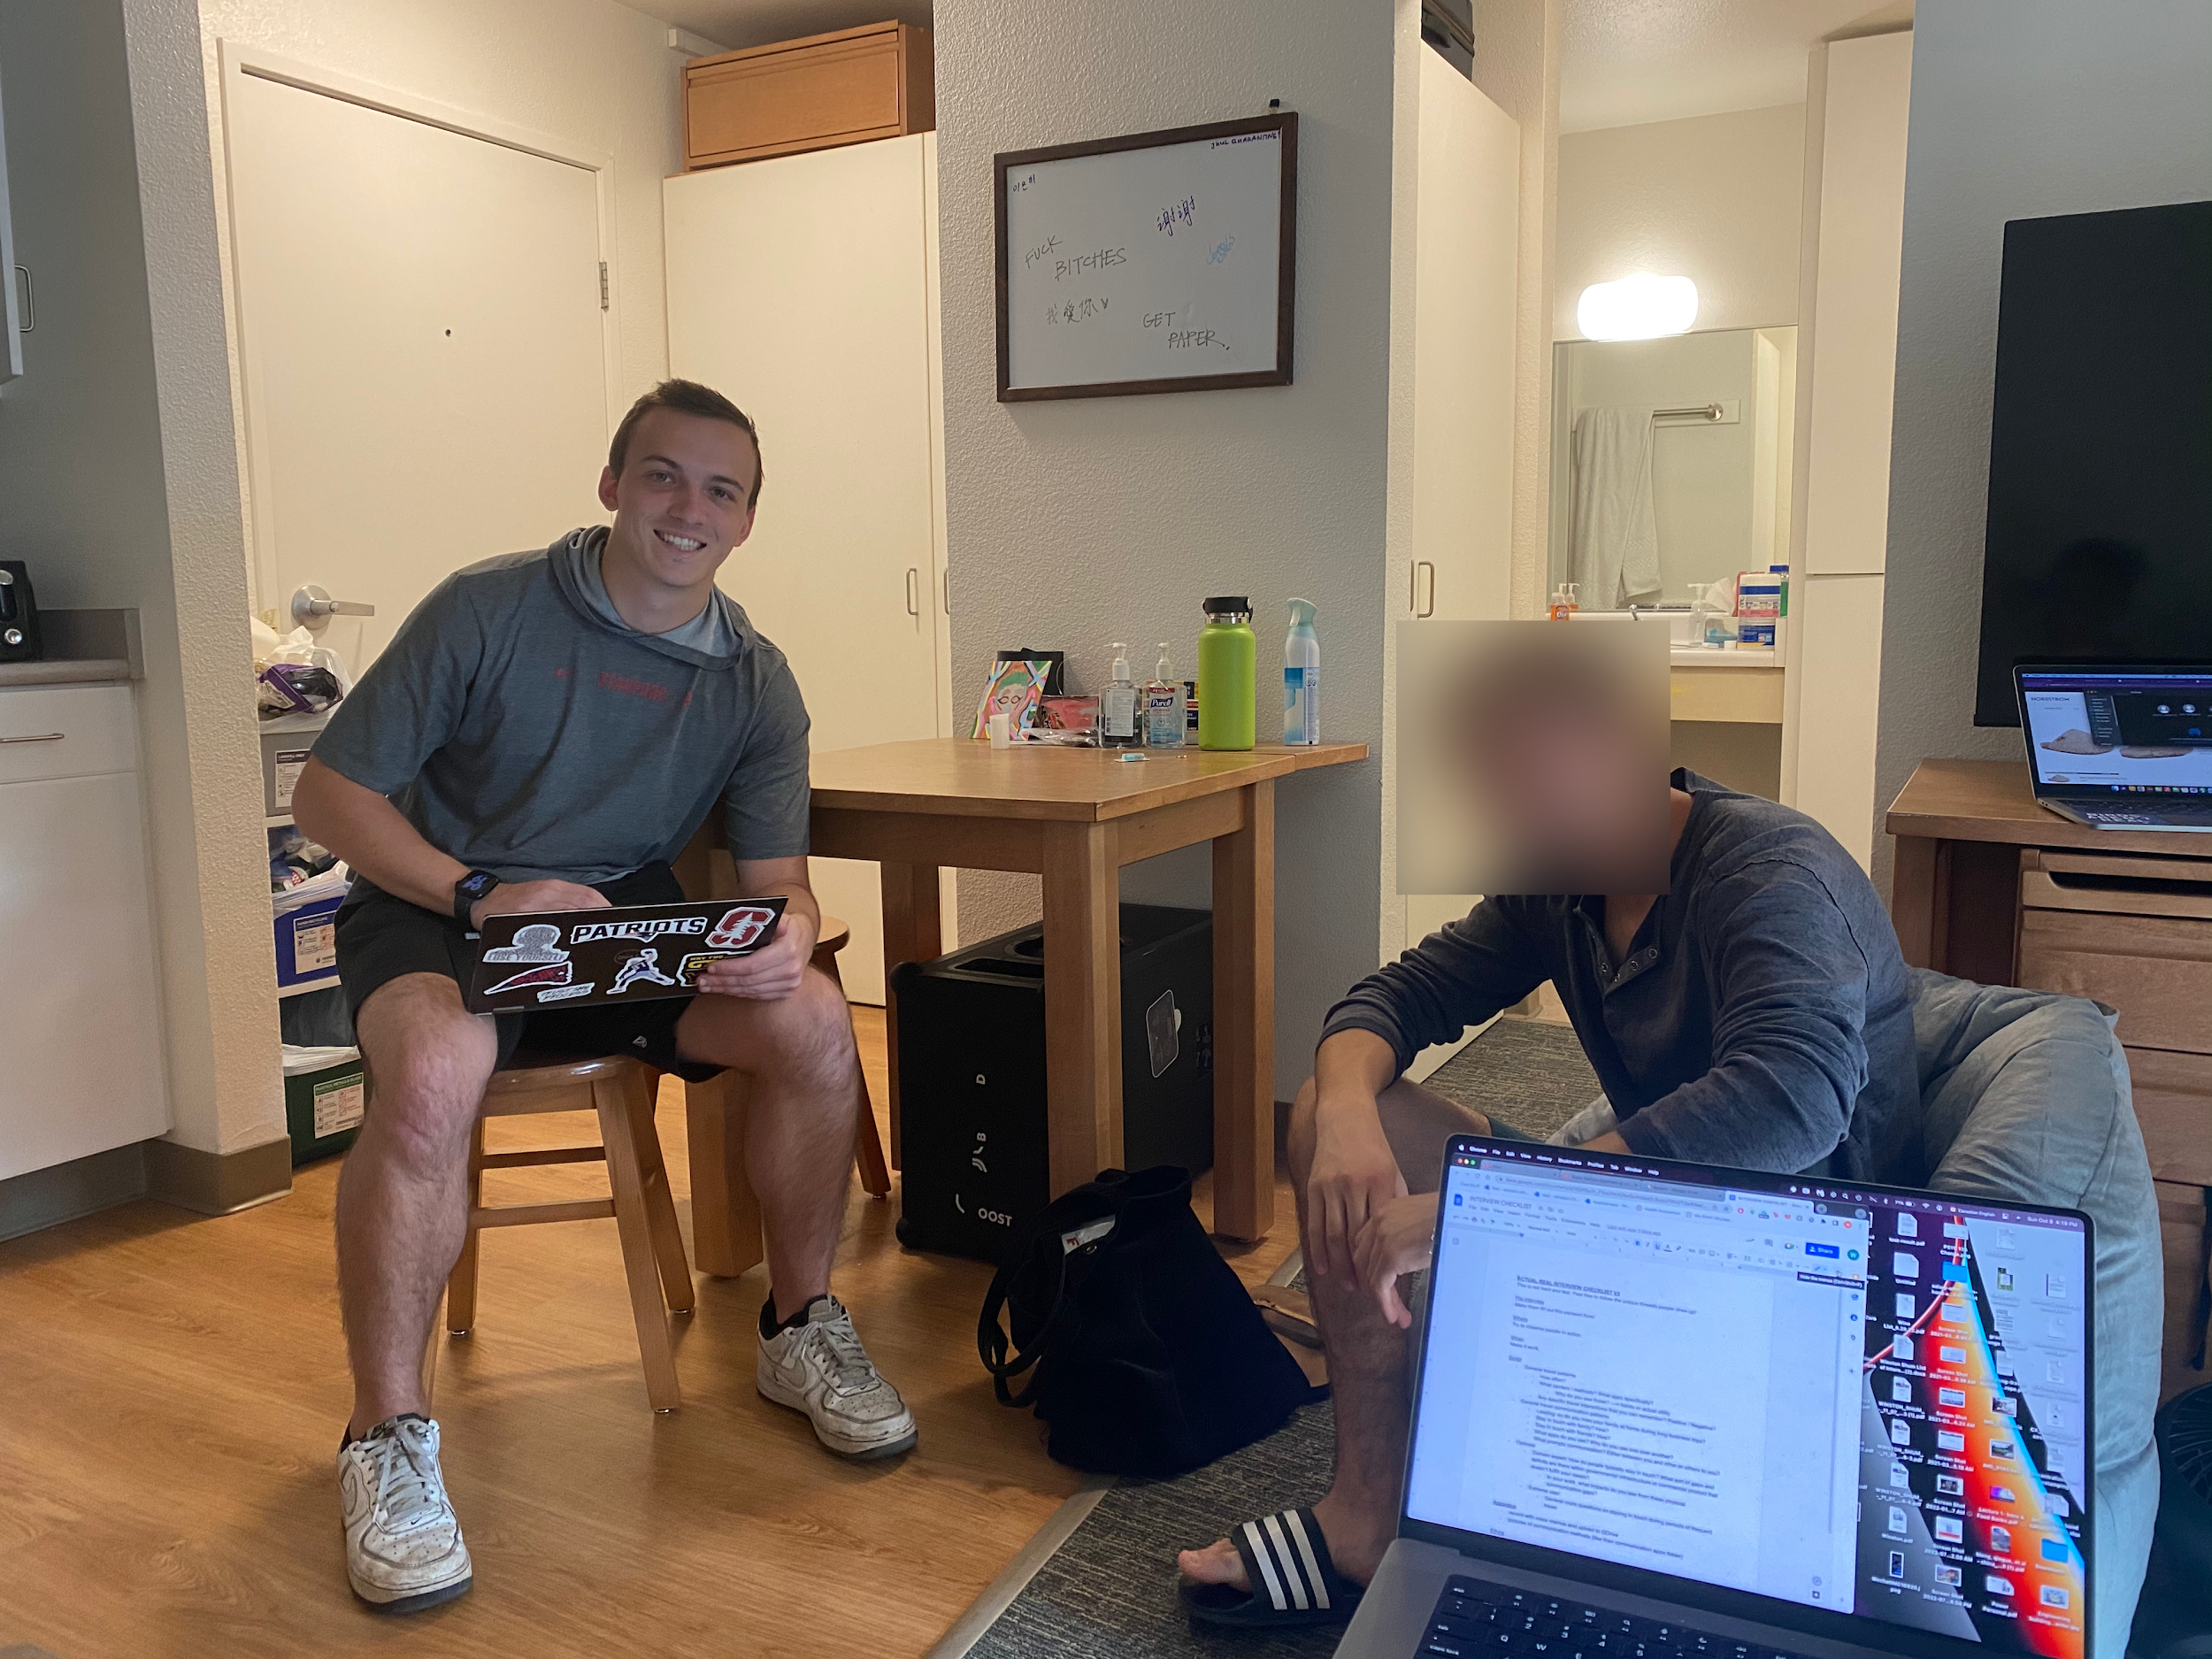
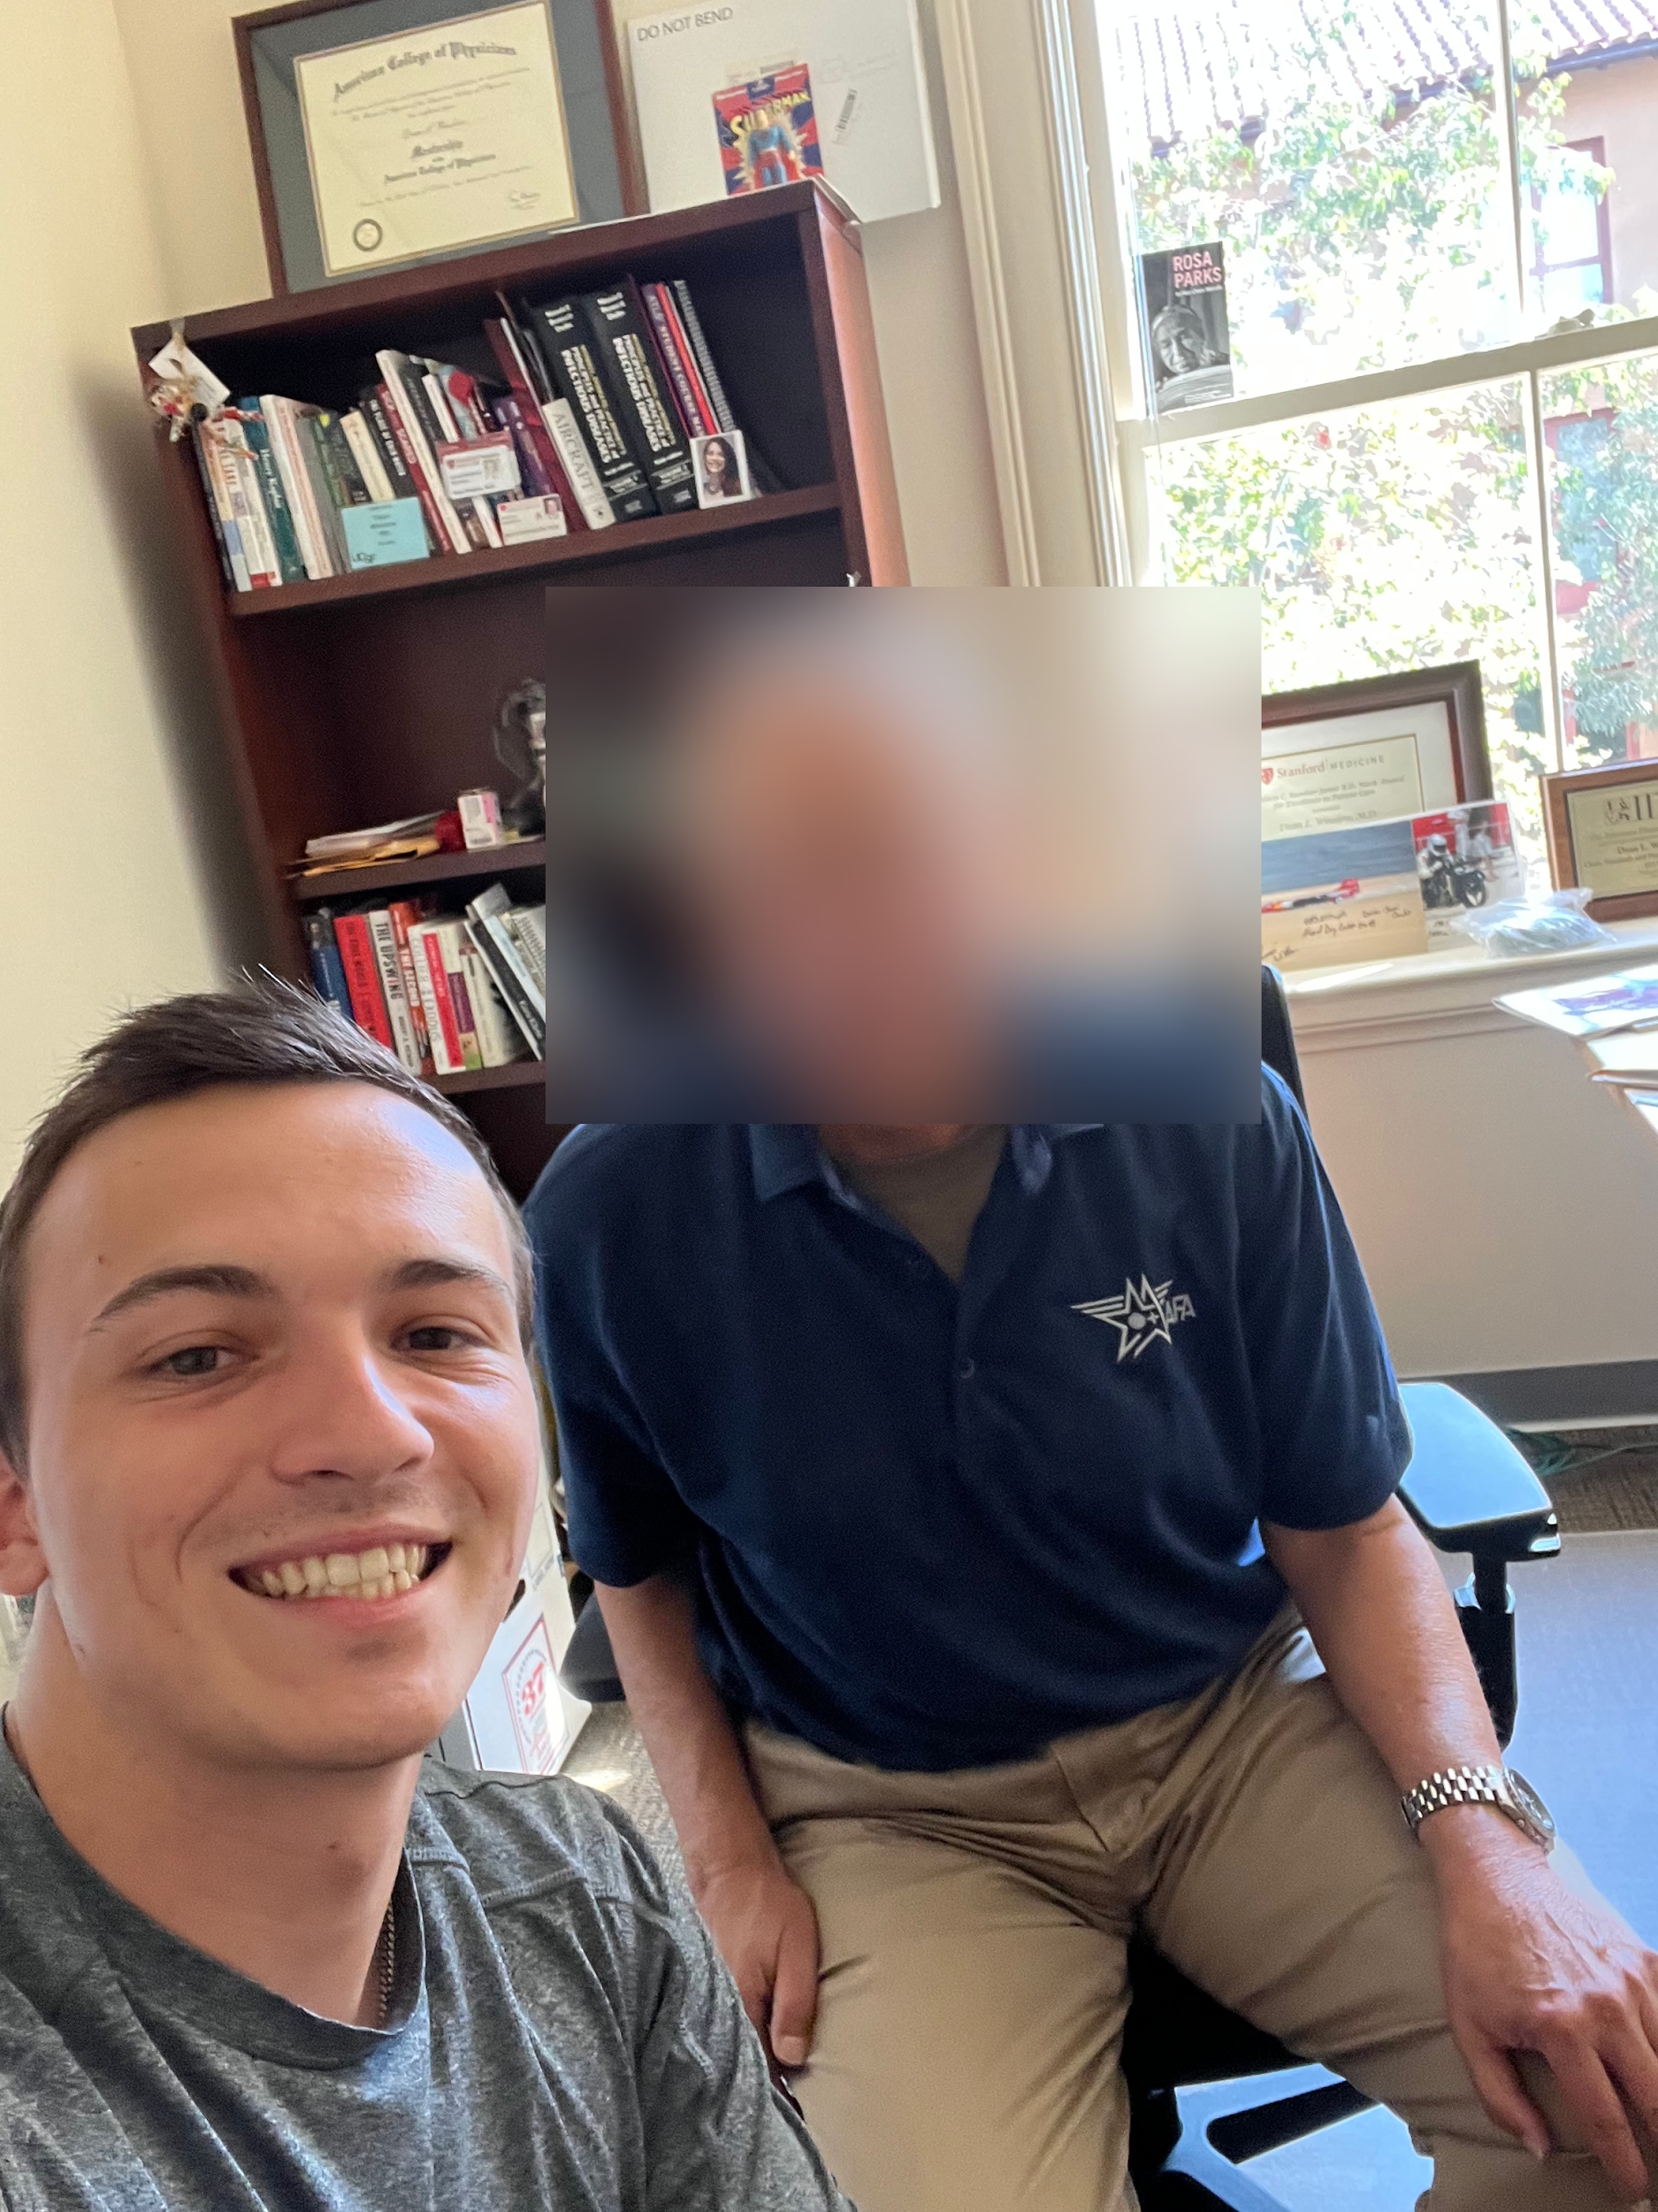
The Travelling Actor & The Professor Parent
Travelling Actor
Friends in many countries
“Out of sight, out of mind”
Values control
Professor Parent
Don’t want to be “helicopter” parent
Keeps in contact at least once a week
Deployed, but was stressful to communicate
Notes:
Gotham photo: https://www.rottentomatoes.com/tv/gotham#&gid=1&pid=5

Slide 8
Major Takeaways
Meeting new people based on common work interests
Comfortable with distance
Concern about checking in too much

Slide 9
2.
Point Of Views
&
How Might We

Slide 10
Studio 2: Initial POV
We met Gerald, a CEO of a global travel agency.
We were surprised to realize that even during trips for vacation, he was still in work mode, evaluating hotels and restaurants.
We wonder if this means he is stressed about finding backup options or potential opportunities for his future tours.
It would be game changing if we could help break the mindset of travel = work.
Notes:
Thinking emoji: https://www.dictionary.com/e/emoji/thinking-face-emoji/

Slide 11
Revised Point Of View Statements
Creating Routine (and Safety) In New Places
We met participant 3, a high school student commuting daily on the caltrain to school.
We were surprised by how fine he was about walking through a “sketchy” route every day to take the caltrain
We wonder if this means that routine instills a sense of safety
It would be game-changing to bring some of this sense of routine into new places.
Vibe Checks
We met participant 8 an infectious disease expert who lives locally and has four children who live far and travel frequently.
We were surprised to learn that he doesn’t worry much about his family’s safety and status when they are traveling, but he still likes to stay in touch with them and talk at least once a week.
We wonder if this means that he trusts his kids to be cautious and safe, or if he doesn’t want to be too intrusive of their lives and appear to be a helicopter parent.
It would be game changing if there was a quick and easy way for him to check up on family without needing to directly contact them as he says he doesn’t want to be a ‘helicopter parent’.
Global Friends
We met participant 7, a young actor studying at Stanford who starred in Gotham since he was a young kid and often travels for work to conventions and film shootings.
We were surprised that he prefers having friends all across the world even if he doesn’t speak with them for long periods of time when he’s not in the same region as they are.
We wonder if this means that professionals who travel often for work do not want all their friends to be localized in one place and would prefer seeing foreign friends once in a while.
It would be game changing to help professionals who travel a lot meet new friends on a global scale to create non-localized friend groups.
Notes:
Total 8 POVs made

Slide 12
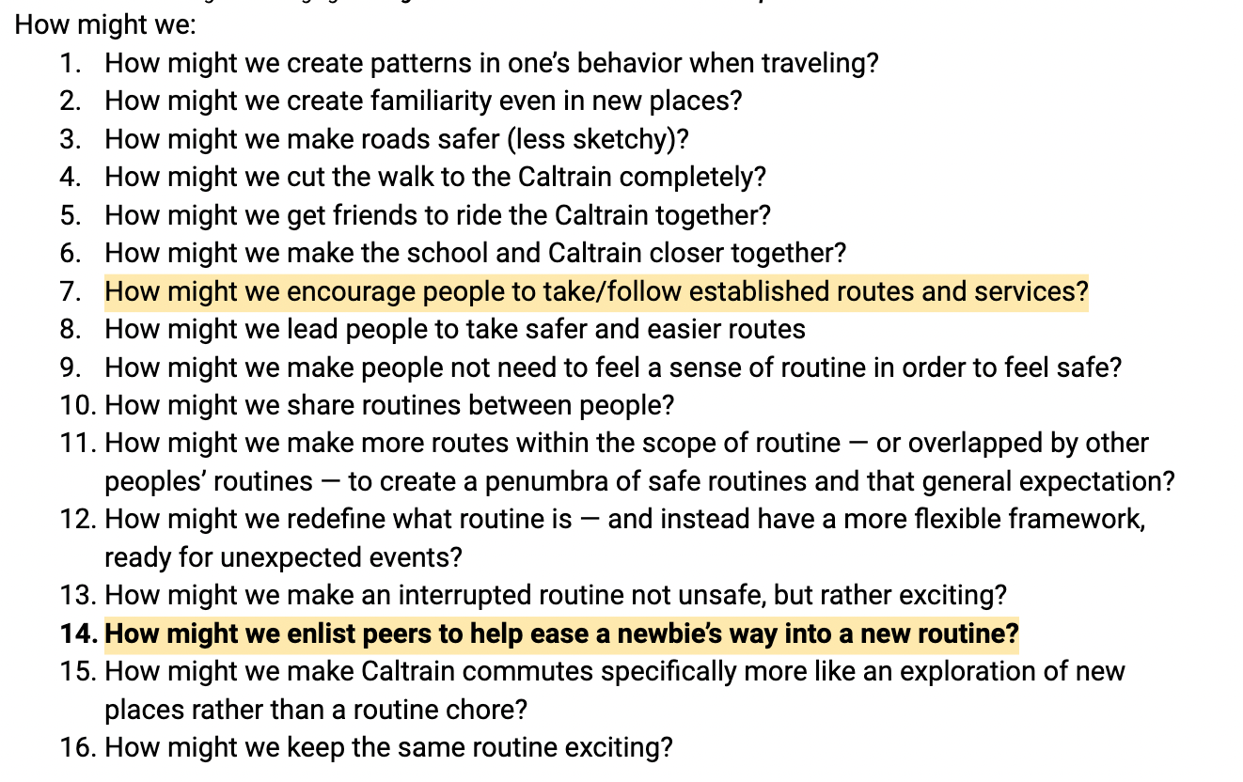
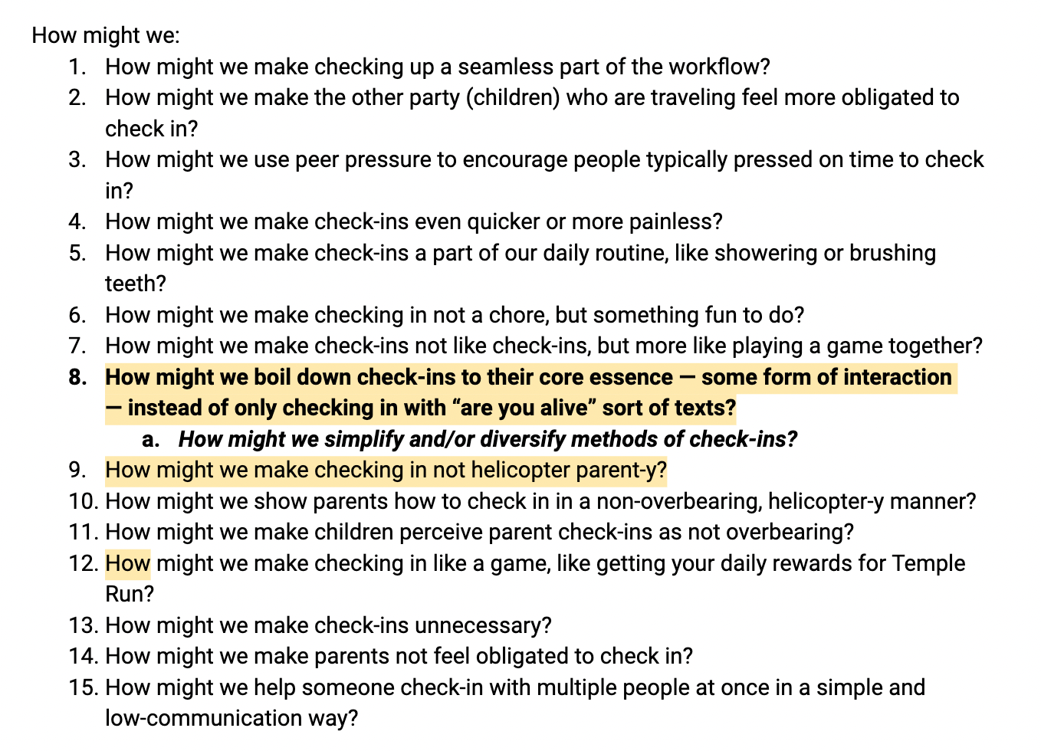
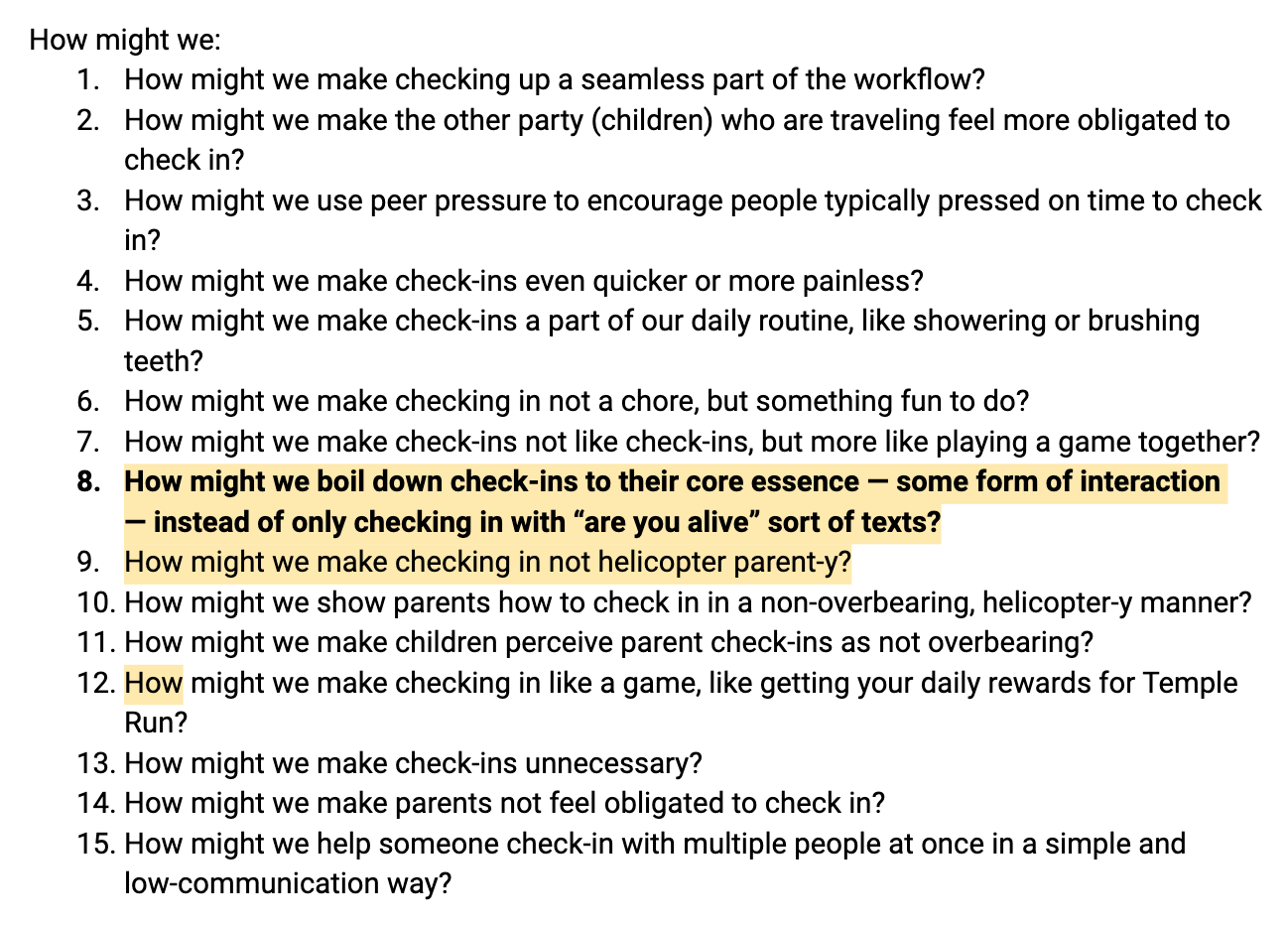
How Might We…?
Creating Routine (and Safety) In New Places
Global Friends
Vibe Checks

Slide 13
POV 1: Creating Routine (and Safety) In New Places
We met participant 3, a high school student commuting daily on the caltrain to school. We were surprised by how fine he was about walking through a “sketchy” route every day to take the caltrain. We wonder if this means that routine instills a sense of safety. It would be game-changing to bring some of this sense of routine into new places.
~
How might we enlist peers to help ease a newbie’s way into a new routine and/or area?

Slide 14
POV 2: Vibe Checks
We met participant 8 an infectious disease expert who lives locally and has four children who live far and travel frequently. We were surprised to learn that he doesn’t worry much about his family’s safety and status when they are traveling, but he still likes to stay in touch with them and talk at least once a week.We wonder if this means that he trusts his kids to be cautious and safe, or if he doesn’t want to be too intrusive of their lives and appear to be a helicopter parent. It would be game changing if there was a quick and easy way for him to check up on family without needing to directly contact them as he says he doesn’t want to be a ‘helicopter parent’.
~
How might we simplify and/or diversify methods of check-ins?

Slide 15
POV 3: Global Friends
We met participant 7, a young actor studying at Stanford who starred in Gotham since he was a young kid and often travels for work to conventions and film shootings. We were surprised that he prefers having friends all across the world even if he doesn’t speak with them for long periods of time when he’s not in the same region as they are. We wonder if this means that professionals who travel often for work do not want all their friends to be localized in one place and would prefer seeing foreign friends once in a while. It would be game changing to help professionals who travel a lot meet new friends on a global scale to create non-localized friend groups.
~
How might we gather traveling professionals together?

Slide 16
3.
Solutions
&
Experience Prototypes
The Initial Test
Notes:
Total 44 solutions

Slide 17
Solutions & Experience Prototypes
Many Solutions
Experience Prototype for Solution
assumption
assumption
assumption
assumption
assumption
assumption
assumption
assumption
Test the assumption
Most Critical

Slide 18
Solution 1: Helping Suggest
Mobile video platform to connect travellers and locals
Allows travellers to contact someone familiar with the area for tips, tricks, and life hacks!
~
People want to talk to locals; locals want to talk to people

Slide 19
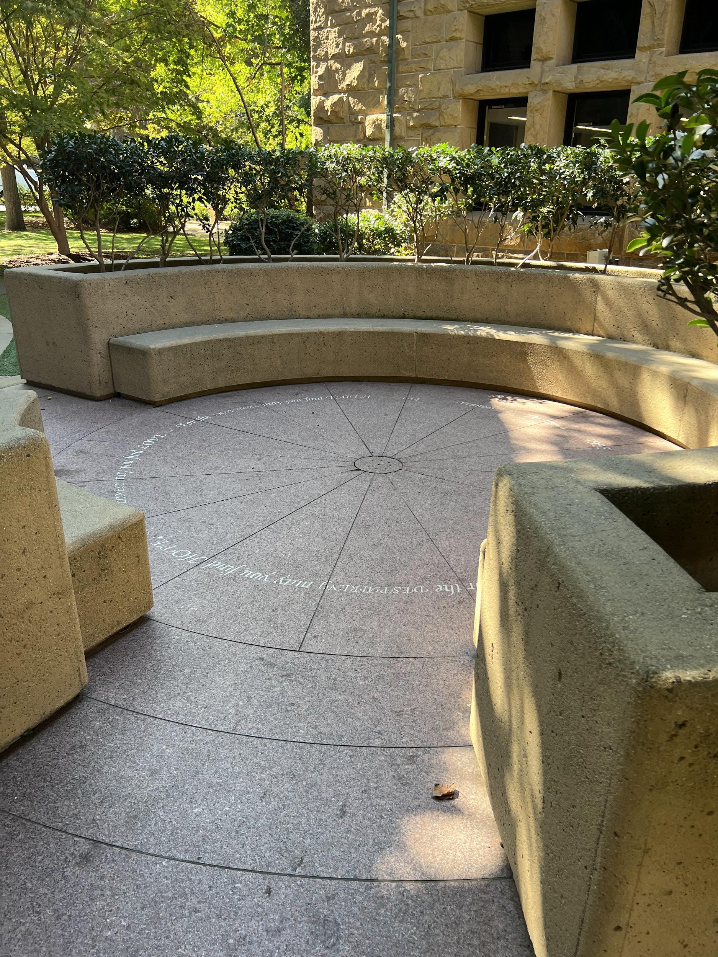
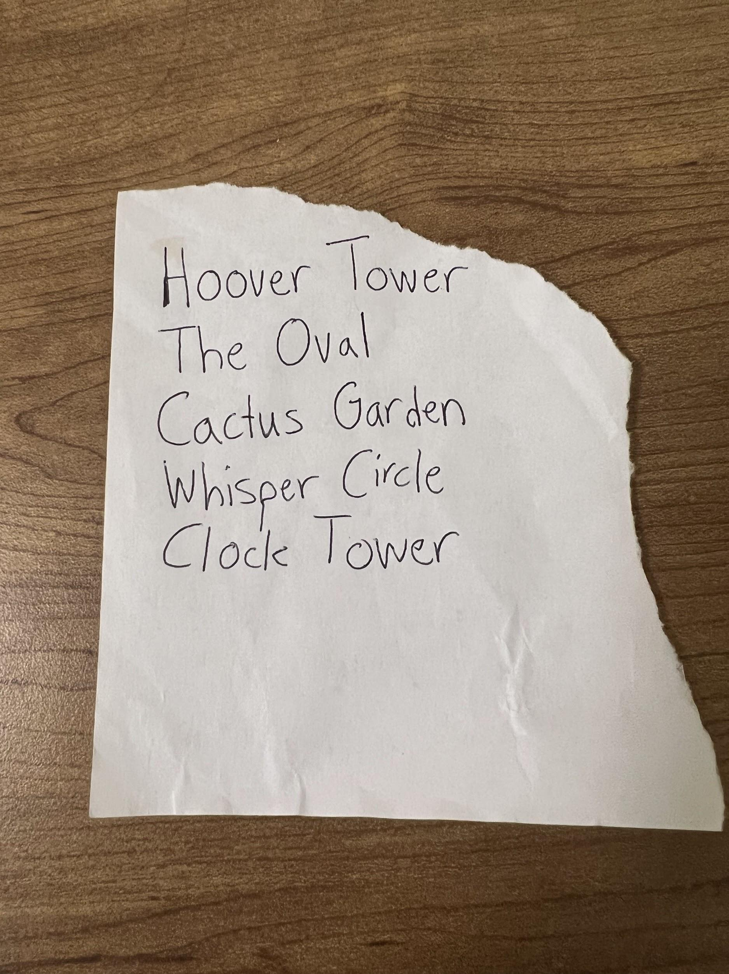
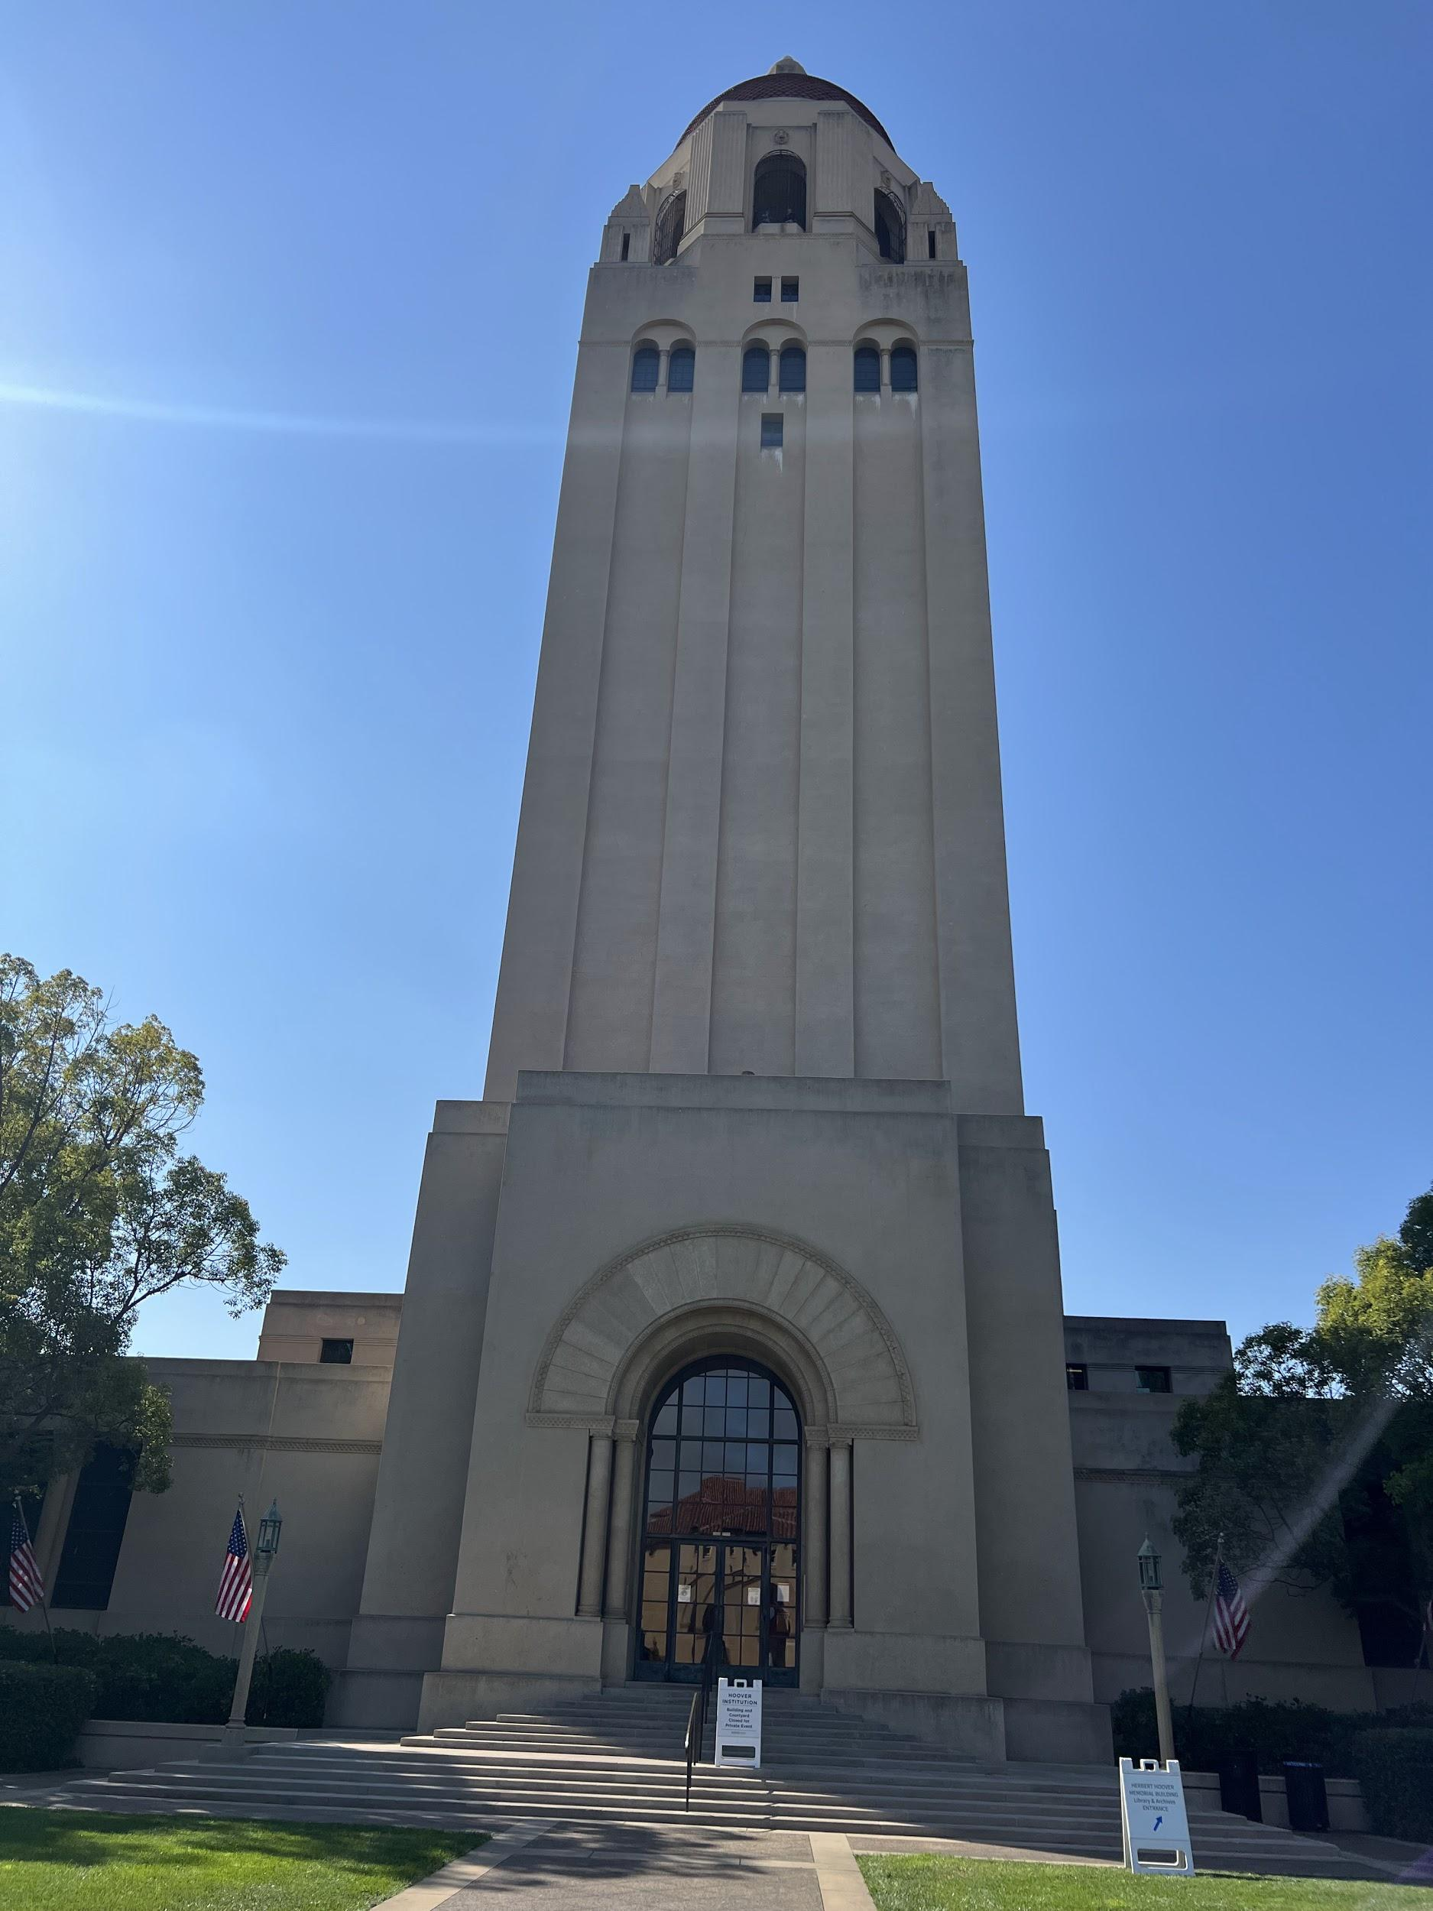
Prototype 1: Helping Suggest
Prototype
List of recommended travel destinations on Stanford Campus
2 perspectives, Local & Tourist
Directions to travel destinations
Participants
Tourists - 2 Groups
Stanford Students - 3 Students
Notes:
Experience Prototype 1 Document: https://docs.google.com/document/d/1MVyEDMDEz0bfHpLI0vLf7_jdHXCWpPeV__y0eFkB5zQ/edit?usp=sharing

Slide 20
Prototype 1: Helping Suggest
Verified - Locals POV
Tourists were friendly and easy to talk to
Excited about recommendations
Verified - Tourists POV
Stanford students were happy to help (if they knew the location)
Considerations
Language barrier could hinder experience
Prior commitments and lack of desired knowledge may result in minimal assistance
Tourists don’t really need help with directions
The Assumption is valid
And we could look into recommendations!
Notes:
Experience Prototype 1 Document: https://docs.google.com/document/d/1MVyEDMDEz0bfHpLI0vLf7_jdHXCWpPeV__y0eFkB5zQ/edit?usp=sharing

Slide 21
Solution 2: Photo Check in
Passive method of “checking in” with family & friends
Instant and unobtrusive
~
People want family members to see their photos

Slide 22
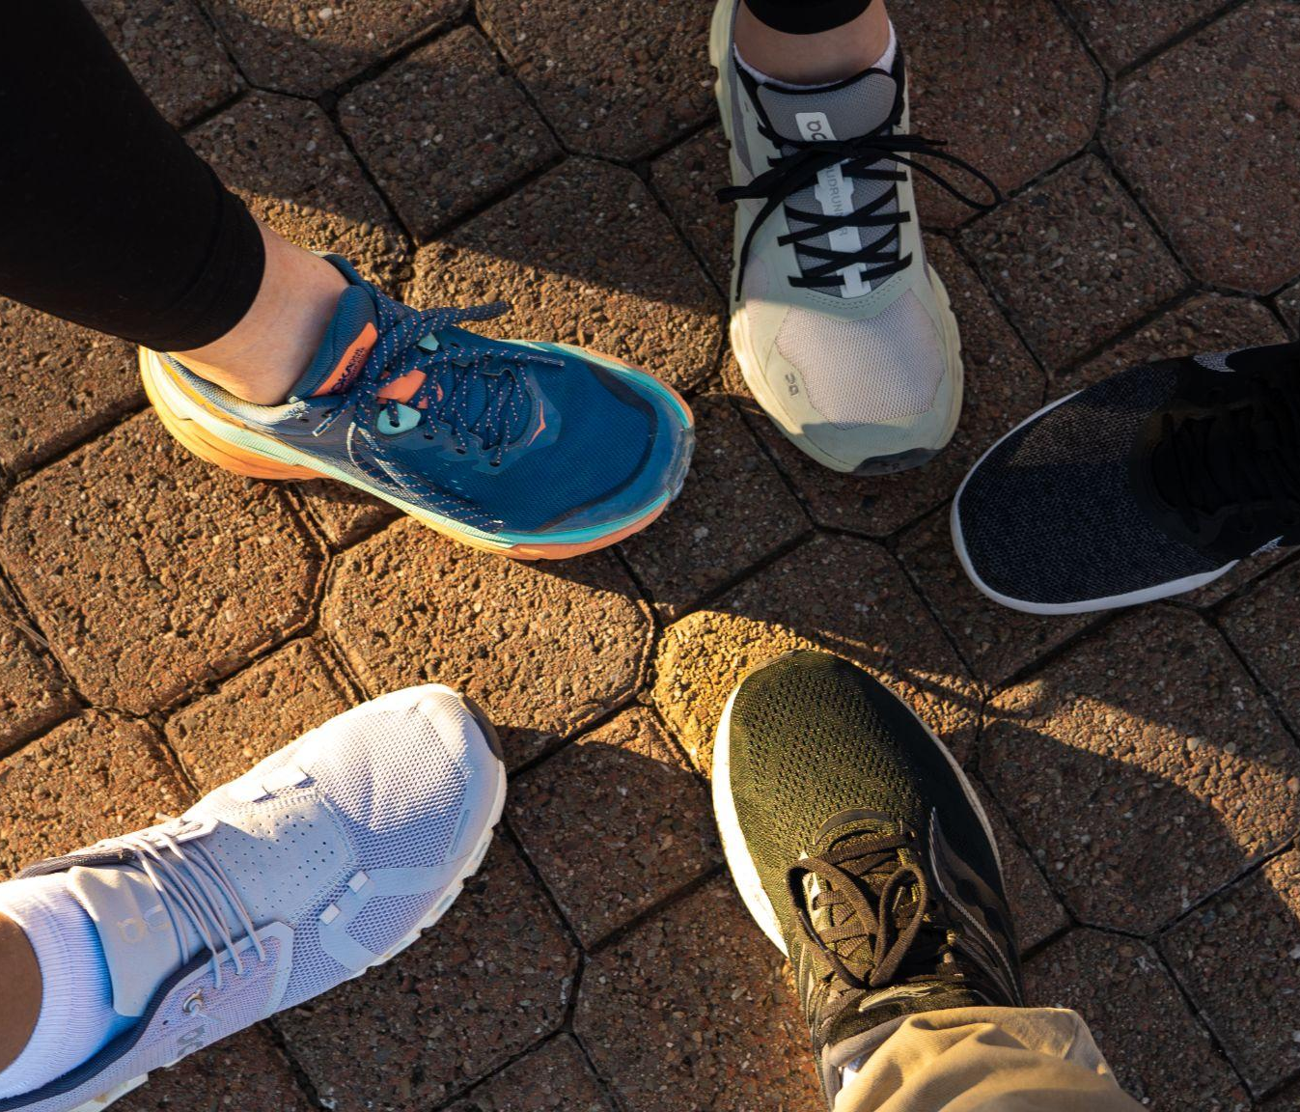
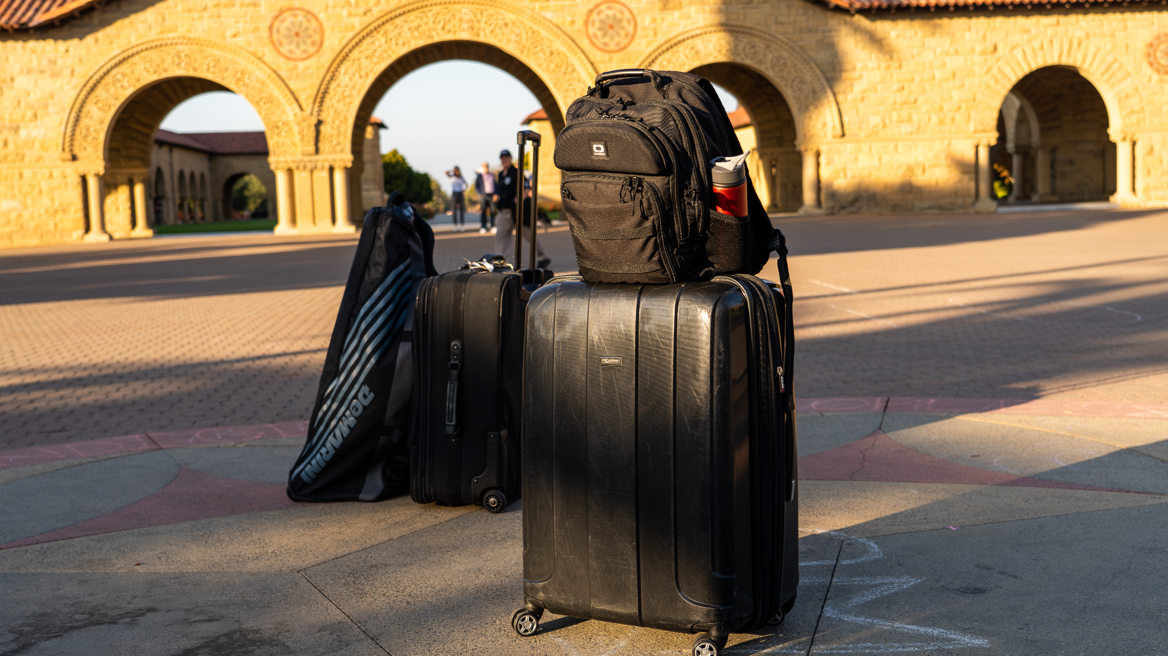
Prototype 2: Photo Check In
Prototype
Photos on participants phone
“Who are the first 5 people you would send these photos to?”
Memorial Church
Participants
Family of 3 from Nashville, Tennessee visiting Stanford for college tour
High school senior visiting Stanford
2 young professionals visiting the Career Fair from NeoCIS
Notes:
Experience Prototype 2 Prep Document: https://docs.google.com/document/d/1EFJELfXruwQp_siP_TbXWU3mNbuCtGqNOOqYnkyPnnc/edit?usp=sharing

Slide 23
Prototype 2: Photo Check In
Verified
All participants named family as a first pick
All participants mentioned friends
Some participants mentioned coworkers
Considerations
Some participants would not share all photos – context dependent
The Assumption is valid
But, we should consider “context” of photos
Notes:
Experience Prototype 2 Prep Document: https://docs.google.com/document/d/1EFJELfXruwQp_siP_TbXWU3mNbuCtGqNOOqYnkyPnnc/edit?usp=sharing

Slide 24
Solution 3: Custom Conference
Facilitates custom meetings with people with shared interests
Allow professionals to meet up with other professionals in the area
~
Professionals in the same industry want to meet up when they go to new places (both close and far) no matter the industry or the level of career experience

Slide 25
Prototype 3: Custom Conference
Prototype
Meetup Simulation “app”
Participants
Candidates crypto/blockchain development space and the finance space in New York - 2 Groups
SWIF (Stanford) attending Silver Lake off-campus event
Notes:
Experience Prototype 3 Prep Document: https://docs.google.com/document/d/1aBHjwySSWEXfyfvLaQSKMq0FG_c9qDe9ZOf3GvcEGT0/edit?usp=sharing
Affiliations for Crypto/blockchain development + Finance space:
Evercore Investment Banking Analyst, Centerview Investment Banking Analyst, institutional investor at crypto firm, NFT project founder, and other interview candidates.
Note: some of these candidates were also not from New York either
** One of the participants was the interviewer!

Slide 26
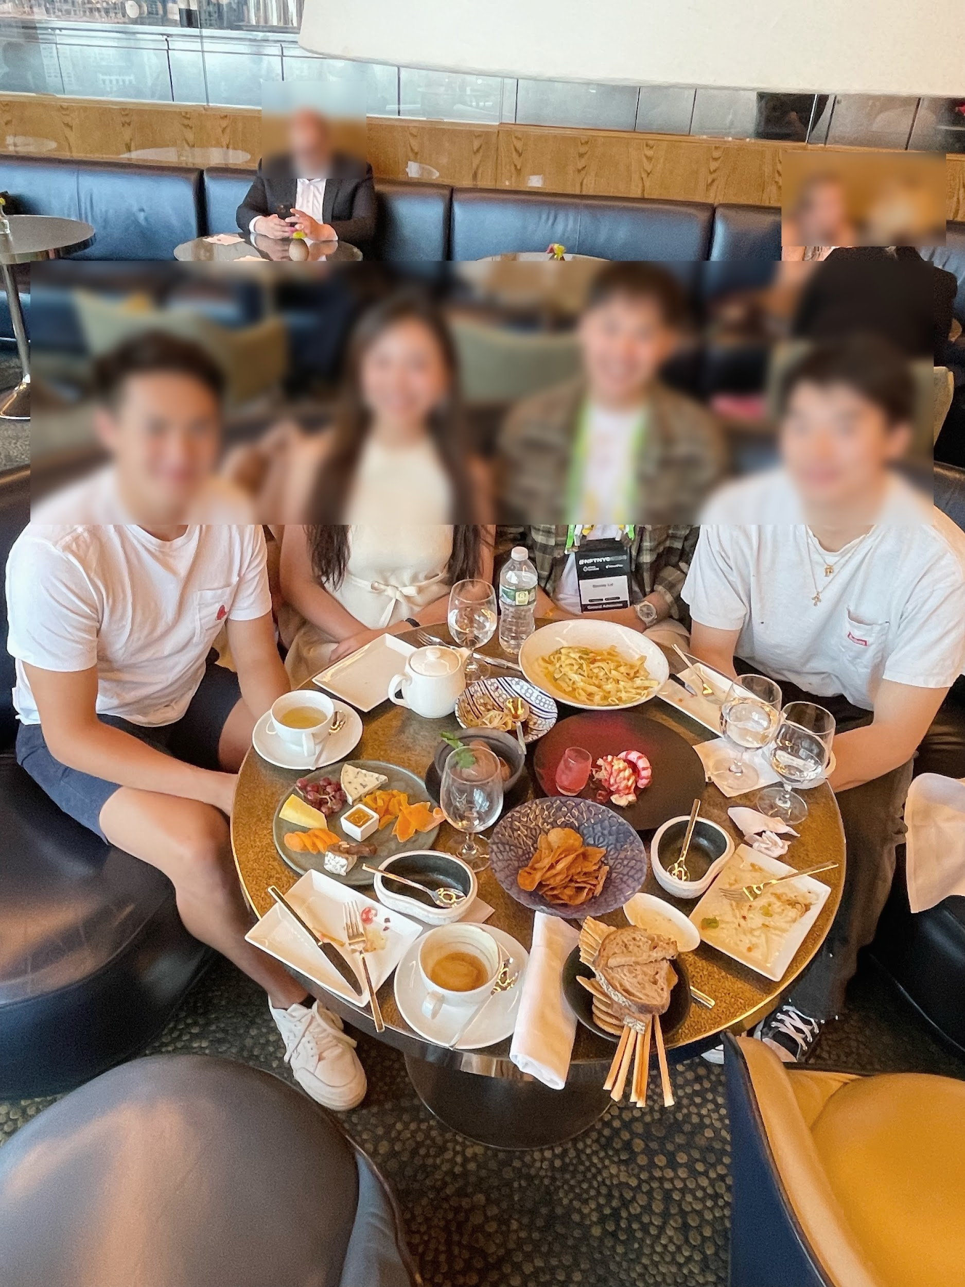
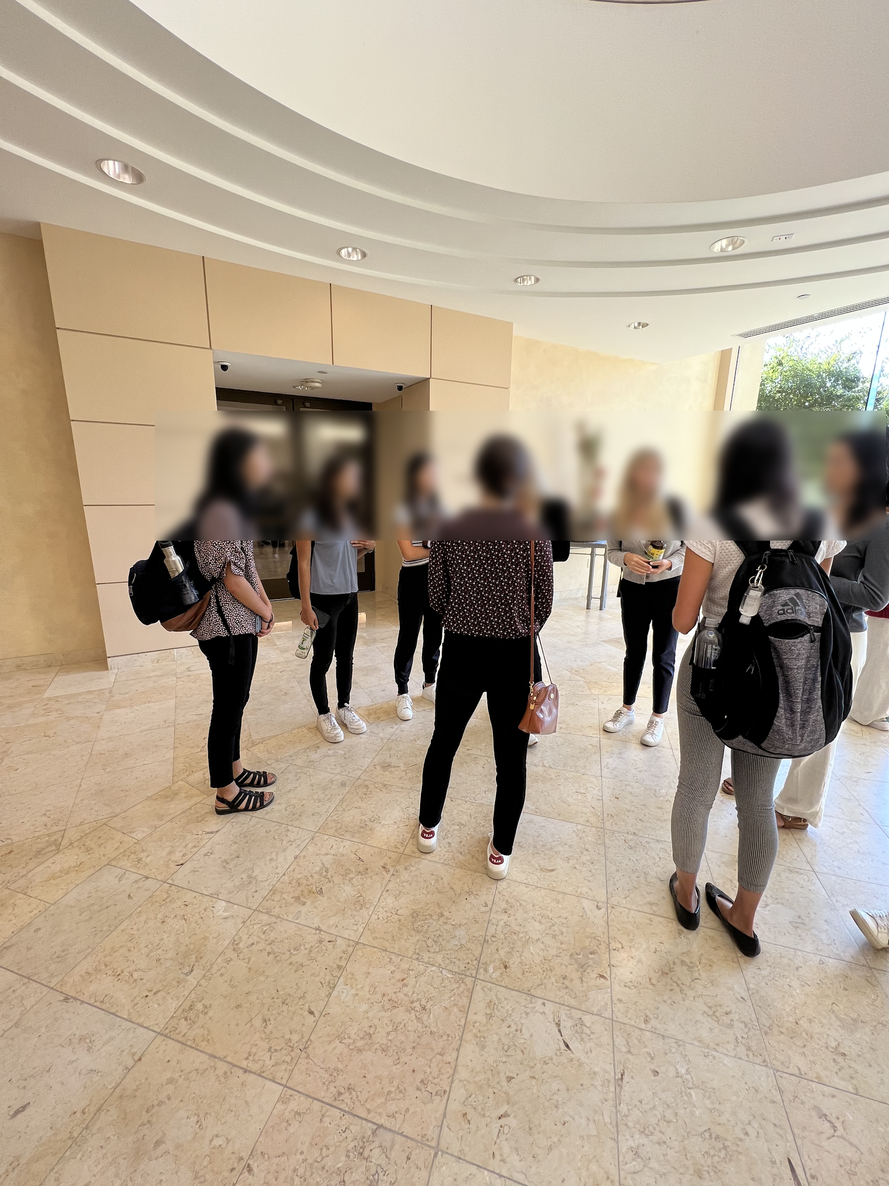
Prototype 3: Custom Conference
New York Crypto
Stanford Silver Lake
Notes:
Experience Prototype 3 Prep Document: https://docs.google.com/document/d/1aBHjwySSWEXfyfvLaQSKMq0FG_c9qDe9ZOf3GvcEGT0/edit?usp=sharing

Slide 27
Prototype 3: Custom Conference
Verified
Young professionals did attend, even strangers
Participants generally enjoyed and expressed interest in planning a similar event
Considerations
The “planner” is hard to find
Turnout is low
Professionals in different sectors
The Assumption is somewhat valid
People in the same industry generally like meeting others in the same industry, and may have meeting preferences
Notes:
Experience Prototype 3 Prep Document: https://docs.google.com/document/d/1aBHjwySSWEXfyfvLaQSKMq0FG_c9qDe9ZOf3GvcEGT0/edit?usp=sharing

Slide 28
4.
Next Steps
Continuing Progress
Notes:
Total 44 solutions

Slide 29
Next Steps: Solution
Moving forward with
Solution 2: Photo Check in
Notes:
Grid
Photo sharing (privacy), stalking, passive, trust & safety (content control/filters), Photos have inherent bias against darker skin
Serving people w/ technologies
Lower-income (technology), limited connection

Slide 30
Next Steps: Ethics & Audience
Ethics Considerations:
Passive photo sharing could have privacy issues
Malicious parties could use photo sharing to stalk or otherwise follow other people
Content control / filters for sensitive photos
Serves:
Individuals with technology and internet connection
Missing
Lower-Income Individuals
Individuals in remote locations
Notes:
Grid
Photo sharing (privacy), stalking, passive, trust & safety (content control/filters), Photos have inherent bias against darker skin
Serving people w/ technologies
Lower-income (technology), limited connection

Slide 31
THANKS!
Any questions?

Slide 32
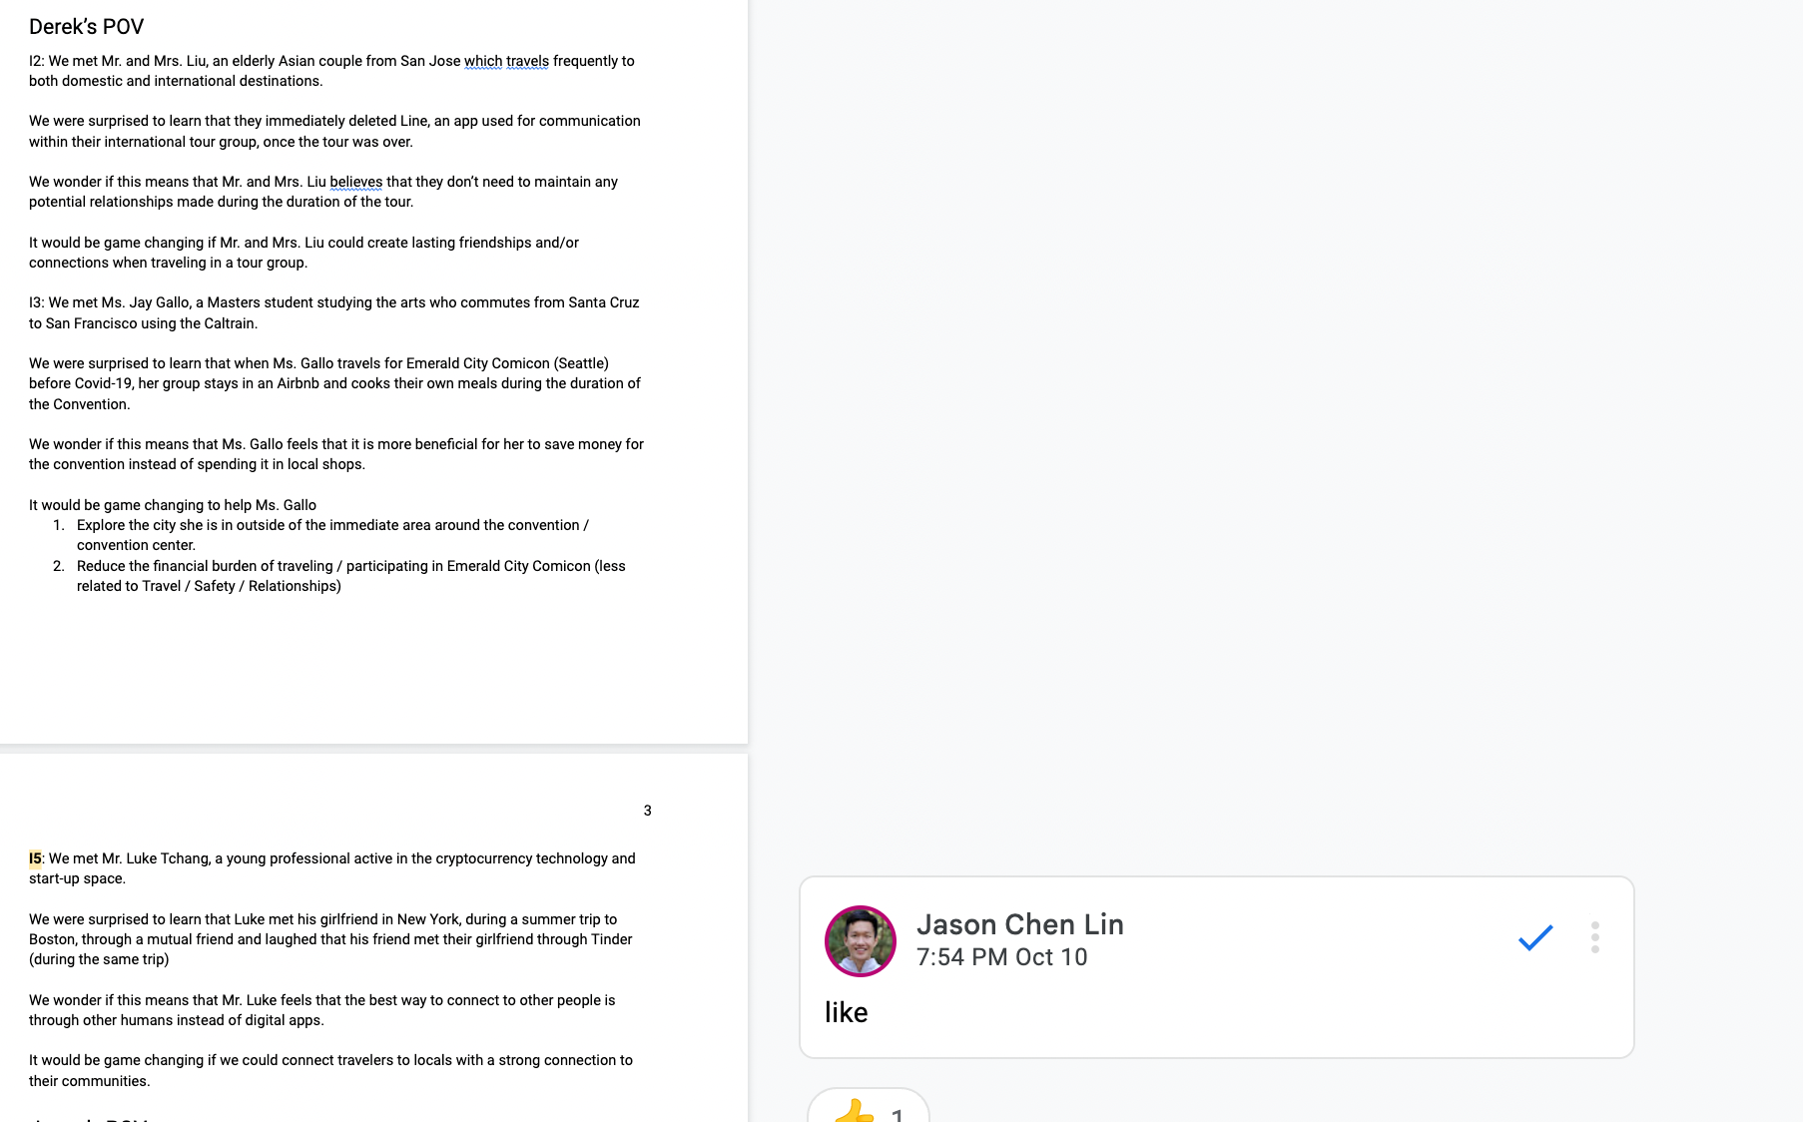
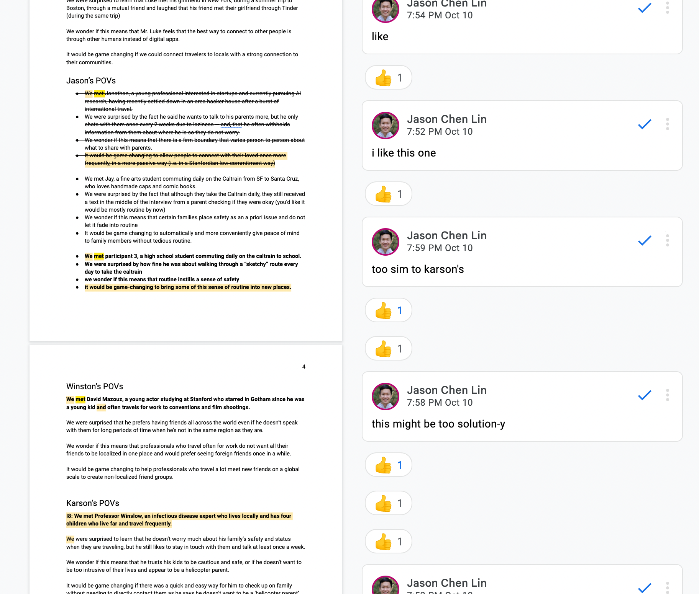
Appendix.
POV Brainstorm
* For full POV, HMW, and Solution Brainstorm, please go to the linked document
Notes:
Additional Interview 1: https://drive.google.com/file/d/1pShdU_6wX6lMgJUef9YIP-xuMbQ63hYa/view?usp=sharing
Additional Interview 1 Notes: https://docs.google.com/document/d/1ZDcv_MzAVOPtVxRMc_9Tnz-M6s-QOBhrT4LcHqKDU5U/edit?usp=sharing
Additional Interview 2: https://drive.google.com/file/d/15HHhdpW2zQtW3nf4Z14wTnYxPdUru9Mu/view?usp=sharing
Additional Interview 2 Notes: https://docs.google.com/document/d/14pwKunBWWxGK3FUVY5cNRh0eRzI14LwdBVSgkrswpcI/edit?usp=sharing
Brainstorm Document for A2 – Includes all POVs, all HMWs, all Solutions: https://docs.google.com/document/d/1Sw2pZdEYmYLkdReYzikwAgowEUR6QxqwM-DuCg2rqMg/edit?usp=sharing
A2 POV: https://drive.google.com/file/d/1BPA6dNHA6-KFaxqQZjahm4GFkwkGyO8X/view?usp=sharing
A2 HMW: https://drive.google.com/file/d/1xXu5_Z_F25NO33g99e5YhbCEpFRR4xx1/view?usp=sharing
A2 Solutions: https://drive.google.com/file/d/1yT8PKfZd_FNV-3O2kl48lgy1_liVgHUK/view?usp=sharing
Experience Prototype 1 Document: https://docs.google.com/document/d/1MVyEDMDEz0bfHpLI0vLf7_jdHXCWpPeV__y0eFkB5zQ/edit?usp=sharing
Experience Prototype 2 Document: https://docs.google.com/document/d/1EFJELfXruwQp_siP_TbXWU3mNbuCtGqNOOqYnkyPnnc/edit?usp=sharing
Experience Prototype 3 Document: https://docs.google.com/document/d/1aBHjwySSWEXfyfvLaQSKMq0FG_c9qDe9ZOf3GvcEGT0/edit?usp=sharing

Slide 33
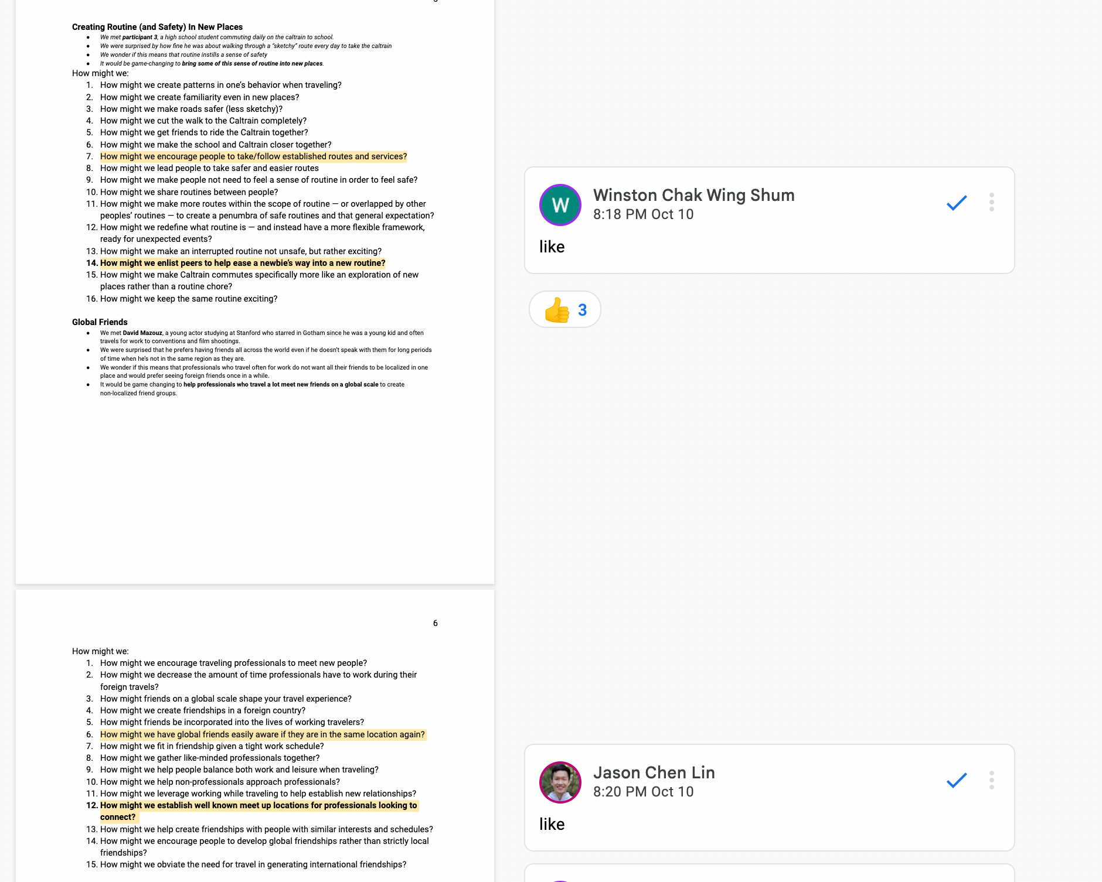
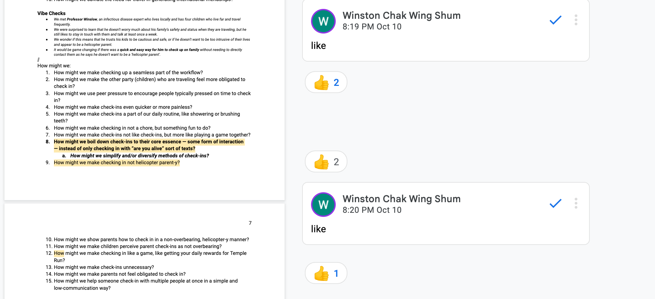
Appendix.
HMW Brainstorm
* For full POV, HMW, and Solution Brainstorm, please go to the linked document
Notes:
Additional Interview 1: https://drive.google.com/file/d/1pShdU_6wX6lMgJUef9YIP-xuMbQ63hYa/view?usp=sharing
Additional Interview 1 Notes: https://docs.google.com/document/d/1ZDcv_MzAVOPtVxRMc_9Tnz-M6s-QOBhrT4LcHqKDU5U/edit?usp=sharing
Additional Interview 2: https://drive.google.com/file/d/15HHhdpW2zQtW3nf4Z14wTnYxPdUru9Mu/view?usp=sharing
Additional Interview 2 Notes: https://docs.google.com/document/d/14pwKunBWWxGK3FUVY5cNRh0eRzI14LwdBVSgkrswpcI/edit?usp=sharing
Brainstorm Document for A2 – Includes all POVs, all HMWs, all Solutions: https://docs.google.com/document/d/1Sw2pZdEYmYLkdReYzikwAgowEUR6QxqwM-DuCg2rqMg/edit?usp=sharing
A2 POV: https://drive.google.com/file/d/1BPA6dNHA6-KFaxqQZjahm4GFkwkGyO8X/view?usp=sharing
A2 HMW: https://drive.google.com/file/d/1xXu5_Z_F25NO33g99e5YhbCEpFRR4xx1/view?usp=sharing
A2 Solutions: https://drive.google.com/file/d/1yT8PKfZd_FNV-3O2kl48lgy1_liVgHUK/view?usp=sharing
Experience Prototype 1 Prep Document: https://docs.google.com/document/d/1MVyEDMDEz0bfHpLI0vLf7_jdHXCWpPeV__y0eFkB5zQ/edit?usp=sharing
Experience Prototype 2 Prep Document: https://docs.google.com/document/d/1EFJELfXruwQp_siP_TbXWU3mNbuCtGqNOOqYnkyPnnc/edit?usp=sharing
Experience Prototype 3 Prep Document: https://docs.google.com/document/d/1aBHjwySSWEXfyfvLaQSKMq0FG_c9qDe9ZOf3GvcEGT0/edit?usp=sharing

Slide 34
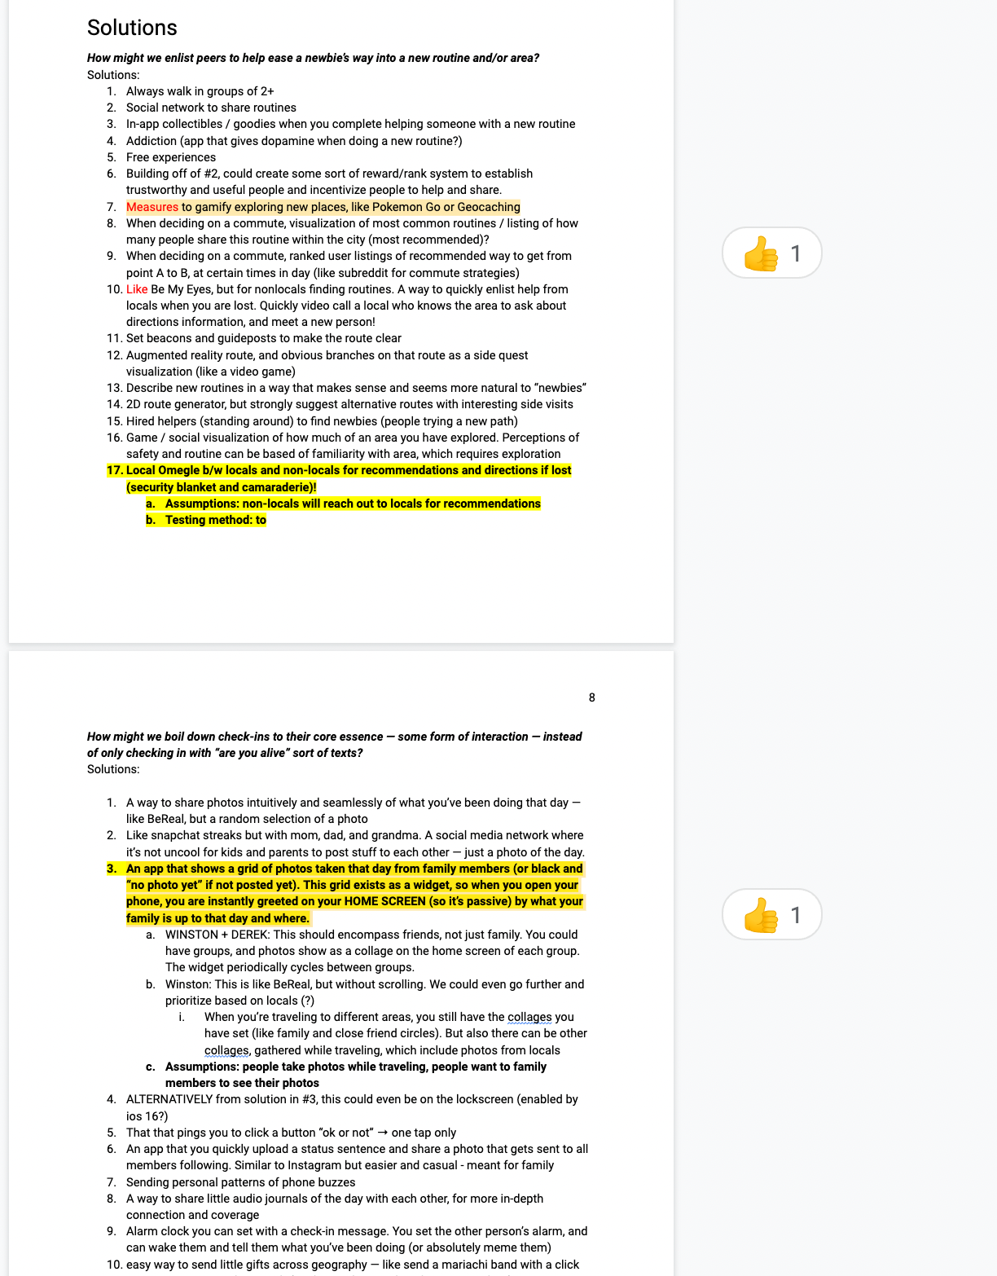
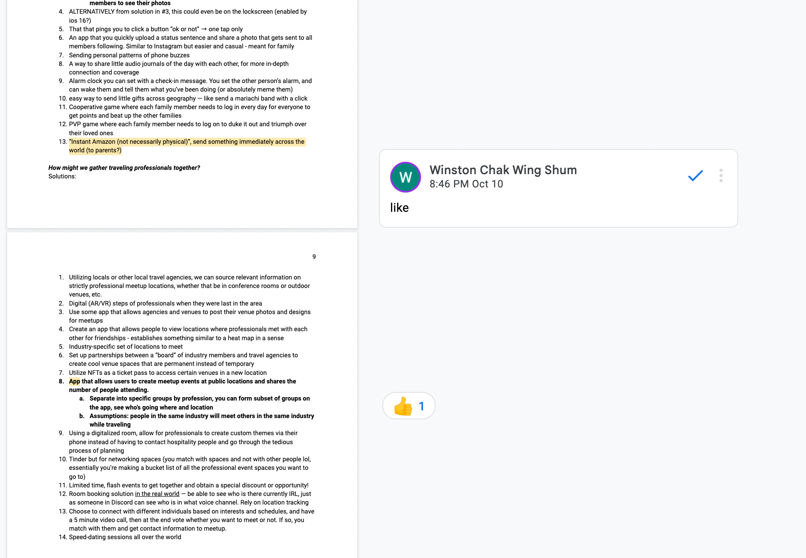
Appendix.
Solution Brainstorm
* For full POV, HMW, and Solution Brainstorm, please go to the linked document
Notes:
Additional Interview 1: https://drive.google.com/file/d/1pShdU_6wX6lMgJUef9YIP-xuMbQ63hYa/view?usp=sharing
Additional Interview 1 Notes: https://docs.google.com/document/d/1ZDcv_MzAVOPtVxRMc_9Tnz-M6s-QOBhrT4LcHqKDU5U/edit?usp=sharing
Additional Interview 2: https://drive.google.com/file/d/15HHhdpW2zQtW3nf4Z14wTnYxPdUru9Mu/view?usp=sharing
Additional Interview 2 Notes: https://docs.google.com/document/d/14pwKunBWWxGK3FUVY5cNRh0eRzI14LwdBVSgkrswpcI/edit?usp=sharing
Brainstorm Document for A2 – Includes all POVs, all HMWs, all Solutions: https://docs.google.com/document/d/1Sw2pZdEYmYLkdReYzikwAgowEUR6QxqwM-DuCg2rqMg/edit?usp=sharing
A2 POV: https://drive.google.com/file/d/1BPA6dNHA6-KFaxqQZjahm4GFkwkGyO8X/view?usp=sharing
A2 HMW: https://drive.google.com/file/d/1xXu5_Z_F25NO33g99e5YhbCEpFRR4xx1/view?usp=sharing
A2 Solutions: https://drive.google.com/file/d/1yT8PKfZd_FNV-3O2kl48lgy1_liVgHUK/view?usp=sharing
Experience Prototype 1 Prep Document: https://docs.google.com/document/d/1MVyEDMDEz0bfHpLI0vLf7_jdHXCWpPeV__y0eFkB5zQ/edit?usp=sharing
Experience Prototype 2 Prep Document: https://docs.google.com/document/d/1EFJELfXruwQp_siP_TbXWU3mNbuCtGqNOOqYnkyPnnc/edit?usp=sharing
Experience Prototype 3 Prep Document: https://docs.google.com/document/d/1aBHjwySSWEXfyfvLaQSKMq0FG_c9qDe9ZOf3GvcEGT0/edit?usp=sharing

