Slide 1
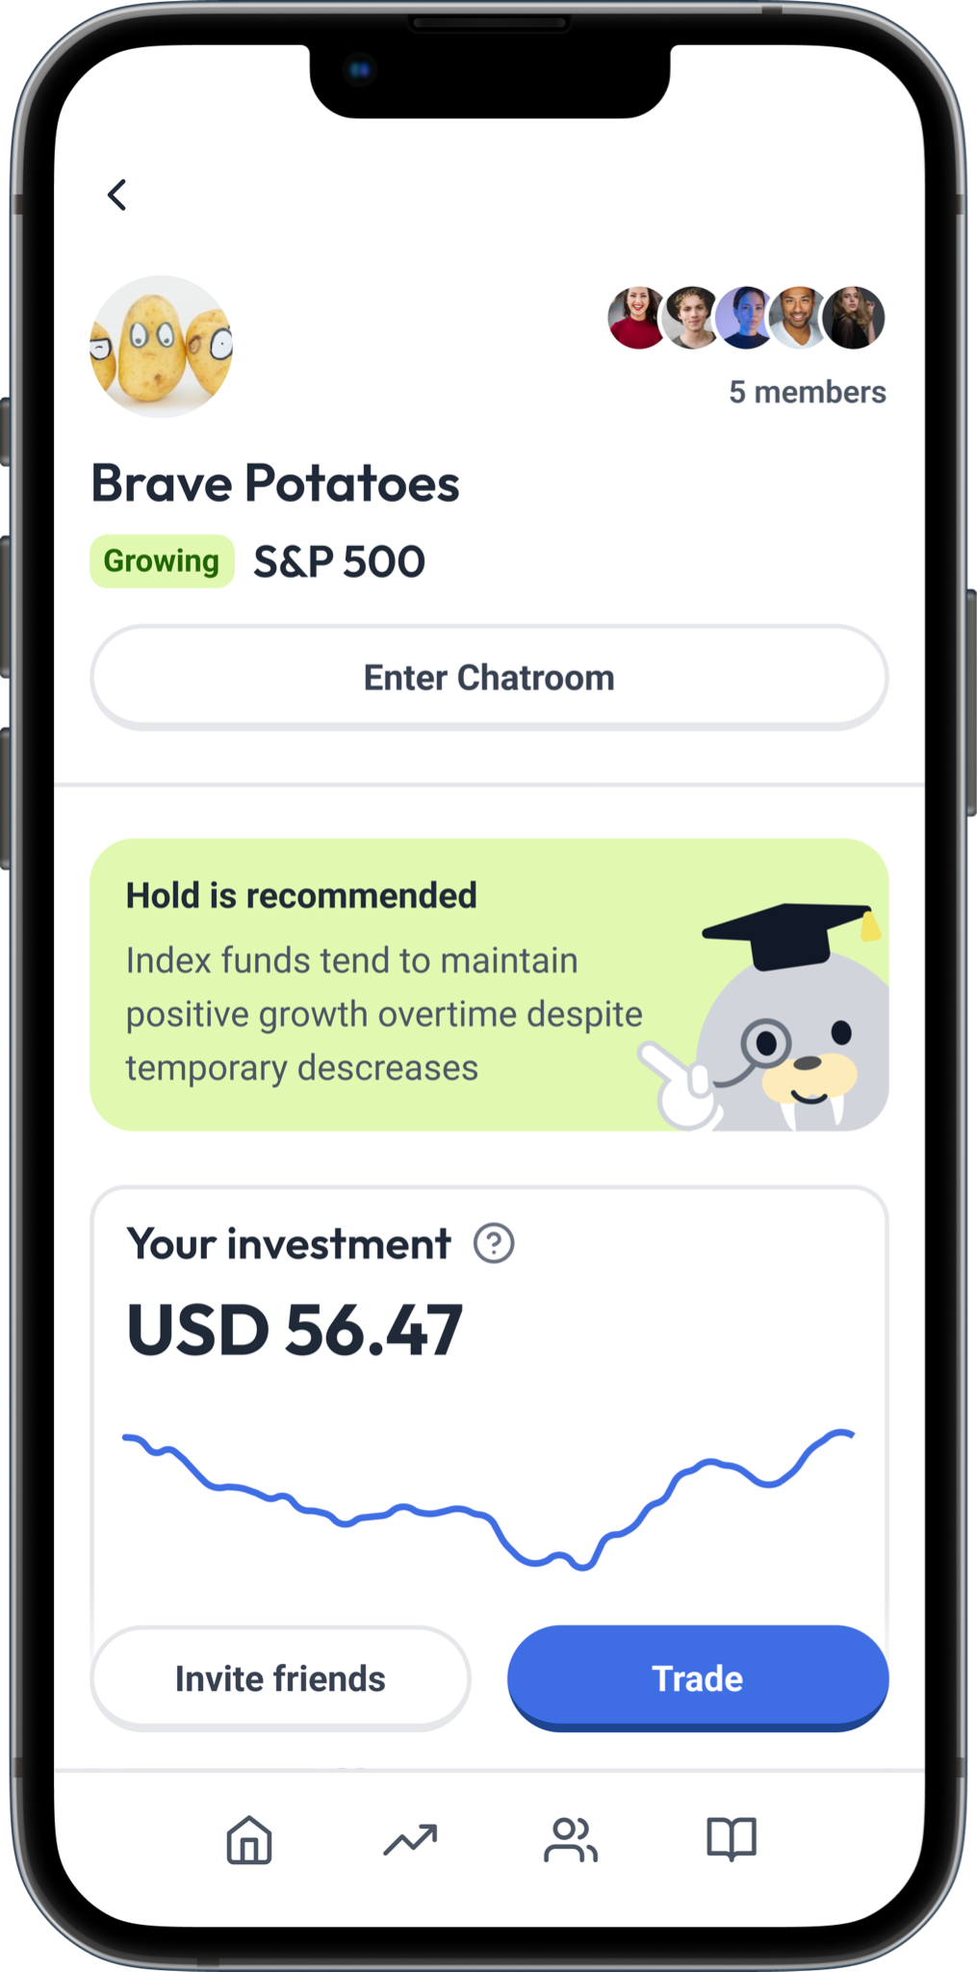
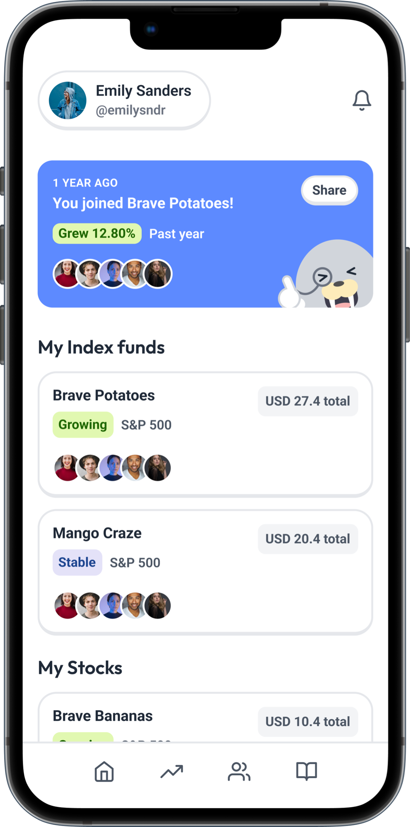
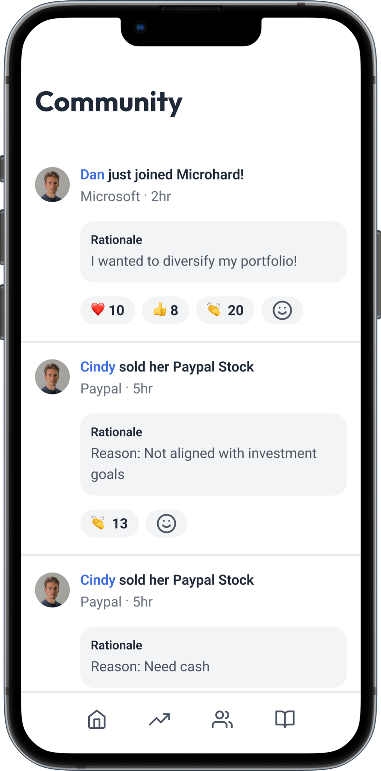



Wallus
Grow investment knowledge with friends
Notes:
Final pitch slide

Slide 2
Drafts

Slide 3
Wallus
Grow investment knowledge with friends

Slide 4
Wallus
Grow investment knowledge with friends

Slide 5
Wallus
Grow investment knowledge with friends

Slide 6
Wallus
Grow investment knowledge with friends

Slide 7
Wallus
Grow investment knowledge with friends

