Slide 1
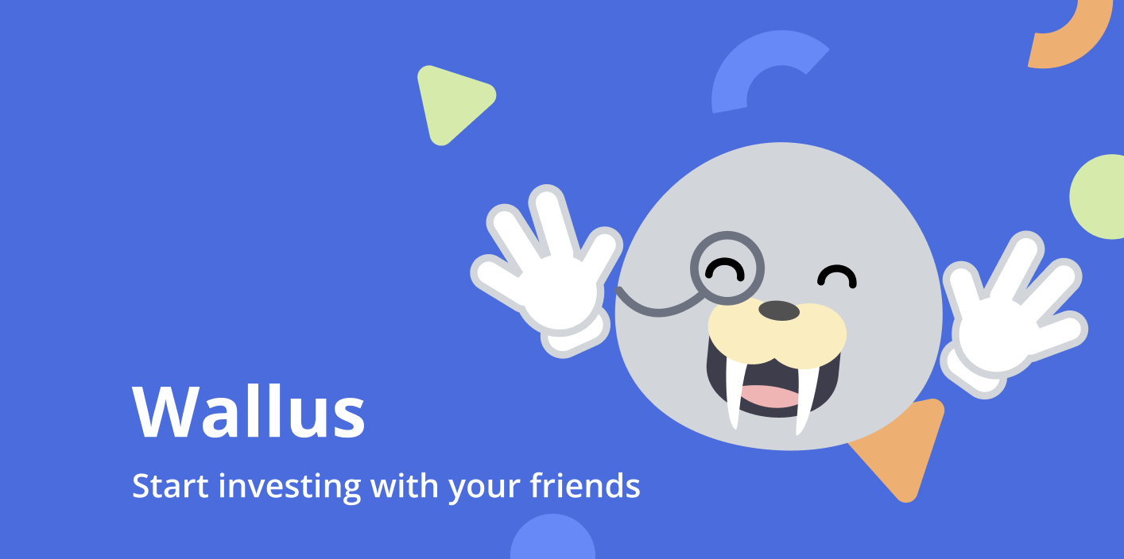


Interactive High-Fi Prototype

Slide 2

Agenda
1
2
3
VALUE PROPOSITION
PROBLEM/
SOLUTION
HE RESULTS
4
5
UI REVISIONS
PROTOTYPE IMPLEMENTATION

Slide 3

Value Proposition
Educate and support investment rookies to gain investment literacy
1

Slide 4









Team Members
Avika Patel
CS ’24
Juben Rana
CS ’24
Madison Fan
Design ’25
Xinyi Wang
CS ’24

Slide 5

Problem
Solution
Wallus helps combat these barriers by encouraging investment rookies to grow investment knowledge through investing in stock choices with their friends. With in-app education, advice, and community support, individuals who are cautious of stocks can start their investing journey!
Despite the importance and benefits of financial investment, people shy away from investing due to the lack of confidence, experience, and relevant knowledge.
2

Slide 6

3
Heuristic Evaluation
Results

Slide 7
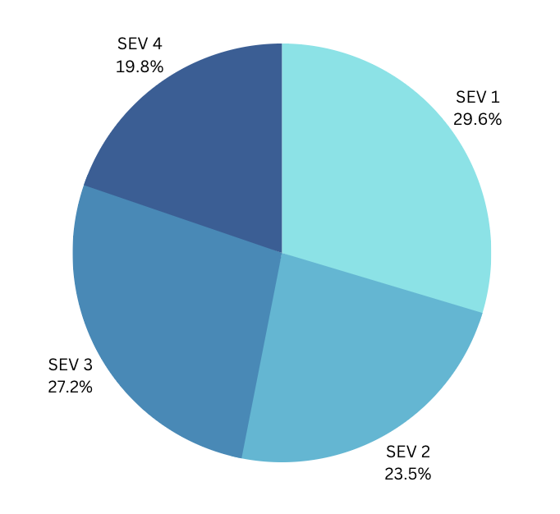
H1: Visibility of Status (12%)
Graphics are confusing to a new investor
Icons (like notifications bell) do not show full info
User decisions (like investing) don’t have confirmation
H4: Consistency & Standards (16%)
Market tab and Invite show different stock information
Buttons are not consistent across app (color, content)
Sections are varying complexity
Information is grouped in different ways
81 Violations
47% SEV 3 and SEV 4
H10: Help & Documentation (12%)
Many investment terms without definition/ ? support
Advice (like “meets investment goals”) is not defined
Icons for % inc. and decrease don’t mention metrics
Each page/purpose is not well-defined
Heuristic Evaluation Results
Notes:
Particularly for SEV 3 and SEV 4 – H1 and H10 were high violations by a large margin (8 SEV 3/4 each)!

Slide 8
Main Concerns
Lots of jargon that is not understandable to newbie investors
ROI, hold, balance, etc
Complicated investment charts that match existing industry standard
Lacking community feature
No personalization
Wallus makes decisions for the user without explaining decision
Wallus has recommendations and advice that are mentioned, undescriptive
Notes:
Section 4 mentions how each of these are fixed
Preview:
Lots of jargon that is not understandable to newbie investors
Deleting many sections that are unnecessary
Adding “?” to all necessary jargon
Lacking community feature
Adding a Community Card to the home page
Seeing members in each investment group
See reasoning of people joining the group within the investment group page
Generally, more sharing of information!
Wallus makes decisions for the user without explaining decision
Onboarding flow so users make their own decisions though highly influenced by Wallus
Each Wallus tip has a title and “why” description

Slide 9
SEV 3 Violations
Wallus decisions made without explanation
Markets tab uses categories like “Daily Movers” that are ambiguous
Axis in charts are not defined
Lots of unnecessary info that is difficult for new users and screen readers
%s are displayed in green and red without metric defined and how to interpret
Profile is not accessible everywhere
No limit on the number of people invited to a investment group
“Recommended for you” is vague and unclear how decisions were made
Report or anti-harrasment feature
Unclear what “Invest” means (more details or invest money)
Notes:
Section 4 mentions how each of these were fixed
Preview:
Wallus decisions made without explanation
Wallus tips includes title and “why” description
Markets tab uses categories like “Daily Movers” that are ambiguous
Deleted this section
Axis in charts are not defined
Deleted this feature
Lots of unnecessary info that is difficult for new users and screen readers
Rethought each page and included only necessary information that is digestible to a new investor
%s are displayed in green and red without metric defined and how to interpret
Red is replaced with deep orange so no mental model for the color red is translated to a rash user action
Instead of current price of a stock, the total invested is shown on the home page
Instead of the trend graph that shows dips and gains in a day, words like “Growing” “Stable” and “Unstable” are used considering long-term trends
Profile is not accessible everywhere
Decision to not keep since the user will not be using the profile button often.
No limit on the number of people invited to a investment group
Decision to keep no limit on the number of people.
“Recommended for you” is vague and unclear how decisions were made
Simplified the section to just be a singular list
Report or anti-harrasment feature
Great idea for a future investment!
Unclear what “Invest” means (more details or invest money)
Clarified wording as “Invest Now” with option to invest individually or with a group.

Slide 10
SEV 4 Violations
Not many “?” pop ups to explain jargon on the app
Information is displayed in the standard, existing format of investment apps
Community tab has no definition
Dictionary is nested too deep in the app
Buy and Sell screens do not show what the user is purchasing
No confirmation screen for declining an invite
View activity of past purchases and sells
View overview of current portfolio
Notes:
Section 4 mentions how each of these were fixed
Preview:
Not many “?” pop ups to explain jargon on the app
Added the symbol to every jargon remaining on the site
Information is displayed in the standard, existing format of investment apps
Redesigned the features and thought about what information is important for a new investor
Community card has no definition
Defined more with blue and stand out
Dictionary is nested too deep in the app
Bring to it’s own tab
Buy and Sell screens do not show what the user is purchasing
Adding more relevant context details to the page for Buy/Sell
No confirmation screen for declining an invite
Decided not to because the user is redirected to the Home page.
View activity of past purchases and sells
In the profile screen
View overview of current portfolio
Decided to remove because a newbie would not be analyzing the overview of a portfolio/might not be building a “portfolio”

Slide 11
4
UI and Product
Revisions
(from HE results SEV1-SEV4)
Notes:
Feedback that we did not implement and our reasoning:
Home:
Title to help explain what the purpose of the community card is.
We won't do this because the visual distinction will clarify that the community card is a different type of information. We will also make the wording more clear.
Investment Group:
To consider: drop downs for news and other sections so it is not overwhelming
Not implementing because there would be too many levels to click through. News is also not in the first view.
Ability to leave group but not sell investment
Edge case not essential to value prop. We will mention in future investments.
Ability to join group if already own stock independently
Edge case not essential to value prop. We will mention in future investments.
Chat Room:
Report and mute button
Edge case that is not central to the value proposition given the group is already friends. Similar to an iMessage group chat, this chat doesn’t have a report function at the moment. We will mention as a future investment.
Send Invite:
Confirmation for Accept/Decline Invite
Existing apps don’t do that (think Instagram friend requests) and we will be navigating the user to the appropriate home page or Group page as a version of a confirmation.
Limit the number of people to invite
Kept as no limit to the number invited, since many could be in the group just to learn and not actually invest (ex. a investing class or club!)
Accept Invite:
Joined and bought are used interchangeably and should be the same.
The words and actions are actually different! Flow for user joining a group doesn’t have an investment amount and they can join as an “auditor.”
Stock choices have ability to not share “why” with friends in their feed
In real-world implementations, this might make sense. But for our value proposition teaching each other through the app, we will keep it a mandatory field to share the why of every sell and buy decision. We will mention this point in future implementation.
Profile:
Add a line under “My Portfolio” describing the graph
Graph deleted because it’s not very important
Add concise summary of stock, pie chart of what percent and what amount of money in each stock or each category
Not helpful for a newbie!
Keen to see a table that justs stock, buy price, sell price, percentage increase, hold time, and ROI of all investments
Too much info for a newbie (and even those experienced!)
Profile button on all pages
While that might be the norm, the user will not be clicking the profile in Wallus often. We do not want to include the button on all pages for that reason.
Trend Graphs
When showing a longer time frame (like 1W, 1M, 1Y) color different time frames a different color to provide more clarity. For example, last day is one color, and the rest of the week another color)
Confusing for newbies and not color branded

Slide 12


Rethinking Investing
Notes:
A key theme to notice throughout the slides of Section 4:
(1) reducing complicated information and
(2) adding more “?” or information that helps a newbie learn investing.
Progress toward our usability goals:
Goal #1 Approachable
By redesigning to be simple, signposting reasoning and decision explanations, and adding “?” more prominently, the app was more approachable to someone that might not know investing at all
Walrus icon and color presence throughout the app made it much for approachable as a fun platform (compared to dark traditional investing sites)
Goal #2 Intuitive
Very few extra details
Mimics traditional social media platforms like Instagram and Venmo so it is easier to understand
Reducing the number of clicking and steps for a user so that ~time to complete task~ is quicker

Slide 13
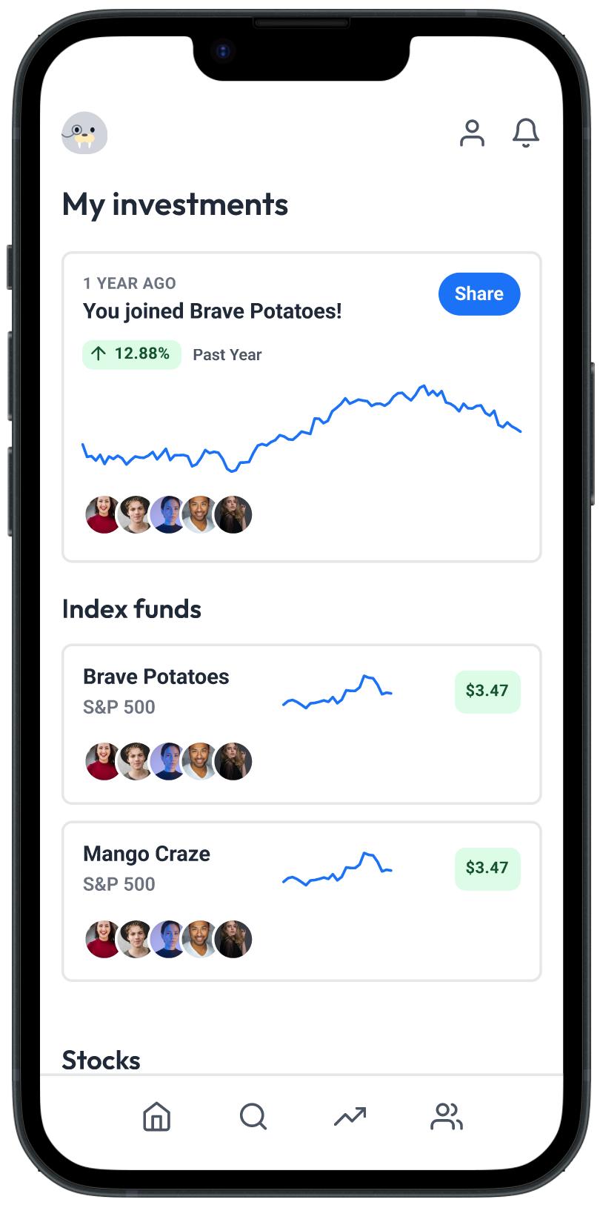
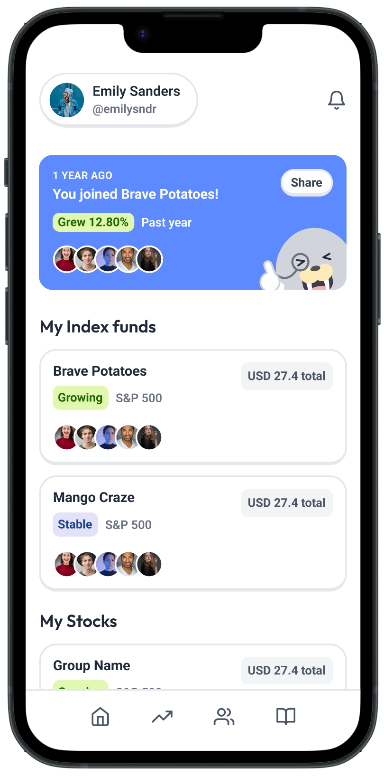
New Visual Design
1
Before
After
The previous visual design did not feel friendly enough. It simply felt like a traditional investment app…
Take away trend graph from home page
Wallus mascot
Bright colors
Images
Rounded edges

Slide 14





New Visual Design
New Wallus Illustrations!
We created more Wallus illustrations to act as an agent for presenting information to prevent information overload

Slide 15
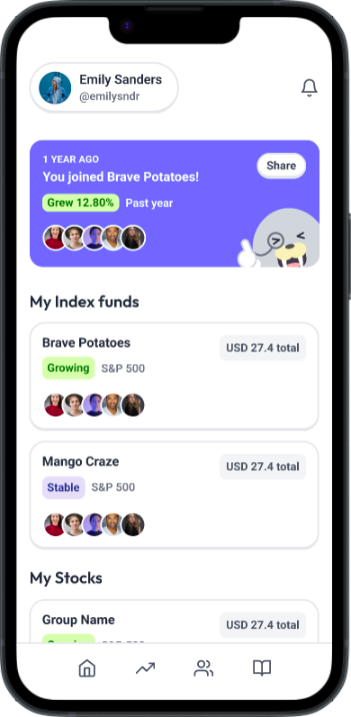
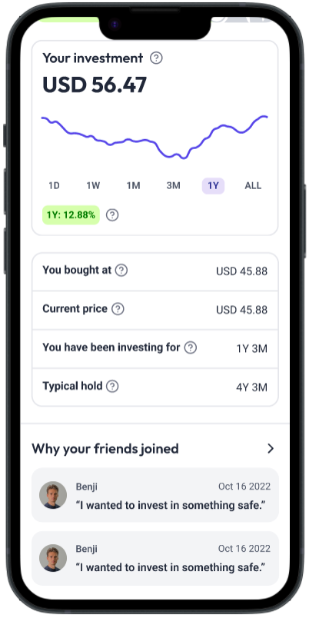
Community
2
Before
After
Make community a more prominent part of the app…
Highlight the community card on the Home page
Each stock detail has the reasoning your friends joined the group
Explicit member details page from group details
Community page labeled and reactable components

Slide 16
Change Home Page details
3
Before
After
Showing the current price of a stock and ↑ or ↓ can cause rash decisions by the user when long-term safe investing is what a newbie should follow…
Show total amount of money invested instead of gains and losses
Describe stock in user friendly words like “Growing” that account for long-term trend

Slide 17
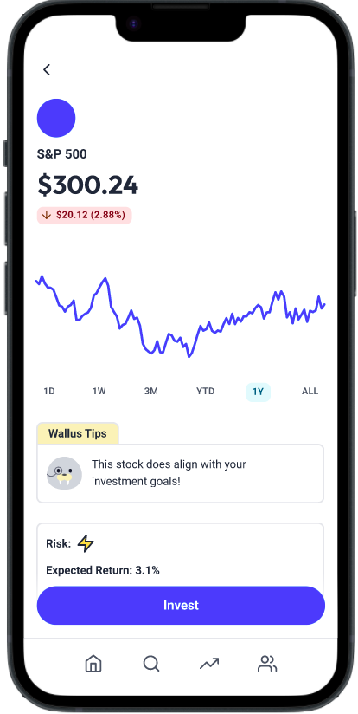
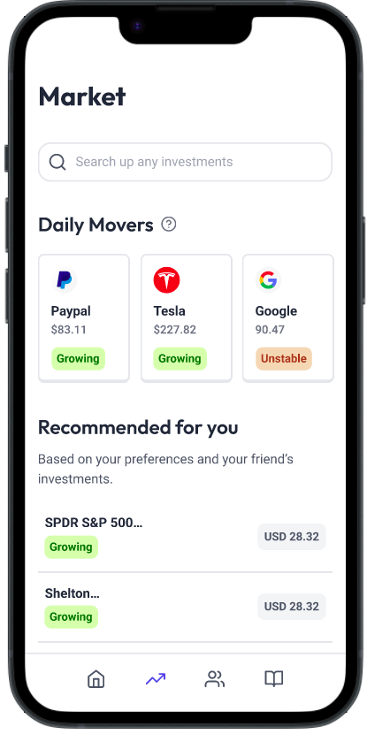
Change red color for price drops
4
Before
After
Drops in stock value are shown in red. This might signify an error and wrongly influence a user to sell stock when it is just a status indicator …
Change the red to a deeper orange

Slide 18
Investment Group

Slide 19
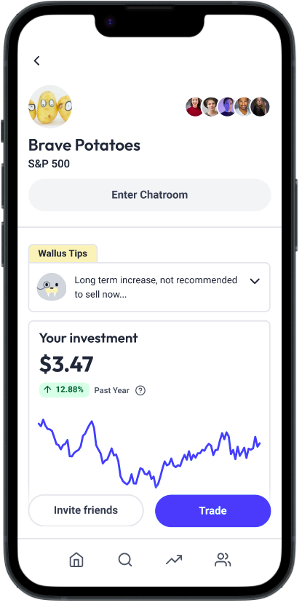
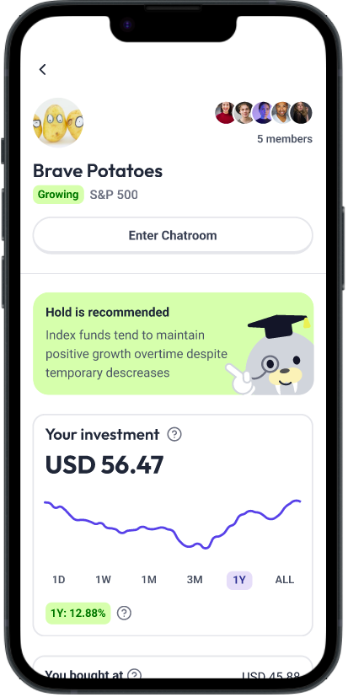
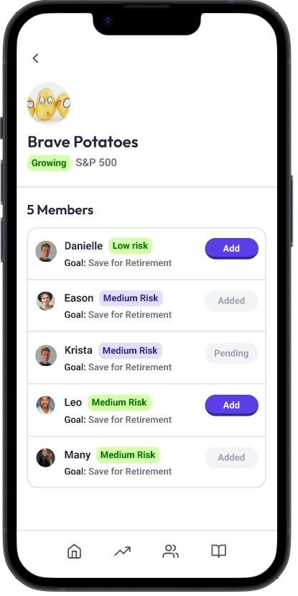
Group members more prominent
1
Before
After
It is not obvious who the people in the investment group are …
Mention the number of members in the group
Clicking on the icons shows each member of the group and their investing habits

Slide 20
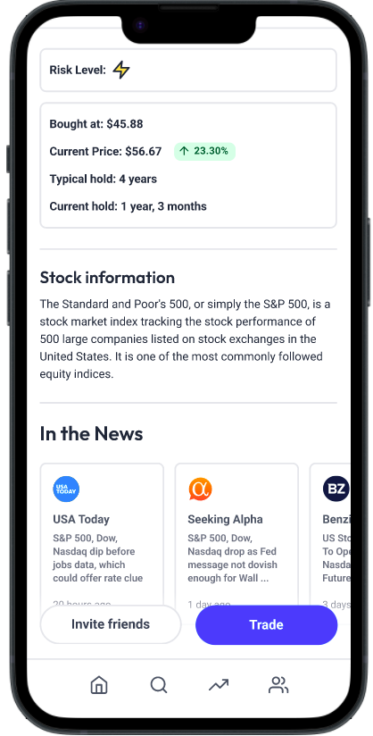
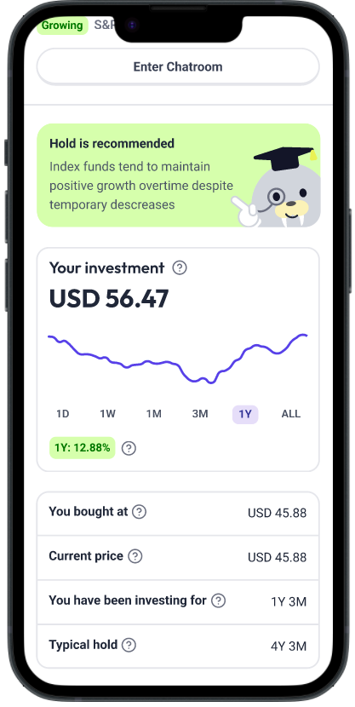
Group details page is concise
2
Before
After
There is too much information that is not clear or useful to a new investor…
Remove risk level as a new user has no calibration 1-3
Remove the news links

Slide 21
Search

Slide 22
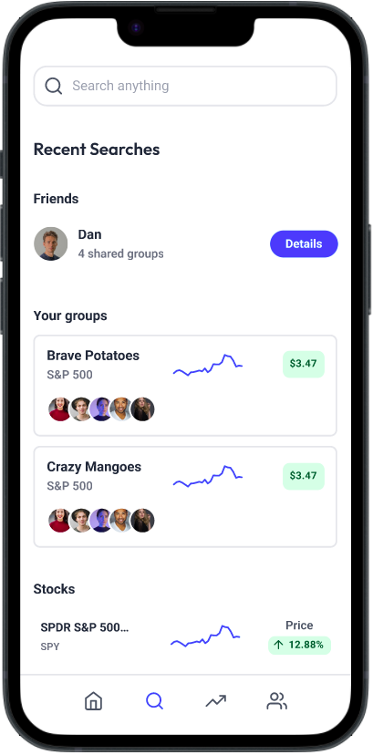
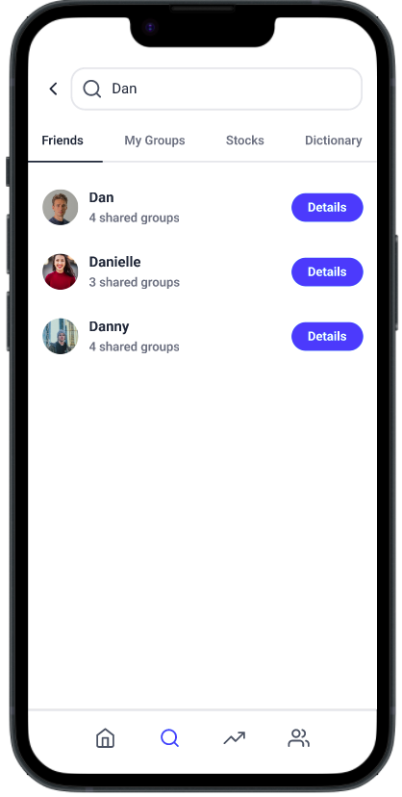
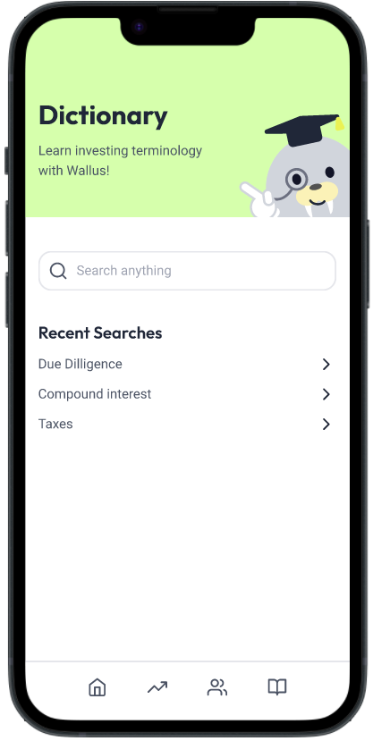
Bring dictionary to higher hierarchy
1
Before
After
The dictionary is found by Search → Type → Dictionary while the use is much more for newbies …
Delete “Friends” and “My Groups” section. Move “Stocks” to Market Tab and make the entire tab a Dictionary tab.

Slide 23
Market

Slide 24
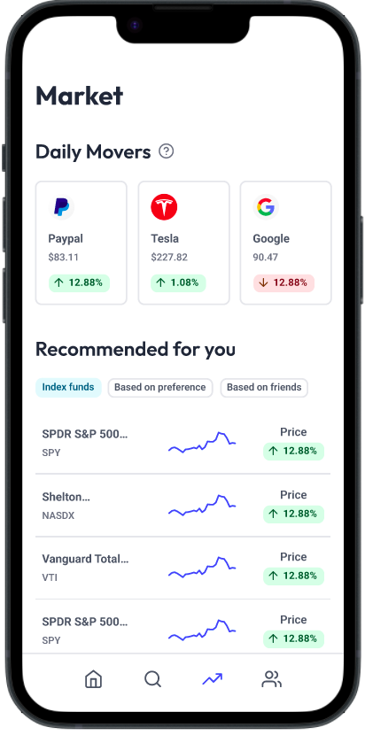
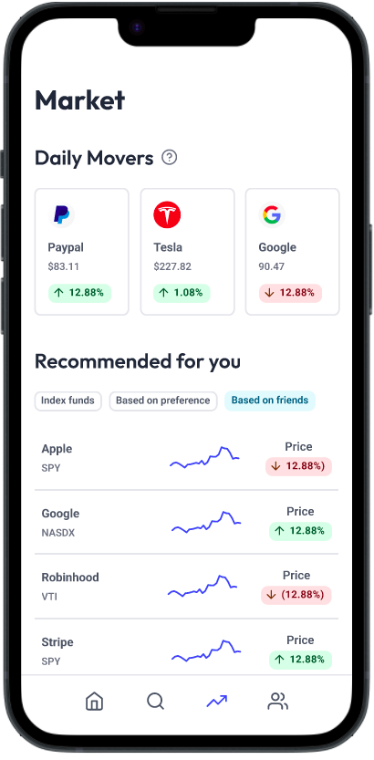
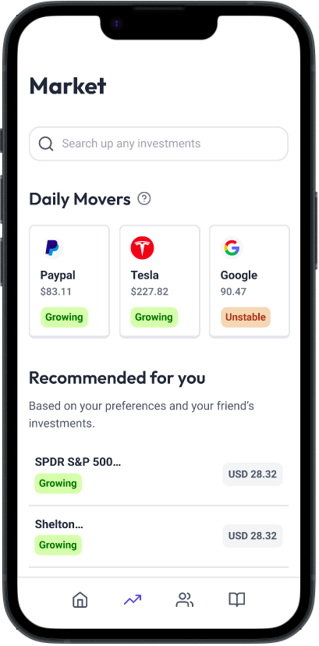
Simplifying “Recommended for you”
1
Before
After
Multiple sections give decision overload to new users and each tab is not clear to the users what “index funds” might mean…
Delete each of the tabs and instead have a list of investments prioritizing index funds w/o telling the users explicitly

Slide 25
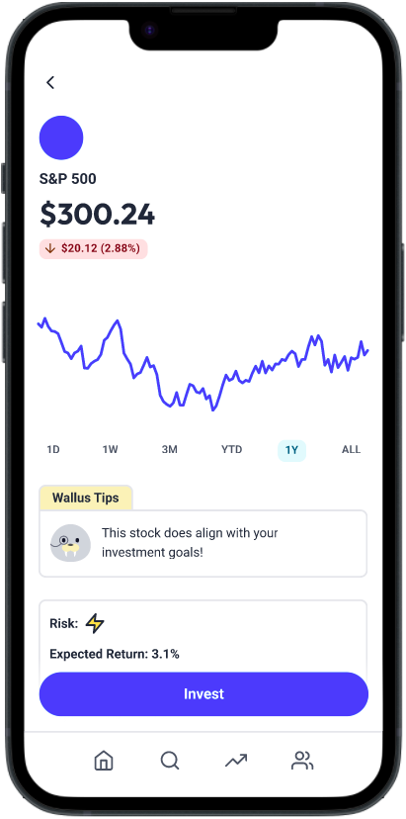
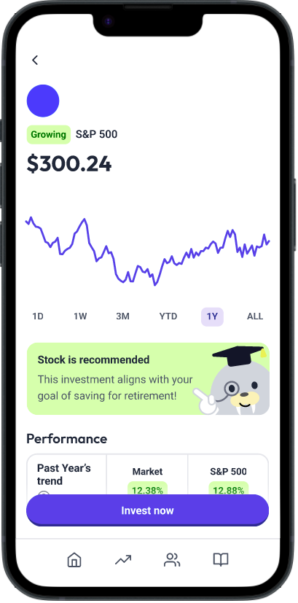
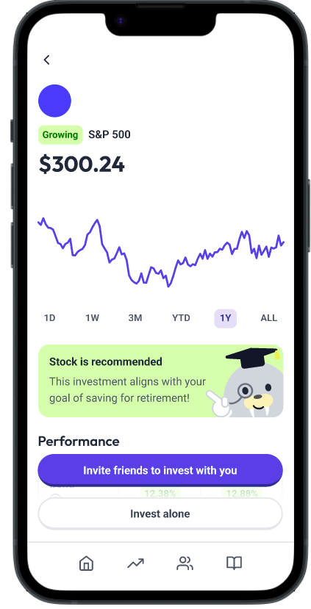
Clarify wording to invest in new stock
2
Before
After
The “Invest” button after clicking a new stock is unclear if it is a monetary commitment or details…
Clicking on a stock from Market page shows a clear “Invest Now” action button
Pop up clarifies option of independent or with friends

Slide 26
Send Invite

Slide 27
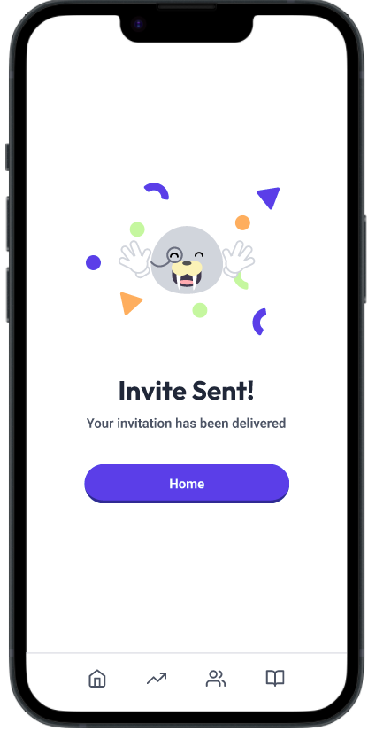
Include confirmation screen
1
Before
After
No status confirmation for the user that an invite has been sent…
Clicking on a stock from Market page shows a clear “Invest Now” action button
Pop up clarifies option of independent or with friends

Slide 28
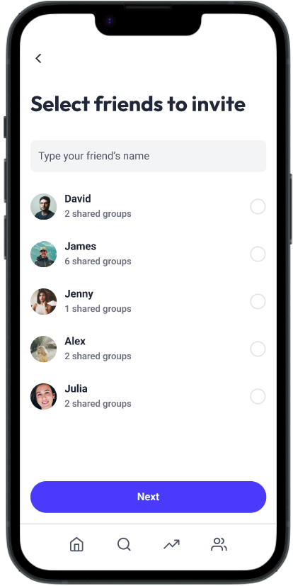
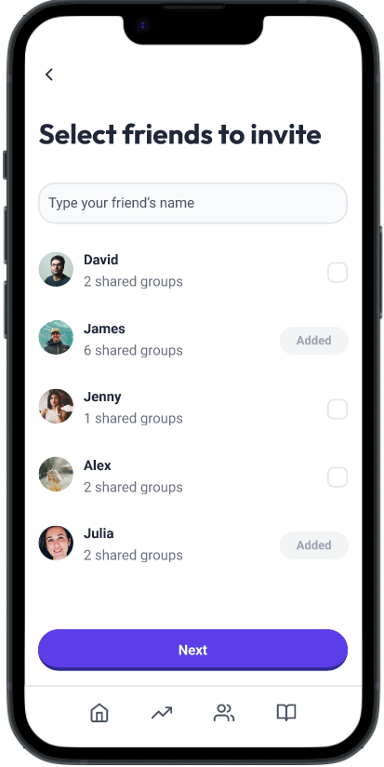
Clarity on existing group members
2
Before
After
Users might run into errors when adding a friend that is already in the app…
The friend selection page marks people who are already in the investment group

Slide 29
Profile

Slide 30
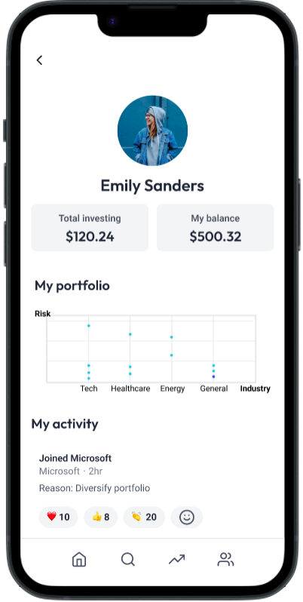
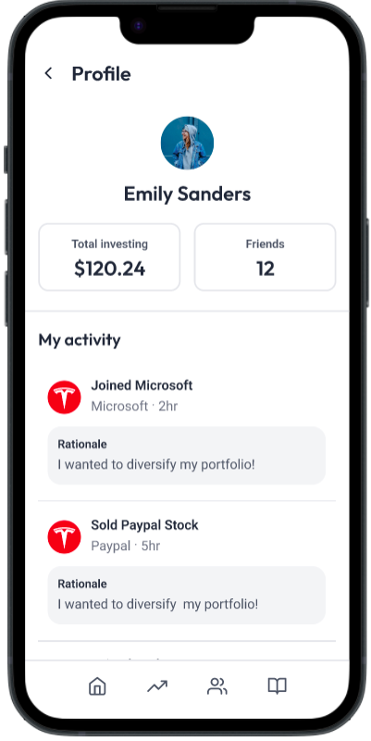
Simplifying display information
1
Before
After
Balance is ambiguous compared to “Total Investing,” chart is ambiguous interpretation, and new investors are not pressed on industry diversification …
Rethinking the necessary information on the profile page and simplifying!

Slide 31
Notifications

Slide 32
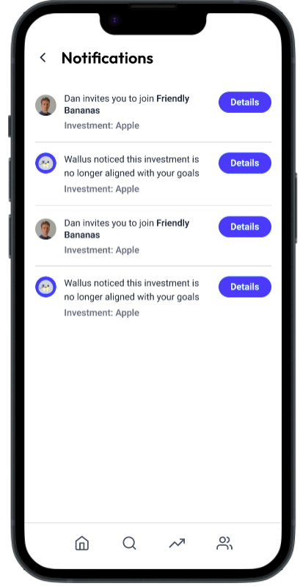
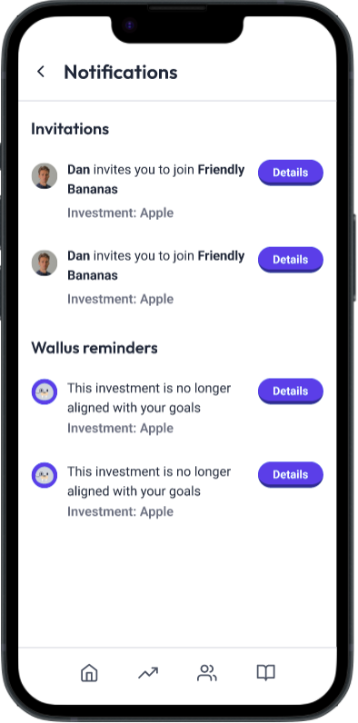
Organizing notification types
1
Before
After
All the notifications are confusing and nondescript to a user …
Organize the notifications into labeled categories

Slide 33
Investment Invite

Slide 34
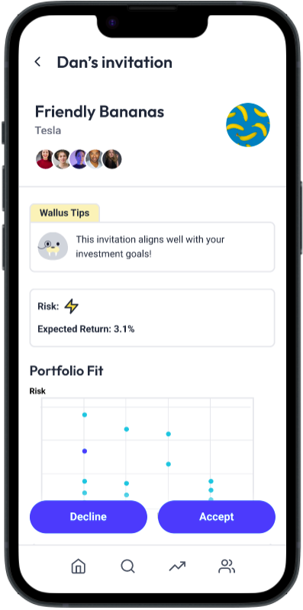
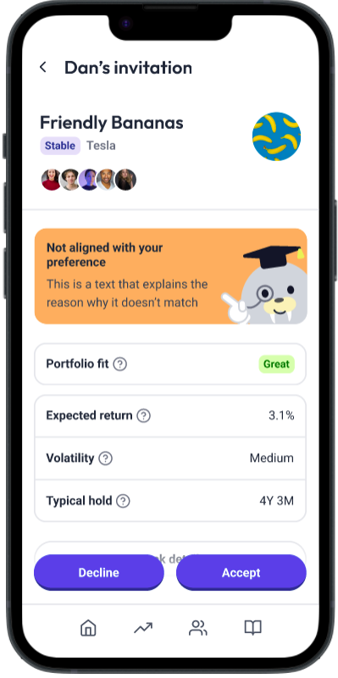
Sharing Wallus decision knowledge
1
Before
After
Currently Wallus only tells the user a decision without explaining why/why not the investment is a match…
Wallus tips is upgraded to also include title line and description to educate the user

Slide 35
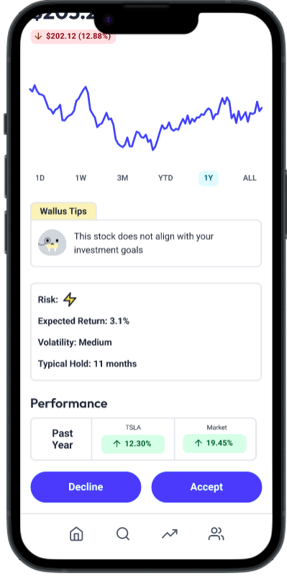
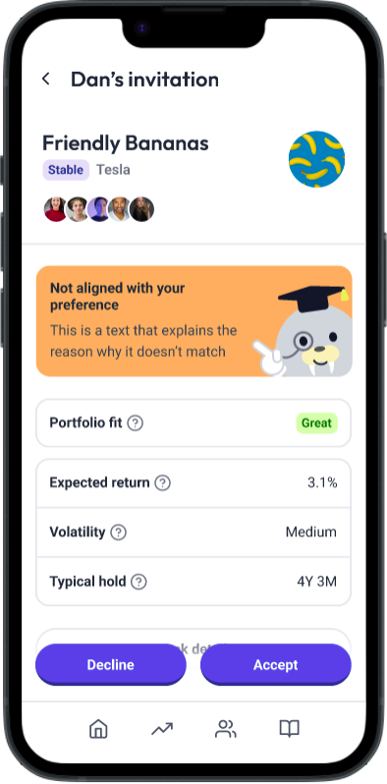
Defining jargon
2
Before
After
Lots of details in the investment details page are not defined for new investors …
“?” needed for all investing terminology on the invite page

Slide 36
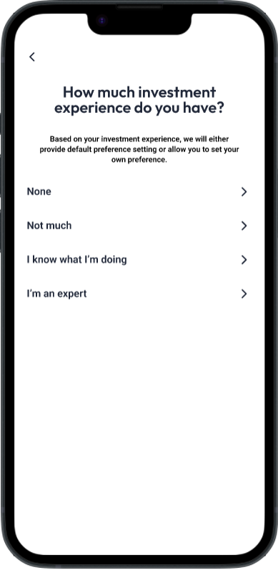
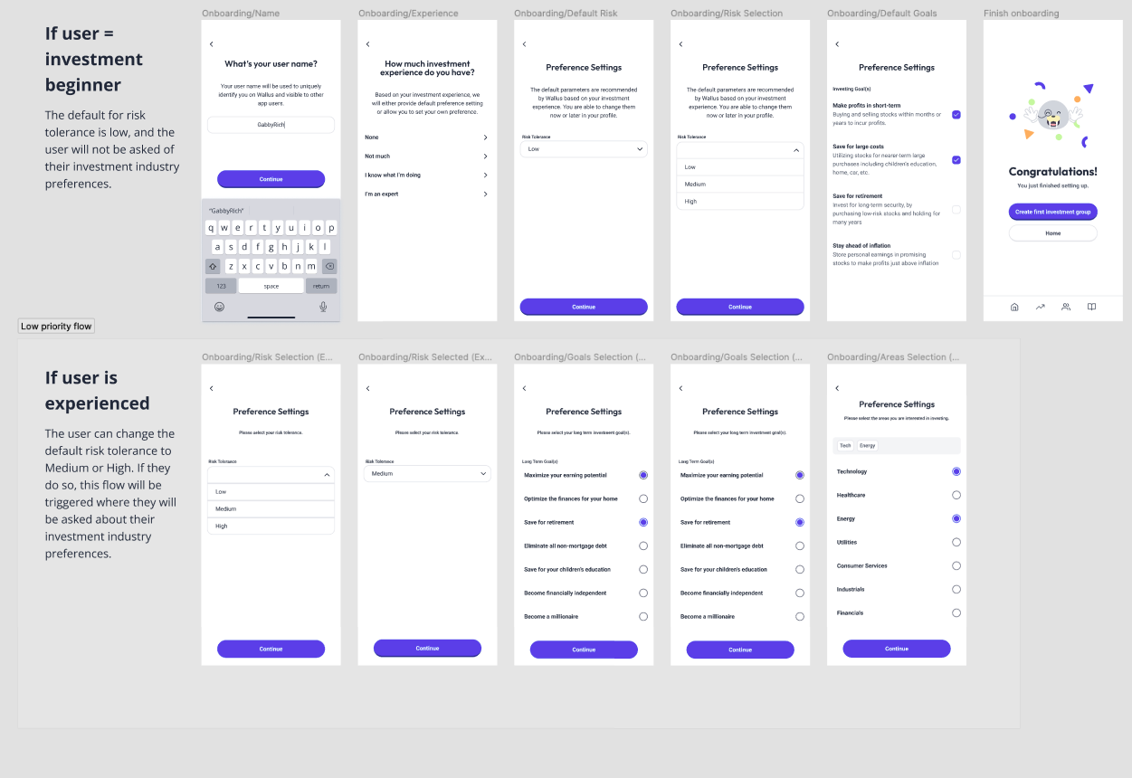
Communicating default settings for newbies
3
Before
After
For a new user automatically marks as low risk without inputting goals. When the user is met with “X meets goals” they are confused what goals since they never chose…
Building an onboarding flow for new users that guides them to pick low risk

Slide 37
Buy/Sell

Slide 38
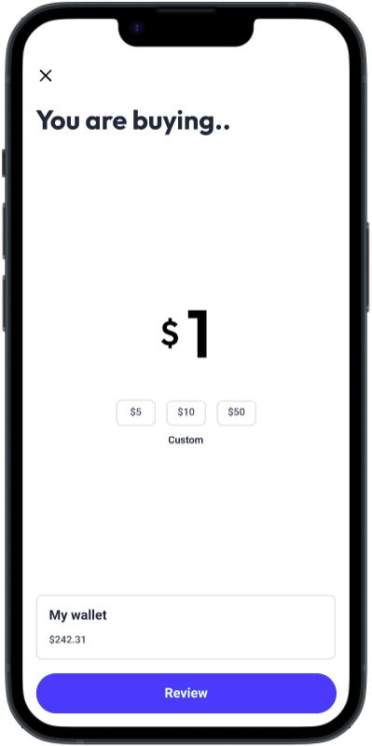
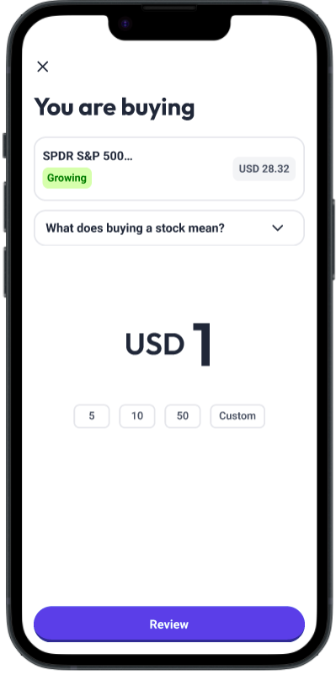
Consistent buttons
1
Before
After
Custom amount seemed unclickable when all the other values are buttons …
Change “Custom” to be a button

Slide 39
Mark the associated stock details
2
Before
After
Currently the page does not mark which stock the transaction is associated with …
Put the name of the stock, stock price, and how much is already invested into the page

Slide 40
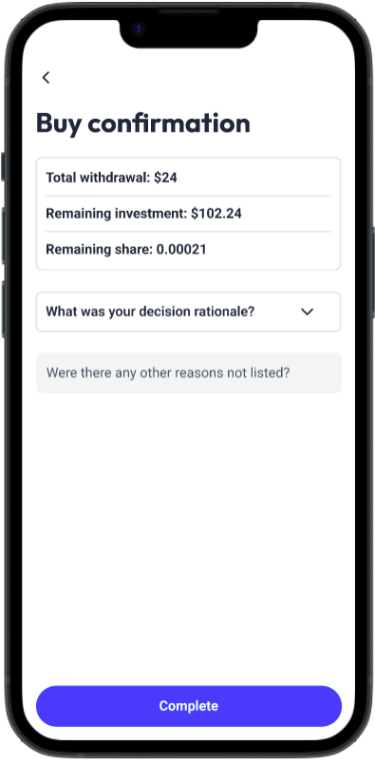
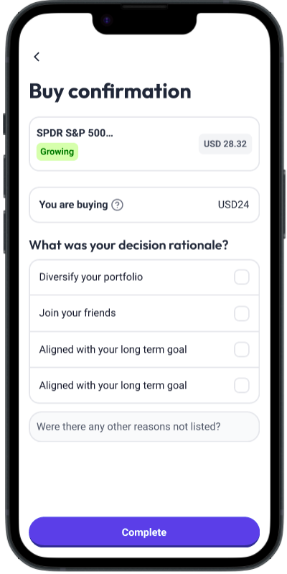
Simplify Buy confirmation page
3
Before
After
On the Buy confirmation page, the “Total withdraw,” “Remaining investment,” etc are very confusing to new users and probably not relevant to their decision …
Remove unnecessary information and just keep how much buying

Slide 41
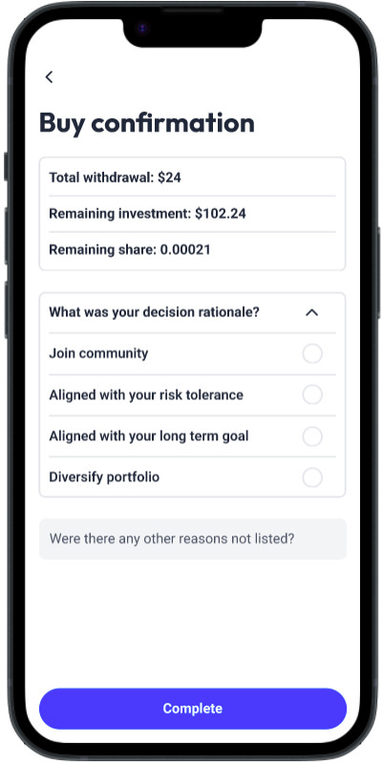
Reducing hierarchy
4
Before
After
Too many clicks for a user to input their rationale will take time to understand and communicates that the feature is not important (though central to the community culture) …
Bring the question out of the dropdown and replace radio buttons with checkboxes

Slide 42
5
Hi-Fi Prototype
Implementation

Slide 43
Frameworks/Tools Used
React Native
Visual Studio Code
GitHub Desktop
Expo
Figma (to create and download icon assets)

Slide 44
Implemented Features
Typography and Colors
Base Components
Navigation bar
Divider
Trend status tags
Profile pictures
Text messages
Buttons
Common reused cards
Investment detail (trend graph)
Investment group (Home Page)
Wallus tips
Community card (Home Page)
Notification
Market investment display
Friend rationale card

Slide 45
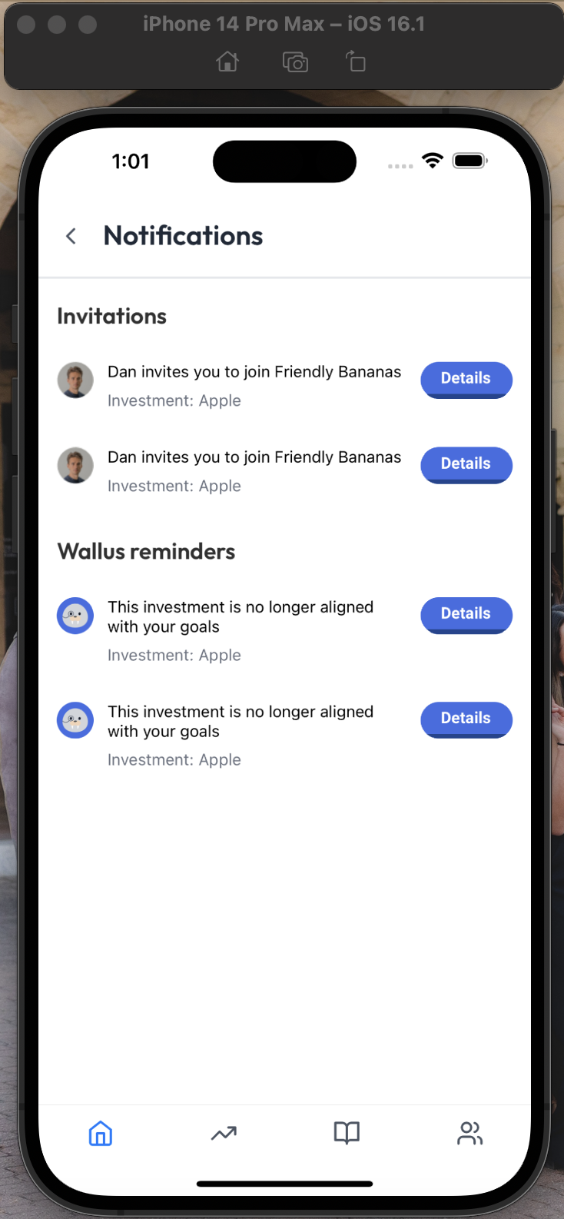
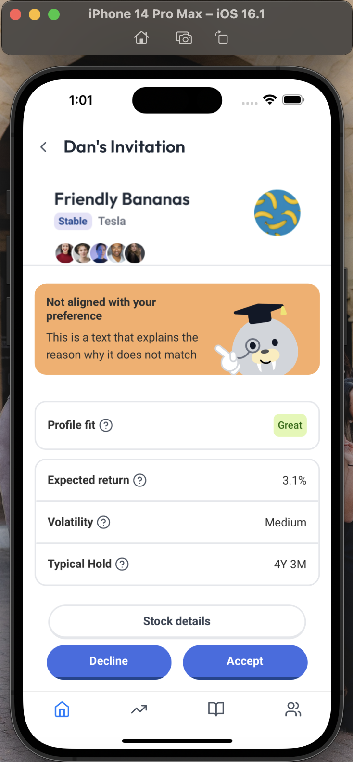
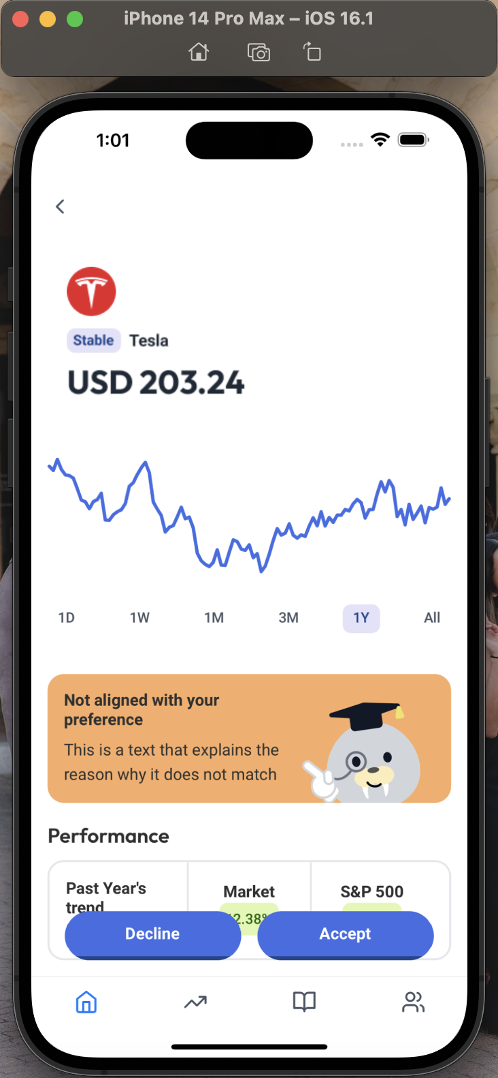
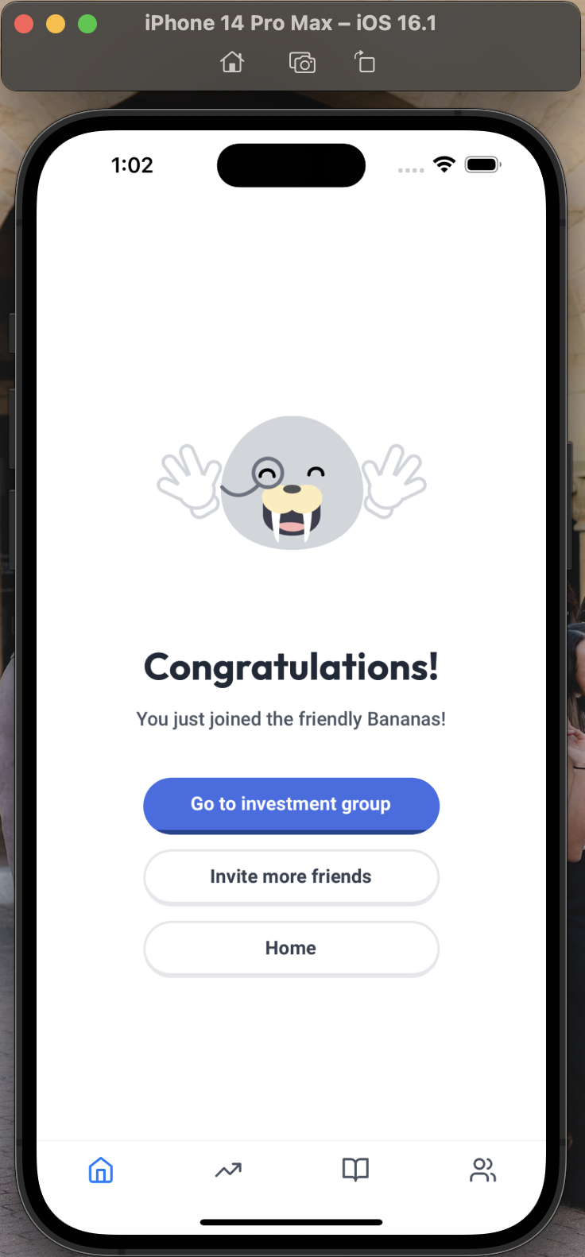
Implemented Features
Navigation
Home, Dictionary, Market, and Community (main tab pages) and Notification pages have been started and navigation built
Task #1 Accept Invitation

Slide 46
Unimplemented Features
Task #2 and Task #3
Home, Market, Dictionary, and Community Tabs
Buy/sell stock flow
Onboarding flow
Profile page
Login / Backend to store different users (CS 47 requirement)

Slide 47
Implementation Plan (Week 10!)
Saturday: Each person takes Task #1, Task #2, Home and Market
Sunday: Each person takes Market, Dictionary, Buy/Sell flow, Onboarding; Poster/Pitch/Demo Video Draft
Monday: Connect screens and navigation flow; Profile Page
Tuesday: Backend; Poster/Pitch/Demo Video Final
Friday: Demo Day; Final Report

Slide 48
Design Simplifications
Hard-Coded
Wizard-of-Oz
Investment trend graph
Investment groups that the user is involved in
Investment stats on invitation detail page
User’s friends
Friend’s investing rationale
Wallus tips are based on human and not AI
Portfolio fit evaluation are based on human and not AI
Displaying user’s investment growth over the past year

Slide 49
Archive: Updated Design
System and Screens!
Click to view Figma →

Slide 50
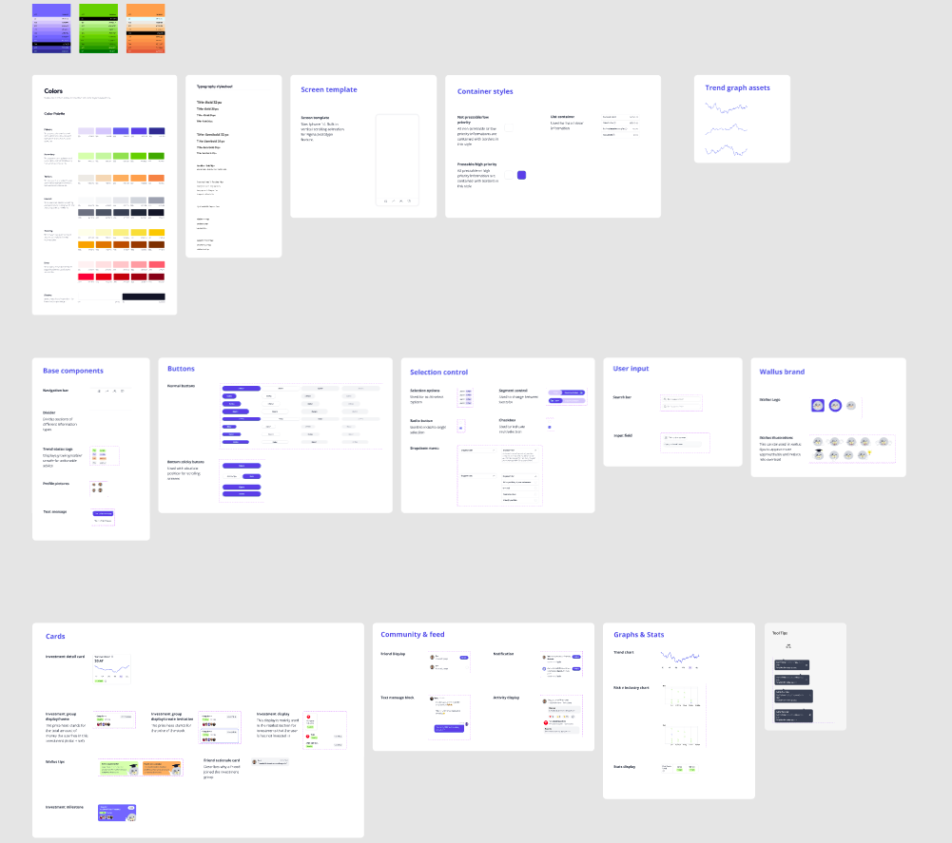
Colors
Typography
Base components
Buttons
Selection control
Brand elements
Cards
And more :))

Slide 51
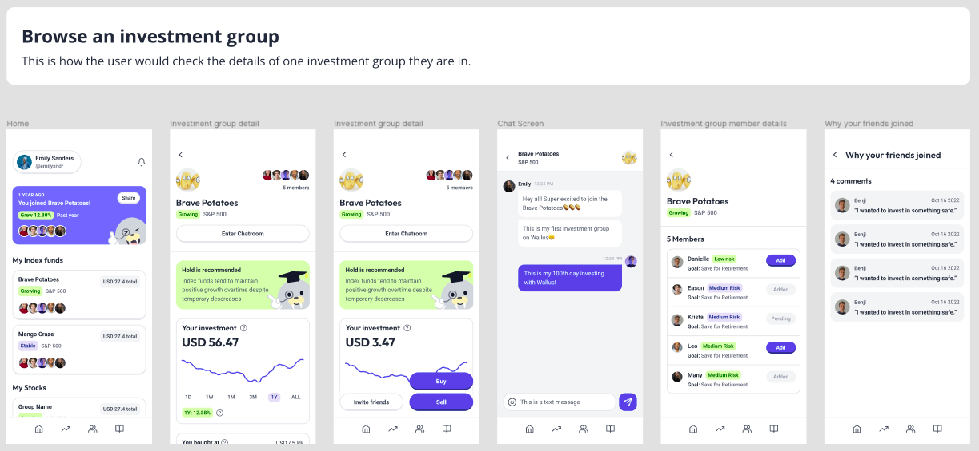

Slide 52
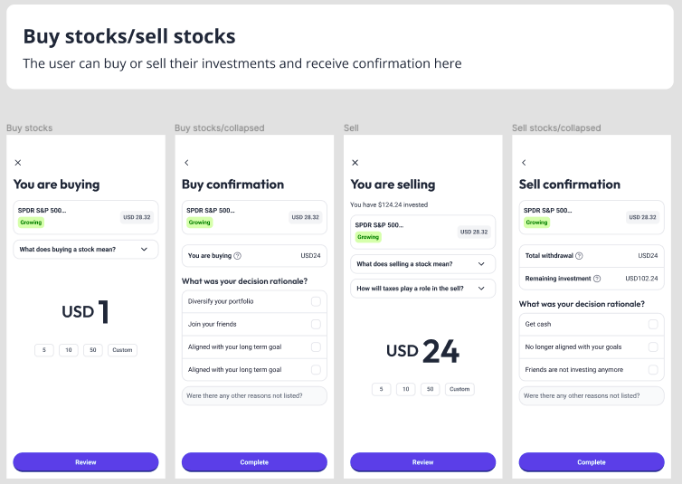

Slide 53
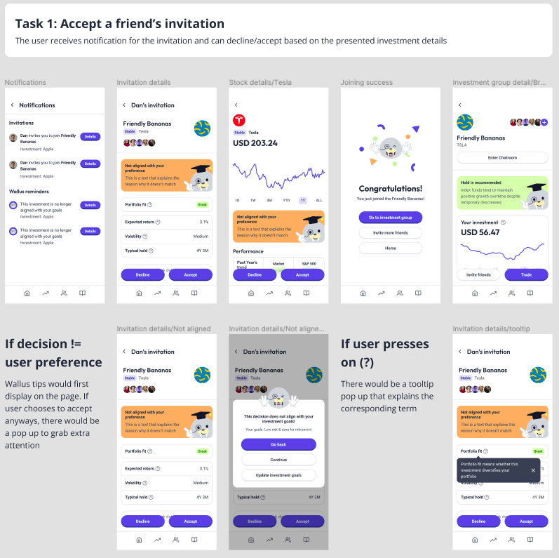
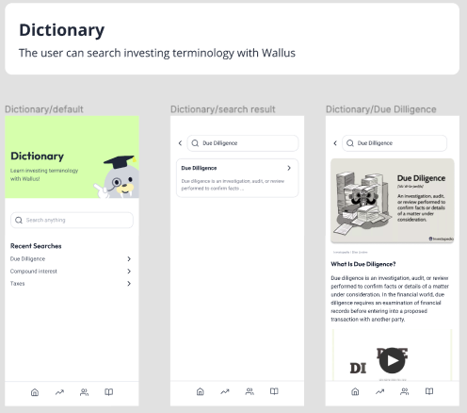

Slide 54
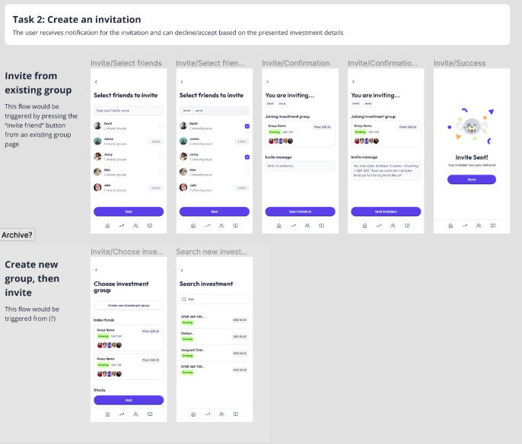


Slide 55



Slide 56


Slide 57


