Slide 1
Team Wallus: Medium-Fi Prototype
Madison Fan, Xinyi Wang, Avika Patel, Juben Rana

Slide 2




Team 3 Members
Avika Patel
CS ’24
Juben Rana
CS ’24
Madison Fan
Design ’25
Xinyi Wang
CS ’24

Slide 3
1
Problem
Solution
Despite the importance and benefits of financial investment, people shy away from investing due to the lack of confidence, experience, and relevant knowledge.
Encourage investment rookies to grow investment knowledge with friends

Slide 4
Value Proposition
Educate and support investment rookies to gain investment literacy

Slide 5
2
Values in Design

Slide 6
Embedded Value #1
Inclusion
All users (especially those with little to no experience with investing) find Wallus intuitive, helpful, and inviting | Groups equally represent all members regardless of all prior investments and size of investment Onboarding procedure is personalized and includes educational content All parts of the app are hyperlinked to definitions and include “?” buttons with tutorials to understand what a concept is and how to interact with it Explanations of “what can be next” are defined at every user decision

Slide 7
Embedded Value #2
Privacy
User information and investments are kept private to only necessary individuals | User’s investment amount is private The only stocks of a user that will be visible to friends are the ones the user and a friend have together No investment will be visible to anyone the user is not a friend of

Slide 8
Embedded Value #3
Autonomy
Users have full control of their money | All features in Wallus will give users the decision to determine where their money is invested, in which groups, what amount, and how long the investment is kept While Wallus will make recommendations to the user based on preferences, the user has the ultimate decision to invest

Slide 9
Embedded Value #4
Safety
No frauds; user’s money is honestly kept where they invest in | The investments in stocks through Wallus genuinely mean an investment into that stock ticker Money invested through Wallus is not held by the app and real-time invested

Slide 10
Conflicting Values
The two biggest values that might conflict are inclusion, so that beginners can be guided through the app, but also autonomy so that folks can determine which friend investment groups they should join. By giving users educational resources, curated recommendations, and guidance on best courses of action at each point for a stock, we provide a lot of information that can influence the investing of a user. However, we want to make sure that autonomy of thought is still maintained by the user.
How we will keep the values in check?
Make sure the emphasize that all educational videos are there to build a user’s investment context and include in depth reasoning of pro/con for recommendations. This will make sure the app is able to help newbies while also always keeping interpretation open!

Slide 11
Tasks
Simple
Complex
3
Accept invitation to join an investment group.
Use in-app resources to learn about the market and invest in a new stock.
Moderate
Same as Assignment 5!
Create an invitation for a friend to join an investment group you are in.

Slide 12
Goals & Measures
4

Slide 13
Usability Goals
Goal 1: Approachable
Goal 2: Intuitive
Key Metric: Users were able to understand the interface or find out what it means
Key Metric: Process time & verbal feedback

Slide 14
Usability Goals: Action from A5
1
2
3
1
2
3
We learned:
Users with less experience had trouble understanding the market page
We learned:
Users are not sure how a new investment can complement their portfolio
We learned:
Many features were not clear in their purpose (ie ‘Pending Invitations’)
We progressed by:
Redesigning the Markets page to focus on “Featured” w/ explanation
We progressed by:
Rethinking pages and wording for each section of the app.
We progressed by:
Add details to the “Accept Invite” screen incl. risk, industry, amount compared to current portfolio

Slide 15
Usability Goals: Progress from A5
1
2
3
1
2
3
Approachable:
Commitment to adding “?” to explain the basic what and how of all features
Approachable:
Adding faces of group members at all possible locations (incl Create Invite)
Approachable:
Creating a Community tab that will help emphasize the friendliness of investing
Intuitive:
Reduced the number of pages to 4 common actions by a user
Intuitive:
Include tutorials only near features (not as a library in Markets tab)
Intuitive:
Add search page for users, concepts, groups not easily found by user in the app

Slide 16
5
Revised Interface Sketches

Slide 17
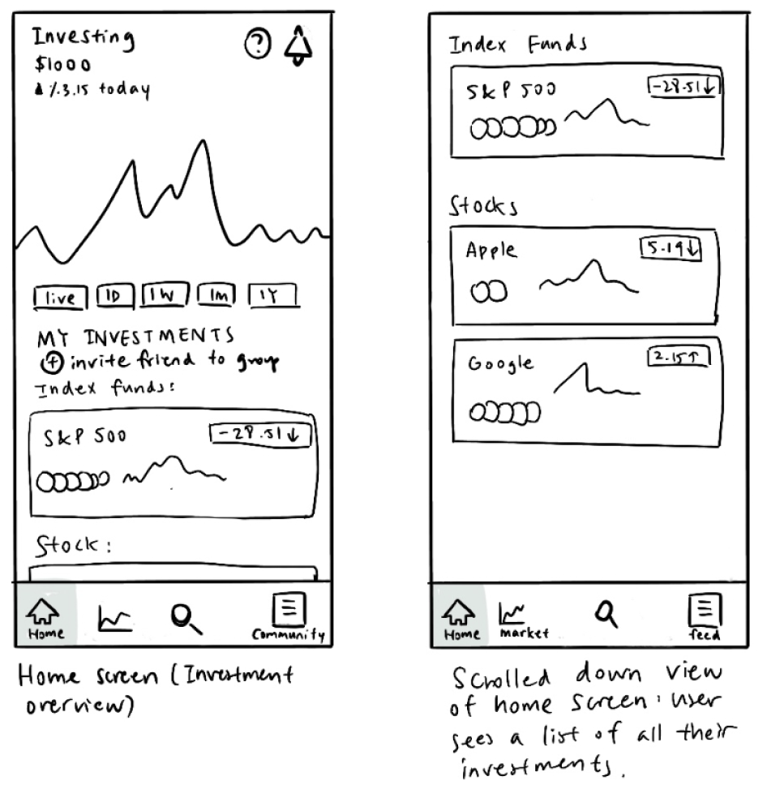
Home
Overall portfolio
All investment groups
CTA to invite a friend

Slide 18
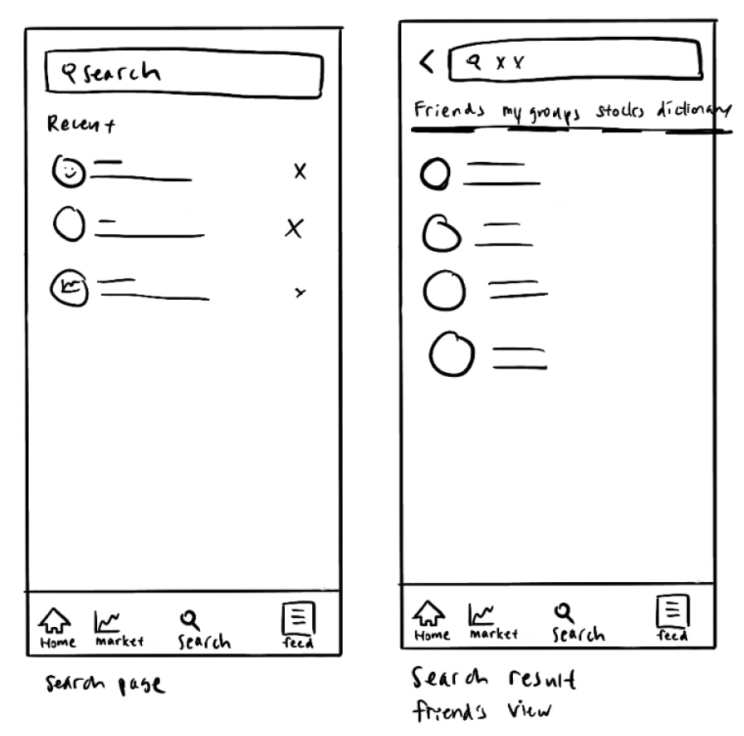
Search
Friend’s Profile
  Activity Feed
  Activity Feed with user
  Invite CTA
User’s groups
Stock research
Investment dictionary

Slide 19
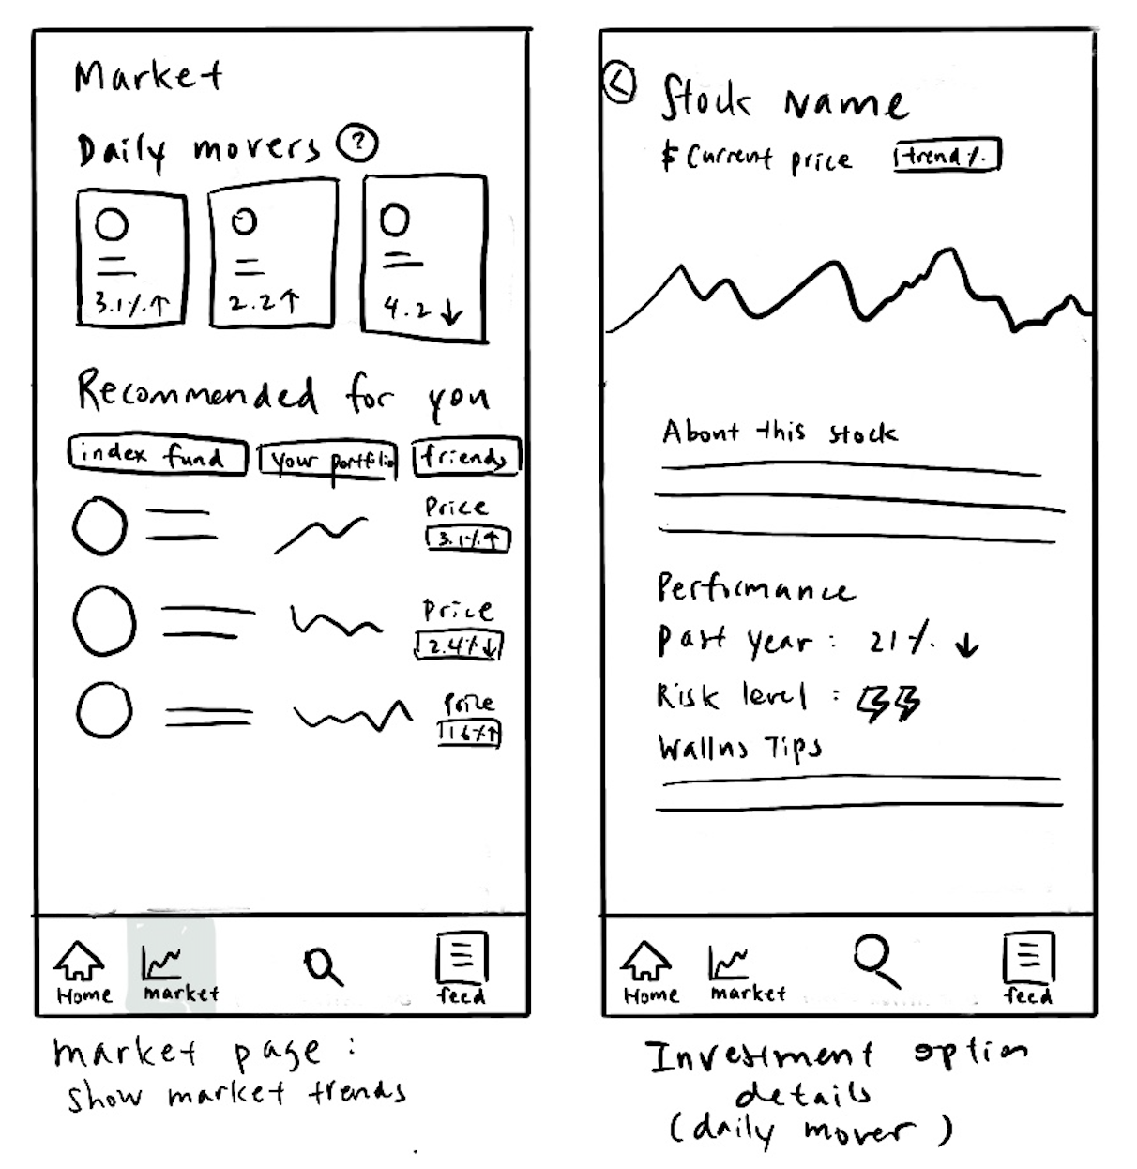
Market
Featured Investments with explanation
  Index funds
  From friends
  From personal investing preferences
Daily market info

Slide 20
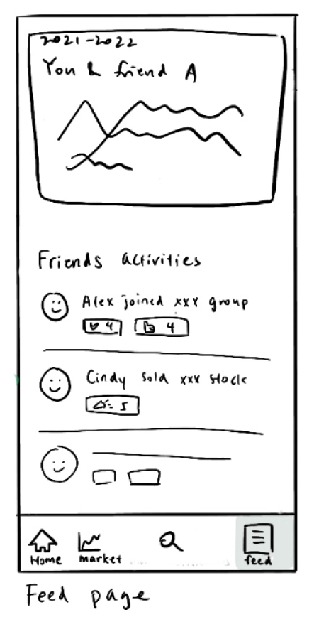
Community
Friend’s investing feed
Daily featured friend and user’s combined portfolio & “journey”

Slide 21
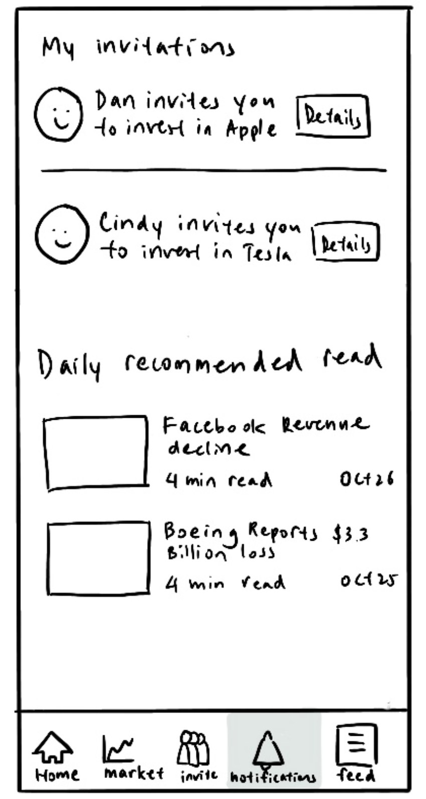
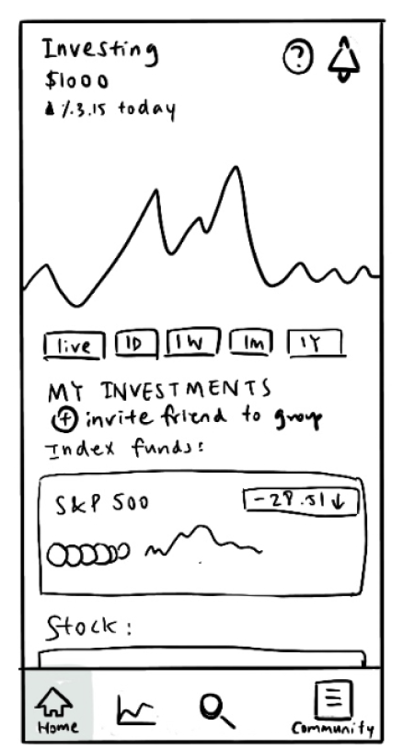
Major Change 1 (Task 1)
Remove “Notifications” tab and add as a constant button in the top right
Usability Goal:
Intuitiveness by making features displayed together also similar in purpose
Intuitiveness by minimizing # of tabs
Before
After
Why the change:
A5 usability tests = unintuitive to have daily news and invitations on the same page
Daily news can and should be a push notification. Invitations are not frequent enough to be a whole sub-tab.

Slide 22
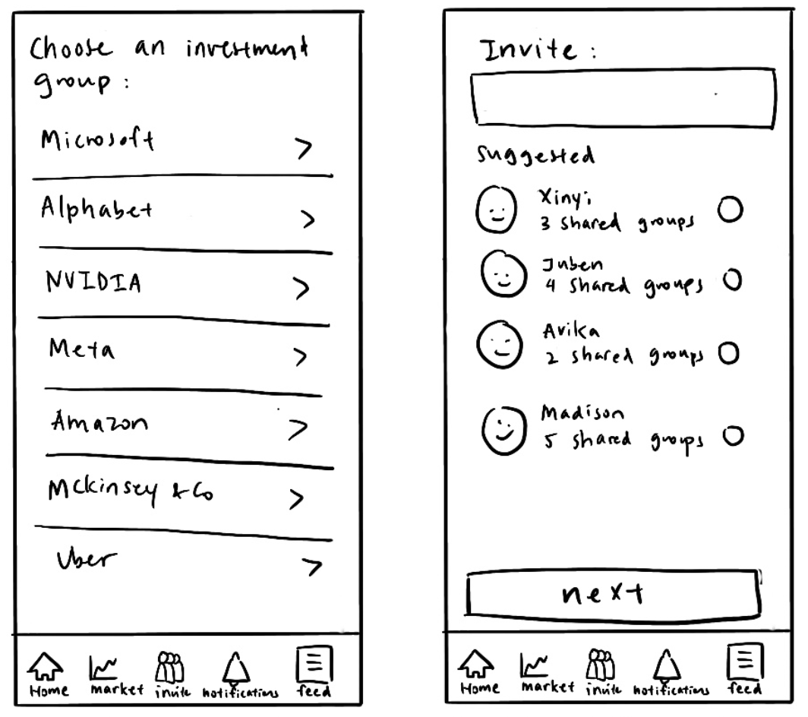
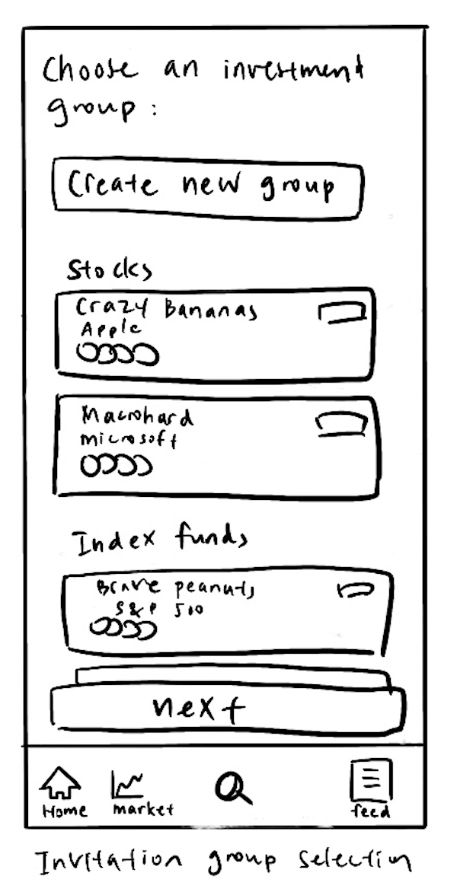
Major Change 2 (Task 2)
Option to invite friends to join new investment group
Usability Goal:
Intuitiveness by reducing the number of steps necessary for a user to invest
Before
After
Why the change:
In the former design, the user would need to find and invest in a stock in “Markets” before inviting friends in “Invite” (with a goal of making sure they learn before investing)
However, A5 usability tests pointed out that research could be done independently, and joining together is a core reason to use Wallus

Slide 23
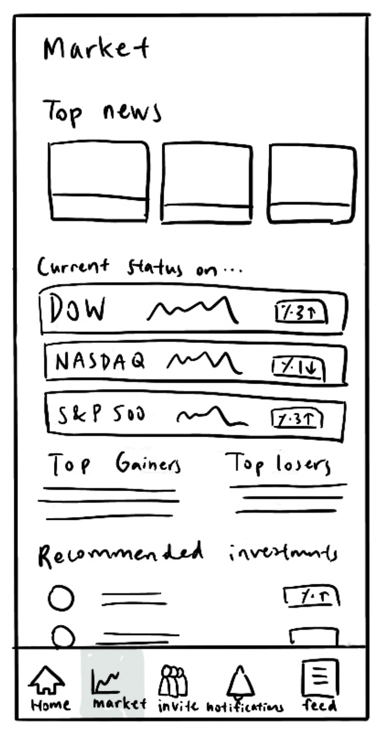
Major Change 3 (Task 3)
Redesign Market tab for new and inexperienced investors
Usability Goal:
Approachable when new investors are comfortable clicking on features with jargon
Intuitive if all sections can be navigated by individuals with no investing experience
Before
After
Why the change:
In the A5 usability test, 4 out of 5 users asked “What do I do now?” or paused at the Markets tab. People didn’t know how to approach.
Lots of features on the old design resemble that of existing investment apps (apps that our needfinding told us where unintuitive) so we should reimagine designing for new users

Slide 24
6
Medium-Fi
Prototypes

Slide 25
Design System

Slide 26
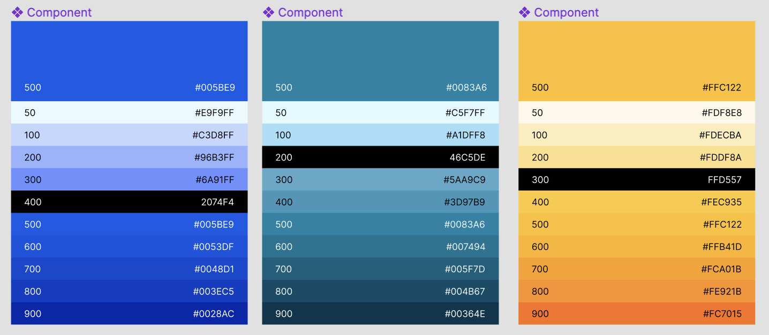
Color Palette
Notes:
In our discussions, we were considering the following choices:
Various shades of blue (security, bank-like)
Orange or yellow (fun, excitement, happy)
Green (money)
Pink (piggy bank)
Ultimately we decided that our primary color would be blue or green. First, we decided against green because it gives the feel of cash, which investing in stocks is considered very “non-cash.” We did not want to associate with cash because stocks are (1) intangible and (2) should not be traded like cash since that can lead to high taxes equivalent to the profits that investors might not realize till too late. The second big reason was color contrast. When using a plug-in that evaluated accessibility and readability of our text on different colors, we could only pass the test if the green was very deep. We were looking for a lighter/brighter color to convey community and fun, which dark green would greatly oppose, and thus chose blue!

Slide 27
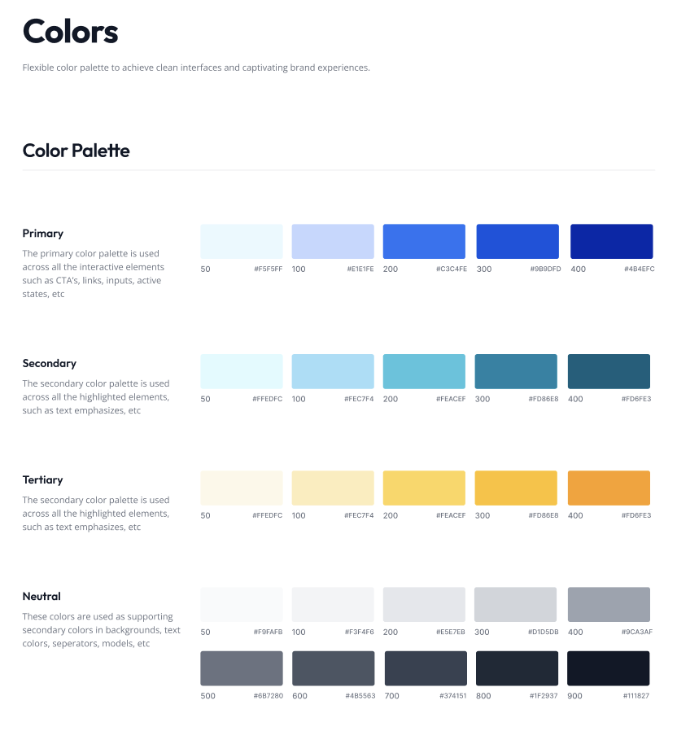
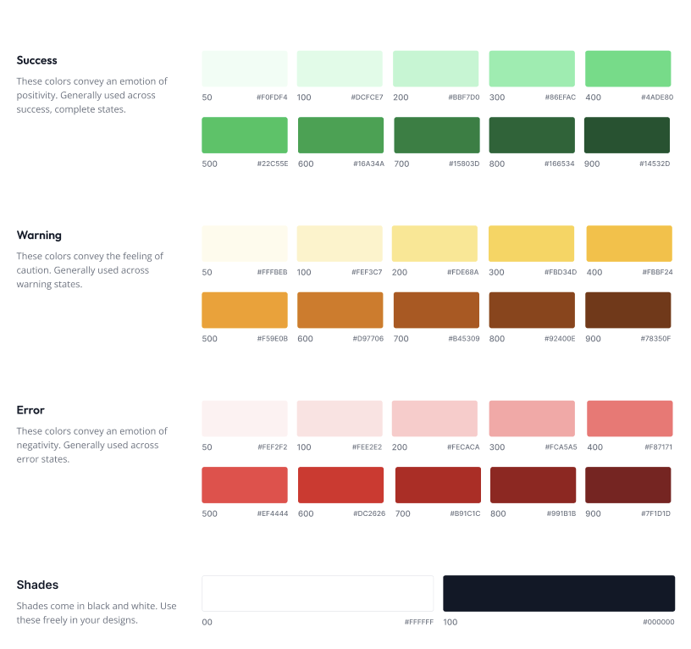
Color Palette

Slide 28
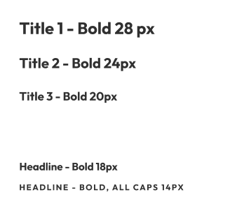
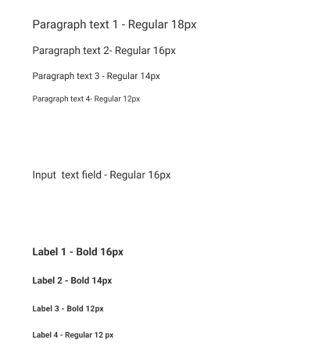
Typography Stylesheet

Slide 29
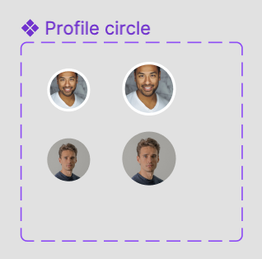
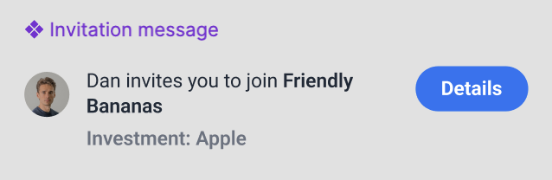
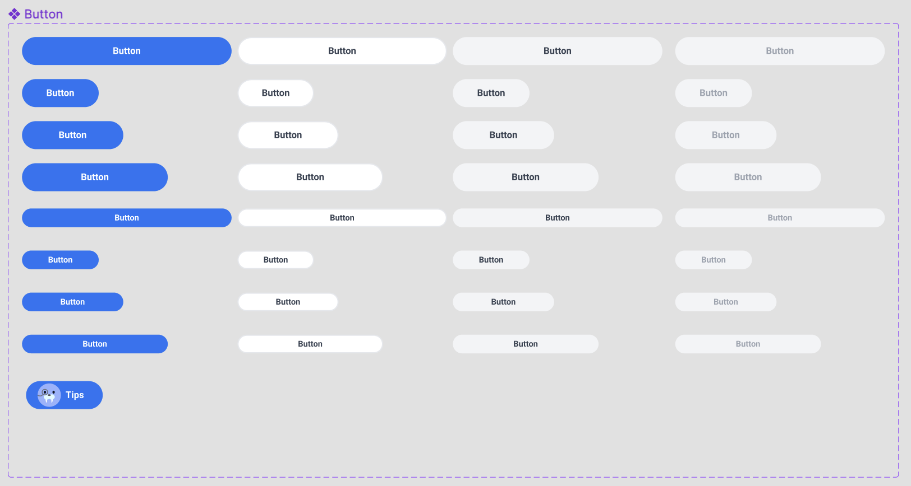
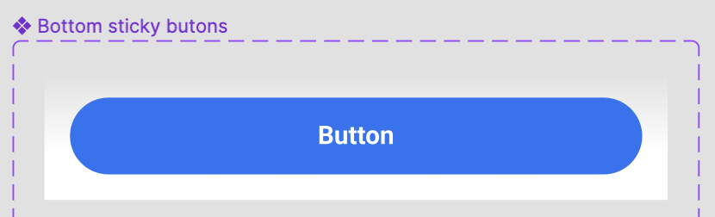
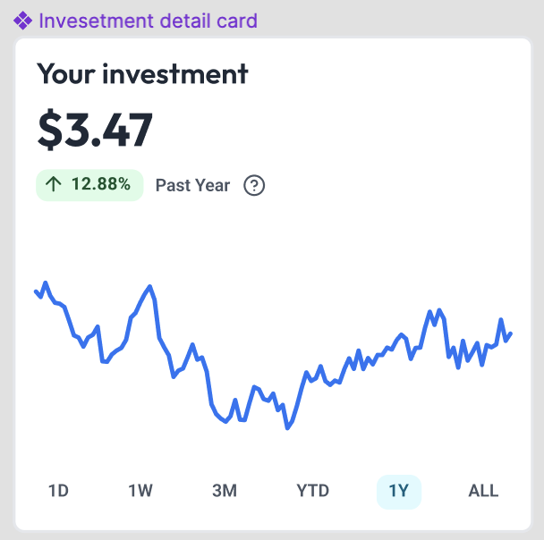
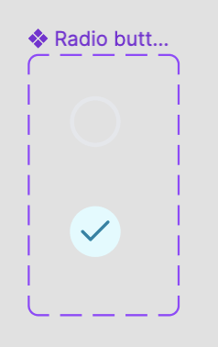
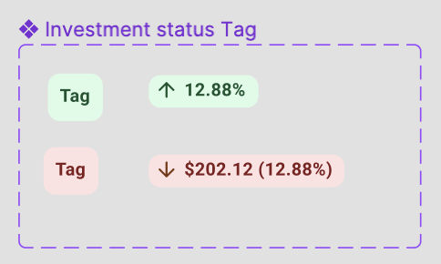
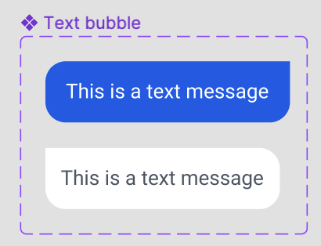
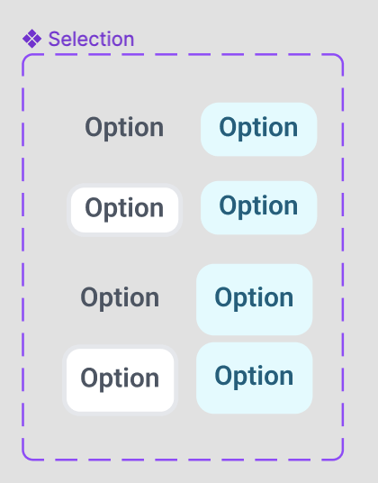
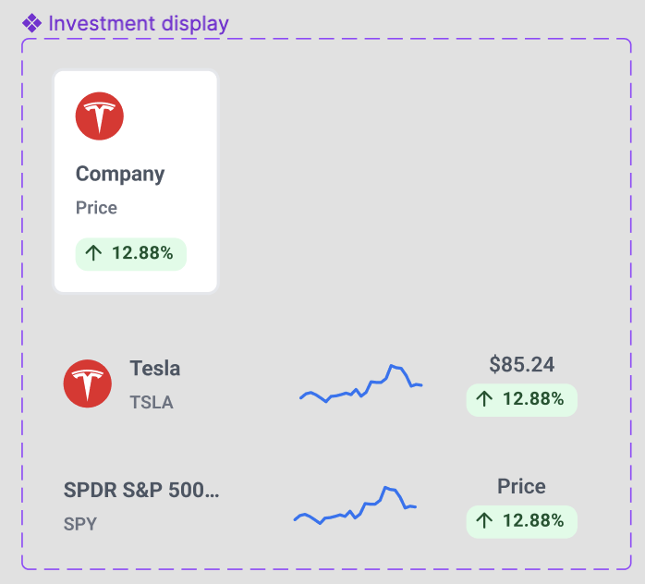
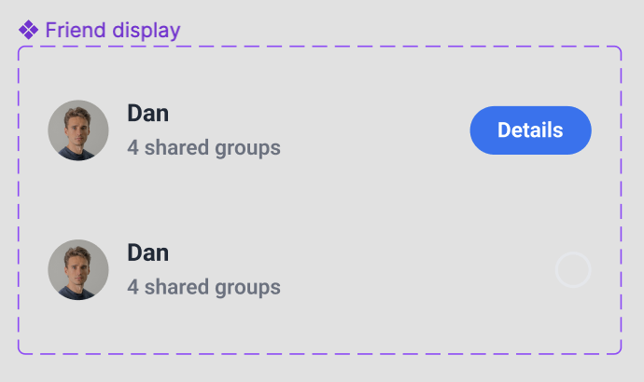
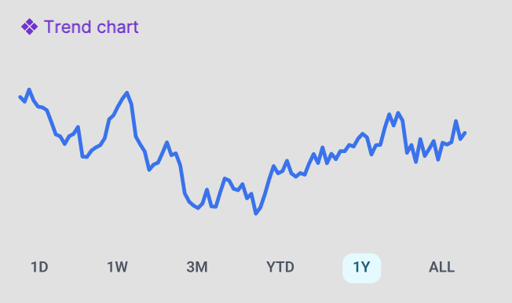
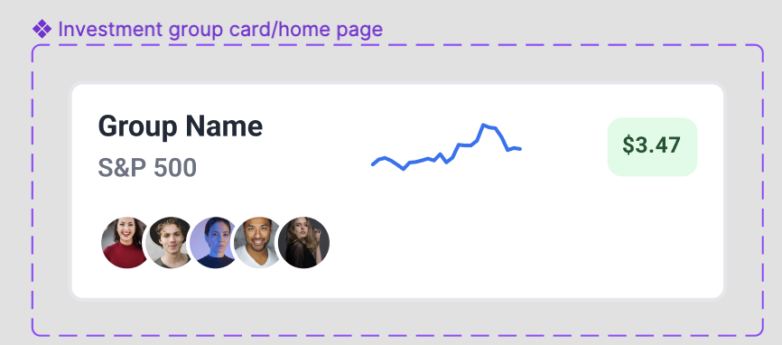
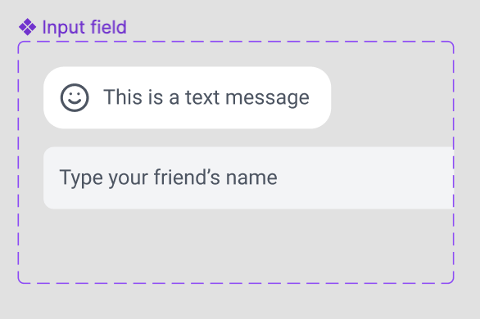
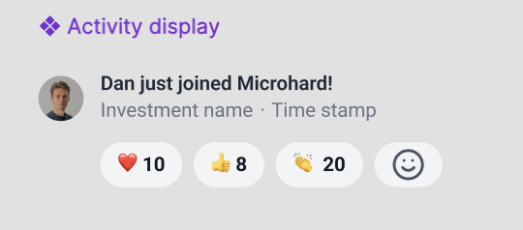
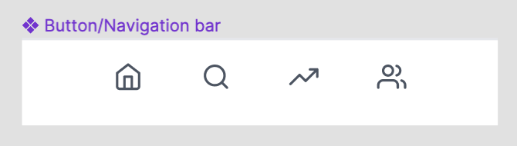
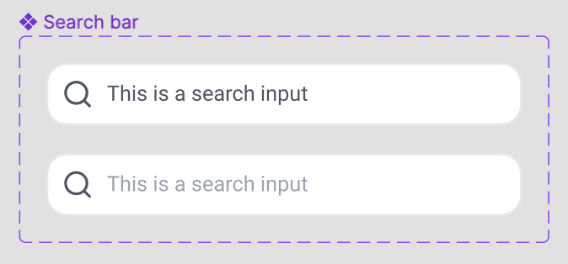
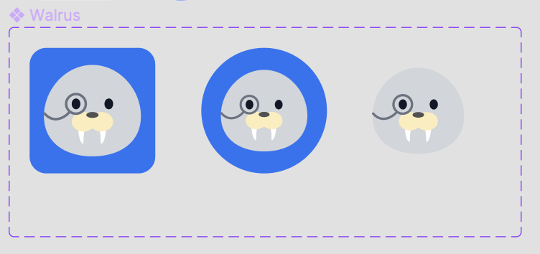
Reusable Components

Slide 30
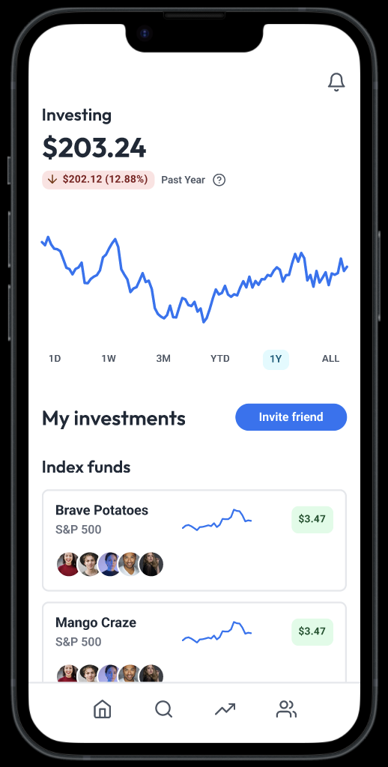
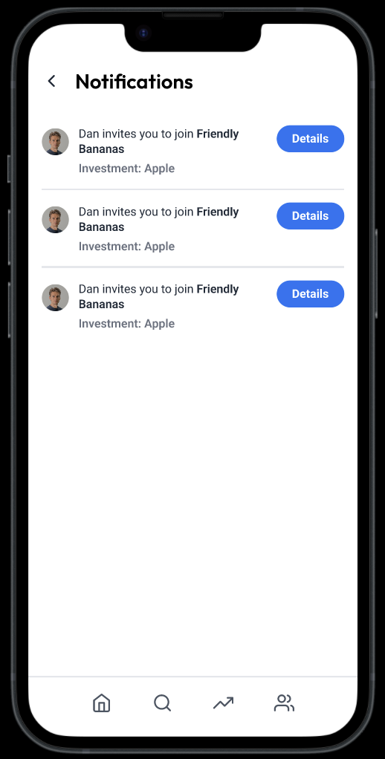
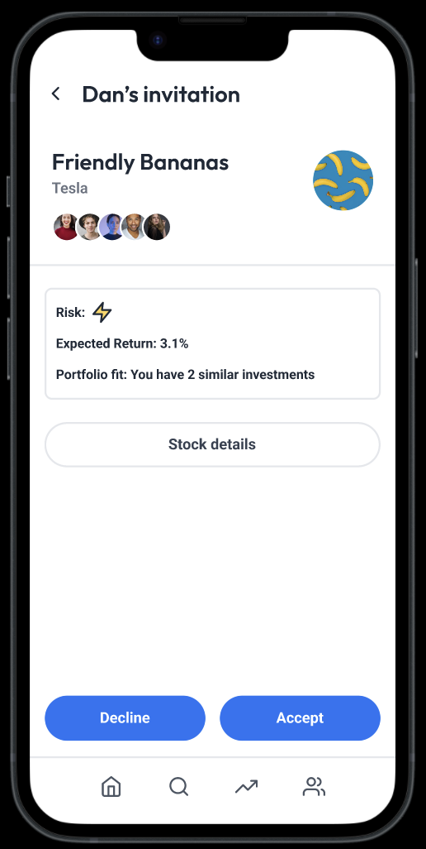
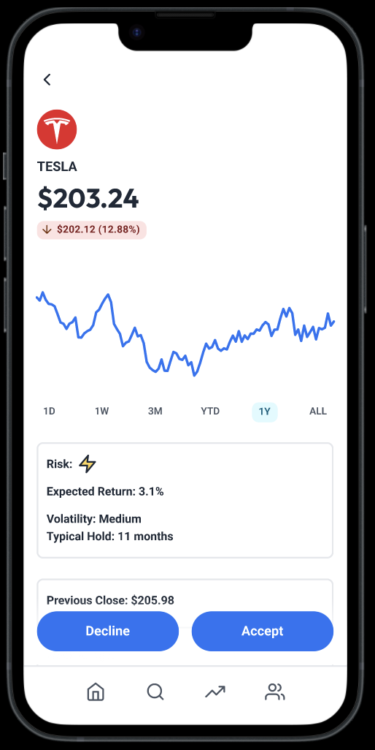
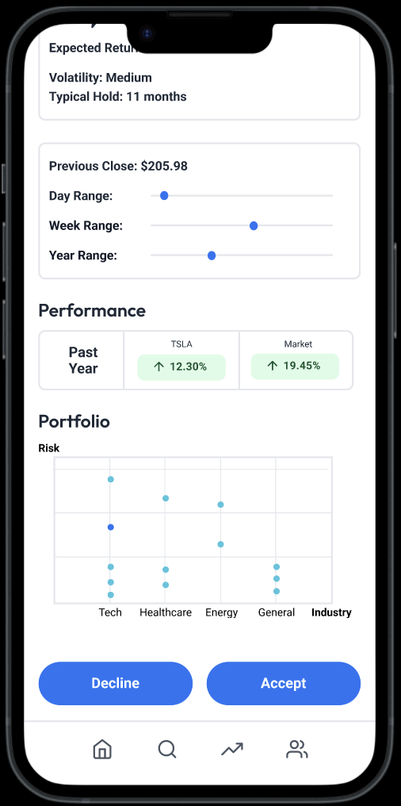
Simple Task: Accept invitation

Slide 31
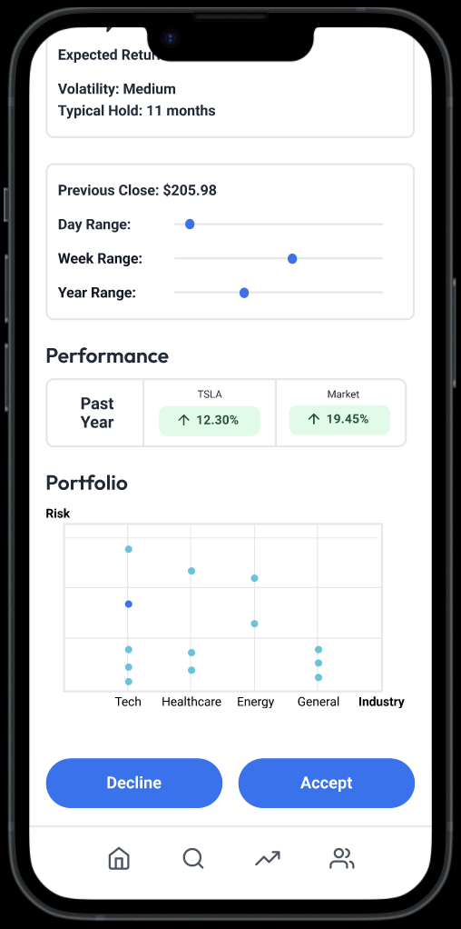
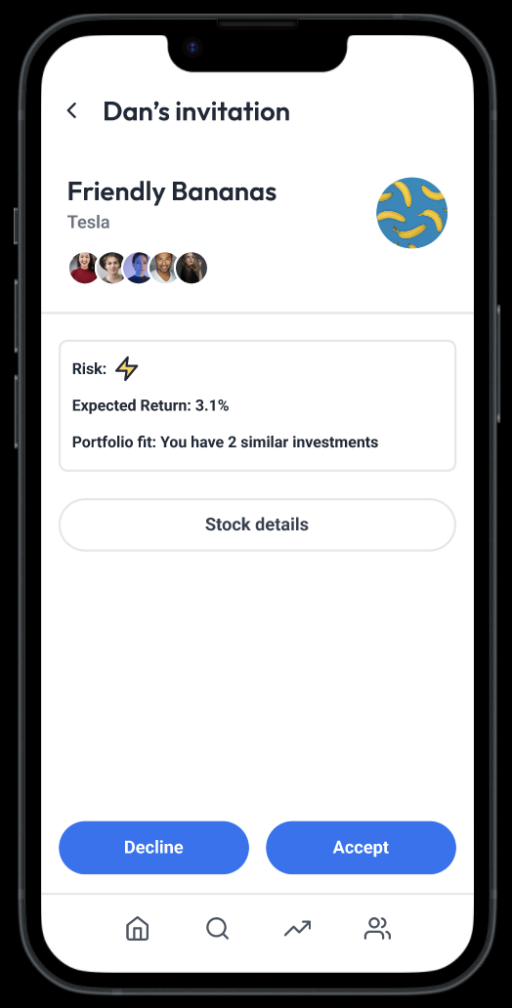
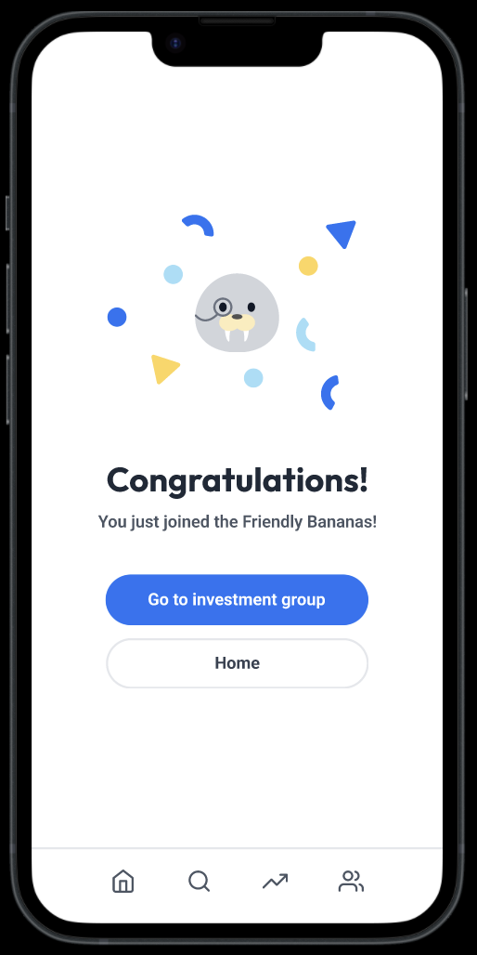
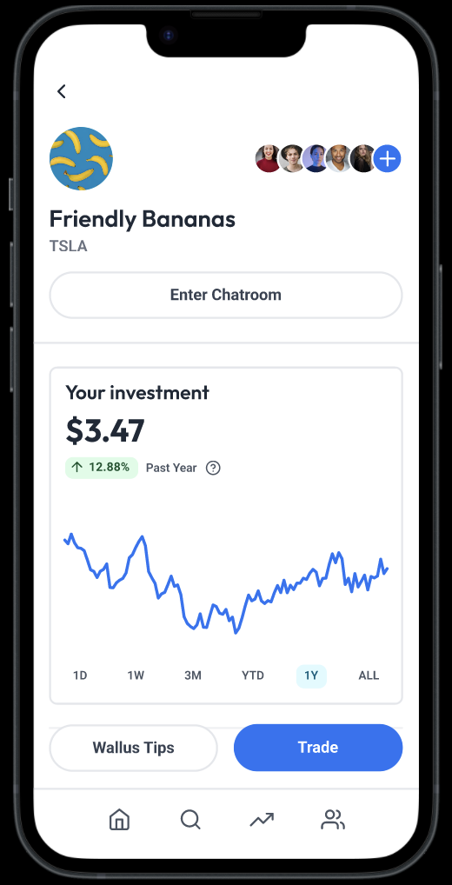
Simple Task: Accept invitation

Slide 32
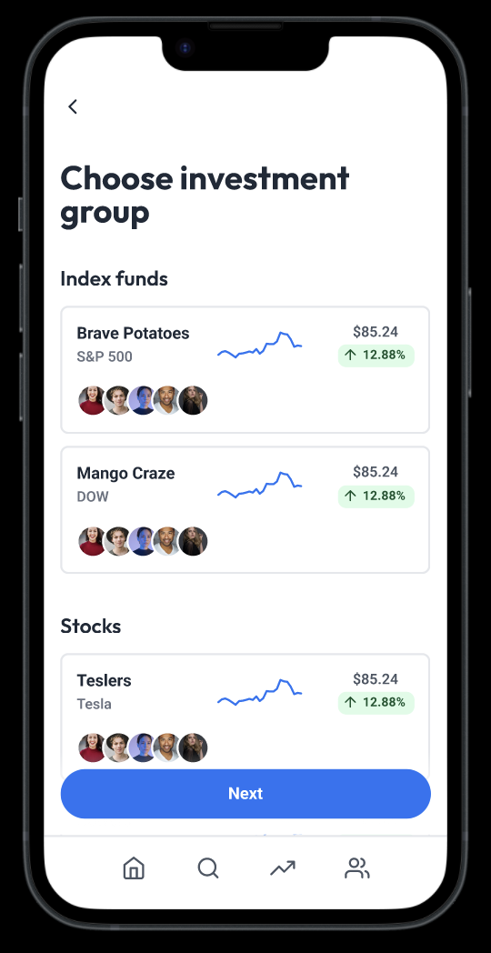
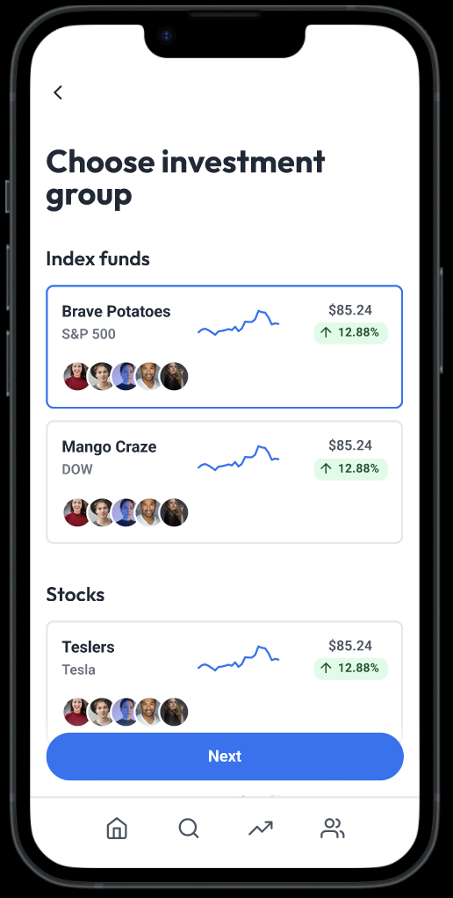
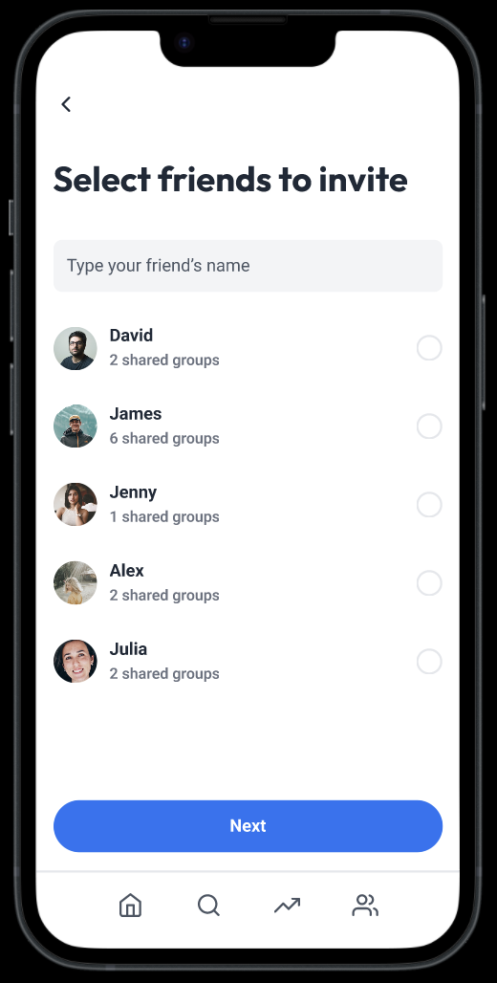
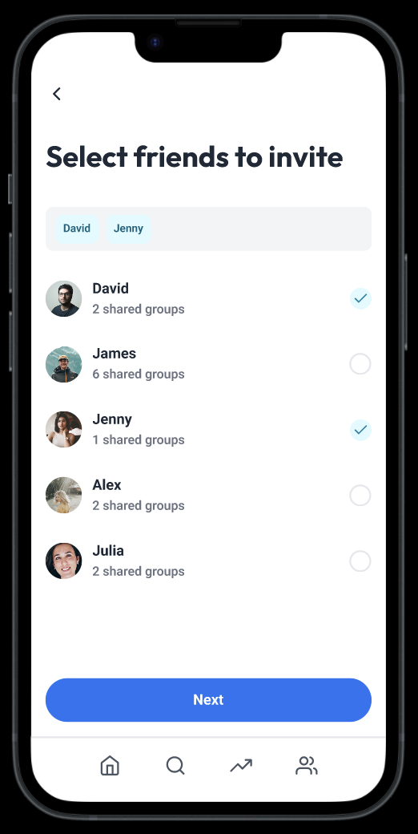
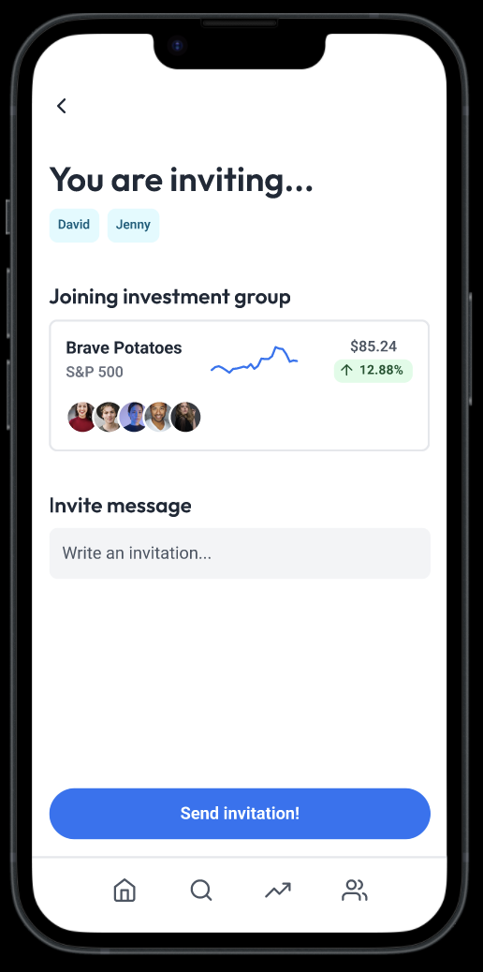
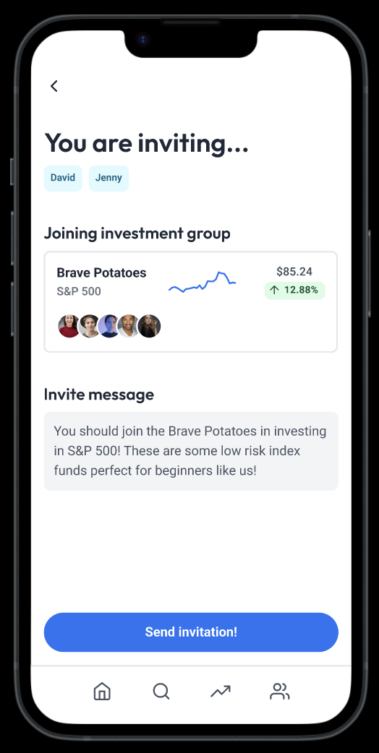
Moderate Task: Create invitation

Slide 33
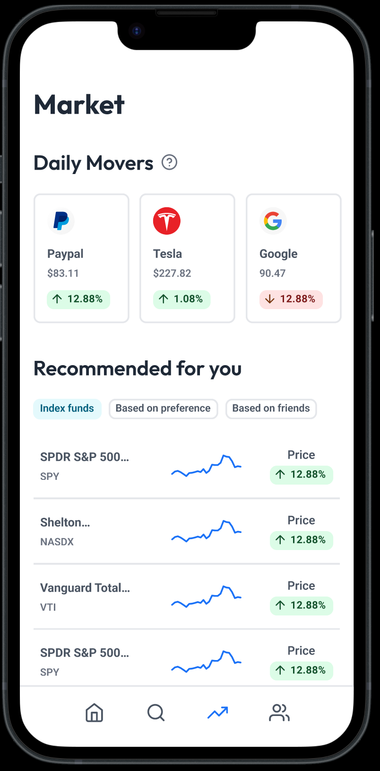
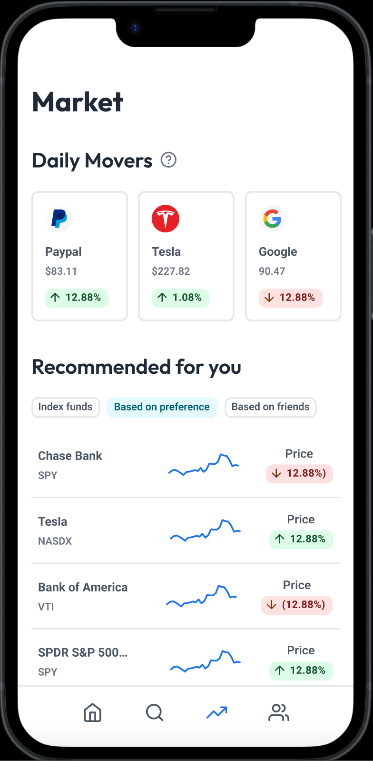
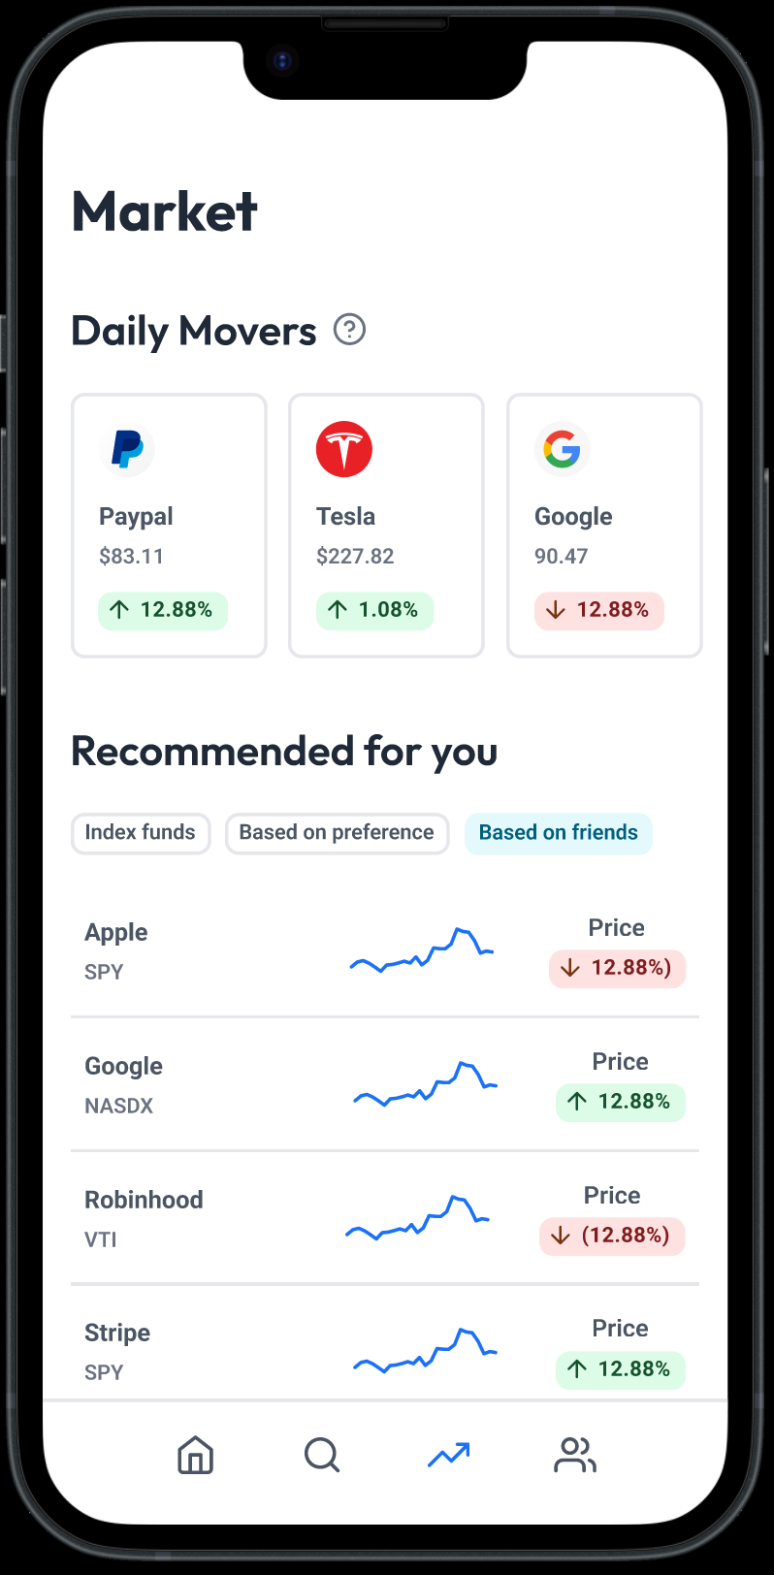

Complex Task: Learn about the market

Slide 34
8
Prototype Implementation

Slide 35

Tools
Figma: collaborative online, web application, for interface design
PROS | CONS
Real-time collaboration Cloud based (no back-and-forth file sharing necessary) Can add interactive elements Figma Mirror to test Plug-ins!! | Requires internet connection Can’t tell who added each edit Requires high tech computer Not all team members are experienced with the platform

Slide 36
Limitations
Click only
Limited Search
Incomplete Content
Many of our features will allow scrolling, such as the home feed (investment groups) and market (recommendations) which were not experienced with just clicking in Figma.
While there are a range of stocks, friends, or concepts that a user can search with the Search feature, the design only has a pre-set example for each. Specifics of choices are non-existent.
Many of the tutorials and dictionary definitions have not been developed, thus are marked as Coming Soon in the design. Numbers and charts are also arbitrary.
These limitations are alright since we are focusing on design for this assignment. Having at least one example of each type of content (ie profile, news, tutorial, etc) can demonstrate!

Slide 37
Design Simplification Choices
Hard-Coded
Wizard-of-Oz
Investment groups that the user is involved in
Investment options with fake data
User’s friends
User’s balance and investing amount
Displaying user’s investment growth over the past year
Wallus recommendations and tips are based on human not on AI
Embedding investopedia in the search tab

Slide 38
Appendix

Slide 39
Link to Figma:
Interactive Prototype
Feedback:
Approachable vs. overwhelming
Is the purpose of each page accomplished by the design?
Notes:
https://www.figma.com/file/f7pnijuxxPQAPoRzF4Rl3n/Medium-Fi-Prototype?node-id=54%3A5927

Slide 40






Mood Boards

Slide 41


Design Changes: Accept Invite (T1)
1
Before
After
Investment Invite includes how the investment looks compared to a user’s current portfolio. Is it similar or diversify by:
Risk
Industry
Amount
Notes:
Design changes directly in medium-fi prototype!

Slide 42

Design Changes: Accept Invite (T1)
2
Before
After
Any page with investment details has a CTA to invest in that stock. Explicitly, clicking into “Stock Details” has an “accept” detail like the main Invite.
Notes:
Design changes directly in medium-fi prototype!

Slide 43


Design Changes: Accept Invite (T1)
3
Before
After
Invite another friend when they join a new group
Notes:
Design changes directly in medium-fi prototype!

Slide 44


Design Changes: Send Invite (T2)
4
Before
After
Got rid of “pending invitations” -> Existing social media apps like instagram doesn’t have this information. It doesn’t provide much extra value. This information is gotten rid of along with the invite tab.
Notes:
Design changes directly in medium-fi prototype!

Slide 45

Design Changes: Send Invite (T2)
5
Before
After
Adding more community to the group name by adding pictures of the group members (more than just a stock title)
Notes:
Design changes directly in medium-fi prototype!

Slide 46


Design Changes: Learn about DOW (T3)
6
Before
After
Recommended investments also show comparison with other similar investment options
Notes:
Design changes directly in medium-fi prototype!

Slide 47


Design Changes: Group personalization
7
Before
After
Add personalization, community, and fun by allowing investment groups to create a custom name
Notes:
Design changes directly in medium-fi prototype!

Slide 48
Studio Feedback -> Action

Slide 49
Lacking of education aspect
Current problems
Wallus tips are too low hierarchy
How can the user reflect on their past decision making? How can the user learn from their friends?
Not enough guidance from the App
The experienced user should not be burdened with teaching responsibility
Notes:
Design changes directly in medium-fi prototype!

Slide 50





Change 1 -Wallus tips
Before
After
Investment group page/ Scrolled down view
Investment group page
Wallus tips
Investment group page
Notes:
Design changes directly in medium-fi prototype!
Before, the user can access tips from Wallus by clicking into the button “Wallus Tips”, which would be in the investment home page. We realized this information was too hidden from the user and should take higher priority. We also realized the Wallus advice page was very text heavy with certain unnecessary information
In our new change, we feature a shortened version of wallus tip at the first view of the investment group page. The user can choose to expand it to see a more detailed explanation. We kept information on the “bought at, current price, typical hold, etc.” information by moving it to the bottom of the investment group page because it is necessary yet low priority.

Slide 51




Change 2 - Logging your decision rationale
Sell confirmation/collapsed
Sell confirmation/expanded
Profile page
Community page
Notes:
Design changes directly in medium-fi prototype!
We decided to incorporate a new feature of requiring the user to input a decision rationale everytime they invest or sell because we want our users to make decisions based on reason and not impulse.
When prompted to input a reason, the user can select multiple reasons from the dropdown or input an unlisted reason in the input field. The inputted reason will be shown on the user’s activity log on their profile screen and their friend’s community tab (If they choose to share). Keeping a log of decision rationales allows the user to reflect on their past decisions and learn from them. Sharing decision rationales with friends allows users to learn from their friend’s investment mindset.

Slide 52

Change 3 - Wallus tips & warnings based on user preference
The addition of a user onboarding flow
Notes:
Design changes directly in medium-fi prototype!
To let the App give the user more guidance, we decided to have Wallus Tips more present throughout all decision making processes: accepting invite to join a group, when the user is buying a stock on their own, buying or selling the stock, etc. We realized that to do all of this, we first need to create an onboarding process, in which the user tells Wallus their experience level, risk tolerance (defaulted to low if they are inexperienced), and long term goals.

Slide 53





Change 3 - Wallus tips & warnings based on user preference
Walllus tips in invitation view
Wallus TIps in Stock view
Wallus warning in decisions when user is not following their preference
Wallus notifications
Notes:
Design changes directly in medium-fi prototype!
We came up with 3 ways to increase Wallus’s guidance:
Display Wallus tips in invitation views and individual stock views: this can guide users when they are deciding whether they want to join a new group and when they are starting a new investment on their own
Interrupt flows with Wallus warning page: when the user is about to do something that does not align with their inputted preferences, Wallus interrupts to warn. This page presents the option to continue if the user wishes, and a button to change their investment preferences if that has changed.
Push Wallus notifications: this grabs the user’s attention about a particular investment group without requiring them to click into the group. The user can read more by clicking on details.

Slide 54
2. How will Wallus work for people with no in person investment friends?
Our rationale
We recognize this app assumes in person friends to use app with, but we think it is important to keep it this way because interacting with online strangers financially can be extremely risky and dangerous
With the education changes built in, a Wallus will still be a beginner friendly investing app compared to other investing options
Notes:
Design changes directly in medium-fi prototype!

Slide 55
3. Information overload
Current problem
Many screens are text heavy and not friendly enough to users
There are information that are less relevant and can be removed
Notes:
Design changes directly in medium-fi prototype!

Slide 56


Change 1 -Removing the Graph from Home
Before
After
Notes:
Design changes directly in medium-fi prototype!
As we looked at the home page, we realized the trend graph that we originally had to show the user’s overall portfolio trend is not very helpful to our target audience. These daily trend graphs are mostly helpful to day traders who want to surf the rises and dips; however, Wallus wants to help people build long-term healthy investing habits that do not require them to stare at the trend graph all day.
We realized what is more important to display here is something that gives the user encouragement and a sense of community, because those are the elements that we found, in our needfinding interviews, what drives investment beginners. We decided to move the “community card” from community tab to home tab; the community card can display t

Slide 57
4. UI is not novel enough
Current problem
The current visual style looks like a standard investing app
Branding does not give the “approachable” and very “friendly” vibe our brand image is supposed to be
Notes:
Design changes directly in medium-fi prototype!

Slide 58

4. UI is not novel enough
Solution Implementation plan
Make the colors more playful
Incorporate more Wallus and cartoon elements
Implementation timeline
Monday - Wednesday Week 7
More similar to the vibes of this page
Notes:
Design changes directly in medium-fi prototype!

Slide 59
Avika’s Notes
@Avika DOW Figma design
@Madison (avika will explain) some elements on figma design don’t show on interactive
Report
Complete interactive design
@Avika add things from slide 14 and 15 (if not added yet)
@Madison + @Avika slide 19, 22, 23, 29, 30, 33, 37, 41-47
Design push notifications
Comment on the flows (descriptions below)
Novel UI rewarded?
Design review notes
Feedback → Action
  Education
  Community for ppl without friends
  Branding (UI novelty)
  Onboarding flow
  Information overload
  Other feedback

Slide 60
Thank you for joining us!
<3 Team Wallus

