Slide 1
Team Wallus: Lofi Prototype
Madison Fan, Xinyi Wang, Avika Patel, Juben Rana

Slide 2




Team 3 Members
Avika Patel
CS ’24
Juben Rana
CS ’24
Madison Fan
Design ’25
Xinyi Wang
CS ’24

Slide 3
Agenda
1
2
3
4
5
VALUE PROPOSITION
EXPLORING DESIGN IDEAS
LO-FI PROTOTYPE
USABILITY TESTING METHODS
TESTING RESULTS

Slide 4
1
Value Proposition
Our solution
Educate and support investment rookies to gain investment literacy
Encourage investment rookies to grow investment knowledge with friends

Slide 5
2
Exploring Design Ideas

Slide 6
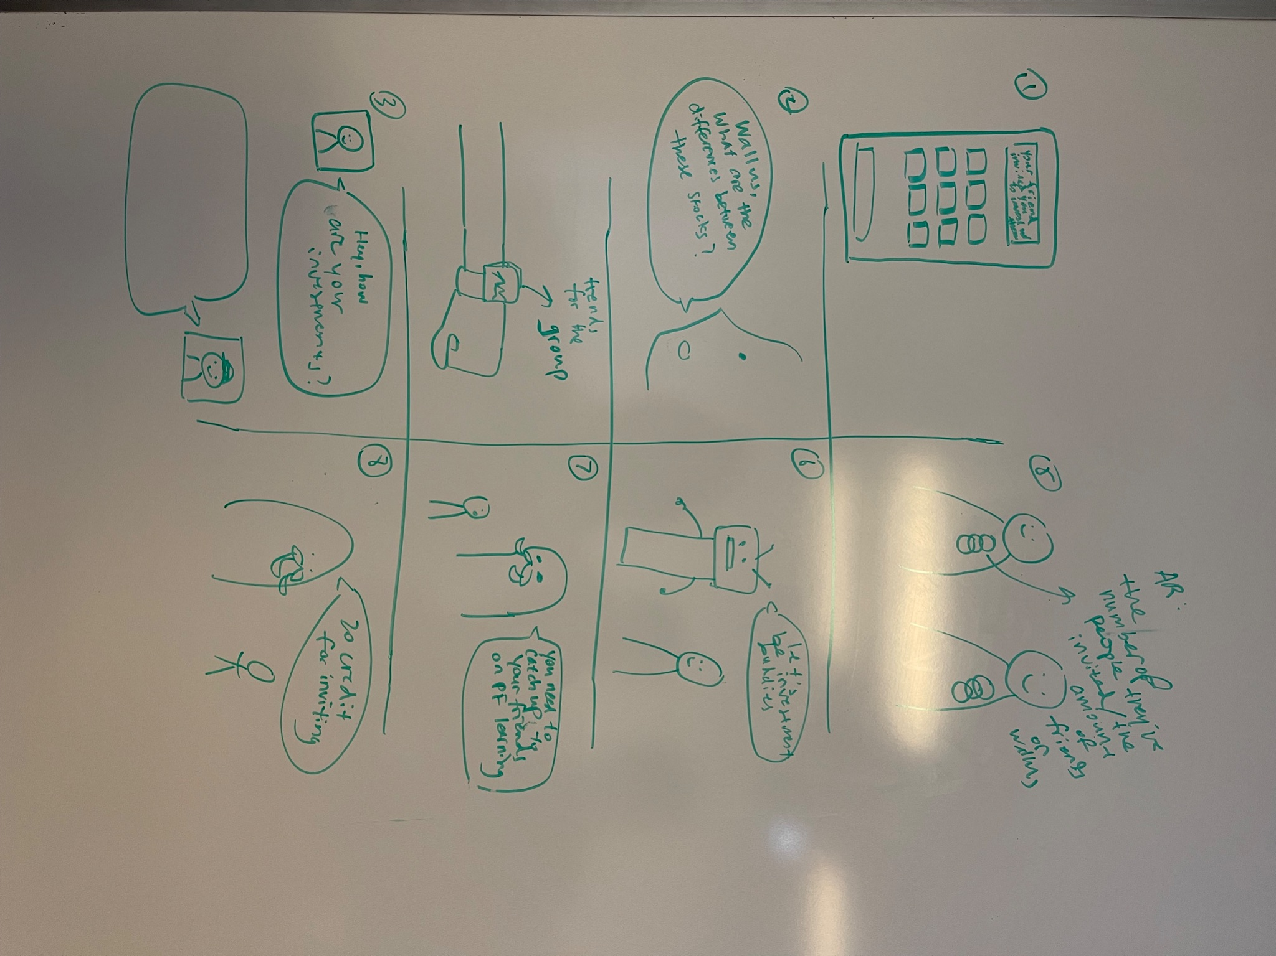
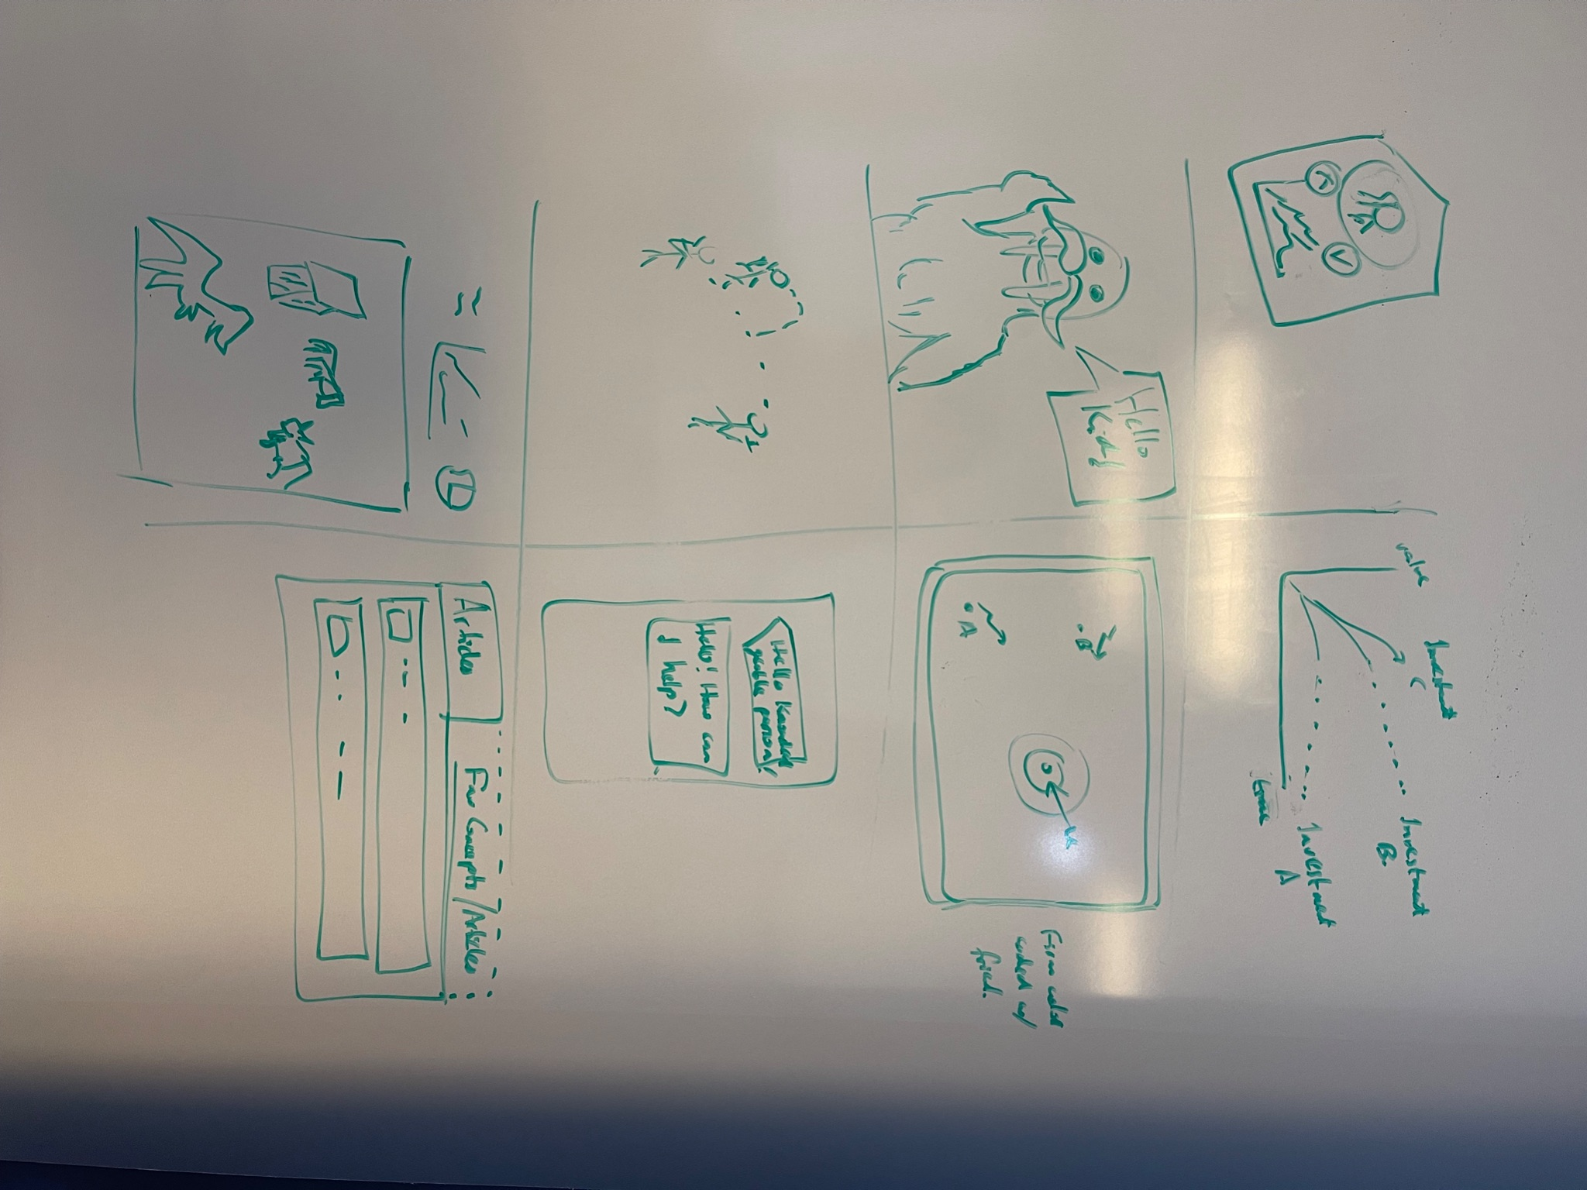
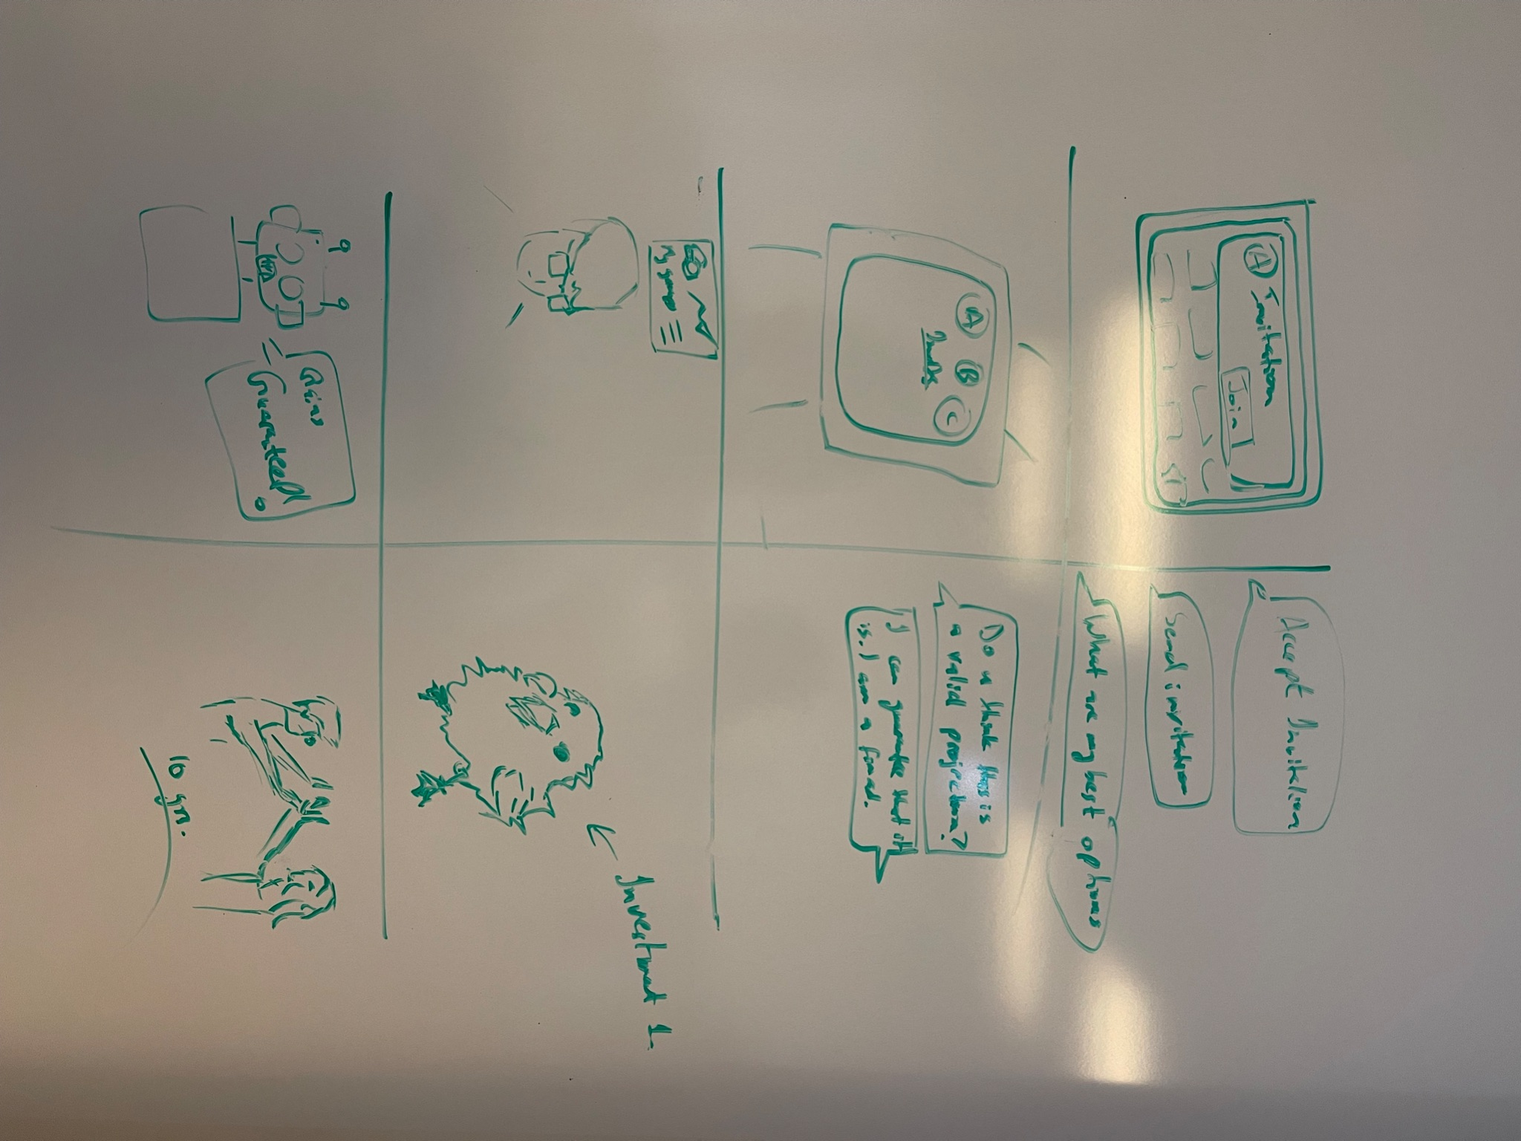
Crazy8s - Wearable (Apple Watch)

Slide 7
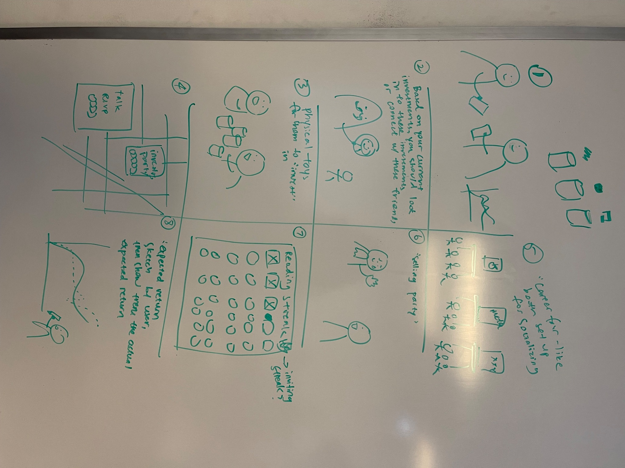
Crazy8s - VR

Slide 8
Crazy8s - AR

Slide 9
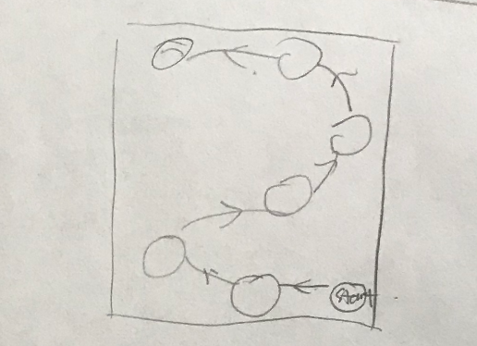
Crazy8s - Map

Slide 10
Crazy8s - Mobile

Slide 11
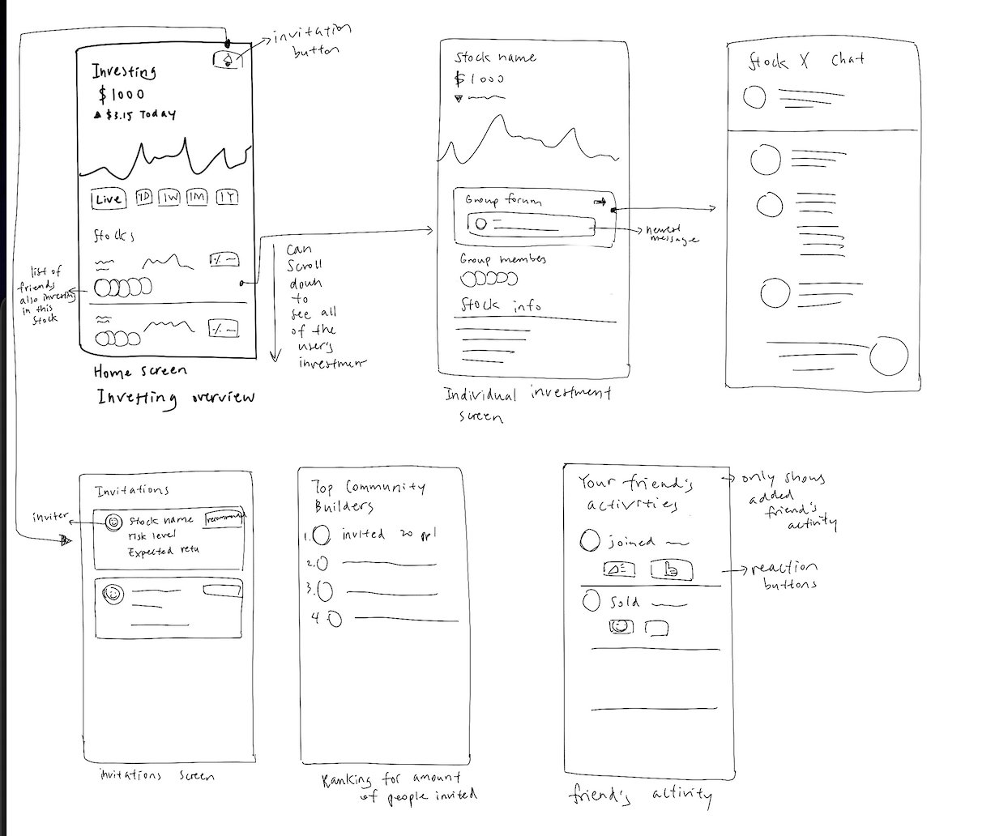
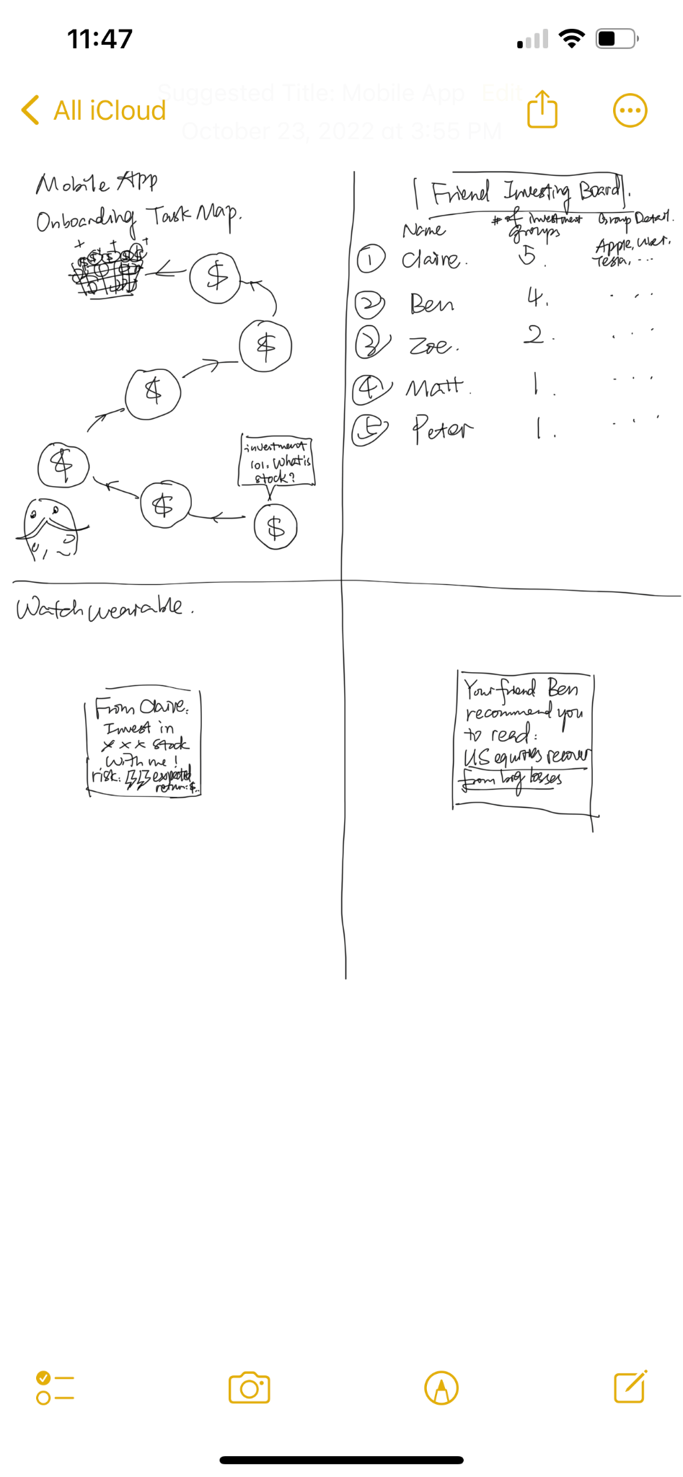
Realization 1: Mobile App

Slide 12
Mobile Pros & Cons
PROS | CONS
Most users have access More space for detailed information Can be connected to external resources without platform issues | Less frequent engagement compared to wearable solution More content could be more overwhelming for investment newbies
Notes:
Pro
The majority of our targeted users have access to a mobile phone.
The information on the mobile app would be presented in a more detailed, comprehensive, and visually appealing way.
It is convenient for users to learn about financial knowledge via the educational content the app directs them to when they encounter something they don’t understand during the investment process.
Con
Less frequent engagement compared to wearable solution
More content could be more overwhelming for investment newbies

Slide 13
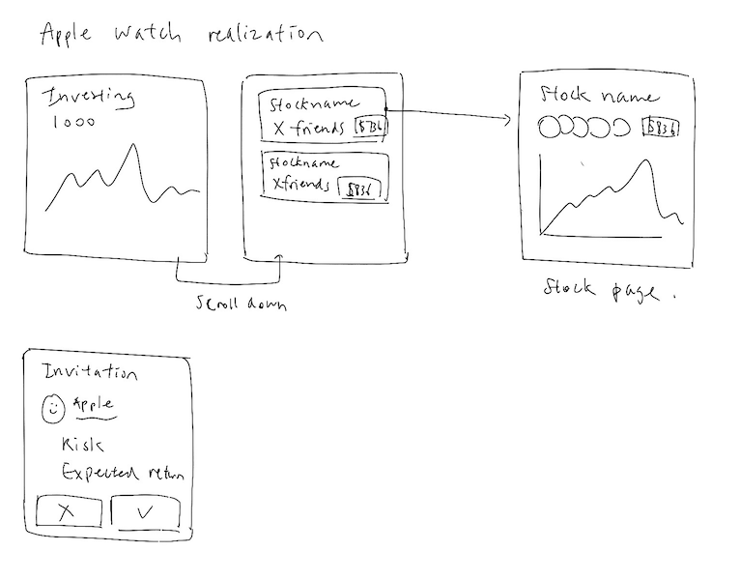
Realization 2: Wearable (Apple Watch)

Slide 14
Wearables Pros & Cons
PROS | CONS
Faster & more convenient view of information (invitations, stock status) Less overwhelming for newbie investors | Limited information display, hard to show detailed stock information Limited information makes decision making harder We don’t want users to make financial decisions “on the go”
Notes:
Pro
The user would be able to view invitations more quickly.
The user would be able to check stock status on the go.
The user would be able to access the most important information selected by the app so it is less overwhelming for newbie investors.
Con
The information shown on the wearable screen is limited, so it would be hard for the user to see the detailed stock / investment group information.
It is not convenient for users to learn financial knowledge through reading articles or watching videos on the wearable.
It is extremely hard to make deliberate investing decisions with only the limited information on the wearable.
We don’t want users to make financial decisions “on the go”

Slide 15
Final Choice: Mobile
We ultimately chose mobile for (1) focusing on our core user base of individuals new to investing (2) building healthy financial habits.
For reason (1) focusing on those new to investing, we wanted a larger screen to show educational resources throughout the investment process. Additionally, we want to be most accessible to folks that might not have high disposable income (those more likely to own an Apple watch and also more likely to already invest) thus a phone is a universal medium that could reach them.
For reason (2) building healthy financial habits, having a small screen that can only fit “Yes” and “No” for real-money decisions is dangerous. Just a notification and decision is dangerous and can build unhealthy financial habits that counter the long-term index fund recommendation strategy that is best for stocks.

Slide 16
Lo-fi
Prototype
3

Slide 17
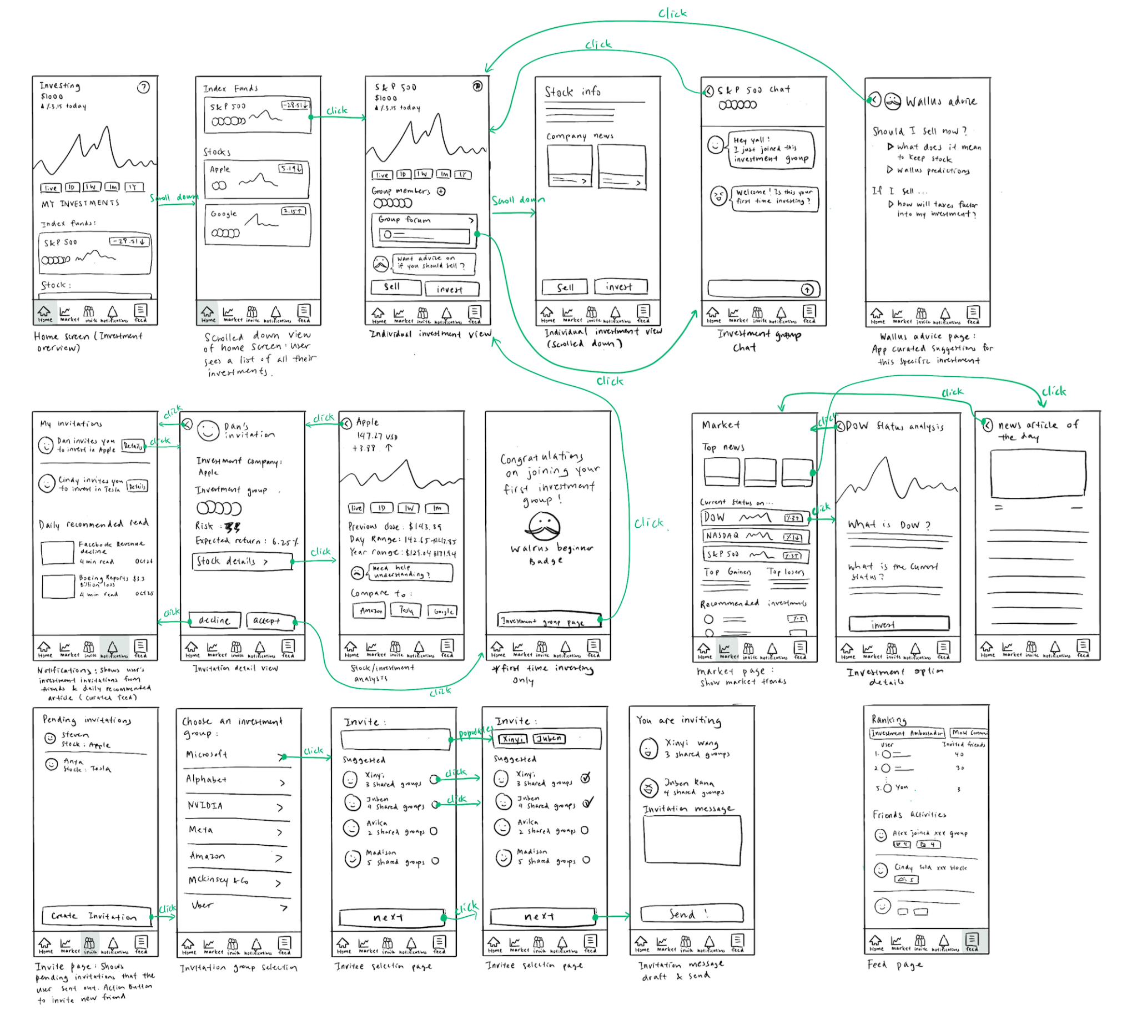
Prototype structure
Notes:
Bird’s eye view of the entire system.

Slide 18
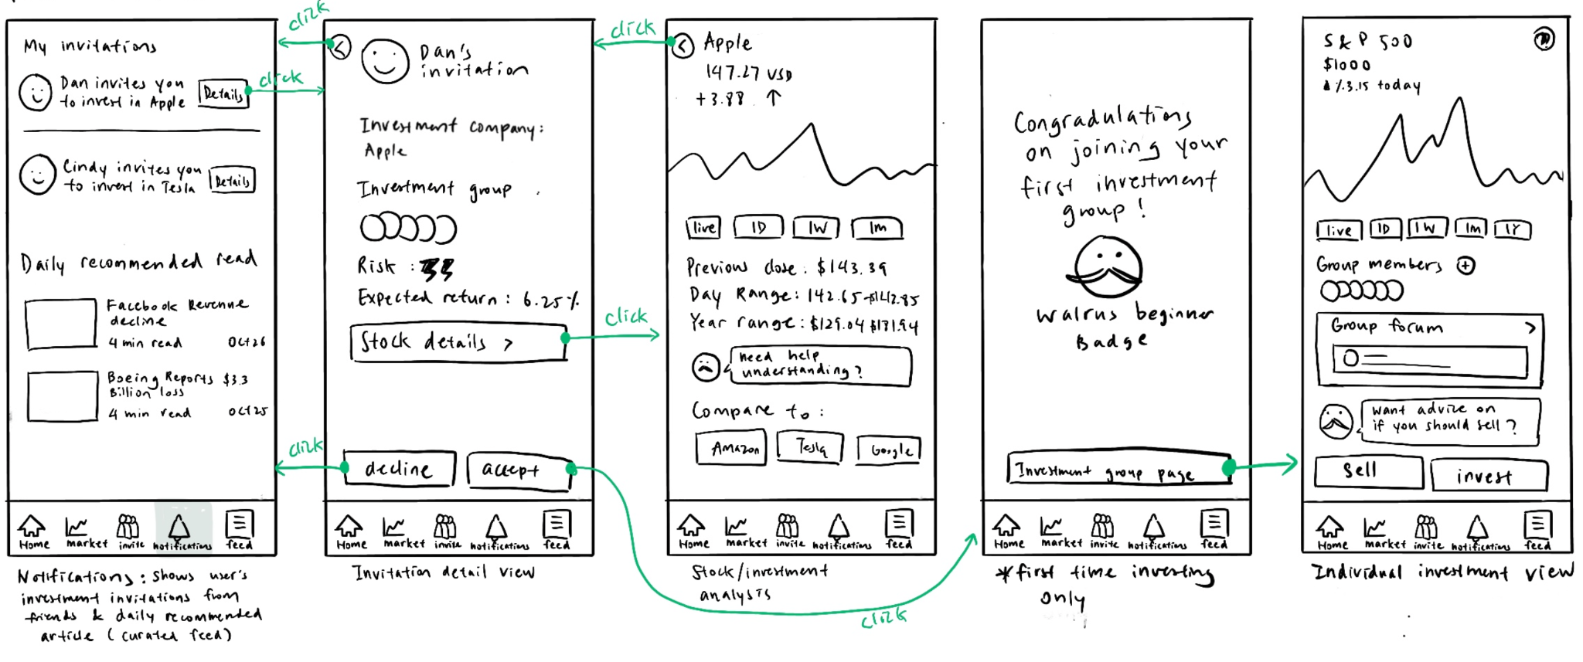
Simple Task: Accept invitation

Slide 19
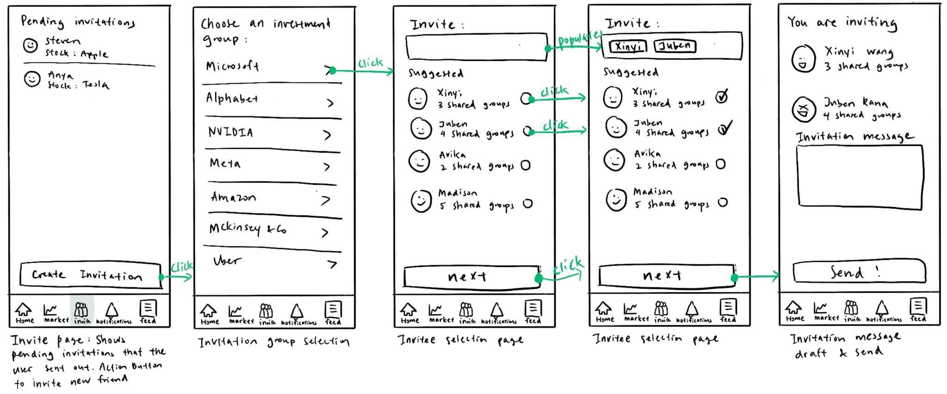
Moderate Task: Create invitation

Slide 20
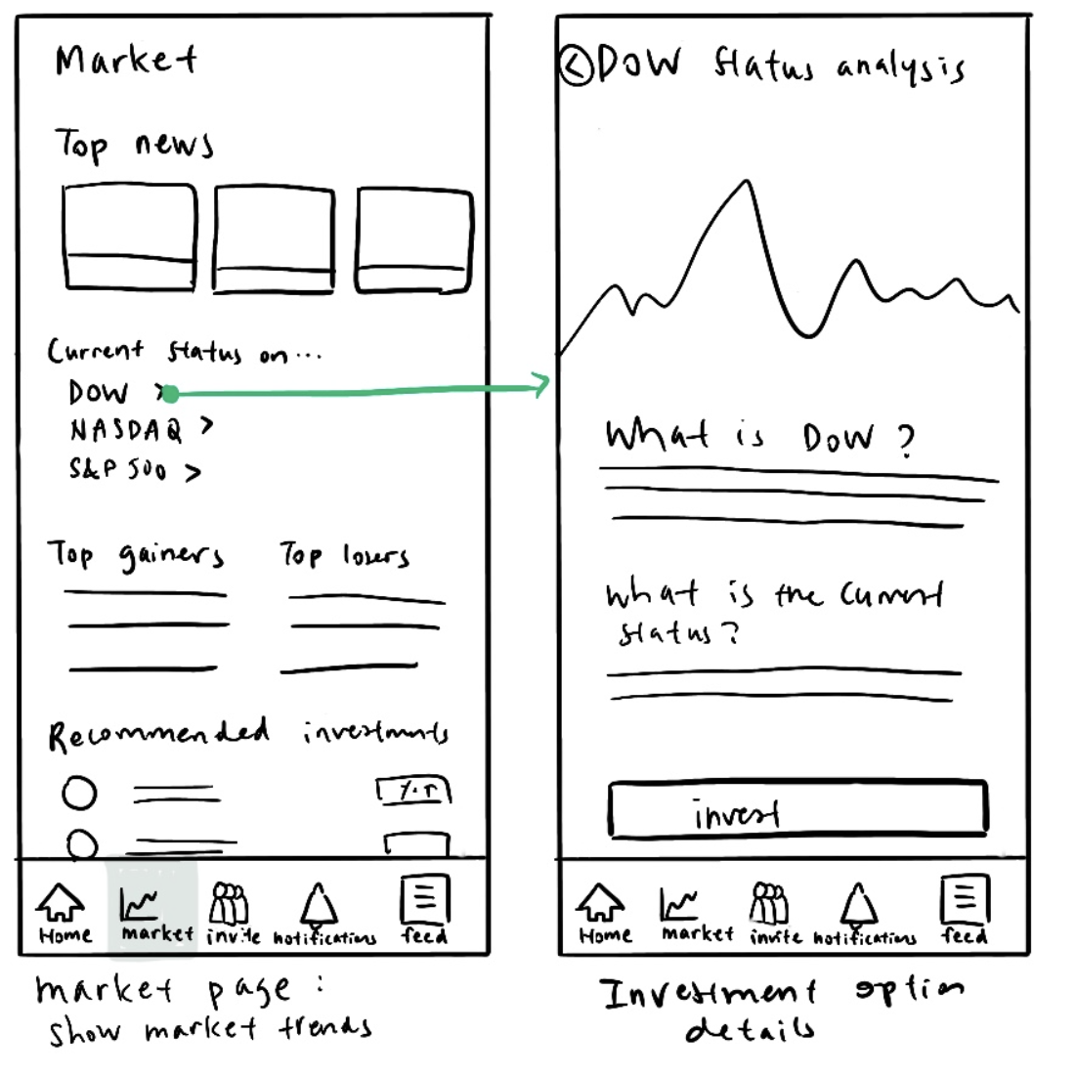
Complex Task: Learn about the market

Slide 21
4
Usability Testing Methods

Slide 22

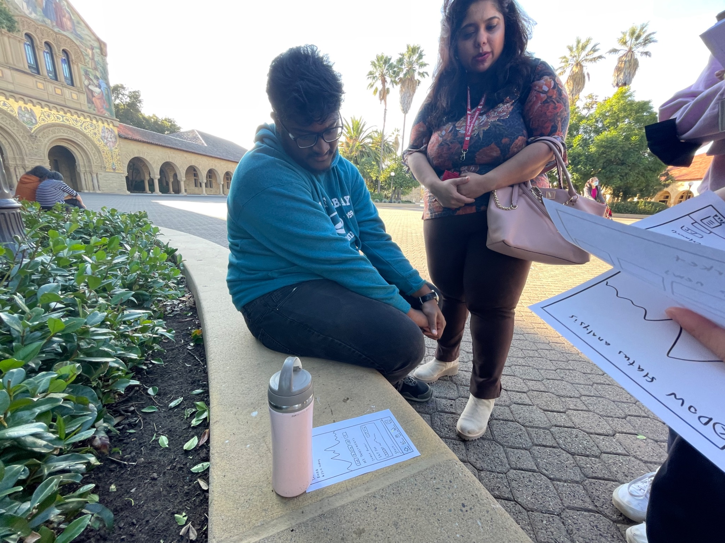
Testing methodology
Location: Main quad
Prototype type: Paper prototype
Recruitment method: Approached strangers and asked for their consent

Slide 23
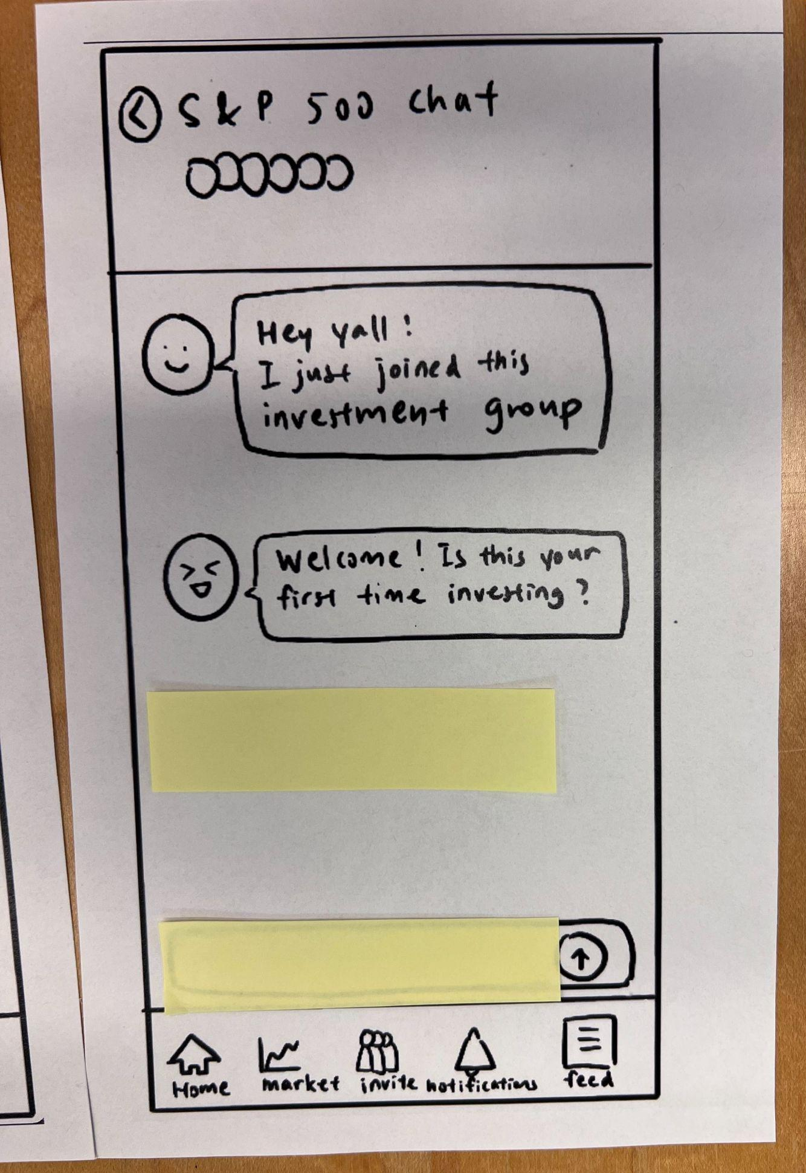
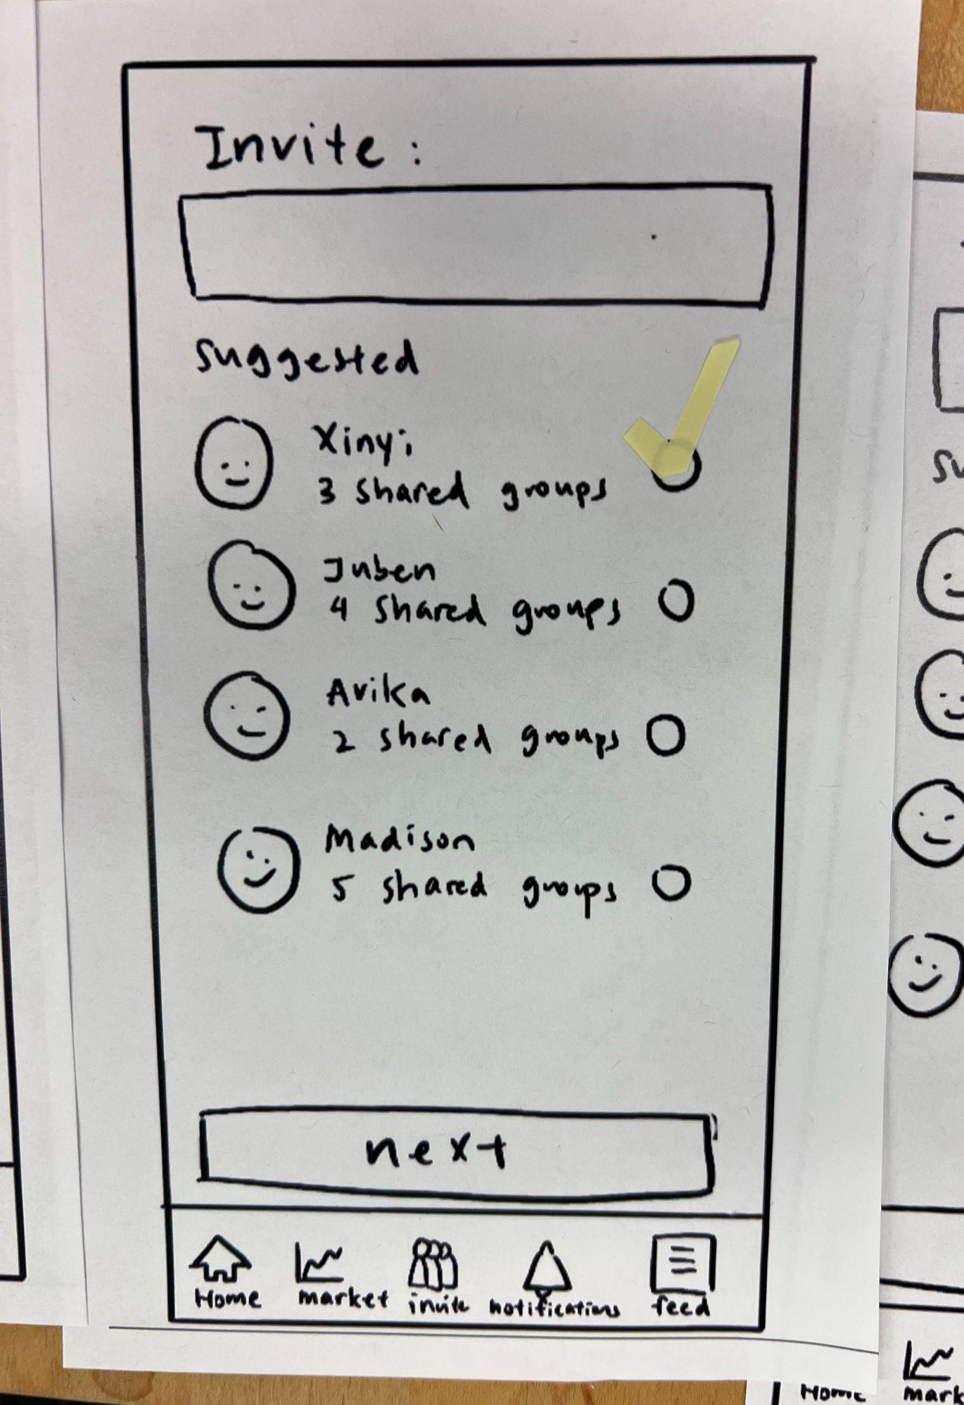
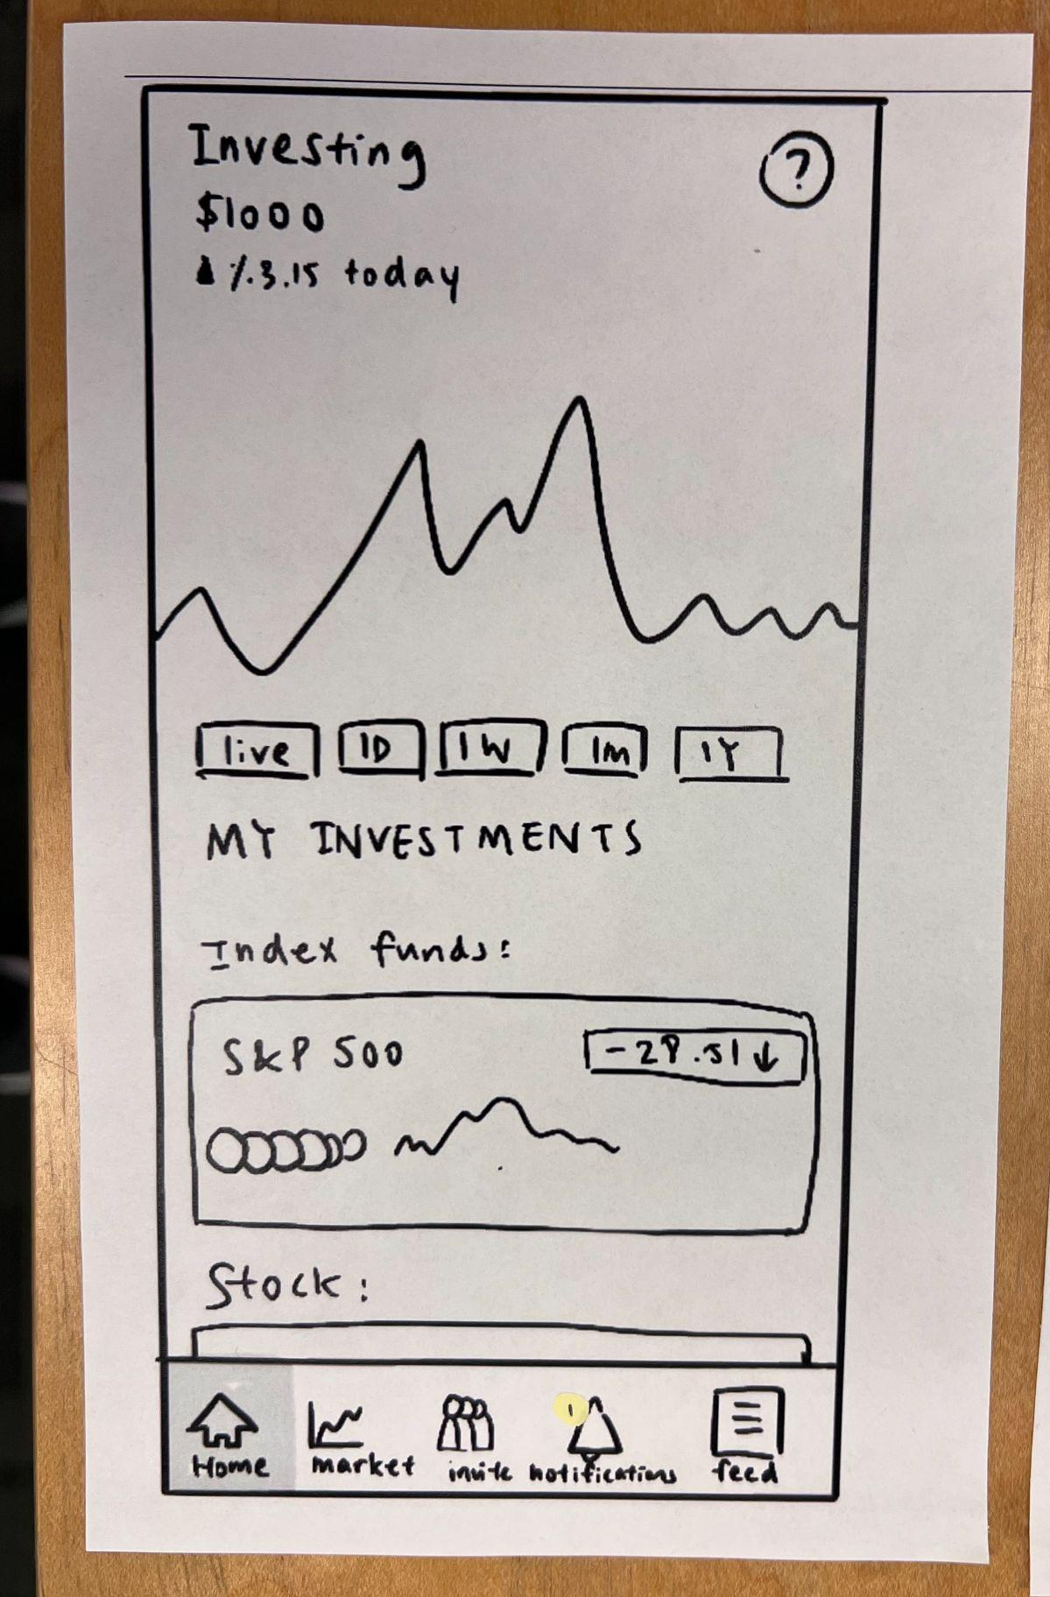
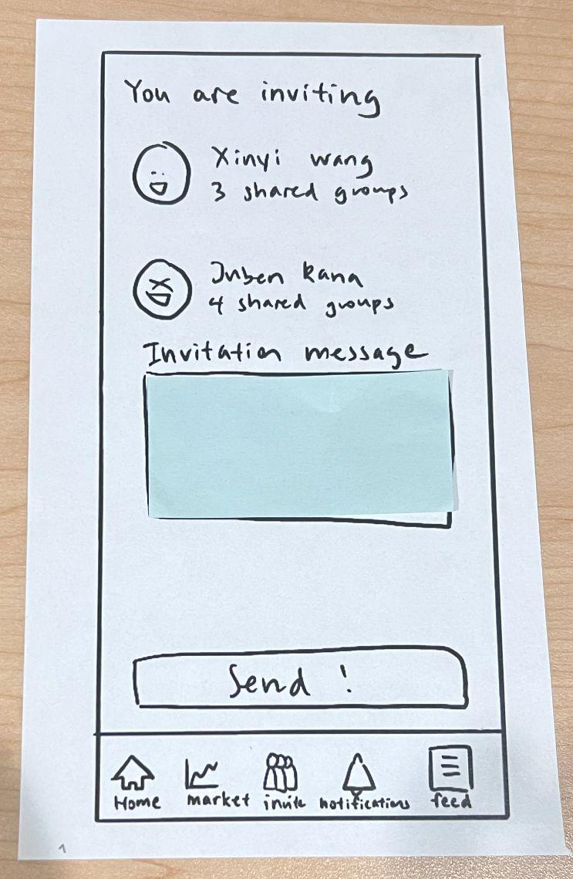
Adding more realistic experiences to paper prototypes!
Sticky note chat
Checks to chose invites
Notification bubble
Sticky note invite

Slide 24
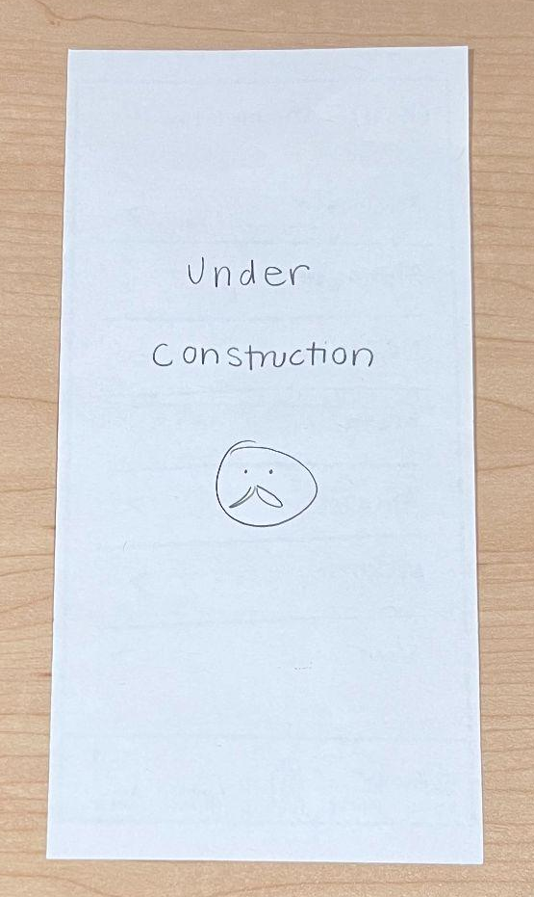
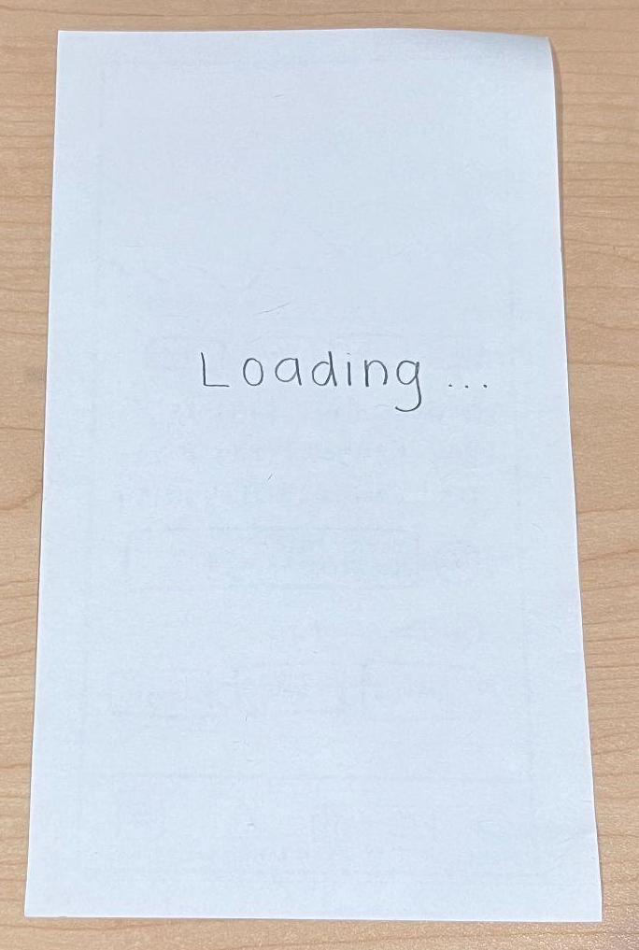
Also necessary … and were used :)

Slide 25
High-level script
Ask for participation
Ice breakers / get to know them
Describe design class
Sign consent form
Demo the system
Communicate 3 tasks, one-at-a-time
Ask for final thoughts
Ask about participants current investment habits

Slide 26
Team member roles
Avika Patel
Facilitator
Juben Rana
Observer
Madison Fan
Computer
Xinyi Wang
Greeter

Slide 27
Testing Procedure
1
2
3
4
Introduce and overview
Complete tasks
Comments & record
Follow-up questions and comments
Facilitator & Greeter asks for consent and gives overview of project
Computer changes the paper prototypes, facilitator instructs when necessary
Users share their reactions during the tasks and the note-taker records
Facilitator asks follow-up questions based on observations & feedback

Slide 28
Participant selection
Mike
Alice
Patrick
Yusef
Susan
LA Artist, Part-time security guard
Stanford Employee at Student Financial Services
AT&T SWE
Middle-Older age living 1 hr from campus
Visitor from Germany

Slide 29
Participant Details
Knows about the market but doesn’t invest because it’s time consuming
Likes the idea of group investing: “Don’t be scared as a group if everyone is investing together”
Mike
Really new investor—heard about investing but never started themself
Alice

Slide 30
Participant Details
Experience in investing
Has “lost money, lost a lot of money”
Patrick
“Don’t have enough money to invest”
New and unfamiliar to investment concepts
Yusef

Slide 31
Participant Details
Lives in Germany
Invests a significant amount “for fun”, but it’s not enough to impact her living even if she loses all
Said that Germany is more strict on investing (requires a questionnaire on investment knowledge)
Has heard of stories of people losing money and suicide and restricts her investment amount
Susan

Slide 32
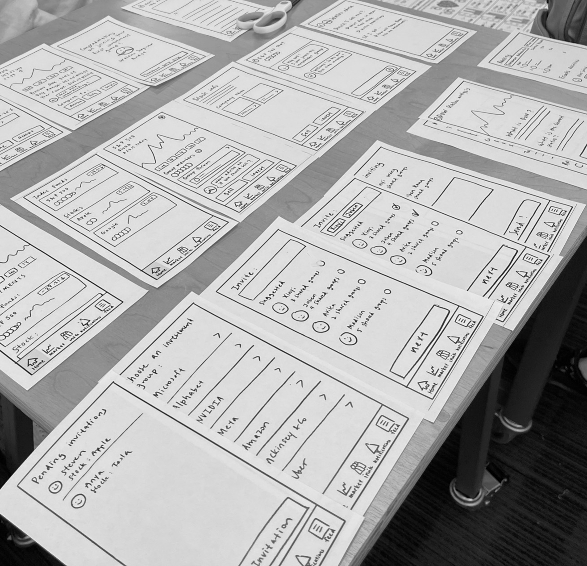
Tasks
Accept a friend’s invitation to join an investment group
Invite friends to join their investment group
Learn about the DOW, an index fund

Slide 33
Usability goals & Key Measurements
Goal 1: Approachable
Goal 2: Intuitive
Key Metric: Users were able to understand the interface or find out what it means
Key Metric: Process time & verbal feedback

Slide 34
5
Testing results

Slide 35
Results: Successes
Concept validation
“[People] won’t be scared if everyone is investing together”
Mike

Slide 36
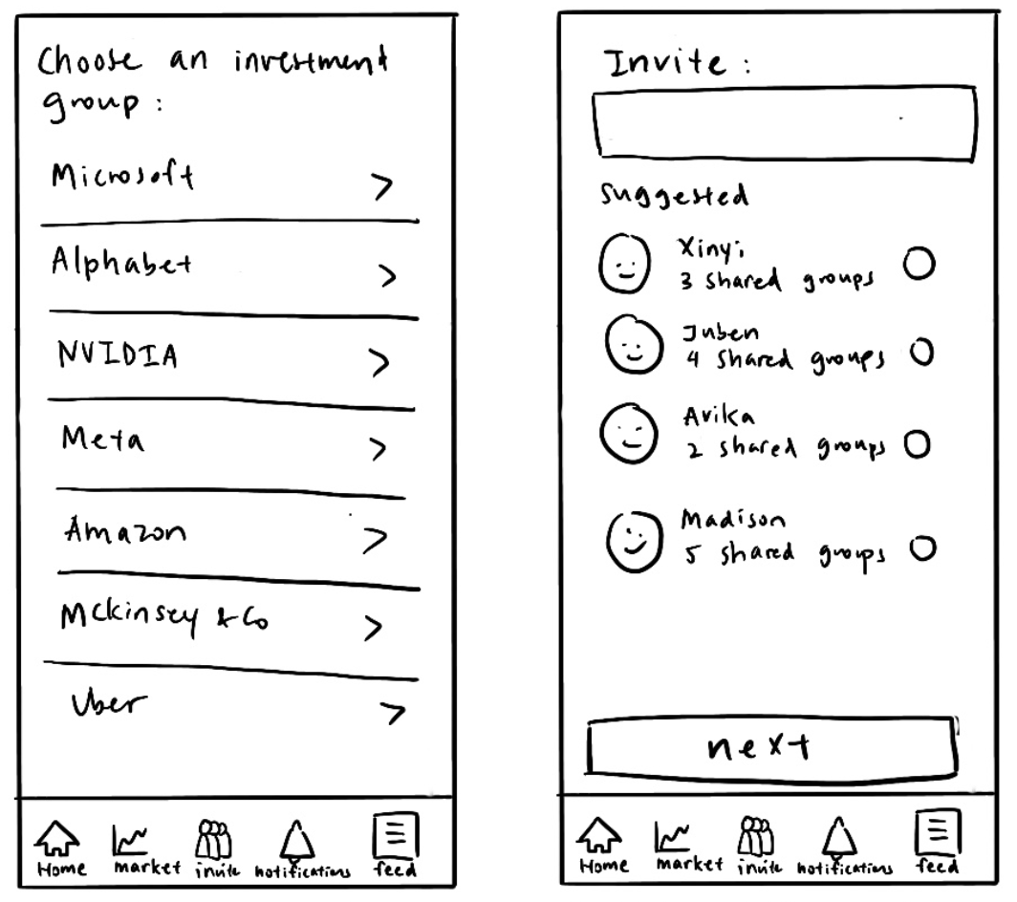
Results: Successes
Generally low friction in navigating invite task and accept task
Notes:
Positive feedback on concept
Invite and accept invite task flows were done with little friction

Slide 37
Results: Errors & Expressed Wants

Slide 38
Accept invite task

Slide 39
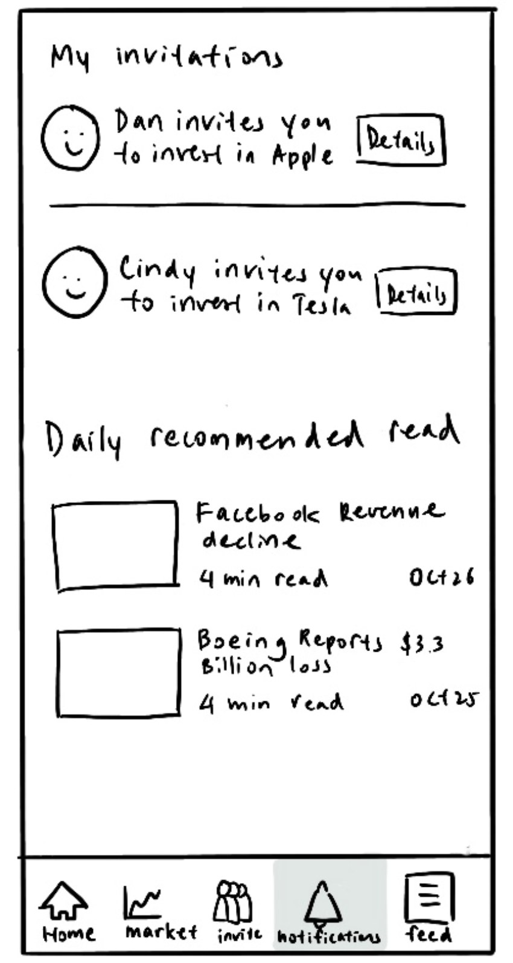
Results: Errors
It was unintuitive to have daily recommended read on the same page as the invitations the user is receiving

Slide 40
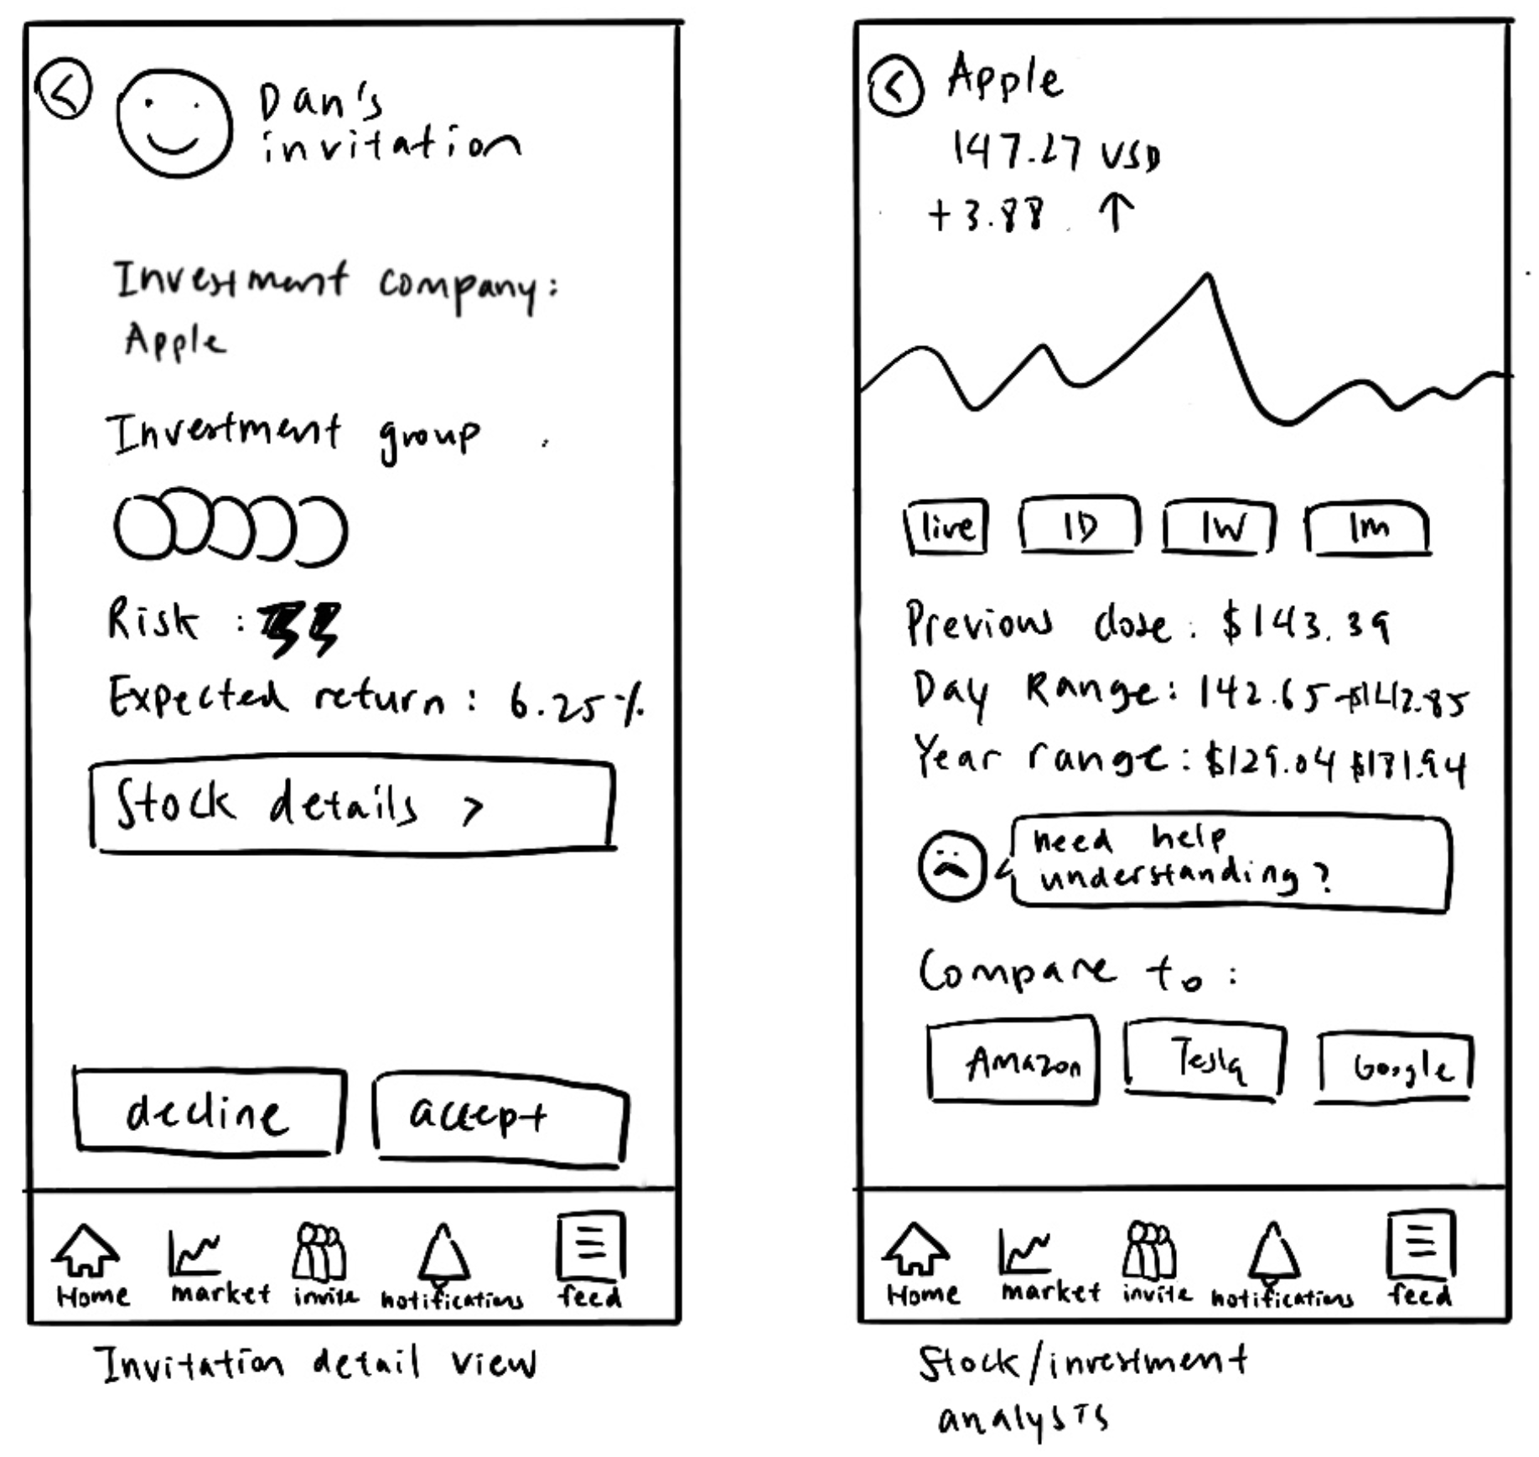
Results: Expressed wants
Alice was hesitant to accept because she’s not sure how the invitation complements her current investments

Slide 41
Results: Expressed Wants
“It seems unintuitive to not be able to accept the request on the page of stock details”

Slide 42
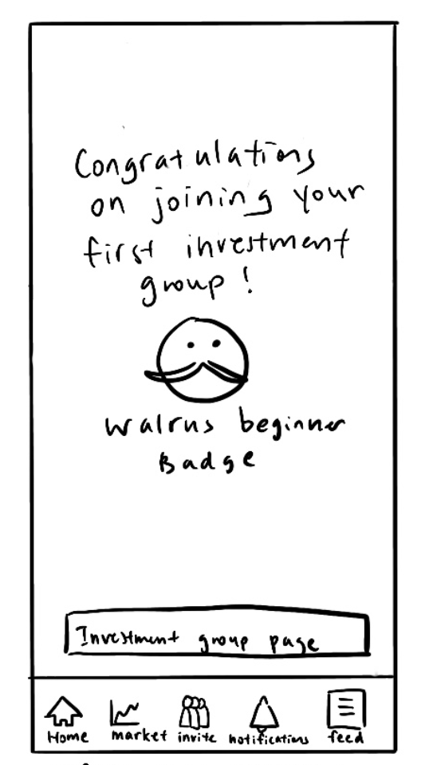
Results: Expressed wants
Users may want to invite another friend when they join a new group

Slide 43
Sending invitation

Slide 44
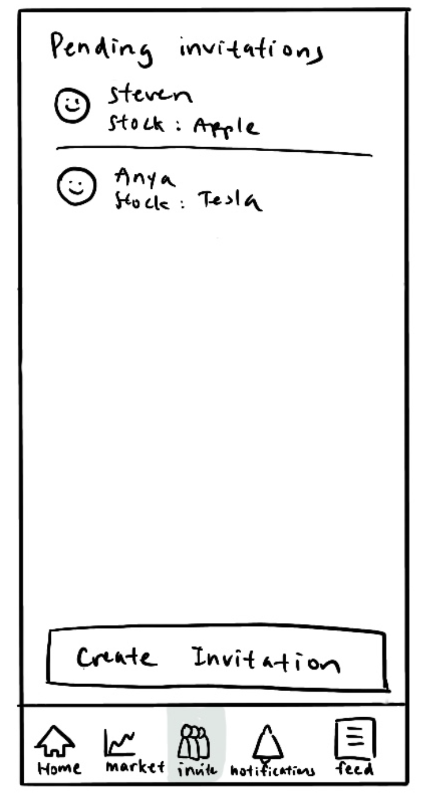
Results: Errors
Confusing whether the invitations here are invitations that the user is receiving or sent out

Slide 45
Results: Expressed want
Option to invite friends to join new investment group

Slide 46
Results: Expressed want
A more personal/intimate group name than company name

Slide 47
Learn about DOW

Slide 48
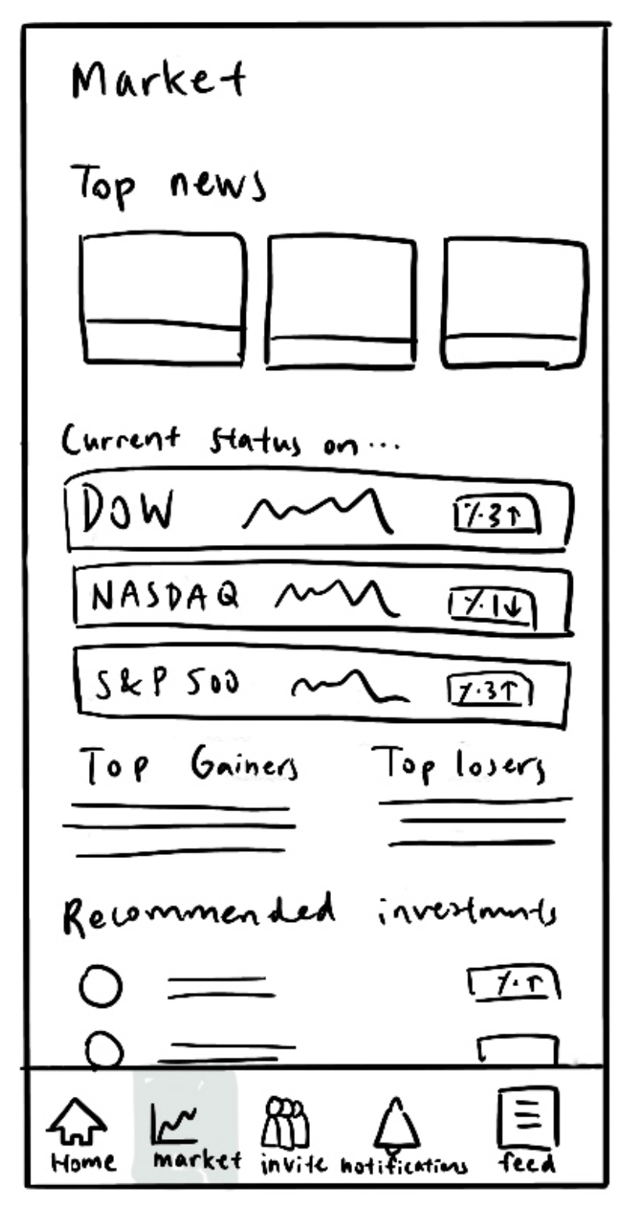
Results: Errors
Not all users knew what to look at when seeing the “Market” Tab
“What do I do now?”

Slide 49
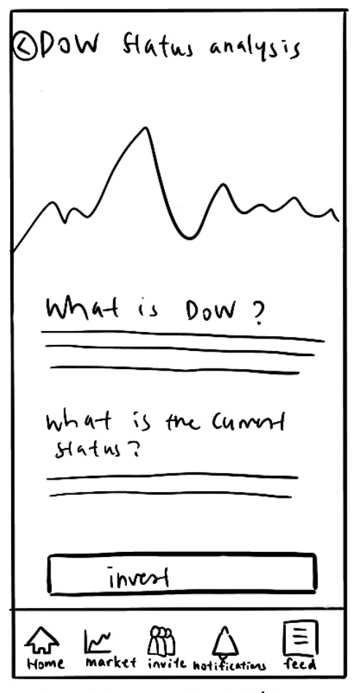
Results: Expressed wants
Wish to be able to compare with other investment options

Slide 50
Usability goals & Key Measurements results
Goal 1: Approachable
Goal 2: Intuitive
Users with less experience had trouble understanding the market page
Users are not sure how a new investment can complement their portfolio
Users generally figured out how to complete tasks in short time
Daily Recommendation feed
More flexibility
Notes:
More flexibility refers to allowing users to do an action without having to navigate back and forth (the stock details page in the accept invitation task), and allowing users to create a new investment group & invite friends at the same time

Slide 51
Future UI Changes

Slide 52

UI Change 1: Revamp send invitation flow
Allow users to give investment group names
Change wording of “pending invitation”
Allow creating group from new investment

Slide 53
UI Change 2: Revamp accept invite flow
Remove daily recommended read section
Provide more info on how the new investment fits into user’s portfolio
Give more info on how user’s friend(s) have committed
Allow users to accept or decline request in stock detail view

Slide 54
UI Change 3: Revamp market
Show comparing options in stock detail page
Combine the daily news recommendation with the Top news section
Provide additional explainers on what each section means

Slide 55
Summary

Slide 56
Summary
We need to give more beginner friendly explanations and information that’s relevant to their concerns
Certain placements or wording of UI were confusing
Certain flows lack intuitive functionality
We should emphasize on community building and friendship more

Slide 57
Appendix

Slide 58
Learned Design Improvements
(2) Paused at “Congratulations” screen after a successful investment, unsure what to click next
Automatically move to investment home page
(0) Unprompted mentioned users “won’t be scared if everyone is investing together”
Adding in more details about the friends already
committed when a user gets an invite
Mike
Notes:
severity rating (0 = no problem, 1 = cosmetic problem, 2 = minor usability problem, 3 = major usability problem, 4 = usability catastrophe)

Slide 59
Learned Design Improvements
(2) Paused and shifted finger back-and-forth at the notification tab showing both new invites and recommended news articles. Patrick was unsure how both connected and wished there was segregation.
Focusing the notification page to just new invites. The
user will still receive push notifications for curated
articles but they will show up as a bubble in Markets.
(3) Missed community aspect in adding people to group
Adding the faces of current group members under the
titles of the stocks that user selects to invite a friend.
(1) Radio buttons even though multiple people could be invited
Change to check boxes at the invite friends page.
Patrick
Notes:
severity rating (0 = no problem, 1 = cosmetic problem, 2 = minor usability problem, 3 = major usability problem, 4 = usability catastrophe)

Slide 60
Learned Design Improvements
(2) Wanted to add a friend directly after joining a group, but had to cancel and click into Invite.
Simplify the flow with a button to “Invite A Friend” on
the congratulations for joining investment page.
(0) Mentioned he lost a lot of money in the past by investing.
Single investments and selling early are the reason for
this. Our app, especially targeting new users, should
recommend and actively push for index funds and long term holding. It should also have more warnings before individual stocks and selling during dips (i.e. providing edu what this means)
(2) Wanted to see “similar to” stocks to compare before choice
Yes! Ex. link to S&P 500 in DOW and EBAY in AMZN
Patrick
Notes:
severity rating (0 = no problem, 1 = cosmetic problem, 2 = minor usability problem, 3 = major usability problem, 4 = usability catastrophe)

Slide 61
Learned Design Improvements
(2) Showed hesitation on accepting investment invite even though it was a simulation. She mentioned that she wished there was more information on how it would affect her
Showing how adding investment adds to person’s
portfolio. What would the choice look like in the long
term — showing a graph or estimation?
(2) Just in general, a lot is unknown. She can click but would like more knowledge on all decisions.
Links to Investopedia for all choices. Even basic words
can be hyperlinked to be more educational.
Alice
Notes:
severity rating (0 = no problem, 1 = cosmetic problem, 2 = minor usability problem, 3 = major usability problem, 4 = usability catastrophe)

Slide 62
Learned Design Improvements
(1) Mentioned a misconception that he believed he doesn’t have enough money to invest
When prompting the user to join an investment. Having
a default value as super small. Indirectly mentions that
investments can be small.
(0) Clicked Market tab before getting to the task we told him
Onboarding of a new user should also focus on lots of
education :)
(0) Backed up and shook his head multiple times at the idea of even interacting with a fake finance app
Wallus will not target older folk
Yusef
Notes:
severity rating (0 = no problem, 1 = cosmetic problem, 2 = minor usability problem, 3 = major usability problem, 4 = usability catastrophe)

Slide 63
Learned Design Improvements
(2) Explicitly mentioned she wished she had more information before she committed to the investment invite.
Currently, we have a button for more information. Since
Wallus deals with real money, we should make the
default showing information and the button to hide.
(3) Once clicking into the stock details, she struggled to find the ‘Invest’ button until realizing she had to press back
Should have the ability to accept investment invite
from any subpage within the Invitation flow
(2) Paused at “Pending Invites” unsure if that meant invites she received or one’s she had sent
Changing the wording to “Invites Sent”
Susan
Notes:
severity rating (0 = no problem, 1 = cosmetic problem, 2 = minor usability problem, 3 = major usability problem, 4 = usability catastrophe)

Slide 64
Learned Design Improvements
(3) Sending an invite didn’t have the ability for her to decide a new investment.
Create a “New” flow in sending invitations for stock
choices the user might not already invest in
(1) Didn’t know how to contextualize the DOW choice by risk
Adding the Risk #s for stocks on Markets just like we
are doing with Invites
(2) She was used to seeing more past stock information in Germany, while the app focuses on predictions of the future
Add a chart of past stock performance to the info
pages as the user is deciding what to invest in. This can
also work as evidence for risk #s we show.
Susan
Notes:
severity rating (0 = no problem, 1 = cosmetic problem, 2 = minor usability problem, 3 = major usability problem, 4 = usability catastrophe)

Slide 65
Learned Design Improvements
(3) 0 of 5 clicked “View Group Info Page” after successful invite accept.
The app can automatically jump to this page or better highlight the
CTA for users on the Congratulations page.
(3) 1 of 5 clicked “Stock Details” for the investment invite they received.
By default show the stock details, callouts, and advice for “what this
means to add to portfolio,” etc. Button to hide information.
(4) 4 of 5 asked “what do I do now?” or paused at the Markets tab for Task #3. People didn’t know what to click on the page.
Better defining the sections (i.e. “Top Gainers” doesn’t mean much
for a new investor so we can title as “News,” “Today’s Numbers,” or
“Investment Recs”) or/and having Walrus at the top asking what the user is interested in that session.
Notes:
severity rating (0 = no problem, 1 = cosmetic problem, 2 = minor usability problem, 3 = major usability problem, 4 = usability catastrophe)

Slide 66
Limitations of the Usability Test
Doing the prototype study provided a lot of insights for our study. However, we are also very aware of some limitations.
The test was done in black and white. Color could be a big reason people focus on and click different features than they might have with us.
We asked the user what tasks to complete and thus could use context clues to pick the option that seems right. However, in a world where the user gets the app themselves, this test was not able to reveal if the purpose of features is intuitive.
This test started with human-to-human connection. Often times, people will be kinder and more patient if they see a human connection. Perhaps if this test was done without a person initiating the conversation, then we could see more frustrations and rage clicks.

Slide 67
Thank you for joining us!
<3 Team Wallus

Slide 68
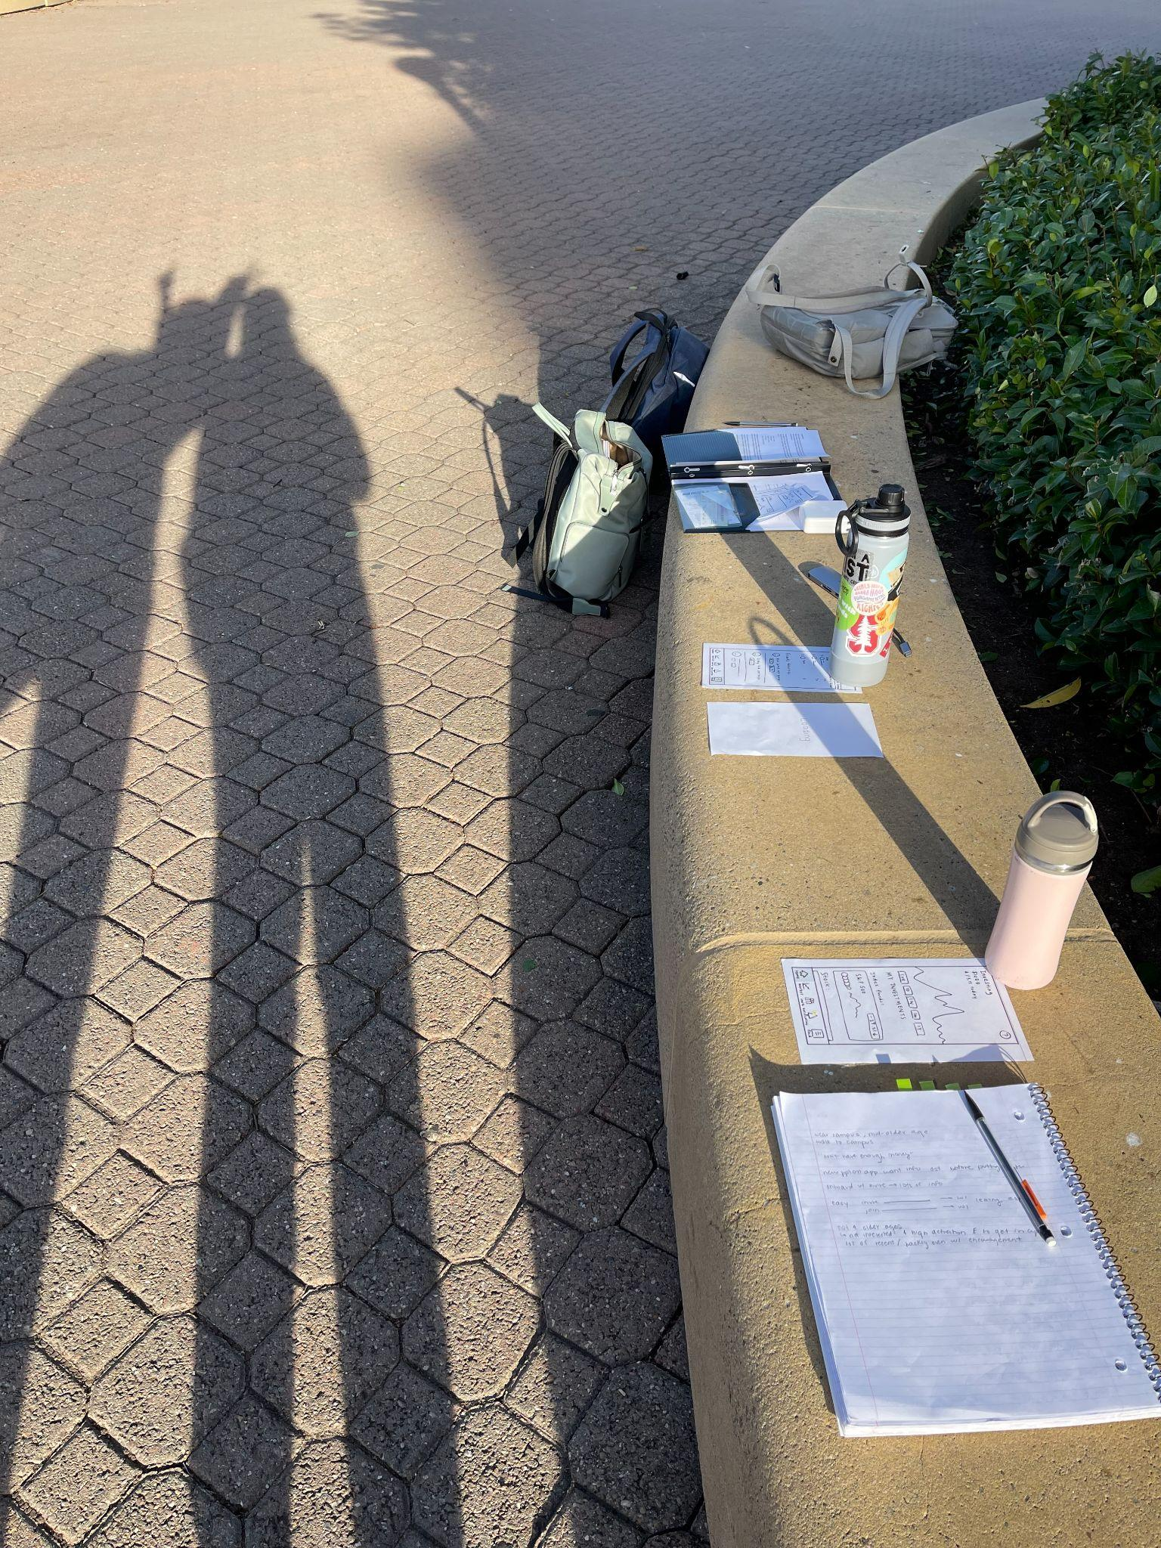

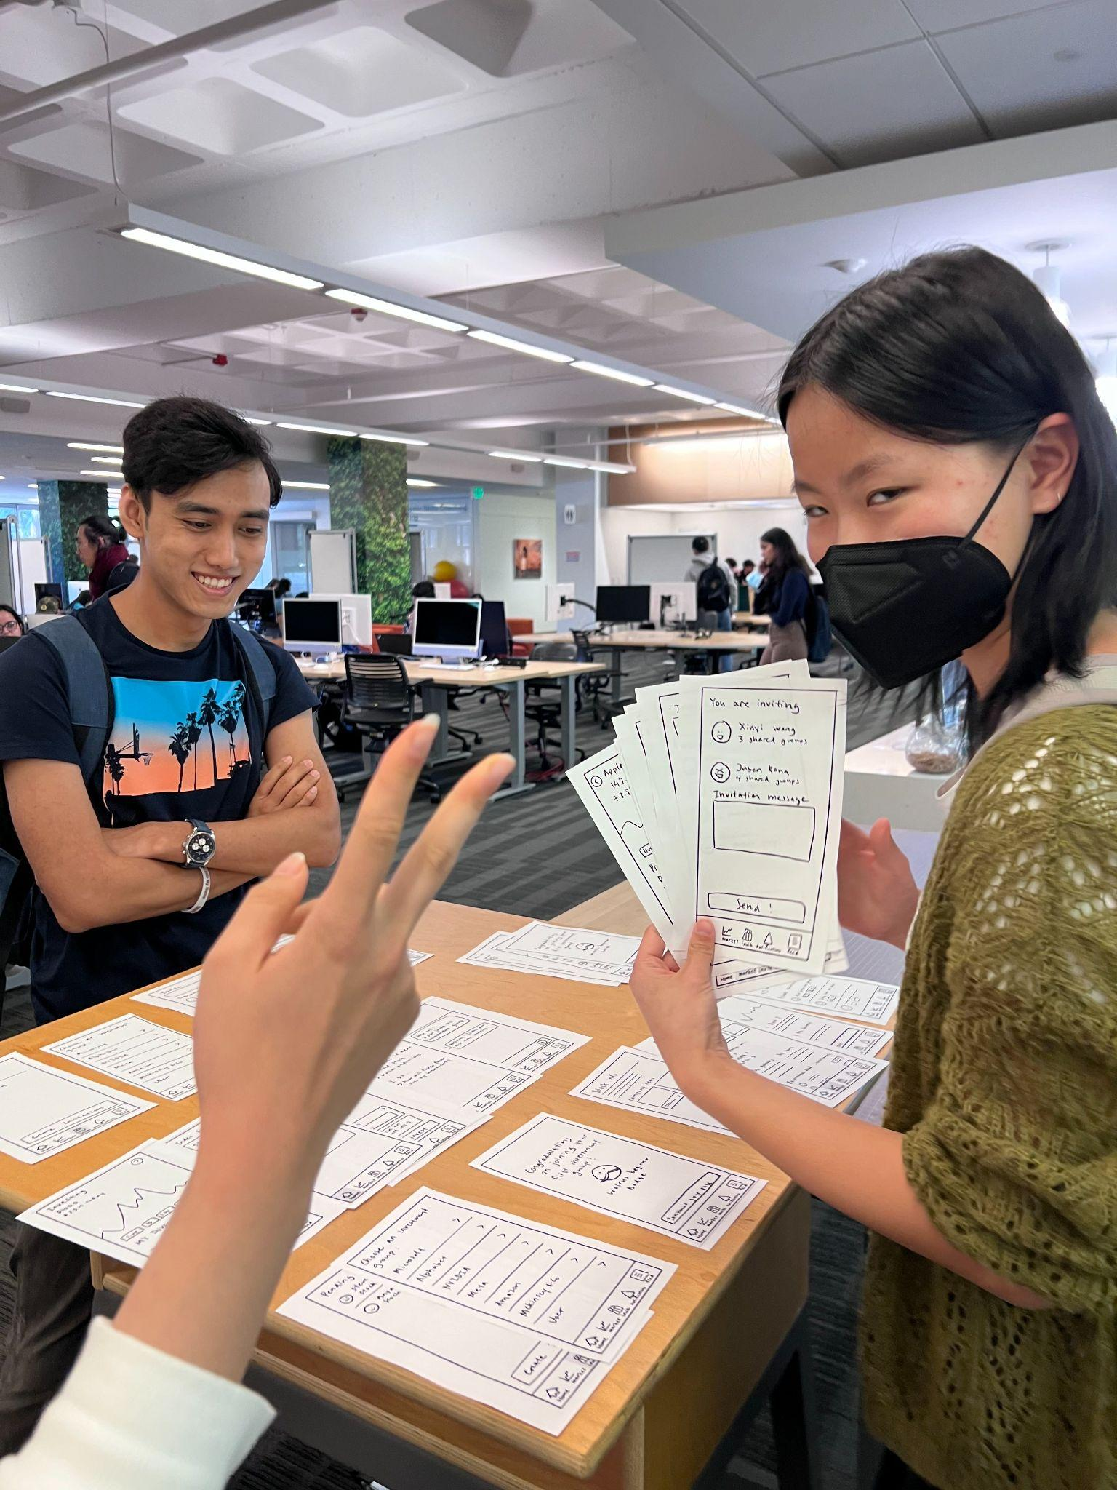

<3 Team Wallus

