Slide 1
Concept Video
Team 3
Avika, Juben, Madison, Xinyi

Slide 2
Table of contents
01
02
03
Market Research
Project Name and Value Proposition
Problem/Solution Overview
04
05
06
Values in Design
Tasks
Video Storyboard

Slide 3
01
Project Name and Value Proposition

Slide 4
Wallus
Our project name, “Wallus,” combines “wallet” and “us”, indicating the focus of our app being investing with friends to create a community that makes investment more accessible. Furthermore, it communicates investing being a viable option to keep one’s savings.
“Wallus” also echoes the name of our mascot “Walrus.”

Slide 5
One-liner
“Grow your investment intelligence with friends”

Slide 6
02 Problem/Solution Overview
Problem: Despite the importance and benefits of financial investment, people shy away from investing due to the lack of confidence, experience, and relevant knowledge.
Solution: Our product enables inexperienced investors to join or form different investment groups and invest together with their friends, which aims at enhancing the support and sense of community for newbie investors. Our product also incorporates educational elements into the users’ onboarding and investing process to equip users with investment knowledge along the way.

Slide 7
03
Market Research

Slide 8

Description: Easily create groups that invest together. Multiple people’s money comes together, creates an LLC, and tracks wealth through the app.
Problem they solve for: Investing with your friends
Benefits: Larger investment sizes means greater returns; making investing a social practice
Drawbacks: A company is incorporated legally so it is not easy to create multiple groups per user; long-term commitment means users are likely to be experienced investors.
How Wallus differentiates: The app is purely UI — while it might seem like a user is investing alongside friends, each user’s money is kept & investested separately under the cover. This allows Wallus users to have multiple groups and no longer-term commitment to any set.
Implications for co-existing products: Folks who are exclusive will likely opt for Tribevest.
Notes:
Clarification for “folks who are exclusive will likely opt for Tribevest”:
Exclusive here means limited number of individuals they would like to invest with. If a certain user only has one group of 3 they would like to make recurring investments with, Wallus won’t make sense since there is greater functionality for adding new people and having different groups. On the other hand, Tribevest would allow a constant group of 4 a lot more benefits for not switching up groups such as legal recognition and higher returns from pooled investment.

Slide 9

Description: Exclusive community for stock investing discussion
Problem they solve for: Shrinking the knowledge gap that exists in investing
Benefits: People can make better decisions on their investments when validated and discussed as a larger community; earn from others’ investments; meet new people
Drawbacks: Members are expected to contribute, making the platform great for mid-range experience. Folks who don’t invest would not find the forum inviting or inducing to learning.
How Wallus differentiates: Wallus provides the same community validation of stocks, but with the inviting and explicit education that is focused on new investors
Implications for co-existing products: If people want to expand outside of their circle, #investing is the choice but they can migrate new found groups to Wallus

Slide 10

Description: Investment simulation app that allows you to check on in-app friends as well
Problem they solve for: Making investing more accessible; educating new folks on the basics of investing; making investing a social experience
Benefits: Users can learn about stocks and trading in a no risk environment; users build confidence in investing; community-based allows discussion of decisions
Drawbacks: Users need to have the motivation to start on the app and would not take the app seriously if they didn’t value the idea of investing
How Wallus differentiates: Option of a friend who invests to kick-start a whole friend group’s habit; invest real money for real returns
Implications for co-existing products: Both apps could co-exist even simultaneously!

Slide 11
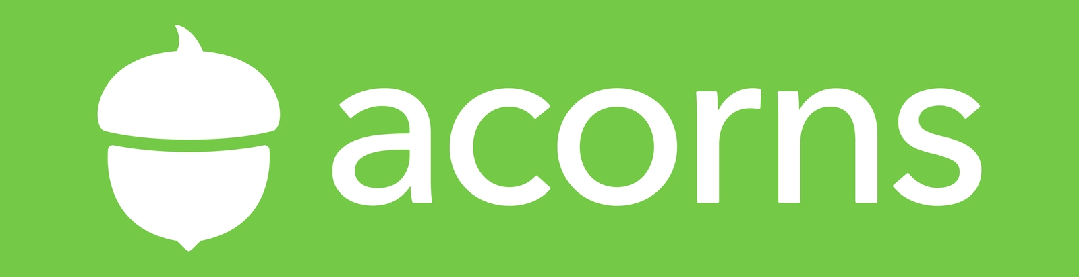
Description: automatically rounds up purchases and invests the change
Problem they solve for: investing is hard to get into and keep up with
Benefits: no thinking investing builds an easy habit; add friends/family who don’t already to user’s account to get them started in investing; automatic and recurring
Drawbacks: very independent practice; doesn’t make investing more tangible; no educational aspect for new folks joining
How Wallus differentiates: users would need to do a lot of pre-planning before using Wallus to invest and would likely be in larger amounts
Implications for co-existing products: it is very possible for users to use both of the apps; or use either or to get into investing and by osmosis of investing interest, try the other

Slide 12
Wallus!!
Easy for newbies
✅
✅
✅
Investing edu
✅
✅
✅
With friends
✅
✅
✅
No legal binding
✅
✅
✅
✅
Invest real money
✅
✅
✅

Slide 13
04
Values in Design

Slide 14
Embedded Values
Value | How to encode it
Inclusion | Easy to get started and invest with friends for users with varying levels of investing experience; Personalized onboarding procedure and educational content for newbies to get introduced to investment
Privacy | The user’s investment amount in a stock is only visible to friends in the investment group of the same company; how the user allocates their money into different groups is only visible to the user themselves
Autonomy | Although our product would make recommendations to the user based on their preferences, it ultimately comes down to the user themselves to decide their investment strategies.
Safety | The investment options on our platform are guaranteed to be safe in the sense that they would not get investors into investing fraud.

Slide 15
Conflicting Values?
The two biggest values that might conflict are inclusion, so that anyone can invest, but also autonomy so that folks can determine which friend investment groups they should join. We are addressing this conflict by making onboarding to the first investment easy and for low amount. From then on, we will include education on each investment, rank the options that come a user’s way, and help a user build their “preference” identity in investing!

Slide 16
05
Tasks

Slide 17
Basic Tasks
Join a friend’s investment group
Invite a friend to invest in the same stock with you
These two tasks are two sides of the same coin. Our product would notify the user of friends who have similar investment preferences. Based on our recommendation, the user could send invitations to their friends to join their investment group for a company’s stock. After receiving the invitation, their friends could decide whether to join the investment group.
These tasks are simple because the users only need to decide whether to invite / accept the invitation based on the recommendation of the platform. It is easy to do and requires little time and no professional knowledge.

Slide 18
Moderate Task
The inexperienced investors learn to make wise choices regarding which investment groups to join that aligns with their investment preferences
This task is moderate in complexity because it requires the newbies to figure out their investment preferences when they have little prior experience in investing. So they first need to get some hands-on practice in investing guided by our platform, through which they can get a sense of where they stand in terms of their risk tolerance, long-term goals, industry diversification, etc. Then following the personalized educational content about investing on our platform, the users need to learn how to invest wisely based on their preferences. It takes time and energy to learn about investment knowledge, and it might be daunting for newbies to make their first investment(s) even with the guidance of our product.

Slide 19
Complex Tasks
Users motivate one another to learn about personal finance routinely
Users share each investment with different numbers of people depending on their own investment situation
Sharing investment and inviting people to join their investment groups require the user to have accumulated some investment experience and know how much they would like to chip in for each company’s stock. Moreover, since this task involves groups of people, an extra layer of complexity lies in getting people with similar investment preferences together and maintaining positive inter-group dynamics to support and motivate one another in the investment process.
This task is complex due to two goals it contains: developing a habit and creating a learning community. Getting people to make investing and updating their investment knowledge part of their day-to-day life presupposes that our product has raised people’s awareness of the importance and necessity of investing. Another challenge is to help users derive motivation from the community of learners and prompt them to keep one another accountable for learning about finance and investment.

Slide 20
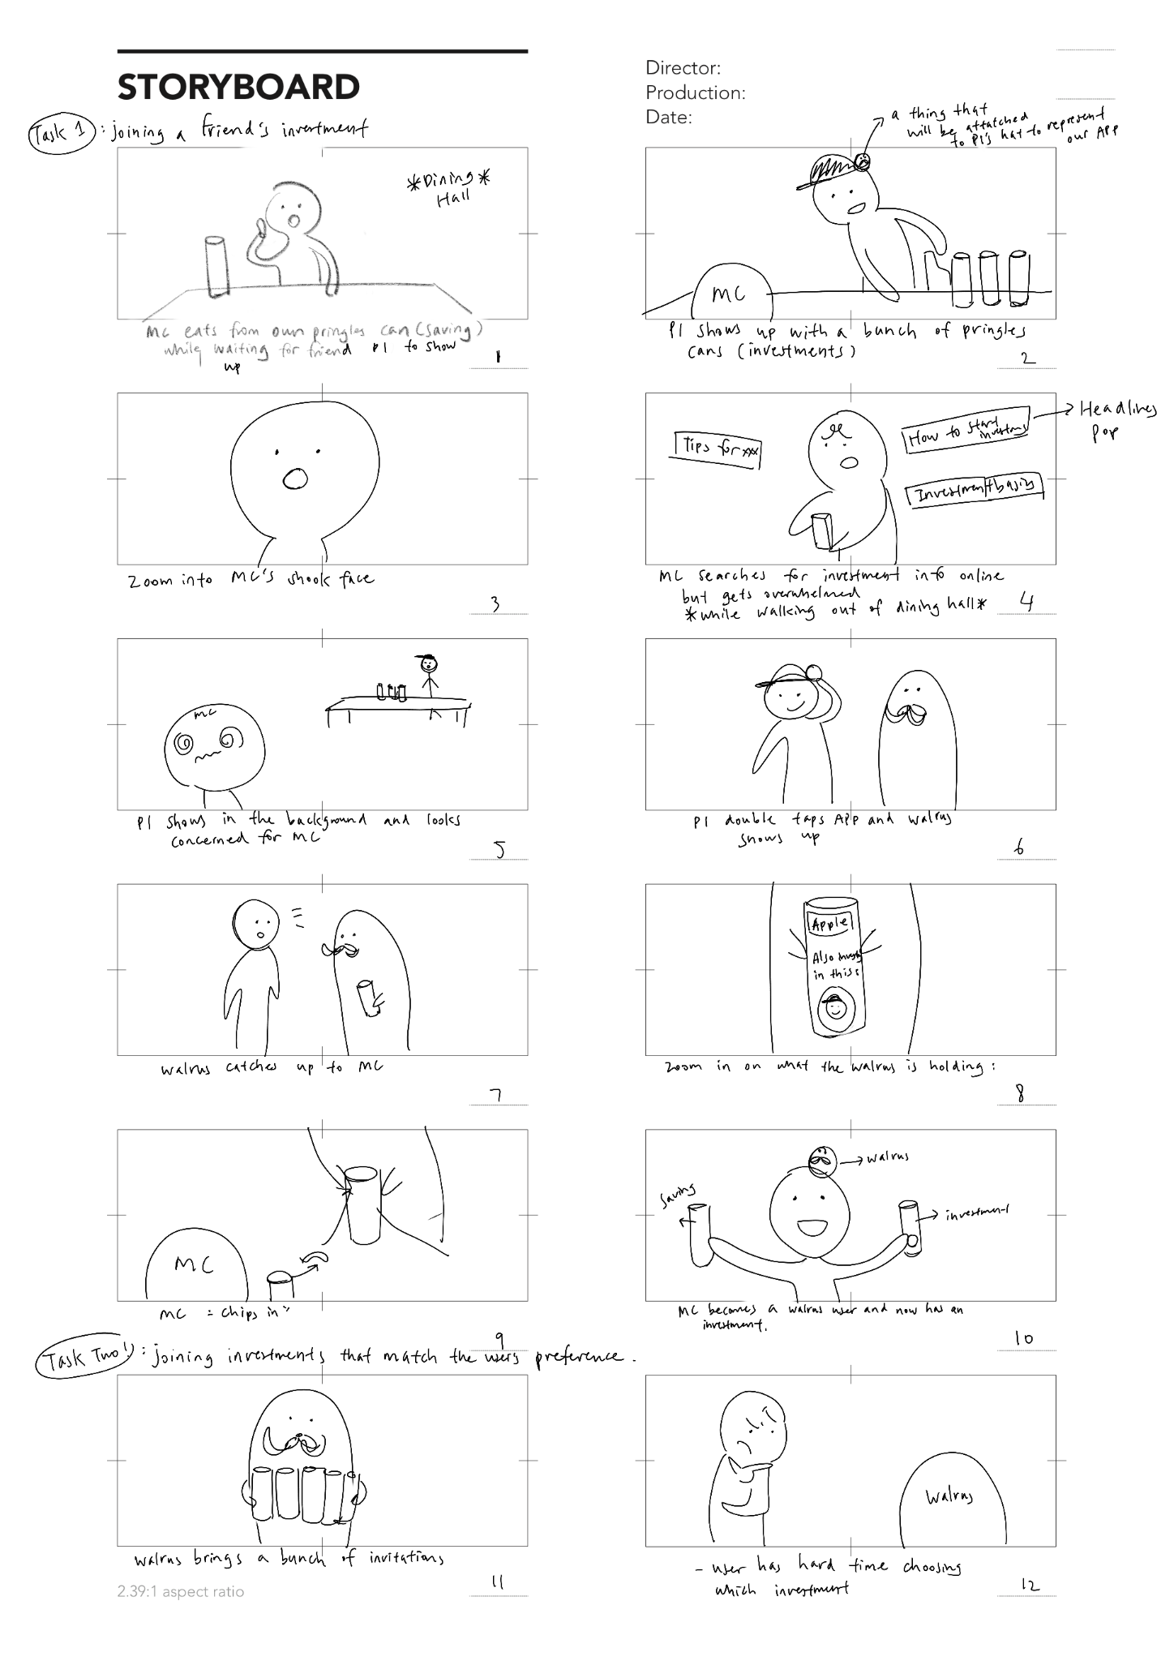
Storyboard

Slide 21
Storyboard

Slide 22
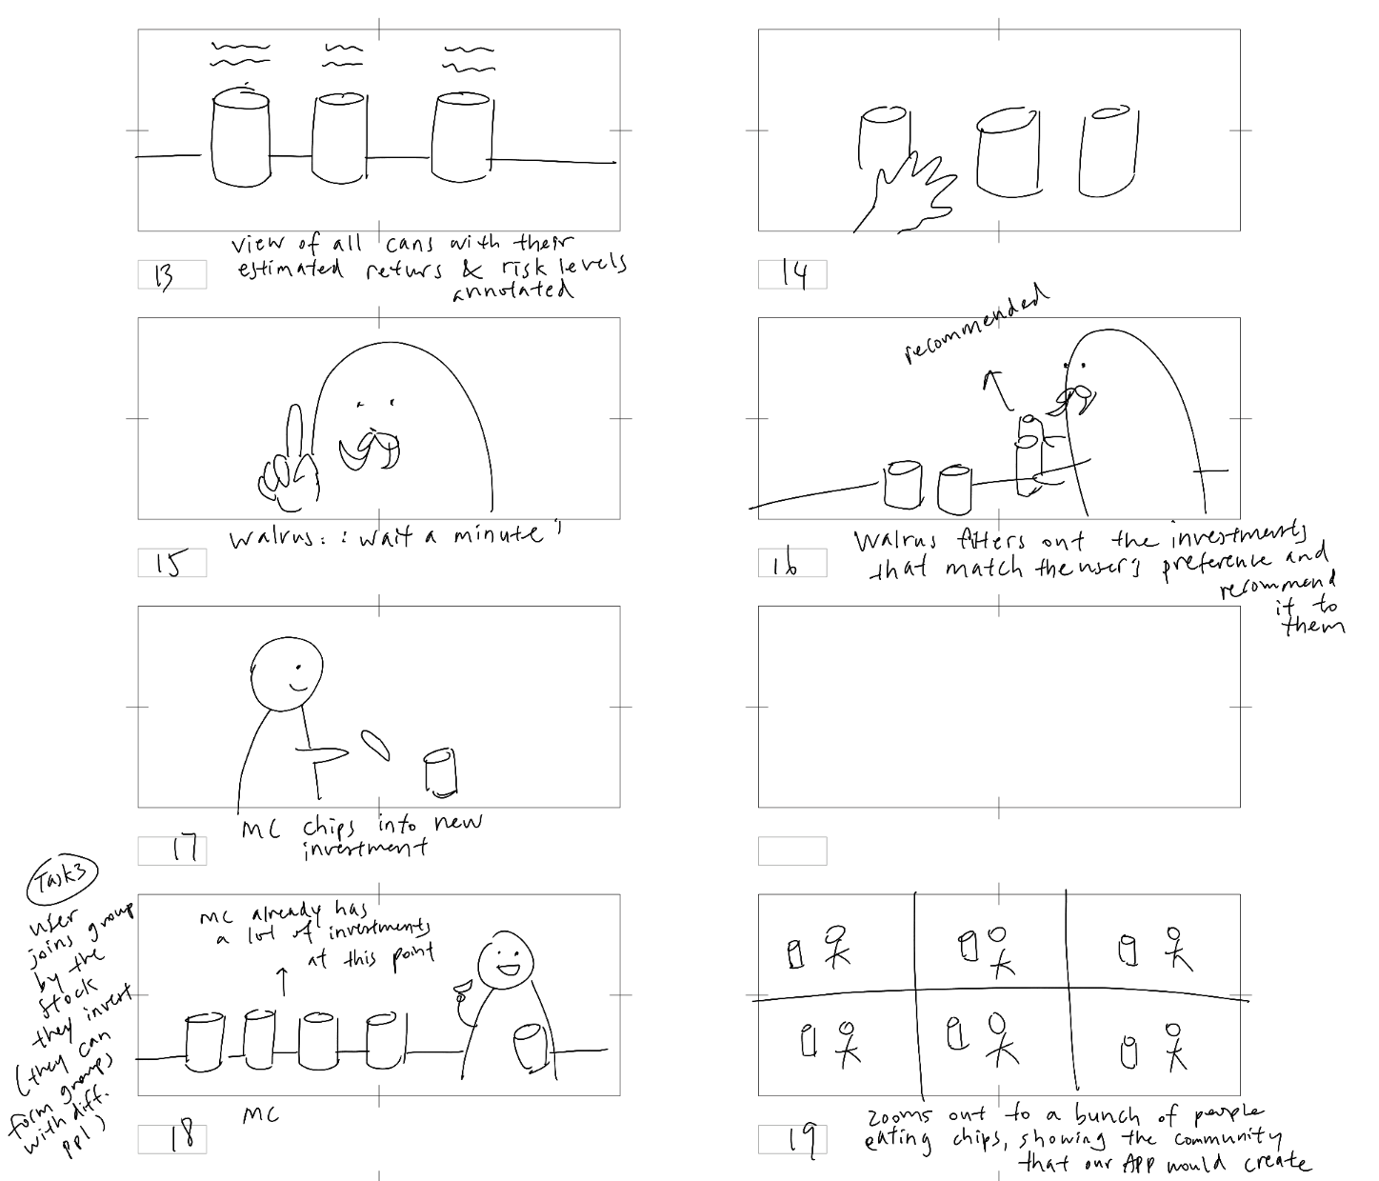
Storyboard

Slide 23
Concept Video Link
Blown Out version: https://youtu.be/tpoNucKAGMs
Notes:
Final Video Link: bit.ly/wallus22
Shot planning document: https://drive.google.com/file/d/1ZGMJaCrUxglFNLtUW8A4NU9WoMMszyAa/view?usp=sharing

