Slide 1
POV & Experience Prototyping
Team 3
Avika, Juben, Madison, Xinyi (Speaker)

Slide 2




Team 3
Avika Patel
CS ’24
Juben Rana
CS ’24
Madison Fan
Design ’25
Xinyi Wang
CS ’24
Notes:
Team name comes at the end!

Slide 3
Agenda
STEP 01
STEP 02
STEP 03
STEP 04
STEP 05
Additional Needfinding Results
POV Development
HMWs
Solutions & Experience Prototype
What’s Next

Slide 4
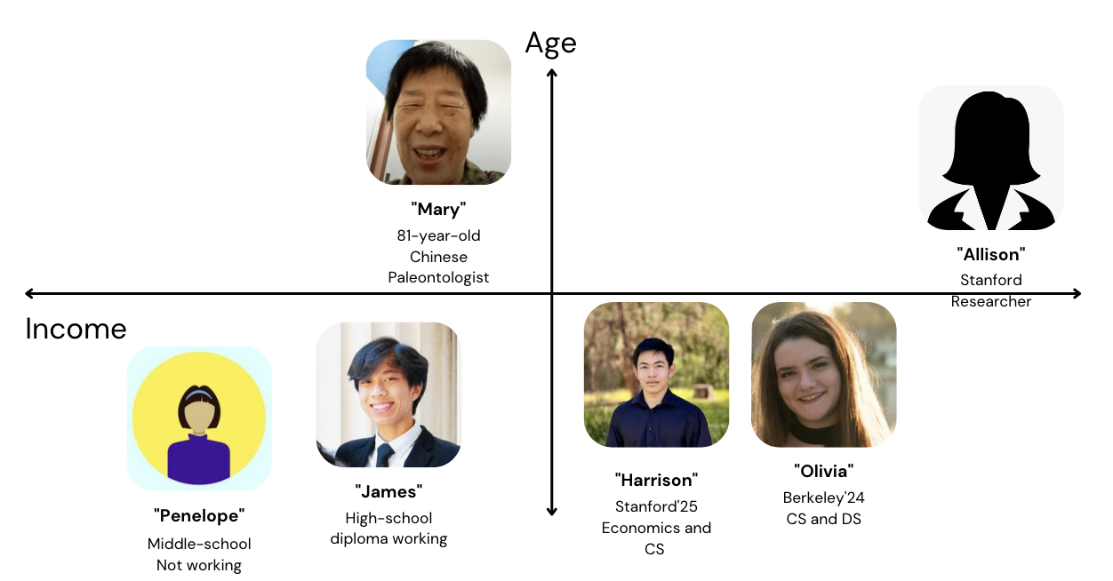
Recap

Slide 5
Recap
It is not just a literacy problem. There are plenty of resources, but there are constraints of time, support, and confidence that prevents people from starting to invest.
It is empowering to invest at a young age. However, kids find it hard keep up with, so often chose to minimize investing later in life.
People have misconceptions about the necessity of investing, different categories of investment, and benefits and risks involved. This is as much a branding game as a product game.

Slide 6
Problem Domain
Before
After
Financial literacy in the stock market
Making investment more accessible
Target Users:
People who are interested in investing or developing investment habit but have various constraints
Notes:
Age range: High-schoolers, young and middle-aged adults
Our product will be friendly and accessible to people outside this age range as well, but they are not our most focused target users.

Slide 7
Additional Needfinding Results

Slide 8

“I didn’t know anything about investing until I started working. Most of my colleagues and friends invest in stocks on Robinhood, so I started doing that as well.”
Insight: Being in a circle of people who invest is a motivating factor for newbies to start investing themselves.
“I wish I could know more about different investment options and their risk levels!”
“Clare”
“Have you tried figuring these out yourself?”
“Nope…I guess it’s just too complicated.”
A 29-year-old
Meta SWE
Time: 30 minutes
Location: Menlo Park
Insight: People with an interest to learn about investing are discouraged by the impression that investment is complicated and inaccessible.
Notes:
Clare did not let me take photo of her in her office for privacy concerns.
Recruit her because she is our target user: Inexperienced but interested in investing. Mid-age and high income, but still not investing.

Slide 9
Friends around her invested with Robinhood that inspired her
Stock prices decreasing should prompt selling stock
Say
Didn’t know anything about investing in college
There is a lot of knowledge about stocks that is unknown
Think
Got interested in investing after stocks were in her comp package
Stocks are unsafe, even if in the long term
Bank is safer than stocks
Investing can be learned online
People trust community opinion in investing
Biases companies she invests in based on personal opinion
Doesn’t want to invest since economic situation is awful
Apps that others use are validated and more safe
Investing is not for people until they have a need (ie given in comp package)
Financial advisor is too expensive
Financial advisors are expensive for the average person
It is harder to learn online
Wants more knowledge in stocks
No knowledge to make confidence decisions
Financial advisors can be trusted to make decisions
When the stock price plummeted she withdrew her stocks
She used to invest in the stock market
Used Robinhood to invest
Inspired by friends to try new financial apps
Attached to familiar companies
Safer putting money in something
Scared of using investing as a way to save money
Still invests most in bank (checking account)
Comforted by group decisions
Happy to do things with friends
Relieved to have forums that share knowledge
Did research on the companies before investing
Joined paid group with “investing expert” that told his strategies to follow
Inexperienced to make financial decision
Trusts experts
Faithful to opinion of experts
Uses xueqiu.com, a forum where people discuss stocks
Afraid of losing her money
Do
Learns new skills with teachers offline
Feel

Slide 10
Friends around her invested with Robinhood that inspired her
Stock prices decreasing should prompt selling stock
Say
Didn’t know anything about investing in college
There is a lot of knowledge about stocks that is unknown
Think
Got interested in investing after stocks were in her comp package
Stocks are unsafe, even if in the long term
Bank is safer than stocks
Doesn’t have the knowledge to motivate herself to invest in stocks
External support is necessary to start investing
Investing can be learned online
People trust community opinion in investing
Biases companies she invests in based on personal opinion
Doesn’t want to invest since economic situation is awful
Apps that others use are validated and more safe
Investing is not for people until they have a need (ie given in comp package)
Financial advisor is too expensive
Financial advisors are expensive for the average person
It is harder to learn online
Wants more knowledge in stocks
No knowledge to make confidence decisions
Financial advisors can be trusted to make decisions
When the stock price plummeted she withdrew her stocks
She used to invest in the stock market
Used Robinhood to invest
Inspired by friends to try new financial apps
Attached to familiar companies
Safer putting money in something
Scared of using investing as a way to save money
Scared of using stocks as a investment method
Motivated to invest with a community
Invests in stocks when there is a community (ie forum influences company choices, friends influence platform)
Still invests most in bank (checking account)
Comforted by group decisions
Happy to do things with friends
Relieved to have forums that share knowledge
Did research on the companies before investing
Joined paid group with “investing expert” that told his strategies to follow
Inexperienced to make financial decision
Trusts experts
Faithful to opinion of experts
Uses xueqiu.com, a forum where people discuss stocks
Afraid of losing her money
Do
Learns new skills with teachers offline
Feel

Slide 11
Interview Analysis
Contradictions
There are people with an interest / need to learn about investing but never actually started learning, because they are discouraged by the impression that investment is complicated and inaccessible.
Tensions
People became scared of investing in stock after they have lost money.
Surprises
Being in a circle of people who invest is a motivating factor for newbies to start investing themselves.
The prevalence of stock-based compensation makes the understanding of investment relevant even to employees who don’t actively invest.

Slide 12

(Stock market simulations) I don’t think the good outweighs the bad … It might empower someone and give them too much confidence and they might end up gambling with too much money on the stock market, and it does not perform as good as it does on the app, they might get upset.
Insight: Simulations with fake money does not replicate real life behaviours and may give a false sense of confidence.
“Hazel”
When asked about co-investing
“I think there is always that grey area. I don’t know if I want to take the risk when to comes to doing something that could potentially ruin a friendship.”
A recent college graduate student who works at Nvidia.
Time: 30 minutes
Location: Stanford
Insight: Co-investing might monetize relationships and cause friction and unnecessary pressure in our social lives.
Notes:
Recruit her because she is our target user: New grad, high income, balancing finances and comp packages for the first time.
this second insight doesn’t completely undermine our idea because our idea is more about creating a community for investing that would motivate people to invest, and this insight can lead us to think hmw make investing tgt not risk a friendship
Also “investing tgt” doesn’t necessarily mean friends are financially tied tgt in their investment, when we say that we mean creating this social environment where people encourage each other to partake in something they have little experience in

Slide 13
No formal training in finance
Her coworkers taught her how to use 401k and stock options for companies.
Trustworthy financial app:
-keeps her data and money secure
-shows where it gets its info from
Trustworthy fin advisor:
-Suggestive not imperative
-Have backing to their claims
Learned a lot from gerrymandering game because it was fun.
Say
Think
Nvidia does not educate their employees on personal finance.
Brother taught her how to use brokerage accounts and vanguard.
Stock market is the most confusing aspect of personal finance.
Family still remains to be the most influential factor when it comes to her current personal finance decisions.
The question of how to handle money is pretty subjective.
Doesn’t know who to trust when it comes to financial advice.
Financial app for children should prioritize on being interactive and fun.
It would be nice to have a formal education where she could learn everything related to personal finance.
Started investing around the time when she transitioned into college.
Before graduating college, she saw investment as a hobby
Stock market is volatile
Saving in the bank is not the best option.
Joined her company’s slack channel on personal finance on the day of the interview.
Does not practice short selling or buy/sell stocks for immediate profit.
Mostly had finance conversations with family members
Overwhelmed looking into personal finance on her own.
Fortunate to have a good role model in her brother.
Afraid that co investing could monetize a friendship.
Didn’t talk about personal finance with friends before joining Nvidia.
Stock market simulation will empower people and give them too much confidence, such that they may end up making bad decisions.
Fears that co investing could potentially ruin a friendship.
Followed her brother’s advice since high school. He is an econ PhD student.
Attempted to look into personal finance on her own but it wasn’t successful.
She talks to people about finance to weigh the different options for allocating her money. (takes it as advice)
Hard and Intimidating to jump into conversations about finance.
She has played financial games such as monopoly and gerrymandering
Safe to trust sources if people she trusts trust them.
Do
Feel

Slide 14
No formal training in finance
Her coworkers taught her how to use 401k and stock options for companies.
Trustworthy financial app:
-keeps her data and money secure
-shows where it gets its info from
Trustworthy fin advisor:
-Suggestive not imperative
-Have backing to their claims
Learned a lot from gerrymandering game because it was fun.
Say
Think
Nvidia does not educate their employees on personal finance.
Brother taught her how to use brokerage accounts and vanguard.
Saw investment as a hobby and not a crucial part of life for a very long time
Investment is the better option compared to a savings account
Stock market is the most confusing aspect of personal finance.
Family still remains to be the most influential factor when it comes to her current personal finance decisions.
Coworkers are really helpful when it comes to learning more about personal finance
The question of how to handle money is pretty subjective.
Doesn’t know who to trust when it comes to financial advice.
Financial app for children should prioritize on being interactive and fun.
It would be nice to have a formal education where she could learn everything related to personal finance.
Started investing around the time when she transitioned into college.
Before graduating college, she saw investment as a hobby
Stock market is volatile
Saving in the bank is not the best option.
Joined her company’s slack channel on personal finance on the day of the interview.
Does not practice short selling or buy/sell stocks for immediate profit.
Mostly had finance conversations with family members
Overwhelmed looking into personal finance on her own.
Fortunate to have a good role model in her brother.
Afraid that co investing could monetize a friendship.
Knows investment is important but is overwhelming to dive into the subject alone
Having someone in the family who knows about investments is incredibly helpful
Didn’t talk about personal finance with friends before joining Nvidia.
Stock market simulation will empower people and give them too much confidence, such that they may end up making bad decisions.
Fears that co investing could potentially ruin a friendship.
Followed her brother’s advice since high school. He is an econ PhD student.
Attempted to look into personal finance on her own but it wasn’t successful.
Involving friends in your investments might ruin friendship and pressure you into making decision you do not want to make
She talks to people about finance to weigh the different options for allocating her money. (takes it as advice)
Hard and Intimidating to jump into conversations about finance.
She has played financial games such as monopoly and gerrymandering
Safe to trust sources if people she trusts trust them.
Do
Feel

Slide 15
Interview Analysis
Contradictions
Thinks it would be nice to have some place formal where she could learn everything related to personal finance but she never took any classes on finance during her years in college.
Felt that a group activity that dealt with gerrymandering was fun and said she learned a lot from it but did not try any games related to finance on her own.
Tensions
She does not co-invest because she thinks mixing friendship with money will ruin relationships.
Believes investment simulations with fake money will give people false confidence.
Surprises
Having a person knowledgeable in finance in the family eliminates the need for a financial advisor.
Thought investment only as a hobby for a very long time.
Trusts sources if her brother (whom she trusts) trusts it.

Slide 16
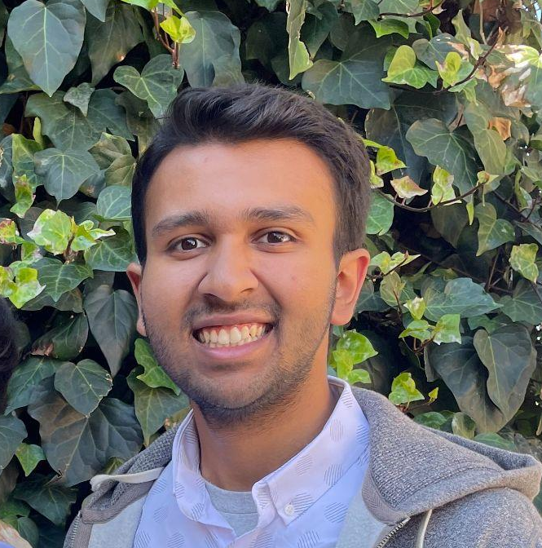
“My mom used to day trade. It was almost like a ‘casino affect’ trying to time the market … I had to convince her it wasn’t worth it”
Insight: Many inexperienced folks invest dangerously and don’t change unless someone close to them tells them otherwise
“I am not really into finance myself… you have to invest if you don’t want to work crazy 16 hour days when you’re older. I use investing as a type of income.”
“Ryan”
20-year old college student on LOA and pre-seed startup CTO
Time: 45 minutes
Location: Duan (EVGRA)
Insight: Finances and investing is boring. However, after understanding its importance, investing is the core to having savings when older.
Notes:
Recruit him because he is our target user: young, handling finances on his own, balancing lower-income and no housing security if job falls through.

Slide 17
Say
Learned guiding rules of thumb from parents
Likes to hear investing hacks, actual investing talk is boring
Trusts market will have 10% increase/year even with recessions
Impossible to beat the market without insider information
Parents are a great source of knowledge for investing
Think
Investing is boring
Notices that a lot of Stanford students don’t invest or don’t talk about it
Investing is time consuming
Market is reliable for returns in the long-run
Stocks are unsafe, even if in the long term
Resources of quant firms are not democratized
Learned concepts as a child with real life examples (ie hoover dam financing on a road trip)
Children can learn financial concepsts
Fun to research stocks, but often no time
People who are wealthy do not need returns so do not invest
Investing tax ramifications are hard to figure out
Investing is inherently unfair
Everyday examples can explain financial concepsts
Researches stocks and gives recs to mom
Secure investing in the stock market
Frustrated with folks roped into day trading
Unintere-sted in talking about fiances
Disappointed that quant firms do not share findings
Saves money through stocks to get higher returns
Talks with a few friends about investing
Follows Apple Stocks
Saves at least half income post tax
Self-confident for student ability to handle finances
Mostly just invests in index funds and waits years
Gratefu for knowledge from parents
Distraught that full information on taxing stock benefits isn’t shared
Researched then convinced his mom that her day trading was detrimental
$7500 in ROTH
Pressured to invest to make money
Reliant on research before investing
Do
Handles his own finances
Feel

Slide 18
Say
Learned guiding rules of thumb from parents
Likes to hear investing hacks, actual investing talk is boring
Trusts market will have 10% increase/year even with recessions
Impossible to beat the market without insider information
Parents are a great source of knowledge for investing
Think
Investing is boring
Notices that a lot of Stanford students don’t invest or don’t talk about it
Considers investing important but knows it takes time to research (present-time) and learn (years as a child)
Investing is a necessary evil to live life comfortably
Knowledge gap in investing (quant firms and day trading)
Market is reliable for returns in the long-run
Investing is time consuming
Stocks are unsafe, even if in the long term
Resources of quant firms are not democratized
Learned concepts as a child with real life examples (ie hoover dam financing on a road trip)
Children can learn financial concepts
Fun to research stocks, but often no time
People who are wealthy do not need returns so do not invest
Investing tax ramifications are hard to figure out
Investing is inherently unfair
Everyday examples can explain financial concepts
Researches stocks and gives recs to mom
Secure investing in the stock market
Frustrated with folks roped into day trading
Unintere-sted in talking about finances
Disappointed that quant firms do not share findings
Saves money through stocks to get higher returns
Talks with a few friends about investing
Follows Apple Stocks
Satisfied with current investments
Frustrated when people fall into traps and make incorrect investments
Invests the maximum he can and only for long-term
Saves at least half income post tax
Self-confident for student ability to handle finances
Mostly just invests in index funds and waits years
Grateful for knowledge from parents
Distraught that full information on taxing stock benefits isn’t shared
Researched then convinced his mom that her day trading was detrimental
$7500 in ROTH
Pressured to invest to make money
Reliant on research before investing
Do
Handles his own finances
Feel

Slide 19
Interview Analysis
Contradictions
Thinking about finances is boring, but enjoys doing extensive research to recommend a stock to his mom
Tensions
People who get tied to media and invest dangerously need to be convinced that it isn’t right (ie. his mom)
Believes it is hard to beat the market because knowledge is concentrated in quant firms and research institutions
Surprises
Thought that people who are wealthier don’t invest because they “don’t need to”
Learned financial concepts as a child with real-world examples from his parents
Enjoys hearing financial hacks and stock tips from friends, but the conversation doesn’t come up often
Invests at least half his income post-tax

Slide 20
2. POV Development

Slide 21
Initial POV
We met
A
C
We wonder if this means
Olivia, a 20 year old college student with an MBA mom and investor dad
She is concerned about the lack of transparency in the financial advising/planning industry.
We were surprised to notice
B
D
It would be game-changing to
She finds investing fun now but is worried about the future when she accumulates wealth and will have to let control over her personal finance go to a financial advisor
Maintain transparency of financial advising while providing the necessary assistance to customers
Notes:
Game-changing is too solution-specific

Slide 22

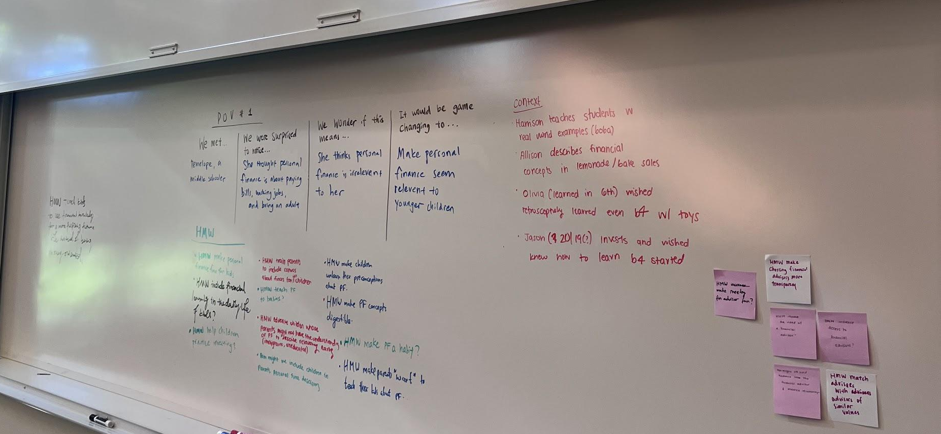
More Interviews
POV Revision

Slide 23
POV #1
We met
A
C
We wonder if this means
Penelope, a middle schooler who is the youngest in a family of three children brought up in a household not very much into investments
She feels that personal finance is irrelevant to her
We were surprised to notice
B
D
It would be game-changing to
She thought personal finance is about paying bills, working jobs, and being an adult
Make younger children more aware of the importance and relevance of personal finance

Slide 24
POV #2
We met
A
C
We wonder if this means
Mary, an 81 years old paleontologist who has a college year granddaughter
Her lack of time for learning how to invest results in fear of investing
We were surprised to notice
B
D
It would be game-changing to
that she prefers investing in bank products because the stock market is unpredictable, needs dedicated time to make good decision, and hard to keep up to date
Make investing less daunting for people with no experience or relevant knowledge

Slide 25
POV #3
We met
A
C
We wonder if this means
Olivia, a 20 year old college student with an MBA mom and investor dad who taught her who to invest in 6th grade
She finds investing increasingly worrisome as she accumulates wealth
We were surprised to notice
B
D
It would be game-changing to
She finds investing fun now but is worried about the future when she accumulates wealth and will have to let control over her personal finance go to a financial advisor
Make people feel in control of their personal finance regardless of their income

Slide 26
3. How Might We…?

Slide 27
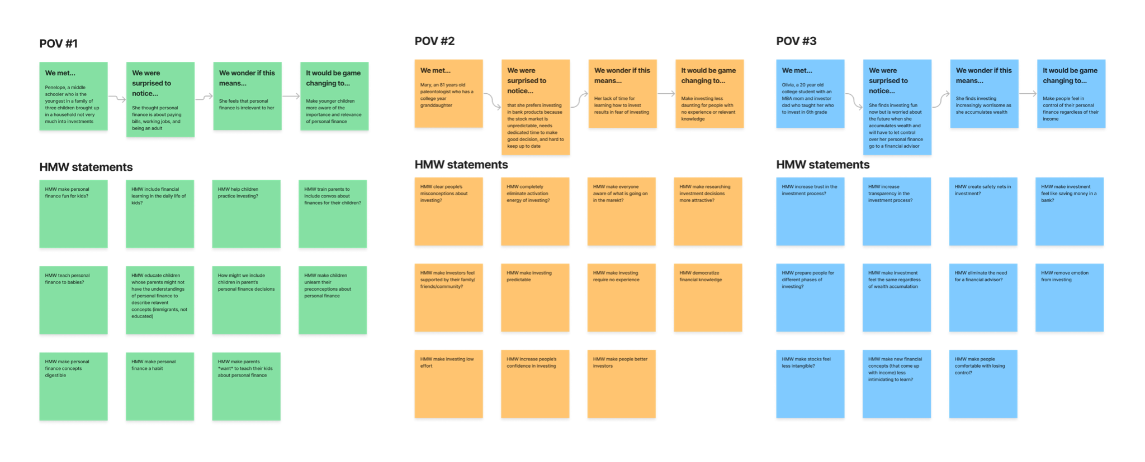
Notes:
HMW Brainstorm FigJam (to see statements)
https://www.figma.com/file/STY6YgipaGASaAWDTIZxXW/HMW-Brainstorm

Slide 28
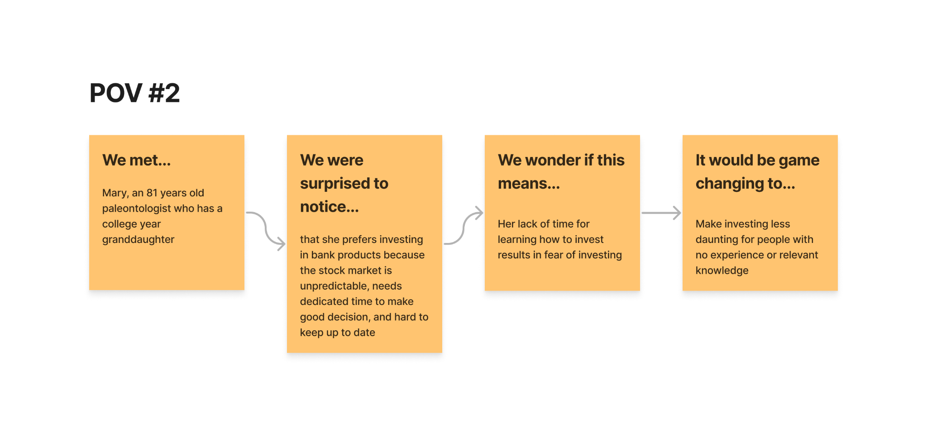
HMW make investing low effort?

Slide 29
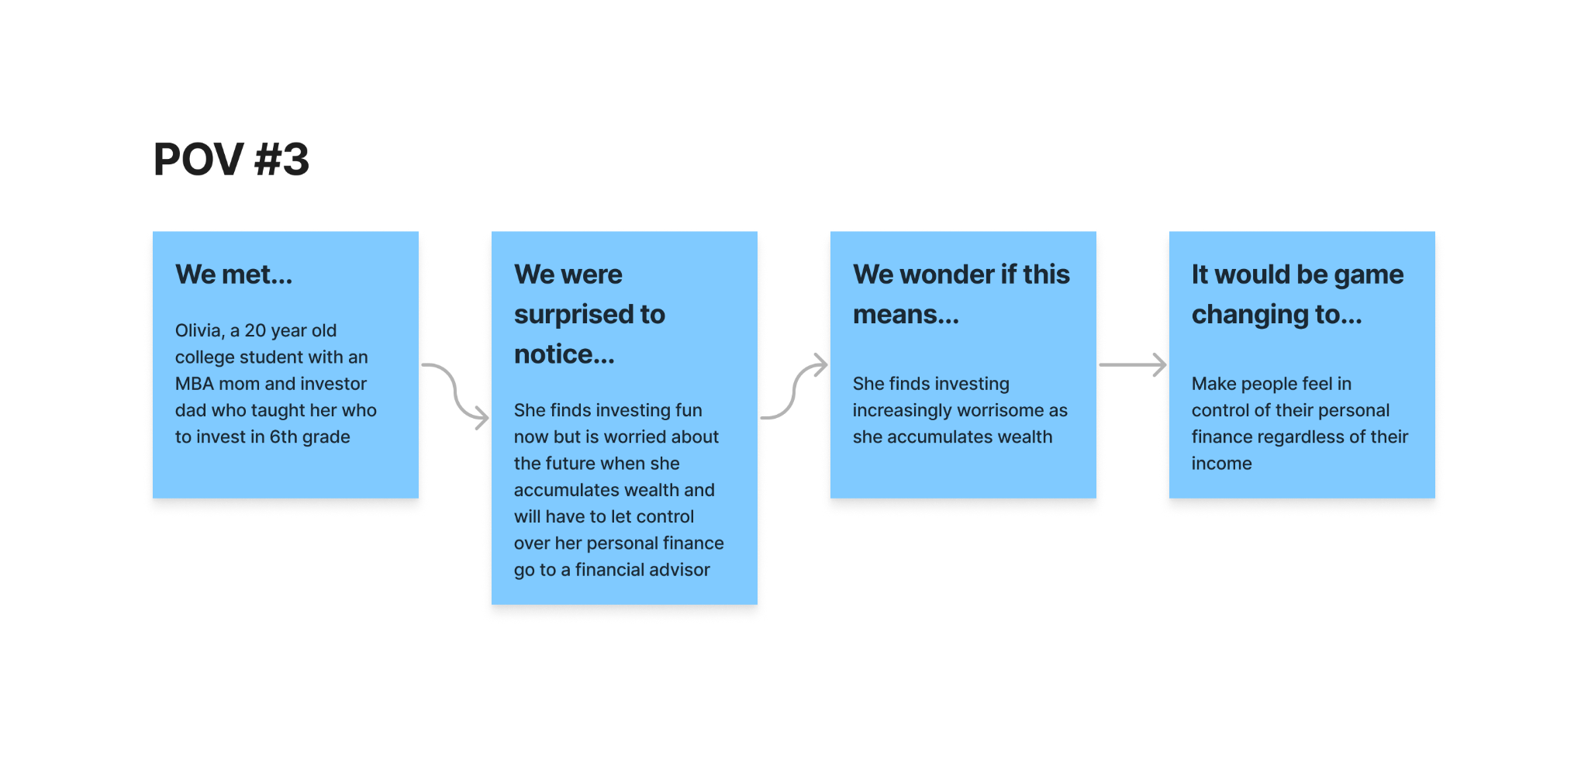
HMW increase transparency in the investment process?

Slide 30
HMW make investing feel like saving money in a bank?

Slide 31
4. Solutions & Experience Prototypes

Slide 32
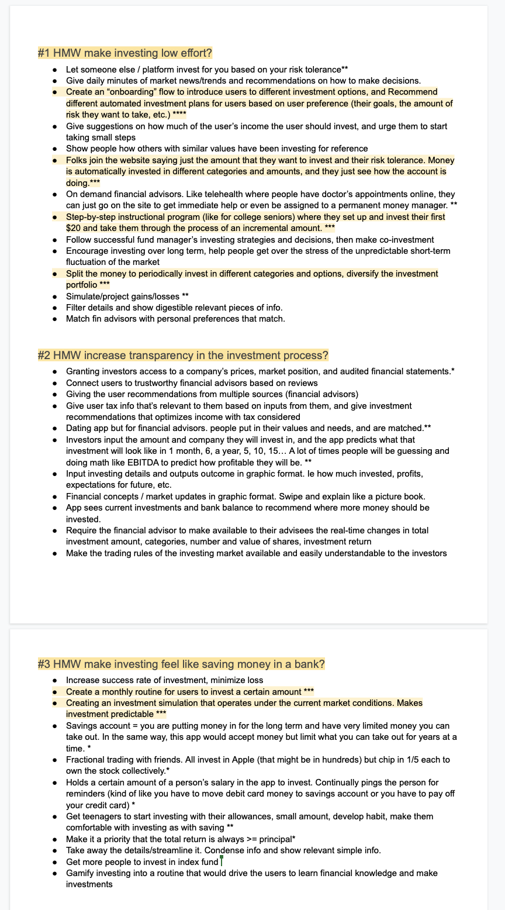
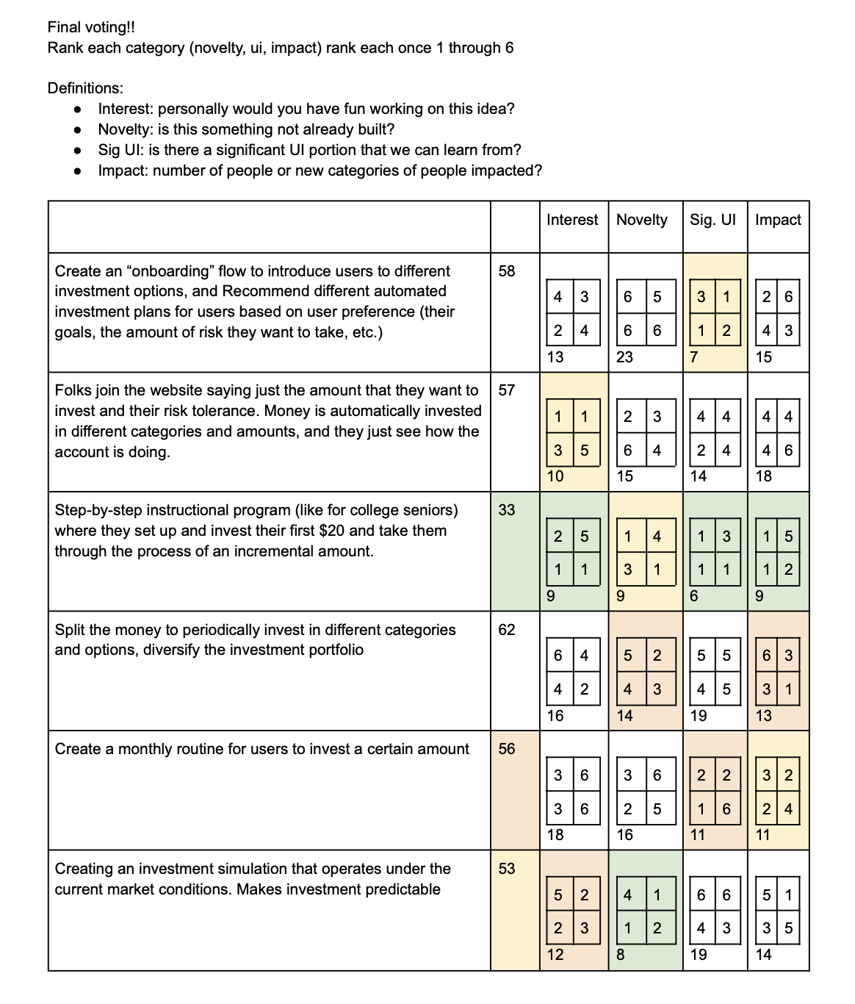
Solution Brainstorming & Voting Process
Round 2
Round 1

Slide 33
Methodology
Brainstorm as many solutions to each HWM
Each of the four members put a * by each idea they would be willing to continue
All ideas with 3 or more * were put into a quantitative voting process
Each member ranked each idea on the axis of (1) Personal Interest (2) Novelty (3) Significant UI learning possible (4) Impact from 1-6
The top ideas were discussed and finalized!

Slide 34
HMW make investing low effort?
Let someone else / platform invest for you based on your risk tolerance**
Give daily minutes of market news/trends and recommendations on how to make decisions.
Create an “onboarding” flow to introduce users to different investment options, and Recommend different automated investment plans for users based on user preference (their goals, the amount of risk they want to take, etc.) ****
Give suggestions on how much of the user’s income the user should invest, and urge them to start taking small steps
Show people how others with similar values have been investing for reference
Folks join the website saying just the amount that they want to invest and their risk tolerance. Money is automatically invested in different categories and amounts, and they just see how the account is doing.***
On demand financial advisors. Like telehealth where people have doctor’s appointments online, they can just go on the site to get immediate help or even be assigned to a permanent money manager. **
Step-by-step instructional program (like for college seniors) where they set up and invest their first $20 and take them through the process of an incremental amount. ***
Follow successful fund manager’s investing strategies and decisions, then make co-investment
Encourage investing over long term, help people get over the stress of the unpredictable short-term fluctuation of the market
Split the money to periodically invest in different categories and options, diversify the investment portfolio ***
Simulate/project gains/losses **
Filter details and show digestible relevant pieces of info.
Match fin advisors with personal preferences that match.

Slide 35
HMW increase transparency in the
investment process?
Granting investors access to a company’s prices, market position, and audited financial statements.*
Connect users to trustworthy financial advisors based on reviews
Giving the user recommendations from multiple sources (financial advisors)
Give user tax info that’s relevant to them based on inputs from them, and give investment recommendations that optimizes income with tax considered
Dating app but for financial advisors. people put in their values and needs, and are matched.**
Investors input the amount and company they will invest in, and the app predicts what that investment will look like in 1 month, 6, a year, 5, 10, 15… A lot of times people will be guessing and doing math like EBITDA to predict how profitable they will be. **
Input investing details and outputs outcome in graphic format. Ie how much invested, profits, expectations for future, etc.
Financial concepts / market updates in graphic format. Swipe and explain like a picture book.
App sees current investments and bank balance to recommend where more money should be invested.
Require the financial advisor to make available to their advisees the real-time changes in total investment amount, categories, number and value of shares, investment return
Make the trading rules of the investing market available and easily understandable to the investors

Slide 36
HMW make investing feel like
saving money in a bank?
Increase success rate of investment, minimize loss
Create a monthly routine for users to invest a certain amount ***
Creating an investment simulation that operates under the current market conditions. Makes investment predictable ***
Savings account = you are putting money in for the long term and have very limited money you can take out. In the same way, this app would accept money but limit what you can take out for years at a time. *
Fractional trading with friends. All invest in Apple (that might be in hundreds) but chip in 1/5 each to own the stock collectively.*
Holds a certain amount of a person’s salary in the app to invest. Continually pings the person for reminders (kind of like you have to move debit card money to savings account or you have to pay off your credit card) *
Get teenagers to start investing with their allowances, small amount, develop habit, make them comfortable with investing as with saving **
Make it a priority that the total return is always >= principal*
Take away the details/streamline it. Condense info and show relevant simple info.
Get more people to invest in index fund
Gamify investing into a routine that would drive the users to learn financial knowledge and make investments

Slide 37
Solution 1:
Automate investing site for beginners: low effort required and all details taken care of.

Slide 38
Solution 1
Unknown
People are aware of their personal risk tolerance in investing
Newbies will be motivated to use an app for finances
Newbies will trust an auto investor with their real money
People will invest more if they don’t have control
Not vital for user experience
Vital for user experience
Newbies don’t want to see the details of their investment
An algorithm will cost less for the user (than a financial advisor)
An algorithm can opt in for a human
Can people follow directions
Known

Slide 39
Solution 1
Assumption
Automated investing site for beginners: low effort required and all details taken care of.
Investment newbies will be willing to let go of control and trust a robo-advisor with their real money

Slide 40
Experience Prototype
Relevance
We want to see whether people are comfortable with having a stranger getting food for them based on their dietary preferences and restrictions at the dining halls.
Participants: college students interested in investment, recruited by approaching people in the dining halls
Core idea: letting go control on something that has intimate, everyday relevance to individuals
Personalized investment preferences & food preferences
First time having a stranger getting food & investment newbies
Notes:
We asked participants about their investment situation to make sure they are within our target user group.

Slide 41


“Mack”
“Matthew”

Slide 42
Results
Things that didn’t go well
Had to get the participant alternatives due to long lines; accidentally chose a food option the participant does not like but did not specify in his dietary preferences
New Learnings
Participants expressed wish to maintain control over their choices for flexibility and autonomy
Participants reported that they would not trust someone they didn’t know to get food for them
Insights
People are not comfortable with handing control over something of personal importance to service providers they don’t know well
When it comes to decisions that need to be tailored to suit individual preferences, people prefer the flexibility and autonomy that comes with making choices themselves
INVALID
Notes:
Not to move forward with autoinvesting because building trust that people have for our auto-investing platform is hard and will take a long time, not to mention our target users involve people with misconceptions/mistrust about investing.

Slide 43
Solution 2:
Step-by-step instructional program for students where they set up and invest their first $20 and take them through the process of an incremental amount.

Slide 44
Solution 2
Unknown
Students will follow up with their real money after the given $20
Students will stay engaged with the complete onboarding process
High school students are interested in personal finance
Not vital for user experience
Vital for user experience
High school students have money to invest
Students can follow directions
Students will invest $20 we give
Known

Slide 45
Solution 2
Assumption
Step-by-step instructional program for students where they set up and invest their first $20 and take them through the process of an incremental amount.
High school students are interested in personal finance

Slide 46
Experience Prototype
Relevance
We went to Palo Alto High School to collect sign-ups for a “Personal Finance Club.”
We stood in 3 different places around the campus
  in-front of a classroom
  communal outdoor space
  loop where kids wait to get picked up
Had a mix of (1) standing with the sign and allowing students to come up (2) directly asking if they would be interested in joining
Palo Alto High School interacts with our target audience of high school students :)
Since the program is a long-term commitment, we asked about joining a Club
Stood in places where students had time to interact with us
Asking them for an email is a direct correlation with interest (ie they are giving up something)
Mentioned “Stanford-led” to correlate with the program being taught by ‘experts’

Slide 47
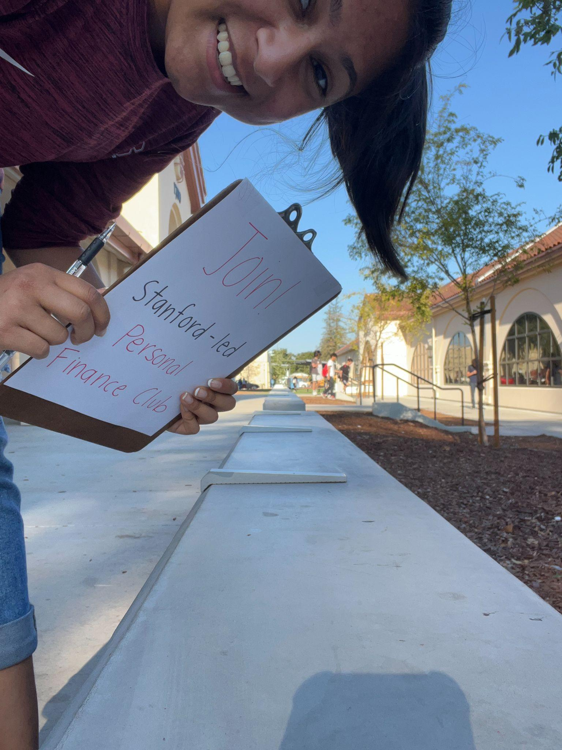
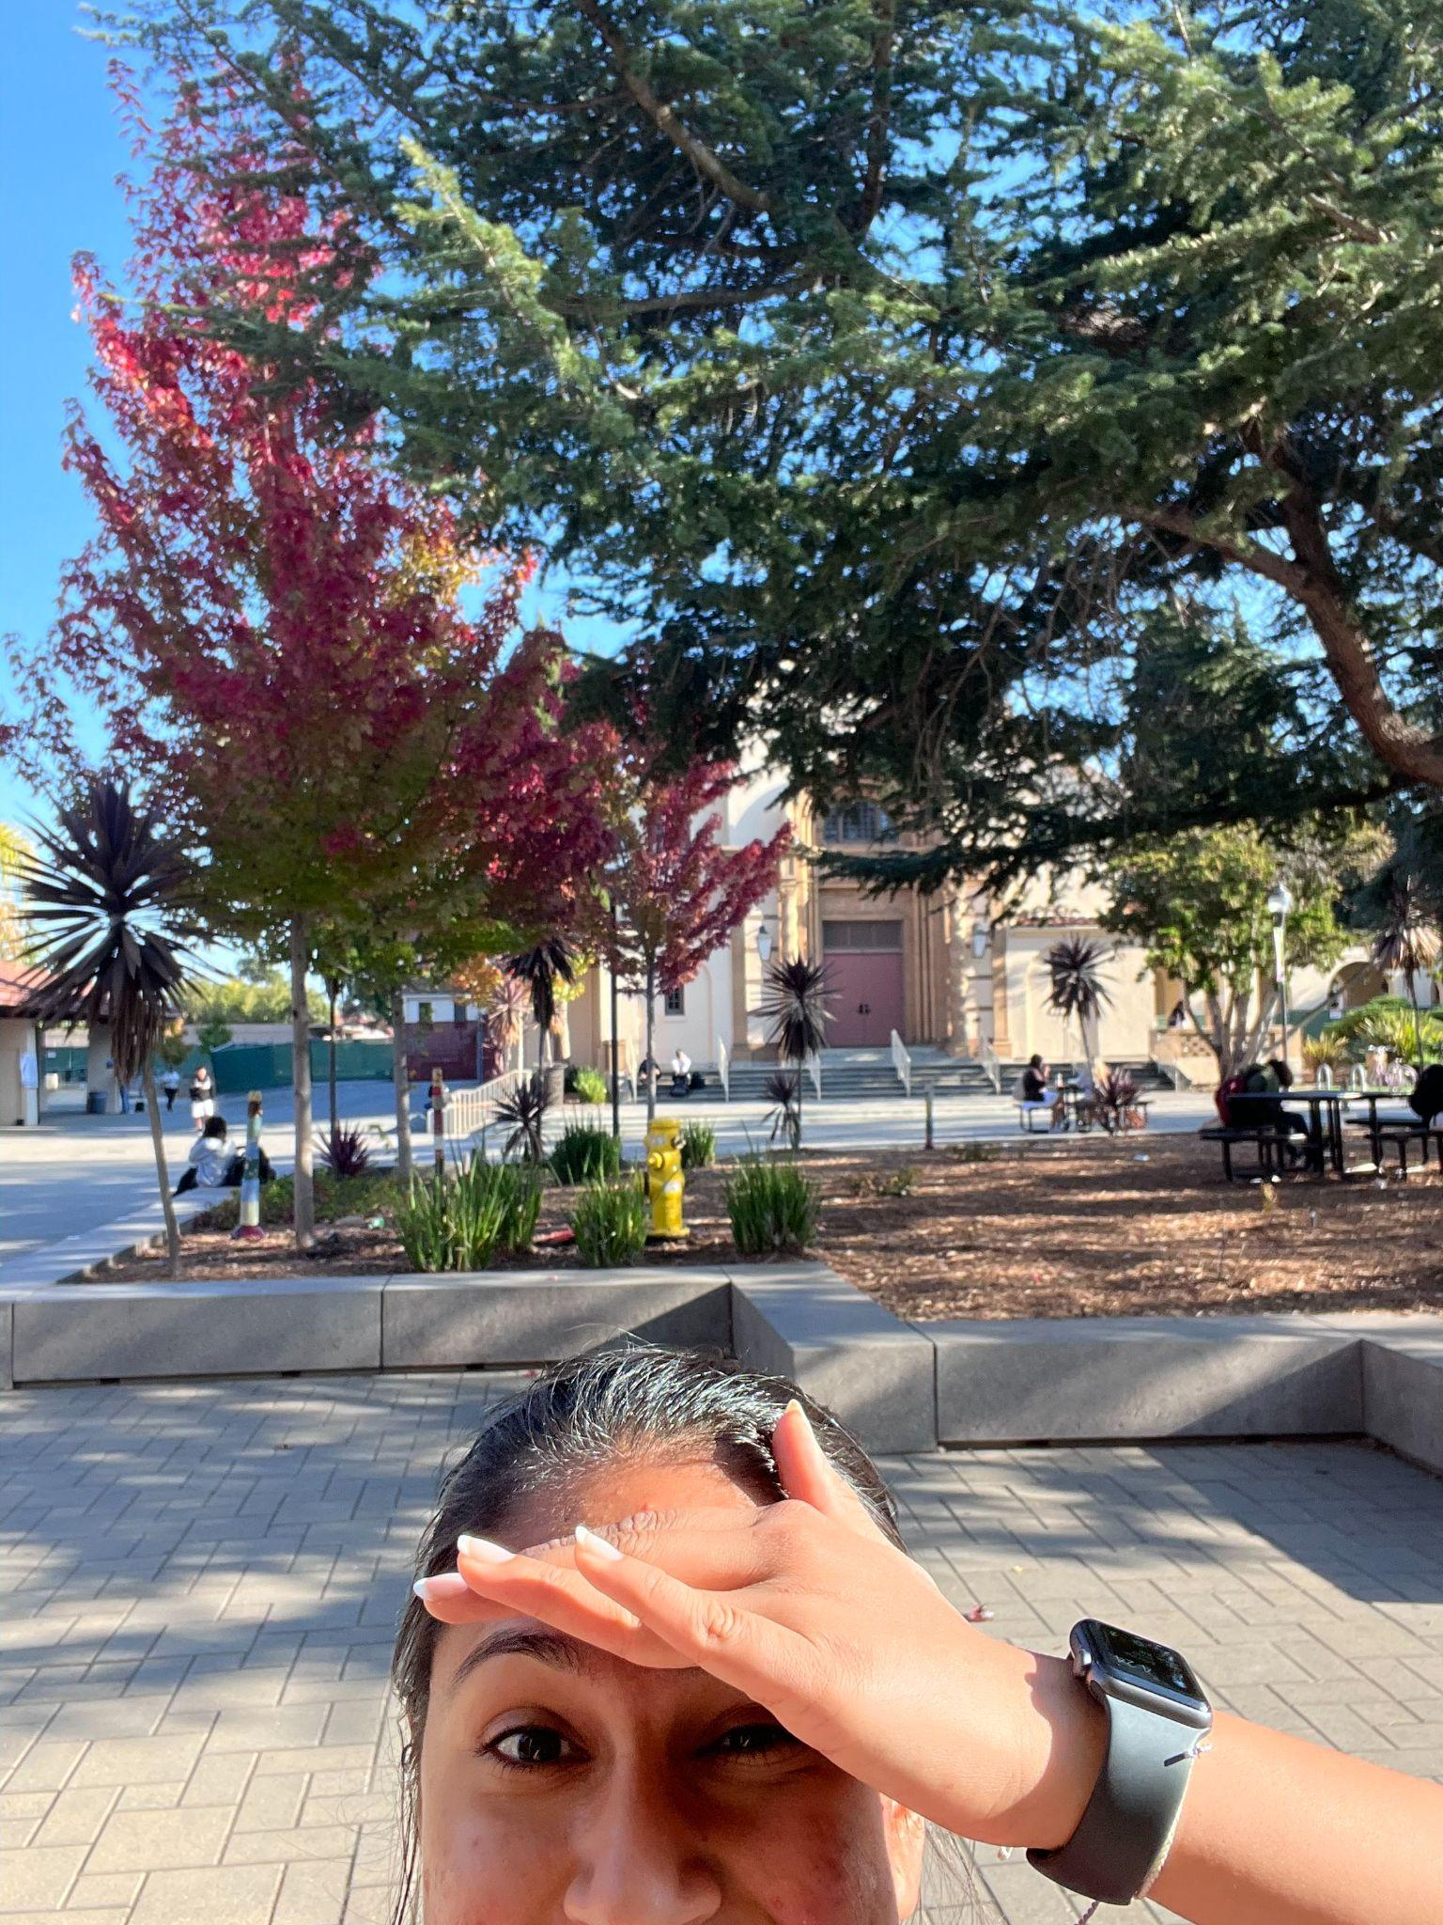
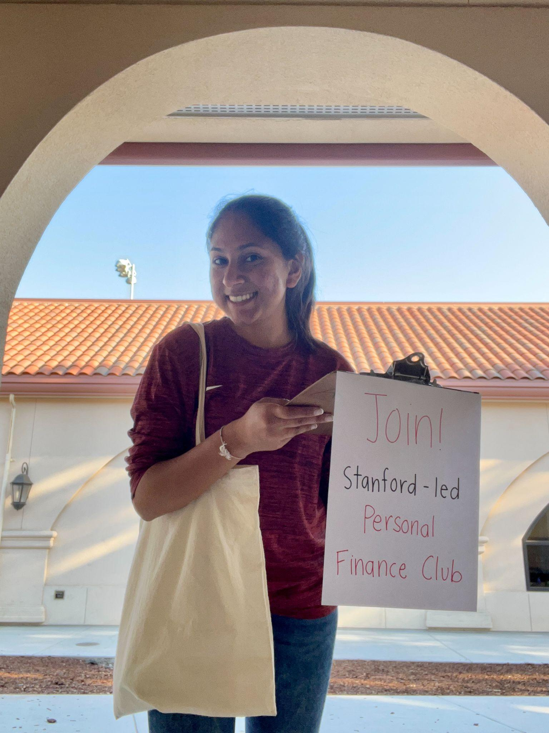

Pictures of EP2

Slide 48



Pictures of EP2

Slide 49
Results
Things that didn’t go well
Stood for a total of ~20 minutes and asked ~50 people → 2 signups
What we noticed
Students passing were intrigued by the sign and stopped to read, before continuing again
Students were kind, said “thank you,” and listened to my full sentence before rejecting
One student signed the paper because he heard me ask about personal finance and was already interested. Later pulled our second sign-up by encouraging her it’s important.
One student responded with “I don’t do my family’s finances”
Insights
Students don’t have an interest in personal finance because there isn’t urgency
When forced on students (asking them to join or through a class) without them knowing the subject of personal finance, students will not be interested
If something is eye-catching even people unfamiliar with the subject will pause to look
People will create new habits if encouraged by their friends
INVALID

Slide 50
Solution 3:
Investing with close friends and family

Slide 51
Solution 3
Unknown
Will people want to share their investment decision with friends
People want to fractionally invest
People will want to coinvest
People will want to share a finance app with friends
Not vital for user experience
Vital for user experience
Investing less is more welcoming to investing
Having a community will encourage people to invest
People will have friends
Known

Slide 52
Solution 3
Assumption
Investing with close friends & family
People want to share their investment decision with friends

Slide 53
Experience Prototype
Relevance
We sent out a google form to group chats that, on the first page, asks the participant to share their investment details.
They are relevant participants because we wanted to see how willing people were to share their investment details with their friends (us!).
We created two following pages that asked how much information the participant was initially hiding from us to see how transparent they are willing to be.
The form was shared with close friends of the team members, testing if friends would share with friends
The form was intrusive to see how much people are willing to share
Google form is anonymous for honest input

Slide 54
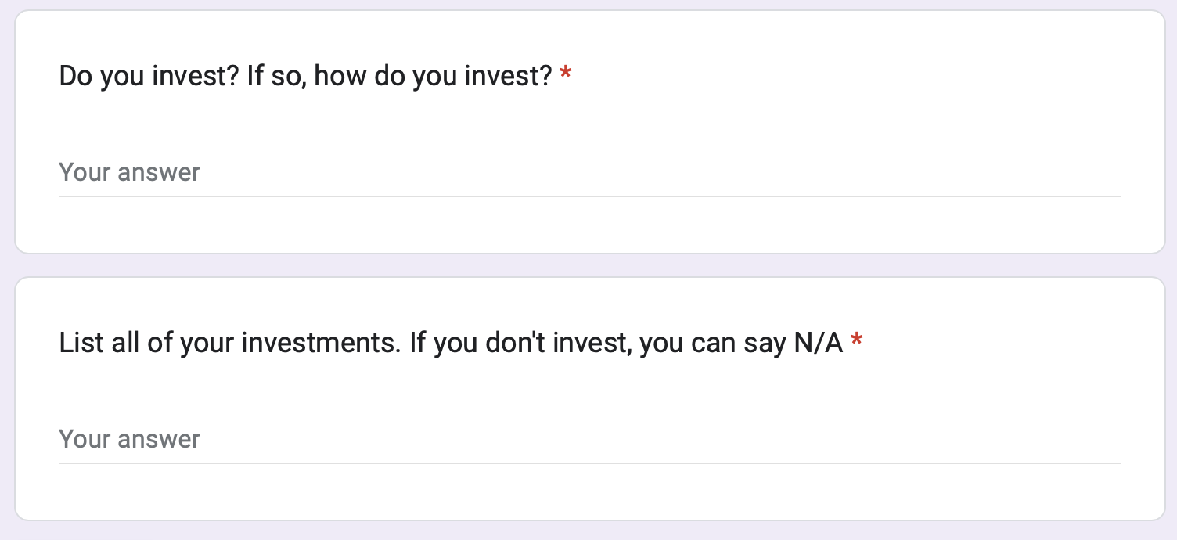
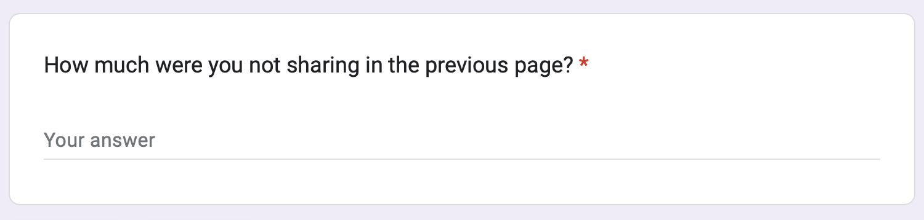
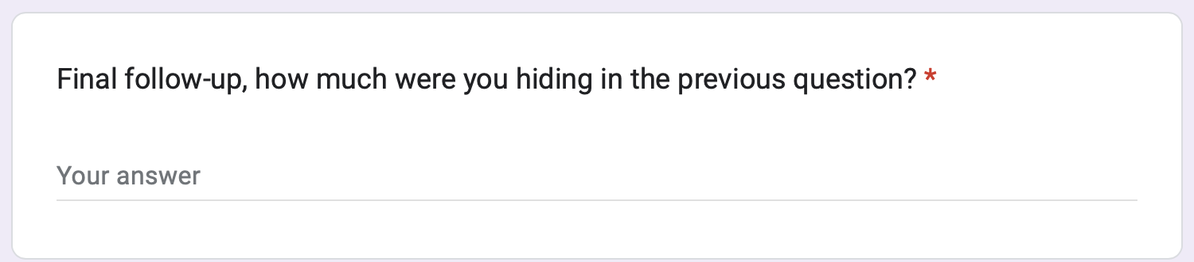
27 Google form responses!
01
02
03

Slide 55
Results
Things that went well
Most people were transparent with what kinds of investments they were making
Things that didn’t go well
Some did not want to share the specific stocks they invested
Surprises
The information that people hid were mostly related to failed investments
People preferred sharing in general terms
Insights
People are comfortable sharing stocks and investing process in detail with friends
Notes:
The assumption was generally valid if the share is within close friends, but we have to be mindful of the level of details we are sharing.
Going forward, this may mean that we have to be mindful in designing interactions between friends so that we don’t reveal overly private information and don’t create unhealthy competition.

Slide 56
Results
Statistics + Insight
52% of respondents don’t invest in stocks
  It is possible that more who don’t invest didn’t think the form was relevant and chose not to respond
  Insight: Majority choose not to invest despite knowing the option to
Of those that answered the platform they use to invest, the only two mentioned across 6 people were Robinhood and Vanguard
  Insight: Despite having many options available, people gravitate toward a few. A few that they know close friends use as well.
ROTH IRA (long-term no tax investing) was mentioned by only 3 people
  Insight: The best investment knowledge is not known by all
Notes:
The assumption was generally valid if the share is within close friends, but we have to be mindful of the level of details we are sharing.
Going forward, this may mean that we have to be mindful in designing interactions between friends so that we don’t reveal overly private information and don’t create unhealthy competition.

Slide 57
Results
Statistics + Insight
Even in the completely anonymous environment, only 14% mentioned they hid details of their complete investments
  Insight: People are very willing to share the details of their investments with friends
Only 1 person (3%) mentioned they hid details on the second page
  Insight: If someone is pointed out hiding something, they will own up and truthfully share from then on
12 stocks mentioned were shared by 2+ people
  Insight: People own similar stocks, but not not all are universal
Of the people that invest and shared, 62% invest in 5+ stocks (max: 27)
  Insight: People diversify their investments
Notes:
The assumption was generally valid if the share is within close friends, but we have to be mindful of the level of details we are sharing.
Going forward, this may mean that we have to be mindful in designing interactions between friends so that we don’t reveal overly private information and don’t create unhealthy competition.

Slide 58
5. What’s Next

Slide 59
Investing with close friends & family
Solution moving forward
Notes:
Also this solution echoes what several interviewees told us about how they got into investing because people around them did the same.

Slide 60
We are “Walrus”!
(wallet + us!)

Slide 61
SOLUTION EXPLAINED
CURRENTLY: each person has their own investment account and portfolio. Conversation about investment choices rarely come up, and the process is boring.
SOLUTION: Folks join the app and own the same stocks as friends. This can be done by creating an in-app groups where everyone owns the same set of stocks (ie. all owning Uber for $25 and seeing together how the stock is doing) or co-owning fractional shares of stocks (ie. 5 friends getting together and all deciding to buy 1/5 of an Apple share and seeing it grow as they all collectively own). Under the cover, the stocks are still owned individually, but the UI will seem like a community where everyone is collaborating, sharing, inviting, and connecting through co-ownership.

Slide 62
Validation: A1 Interviews
“Penelope”
Before: Personal finance is about paying bills and working jobs
  Walrus: Personal finance hold a community building purpose
Before: Games are engaging, especially when played with or as a competition with friends
  Walrus: People collaborate and share portfolios, seeing progress together or against other groups
“Mary”
Before: Could not keep up with trends as her children/grandchildren
  Walrus: A group can be created across the family so younger generations choose the stock and older can automatically join decisions
Before: Considers banks the safest investment
  Walrus: If friends are investing in stocks, it can seem more safe and approachable to do the same … plus we’re (wallet + us) giving bank vibes!

Slide 63
Validation: A1 Interviews
“Allison”
Before: Investing in stocks is overwhelming and takes a lot of time
  Walrus: Others can do the research and users join in as contributors
Before: There is a tough balance between sharing financial concepts with kids and making them “too adult”
  Walrus: Owning stocks, fractional stocks, and investing are all much more accessible through a gamified community system
“James”
Before: Lots of opaque information that makes it difficult to learn investing
  Walrus: Only need one friend to send an invite and folks can join existing researched and learned investment choices with no effort of their own
Before: Wants something to input expected return over time and anatomical details are automatically figured out
  Walrus: As little or as much investment decision as wanted!

Slide 64
Validation: A1 Interviews
“Olivia”
Before: Worried about letting control go to a financial advisor
  Walrus: Friends and close ones are the financial advisors. Compared to an external advisor, they are also putting money on the line so will make conscious and well-thought out decisions
Before: The idea that stock investing is necessary to beat inflation is not well-known to all
  Walrus: Gamifying and making a community makes people want to invest, making them more receptive to acting when they also hear the why
“Harrison”
Before: Tricky to navigate as a solo-learner
  Walrus: Breaks down investing to the simple act of adding money. Decision making and research can come later with experience!
Before:
  Walrus:

Slide 65
Validation: Recap
Not investing isn’t just a literacy problem. There are plenty of resources, but there are constraints of time, support, and confidence that prevent people from starting to invest.
  Walrus: Users can hop onto decisions of others with no time of their own, have the support of more experienced investors in their portfolios, and can grow confidence in investing seeing others/a community engaging
Investing is fun at a young age, but harder to keep up later in life.
  Walrus: The competition and community aspect of the platform continues the fun of investing while young. When the users are older, they can be a part of portfolios of younger/more interested folk to stay up to date without much effort of their own.
This is branding game, in addition to a product game. Users must build trust of an online platform and rewrite the mindset that investing is hard.
  Walrus: Having friends on the app, inviting, and sharing builds trust for the application and investing as a practice. Just joining and adding to existing portfolios, and sharing knowledge of those more experienced, makes it easy

Slide 66
Validation: A2 Interviews
“Clare”
Before: She followed onto others getting Robinhood and joined
  Walrus: It is one thing to join a platform because others are, and actually knowing how to. Through Walrus, they would join because others invite them, but also know exactly where to commit
Before: Considers investing too complicated so doesn’t start
  Walrus: The start to a habit here could be as small as $5 and trust in a friend! Joining in is simple and takes no thought
“Hazel”
Before: Knows investment is important but hard to dive in alone
  Walrus: Can do all investing with friends!
Before: Saw investment as a hobby and not crucial for a long time
  Walrus: Can start the transition process of hobby → crucial earlier but having an app that people engage with at younger ages

Slide 67
Validation: A2 Interviews
“Ryan”
Before: Mom dangerously day traded
  Walrus: Since the portfolio is shared among many people, day trading is inherently discouraged and people join for long-term investing
Before: Considered investing a necessary evil for saving money
  Walrus: Makes investing more enjoyable, and a end-in-itself instead of a means-to-end
Before: Knowledge gap in investing is very apparent
  Walrus: Groups can be made with ranges of experience so knowledge is always shared and spread

Slide 68
Validation: A2 Experience Prototypes
#ONE
Participants do wish to have control of their choices for flexibility and autonomy
  Walrus: Ultimately all investment choices are independent
Participants would not trust someone they didn’t know to make decisions
  Walrus: All portfolios and investment decisions are made by friends.
#TWO
Students don’t have an interest in personal finance because no urgency
  Walrus: Friend notifying and inviting them can create urgency
When the practice was forced without prior knowledge, students aren’t interested
  Walrus: Joining is completely their decision and they would commit
If something is eye-catching, even people unfamiliar with finance will pause
  Walrus: Gamification/community can catch the eye of those that don’t invest
People will create new habits if encouraged by their friends
  Walrus: The platform only needs one friend that invests to encourage others!

Slide 69
Validation: A2 Experience Prototypes
#THREE
People were transparent with what kinds of investments they were making
  Walrus: The premise of the app will work!
The information people hid were mostly failed investments
  Walrus: Failing together (which is inevitable sometimes) is less embarrassing
Majority don’t invest despite knowing the practice
  Walrus: Enough catalyst to get the rest of their friends investing
The best investment knowledge is not known by all
  Walrus: Investing independently is dangerous and will bring less returns, thus investing as a group can spread/enhance knowledge
If someone is pointed out hiding something, they will own up and truthful share
  Walrus: The more the platform is used, the more open people will be
People will own similar stocks, but not all are universal
  Walrus: There are a lot of similarities that mean people can co-own stocks

Slide 70
Next steps
Ethical implications
Data privacy, risk of distress from unhealthy competition
Who does it serve?
People who are interested in investing or developing investment habit but have constraints of support and confidence
Who might it leave out?
People who do not feel comfortable sharing financial connections with their friends
People who are experienced with investing and don’t need a motivator/support system
Notes:
Going forward, this may mean that we have to be mindful in designing interactions between friends so that we don’t reveal overly private information and don’t create unhealthy competition.

Slide 71
OUR POV RECENTLY :))

Slide 72


Slide 73
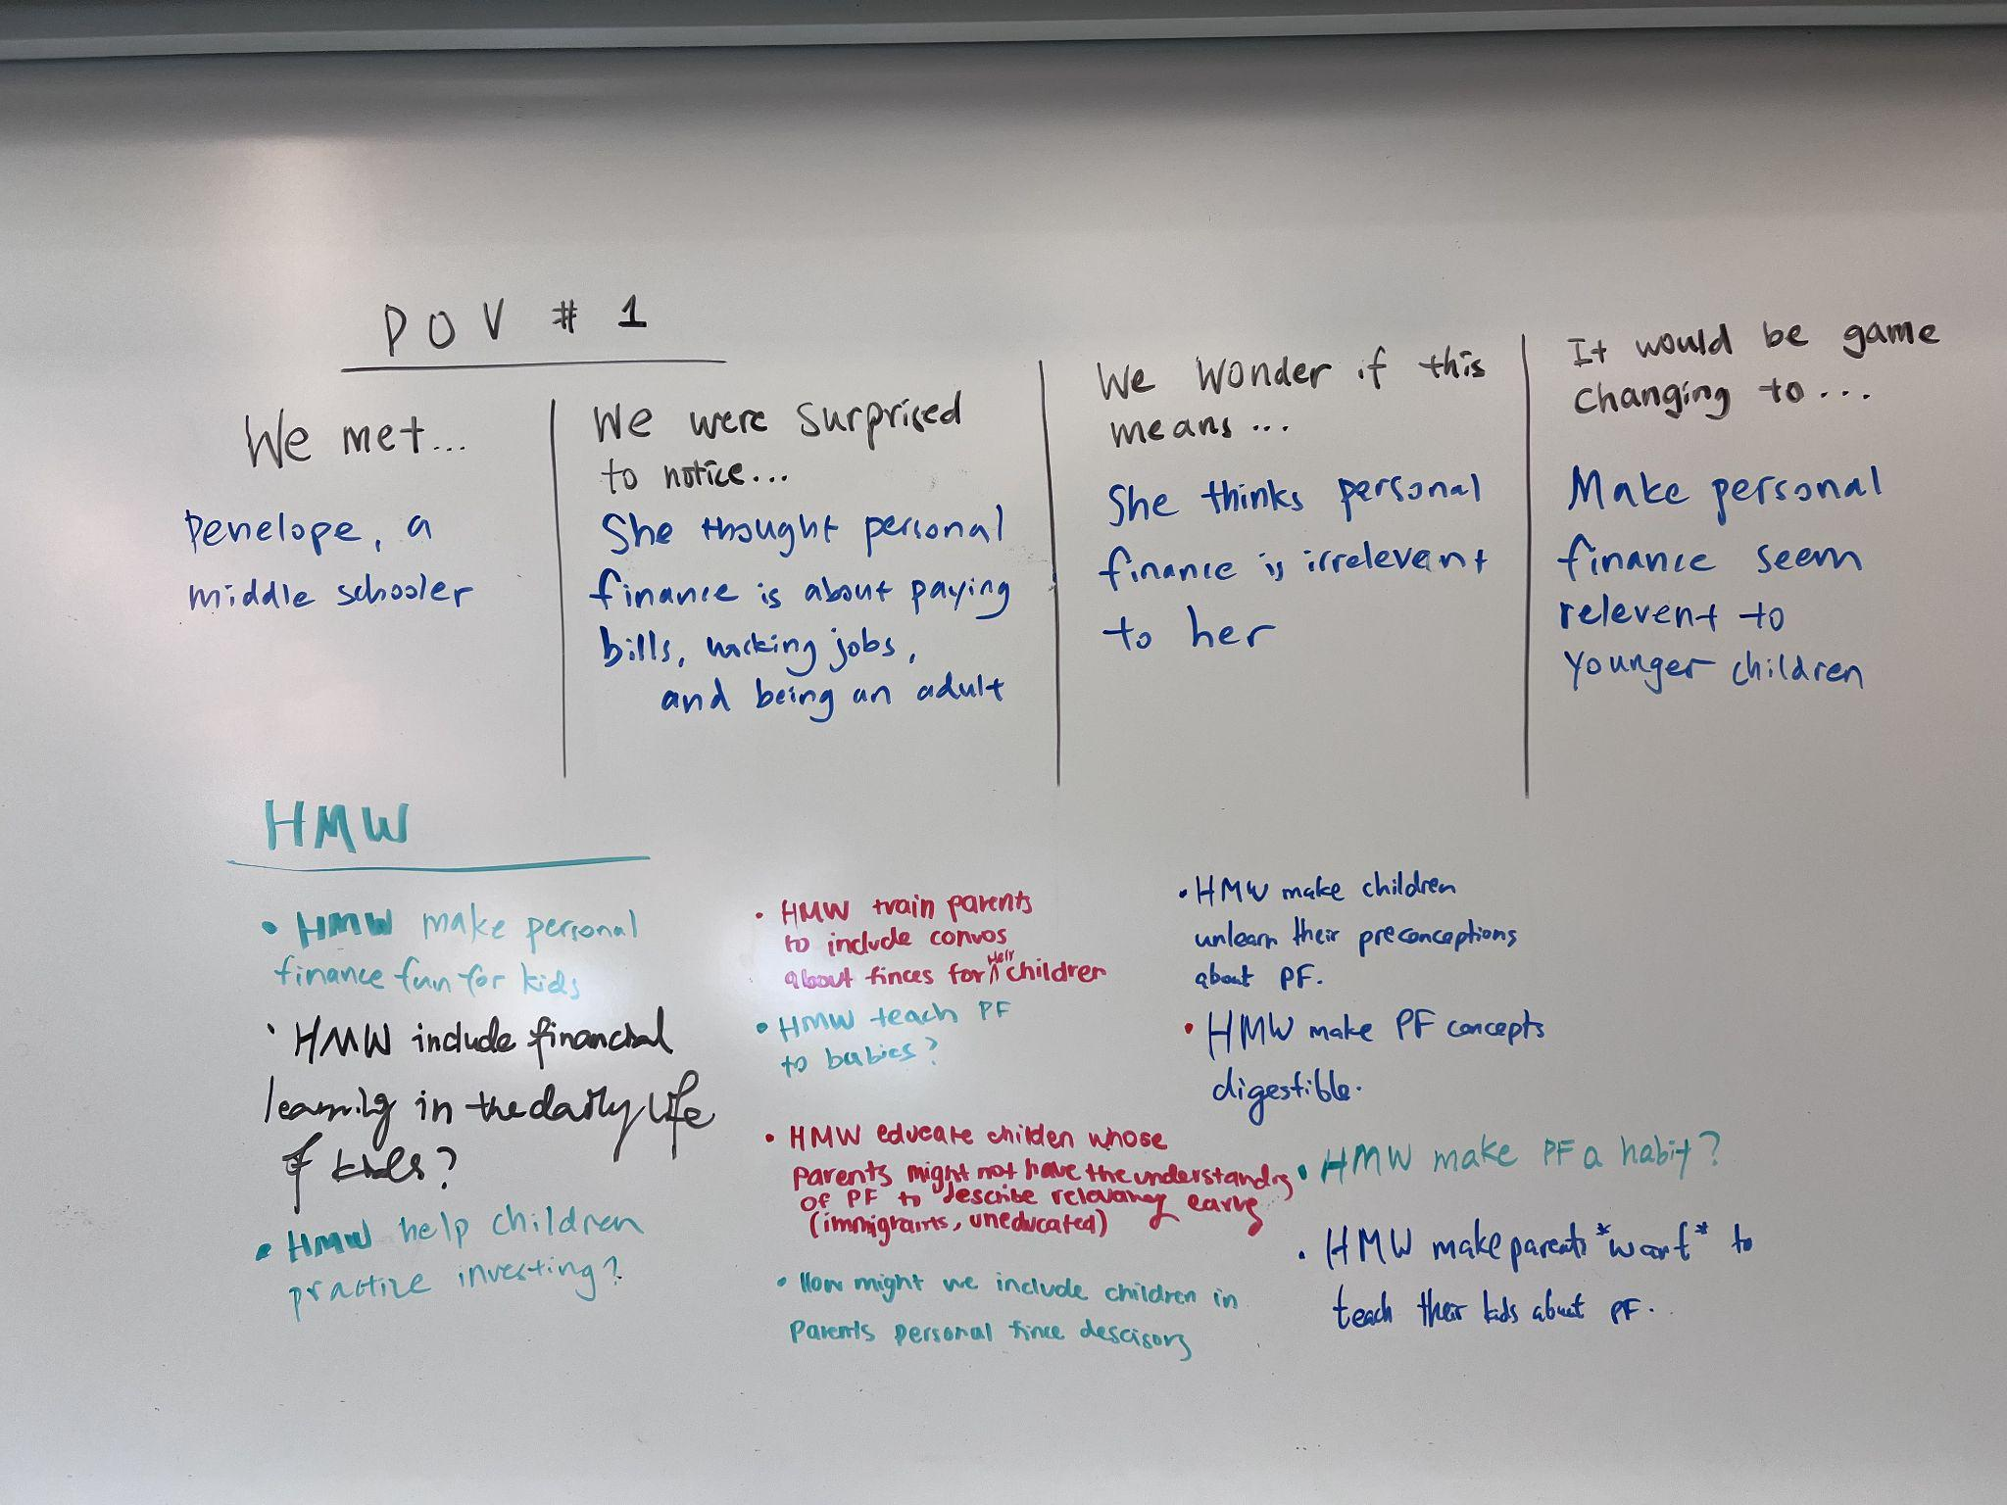
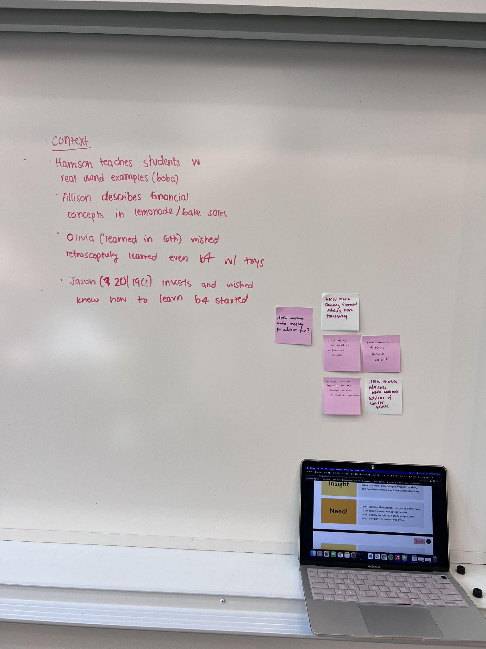
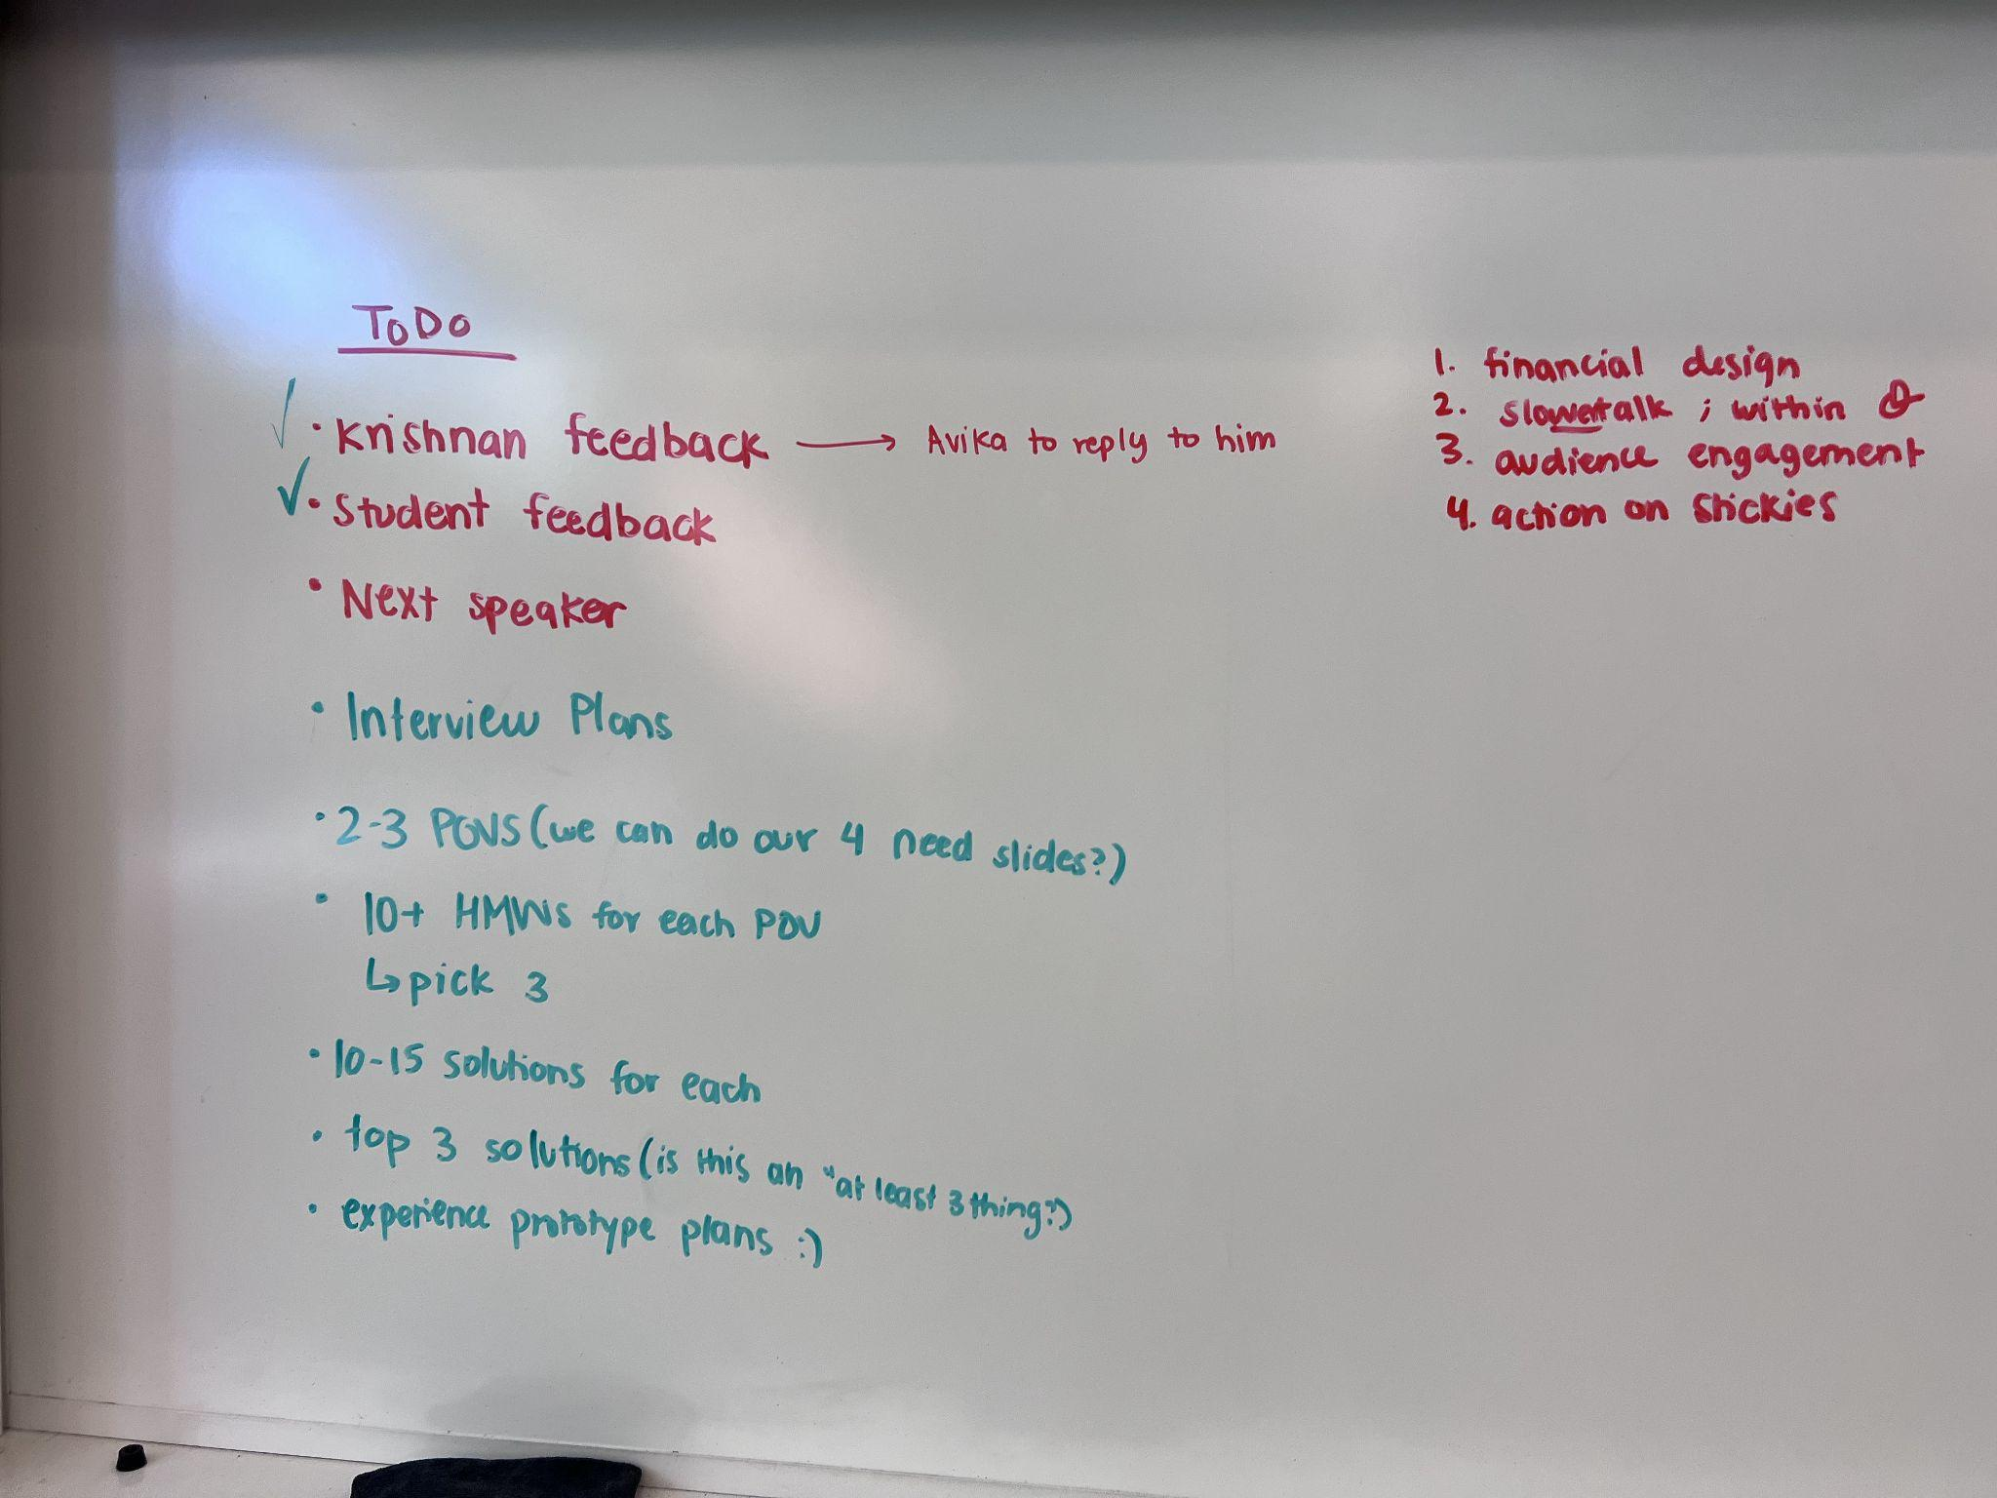
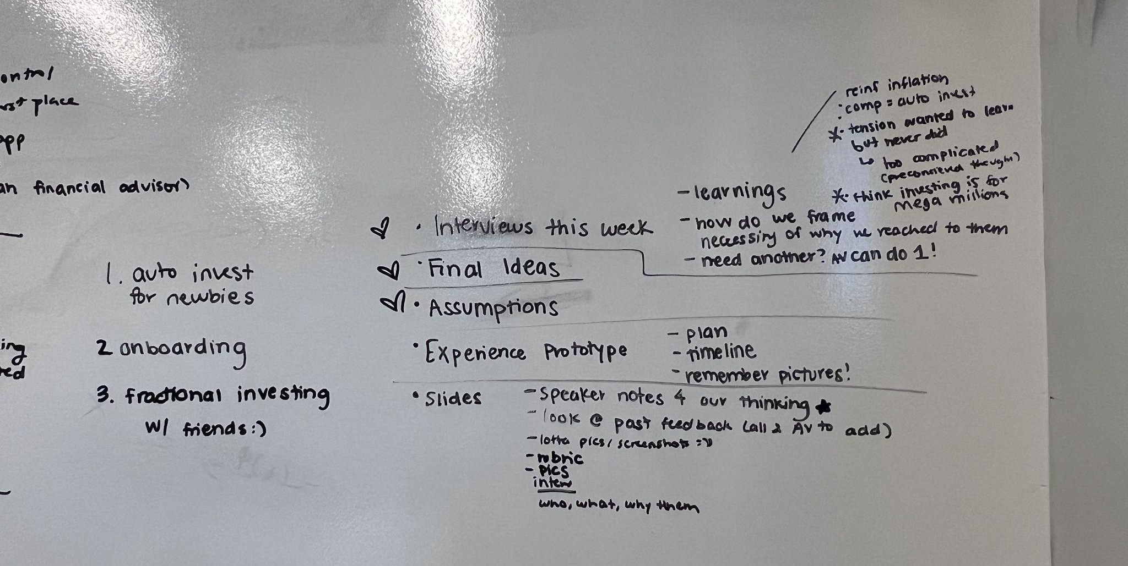
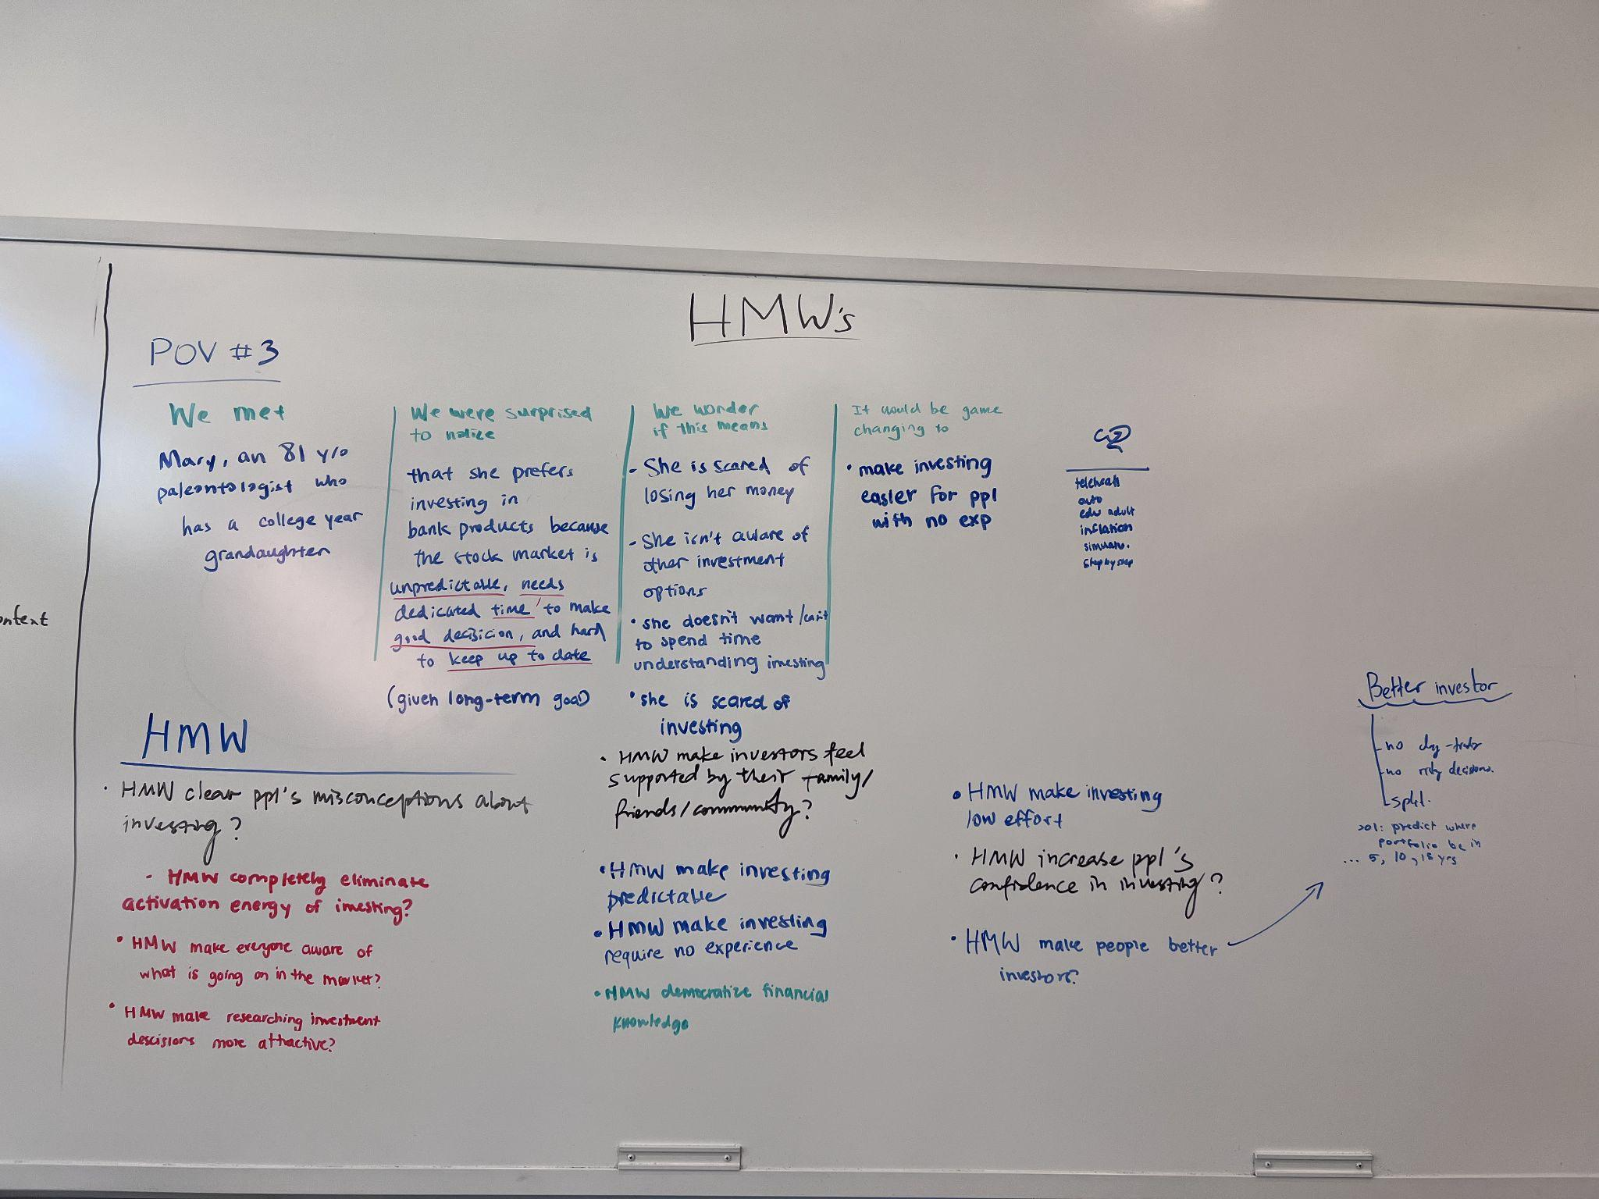
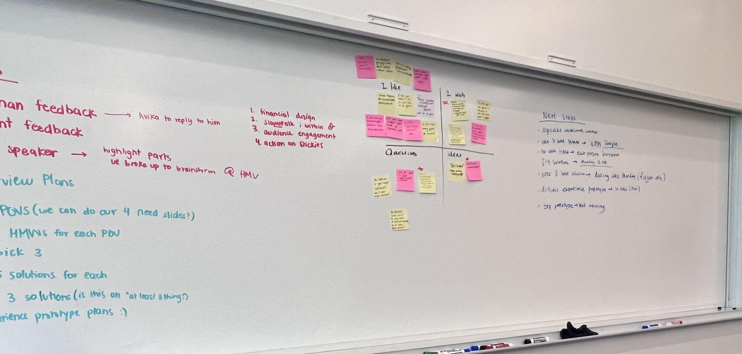
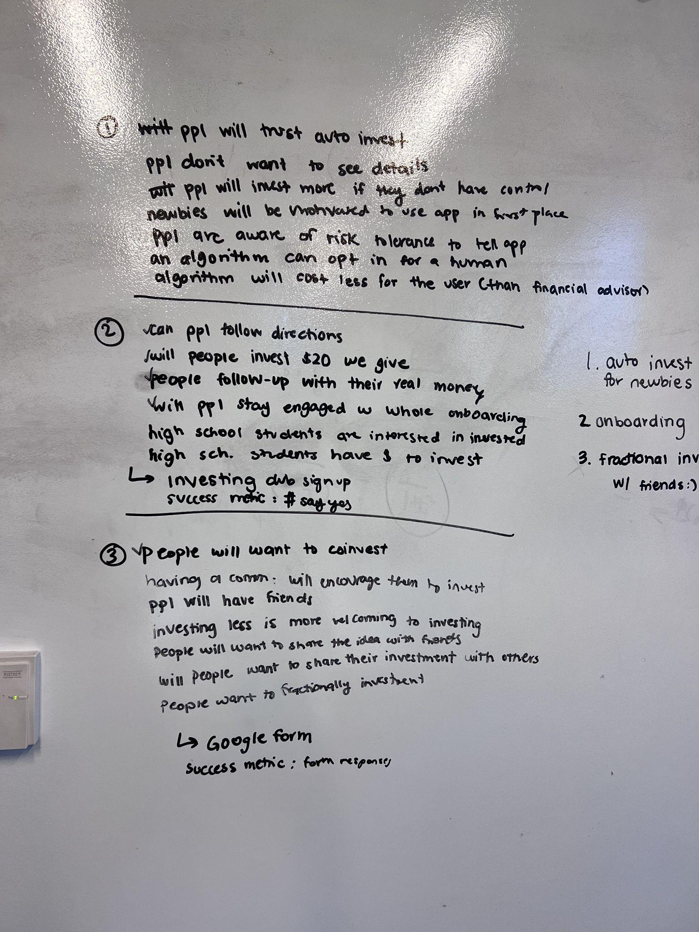
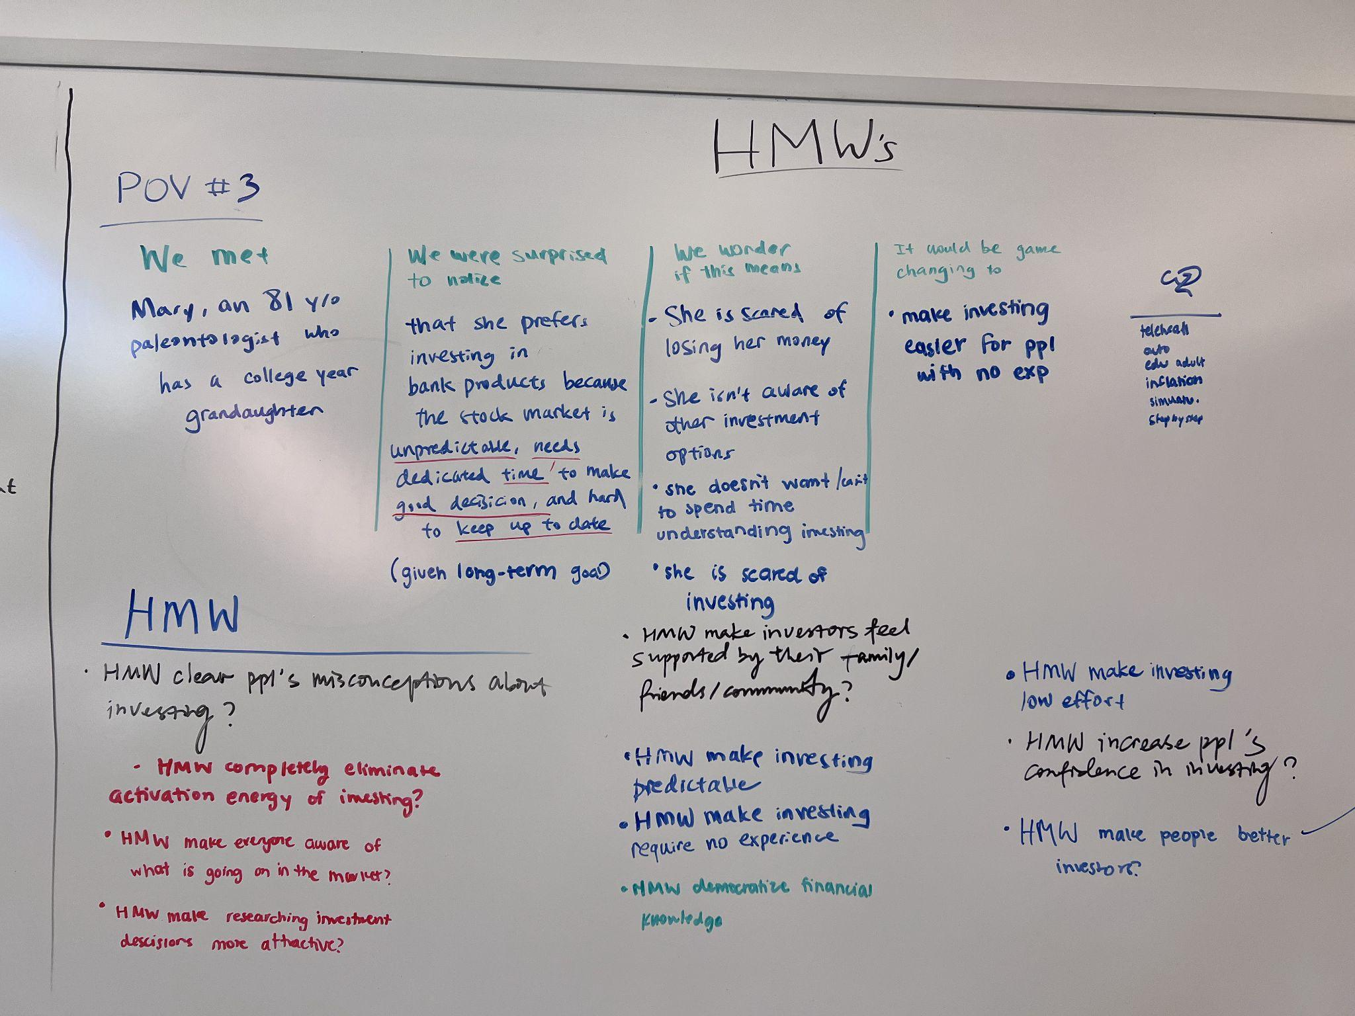
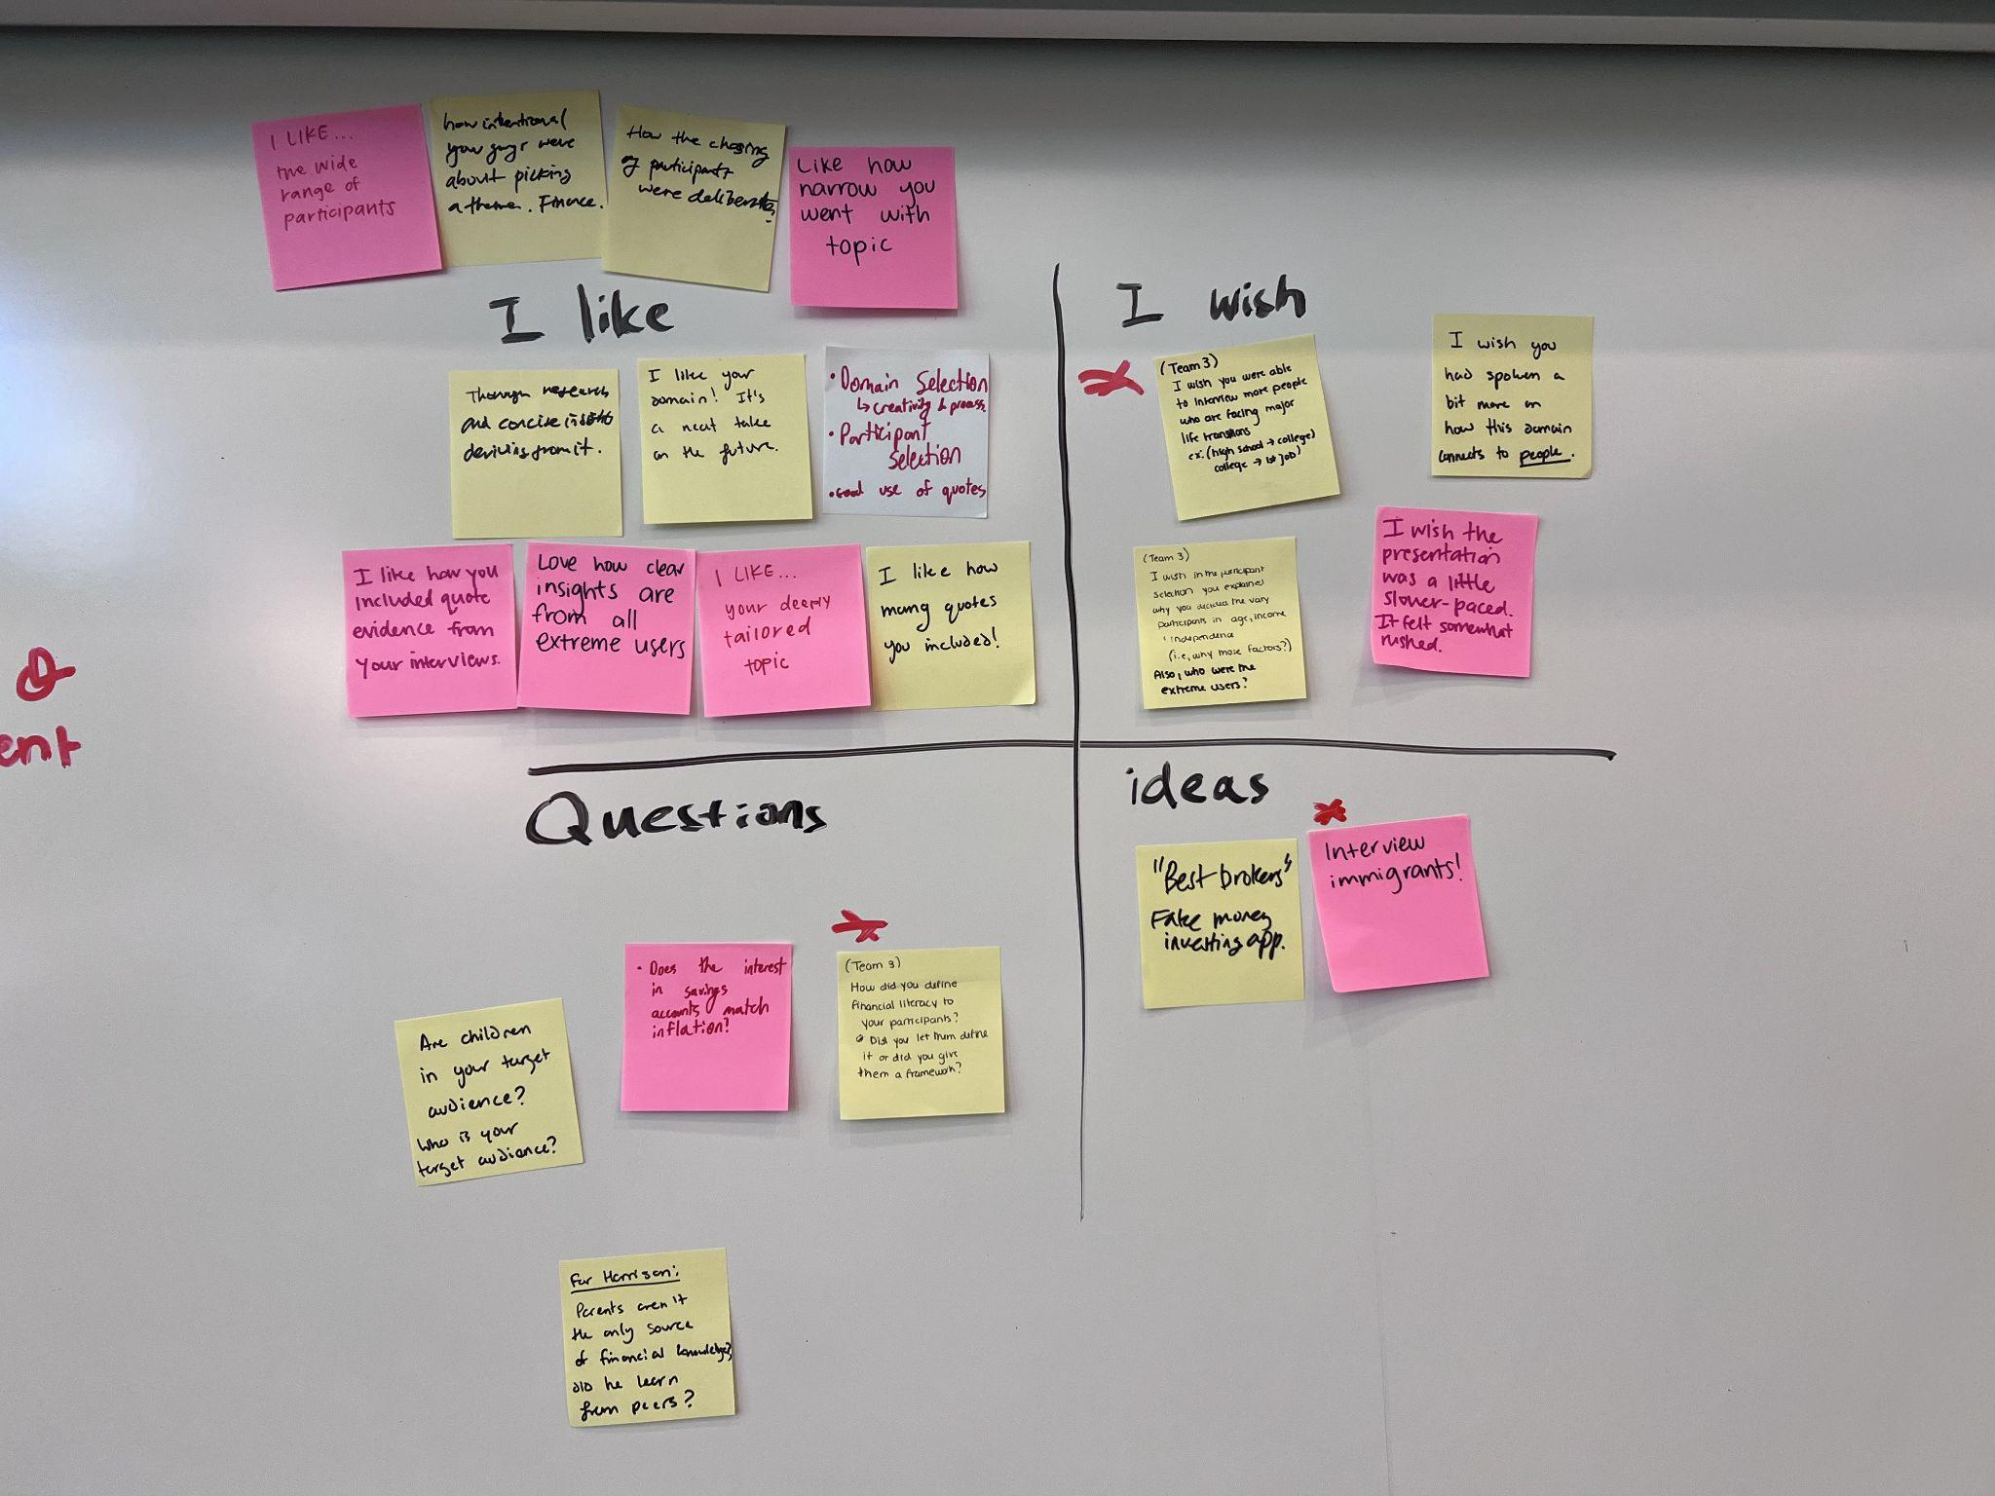
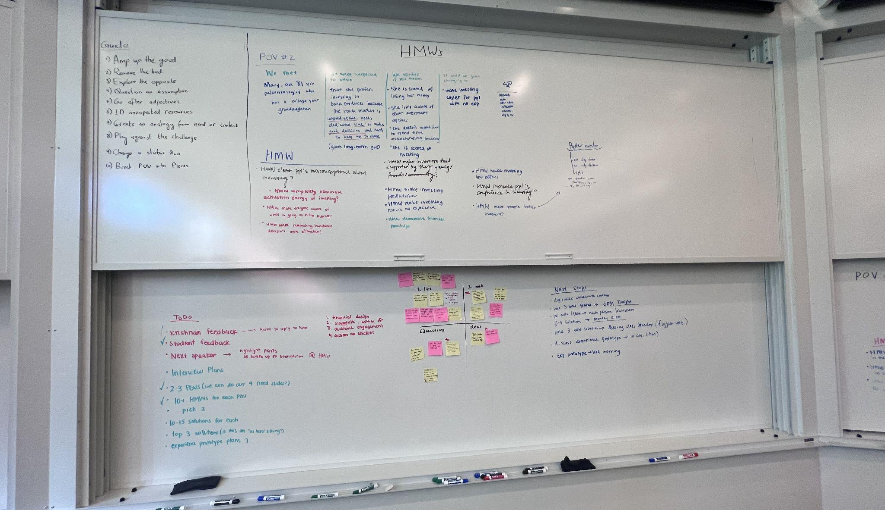
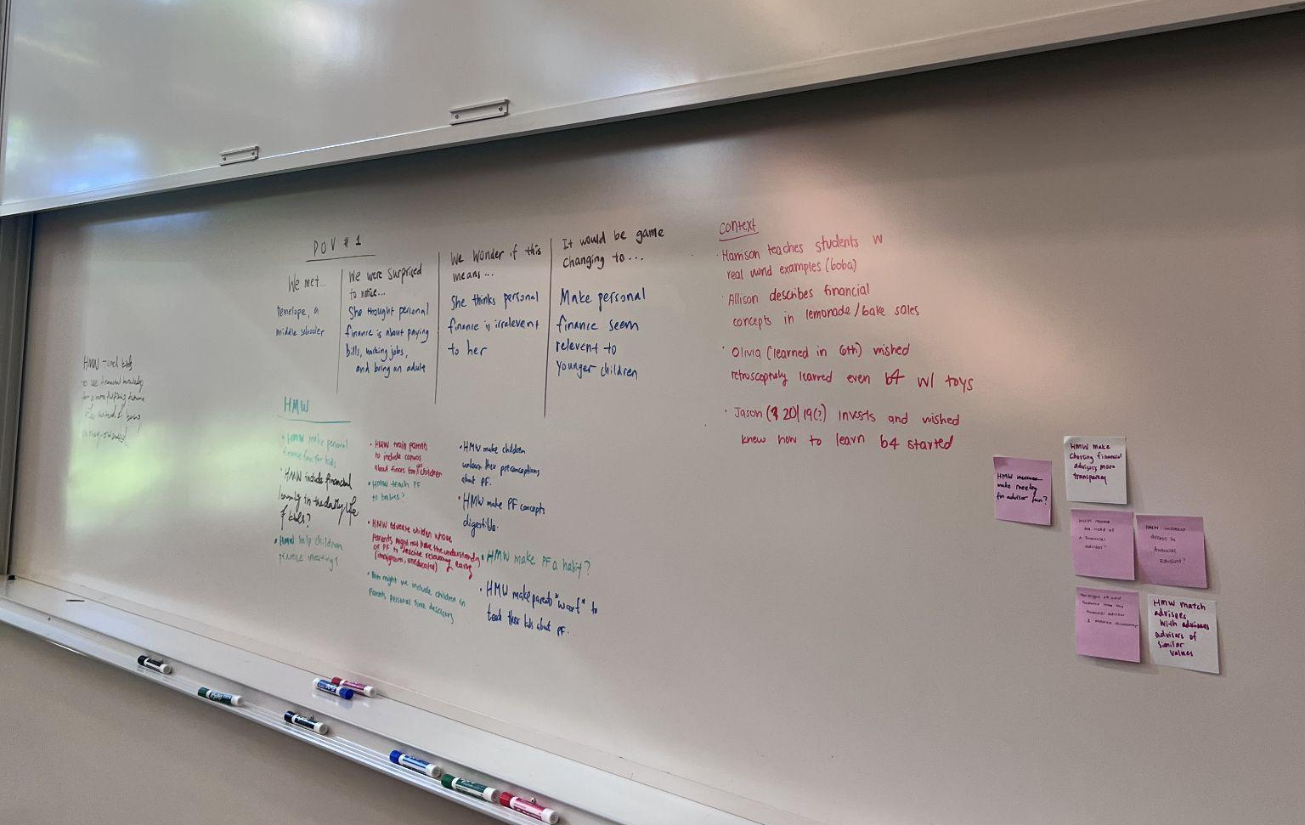
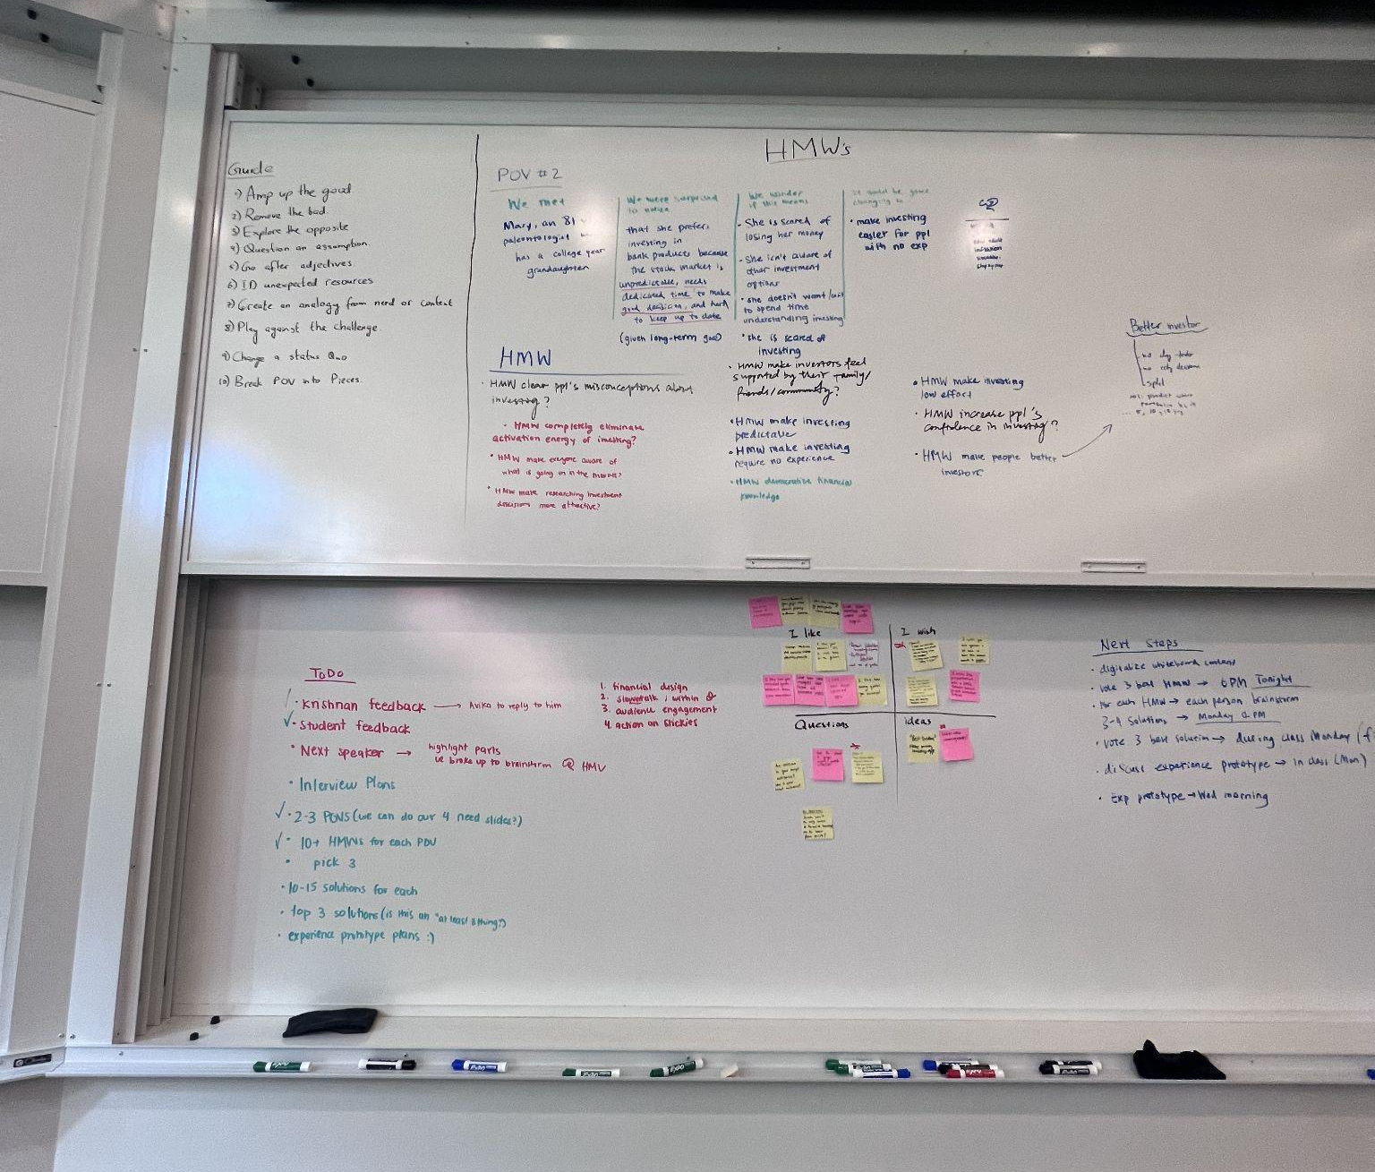
:D

