Slide 1
Steppin thru time: Team 1 Presenting
Point-OF-VIEW &
Experience Prototypes

Slide 2
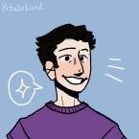
Team Introduction
Janine
Fleming
Elizabeth Fitzgerald
William
Song Liu
Hyunseok
Hwang

Slide 3
Outline
01
Additional Needfinding (+2 interviews)
02
POV’s and How Might we’s
03
Solutions + Experience Prototypes
04
Moving Forward

Slide 4
01
Additional Needfinding
Feedback from last week: emphasis on
“average user” & “extreme user”
Notes:
art+memory+time

Slide 5
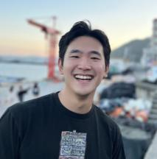
Interview #1 - extreme User
Topic On Art: Interesting quotes
“ART IS IN EVERYDAY LIFE, NOT IN MUSEUMS OR EXHIBITIONS!!!”
“I take photos of everyday art if the art is not transient - otherwise just enjoy the moment”
“I like going through jumbled up memories - fun things to find down there”
Thomas Kook
“I don’t believe in the value of art”
“There is value in historic art because of the supply & demand makes sense to me”
Notes:
Thomas Kook, who I knew from highschool, rising junior at JHU,

Slide 6
Interview #1 - summary
Additional learnings:
He prefers the jumble up of contents then curated, categorized viewing of art.
He wants to learn to communicate his interpretations of art better but lack the vocabulary to do so.
He doesn't like to take photos of art if it is transient. Rather keep it in his memory.
Thomas Kook
“I don’t believe in the value of art”
Notes:
https://www.figma.com/file/Tjgr7xEWA6UbdPNTS3EWP7/Thomas-Kook?node-id=0%3A1
Transcripts and questions shared in the drive.

Slide 7
Interview #2- Average User
Topic On Art: Interesting quotes
“AR is lame, I haven’t seen one AR product that I actually like.”
“Engaging VR environment will be essential for the technology to be worthwhile”
“If you come to the table with your definition of art as the only definition of art, I don’t like talking to you.”
David Walker
College Senior studying Psychology online
“Art is better experienced in person than viewing it on a 2D screen or 3D virtual environment”

Slide 8
Interview #2- Summary
Additional learnings:
Traditional Art is better experienced in person!
Video games are also art. Challenging the notion of traditional art!
VR/AR technology is cool but there needs to be good content for it to be worthwhile.
David Walker
College Senior studying Psychology online

Slide 9
02
POV’s and HMW’s
Initial POV of Yvonne
+ revised & selected 3 POV’s

Slide 10
Initial POV for Yvonne
We met Yvonne, an experienced docent at the Cantor Arts Center.
We were surprised to learn that she didn’t remember her favourite arts.
We wonder if this means she doesn’t like documenting art in the moment of viewing art.
It would be game-changing to provide her an application where she can log her art.
Yvonne LIU
Docent at Cantor Art Centre

Slide 11
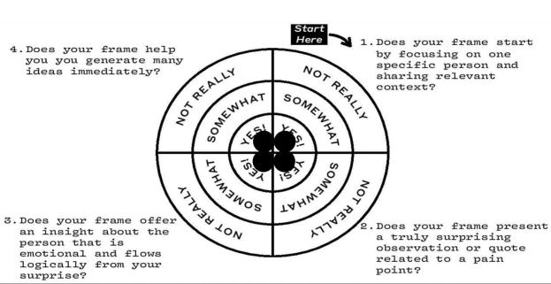
Initial POV for Yvonne
We met Yvonne, an experienced docent at the Cantor Arts Center.
We were surprised to learn that she doesn't keep records or notes on even art pieces she's really enjoyed.
We wonder if this means that she gets frustrated when she tries to remember the emotions she feels as she looks at art.
It would be game-changing to give her an easy way to re-experience emotions she feels when interacting with art.
Yvonne LIU
Docent at Cantor Art Centre

Slide 12
Initial POV for Yvonne - REvised version
We met Yvonne, an experienced docent at the Cantor Arts Center and a lover of physical art.
We were surprised to learn that she doesn't keep records or notes on art pieces she's really enjoyed.
We wonder if this means that she gets frustrated when she tries to remember the emotions she feels as she looks at art.
Yvonne LIU
It would be game-changing to give her an easy way to re-experience emotions she feels when interacting with art.
Docent at Cantor Art Centre
Notes:
Referring to how we improved from the initial POV, we selected 3 people and developed their povs. We focused on getting diverse group of interviewees…

Slide 13
3 Point-of-Views: diverse candidates
Thomas Kook
Veronica Graham
Yvonne Liu
“Everyday-art collector”
“AR/VR professor and enthusiast”
“Docent at Cantor arts centre”
Reason:
initially thought as extreme user but turns out he is our average User!!!
REason:
offers unique perspectives from a creator & teacher point of view.
REason:
art lover, gave us insight into how people remember artistic experiences.
Notes:
the 1st pov we developed was for…

Slide 14
POV1: thomas kook
We met Thomas, who often takes photos & videos of everyday art and shares them with his friends via instagram stories.
We were surprised to notice he prefers going through jumbled up, non-curated collections of his art memories.
We wonder if this means people inherently enjoy and value the variable reward of the Hunt even in search of their memories.
It would be game-changing to make going through art a fun experience by finding the sweet spot between curated content and random content.
Notes:
“Rewards of the hunt is the search for material resources and information.

Slide 15
How might we…
make going through your camera roll a surprising and fun experience?
Notes:
and the 2nd pov we developed was for…

Slide 16
POV2: Veronica Graham
We met Veronica, who is a VR artist/creator and also lectures a VR art class at Stanford.
We were surprised to notice that she believes a work of VR art is a shared experience between the creator and the player.
We wonder if this means that her goal as an artist is to establish an emotional connection with her audience.
It would be game-changing to give artists a simple way to build shared experiences with their audience.

Slide 17
How might we…
have artists collaborate with their audience on their next artwork?
Notes:
and the 3rd pov we developed was for…

Slide 18
POV3: Yvonne liu
We met Yvonne, an experienced docent at the Cantor Arts Center and a lover of physical art.
We were surprised to learn that she doesn't keep records or notes on art pieces she's really enjoyed.
We wonder if this means that she gets frustrated when she tries to remember the emotions she feels as she looks at art.
It would be game-changing to give her an easy way to re-experience emotions she feels when interacting with art.

Slide 19
How might we…
transport a museum or an exhibit into a person’s home?
Notes:
we took the diverge and converge approach to come up with the How might we’s

Slide 20
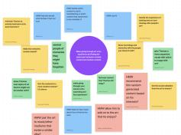
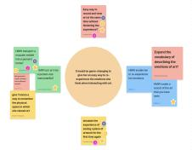
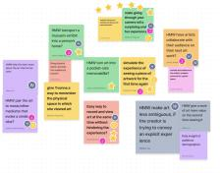
Brainstorming Methodology: Figjam
Diverge
Converge
Aggregate
Then we voted again on the top HMW’s and the result was…
Notes:
diverge and converge method, and multiple session of voting

Slide 21
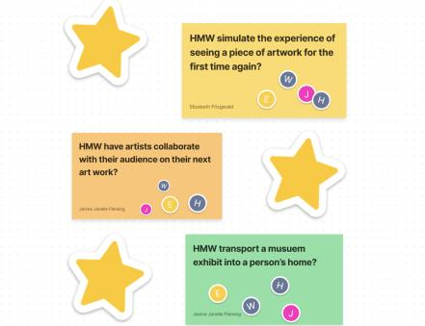
Selected HMW’s
Notes:
From these HMWs we next brainstormed possible solutions for them.

Slide 22
Outline
01
Additional Needfinding (+2 interviews)
02
POV’s and How Might we’s
03
Solutions + Experience Prototypes
04
Moving Forward: Pivot Time

Slide 23
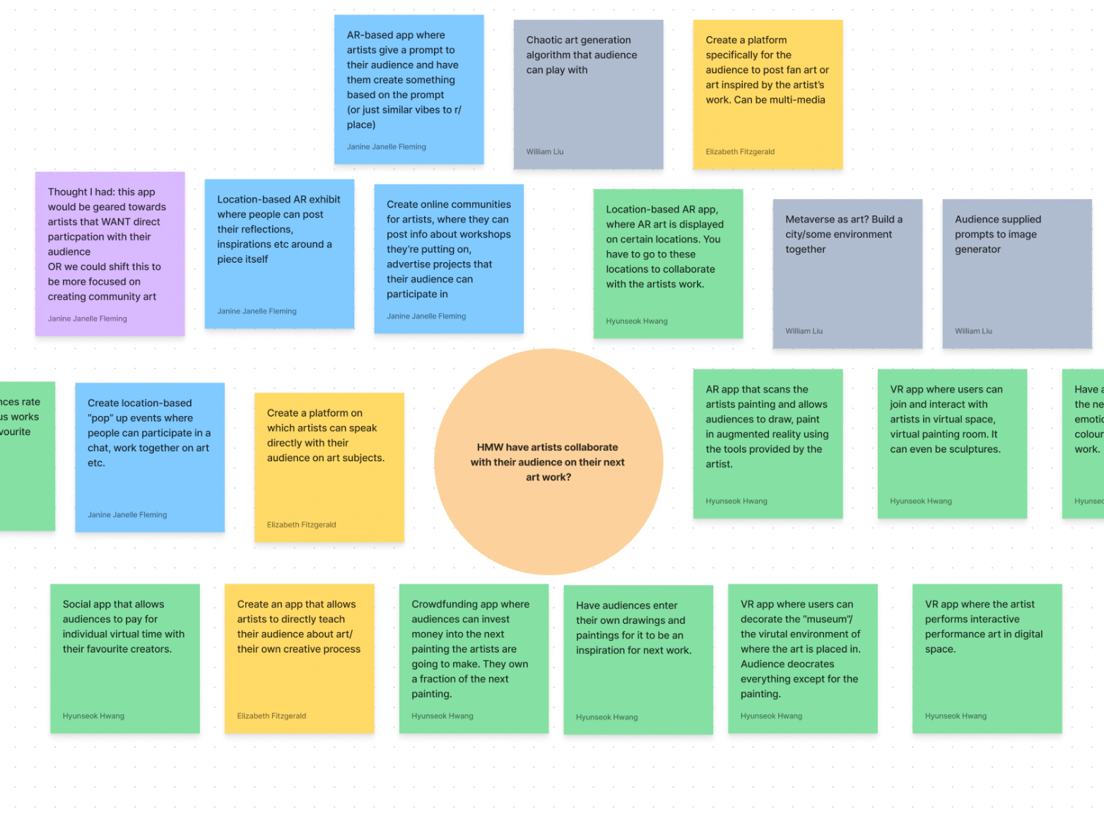
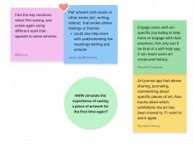
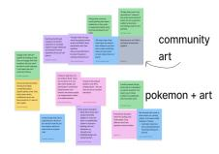
AGAIN… SAME MEthodology {different pictures i Promise}
Diverge
Converge
Aggregate
Then we voted again on the top SOLUTIONS and the result was…
Notes:
and the first solution we came up with

Slide 24
Solution #1
An application that allows people to easily collaborate to produce a community art piece.
Community members have an aligned goal.
Notes:
to test this assumption we conducted our experience prototype at

Slide 25
METHODOLOGY
Community members have an aligned goal.
Location: Enchanted Broccoli Forest
In-person
Duration: 30 minutes
Apparatus: 1 giant sheet of paper + pens + 10 participants
Notes:
The participants were people who were living in EBF, and they were more open to artistic expression and experiences, we conducted the experiment there. And it looked something like this

Slide 26
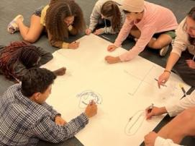
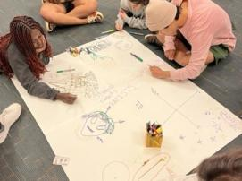
METHODOLOGY
Community members have an aligned goal.
Notes:
People sat on the floor to participate. There was no other directions other than “Draw whatever you want”

Slide 27
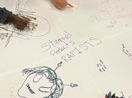
FINDINGS
Community members have an aligned goal.
Observations:
People seemed to show willingness to add other people’s drawings
Collaborate other ways: sharing materials/passing markers
Helped each other name their drawings
Laughed together over their drawings
Medium to amplify voice - “Stanford Protects Rapists”
Notes:
Other observations we had…

Slide 28
FINDINGS
Community members have an aligned goal.
Observations:
People started drawing individually
Expressed worry about their drawing skills
Defaulted to drawing random/silly things - doodling
Most people stopped drawing after 10 minutes
Notes:
However, when we asked the participants about the experiment…

Slide 29
Results
Community members have an aligned goal.
Responses from participants
Liked how free-flowing it was
Therapeutic and fun
Wished there was more structured way to collab
Felt restrained because they could only work with people next to them
Result: ASSUMPTION was wrong because there was no collaboration but got good new insights!
Notes:
moving on..

Slide 30
REsults
Moving forward:
People showed discomfort in sharing their skills. If all users were anonymous, people may be better at expressing themselves?
Key emphasis on the positive emotions they felt from the experience!
Notes:
The 2nd solution we came up with was

Slide 31
Solution #2
An application that pairs artwork with music or other works (art, writing, videos) that evoke similar feelings or themes.
Notes:
and the assumption that derived from this solution was

Slide 32
Solution #2
An application that pairs artwork with music or other works (art, writing, videos) that evoke similar feelings or themes.
People can make emotional connections between new pieces of art and those which they have already observed.
Notes:
we tested this assumption by

Slide 33
METHODOLOGY
People can make emotional connections between new pieces of art and those which they have already observed.
Location: Tressider Union
In-person
Duration: 30 minutes
Apparatus: 1 Art Piece + whiteboard + candy + 9 respondents
Notes:
The participants were random strangers who were walking by tressider union, and we wanted to test average day users for the solution, because we were curious if average person could make the connection. It looked something like…

Slide 34
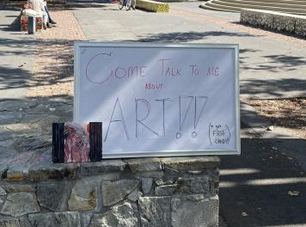
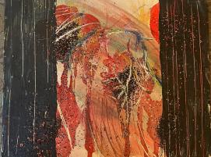
METHODOLOGY
People can make emotional connections between new pieces of art and those which they have already observed.
Notes:
What do you feel, emotionally, when you look at this painting?
and the answers to these questions were very interesting.

Slide 35
FINDINGS
People can make emotional connections between new pieces of art and those which they have already observed.
What do you feel, emotionally, when you look at this painting?
: Pleasant, pretty cool, serene, gorgeous, creative, LOOKS NICE
Does this remind you of any other art pieces?
: NO
Notes:
from this we saw that people were

Slide 36
REsults
Things that worked:
Happy to give their interpretation of what they see in art.
Things that didn’t work:
Cannot make connection between a new art and previous arts.
Surprises:
The variety of interpretations the painting got.
New Findings:
People seem to enjoy interpreting art.

Slide 37
REsults
Moving forward:
Maybe people find it difficult to connect the two arts together BECAUSE they don’t have the tools for it.
Perhaps our product could provide them with answers!
Notes:
The final solution we came up with

Slide 38
Solution #3
Location-based AR app, where AR art is displayed at certain locations for people to discover and interact with.
People are willing to move short distances to discover AR art.

Slide 39
METHODOLOGY
People are willing to move short distances to discover AR art.
Location: Memorial Church
In-person
Duration: 25 minutes
Apparatus: Sticky notes + pen + 10 people who threw away the sticky notes
Notes:
We wanted to test this solution on strangers, average users because it didn’t have a specific theme. Wanted to see if people would respond to any stimulus about AR.

Slide 40
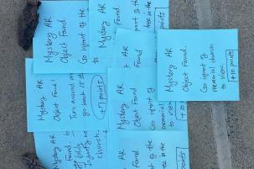
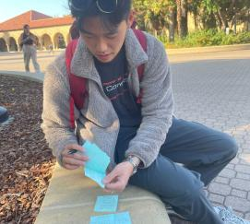
METHODOLOGY
People are willing to move short distances to discover AR art.
Notes:
and the observations we discovered was

Slide 41
FINDINGS
People are willing to move short distances to discover AR art.
Observations:
People took the sticky notes when given to them, read it once and walked away.
Some people looked around but no direct responses.
TWO women found the “tallest tree” but they were part of another scavenger hunt.
No one came to us to ask for clarifications.
Notes:
this told was insights such as

Slide 42
Results
People are willing to move short distances to discover AR art.
Insight:
People are not fascinated by AR objects as much as we thought.
People are generally busy and making them move to a certain place is hard.
Perhaps WRONG location, Gates or Huang may have been a better choice.
Result: ASSUMPTION was wrong. People are not aware or are interested by Augmented Reality objects!
Notes:
Now that all our assumptions were wrong, what can we do to move forward?

Slide 43
What’s next?

Slide 44
What’s next?
Focusing on Collaboration with ART in digital space!
(with a smidge of AR?)
Notes:
we wanted to do a market analysis to see the existing products

Slide 45
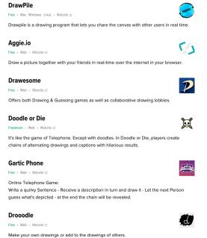
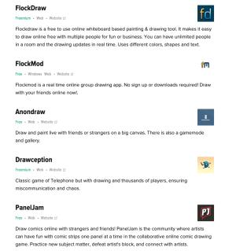
Existing market analysis
Google search: “Collaborative Drawing Application” result

Slide 46
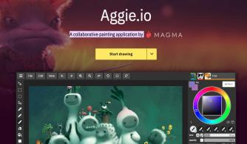
Existing market analysis
Google search: “Collaborative Drawing Application” result

Slide 47
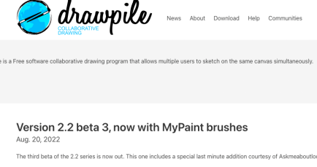
Existing market analysis
Google search: “Collaborative Drawing Application” result
Notes:
Tensions, contradictions and surprises

Slide 48
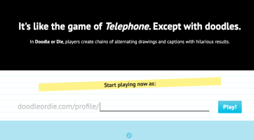
Existing market analysis
Google search: “Collaborative Drawing Application” result
Notes:
Tensions, contradictions and surprises

Slide 49
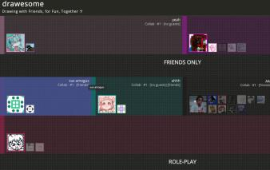
Existing market analysis
Google search: “Collaborative Drawing Application” result
Notes:
Tensions, contradictions and surprises

Slide 50
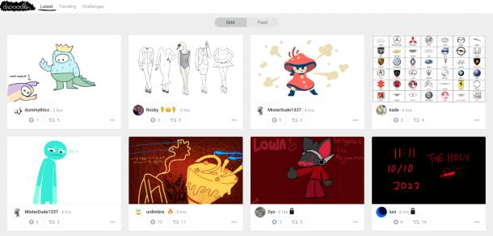
Existing market analysis
Google search: “Collaborative Drawing Application” result
Notes:
Tensions, contradictions and surprises

Slide 51
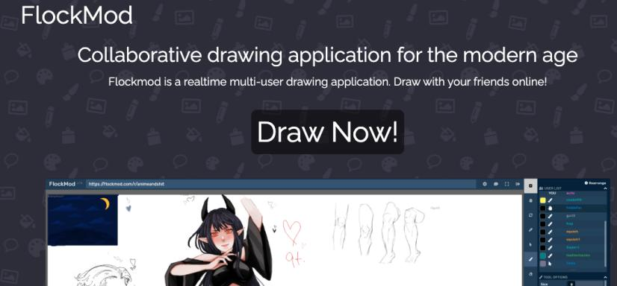
Existing market analysis
Google search: “Collaborative Drawing Application” result
Notes:
Tensions, contradictions and surprises

Slide 52
Existing market analysis
Google search: “Collaborative Drawing Application” result
Notes:
Tensions, contradictions and surprises

Slide 53
What’s next?
PIVOT TIME…
Notes:
Tensions, contradictions and surprises

Slide 54
questions?

Slide 55
Appendix
Notes:
All the contents are listed in the google drive you have made for us. Thank you! https://drive.google.com/drive/folders/1iqYN03YFn3NKRfaOEw4KjH1QC4ZPTcx6?usp=sharing
Brainstorm links
https://docs.google.com/document/d/1R8VPMSIWis6YeVgO2JfxDB6U9K23VWpKCBIP0i5L9_Y/edit?usp=sharing

