Slide 1
LoW-Fi Prototype & Usability Testing
Stepping Through Time, Team 1 Presents:

Slide 2
Team Introduction
Janine
Fleming
Elizabeth Fitzgerald
William
Song Liu
Hyunseok
Hwang

Slide 3
Our Problem
When we reminisce about our old memories, we want to remember the emotions we felt in those moments.
Current tools exist to help document our memories (ex: 2D photos), however, it’s still difficult for people to fully revisit and re-experience the emotions they felt.
Our solution?

Slide 4
“Treasure your memories”
Notes:
Will go over problem and solution overview here too

Slide 5
Outline
01
Sketching Exploration
02
Our Low-Fi Prototype
03
Usability Testing
04
Discussion

Slide 6
01
Sketching Exploration
From Crazy 8’s Storyboarding to our Final Realization
Notes:
The first interview was

Slide 7
Map-Based Exploration
AR Mobile App
AR Glasses
Smart Watch
Mobile App w/ VR Headset Compatibility
Notes:
Why we chose

Slide 8
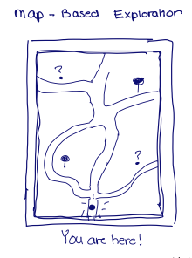
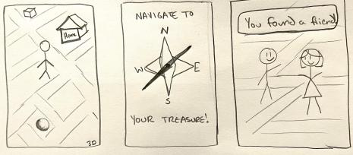
Map-Based Exploration
Notes:
Why we chose

Slide 9
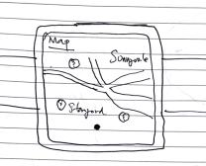
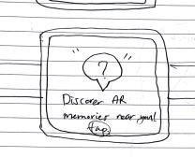
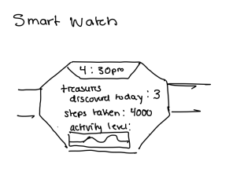
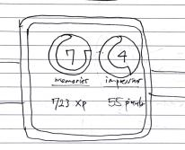
Smart Watch
Notes:
Why we chose

Slide 10
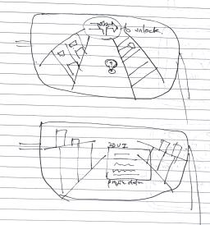
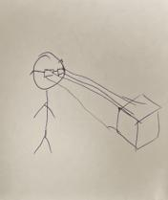
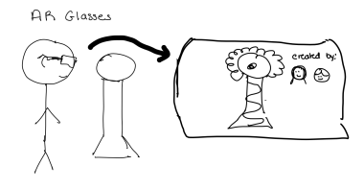
AR Glasses
Notes:
Why we chose

Slide 11
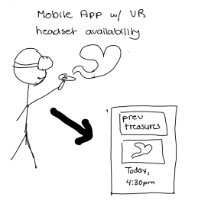
VR Headset
Notes:
Why we chose

Slide 12
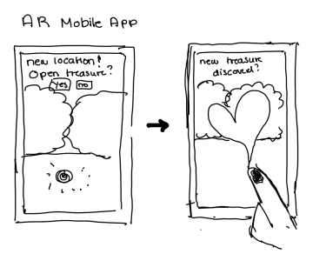
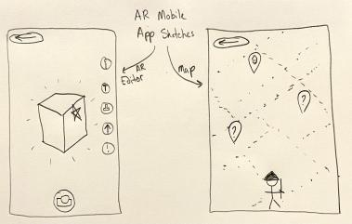
AR Mobile App
Notes:
Why we chose

Slide 13
Map-Based Exploration
AR Mobile App
AR Glasses
Smart Watch
Mobile App w/ VR Headset Compatibility
Notes:
Why we chose

Slide 14
Smart Watch
AR Mobile App
Notes:
Why we chose

Slide 15
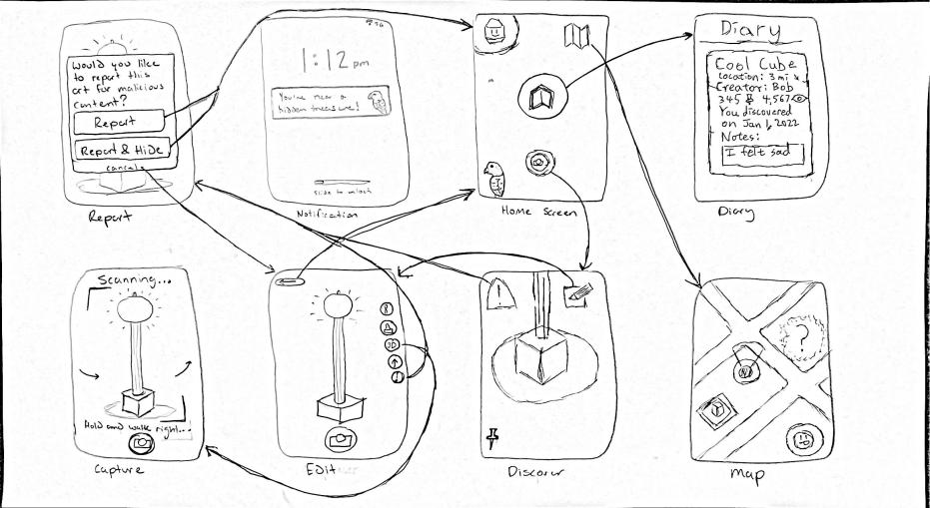

Slide 16
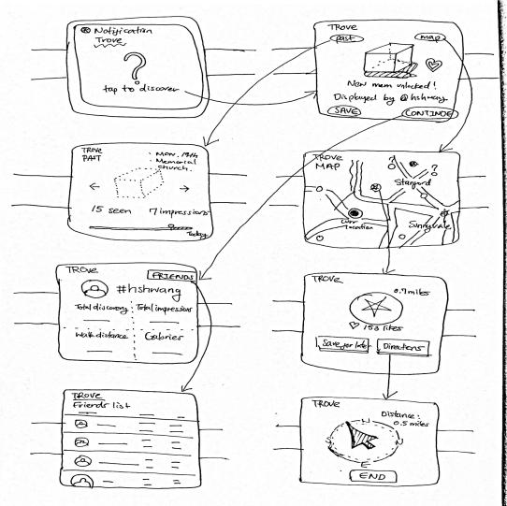

Slide 17
SMART WATCH
PROS
CONS
Easy to wear; portable
Encourages mobility; can capture mobility measurements
Users are familiar with using wearables
Simple integration of map/navigation and notification system
Small screen makes it difficult to include critical features (ex: drawing on/editing an AR piece, scanning in an object)
Integration of AR + Smart Watch isn’t common

Slide 18
AR MOBILE APP
PROS
CONS
Most people have mobile devices
Ability to integrate map and notification system
Quick access to view logged art/memories
Encourages spontaneity to explore environment; can implement more interactive elements
Not all phones support AR
Smaller screen makes it difficult to edit AR pieces

Slide 19
SELECTED INTERFACE - AR MOBILE APP

Slide 20
02
Our Low-Fi Prototype
A review of it’s design and our task flows
Notes:
The first interview was

Slide 21
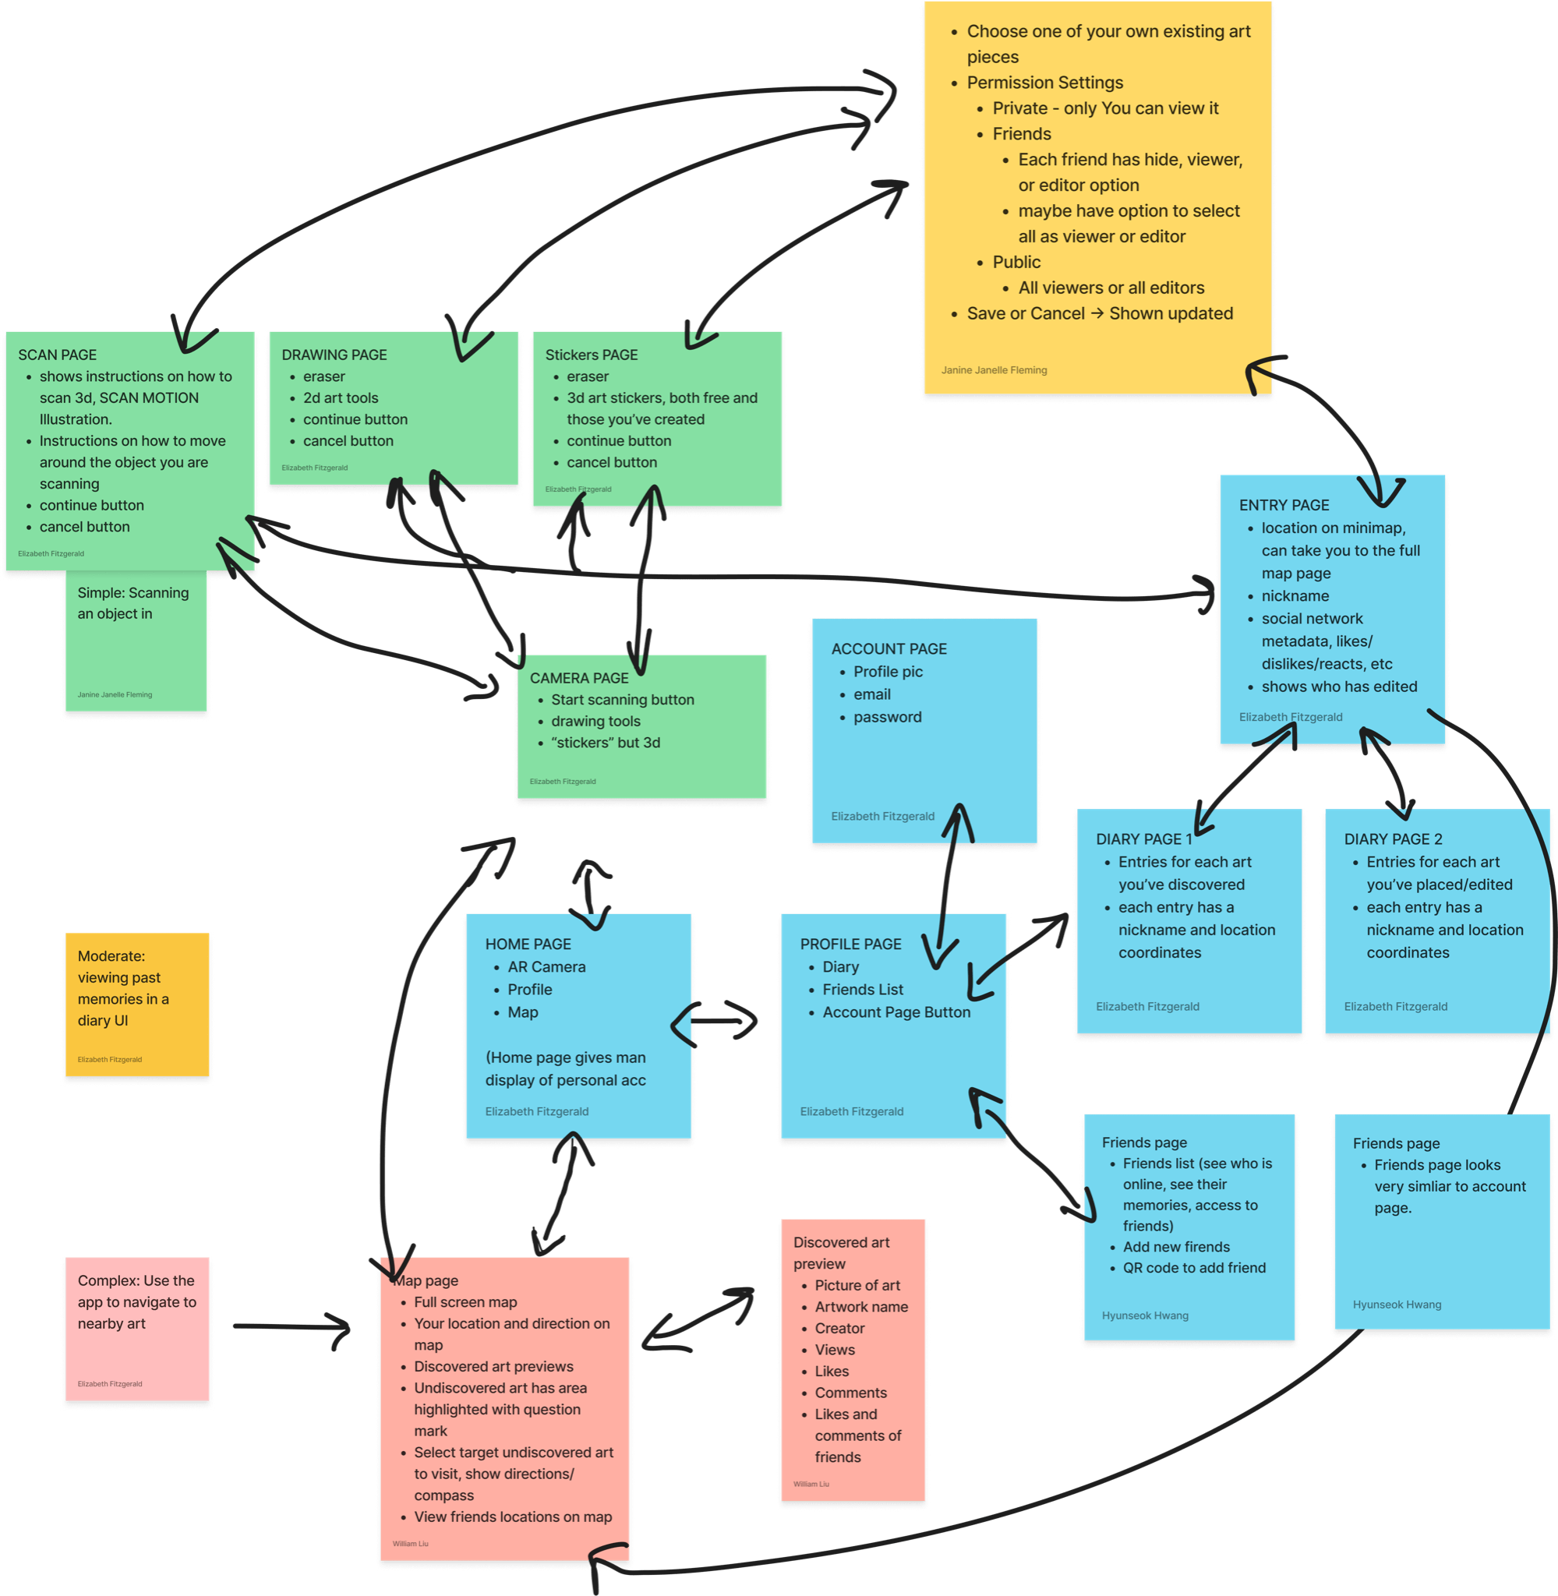
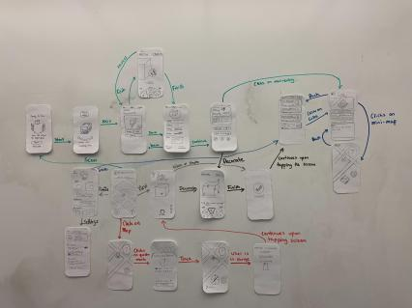
Prototype Construction

Slide 22
Features and Interactions
Map - Shows user location and AR pieces (i.e treasures) nearby, both discovered and undiscovered
Social Network - Add your friends and access treasures they’ve liked or created; share location of treasures you’ve created with your friends
Diary (i.e Trove) - Records all of the pieces you’ve created or discovered. Each entry has a name, location coordinates, description, and view/edit permission settings
Camera/Decoration Page - Scan in objects from the real world to create your own treasure. Draw or add stickers to decorate.

Slide 23
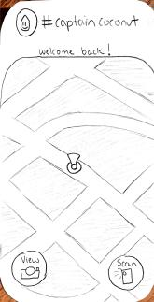
Tasks
Simple: Create your own treasure via scanning in a real-world object.
Moderate: Find a past treasure you created and edit the description.
Complex: Locate an undiscovered location nearby and save it
Homepage

Slide 24
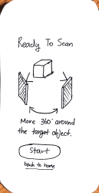
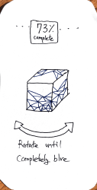
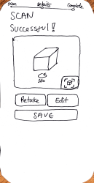
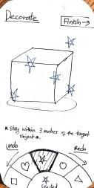
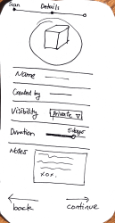
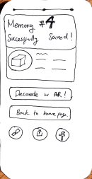
Simple Task
User starts at the homepage. Presses the scan button
Scanning instructions + prompts user to start
Progress bar of scanning
Scan is successful; Options to edit, retake or save
Decorating page where user can add stickers to scanned object
New entry log to set visibility and description
New entry saves directly into the Trove

Slide 25
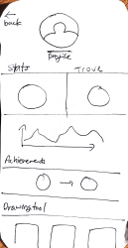
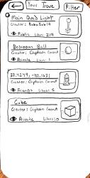
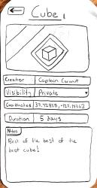
Moderate Task
User starts at the homepage. Presses the profile page at the top.
Profile appears. To access past entries, user clicks on Trove.
Log of collected treasures. Click most recent memory at bottom
Entry details. User can edit the description.
Once done editing, the treasure is saved again.

Slide 26
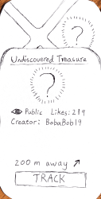
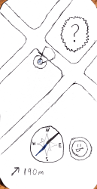
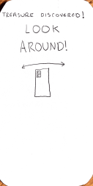
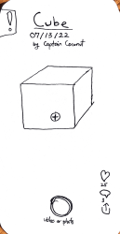
Complex Task
User starts at the homepage. Presses the view button.
Map with nearby locations shown. Click on unknown treasure
Info card of unknown treasure pops up. To locate, user presses track
Compass and distance counter leads user to location
Once near unknown treasure, wave your phone to uncover it
Object is discovered; User has option to save and edit new treasure.

Slide 27
03
Usability Testing
Methodology and Results
Notes:
The first interview was

Slide 28
Target Audience
1) People who are artists or interested in viewing art
2) Teens, Young Adults, and Millenials - most familiar with social media apps
Goal: Find younger participants who are engaging with art/architecture around them

Slide 29
Participants
Name: Claire
Age: Young Adult
Cantor Arts Museum visitor
Name: Alex
Age: Young Adult
Uni Student interested in Product Design
Name: Yeulige
Age: Young Adult
Tourist visiting Stanford’s campus
Name: Julio
Age: Young Adult
Photographer, Heavy Snapchat user
Notes:
In general, our app is targeted towards younger people (teens -> millennials) who are interested in art

Slide 30
Usability Goals And Key measurements
1) Efficiency - How seamless was it to navigate our tasks?
2) Pleasurable - Did the participants enjoy the experience?
Values in mind: Creativity/Creative Expression, Mobility, Safety

Slide 31
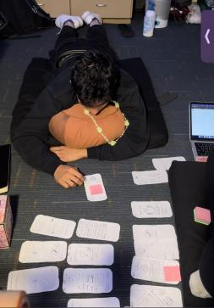
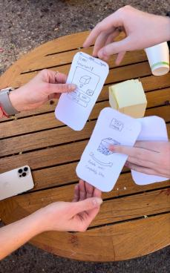
Testing Procedure

Slide 32
Key Findings - Successes
Overall, UI was simple and intuitive
Map and “treasure hunting” aspect was enjoyable
Customization of your created treasures made it more personable

Slide 33
Key Findings - Failures
Confusion on the purpose of our application
UI of Decoration Page was difficult to use
Accessing the Trove felt too cumbersome
Some critical UI icons didn’t make sense (ex: Profile icon, Compass)
Mistakes in scanning in an object

Slide 34
04
Discussion
Implications and What’s Next
Notes:
The first interview was

Slide 35
Thanks for Listening!
Any Questions?

Slide 36
Appendix
Pros and Cons List here
Script for Testing here
Log of Critical Incidents here
Sketching Report here
Consent Forms here
Icons created by Freepik from Flaticon
Notes:
Icons made by
<a href="https://www.flaticon.com/free-icons/person" title="person icons">Person icons created by Freepik - Flaticon</a>

