Slide 1
Assignment 4: Concept Video
Presented by Time & Space: Team 1

Slide 2
Team Introduction
Janine
Fleming
Elizabeth Fitzgerald
William
Song Liu
Hyunseok
Hwang

Slide 3
Problem and Solution Overview
Problem
When we reminisce about our memories, we want to remember the emotions we felt in those moments. Current tools exist to help document our memories (ex: 2D photos), however, it’s still difficult for people to fully revisit and re-experience the emotions they felt.
Solution
A location-based AR app that ties AR memories in specific locations. Users can create their own pieces from scratch or scan in objects around them. These pieces can only be shown at the places they are placed. Once a user discovers a location, a 3D render of their piece will show up on their phone.

Slide 4
Project Name & Value Proposition
The definition of trove is “a store of valuable or delightful things”.
Memories are valuable to us, and we want to have a safe place to store and view them.
Value Proposition: “Treasure your memories”.
Although there are many other apps that are used to document memories, they don’t allow you to fully re-experience your emotions that make your memories valuable in the first place.
“Treasure your memories.”

Slide 5
03
Market Research
Deep analysis + Competitive matrix
Notes:
The first interview was

Slide 6
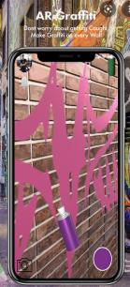
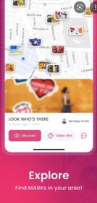
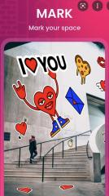
Competitor analysis 1
MARK: AR Social Network
Developed By
“People sharing streetart together”
+1K Downloads on PlayStore

Slide 7
Competitor analysis 1
Storing AR Object at a proximate location.
Sharing AR Art with friends.
Theme is centred on spray/graffiti paint style
Overlapping target audience.
Does not offer diverse editing tools
No persistent AR object.
AR drawing/editing tool is primarily in 2D.
Lacks realism and does not offer 3D object scanning.
MARK: AR Social Network
Developed By
“People sharing streetart together”
+1K Downloads on PlayStore

Slide 8
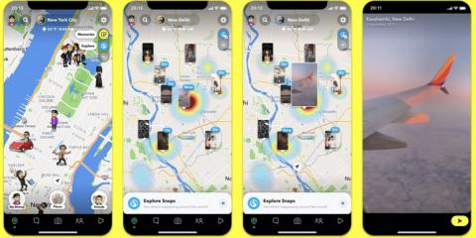
Competitor analysis 2
Snapchat
Valuated at 38.3 Billion USD
Snapchat Map: secondary feature

Slide 9
Competitor analysis 2
Displaying 2D videos and photos at a proximate location.
Sharing AR Art recordings with friends + global audience
Offers diverse APKs and development environment.
Emphasis on social network ability.
Live feed of new uploads.
Huge user acquisition.
AR memories are not interactive.
AR objects does not appear in physical location.
Snapchat
Valuated at 38.3 Billion USD
Snapchat Map: secondary feature

Slide 10
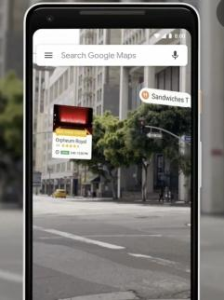
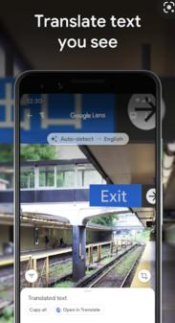
Competitor analysis 3
Google Lens
Developed By Google
Valuated at 1.3 Trillion USD
AR placed in physical world context

Slide 11
Competitor analysis 3
Viewing physical world with AR object as assistant.
Persistent AR object tied to specific physical object.
High quality AR with enabled occlusion.
Mainly used for searching computer vision database.
No emphasis on memories or logging data.
Provides additional information overlaid on top of the physical world.
Does not offer AR object placement tool.
User cannot place new object without getting verified.
Limited artistic expression.
Google Lens
Developed By Google
Valuated at 1.3 Trillion USD
AR placed in physical world context

Slide 12
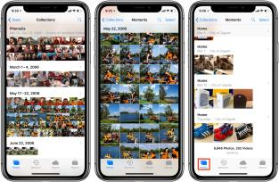
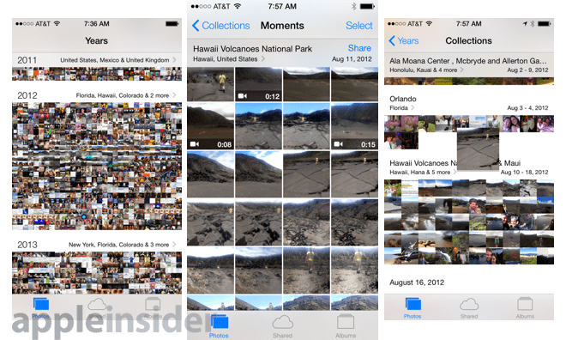
Competitor analysis 4
Apple Photos
Developed By Apple
Valuated at 1.3 Trillion USD
2D Photo/Video Storage with location tags

Slide 13
Competitor analysis 4
Storing 2D photos and videos.
Categorize photos via location tags.
Can easily create albums and share with friends.
Built-in product to primary hardware.
Huge user base and overlapping target audience.
Easy-to-use and accessible.
No social interaction feature included.
No AR memory included.
No gamification included.
Apple Photos
Developed By Apple
Valuated at 1.3 Trillion USD
2D Photo/Video Storage with location tags

Slide 14
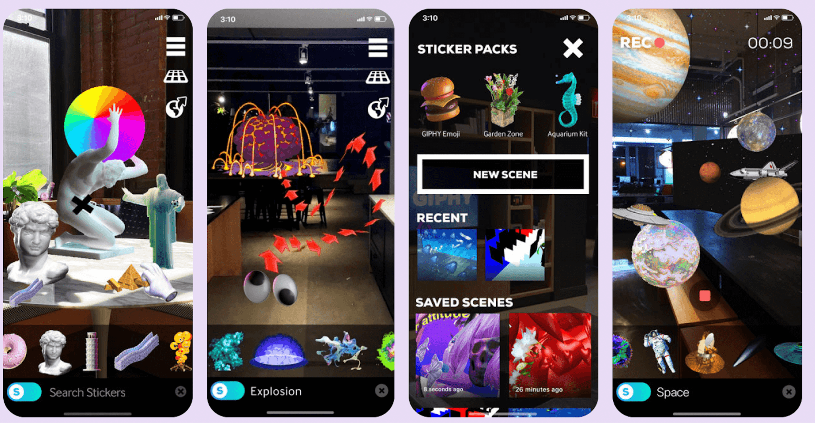
Competitor analysis 5
Giphy World
Developed By Giphy: Acquired By Meta
Valuated at 900 Million USD
AR object manipulation tool

Slide 15
Competitor analysis 5
Extensive range of tools to interact w AR object.
Manipulation of AR object in the user’s physical location.
Targets artistic individuals interested in 3D drawing
Realistic AR objects with occlusion + shadows.
No gamification or social context.
No persistent AR saving feature.
No sharing AR memory with friends other than 2D recordings.
Giphy World
Developed By Giphy: Acquired By Meta
Valuated at 900 Million USD
AR object manipulation tool

Slide 16
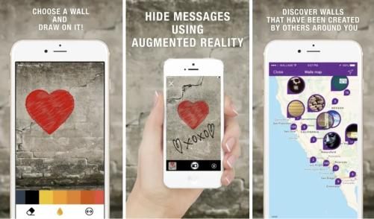
Competitor analysis 6
WallaMe
Developed By Wallame LTD
Valuation Unknown
Sharing AR contents via location

Slide 17
Competitor analysis 6
Storing AR Object at a proximate location.
Sharing AR Art with friends.
Message only discoverable at physical location.
Overlapping target audience.
Private and public message feature.
Does not have extensive reputation nor user base.
AR drawing/editing tool is primarily in 2D.
Lacks realism and does not offer 3D object scanning.
WallaMe
Developed By Wallame LTD
Valuation Unknown
Sharing AR contents via location

Slide 18
Competitive Matrix: Features + Target Audience
 | Realistic AR | Location-based | Social context | Gamification | Target user
1.MARK | ❌ | ✅ | ✅ | ✅ | ✅
2.SNAP | ✅ | ✅ | ✅ | ✅ | ✅
3.LENS | ✅ | ✅ | ❌ | ❌ | ❌
4.PHOTOS | ❌ | ✅ | ❌ | ❌ | ✅
5.GIPHY | ✅ | ❌ | ❌ | ❌ | ❌
6.WallaME | ❌ | ✅ | ✅ | ✅ | ✅

Slide 19
04
Values in Design
Notes:
The first interview was

Slide 20
Values in Design
Creativity and creative expression:
We will be providing diverse range of tools as to not limit their expression.
Accessibility + Mobility:
We will be providing necessary substitute recording methods for people with disability or additional needs.
Safety + Censorship:
We will not be providing service in dangerous areas or have parental controls to make app use safe for minors. We will also monitor contents via computer vision to remove inappropriate contents.

Slide 21
Values in Design: Conflicting values
Violation of Privacy Rights of individuals scanned
as AR objects:
We realise that some individuals do not wish to be featured in our database as AR objects. Unless given explicit permission or identification, we will be substituting anonymous AR object’s faces with pre-rendered avatar faces to public display.
And also have extensive content report system to eliminate abuse of the privacy rights.

Slide 22
05
Our Tasks
Simple Moderate Complex
Notes:
The first interview was

Slide 23
Our tasks
We categorized different tasks conducted by users by focusing on two main matrics: Frequency of use + Complexity of use.
Frequency of use: How often in the application cycle, is the task completed to serve its purpose to fulfil users’ needs.
Complexity of use: How many steps of interfaces are required to complete the task without the need for additional learning by the user.

Slide 24
Our tasks
Simple
Recording and placing AR art in the real-world.
Moderate
Change who has access to and who can edit your AR memory piece.
Editing existing AR artwork.
Complex
Finding a location where an AR art piece was placed.
Scrolling through different time frame collections of the same location.

Slide 25
06
Concept Video StoryBoard
Notes:
The first interview was

Slide 26
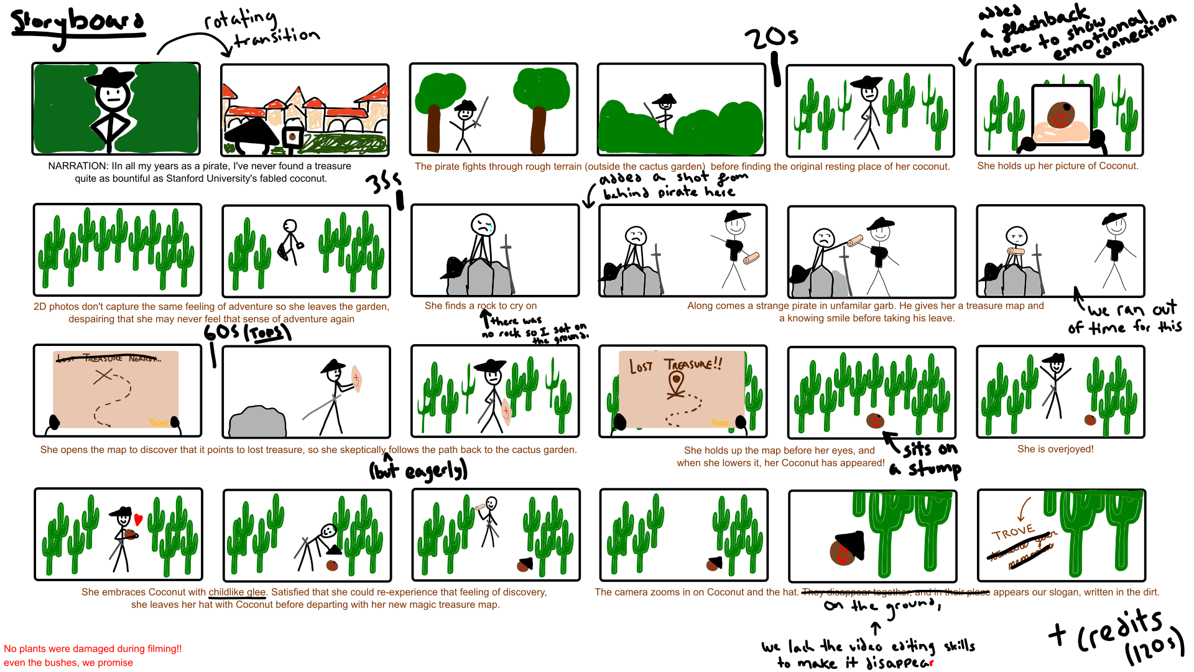
Notes:
For full-blown image, link is in the appendix

Slide 27
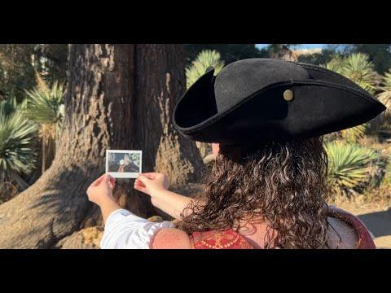
Concept Video - trove

Slide 28
Appendix
Here’s a link to our storyboard (also included in the deliverable).
Here’s a link to our video.

