Slide 1
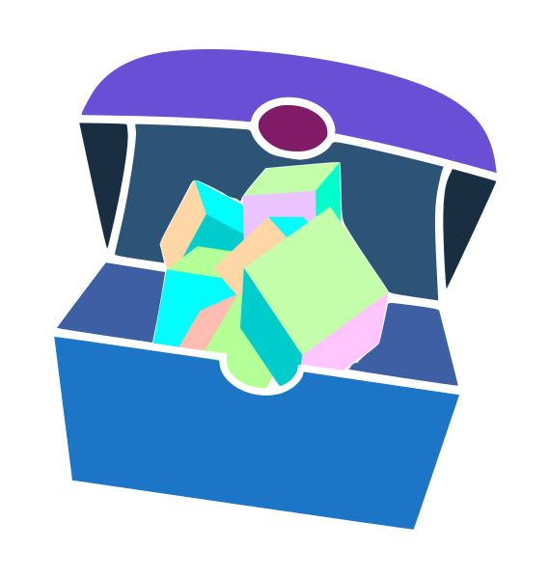
Trove
Treasure your memories.

Slide 2
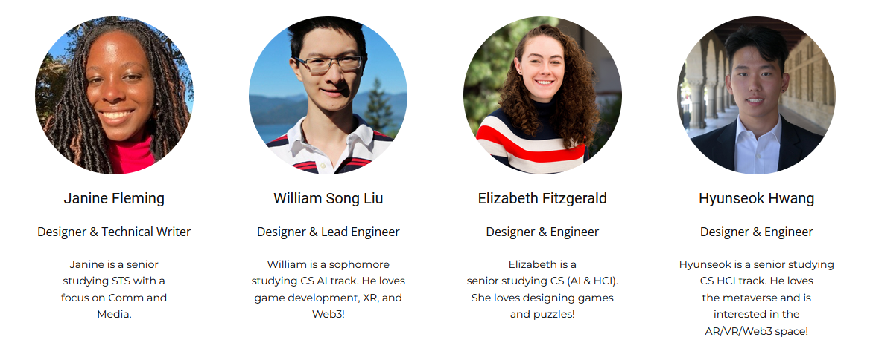
Our Team

Slide 3
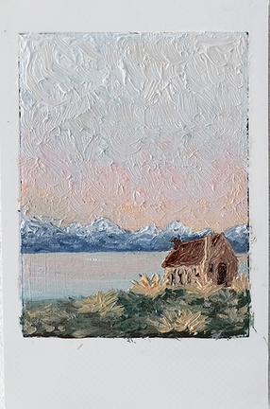
Value Proposition
Treasure your memories.

Slide 4
Problem
People struggle to revisit the emotions they feel when they view art.
2D photos and journals don’t cut it.

Slide 5
Solution
Trove is a location-based mobile app that allows users to discover and create AR art pieces hidden around the real world.
Through immersive AR technology, users can form stronger and longer-lasting connections with art that they interact with.

Slide 6
Overview
Heuristic Evaluation
87
Major UI Changes
Prototype
Status
Demo!

Slide 7
Heuristic Evaluation Results
Heuristic | H1 | H2 | H3 | H4 | H5 | H6 | H7 | H8 | H9 | H10 | H11 | H12
# of Violations | 9 | 5 | 9 | 15 | 4 | 3 | 7 | 19 | 1 | 5 | 8 | 2
87 violation in totals.
Severity | Sev. 0 | Sev. 1 | Sev. 2 | Sev. 3 | Sev. 4
# of Violations | 1 | 24 | 36 | 20 | 6
H4. Consistency and standards
Users should not have to wonder whether different words, situations, or actions mean the same thing. Follow platform conventions.
H8. Aesthetic and minimalist design
Dialogues should not contain information which is irrelevant or rarely needed. Every extra unit of information in a dialogue competes with the relevant units of information and diminishes their
relative visibility.
30% of violations were Sev. 3 or Sev. 4.

Slide 8
Specific findings for the Sev. 3 and Sev. 4 violations
Heuristic | H1 | H2 | H3 | H4 | H5 | H6 | H7 | H8 | H9 | H10 | H11 | H12
Sev. 3 | 3 | 1 | 2 | 1 | 2 | 2 | 3 | 1 | 0 | 2 | 2 | 1
Sev. 4 | 1 | 0 | 1 | 1 | 1 | 0 | 1 | 0 | 0 | 1 | 0 | 0
H1 violations included:
Scanning progress is shown numerically rather than visually.
There is no button to save changes made to a Trove entry.
After arriving at a memory, the user can still scan in their own object.
After decorating, the top right still says “Done,” which is confusing.
H7 violations included:
The user cannot upload scans of digital art during scanning.
The user cannot view changes to their art from the Trove.
The user sees comments on memories but cannot add their own.
The user does not get a description of the art they’ve navigating to before seeing it in-person.
H1. Visibility of system status
The system should always keep users informed about what is going on, through appropriate feedback within reasonable time.
H7. Flexibility and efficiency of use
Accelerators -- unseen by the novice user -- may often speed up the interaction for the expert user such that the system can cater to both inexperienced and experienced users. Allow users to tailor frequent actions.

Slide 9
Usability Goals
Ease of Use
We want our app to be easy to learn, even for users who have never used AR.
Fun to Use
We want users to have fun with every task included in our app.

Slide 10
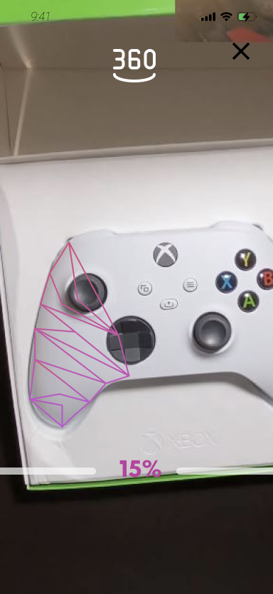
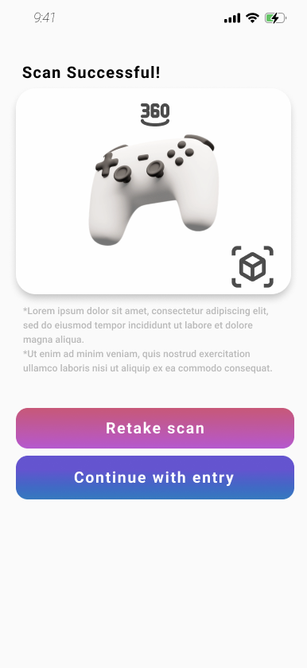
Issues - Scan
Scan
Cannot view scanning tips again after starting (H10)
Cannot restart a scan midway without exiting and coming back (H3)
Retake scan button may be first read (H8)

Slide 11
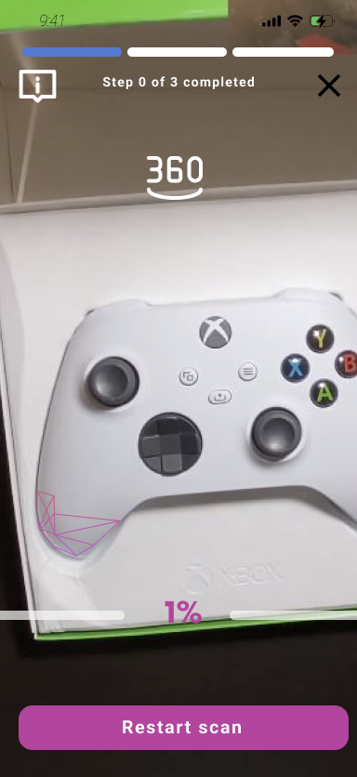
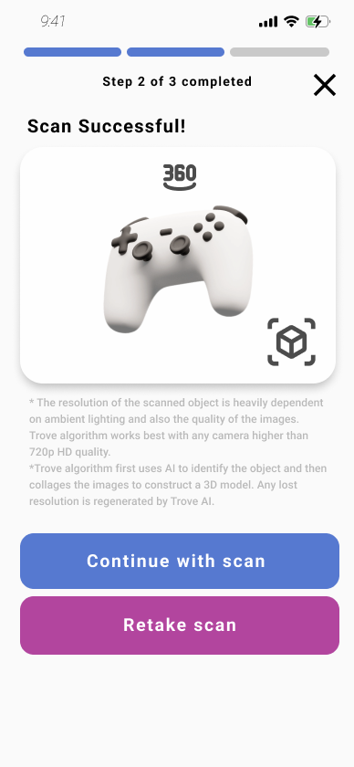
Revised - Scan

Slide 12
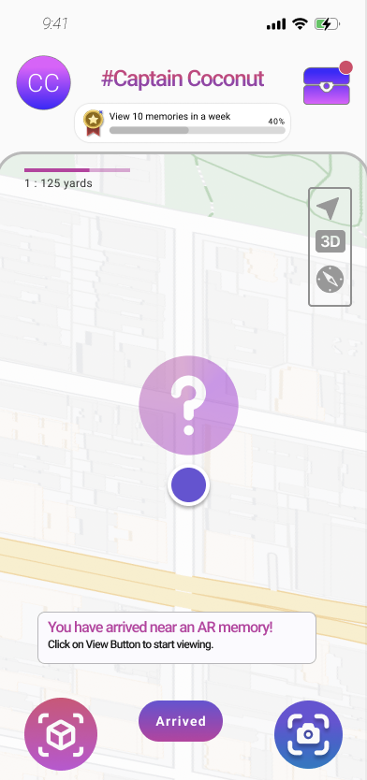
Issues - Navigate
Navigate
Poor process funnel; uses notification to tell user to click view button (H10)
View and scan buttons are enabled during navigation, can accidentally exit navigation process funnel (H5)

Slide 13
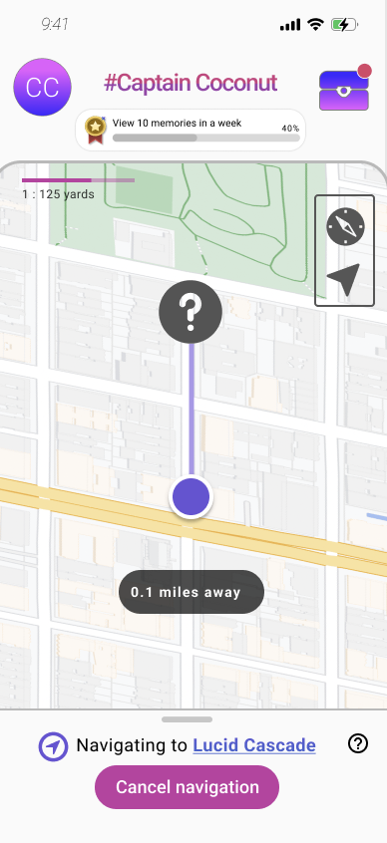
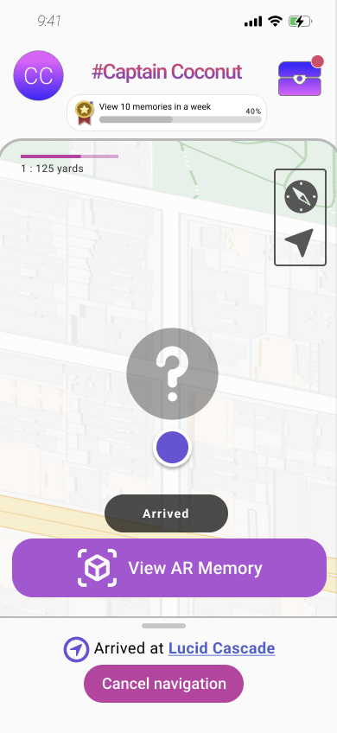
Revised - Navigate

Slide 14
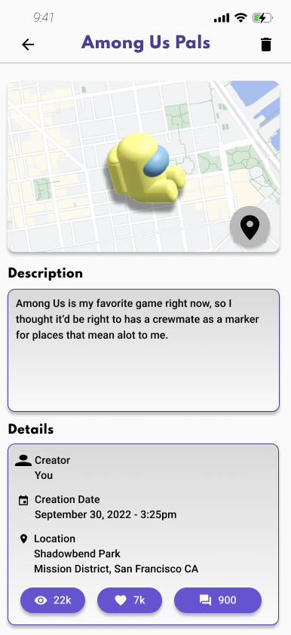
Issues - Trove
Trove
No way to edit Trove entry settings (H3)
No way to save your edits (H1)

Slide 15
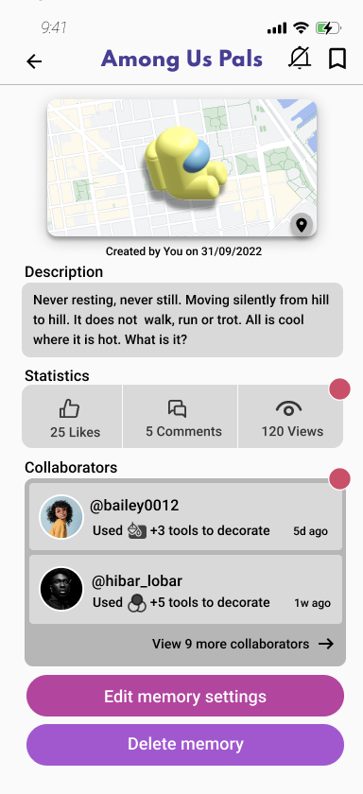
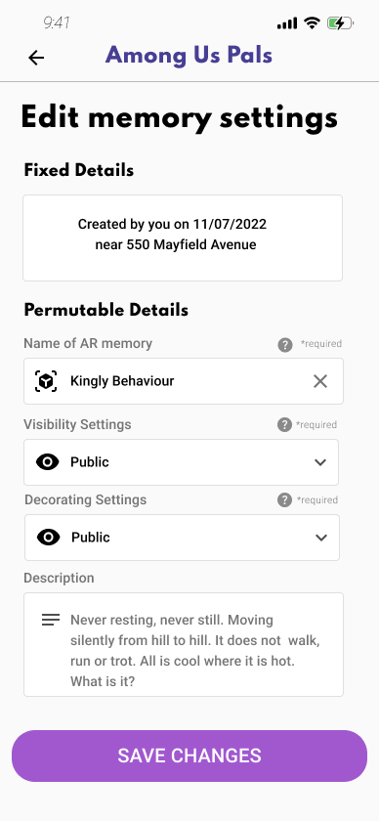
Revised - Trove

Slide 16
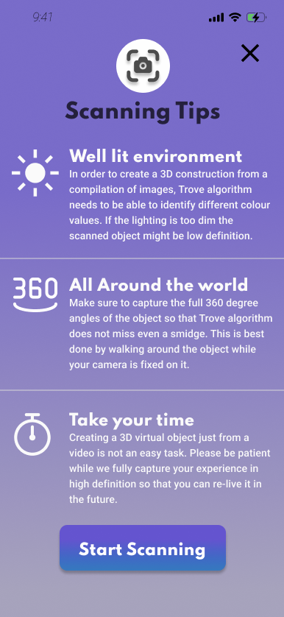
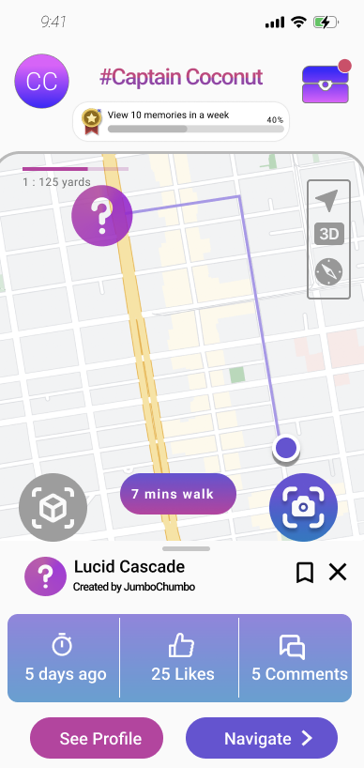
Issues - Color
Color
White text might not have enough contrast against the background (H11)
Confusion of what is a button or not (H4)

Slide 17
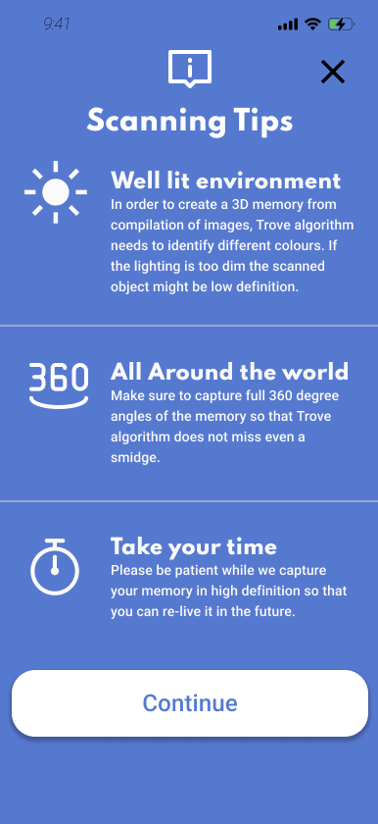
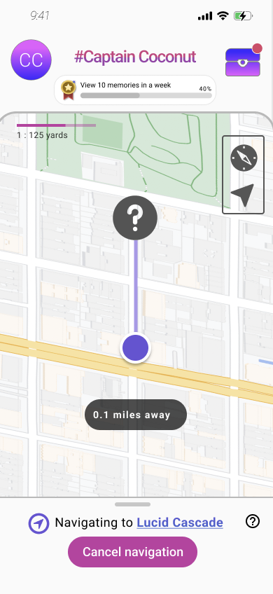
Revised - Color

Slide 18
Prototype Implementation Status - Tools
Unity
Visual Studio
Plastic SCM
Figma

Slide 19
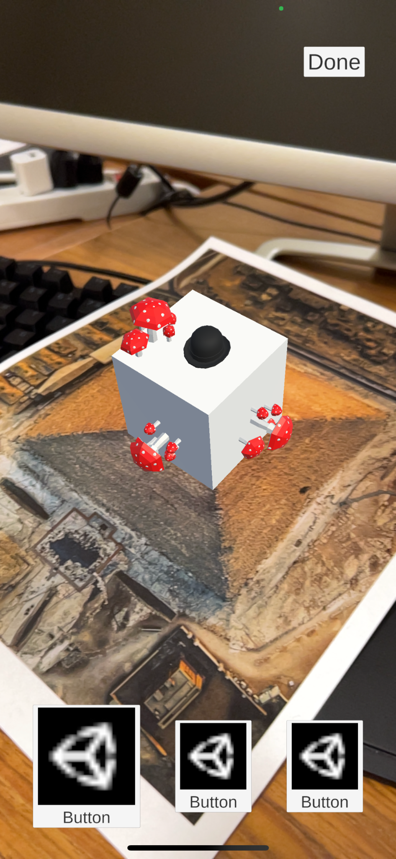
Prototype Implementation Status - Completed Task
View and Decorate an Object
Note: This is an Auxiliary Task!
We implemented AR tracking on a reference image and the ability to display 3D object.
Users can place decorations on 3D object.
Users can save their selected decorations.

Slide 20
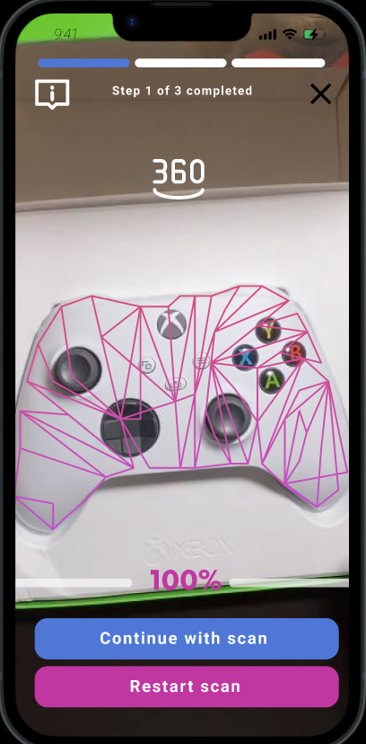
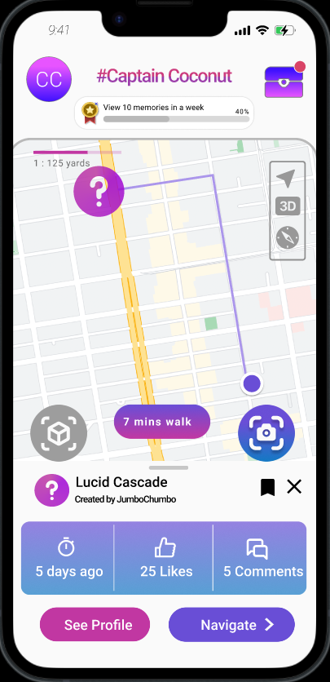
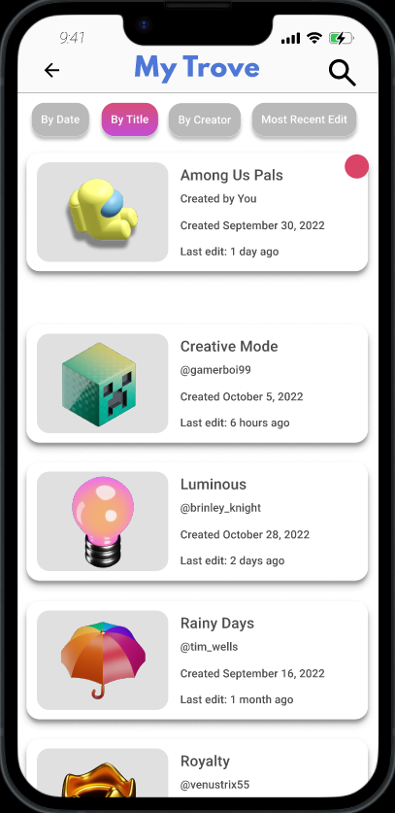
Prototype Implementation Status - Next Steps
Scanning
an Object
Using the Map for Navigation
View and Edit a Trove Entry
Adapt existing code from the View and Decorate task.
Implement map and navigation system.
Implement UI.

Slide 21
Prototype Implementation Status - Wizard of Oz
Scanning
an Object
Using the Map for Navigation
We use AR tracking tags to locate a predetermined object.
We’re doing navigation by tapping rather than GPS.
Hard-Coded Features
Area of map
Navigation route
Scanned object
Decorations

Slide 22
Demo Time!

Slide 23
Thank you!

Slide 24
Appendix
Demo video link: https://drive.google.com/file/d/1rhl_w9GXxXw1Ei7fRh37joqUpLj3ZHOr/view?usp=share_link

