Slide 1
Assignment 6
Med-Fi Prototype
Stepping Through Time: Team 1

Slide 2
People struggle to revisit the emotions they feel when they view art.
2D photos and journals don’t cut it.

Slide 3
Trove
Treasure your memories.

Slide 4
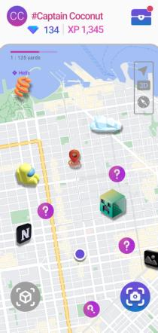
What is Trove?
Trove is a location-based art mobile app that allows users to discover and create AR pieces hidden around the real world.
Our aim is to encourage spontaneity and make art an everyday and interactive experience.

Slide 5
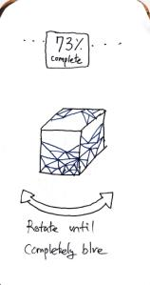
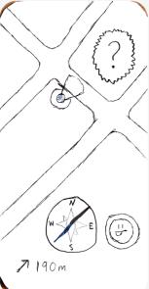
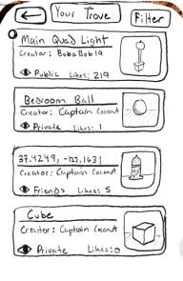
Revisiting our Tasks
Simple | Moderate | Complex
Scan and decorate a new 3D object. | Use the map to find an undiscovered piece of AR art | Edit an entry in your Trove

Slide 6
What are our values?
Make art interactive
Community
“Treasure Hunt” Map
AR Art Tools
Creative Expression
Social network features
Gain experience to unlock status badges
Scanning 3D objects
Creating AR art
“Decorating” AR art
Notes:
While our values don’t conflict, one thing we’re wary of is user safety. We don’t want to let users place objects in the middle of busy intersections, roofs, etc.

Slide 7
Usability Goals & Key Measurements
Number of Errors
Ease of Use
We want our app to be easy to learn, even for users who have never used AR.
What did you find unintuitive?
Fun to Use
Rated from 1-10
We want users to have fun with every task included in our app.
What did you like?
What did you not like?

Slide 8
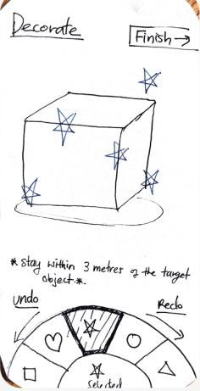
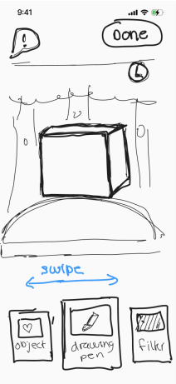
Notable Revisions
Decoration Page
Users found the wheel confusing to interact with. In response, we created cards that are easier to understand and see. Users will better understand how to navigate and use the decorate tool.

Slide 9
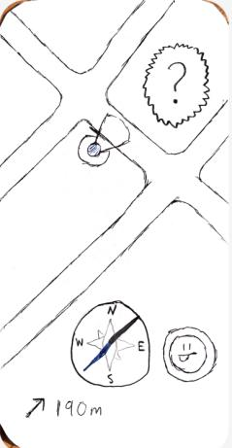
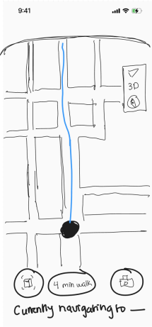
Notable Revisions
Navigation
The compass did not reflect navigation in urban environments where directions are not in straight lines. In response, we removed the compass during navigation and adopted a Google Maps interface. Users are already familiar with the interface and will learn to use our map more easily.

Slide 10
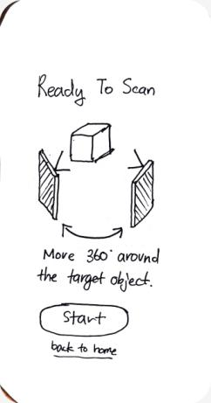
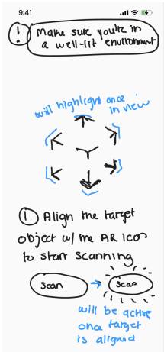
Notable Revisions
Scanning
Users did not understand how to complete the scanning task. In response, we provided an instructions page where we can give an idea on how scanning works. Users will learn to use the scanning functionality more easily.

Slide 11
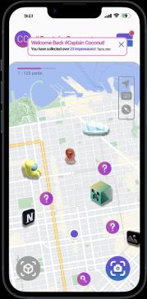
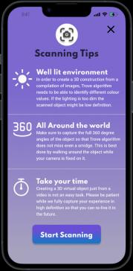
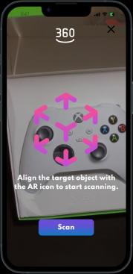
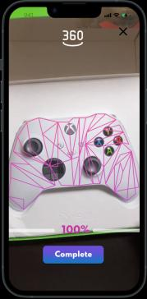
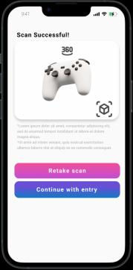
Revised Simple Task Flow
This is the homepage, which opens to a map.
When you select the scanning icon, it gives brief instructions
Before scanning, the user is told to point the icon at the object.
Scanning proceeds until complete.
You have the option to retake the scan or create the Trove entry.

Slide 12
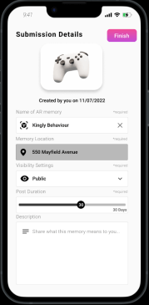
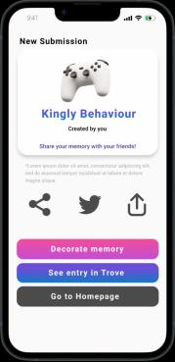
Revised Simple Task Flow
After selecting “Continue to Entry,” can change the settings on their new AR memory.
At the end of the flow, users can choose to go back to the homepage, see their entry, or decorate the memory.

Slide 13
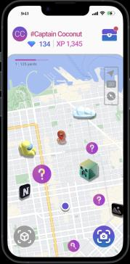
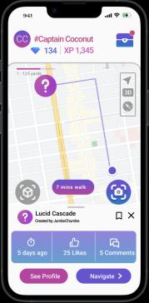
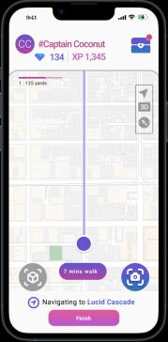
Revised Moderate Task Flow
This is the homepage, which opens to a map.
To start finding a new undiscovered AR piece, click on one of the question icons.
Info about the piece appears. Click on “Navigate” for directions.
Map will show directions to new art piece.
During navigation, a pop-up cautions you to avoid distractions. Click “I understand” to resume,

Slide 14
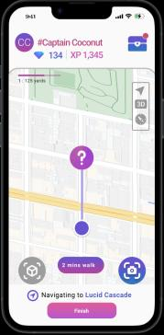
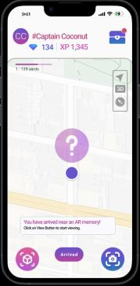
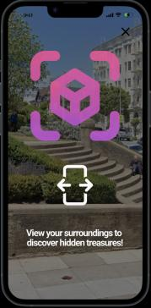
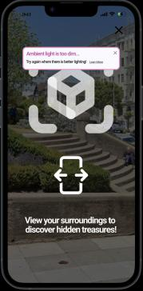
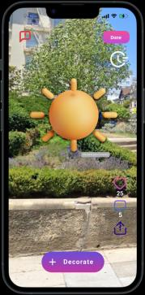
Revised Moderate Task Flow
ETA changes as you get closer to the AR piece.
When Trove notifies you that you’re close, click on the “View” Button to start uncovering the AR piece.
Move your phone around your surroundings to reveal the AR piece.
You may need to reset or try a different time if the camera has trouble capturing the AR.
Once discovered, the AR piece will show on your screen. You can decorate it, or save it to your Trove by hitting Done.

Slide 15
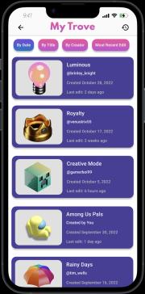
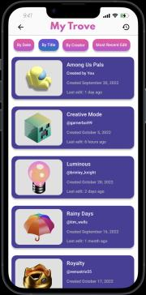
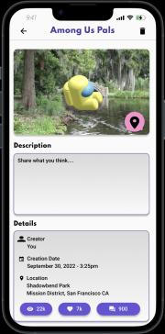
Revised Complex Task Flow
This is the homepage, which opens to a map.
To open up your Trove, tap the treasure chest icon in the top right.
“My Trove” contains all of your AR entries. To order them by name, tap the “By Title” filter button.
Entries reorder themselves based on the filter. To open up a AR piece you created, tap on the “Among Us Pals “entry.
Once you tap on the entry, it’ll bring you to it’s detail/description page.

Slide 16
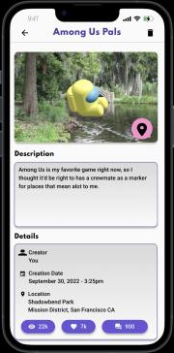
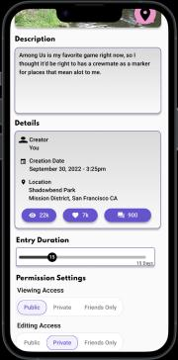
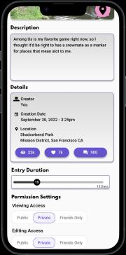
Revised Complex Task Flow
Each entry page contains a description, metadata about the creation, and permission settings.
Tap the description box to change the description.
Scroll down the page to find the permission settings. Permission settings allow you to control who’s able to view and/or edit your AR piece.
To limit viewing access to just yourself, tap the “Private” button on the toggle bar below “Viewing Access”.

Slide 17
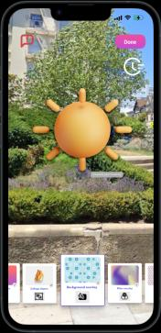
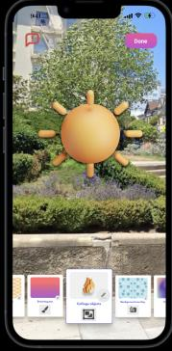
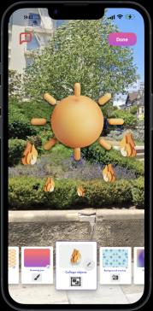
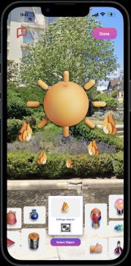
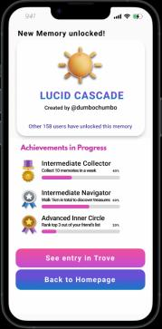
Auxiliary Task - Decorating
Swipe the decoration toolbar to browse various filter effects and objects.
When you find a object you’d like to use, click on the icon to add it into the world.
You change the kind of object you use by pressing the edit button.
Swipe and select any other objects you’d like to use. Once you’re finished, click “Done” to save your entry.
After you’ve saved the entry, Trove will show your achievements in progress.

Slide 18
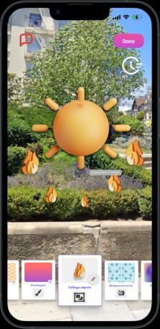
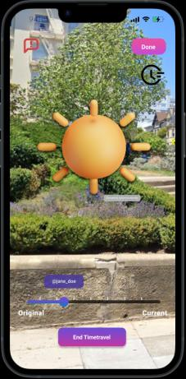
Auxiliary Task - Timetravel
The user can view the edit history of the AR memory by using the Timetravel feature!

Slide 19
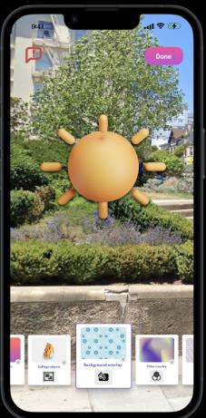
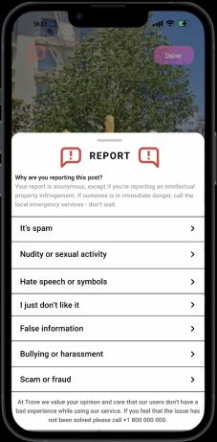
Auxiliary Task - Reporting
If the user believes that the AR piece violates community guidelines, they have the option to report it. Click on the “Report” button and specify your reason for reporting.

Slide 20
Prototype Implementation
Pros
Hardcoded Features
Figma allows for sleek prototype design.
Multiple team members are able to work on the prototype at once, and from anywhere.
Figma’s alignment tools are powerful.
Open-source community tools are helpful for niche design tasks.
3D Scanning must be hard-coded because it is very technically complex.
Map functionality is hardcoded for the Med-Fi.
The entries on the Trove page are hardcoded.
Trove entry creation page is hardcoded due to technical limitations.
Cons
Camera interface must be simulated for both scanning and viewing AR objects.
No sharing functionality and no social component because no internet connection.

Slide 21
THANKS!
https://www.figma.com/proto/QJiQjKnRpHhrkwobpfWwOX/Prototype?node-id=134%3A51959&starting-point-node-id=11%3A4342
Notes:
https://www.figma.com/proto/QJiQjKnRpHhrkwobpfWwOX/Prototype?node-id=134%3A51959&starting-point-node-id=11%3A4342

