Slide 1
Hi-Fi Prototype Midway
Culture through Cuisine
Defne Genç, Janet Zhong,
Amrita Palaparthi, Kyla Guru

Slide 2
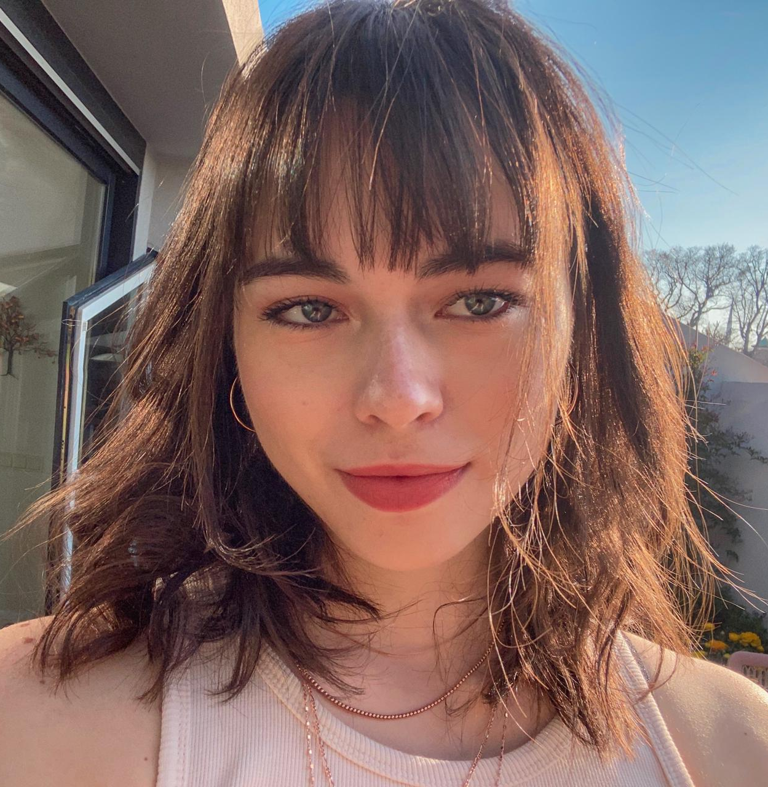
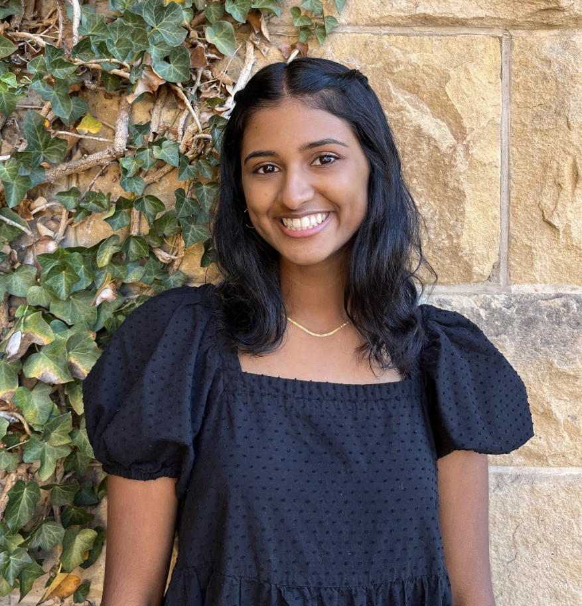
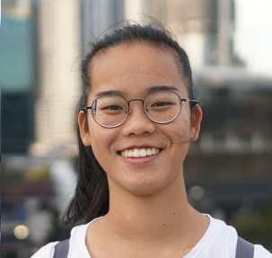
Meet Our Dishcover-ers
Defne
Kyla
Janet
Amrita
Dish of choice:
Dish of choice:
Dish of choice:
Dish of choice:

Slide 3
Problem Statement
Learning about and creating food with ingredients from other cultures can be an intimidating experience.

Slide 4
Our Solution
Dishcovery helps you recognize, learn about, and cook with foods from around the world. We use image recognition to identify new ingredients and enable you to delve into their cultural context and authentic recipes using them, providing a cultural culinary companion from the grocery store to your kitchen.

Slide 5
Table of Contents
Summary of heuristic evaluation results.
Heuristic Evaluation Results
Details and rationale on major changes, progress towards usability goals through revisions.
Major UI & Product Revisions
Framework and features thus far, explanation of techniques, and plans for moving ahead.
Prototype Implementation
Dish-cover Dishcovery in action (so far)!
Demo

Slide 6
Heuristic Evaluation Summary
6
22
Severity - 4
Severity - 3
Our highest priority violations.
Second priority violations.
31
82
Severity - 2
Violations Total
The most numerous amount of violations -- .
With the remaining Severity 1.

Slide 7
Heuristic Evaluation Summary
Consistency
Consistent look and feel across pages
Layout, element placement within pages
Aesthetics and Minimalism
Colors used in our app with meaning and intention
Only necessary animation between pages
Clear differentiation between different components in our UI
Signposting + Handling Failure Paths
Notifications upon success and failure for tasks like scanning
Paths to re-scan an element when a scan fails
Clearer instructions for scanning and searching through dishes

Slide 8
Unaddressed Revisions
Some qualitative recommendations and questions, i.e. which cultures will be addressed, where to get the data, and how to present foods that belong to multiple cultures
Will be left to decide for when we have real datasets, beyond implementation
Some button flows that don’t work aren’t all resolved in the Figma (i.e. scan screens because of Figma limitations), more so left for the implementation prototype.
Mentioning cultural significance in the context
Again, this depends on the datasets we plan on using, so it would be premature at this stage to try and reconcile what we will mention regarding the cultural significance of an ingredient
We didn’t remove the match percentage (%90), but rather added a “match” text to clarify.

Slide 9
Heuristic Revision Methodology
Rank
Revise
Violations by severity and colour-code them.
Design to execute changes.
Separate
Prioritise
Mark
Violations by task
Higher severity to be resolved sooner.
Changes made in green.

Slide 10
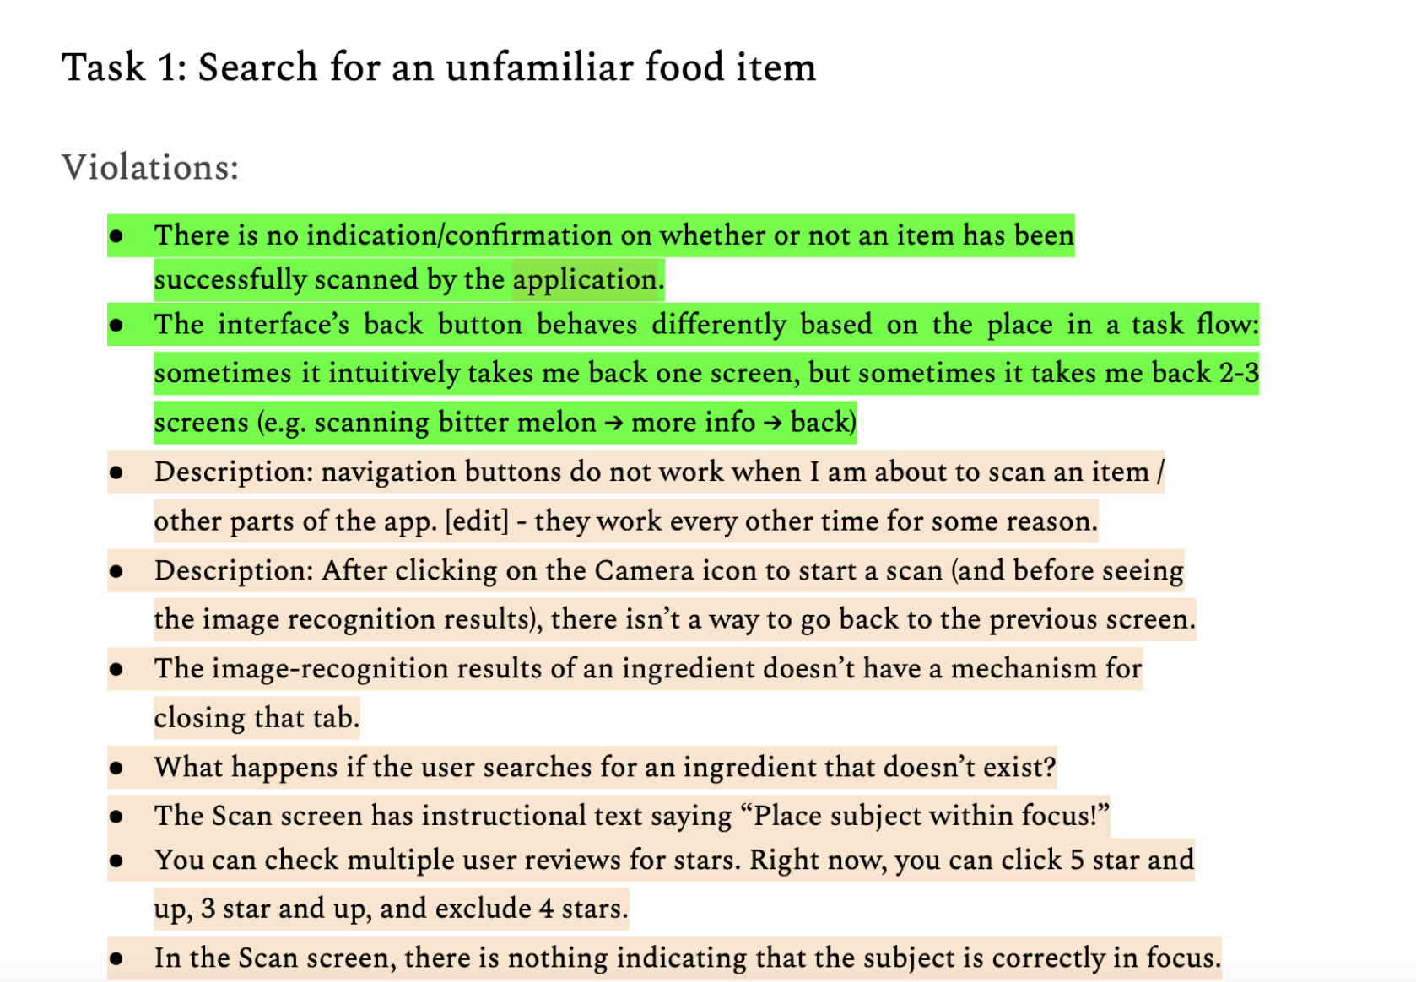
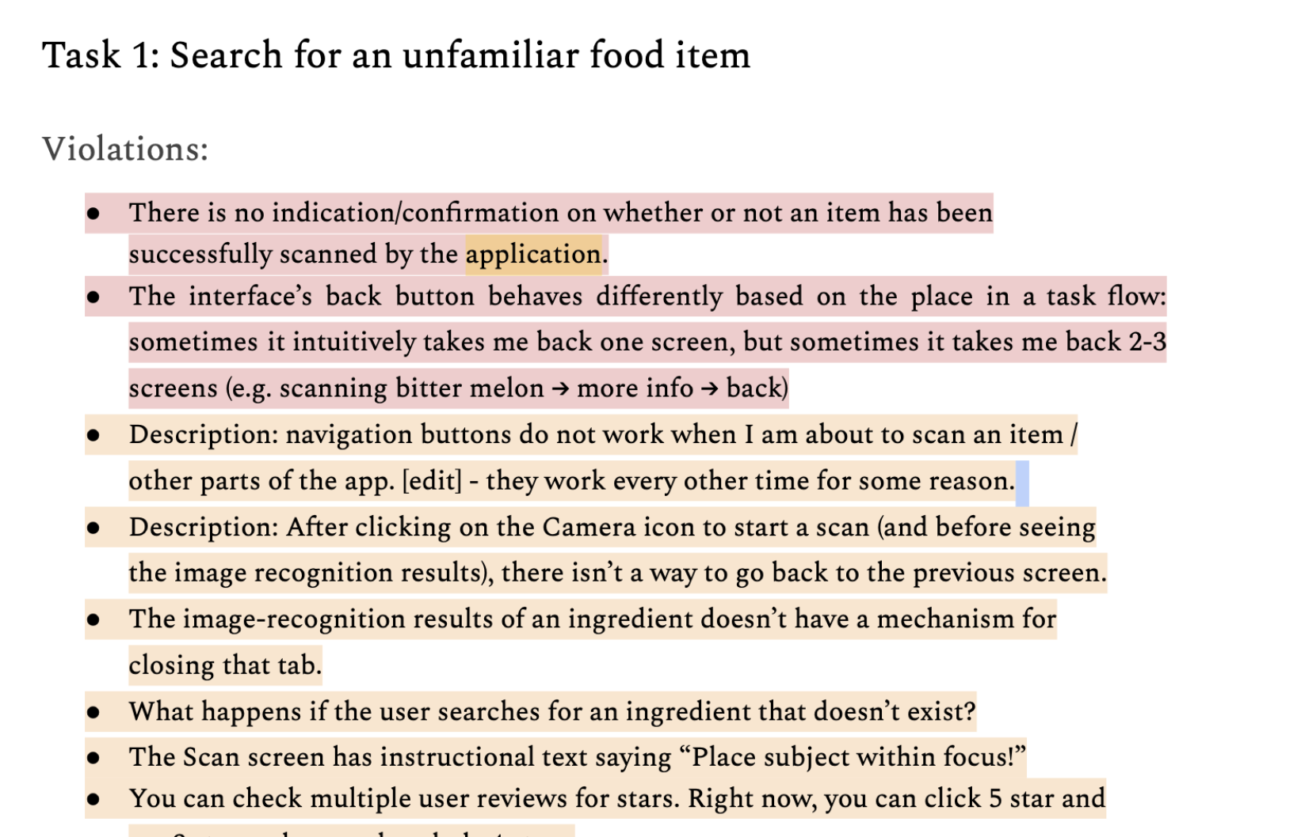
Encoding Violations to Prioritize
Red: Severity=4, Orange:Severity=3

Slide 11
Recap of our Task Flows
1
Search
For an unfamiliar food item through scanning.
2
Contextualise
Using the information provided in the app.
3
Authentic Cooking
Through recipes the user finds and/or saves.

Slide 12
Task 1: Search for an unfamiliar food item
Severity | Description | Solution/Rationale
4 | No confirmation when item scans or when the item isn’t recognised. | Use colours, confirmation, and warning as appropriate.
4 | Some buttons not working properly in prototype. | Addressed in implementation.
3 | No warning for when subject isn’t in focus. | Added a warning to place subject in focus.
3 | Colour scheme hard on the eyes. | Changed to a single accent colour and removed gradients.

Slide 13
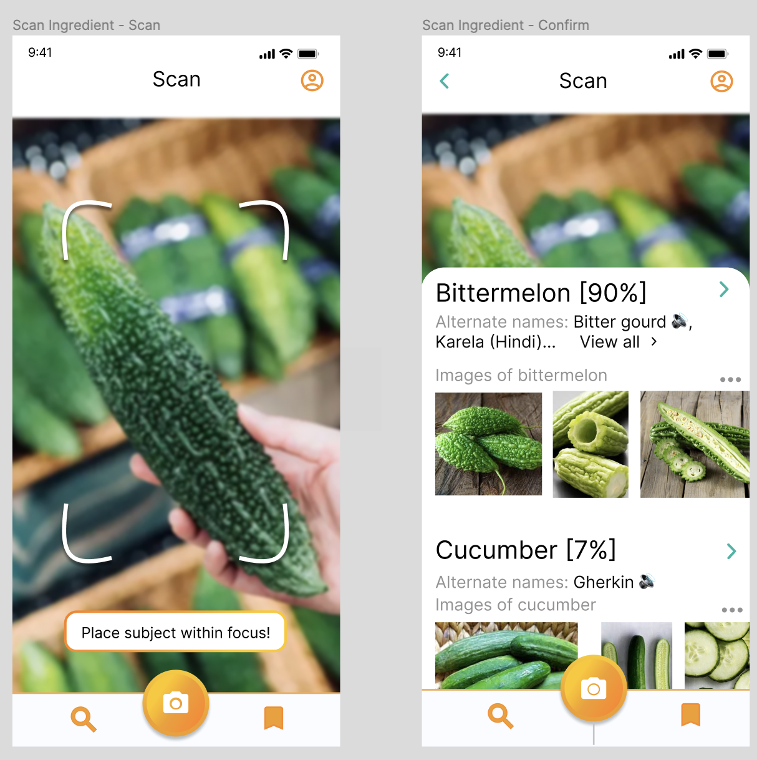
Task 1: Search for an unfamiliar food item (V1)

Slide 14
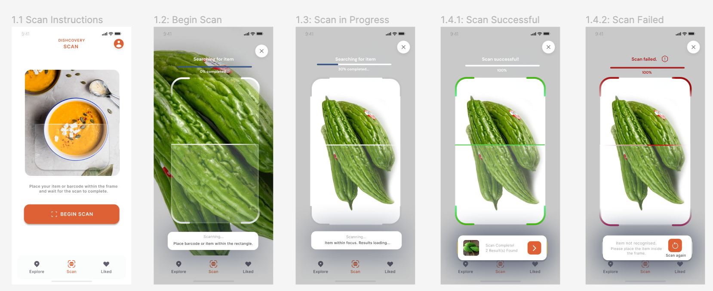
Task 1: Search for an unfamiliar food item (V2+Rationale)
S3: Removal of gradients to introduce a cleaner aesthetic.
S3: Clear instructions for placing item in focus and search in progress.
S4: Clear errors to guide user towards accurate scan results.

Slide 15
Task 2: Contextualization
Severity | Description | Solution
4 | “View all” button not visible because it’s in the same colour as the text. | Changed to accent colour.
4 | Need to re-scan to go back to the context from recipes. | Added a back button.
3 | Inconsistent tab names, spacing and punctuation. | Standardised using components.
3 | Which recipes and cultures to include? | “Request recipe” option added for inclusivity.

Slide 16
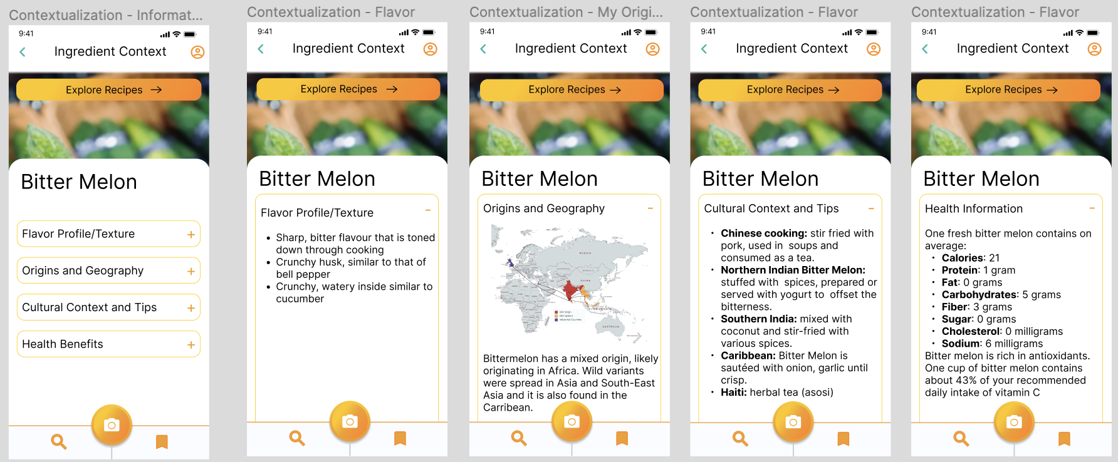
Task 2: Contextualization (V1)

Slide 17
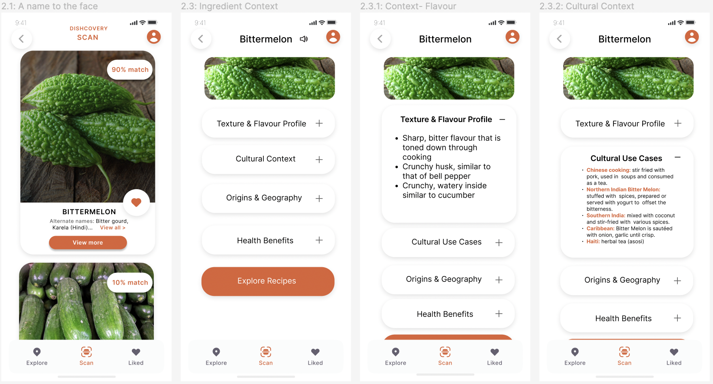
Task 2: Contextualisation (V2+Rationale)
Usability goals: increasing learnability!
S4: Added a back button.
S3: Standardized styles to improve consistency.
S4: Changed “view all” button to accent colour for improved readability.

Slide 18
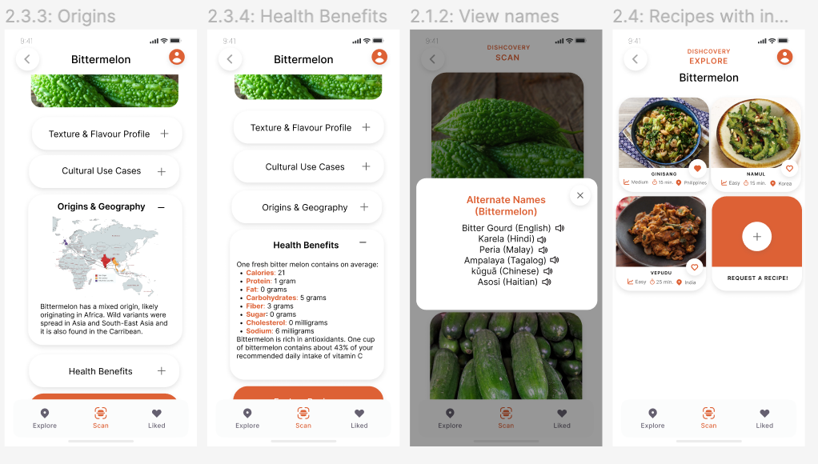
Task 2: Contextualisation (V2+Rationale)
S3: “Request recipe” option added for inclusivity
of currently under-represented cultural foods
within our app.

Slide 19
Task 3: Authentic Cooking
Severity | Description | Solution
4 | Some buttons and texts take user to wrong destination. | Addressed in prototype and implementation.
3 | Inconsistent fonts and headers. | Addressed in prototype and implementation.
3 | No confirmation before un-saving. | Confirmation added.
3 | Filters buttons move when changed. | Used auto layout for filters.

Slide 20
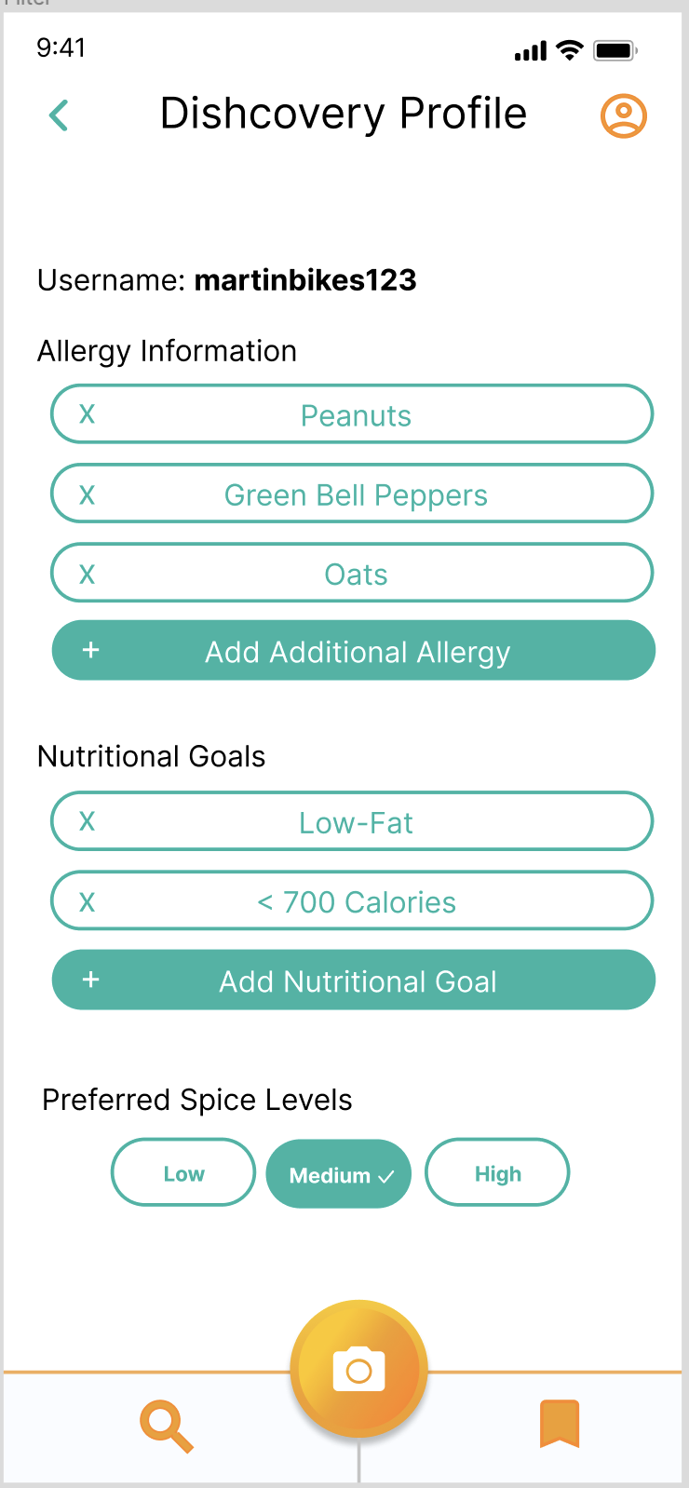
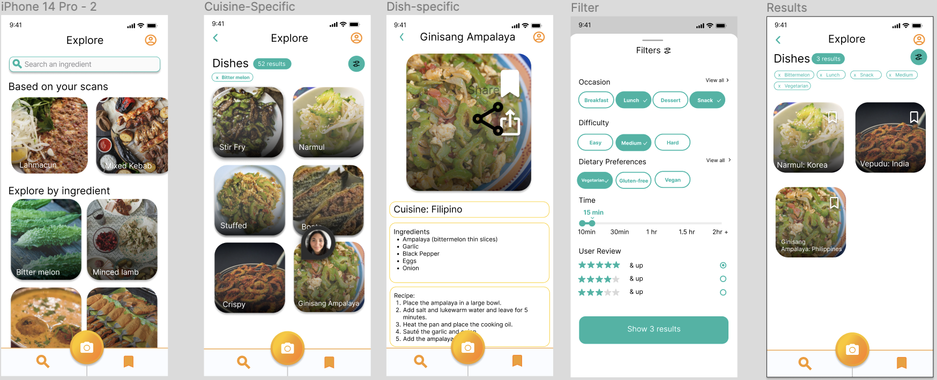
Task 3: Authentic Cooking (V1)

Slide 21
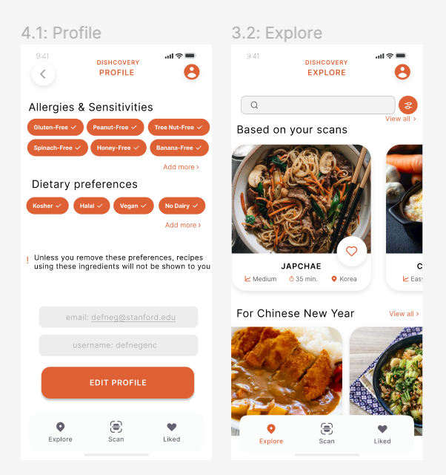
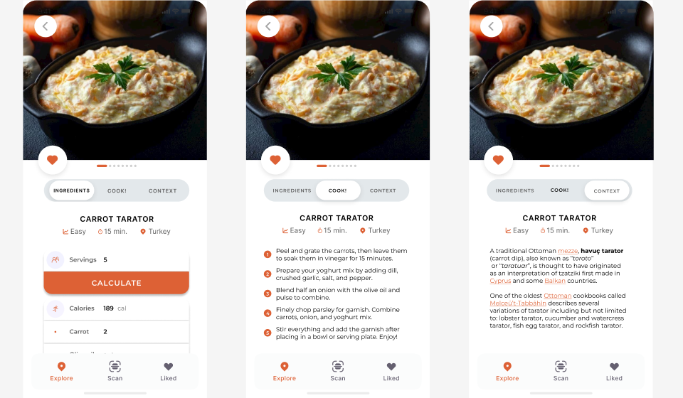
Task 3: Authentic Cooking (V2+Rationale)
S3: more consistent fonts and headers.
Usability goals: increasing efficiency of access to recipes!

Slide 22
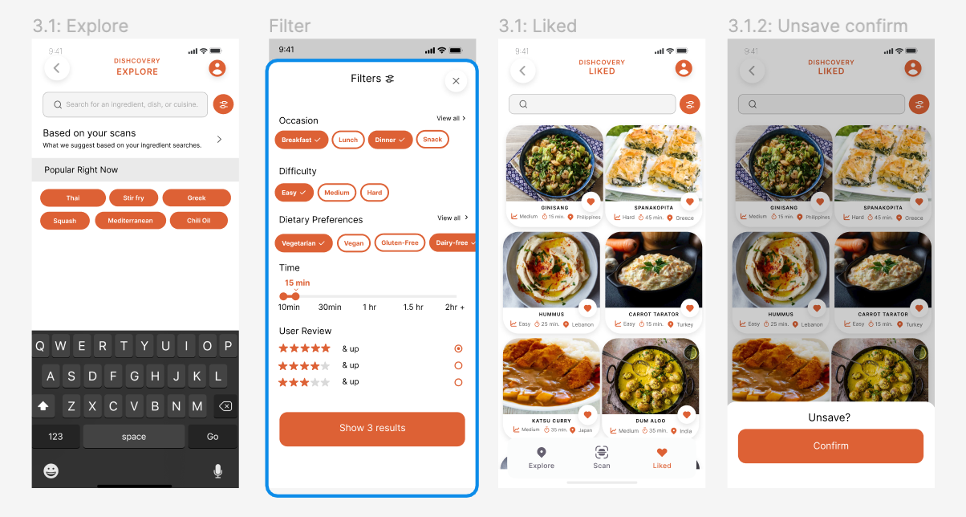
Task 3: Authentic Cooking
S3: Auto-layout for filters to improve readability
S3: Unsave confirmation added for greater visibility of status

Slide 23
Progress Towards Usability Goals
Efficiency
Learnability
Increasing the relevance of recipes
Scan results organization
To help the user quickly find a recipe that suits their preferences, we improved the options provided in preferences and the filtering flow. The user can also calculate ingredients required depending on serving size.
Instead of having several options for what the ingredient may be, the prototype presents the most likely ingredient prominently and *feeds* the user consumable and well-formatted cultural content.
Easy access to cultural context
Guiding the user’s eyes quicker through design
Ease of use in navigating recipe with consistent fonts/coloring, added bar navigation inside the recipe itself.
The user can access cultural context of a specific ingredient after scanning, as well as the cultural context of the selected dish after recipe selection.

Slide 24
Design Revisions Recap
H8 and H11: Accessible and Minimalist Design
H1: Visibility
Letting the user know the status and result of the scan.
Fewer colours and higher contrast for ease of reading.
H12: Inclusion
H7: Efficiency
More nutrition settings to be more inclusive of religious preferences.
Making all buttons fully functional.
H5: Error Prevention
H4: Consistency
Confirmations add to help users avoid mistakes.
Standardising fonts, sizes, punctuation and names.

Slide 25
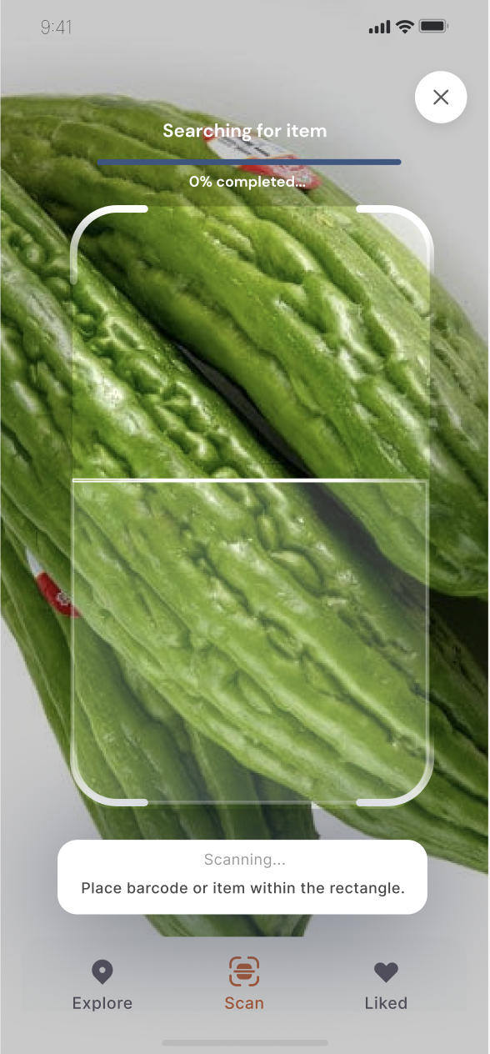
Prototyping
Converting design to code

Slide 26
Framework and Tools Used for Dev
GitHub
VSCode
LiveShare
Expo
We have a central repo where we push updates to.
Especially when we are remote, LiveShare allows us to code collaboratively.
Expo lets us see our code changes (or code errors) come to life.
VSCode allows us to produce code files and debug errors from Expo

Slide 27
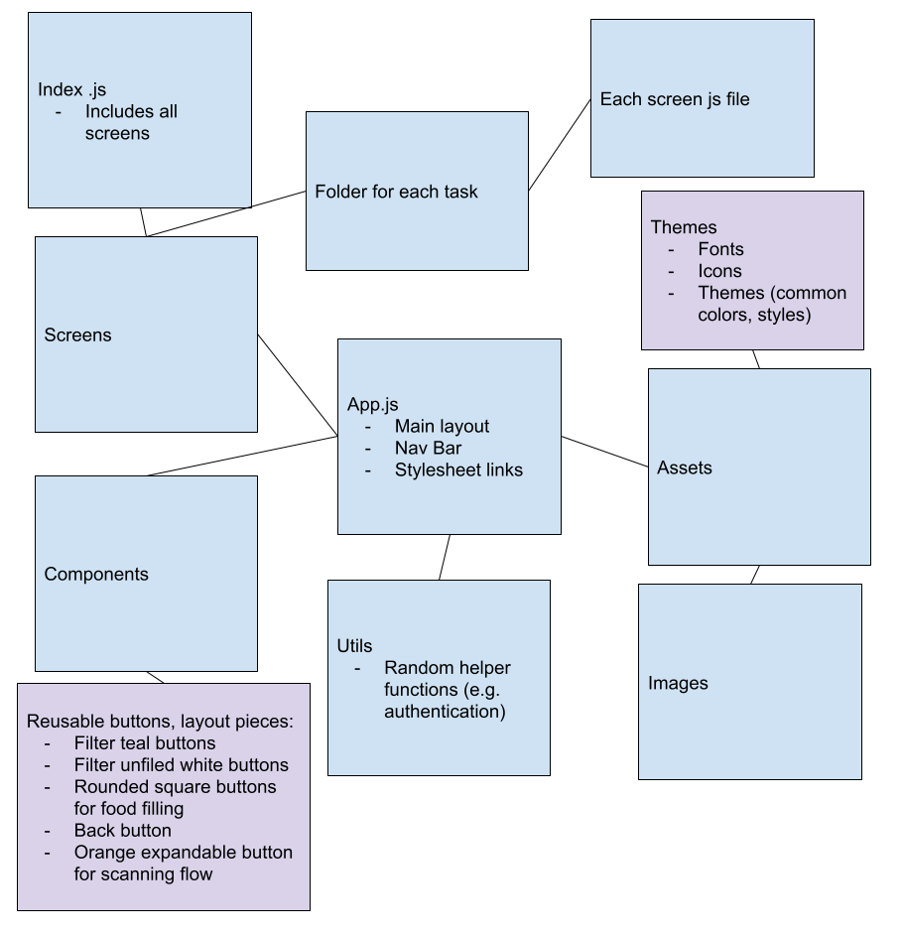
Code Organization
Assets
Fonts, icons, images styles
Constants (assets made into variables)
Fonts, icons, images, styles
Screens (organized by task flow)
HomeScreen
Scan (completed)
ScanIntroScreen
ScanScreen
ScanCompleteScreen
Additional Context Screen
Explore
SavedScreen
ProfileScreen
Components (reused in different screens)
DishCard

Slide 28
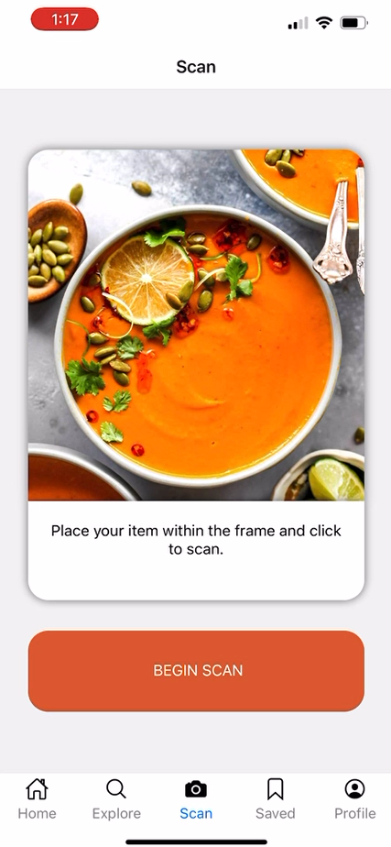
Implemented Features
Navigation for all main pages has been coded (Tab Navigator for Home, Explore, Scan, Saved, Profile and nested Stack Navigator for Scan Flow screen)
Functionality of Task 1: Scan an Unfamiliar Ingredient has been completed
Connected to camera
Linked to Clarifai image recognition API
Created a library of cultural ingredients in the assets folder
Can recognize the items from the cultural ingredients (within some accuracy)
If ingredient is found, links to additional context page
If ingredient is not found, button to rescan
UI for Task 1: Scan an Unfamiliar Ingredient has also been completed
Begin Scan UI
Animated white scanning aimer gif on top of camera
Progress bar as image recognition is searching
Scan box and progress bar turn red or green if image recognition is successful or not successful

Slide 29
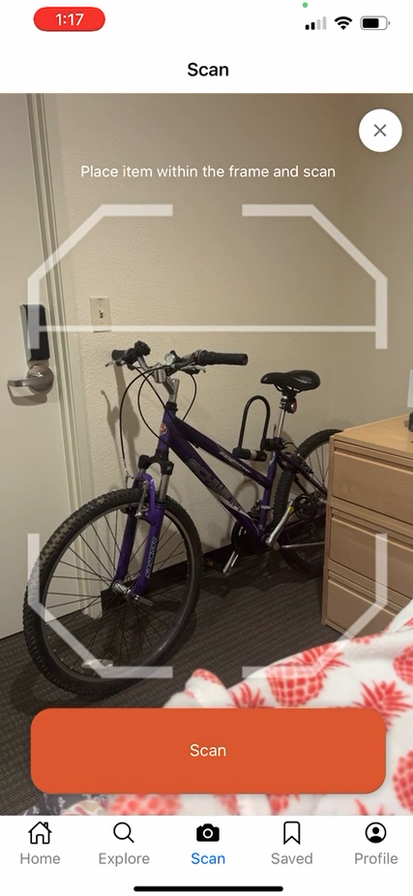
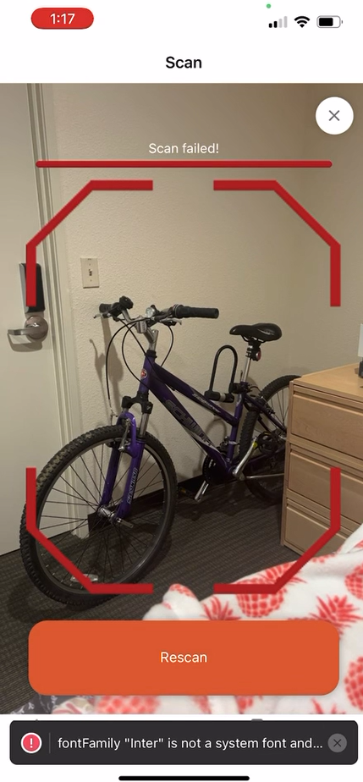
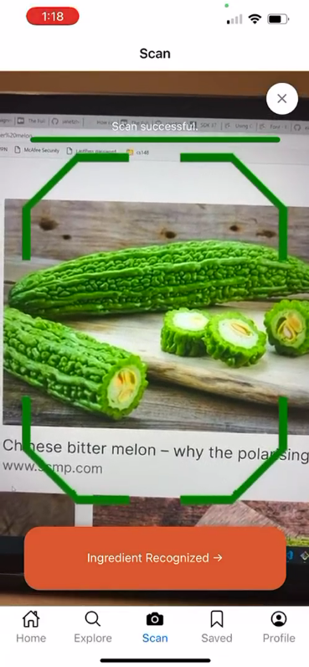
Implemented Features
*UI is slightly different to Figma because in the code you have to click to scan, and it doesn’t scan if you just hover like a QR code

Slide 30
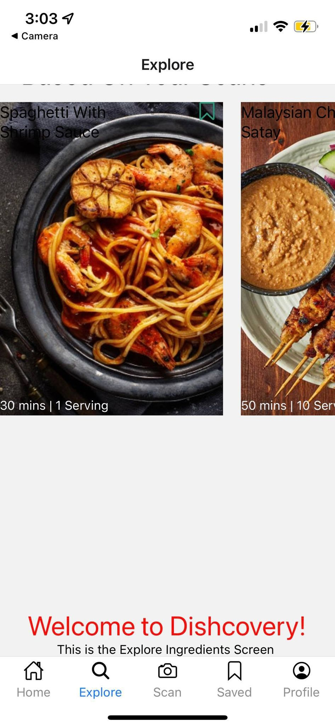
Unimplemented Features and Plans to Finish
Task flow 2 and 3
We have started the explore page!
Search by recipe function
Filter recipe function
Profile page
Pre-filtering of searching recipes using profile data
Connect app to Firebase/ Supabase to save user’s data if they want to save recipes
Saved recipe page
(We no longer have a home page - it is now the explore page)
We also have to write the hard-coded cultural context information
Unify the UI (common fonts, button sizes, boxes etc) We will have a weekend “hackathon” to finish!

Slide 31
Wizard of Oz or Hard-Coded Elements
Wizard of Oz - Accuracy of Image Recognition
Hard-coded
Surprisingly, our image recognition is actually fully functional (woohoo!) and not wizard of oz’d. However, the perceived accuracy is a wizard of oz technique as it only recognizes three ingredients from a list that we create.
Image recognition only uses guesses that are in both the Clarifai API food-item library (around 500 generic ingredients) as well as our custom library of cultural food items. Currently we only have three items, bitter melon, cardamom and lemongrass. So if one scanned a cucumber, it would probably come up as bitter melon.
The cultural context of our selected items is currently hard-coded and stored locally on the app. In practice, this could potentially be sourced by searching the internet and interviewing individuals who prepare traditional cultural recipes

Slide 32
Issues/Questions
We haven’t had significant roadblocks in our code so far but we do raise the following issues if this were to become a real app:
The Clarifai AI library only recognizes fairly generic food items. If our aim is to recognize cultural / uncommon ingredients, then using Clarifai library is actually biased against this. One would need to create their own annotated data set of cultural ingredients and train their own computer vision model to truly achieve Discovery's aim. This is actually doable though - it could potentially be sourced by scraping/ downloading foreign food items from ethnic online grocery websites.
In a real app, sourcing the cultural context and making it very authentic is also a difficult and hard to scale problem if this cultural context is manually sourced.

Slide 33
Progress and Trajectory
We are here!
Design
Dev pt. 1
Dev pt. 2
Complete!
Revise and prepare to code.
Code our first task flow, which is scanning.
Code up and refine the rest of our implementation in accordance with the design.
Project expo and video

Slide 34
Demo Video!

Slide 35
Appen-dish

