Slide 1
Dishcovery
Med-Fi Prototype
Culture through Cuisine
Dishcovery
Defne Genç, Janet Zhong,
Amrita Palaparthi, Kyla Guru
Notes:
Janet
Space Grotesk
Anaheim
Barlow Semi-Condensed Normal

Slide 2
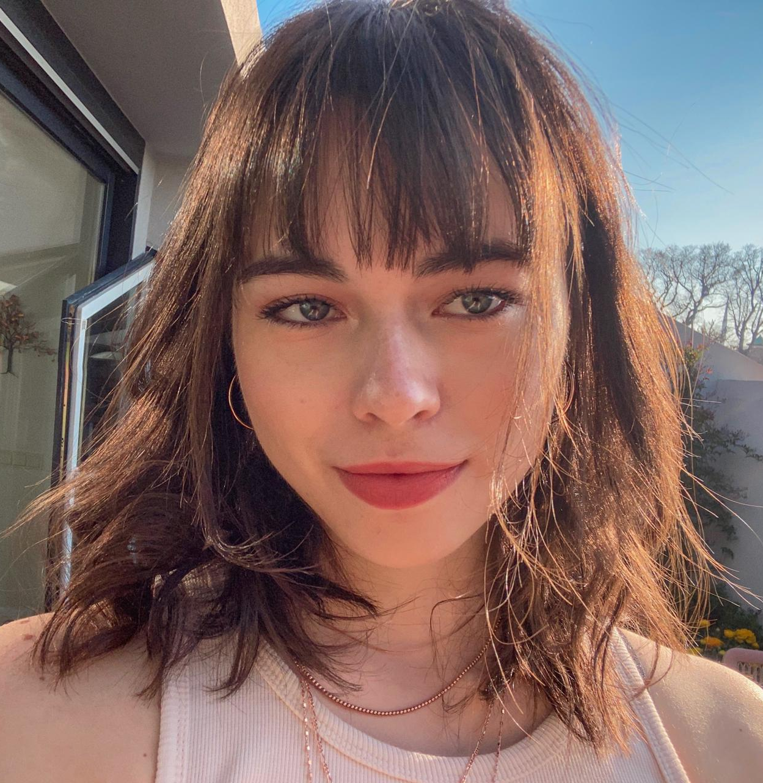
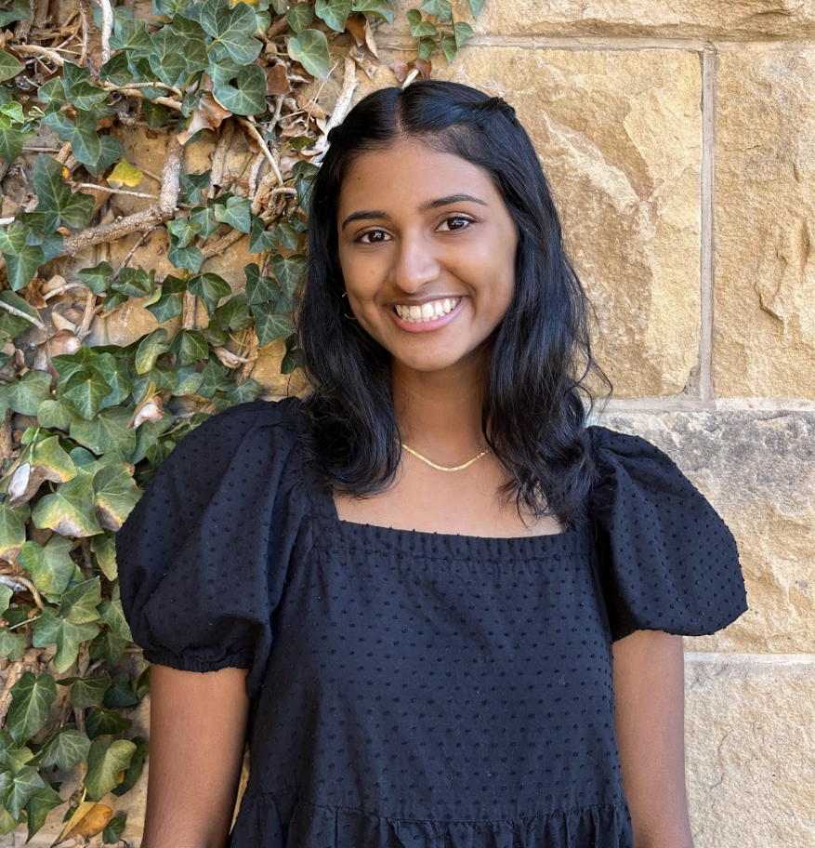
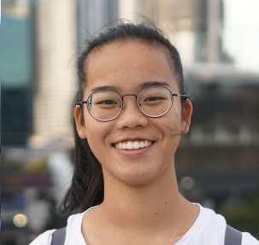
Our PotLuck
Defne
Kyla
Janet
Amrita
Potluck item:
Potluck item:
Potluck item:
Potluck item:
Notes:
Janet
Spanning across India, Turkey, Australia

Slide 3
Dishcovery
Dishcovery
your cultural culinary companion.
Notes:
Janet

Slide 4
Dishcovery
Problem
Learning about and creating food with ingredients from other cultures can be an intimidating experience.
Notes:
Janet

Slide 5
Dishcovery
Our Solution
Dishcovery helps you recognize, learn about, and cook with foods from around the world. We use image recognition to identify new ingredients and enable you to delve into their cultural context and authentic recipes using them, providing a cultural culinary companion from the grocery store to your kitchen.
Notes:
Janet

Slide 6
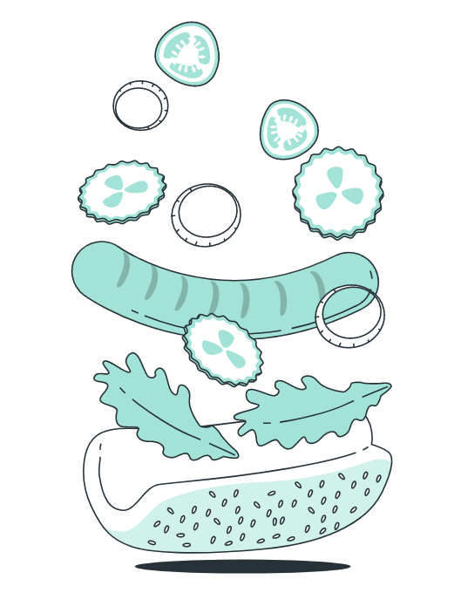
Dishcovery
Dishcovery Core Values
Inclusivity
Encouraging
Inclusive of all cultures and food norms
Mitigate intimidation of exploring new cultures / cooking
Utility
Homey
Allows people to save time and make healthy choices
Make you feel connected to your own culture or new ones
Educational
Explorative & Novelty
Informative, reducing language or information barriers
Simulate feelings of adventuring into new cultures
Notes:
Kyla

Slide 7
Dishcovery
How will these values be implemented?
Embedded in Design
Potential conflicts
Explaining everything that’s unfamiliar (dishes, ingredients, language) in a friendly way. Help features or instructional videos
Ways for users to provide feedback if cultural context is inaccurate or missing
Diversity of recipes included in results
How to cater for expert users
Risk of highlighting one culture over others
Risk of wording sounding “lecture-y” vs. encouraging
Inclusivity
Quick, accurate results after scanning
Personalized to user’s dietary restrictions
Effective sort features when looking up recipes
Saved lists for grocery shopping, etc.
Useful features can make an app feel less “fun” or game-like.
May take away from the exploratory part of the app
Utility
Notes:
Kyla

Slide 8
Dishcovery
How will these values be implemented?
Embedded in Design
Potential conflicts
Suggesting new recipes they haven’t explored before
Recipe generator, lucky ingredient generator/surprise me feature
There is a trade-off to newness and being able to feel homey/ familiarity
Explorative
Detailed tutorials and recipe lists
Personalization for difficulty of recipe
Stories of people succeeding with the dish or user feedback
Still want to encourage users to try new things and feel adventurous, while giving them enough guidance
Encouraging
Notes:
Kyla

Slide 9
Dishcovery
How will these values be implemented?
Implementation through design
Potential conflicts
Nailing the cultural touches/ insight that only people from the culture will know
Including stories “from the kitchen” that bring the ingredients and culture close to home.
Could compete with exploring new cultures and adventurous values
Homey
Enriching results screen upon scanning, filled with content that is relevant and cultural.
Translation services to accommodate for all types of users
Cultural stories “from the kitchen”
We still want to make the app have high utility and spark a sense of adventure, while delivering information.
Educational
Notes:
Kyla

Slide 10
Dishcovery
Tasks
Notes:
Amrita

Slide 11
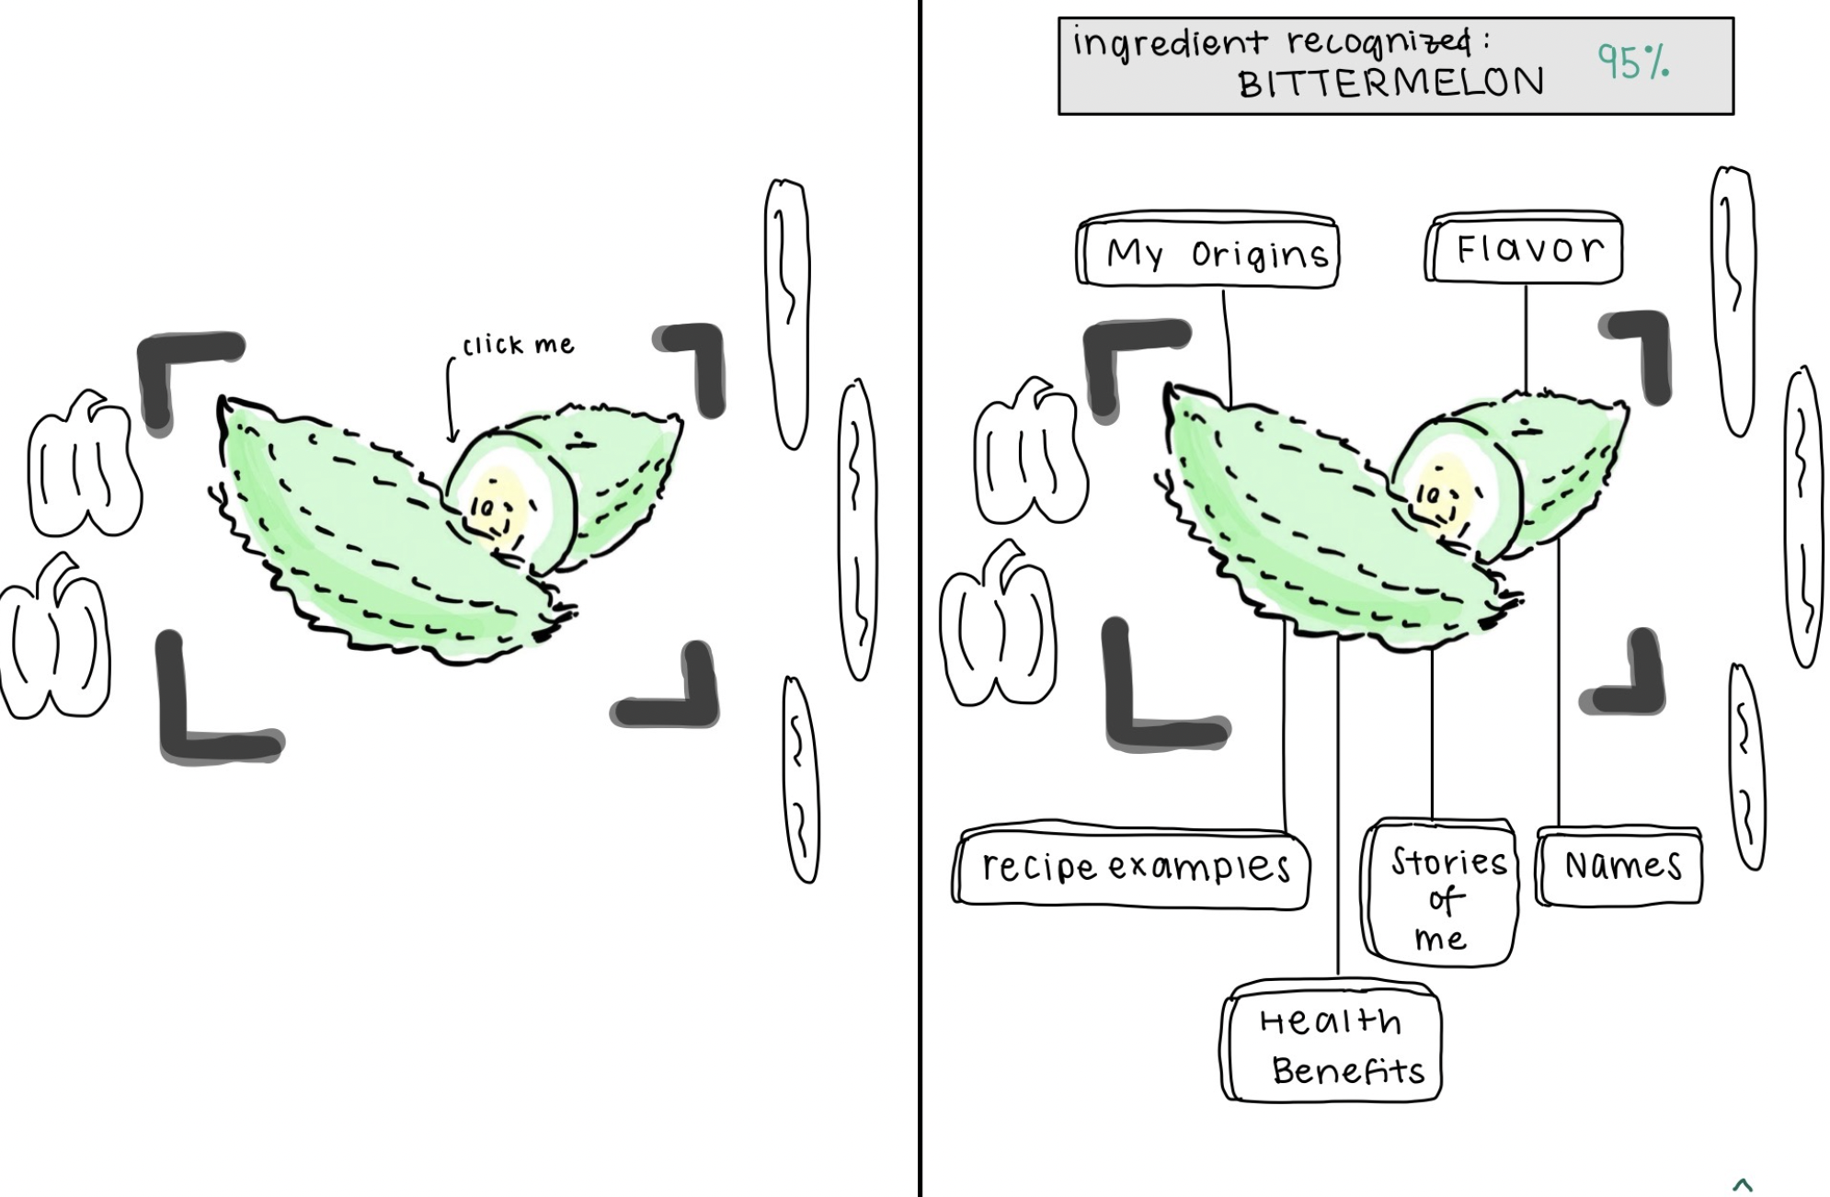
Dishcovery
Task 1: Identification
Description: I want to automatically identify an unfamiliar food item
Category: Simple
Notes:
Amrita

Slide 12
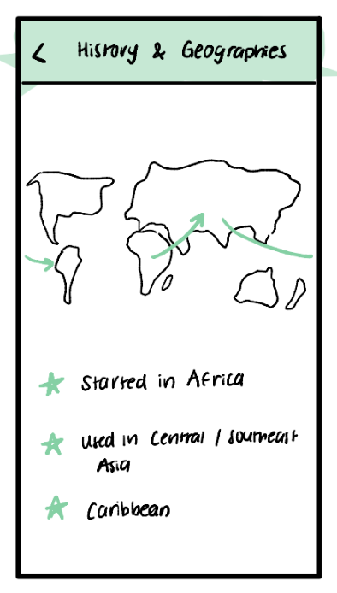
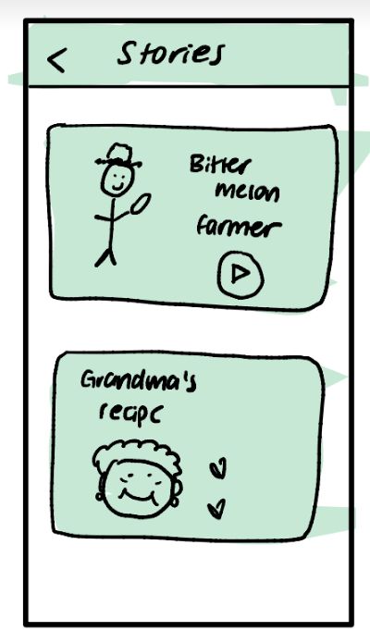
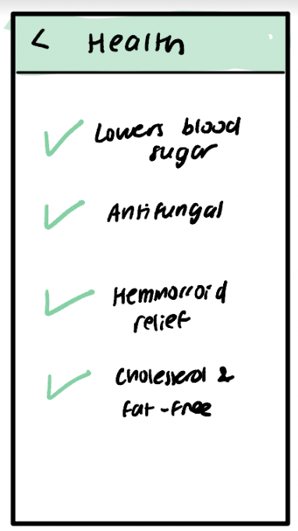
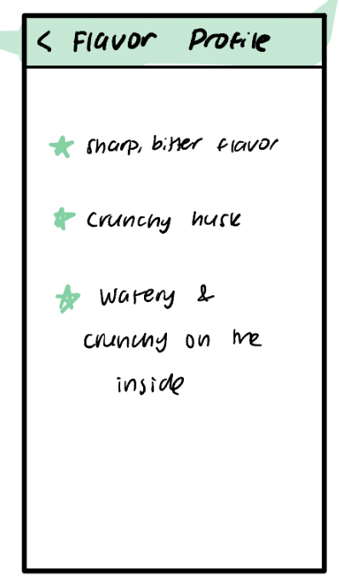
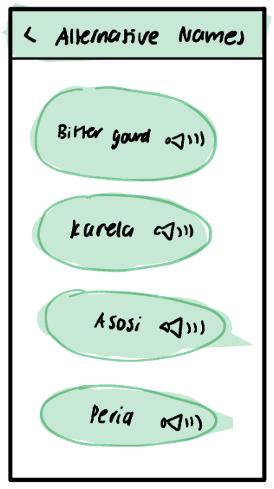
Dishcovery
Task 2: Contextualization
Description: I want to learn more about the cultural context behind a food item and its uses in recipes
Category: Moderate
Notes:
Amrita

Slide 13
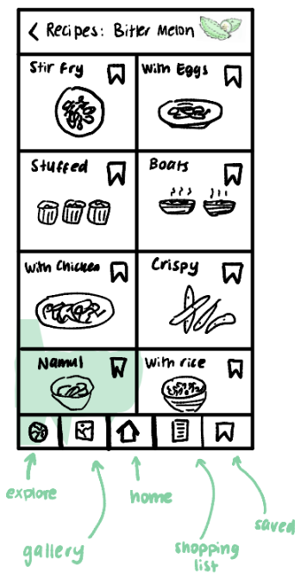
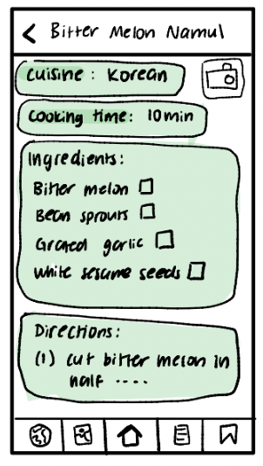
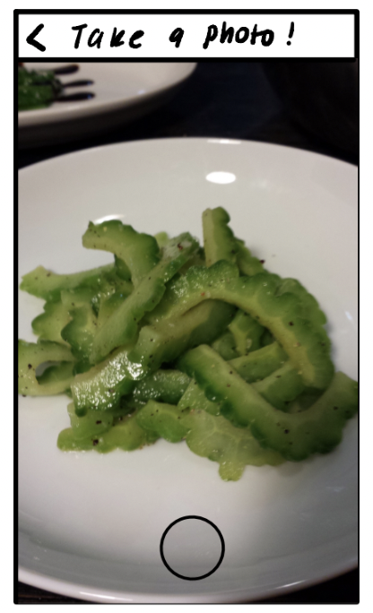
Dishcovery
Task 3: Authentic Cooking
Description: I want to cook a cultural authentic dish with a new ingredient
Category: Moderate/ Hard
Notes:
Amrita

Slide 14
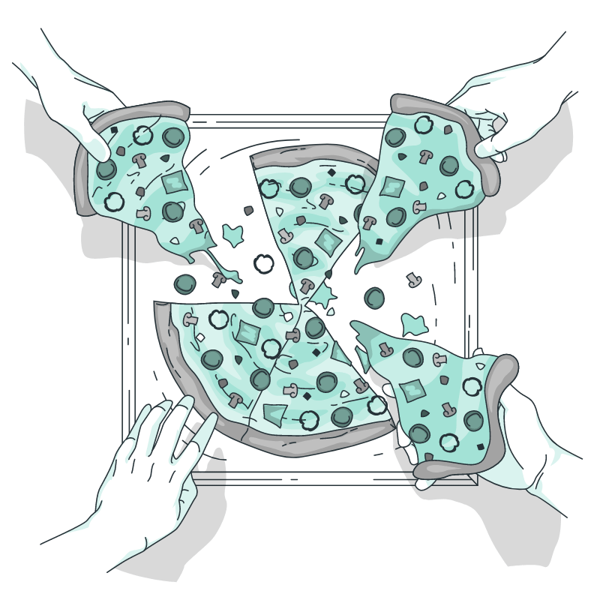
Dishcovery
Bonus tasks
Sharing with friends - cooking or eating together or sharing recipes with friends
Habit planning - making exploring cultural dishes into a long term habit rather than a one-off thing
Notes:
Amrita

Slide 15
Dishcovery
Usability Goals and Key Measurements

Slide 16
Dishcovery
Usability Goals
Efficient - users should be able to quickly find recipes associated with an ingredient they are seeking to explore
Key Measurement: time needed to find a recipe given an ingredient and filtered by preferences
Learnable - Users should be able to easily identify and access contextual information about an ingredient with less than 2 errors.
Key Measurement: number of errors between first scanning an ingredient and exploring all cultural context pages, facts that stuck out to them most
Notes:
Amrita

Slide 17
Dishcovery
Progress towards hitting usability goals
Taking into account feedback from low-fi prototypes
Making scanning more prominent within the app
Making it easier to access contextual information that you need and ignore what you’re not as interested in → can open up context information with separate expandable context for flavor profile, origins, health benefits, etc.
Multiple methods for finding and filtering recipes
Can input dietary restriction in user profile that are consistent across searches for recipes
After scanning an ingredient, recipes are auto-filtered to show dishes that include that ingredient
Can search for recipes based on ingredients either through scanning or by explicitly inputting an ingredient name

Slide 18
Dishcovery
Revised sketches

Slide 19
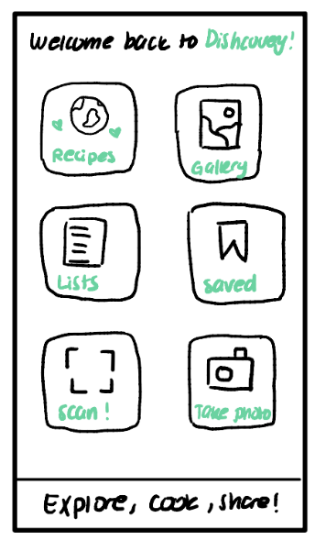
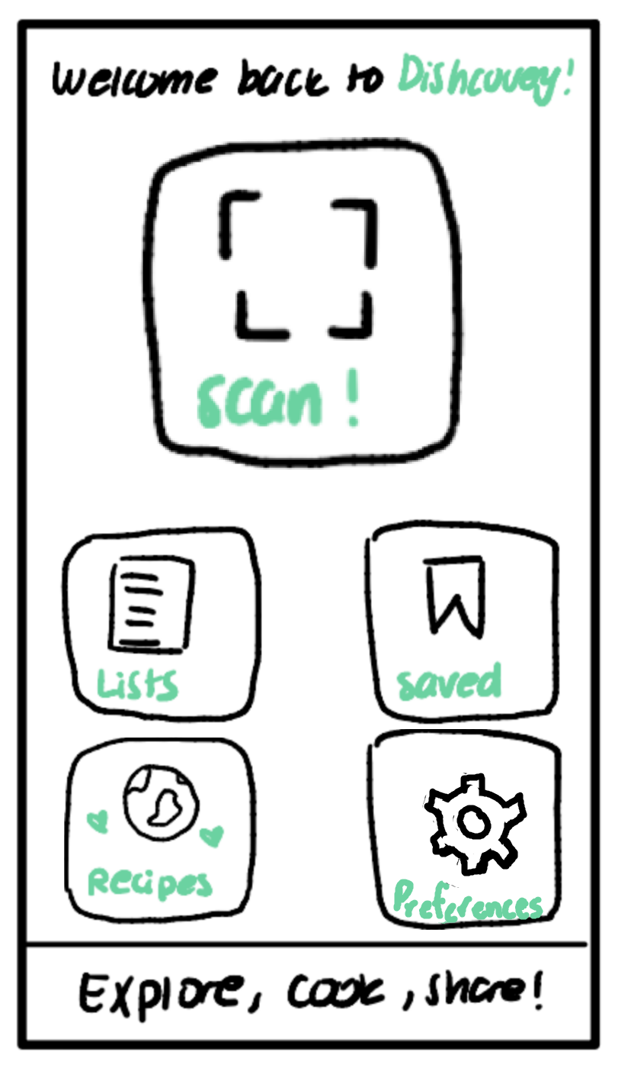
Dishcovery
Home Screen
Emphasized scanning feature, removed “Take Photo” and “Gallery” buttons based on low-fi feedback
Usability: makes the process of identification easier to remember by emphasizing the action

Slide 20
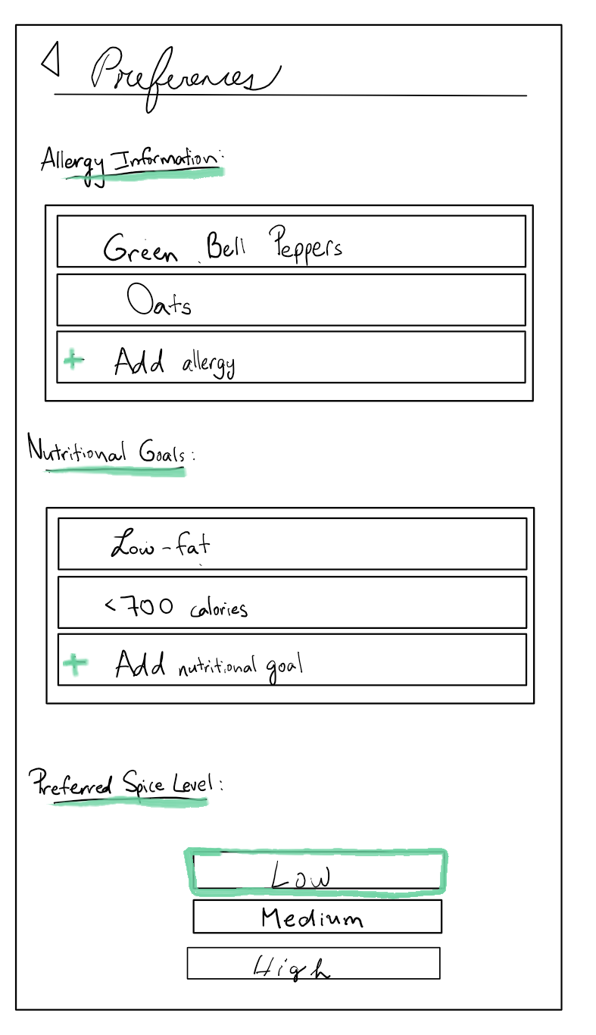
Dishcovery
Preferences Screen
Enables users to add food allergies, nutritional preferences, and spice tolerance
Accessible from Home screen
Common request from our experience prototypes and low-fi testing
Only recipes that satisfy these constraints will be shown
Users can update their preferences at any point when through this screen
Usability: makes finding recipes more efficient by remembering some user preferences that don’t change easily (e.g. dietary restrictions)

Slide 21
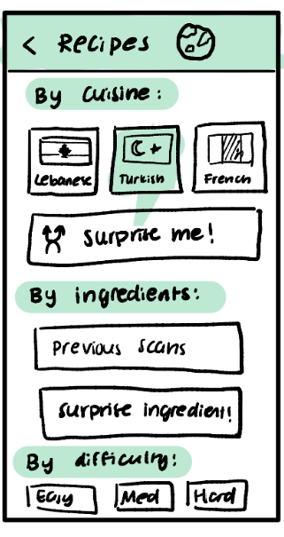
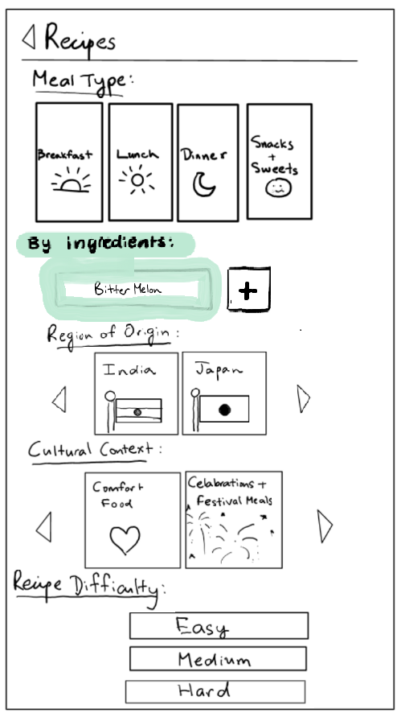
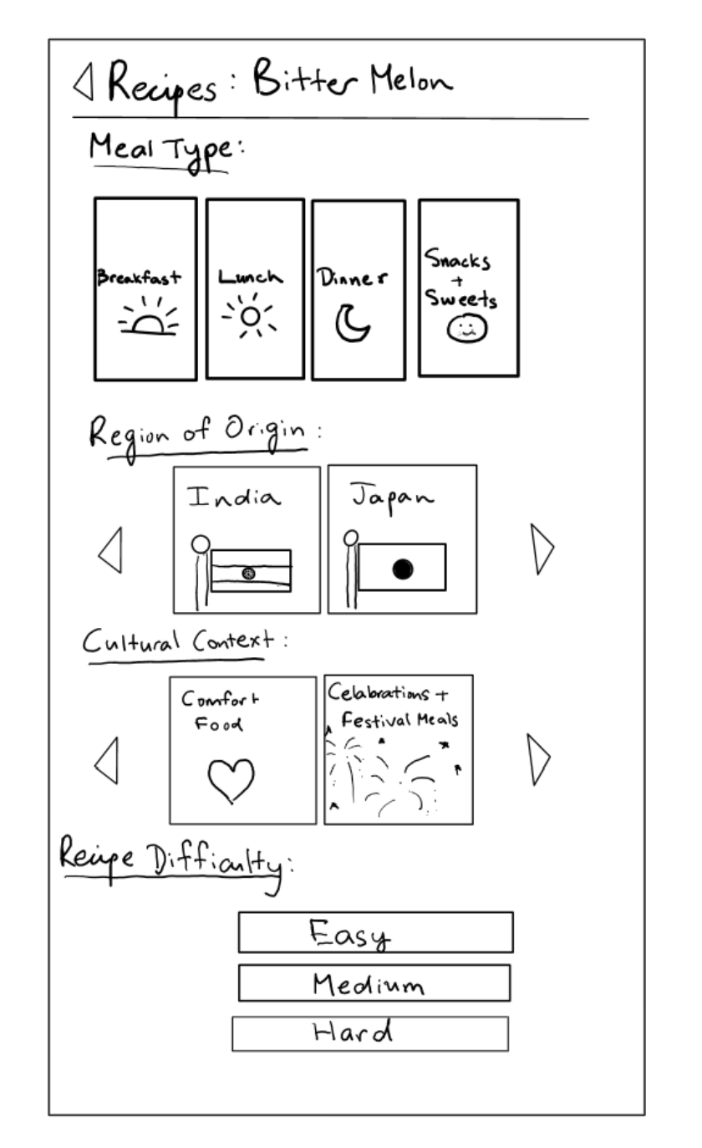
Dishcovery
Consolidate Recipes Screens
Our original task flow contained two recipe preferences screens → one through filtering and one when selecting recipes from the home screen
We combine these into one recipe filtering screen accessible from both the home screen and scanning an ingredient
Repeated screens were a point of confusion in studio and in low-fi testing
Usability: makes recipe filtering more efficient by reducing redundant screens, reduces the need for users to learn two separate flows for recipes based on whether they scan an ingredient or search

Slide 22
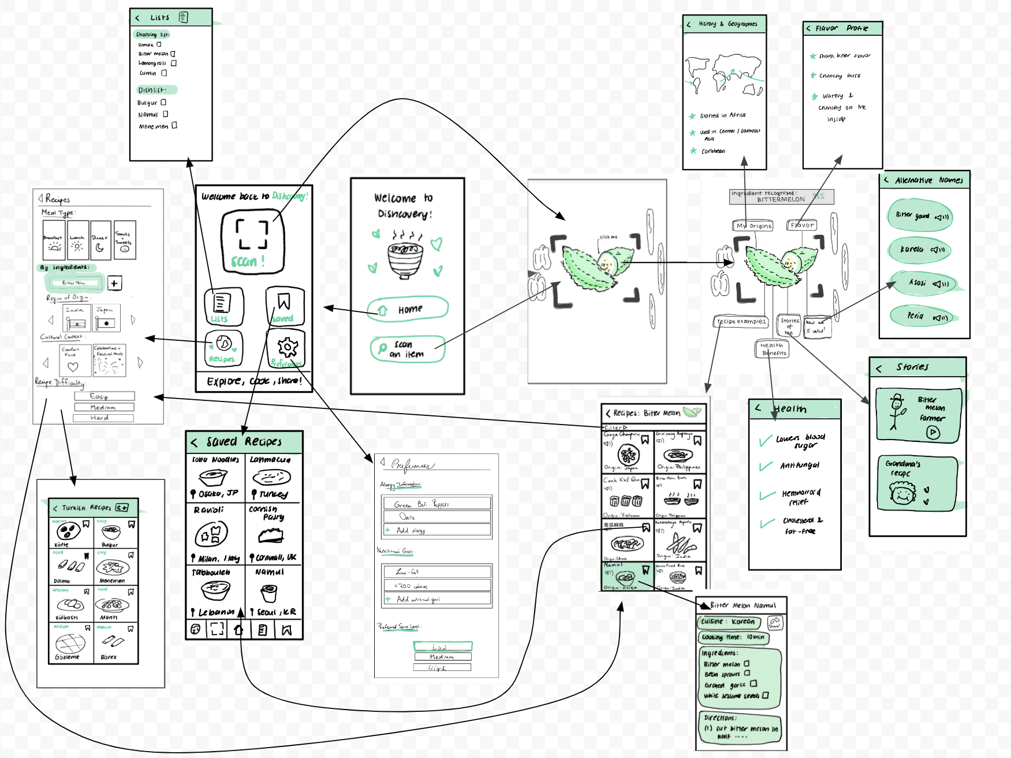
Dishcovery
Revised Birds-eye View
Notes:
Defne

Slide 23
Dishcovery
Medium-fi task flows

Slide 24
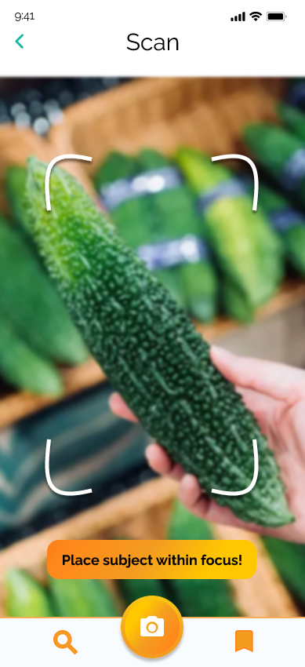
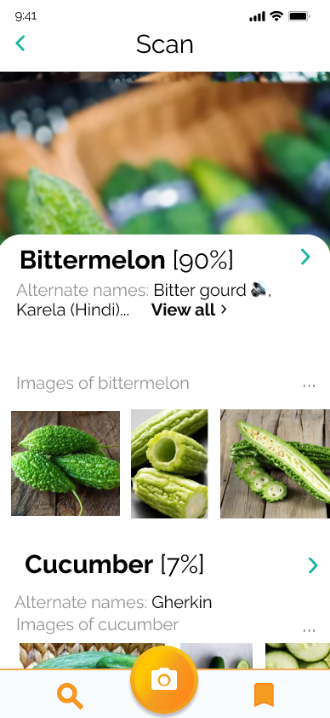
Dishcovery
Medium-Fi Task Flow: Scanning (Task 1)
Figma Prototype
Notes:
Defne

Slide 25
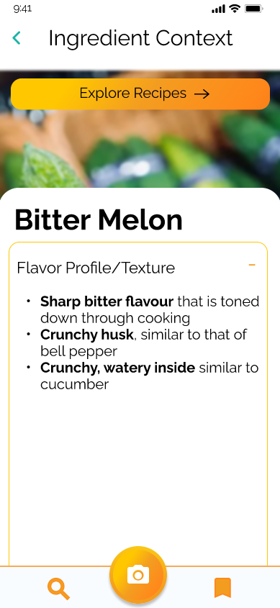
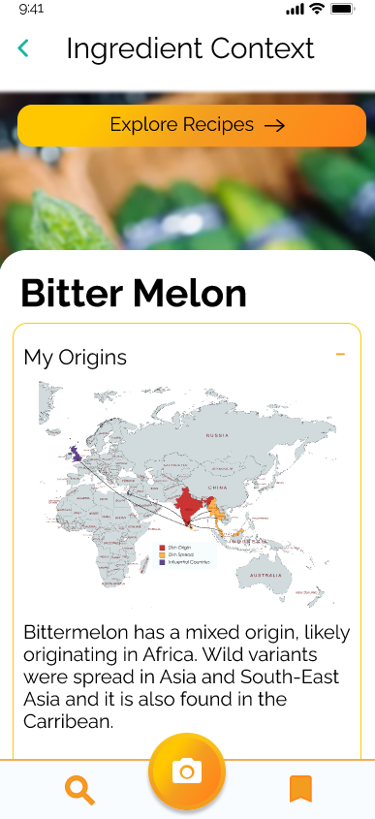
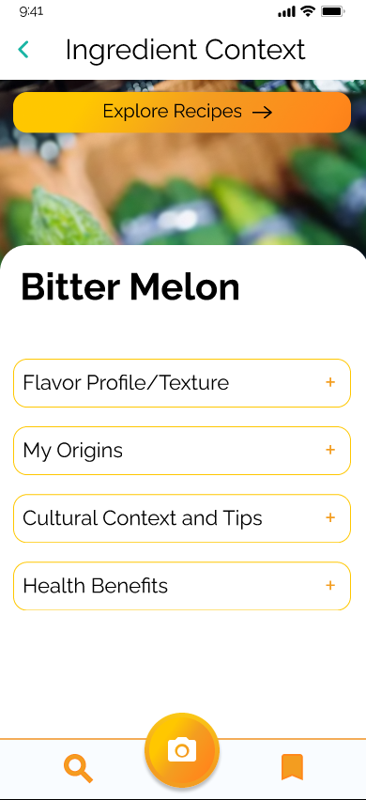
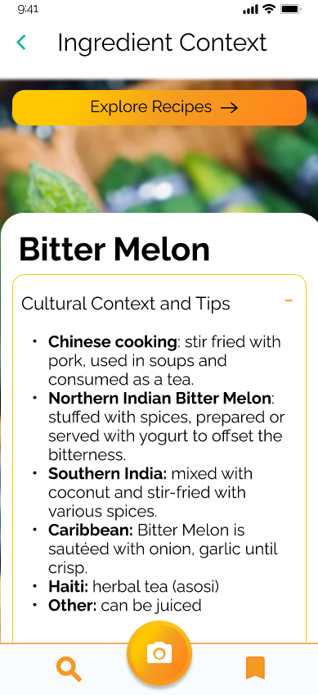
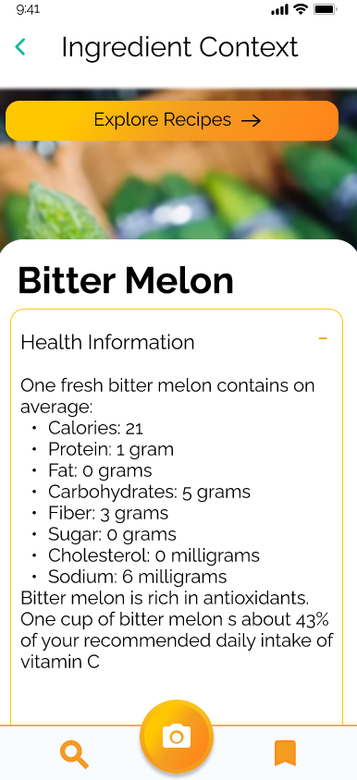
Dishcovery
Medium-Fi Task Flow: Context (Task 2)
(to task flow 3)
Notes:
Defne

Slide 26
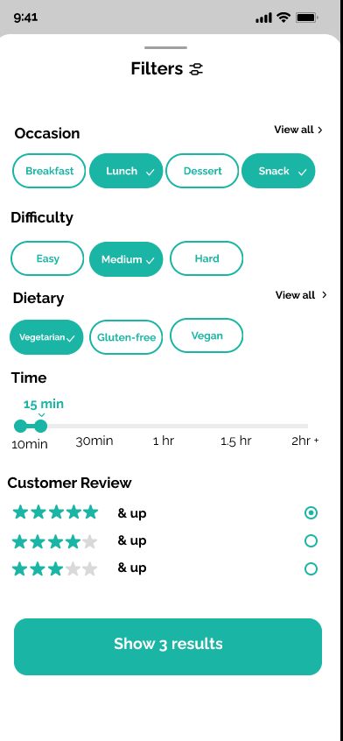
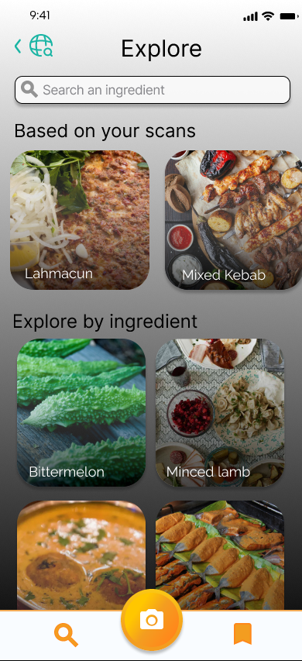
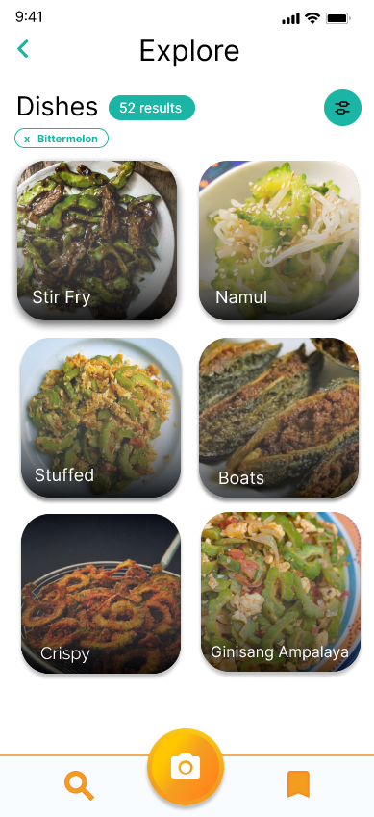
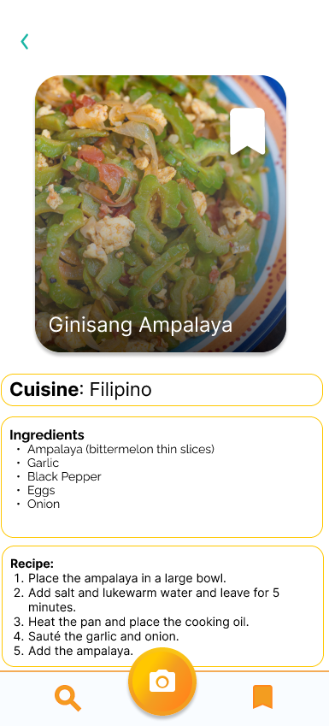
Dishcovery
Medium-Fi Task Flow: Recipes (Task 3)
Figma Prototype
Notes:
Defne

Slide 27
Dishcovery
Med-fi prototype - Figma Link

Slide 28
Dishcovery
Prototype Implementation

Slide 29
Dishcovery
Dishcovery
Prototyping Tool Used: Figma
Pros
Easy to create reusable components and templates
Fine-grained control over colors, fonts, and shapes
Can implement smooth transitions between screens to simulate actions like clicking buttons and scrolling
Real-time collaboration, which enabled us to edit screens at the same time and talk through design decisions
Tools like “tidy up” helped us maintain alignment and group items together
Cons
Steep learning curve
Difficult to approximate some transitions that don’t involve clicking (e.g. scanning an ingredient and having a pop-up when that ingredient appears in the camera)
Discrepancies in included features/fonts in Windows and Mac made collaboration and simultaneous work more challenging
Notes:
Defne

Slide 30
Food Lover
Interactive Maps
01
Limitations in Prototyping
Functionality to Add Reviews
02
Sharing
03
Full Filter Options
04
In the contextualization flow, our prototype doesn’t yet include a map that shows a clickable journey of the ingredient rather than a static image of the maps for context.
In the recipe flow, the user is currently unable to add their own reviews to recipes that they try, or filter by review star-rating.
Screens to share recipes you’ve shared over social media or messaging
User cannot dynamically change filters currently or see how results change depending on the filters applied.

Slide 31
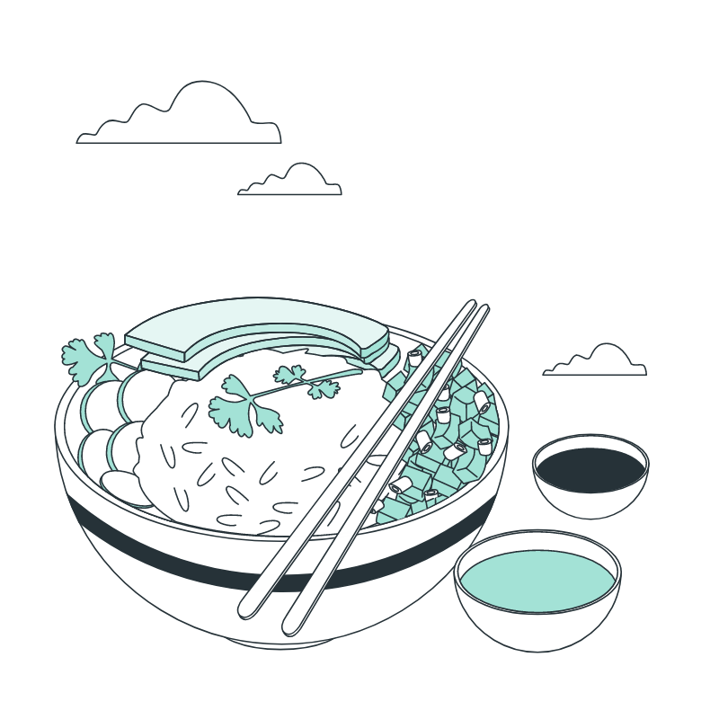
Food Lover
Hard-coded/
Wizard of Oz Features
Image Recognition
01
Viewing Previous Scans
02
Dynamic Filtering
03
Computer vision for automatically identifying food items is abstracted away to just predict a specific ingredient (bitter melon in our prototype)
Storage of previous scan data and recommendations for recipes including these ingredients.
Filtering logic based on dietary restrictions in profile and selected preferences is hard-coded

Slide 32
Food Lover
Hard-coded/
Wizard of Oz Features
Search by ingredient
04
Contextual information
05
www.slidesgo.com
We don’t have a proper recipe database yet to search by ingredient or find recipes related to a specific culture.
Contextual information, as well as recipes, related to the scanned item was manually sourced.

Slide 33
Dishcovery
Appendix

Slide 34
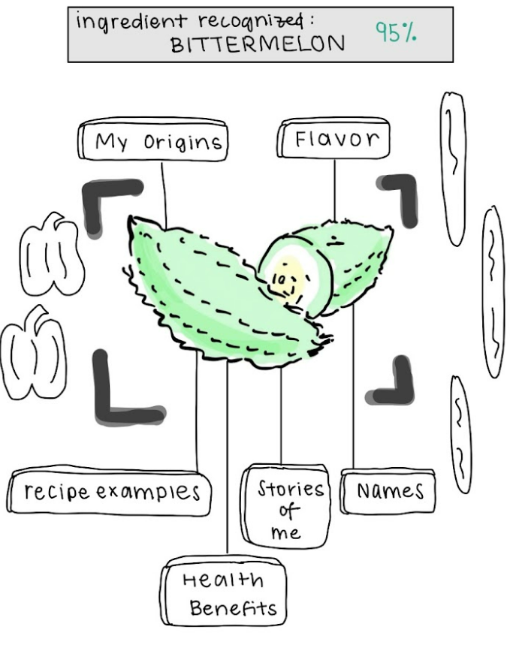
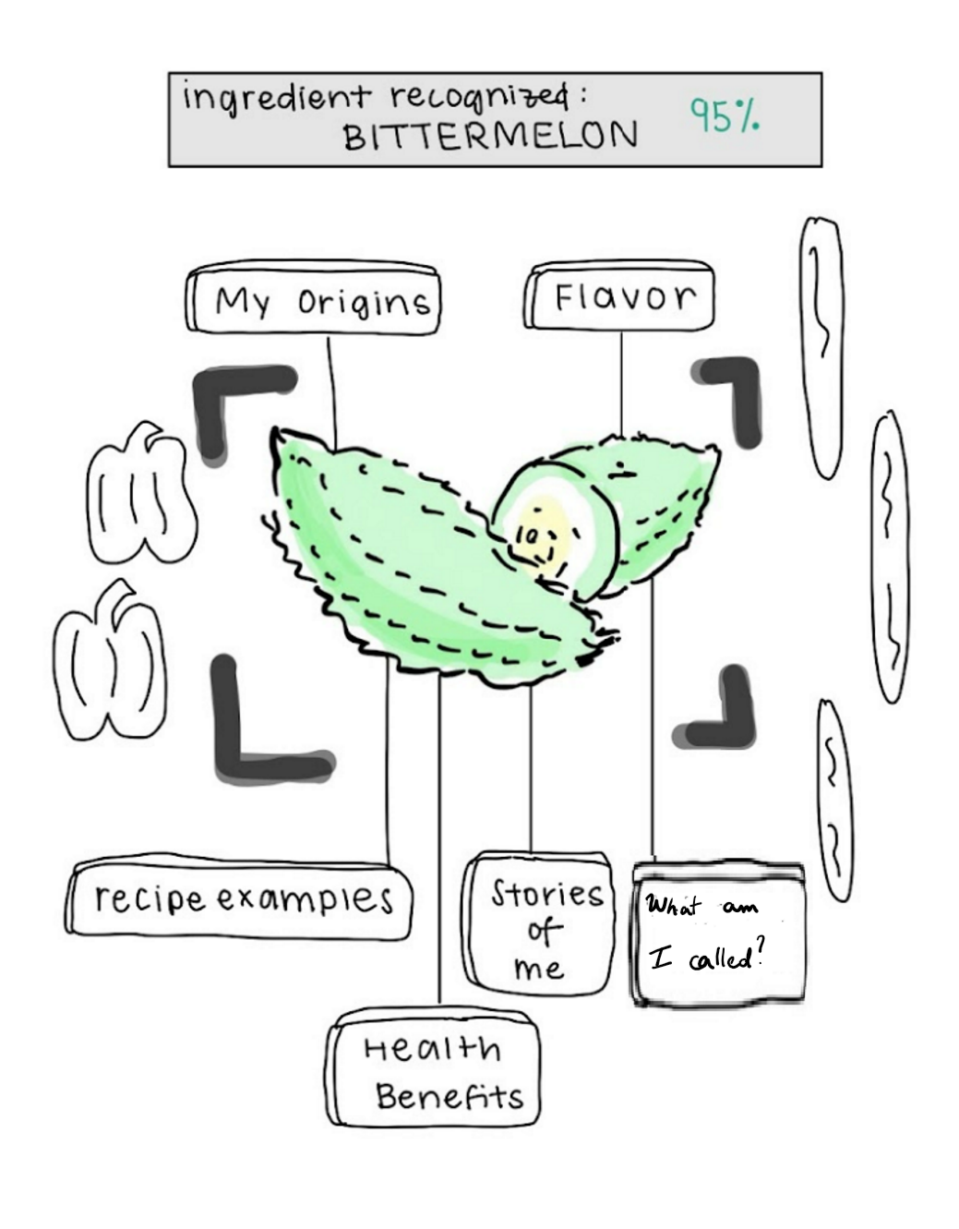
Dishcovery
Additional Sketch Modification: Scanning
Renamed “Names” button to “What am I called?” to provide more clarity

Slide 35
Dishcovery
Your cultural culinary companion

