Slide 1
Dishcovery
Lo-Fi Prototype
Culture through Cuisine
Dishcovery
Defne Genç, Janet Zhong,
Amrita Palaparthi, Kyla Guru
Notes:
Space Grotesk
Anaheim
Barlow Semi-Condensed Normal

Slide 2
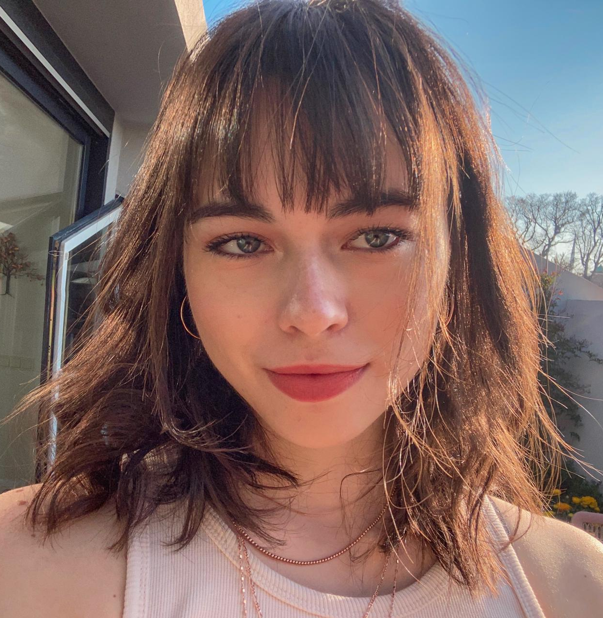
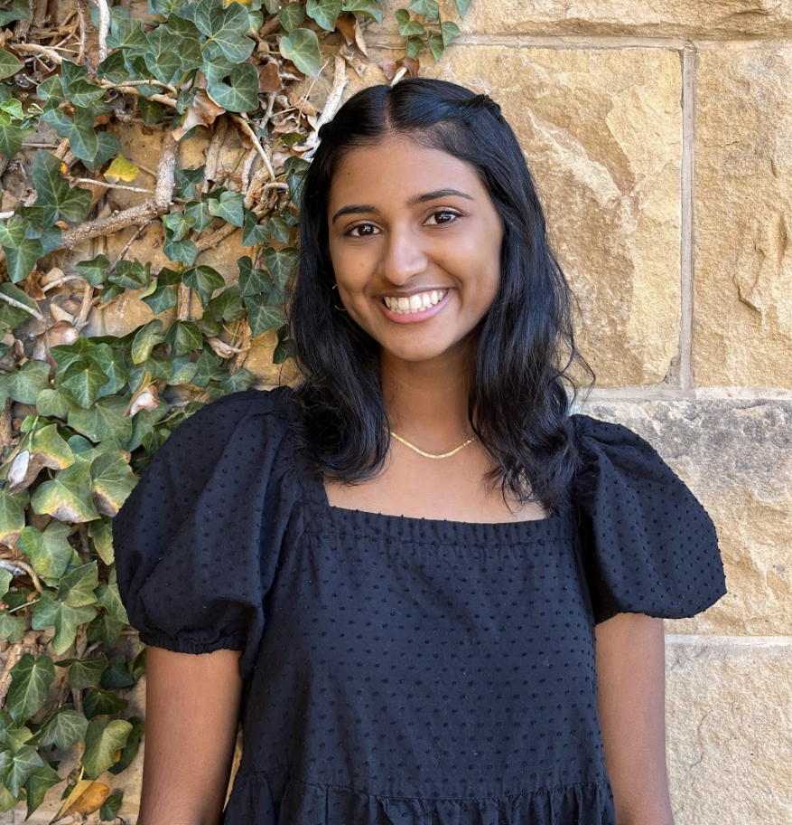
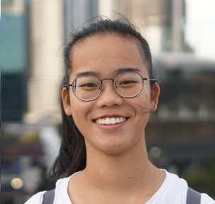
Our PotLuck
Defne
Kyla
Janet
Amrita
Potluck item:
Potluck item:
Potluck item:
Potluck item:
Notes:
Spanning across India, Turkey, Australia

Slide 3
Dishcovery
Problem
Learning about and creating food with ingredients from other cultures can be an intimidating experience.

Slide 4
Dishcovery
Task 1: Identification
Description: I want to automatically identify an unfamiliar food item
Category: Simple

Slide 5
Dishcovery
Task 2: Contextualization
Description: I want to learn more about the cultural context behind a food item and its uses in recipes
Category: Moderate

Slide 6
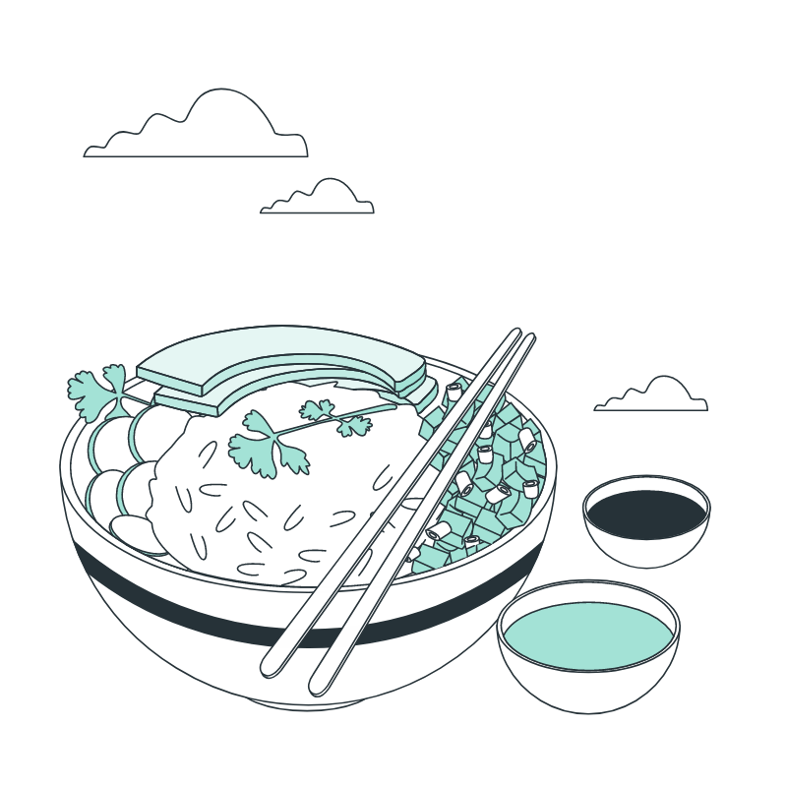
Dishcovery
Task 3: Authentic Cooking
Description: I want to cook a cultural authentic dish with a new ingredient
Category: Moderate/ Hard

Slide 7
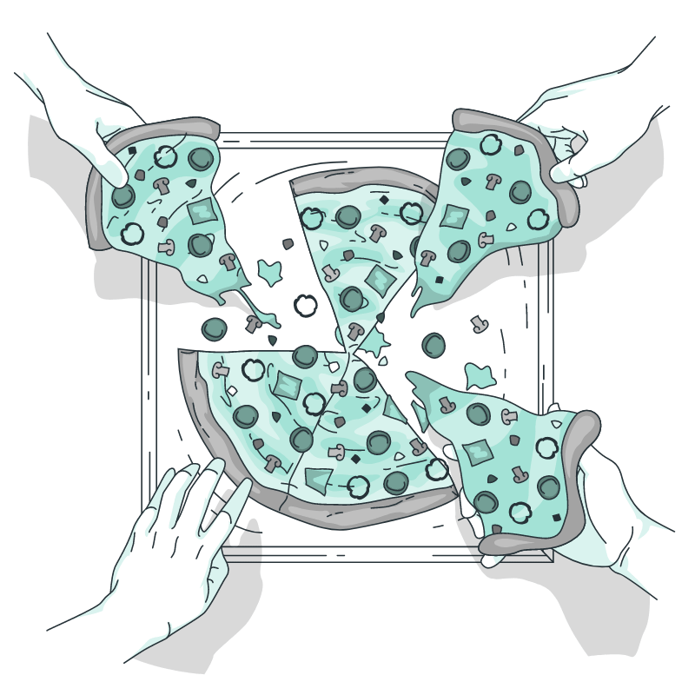
Dishcovery
Bonus tasks
Sharing with friends - cooking or eating together or sharing recipes with friends
Habit planning - making exploring cultural dishes into a long term habit rather than a one-off thing

Slide 8
Dishcovery
Our Solution
Dishcovery helps you recognize, learn about, and cook with foods from around the world. We use image recognition to identify new ingredients and enable you to delve into their cultural context and authentic recipes using them, providing a cultural culinary companion from the grocery store to your kitchen.

Slide 9
Dishcovery
Table of Contents
Sketching Exploration
Concept sketches and our reasoning in narrowing in on one realization
Interface Design
Elements in our selected interface and our rationale
Lo-Fi Prototyping
Task flows we ideated and the transition from drawings to lo-fi testing environment
Testing & Summary
Methodology of testing and observations from our data

Slide 10
Dishcovery
Exploring Sketches of Solutions

Slide 11
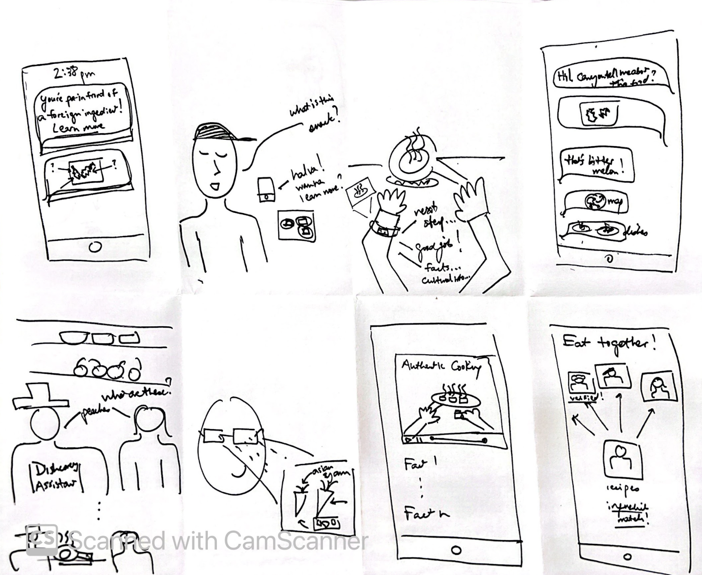
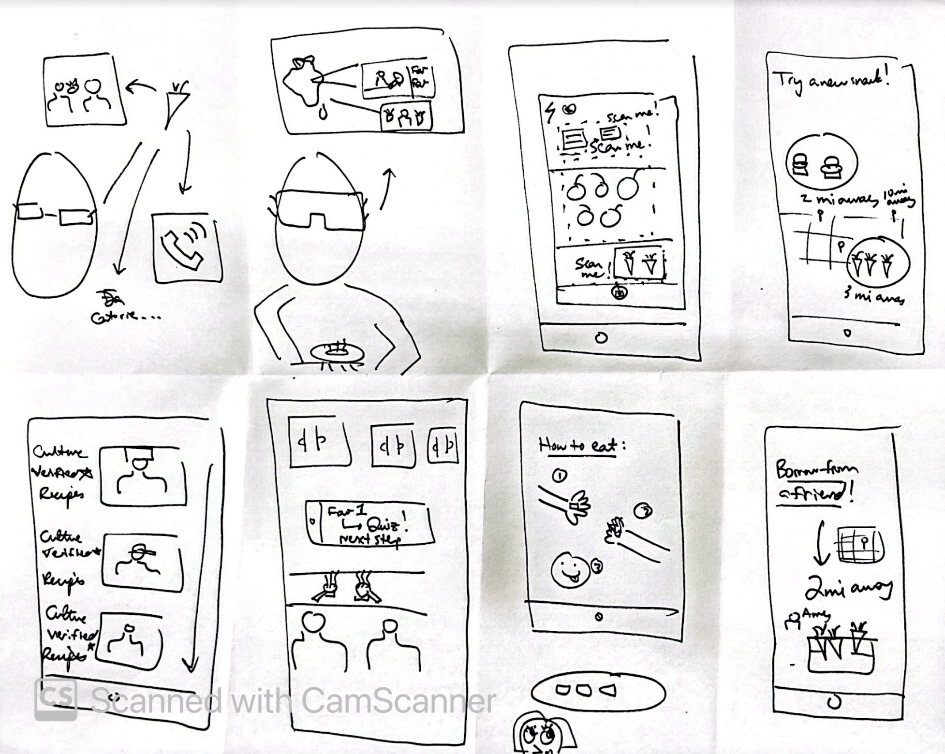
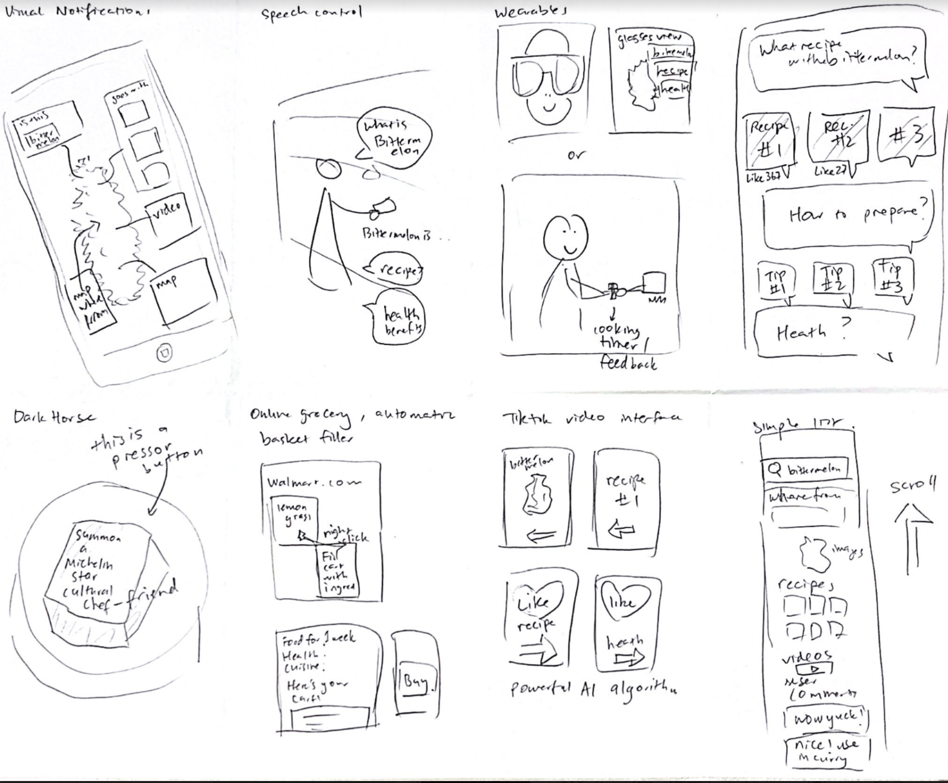
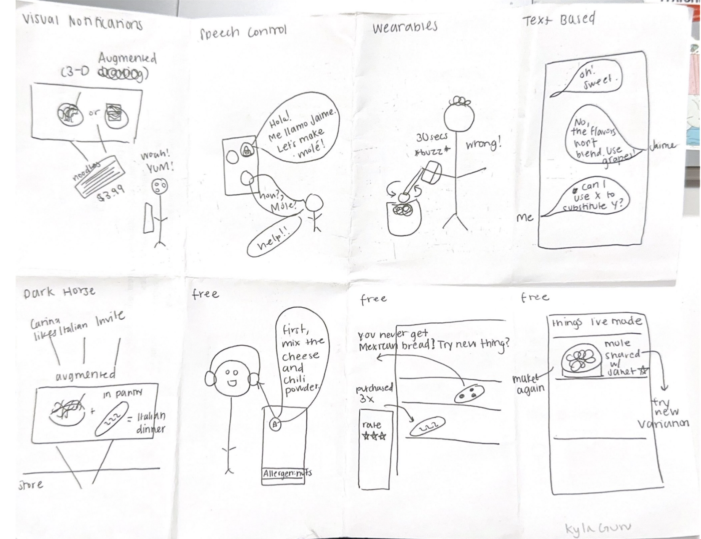
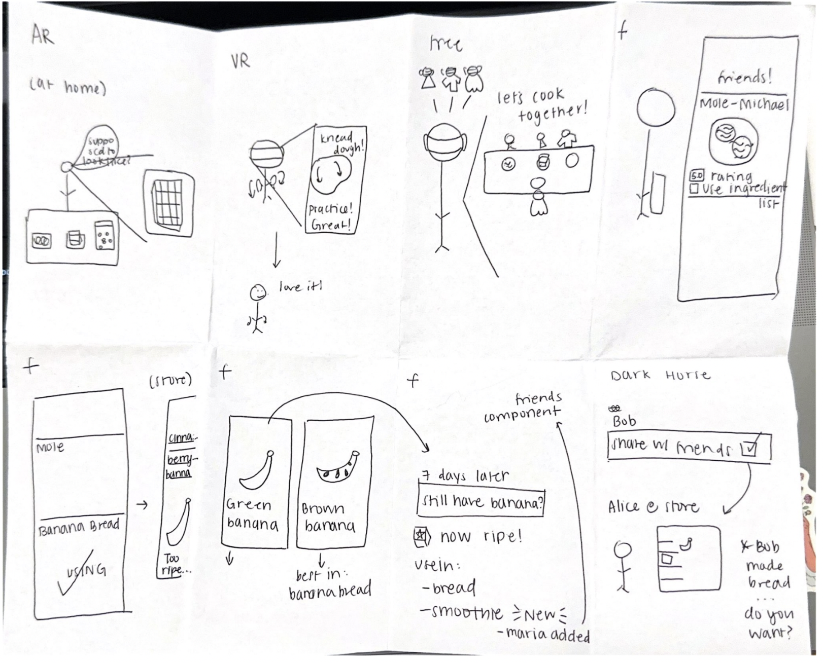
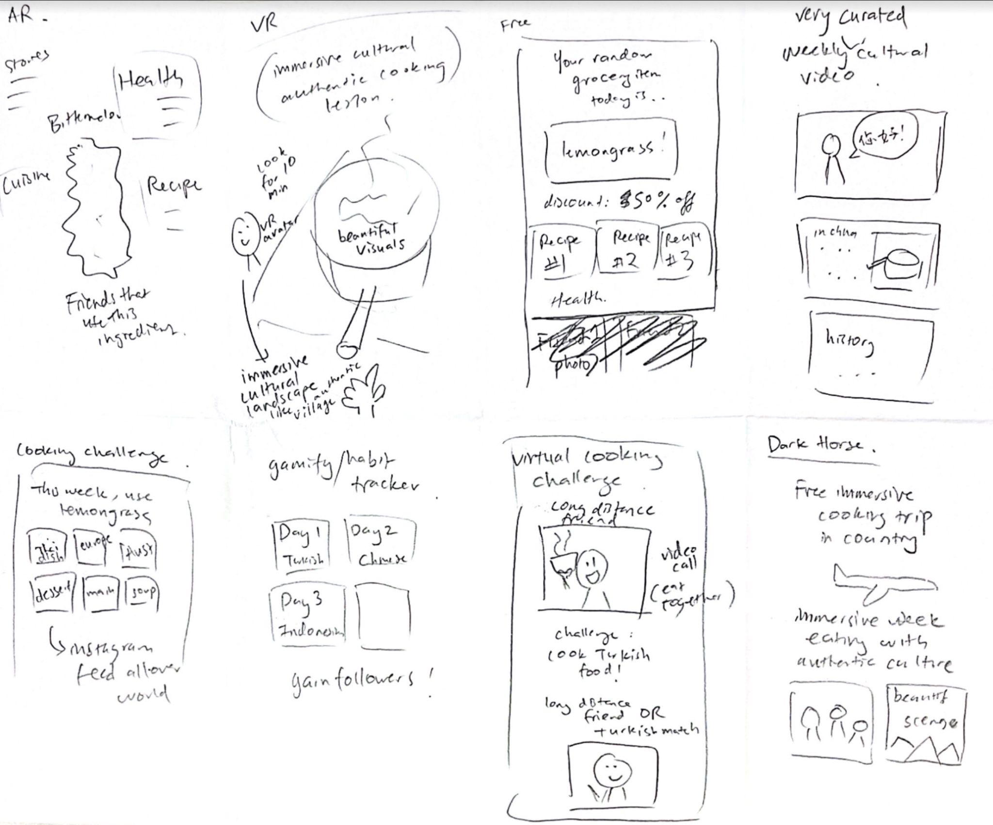
Initial Concept Sketches

Slide 12
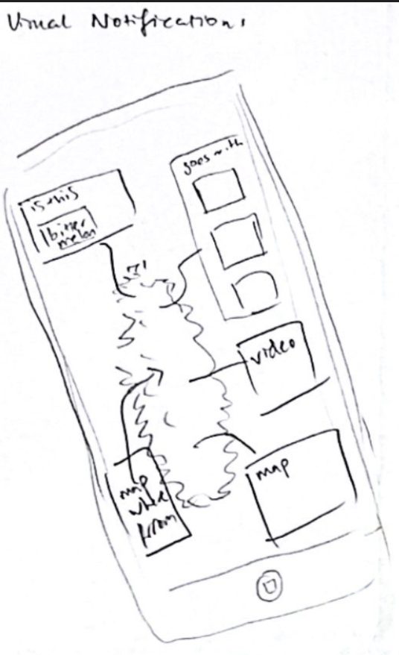
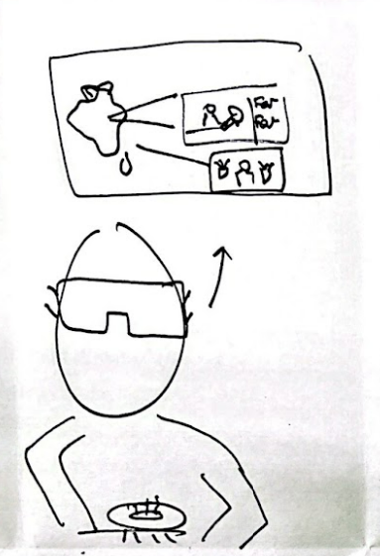
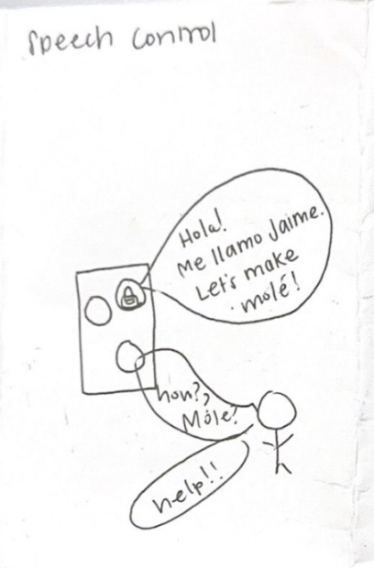
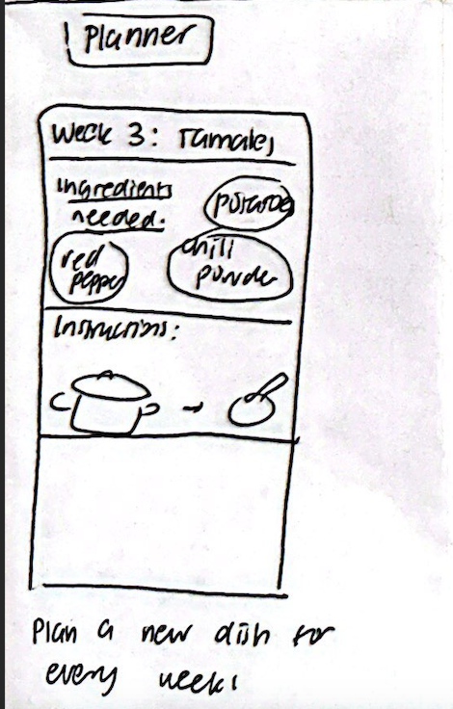
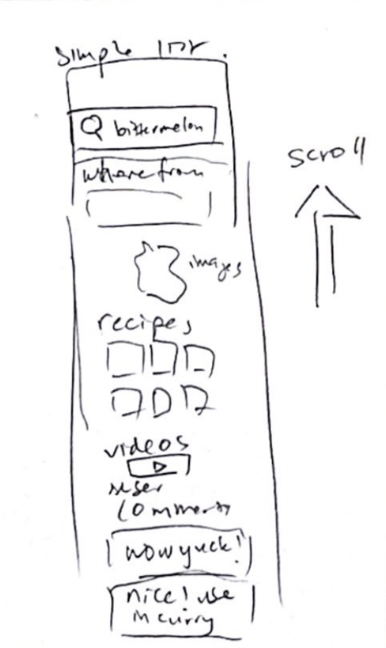
Our Favorites
Meal planning & suggesting combinations
Scroll-View
Image recognition with cultural context
Transport to cultural location via VR!
Voice memos to add personal touch

Slide 13
Dishcovery
Final Two Selections
Augmented Reality pantry planner and cooking companion
Image Recognition grocery shopping companion
Scan pantry and see enticing final cooked dishes rotating
Habit tracker and pantry planner
Suggested ingredients and recipes based on your pantry
Voice notes from chefs while cooking
Scan unfamiliar ingredients and find out cultural context, historical facts, nutritional information, personal stories involving ingredient
Suggested cultural recipes
Provide steps, information, and sharing for cultural recipes

Slide 14
Dishcovery
Augmented Reality for Pantry Planning
Pros
Cons
Work with what you have, integrates into your lifestyle (habit)
Makes it easier to shop
More incentive to buy cultural ingredients that go well with existing ingredients you already own
AI recommendation software can be added to understand recipes they haven’t cooked before and what they’ve enjoyed in the past
Potential to integrate with image recognition: showing what the final product food could look like?
Helps people visualize final dish/ cooking while they are in the mode about to cook
People may be too lazy to input everything in their pantry
Does not really target the non-food motivated audience
Who do we source recipes from? How do we decide which recipes to recommend?
Additional, expensive hardware for AR
Not accessible to visually impaired users
If they are already in the pantry, will they have a lot of incentive to go out and buy new ingredients?

Slide 15
Dishcovery
Final Selection: Image Recognition
Pros
Cons
Real-time, fits into the cultural companion narrative as an app that is with you while you shop
Very clear relation to our needfinding interview with 99 Ranch
Variety of information is easily available to add as part of the visual experience of scanning an ingredient
Users can already have experience with using image recognition/scanning through their camera for things like QR codes
Requires no additional hardware, only a phone with an integrated camera
Risk of inaccuracy
Curating the information that populates about a certain ingredient may be difficult and require an understanding of accurate data sources to find this information
Inaccessible for those that cannot hold their phone up for a longer period of time to capture the photo
Visual focus might not be as accessible for visually impaired users
People who are shopping for groceries in-person may be in a rush and won’t want to explore too much

Slide 16
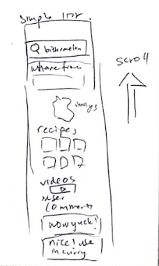
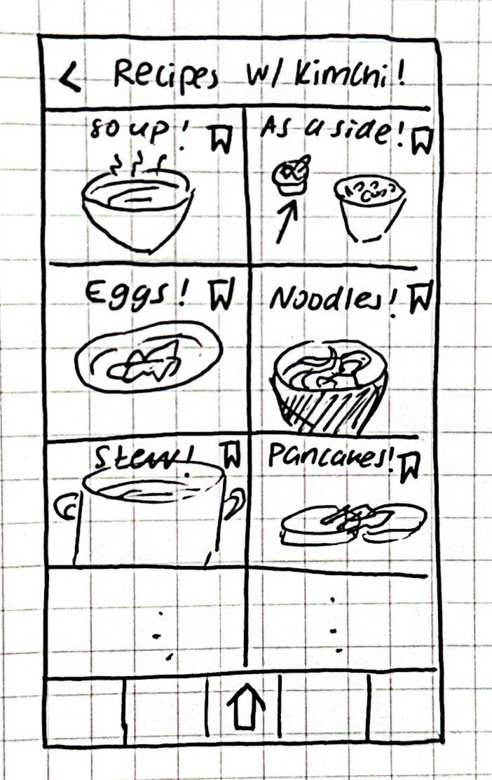
Dishcovery
Why Image Recognition?
Vision repeated over all of our product sketches
Need for ingredient detection and simplifying the recipe were reflected through need-finding (e.g. manager of 99 Ranch)
Incentives are limited for user data-entry for pantry idea

Slide 17
Dishcovery
Lo-Fi Prototyping from Sketches

Slide 18
Dishcovery
Key Features and Interactions
Image recognition feature
Nice UI for cultural context (different ideas of interaction include: QR code-like hovering text boxes, scrolling curated content, tik-tok like videos of context/ recipes/ stories)
Search recipes by culture

Slide 19
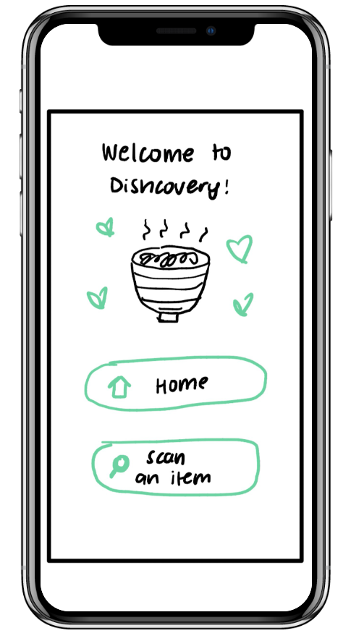
Dishcovery
Link to lo-fi prototype on Marvel prototyping app
Notes:
https://marvelapp.com/prototype/18abihj4/screen/89302233?fbclid=IwAR2xeJs5auwQAMSIMwNgYeWLFfEMEvDkwLy6hkkE8PhbvrBKaTr-Usu8_UE&

Slide 20
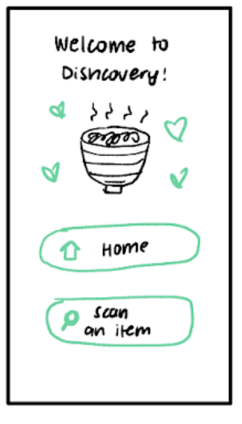
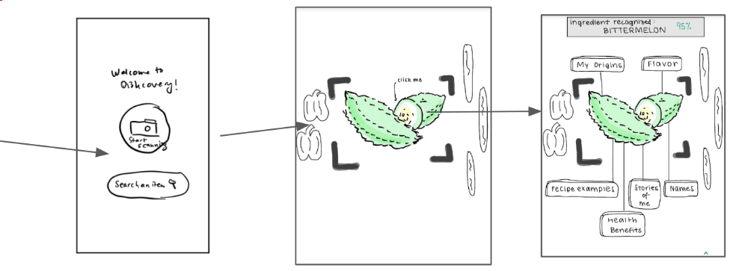
Dishcovery
Task Flow 1: Scanning & Identification

Slide 21
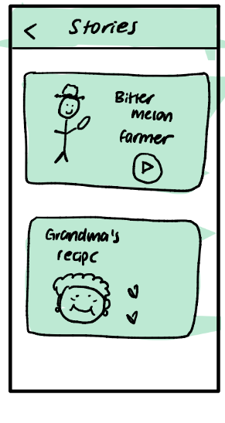
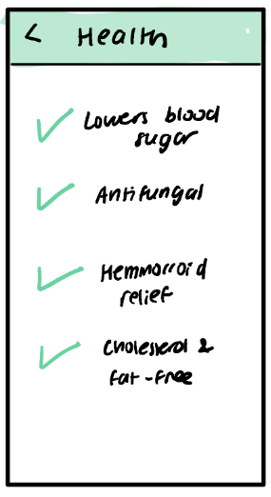
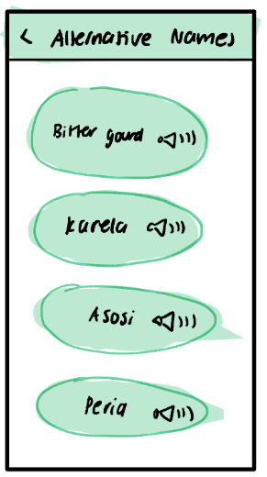
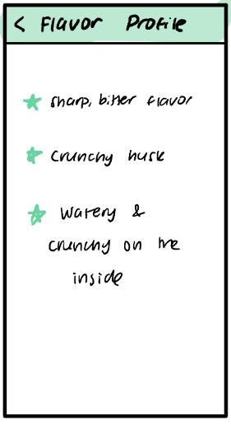
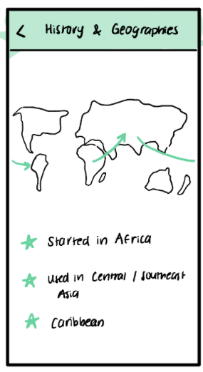
Dishcovery
Task flow 2: Additional Context

Slide 22
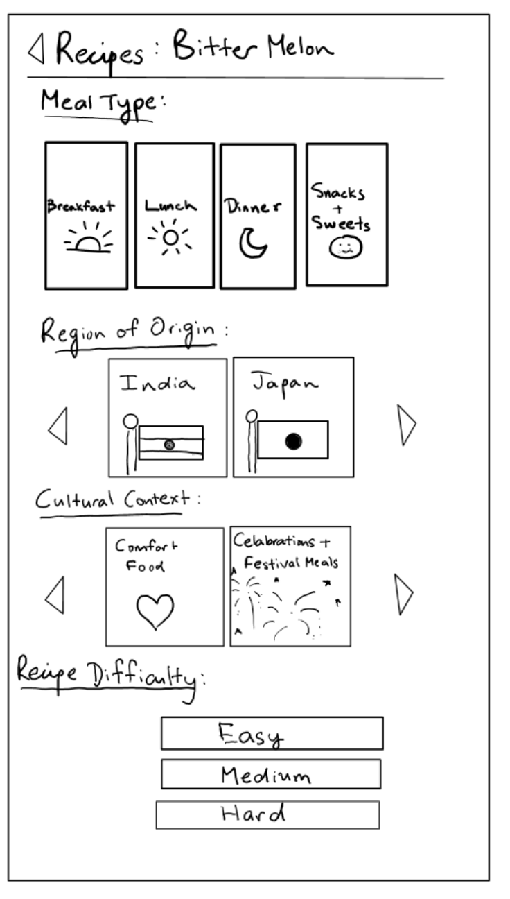
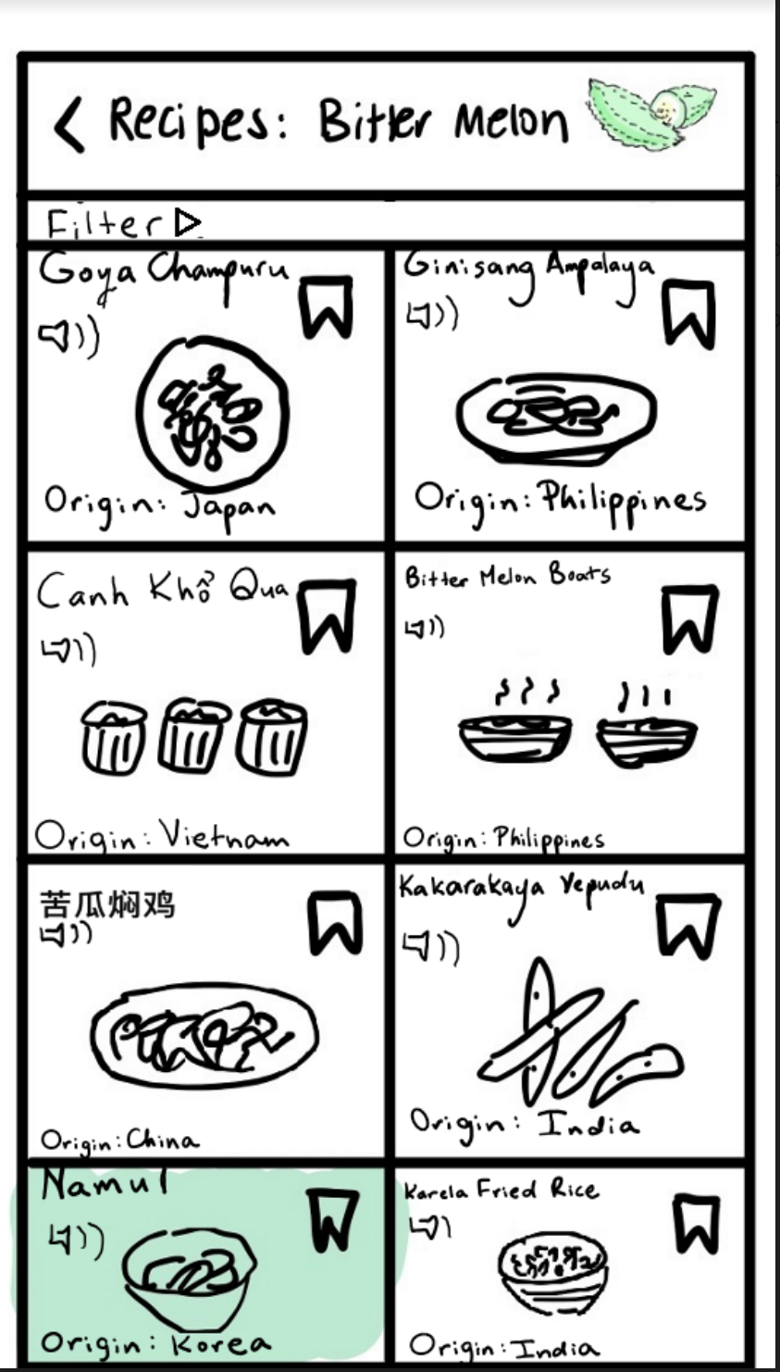
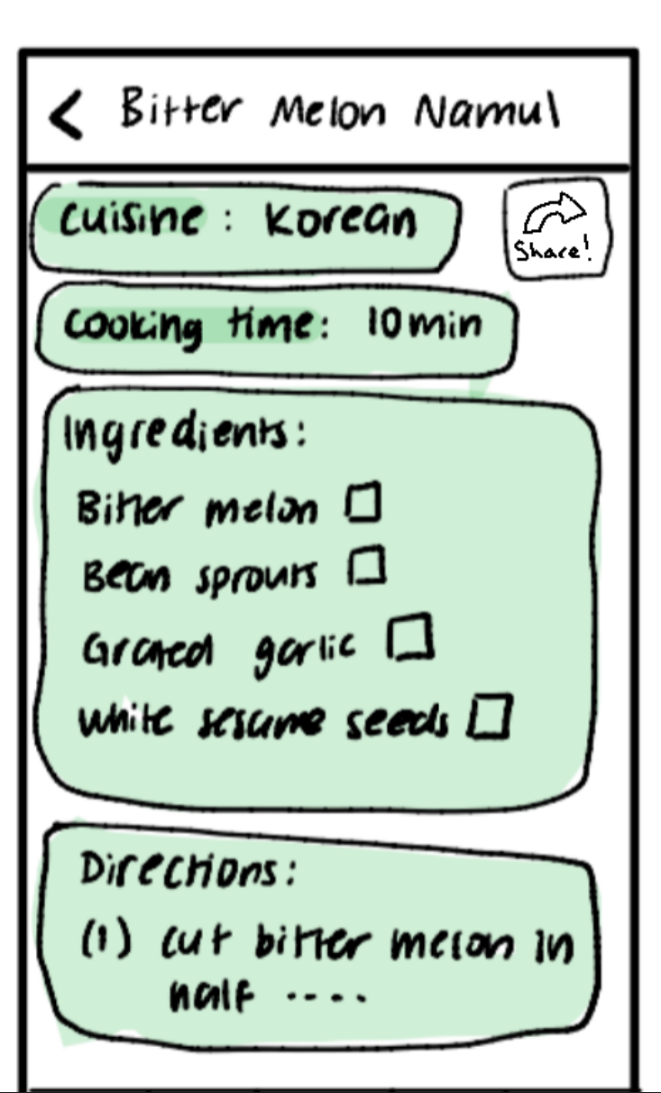
Dishcovery
Task flow 3 - Cooking with A Scanned Ingredient
Filter to see a subset of recipes
Click on “recipes”
Click on a selected recipe

Slide 23
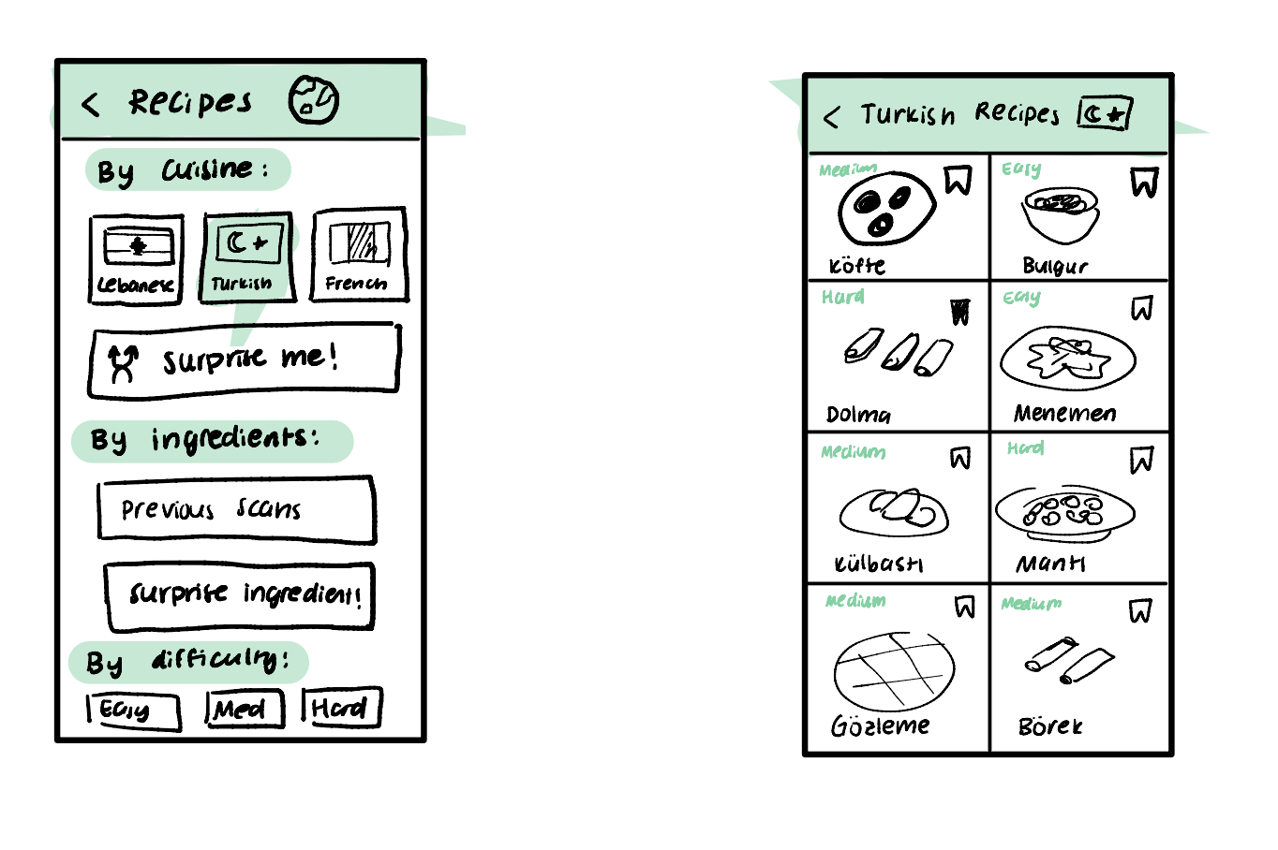
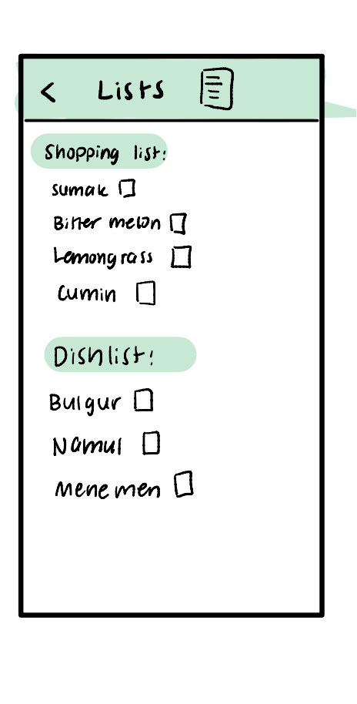
Dishcovery
Task flow 3 - Cooking A Selected Recipe
Track your ingredient list & Dishlist under “Lists”!
Browse through recipes under “Recipes” and…
(Home Screen)

Slide 24
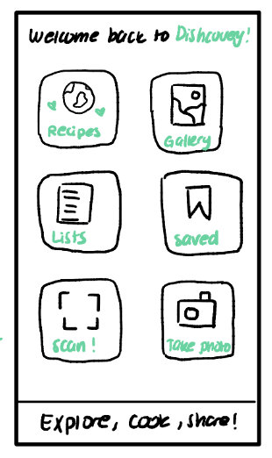
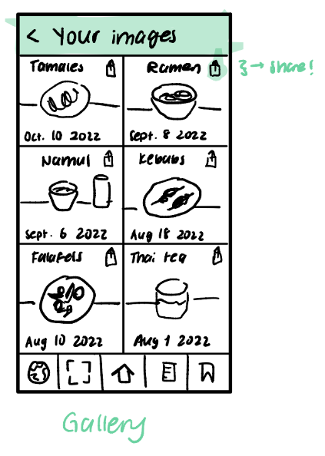
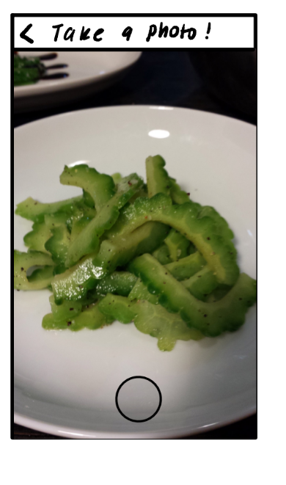
Dishcovery
Gallery where you can keep track of your dishes and share finished with friends
Bonus task flow - sharing with friends/habit tracking

Slide 25
Dishcovery
Testing
Tested on four participants in Palo Alto

Slide 26
Interviewees
Perspectives
Dishcovery
Our PotLuck-ers
Locations: Salt n’ Straw and Verve in Palo Alto, California
Voice record + physical notes
Age range: early professional - late career
Non-Stanford Students!
Diverse backgrounds: immigrants from different countries
Variety of job roles
Variety of motivations behind cooking
Variety of cooking experience and interest levels

Slide 27
Team PotLuck
Meet Our PotLuck-ers
Medical Professionals
Social Science Researcher
Financial Analyst
01
02
03
04
Nora and Pamela
Ahmed
Casey

Slide 28
Team PotLuck
Measurements for Usability Goals
Effectiveness
Satisfaction
How easy is the flow of the interface?
Would you be comfortable sending your a friend or partner to a foreign grocery equipped with this app?
How do you think you would use this app?
What feature do you think you wouldn’t use much? What do you want to see more of?
Observations: What is the user clicking the most? When do they get lost/confused?
What was your favorite part of the app experience?

Slide 29
Dishcovery
Medical Researchers (30s)
Participant 1 & 2: Nima and Priya
Add in a preferences page for dietary information
Confusion about easy, medium, hard vs speed (Noema is not super into cooking so wants quick dishes)
Liked the interactive scanner
Keep it raw, cute vs formal
Add in Drinks/beverages
Nima would not look at alternate names but this was a key feature for Priya, who has an Italian husband
Scan me is particularly helpful —> can navigate in a foreign grocery
Can include calories/nutrition information for recipes
UI - have the scan button highlighted because that’s the main part of the app

Slide 30
Dishcovery
Social Science Researcher (40s)
Participant 3 - Amar
Health benefits first, then flavor, origins less interesting
Heading back to Home Screen from a single recipe instead of the recipes page
Seems to overlap a lot —> lists, saved, and recipes
Minimize friction to get to actually cooking Distinguish between utility and education
Take a photo not super clear that it’s of a dish
Lot of clutter in top 3 options
Vegetarian, vegan, gluten free, etc also important to include
Filter by health benefits as a preference at the beginning
Background: research scientist at fb

Slide 31
Dishcovery
Financial Analyst (20s)
Participant 4 - Cassey
Flavor first —> want to filter by that
Names is unclear, kind of auxiliary
Liked the save recipes options
Wants to save from a specific recipe
Timeframe for recipes, number of ingredients
More confusion about what “take a photo” meant
Can tag a recipe to a photo
Make the scan bigger
Most important: scanning feature
Can take photo and scan be merged?

Slide 32
Dishcovery
Key Results
Confusion between ‘take a photo’ and ‘scan.’
Scanning should be made more prominent and bigger
Confusion between recipes tab on home page and recipes shown after scanning ingredients
Being able to set food preferences/dietary profile
Honing in on the features people like when filtering recipes
Time required for preparation, flavour profile of dish, etc.
In general, people liked the information from the scanning and the way it was presented
Users favored towards the flavor profile, names*, recipes tabs
*Confusion on what ‘names’ means
Some tasks - like the sharing, saving photos etc not so clear

Slide 33
Dishcovery
Limitations
Will people actually use image recognition or would something like search be easier? If search is better this may affect our UI with the QR-code like hovering boxes
How accessible is this for the visually impaired?
Would people have time to look up additional information in the grocery store?

Slide 34
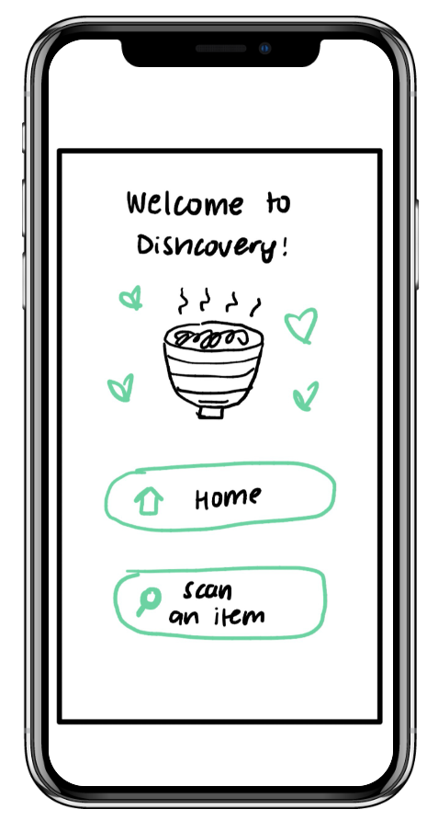
Dishcovery
Next steps forward
At the beginning, include a set-up page where they can set their food allergies, dietary profiles and preferred flavour profiles (spice level etc.) preferred health benefits and automatically filter recipes or give a matching score based off of this
Preferences?

Slide 35
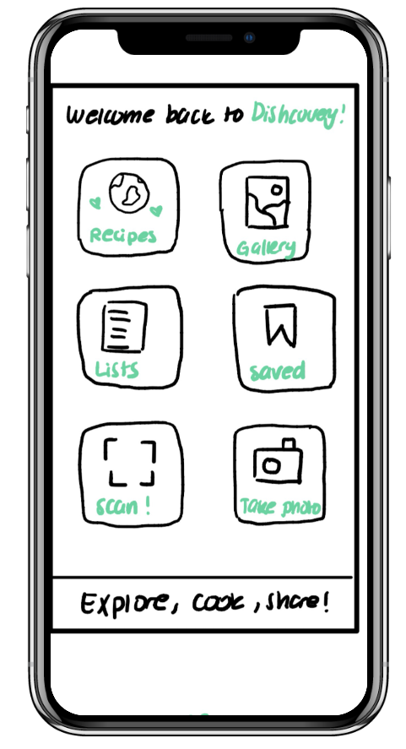
Dishcovery
Next steps forward
In the home page, make the scanning of the unfamiliar ingredients much bigger and the main button

Slide 36
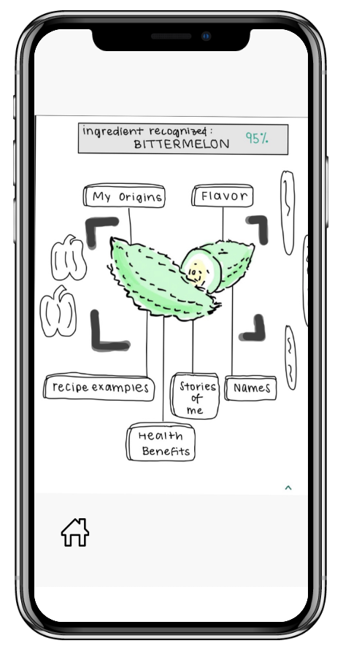
Dishcovery
Next steps forward
Some clarity between the recipe button in home page and recipe button after scanning ingredient

Slide 37
Dishcovery
Next steps forward
Make it clear that these take a photo and gallery tools are for finished dishes, not scanning ingredients, if we choose to keep it

Slide 38
Dishcovery
Next steps forward
After this, we can simplify this home page and make the tasks more clear. Our additional tasks - sharing recipes, habit tracking (by saving the dishes in a long term gallery) are sort of added but not made extremely clear/ well defined through the UI

Slide 39
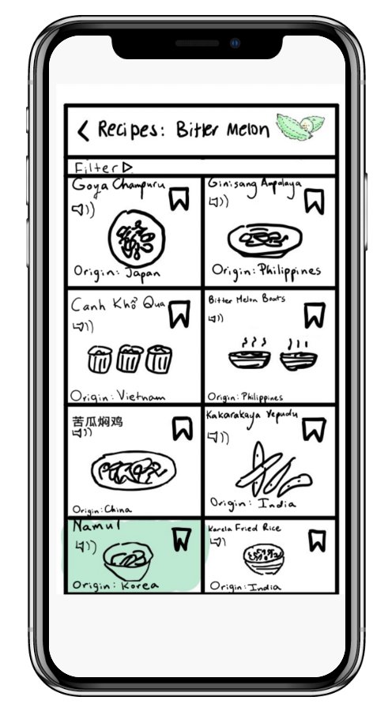
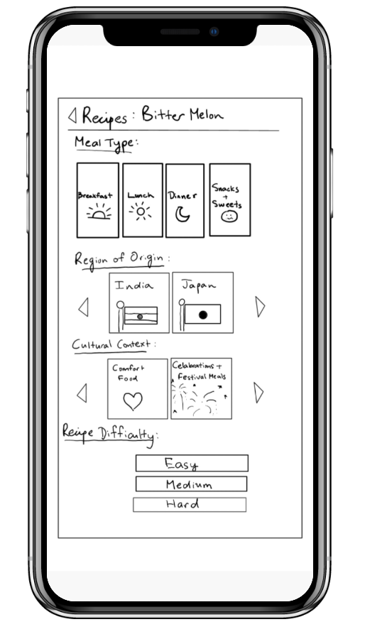
Dishcovery
Next steps forward
This filter option is a little hidden away (all participants had to be prompted), but sorting through recipes and being able to filter by culture etc is one of our main features, so we should make this more obvious

Slide 40
Dishcovery
Next steps forward
Some people prefer to sort by time required for the recipes, number of ingredients etc.

Slide 41
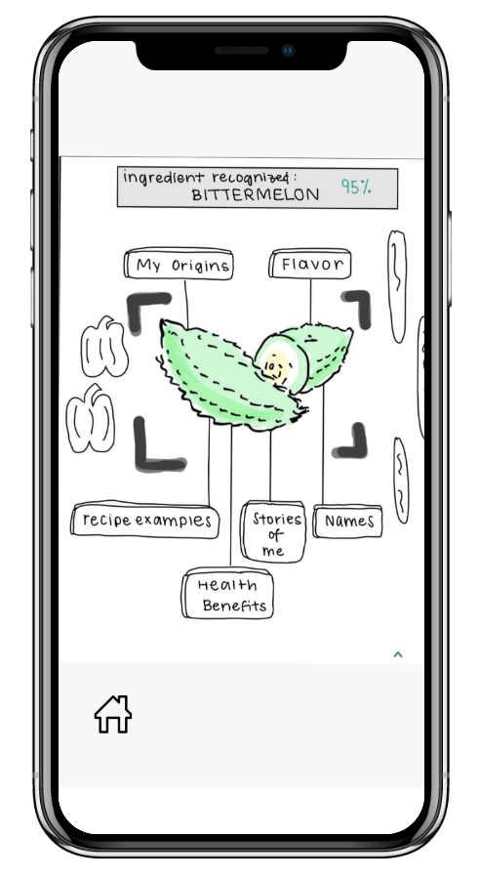
Dishcovery
Next steps forward
In general, people liked the UI of this page, but actually it was not immediately obvious what the bittermelon is. So make a very clear “what is this item?” feature/ description at the top
The translation or look-up of foreign items turned out to be a key feature for some participants - we forgot to include a setting for automatic translation (of foreign packaging on text)

Slide 42
Dishcovery
Appendix

Slide 43
Dishcovery
Appendix
Link to lo-fi prototype on Marvel prototyping app
Notes:
https://marvelapp.com/prototype/18abihj4/screen/89302233?fbclid=IwAR2xeJs5auwQAMSIMwNgYeWLFfEMEvDkwLy6hkkE8PhbvrBKaTr-Usu8_UE&

Slide 44
Dishcovery
Augmented Reality: Full List of Pros/Cons
Pros
You can work with what you have and makes shopping for ingredients less intimidating
Ability to document what you’ve cooked in the past
AI recommendation software can let the user know which recipes to try based on what they haven’t cooked before and what they’ve enjoyed in the past
Setting goals like “Try 1 new authentic recipe a week!” can constantly incentivise the user to try new things
Know what you can cook with your existing ingredients
Makes it easier to shop/more incentive to buy cultural ingredients that go well with existing ingredients you already own
You know what to buy and what to look out for
Potential to integrate with image recognition: showing what the final product food could look like?
Spinning dishes are aesthetic
Helps people visualize final dish/ cooking while they are in the mode about to cook
Cons
May be high-maintenance to talk to the app unless it’s through something like an Alexa integration
People may be too lazy to input everything in their pantry, so each recipe may have to ask on a recipe-by-recipe basis
Does not really target the non-food motivated audience if it is too focused on pantry organization
Who do we source recipes from? How do we decide which recipes to recommend?
Requires additional, often expensive hardware for AR
May not be accessible to visually impaired users
If they are already in the pantry, will they have a lot of incentive to go out and buy new ingredients? But maybe that’s the point that it suggests things missing from the pantry too…

Slide 45
Dishcovery
Image Recognition: Full List of Pros/Cons
Pros
Real-time, fits into the cultural companion narrative as an app that is with you while you shop
Visual learning to improve memory around food
Variety of information is easily available to add as part of the visual experience of scanning an ingredient
Users can already have experience with using image recognition/scanning through their camera for things like QR codes
Really clear connection to our original tasks (helping know what something is while grocery shopping)
Quite flexible and can add lots of UI components
Requires no additional hardware, only a phone with an integrated camera
Technically easier to implement
Cons
Accuracy is imperative and might take lots of training data: risks of inaccuracy is greater with cultural stereotyping
Navigating bias toward more common foods or cultures that are more represented
Curating the information that populates about a certain ingredient may be difficult and require an understanding of accurate data sources to find this information
Potentially inaccessible for those that cannot hold their phone up for a longer period of time to capture the photo
Maybe a lot of people who are shopping for groceries in-person are in a rush and won’t want to explore too much / won’t want to pause and look up heaps of things
Visual focus might not be as accessible for visually impaired users

Slide 46
Dishcovery
Participant 1 & 2 - Noema and Preethi
Allergen info
Preferences —> add in preferences page
Suggested dishes that it goes well with
Confusion about easy, medium, hard vs speed
Liked the interactive scanner
Keep it raw, cute vs formal
Add in Drinks/beverages
Would not look at alternate names/would look at names —> common languages
Can include calories/nutrition information for recipes
Have the scan button highlighted because that’s the main part of the app
Partner is Italian, helpful to translate names for ingredients between languages
Scan me is particularly helpful —> can navigate in a foreign grocery

Slide 47
Dishcovery
Participant 3 - Ahmed
health benefits first, then flavor, Origins less interesting
Heading back to Home Screen from a single recipe instead of the recipes page
Seems to overlap a lot —> lists, saved, and recipes
Minimize friction to get to actually cooking
Take a photo not super clear that it’s of a dish
Lot of clutter in top 3 options
Vegetarian, vegan, gluten free, etc also important to include
Filter by health benefits
Can compile recipe from ingredients
What is this? Setting could be good to add
Favorite: image recognition and getting insights on data from stuff you know on the street —> feels curated
Some stuff felt more edutainment, others felt more about utility
Background: research scientist at fb

Slide 48
Dishcovery
Participant 4 - Casey
flavor first —> want to filter by that
Names is unclear, kind of auxiliary
Liked the save recipes options
Wants to save from a specific recipe
Timeframe for recipes, number of ingredients
More confusion about what “take a photo” meant
Can tag a recipe to a photo
Make the scan bigger
Most important: scanning feature
Can take photo and scan be merged?

Slide 49
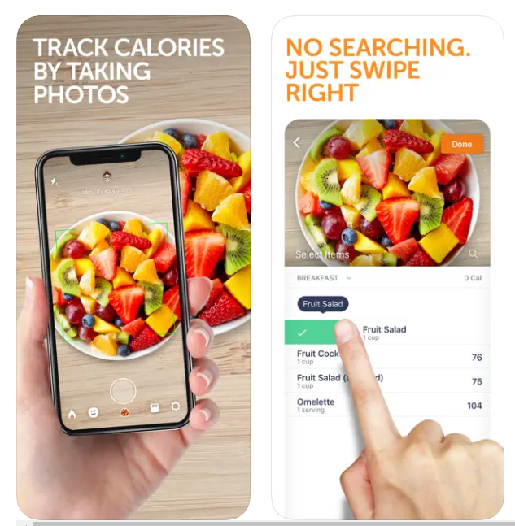
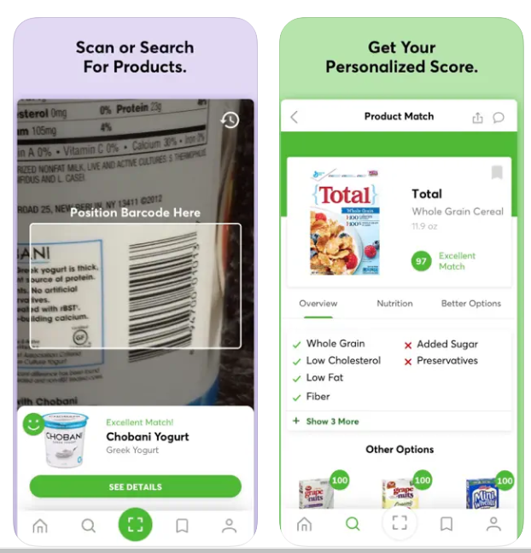
Sketch inspirations
Calorie Mama
ShopWell
Image recognition with cultural context

Slide 50
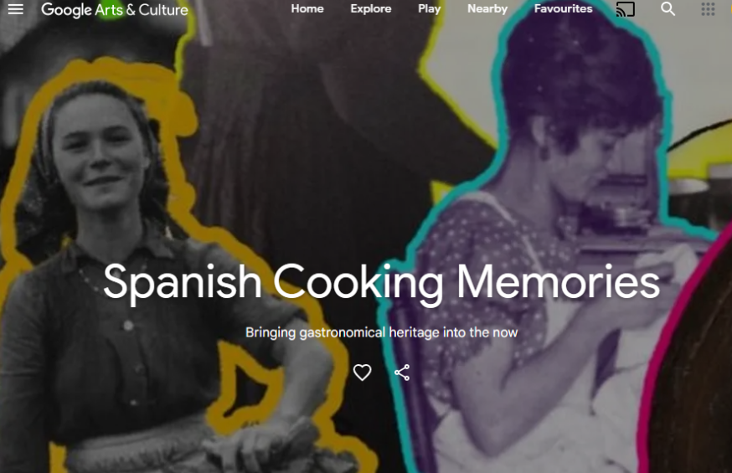
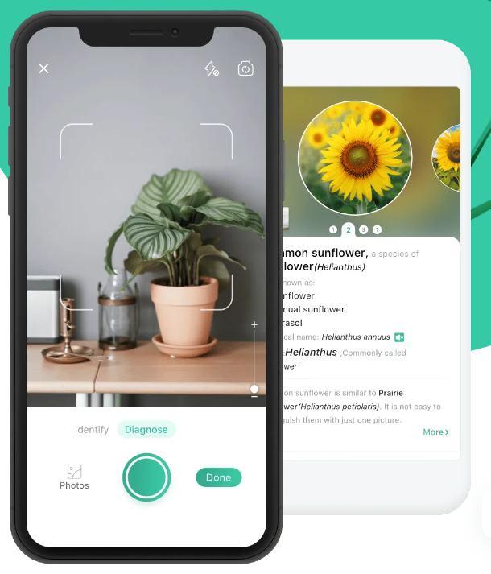
Sketch inspirations
Google arts and culture page on spanish cooking LINK
Picture This (plant id app)
Scroll-View

Slide 51
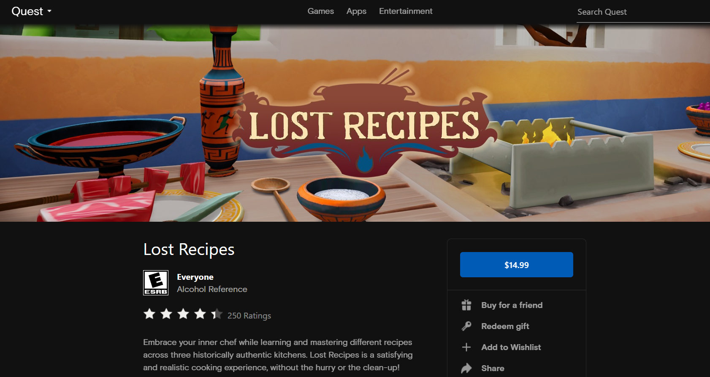
Sketch inspirations
Transport to cultural location via VR!

Slide 52
Dishcovery
Testing Procedure
Process
Script Notes
First, provide an overview of the app’s purpose and function
App Name: Dishcovery
Value proposition
Where you would use the app → grocery store, kitchen, etc
Explain what the low-fi prototype is
Note that we’ve used color to denote features that are clickable for users to try
Roles
Greeter talks through the script notes
Computer holds the phone to present the prototype to the user
Facilitator prompted the user to explain their choices of what they’d clicked on in a certain order
Ex: “Why did you click on Health Facts first?”
Ex: “What made you interested in doing this kind of filtering on your recipe?”
Notetaker took verbal notes and maintained a voice recording of the experience
Prompted facilitator to ask questions about motivation for certain interactions

Slide 53
Dishcovery
Your cultural culinary companion

