Slide 1
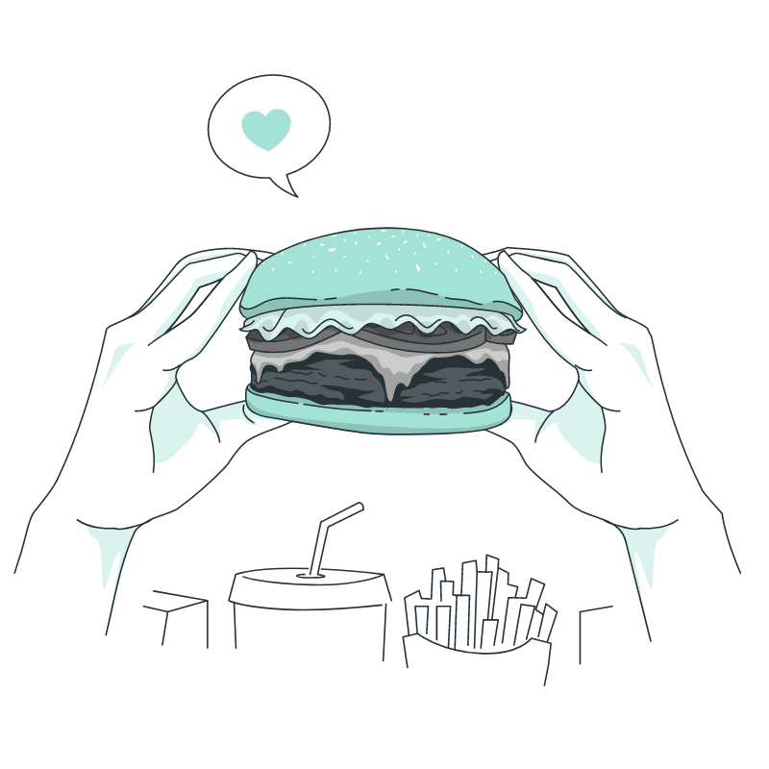
Team PotLuck
Define & Ideate
Culture through Cuisine
Defne Genç, Janet Zhong,
Amrita Palaparthi, Kyla Guru
Notes:
Space Grotesk
Anaheim
Barlow Semi-Condensed Normal

Slide 2
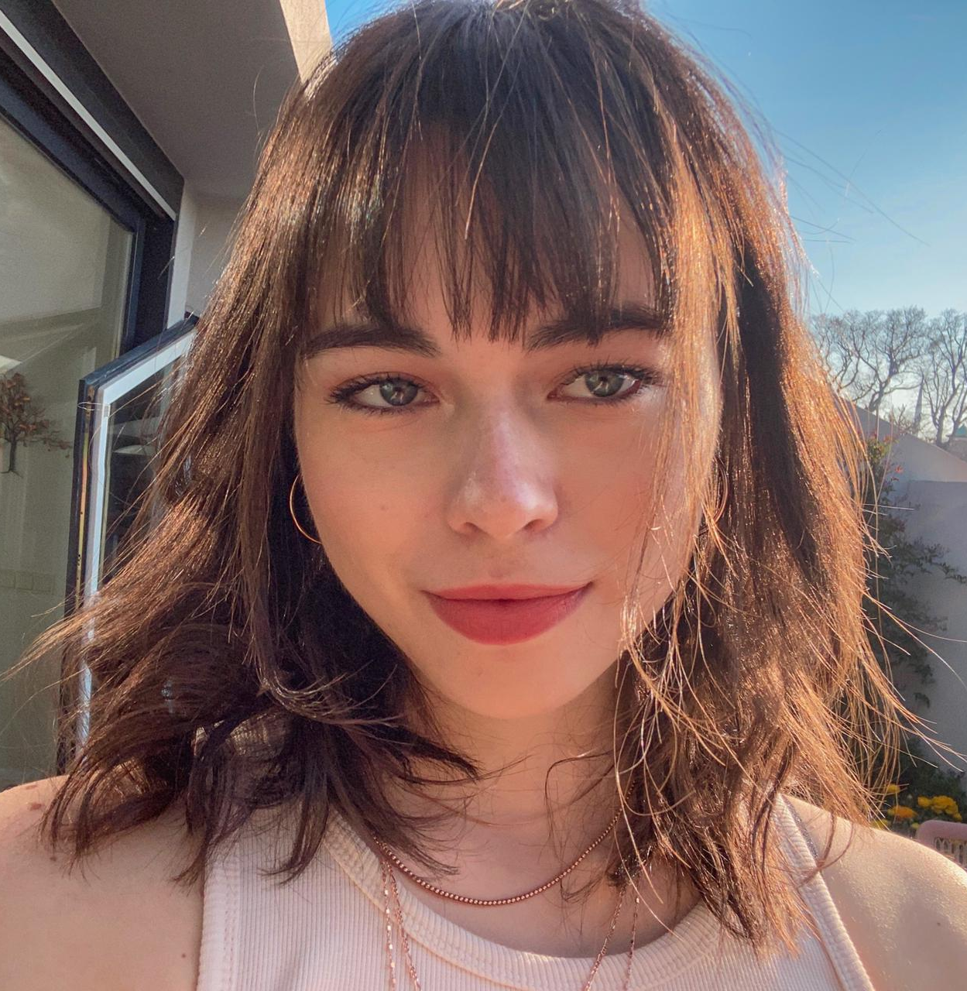
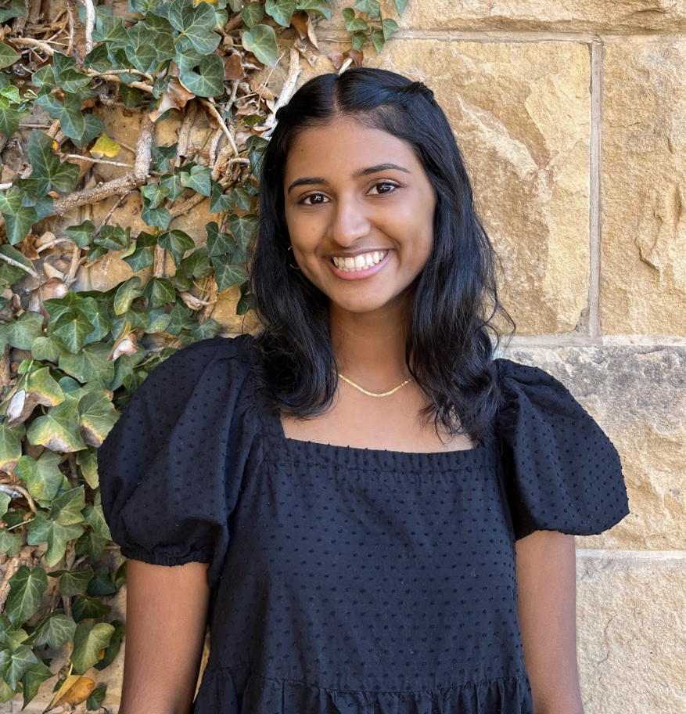
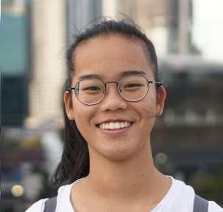
Our PotLuck
Defne
Kyla
Janet
Amrita
Potluck item:
Potluck item:
Potluck item:
Potluck item:
Notes:
Spanning across India, Turkey, Australia

Slide 3
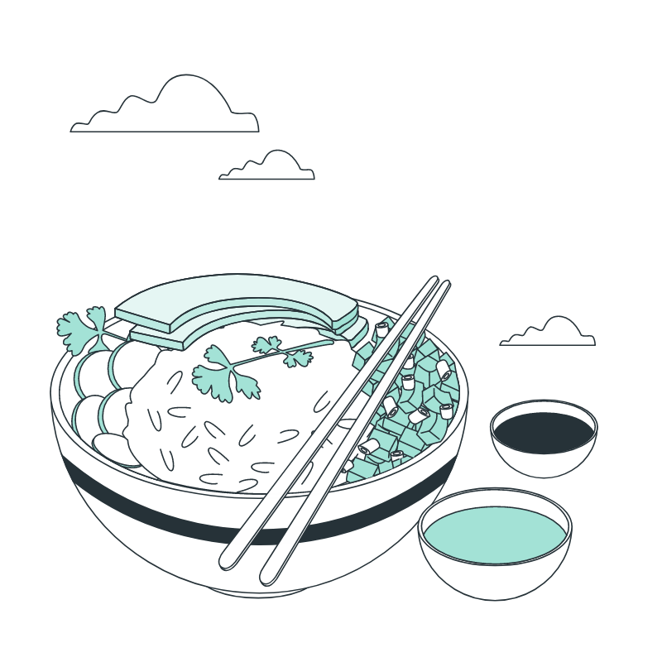
PotLuck
Recap
Last time, we saw where our interviewees struggled, hesitated, smiled, stuttered, were uninterested, or showed excitement. Will we be able to brainstorms solutions to address their problems, or to enhance the good parts of their cooking experiences?

Slide 4
Food Lover
Problem Domain
Sharing and learning about other cultures through food and cooking
www.slidesgo.com

Slide 5
Team PotLuck
Table of Contents
New Interviews
Dig deeper into our problem domain of cooking & food authenticity.
Revisiting Old Interviews
What problems did our needfinding point to?
Solutions & Prototypes
How do new people react to prototypes built around our assumptions?

Slide 6
Team PotLuck
Ideation Methodology
Brainstorm
Prototype
Some HMWs based on what might be “game-changing” to them.
Have our ideas receive feedback from real people.
Generate
Ideate
POVs for our past and new interviewees.
Quickly generate a variety of solutions and narrow scope.

Slide 7
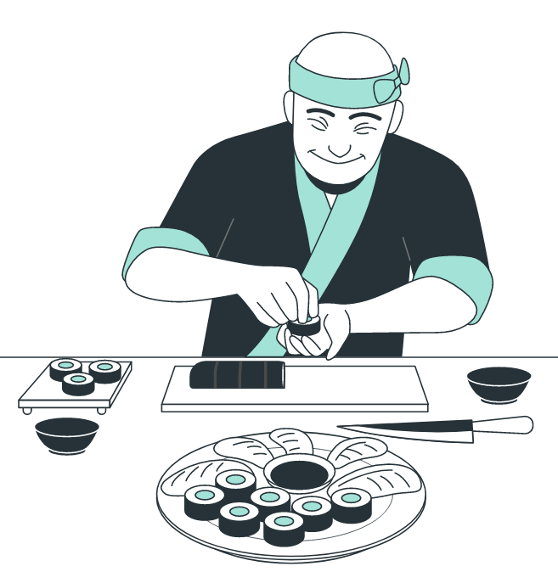
Food Lover
What stuck from our interviews
Sofia
Martin
Grace
Learned cooking by doing, learned to be a chef on the job as a hasher.
She noticed a lot of people didn’t bring in authentic recipes when looking for ingredients.
Despite having an appreciation for good food, doesn’t think that cooking is a personal experience worth the time investment.
↓
↓
↓
Did a lot of her learning being non-verbal and practical allow her to get used to cooking in a more natural way?
Concerned that authenticity behind food is lost through language barriers or inauthentic recipes?
Can’t feel connected to the cultural context, history, and stories behind food?

Slide 8
Team PotLuck
Testing Assumptions
Does going through the motions of cooking teach you how to be a better cook?
Do challenges faced when cooking from a recipe come from a lack of experience?
Do they come from intimidation? A lack of cultural context?
Is the appearance of a new food what’s intimidating for people unwilling to try it?
When you don’t understand the context of a recipe, does that make you less interested in cooking it?
Do people use inauthentic recipes because they’re mostly available in English?

Slide 9
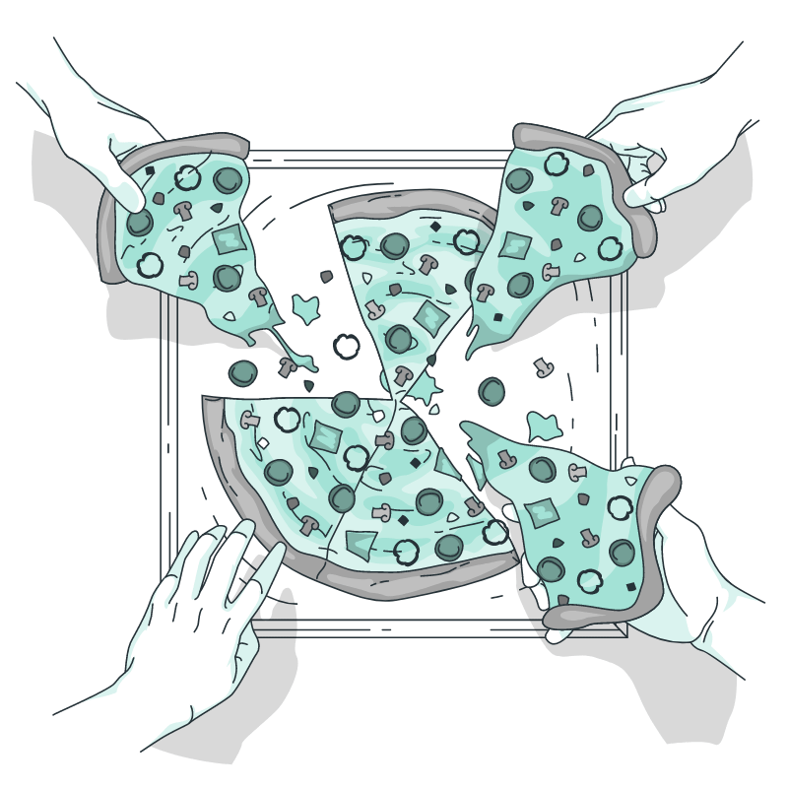
Interviewees
Prototypers
Team PotLuck
Our PotLuck-ers
Workers (around food), industry knowledge (startup founder)
Non-Stanford students!
Diverse ages: students, parents
Interviewed in a variety of locations.
Variety of motivations behind cooking
Variety of expertise around food consumption.

Slide 10
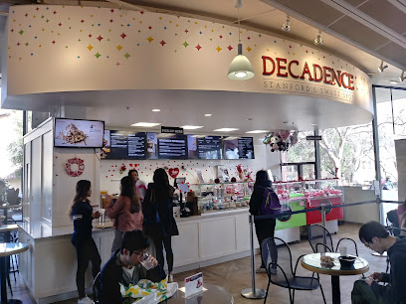
Food Lover
Amy - Server @ Decadence
Interviewed by Kyla at Decadence at Stanford
Context
Amy is from Oakland, CA and her parents are from Alabama and Oklahoma
Amy took this role at Decadence as a way to make ends meet
Her favorite part of her job is making people happy through acai bowls and gelato.
Key Findings
Amy finds that homestyle Southern food is hard to obtain in the Bay Area and on campus
Amy loves her mom’s Southern Hot Water Cornbread says that her mom would not let anyone in the kitchen while creating it
Amy has not made her mom’s signature dish since her mom’s passing
She says she might consider making it if she were to find a recipe that was similar and she was making it with her sisters
Notes:
See second slide of appendix for all solutions associated with this HMW

Slide 11
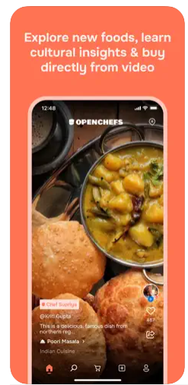
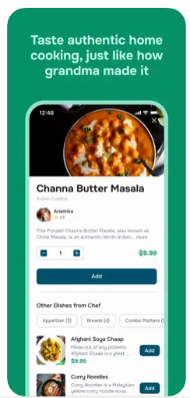
Food Lover
Jeson - Founder of OpenChefs
Context
Jeson is 24, an immigrant from Malaysia, making an early stage startup that is a home-made food delivery app
He founded it because he was homesick in the Bay Area and missed authentic Malaysian food
Key Findings
The main people buying food are immigrants in their 20’s to 30’s and the main people selling food are middle-aged immigrants.
The sellers mainly did it for passion or economic purposes (the former is preferred for food quality, but the latter has more social impact benefits)
They use a TikTok-like interface, but there is a difference between food entertainment and what makes food sell
The majority of users buy foods that remind them of home - there is less criss-crossing of cuisines
This app would perform quite differently in different areas, New York (authentic food already exists), Texas (perhaps less open to new cuisines)
Notes:
See second slide of appendix for all solutions associated with this HMW

Slide 12
Food Lover
Key Learnings
Amy: Authenticity is hard to come by, and most people are troubled because they don’t know how to recreate it.
Jeson: Although a sentimental connection to food through culture remains pervasive in some communities, people still struggle to feel ownership towards other cultures’ cuisines.
www.slidesgo.com

Slide 13
Team PotLuck
01
Martin
Real estate developer from Oakland
Interview conducted at Verve cafe while taking physical notes

Slide 14
Team PotLuck
Point of View - Martin
We met…
Martin, a real estate developer and avid biker from Oakland in his 30s, who makes only very simple meals for himself a few times a week
We were surprised to realize that…
Despite taking pride in his ability to appreciate well-made home-cooked meals and making an effort to focus on the cultural authenticity of food, he doesn’t describe himself as food motivated and feels like cooking complex dishes for himself isn’t worth the time and effort investment
We wonder if this means…
He needs to understand the personal stories and cultural context of food in order to be more emotionally connected to it and be excited to cook it as a worthwhile experience
It would be game-changing to…
Help people feel connected to the cultural context and stories behind dishes in a way that makes cooking other cuisines feel personal.
Notes:
Takes pride in his ability to notice delicious food options

Slide 15
Food Lover
How might we… present recipes in the cultural/historical context and the personal stories associated with them?
www.slidesgo.com
Notes:
See first slide of appendix for all HMWs for this POV. These are also listed below:
HMW present recipes in the cultural or historical context and personal stories associated with them?
HMW help people share the personal and cultural meaning of their food with others so that they can understand and appreciate them?
HMW connect food with specific memories and shared experiences?
HMW make the process of cooking a more complicated meal for oneself feel worthwhile?
HMW make Martin seek out the story behind what he’s eating?
HMW make food from another culture feel like one’s own?
HMW reduce the friction in reading about different recipes and cultures?
HMW motivate people to research food from different cultures?
HMW make “foregin” food feel like home?
HMW make cooking feel more personal and less transactional for Martin?
HMW use practicality to create passion?

Slide 16
Food Lover
Solution Selection - Meal Journeys
www.slidesgo.com
Solution
Connect recipes to places and journeys, pairing each dish with a map of where it originated from, associated cultural and personal stories, and how it has changed as it has spread to different places over time
Key Assumption
Foreign dishes will feel more exciting and less intimidating to cook when you learn about the history, culture, and stories associated with them
Notes:
See second slide of appendix for all solutions associated with this HMW

Slide 17
Team PotLuck
Experience Prototype
Show participants a picture of a dish they’ve likely not seen before = one not popularly consumed in the West but instead regional in some other part of the world.
Ask them how they feel about eating it. (answer may be positive or negative)
Ask them why or why not they would consider cooking it
Ask them what they think the food is made of, where it’s from, and what the culturally appropriate way of eating it is
Show them the region of origin and the spread of the dish over time on a world map, pictures of the dish within the region, and the people from there eating and cooking that food
Ask them if their opinions have been affected, how they feel about the food now.
How has their opinion on this dish changed? Are they more or less excited to eat it?
Would they themselves cook it? Why? If they need more information, what’s missing?

Slide 18
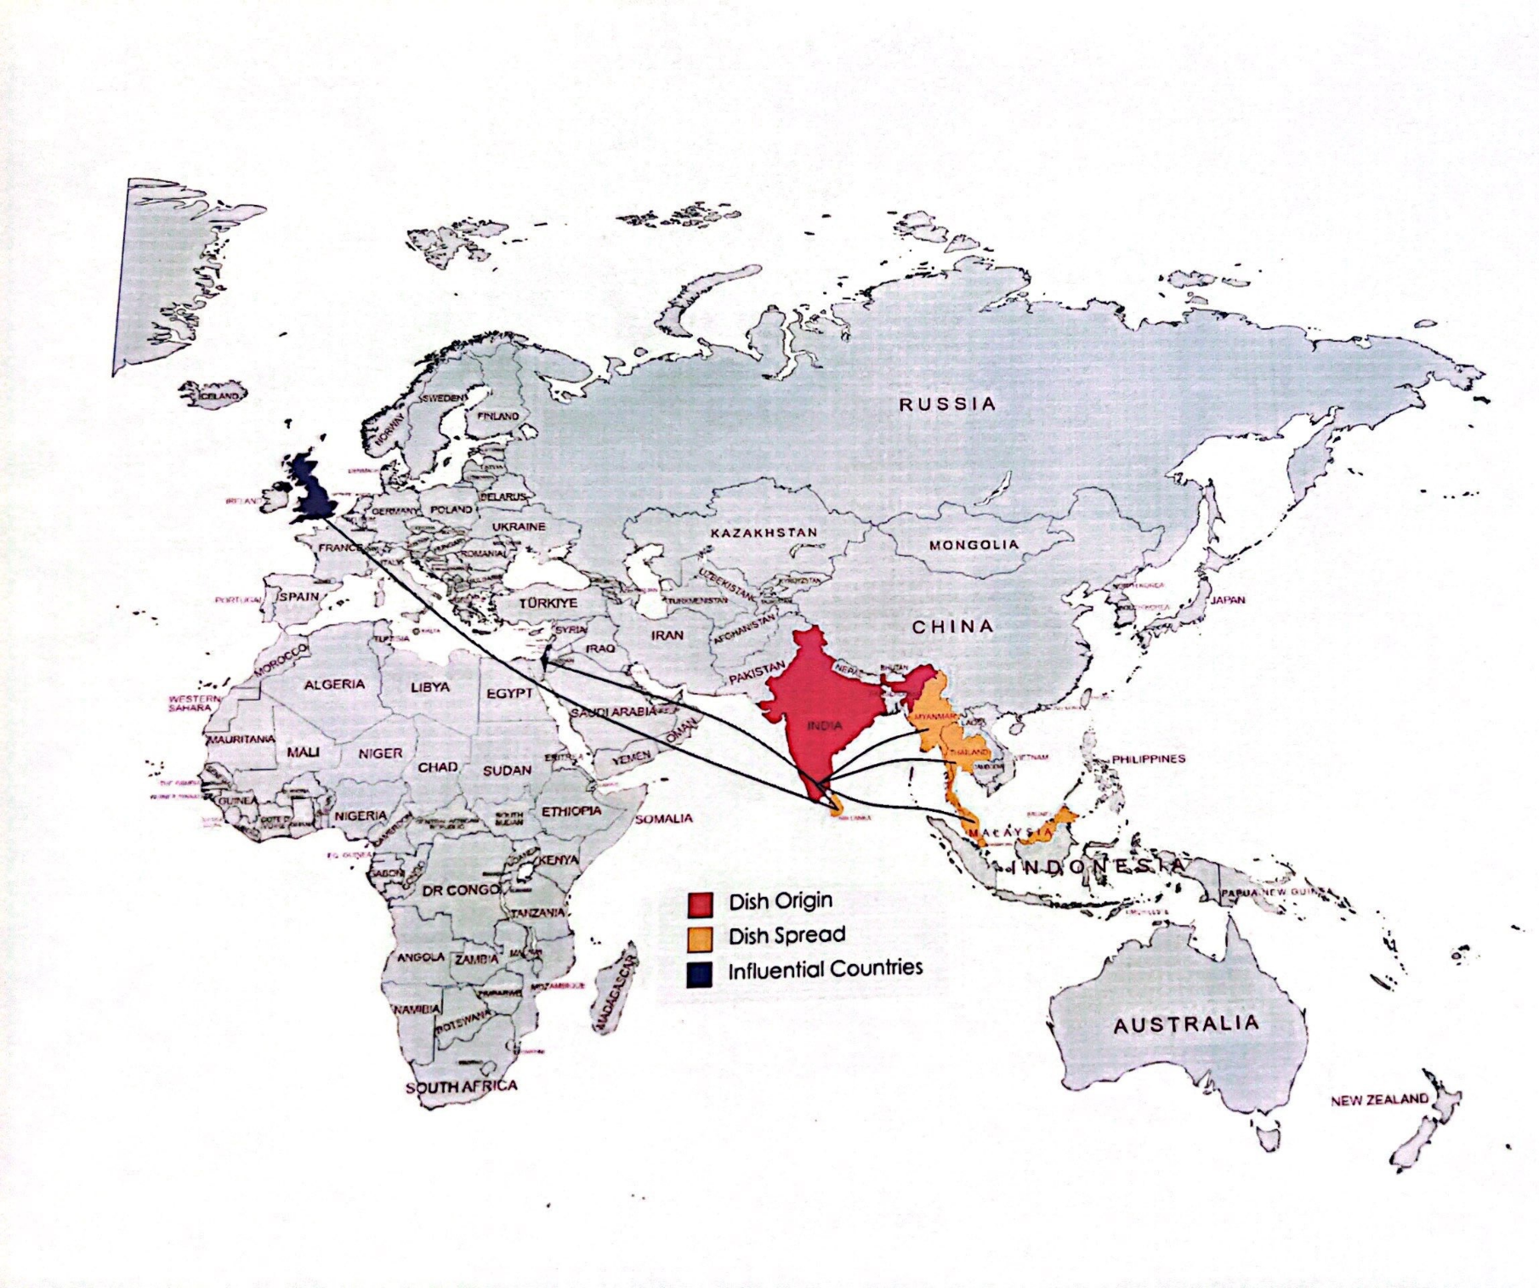
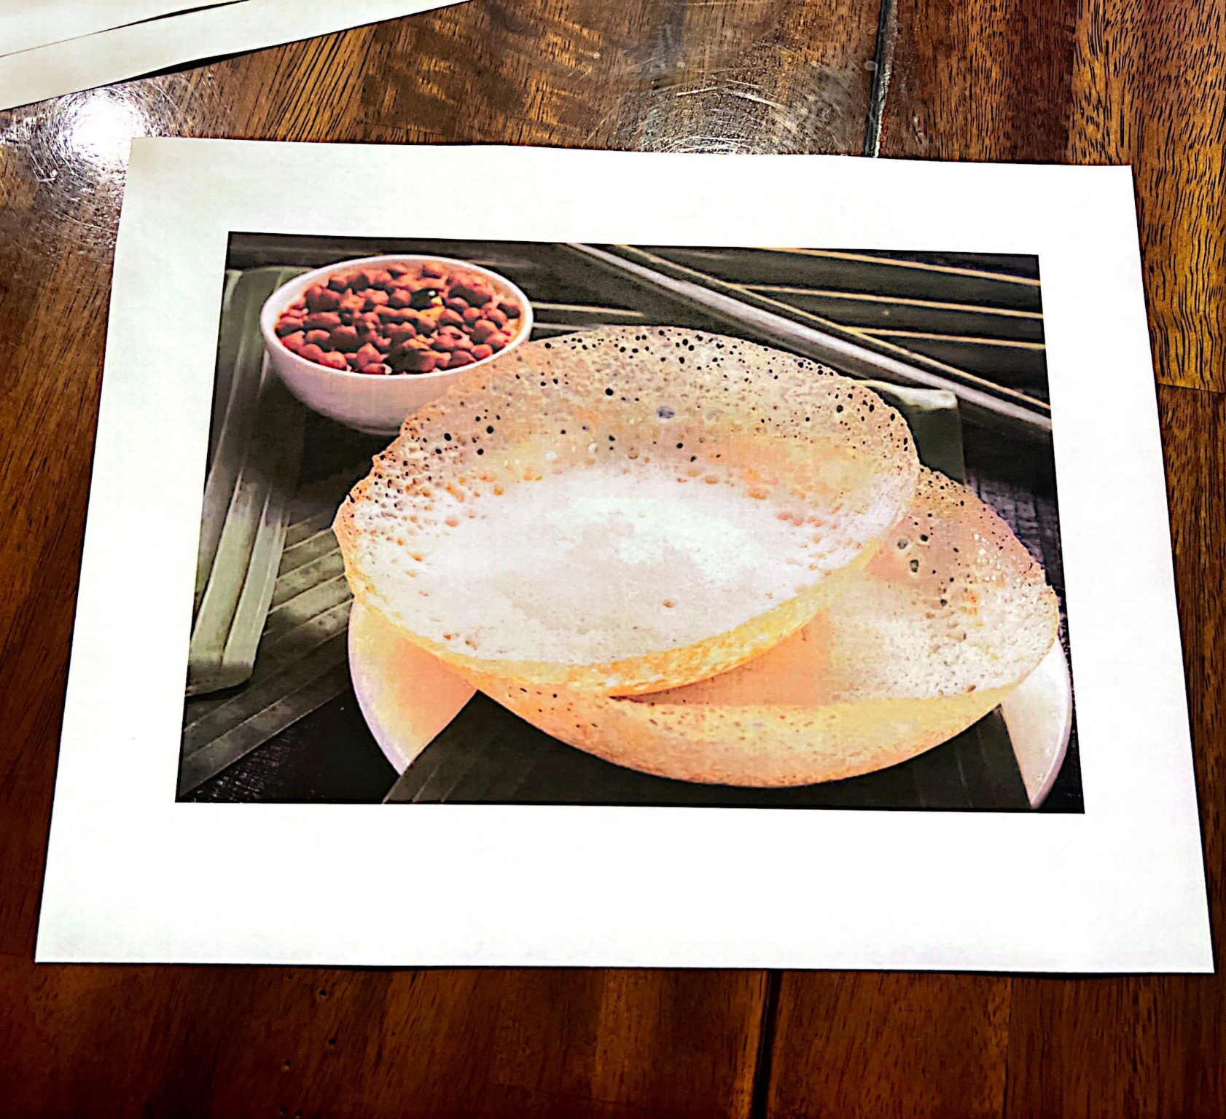
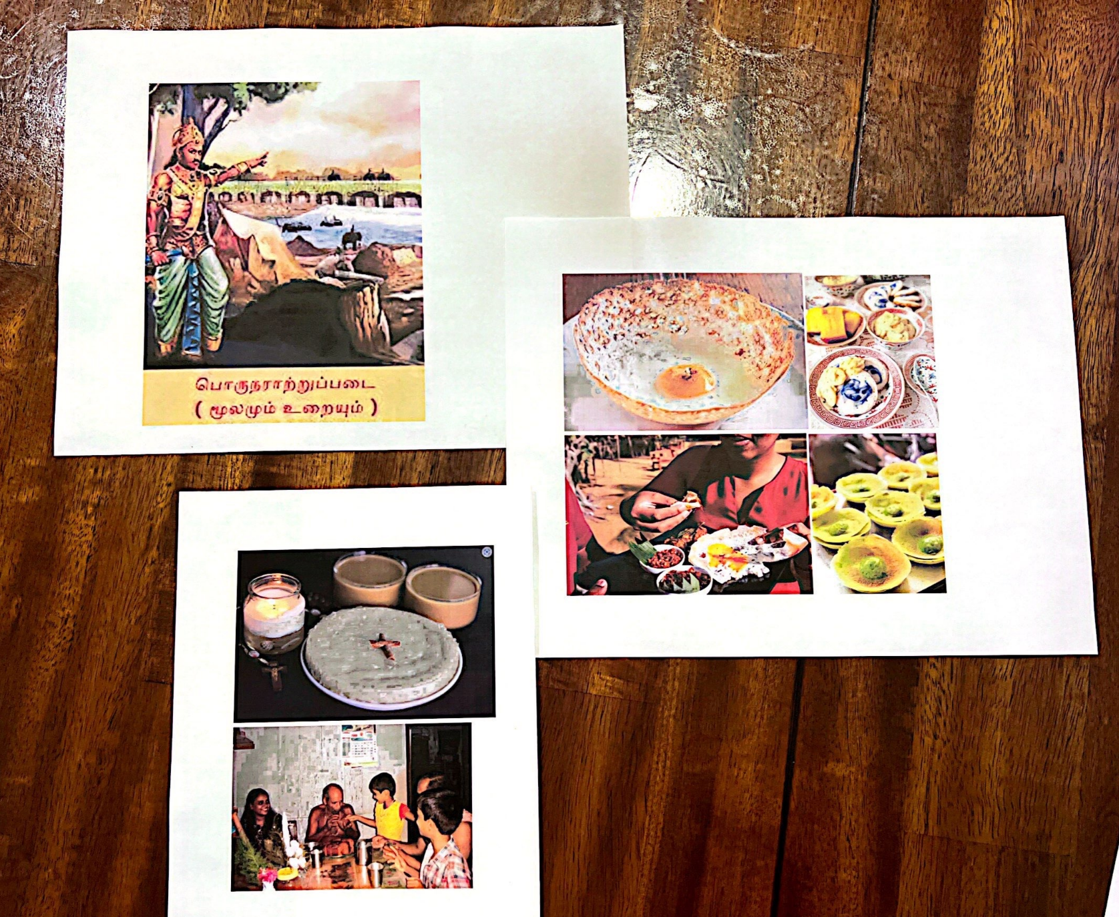
Team PotLuck
Mother (age ~50) who frequently cooks for her family
01
Confident in her ability to tackle complex foreign dishes
Father (age ~50) who occasionally cooks
02
Somewhat skeptical of unfamiliar foods, but willing to try interesting new things
USC student (age 20)
03
Not at all experienced with cooking, interested in learning but nervous about complex foreign dishes
Prototype testing conducted at guest residence while visiting the Bay Area

Slide 19
Team PotLuck
Key Insights
What worked?
Showing origin and spread on a colorful map drew substantial interest in the dish as participants realized its popularity
Participants were generally excited and intrigued by the dish’s history of creating commonalities between religious groups in India and asked several questions about the connection
Assumption was valid: All participants were more inclined to eat and cook the dish after learning the journey
What didn’t work?
One participant was a bit confused by images of alternate versions of the dish, asking which one they would be cooking
The food journey did not provide any references to get started with cooking the dish, which Participant 03 noted as something they would need to move forward
Key Quotes
“Seeing that this dish has been around for so many centuries and is popular in so many countries makes it a little more exciting to try” - Participant 01
“Ooh, that’s an interesting story! I’ll be making this for my family on the weekend” - Participant 02
“I wonder if there’s a way to make it easier to approach cooking this, but I’d like to give it a shot” - Participant 03

Slide 20
Team PotLuck
02
Grace
Interviewed by Janet & Observed by Defne
Manager of 99 Ranch (Asian Grocery)
Interview conducted at 99 Ranch while taking physical notes

Slide 21
Team PotLuck
Point of View - Grace
We met…
Grace, the manager of 99 Ranch in Mountain View, who cooks at home and observes customers who are looking for ingredients for Asian cooking
We were surprised to realize that…
She noticed a lot of people didn’t bring in authentic recipes when looking for ingredients, instead defaulting to westernized versions of traditional Asian foods.
We wonder if this means…
She was concerned that a lot of authenticity behind food was lost through language barriers or inauthentic recipes
It would be game-changing to…
Connect people exploring new cuisines to authentic recipes or expert sources of information
Notes:
Takes pride in his ability to notice delicious food options

Slide 22
PotLuck
How might we…
make it so that unfamiliar ingredients speak for themselves?
www.slidesgo.com
Notes:
See first slide of appendix for all HMWs for this POV. These are also listed below:
HMW present recipes in the cultural or historical context and personal stories associated with them?
HMW help people share the personal and cultural meaning of their food with others so that they can understand and appreciate them?
HMW connect food with specific memories and shared experiences?
HMW make the process of cooking a more complicated meal for oneself feel worthwhile?
HMW make Martin seek out the story behind what he’s eating?
HMW make food from another culture feel like one’s own?
HMW reduce the friction in reading about different recipes and cultures?
HMW motivate people to research food from different cultures?
HMW make “foregin” food feel like home?
HMW make cooking feel more personal and less transactional for Martin?
HMW use practicality to create passion?

Slide 23
PotLuck
Key Assumptions - Making Ingredients Less Intimidating
Understanding where an ingredient comes from will make a foreign ingredient less intimidating
Seeing example recipes using a foreign ingredient less intimidating
Automatic translation of foreign text will make a foreign ingredient less intimidating
Personal food tips of how something is will make a foreign ingredient less intimidating
Watching a video of an ingredient being prepared will make a foreign ingredient less intimidating
People have time when grocery shopping to scan things and read/ watch more about it (are most people in a rush?)
Authentic opinions from people who cook the cuisine, will sway people to try more authentic dishes
Notes:
See second slide of appendix for all solutions associated with this HMW

Slide 24
Food Lover
Solution - Grocery shopping cultural assistant
Smart scanning ingredients at the grocery store
Solution
Which cuisines is this found in?
Automatic translation of foreign text
Use image recognition to automatically present relevant cultural and recipe-related information upon scanning an ingredient with your camera, including:
The taste and function of the ingredients
Voice notes from chefs
Recipe suggestions/ Food tips of how to cook the ingredients
Where the ingredients are from
Where is this ingredient from?
Video tips from chefs
Suggested cultural recipes?
Food tips/ reviews from real people
Notes:
See second slide of appendix for all solutions associated with this HMW

Slide 25
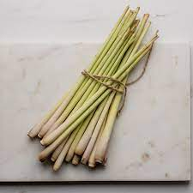
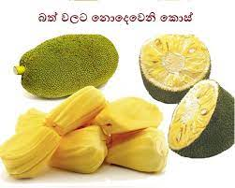
Team PotLuck
Experience Prototype
Show participants three unlabelled foreign ingredients (lemongrass, khmeli suneli, jackfruit). Ask them to rank each 1 (I would not buy) to 5 (I would buy)

Slide 26
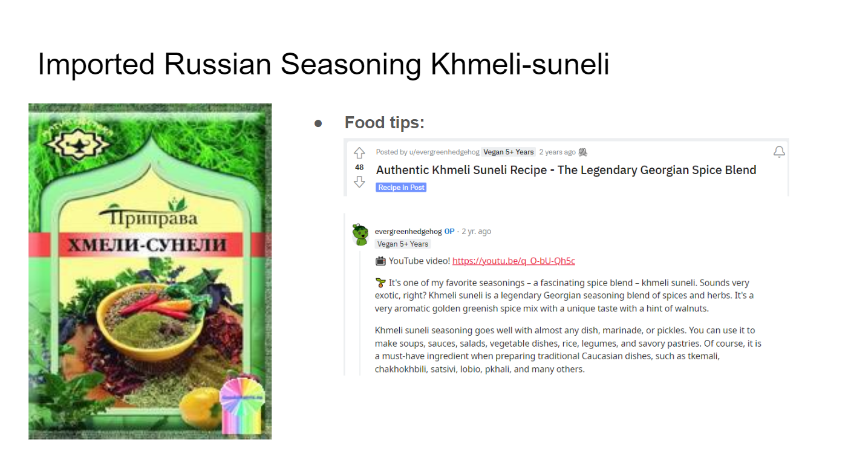
Team PotLuck
Experience Prototype
Tell participants the translation of any foreign text, the taste/ function of the ingredient, where it’s from, suggested recipes with images, food tips from Reddit, video tips from Youtube (~ all this takes 4 mins)
Translations, origin, taste/ function, contents of the food item
Suggested cultural recipes
Comments from Reddit simulates real user comments
Video tips from YouTube

Slide 27
Team PotLuck
Experience Prototype
Lemongrass
Khemli Suneli
Jackfruit
Show participants three labelled foreign ingredients (lemongrass, khmeli suneli, jackfruit). Ask them to again rank each 1 (I would not buy) to 5 (I would buy)
If their rating changed, ask them why?
Which of the factors influenced them more?
The translation
Knowing where it’s from
The taste/ function
Suggested recipes
Food tips from users
Video of someone preparing it
Ask them how often they try new things when grocery shopping?

Slide 28
Team PotLuck
Simon - middle aged man (age ~50)
01
Mitchell and Kirstie - young couple (age ~late 20s)
02
03
Janelle - young female student (age ~20)
Prototype testing at Canadian airport
Notes:
https://notion-avatar.vercel.app/

Slide 29
Team PotLuck
Results
Simon
Mitchell and Kirstie
Janelle
Initial Rating -> Final Rating
Lemongrass 3 → 2
Jackfruit 1 → 1
Khmeli Suneli 2 → 4
Initial Rating -> Final Rating
Lemongrass 5 → 5, 4 → 5
Jackfruit 3 → 4, 3 → 5
Khmeli Suneli 2 → 4, 1 → 4
Initial Rating -> Final Rating
Lemongrass 3 →3
Jackfruit 1 → 3
Khmeli Suneli 1 → 5
Biggest factor was the taste of the ingredient (lemongrass lowered) and what dish it was used in (the suggested recipes)
Hearing where it was from had no effect
Food tips are interesting but does not sway his opinion (but cultural comments would be more effective - eg he likes Indian food)
Video tips help if he has never seen it before
How often does he try new things? Once a month, mainly shops for convenience
Low score initially is almost entirely because they just don’t know what it is
Just knowing what the product is changed their opinions the most (eg containing familiar spices)
Seeing the recipes had a big effect on Mitchell - it looked appetizing
Food tips are helpful, videos not as much
Where it was from didn’t have a big impact
How often do they try new things? Not often, maybe once every few months
Also said just knowing what it is and what it tastes like was most impactful
Translations are useful
Suggested recipes are useful, where it was from not so much
Food tips/ user comments had a big impact, because she loves reviews
How often does she try new things? Only if trying a new recipe, otherwise she shops mainly for convenience

Slide 30
Team PotLuck
Key Insights
Analysis
Each factor affects people differently, but the left is the general trend
Everyone’s scores changed fairly substantially
Although people generally became more positive towards the ingredients, most people don’t look for new ingredients very often and instead grocery shop for convenience. We wonder if the audience for the solution should be general public who are not super motivated to try new things, or to focus on the niche that enjoys exploring new cultures
One factor that could be tested more, is more in depth cultural stories like Amrita’s prototype, rather than dot point facts
It would be useful to test how time pressured most people feel in grocery stores, or how much time they would spend learning about a product
On average… which impacted people the most?
Translations/ knowing what the foreign product is: High
Where it was from: Low
What it tastes like: High
Suggested Recipes: Medium - High
Food tips: Medium
Video tips: Low - Medium

Slide 31
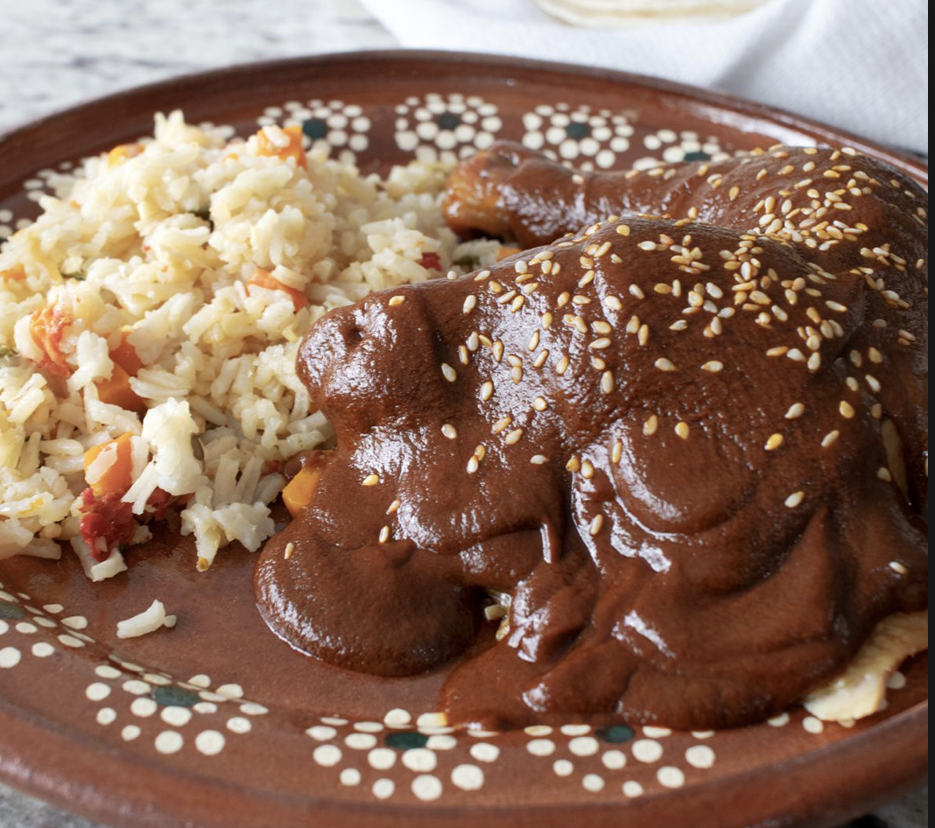
Team PotLuck
04
Sofia
Interviewed by Defne & Observed by Kyla
Extreme user!
Chef at Xanadu House at Stanford.
Interview conducted in Xanadu computer cluster, recorded with Otter.ai

Slide 32
Team PotLuck
Point of View - Sofia
We met…
Sofia, the chef for Xanadu House at Stanford, who hated to cook but came here as a hasher and learned her cooking skills on the job to become a chef.
We were surprised to realize that…
Despite having hundreds of screenshots of recipes on her phone, she said she had a much easier time learning most of the dishes she knows how to cook from someone else in real life with kinesthetic learning and real-time interaction.
We wonder if this means…
She doesn’t directly benefit in terms of confidence from unfamiliar, potentially complex recipes online until she has someone knowledgeable show it to her as she cooks it.
It would be game-changing to…
Provide the confidence of someone else’s expertise and assurance with real-time feedback when Sofia wants to try cooking a new dish.

Slide 33
Food Lover
How might we…
use real-time feedback to infuse comfort into the process of preparing complex foods?
www.slidesgo.com
Notes:
See appendix for all HMWs for this POV. These are also listed below:
…convey to Sofia that students actually like trying new foods?
…create an environment that encourages sharing unfamiliar foods?
…use unfamiliarity itself to make cooking more exciting?
…help students understand the history and processes behind Sofia’s favorite dish?
…help unfamiliar flavours grow on people?
…gamify trying unfamiliar foods?
…infuse comfort into the process of preparing complex traditional cultural food instead of stress and insecurity?
…make unfamiliar recipes exciting to new cooks?
…prepare people for trying new foods?
…make trying cooking new things a fun shared experience?
…connect the process of cooking unfamiliar cuisines seem more familiar?
…combine the acts of tasting and cooking into a holistic experience?
…remove the stress of unfamiliarity?
…infuse comfort into the process of preparing complex traditional cultural food instead of stress and insecurity?

Slide 34
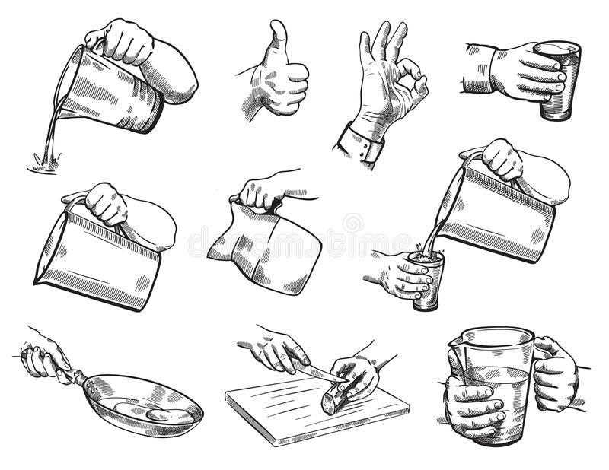
Food Lover
Solution - Learn by doing
www.slidesgo.com
Solution
A sensory app that guides you through recipes by showing you the motion of how to cook and prepare the dish properly and authentically, with haptic feedback built in.
Help recipes feel more intuitive to people by letting them learn by experiencing. Let users receive auditory or sensory feedback while trying to cook a novel dish.
Key Assumption
Without having to divert attention by constantly checking a set of instructions, people experiencing a new recipe can gain confidence in it with live, external feedback.
Notes:
See second slide of appendix for all solutions associated with this HMW

Slide 35
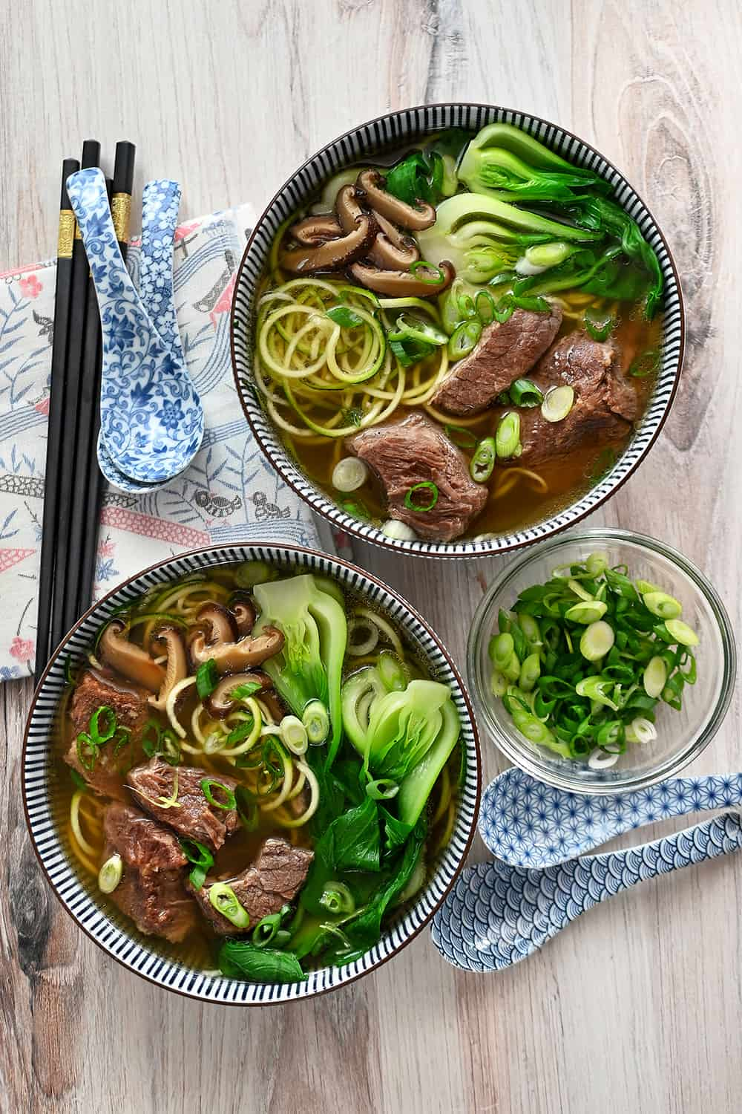
The Participants
Prototyped outdoors on University Ave.
Roy - Software engineer, learned Asian cooking from his mother (age: 27)
01
Emma - Works in HR, child of two Asian immigrants, loves to cook (age: 30)
02

Slide 36
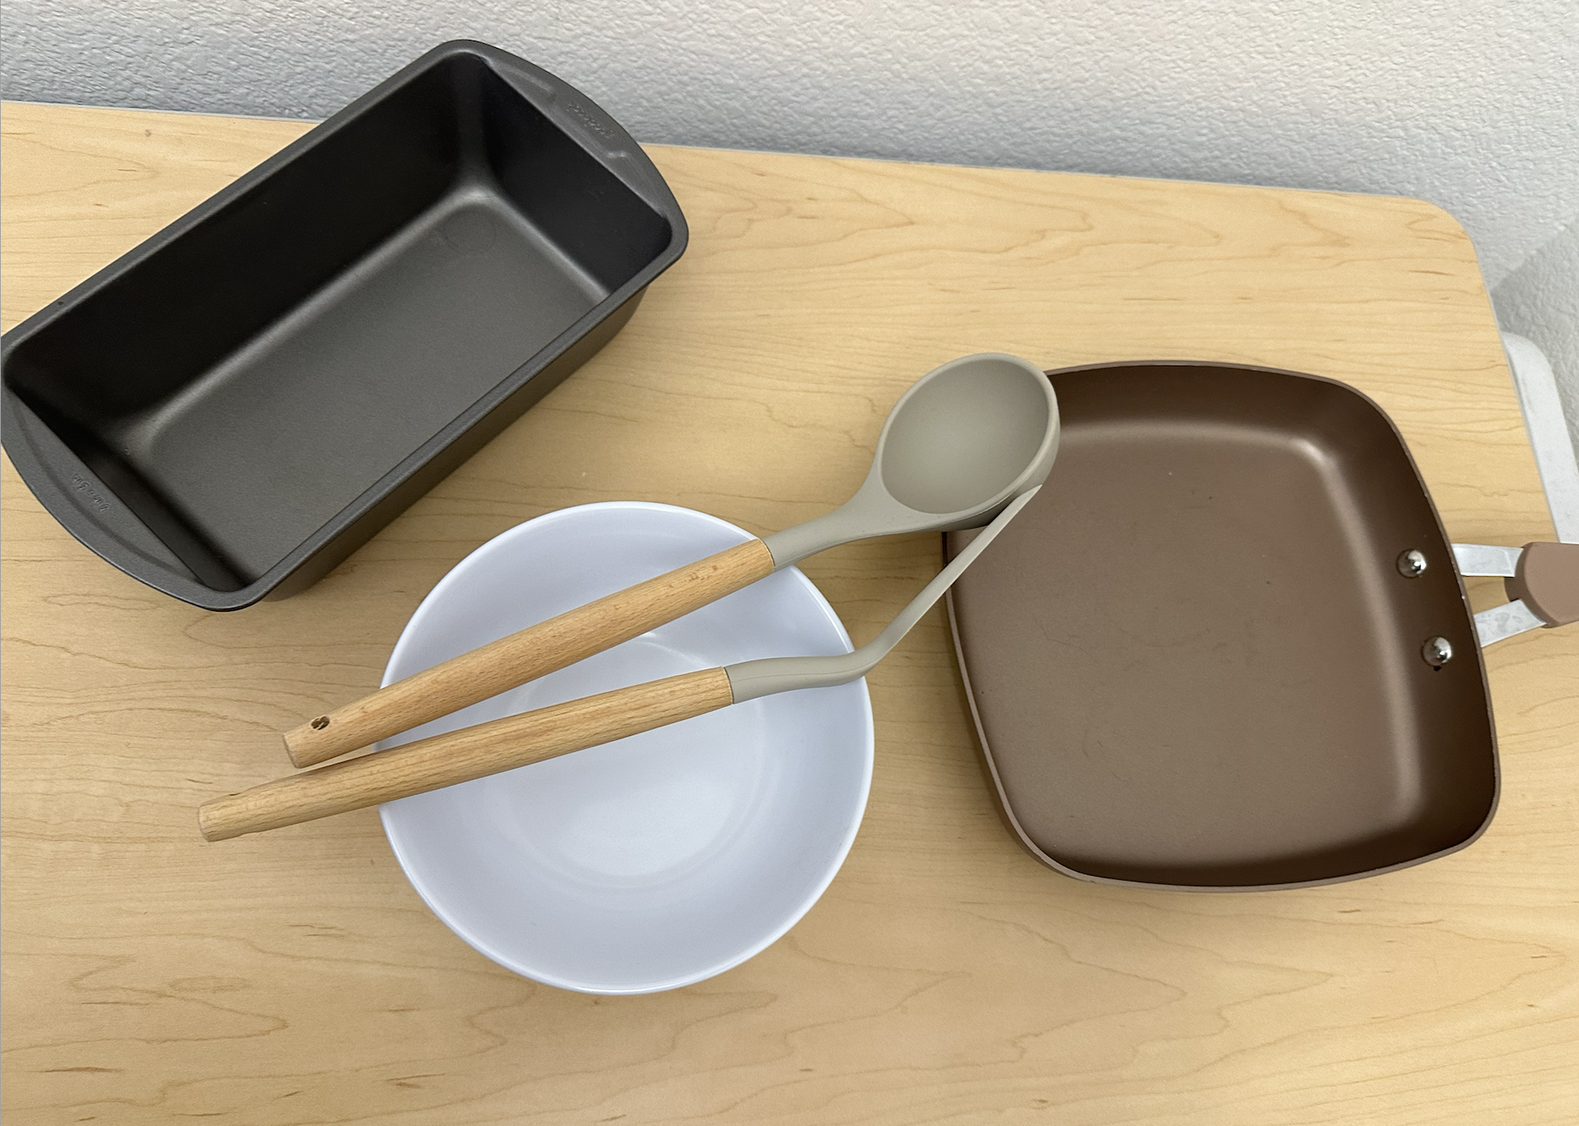
The Prototype
The task:
Emma has to teach Roy to cook a complicated dish by using the props provided.
Emma has to first demonstrate and verbalise all steps while Roy watches her.
Roy has to repeat the preparation for the dish under three circumstances:
No feedback from Emma whatsoever.
Emma is allowed to verbally correct him when he does something wrong or forgets.
Emma is allowed to tap Roy if he does something wrong (or in our case, right!)
The dish:
Chinese beef noodle soup.

Slide 37
Results & Key Learnings
What worked:
Auditory feedback for corrections
Auditory feedback when he forgot the name of an ingredient
Repetition & mimicking Emma’s movements
Introducing feedback removed Roy’s hesitation
What didn’t work:
Roy didn’t need the haptic feedback after the auditory feedback
Taps weren’t helpful when he was stuck.
Watching Emma & mimicking her movements
Roy already had the movements down, so did not benefit from the haptic feedback by the third try.
Key Learnings:
When learning something from scratch, the pressure to remember everything with no aid was stressful if not slightly debilitating.
After having verbal feedback, haptic-style feedback is less valuable.
Having another person present takes the weight off of the pressure to make no mistakes.
If anything, Emma’s presence ENCOURAGED mistakes and made the correct methods more memorable.

Slide 38
Food Lover
In summary…
www.slidesgo.com
 | Description | Emotions
Solution 1 | Delving into unfamiliar ingredients around you | Apprehensive → Positive, Encourage to purchase
Solution 2 | Real-time haptic and auditory feedback while cooking | Uncomfortable, Task-oriented → confident, comfortable
Solution 3 | Journey and cultural context of traditional foods | Nervousness → Excitement, Curiosity

Slide 39
Team PotLuck
Final (Combination) Solution
Your personal cultural food assistant
Use image recognition to automatically provide cultural context upon scanning an ingredient with your camera or exploring dishes to cook with your ingredients. Maps of a food’s journey, video food tips, authentic user comments, suggested recipes, taste and function of ingredient, personal cultural and historical stories of the ingredient/ dish
Combination of Solution 1 (more context between ingredients) and Solution 2 (more context/personal stories behind cultural dishes)

Slide 40
Team PotLuck
Final (Combination) Solution
What are the ethical implications of this solution? Have to be careful where information is sourced - it is easy to find inauthentic secondary sources instead of actual people from the culture if scraping internet sources
Who does it serve? Have to decide if want to focus on general public (who may not be food-motivated) or the more niche audience that really likes exploring new cuisines
Who might it leave out? It only serves the technologically savvy - older people (who perhaps we should be focussing on if preserving culture) may be left out or require help to use the solution
People cooking traditional recipes in areas without internet access, particularly those in non-Western countries or with less economic means
Notes:
Which solution (or combination) will move forward? b. What are the ethical implications of this solution? c. Who does it serve? Who might it leave out?

Slide 41
Appendix
Images:
https://food52.com/recipes/84225-mole-sencillo-recipe
https://www.dreamstime.com/stock-illustration-isolated-hand-gestures-illustration-kitchen-theme-image53804748
https://tryopenchefs.com/
https://nomnompaleo.com/chinese-beef-noodle-soup
https://www.airasia.com/play/assets/bltdc26f767b5a3f361/appam-a-south-asian-pancake-with-a-surprising-story

Slide 42
Initial POV - Grace
We met… Grace, the manager of 99Ranch in Mountain View, who cooks at home and observes customers who are looking for ingredients for Asian cooking.
We were surprised to realise that… she was concerned that a lot of authenticity behind food was lost through language barriers or inauthentic recipes.
We wonder if this means… she worries that people don’t have the most authentic sources of information when it comes to food.
It would be game-changing to… remove language as a barrier when learning about new cuisines.

Slide 43
Initial POV - Sofia
We met… Sofia, the chef for Xanadu House at Stanford, who hated to cook but came here as a hasher and learned her cooking skills on the job to become a chef.
We were surprised to realise that… she felt trepidation sharing her favourite food, which is one of her more authentic recipes, with students (Mole)
We wonder if this means… She feels worried that people would find unfamiliar food unpalatable
It would be game-changing to… use unfamiliarity as a tool to make trying new cuisines exciting rather than stressful.

Slide 44
Initial POV - Martin
We met… Martin, a real estate developer and avid biker from Oakland in his 30s, who makes only very simple meals for himself a few times a week.
We were surprised to realise that… despite taking pride in his ability to appreciate well-made meals and displaying a strong interest in the cultural authenticity of food, he doesn’t describe himself as food-motivated and doesn’t take time to cook complex dishes for himself.
We wonder if this means… people need to understand the story, cultural context, and experience behind food in order to be connected to it and appreciate it further
It would be game-changing to… make the process of understanding the context behind a food item more approachable.

Slide 45
Team PotLuck
How Might We? - Martin
…make Martin seek out the story behind what he is eating?
…make cooking feel more personal and less transactional?
…make food from another culture feel like one’s own?
…present recipes in the cultural or historical context and personal stories tied to them?
…reduce the friction in reading about different recipes and cultures?
…help people share the personal and cultural meaning of their food so that others can understand and appreciate them?
…motivate people to research food from different cultures?
…make the process of cooking more complicated meals for oneself feel worthwhile?
…make “foreign” food feel like home?
…use practicality to create passion?
…connect food with specific memories and shared experiences?
Notes:
Takes pride in his ability to notice delicious food options

Slide 46
Team PotLuck
How Might We? - Sofia
…convey to Sofia that students actually like trying new foods?
…make unfamiliar recipes exciting to new cooks?
…create an environment that encourages sharing unfamiliar foods?
…prepare people for trying new foods?
…make trying cooking new things a fun shared experience?
…use unfamiliarity itself to make cooking more exciting?
…connect the process of cooking unfamiliar cuisines seem more familiar?
…help students understand the history and processes behind Sofia’s favorite dish?
…combine the acts of tasting and cooking into a holistic experience?
…help unfamiliar flavours grow on people?
…gamify trying unfamiliar foods?
…remove the stress of unfamiliarity?
…infuse comfort into the process of preparing complex traditional cultural food instead of stress and insecurity?

Slide 47
Team PotLuck
How Might We? - Grace
… teach new cuisines without words?
…connect people who are exploring new cuisines?
… create a really welcoming environment for people to explore new cultures?
…help Grace understand her customers better?
…help customers tune into authentic ingredients to create a closer connection to the cultural food they’d like cook?
…make it easier to find authentic recipes?
…make it so the ingredients speak for themselves?
…create a measure of authenticity for recipes?
…make it easier for customers to read the packaging on foreign ingredients?
…restructure a grocery store to be informative to people unfamiliar with the types of cuisines offered?

Slide 48
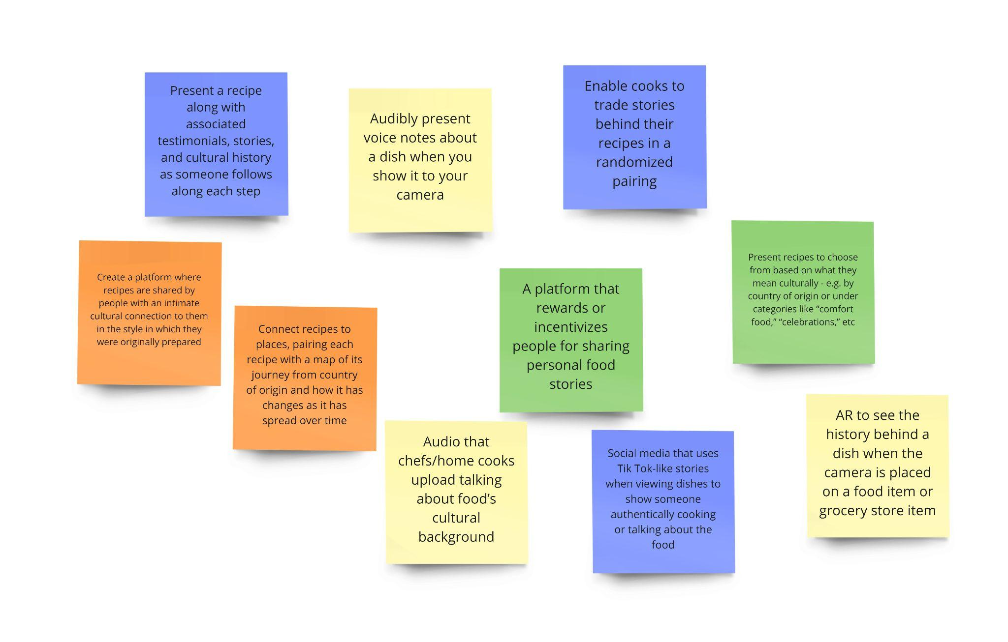
Team PotLuck
Solution Generation - Martin

Slide 49
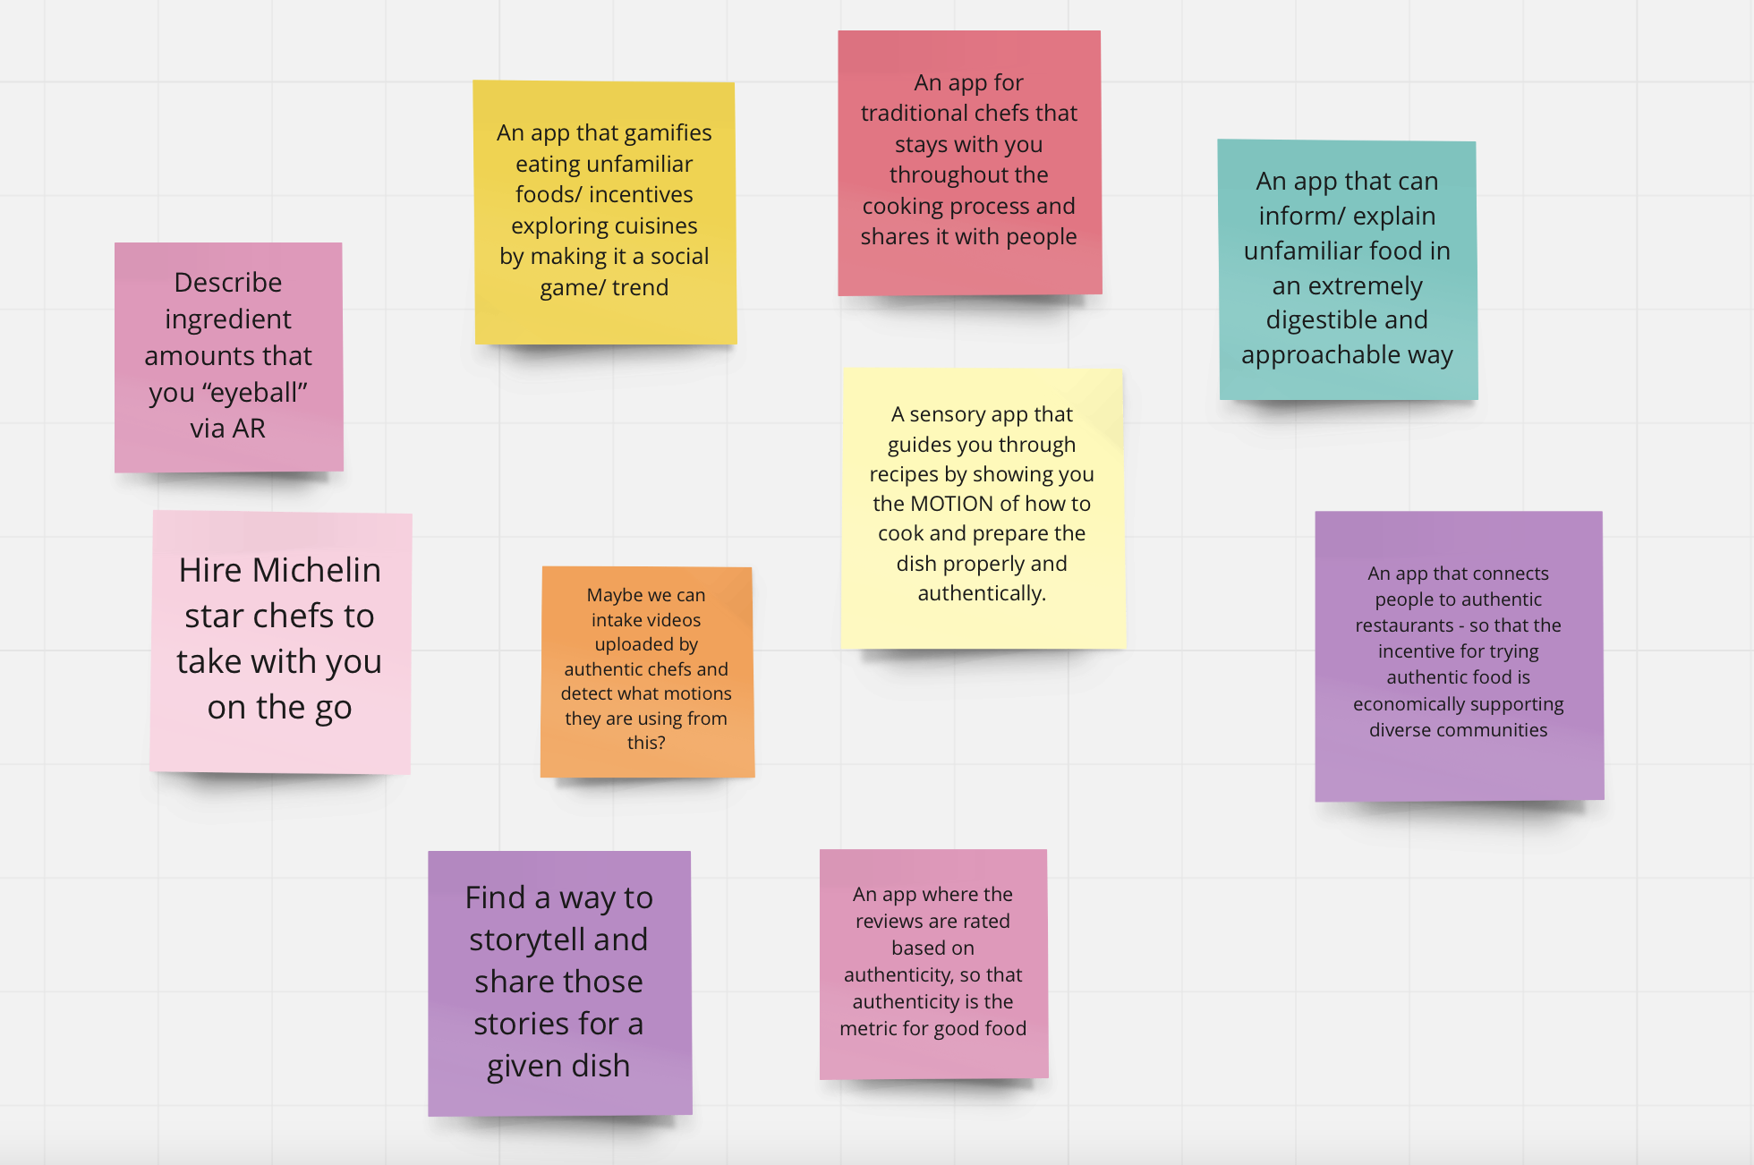
Solution Generation - Sofia

Slide 50
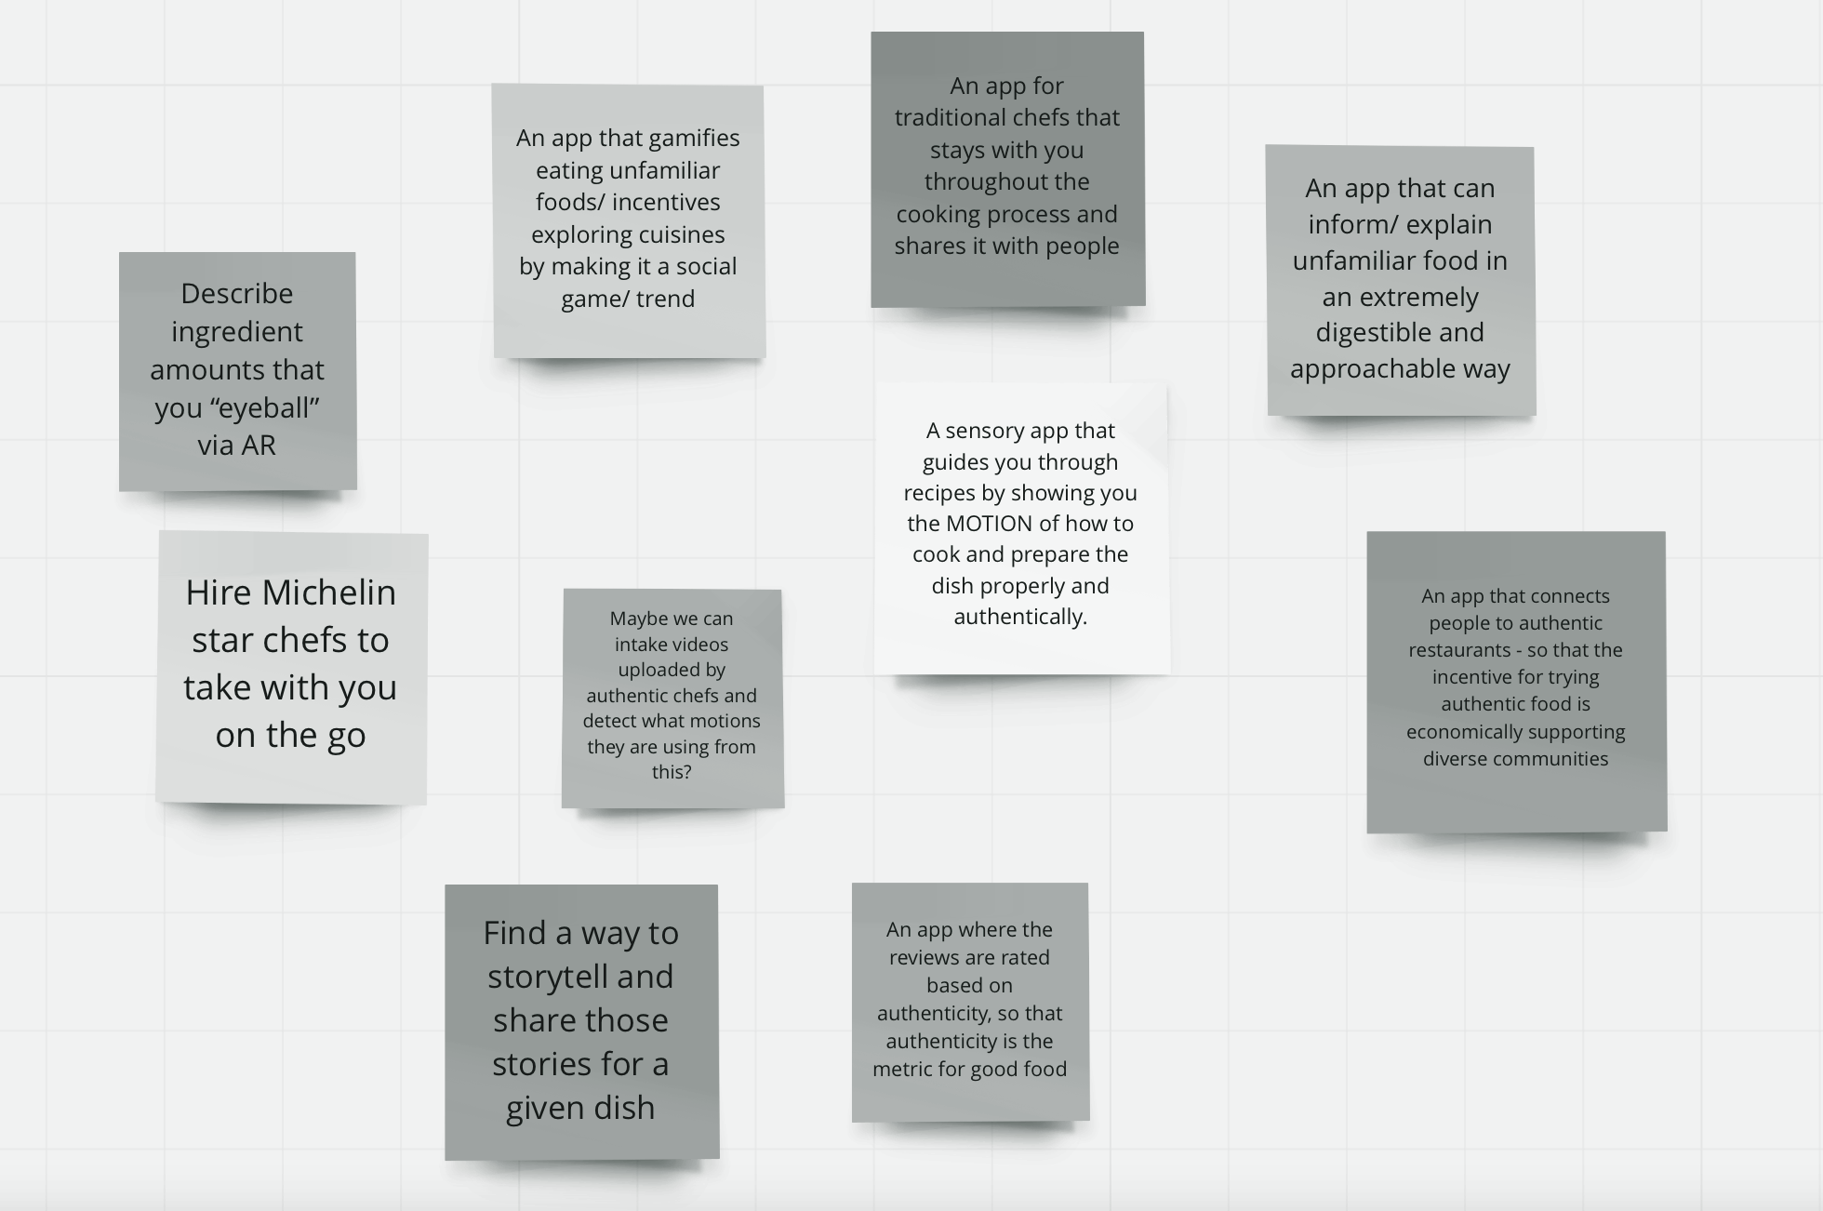
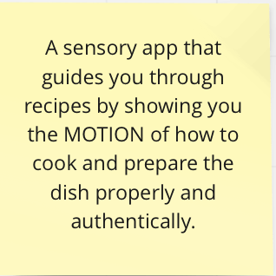

Slide 51
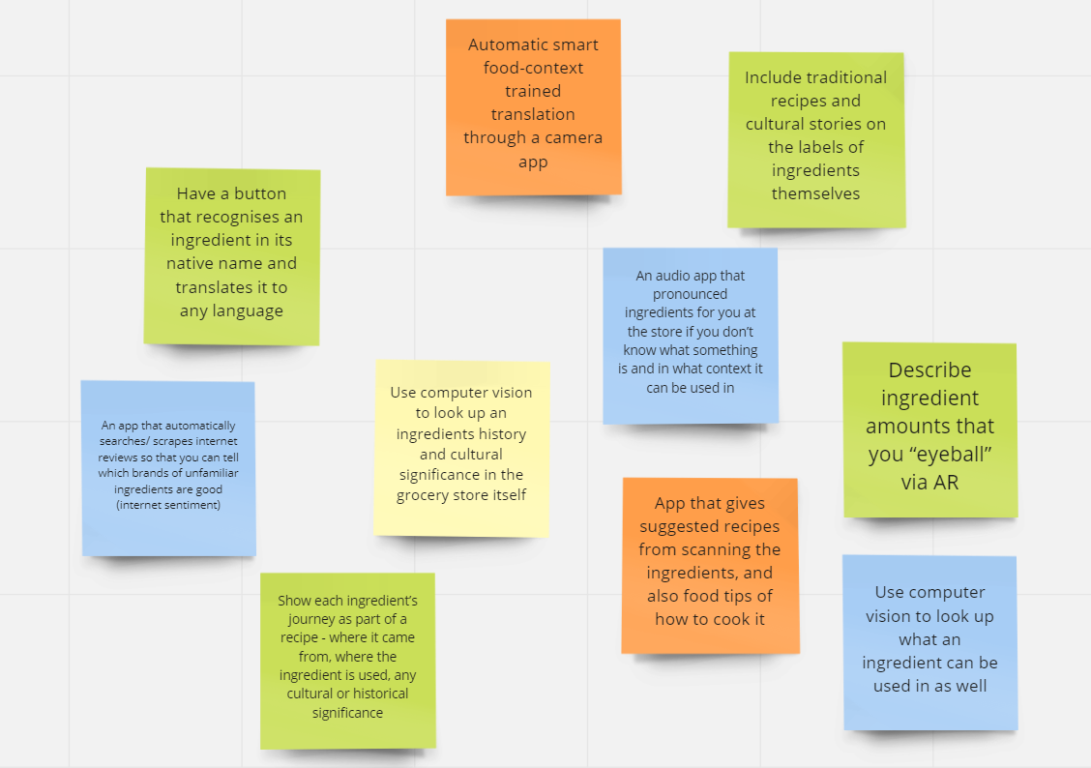
Team PotLuck
Solution Generation - Grace

