Slide 1
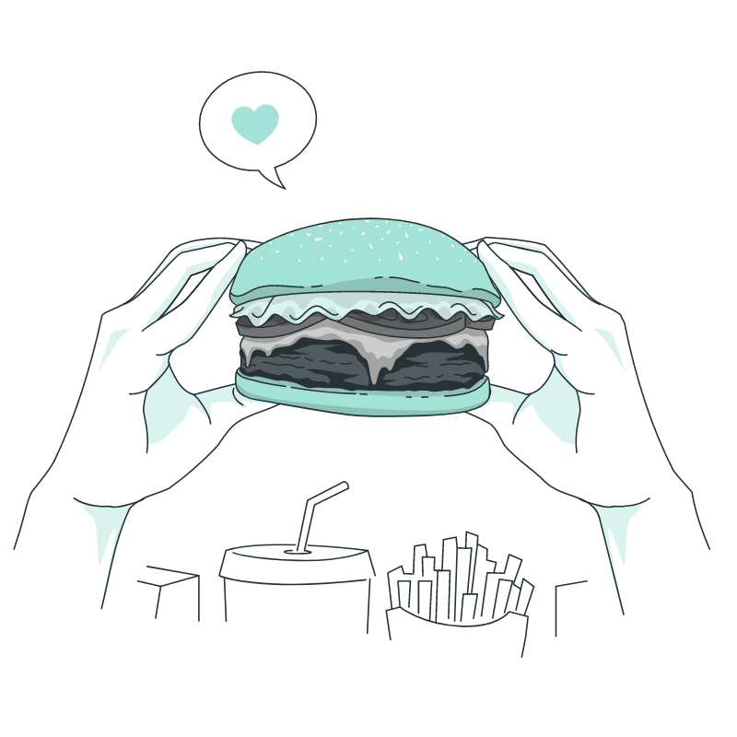
Team PotLuck
Needfinding
Culture through Cuisine
Defne Genç, Janet Zhong,
Amrita Palaparthi, Kyla Guru
Notes:
Space Grotesk
Anaheim
Barlow Semi-Condensed Normal

Slide 2
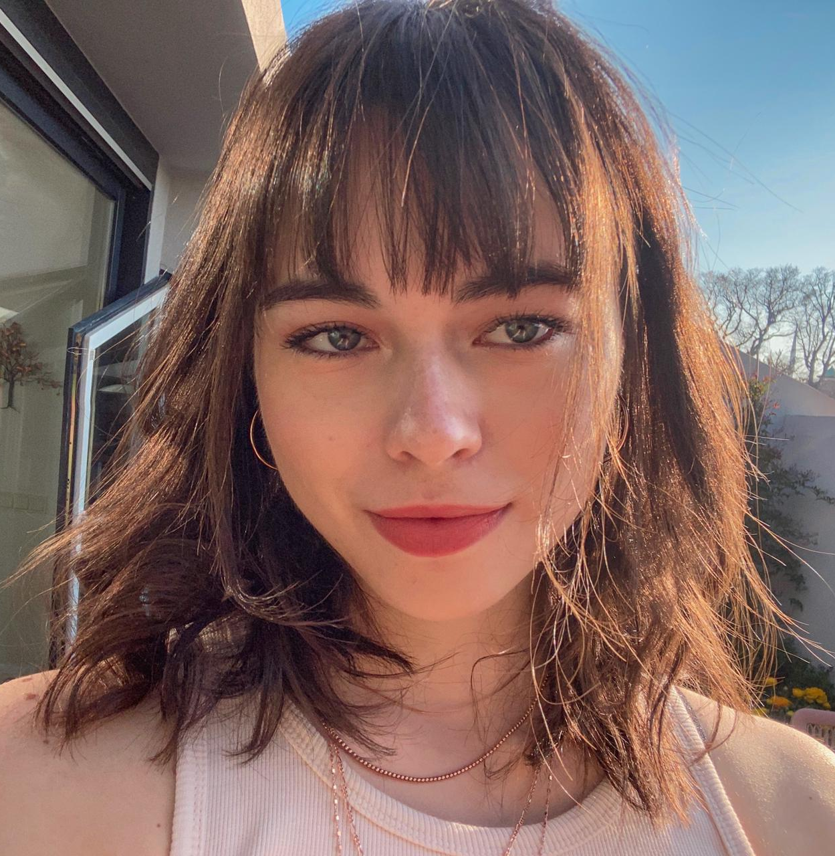
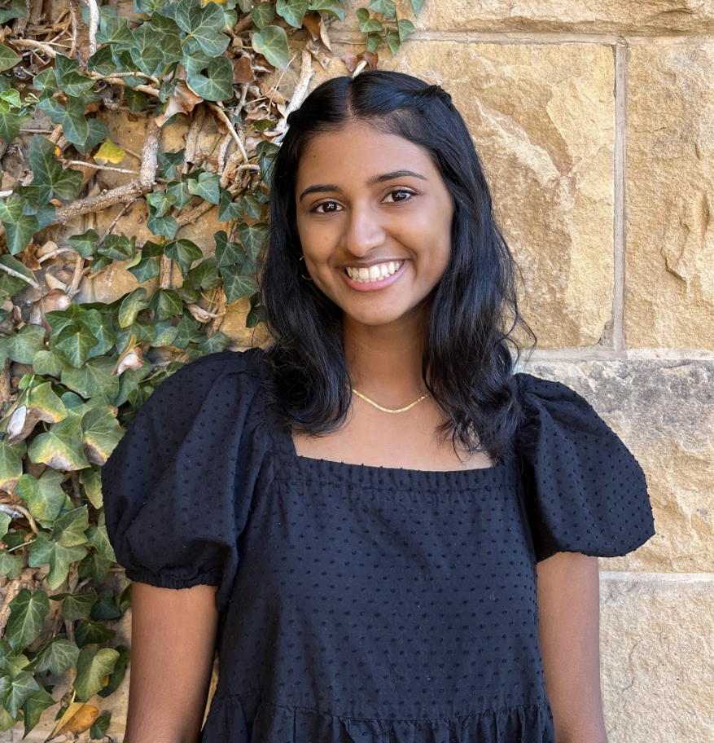
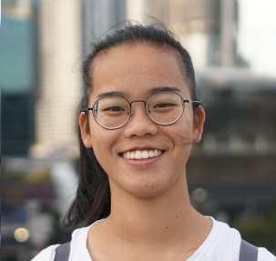
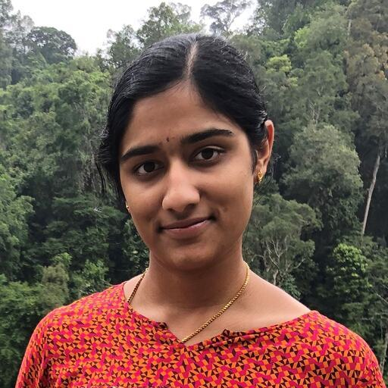
Our PotLuck
Defne
Kyla
Janet
Amrita
Potluck item:
Potluck item:
Potluck item:
Potluck item:
Notes:
Spanning across India, Turkey, Australia

Slide 3
Team PotLuck
Table of Contents
Problem Domain
Food as a means of connection and a measure of vitality.
Needfinding
Methodology, Location, and Extreme Users
Analysis
Selected empathy maps and Key Findings

Slide 4
Team PotLuck
Methodology
Brainstorm
Analyse
Who extreme users might be.
Understand what their insights were and empathize.
Generate
Interview
Questions for different types of interviewees.
Through conversation and careful observation.

Slide 5
Team PotLuck
Questions
How often do you cook, and what dishes do you make?
What are some of the biggest challenges you’ve faced when cooking from a recipe?
Traditions or rituals you have around food?
What does food mean to you?
Strong memories you have around food?
How have you replicated food that feels like home?
What were mealtimes like for you growing up? How has that changed?
Tell us about your first time making food for someone else?

Slide 6
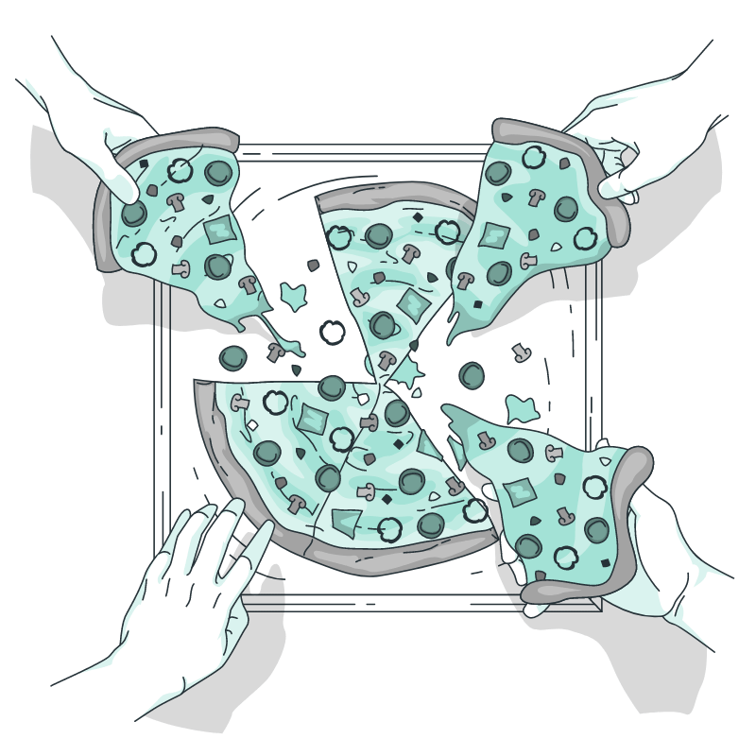
Interviewees
Perspectives
Team PotLuck
Our PotLuck-ers
Average users (consumers), extreme users (chefs), non-user (industry expert)
Non-Stanford students
Diverse backgrounds: immigrants from different countries
Variety of job roles
Variety of motivations behind cooking
Variety of cooking experience and interest levels

Slide 7
Team PotLuck
Meet Our PotLuck-ers
Food Consumer
Shop Owner
Chef
Chef
01
02
03
04
Martin
Grace
Jaclyn
Sofia
(Extreme)
(Extreme)

Slide 8
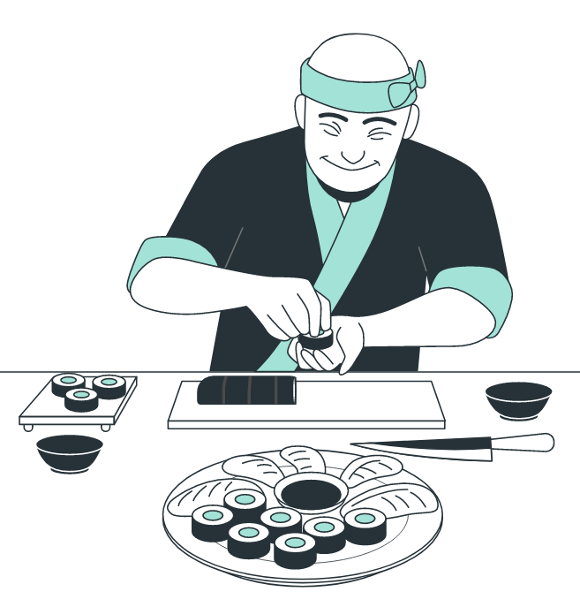
Team PotLuck
01
Martin
Interviewed by Amrita & Observed by Janet
Real estate developer from Oakland
Interview conducted at Verve cafe while taking physical notes

Slide 9
Team PotLuck
Context & Observations
Who is Martin?
Avid biker in his mid-30s
Can recognize “well-made food with high-quality ingredients”
From Oakland, no strong cultural ties outside the Bay Area
Puts together very simple meals on most days and eats out twice a week
Surprises:
Holds “no traditions or rituals associated with food” and enjoys trying food from other cultures that are prepared traditionally
Describes himself as not particularly “food-motivated,” sees exploring food as a hobby
Contradictions:
Doesn’t consider food a passion/hobby of his
Cares about the quality and cultural authenticity of his food, but doesn’t feel that replicating more complex dishes is worth it when only cooking for himself
Notes:
Takes pride in his ability to notice delicious food options

Slide 10
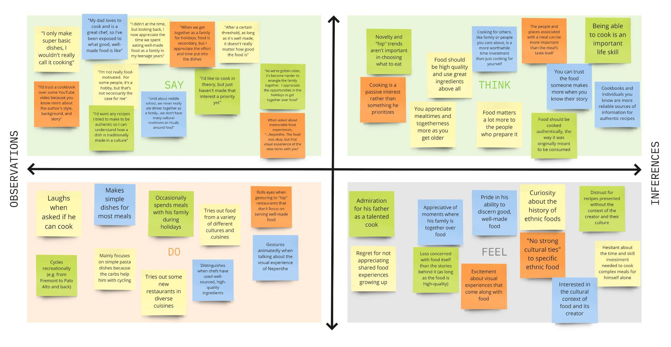
Team PotLuck
PotLuck

Slide 11
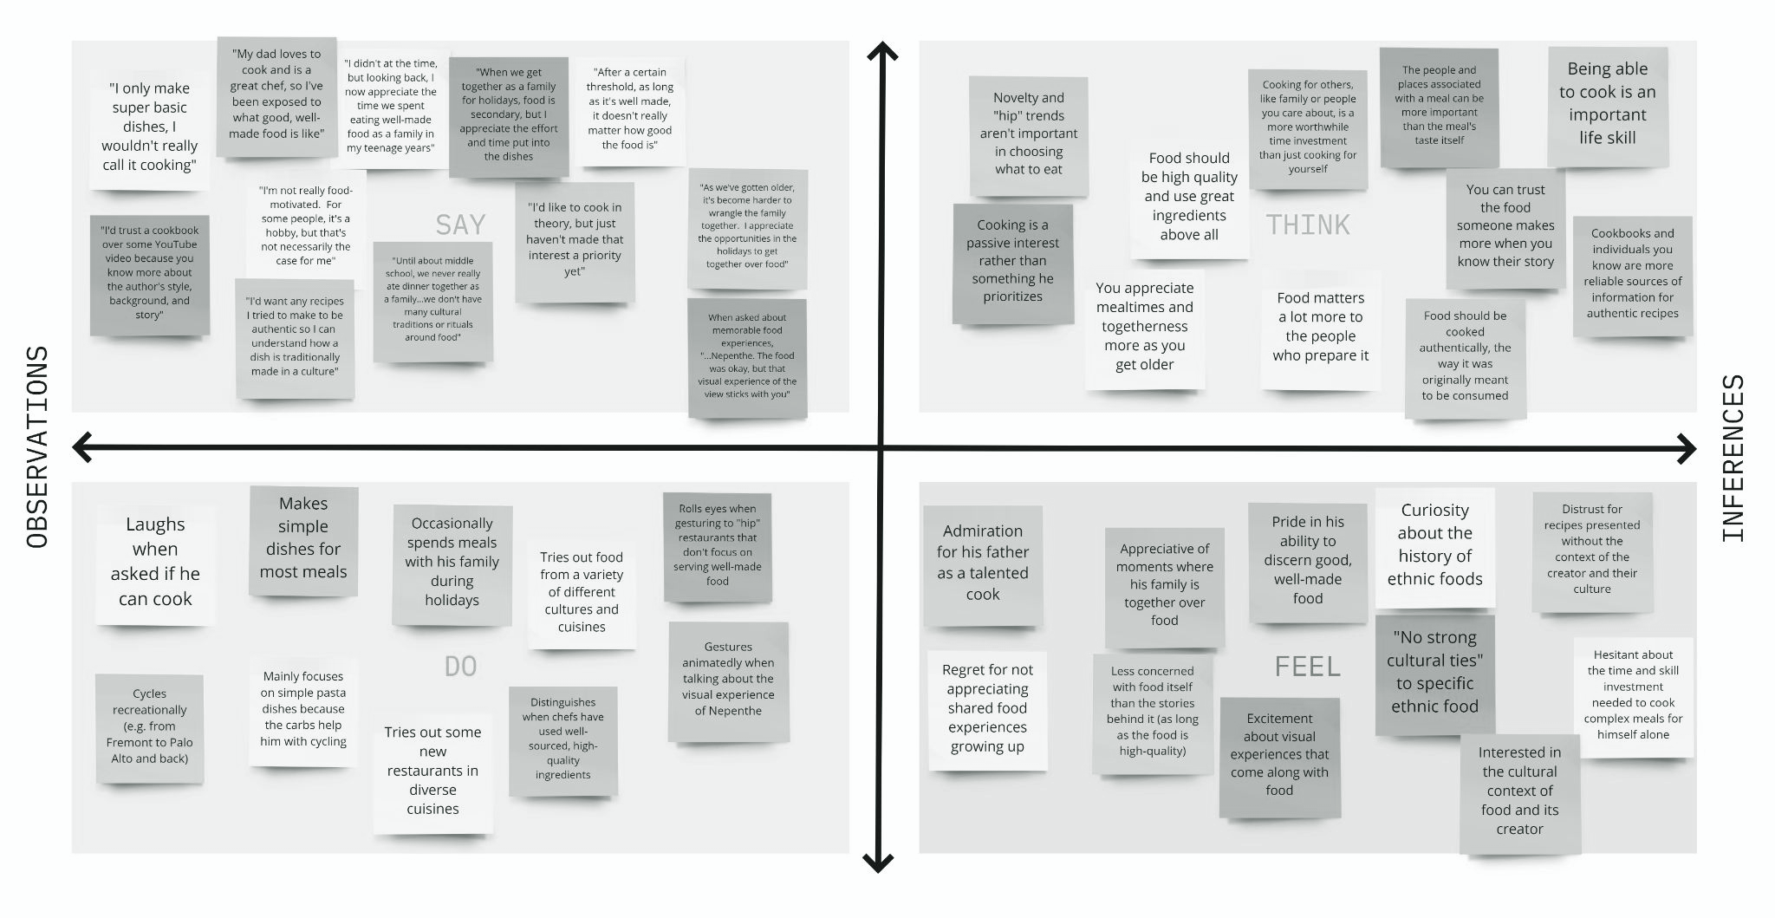
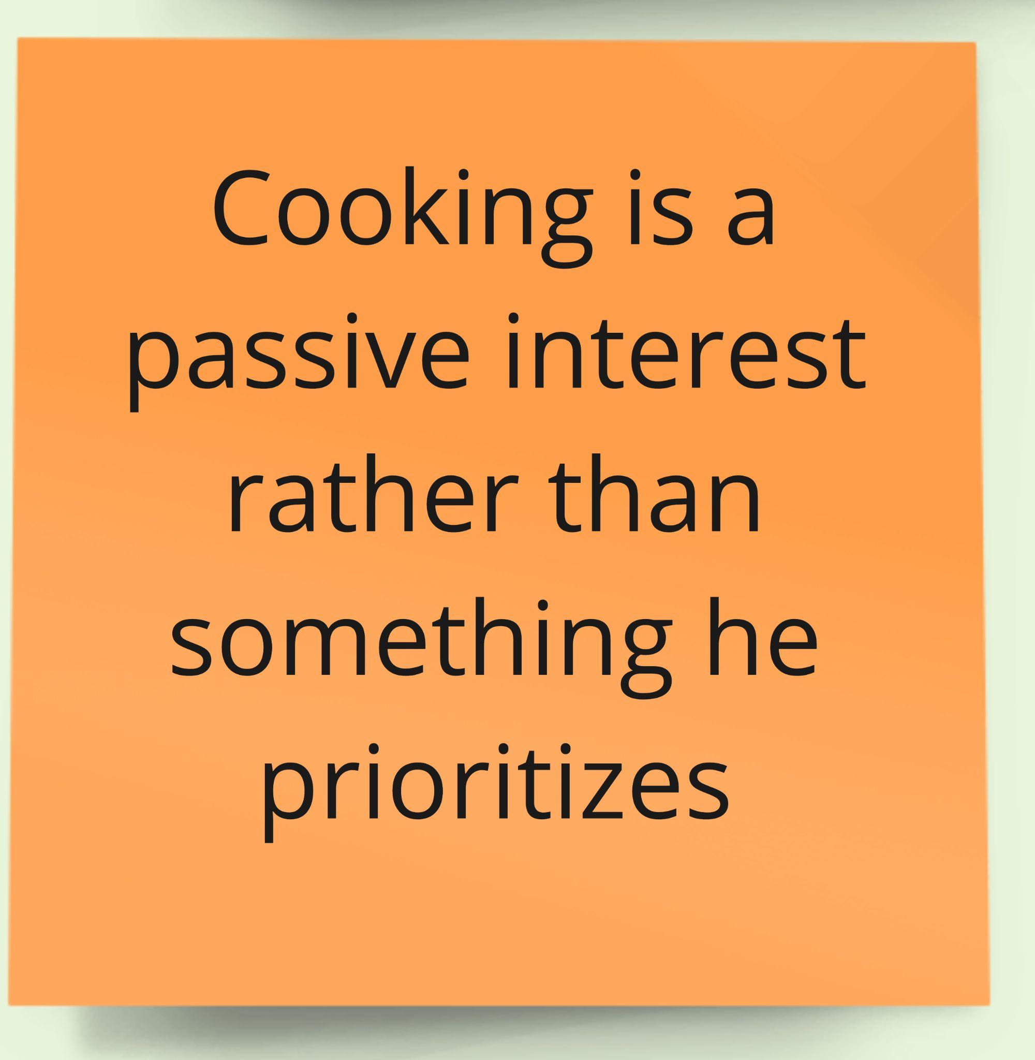
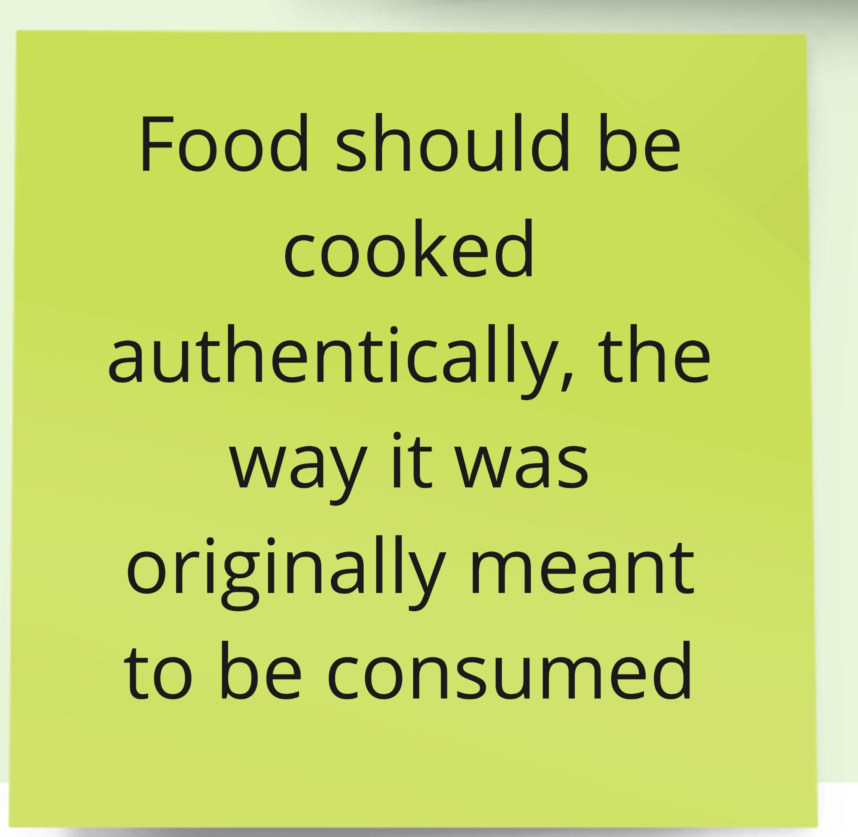
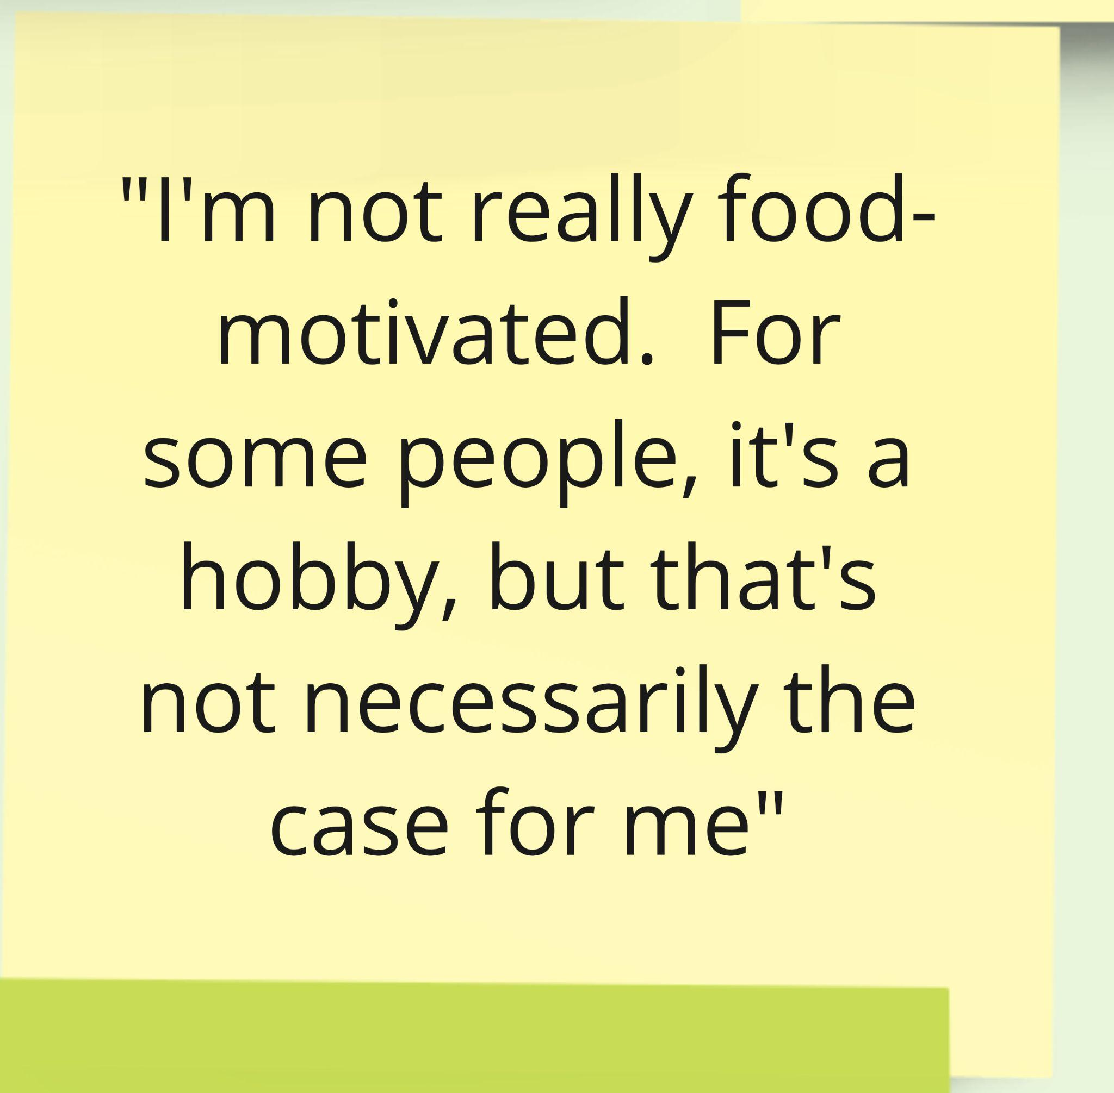
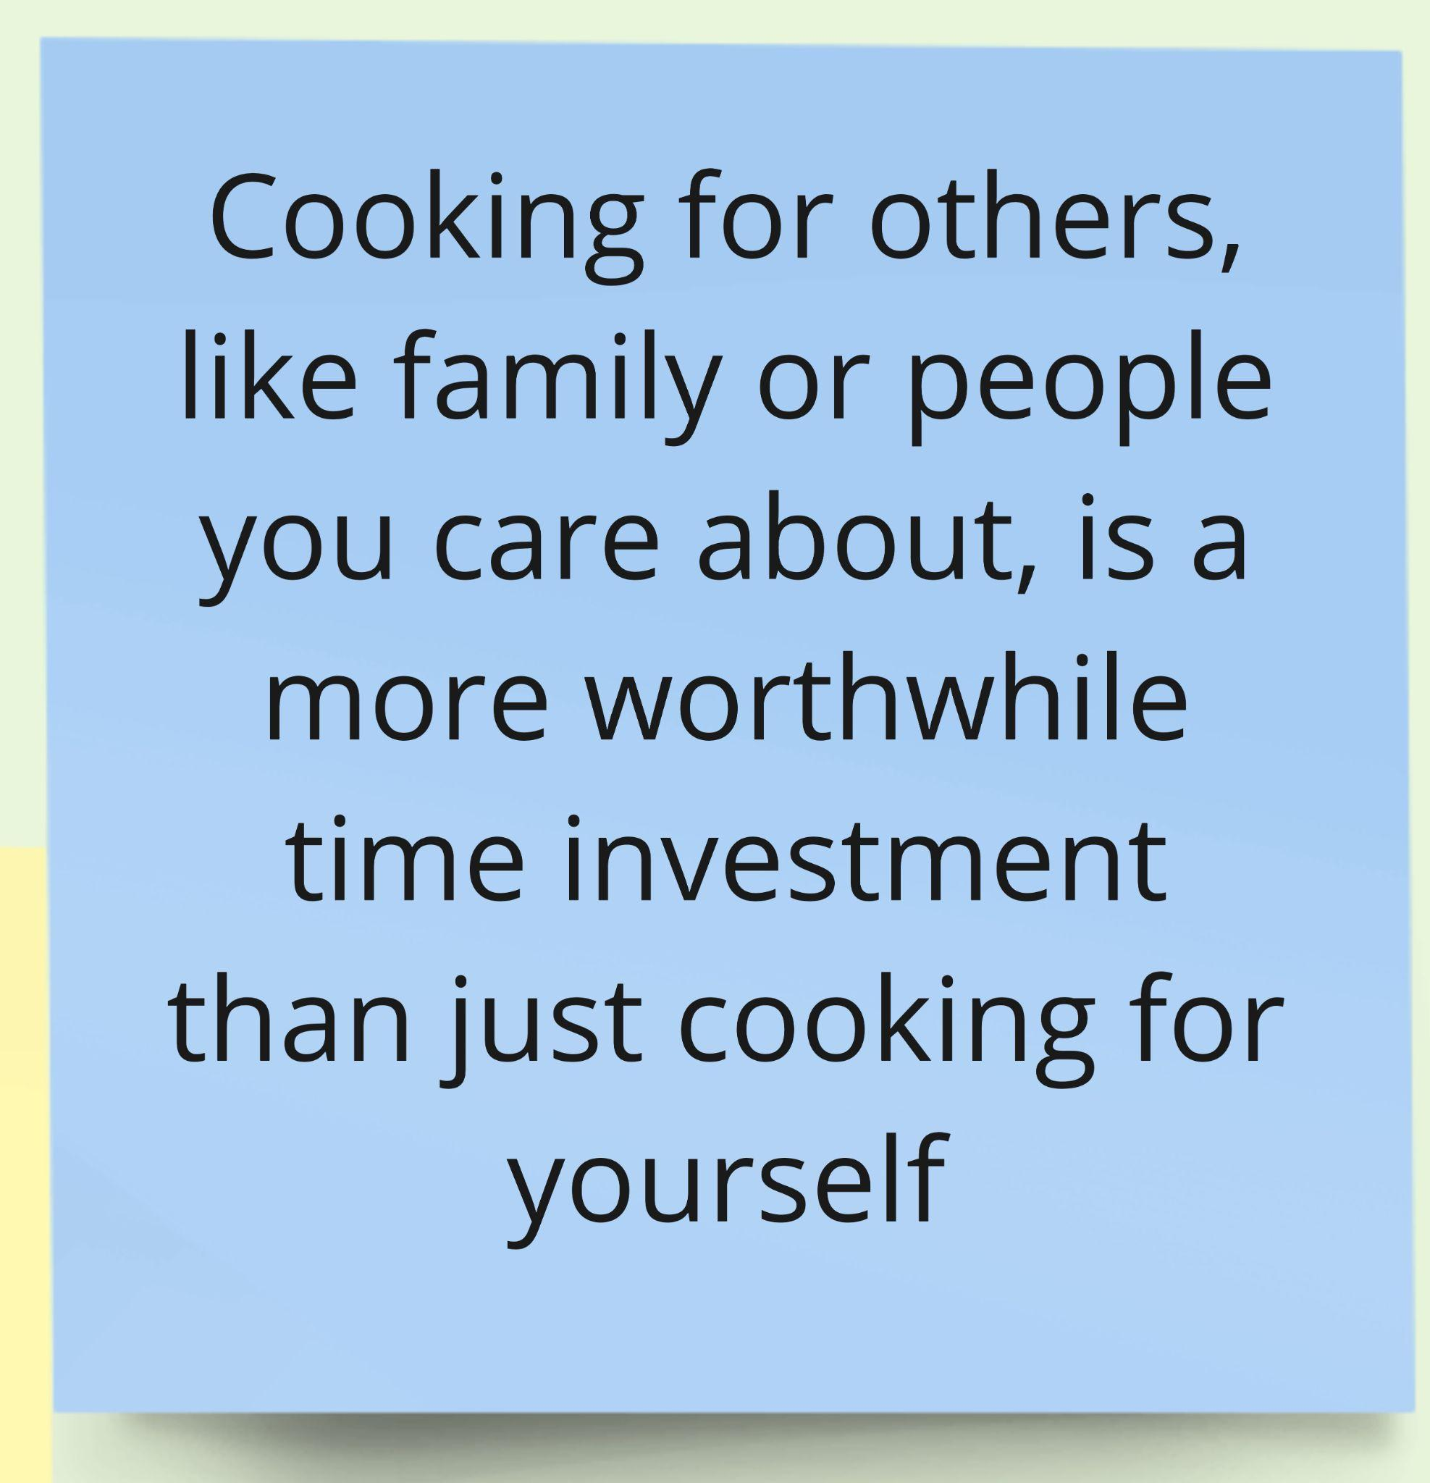
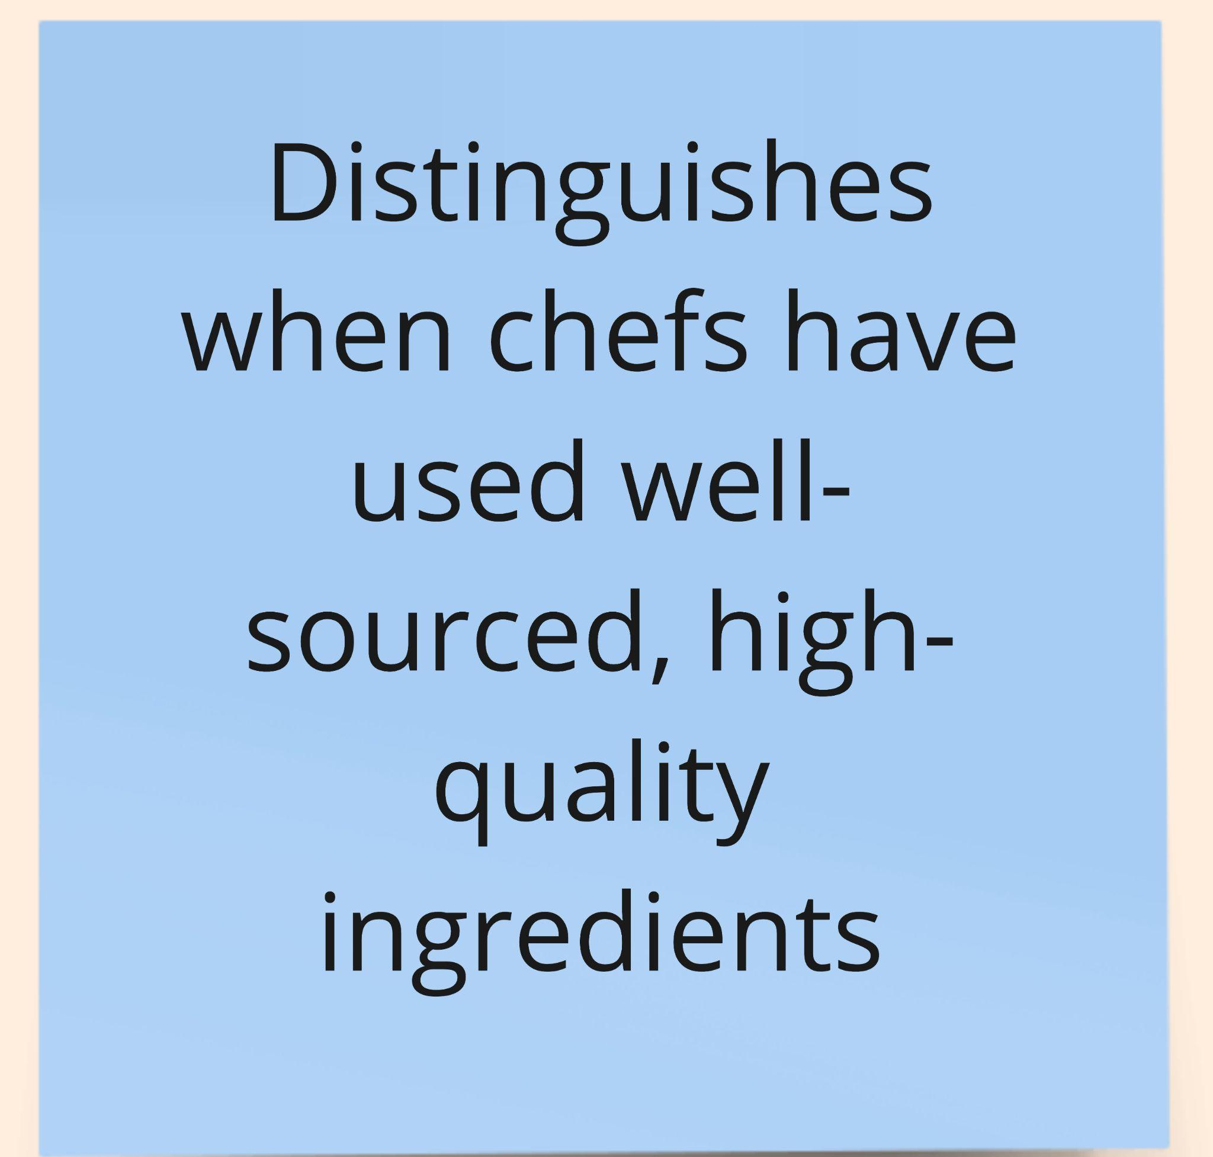
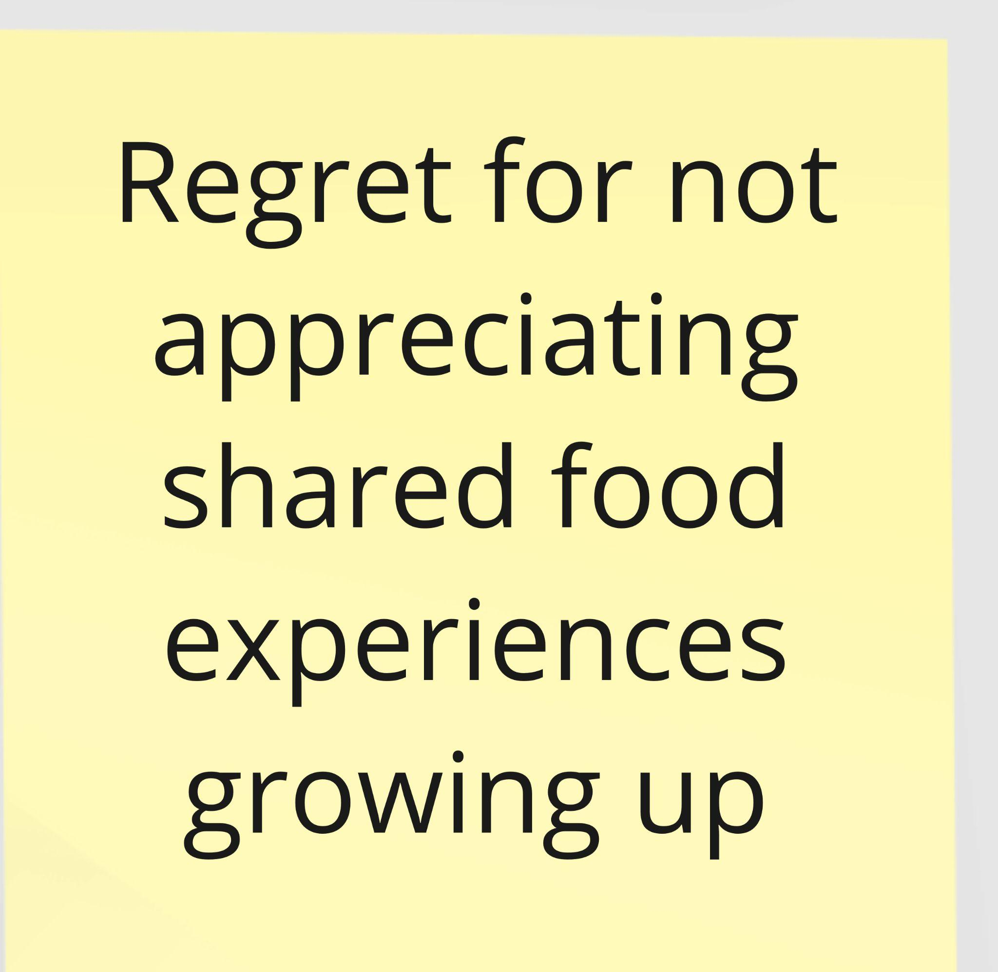
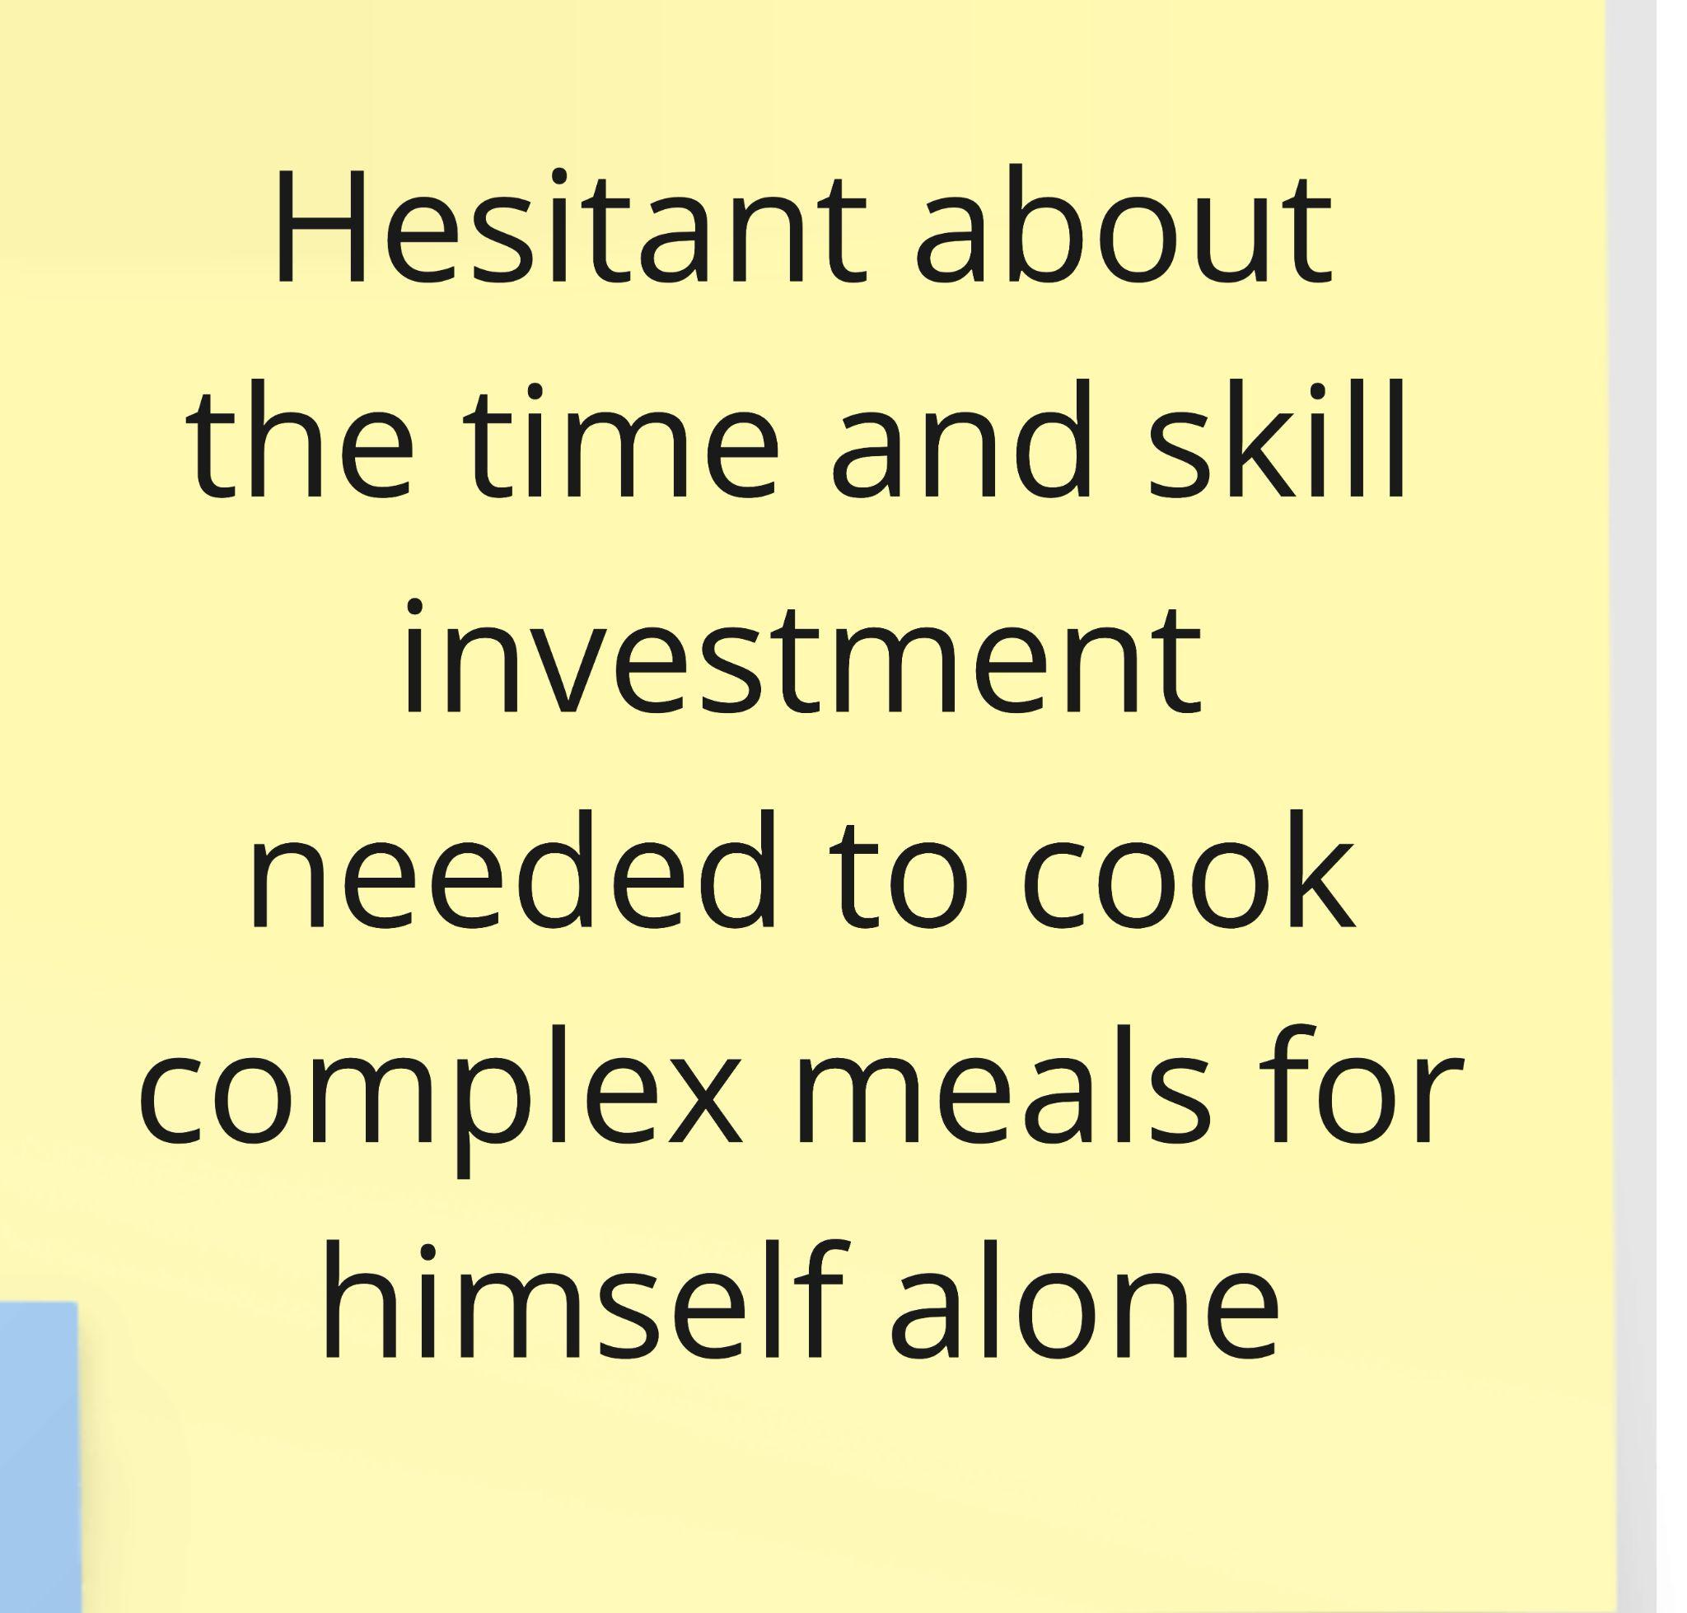

Slide 12
Team PotLuck
Key Insights
Key Insights:
Some people see food as a passive interest rather than a passion or hobby
People can appreciate well-made, high-quality, home-cooked food and still feel that making such food for themselves is not worth the difficulty
We wonder if this means…
People need to understand the story, cultural context, and experience behind food in order to be connected to it and appreciate it further
Cooking for others may feel more meaningful than cooking for yourself
Notes:
Cares about the authenticity of the food he tries
Doesn’t particularly consider himself a foodie or want to cook for himself
May consider cooking for others

Slide 13
Team PotLuck
02
Grace
Interviewed by Janet & Observed by Defne
Manager of 99 Ranch (Asian Grocery)
Interview conducted at 99 Ranch while taking physical notes

Slide 14
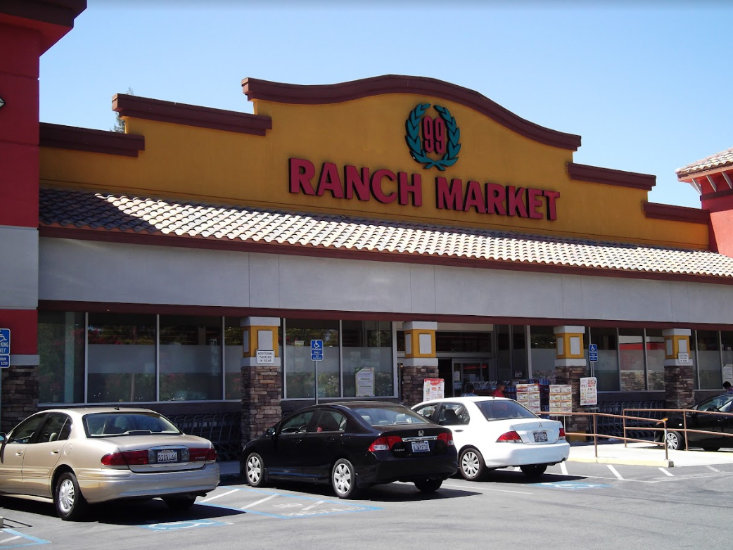
Team PotLuck
Context & Observations
Who is Grace?
Immigrated with her husband and children from Taiwan 10 years ago
Surprises
Some immigrants feel a lot of comfort at an Asian grocery because it reminds them of home
The Asian grocery also has western products, so can help bridge cultures
When people bring recipes of a cuisine they are not used to, they are not always authentic
Contradictions
She misses Taiwanese food culture, but also enjoys American food culture

Slide 15
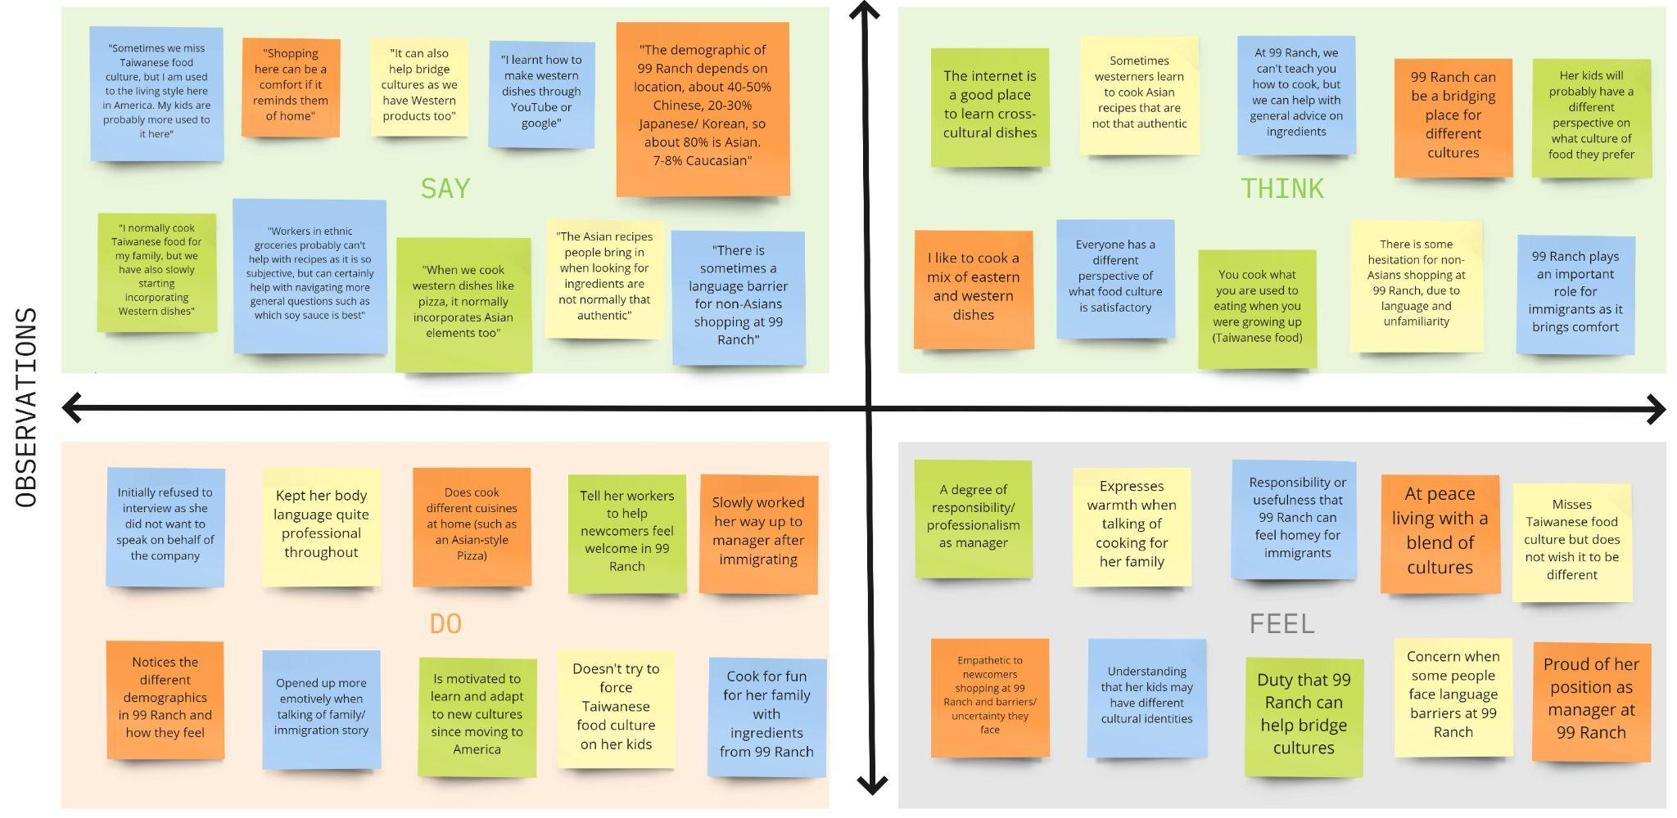
Team PotLuck

Slide 16
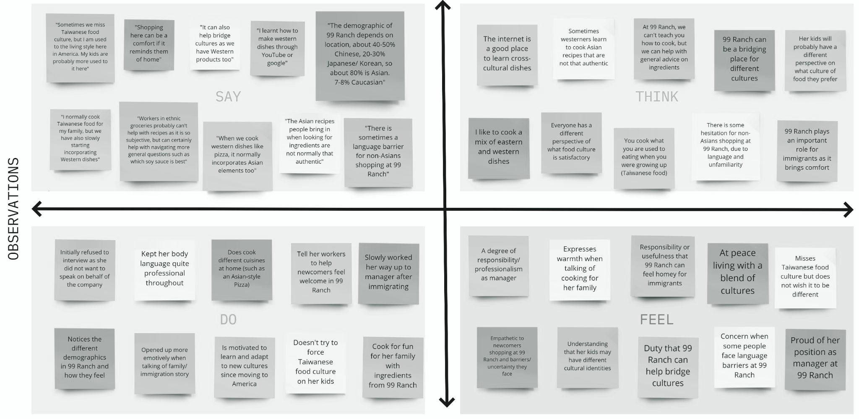
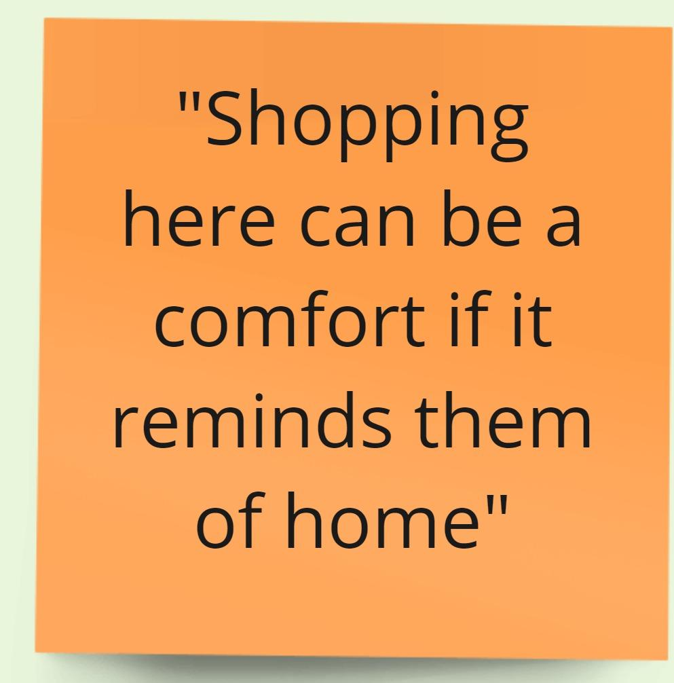
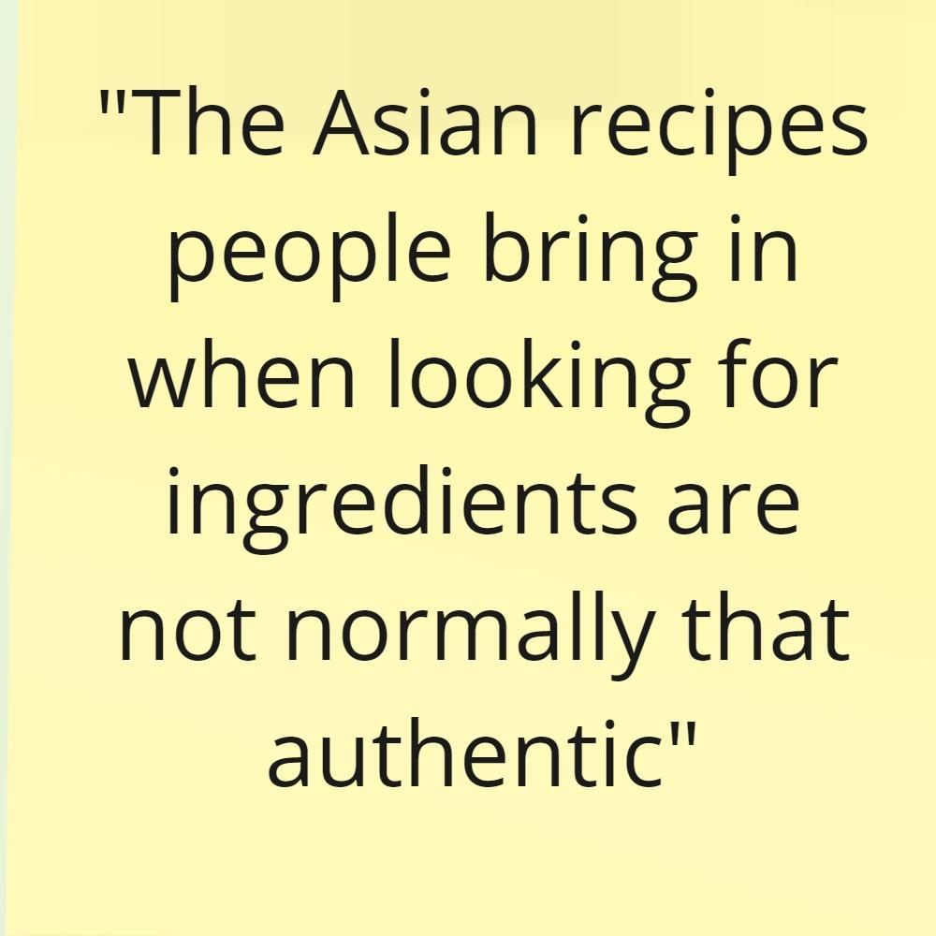
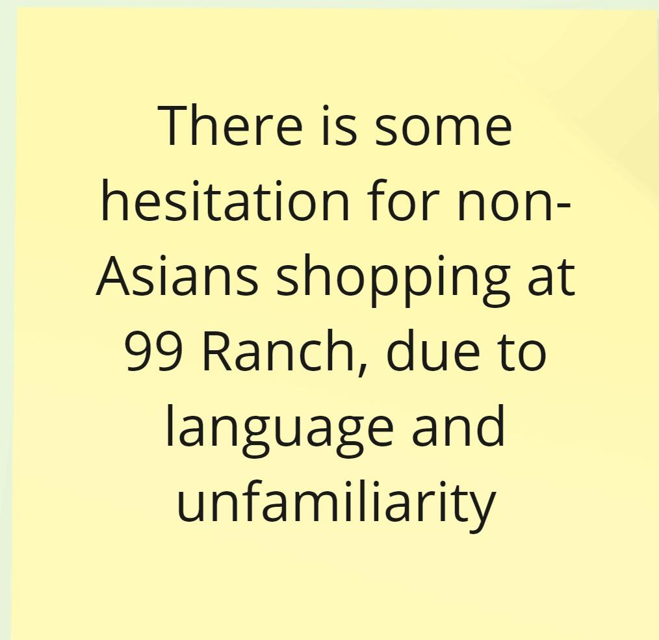
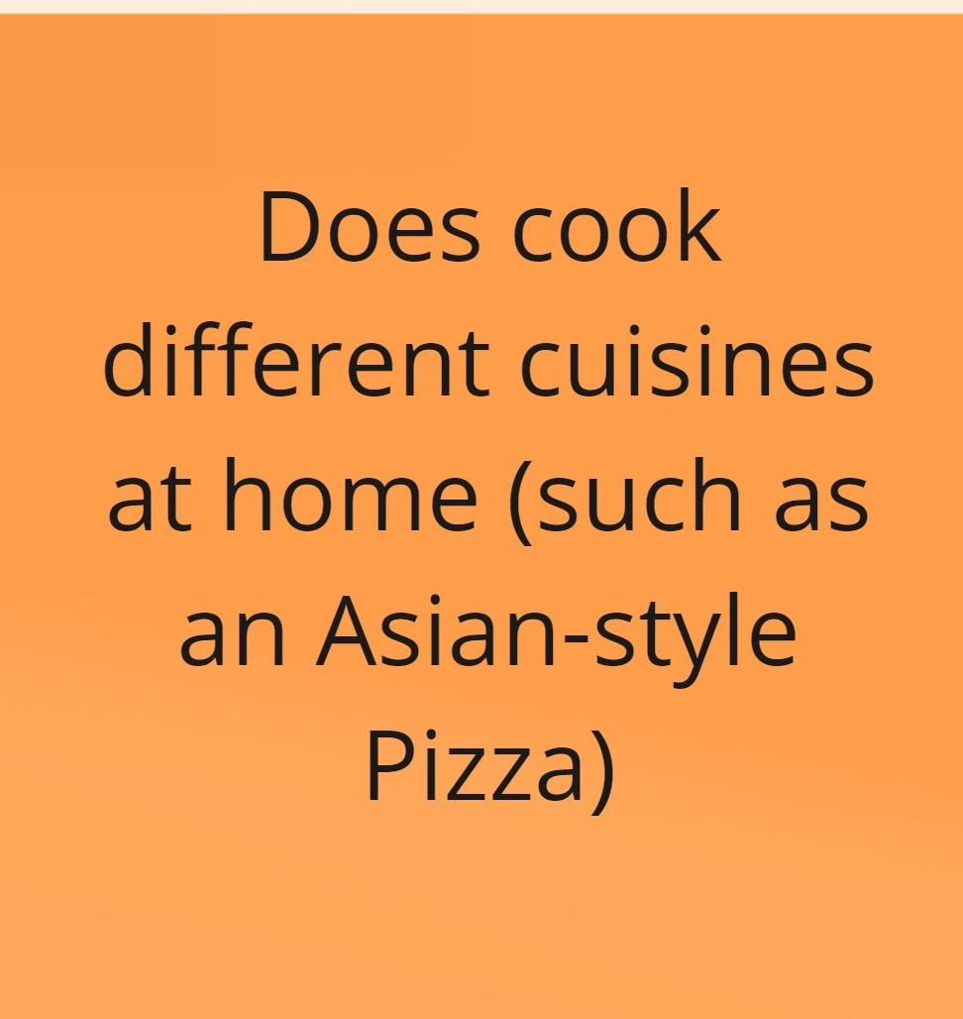
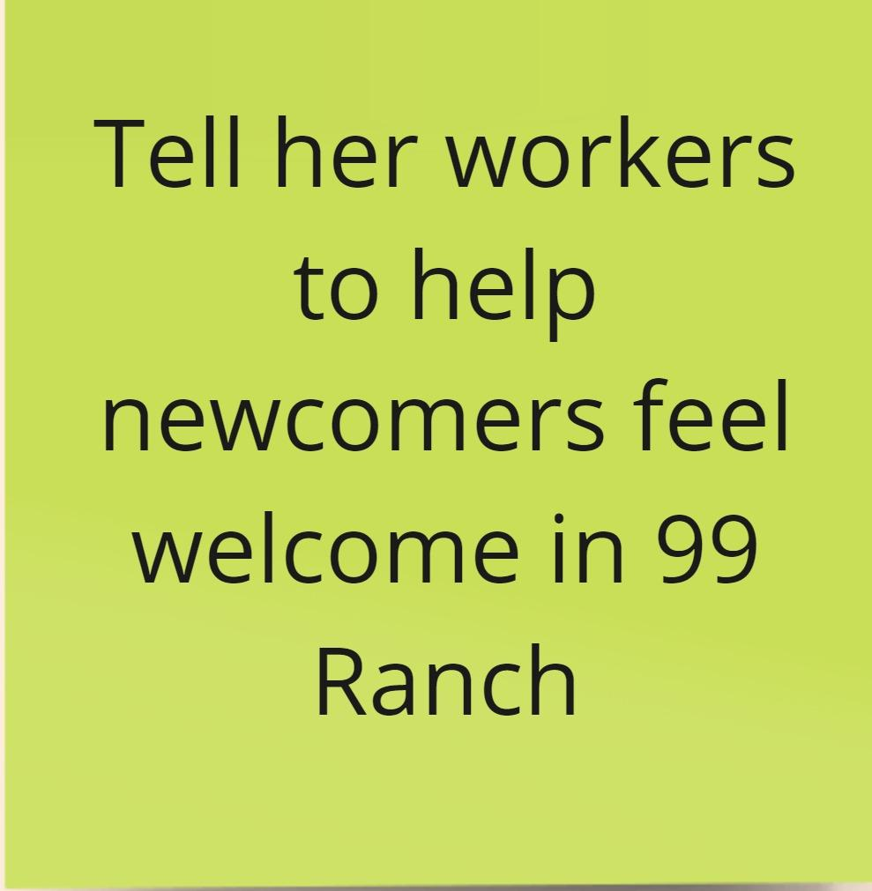
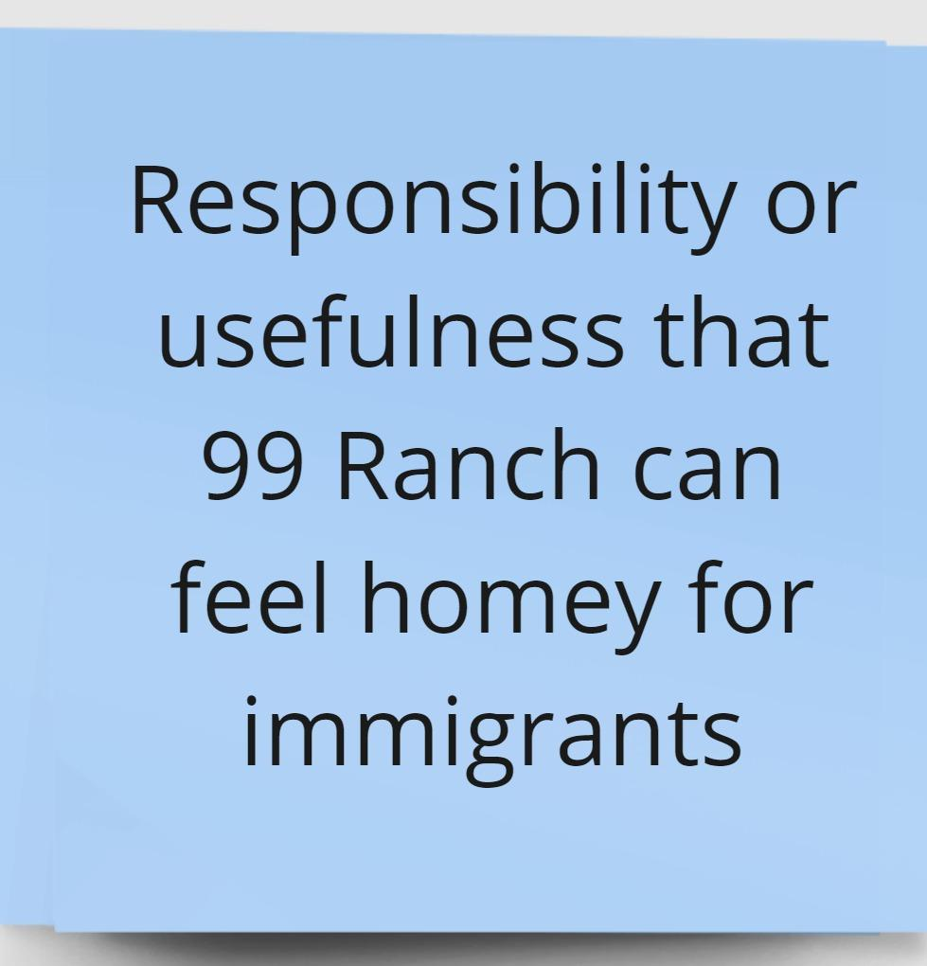
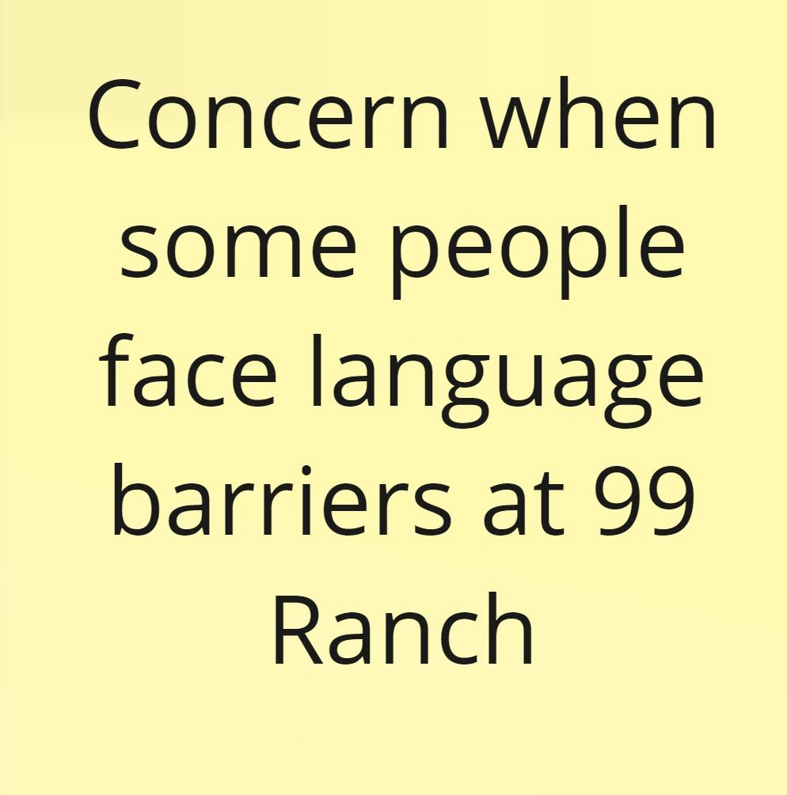
Team PotLuck
Notes:
Say Think
Do Feel

Slide 17
Team PotLuck
Key Insights
Key Insights:
There is some difficulty in finding authentic recipes from different cultures due to language barriers and where to find these resources
Familiar and unfamiliar foods can lead to feelings of comfort/ belonging or discomfort/ hesitation
We wonder if this means…
There are more barriers to cooking cross-cultural dishes than we realized (logistic / language difficulties as well as self-consciousness)
Authentic ingredients can have a big impact on one’s connection to culture

Slide 18
Team PotLuck
03
Jaclyn
Interviewed by Kyla & Observed by Amrita
Owner and Head Chef of Comida Peruana
Interview conducted at Farmers Market and transcribed using with Otter.ai

Slide 19
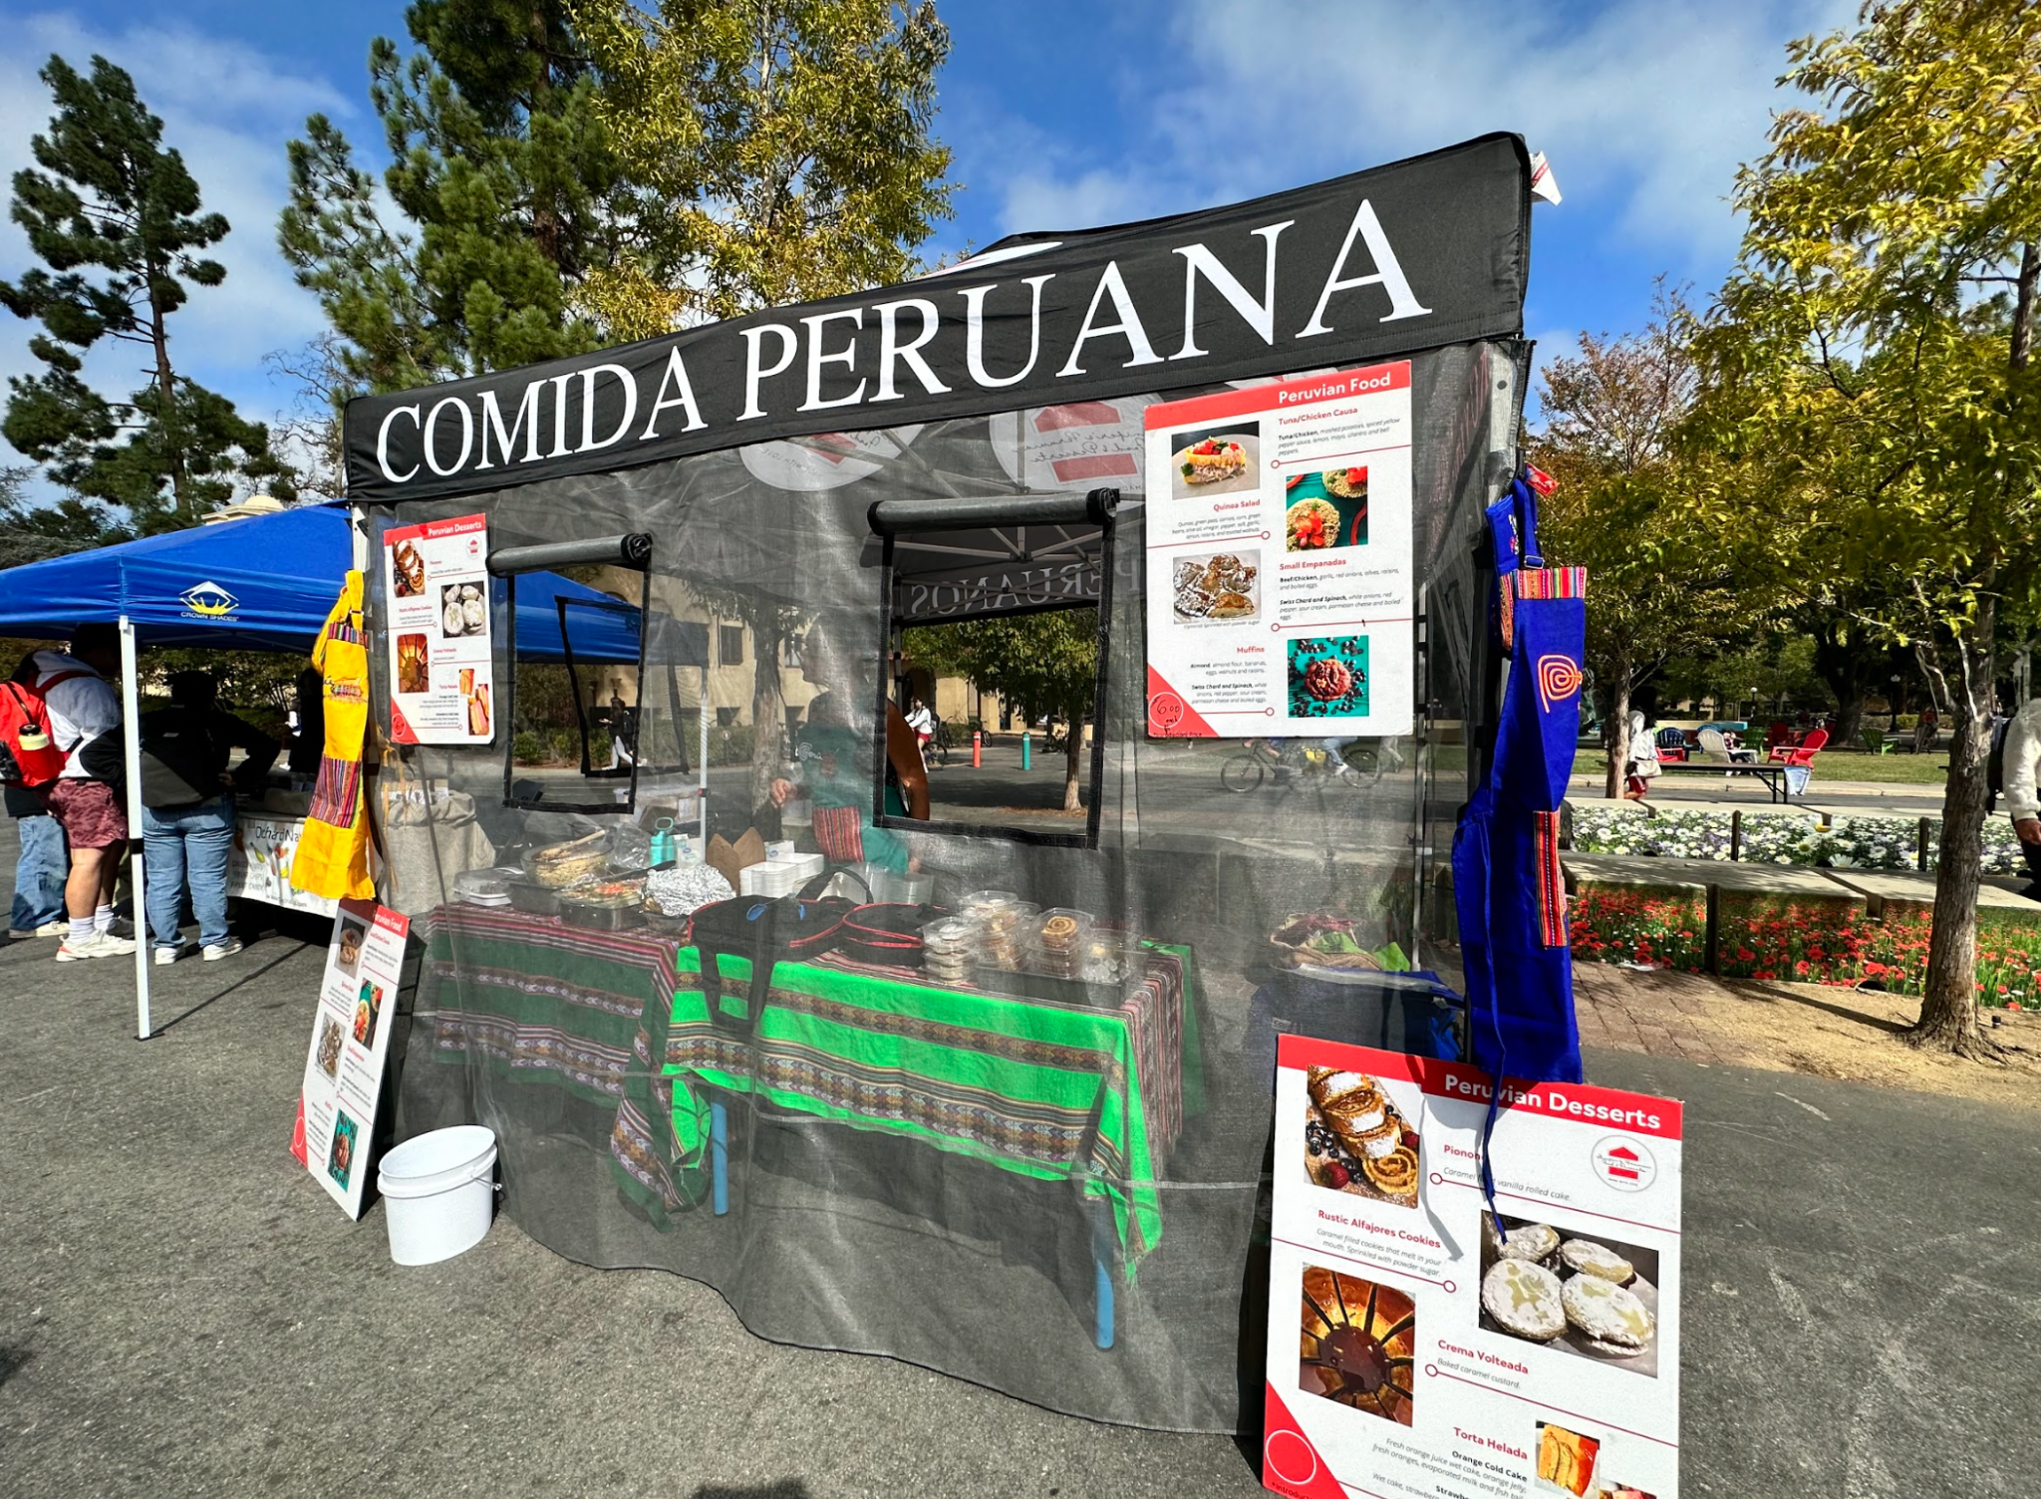
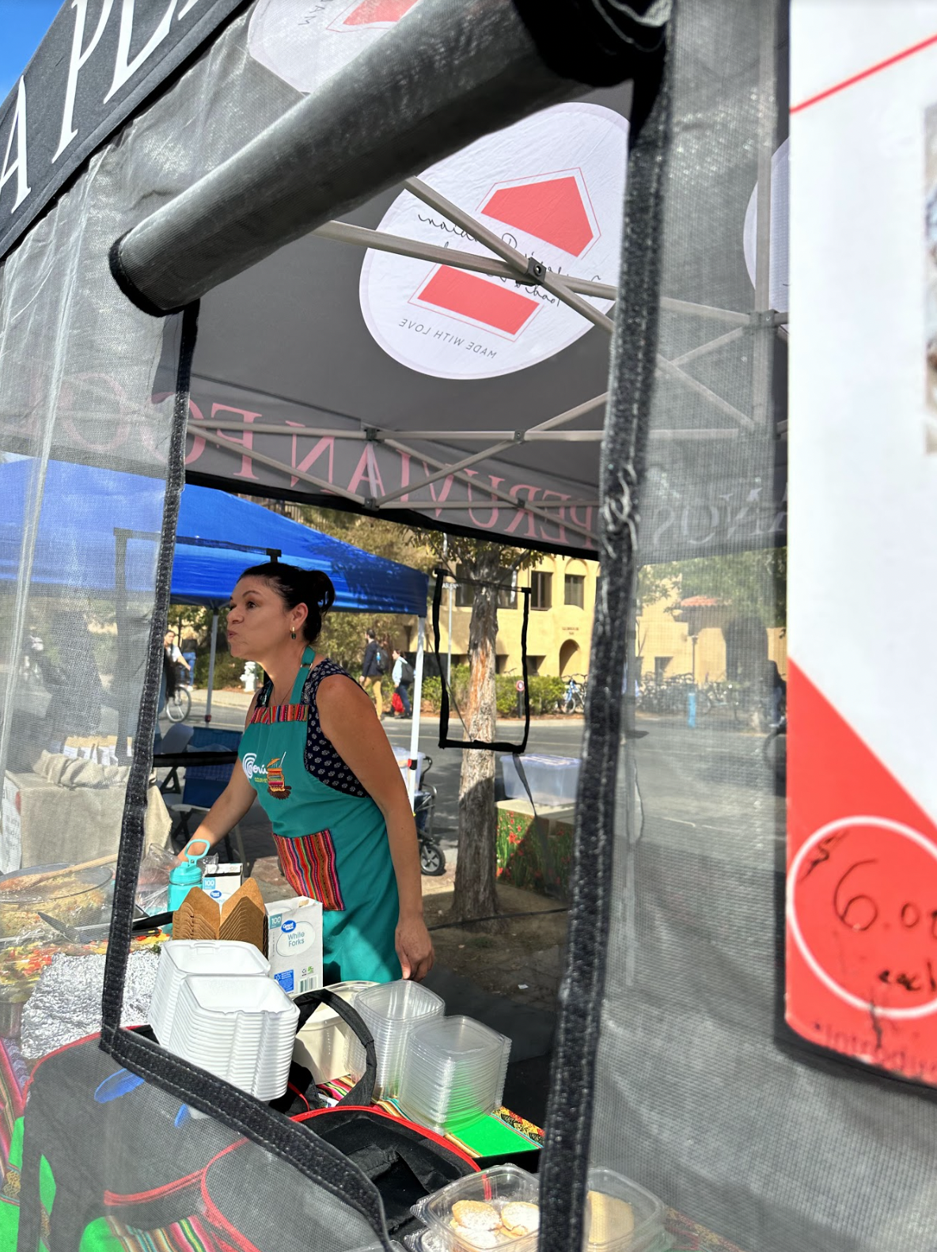
Team PotLuck
Context & Observations
Who is Jaclyn?
Immigrant from Peru, Mother
Dreams of opening up a Peruvian coffee shop one day
Surprises:
To experience authentic Peruvian food, Jaclyn believes you must visit Peru.
Jaclyn was incredibly knowledgeable about the historical traditions that the food represented: e.g. Chasqui Peruvian messengers gaining strength through quinoa
What you eat is a representation of your health and discipline
Contradictions:
Wants to expand her business and scale, but is scared to teach other individuals and let go of “her way” of cooking
Notes:
Jaclyn even carried Peruvian cloth at her stand to sell

Slide 20
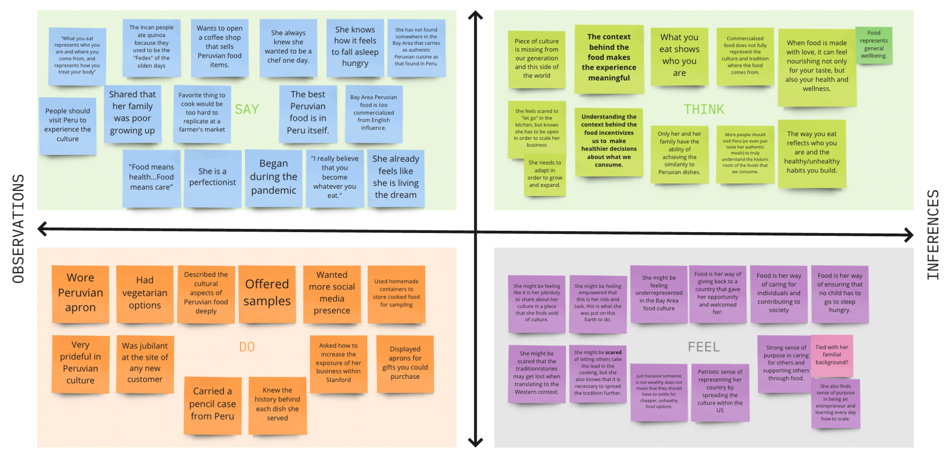
Team PotLuck

Slide 21
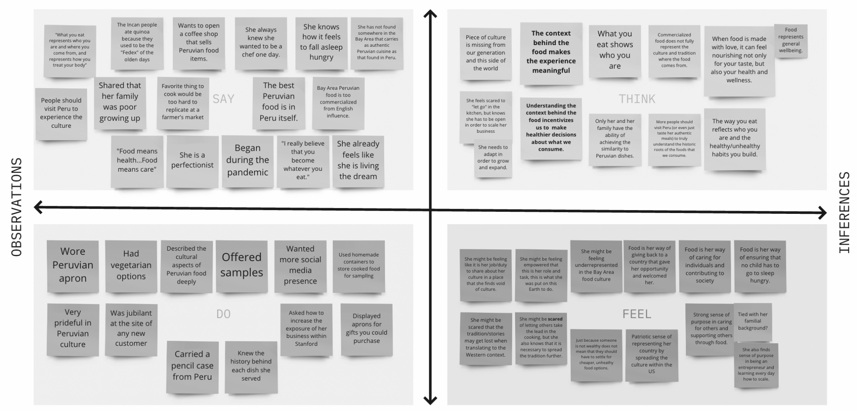
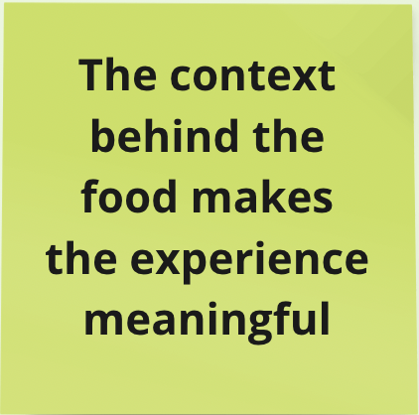
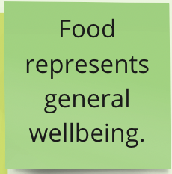
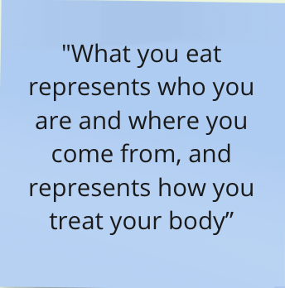
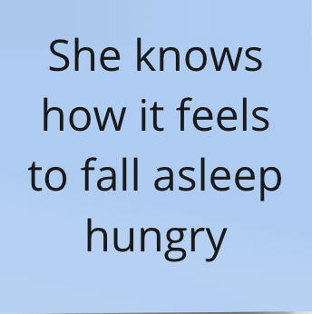
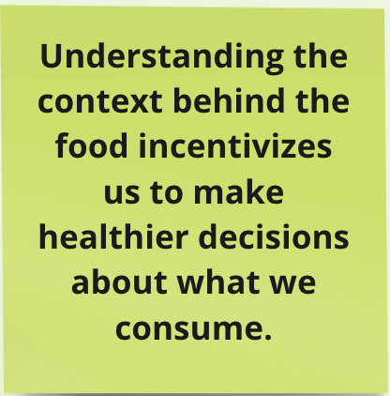
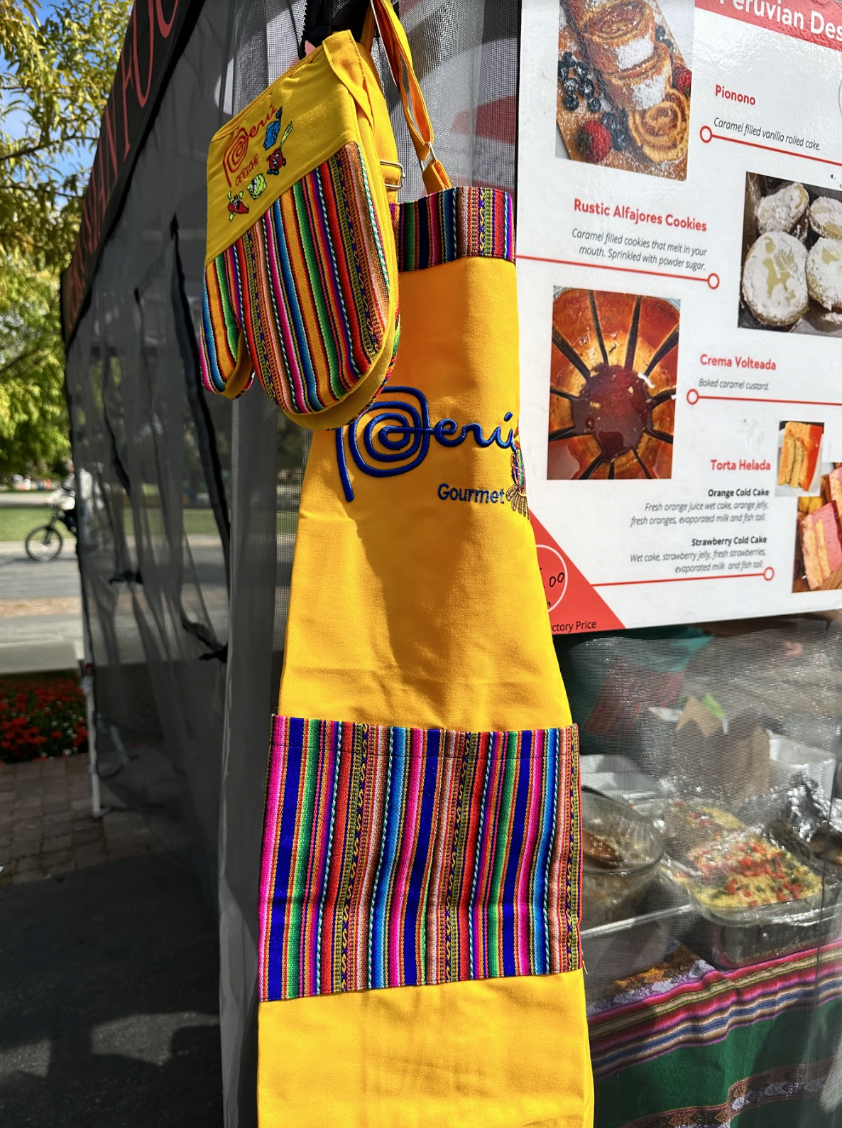
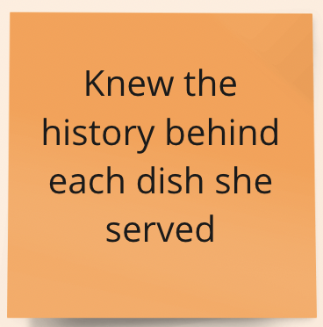
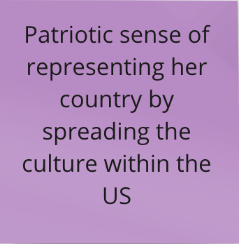
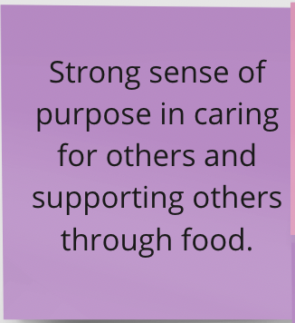
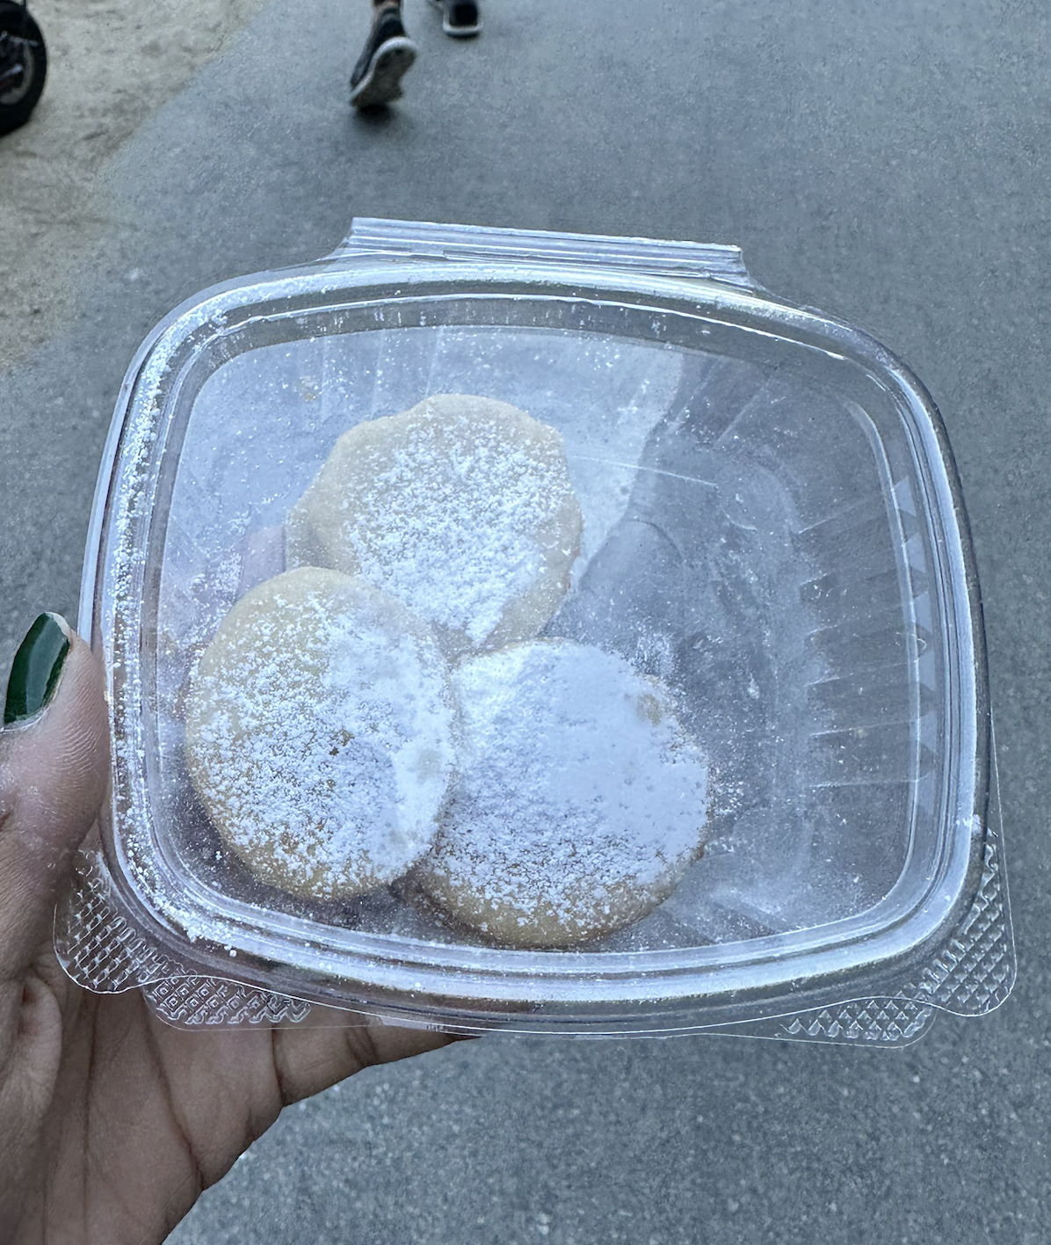
Team PotLuck

Slide 22
Team PotLuck
Key Insights
Key Insights:
The history of a food can be used to contextualize its health benefits.
Authentic cuisine is difficult to recreate in a casual setting without the right ingredients and equipment.
Scaling means more chefs trained with similar recipes--this is a source of worry!
We wonder if this means…
People need to be informed on the cultural/historical context of a food to recognise its health benefits
Chefs want to balance preserving authenticity with making recipes easy-to-replicate and scalable

Slide 23
Team PotLuck
04
Sofia
Interviewed by Defne & Observed by Kyla
Extreme user!
Chef at Xanadu House at Stanford.
Interview conducted in Xanadu computer cluster, recorded with Otter.ai

Slide 24
Team PotLuck
Context & Observations
Who is Sofia?
Came to the U.S. from Mexico when she was 16.
Used to be a hasher before she became a chef at Stanford.
Surprises:
She hated to cook as a child and learned to cook on the job as a hasher.
Dislikes the idea of cooking at home and goes out to eat on weekends.
Goes to English websites even for Mexican dishes.
Contradictions:
Enjoys the appreciation for her cooking from students, but never cooks for family or loved ones.
Says she has more screenshots of recipes than pictures with her family on her phone, yet doesn’t ever cook outside of Stanford.
Says her mother is the best cook she knows, but also doesn’t reference her as a source of recipes.

Slide 25
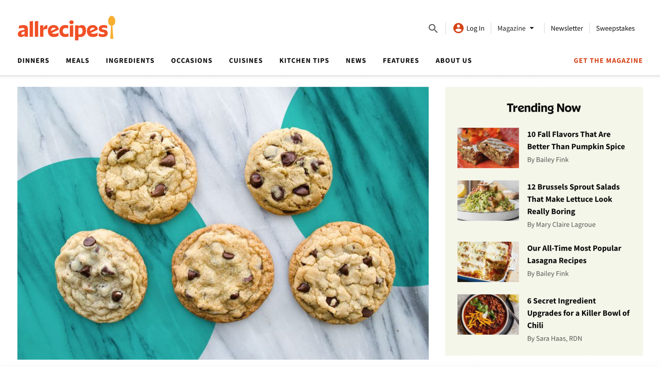
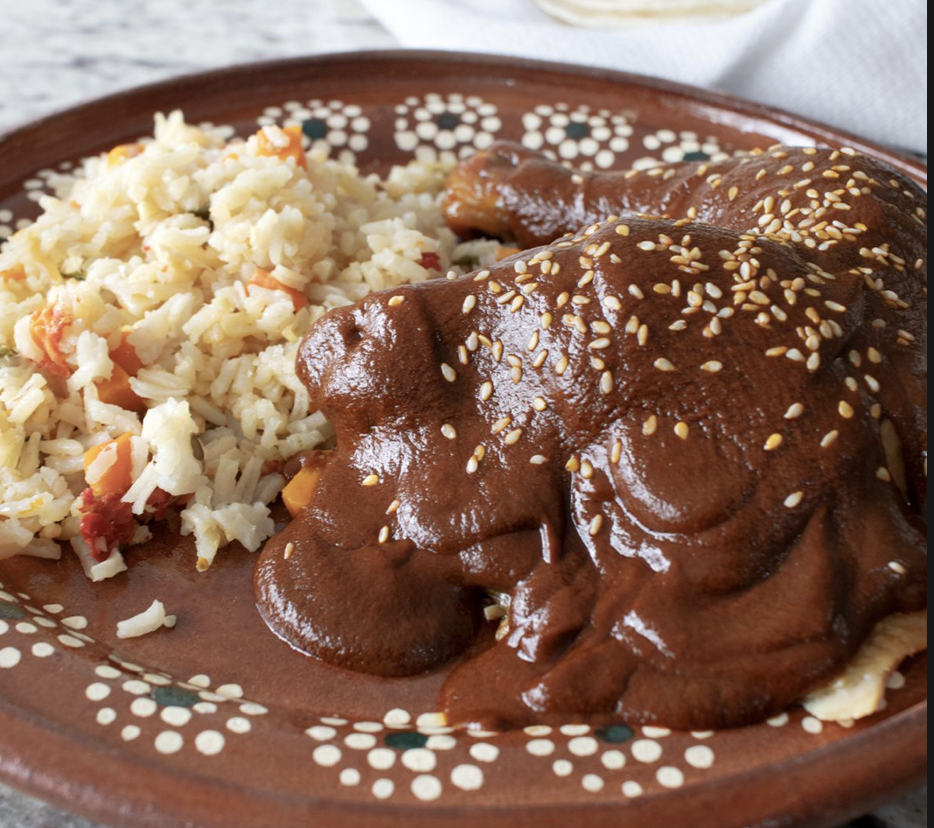
Notes:
Sofia’s favourite website for recipes, allrecipes. And this is her favourite dish, mole (which she thinks students wouldn’t like.)

Slide 26
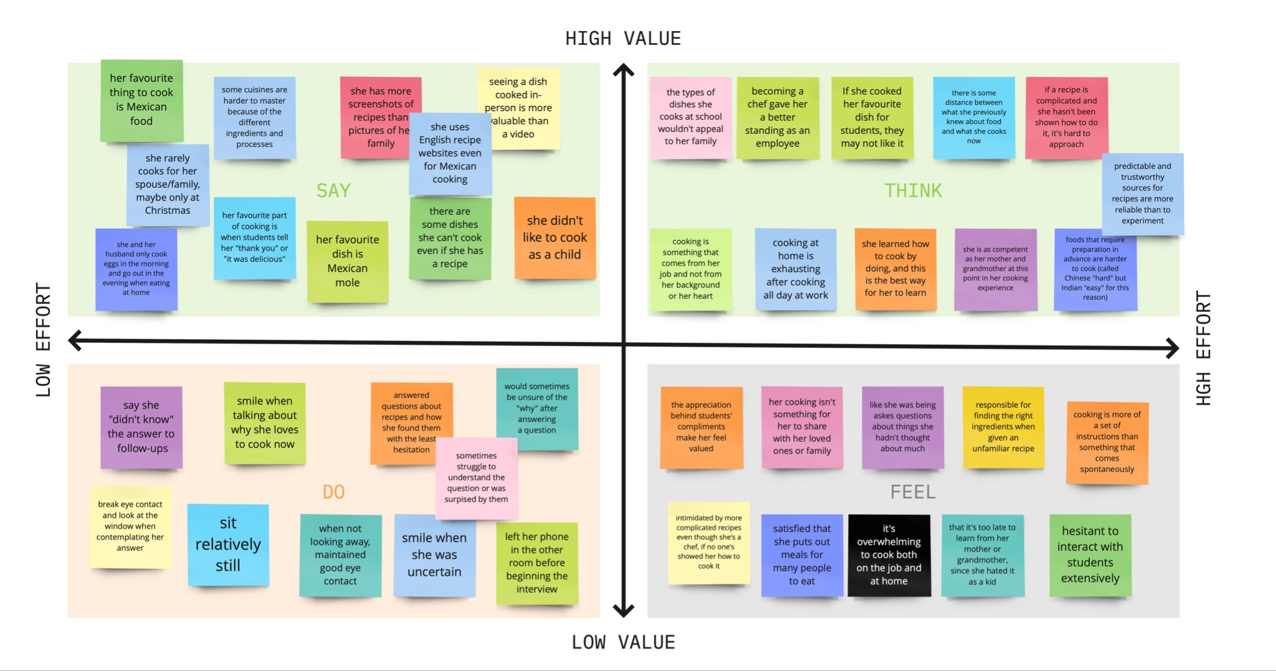
Team PotLuck

Slide 27
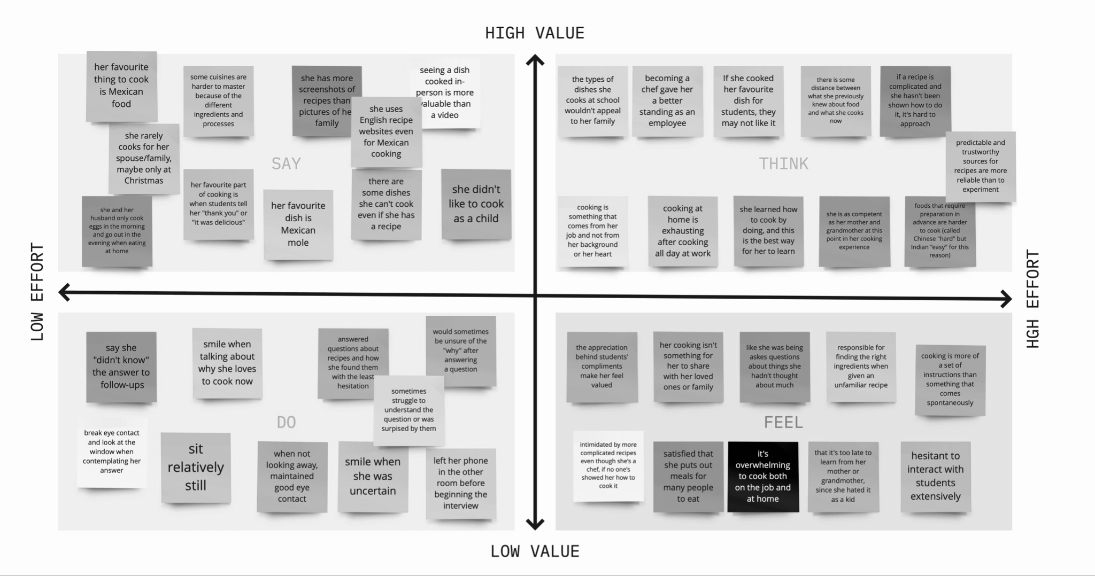
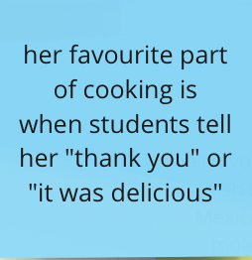
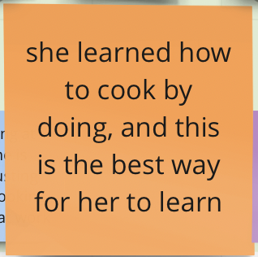
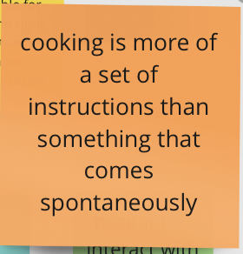
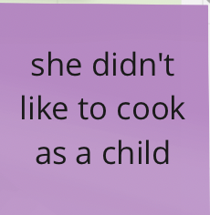
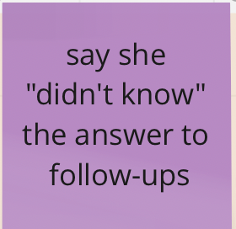
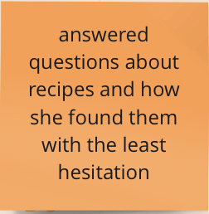
Team PotLuck

Slide 28
Team PotLuck
Key Insights
Key Insights:
Seeing the real-life movements of somebody cooking greatly accelerated her learning process. (preferred videos > recipe books)
She didn’t like the idea of cooking until she learned it on the job.
Her favourite part of cooking is receiving compliments from students.
She wouldn’t cook the same things for the students and her family, and always uses English recipe sites.
We wonder if this means…
Her perspective on the food she cooks is heavily influenced by whom she’s cooking it for.
Learning how to cook oftentimes comes from necessity and not genuine passion or interest.
More widely-accepted dishes are less intimidating to want to cook for others.

Slide 29
Team PotLuck
Recurring Themes
Authenticity
Hesitation
Authentic food made from authentic ingredients is hard to come by, but extremely relished.
There is some barrier to sharing food/cooking for others (perfectionism, being unsure if palatable to different cultures, etc.)
Outlook
Audience
The experience of cooking and eating can be purely transactional (for work, just to be full) rather than deeply personal and intentional.
Who they cooked for mattered to most of our interviewees and shaped the way they think about cooking.

Slide 30
Summary: What’s Next?
Team PotLuck
Diving further into effective ways of preserving tradition while spreading culture.
Diving further into reducing barriers (effort, language, insecurity) to authentic cooking
We’ve seen common threads of hesitation and with several topics around food– what could help them?
Interviewing more people and validating/invalidating these insights.
Developing prototypes for re-emerging ideas!

Slide 31
Appendix
https://food52.com/recipes/84225-mole-sencillo-recipe
https://www.allrecipes.com

