Slide 1
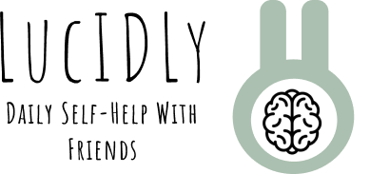
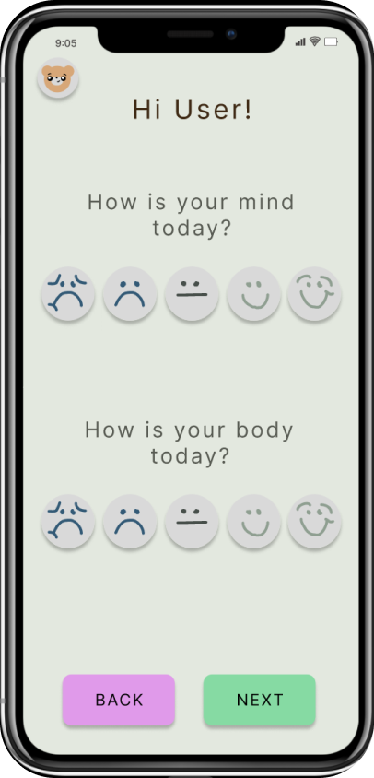
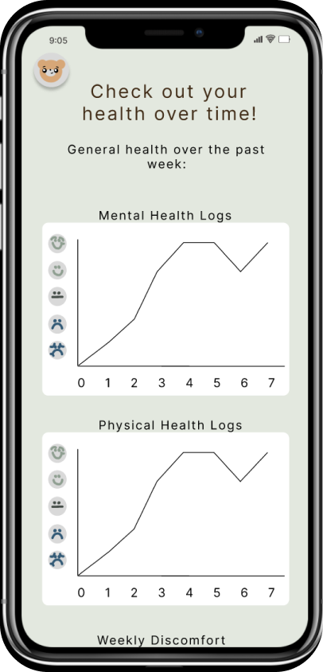
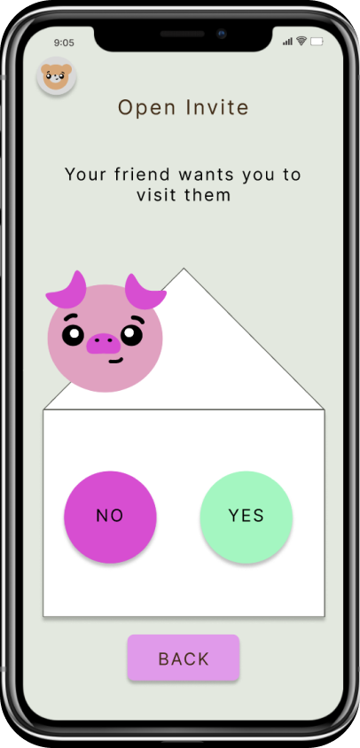
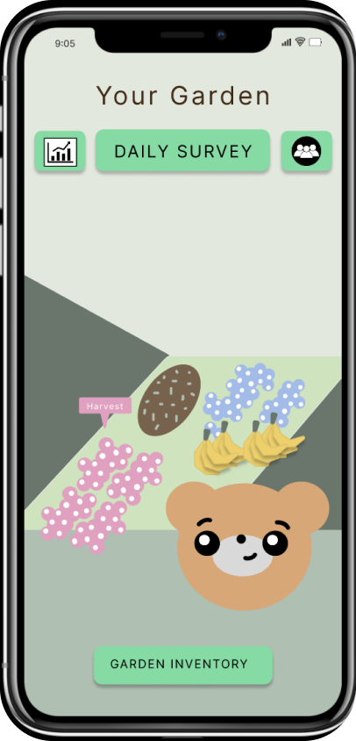
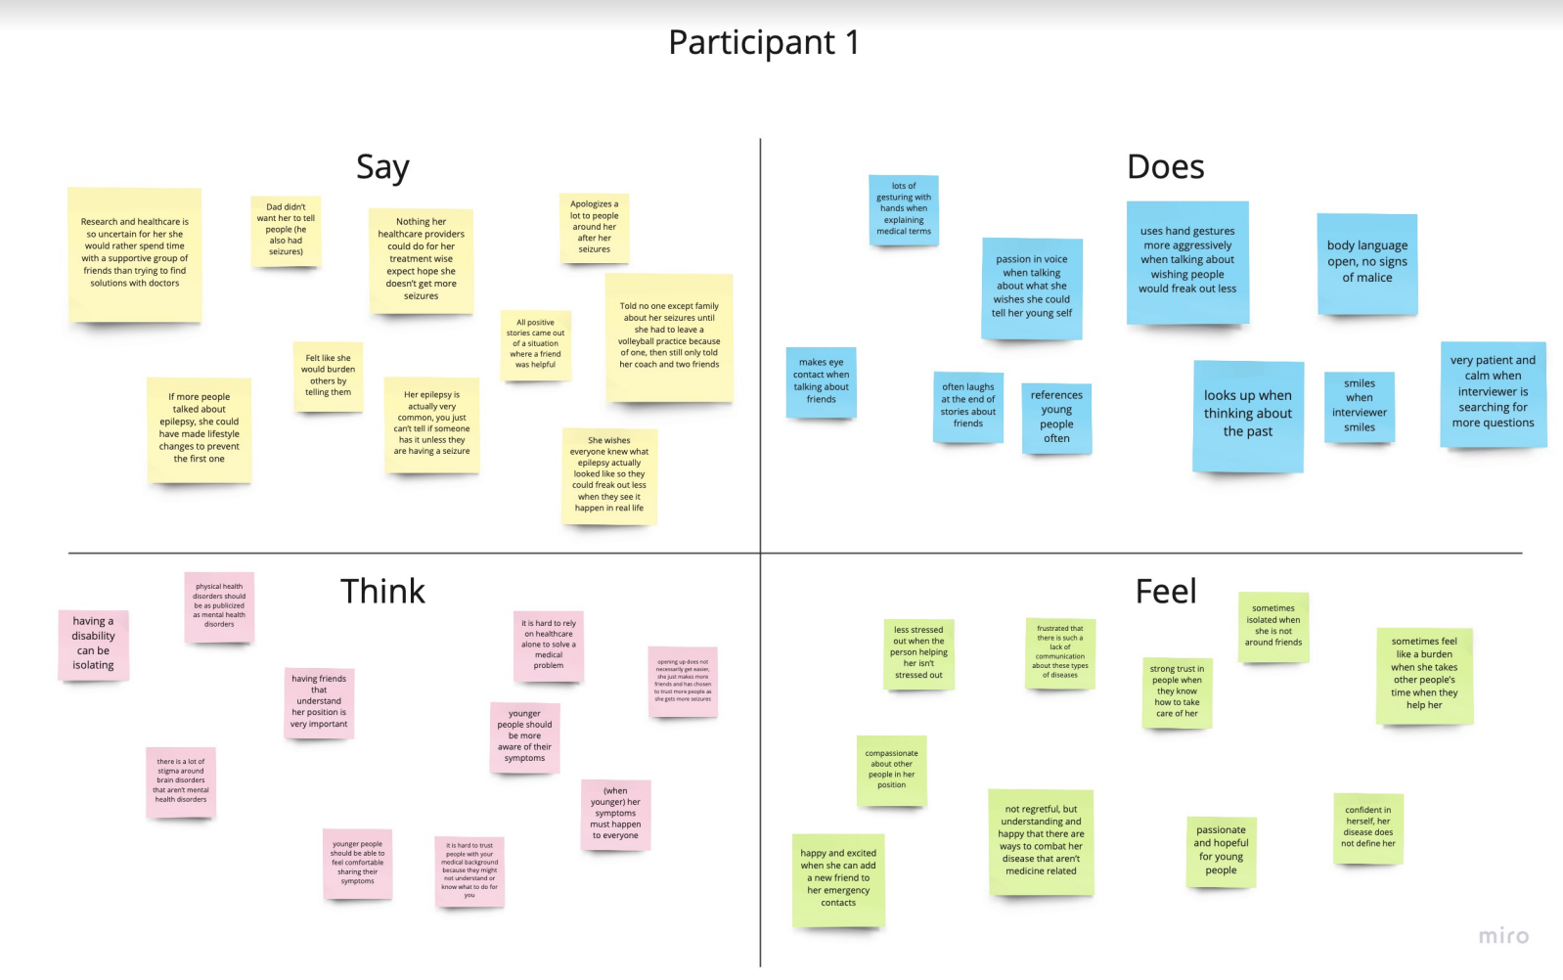
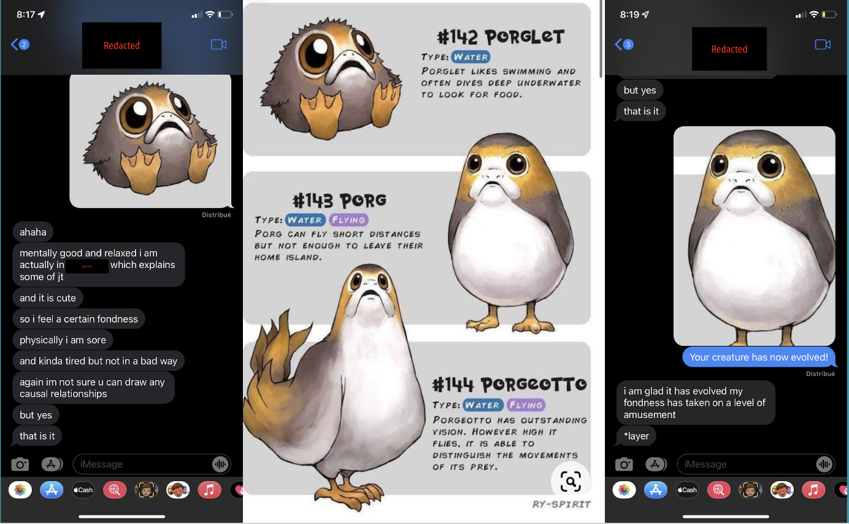
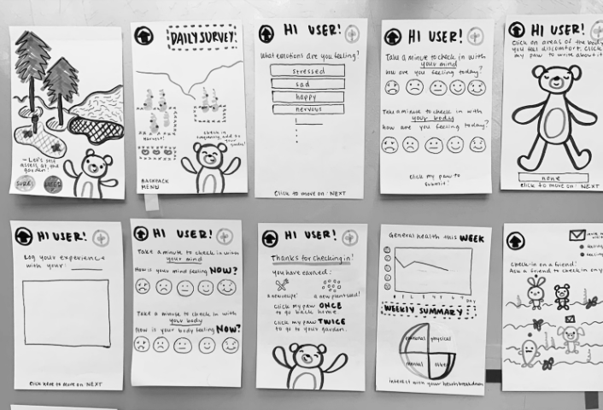
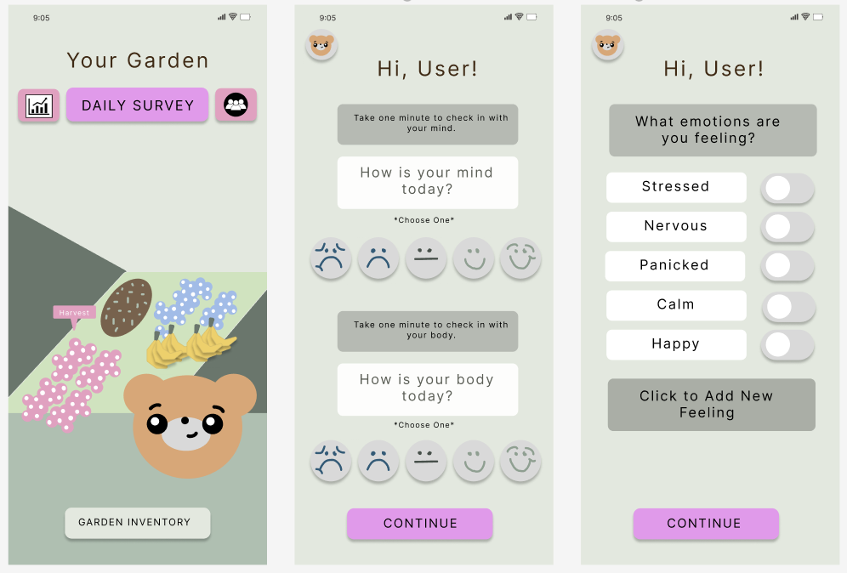
Log Daily Symptoms
Track Health Over Time
CHeck on Friends
Grow Your Garden
DESIGN PROCESS:
1. Needfinding 2. Testing
PROBLEM
How can users feel confident & enjoy self assessment & tie this to community?
SOLUTION
An idle game where the user answers daily questions about their wellbeing to earn rewards, expand their gardens & get health insights over time. Users visit friends’ gardens to chat & share rewards.
3. Low-FI 4. Med-Fi
Jonathan A, Gayatridevi T, Maya H, Janelle R | CS 147 Autumn 2022 | https://hci.stanford.edu/courses/cs147/2022/au/projects/EquitableHealthcare/lucIDLy/

