Slide 1
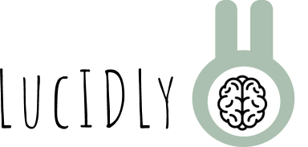
Midway Milestone Presentation
CS 147 Assignment 8

Slide 2
Our Team
Jonny
Maya
Janelle
Gaya

Slide 3
Daily Self Help with Friends
Value Proposition

Slide 4
Problem/Solution Overview
Problem
Solution
Hard to understand symptoms* when they are not talked about
Younger people need these conversations in their community to assess their symptoms*
Hard to report symptoms* because of social pressures/lack of conversations around many medical conditions
Create an empowering and fun routine to help the user better understand how they are feeling currently and over time that utilizes the power of community
*Symptoms = Mental and Physical Changes from “normal” apparent to the user

Slide 5
Talk Overview
Heuristic Evaluation
UI and Product Revisions
Prototype Status
Demo
Summary
Feedback
1
2
3
4
5
6

Slide 6
Heuristic Evaluation

Slide 7
Summary of Heuristic results
-Main issue was UI consistency which impacted our usability
-Too much text, confusing and inconsistent buttons, overall clutter to make tasks easier
-Did not make many severity 3 or 4 errors but the amount of consistency problems ended up creating a less usable experience for the users
-Some issues came from Figma limitations that will be clearer in the Hi-fF

Slide 8
Notes on Severity 3 & 4
-As mentioned before, the main problem actually was not severity 3 and 4 problems
-Most of the 3 and 4 issues came from poor design decisions that lead the user to assume/not understand certain things
-Examples of this are:
Having a globe to represent friends when the globe is not used as a map
Making text boxes the same format as buttons
Allowing users to harvest without then showing them where their harvest goes

Slide 9
Violation Breakdown
Severity 0-2: 42
Severity 3-4: 10
Most validated Heuristics: H4 (17) and H8 (7)

Slide 10
Design Revisions

Slide 11
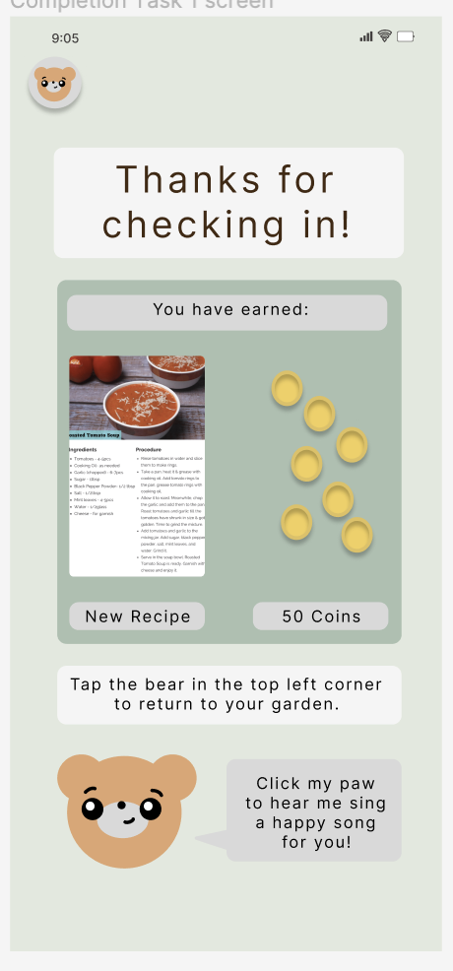
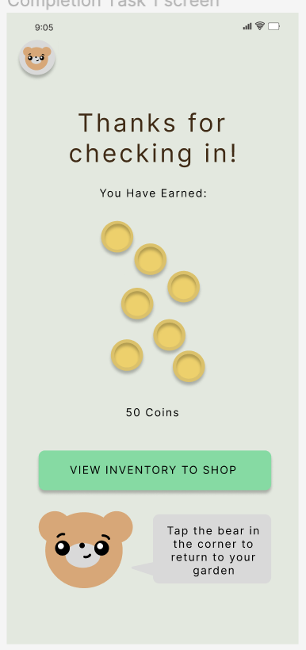
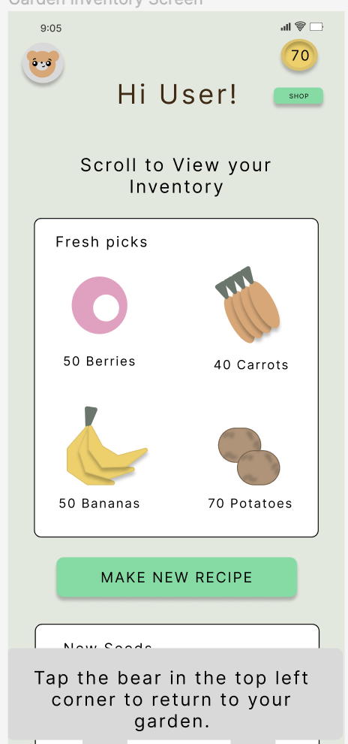
H1: Visibility of System Status
-After earning coins and completing the survey, there is no indication of where the coins go or what they are used for
-clear view button and coin visibility

Slide 12
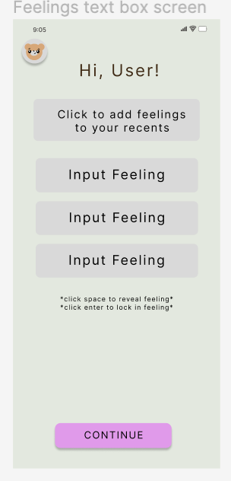
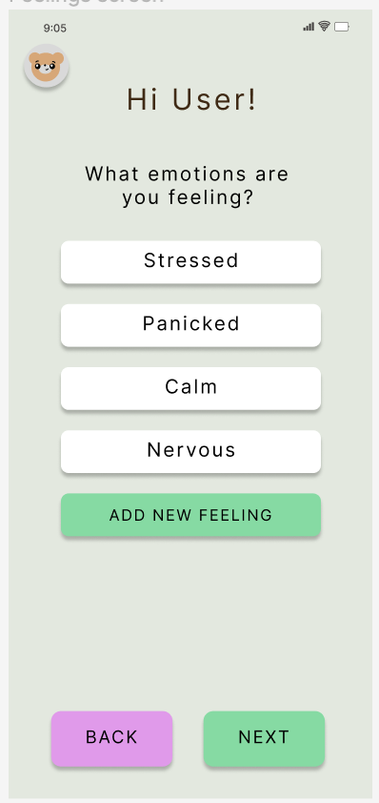
H3: User Control and Freedom
-In the survey, users can’t go back or all progress will be lost
-new back button

Slide 13
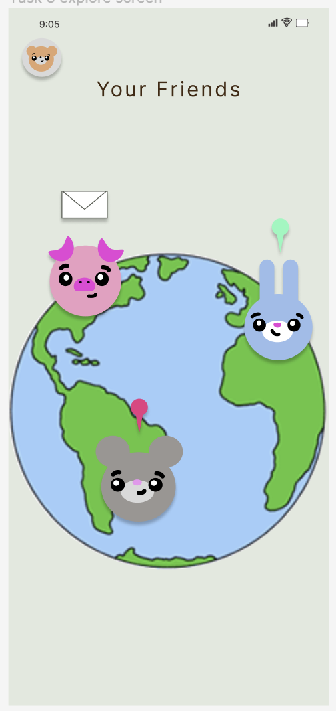
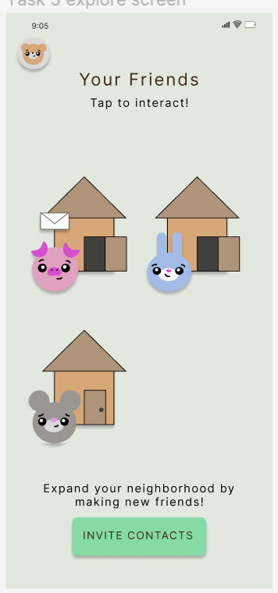
H3: User Control and Freedom
-intuitively, a globe should represent where users are on a map but our globe was just a background
-new house view to get rid of geography confusion

Slide 14
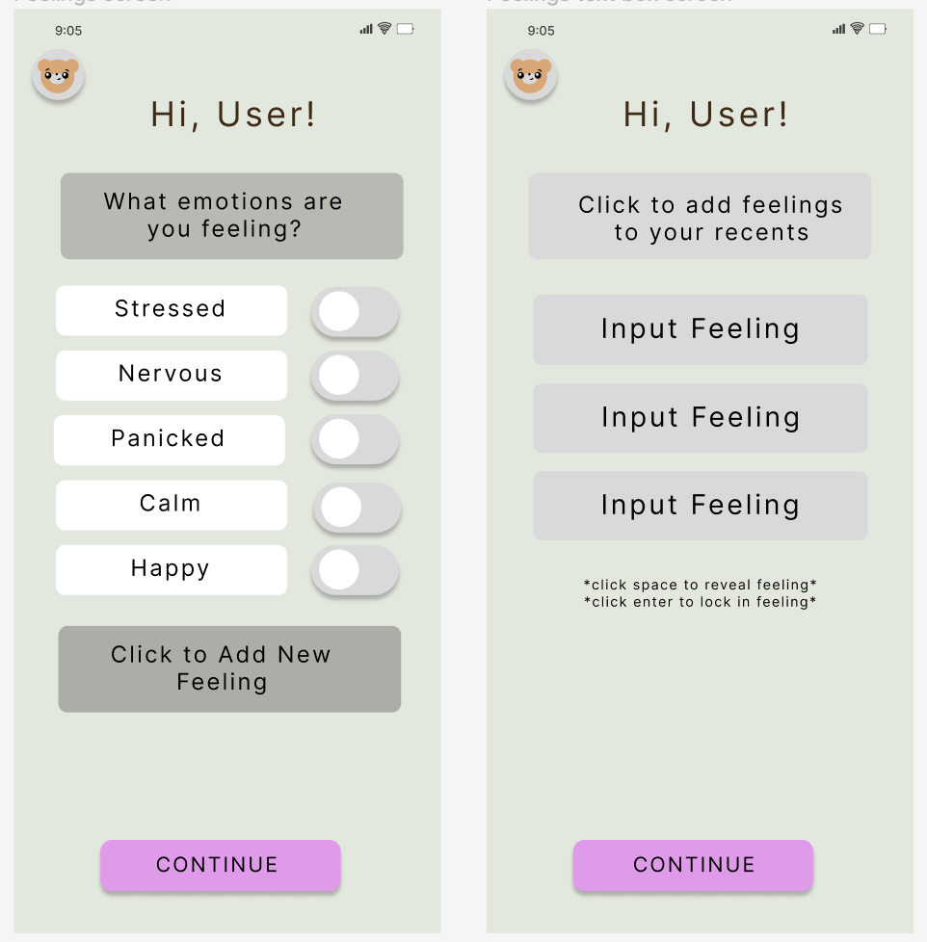
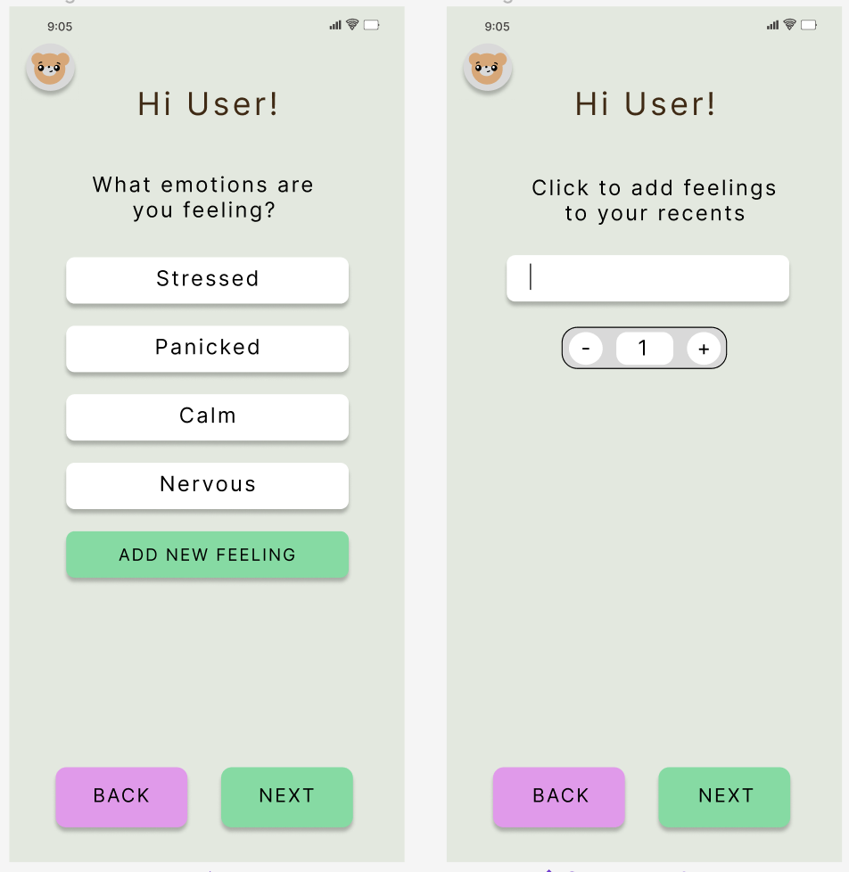
H4 Consistency and Standards
- “add new feelings” button is grey like deactivated buttons
-created brighter and more consistent and obvious button colors

Slide 15
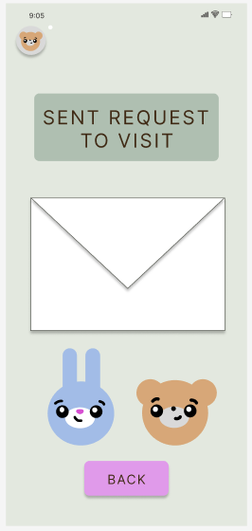
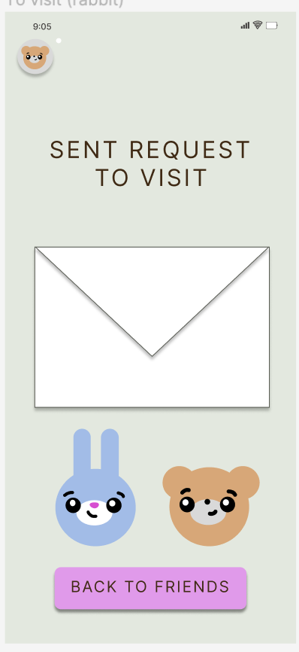
H4: Consistency and Standards
-the page that confirms an invite was sent contains a back button, when the user wants to go back to the main friends page
-made the back button more specific

Slide 16
H3: User Control and Freedom
-intuitively, a globe should represent where users are on a map but our globe was just a background
-new house view to get rid of geography confusion

Slide 17
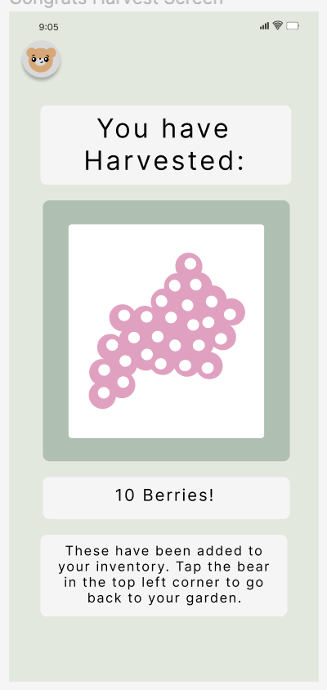
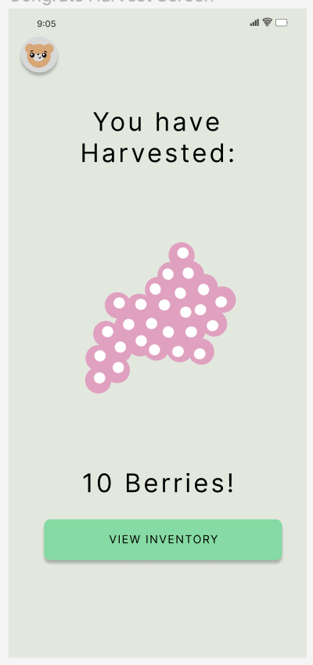
H10: Help and Documentation
-unclear what happens after a harvest or where to go to view what has been harvested
-clearer button to show the user their inventory and less text for cleanliness

Slide 18
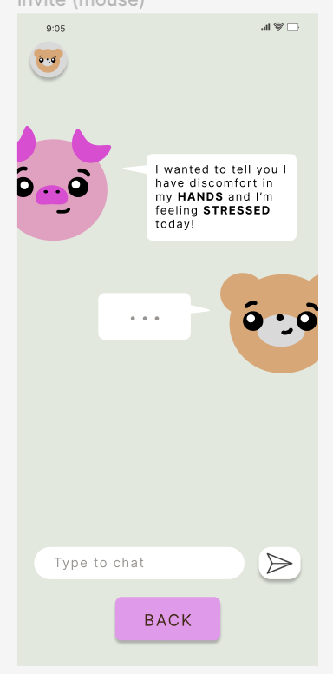
H12: Value Alignment and Inclusion
-there should be more than just the ability to see what friends are feeling
-implemented a chat feature to dive deeper into connections

Slide 19
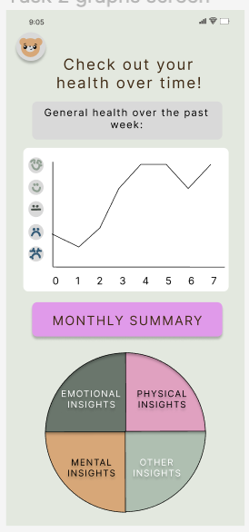
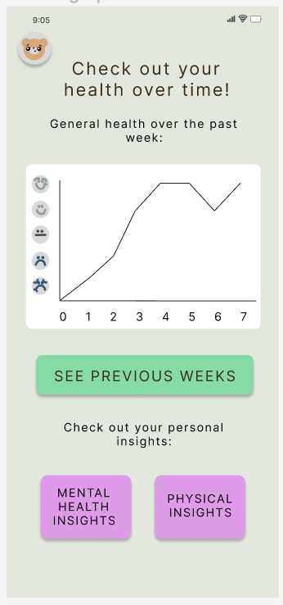
H2: Match Between System and Real World
-unintuitive pie chart
-change to be obvious buttons with clear intentions

Slide 20
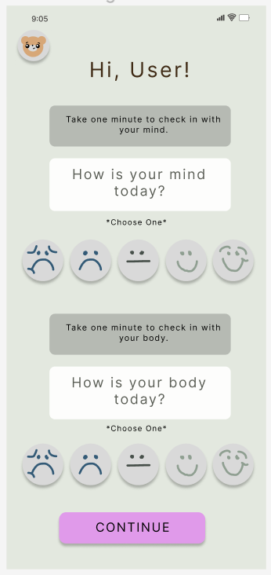
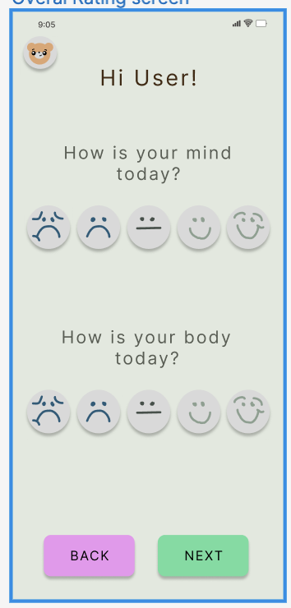
H4: Consistency and Standards
-rounded text backgrounds look the same as buttons
-through the entire app got rid of confusing text backgrounds

Slide 21
Progress towards Usability Goals
After majorly simplifying and clarifying our design, our prototype is much easier and more intuitive. There is a systematic use of colors and symbols that were not present before, making for an overall simpler experience. We learned that bigger does not always mean better at the expense of consistency and clarity.

Slide 22
Prototype Status

Slide 23
Features
Implemented
Unimplemented
Task 1 - recording one’s mental and physical well-being
Users are able to:
View homepage and click Daily Survey button
Answer survey questions
Rating state of being
Adding feelings to recents
Click pain locations on bear
Task 2 - compare and track mental and physical wellbeing over time
Seeing general health over time
Viewing mental and physical health insights
Task 3 - make others aware of how one is feeling
Visit friends and invite friends to visit
See friends’ gardens
Chat with friends and alert them to how one is feeling
& interacting with inventory

Slide 24
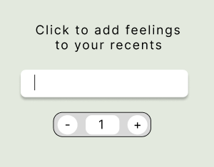
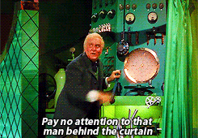
Wizard of Oz
When adding feelings, users are told that they are being added to “recents” behind the scenes
However, lacking backend functionality means while this appears to be the case, there is no storage occurring

Slide 25
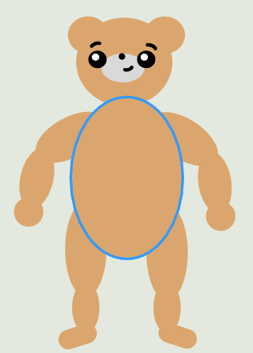
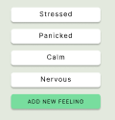
Hard-Coded
Users are only able to click on limited locations on the bear
Default emotions provided already

Slide 26
Issues and Questions
How do we implement a functional reward system?
Full implementation of bear body (user freedom to click anywhere)
Can’t save changes on survey screen

Slide 27
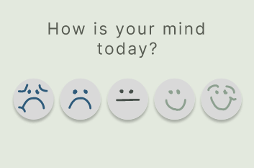
Demo of Prototype
[link to video here]

Slide 28
Summary
Have augmented interface to address several failures to comply with H1, H2, H3, H4, H10, and H12 violations
Improved color scheme and simplified design overall
Users are able to complete daily survey but unable to interact with friends or view insights yet
Potential improvements for reward system and bear implementation

Slide 29
Thank You!

