Slide 1
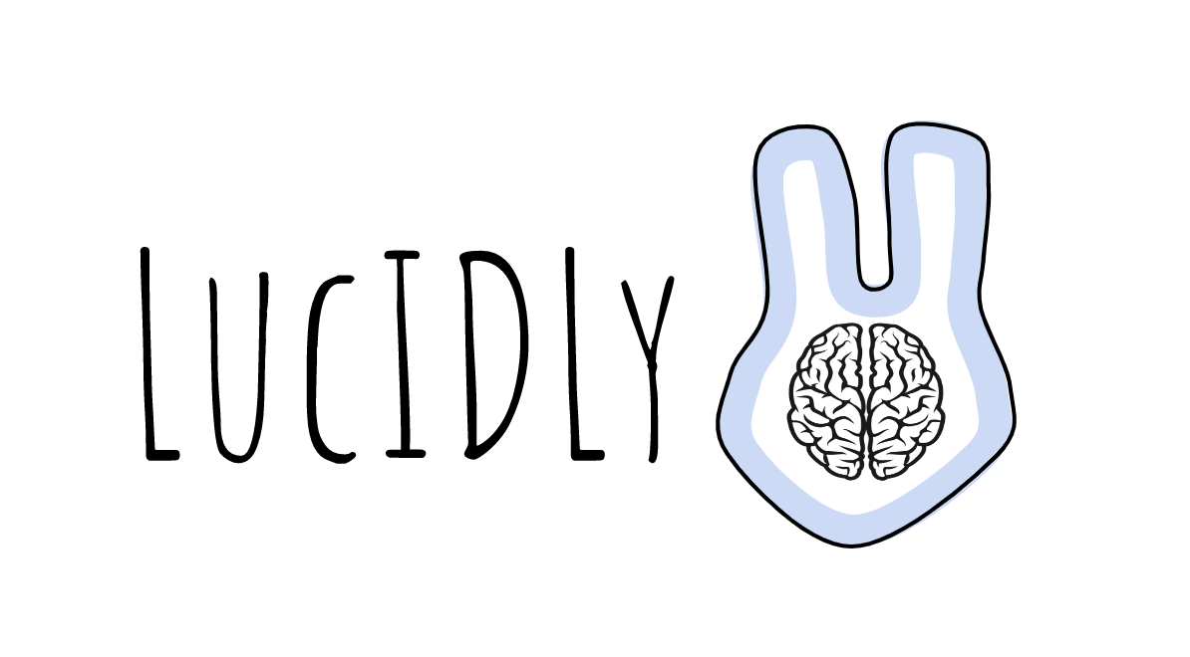
Interactive Medium-Fi Prototype (Checkpoint)
Maya Harvey, Jonathan Affeld, Janelle Rudolph, Gayatridevi Tarcar

Slide 2
Daily Self-Help With Friends

Slide 3
Problem/Solution Overview

Slide 4
The Problem
Hard to understand symptoms* when they are not talked about
Younger people need these conversations in their community to assess their symptoms*
Hard to report symptoms* because of social pressures/lack of conversations around many medical conditions
*Symptoms = Mental and Physical Changes from “normal” apparent to the user
Notes:
Problem

Slide 5
The Question
how do we let users feel confident and enjoy independent self assessment while connecting this with a form of community?

Slide 6
The Solution
Create an empowering and fun routine to help the user better understand how they are feeling currently and over time that utilizes the power of community

Slide 7
HOW?
Concept: An idle game model with a garden and creatures where the user is prompted to answer daily questions about their wellbeing.
Motivation: Upon completion of these questions they will earn coins/credits/rewards that will enable them to expand and evolve their garden and creatures
Novelty: Users also will be able to visit other users' habitats and talk to other users. They can choose to share their health status, invite friends over or ask to check on friends.

Slide 8
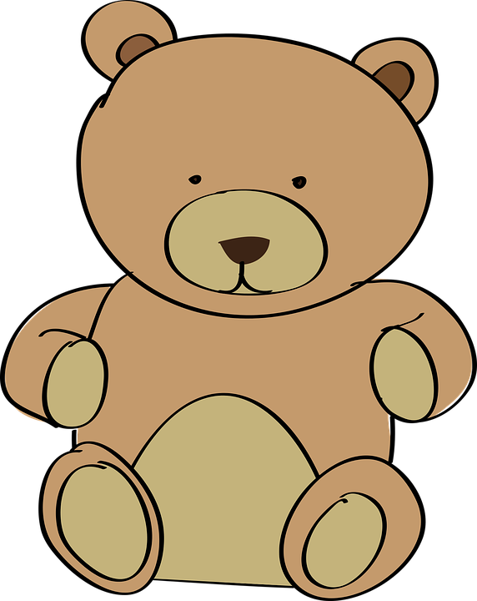
INTERFACE
Screen console built into a plush toy with a dual app component that can be used on the go. The toy is to create a comfortable home base for users.

Slide 9
Values Encoded

Slide 10
Privacy and Agency
We want our users to feel safe and in control while sharing their personal health information with us.
Community Support
We want our users to discuss their symptoms with their community to foster a more supportive, open discourse around medical conditions.
Accountable Wellness
We want our users to track health performance and progress over time
Values Encoded

Slide 11
Privacy and Agency: Design Features
Control over share with friends feature:
User can choose to share personal information with friends or not
User can choose what information to share
User can choose which friends have access to their information
Backend privacy:
User’s information will not be used or shared by developers

Slide 12
Community Support: Design Features
Share with friends feature:
Users can invite to learn more about their health
Users can ask to learn more about their friends’ health
Visit friends feature:
Multiple users can visit a friend’s habitat simultaneously
Users can see their friends’ gardens and contribute to their garden’s growth
Chat feature:
Users can chat with friends within the app when visiting their friends’ habitats

Slide 13
Accountable Wellness: Design Features
Daily Survey feature:
Users are prompted daily to check in with their bodies and answer various questions about their current health
Accountability Garden feature:
Upon completion of the daily survey, users receive rewards that they can use to grow their garden
Users can see their own and their friends’ gardens; thus, they can track their progress tangibly by looking at the health and size of their garden
Track health performance:
Users can track their health stats over weeks, months, quarters and years in the form of graphs, pie charts and other visual statistic data.

Slide 14
Value Conflict
Privacy versus Accountability
As we will be using the users information and storing it to track their health performance to make them accountable. This requires storing their health data which could be a privacy violation if stored improperly.
Agency vs Community
We want to give users the agency to share their information at will. However, the community aspect of lucIDLy is built on the assumption of transparency; we believe that users would have to share some degree of health information with each other to foster this. We reached a middle ground by giving the user the agency to choose whom they want to share their information and giving them the ability to have friends visit them without explicitly sharing health information.

Slide 15
Tasks

Slide 16
Simple: record one’s current mental and physical well-being
Moderate: compare and track mental and physical wellbeing over time
Complex: make others aware of how one is feeling

Slide 17
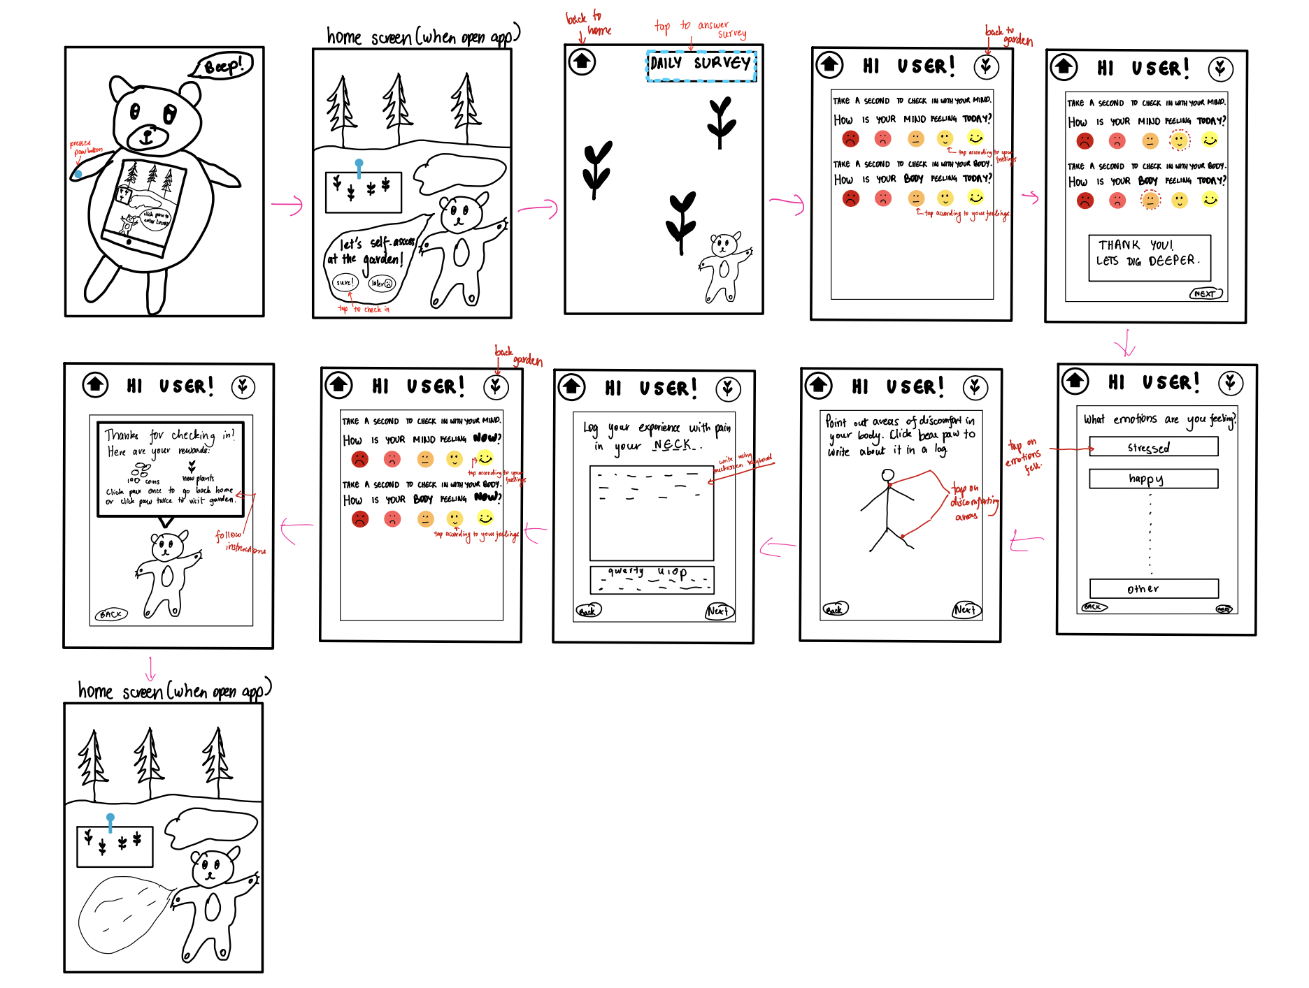
A5 Taskflows - Simple
We will make the home page less crowded and more clear
We will make the survey more intuitive, with less short answer questions.
We will label each component of the homepage clearly to enable the user to learn how to access things easily.

Slide 18
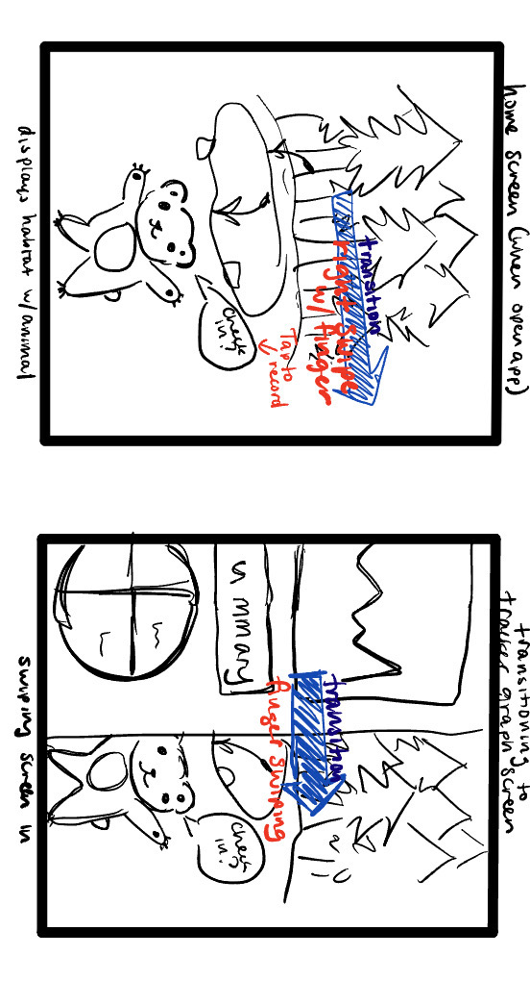
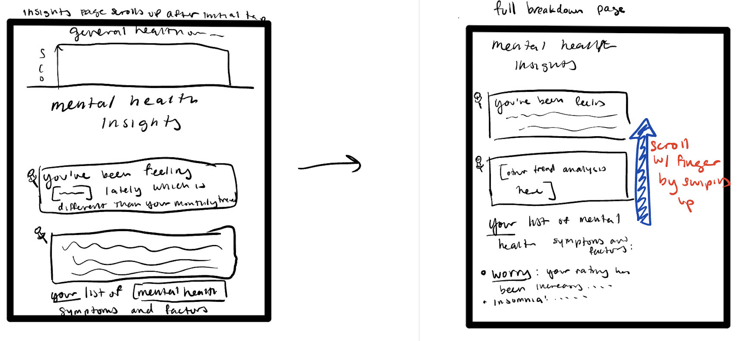
A5 Taskflows - Moderate
We will add more graphs to represent health information.
Make the pie chart buttons more intuitive; have clickable icon on them to inform user that they are clickable.

Slide 19
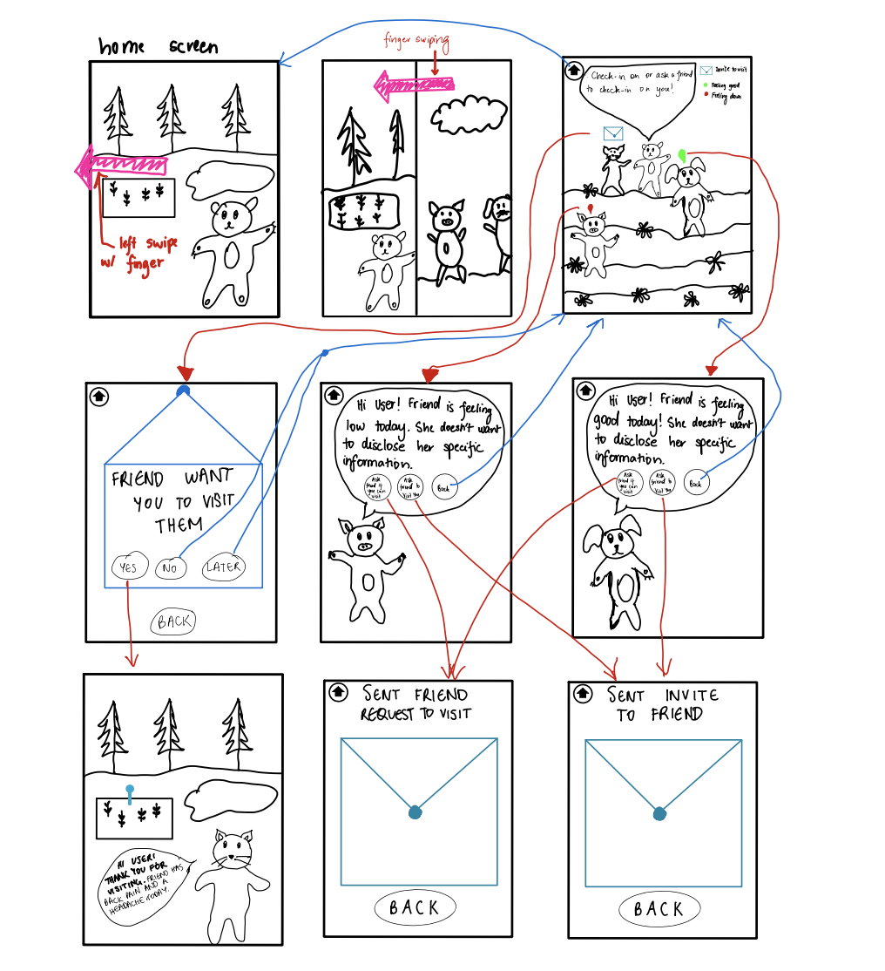
A5 Taskflows - Complex
We will make it more clear that you can view your friend’s garden.
We will make task flow slides 5 and 6 less wordy and add more intuitive imagery.

Slide 20
Usability Goals & Key Measurements

Slide 21
Efficient: Users are able to complete tasks in a reasonable amount of time with little issues
Pleasing: Users enjoy interacting with the prototype and want to come back for more
Key Measurement: amount of misclicks and how long it took to understand how to progress to the next screen
Three participants had severe problems interacting with the buttons in Task 2, from not clicking to clicking the wrong things to not realizing there were buttons on that screen
Three participants didn’t understand how to operate the free response question and chose to click ahead
One participant took 3 minutes to figure out how to take the daily survey from the home screen
Two users did not know how to progress without explicit next and back buttons
Two participants confused instructions to click the bear paw with clicking the screen instead
Key Measurement: how many times users expressed desire to continue and how many aspects of the prototype they found displeasing
One user had expressed outwardly that the community aspect made them feel safe and like their privacy was protected
Three of the users noted that there were places where certain wording elicited negative emotions, such as the phrase “here is how you are dealing with”
Two participants expressed eagerness to see their real “past” and “future” health stats
Three participants expressed excitement and satisfaction when their invites to their “friends” were successfully sent
All participants expressed interest in the garden and what it could possibly look like
Two users wanted to continue using the prototype after the tasks were completed

Slide 22
Progress Towards Goals
Currently, we have been working towards Efficiency by providing users clearer instructions on the screen and reducing ambiguity
For example, all clickable buttons now tell the user “Click for…” to indicate that it is a button, and scrollable pages have a hovering text bar telling the user “Scroll to…” to indicate scrollability
Free response questions have been replaced by yes/no formatted questions where a user is able to indicate if they are experiencing a certain emotion, feeling, etc. by clicking a button
We have been improving how Pleasing the prototype is by implementing friendlier and clearer wording and more specific health trend data
We have taken user feedback and augmented wording to make sure there is no implied suffering or hardship - rather, wording is open for the user to interpret
We have added additional graphs displaying individual symptom/emotion trends over time in the Monthly Summary tab

Slide 23
Revised Interface Sketches

Slide 24
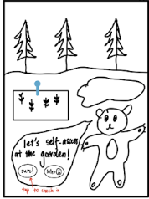
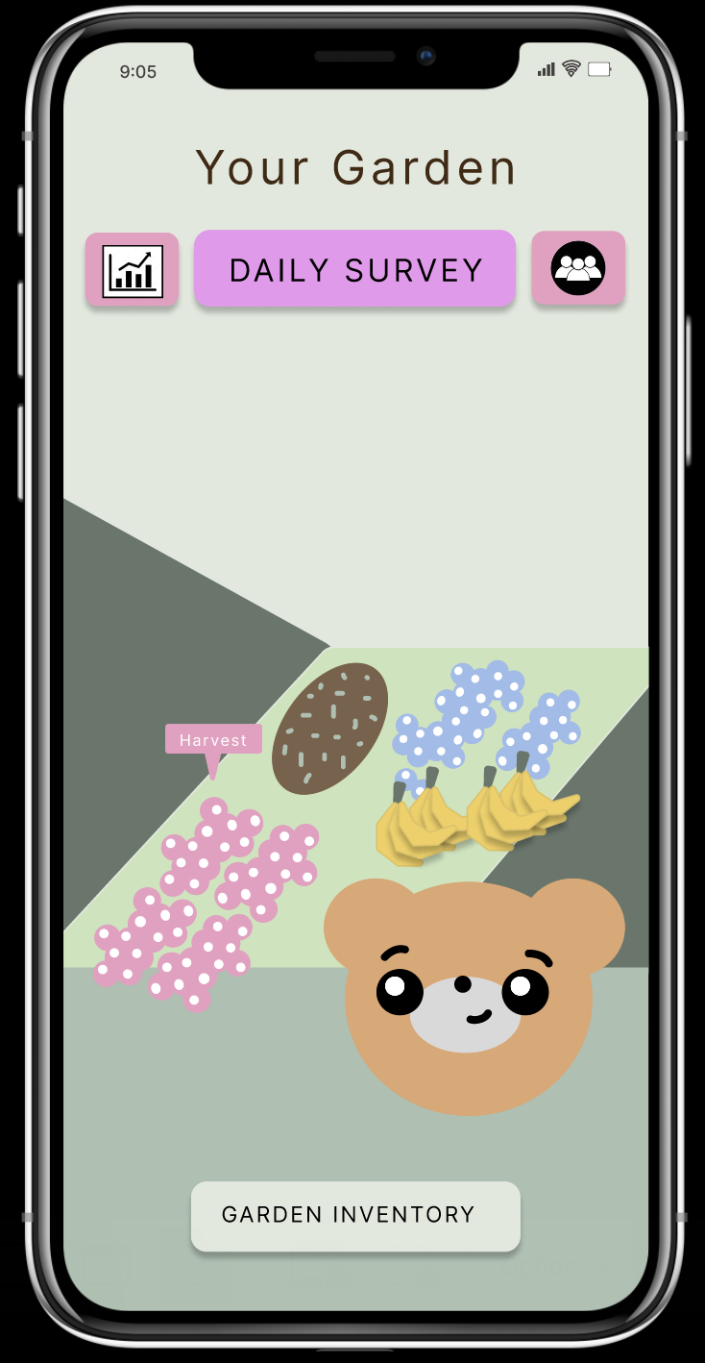
UI Change 1: Home Screen
Changes:
Organised homepage
We removed unnecessary background imagery and made the garden the focal point of the homepage. This incorporates feedback from our users to make the homepage less cluttered and our peers to reduce redundancy.
Improved navigation
We added icons to replace swiping to the friends and stats pages. We did this because users did not know how to swipe to their preferred page. Thus, the icons improve user efficiency. Additionally, we incorporated CA feedback and removed “Click for” usage and made our “Garden Inventory” and “Daily Survey” buttons more visible and differentiated as buttons.
Changed Color Scheme
We changed the colors of the buttons to provide contrast with the background. Our pastel colour scheme adds to the pleasing nature of our app.
Low-fi Sketch
Mid-fi Revision

Slide 25
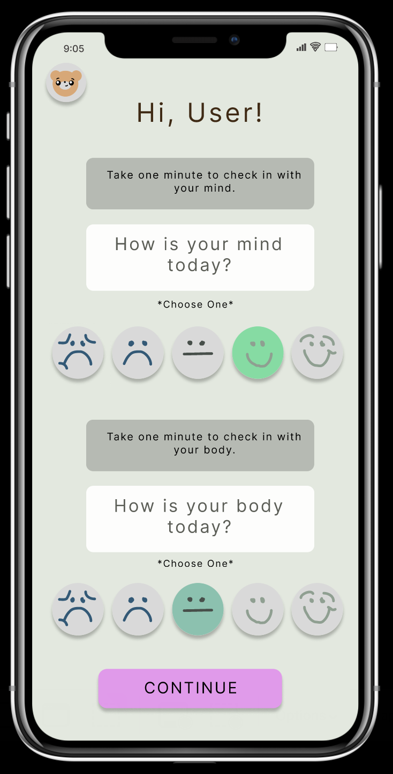
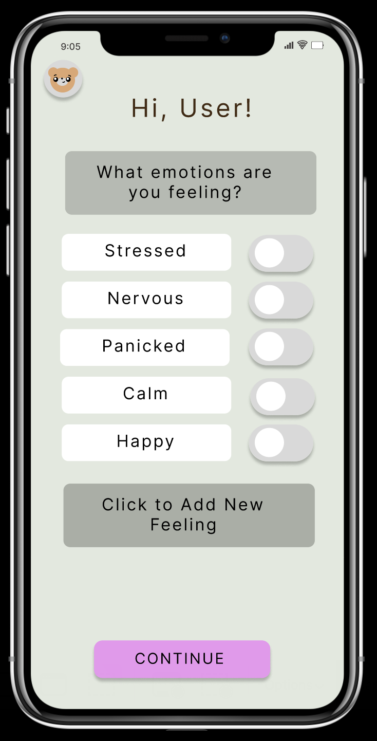
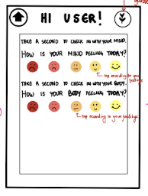
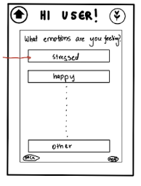
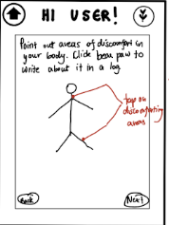
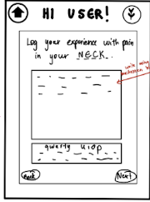
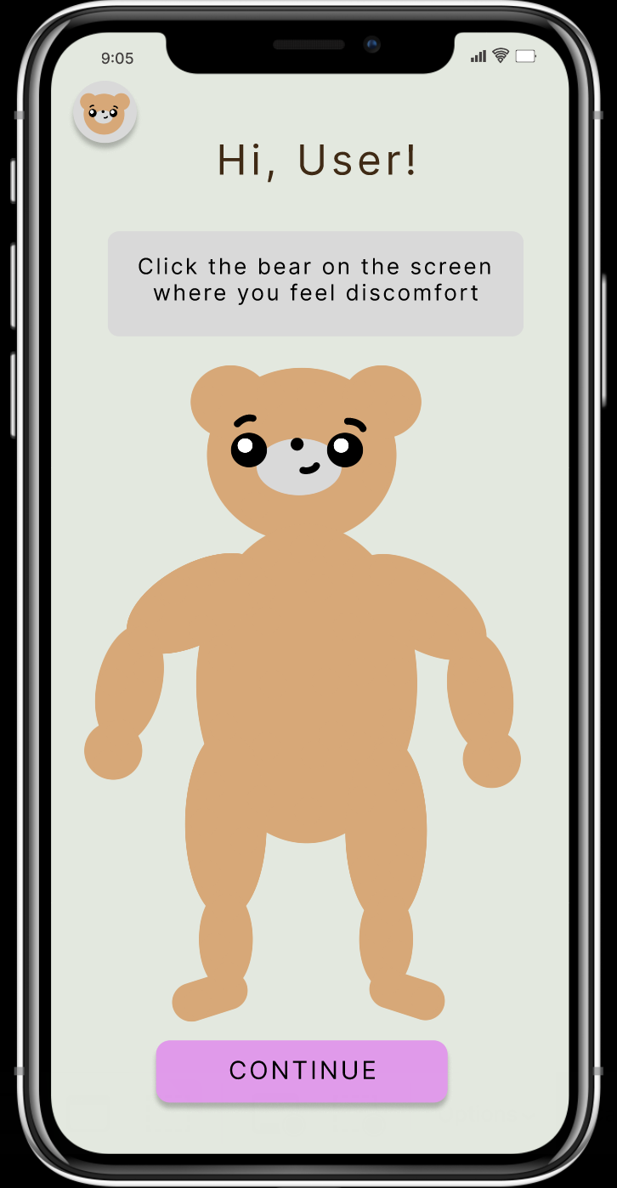
UI Change 2: Daily Survey
Changes:
Aesthetic Changes
We changed the image of the home button to reflect the playfulness of our app and made it easier to understand. We also changed the spectrum of colours in our mind-body check-in to more calming colours in shades of blue and green.
Intuitive Check-In
We removed check-in questions requiring extended paragraphs as our prototype testees responded negatively to those. Instead, we used on-off buttons for our emotional check-in to make inputting emotion easier and included an option to add a new feeling. Instead of having our user click on the physical bear to check-in with their body, we used the drawing of a bear with clickable body parts. We did so as prototype testees did not understand how the physical bear was to be used in this setting.
Low-fi Sketch
Mid-fi Revision

Slide 26
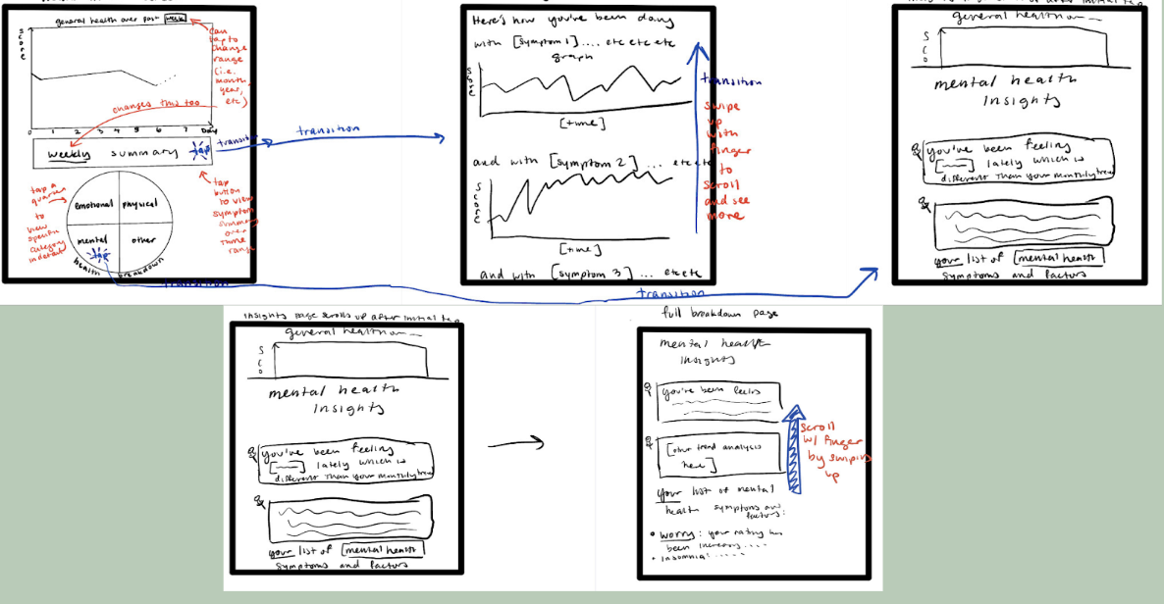
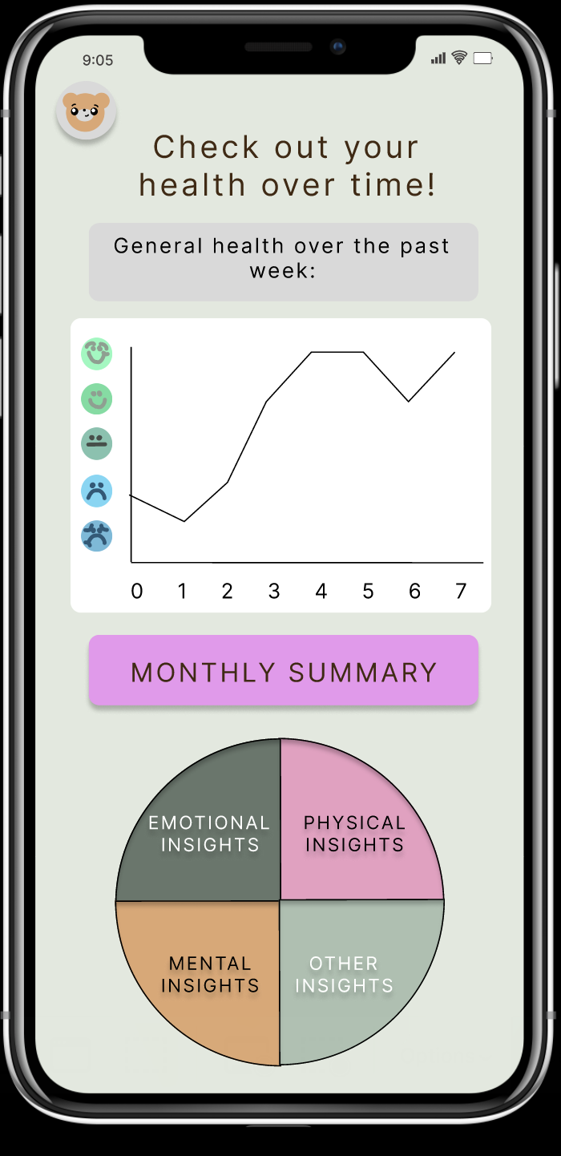
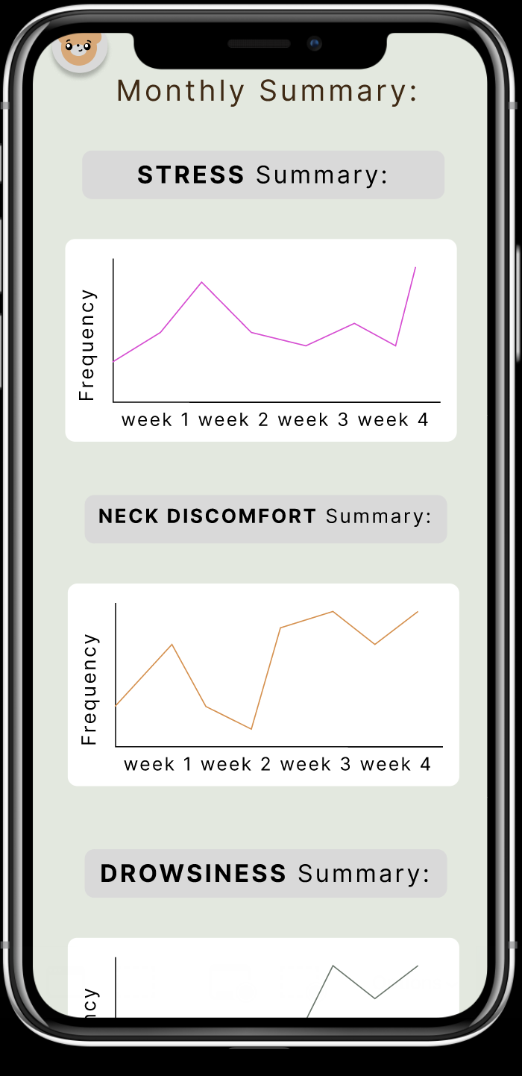
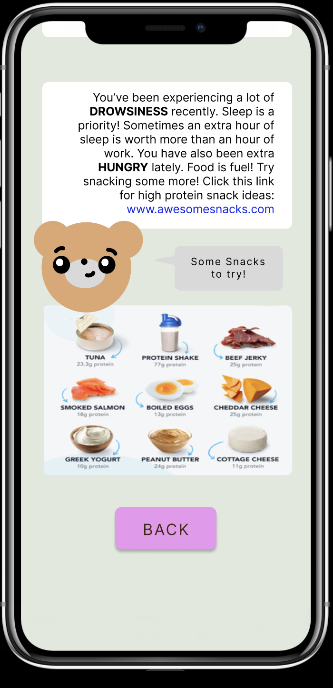
UI Change 3: Insights Page
Changes:
Intuitive buttons
Our users didn’t realise our monthly summary and pie chart buttons were buttons. Thus, we changed their colours and shapes to differentiate them as clickable buttons.
Back and home page buttons
We added both, back and home page buttons on each page so that users can efficiently navigate to whatever page they need, as they expressed the want to do so during testing.
Imagery
We received feedback in studio and during testing that our data was too wordy. We not only added more graphs, but also added pictures (in this case, of neck exercises and food items) to enable the user to break the monotony of the data so that they can have a more pleasant experience and navigate the information on the page with ease.
Low-fi Sketch
Mid-fi Revision

Slide 27
Medium-Fi Taskflows

Slide 28
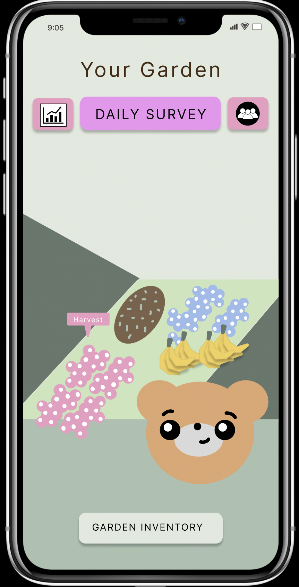
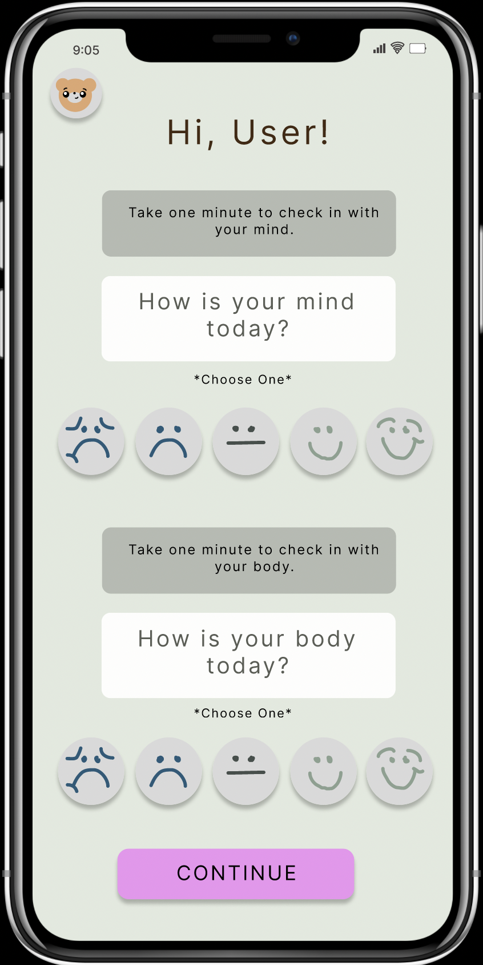
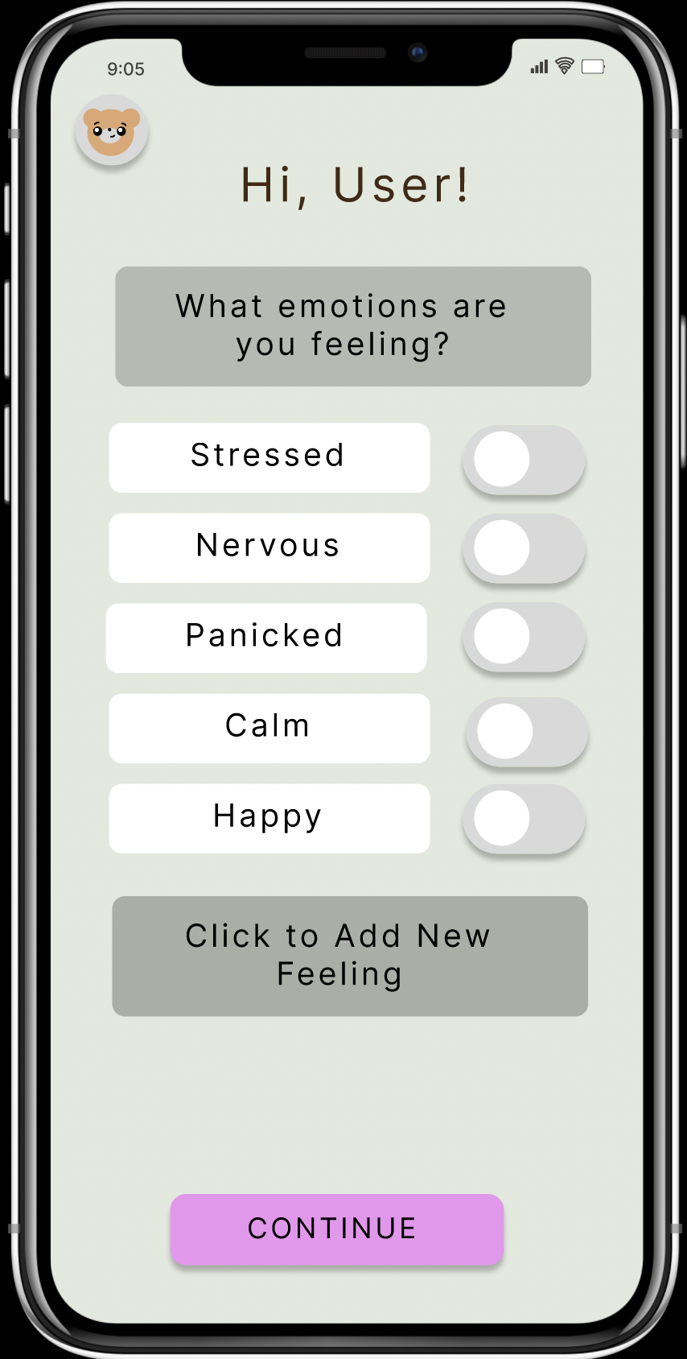
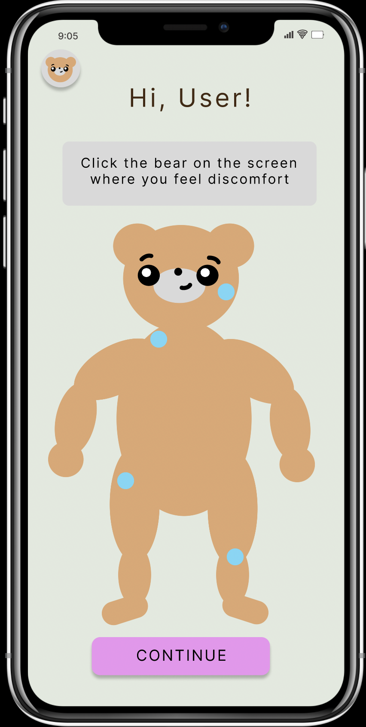
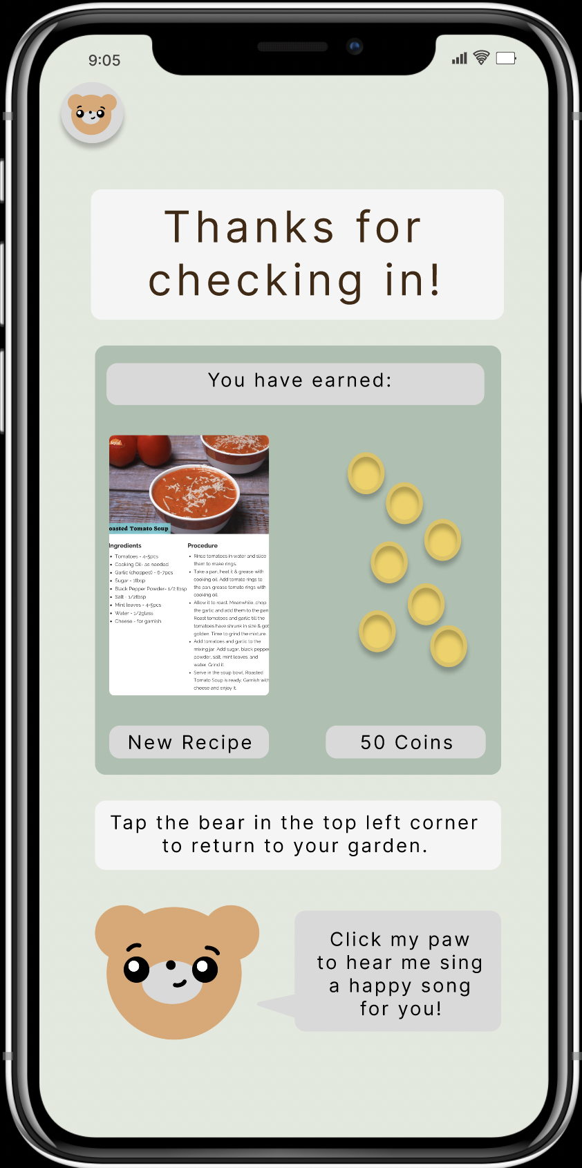
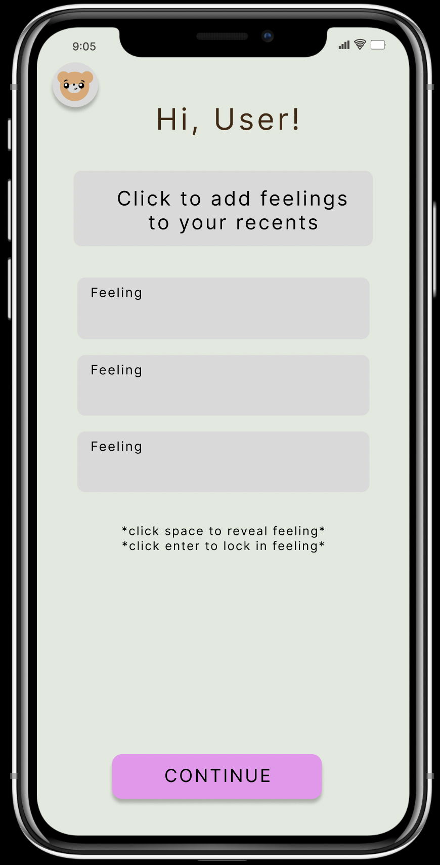
record one’s current mental and physical well-being
Click Daily Survey to start task
Click faces to select answer
Click Continue for next screen
Toggle button to select emotion
Click Continue for next screen
Click Continue for next screen.
Areas on body light up on click
Click Bear in top left corner to return to home screen.
Click text box to input new emotion.
Click continue for next screen

Slide 29
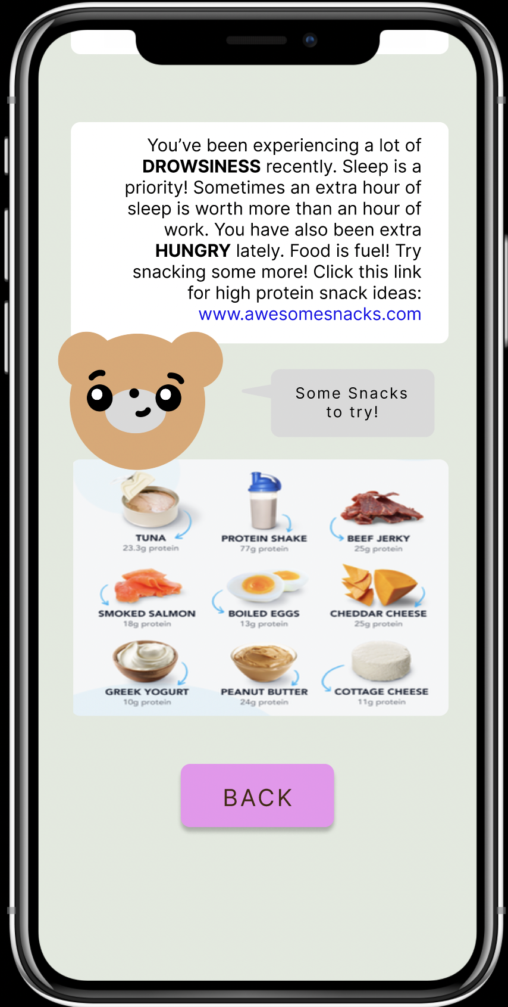
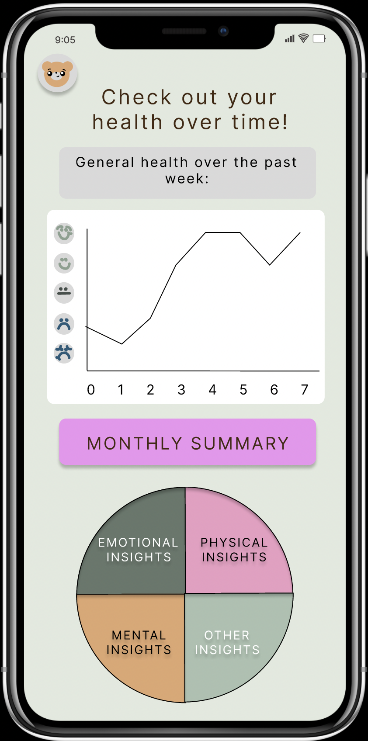
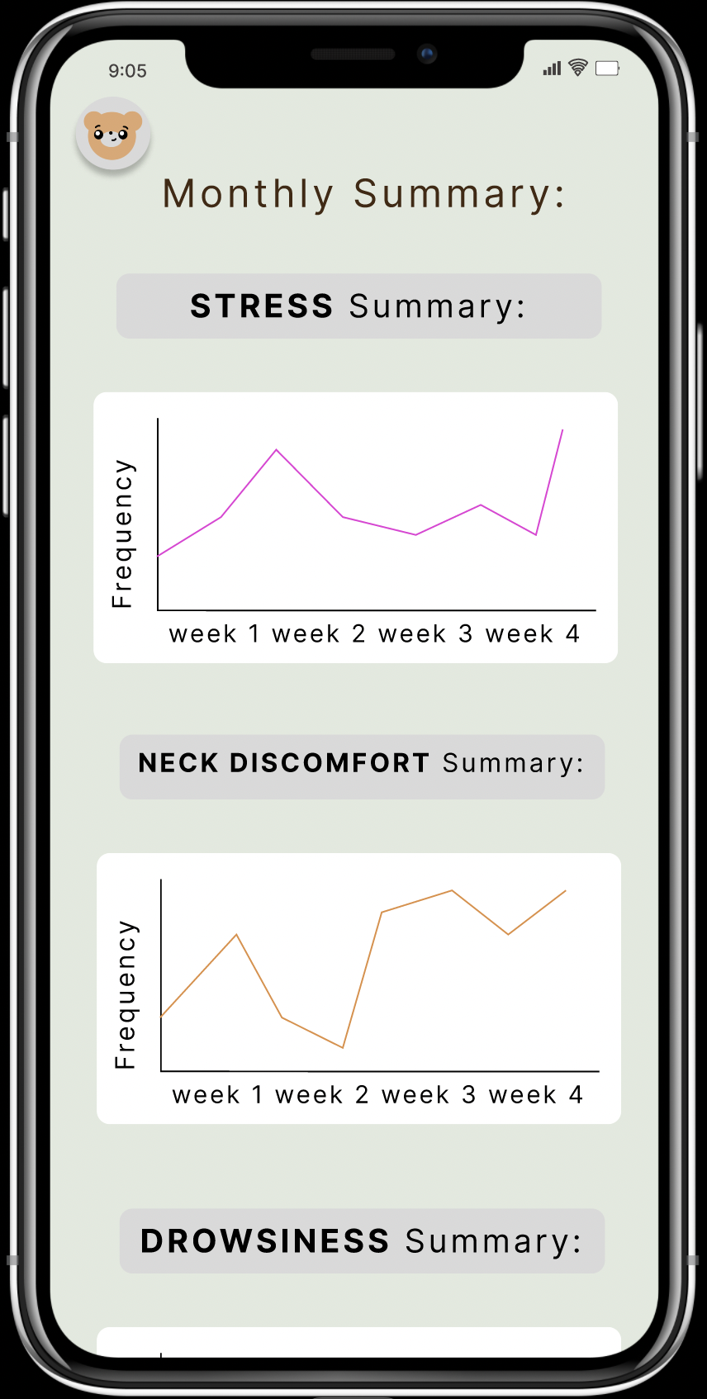
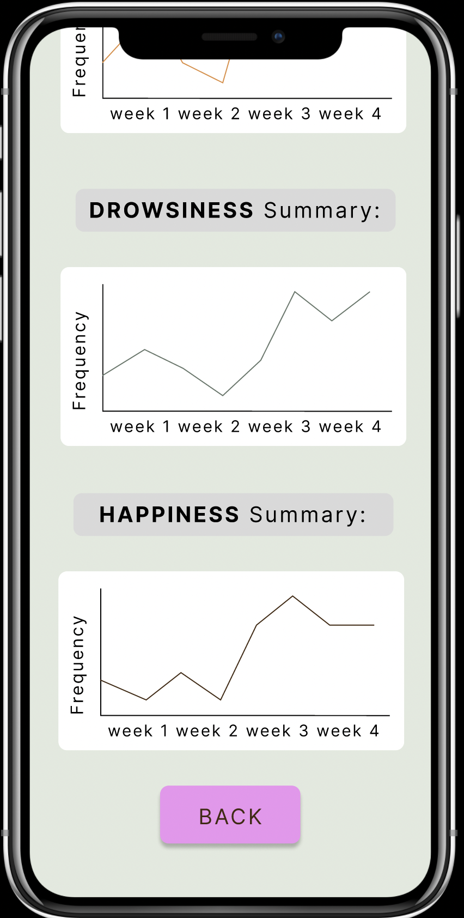
compare and track mental and physical wellbeing over time
Scroll to continue reading insights.
Click Back to return to summary screen
Click Chart Icon to start task
Click Monthly Summary to view detailed graphs
Click pie chart components for detailed breakdown of wellbeing
Scroll to continue reading insights.
Click Back to return to summary screen

Slide 30
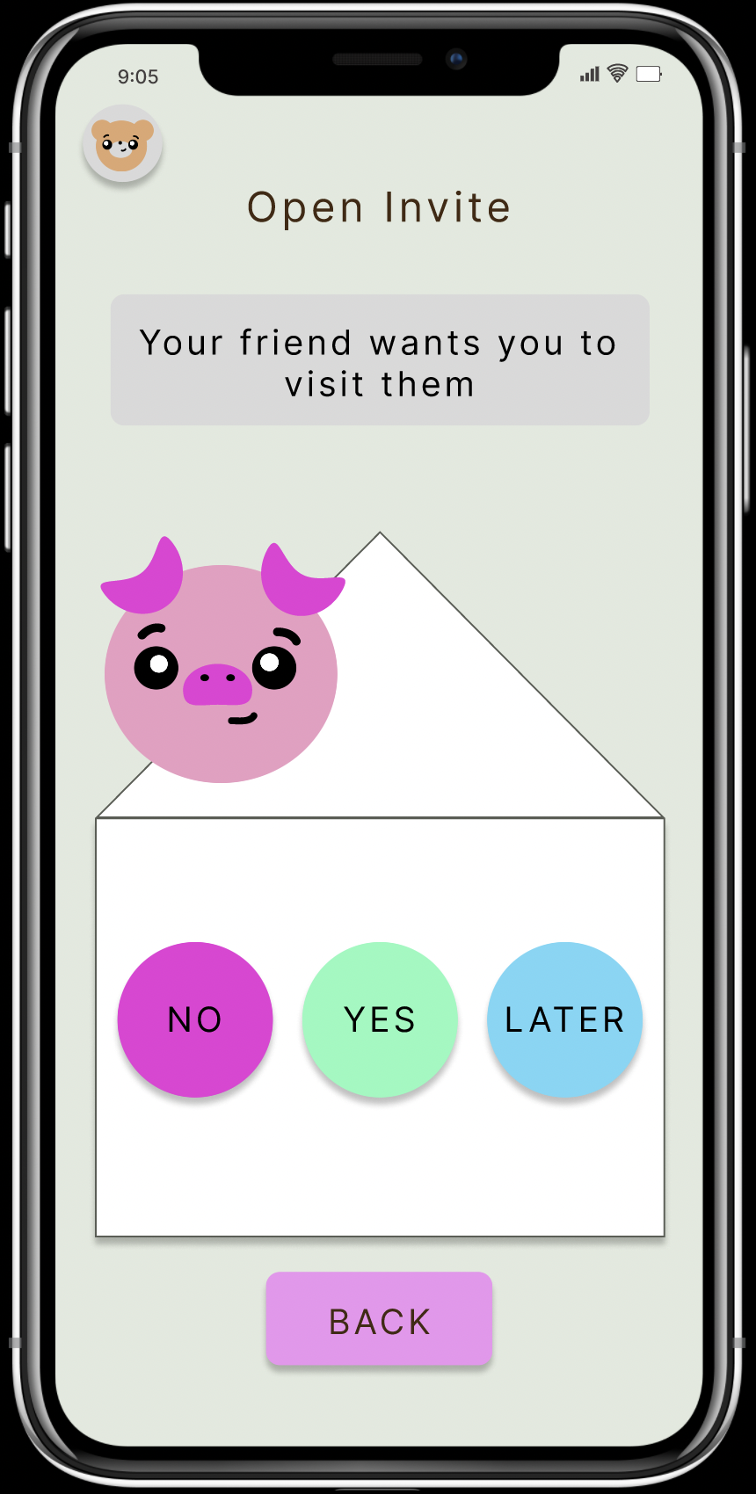
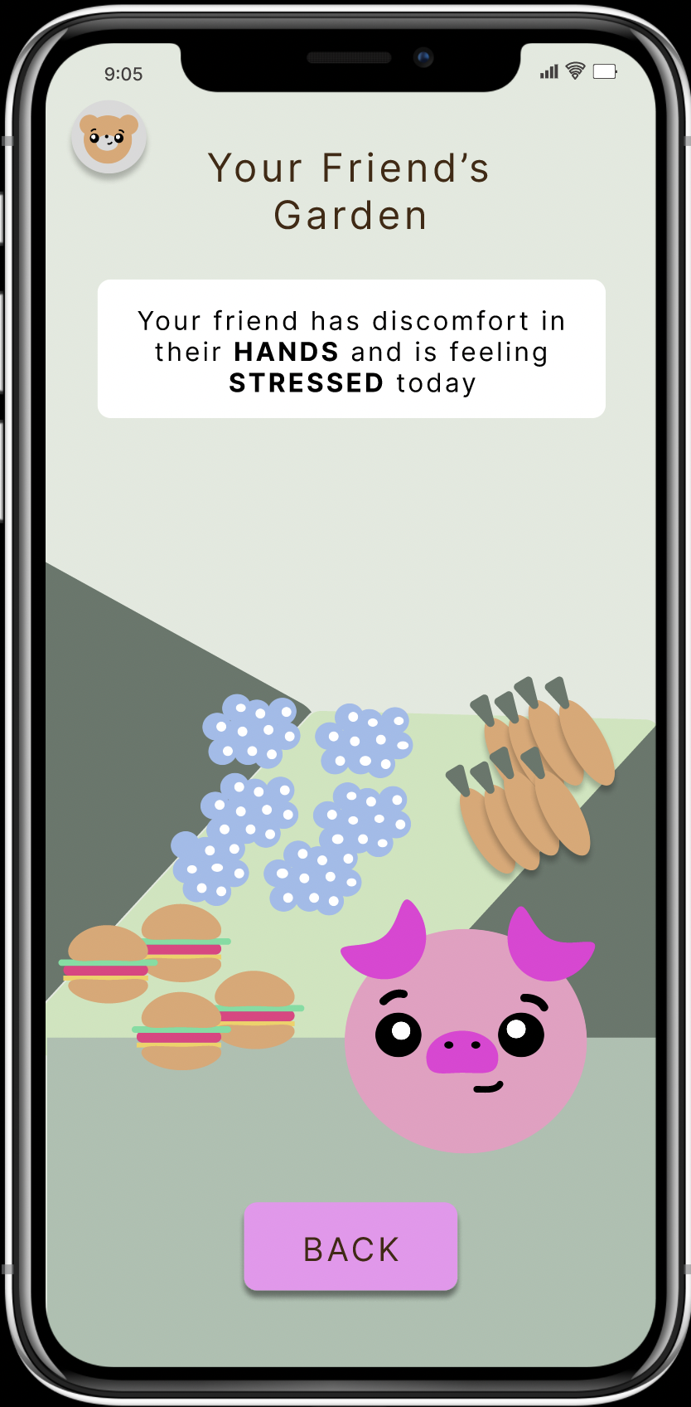
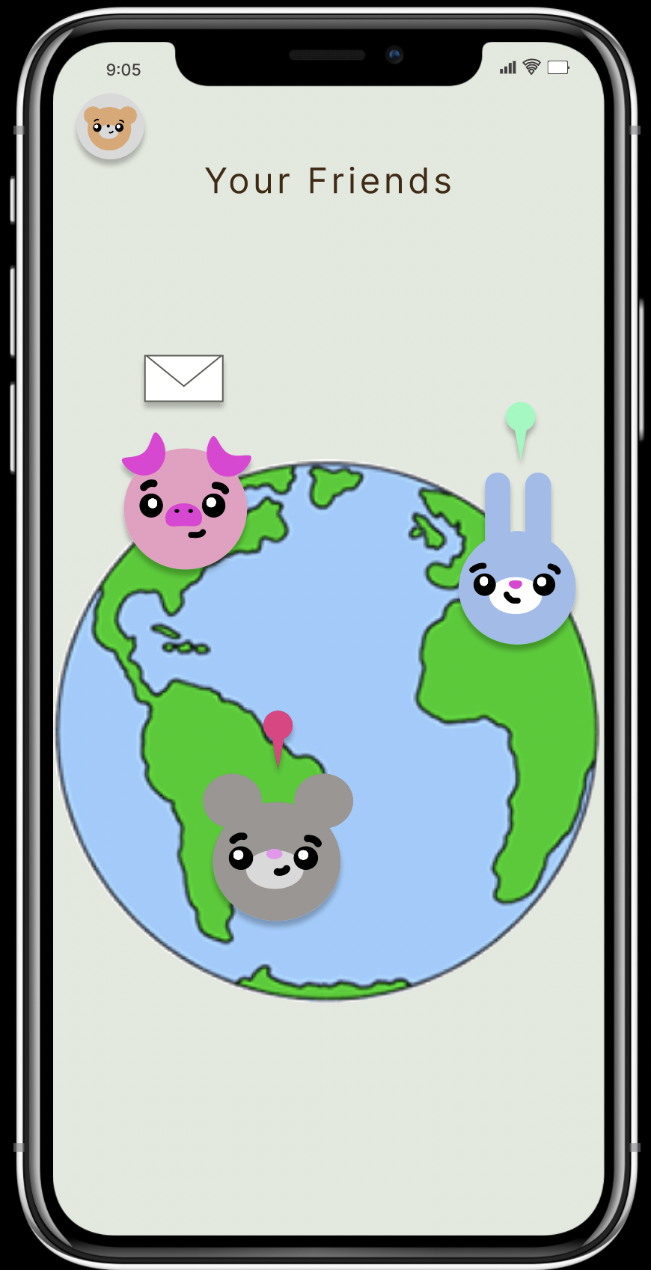
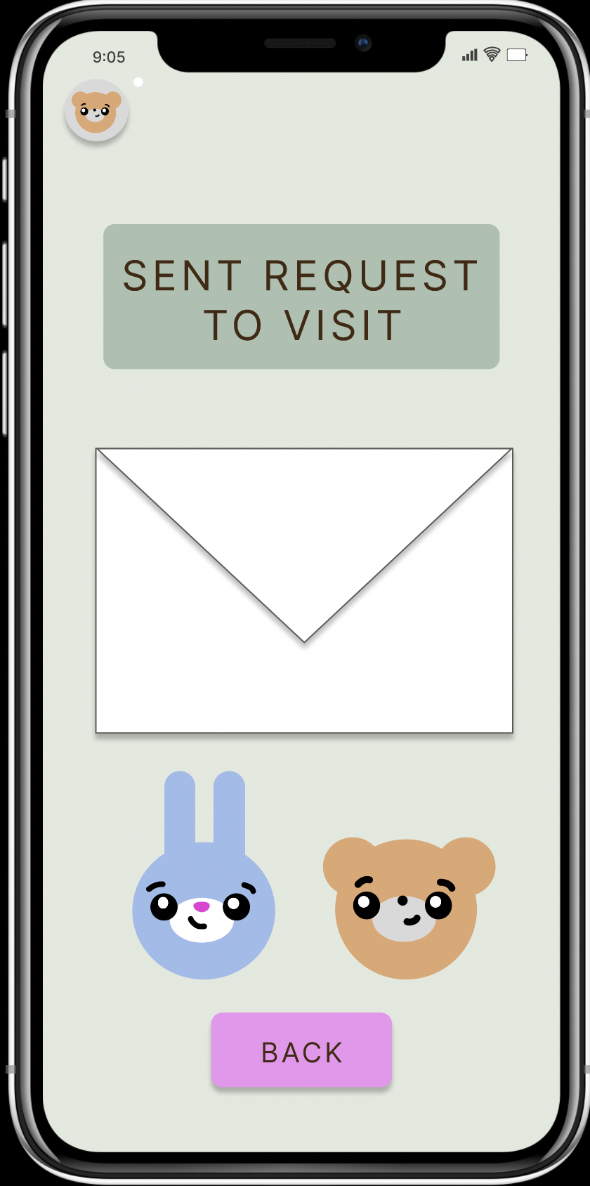
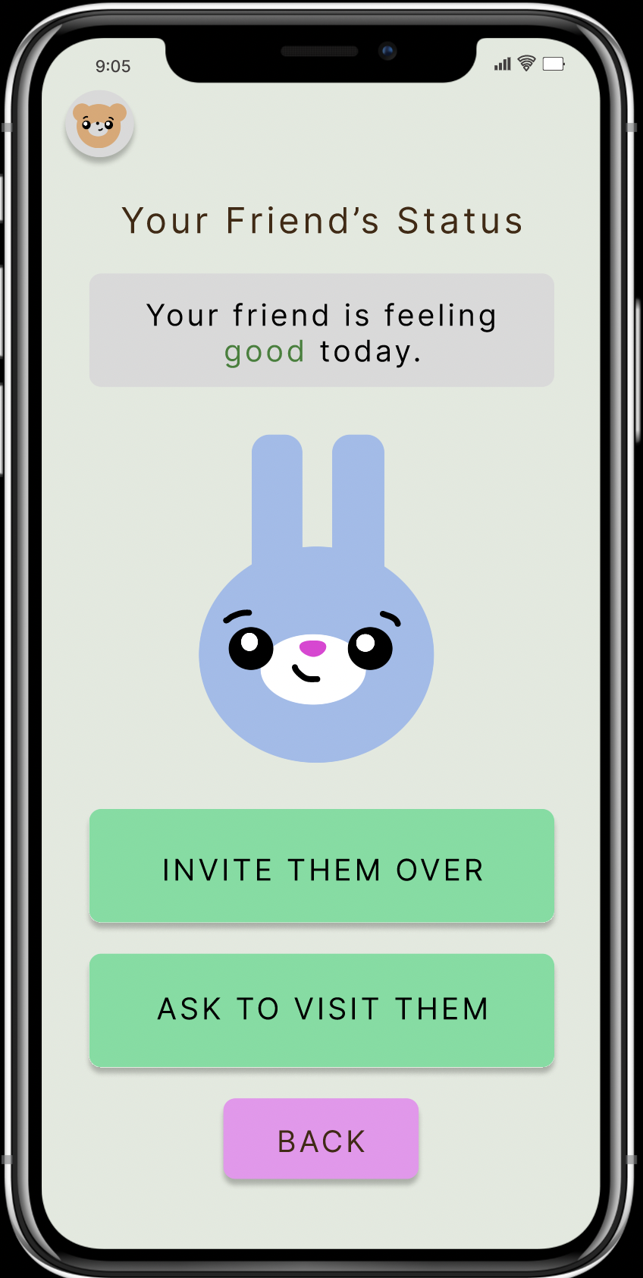
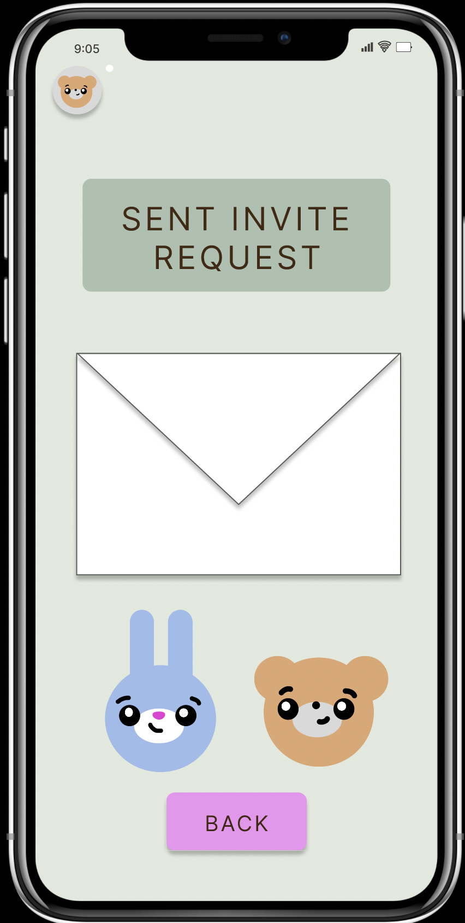
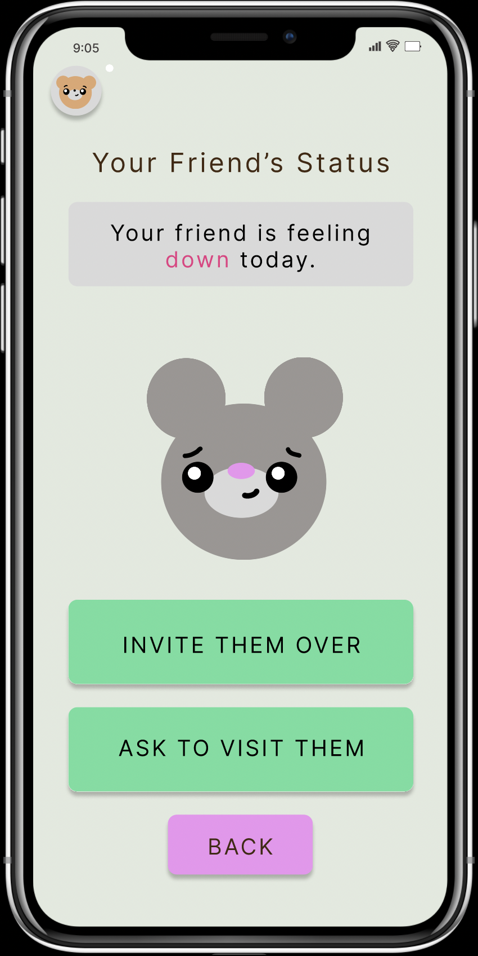
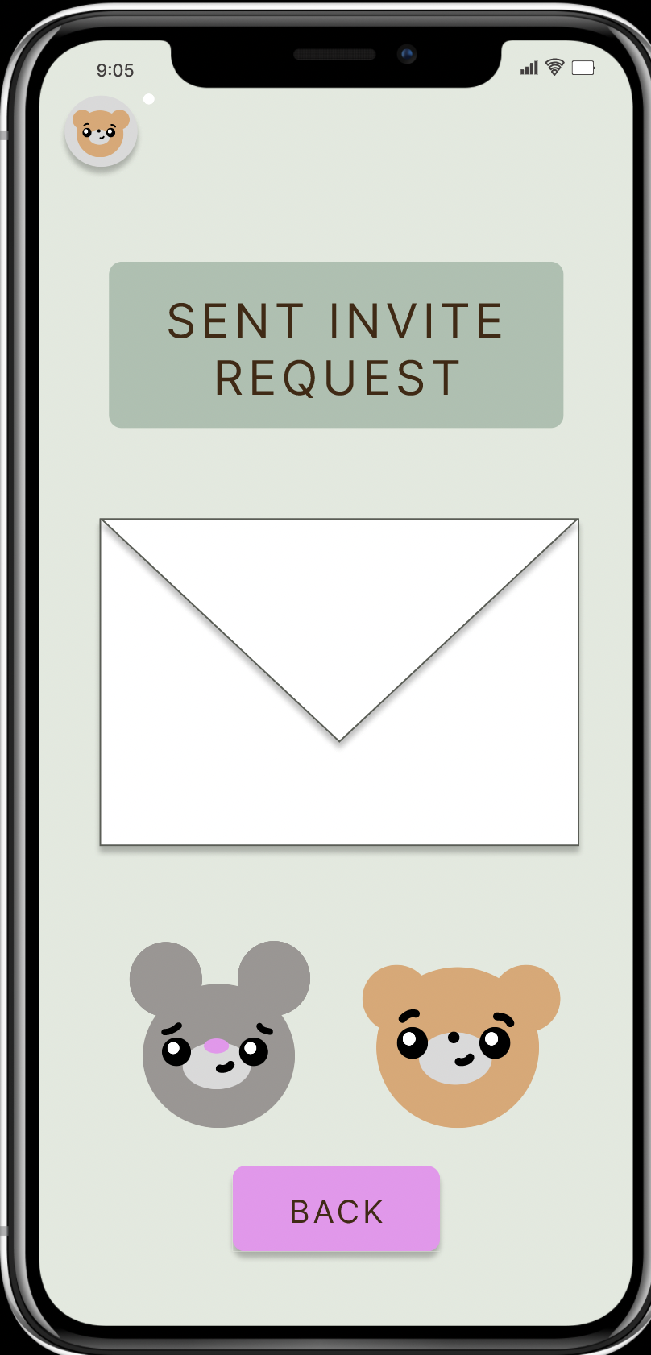
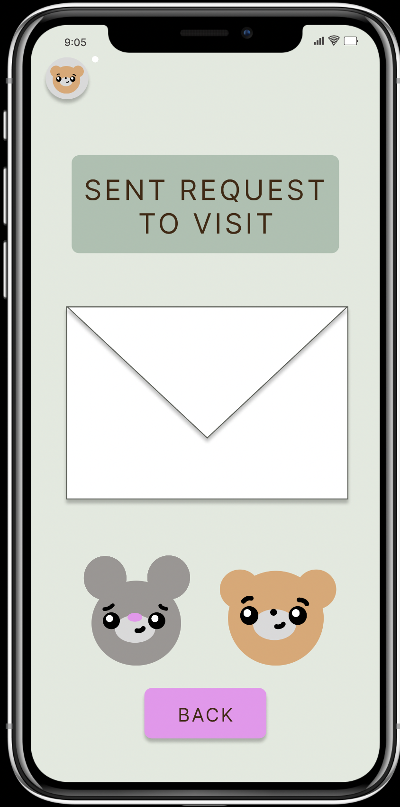
make others aware of how one is feeling
Click group icon to start task
Click animals for detailed messages

Slide 31
Prototype Implementation

Slide 32
Tools
We constructed our medium-fidelity prototype using Figma. Since lucIDLy is an app with a mobile format (even when accessed from the plush toy’s screen), we were able to develop an iPhone UI for lucIDLy with Figma. This gave us the advantage of an easily and realistically testable prototype. All graphics for the prototype were constructed inside Figma using shapes and text.
Though lucIDLy is intended to be for use with all mobile platforms (such as Android, etc), Figma only allowed us to model for an iOS platform. This means that users of different mobile operating systems might not experience a 100% accurate prototype to what their use of the app would really look like.

Slide 33
Limitations
For our Med-fi prototype, we were unable to implement every single small feature of the app, especially those that were extremely similar to other features and would be redundant to implement for the prototype. For example:
Users are only able to harvest one type of crop at this time, as displaying multiple right now would be redundant
Users are not able to physically type text input into free-response questions, as this feature is not yet necessary to demonstrate how the free-response questions work
On the health-over-time screen, users are not able to change the specific stat that the graph displays even after toggling the emotion faces next to the graph
On the same screen, not all of the insight buttons have been implemented yet, as they all will lead to roughly the same format of screens that follow. Only the Physical Insights button has been implemented to demonstrate the format.
On the world-view screen where users are able to view friends and their statuses, the invitation to view the pig’s garden is only able to be accepted, and none of the other options have been implemented, as they all lead back to previously seen screens
We also have not yet implemented the user privacy feature where on the user’s end, they are able to set who is able to view their health check-in report. We can see the result of this feature on the world-view screen where friends display how they are feeling, but the process on the user’s end will be added later.

Slide 34
Wizard-of-Oz
Hard-Coded
Health Insights: Due to the lack of historic use, there is no past data to draw from - as such, the prototype ‘magically’ analyzes supposed past health data to give the user insights, without demonstrating how this occurs.
Free-Response Input: Users are unable to actually input their own data freely, so canned responses have been hard-coded and will ‘magically’ appear after a few keys have been pressed.
Rewards: Since there is no past user data to demonstrate the ‘progress’ that this user might have made as reasoning for why they are receiving specific rewards, we have acted as the algorithm that will determine the quality and quantity of rewards that the user receives from checking in.
Friend Status: Users are unable to manually set their own status. However, on the world-view screen, we are still able to view other friends’ statuses even with skipping this step. This is so that users can understand the results of this feature and how it might impact friend visit requests without having to do anything on their end.
User information: As there are no users on the app, all user data, including the one who is currently using the app, has been hard-coded. All historic health data has been hard-coded, as there is no historic use to draw from. All friend data - habitats, current status, etc. has been hard-coded so that there are friends to interact with.
Free-Response Input: In the daily survey, the option to input new feelings does not allow the user to manually input their own data. Instead, canned responses are hard-coded as examples.
Inventory: As there is no historic use by the current user, all objects in the inventory must be hard-coded.
Health Insights: Again due to the lack of historic use, the health insights page has been fabricated and hard-coded to provide an example.

Slide 35
Appendix

Slide 36
Figma Link
https://www.figma.com/proto/wiNsBl88RIobAiH8NeEOMg/Lucidly?node-id=1%3A2&scaling=scale-down&page-id=0%3A1&starting-point-node-id=1%3A2

