Slide 1
Sketching, Low-fi Prototyping & Pilot Usability Testing
Maya Harvey, Jonathan Affeld, Janelle Rudolph, Gayatridevi Tarcar

Slide 2
Daily Self-Help With Friends

Slide 3
Problem/Solution Overview

Slide 4
The Problem
Hard to understand symptoms when they are not talked about
Younger people need these conversations in their community to assess their symptoms
Hard to report symptoms because of social pressures/lack of conversations around many medical conditions
Notes:
Problem

Slide 5
The Question
how do we let users feel confident and enjoy independent self assessment while connecting this with a form of community?

Slide 6
The Solution
Create an empowering and fun routine to help the user better understand how they are feeling currently and over time that utilizes the power of communtiy

Slide 7
HOW?
Concept: An idle game model with a habitat and creatures where the user is prompted to answer daily questions about their wellbeing.
Motivation: Upon completion of these questions they will earn coins/credits/rewards that will enable them to expand and evolve their garden and creatures
Novelty: Users also will be able to visit other users' habitats and talk to other users. They can choose to share their health status, invite friends over or ask to check on friends.

Slide 8
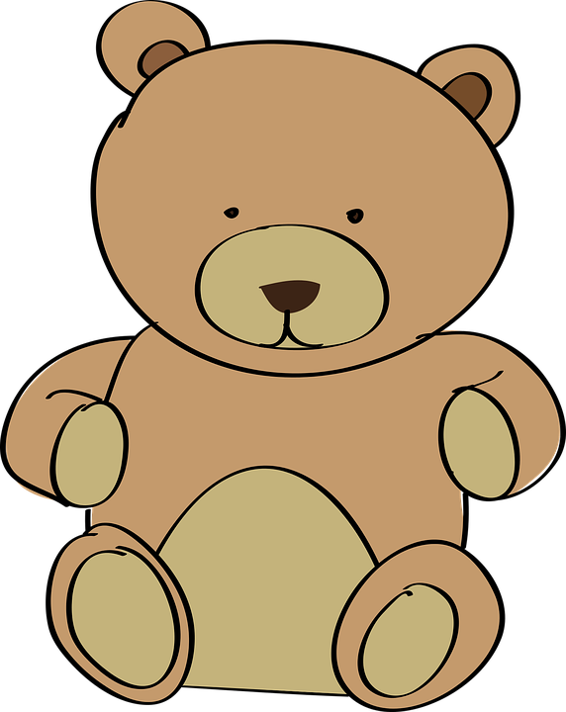
INTERFACE
Screen console built into a plush toy with a dual app component that can be used on the go. The toy is to create a comfortable home base for users.

Slide 9
Outline of Talk

Slide 10
Overview sketching process
Interface selection rationale
How did we construct the low-fi prototype?
Taskflow overview
Testing process
Results overview
Implications?

Slide 11
Concept Sketches

Slide 12
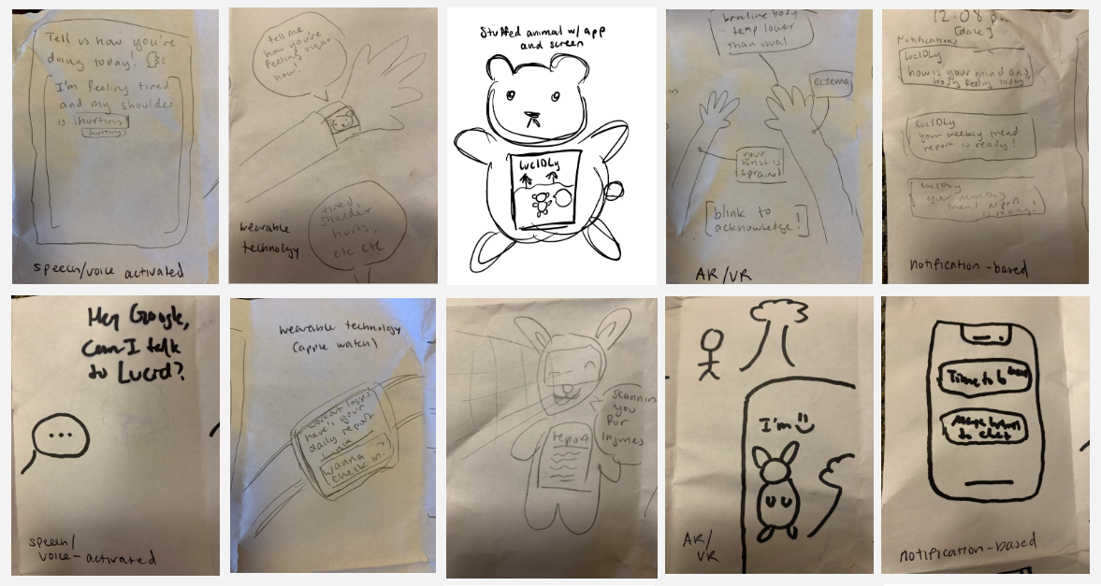
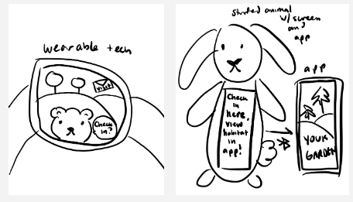

Slide 13
Realizations

Slide 14
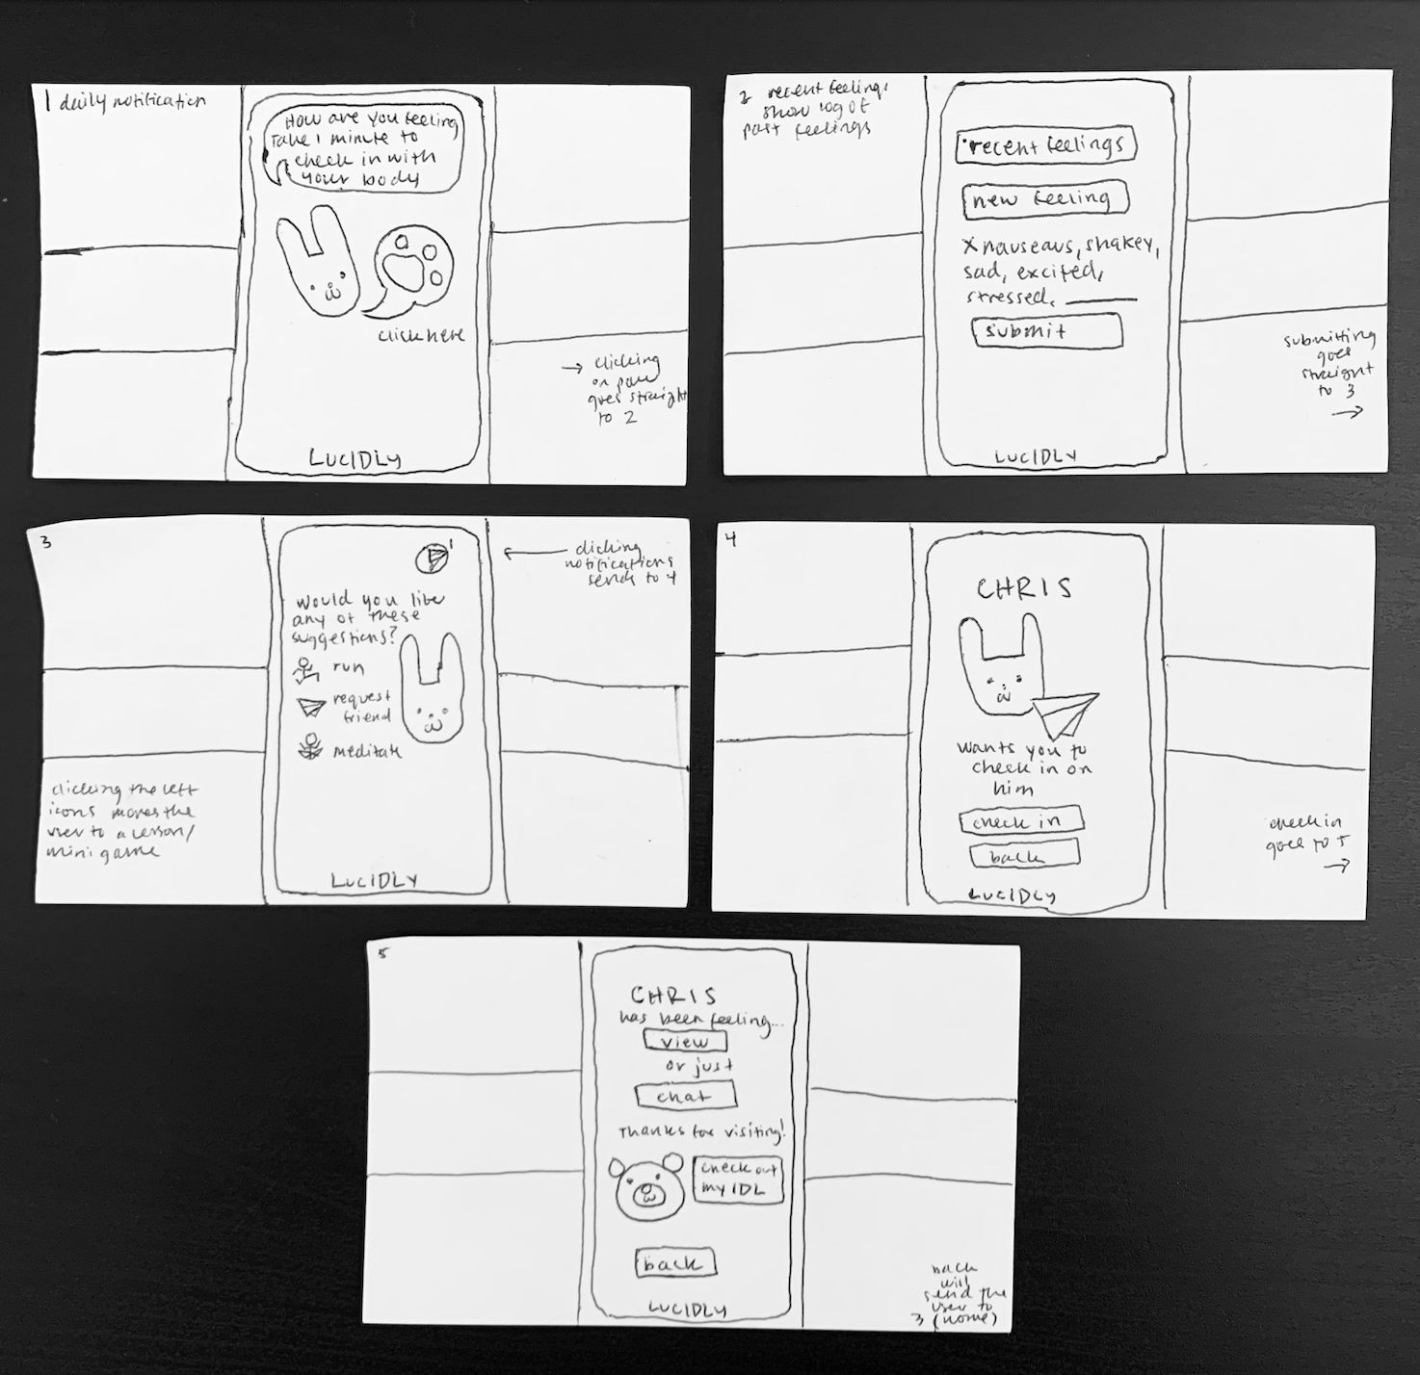
Wearable Tech
(Apple Watch)

Slide 15
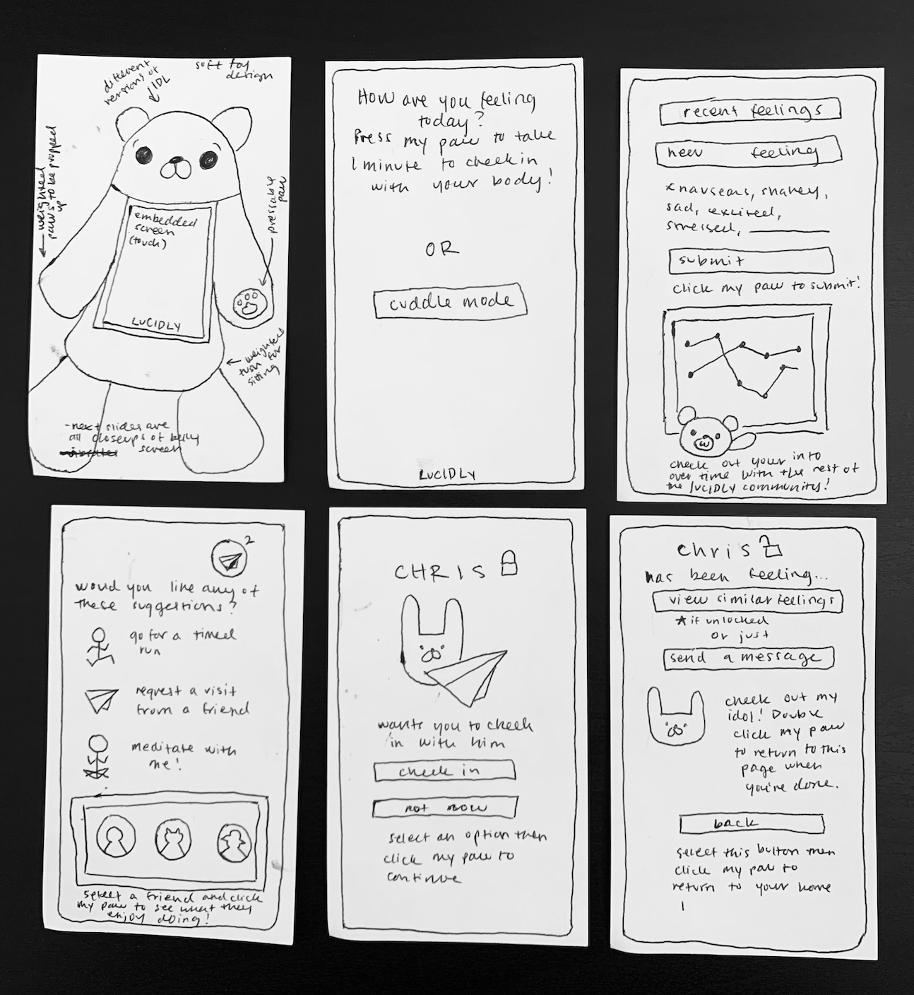
Stuffed Animal w/Screen and App

Slide 16
Selected Interface and Rationale

Slide 17
Stuffed Animal w/ Screen & App
Winner Winner!

Slide 18
Pros of Stuffed Animal
Very unique and novel in market space
Brings the value of wellness home, having a physical animal could make the user feel very safe and comfortable
Help create sense of community by creating trend to have the toys
Opportunity for creative and never before seen design
Pros of Wearable Tech that were good but not good enough:
Already has biometric stat collection built into Apple Watch
Convenient for travel which would make logging symptoms easy
These Pros did not benefit our design values enough!

Slide 19
Cons of Stuffed Animal
Cons of Apple Watch:
Not everyone has an Apple Watch; unequal opportunity
Limited space to view habitat on small screen
Unoriginal
People might not want to carry around an animal, too cumbersome
Don’t want people to purchase just for the physical toy but also to actually use the app and self-assess
By connecting the stuffed toy interface with an app that you can download on your phone, these cons can be minimized.

Slide 20
…Constraints of the Stuffed Toy Platform?
Necessitates both stuffed toy screen functionality and phone app functionality
Screen on stuffed toy must be large enough to be readable but small enough to fit within medium sized toy chest and not obstruct cuddliness of toy
User must be able to physically interact with stuffed toy (i.e. press paw) and have this result in a change on screen

Slide 21
What Ultimately Shaped Our Decision?
After conducting extensive market research, no other health assessment/self-help/personal health app has a direct interface with a stuffed plush toy
Many members of the team reflect fondly on stuffed toys they were attached to as children and still have today, demonstrating clear emotional attachment and grounding in these stuffed toys that will help with consistent self-assessment

Slide 22
Low-Fi Prototype Construction

Slide 23
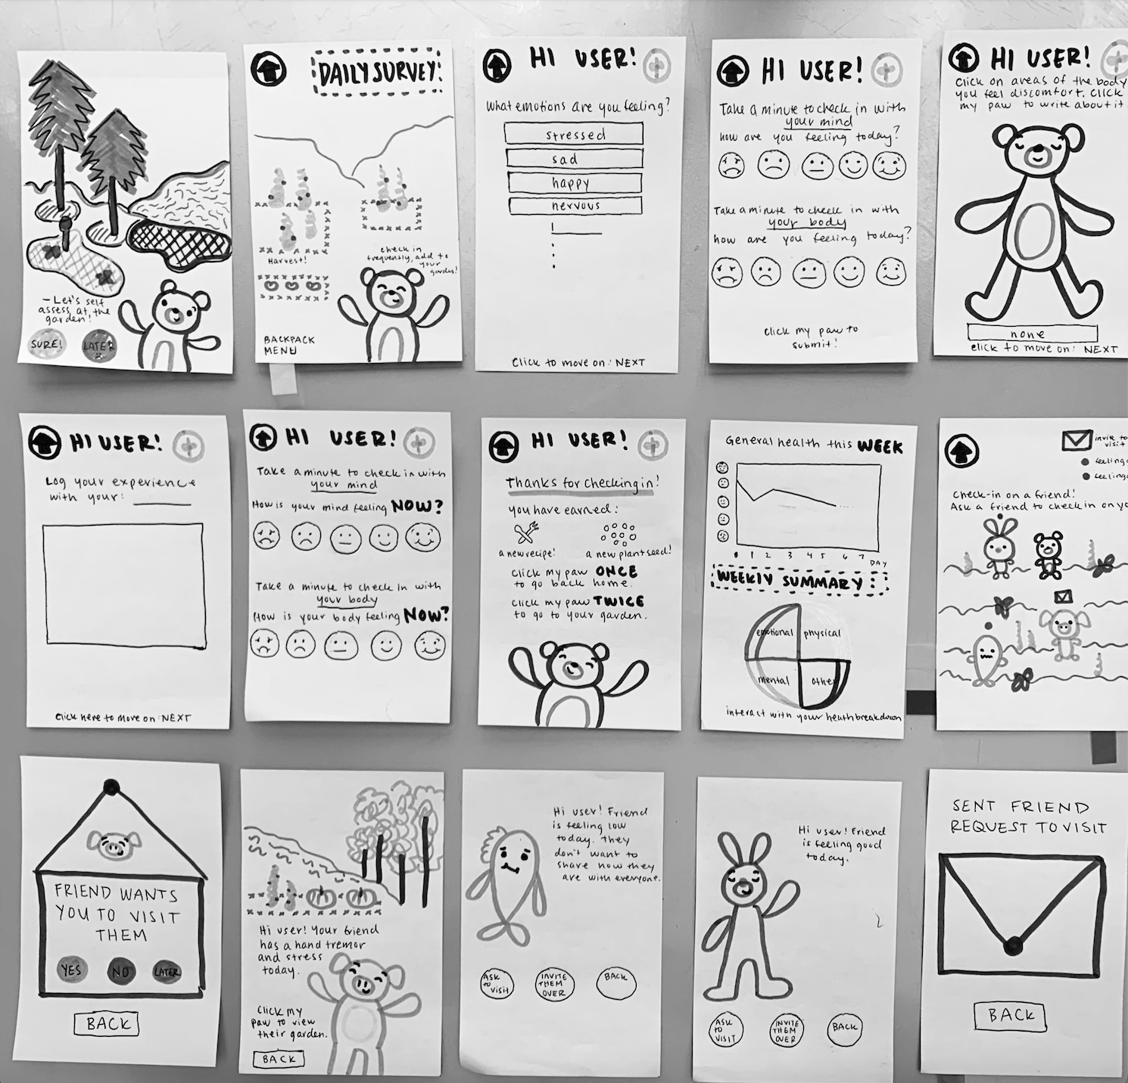
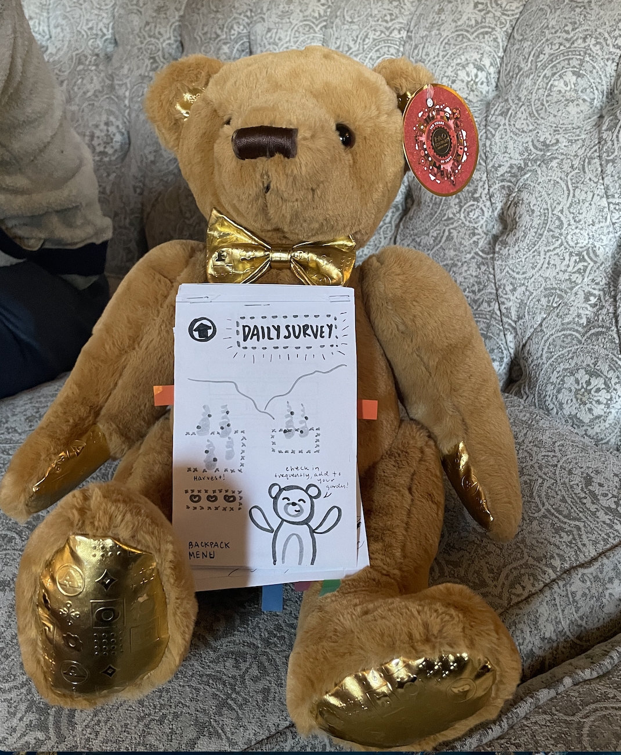
For our low-fi prototype, we chose to use a paper flip book with tabs to simulate an app. We have extended paper segments to simulate scrolling, and page flips to represent button taps. The flip book is mounted onto a stuffed bear on its belly, in the same place the screen would be attached to.

Slide 24
Low-Fi Prototype: 3 Task Flows

Slide 25
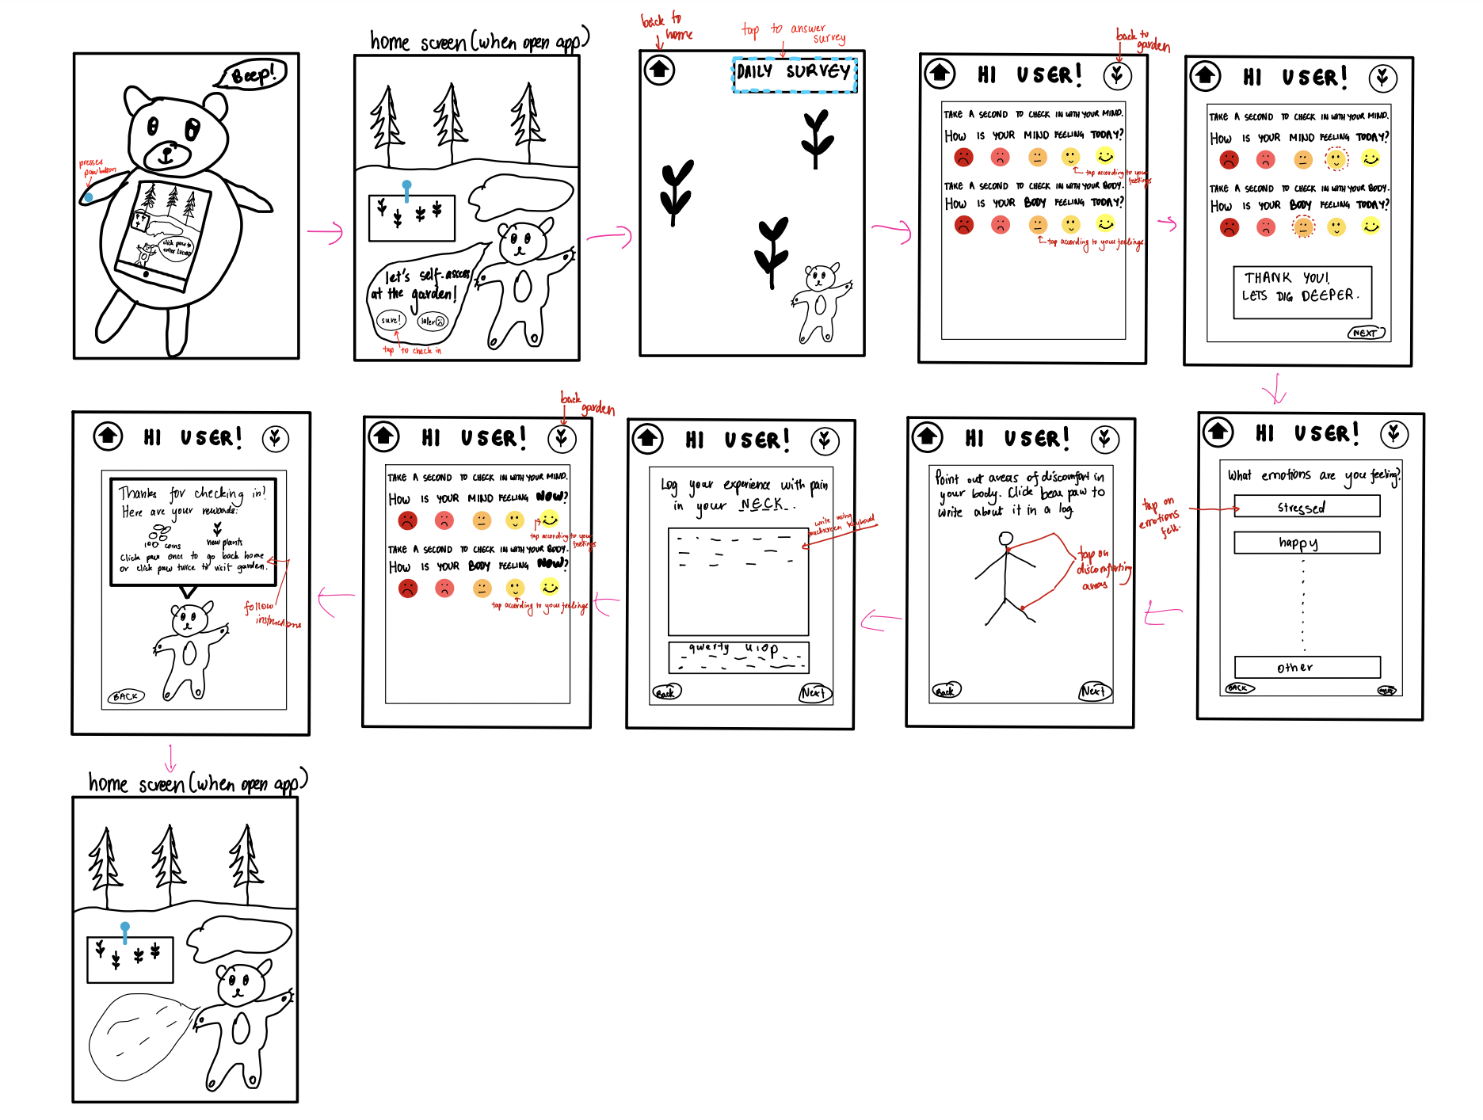
Simple

Slide 26
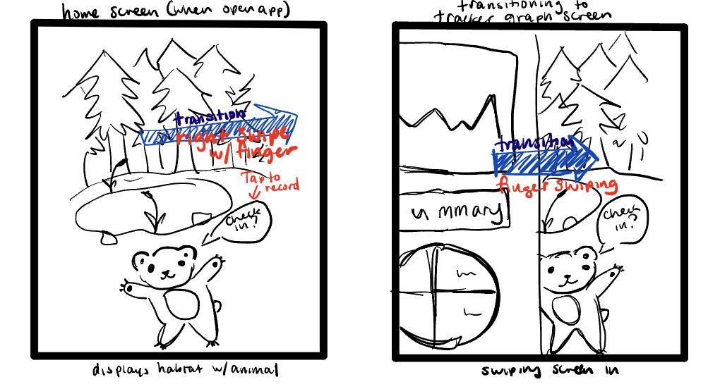
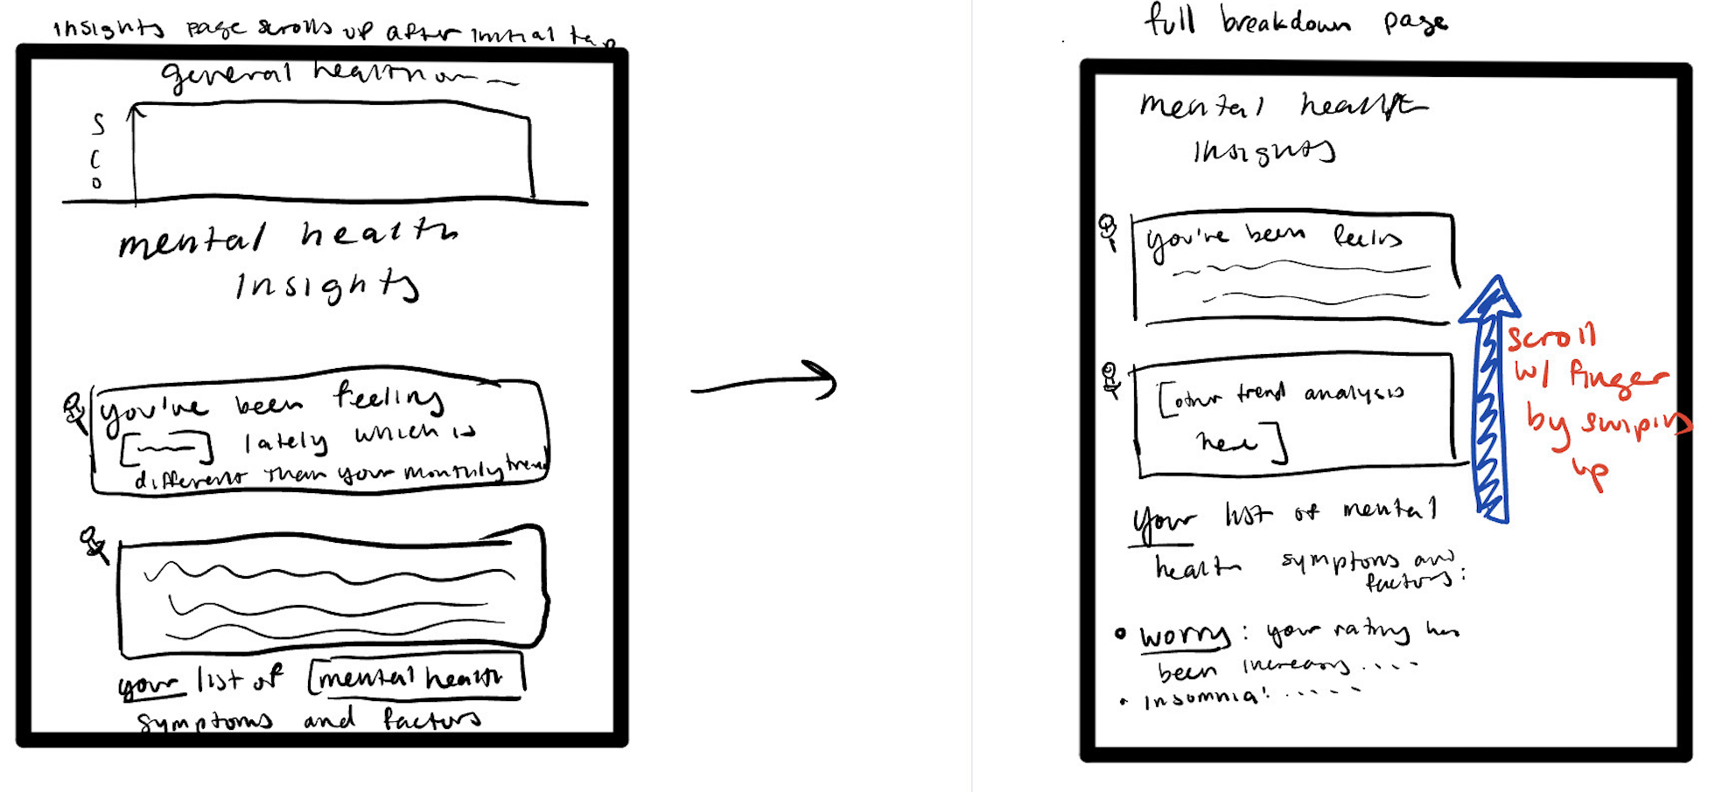
Moderate

Slide 27
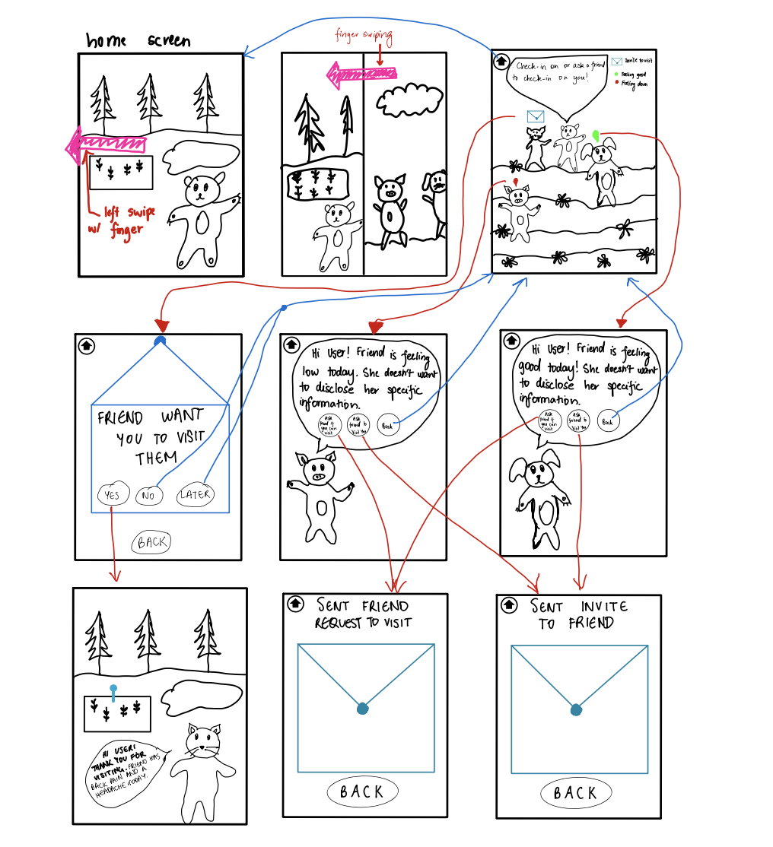
Complex

Slide 28
Testing Methodology

Slide 29
Our Participants:
Participant 1, a Highschool girl met outside Pete’s Coffee
Participant 2, a Post-Grad student (non Stanford) male met in parking lot on campus
Participant 3, a Highschool boy met outside local swim team practice
Participant 4, a male Stanford Student met in a dorm common room

Slide 30
Target audience: a younger demographic; focused on young people of different genders, equal gender distribution
Recruitment: To ensure diversity, the first three participants were approached at random.
Compensation: We compensated each participant with a Halloween inspired recipe when they reached the survey completion screen.

Slide 31
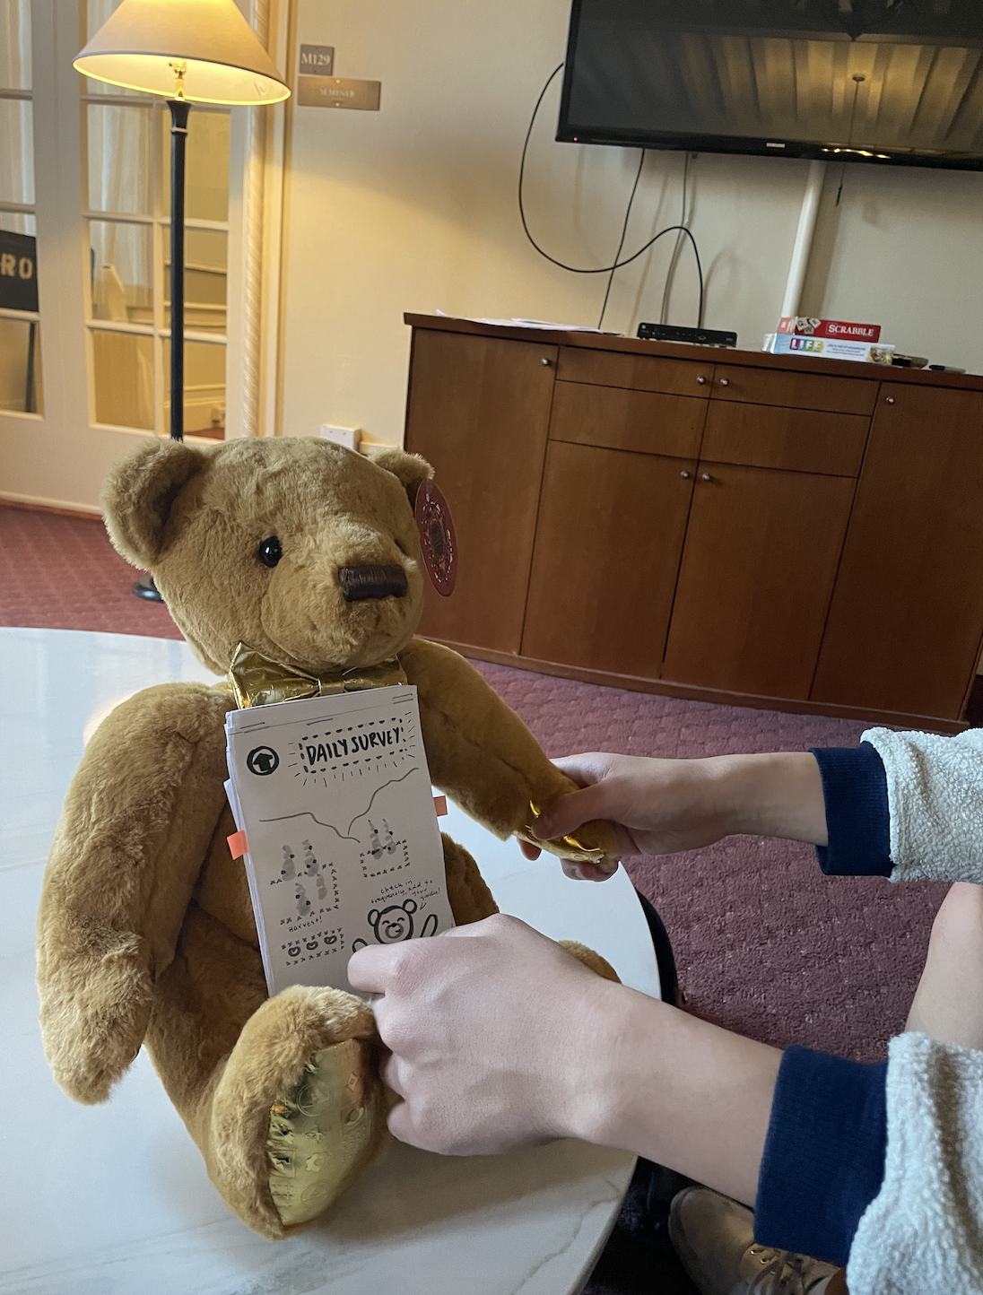
Environment and Apparatus
We tested two of our participants inside, and two of them outside. We had all participants sit down to help with fluidity of flipping the screens.
Apparatus included prototype (right images) and iPad for note-taking and recording.

Slide 32
Roles
Participant 1 was interviewed by Maya who served as facilitator, observer, and computer.
Participant 2 was interviewed by Janelle as facilitator and by Jonny as observer and computer.
Participant 3 was interviewed by Jonny as facilitator and by Janelle as observer and computer.
Participant 4 was interviewed by Gaya who served as facilitator, observer, and computer.

Slide 33
Testing
Procedure
Introduce team & thank participants for their consent. Provide background to project including values and goals.
Thank the participant!
Demo how to flip pages with button clicks, paw clicks and tabs
Conclude at the end by again asking how the experience made the user feel, and what was difficult and easy about the whole process.
Encourage participants to verbalize their thoughts and emotions while interacting with the prototype
After each task, ask the participant what stood out to them and what was easy or difficult.
Explain each goal to user one a time; repeat for each task
Notes:
Introduce the team, thank the participants for their consent and participation and provide background to our project. This included our values and goals.
Show a quick demonstration of how to flip pages with button clicks and how to lift pages with tabs.
Encourage participants to explain their thoughts and emotions and to verbalize how they were interacting with the prototype.
Explain the goal for the user one at a time, repeat for each task.
After each task, ask the participant what stood out to them and what was easy or difficult.
Conclude at the end by again asking how the experience made the user feel, and what was difficult and easy about the whole process.
Thank the participant.

Slide 34
Usability Goals and Key Measurements
Efficient: Users are able to complete tasks in a reasonable amount of time with little issues
Pleasing: Users enjoy interacting with the prototype and want to come back for more
Success:
Users complete tasks with no interruptions
Users interact with button clicks, tab slides, and scrolls without help
Users have fun and feel comfortable while using the prototype
Users express interest in using the prototype and desire to continue interacting with it
Failures:
Users need help completing tasks
Users are confused or frustrated by buttons and flips
Users express confusion, distaste, or discomfort in using the prototype

Slide 35
Testing Results

Slide 36
Process Data: Strengths
All 4 participants successfully used the swiping mechanism to toggle between tasks
All buttons on the screens in Task 1 were successfully pushed and navigated to the next pages
Were willing to interact with the stuffed animal outside of the screens
2 participants expressed eagerness to see their real “past” and “future” health stats
All participants expressed interest in the garden and what it could possibly look like
3 participants expressed excitement and satisfaction when their invites to their “friends” were successfully sent
2 users wanted to continue using the prototype after the tasks were completed

Slide 37
Process Data: Weaknesses
3 participants had severe problems interacting with the buttons in Task 2, from not clicking to clicking the wrong things to not realizing there were buttons on that screen
3 participants felt the free response screen was too open ended and preferred to just tap
Sometimes participants would incorrectly interact with the plush toy at different times
2 users wished there were more next and back buttons
Swiping and scrolling seemed “unintuitive”
1 user expressed confusion about the bear body parts screen and what was supposed to be tapped (the physical plush toy or the bear on the screen)

Slide 38
Kay Measurements of Success
Users complete tasks with no interruptions
Users interact with button clicks, tab slides, and scrolls without help
Users have fun and feel comfortable while using the prototype
Users express interest in using the prototype and desire to continue interacting with it
Bottom-Line Data:
3 participants had severe problems interacting with the buttons in Task 2, from not clicking to clicking the wrong things to not realizing there were buttons on that screen
Swiping and scrolling seemed “unintuitive”
3 participants expressed excitement and satisfaction when their invites to their “friends” were successfully sent
2 users wanted to continue using the prototype after the tasks were completed

Slide 39
Usability Goals: Efficiency
Achieved goals for efficiency with Task 1 and 3; had mis-clicks and misunderstandings with Task 2
Task 1: when to click paws vs screen, when to swipe vs click
Task 2: Inefficient because not intuitive, instructions not clear
Task 3: Very few issues, successful!
Need for more back/next buttons made experience less efficient
Notes:
We achieved our usability goals for efficiency with Task 1 and 3 rather proficiently, but there were a few mis-clicks as well as some more severe problems with Task 2. The main problems from Task 1 came from confusion on when to click the bear’s paw and when to click on the screen. There also was a lack of back and next buttons that could have made the overall experience a little more linear. Most participants experienced a learning curve by task 3 so there were less issues there. Most of the time, the wording was not clear enough on where to click or when to swipe.

Slide 40
Usability Goals: Pleasing
Achieved
Users wanted to come back for more
“community aspect made me feel safe”
“my privacy was protected”, aligns with our values
Phrase “here is how you are dealing with” in Task 2 elicited negative emotions; could be replaced with “here is a summary”
Notes:
Our usability goal of being pleasing was more accomplished. Most users expressed wanting to come back for more. One expressed outwardly that the community aspect made them feel safe and like their privacy was protected, which aligns very well with our values. A few times there were places where certain wording elicited negative emotions, such as the phrase “here is how you are dealing with,” where these words could be replaced with less emotional phrases like “here is a summary” to bring up less negative emotions.

Slide 41
Discussion

Slide 42
Participants were very eager to interact with their community in this personal way
Concepts of each task were exciting and valuable to users.
Satisfactory usability, can improve
Many users struggled with button presses and understanding when to use the plush toy interface.
Limitation: hard to truly simulate a swipe

Slide 43
Moving Forward
Make buttons more obvious and wording more clear
Remove text box survey component from task 1
Have hovering arrows that guide the user to swipe
Change some weighted emotional wording to simpler phrases
Dive deeper into implementing what a garden would look like
Add back and next buttons for linearity

Slide 44
Things Testing Might Not Reveal?
Will the kind of stuffed toy impact how easily users interact with it?
How easily integratable the stuffed toy with a screen will be with a separate phone app
Will users prefer to just use the phone app as opposed to playing with the stuffed toy?
Whether or not notifications will be helpful to remind users to self-assess

Slide 45
Thank You

Slide 46
Appendix

Slide 47
Full Pros & Cons List - Wearable Tech/Apple Watch
PROS:
-Already has biometric stat collection built into apple watch (i.e. heart rate etc)
-Opportunity for very clean, tamagotchi-like design
-Already have easy ways to connect with others
-Convenient for travel which would make logging symptoms easy
CONS:
-Need to format it for the Apple Watch
-Not everyone has an Apple Watch - unequal opportunity
-Need to be able to integrate with apple health, etc?
-Limited space to view habitat on small screen
-Would make the community aspect wholly virtual
-Unoriginal

Slide 48
Full Pros & Cons List - Stuffed Toy w/Screen, App
PROS:
-Very unique and novel in market space
-Brings the value of wellness home, having a physical animal could make the user feel very safe and comfortable
-Help create sense of community by creating trend to have the toys
-Materializes the solution in the physical world rather than in cyberspace or virtual reality
-Could be like a “home base” for people, if the toy is always on a bed/desk it would be an extra manifestation/reminder to log how one is feeling
-Opportunity for creative and never before seen design
CONS:
-Difficult to implement in timely manner due to having two interfaces: one on toy and one on app
-People might not want to carry around an animal - too cumbersome
-Don’t want people to purchase just for the physical toy but also to actually use the app and self-assess

Slide 49
Testing Script
Tasks:
-”Please explain what you are doing and what you are thinking as you tap.”
Task 1: “Your first task is to log how you are feeling today. Use this app to do so”
-Task ends when participant reaches the “Thank you for checking in” Screen
Task 2: “Your next task is to see your progress over time”
-facilitator will explain this demo is what you can expect for your own personal information
-Task ends when the participant has checked on all the Task 2 screens and is back at the home page
Task 3: “Your final task is to check on and share with friends”
-Task 3 ends when the participant has sent an invite or has requested to visit to a friend.
Conclusion:
“How did that whole experience make you feel? What were some key emotions you felt or feel about the app?
“What was difficult to navigate or confusing? Or was anything easy?
Thank you so much for participating in our study! We are Stanford Computer Science students testing a new app called LucIDLy that guides users through their daily mind and body symptoms. We would appreciate your help to test our app. As you explore this prototype, please verbalize what you’re thinking as you tap buttons and complete tasks. There is no such thing as talking too much, the more you explain what you’re thinking the better.
Background Questions:
-Name, Age, background (are you in school? Are you a parent?)
System Demo:
-Facilitator will raise tabs, will only explain the swipe right and swipe left features due to the paper form of the prototype
-The Facilitator will lift up the sheets in the demo as the participant swipes and clicks for fluidity

Slide 50
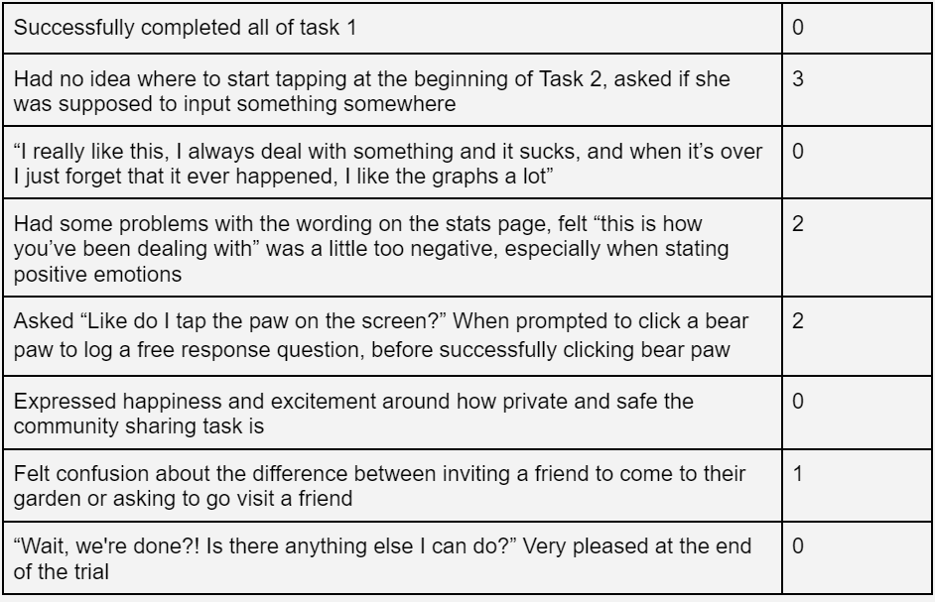
Critical Incident Log - Participant 1

Slide 51
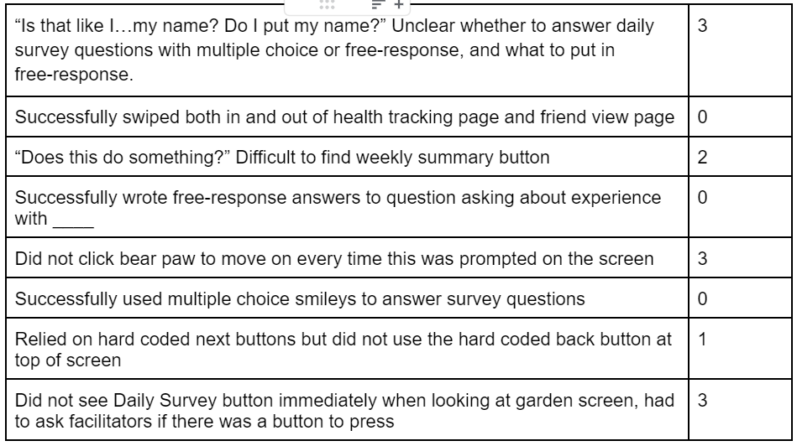
Critical Incident Log - Participant 2

Slide 52
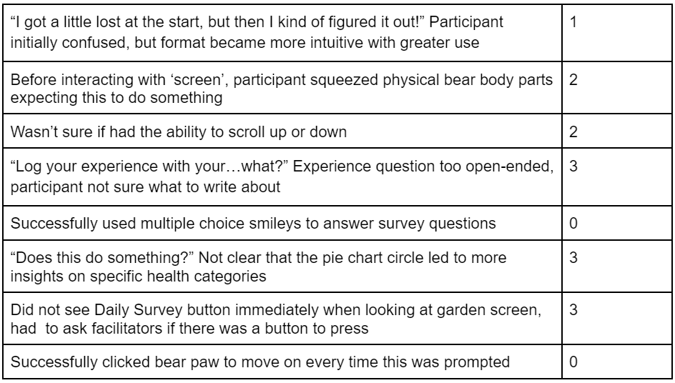
Critical Incident Log - Participant 3

Slide 53
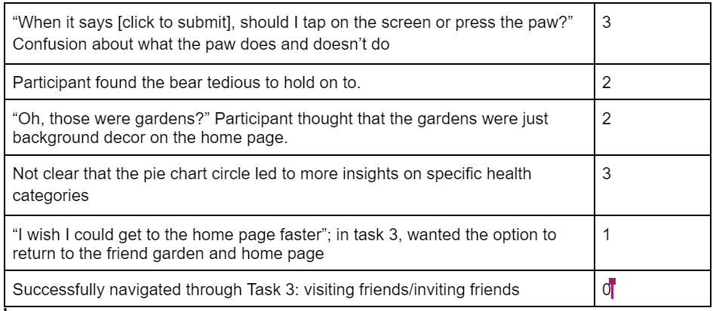
Critical Incident Log - Participant 4

Slide 54
Elaborating on Testing Results

Slide 55
Process Data & Strengths
All four participants successfully used the swiping mechanism to toggle between tasks
All buttons on the screens in Task 1 were successfully pushed and navigated to the next pages
Were willing to interact with the stuffed animal outside of the screens
Two participants expressed eagerness to see their real “past” and “future” health stats
Three participants expressed excitement and satisfaction when their invites to their “friends” were successfully sent
All participants expressed interest in the garden and what it could possibly look like
Two users wanted to continue using the prototype after the tasks were completed

Slide 56
Bottom-Line Data & Weak Points
Three participants had severe problems interacting with the buttons in Task 2, from not clicking to clicking the wrong things to not realizing there were buttons on that screen
Three participants felt the free response screen was too open ended and preferred to just tap
Sometimes participants would incorrectly interact with the plush toy at different times
Two users wished there were more next and back buttons
Swiping and scrolling seemed “unintuitive”
One user expressed confusion about the bear body parts screen and what was supposed to be tapped (the physical plush toy or the bear on the screen)

Slide 57
Usability Goals: Efficiency
We achieved our usability goals for efficiency with Task 1 and 3 rather proficiently, but there were a few mis-clicks as well as some more severe problems with Task 2. The main problems from Task 1 came from confusion on when to click the bear’s paw and when to click on the screen. There also was a lack of back and next buttons that could have made the overall experience a little more linear. Most participants experienced a learning curve by task 3 so there were less issues there. Most of the time, the wording was not clear enough on where to click or when to swipe.

Slide 58
Usability Goals: Pleasing
Our usability goal of being pleasing was more accomplished. Most users expressed wanting to come back for more. One expressed outwardly that the community aspect made them feel safe and like their privacy was protected, which aligns very well with our values. A few times there were places where certain wording elicited negative emotions, such as the phrase “here is how you are dealing with,” where these words could be replaced with less emotional phrases like “here is a summary” to bring up less negative emotions.

