Slide 1
Concept Video for
lucIDLy: Health With Friends
Maya Harvey, Janelle Rudolph, Jonathan Affeld, Gayatridevi Tarcar

Slide 2
Why lucIDLy: Health With Friends?

Slide 3
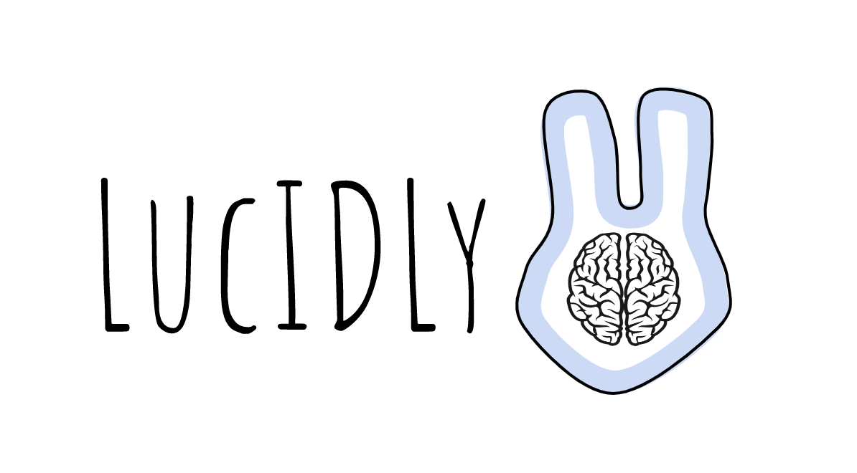
Logo?

Slide 4
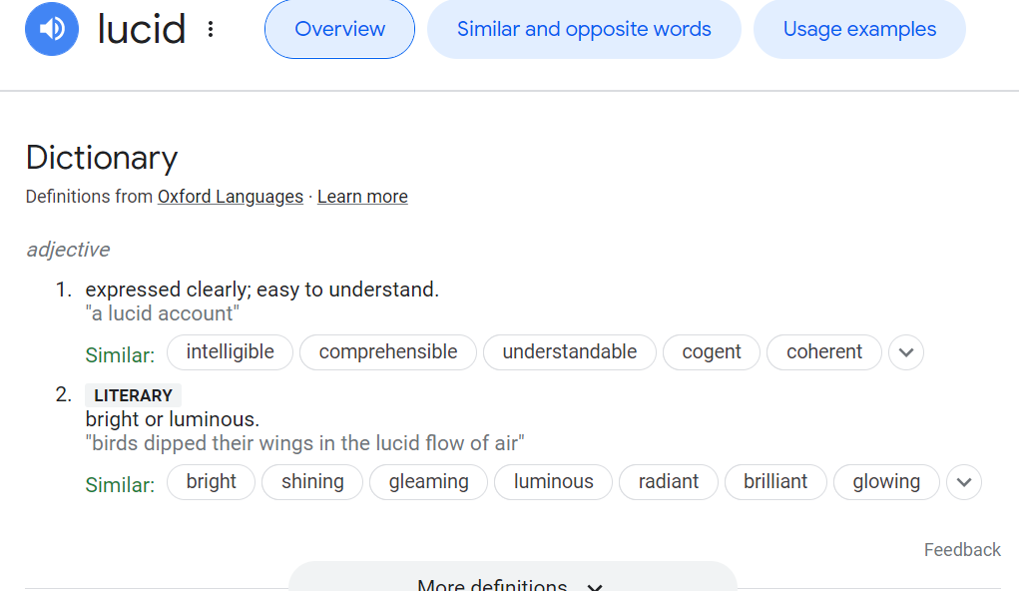
Behind lucIDLy
Our solution’s foundation is an idle game that enables you to grow and evolve multiple “idol” creatures within a habitat, so we wanted to combine the words “idle” and “idol” in a meaningful way. Meanwhile, the word “lucid” is defined as meaning “expressed clearly; easy to understand”. Since a goal of our solution is to help people routinely clearly express how they are doing and gain health insights in an easy to understand manner, we felt that “lucid” was an apt word to use. Thus, we highlighted the main consonants of “idle”/”idol” within the adverb form of lucid.

Slide 5
Sanity Check: Health With Friends
We believe that “Health With Friends” is uniquely applicable to lucIDLy. After conducting market research, we discovered that the overwhelming majority of self-care and health apps focused on just the user, without any kind of community aspect or connection to other users. Rather, these apps keep data localized for only your personal use, and maintain complete privacy. lucIDLy is unique in the market in that no other self-care app allows you to also support and be supported by a community in your health journey - as such, “Health With Friends” is this first value proposition of its kind.

Slide 6
Problem/Solution Overview
The problem we are tackling is how do we let users feel confident and enjoy independent self assessment while connecting this with a form of community?
Our proposed solution is to make an empowering and fun routine to help the user better understand how they are feeling currently and over time by using an idle game model with a habitat and creatures where the user is prompted to answer daily questions about their wellbeing, and upon completion of these questions they will earn coins/credits/rewards that will enable them to expand and evolve their habitat and creatures. To incorporate the necessary community aspect, users also will be able to visit other users' habitats and talk to other users - when the user is prompted to answer a question, they will be able to select an option to post their answer publicly, privately, or to a select group of friends.

Slide 7
Market Research

Slide 8
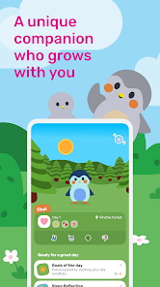
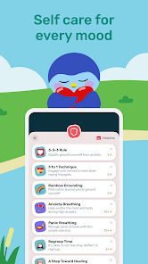
Competitor: Finch
Finch is a self-care app available for iOS and Android that allows users to start off with an animal companion in baby form that grows and develops a unique personality depending on how the user interacts with it. The user is able to develop the companion animal by performing various self-care tasks and answering health-related questions, such as logging emotions, on a daily basis. There are various goals that the user can assign themself that the app will monitor and remind the user to complete. Users are able to invite friends to use the app and to ‘visit’ friends’ companions. This app has been successful due to its cute and user-friendly interface that allows users to perform self-care tasks in a warm and safe environment while also being passively reminded to do so. Users are also drawn to the ability to customize and interact with their own virtual pet. A major drawback is that Finch is pay-to-use after the initial steps of registration. Another drawback about Finch is that while users can invite friends to visit their companions, there are no emotional or health insights that users can gain from this - it is just a superficial viewing of the other user’s pet that allows users to see what cool items the companion is wearing, etc. This leads into what makes lucIDLy unique: in our solution, users are able to share specifically how they are doing health-wise with friends, leading to community accountability. Furthermore, lucIDLy keeps track of trends that follow from user answers to the daily health check-in questions, and allows for analysis of these trends to give real health insights to the user. Finch lacks this progress-over-time feature that makes lucIDLy one of a kind.

Slide 9
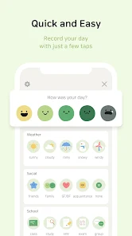
Competitor: DailyBean - Simplest Journal
DailyBean is a diary app available on iOS and Android that allows users to easily record what each day feels like for them. It provides brief multiple choice questions for users to categorize each day. This allows for a calendar and statistics that show mood trends over time and a simple analysis for these trends with what factors might be causing them. This ease of use and simplicity of design has been DailyBean’s major draw and is what makes them stand out in the market. The ability to draw insights from data trends is also an extremely useful feature when informing users about their personal health. lucIDLy differs from DailyBean in key aspects, however: lucIDLy requires users to answer daily prompts about general emotions that appear in their notifications that are open-ended and text response based, as opposed to DailyBean’s multiple-choice questions that require users to open the app first. While lucIDLy also employs the trend-over-time analysis feature, DailyBean lacks lucIDLy’s community focus. Where DailyBean’s journaling is limited to use by just the user themself, lucIDLy allows users to check in on friends and vice versa via public journaling, creating general community health accountability and awareness.

Slide 10
Competitor: Animal Crossing: New Horizons
Animal crossing is an open-ended life simulation Nintendo game. There are tasks that users are asked to complete along a story, but there is no consequence or effect on user experience if users choose not to complete any tasks. There is also an option in New Horizons, the most recent release, to invite friends to share recipes, create new plants, and just check out others’ creations. Animal Crossing’s strength is in it’s calming abilities and they way it promotes gameplay at the user’s pace. LucIDLy follows these same guidelines, with cute idols that do not pressure the user to interact with them or their friends unless they are comfortable. The new community aspect of Animal Crossing New Horizons is what made it the second best selling game of all time in Japan in 2022, which shows that the community aspect of LucIDLy could be one of its main draws. The difference between the two is that Animal Crossing is more of an escape from the user’s real world problems, while LucIDLy encourages the user to find peace with their problems and recognize them as such. Animal crossing can be seen as a time vacuum, while LucIDLy is a relaxing and fun experience as well as a chance for users to improve and learn about themselves.

Slide 11
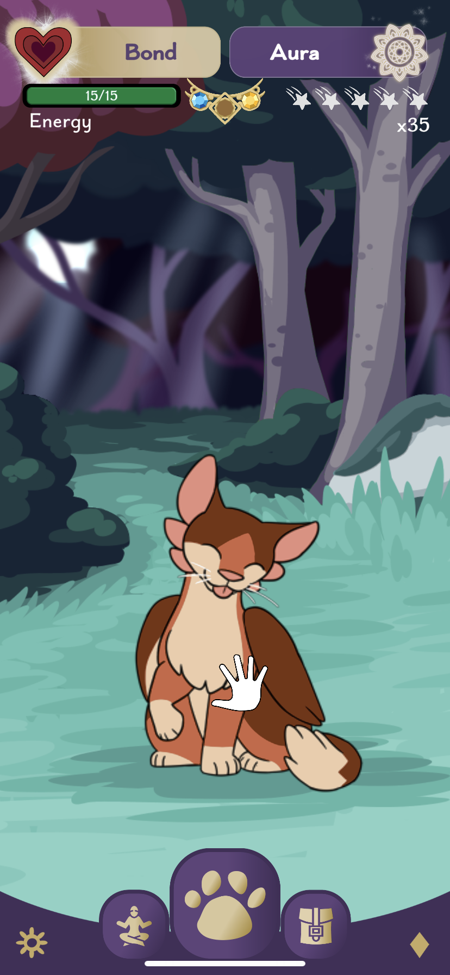
Competitor: Amaru - The Self Care Pet
Amaru is another self-care app for iOS and Android that allows users to level up a cute animal companion and customize it to the user’s discretion. The user is able to explore and play with the animal while also fulfilling self-care goals that are detailed in the app. The app also features mindfulness exercises such as guided meditation and GLAD journaling. What Amaru does best is the simplicity and enjoyableness of the mindfulness exercise features that you can perform with your companion. In addition, the animal itself is comforting and nostalgic for childhood video games and allows users to be engaged in a storyline while simultaneously practicing independent mindfulness and self-care. Though Amaru is great at accomplishing the former tasks, it lacks any ability to track tangible and actual health trends over time, and is merely an app to help improve mindfulness and introspection. There is also no community aspect - users are unable to view other users’ story progression or health status. This again means that lucIDLy is able to differentiate itself by its progress-over-time feature and its community-based health accountability. lucIDLy is not just an independent app meant for users to simply get better at mindfulness by themselves - lucIDLy provides genuine health insights and analysis based on user responses and is founded on the ability to see how other users are doing health-wise.

Slide 12
Values in Design

Slide 13
Privacy, Consent, and Safety
As a health app with its foundation built on the voluntary sharing information by its users, Privacy, Consent, and Safety are values we deemed fundamental to its ethics. Users should feel like they are able to honestly answer the app’s questions about their health due to the app providing a safe environment to do so. In order to incorporate these values, we will give users an option to choose who their answers are shared with - just themselves and their personal account, or any/all other users. This ensures that users Consent to the sharing of any information with anyone else. This in turn allows for Privacy to be encoded - user information may not be accessed by anyone who lacks permission. By ensuring that this occurs, lucIDLy also makes itself a Safe environment for anyone to make an account and pursue their health journey. Without fearing for unwanted information access and violations of privacy, user Safety is thus prioritized, allowing users to fully buy into the app and be completely truthful about their health.

Slide 14
Accountability and Community
As one of the purposes of the app is to create greater consistency in user self-assessment regarding their health, Accountability (especially Self-Accountability) is a key value of lucIDLy. We will ensure that it is incorporated by employing the feature of daily prompts to answer various questions about the user’s health - where upon answering, the user receives a reward that they may use to improve their habitat/creature/etc. This ensures that users will be incentivized to stay Accountable with their health and self-assessment.
The creation of a Community that users are able to interact with and share health insights with is also a key purpose of lucIDLy. This will be incorporated by lucIDLy granting the users the ability to not only have ‘friends’ on the app but the ability to invite non-users to join. In addition, lucIDLy will allow users to visit each other’s habitats and view each other’s public health postings. This will also create a sense of Community Accountability - when users see that others are staying personally accountable with their health self-assessment, they will be encouraged to do so as well. Finally, users will be able to directly communicate with one another through the app and ask other users for help or to check in on them.

Slide 15
Wellness
Wellness is the value that comprises the overall goal of lucIDLy. The main feature of the app that targets this value is the ability of lucIDLy to track health performance and progress over time. By doing so, the app will be able to offer not only direct health insights to the user but also built-in analysis and suggestions for how to improve on downward trends or even what specific health issues the user might be experiencing. With this feature, lucIDLy keeps user Wellness at the forefront of its values, as every comment made to the user is made to optimize the Wellness of the user.

Slide 16
Conflicting Values?
Trying to incorporate Privacy and Community might result in a conflict of interest due to the fact that by definition trying to preserve Privacy might result in an inability to adequately create a form of Community. Since this is an app based on the sharing of health information, it is vital that users are able to avoid sharing data that they do not wish to share with parties of their discretion. However, the Community aspect of lucIDLy is built on the transparency that users must share to a degree with one another regarding their health information. This begs the question: how is it possible to respect information confidentiality while also making user vulnerability and transparency of expression a priority? We address this issue by allowing users to select an audience for each health question answer the app will prompt. Users will be able to retain certain answers as private to only their account, while another option will render answers visible for a certain selected number of friends, or visible for all other users.

Slide 17
Tasks

Slide 18
Simple
Record one’s current mental and physical wellbeing.

Slide 19
Moderate
Compare and track mental and physical wellbeing over time.
Improve self-assessment consistency.

Slide 20
Complex
Make others aware of how one is feeling.

Slide 21
Storyboards

Slide 22
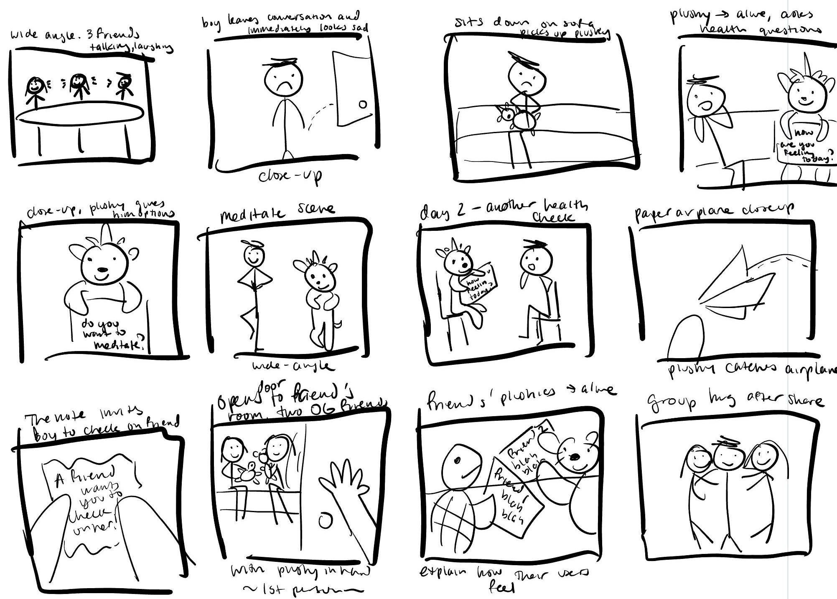

Slide 23
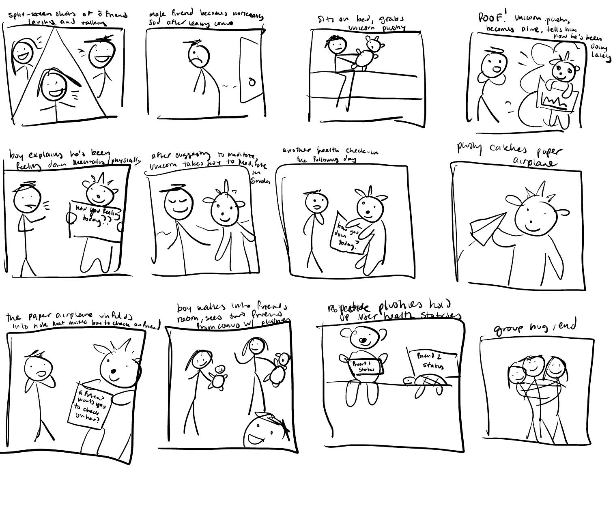

Slide 24
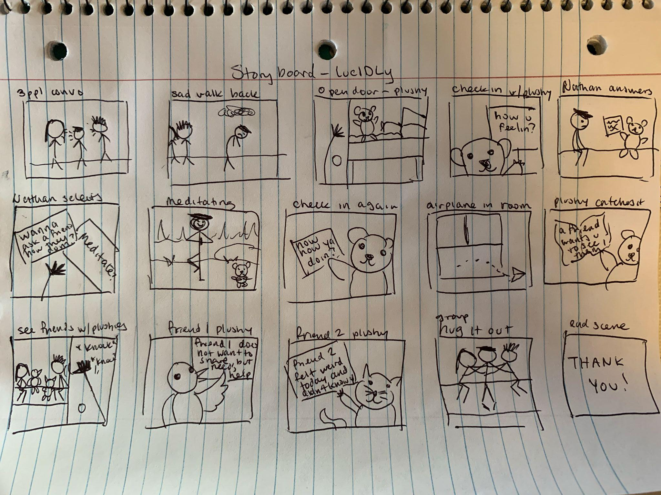

Slide 25
Storyboard transcript:
Three friends converse, all look happy. One friend turns away and his smile fades, visibly distraught. He arrives at his dorm room to be met by his plushie, who comes to life and asks him: “[whatever]” then the plushie goes into a series of questions related to symptoms that the boy might have based on past interactions over time such as: “are you nauseous? Are you shaky? Are you sad for no reason?” The boy checks off his current symptoms and the plushie gives him some helpful suggestions: “would you like to ask a friend to check on you? Go for a run? Meditate?” The boy chooses to meditate and the scene cuts to him and the plushie meditating. After, the plushie re-checks in to create routine. Then, a paper airplane flies in the shot- a notification from a friend. The friend is asking the boy to come check on them. The boy arrives at the friend’s dorm and opens the door to see both the friends from the first scene with their own plushies. Their plushies come to life. One explains “[whatever is on the whiteboard]” and the other explains “[other whiteboard].” The boy is happy and excited to find out his friends are experiencing symptoms too and that he is not alone. The three friends hug it out in conclusion and the camera pans to the three plushies.

Slide 26
Video Link
https://youtu.be/r-ZQ8zSwiDQ

