Slide 1
Equitable Healthcare Group 1
Maya Harvey, Jonathan Affeld, Janelle Rudolph, Gayatridevi Tarcar

Slide 2
Domain

Slide 5
Additional Needfinding

Slide 6
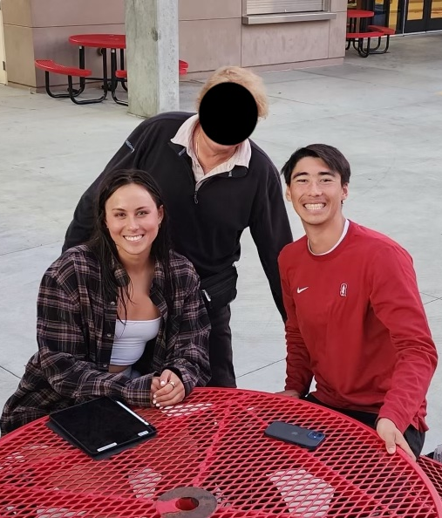
Participant 5
Male in late 50s/early 60s
Parent
Born In Sweden
Redacted
No prior severe medical conditions
Sister passed from Cancer last Spring
Jonathan Interviewer
Janelle Annotator
Met at Henry M. Gunn High School

Slide 7
Results
Quotes
Insights
“When I’m sick, I want to be in the US. If I’m sick and I’m here [US], they are going to throw their best at me. But If I’m not sick, I worry about the profit motive. The doctors will try to figure out how to make money off of me.”
People will not go to the doctor unless they need life saving care due to costs
“I am worried not about their [his kids] health but more about their coverage … Coverage in the US is paid by companies”
There is pressure to succeed professionally in the US due to the necessity of healthcare insurance
“The skypes were the only good thing that came from it [sister’s cancer]”
People seek community no matter the barriers in times of need

Slide 8
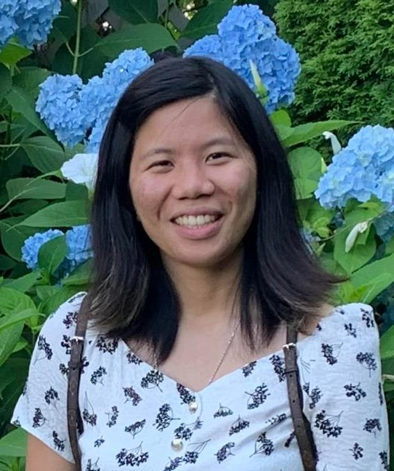
Participant 6
Female in early 30s
Board Certified Neurologic Music Therapist
Disability Community space program coordinator
Redacted
Has Epilepsy
Janelle Interviewer
Gaya Annotator
Cold-emailed and met on campus

Slide 9
Results
Quotes
Insights
“When it comes to applying for jobs and getting hired, I know I can’t list my disability, because it will affect whether or not I get hired”
People with disabilities face lower job security and discrimination because of their disability
“...the fear in people’s eyes when they meet me or someone they know who has a disability”
People with disabilities are hesitant to disclose their disability to people they know in fear of rejection/discrimination

Slide 10
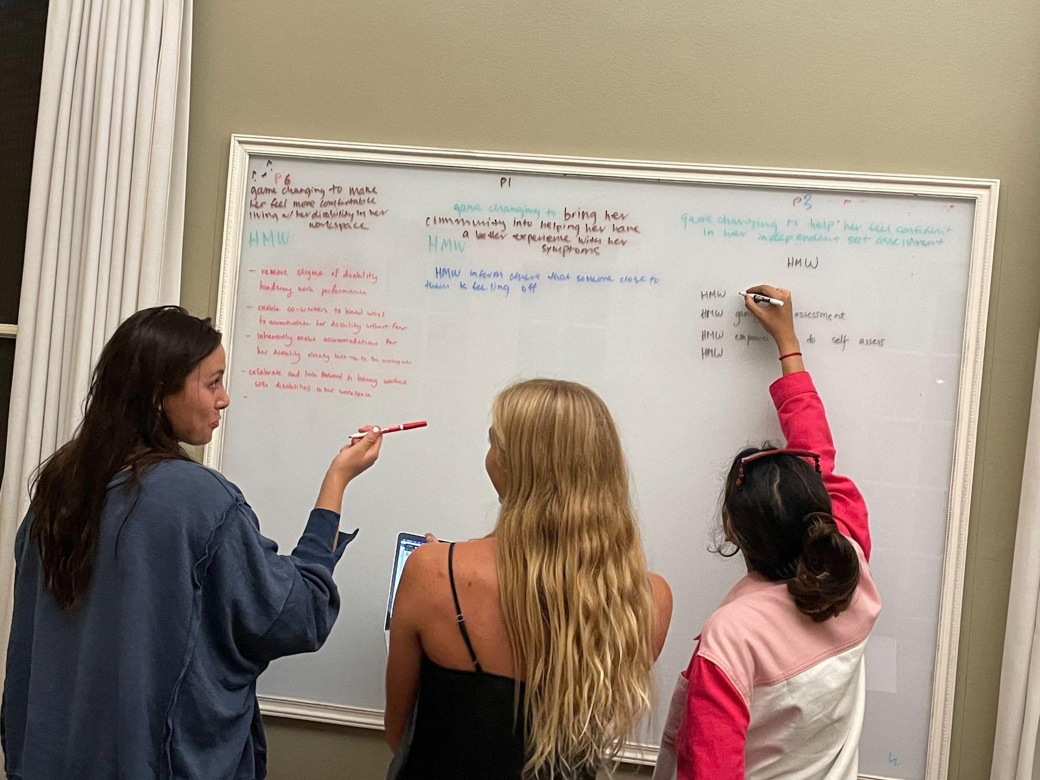
POV Development

Slide 11
Last Studio…
We met participant 3, a 3rd year Psychology student from India who suffers from an anxiety and panic disorder.
We were surprised to realize that when she confided in her parents, they denied her problems and didn’t get her professional help.
We wonder if this influenced how open she was to share her issues with others and her fear of judgment
It would be game changing to provide a trusted, judgment free zone (perhaps anonymized to achieve this) where she could talk about her problems (destigmatize them) and find professional help.
We met participant 1, a Junior athlete in Beach Volleyball at Stanford with epilepsy that could have been prevented if she made lifestyle changes when she was young
We were surprised to realize that she thought her symptoms were normal when she was young
We wonder if this means she learned from a social norm where young people fail to report symptoms because of this kind of thinking
It would be game changing to destigmatizing feeling weird or off
We met participant 4, a weights trainer that works with a lot of ailed athletes
We were surprised to realize that he felt guilty when working with disabled athletes because he never had any physical ailments
We wonder if that means there is a disconnect between the less able and more able who share the same community
It would be game changing to break this barrier to create more of a conversation and understanding.
We met participant 2, an australian rower who is half deaf and overcoming a brain tumor
We were surprised to realize that he is frustrated that coaches don’t remember he is still recovering from his tumor, but doesn’t want to be treated differently
We wonder if this means there is a lack of general understanding of what recovery means for individuals
It would be game changing to help him feel understood by the people around him

Slide 12
Refined Pov’s

Slide 13
We wonder if, because her feelings were invalidated by trusted and respected people in her life, this made her feel less confident in her judgment regarding her physical and mental well-being
We met participant 3, a 3rd year Psychology student from India who suffers from an anxiety and panic disorder.
We were surprised to realize that when she confided in her parents, they denied her problems and didn’t get her professional help.
It would be game changing to help her feel confident in her independent self assessment
HMW
Make discussing disabilities in the workspace welcoming instead of inciting "fear"

Slide 14
Mercury
Mars
We met participant 1, a Junior athlete in Beach Volleyball at Stanford with epilepsy that could have been prevented if she made lifestyle changes when she was young
We wonder if she thought that everyone experienced her symptoms because her symptoms weren’t recognized by her community
We were surprised to realize that she thought her symptoms were normal when she was young
It would be game changing to bring her community into helping her have a better understanding of her symptoms
HMW
Increase public knowledge of symptoms in an engaging way

Slide 15
We wonder if this means that she felt compelled to hide her medical history or not talk about her disability to avoid discomfort
We met participant 6, a certified music therapist and program coordinator for the Disability Community (DisCo) at Stanford University with epilepsy
We were surprised to hear that she felt most isolated when talking about her disability in professional spaces due to people looking at her with fear
It would be game changing to make her feel more comfortable living with her disability in her workspace
HMW
Have her enjoy assessing herself routinely

Slide 16
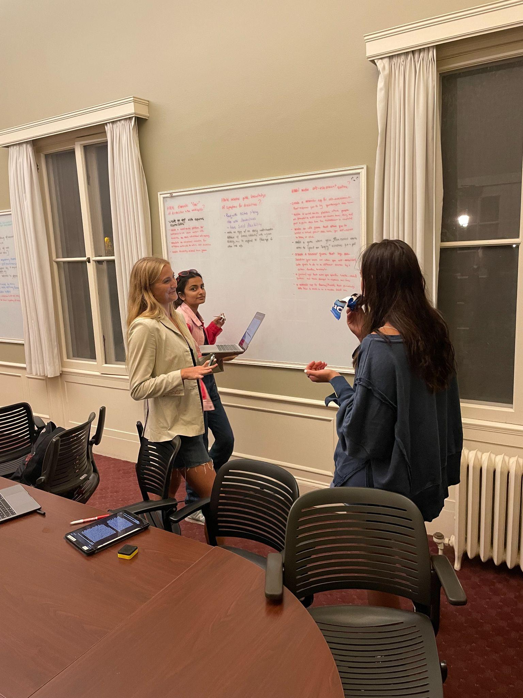
Solutions

Slide 17
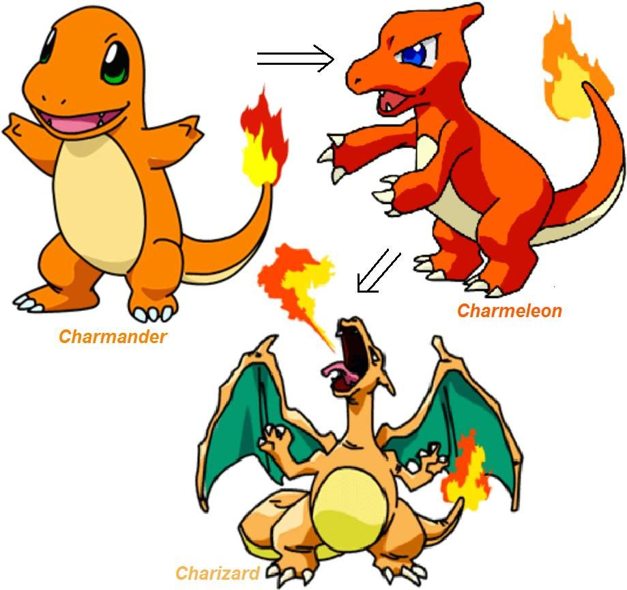
Daily Survey Idle Game

Slide 18
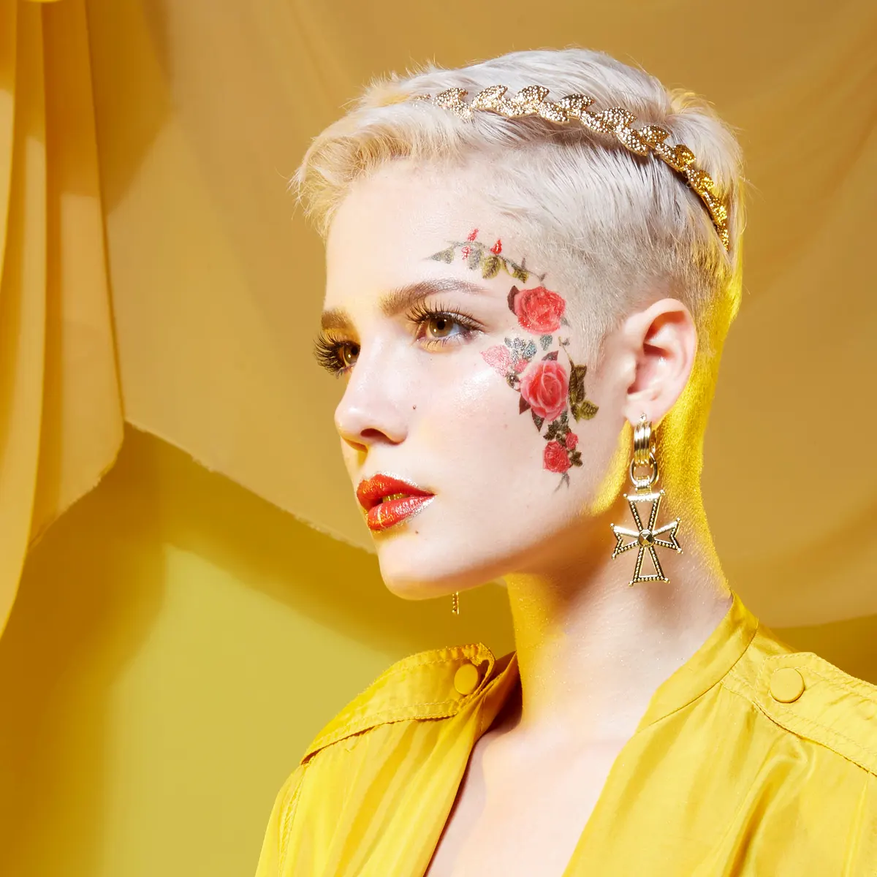
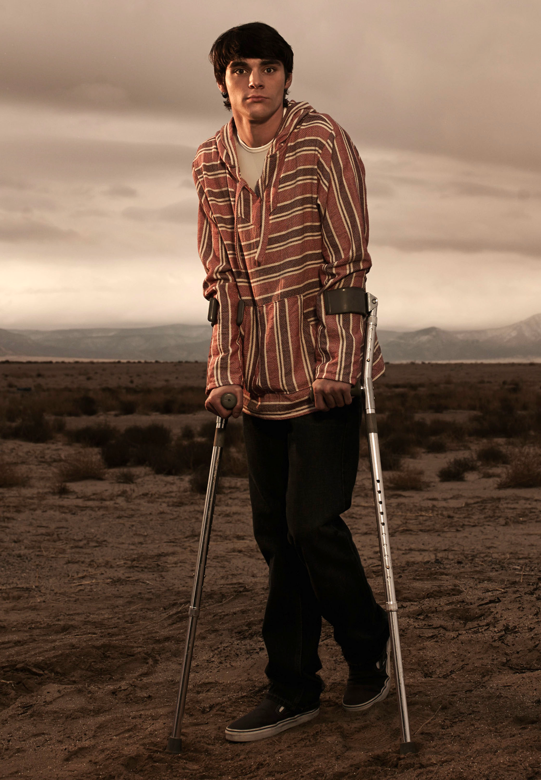
Celebrity Database

Slide 19
Guess that Symptom!

Slide 20
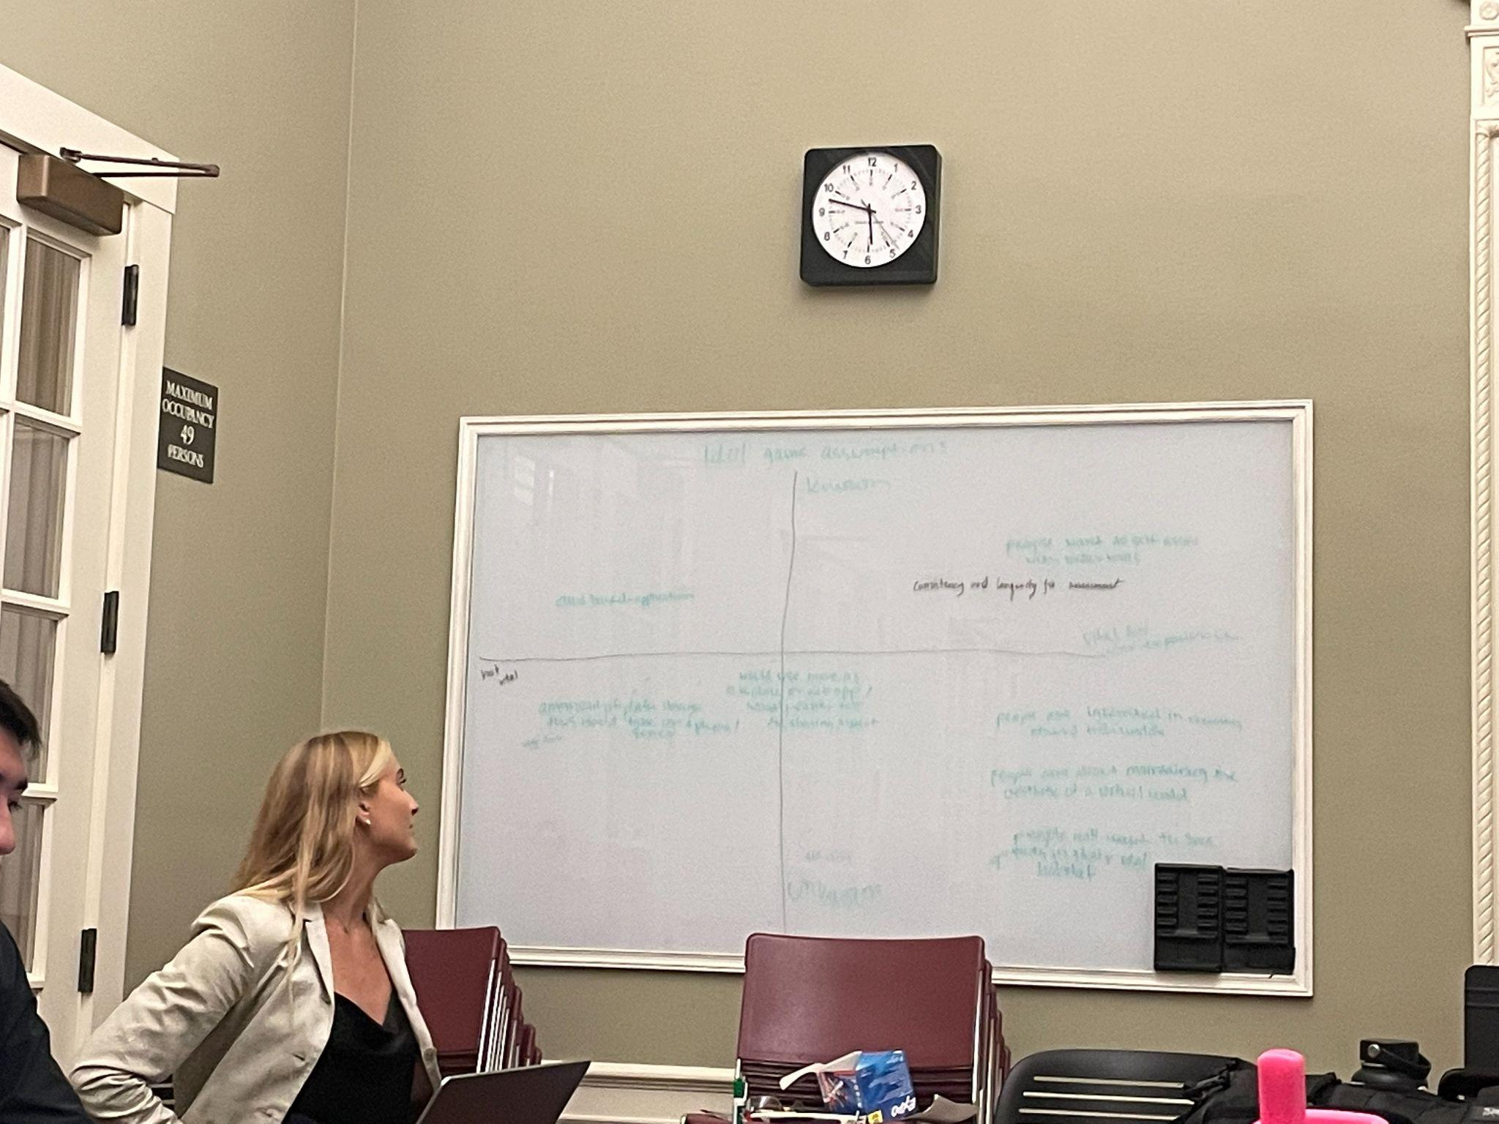
Experience Prototypes

Slide 21
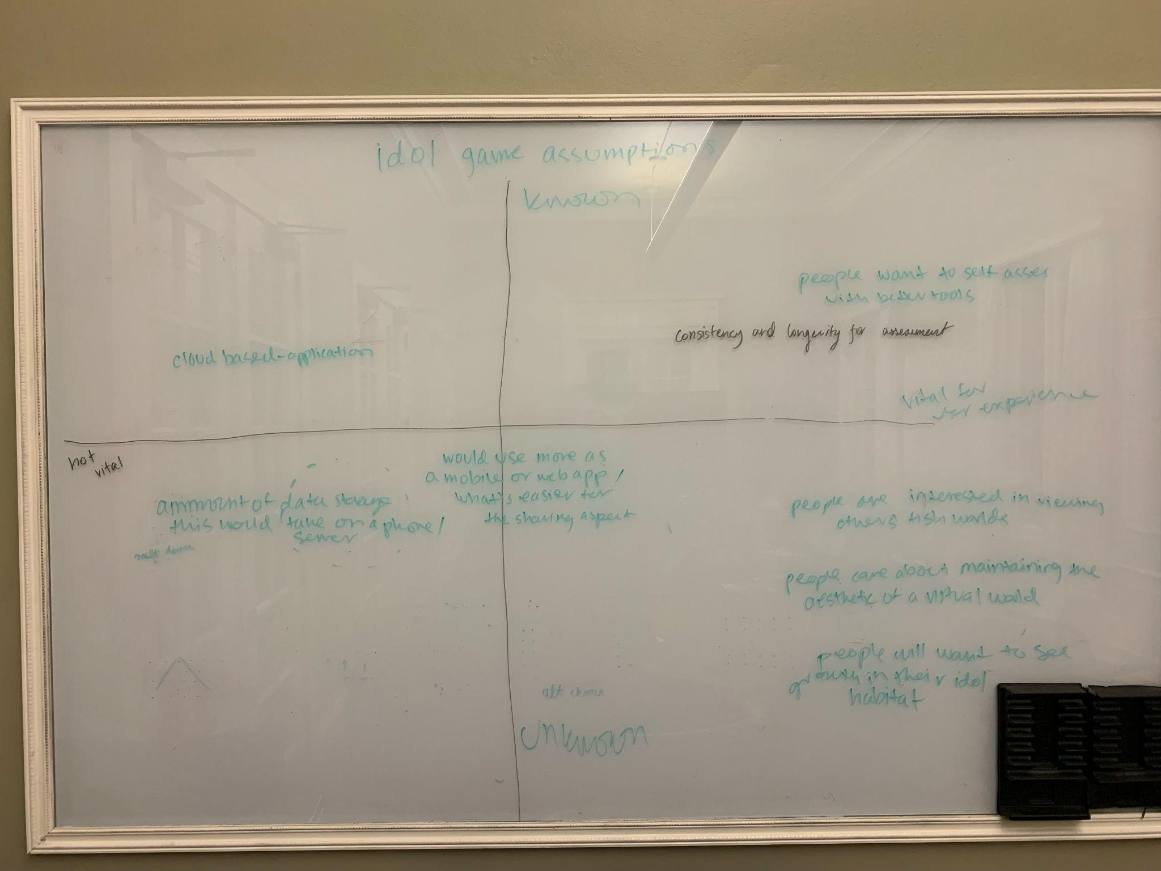
Idle Game

Slide 22
Do people want to see growth in their habitat and will they feel satisfied by it?

Slide 23
1
2
3
Start participants with a small cute creature
Ask them to text us when they feel a notable change in their body or mind
Send them an upgraded version of their little creature and ask them to log in their notes app how receiving the new creature made them feel

Slide 24
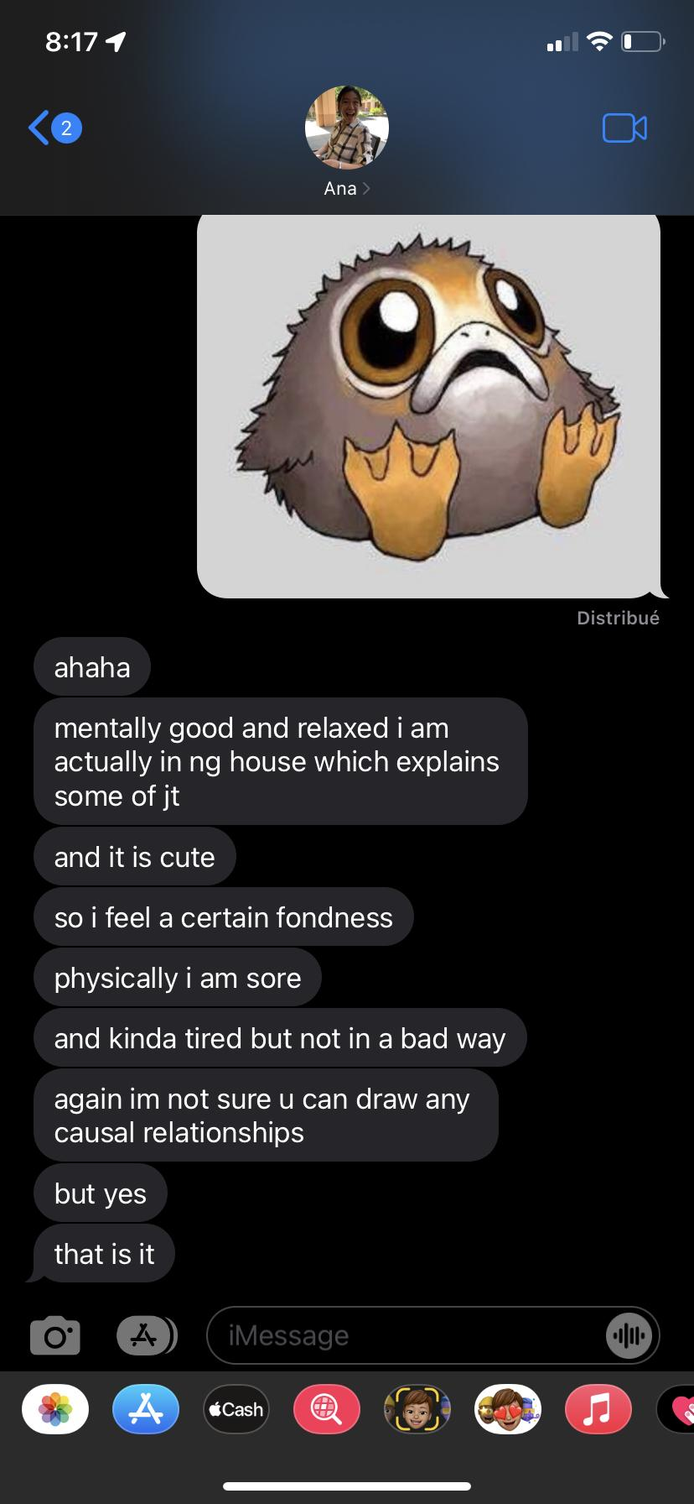
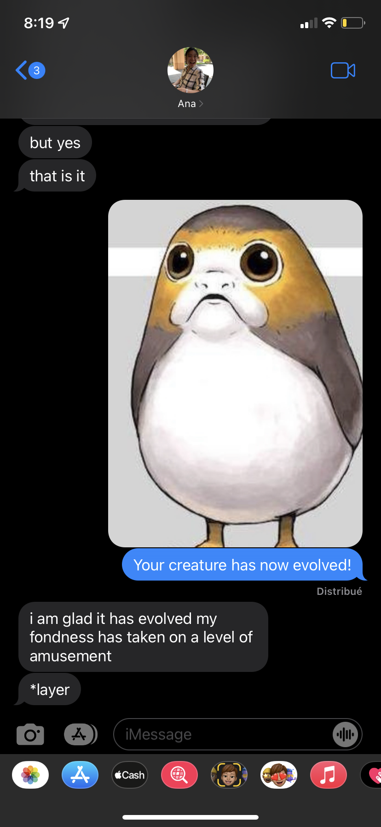
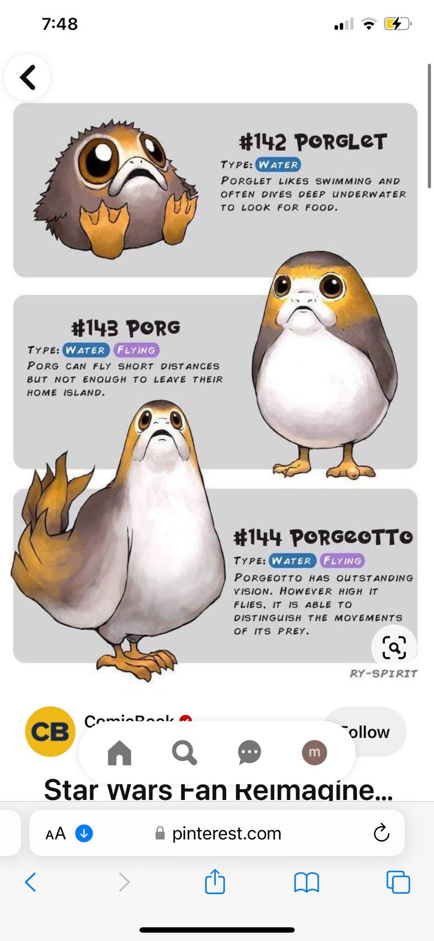
Redacted
Redacted
Redacted
Notes:
This is the 20 year old female college student with anxiety

Slide 25
Participants
Older male
Athletic Coach
Recruited wide range of ages to see if game appealed to all ages
Highschool Female over 18
Sister of teammate
Recruited wide range of ages to see if game appealed to all ages
1
2
Female in mid-30s
Stanford Staff member
Recruited wide range of ages to see if game appealed to all ages
3

Slide 26
Results
What worked?
People were excited to see their idol and wanted to see it grow more
The feelings of discomfort were replaced by happy feelings
What did not work?
Leveling up avatar was not as personal
People could say anything and the avatar would level up
Mood boost was only temporary

Slide 27
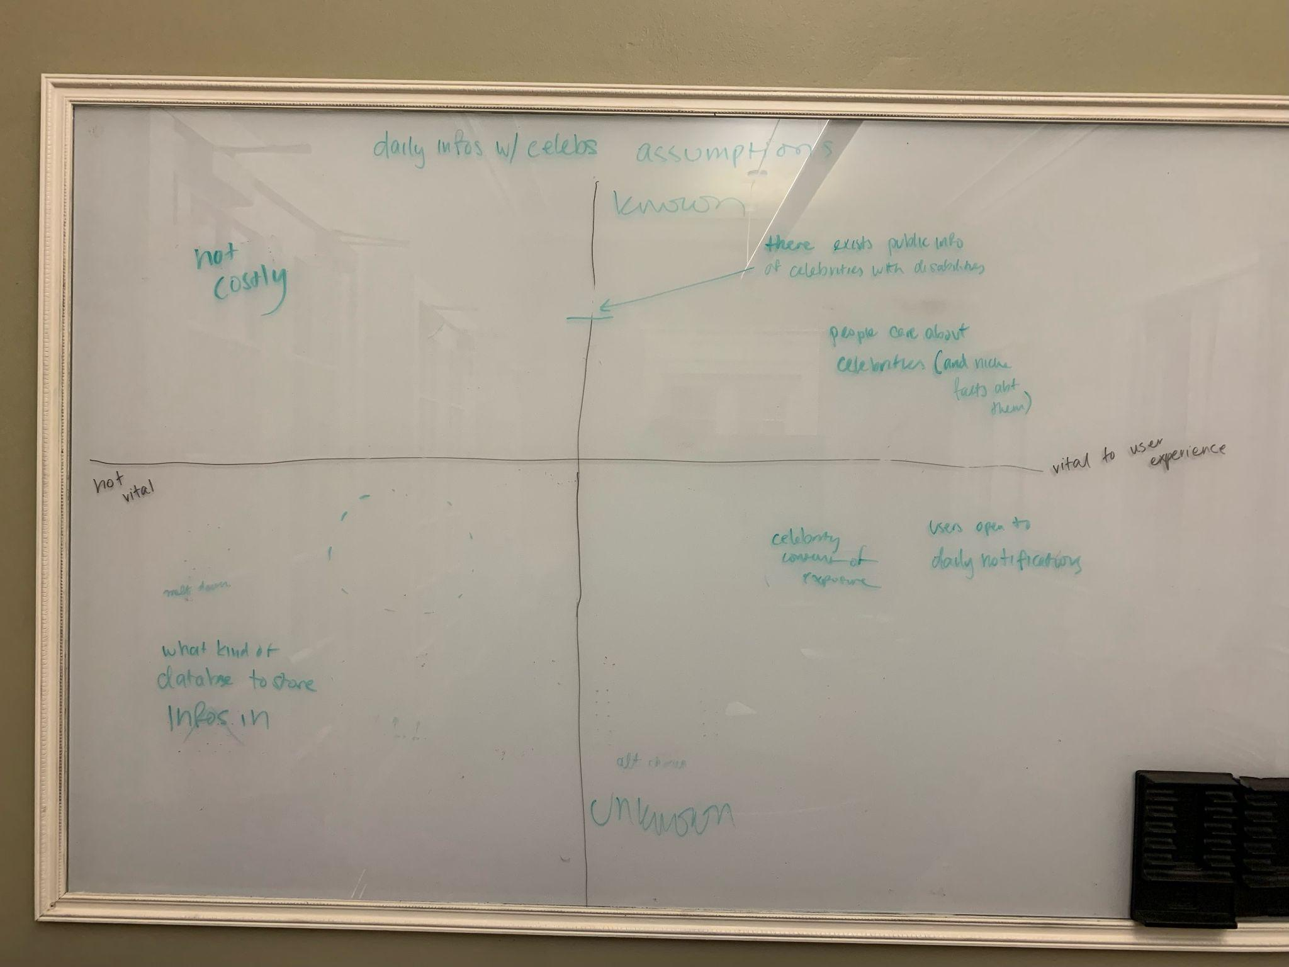
Celebrity Database

Slide 28
Do people really care about celebrities?

Slide 29
1
2
3
Send an article about a disability/disease
Ask them to read as much as they want and then note their feelings about it
Send them a celebrity with that disability/disease and ask them to reflect on if their feelings changed

Slide 30
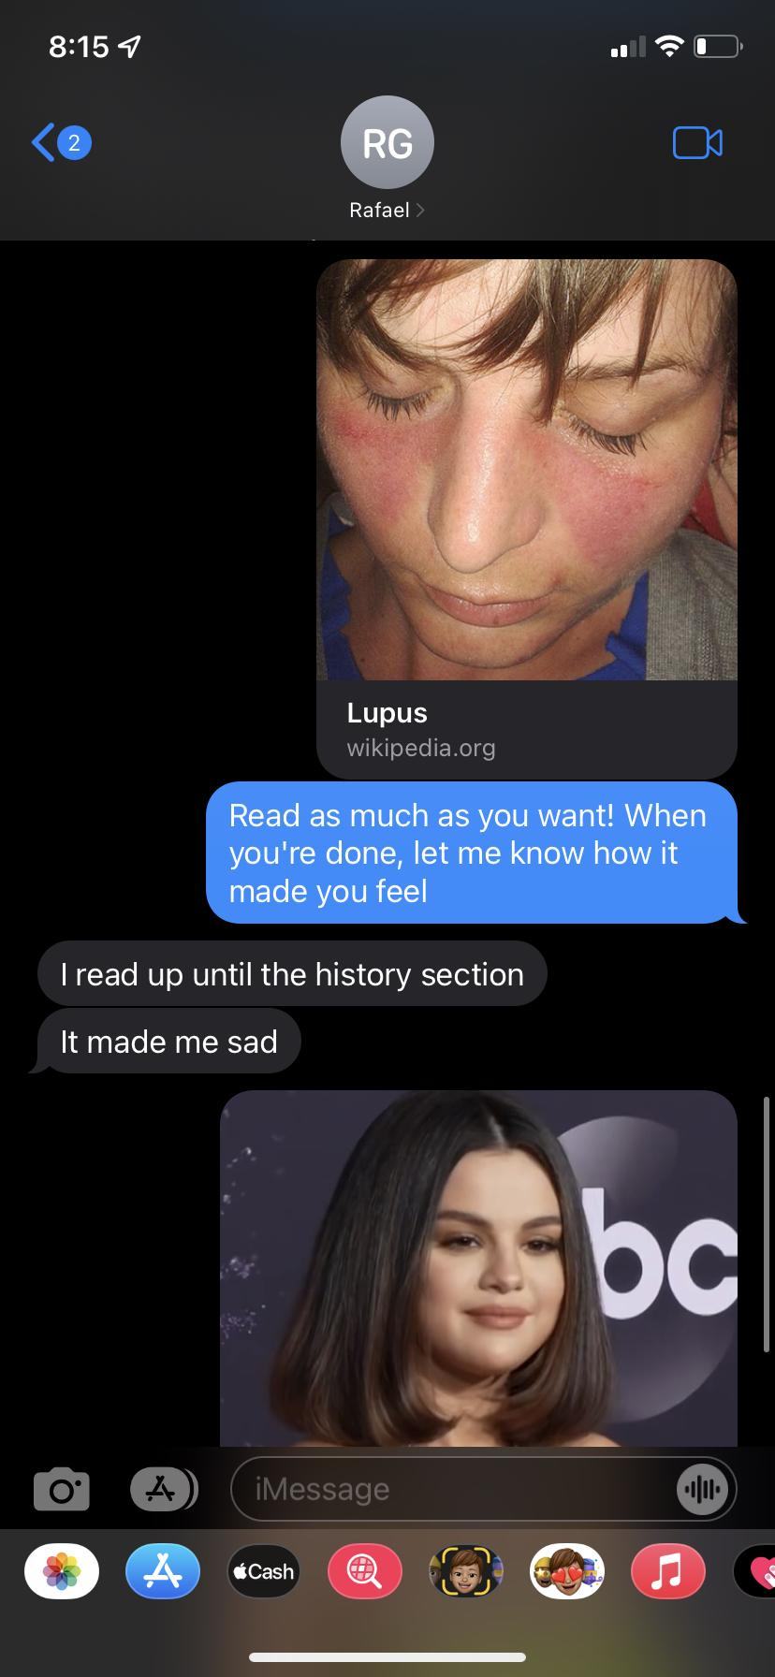
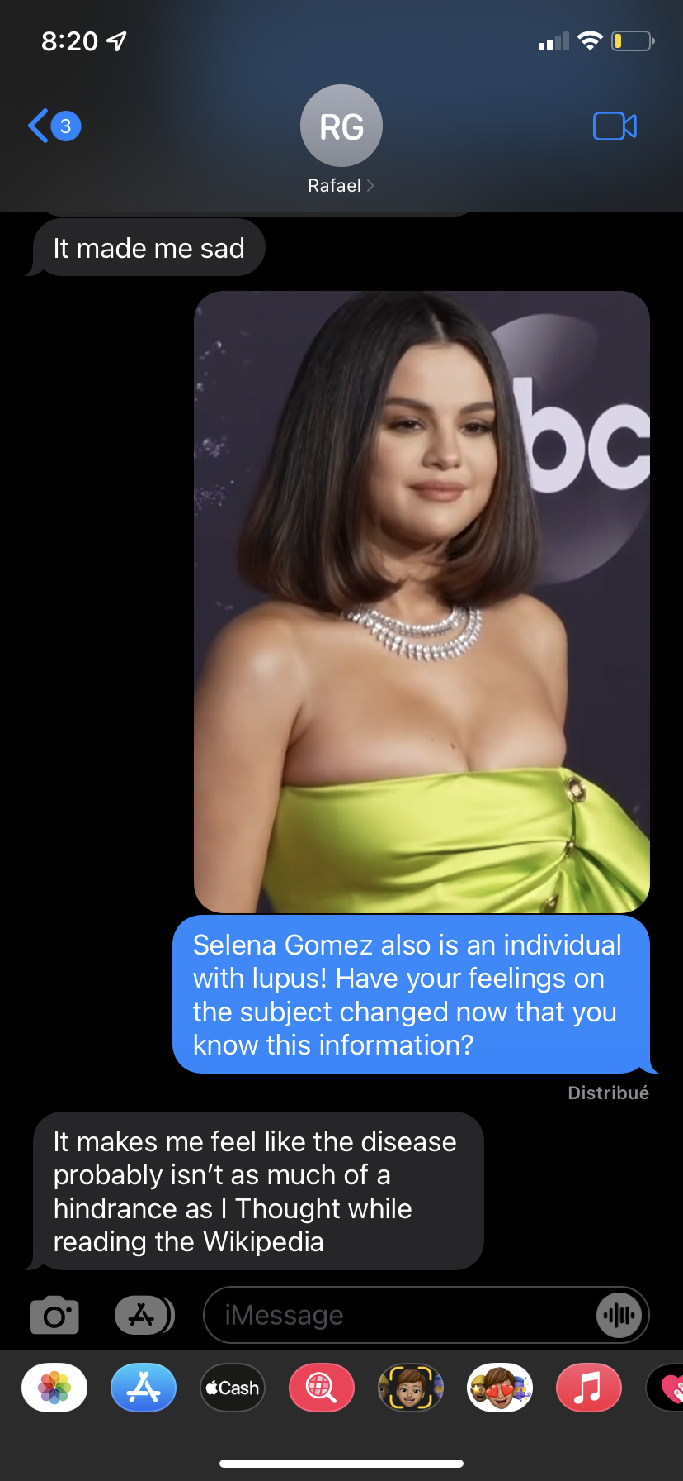
Redacted
Redacted

Slide 31
Participants
College aged female
Asked in Dining hall
Younger people tend to follow pop culture
College aged female
Asked in Dining hall
Younger people tend to follow pop culture
1
2
Very old male
Referred through friend of teammate
May not be as in tune with pop culture
College aged male
Roommate of team member
Enjoys movies
3
3

Slide 32
Results
What worked?
People reflected on disabilities presented to them
Participants were excited to learn new info about celebrities
What did not work?
Emotions associated with the experience prototype were sad- “empathetic, depressing, dismal”
People took a while to respond

Slide 33
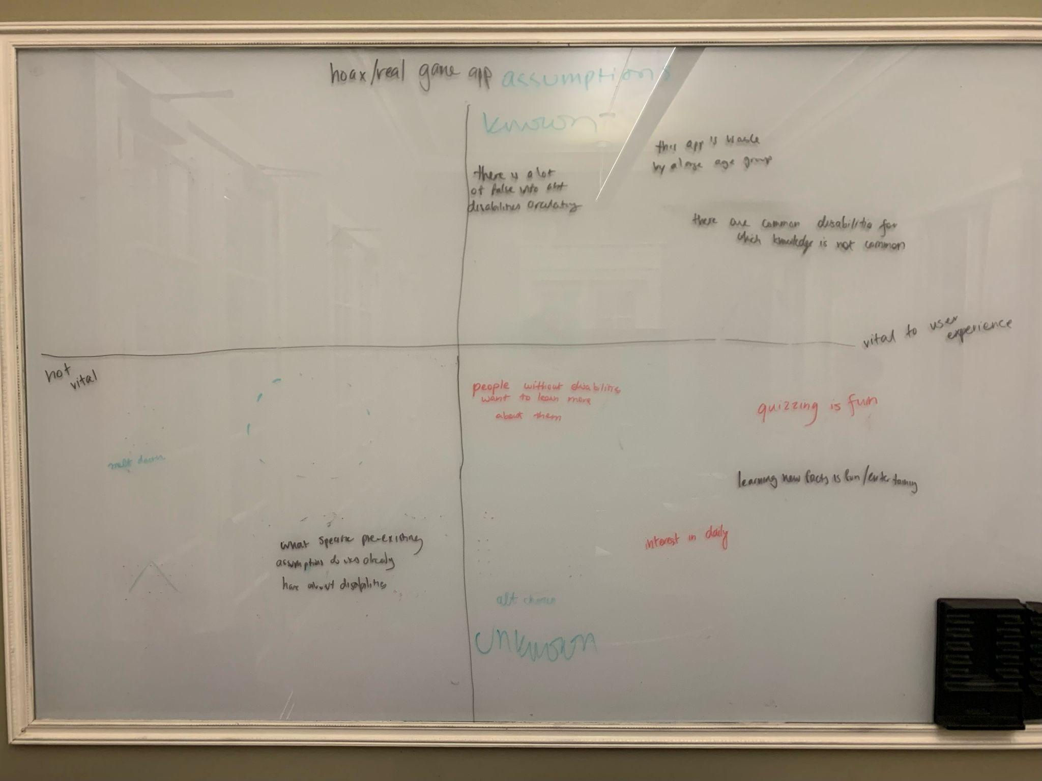
Guess that Symptom!

Slide 34
Will the quiz be fun regardless of the amount of knowledge a person has?

Slide 35
1
2
3
Ask participant if they want to play an engaging game that will teach them about disabilities
Provide symptoms that are both real and fake! Ask the participant to guess if the symptom is from a real disorder or not
At the end, ask them how the experience made them feel

Slide 36
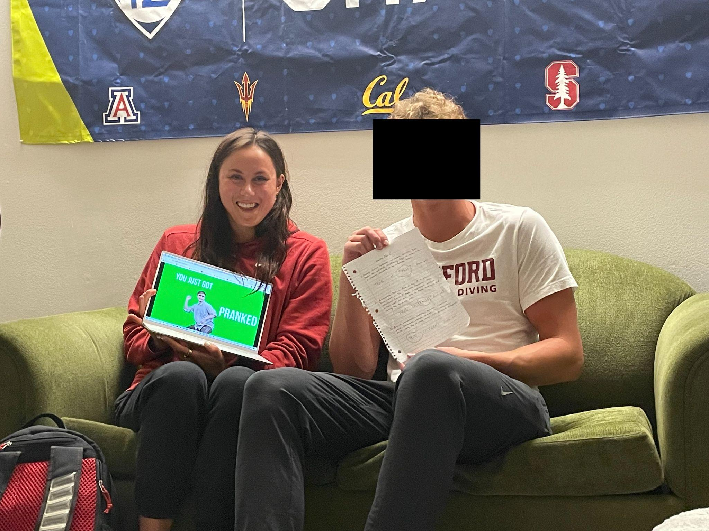
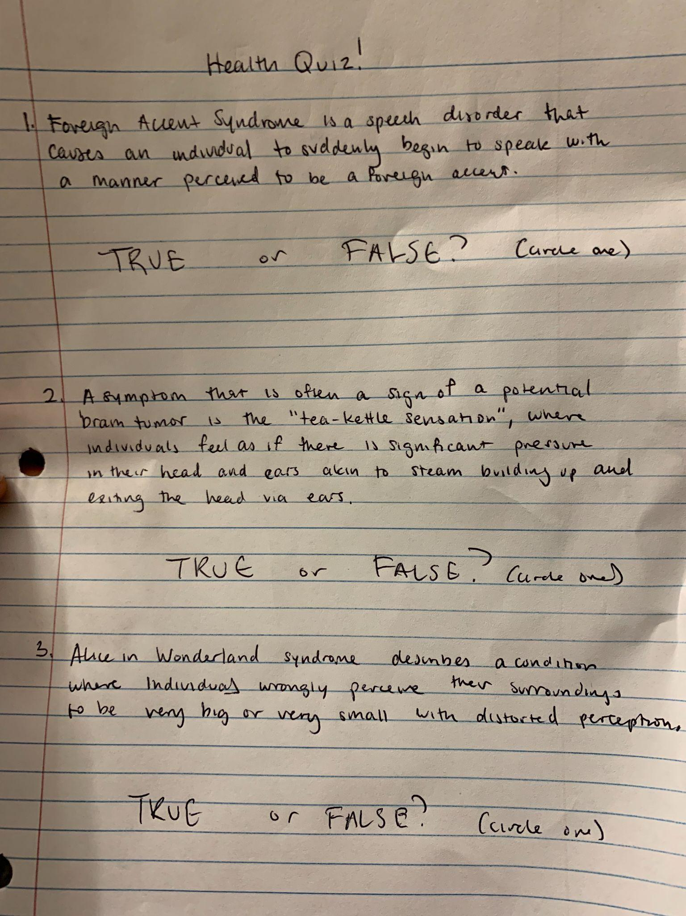
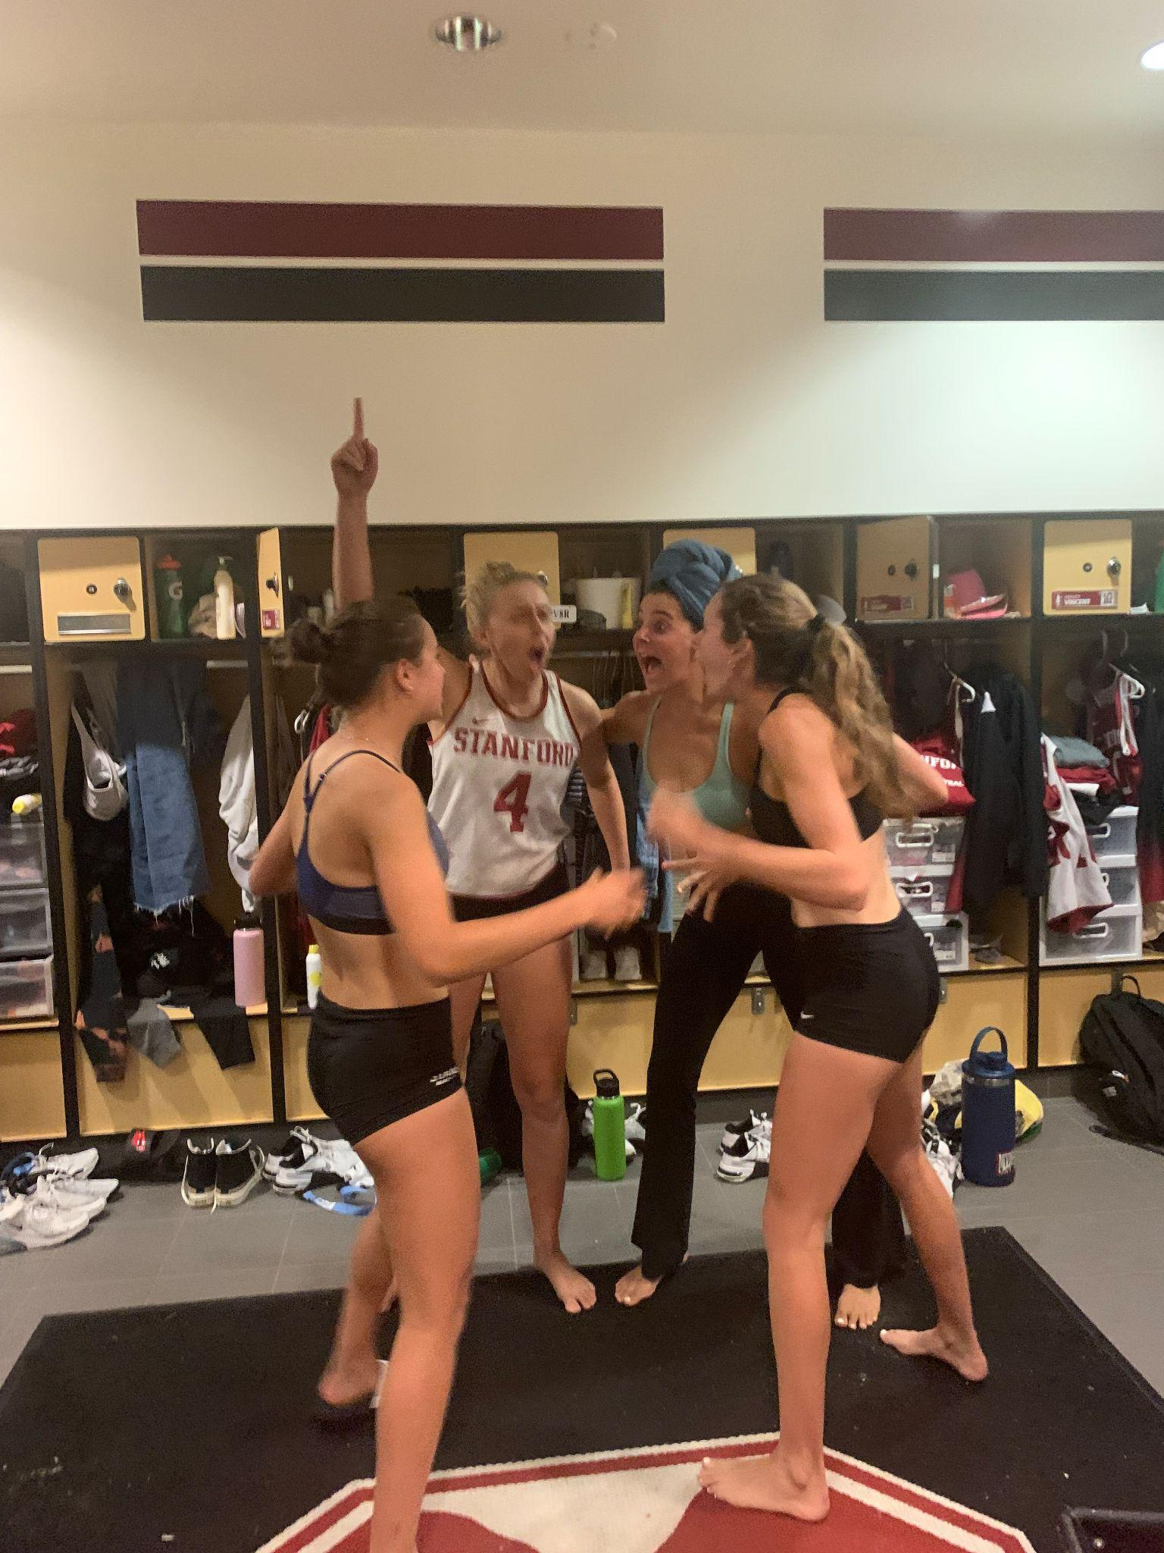
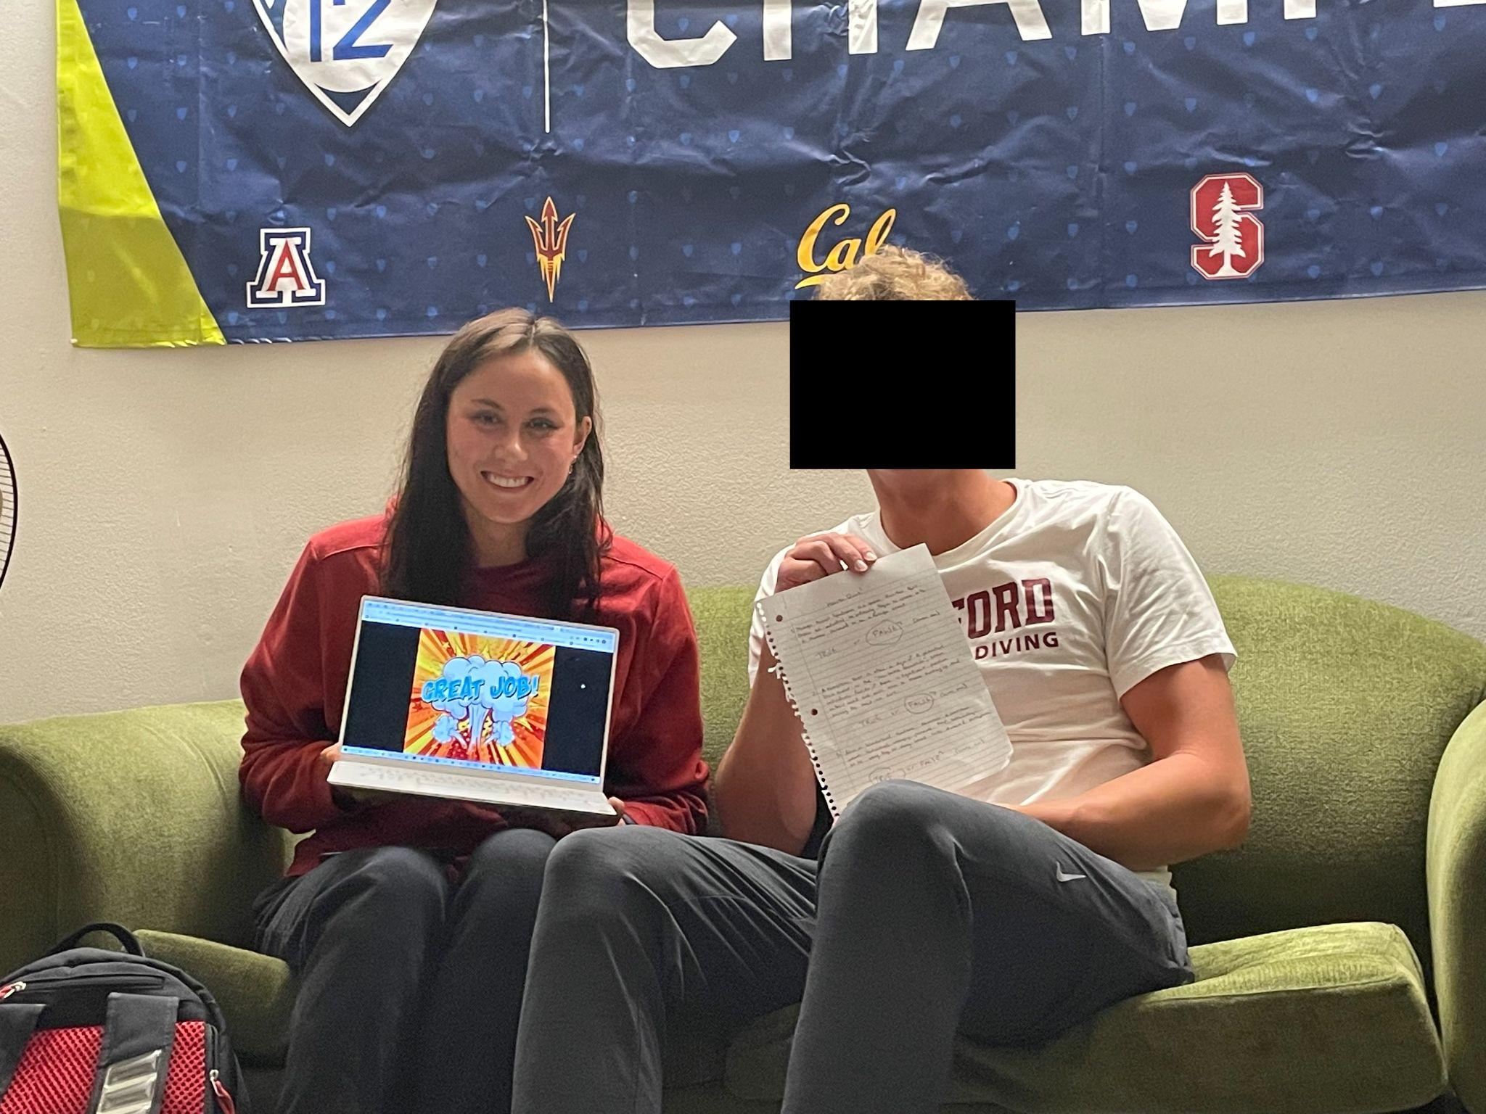
Redacted
Redacted
Redacted

Slide 37
Participants
Group of 4 beach volleyball
teammates
On same athletic team as team member
Competitive group
College aged male
On same athletic team as team member
Competitive person
1
2
College aged female
Found in dining hall
Random selection to diversify test group
College aged male
Found in dining hall
Random selection to diversify test group
3
3

Slide 38
Results
What worked?
People wanted to play the game more
People were interested in learning about the causes of certain conditions/symptoms
A participant verbally noted that they wished to follow up on symptoms they were personally experiencing
People enjoyed competitive aspect
What did not work?
User engagement and excitement when getting answers wrong depended on outside stimulus
Greater energy and more positive responses were generated in a group compared to individual participants
Slightly uncomfortable to hear about the symptoms
Pressured to answer fast in group setting

Slide 39
What’s Next?

Slide 40
Moving Forward…

Slide 41
…Ethics?

Slide 42
Could our creation of ‘fake’ disorders and symptoms be considered making fun of having conditions?
Want to avoid centering conversation around the ‘fake’ disorders

Slide 43
Who Does it Serve?

Slide 44
Individuals seeking to increase education
Users with concerns about mental health
Users desiring routine
Individuals who lack mobility or dexterity
Individuals not concerned about their health
Individuals that require immediate medical help

Slide 45
Thank You

Slide 46
Appendix

Slide 47
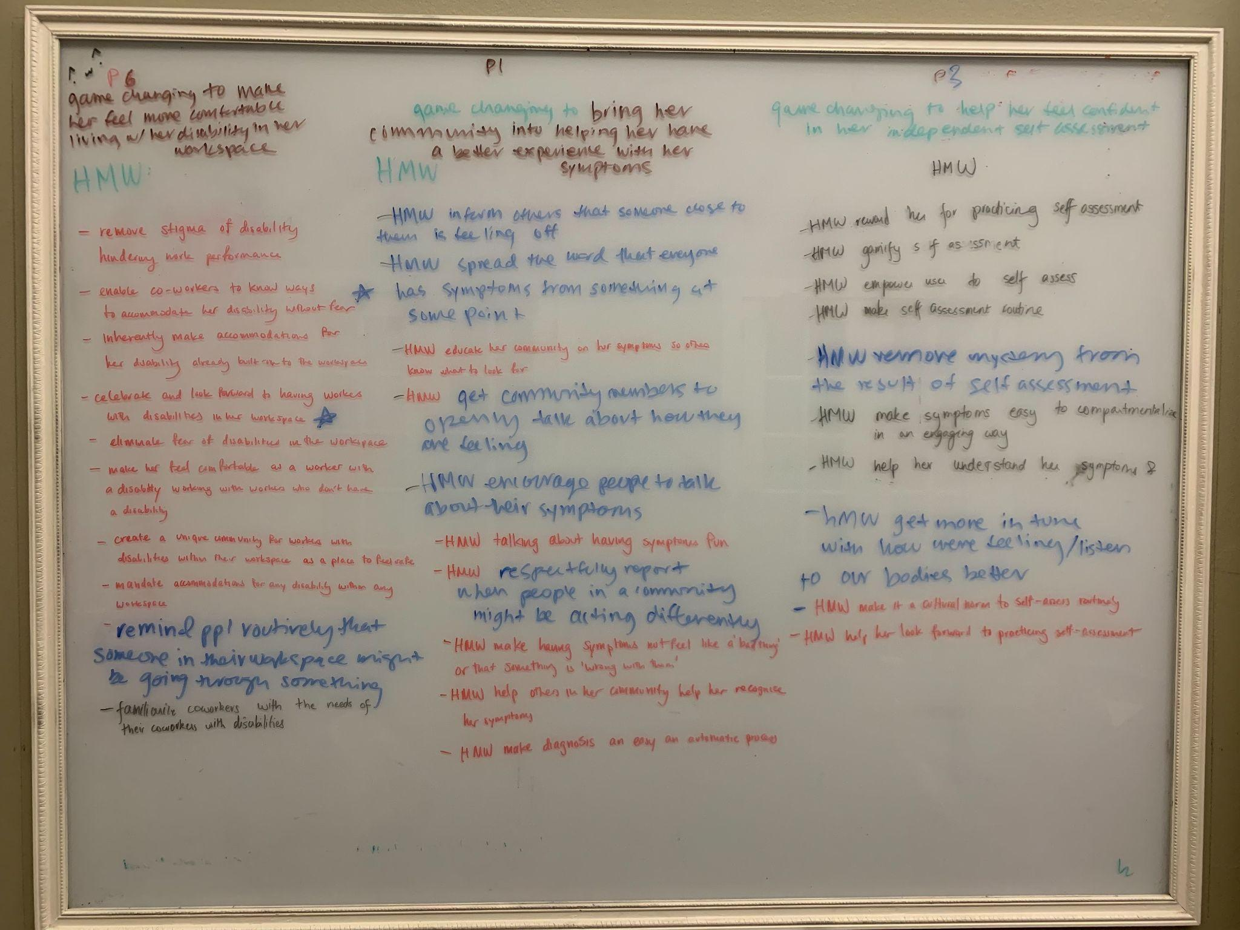

Slide 48
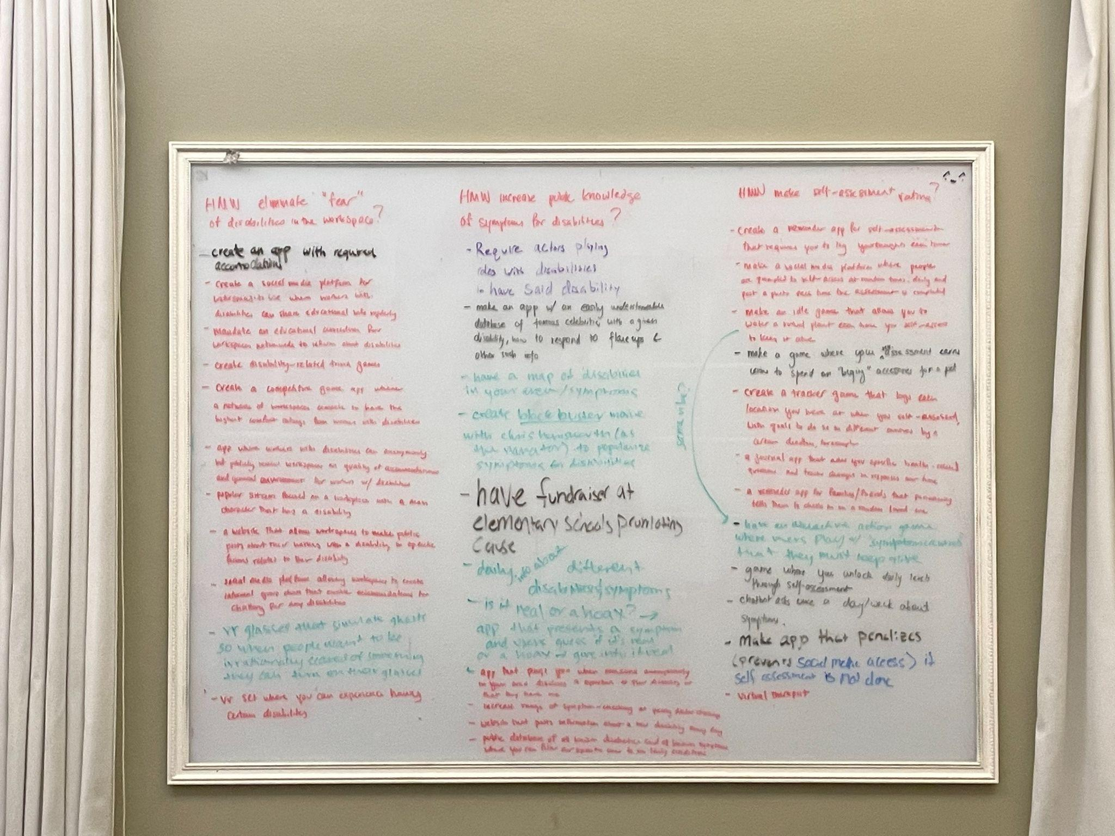

Slide 49
