Slide 1
Needfinding
Jonathan Affeld, Maya Harvey, Janelle Rudolph, Gayatridevi Tarcar

Slide 2
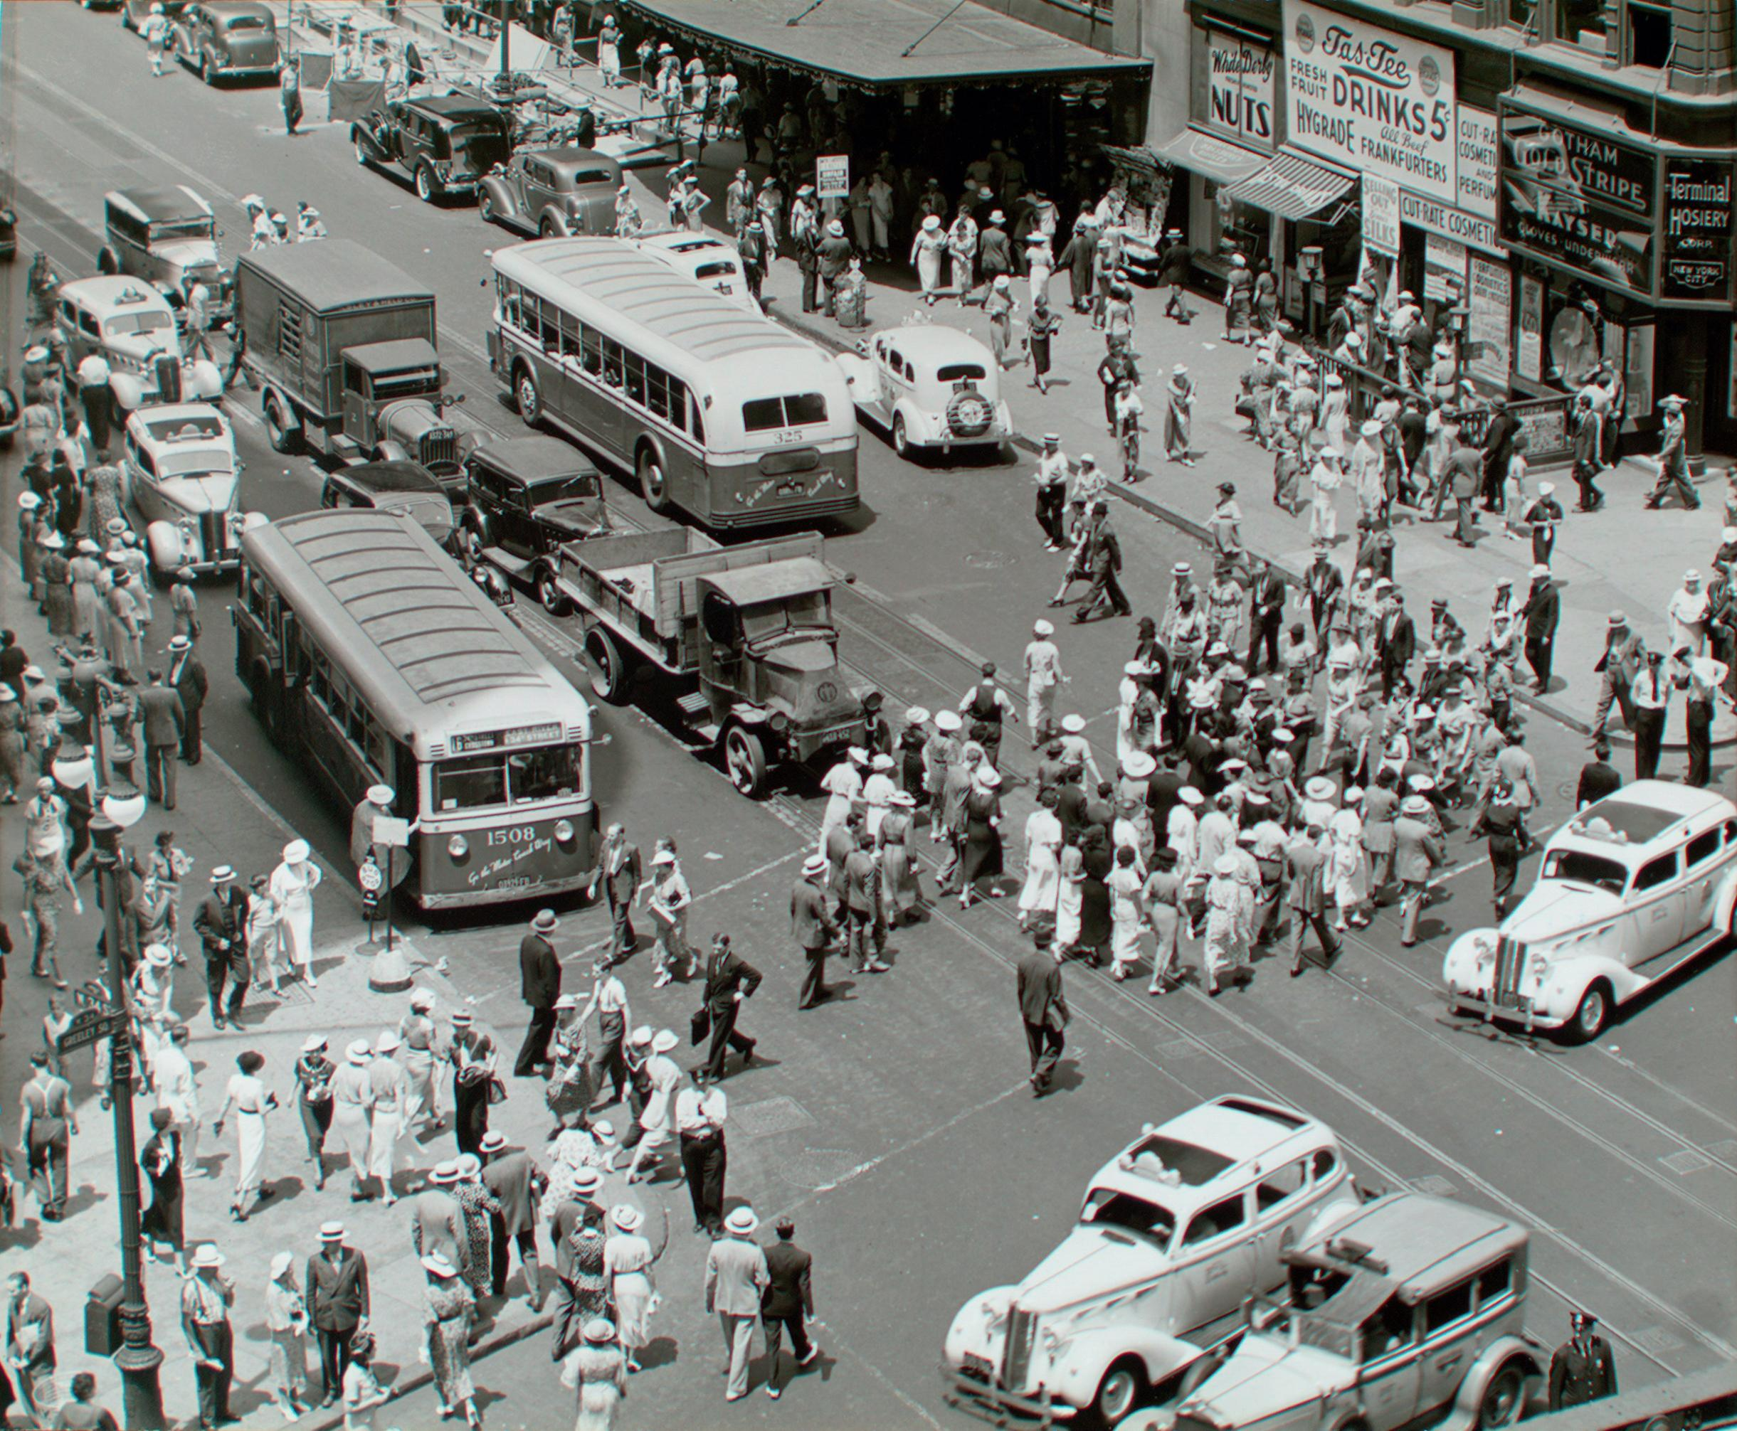
Domain
People with unique medical histories that differ from their immediate community
Why?
What goes on behind the scenes in the medical lives of seemingly normal people?
How do these “hidden” disabilities affect the way people interact with strangers and their community?

Slide 3
Participants
Female, high school sophomore
Currently lives with juvenile epilepsy
Personal connection to a team member
Female, 3rd year psychology student
Lives with anxiety, panic attacks, overthinking
Personal connection to team member
-lives in a very different community
1
3
Male, college athlete
Had brain tumor
Currently lives with deafness in one ear
Personal connection to a team member
Extreme user due to multiple unique health challenges and is receiving ongoing treatment
Male, college athletic coach
Has family members with healthcare challenges
Works daily with athletes who have physical limitations
Met at Jimmy V’s (campus cafe)
Non-user, has no direct medical challenges
2
4

Slide 4
Interview Logistics
Participant 1 was interviewed in person (Maya interviewer, Jonathan transcriber).
Participant 2 was interviewed in person (Maya interviewer/transcriber) on UC Berkeley campus.
Participant 3 was interviewed via Zoom (Gaya interviewer, Maya transcriber).
Participant 4 was interviewed in person (Jonathan interviewer, Janelle transcriber) at a Stanford Cafe.
Apparatuses used included laptops and iPad to take notes and transcribe interviews.

Slide 5
Questions Asked
How do people compensate for having a disability/strategies used for accommodating them?
Tell me about a time you experienced issues with accessing healthcare?
Was there ever a time where you found healthcare support in your community?
Was there a time when your community was lacking in healthcare?
Have you ever felt isolated by your medical history? And/Or what has helped you overcome that?
Do you feel adequately supported for your health, mental and physical? Why?
Was there any challenge in your life that a disability or health issue has impacted?
What unique challenges or experiences have your health issues brought into your life?
What tactics have you used to accommodate people with different medical backgrounds than you?

Slide 6
Key Quotes
“Community is way more important than medical care” - Participant 1
“[you] have to try and understand what people are going through, but not let it affect you” - Participant 3
“a lot of people in [my] current community don’t know [I] had a brain tumor” - Participant 2
“Gone through the hardest of the hard” - Participant 2
“Google can help or make things worse. What really helps [with stress and anxiety] is talking to others and seeking community” - Participant 4

Slide 7
Surprises?
Majority of participants seemed to suggest of their own volition finding community as method for dealing with isolation and healthcare challenges
Can also be extremely stressful for non-users to perceive the healthcare challenges that users deal with
Human body, mind, spirit is extremely resilient
Some people that one might think are obligated to help individuals with healthcare concerns (i.e. parents) may actually obstruct access to healthcare
Sometimes change of environment is significant help for increasing healthcare access

Slide 8
Analysis - Empathy Map for Participant 1

Slide 9
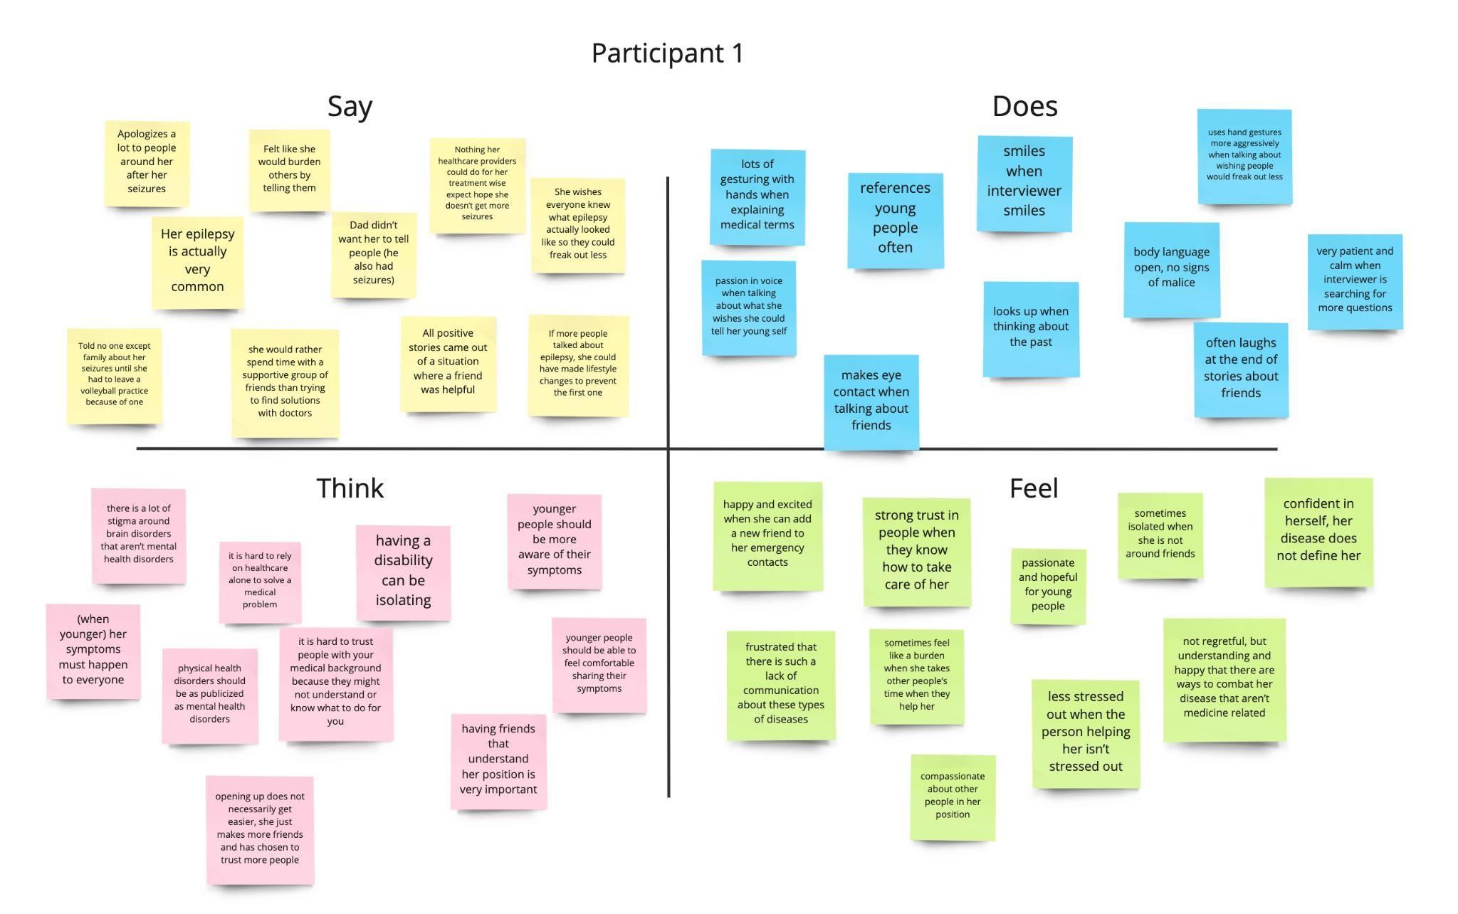

Slide 10
Analysis - Key Insights
Fear stigma and how people will react greatly affects openness
Young people and children seem less likely to report symptoms
More people suffer than meets the eye
Community can be helpful for recovery, but often it is hard to reach

Slide 11
Analysis - Empathy Map for Participant 4

Slide 12
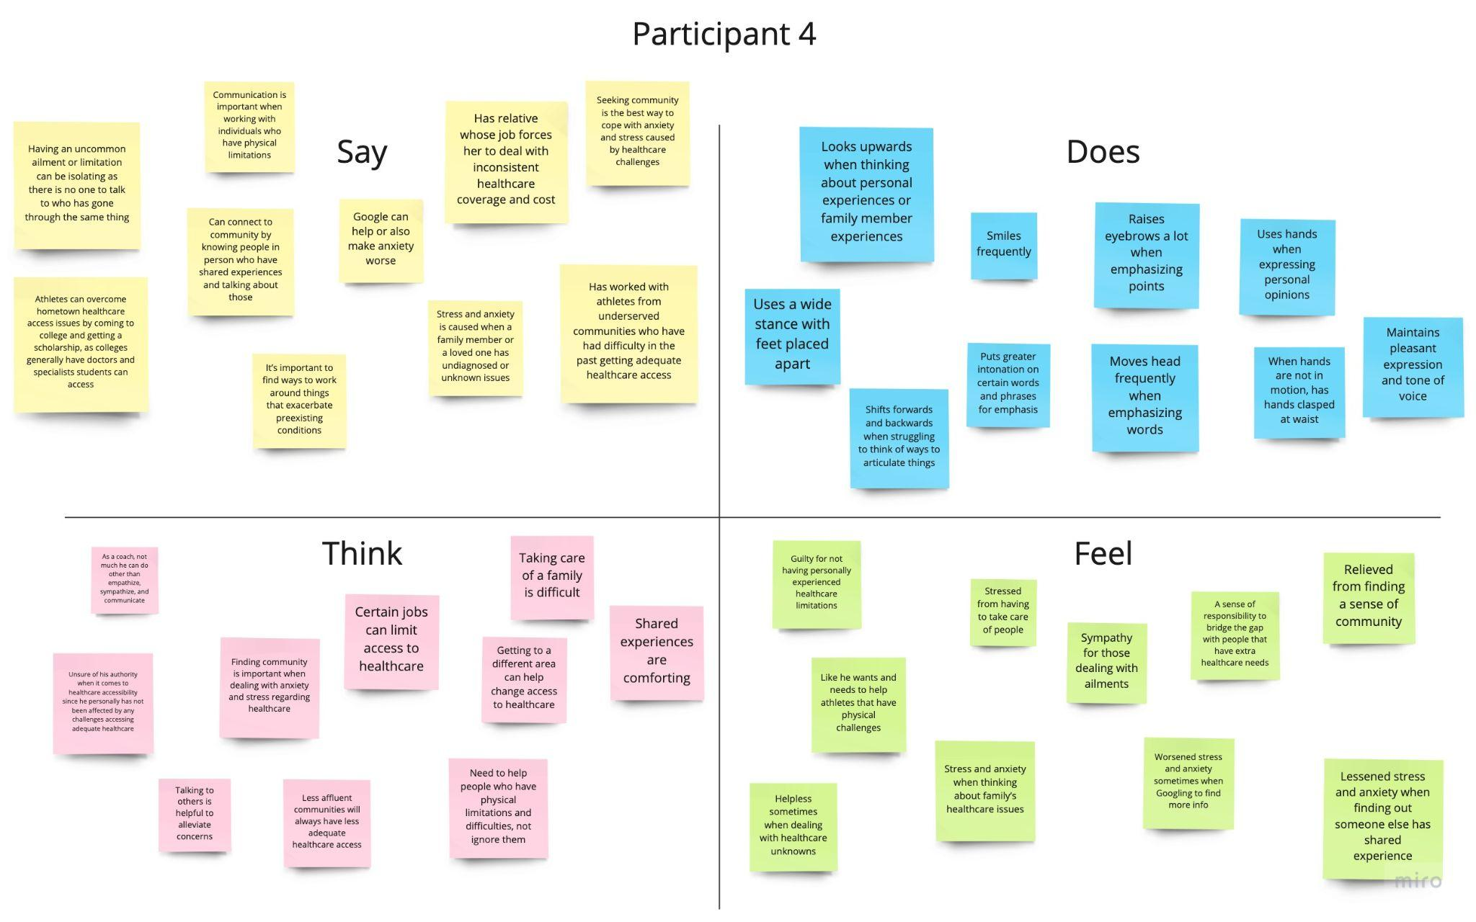

Slide 13
Analysis - Key Insights
Health and opinions of loved ones impacts own mental health
Location impacts access to health care
Community can be impactful in recovery
Fact discovery does not always quell anxiety

Slide 14
Summary
What’s Next?
How do we establish a form of community to bring together individuals with unique health concerns?
How do we connect these communities to healthcare specialists so they can have adequate healthcare access? Or, how might we notify their personal communities of their situation to make living more comfortable?
How do we make sure this form of community is accessible to all in the first place?
Key Learnings:
Finding community is both a key coping mechanism and method of achieving greater access to healthcare
While workarounds can help make the best of a situation, real help is needed
There is a wide variety of access to healthcare consistency and cost
Younger people who cannot identify what they are going through struggle with identifying with a group after diagnosis

Slide 15
Thank You

