Slide 1
RecoveryGrow
Holistic and Supportive Concussion Recovery

Slide 2
Our Team
01
03
Kimberly
Nico
02
04
Sharon
Crystal

Slide 3
Problem + Solution Overview
While concussions directly impact one’s physical health, mental and emotional impacts are often overlooked, with those recovering from concussions often expressing feelings of isolation and lowered perceptions of self.
Recovery Board works to meet the emotional needs of individuals healing from concussions, providing a space for users to reflect on one’s well-being and connect with others.

Slide 4
Outline of Today’s Content
01
02
03
04
Design Revisions
Heuristic Evaluation
Targeting changes that better reflect our usability goals
Looking at the highest severity and most frequent violations
Demo
A live demonstration of working prototype
Prototype Status
Exploring tools used and features implemented

Slide 5
Heuristic Evaluation Results
Familiarity with our own ideas led us to produce a confusing user interface for our evaluators, especially when it came to system status
Inconsistent and unlabelled iconography also clouded the experience for our test users, making the navigation through our prototype not as seamless as we would’ve hoped
However, our evaluators enjoyed the overall aesthetic appearance of our app and just wished for more freedom when working through tasks

Slide 6
Heuristic Evaluation Results
39 Total Severity 3 and 4 violations
35 severity 3 and 4 severity 4
Most: Match b/w System and Real World (H2)
Visibility of System Status (H1)
User Control and Freedom (H3)
Accessible Design (H11)
Least: Flexibility and Efficiency of Use (H7)
Severity with accommodating for expert users

Slide 7
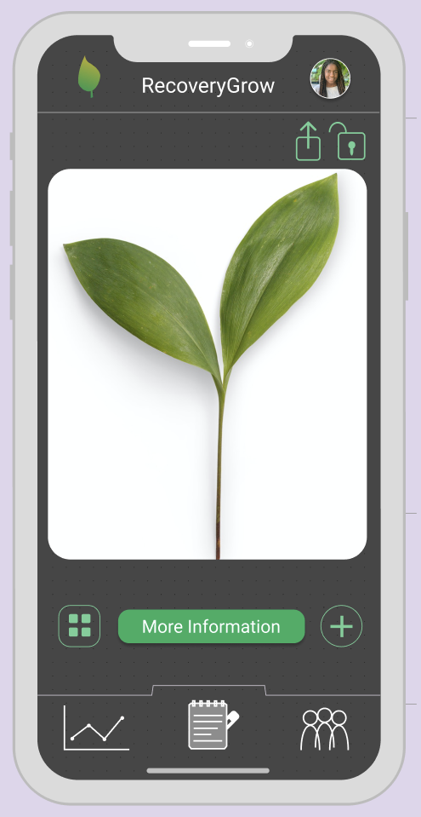
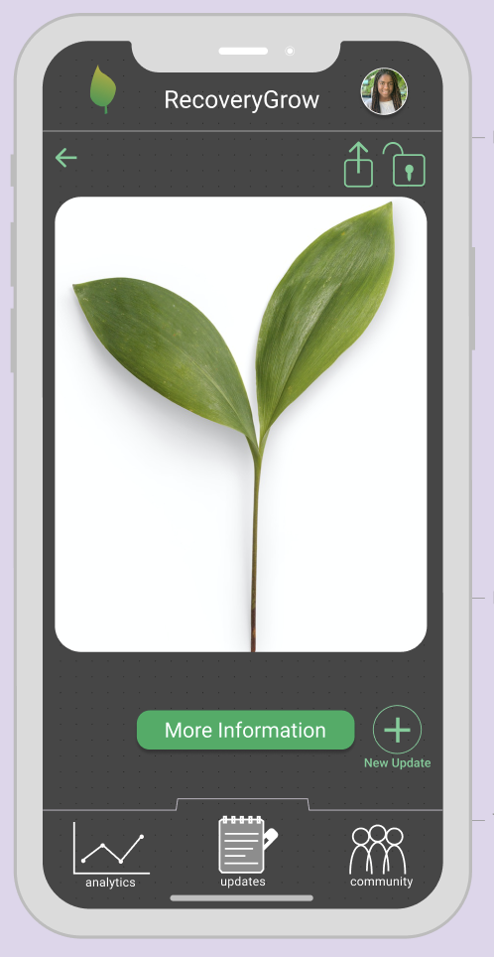
UI Revisions
Changed:
Consistent back button
Labeled tab buttons
Text that identifies the function of the add button
Not Changed:
Public or private notification

Slide 8
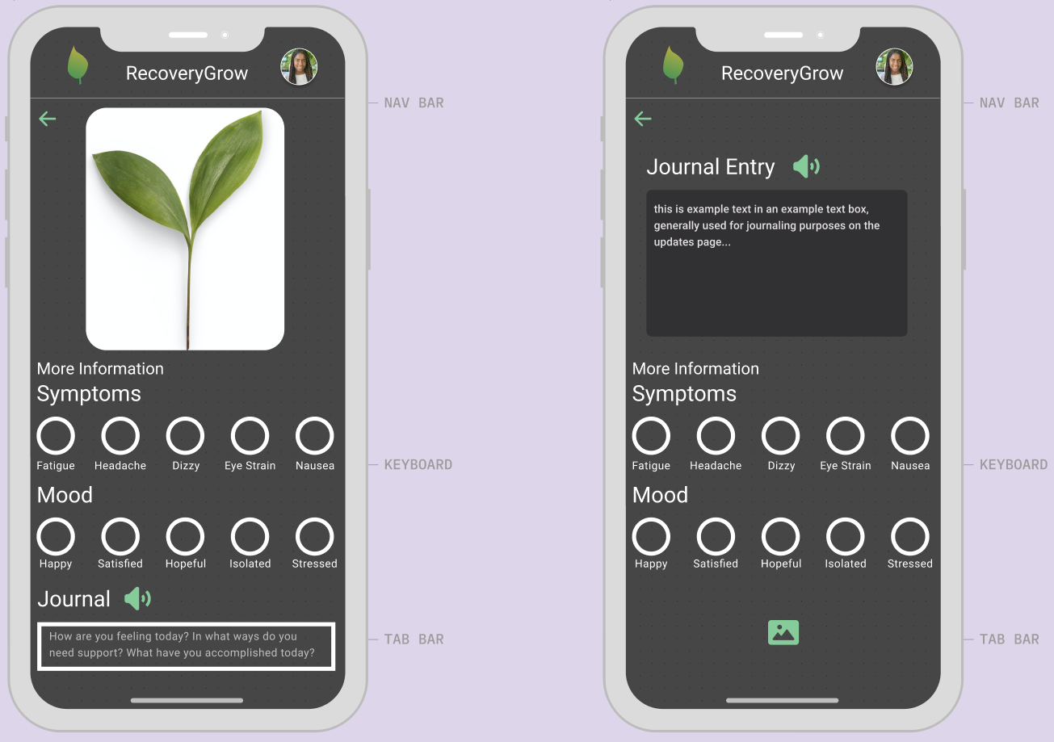
UI Revisions
Changed:
Information about date of update
Different format of journal entry boxes
“Journal” vs “Journal Entry”
Freedom to delete an update
Ability to record voice memo

Slide 9
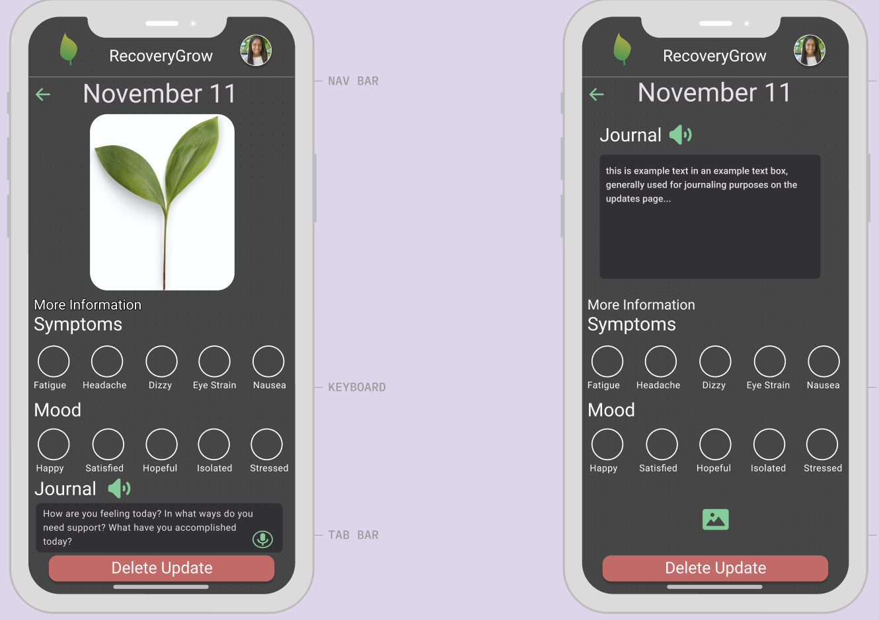
UI Revisions
Changed:
Information about date of update
Different format of journal entry boxes
“Journal” vs “Journal Entry”
Freedom to delete an update
Ability to record voice memo

Slide 10
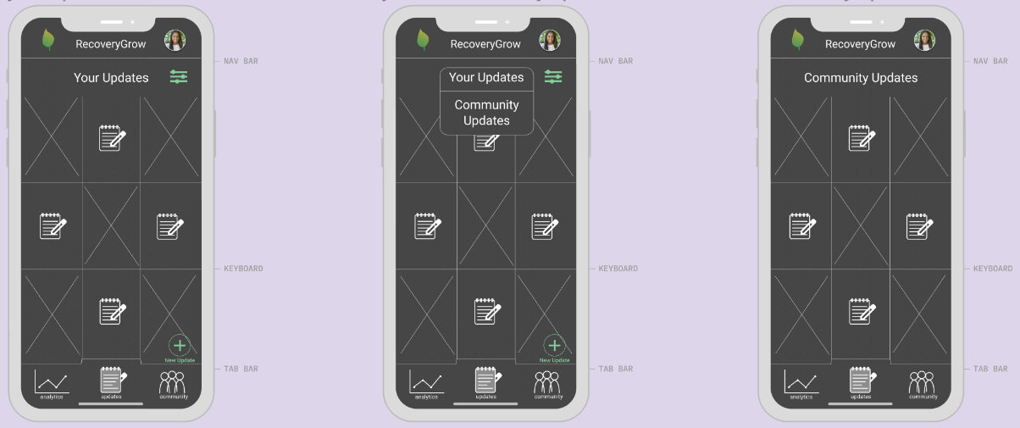
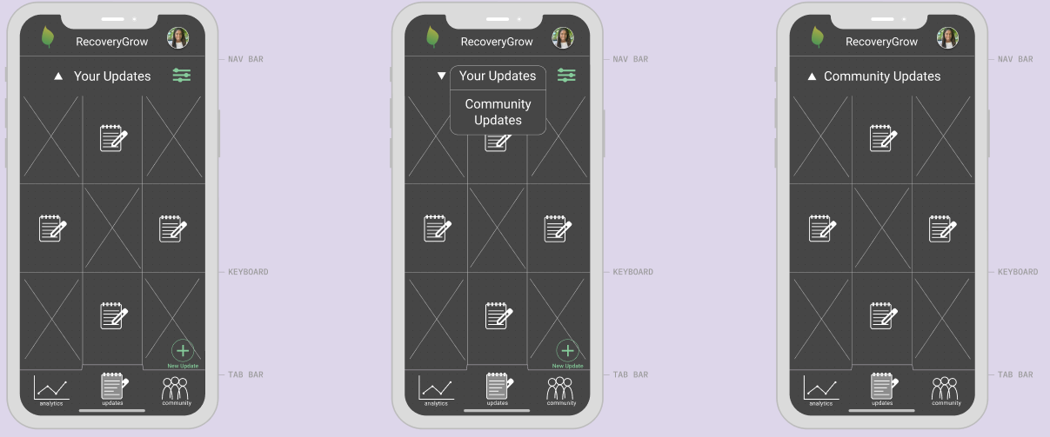
UI Revisions
Changed:
Clearer to change between “Your Updates” and “Community Updates” with addition of small white triangle

Slide 11
UI Revisions - Usability Goals
Already difficult to navigate a world that can be inaccessible for someone that is recovering from head trauma
Revisions, such as including voice memos, allows ease of use for the intended users of our app
With clearer and more descriptive UI, people that are recovering from concussions can use our app to better reflect on their physical and emotional health

Slide 12
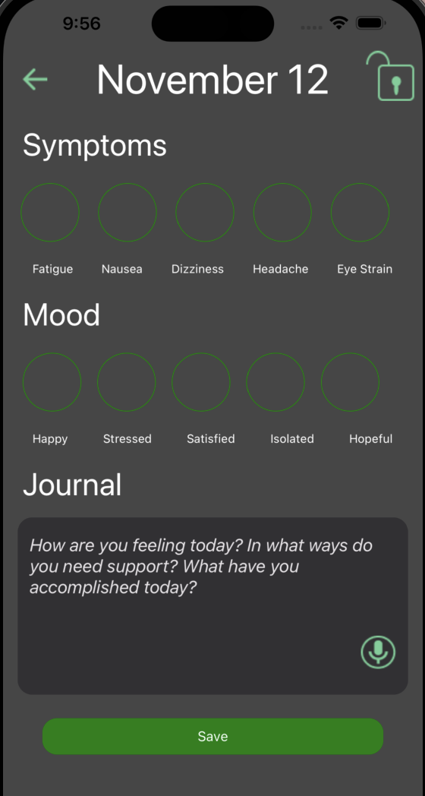
High-Fi Prototype Implementation
React Native
Implemented
Logging symptoms, journaling, analytics
To-Do
Forum, sharing, backend
Wizard of Oz
Speech-to-text
Hard Coded
Symptom logs + journals

Slide 13
Demo
We will now have a live demo of the prototype

Slide 14
Appendix
Further examples of design updates to medium-fi prototype

Slide 15
Design Changes

Slide 16
Alternative resources
Here’s an assortment of alternative resources whose style fits that of this template:

