Slide 1
RecoveryGrow
Holistic and Supportive Concussion Recovery Tracking
Nico, Sharon, Crystal, Kimberly

Slide 2
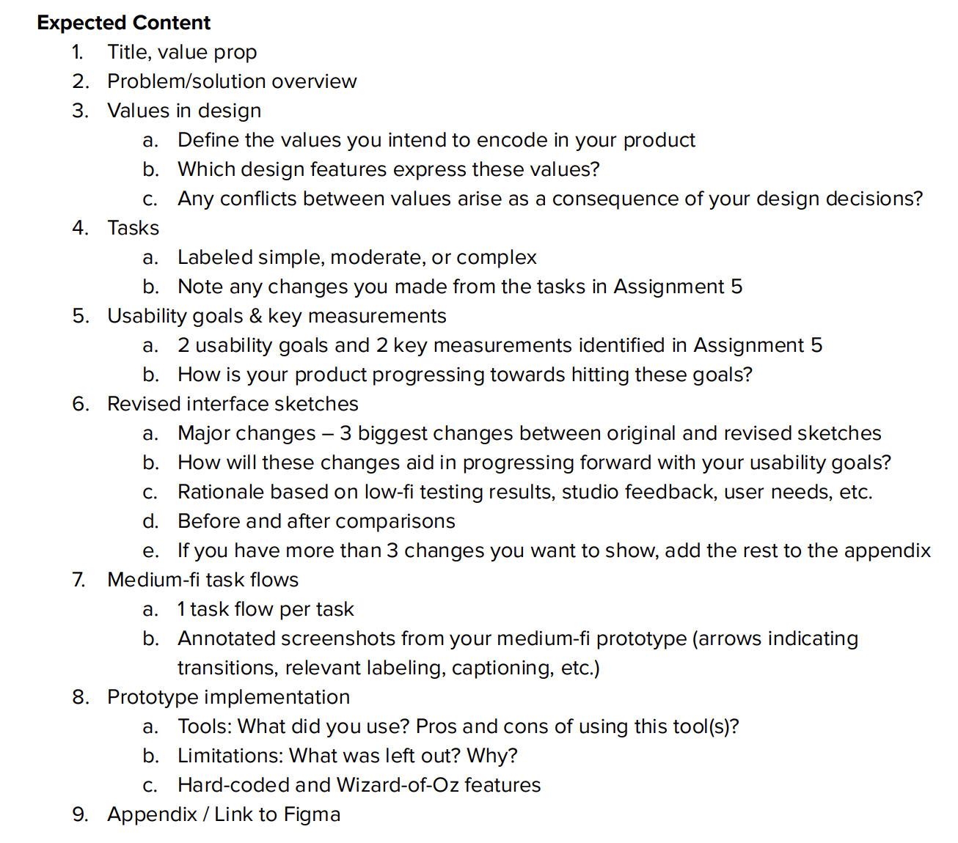

Slide 3
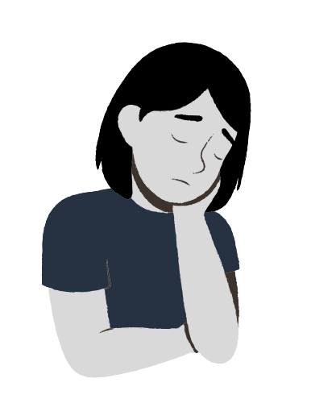
THE PROBLEM
While concussions directly impact one’s physical health, mental and emotional impacts are often overlooked, with those recovering from concussions often expressing feelings of isolation and lowered perceptions of self.
Recovery Board works to meet the emotional needs of individuals healing from concussions, providing a space for users to reflect on one’s well-being and connect with others.

Slide 4
OUR VALUES
BALANCE
EMPOWERMENT
COMMUNITY
acknowledging the emotional toll that accompanies recovery + emphasizing mental health as a priority alongside physical health
Feat: users log physical recovery + emotional state
combatting feelings of inadequacy
Feat: offering reflection prompts that emphasize a positive mindset
ensuring users do not feel alone in the recovery process
Feat: offering community between users + ways for personal connections to interact w/ one’s recovery
Notes:
Our three main values are balance, empowerment, and community. We hope to encode these values into our product in a variety of ways. First, with balance, we will implement both physical and mental tracking to help emphasize the mental health recovery aspect and lift it up alongside the physical recovery from the injury. For empowerment, we will offer reflection prompts to guide users towards positive thinking and focusing on their strengths throughout recovery. Lastly, with community, we will offer ways for users to connect with other people who are recovering as well as easily communicate with contacts in their personal life about their recovery. With these values, there are no obvious contradictions or challenges among them.

Slide 5
SIMPLE TASK
recording and keeping track of daily symptoms + emotional wellbeing

Slide 6
MODERATE TASK
analyze symptoms and gain insights into one’s recovery journey

Slide 7
COMPLEX TASK
connect with others recovering from concussions + share insights with personal connections
Notes:
Though we have not changed the complex task, we have pivoted to de-emphasize elements of the community task that connected it to social media. This change can be seen in adjustments of our simple and complex task-flows, but had the most impact on how we approached our complex task. Instead of a feed, we will be using a forum-approach to help users engage with online community in addition to the friend and chat features we are keeping. More information on this can be found in our last “revised sketches” slide!

Slide 8
Usability Goals
01
02
03
Concussion-friendly Interface
Easy, Independent Navigation
Clear Understanding of all available interactions
Our users should be able to use our app without worry that it will have major negative impact on their symptoms
We want our users to be able to use the app without guidance from a facilitator.
Clear iconography and buttons that don’t leave users guessing.
Notes:
To help give a clear understanding of all available interactions, we have opted for more clear iconography, using icons already associated with each function (ex. speaker icon for recording). We are also using color to help indicate clickable buttons as well as screen titles to aid in providing easy, independent navigation for the user.
(Next Slide explores the third usability goal which is new)
We believe that our product is progressing well towards our usability goals.

Slide 9
New Usability Goal: Expanded
03
Concussion-friendly Interface
Dark Theme
  Possibly triggering accessibility feature for dimmer light
Audio based experiences
  Voice recording, playback
  speech -to-text and regular typing available
Our users should be able to use our app without worry that it will have major negative impact on their symptoms
Notes:
A new usability goal that we have taken on is making our app as concussion-friendly as possible, so that recoverees can use it without risking significant negative impact on their symptoms. We have created our app with a dark theme, and are discussing a feature where the app can trigger the iPhone accessibility feature that allows a user to make their screen even dimmer than dimmest default setting.
To reduce time that a user would need to look at their screen, we have made the time-intensive, text heavy interactions (journaling, engaging with the forum) predominantly audio based. Users will voice record their journaling and posts to the forum. We are making sure to include typing and speech-to-text options as well for people who choose to engage with the app that way.
We believe that our product is progressing well towards our usability goals.

Slide 10
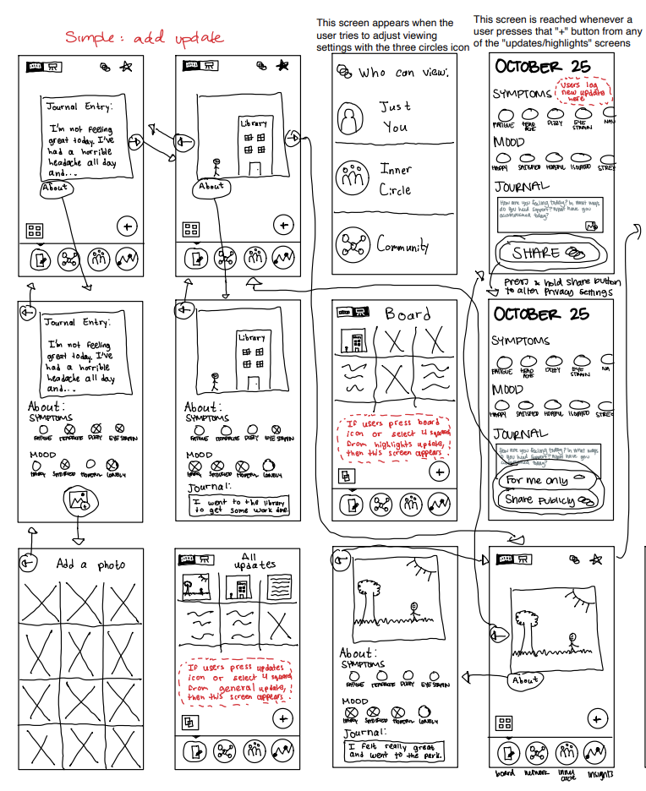
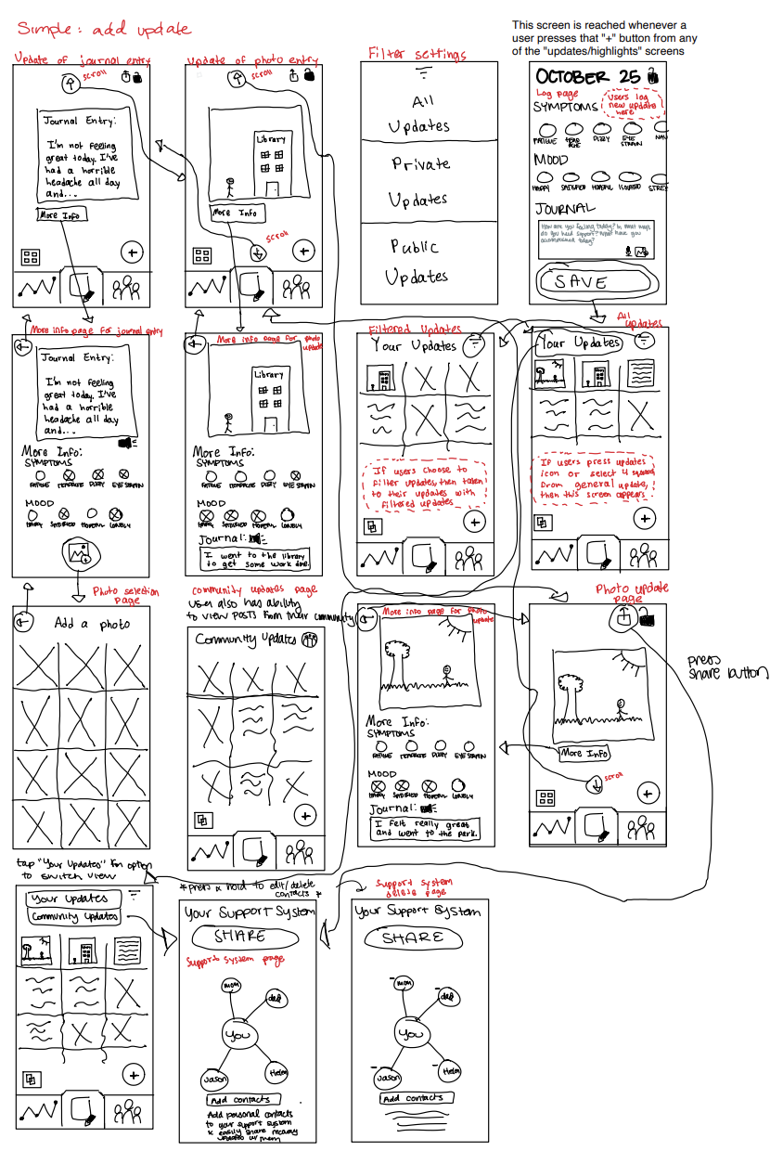
Revised Sketches - Simple
Notes:
Left Picture: Before; Right Picture: After
To help us achieve our goal pivoting away from a social-media heavy experience, we have taken off the option of having a highlighted updates board, in order to remove the pressure of seeing and creating overly curated representations of people’s highly personal recovery journeys. We instead have a toggle between personal updates and community updates where people can see the most recent postings of the community, without the option to like the post. By having a toggle in this journaling/updates tab instead of the community tab, we believe we are taking the emphasis off of the feed-like engagement experience.
To help give a clear understanding of all available interactions, we have opted for more clear iconography, using icons already associated with each function (ex. the sharing icon). We are also removed the inner-circle icon from the navigation bar on the bottom, as it caused a lot of confusion for our testers (more about this in the next slide).
In addition, during further discussion between the revised sketches and medium-fi prototype implementation, we later decided to add titles to the screens that give a clear understanding of the feature you are on (ex. “Your Support System”). This is reflected in the medium-fi prototype.

Slide 11
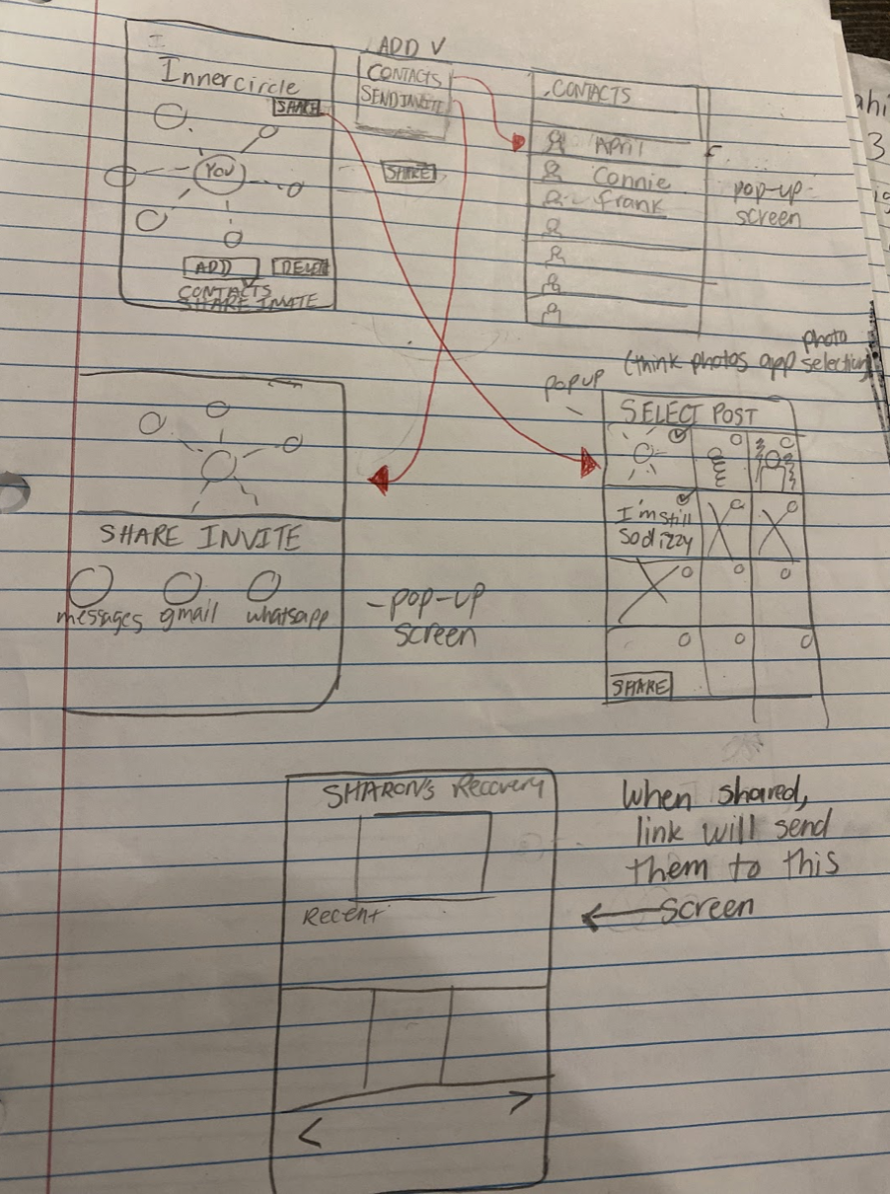
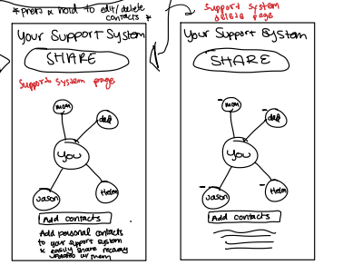
Revised Sketches - Complex
Notes:
We took a step toward our usability goal of creating easy, independent navigation for the user by taking the inner-circle feature off the navigation bar and putting it under the journal/updates tab. This was to reduce redundancies that confused our users during out Lo-fi prototype testing, as they didn’t understand the difference between the online community and the real-life support system, or the necessity of a separate, additional procedure of sharing posts. The new placement of the feature helps to streamline the process of sharing posts with a user’s support system.

Slide 12
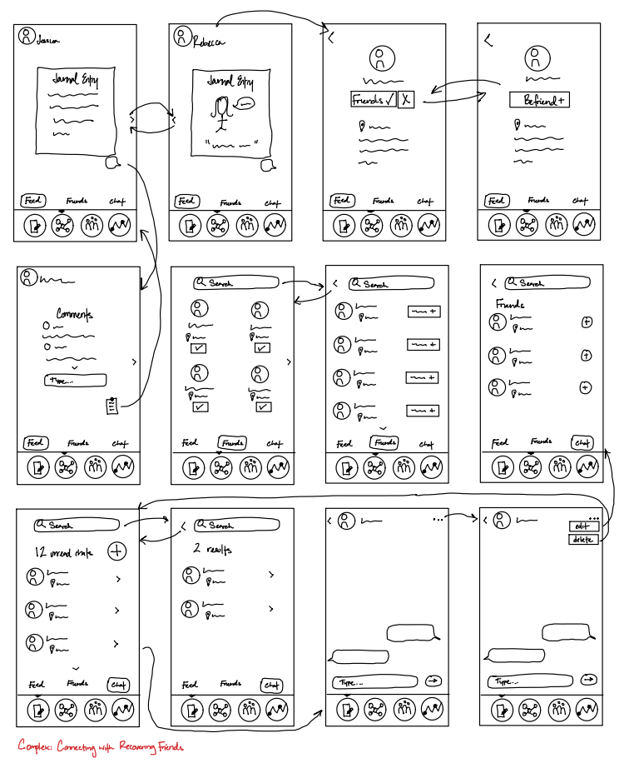
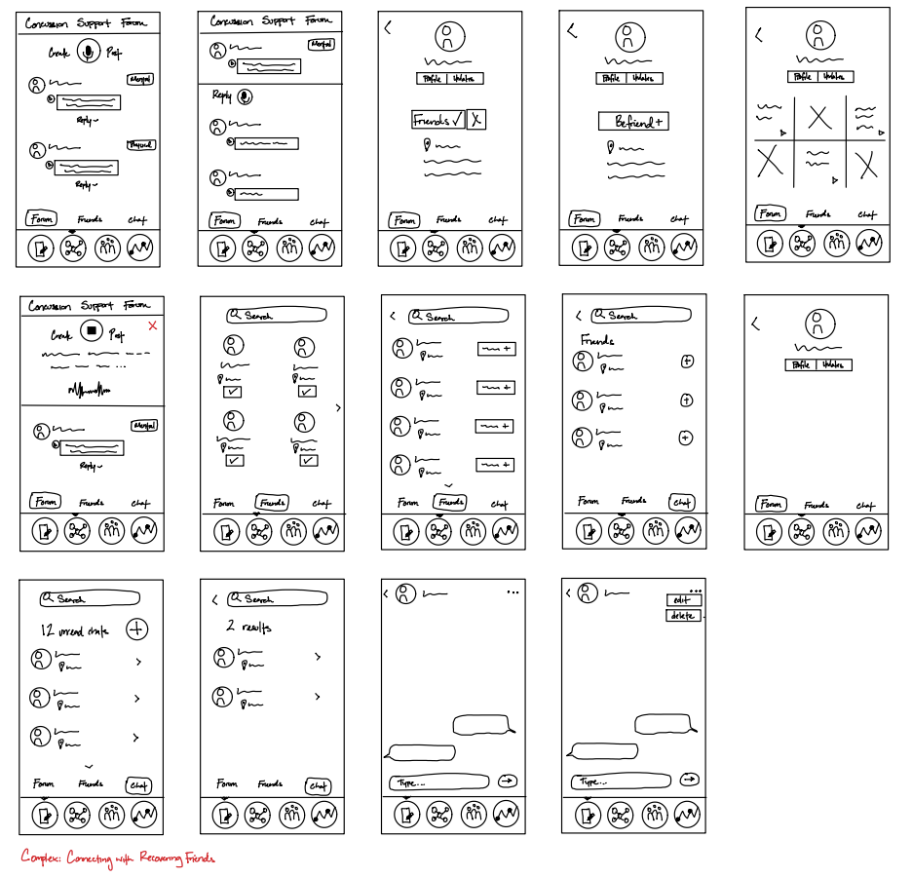
Revised Sketches - Complex
Notes:
Left Picture: Before; Right Picture: After
Our approach to implementing the complex task has changed significantly. As we stated, have pivoted to de-emphasize elements of the community task that connected it to social media. By switching from a feed to forum-based community building, we hope to remove the aspirational aspect that could arise from adding a social media aspect of the app.
This pivot helps us convey our values, specifically empowerment and community, in our app. By pivoting away from a feed-based engagement experience, we are preventing our app from causing the same feelings of inadequacy we are trying to combat. In addition, the forum will allow for more direct communication and community-building as users can trade tips and experiences. Our new approach also helps us in our usability goal of creating an interface that won’t negatively impact their symptoms, as social media has shown to have negative effects on mental health.

Slide 13
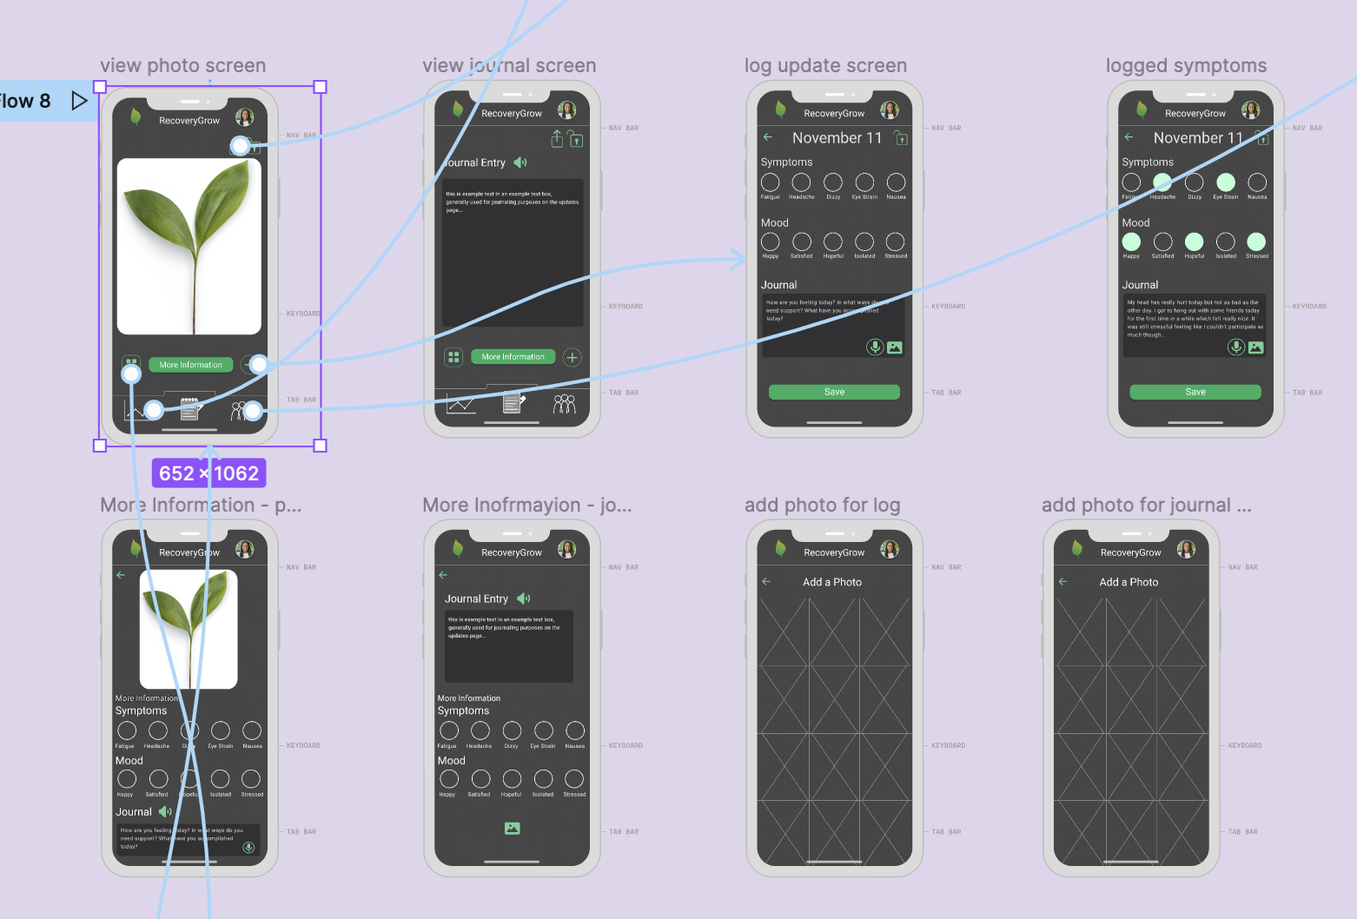
Medium-Fi Task Flow: Simple Task
log physical symptoms and general feelings while recovering from concussion
Notes:
This slide shows the simple task of viewing a previous log entry. More specifically, it shows how a photo log looks like as well as some of the screens that it flows through. From the photo entry, a user you can choose to view more information about that specific log. The user can also choose to go back to view all their own updates (grid icon). They can even change the privacy setting of their updates (as indicated by the lock icon) or share their update with their personal connections (as indicated by the share icon, or arrow in a box). They can also log a new update if they click on the add icon (plus sign in a circle).

Slide 14
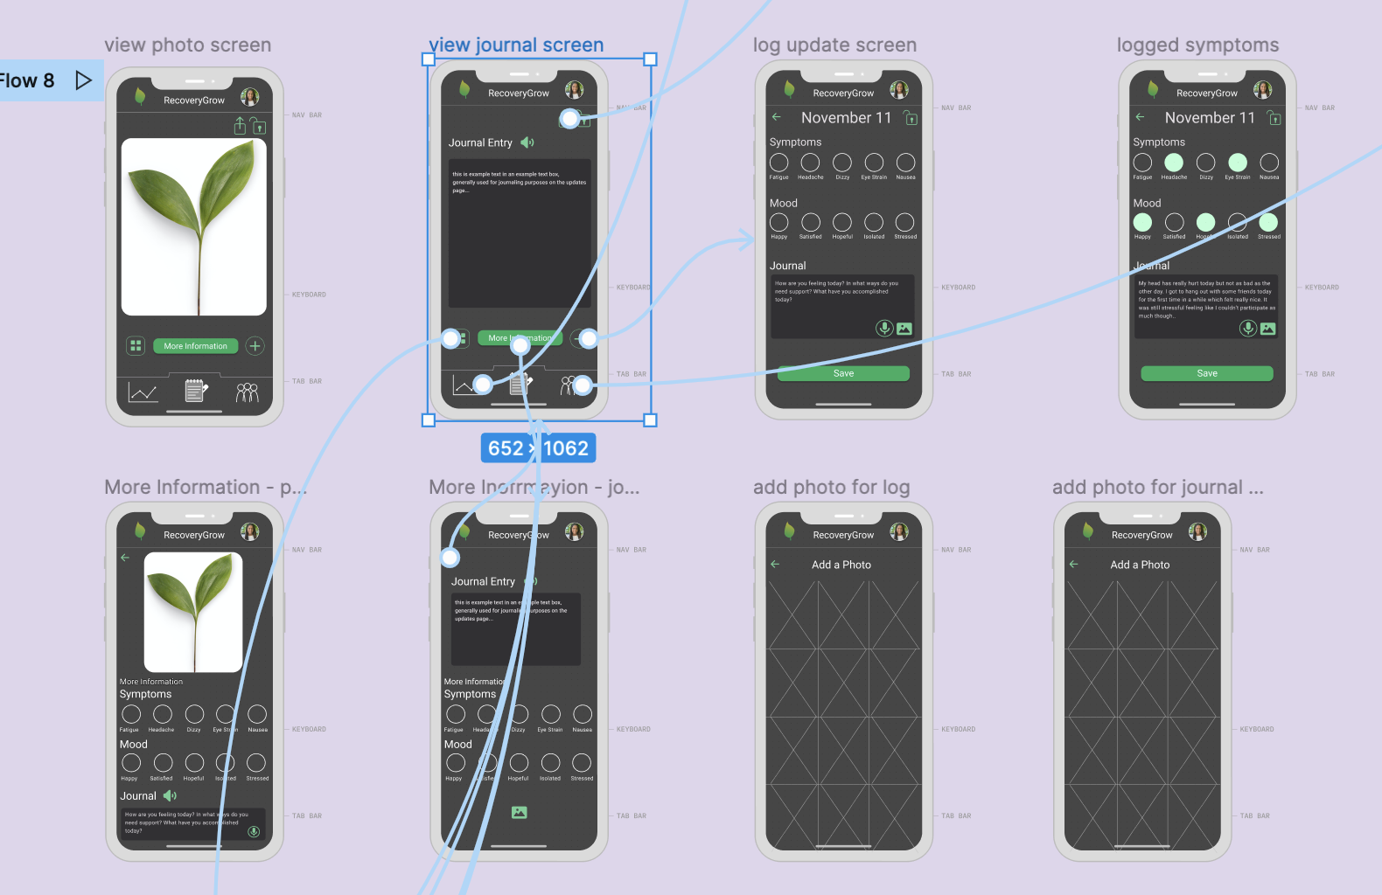
Medium-Fi Task Flow: Simple Task
log physical symptoms and general feelings while recovering from concussion
Notes:
This slide shows the simple task of viewing a previous log entry. More specifically, it shows how a journal log looks like as well as some of the screens that it flows through. From the journal entry, a user you can choose to view more information about that specific log. The user can also choose to go back to view all their own updates (grid icon). They can even change the privacy setting of their updates (as indicated by the lock icon) or share their update with their personal connections (as indicated by the share icon, or arrow in a box). If they didn’t have a photo with their journal entry before, then they can decide to add a photo by clicking on the landscape icon. They can also log a new update if they click on the add icon (plus sign in a circle).

Slide 15
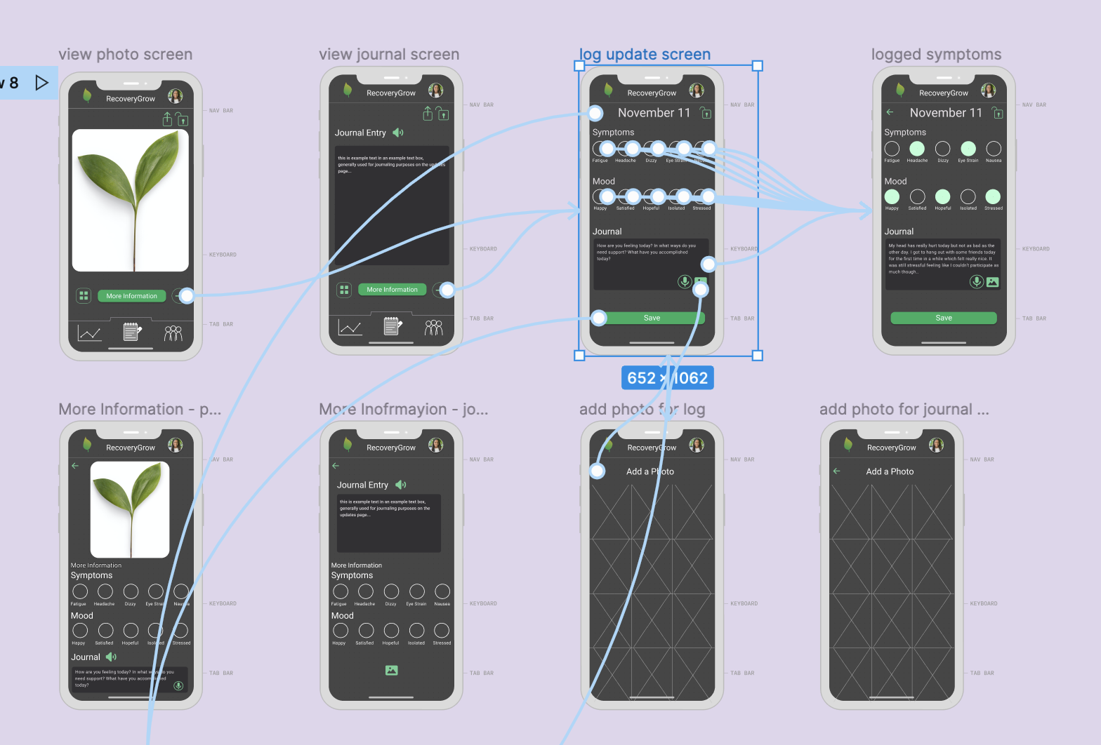
Medium-Fi Task Flow: Simple Task
log physical symptoms and general feelings while recovering from concussion
Notes:
This slide shows the simple task of adding a log entry. More specifically, it shows how adding a log looks like as well as some of the screens that it flows through. From the add a log screen, a user you can mark down the physical symptoms that they are experiencing during that day (grey circle outline to filled green circle will be worked on this week, we just learned about variants :) ). They can also add a journal entry to describe their thoughts and emotions and add a photo by clicking on the landscape icon. Furthermore, they can change their entry to be private or public by clicking the lock/unlock icon. Once they’re done, they can click save to log entry, which will take them back to viewing all their updates.

Slide 16
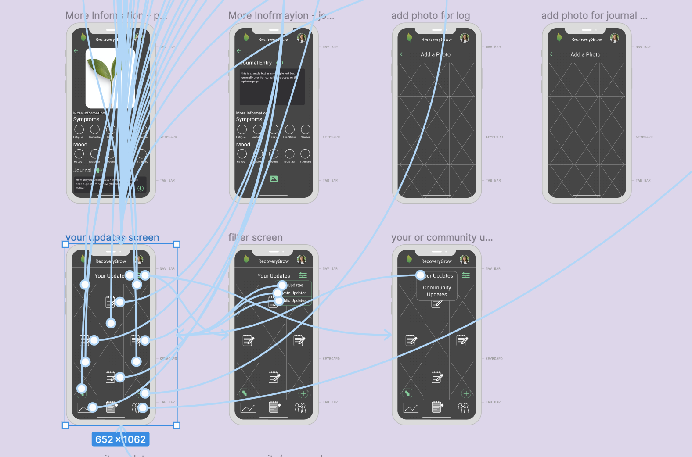
Medium-Fi Task Flow: Simple Task
log physical symptoms and general feelings while recovering from concussion
Notes:
This slide shows the simple task of viewing all previous log entries (your updates screen). From this screen, a user you can choose which entry they would like to view. X’s indicate photo entries and journals indicate journal entries just for simplification. They can also filter their updates by clicking on the filter icon (three lines with circles in different positions) to view all, public, or private updates. Furthermore, they can change back to view single updates at a time by clicking on the single view icon or they can add a new entry by clicking on the add icon. Lastly, they can view community updates, which are their online friends made through the app, by clicking on your updates and changing it to community updates.

Slide 17
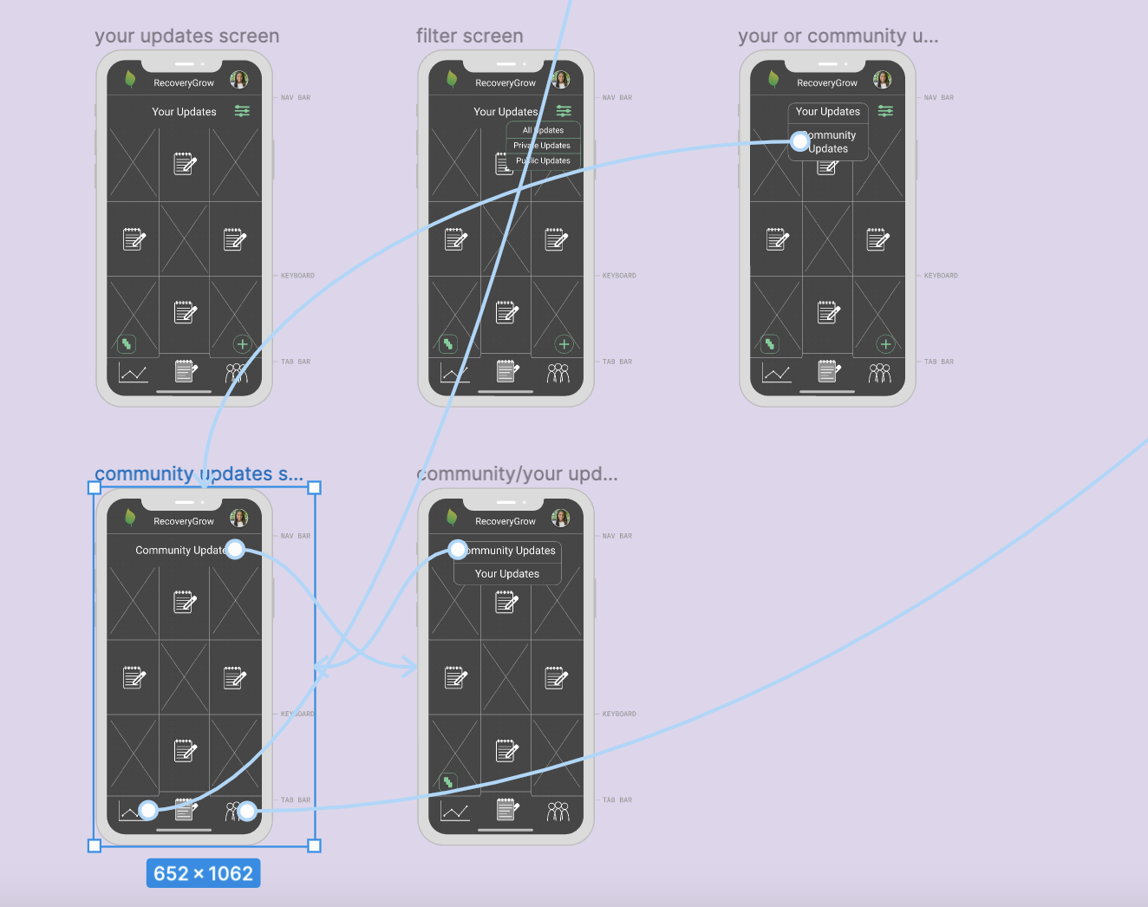
Medium-Fi Task Flow: Simple Task
log physical symptoms and general feelings while recovering from concussion
Notes:
This slide shows the simple task of viewing community updates (your updates screen). From this screen, a user you can choose which of their friends’ entries they would like to view. X’s indicate photo entries and journals indicate journal entries just for simplification. Lastly, they can view their own personal updates by clicking on community updates and changing if to your updates.

Slide 18
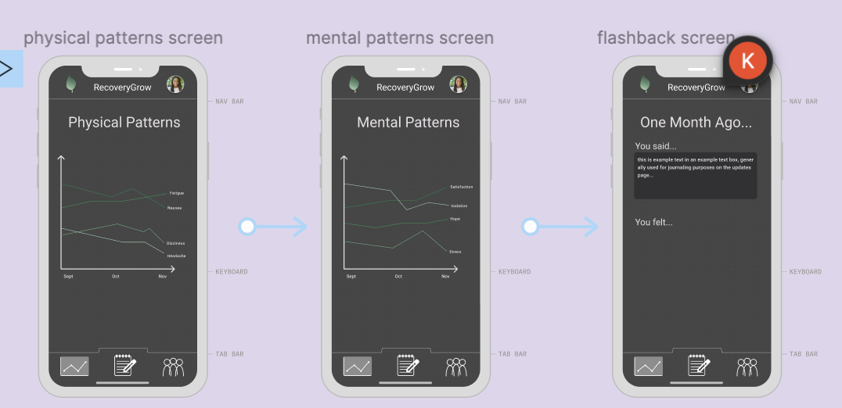
Medium-Fi
Task flow: Moderate task
analyze symptoms and gain insights into one’s recovery journey
Notes:
On the analytics tab, the user is able to view insights of their logs including patterns of their physical symptoms and mental wellbeing. In addition to this, users will be able to view a “flashback” of a past log.

Slide 19
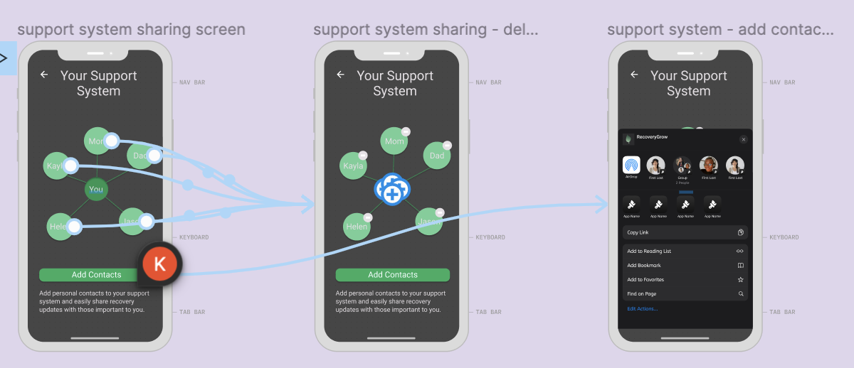
Medium-Fi
Task flow: Complex task
share insights with personal connections
Notes:
Users are able to share individual posts with people in their “support system”, which consists of those important to them in their personal lives. If a user presses the add contacts button, they will be able to share a link with their contacts. If they press and hold on an individual in the support system, they can remove them.

Slide 20
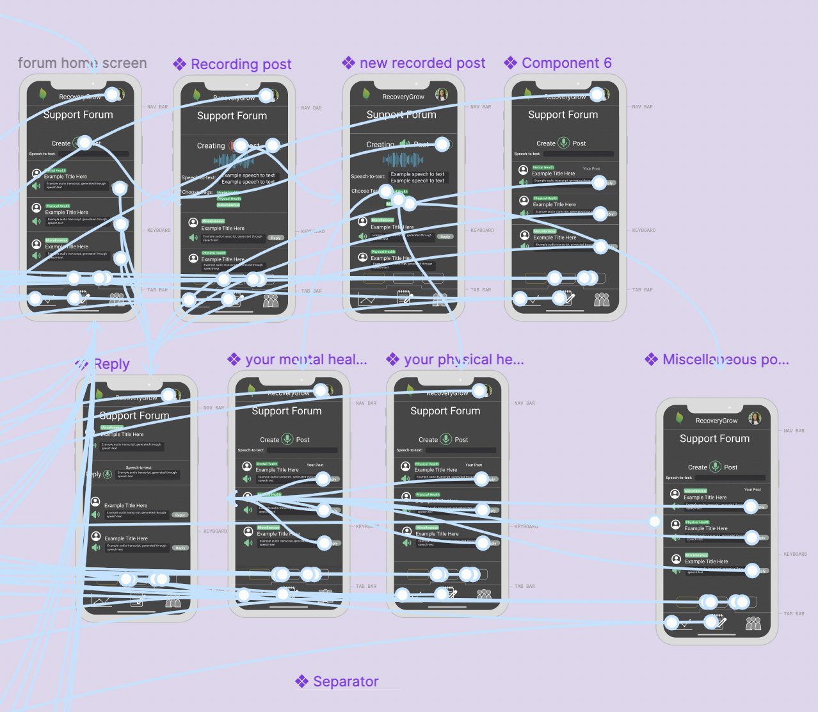
Medium-Fi
Task flow: Complex task
Connect with other recoverees in an online support forum
Notes:
Users can use the forum to interact with other recoverees. The “Mental Health,” “Physical Health,” and “Miscellaneous” tags make it simple for users to find conversations they want to engage with. The recording and playback features are hard-coded as we don’t have back-end storage. To make the forum easier for recoverees to use, we have made it mostly audio based. Users record posts, while speech-to-text creates an audio transcript of what they said. By lessening the amount of time that a user has spend typing and reading text, we hope create an experience that users can engage in without worrying about worsening their symptoms.

Slide 21
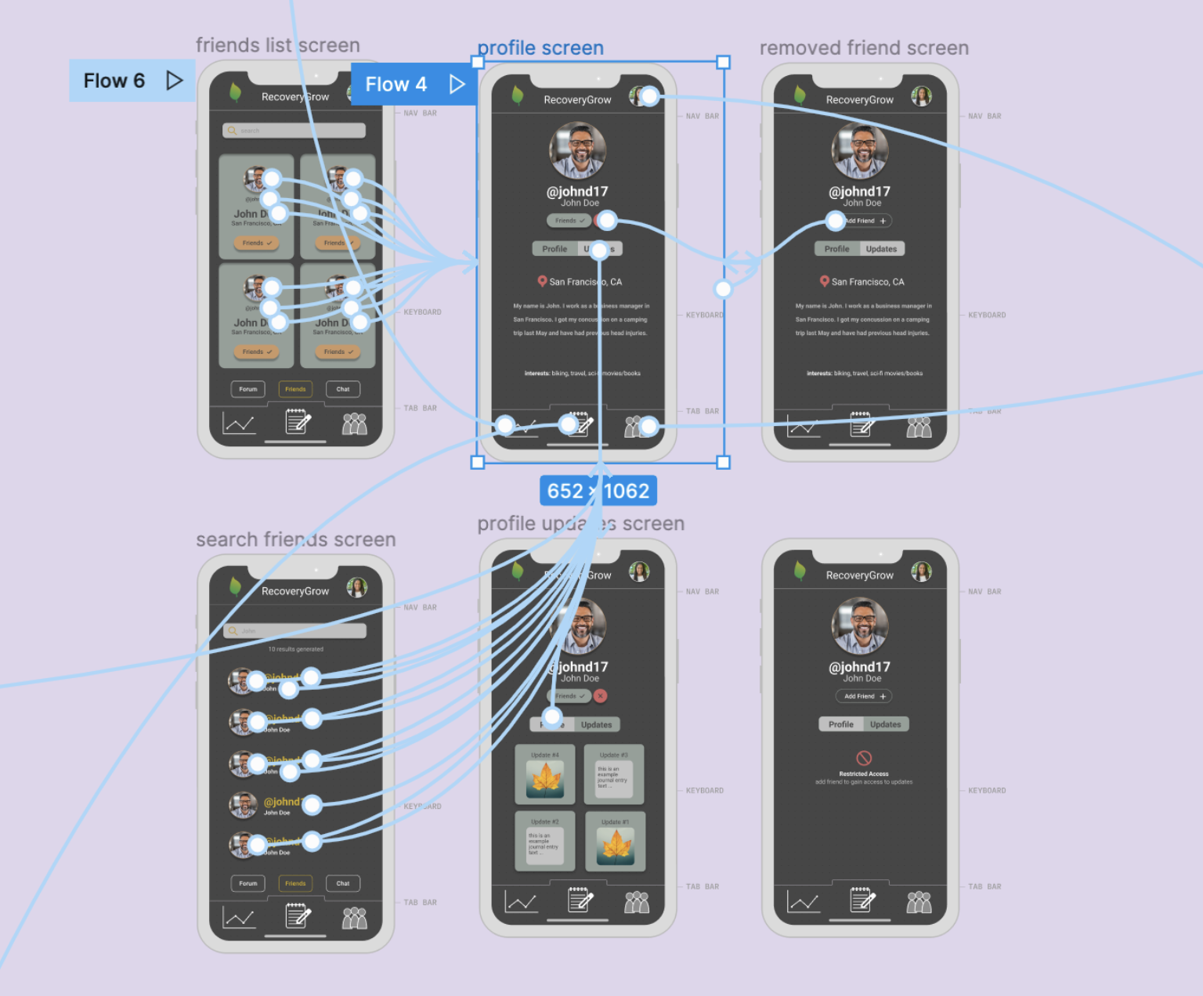
Medium-Fi
Task flow: Complex task
Connect with (find and befriend) other Recoverees
Notes:
This screen showcases the friends homepage of the communities tab, which touches on the complex task of connecting with other recoverees. This page specifically allows for users to find and befriend other users of the app (as well as seeing and searching among their existing friends), The homepage allows for two main options (outside from the navigation bar at the bottom). The first of these actions is the opportunity to see a friend’s profile. The second option is to search people (all users of the app, not just friends). With the second option, clicking on the search bar with generate results of people found. From there, users can click on a user to see their profile. With the first option, clicking on the user with also allow you to see their profile. The opening view on the profile page is the username, first and last name, location, about me, and interests. In addition to these components, users can als manage their friendship status with the person. Clicking on “updates” will switch the toggle and users that are friends with the person will be able to see a capsized version of the person’s updates.

Slide 22
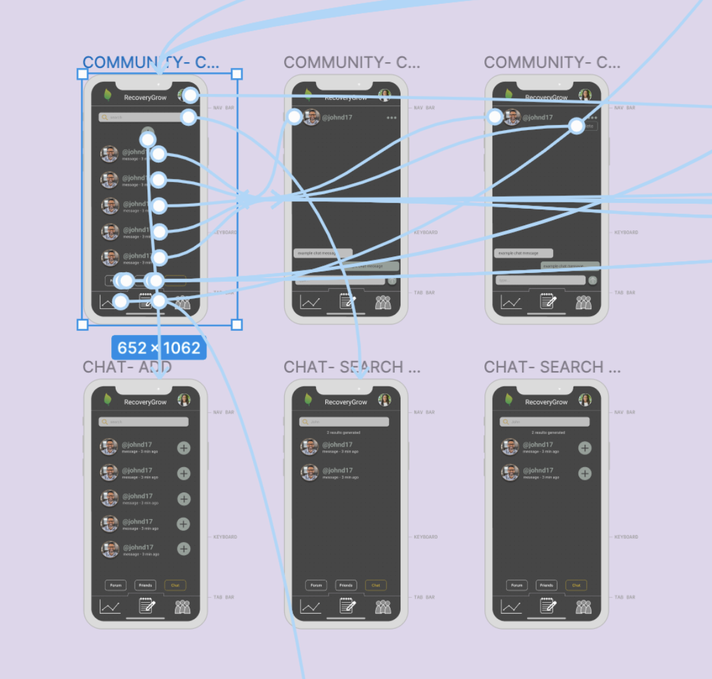
Medium-Fi
Task flow: Complex task
Connect with (chat to) other Recoverees
Notes:
This screen shows the chat section of the Community tab, which touches on the complex task of connecting with others. Users can go from the chat home page to the actual open chat by clicking on one of their active conversations (includes the last time a message was received if applicable). The active chat has one major task, looking outside from the navigation bar at the bottom, and that is to delete the chat. There is an ellipse in the top right-hand side that can be clicked to present the option to delete the chat. There is also the option to go back to the chat overview (where all active chats are presented). To start a new chat (from this overview page) users can click the plus icon. From there they are presented a directory of friends that they can converse with. Within this directory is the option to search among the list of friends (this is also available from the original chat page). The results of the search will be generated and users can start a chat (or, on the homepage, select an existing one)

Slide 23
Prototype Implementation Tool: Figma
PROS
CONS
Components that can be copied for widespread use in the app, shared workspace
Creating new icons can get clunky, still figuring out interactions- tapping specific buttons on a screen

Slide 24
Prototype Implementation
Limitation: Visual component creates difficulty for some users to engage at all
Hardcoded recording/playback interaction (no back-end storage)
Possible Wizard-Of-Oz: Audio-Only Interface
Notes:
One possible Wizard-of-Oz feature we were considering is to be able to navigate the app just through speech. We haven’t started implementing this but had discussions around use of screen-reader.

Slide 25
Thank You!
Appendix on next slide

Slide 26
Figma link: https://www.figma.com/file/HuUYZwkx5wGU7zNQsV2ggU/RECOVERY-BOARD-DESIGN-KIT?node-id=52723%3A31606
README: https://web.stanford.edu/class/cs147/projects/AccessibleDesignEmily/RecoveryBoard/README.pdf

