Slide 1
RECOVERY BOARD
Kimberly Batdorf, Crystal Chidume, Sharon Wambu, Nico Caminero

Slide 2
VALUES
1
2
3
Empower people who are recovering from concussions
Emphasize both physical and mental health
Provide community for our users

Slide 3
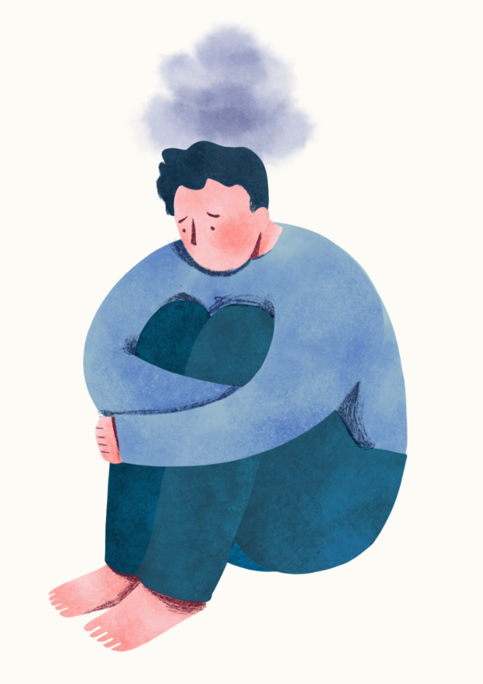

PROBLEM
Mental health is not typically emphasized during the concussion recovery process, often leaving individuals in a lowered emotional state
SOLUTION
Provide a space for people to reflect on their health and strengthen their relationships

Slide 4
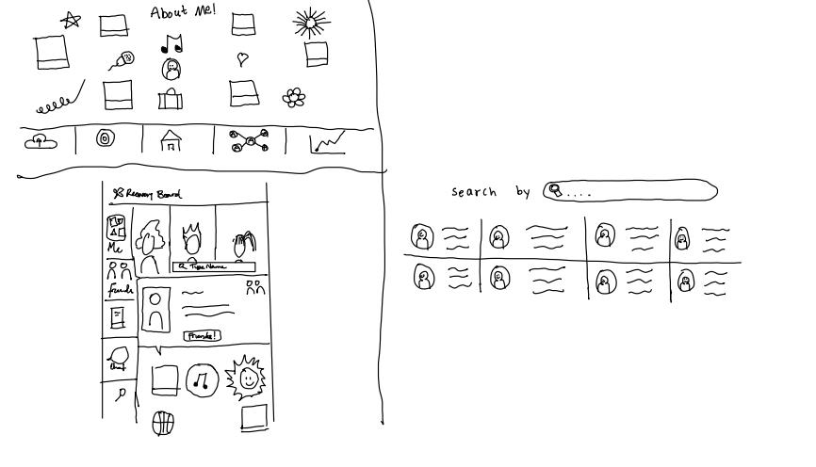
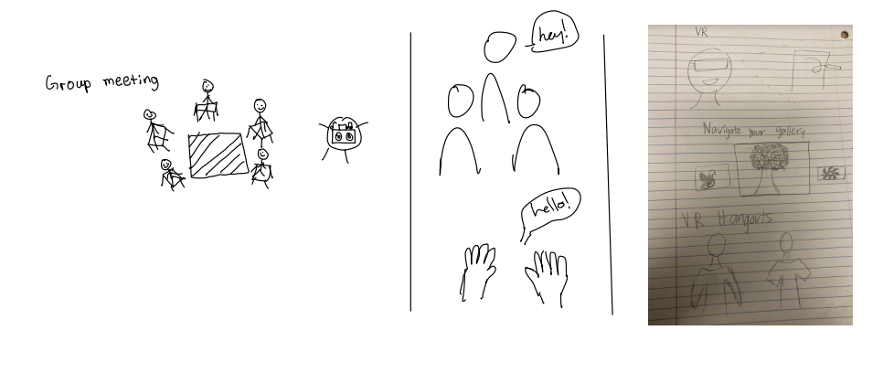
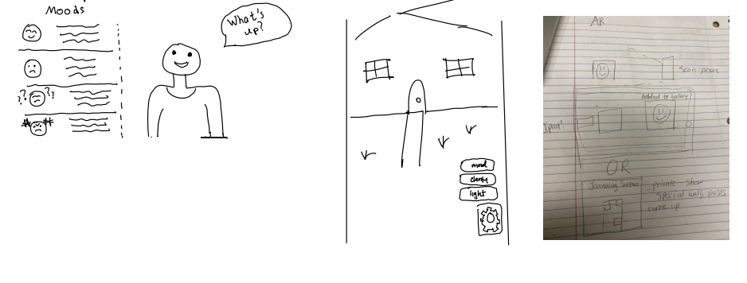
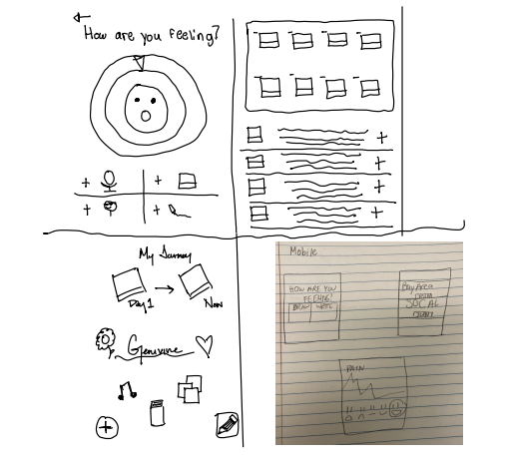
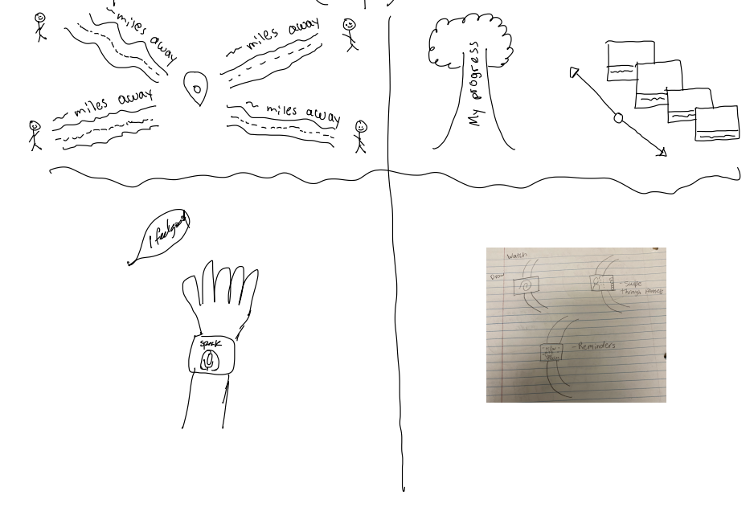
CONCEPT SKETCHES
WEBSITE
VIRTUAL REALITY
AUGMENTED REALITY
MOBILE APP
WEARABLE (WATCH)

Slide 5
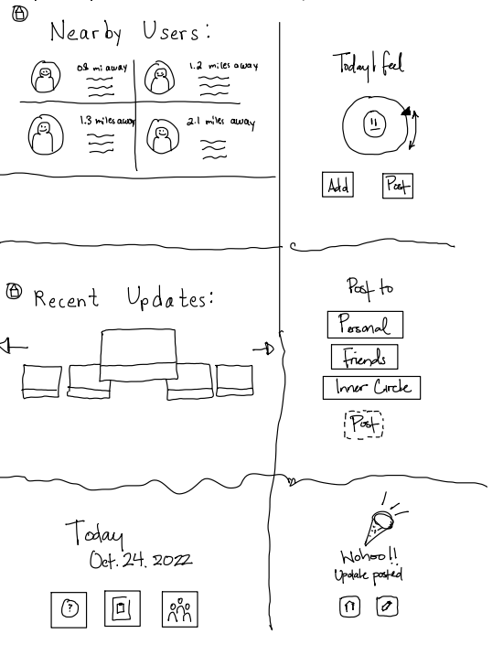
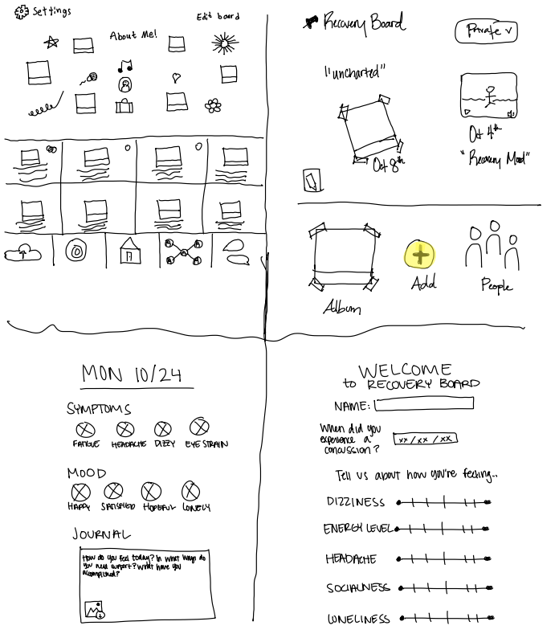
REALIZATIONS
WEARABLE (WATCH)
MOBILE APP

Slide 6
SELECTING AN INTERFACE
SMART WATCH PROS
  Simple interface
  Adaptable for active lifestyles
    might be easier to look at watch than phone if you're on the go
  Minimal scrolling to access tasks
SMART WATCH CONS
  Hard to type + not conducive to reflecting/journaling
  Smart watches not as common as mobile devices – not everyone is familiar with smart watch applications
  Not necessarily realistic to assume that those recovering from concussions in addition to their support network has access to smart watch
MOBILE APP PROS
  Bigger screen makes it easier to navigate a complex app
  Many people have access to mobile devices
  Interface is also likely easily adaptable to the web + tablets
MOBILE APP CONS
  Lots of potential scrolling and typing when performing tasks
  Can get overwhelming or clustered as compared to watch
  May be less accessible to input updates daily (notifications get buried, etc.)

Slide 7

OUR SELECTION:
MOBILE APP!

Slide 8

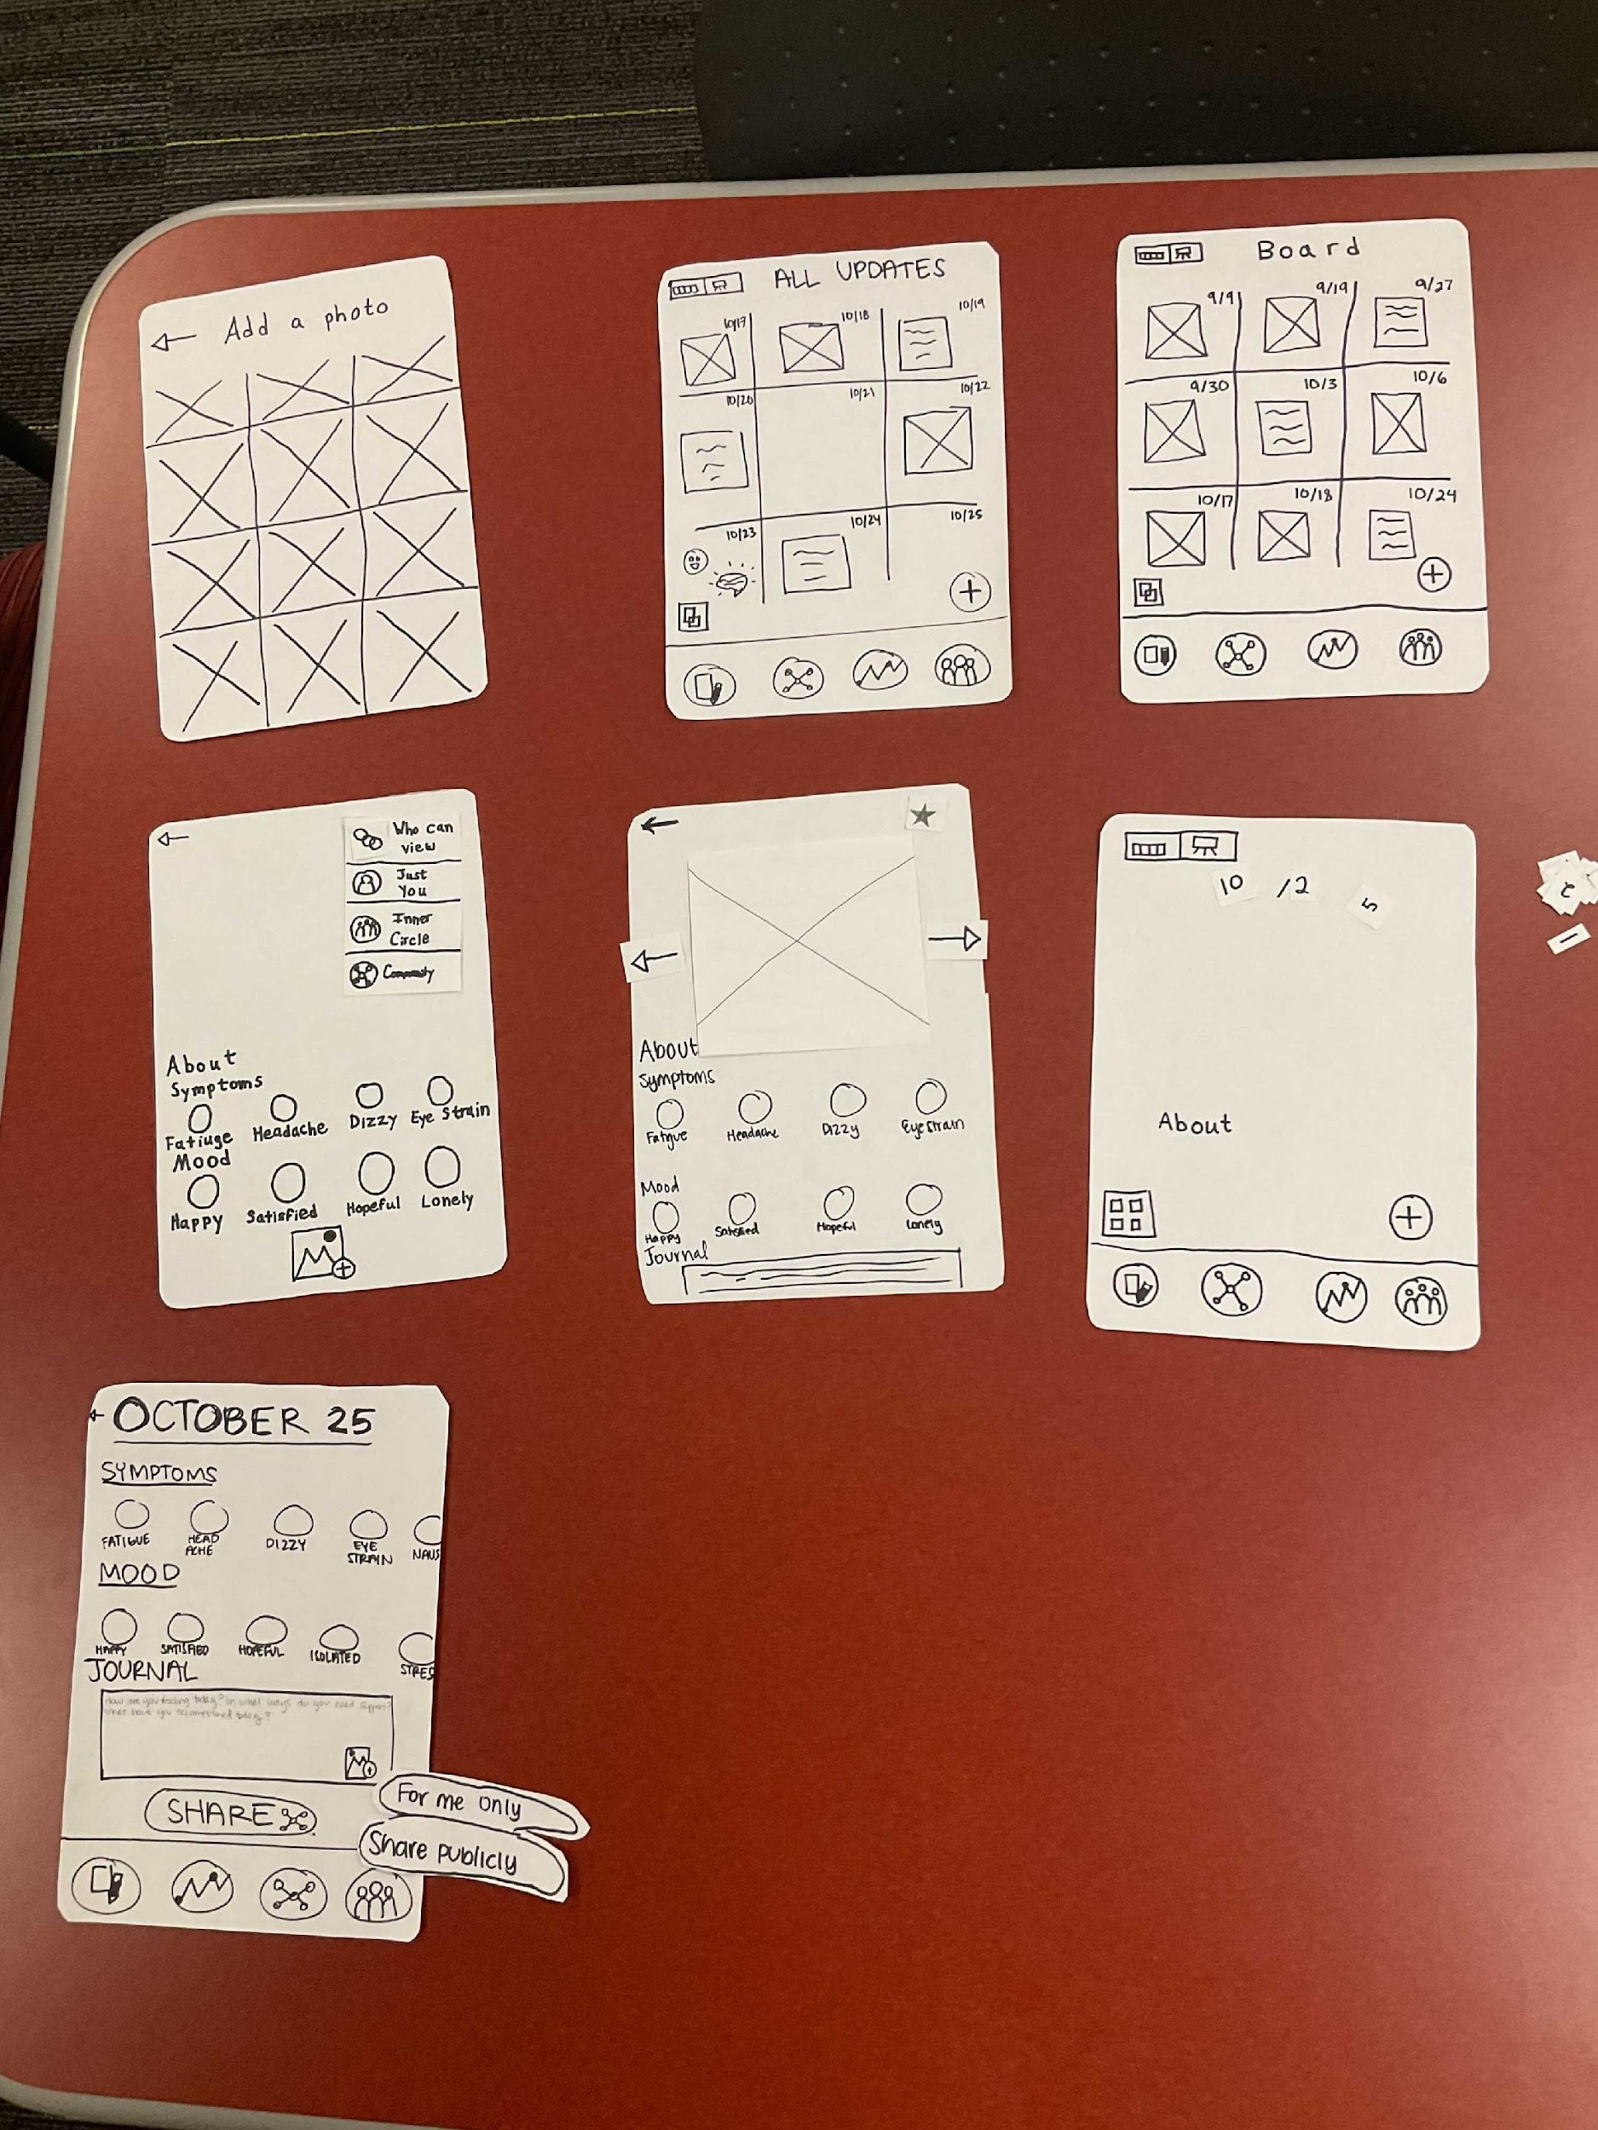

PROTOTYPE CONSTRUCTION
Paper prototype was built by all team members
Used base screens when only one or two components changed
Tried to keep buttons and small features swappable

Slide 9
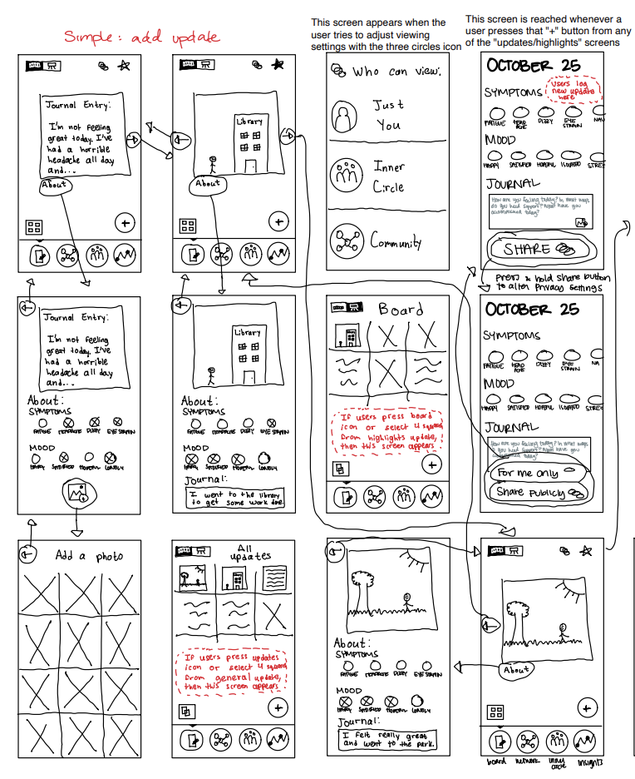
TASK FLOW: SIMPLE

Slide 10
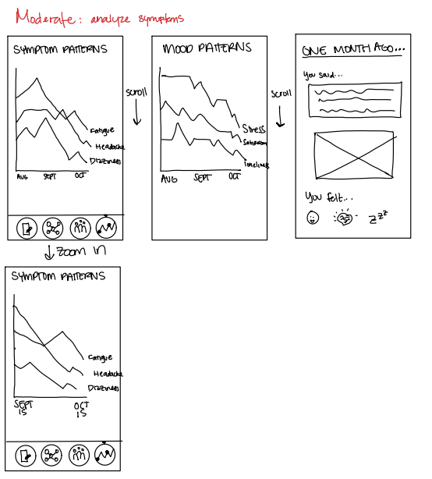
TASK FLOW: MODERATE

Slide 11
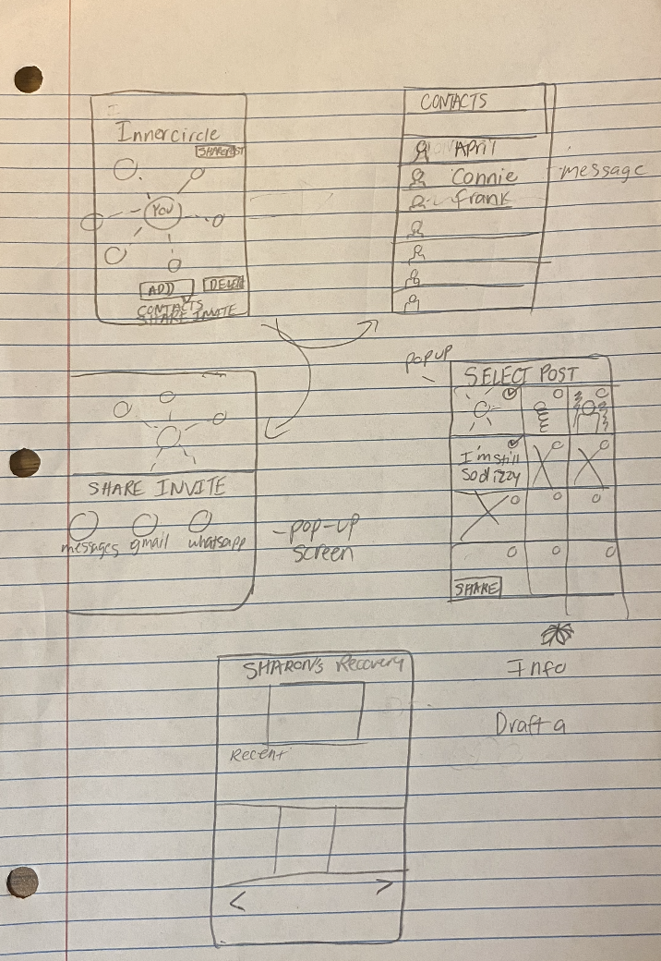
TASK FLOW: COMPLEX

Slide 12
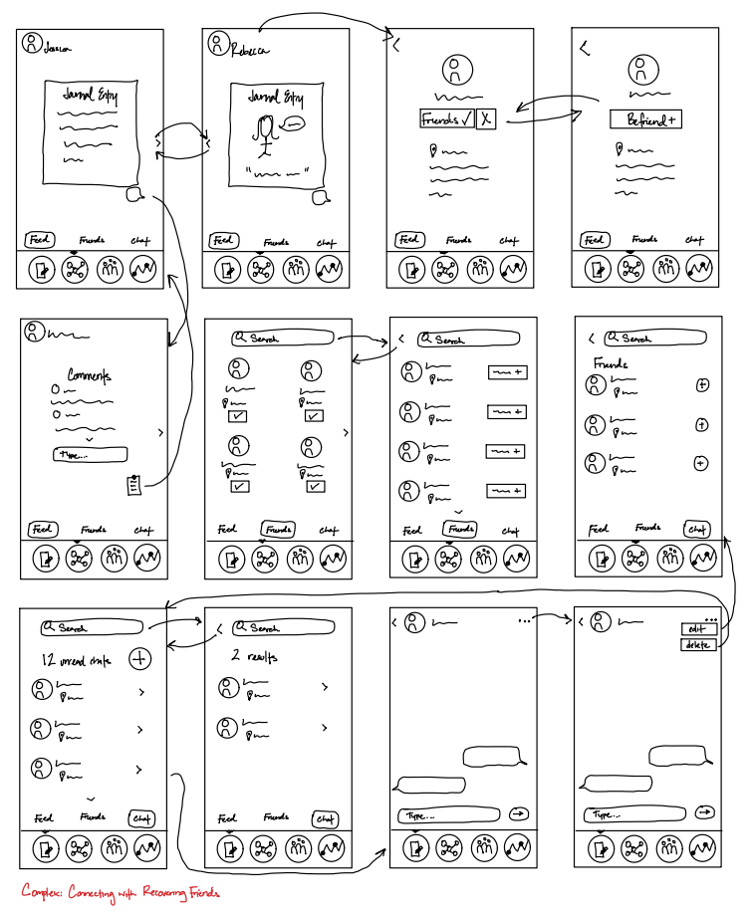
TASK FLOW: COMPLEX

Slide 13
PARTICIPANTS
Katie
John
Sarah
Jessica
Current Berkeley student
Responded to a Reddit post
Current Stanford student
Responded to message through dorm chat
A resident of the Bay area
Contacted through Facebook messenger
College student living in San Jose
Word-of-mouth, a sister of a friend

Slide 14

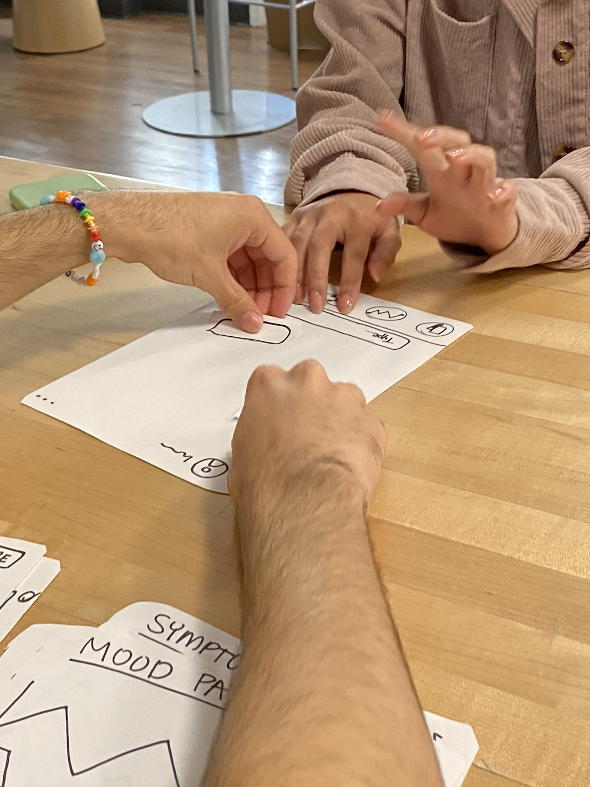
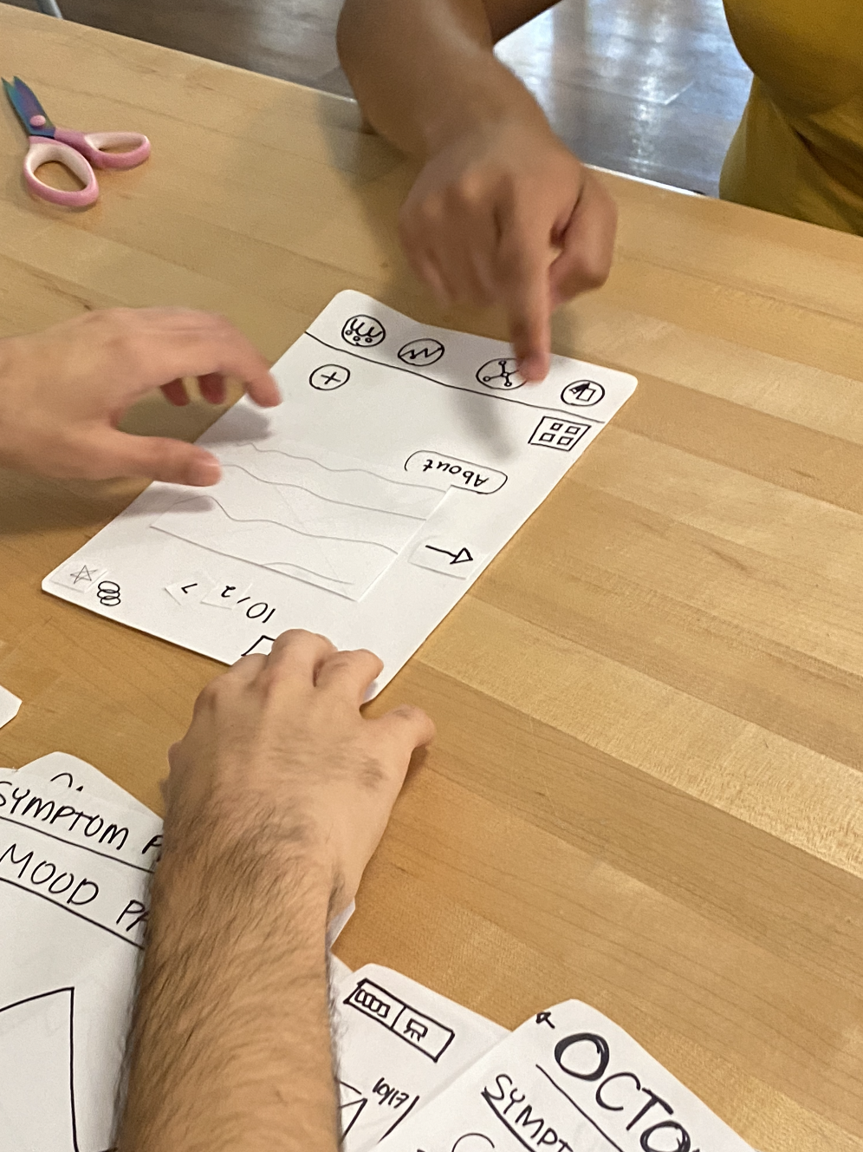
TESTING METHODOLOGY
Team rolls
  Computer: Nico
  Facilitator: Sharon
  Greeter: Kimberly
  Observer/Note-taker: Crystal
Usability goals and measurements
  Seamless navigation while completing tasks
  Understanding of all possible interactions

Slide 15

TESTING RESULTS
Overall: most tasks were completed but there was a fair amount of hesitancy
Need clearer and more distinct iconography
Benefit from more eye-catching element
Testers felt bad for computer
Users confused between online community and IRL support system
Accomplished our usability goals fairly well

Slide 16
TESTING RESULTS
4/4 participants succeeded at logging symptoms
4/4 participants succeeded at viewing analytics
3/4 participants failed when trying to share with personal community

Slide 17

DISCUSSION
"Social media for people with concussions?"
Icons and language throughout app were a bit confusing
Test doesn't reveal
  emotional effects of the app
  impacts of using app on regular basis when concussed

Slide 18

NEXT STEPS
Connecting with others in a meaningful way via advice columns/forums
  As opposed to feeling like social media
Adopting consistent language
Implementing future prototypes in "dark mode"
Allowing for voice memos as a form of journaling
Exploring navigating the app via speech

Slide 19
THANK YOU!
Questions?

Slide 20
APPENDIX
Prototype testing script
Changes made throughout testing
Consent forms

