Slide 1
RECOVERY BOARD
empowering individuals throughout concussion recovery

Slide 2
RECOVERY BOARD
empowering individuals throughout concussion recovery
Notes:
We chose our name to emphasize that our solution is centered on users’ recovery journeys. Given that our solution is inspired by storyboards and our goal of allowing users to map out their concussion recoveries, we thought that Recovery Board would be an appropriate name.
We chose our tagline because we believe that empowerment is our most salient value, one that encompasses all other values of Recovery Board. By having an emphasis on mental health and providing community to users, we hope to empower users such that they do not have to suffer through feelings of isolation or inadequacy throughout the recovery process.

Slide 3
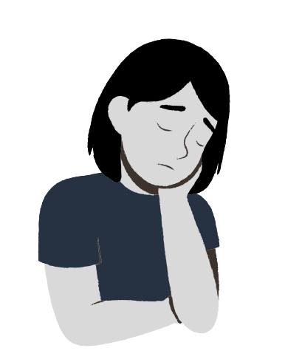
THE PROBLEM
While concussions directly impact one’s physical health, mental and emotional impacts are often overlooked, with those recovering from concussions often expressing feelings of isolation and lowered perceptions of self.
Recovery Board works to meet the emotional needs of individuals healing from concussions, providing a space for users to reflect on one’s well-being and connect with others.

Slide 4
MARKET RESEARCH

Slide 5
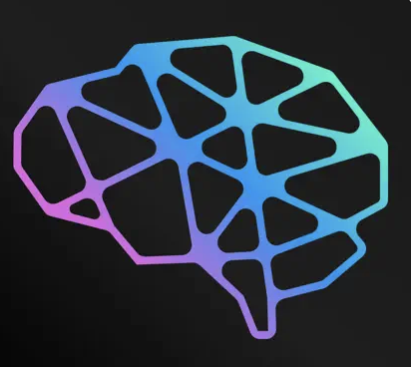
CONCUSSION TRACKER
DESCRIPTION
allows for others to follow the individual’s recovery
offers resources on finding a clinic, scheduling baseline testing, etc
DRAWBACKS
targeted specifically at athletes
solely targeted on physical recovery
Notes:
Concussion Tracker is a platform that allows for athletes specifically to track their concussion recovery journeys. Concussion Tracker is focused on tracking one’s physical symptoms and additionally serves as a point of reference in seeking resources. While Concussion Tracker seems like a suitable app for tracking one’s physical recovery, it does not seem to have any sort of focus on the mental/emotional wellbeing of users. Moreover, the app is extremely centered on the athletic experience. Individuals recovering from concussions who are not athletes may find that this app is not suitable for them and

Slide 6
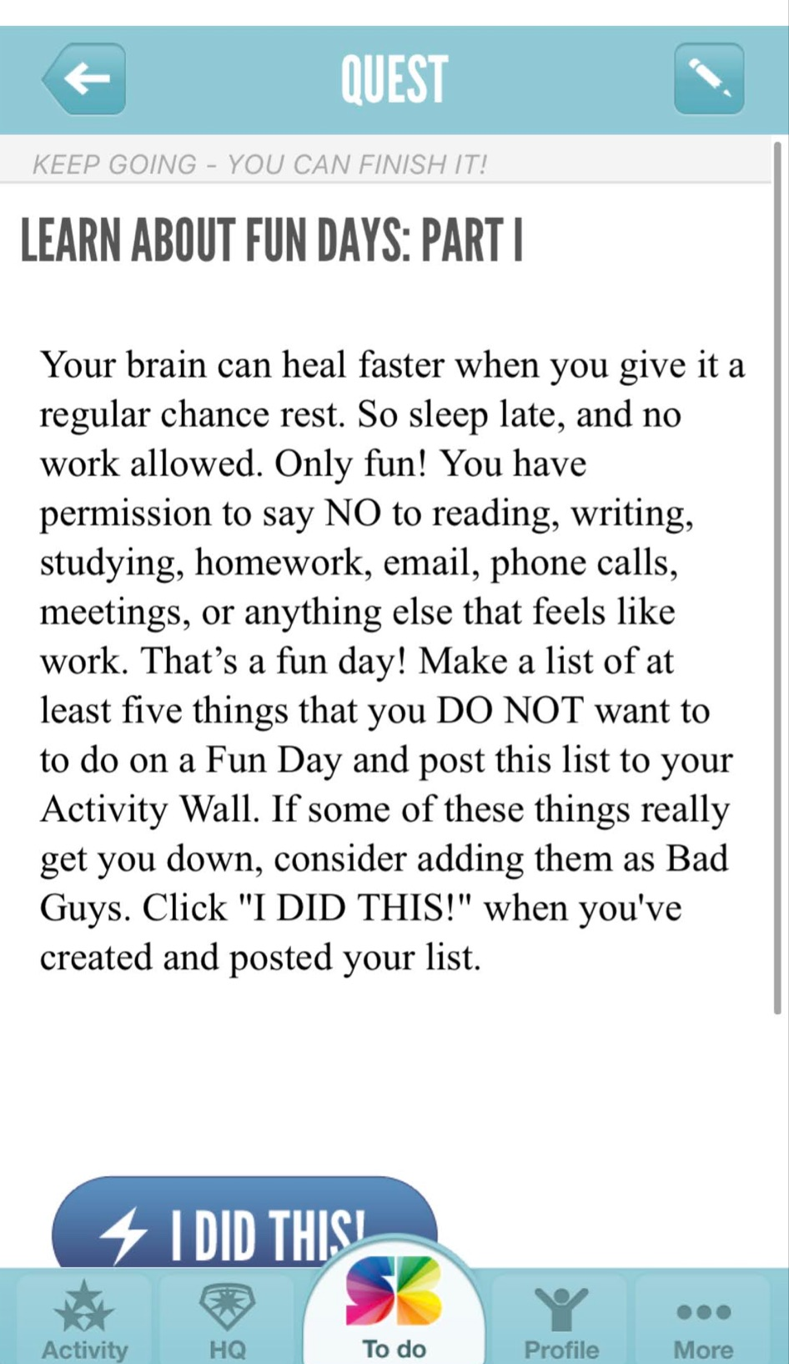
SUPERBETTER
DESCRIPTION
gamifies mental wellbeing
aimed to “help build personal resilience”
DRAWBACKS
not directly related to medical recovery/physical health
clunky UI
not personalizable

Slide 7
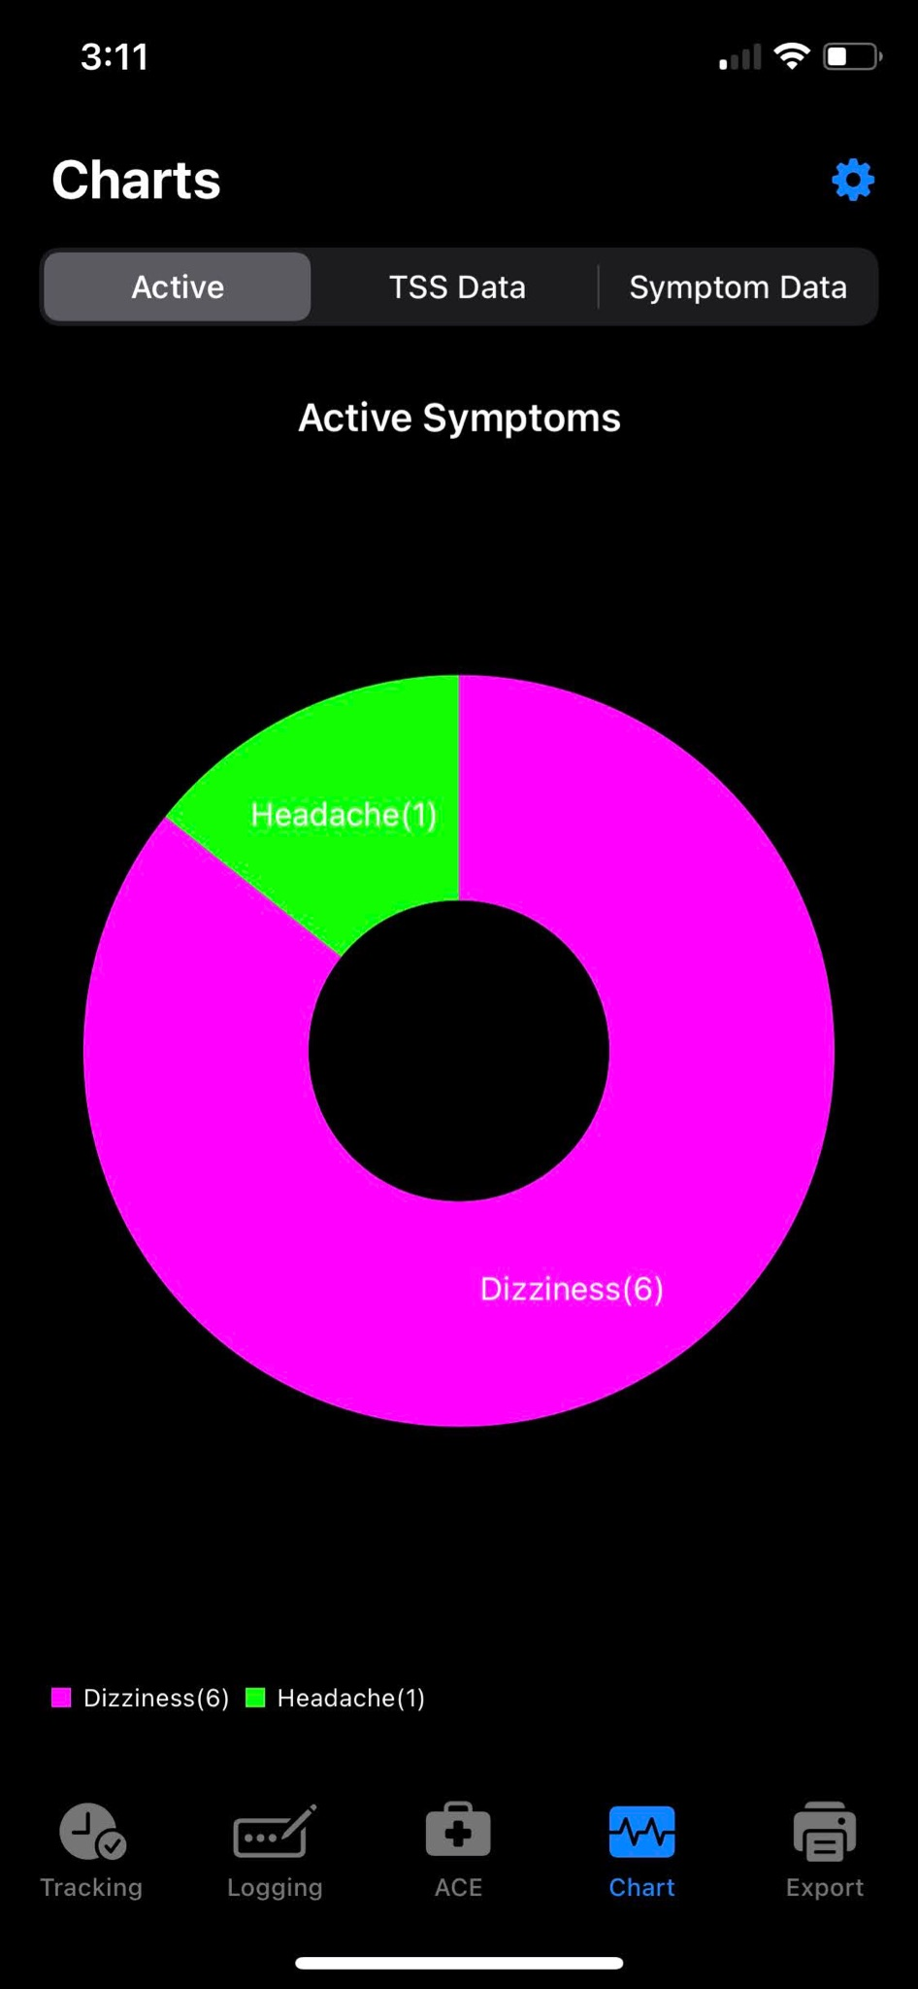
CLOCK CONCUSSION
DESCRIPTION
tracking symptoms + visualizing concussion progress
daily reminders to log symptoms
DRAWBACKS
only concerned with physical symptoms, no focus on mental health
clunky UI
Notes:
Clock Concussion is an app that is used to track one’s physical symptoms associated with a concussion. The app allows for users to visualize their activity by creating different graphs associated with a user’s symptoms. Clock Concussion additionally offers daily reminders to users, ensuring that they log their symptoms on a regular basis. Similar to Concussion Tracker, Clock Concussion is only focused on the physical symptoms of a concussion, and has no mention of mental/emotional wellbeing. The app itself is also quite difficult to use and does not have a very appealing design. The interface is hard to navigate and does not feel very welcoming.

Slide 8
OUR VALUES
BALANCE
EMPOWERMENT
COMMUNITY
acknowledging the emotional toll that accompanies recovery + emphasizing mental health as a priority alongside physical health
users log physical recovery + emotional state
combatting feelings of inadequacy
offering reflection prompts that emphasize a positive mindset
ensuring users do not feel alone in the recovery process
offering community between users + ways for personal connections to interact w/ one’s recovery board
Notes:
Our first value is balance. The goal of Recovery Board is to bring attention to the emotional toll that accompanies concussion recovery and to emphasize mental health as a focus that should be balanced alongside physical recovery. In order to realize this value, Recovery Board’s main function will be to log not only users’ physical recovery, but also their emotional states throughout their recovery journey.
Our second value is empowerment. Throughout the interview process, we heard many stories of individuals facing feelings of inadequacy as a result of them not being able to work or socialize at a level that they were used to. We hope to empower users, such that they feel in control of their lives, as opposed to their concussion being in control. As users log their symptoms and reflect upon their emotional states, they will be offered prompts that lend a hand to a positive mindset. Similar to Facebook’s prompt “What’s on your mind?” or Twitter’s “What’s happening?”, Recovery Board will encourage reflection through prompts that get users to think about their own strengths and the positive experiences of their journey.
Our last value is community. In addition to expressing feelings of inadequacy, many of our interviewees expressed facing feelings of isolation. Recovery Board will work to ensure that users do not feel alone throughout the recovery process. We will do so by offering community between users such that they can connect with others who are recovering from concussion. A user will also have the option to invite the personal connections in their lives to Recovery Board such that they can stay up to date with their recovery and be in tune with their needs and how they can support.
One conflict that may arise comes from the fact that Recovery Board is a mobile app. Individuals with extreme concussions often cannot use screens for an extended period of time – therefore, we hope to build screen time reminders into our app such that it is not used for an extended period of time.

Slide 9
SIMPLE TASK
recording and keeping track of daily symptoms + emotional wellbeing
Notes:
The basis of our app, and most common task, will be recording and keeping track of one’s symptoms and emotional well-being.

Slide 10
MODERATE TASK
analyze symptoms and gain insights into one’s recovery journey
Notes:
Our moderate task involves analyzing one’s log of symptoms such that they can gain insights into their recovery journey. While the main purpose of Recovery Board is to serve as a log for one’s physical + emotional journey through concussion recovery, users may also find themselves occasionally looking back on these logs and coordinating their story board.

Slide 11
COMPLEX TASK
connect with others recovering from concussions + share insights with personal connections
Notes:
Our complex task involves connecting users both with others recovering from concussions and personal connections in their lives. This will work to help users combat feelings of isolation that come with concussion recovery and will also make it easy for them to communicate about their journey with those in their daily life.

Slide 12
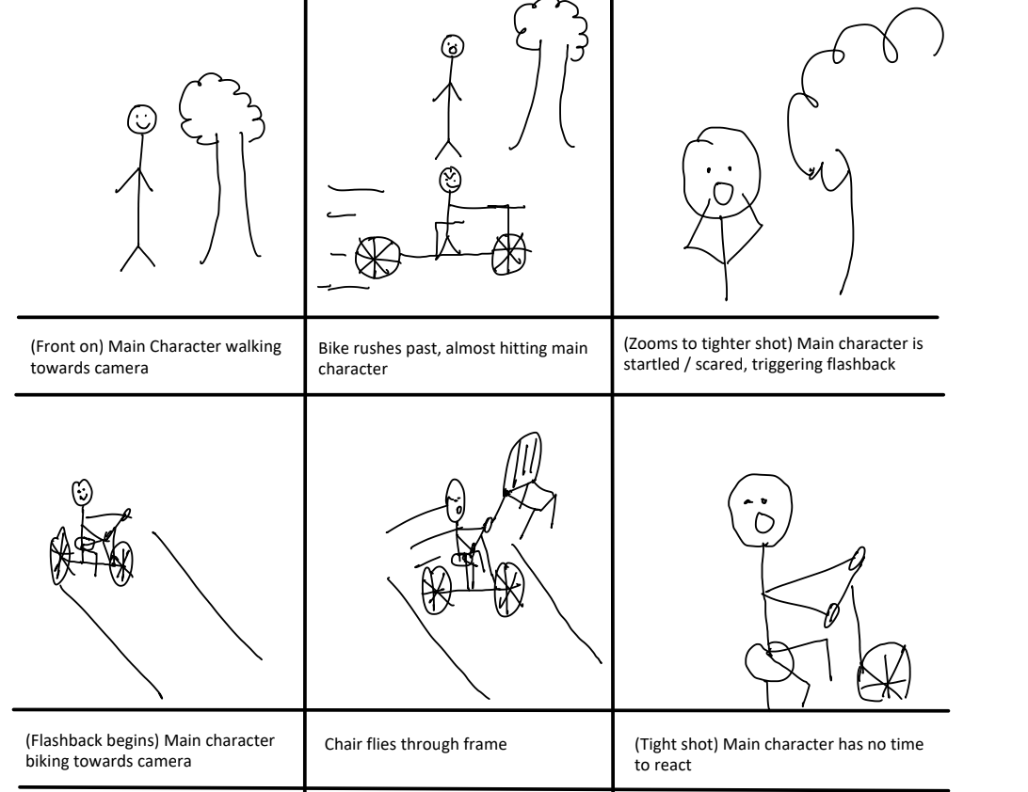
STORYBOARD

Slide 13
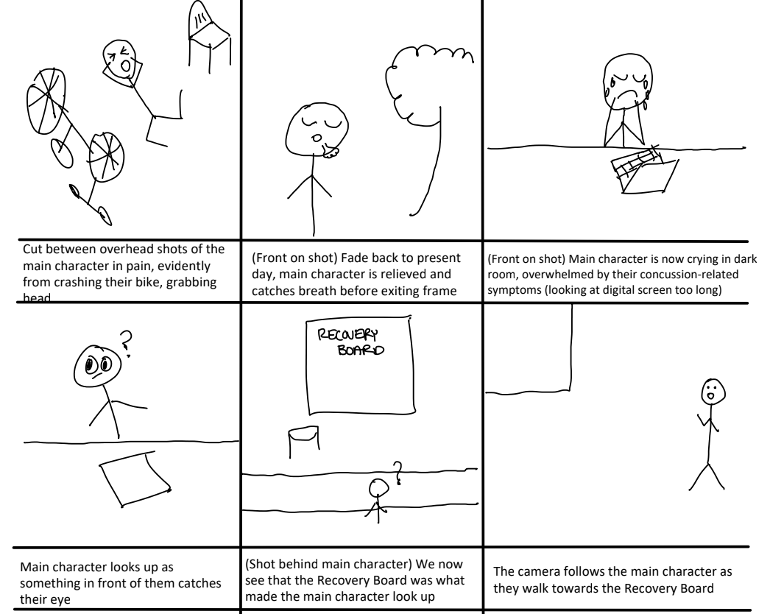
STORYBOARD

Slide 14
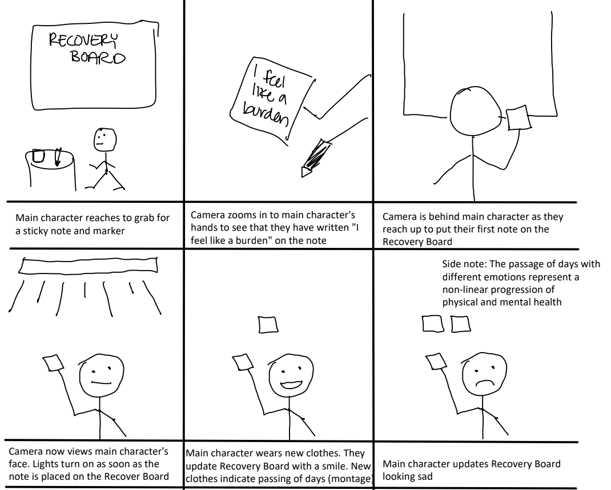
STORYBOARD

Slide 15
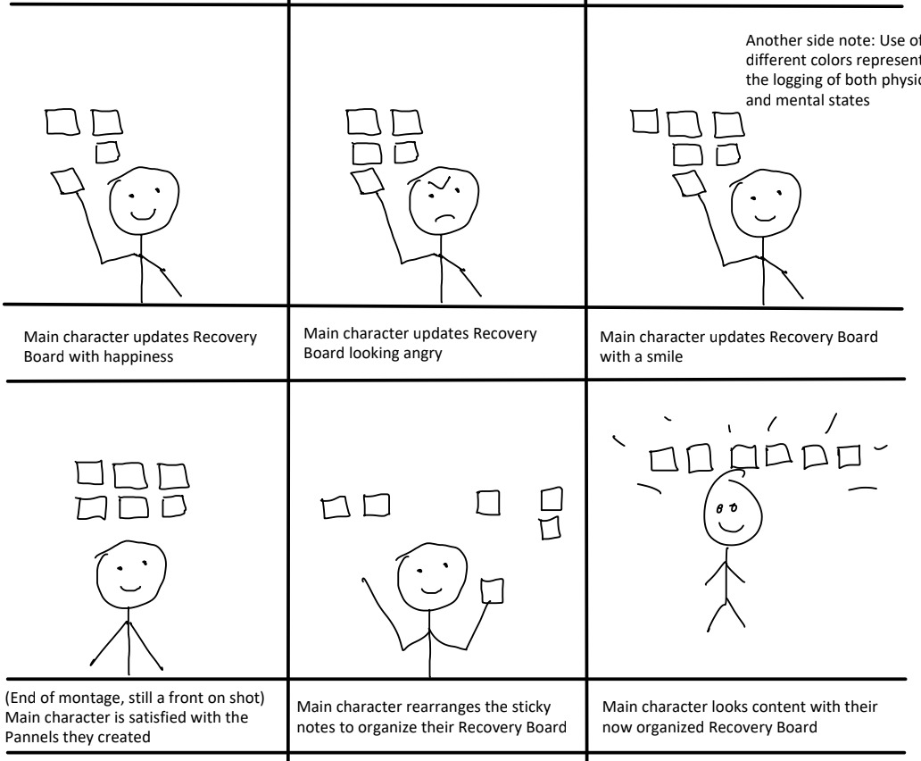
STORYBOARD
Notes:
The side note was slightly cut off so here it is below:
Use of different colors represent the logging of both physical and mental states

Slide 16
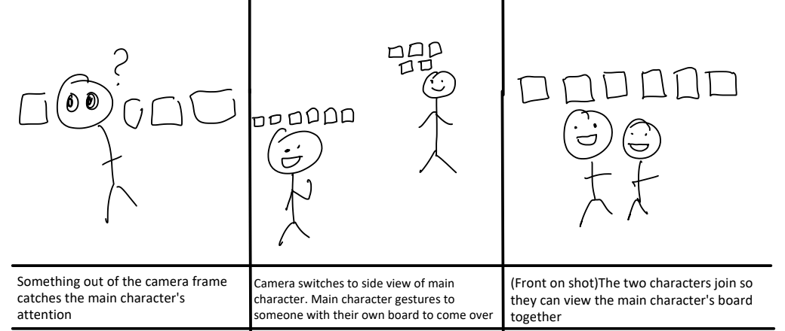
STORYBOARD

