Slide 1
Concussions.
Invisible, not-so-temporary illnesses
Crystal Chidume, Kimberly Batdorf, Sharon Wambu, Nico Caminero

Slide 2
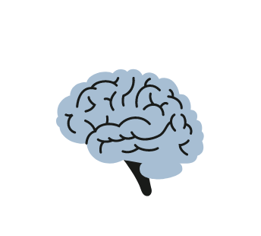


Problem Domain
Initially interested in providing accessibility for temporary injuries, but eventually landed on the invisible, not-so-temporary injury of concussions
Notes:
Scope: original and more focused problem domain

Slide 3
Additional Interviews
Alexander
Randall
Confirmed the notion of risks that are associated with going back to hobbies
Provided powerful insight towards the need for support group and reliable online resources
Made unique mention of healthcare costs
Brought to mind the situation of workplace injuries and the challenge of regulations
Highlighted a perhaps common progress tracking method: trial and error
Emphasized the uncertainty around duration of recovery as well as severity of limitations
Notes:
Additional Learnings: 2 last interviews
For the last two interviewees we wanted to make sure that they were men because the previous 5 interviews were done with women. This allowed us to diversify our user experiences and they’re needs. The additional insights that we gathered are surrounding the difficulties of workplace injuries as well as the unique health costs that can make people resort to online social networks for advice.

Slide 4
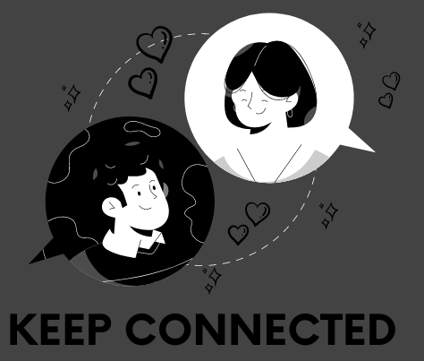
WE MET…
Jamie, a 37-year old paramedic student in the Bay Area who has a history of severe head injuries.
WE WERE SURPRISED TO REALISE.
how much their concussion negatively affected their relationship with loved ones, causing them to move away from family and friends to better recover.
WE WONDER IF THAT MEANS..
support and understanding from loved ones is vital to the recovery process of the injured party.
IT WOULD BE GAME-CHANGING TO..
help those recovering from concussions better communicate with others.
Notes:
Jamie POV created when we met up after class.
ALL HMWs LISTED IN SLIDE NOTES ON NEXT SLIDE

Slide 5
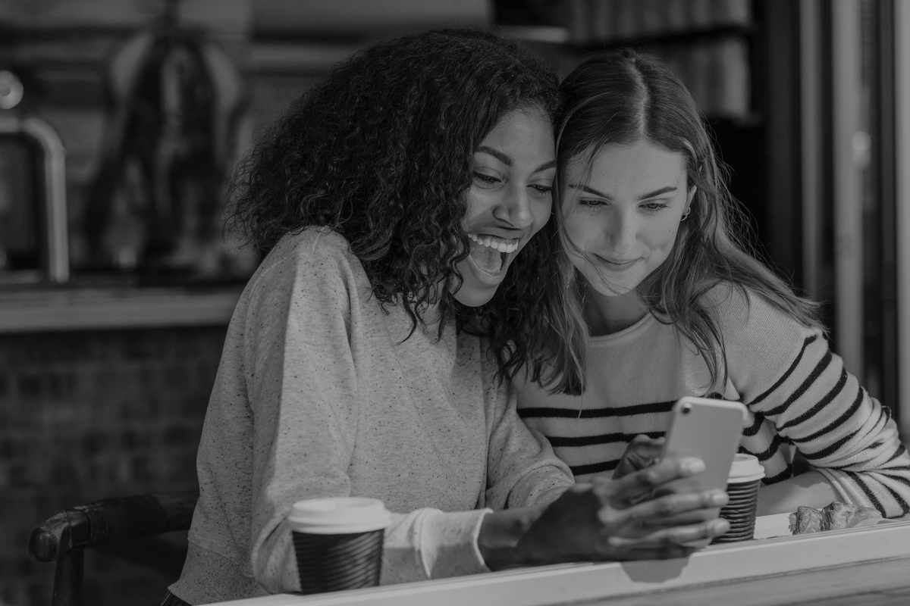
HOW MIGHT WE
Make sharing daily feelings (symptoms, etc.) more exciting
Notes:
How Might We #1: ease the burden of having conversations about how they are feeling each day
How Might We #2: allow them to feel a part of social interactions
How Might We #3: lower the cognitive load of being “on” in conversations
How Might We #4: make sharing their symptoms daily something that is exciting
How Might We #5: encourage them to share where they are at with their symptoms
How Might We #6: ease the burden of advocating for themselves
How Might We #7: make the journey to recovery fun, less stressful
How Might We #8: encourage others to spark conversation with those recovering
How Might We #9: reduce the negative responses around sharing symptoms
How Might We #10: eliminate the need to communicate about recovery
How Might We #11: increase compassion from others during the recovery process
How Might We #12: make communicating easier for the person recovering

Slide 6
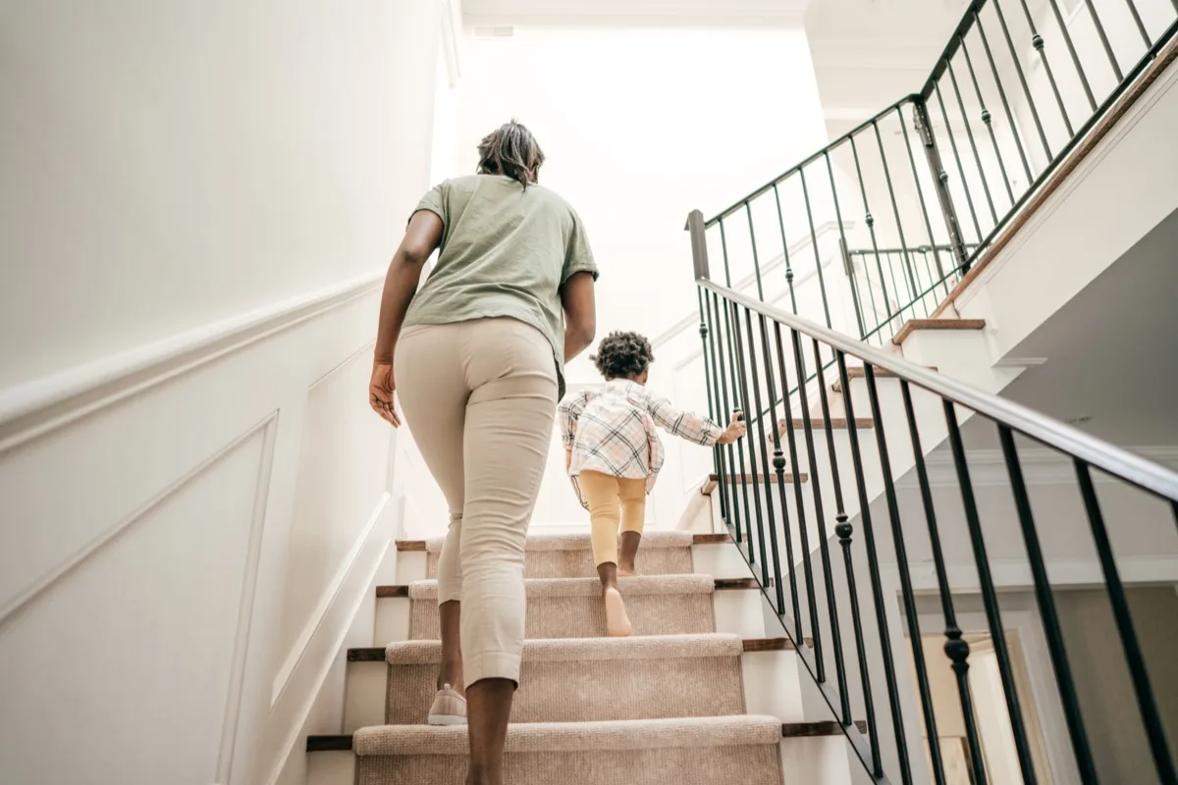
WE MET…
Nadia, a 23-yr old student and restaurant worker who has experienced three concussions in the past year
WE WERE SURPRISED TO REALISE..
daily tasks like walking up stairs or going out for drinks with friends present a huge risk for another injury and there was a lot of fear around this.
WE WONDER IF THAT MEANS..
those that recovering from concussions have to make hard decisions around daily actions.
IT WOULD BE GAME-CHANGING TO..
reduce the fear of getting re-injured associated with daily actions for those in recovery.
Notes:
NadiaPOV created when we met up after class.
ALL HMWs LISTED IN SLIDE NOTES ON NEXT SLIDE

Slide 7
HOW MIGHT WE
Make daily activities feel fun & safe
Notes:
How Might We #1: make daily activities feel fun and safe
How Might We #2: eliminate the fear of getting another injury
How Might We #3: let others make the daily decisions for them
How Might We #4: help them make informed decisions
How Might We #5: eliminate the need for daily tasks (walking up stairs)
How Might We #6: highlights the benefits of actions over the (risk of) harm they present
How Might We #7: make decisions the easiest part about recovery
How Might We #8: make caution the least important part of recovery
How Might We #9: create less-risky, similarly appealing alternatives to risky behavior (going out w friends)
How Might We #10: leverage hobbies and interests to promote daily activity

Slide 8
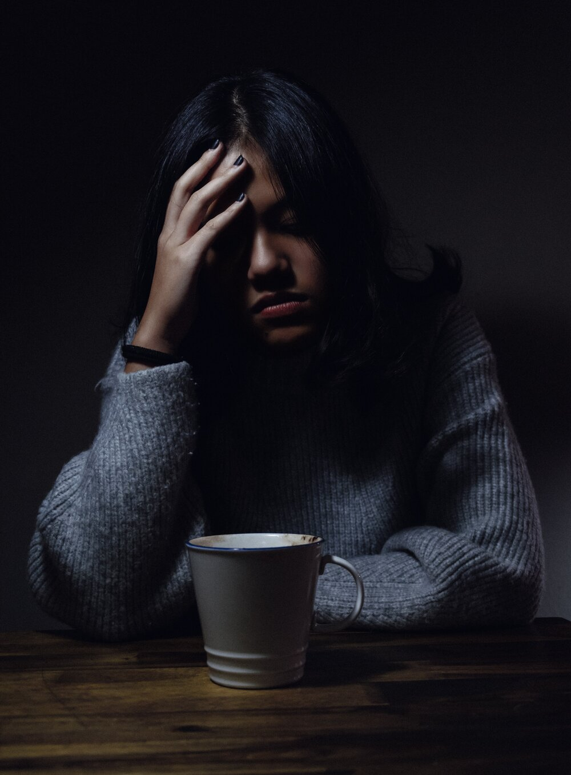
WE MET…
Charlotte,a busy and involved student who had another head injury before the concussion
WE WERE SURPRISED TO REALISE.
how much mental weight they have to bear with little to no professional help
WE WONDER IF THAT MEANS..
how much specialized professional help from different aspects (physical, mental, speech...) help recovery process
IT WOULD BE GAME-CHANGING TO..
connect suitable professional help that fits their specialized need
Notes:
Old Charlotte POV that we created during studio 2. We decided that it was offering too specific of a solution and met up again to revise it.

Slide 9
WE MET…
Charlotte, an ambitious, highly involved Stanford Student
WE WERE SURPRISED TO REALISE..
that the mental struggle of concussion recovery can be just as, or even more tough to deal with than the physical struggle.
WE WONDER IF THAT MEANS..
that mental health is overlooked within the bases of support available to people recovering from concussions.
IT WOULD BE GAME-CHANGING TO..
to provide adequate mental health resources to individuals in concussion recovery.
Notes:
Updated POV that was created when we met in person and brainstormed.
ALL HMWs LISTED IN SLIDE NOTES ON NEXT SLIDE

Slide 10
HOW MIGHT WE
Make the individual feel empowered during their recovery
Notes:
How Might We #1: make the individual feel empowered during recovery
How Might We #2: make the concussion recovery process less lonely
How Might We #3: leverage current mental health resources to help in the recovery process
How Might We #4: make person feel understood by their provider
How Might We #5: make mental resources more accessible (affordable, approachable, etc.)
How Might We #6: bring mental/emotional support to the forefront alongside physical recovery
How Might We #7: make those recovering find value in themselves (who they were and who they want to be)
How Might We #8: allow people to explain the symptoms related to their concussion
How Might We #9: make the mental recovery process light-hearted and fun
How Might We #10: prevent those recovering from being without a mental support network

Slide 11
Solution 1
Build an app that shows those recovering from a concussion how safe an activity is
Assumptions
Users listen to/follow labels
Users try to avoid risk
Users have the time to check the safety of an activity before actually doing it
Users are unaware of what activities are safe or not
Using the phone doesn’t hurt them
Notes:
Solution #1 and assumptions

Slide 12
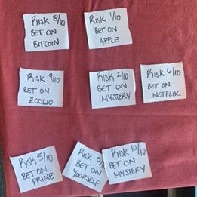
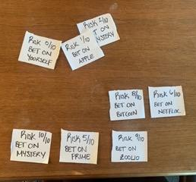
Experience Prototype 1: Owen
Able to bear consequences
Unable to bear consequences
Notes:
Experience Prototype #1
Critical assumptions being tested:
Users listen to/follow labels
Users try to avoid risk
Users have the time to check the safety of an activity before actually doing it
Users are unaware of what activities are safe or not
Using the phone doesn’t hurt them
Prototype description:
Participants: Who are they? How were they recruited? Why are they relevant?
Owen, a rugby player who has had concussions in the past. He was asked to participant during rehab on his knees via Club Sports. He is relevant because he could’ve potentially used this solution when recovering from his concussion.
Results: What worked/didn’t work? New learnings? Was the assumption valid? What does it mean for your work going forward?
What worked if the prototype was that he had to make decisions around risk, but what didn’t work was the avoidance of risk in the initial trial. I had to ask him why he betted on what he did and have him change his perspective and play again. This means that avoiding risk isn’t always intuitive but can be brought about if people feel like they can’t bear the consequences.

Slide 13
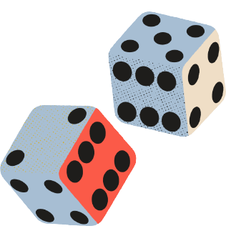
Solution 2
Build an app that makes a game of sharing symptoms
Assumptions:
Users are willing to play games when recovering
Users feel comfortable sharing their symptoms
Games help people to share
Notes:
Solution #2 and assumptions

Slide 14
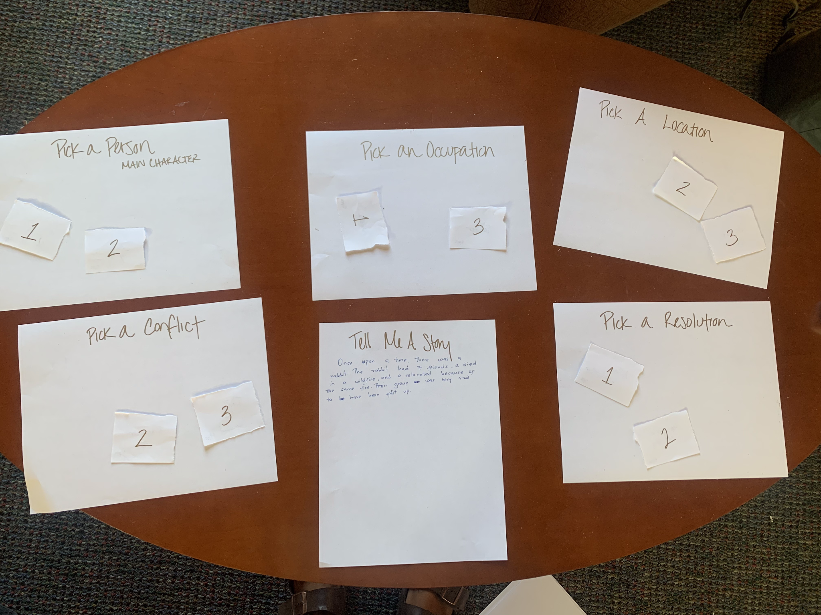
Experience Prototype 2: Sam
Notes:
Experience Prototype #2
Critical assumptions being tested:
Users are willing to play games when recovering
Users feel comfortable sharing their symptoms
Games help people to share
Prototype description:
Participants: Who are they? How were they recruited? Why are they relevant?
Sam, a club sports athlete in multiple sports, including Rugby. Was recruited because of her participation in a concussion study, She is relevant because it a potential future user of this solution.
Results: What worked/didn’t work? New learnings? Was the assumption valid? What does it mean for your work going forward?
What worked was that the game helped her share in more detail but didn’t innately make her share significantly more, in content.

Slide 15
Solution 3
Build an app that allows users to create a recovery storyboard
Assumptions:
Progress timelines are empowering
Users are willing to track their progress
Users will not be discouraged if progress is not linear
Notes:
Solution #3 and assumptions

Slide 16
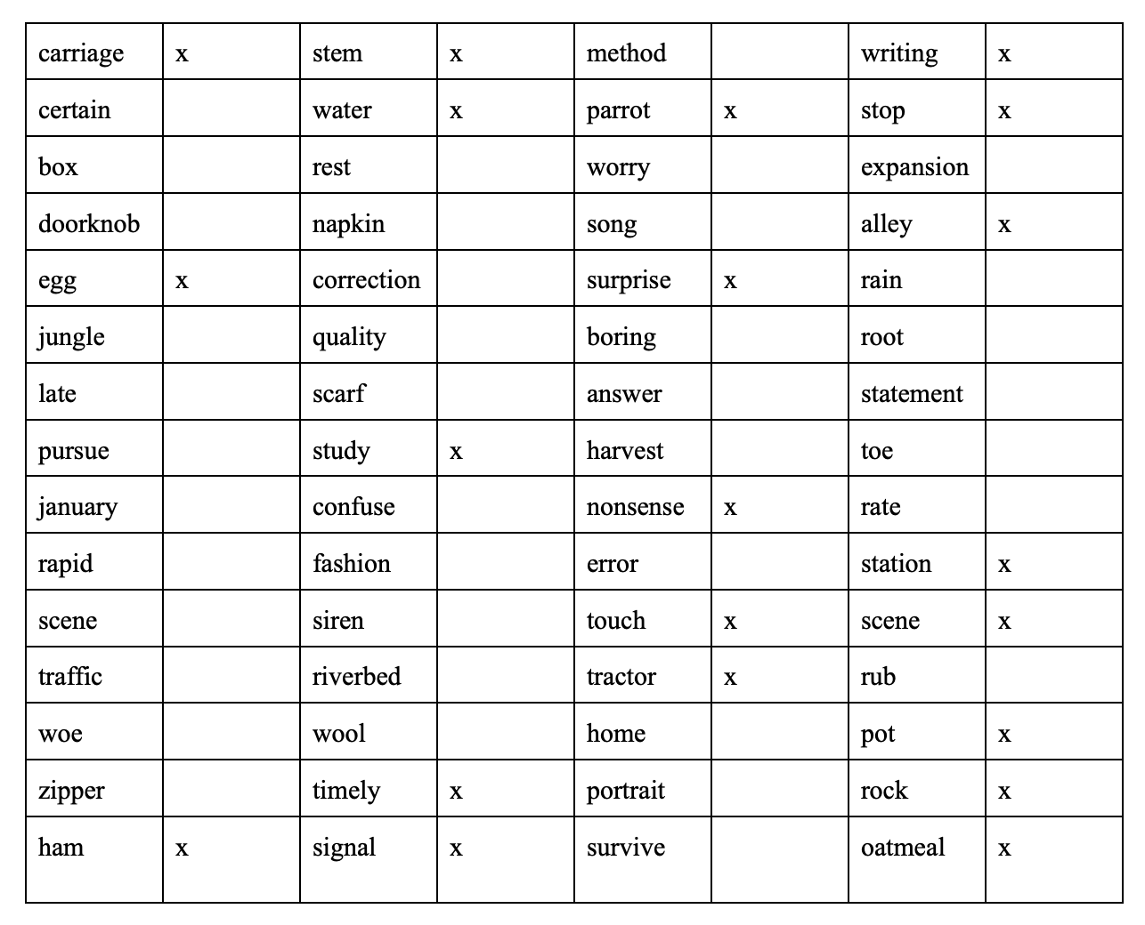
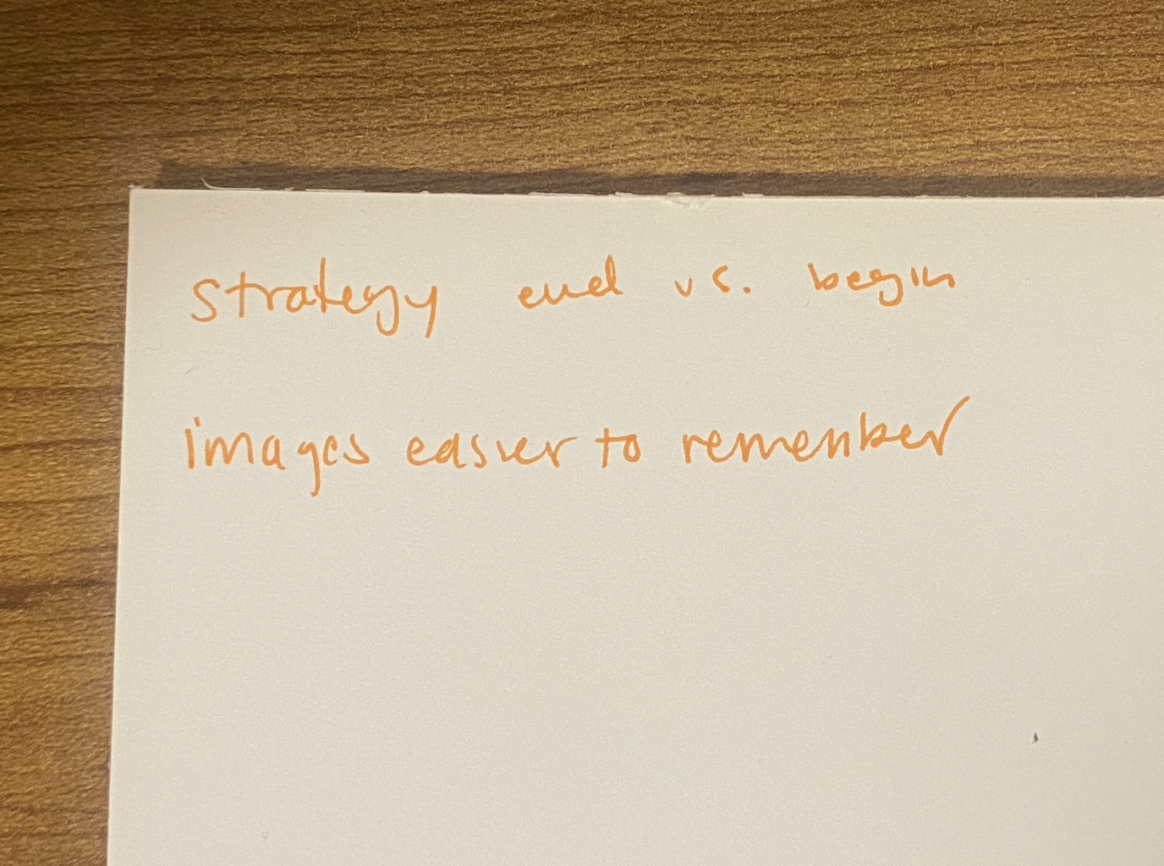
Experience Prototype 3:
At first hesitant to log experiences, but later utilized the notepad.
Reflected upon strategy and displayed improvement
Notes:
Experience Prototype #3
Critical assumptions being tested:
Progress timelines are empowering
Users are willing to track their progress
Users will not be discouraged if progress is not linear
Prototype description: For this prototype, the individual was tasked with a word recall game. There were 4 rounds where words were first read to the participant, who then had 60 seconds to recall as many as possible. The participant was also offered a pen and paper to use how they wish in between each round. The participant was told for each round that they improve, they would be able to win a prize.
Participants: Who are they? How were they recruited?
Residence neighbor, recovering from a concussion
Recruited via dorm chat
Results: What worked/didn’t work? New learnings? Was the assumption valid? What does it mean for your work going forward?
At first the participant was hesitant to log about their experience, but they later said they decided to start logging once they realized how difficult the task at hand was. Overall, the participant made a lot of progress and said that they found reflecting to be helpful in crafting their strategy. We found this to be insightful, for the participant found value in logging their experience over time. Our assumption was valid and we will work to incorporate this idea into the solution that we implement.

Slide 17
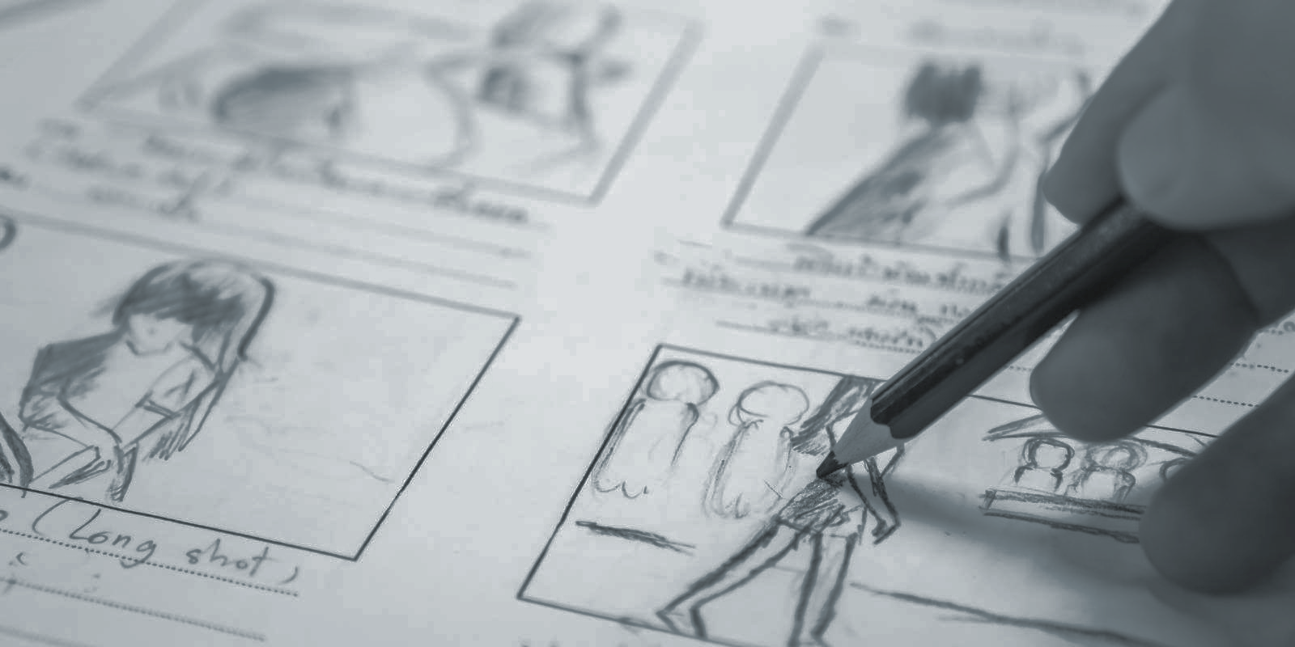
Recovery Storyboard
Notes:
What’s next? Final Solution!!
Recovery storyboard
People recovering from concussions will be able to log their progress and document their recovery journey.

Slide 18
Risks and Implications
Who this solution is for:
People in the recovery process who are looking for support / uplifting ways of expressing their current state
Who might this solution exclude:
People with severe symptoms (no screen time)
Those without capacity/time to track progress closely
Risks and Ethical Implications
Privacy and Data Storage (HIPAA)
Pressure to always show progress
Over-reliance on social networks instead of medical professionals
Notes:
What to account for: Ethical implications of the recovery storyboard solution as well as who it serves/who it leaves out.

Slide 19
Thank you..
Appendix located in the following Slides
Notes:
Thank you. (appendix follows)

Slide 20
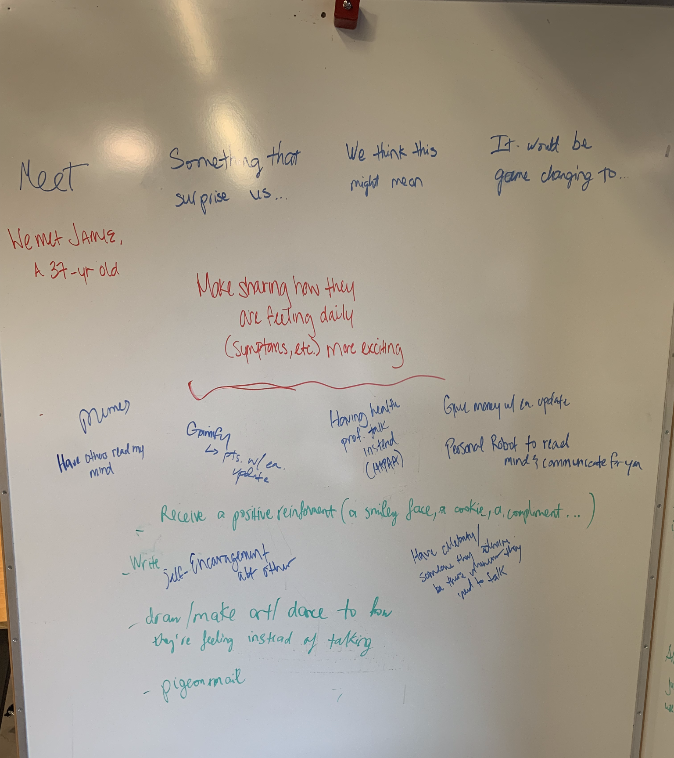
Appendix A: HMW1 Solutions Brainstorm
Notes:
Solution Brainstorms

Slide 21
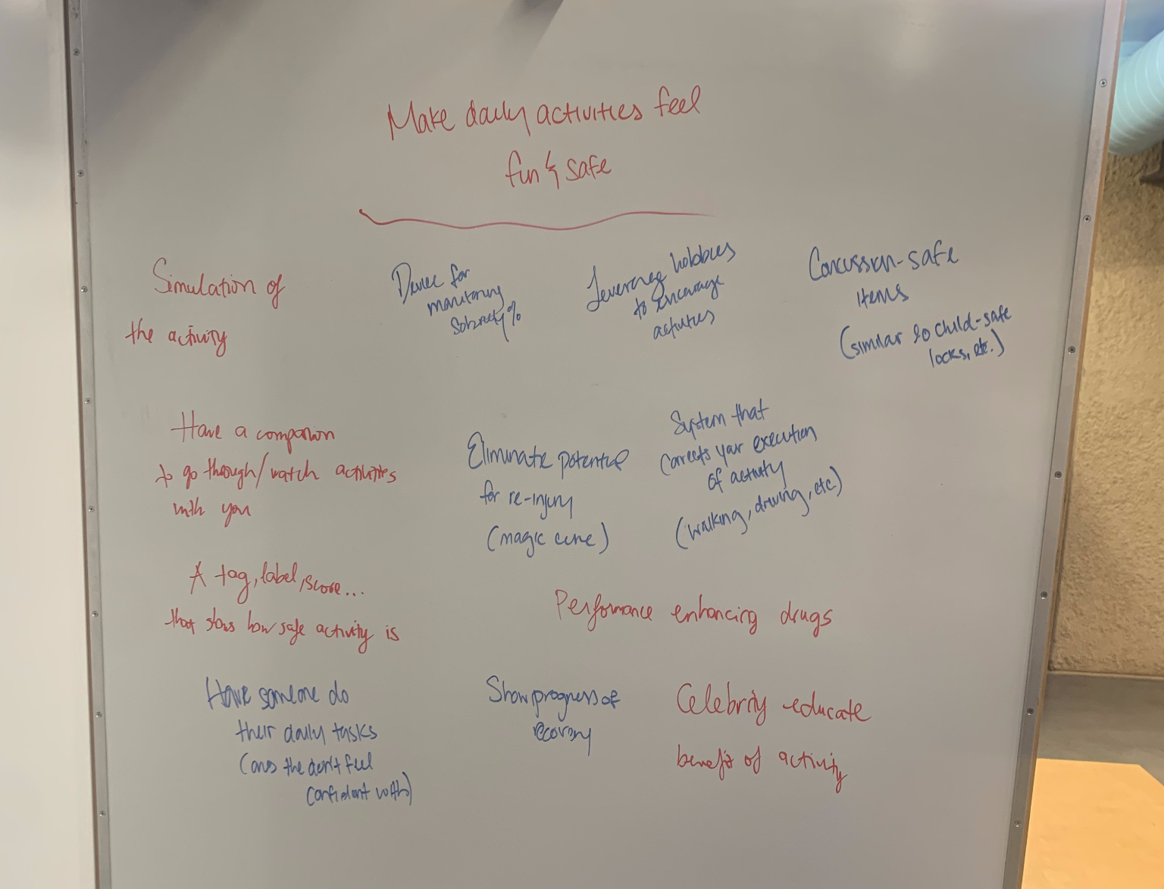
Appendix B: HMW2 Solutions Brainstorm
Notes:
Solution Brainstorms

Slide 22
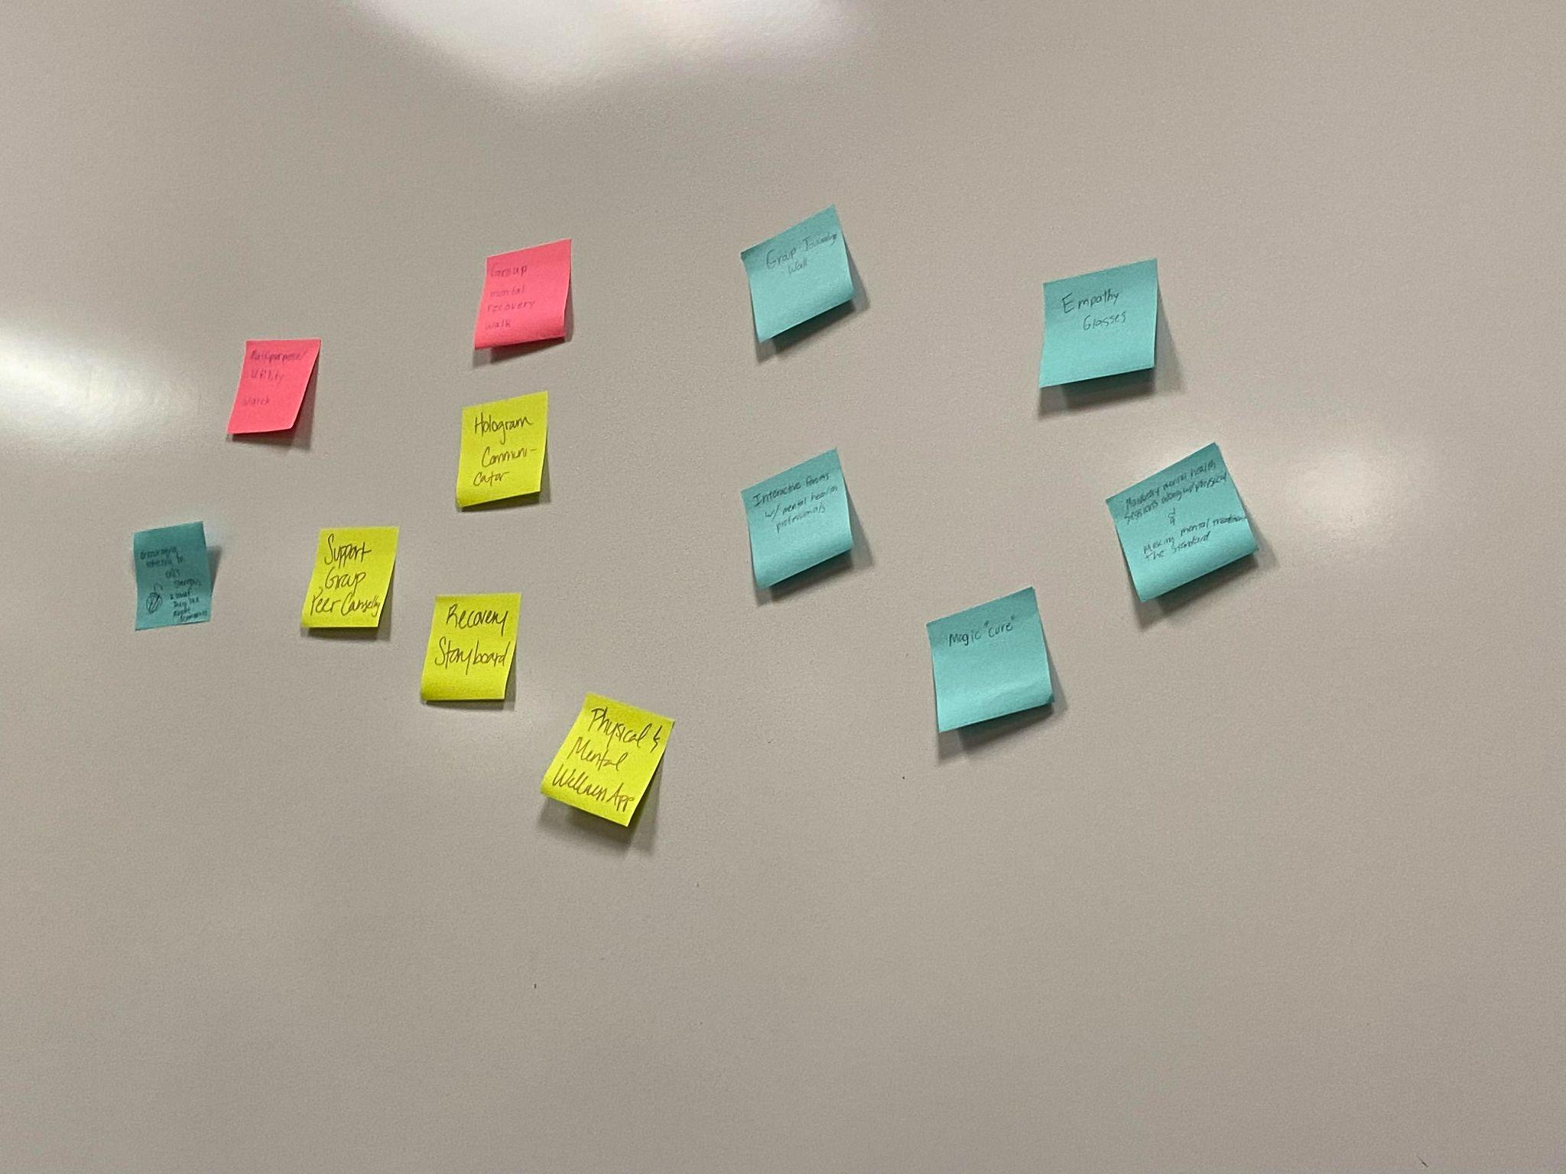
Appendix C: HMW3 Solutions Brainstorm
Notes:
Solution Brainstorms

