Slide 1
.
Concussions
dealing with transitions, uncertainty, & lasting effects.

Slide 2
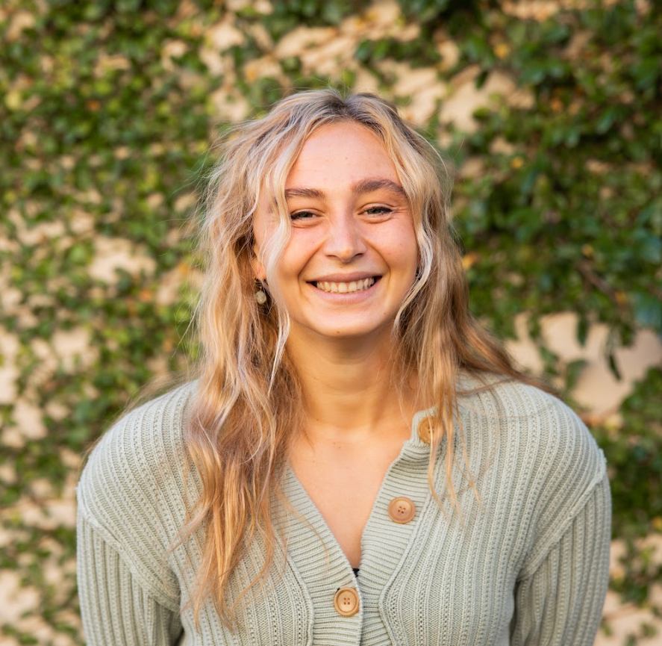
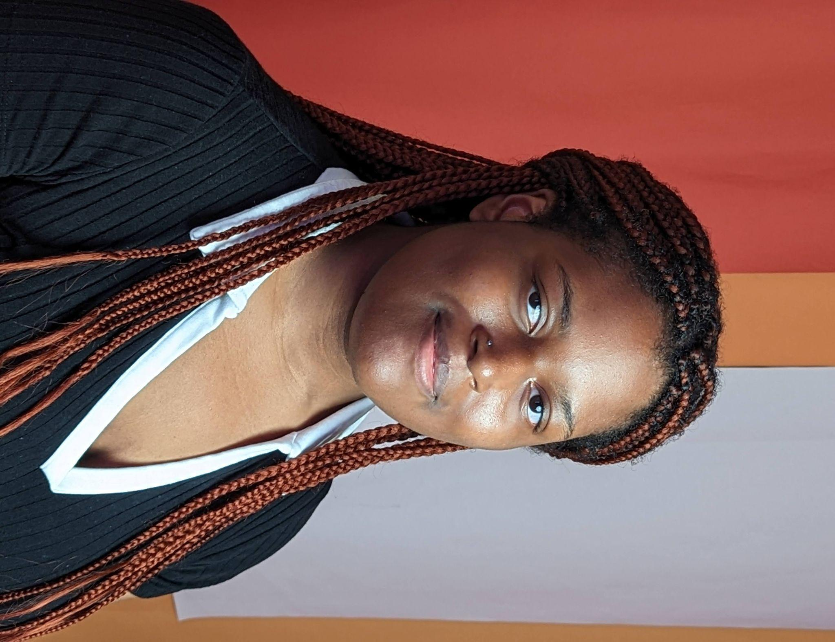
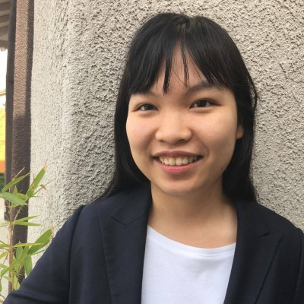
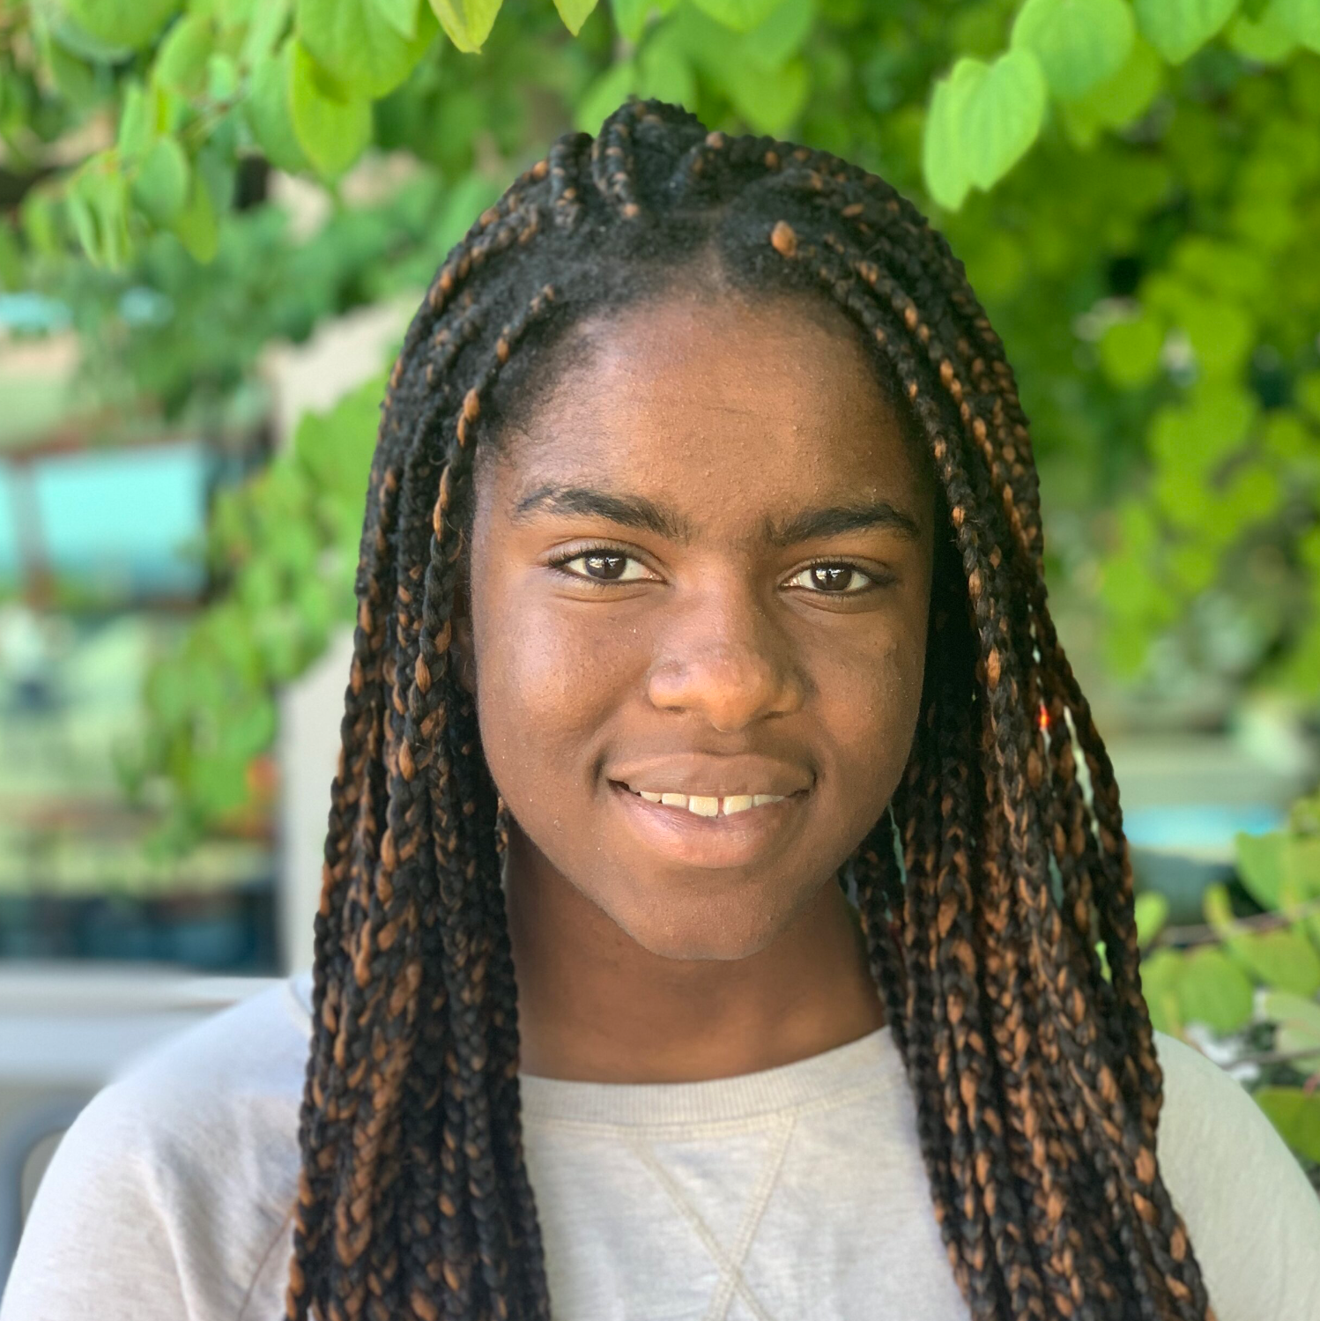
.
the team

Slide 3
Exploring the transitory period of short-term disabilities and potential long term effects to health
Most people will be disabled at least one point in their lives
Invisible disabilities present a unique design opportunity
.
the why

Slide 4
1.6- 3.8M
concussions happen in the US each year.
Notes:
CDC experts estimate ^

Slide 5



.
the why
20% of children are affected by a concussion by the age of 16
80% of concussions don’t seek medical attention
30% of concussions have ongoing symptoms

Slide 6
*.
participants
Jamie
Tina
Rose
Nadia
Ex-firefighter/
paramedic student
1+ year of symptoms
South African government official
6 mo+ of symptoms
Stanford MS Student
1+ year of symptoms
Waiter and part-time student
1+ year of symptoms
Charlotte
Kady
Katrina
Chloe
Stanford junior
6 months of symptoms
Architect/ Urban designer
Pending
Occupational therapist
Pending
PM at zoom
Pending
*names have been changed to provide anonymity

Slide 7
.
what we asked
Actions/feelings surrounding their injury
How their life has been affected by their injury, how they deal with symptoms
Relationships with friends and family
How they view and track their health journey
Workplace accommodations
How others perceive their disability
Notes:
Themes about what we asked about — actual questions are in the appendix

Slide 8
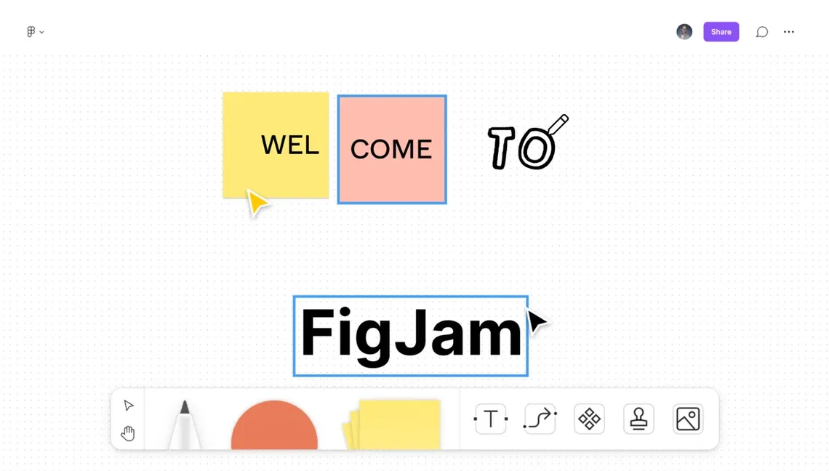
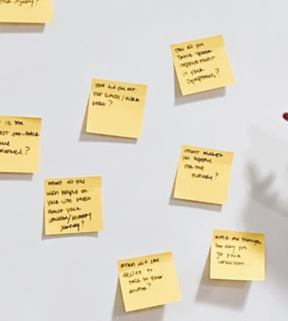

.
methods + tools
old fashioned post its!

Slide 9
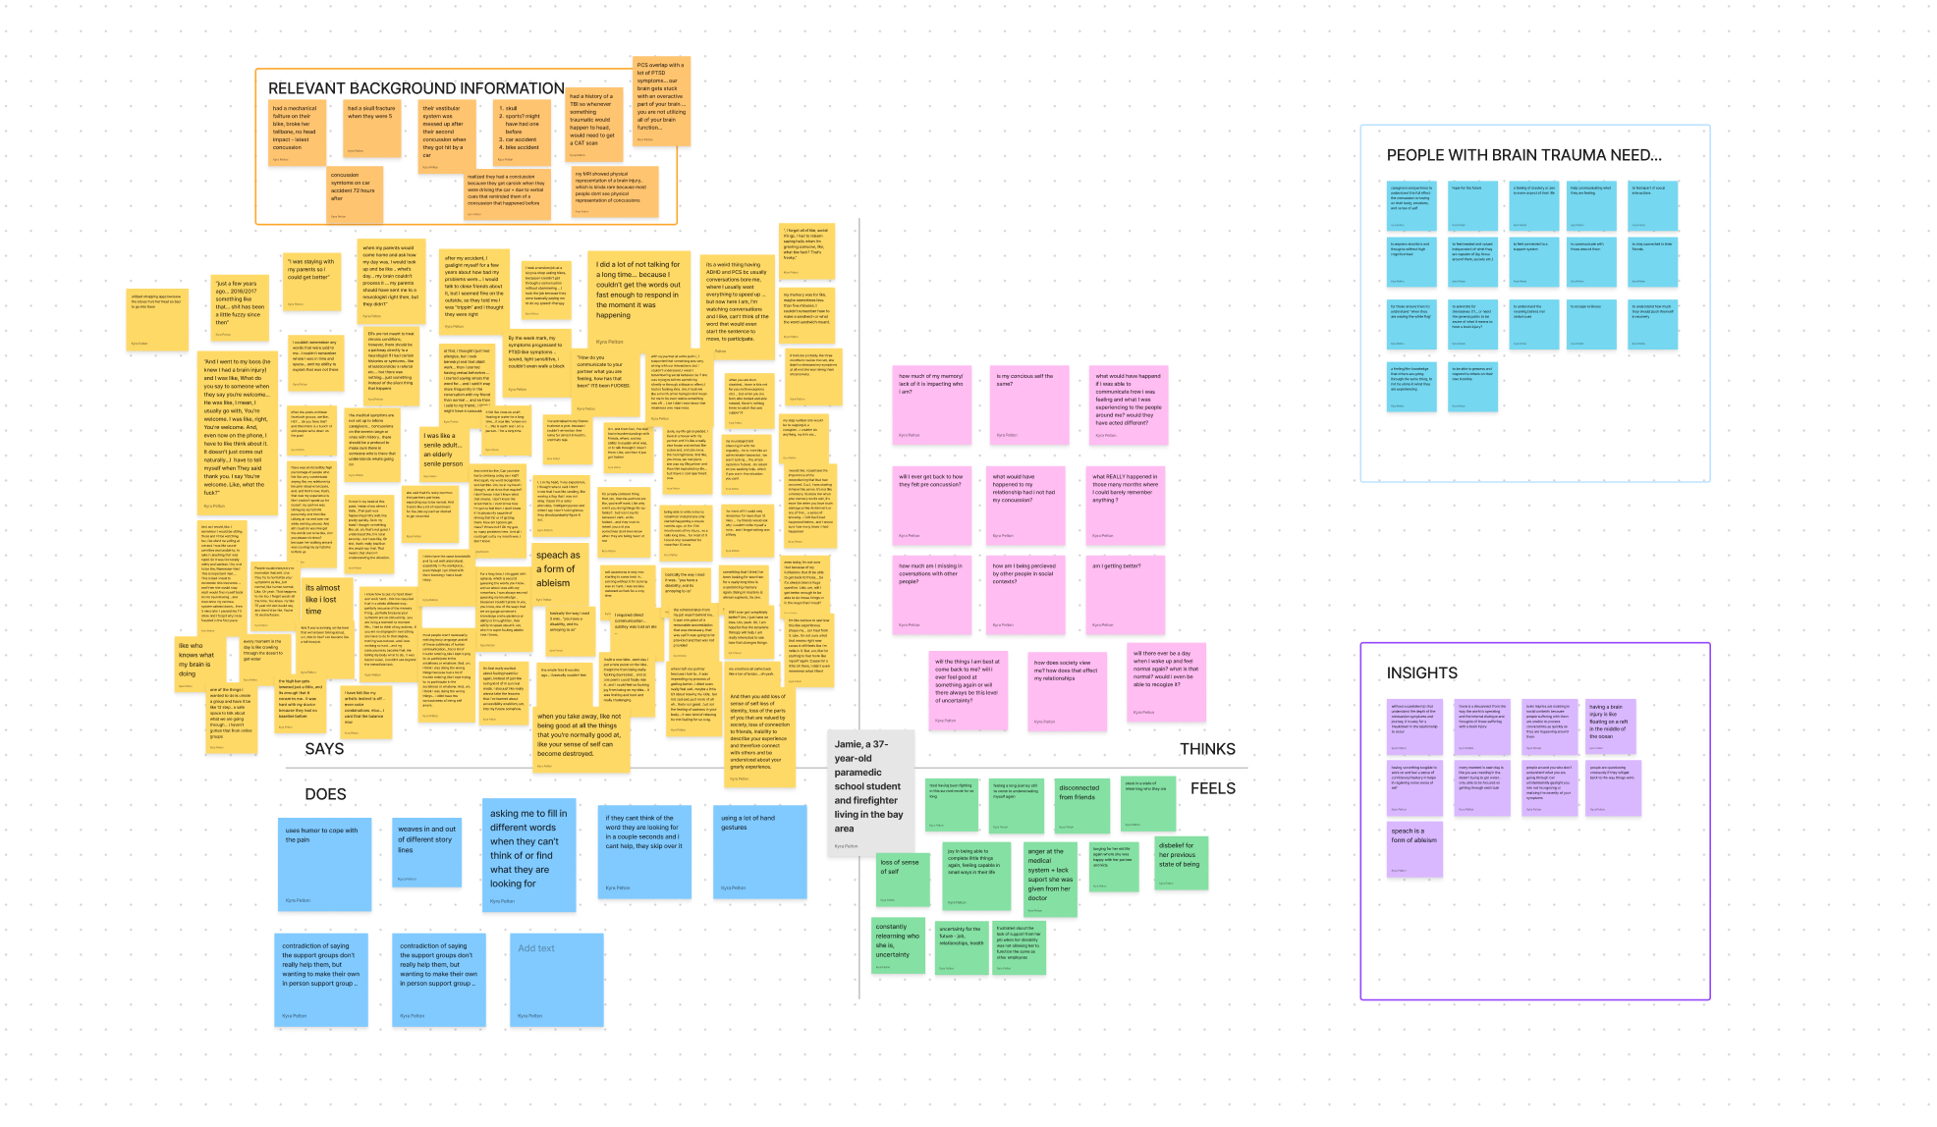
.
empathy map

Slide 10
.
meet Jamie
“I did a lot of not talking for a long time... because I couldn’t get the words out fast enough to respond in the moment it was happening”
Jamie is a 37 year old paramedic student currently on disability leave living in the Bay Area.
“I haven’t talked to my friends in almost a year, because I couldn’t remember their names for almost 6 months.”
They injured their head in a non head contact bike accident where they also broke their tailbone.
“And then you add loss of sense of self loss of identity, loss of the parts of you that are valued by society, loss of connection to friends, inability to describe your experience and therefore connect with others and be understood, it is a gnarly experience.”

Slide 11
.
meet Tina
"Psychologically I actually needed to get out and start doing things again"
Tina is a horseback-riding enthusiast who’s passionate about her work for the South African government
"I'm 100% confident i'll recover, the only question is how long will it take"
She injured her head falling off their horse, which has caused many of her previous concussions.
"I don't feel like i'm less of a person... but i do worry... there's going to be a mistake [in my work]"

Slide 12
.
meet Rose
“And it was almost a little bit wild because Cam would want to say something and she make a sound and a hand motion. And I would have to figure out what she meant. It's like you're playing charades all the time... but there was always this level of frustration from Cam because she couldn’t say she wanted to say.”
Rose is a 24 year old engineering graduate student, taking part time classes and working as a teaching assistant.
She injured her head at a summer internship last summer walking into a glass door, she also cared for her partner while she suffered a concussion at the beginning of their relationship.
Like for me, so much of whether I have a good day or not is related to like how many symptoms I am having... if I feel better I can do more.... the worst part about having a concussion you can’t distract yourself from it... When I am having these symptoms, I just get so defeated and you are just in your head.

Slide 13
.
Meet Charlotte
“As a CS major, I couldn’t look at my screen for more than 2 minutes”
Charlotte is a high achieving CS student, highly involved in her classes and extracurriculars.
She fell off her bed and hit her head during the end of Winter quarter.
“I hit a mental low”
“The physical repercussion sucked, but they improve over time. The biggest impact on me was mental.”
“It was hard for people who don’t know me that well, whereas my friends and professors who are seeing me struggle to get through my days, it’s more visceral.”

Slide 14
.
meet Nadia
“going to the grocery store felt like, like an achievement. I remember... that's when I was like, okay, I am like getting better.”
Nadia is a college student and restaurant worker, hoping to one day become a therapist
She has suffered three concussions within the past year (on a deck, at a football game, and at work).
“[My bosses and coworkers] weren't being all that nice before I got a doctor's note. ”
“when you explain to people how bad it is, you feel like you're like trying to get people to feel sorry for you, which is not really what I want.”
“I don't think I've ever felt more down than I did when I've had [concussions]”

Slide 15
.
key needs
feel connected to a support network
to feel apart of social interactions
hope for the future
common needs
Assurance that they aren’t a burden to those around them
to understand the meaning behind non verbal cues
to not be alone in what they are experiencing
to feel comfortable sharing their limitations
to be able to process and respond to others on their own timeline
context needs
caregivers and partners to understand the full effect the concussion is having on their body, emotions, and sense of self
not feel guilt of “letting others down”
to express emotions and thoughts without high cognitive load
to feel needed and valued independent of what they are capable of (by those around them, society, etc.)
a break from constantly advocating for themselves, and asking for accomodations
for those around them to understand “when they are waving the white flag”
activity needs
to celebrate the small wins in their recovery
to advocate for themselves
qualifier needs
an indication or cue for those around that they are not doing well

Slide 16
.
recovery journey
“The high bar gets lowered just a little with each hit, and its enough that it concerns me.” (Jamie)
“My concussion journey feels like I am constantly feeling these highs and lows … I am just trying to maintain this new normal of not being in too much pain” (Rose)

Slide 18
.
key insights
Without a caretaker(s)that understand the depth of the concussion symptoms and journey, it is easy for a breakdown in the relationship to occur
Having something tangible to work on and feel a sense of confidence/mastery in helps regain some sense of self
People with brain trauma are constantly worried about how they are perceived by others since they often don’t feel like themselves
People with brain injuries can feel isolated in social contexts because they are unable to process conversations as quickly as they are happening around them
Each low point or bad day in your concussion journey often spirals because of the overwhelming weight of the fear and uncertainty of how long it will last
Every moment in each day feels like “you are crawling in the desert trying to find water”...where you are only able to be focused on getting through each task

Slide 19
.
next steps
Conduct more interviews with those with less extreme stories +with the caregiver/partner of those experiencing concussions
Construct HMW and POV statements based on the interviews
Design experience prototypes to test our current insights and proposed needs

Slide 20
.
Thank you

Slide 21
.
Appendix

Slide 22
.
what we asked
Walk me through the day you received a concussion.
How did you let your school/workplace know about your concussion and the accommodations you need(ed)? Did you experience any pushback?
How do you track your symptoms?
How do you deal with particularly bad symptom days?
What has helped you most in adapting to your concussion?
How helpful do you feel like these support groups are? What do you get out of them?
How do you wish you would have been able to communicate with your friends ?
What hindrances or steups do you notice in your daily life that weren’t there before? What could you do before that you can no longer do?
Is there anything that you couldn’t do before that you can do now?
How have you changed as a person since the onset of your concussion?
How have your family and friends reacted to your concussion?
How do you think other people perceive your disability?
What do you wish people knew about living with a concussion?
What makes you hopeful for the future?

Slide 23
.
interview details
Jamie (extreme user) | Tina | Rose | Charlotte | Nadia
Found on Meta’s Post-Concussion Syndrome Support Group Fractured their skull at 5 years and has had 4 concussions in total Interviewed in-person by Kyra, Sadorian as notetaker | Found on Meta’s Post-Concussion Syndrome and Brain Injury Support Group Chosen due to having 10+ concussions over their lifetime Interviewed over Zoom by Kyra, Sadorian as notetaker | Chosen due to having had concussive symptoms for 1+ year Interviewed in-person by Kyra, Sadorian as notetaker | Chosen due to having concussive symptoms for 6+ months Interviewed in-person by Hong, Crystal as notetaker | Found via Facebook Group Chosen due to having had concussive symptoms for 1+ year Interviewed over Zoom by Crystal, Hong as notetaker

Slide 24
.
empathy maps link
https://www.figma.com/file/zTqqDxz7MpzgctMmN3I9Je/empathy-maps-%2F-interview-breakdown?node-id=0%3A1

