Slide 1
Needfinding
by Rachel Leou, Katrina Liou,
Grace Zhang, and Anthony Xie

Slide 2
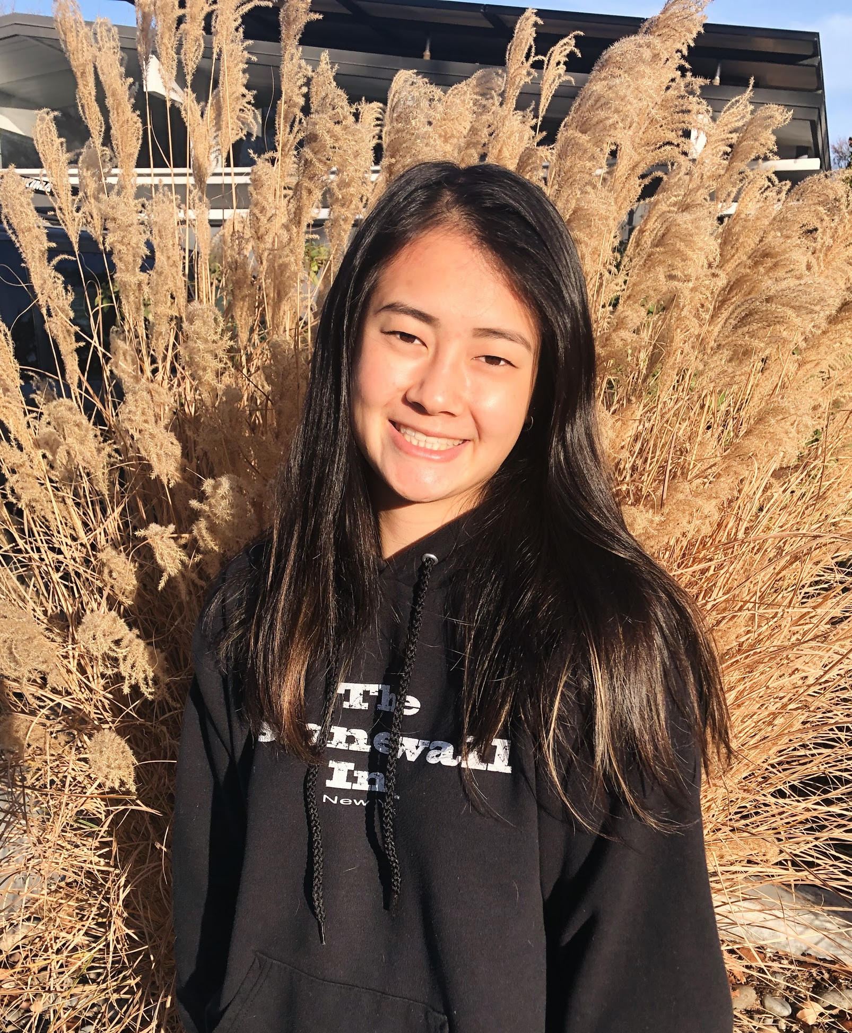
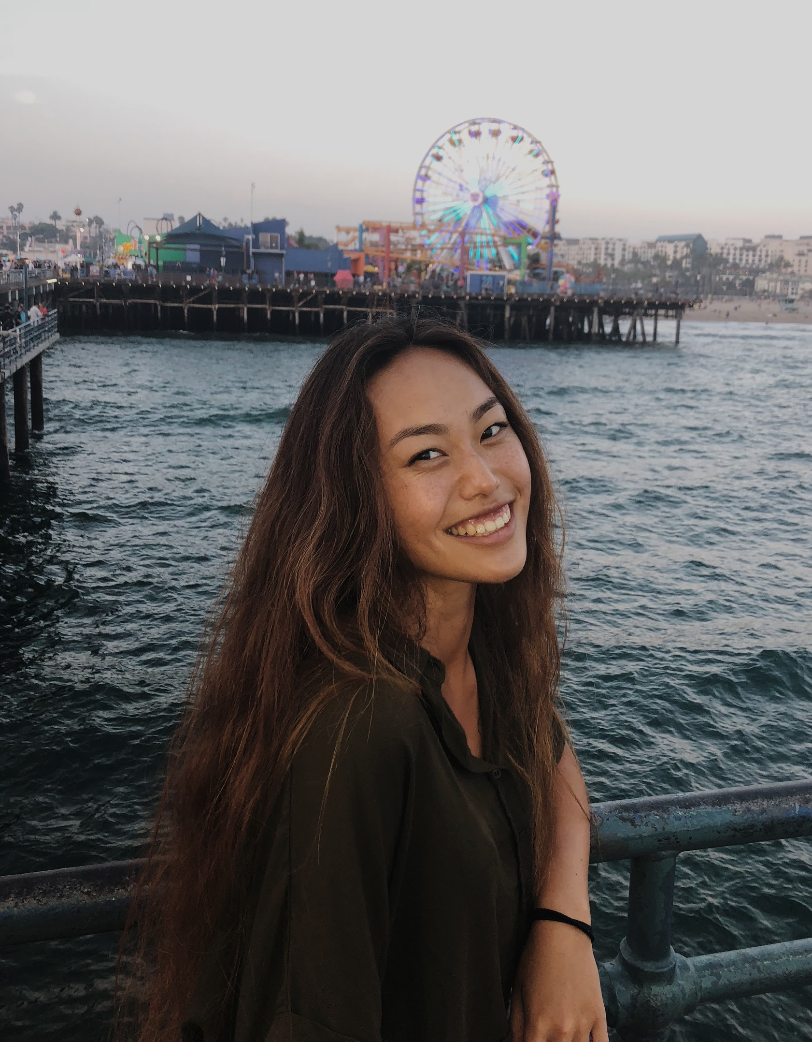
Rachel Leou
design
team
Katrina Liou

Slide 3
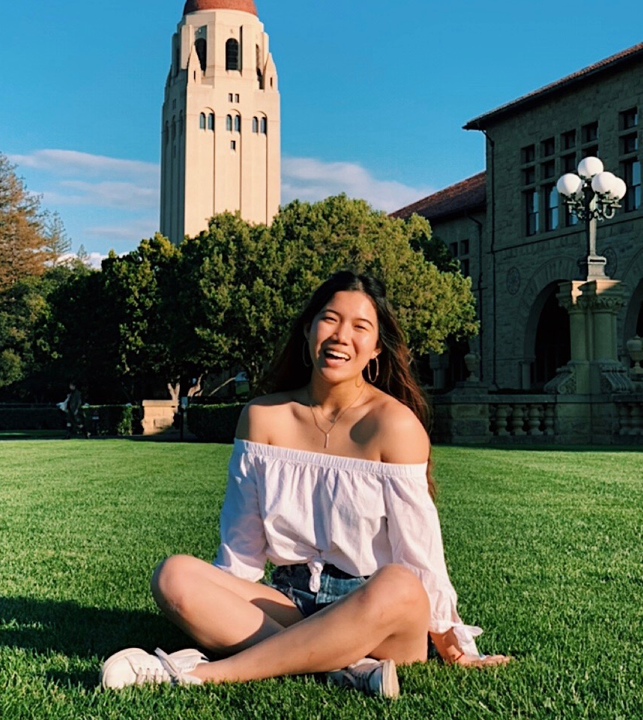
Anthony Xie
developing team
Grace Zhang

Slide 5
methodology

Slide 6
methodology
results

Slide 7
methodology
results
analysis

Slide 8
methodology

Slide 9
What is stopping you from living more sustainably?
Does making sustainability “trendy” make it more attractive or accessible?
Is lack of education or awareness the biggest bottleneck?
What made you start caring about getting into sustainability?
Is there a habit or part of your life that you would want to change?
Should we focus more on targeting industries or individuals?
What are sustainable practices you currently employ?
Where is there wastage in your life or in society in general?
What role has tech played in helping you become more sustainable?
How and where were you exposed to this?
Does your company or industry employ sustainable practices?
Is there a lot of competition within the sustainability industry?
Notes:
Questions we asked

Slide 10
What is stopping you from living more sustainably?
Does making sustainability “trendy” make it more attractive or accessible?
Is lack of education or awareness the biggest bottleneck?
What made you start caring about getting into sustainability?
Is there a habit or part of your life that you would want to change?
Should we focus more on targeting industries or individuals?
What are sustainable practices you currently employ?
Where is there wastage in your life or in society in general?
What role has tech played in helping you become more sustainable?
How and where were you exposed to this?
Does your company or industry employ sustainable practices?
Is there a lot of competition within the sustainability industry?
Notes:
Questions we asked

Slide 11
What is stopping you from living more sustainably?
Does making sustainability “trendy” make it more attractive or accessible?
Is lack of education or awareness the biggest bottleneck?
What made you start caring about getting into sustainability?
Is there a habit or part of your life that you would want to change?
Should we focus more on targeting industries or individuals?
What are sustainable practices you currently employ?
Where is there wastage in your life or in society in general?
What role has tech played in helping you become more sustainable?
How and where were you exposed to this?
Does your company or industry employ sustainable practices?
Is there a lot of competition within the sustainability industry?
Notes:
Questions we asked

Slide 12
What is stopping you from living more sustainably?
Does making sustainability “trendy” make it more attractive or accessible?
Is lack of education or awareness the biggest bottleneck?
What made you start caring about getting into sustainability?
Is there a habit or part of your life that you would want to change?
Should we focus more on targeting industries or individuals?
What are sustainable practices you currently employ?
Where is there wastage in your life or in society in general?
How and where were you exposed to this?
What role has tech played in helping you become more sustainable?
Does your company or industry employ sustainable practices?
Is there a lot of competition within the sustainability industry?
Notes:
Questions we asked

Slide 13
What is stopping you from living more sustainably?
Does making sustainability “trendy” make it more attractive or accessible?
Is lack of education or awareness the biggest bottleneck?
What made you start caring about getting into sustainability?
Is there a habit or part of your life that you would want to change?
Should we focus more on targeting industries or individuals?
What are sustainable practices you currently employ?
Where is there wastage in your life or in society in general?
How and where were you exposed to this?
What role has tech played in helping you become more sustainable?
Does your company or industry employ sustainable practices?
Is there a lot of competition within the sustainability industry?
Notes:
Questions we asked

Slide 14
What is stopping you from living more sustainably?
Does making sustainability “trendy” make it more attractive or accessible?
Is lack of education or awareness the biggest bottleneck?
What made you start caring about getting into sustainability?
Is there a habit or part of your life that you would want to change?
Should we focus more on targeting industries or individuals?
What are sustainable practices you currently employ?
Where is there wastage in your life or in society in general?
How and where were you exposed to this?
What role has tech played in helping you become more sustainable?
Does your company or industry employ sustainable practices?
Is there a lot of competition within the sustainability industry?
Notes:
Questions we asked

Slide 15
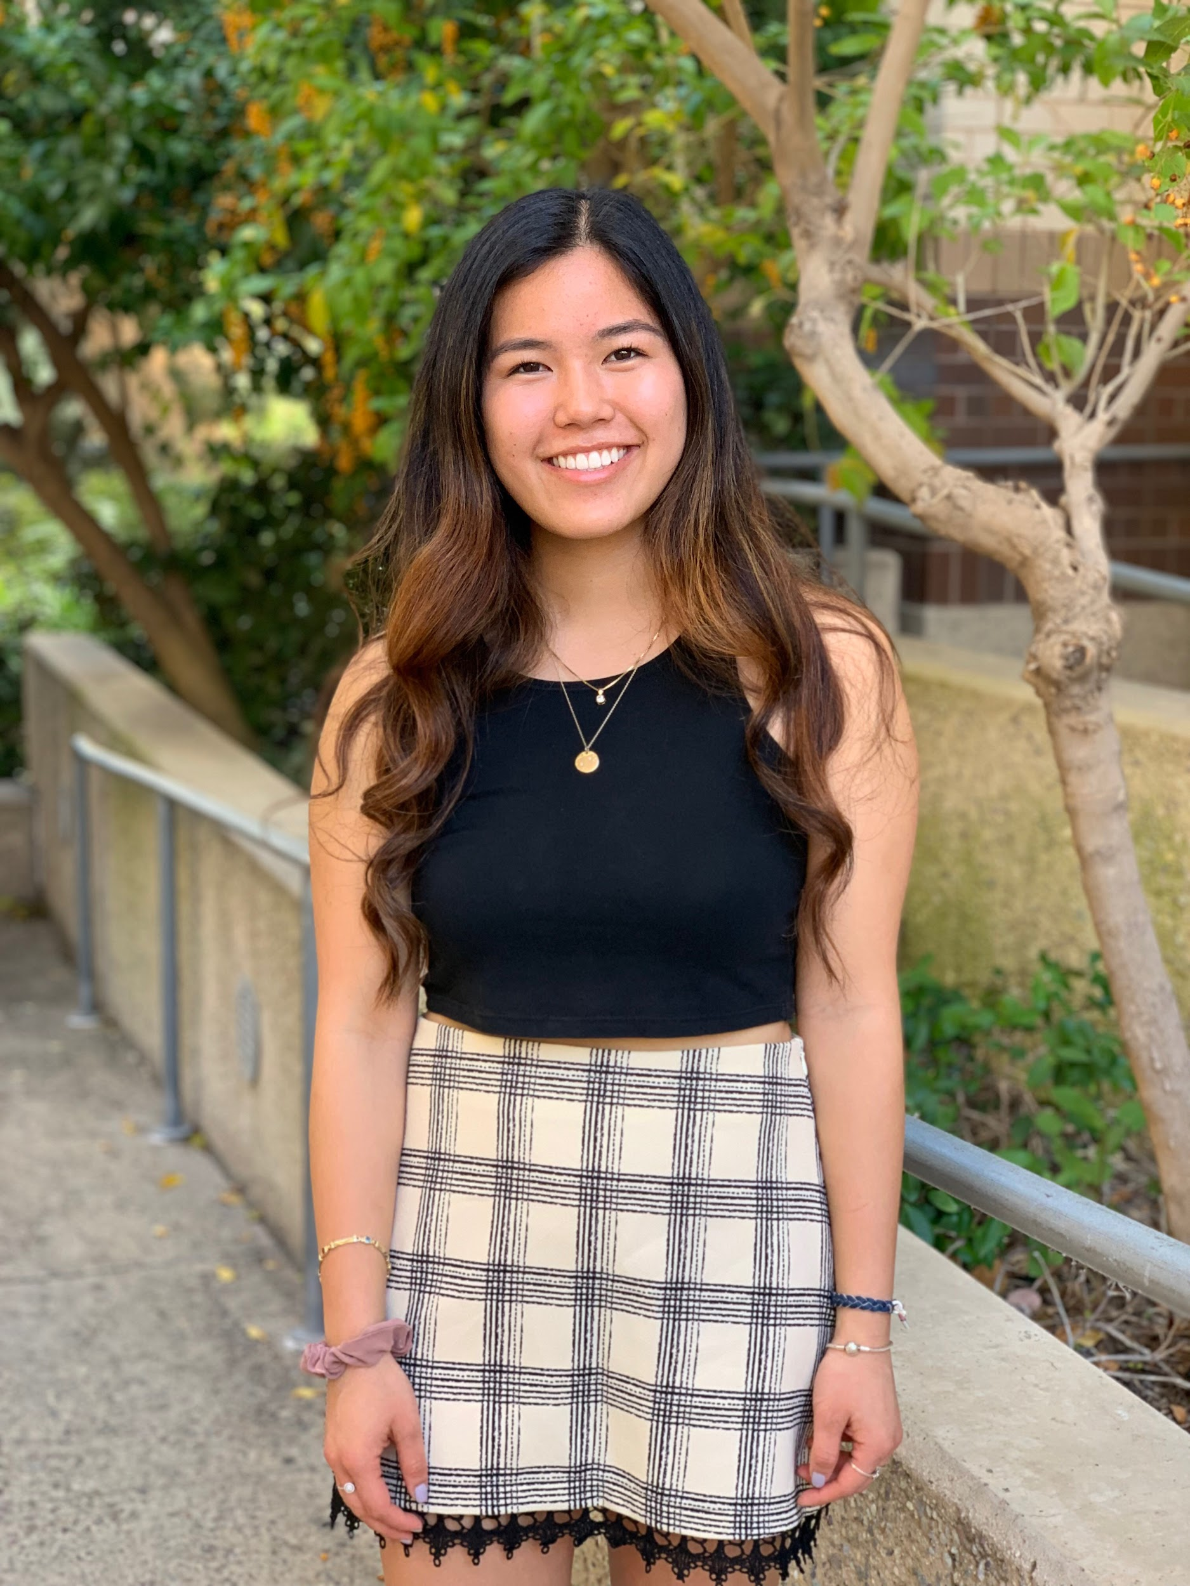
Julia
meet
marketing associate at BEHR
Notes:
Julia is a UCI alum and currently works as a marketing associate at BEHR. I, personally, have known Julia for as long as I can remember and I have been able to see a major lifestyle change in her as time has worn on. Like many individuals today, Julia used to live a conventional lifestyle without a care in the world whether her take out containers were paper or styrofoam; however, she now makes a conscientious effort to reduce her footprint by means of recycling, supporting businesses that also make efforts to be sustainable, composting, and more. We felt as though Julia would be a good partner to interview because she offers a great perspective on how to overcome the barriers of living sustainably.

Slide 16
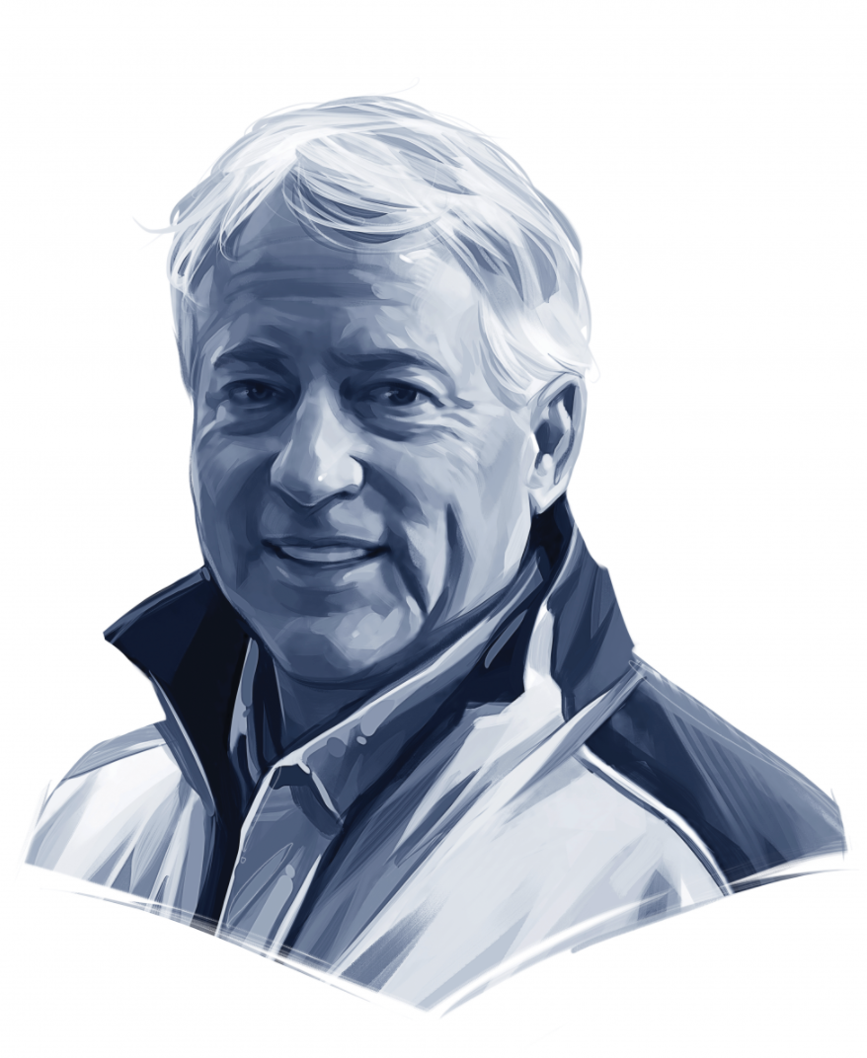
Joe
meet
environmental activist
Notes:
Joe is a long-time environmental activist from Maryland. We thought he would be a good candidate to interview because of his extensive experience in the field -- not only did he serve on a sustainability commission for several years, but he also started his own programs that teach about sustainability and composting and waste at elementary, junior and high schools and runs a sustainable summer camp. As an active rotary member, He has given talks at the Environmental Sustainability Rotarian Action Group.

Slide 17
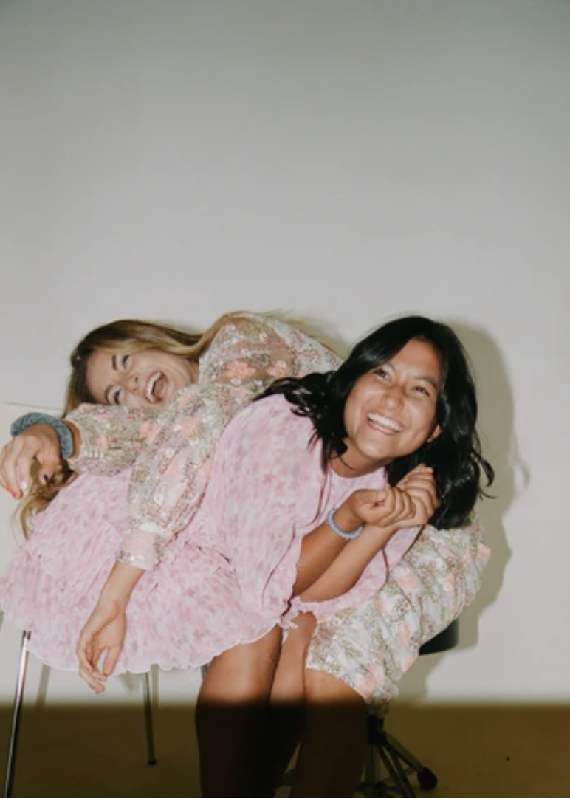
Ellie
meet
founder of Oddli Apparel
Notes:
Ellie is the founder of Oddli Apparel, a sustainable clothing brand that creates new statement pieces from unused fabric from the fast fashion industry. Ellie is a Stanford alum who created Oddli as her capstone project. After gaining traction as a brand and developing a passion for the company, Ellie and her co-founder have become entrepreneurs in a budding market. We felt as though Ellie would be able to provide the perspective on the role of sustainability both in business and as a trend.

Slide 18
Ellie
meet
founder of Oddli Apparel
Notes:
Ellie is the founder of Oddli Apparel, a sustainable clothing brand that creates new statement pieces from unused fabric from the fast fashion industry. Ellie is a Stanford alum who created Oddli as her capstone project. After gaining traction as a brand and developing a passion for the company, Ellie and her co-founder have become entrepreneurs in a budding market. We felt as though Ellie would be able to provide the perspective on the role of sustainability both in business and as a trend.

Slide 19
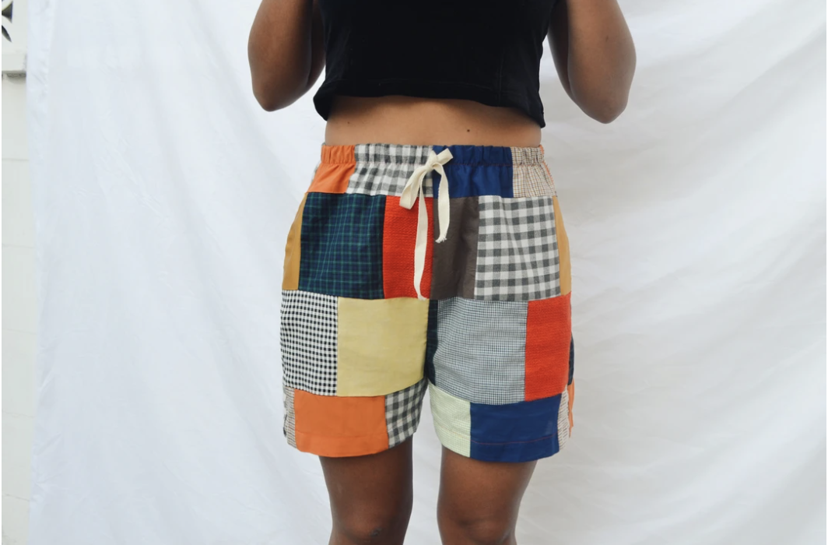
Ellie
meet
founder of Oddli Apparel
Notes:
Ellie is the founder of Oddli Apparel, a sustainable clothing brand that creates new statement pieces from unused fabric from the fast fashion industry. Ellie is a Stanford alum who created Oddli as her capstone project. After gaining traction as a brand and developing a passion for the company, Ellie and her co-founder have become entrepreneurs in a budding market. We felt as though Ellie would be able to provide the perspective on the role of sustainability both in business and as a trend.

Slide 20
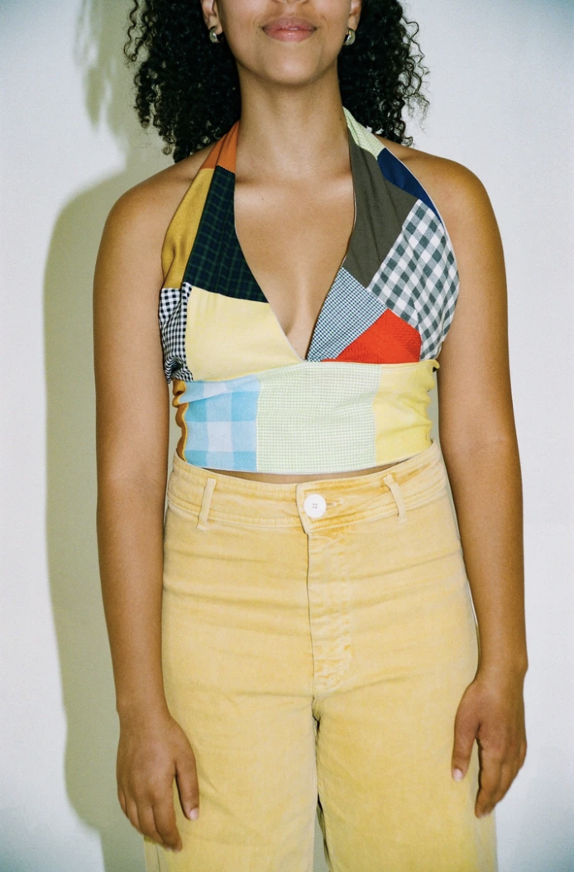
Ellie
meet
founder of Oddli Apparel
Notes:
Ellie is the founder of Oddli Apparel, a sustainable clothing brand that creates new statement pieces from unused fabric from the fast fashion industry. Ellie is a Stanford alum who created Oddli as her capstone project. After gaining traction as a brand and developing a passion for the company, Ellie and her co-founder have become entrepreneurs in a budding market. We felt as though Ellie would be able to provide the perspective on the role of sustainability both in business and as a trend.

Slide 21
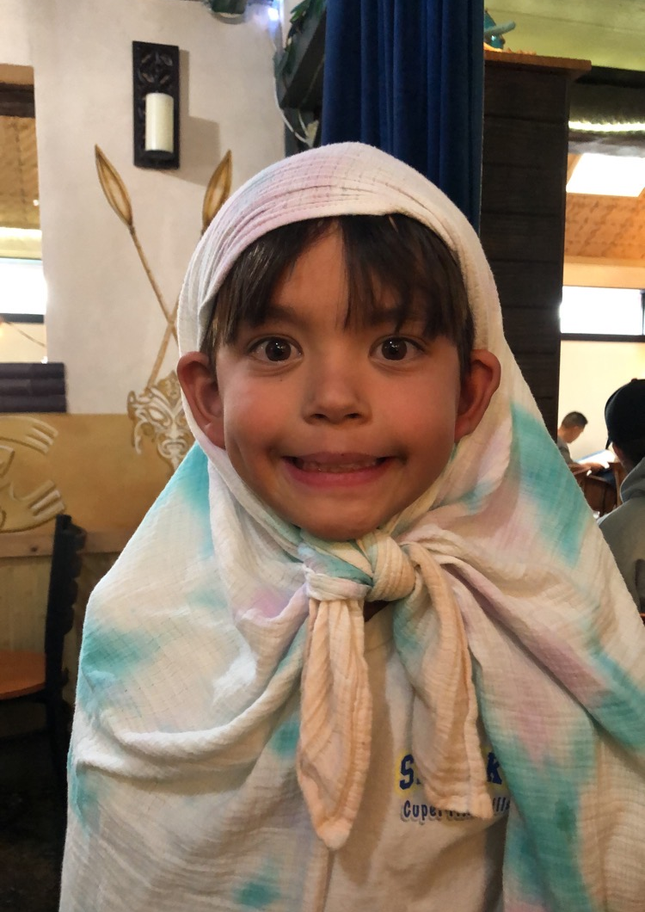
Andrew
meet
4th grader
Notes:
Andrew is 10 years old and is a 4th grade student from the Bay Area. We thought he would be a good candidate to interview because of his age. We were especially interested in his education in sustainability and were surprised to learn that he knew lots about renewable energy and climate change.

Slide 22
results

Slide 23
say
“Kids really care about this stuff--they just need direction and action to take”
“How do you find that line of creating a product that people want that is sustainable and ethical and knowing that it will be priced higher, and also respect the rest of the market”
“Being zero waste is really overwhelming, so it’s more about just trying to reduce your waste”
“In science I just learned about renewable energy”
“I think it’s important to keep the earth healthy so we can live on it longer”
“It’s no longer okay not to know about environmental issues”
“Younger people better understand the issues at hand, and are much more inclined to engage”
“Fashion should be more cyclical”
“Waste has become part of our culture”
“I had no idea just how bad the fashion industry has been for our environment”
“A lot of the time, you have to search for the information because it’s not readily available for you”
“Sustainable has no definition in the fashion industry”
“We’re terrible at recycling”

Slide 24
say
“Kids really care about this stuff--they just need direction and action to take”
“Being zero waste is really overwhelming, so it’s more about just trying to reduce your waste”
“How do you find that line of creating a product that people want that is sustainable and ethical and knowing that it will be priced higher, and also respect the rest of the market”
“In science I just learned about renewable energy”
“I think it’s important to keep the earth healthy so we can live on it longer”
“It’s no longer okay not to know about environmental issues”
“Younger people better understand the issues at hand, and are much more inclined to engage”
“Fashion should be more cyclical”
“Waste has become part of our culture”
“I had no idea just how bad the fashion industry has been for our environment”
“A lot of the time, you have to search for the information because it’s not readily available for you”
“Sustainable has no definition in the fashion industry”
“We’re terrible at recycling”

Slide 25
say
“Kids really care about this stuff--they just need direction and action to take”
“Being zero waste is really overwhelming, so it’s more about just trying to reduce your waste”
“How do you find that line of creating a product that people want that is sustainable and ethical and knowing that it will be priced higher, and also respect the rest of the market”
“In science I just learned about renewable energy”
“I think it’s important to keep the earth healthy so we can live on it longer”
“It’s no longer okay not to know about environmental issues”
“Younger people better understand the issues at hand, and are much more inclined to engage”
“Fashion should be more cyclical”
“Waste has become part of our culture”
“I had no idea just how bad the fashion industry has been for our environment”
“A lot of the time, you have to search for the information because it’s not readily available for you”
“Sustainable has no definition in the fashion industry”
“We’re terrible at recycling”

Slide 26
say
“Kids really care about this stuff--they just need direction and action to take”
“Being zero waste is really overwhelming, so it’s more about just trying to reduce your waste”
“How do you find that line of creating a product that people want that is sustainable and ethical and knowing that it will be priced higher, and also respect the rest of the market”
“In science I just learned about renewable energy”
“I think it’s important to keep the earth healthy so we can live on it longer”
“It’s no longer okay not to know about environmental issues”
“Younger people better understand the issues at hand, and are much more inclined to engage”
“Fashion should be more cyclical”
“Waste has become part of our culture”
“I had no idea just how bad the fashion industry has been for our environment”
“A lot of the time, you have to search for the information because it’s not readily available for you”
“Sustainable has no definition in the fashion industry”
“We’re terrible at recycling”

Slide 27
say
“Kids really care about this stuff--they just need direction and action to take”
“Being zero waste is really overwhelming, so it’s more about just trying to reduce your waste”
“How do you find that line of creating a product that people want that is sustainable and ethical and knowing that it will be priced higher, and also respect the rest of the market”
“In science I just learned about renewable energy”
“I think it’s important to keep the earth healthy so we can live on it longer”
“It’s no longer okay not to know about environmental issues”
“Younger people better understand the issues at hand, and are much more inclined to engage”
“Fashion should be more cyclical”
“I had no idea just how bad the fashion industry has been for our environment”
“Waste has become part of our culture”
“A lot of the time, you have to search for the information because it’s not readily available for you”
“Sustainable has no definition in the fashion industry”
“We’re terrible at recycling”

Slide 29


Slide 31
do
Excited to offer the help that she was able to
Recited very specific statistics relevant to the conversation
Showed pictures taken of students participating in trash sorting
Uses solar power at home and actively composts
Encouraged me to check out his website and talks online
She is very positive and smiles a lot, while encouraging our questions
He showed us his textbook with all of the sustainability content he is currently learning
She was being humble about her knowledge and her habits
She seemed slightly agitated when talking about sustainability habits in the US
He was very shy and pauses a lot to think
Became excited when talking about his projects
Furthered her capstone and started a company

Slide 32
do
Excited to offer the help that she was able to
Recited very specific statistics relevant to the conversation
Showed pictures taken of students participating in trash sorting
Uses solar power at home and actively composts
Encouraged me to check out his website and talks online
She is very positive and smiles a lot, while encouraging our questions
He showed us his textbook with all of the sustainability content he is currently learning
She was being humble about her knowledge and her habits
She seemed slightly agitated when talking about sustainability habits in the US
He was very shy and pauses a lot to think
Became excited when talking about his projects
Furthered her capstone and started a company

Slide 33
do
Excited to offer the help that she was able to
Recited very specific statistics relevant to the conversation
Showed pictures taken of students participating in trash sorting
Uses solar power at home and actively composts
Encouraged me to check out his website and talks online
She is very positive and smiles a lot, while encouraging our questions
He showed us his textbook with all of the sustainability content he is currently learning
She was being humble about her knowledge and her habits
She seemed slightly agitated when talking about sustainability habits in the US
He was very shy and pauses a lot to think
Became excited when talking about his projects
Furthered her capstone and started a company

Slide 34
do
Excited to offer the help that she was able to
Recited very specific statistics relevant to the conversation
Showed pictures taken of students participating in trash sorting
Uses solar power at home and actively composts
Encouraged me to check out his website and talks online
She is very positive and smiles a lot, while encouraging our questions
He showed us his textbook with all of the sustainability content he is currently learning
She was being humble about her knowledge and her habits
She seemed slightly agitated when talking about sustainability habits in the US
He was very shy and pauses a lot to think
Became excited when talking about his projects
Furthered her capstone and started a company

Slide 35
do
Excited to offer the help that she was able to
Recited very specific statistics relevant to the conversation
Showed pictures taken of students participating in trash sorting
Uses solar power at home and actively composts
Encouraged me to check out his website and talks online
She is very positive and smiles a lot, while encouraging our questions
He showed us his textbook with all of the sustainability content he is currently learning
She was being humble about her knowledge and her habits
She seemed slightly agitated when talking about sustainability habits in the US
He was very shy and pauses a lot to think
Became excited when talking about his projects
Furthered her capstone and started a company

Slide 36
analysis

Slide 37
think
Younger people better understand the issues at hand, and are much more inclined to engage
I’m frustrated with human behavior
I want to preserve the Earth so my grandkids and their grandkids can also enjoy what I did
Believed in the importance of targeting individuals as opposed to targeting industry
Much more important to target individuals as an audience vs industry as a whole
There are many resources to “get into sustainability”-- people just need to take the initiative
How am I going to juggle all of this? What should I prioritize?
she is very realistic about the bounds of living sustainably
How can we educate our audience/ consumers while making them feel good about what they buy?
seeing your contribution is a good incentive
How big of an impact do I make?
thinking about her own personal experiences to living more sustainably and the problems that she runs into
people must be willing to DOWNSIZE to make a difference
I am excited to learn from this cool textbook

Slide 38
think
Younger people better understand the issues at hand, and are much more inclined to engage
I’m frustrated with human behavior
I want to preserve the Earth so my grandkids and their grandkids can also enjoy what I did
Believed in the importance of targeting individuals as opposed to targeting industry
Much more important to target individuals as an audience vs industry as a whole
There are many resources to “get into sustainability”-- people just need to take the initiative
How am I going to juggle all of this? What should I prioritize?
she is very realistic about the bounds of living sustainably
How can we educate our audience/ consumers while making them feel good about what they buy?
seeing your contribution is a good incentive
How big of an impact do I make?
people must be willing to DOWNSIZE to make a difference
thinking about her own personal experiences to living more sustainably and the problems that she runs into
I am excited to learn from this cool textbook

Slide 39
think
Younger people better understand the issues at hand, and are much more inclined to engage
I’m frustrated with human behavior
I want to preserve the Earth so my grandkids and their grandkids can also enjoy what I did
Believed in the importance of targeting individuals as opposed to targeting industry
Much more important to target individuals as an audience vs industry as a whole
There are many resources to “get into sustainability”-- people just need to take the initiative
How am I going to juggle all of this? What should I prioritize?
she is very realistic about the bounds of living sustainably
How can we educate our audience/ consumers while making them feel good about what they buy?
seeing your contribution is a good incentive
How big of an impact do I make?
people must be willing to DOWNSIZE to make a difference
thinking about her own personal experiences to living more sustainably and the problems that she runs into
I am excited to learn from this cool textbook

Slide 40
think
Younger people better understand the issues at hand, and are much more inclined to engage
I’m frustrated with human behavior
I want to preserve the Earth so my grandkids and their grandkids can also enjoy what I did
Much more important to target individuals as an audience vs industry as a whole
Believed in the importance of targeting individuals as opposed to targeting industry
How am I going to juggle all of this? What should I prioritize?
There are many resources to “get into sustainability”-- people just need to take the initiative
she is very realistic about the bounds of living sustainably
How can we educate our audience/ consumers while making them feel good about what they buy?
seeing your contribution is a good incentive
How big of an impact do I make?
people must be willing to DOWNSIZE to make a difference
thinking about her own personal experiences to living more sustainably and the problems that she runs into
I am excited to learn from this cool textbook

Slide 41
think
Younger people better understand the issues at hand, and are much more inclined to engage
I’m frustrated with human behavior
I want to preserve the Earth so my grandkids and their grandkids can also enjoy what I did
Much more important to target individuals as an audience vs industry as a whole
Believed in the importance of targeting individuals as opposed to targeting industry
How am I going to juggle all of this? What should I prioritize?
There are many resources to “get into sustainability”-- people just need to take the initiative
she is very realistic about the bounds of living sustainably
How can we educate our audience/ consumers while making them feel good about what they buy?
seeing your contribution is a good incentive
How big of an impact do I make?
people must be willing to DOWNSIZE to make a difference
thinking about her own personal experiences to living more sustainably and the problems that she runs into
I am excited to learn from this cool textbook

Slide 42
think
Younger people better understand the issues at hand, and are much more inclined to engage
I’m frustrated with human behavior
I want to preserve the Earth so my grandkids and their grandkids can also enjoy what I did
Much more important to target individuals as an audience vs industry as a whole
Believed in the importance of targeting individuals as opposed to targeting industry
How am I going to juggle all of this? What should I prioritize?
There are many resources to “get into sustainability”-- people just need to take the initiative
she is very realistic about the bounds of living sustainably
How can we educate our audience/ consumers while making them feel good about what they buy?
seeing your contribution is a good incentive
How big of an impact do I make?
people must be willing to DOWNSIZE to make a difference
thinking about her own personal experiences to living more sustainably and the problems that she runs into
I am excited to learn from this cool textbook

Slide 43
Love and care for the planet’s well being
Excited to learn more in school
Frustrated about industry bottlenecks in making sustainability more accessible and widespread
Happy that she gets to work on what she loves and dreams about
Anger that the fast fashion industry produces so much waste
Passionate about the growth of his Lunch out of Landfills initiative
feel
slightly frustrated
Exhausted from juggling so much from design to business
eager to be helpful and provide insight
Excited to give more talks at conferences in the future
inspired by the sustainable lifestyles of bloggers and youtubers
Enthusiastic about directing me towards other organizations and resources
Shy because he doesn’t know what sustainability means
laid back & comfortable

Slide 44
Love and care for the planet’s well being
Excited to learn more in school
Frustrated about industry bottlenecks in making sustainability more accessible and widespread
Happy that she gets to work on what she loves and dreams about
Anger that the fast fashion industry produces so much waste
Passionate about the growth of his Lunch out of Landfills initiative
feel
slightly frustrated
Exhausted from juggling so much from design to business
eager to be helpful and provide insight
Excited to give more talks at conferences in the future
inspired by the sustainable lifestyles of bloggers and youtubers
Enthusiastic about directing me towards other organizations and resources
Shy because he doesn’t know what sustainability means
laid back & comfortable

Slide 45
Love and care for the planet’s well being
Excited to learn more in school
Frustrated about industry bottlenecks in making sustainability more accessible and widespread
Happy that she gets to work on what she loves and dreams about
Anger that the fast fashion industry produces so much waste
Passionate about the growth of his Lunch out of Landfills initiative
feel
slightly frustrated
Exhausted from juggling so much from design to business
eager to be helpful and provide insight
Excited to give more talks at conferences in the future
inspired by the sustainable lifestyles of bloggers and youtubers
Enthusiastic about directing me towards other organizations and resources
Shy because he doesn’t know what sustainability means
laid back & comfortable

Slide 46
Love and care for the planet’s well being
Excited to learn more in school
Frustrated about industry bottlenecks in making sustainability more accessible and widespread
Happy that she gets to work on what she loves and dreams about
Anger that the fast fashion industry produces so much waste
Passionate about the growth of his Lunch out of Landfills initiative
feel
slightly frustrated
Exhausted from juggling so much from design to business
eager to be helpful and provide insight
Excited to give more talks at conferences in the future
inspired by the sustainable lifestyles of bloggers and youtubers
Enthusiastic about directing me towards other organizations and resources
Shy because he doesn’t know what sustainability means
laid back & comfortable

Slide 47
Insights
& Needs
Notes:
SUMMARY OF RESULTS
change your mindset/narrow your perspective
it’s hard to do things on your own/encourage direction

Slide 48
“I think it’s important to keep the earth healthy so we can live on it longer”

Slide 49
Andrew cares about our planet and receives great education
“I think it’s important to keep the earth healthy so we can live on it longer”
Insight:

Slide 50
Andrew cares about our planet and receives great education
easily accessible education and motivation
Insight:
“I think it’s important to keep the earth healthy so we can live on it longer”
Need:

Slide 51
“We’re terrible at recycling; something says it’s recyclable but it’s not”

Slide 52
The recycling system is flawed
“We’re terrible at recycling; something says it’s recyclable but it’s not”
Insight:

Slide 53
The recycling system is flawed
People need help with waste processing instruction
“We’re terrible at recycling; something says it’s recyclable but it’s not”
Insight:
Need:

Slide 54
“There are great venues to learn more about sustainability, but the people who could really benefit don’t go because they aren’t aware.”

Slide 55
Learning about sustainability is very niche
“There are great venues to learn more about sustainability, but the people who could really benefit don’t go because they aren’t aware.”
Insight:

Slide 56
Learning about sustainability is very niche
Effortless opportunities to learn about sustainability
“There are great venues to learn more about sustainability, but the people who could really benefit don’t go because they aren’t aware.”
Insight:
Need:

Slide 57
“We live in a culture that promotes wastage without meaning to”

Slide 58
waste lies within the way that society is conditioned and structured
“We live in a culture that promotes wastage without meaning to”
Insight:

Slide 59
waste lies within the way that society is conditioned and structured
understanding of the necessity of downsizing
Insight:
“We live in a culture that promotes wastage without meaning to”
Need:

Slide 60
“How do you find that line of creating a product that people want that is sustainable and ethical and knowing that it will be priced higher, and also respect the rest of the market?”

Slide 61
Sustainable businesses struggle with competition
“How do you find that line of creating a product that people want that is sustainable and ethical and knowing that it will be priced higher, and also respect the rest of the market?”
Insight:

Slide 62
Sustainable businesses struggle with competition
A way to shift consumer standards
“How do you find that line of creating a product that people want that is sustainable and ethical and knowing that it will be priced higher, and also respect the rest of the market?”
Insight:
Need:

Slide 63
“Though I sacrificed stability for the time being, I’m so happy.”

Slide 64
The benefit outweighs the hardship
“Though I sacrificed stability for the time being, I’m so happy.”
Insight:

Slide 65
The benefit outweighs the hardship
The ability to see the impact and influence of becoming sustainable
“Though I sacrificed stability for the time being, I’m so happy.”
Insight:
Need:

Slide 66
1
Encouraging individuals to understand the importance of their personal contribution
Younger people are highly receptive to learning, but need proper education and motivation
2
summary
3
Redefining what it means to live sustainably to make it seem more accessible
Shifting consumer culture to be more environmentally conscious
4

