Slide 1

barefoot
one step at a time
Notes:
The world is at your doorstep
We have a world to see
Meet the world
Where your journey begins
Walk the earth
One step at a time

Slide 2
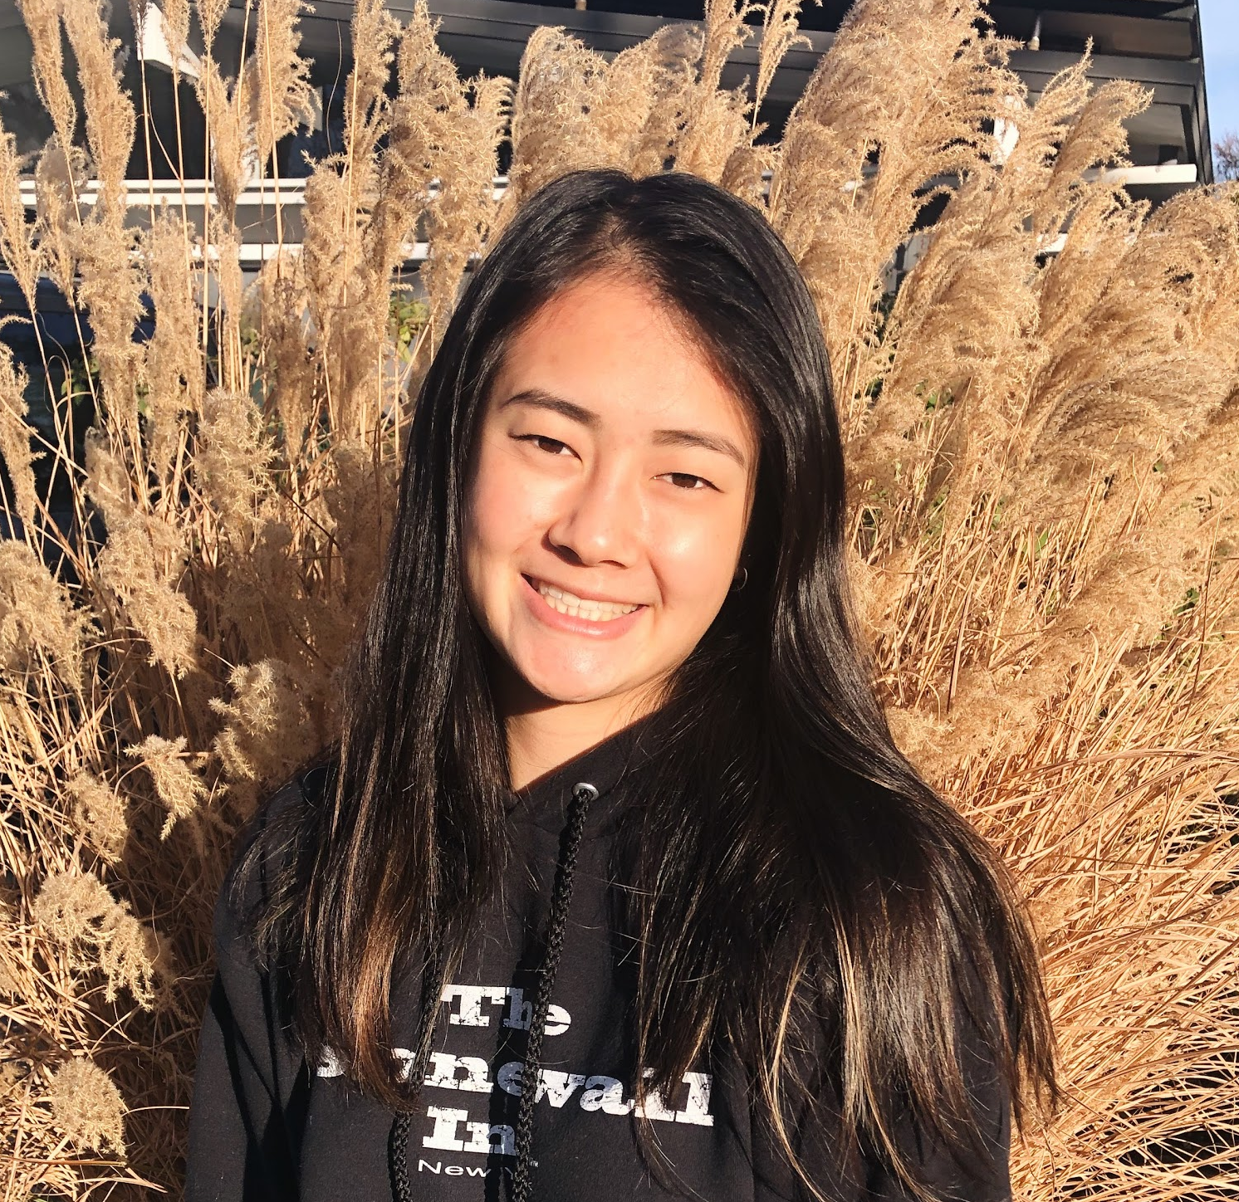
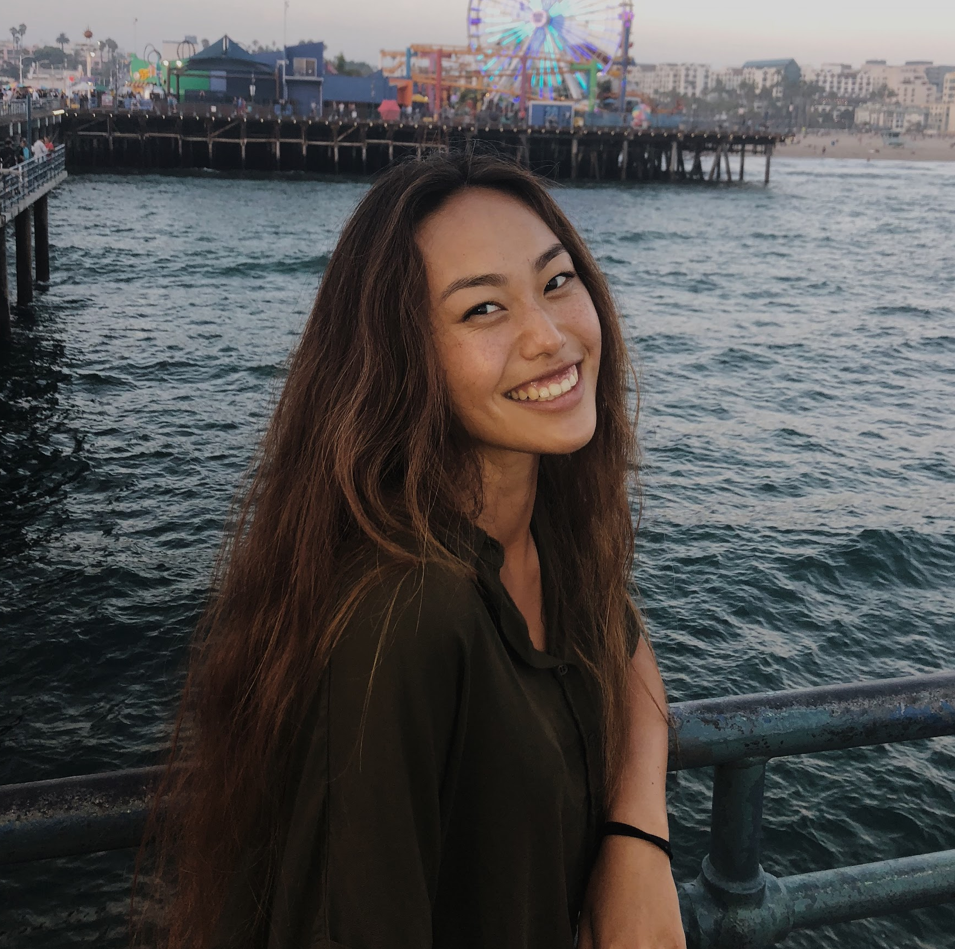
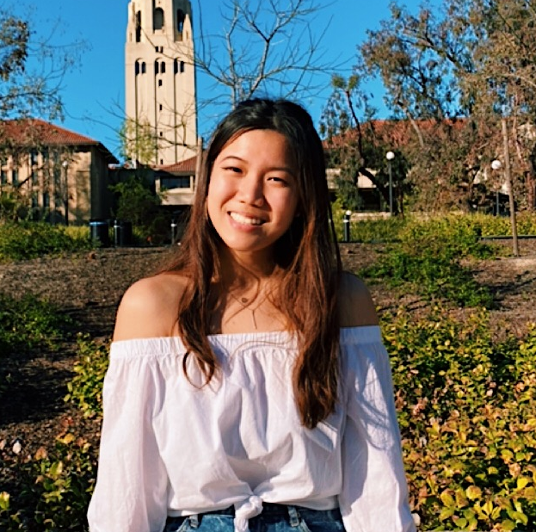
Katrina L
Rachel L
Grace Z
Anthony X

Slide 3
Mission Statement
Notes:
We met Andrew
We were amazed to learn about how the school organizes walk to school days. Parents add their address to a map and coordinate walking to school with peers who live close by.
It would be game changing to broaden/ expand this to more than just elementary school children

Slide 4
Technology has made it incredibly easy to live a sedentary lifestyle and lose awareness of the environment around us.
This lack of environmental education and care towards nature makes it difficult for individuals to take action to live sustainably.

Slide 5
Technology has made it incredibly easy to live a sedentary lifestyle and lose awareness of the environment around us.
This lack of environmental education and care towards nature makes it difficult for individuals to take action to live sustainably.
we hope barefoot can help people foster a deeper connection with the outdoors by immersing them in nature with contextual learning...

Slide 6
Technology has made it incredibly easy to live a sedentary lifestyle and lose awareness of the environment around us.
This lack of environmental education and care towards nature makes it difficult for individuals to take action to live sustainably.
we hope barefoot can help people foster a deeper connection with the outdoors by immersing them in nature with contextual learning…
one step at a time

Slide 7
Overview
Notes:
We met Andrew
We were amazed to learn about how the school organizes walk to school days. Parents add their address to a map and coordinate walking to school with peers who live close by.
It would be game changing to broaden/ expand this to more than just elementary school children

Slide 8
TASKS
REVISED INTERFACE
MED-FI TASK FLOWS
PROTOTYPE OVERVIEW

Slide 9
Tasks
Notes:
We met Andrew
We were amazed to learn about how the school organizes walk to school days. Parents add their address to a map and coordinate walking to school with peers who live close by.
It would be game changing to broaden/ expand this to more than just elementary school children

Slide 10
Simple: Follow previously published trails by other app users
Moderate: Explore and learn about nature in context
Complex: Publish your own trail
Moderate: Invite friends directly to follow your trail

Slide 11
Revised Interface
Notes:
We met Andrew
We were amazed to learn about how the school organizes walk to school days. Parents add their address to a map and coordinate walking to school with peers who live close by.
It would be game changing to broaden/ expand this to more than just elementary school children

Slide 12
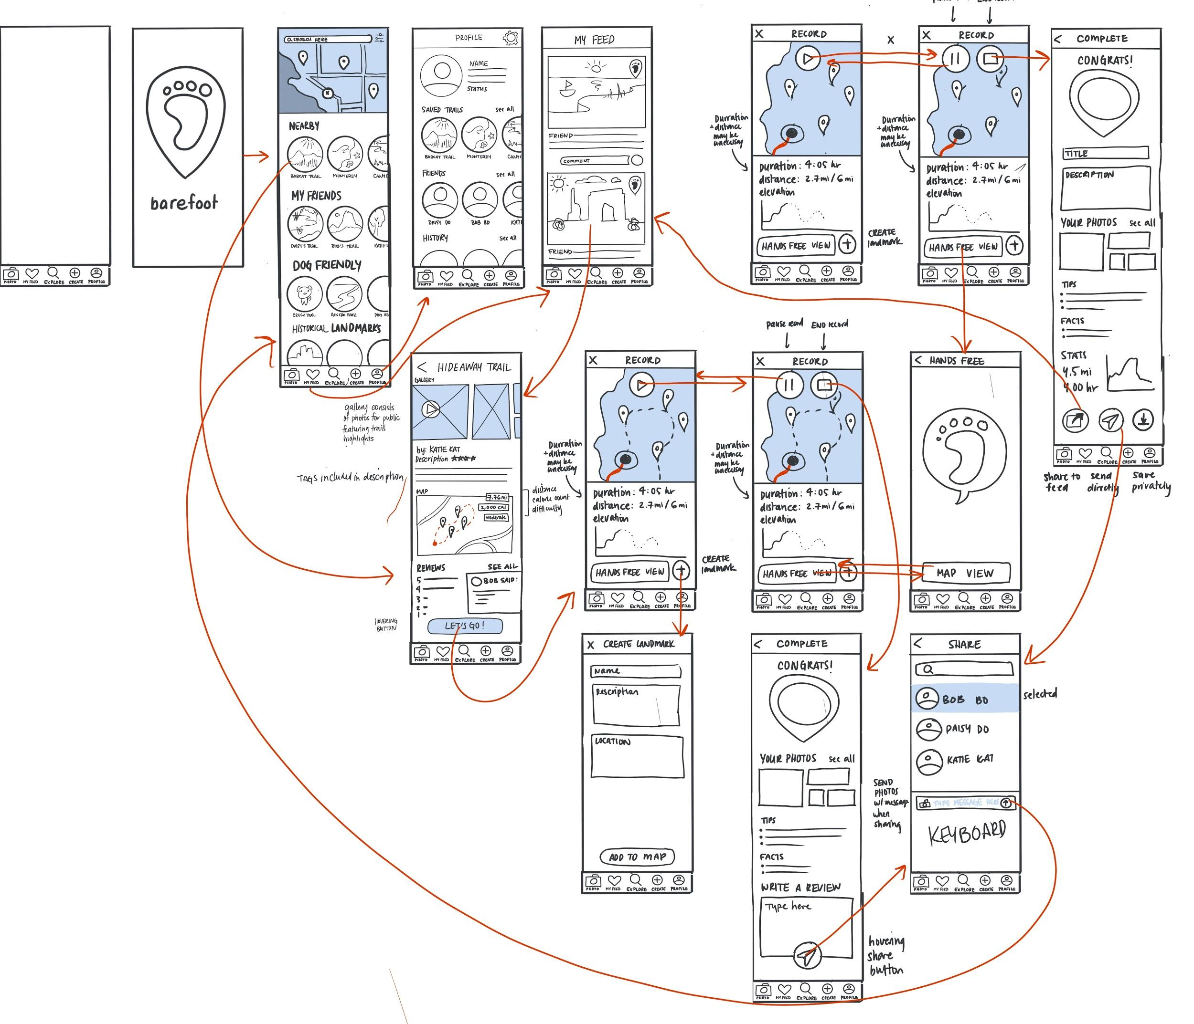
OUR NEW STORYBOARD

Slide 13
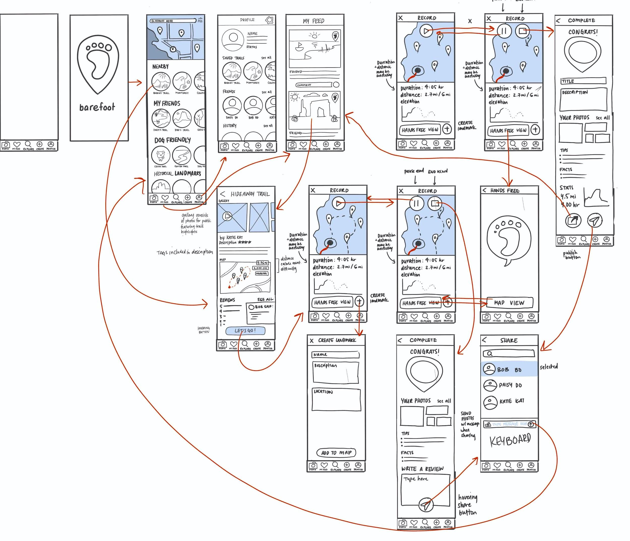
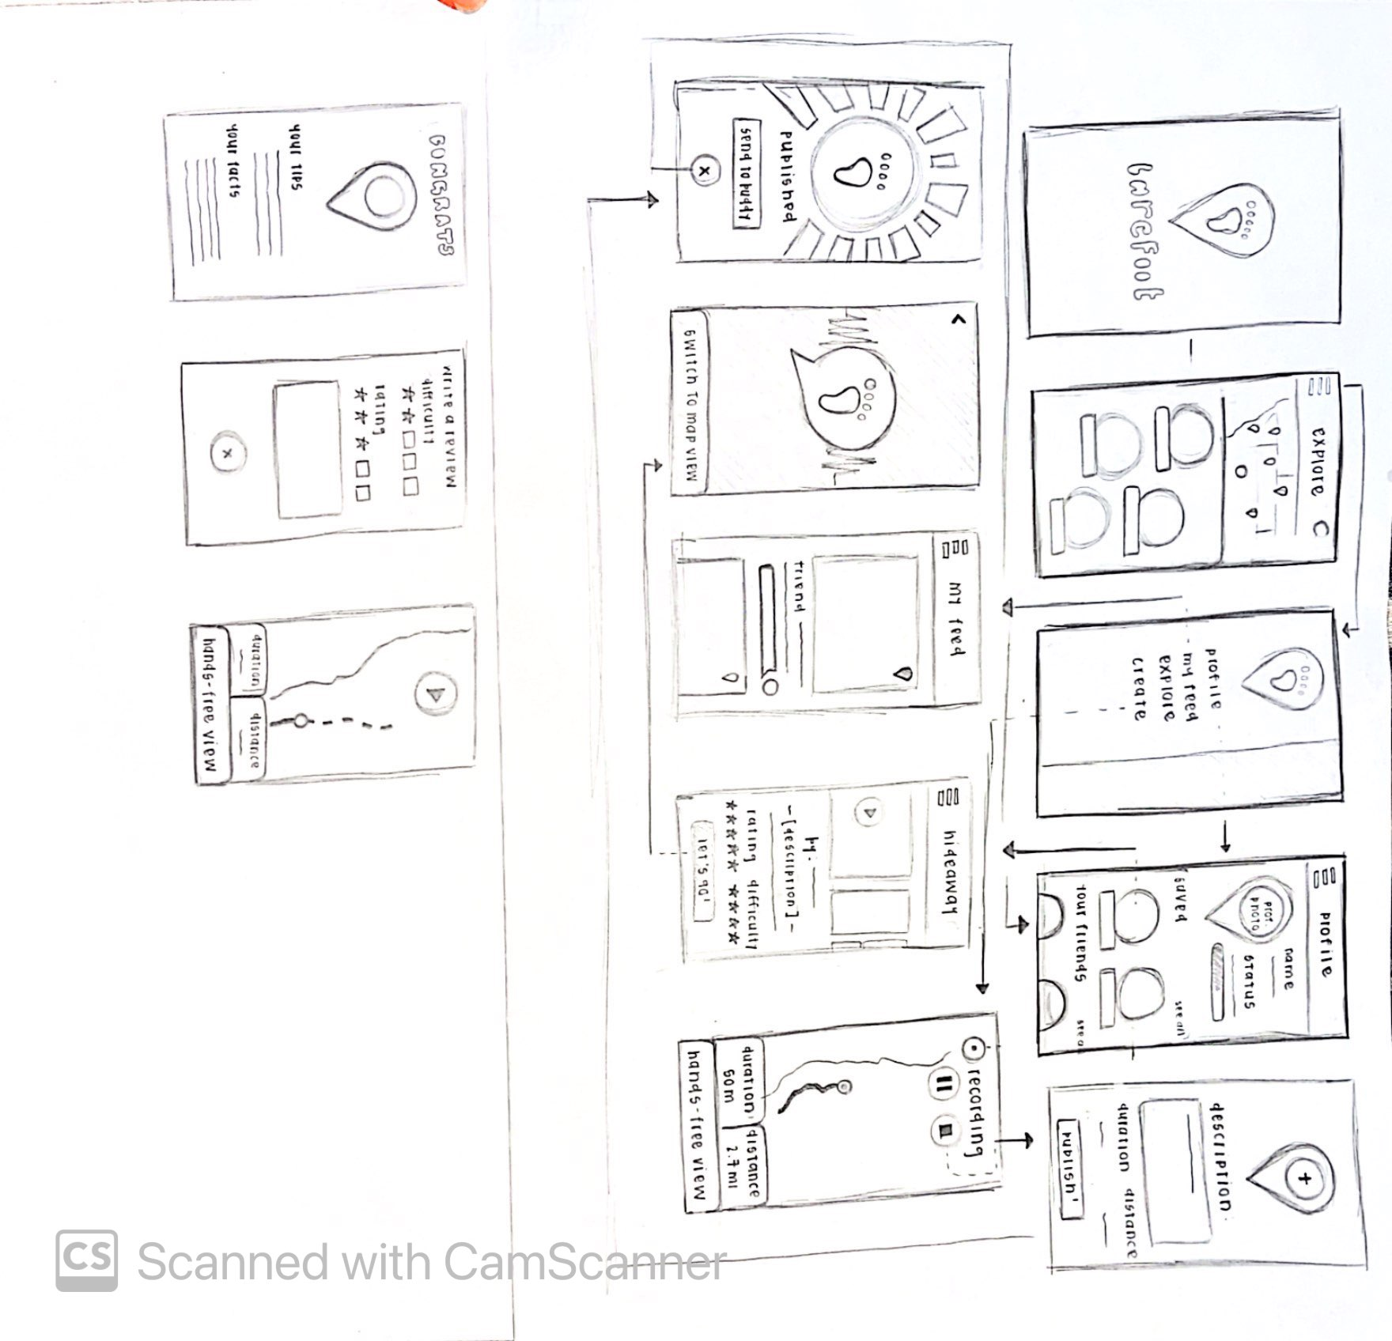
Design Change #1: Menu Bar
Before:
After:

Slide 14
Design Change #1: Menu Bar
Before:
Too many steps required to navigate between screens
No way to go back to previous screens
Slide-out screen disrupts from usage
After:
Replaced with static task bar
More intuitive and familiar for users, especially for app
Allows easy navigation anytime
More seamlessly integrated

Slide 15
Design Change #1: Menu Bar
Rationale:
We encountered significant confusion across the majority of users about how to navigate through the app with the original menu.
Having to essentially open new screen every time the menu was clicked became frustrating
This allows users to start each task more seamlessly
The placement is also easier physically
We figured this familiar taskbar (reminiscent of apps like FB/insta) would decrease friction to using app and completing tasks

Slide 16
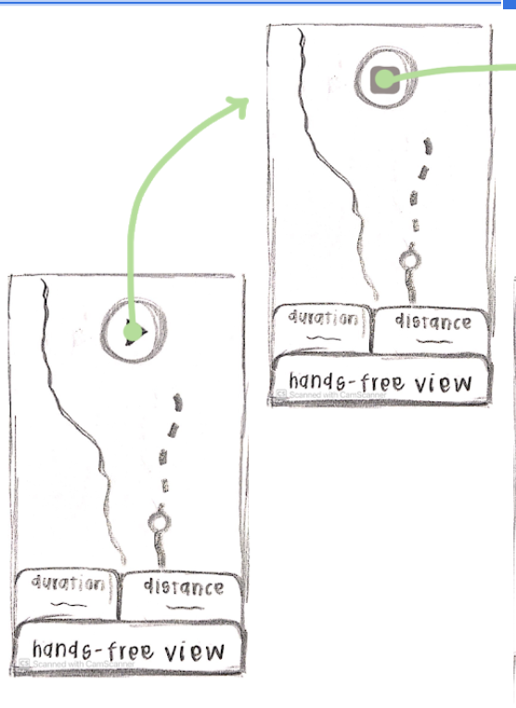
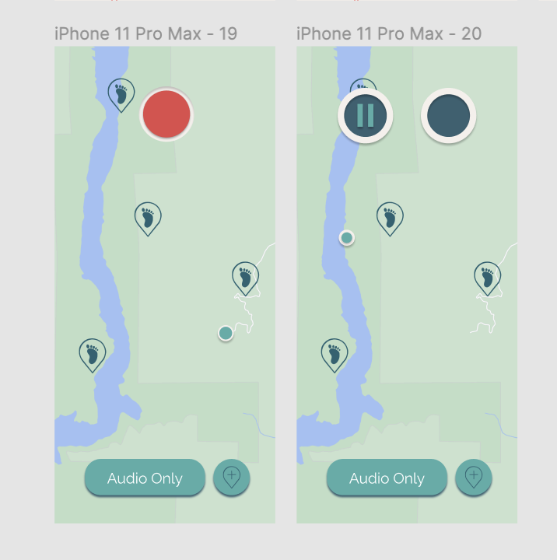
Design Change #2: Pause Button
Before:
After:

Slide 17
Design Change #2: record/pause Button
Before:
Function of single floating play button was unclear
No additionally metrics such as time/distance traveled while recording
After:
Having an explicit record button helps mitigate confusion over recording vs starting trail
Allows users to be in control of how much of the trail they want recorded

Slide 18
Design Change #2: record/pause Button
Rationale:
We encountered confusion across the most users about whether the play button was to start following the trail and navigation, or if it was to actually record the adventure.
Not all users wanted their entire trail to be recorded, and wanted an option to be able to control the tracking

Slide 19
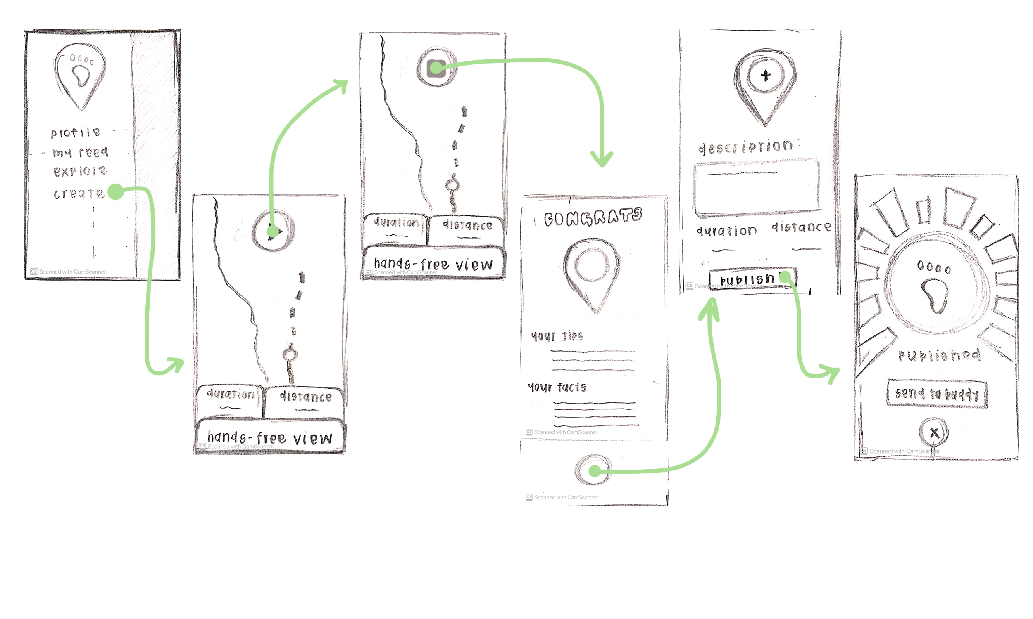
Design Change #3: Finish and Share
Before:
After:

Slide 20
Design Change #3: Finish and Share
Before:
Single-dimensional flow: had to finish and publish before presented with option to share with friends
Assumed that every finished trail would be published
Too many screens/steps
After:
Introduced 3 distinct options after completing trail: saving, sharing globally, sharing privately
Scrolling mechanism more intuitive and efficient than separate screens
Back buttons so that sharing is optional

Slide 21
Med-Fi Task Flows

Slide 22
Simple: Follow previously published trails by other app users

Slide 23
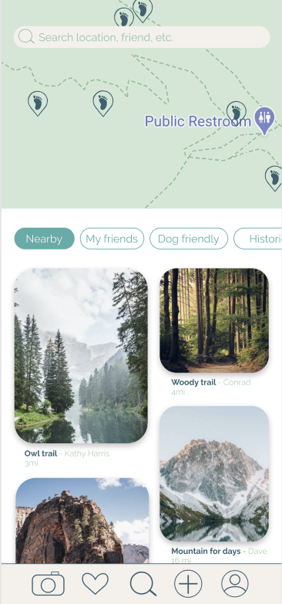
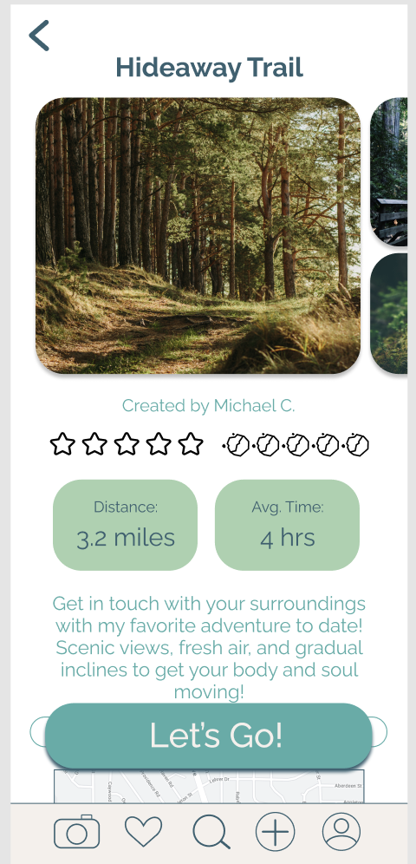
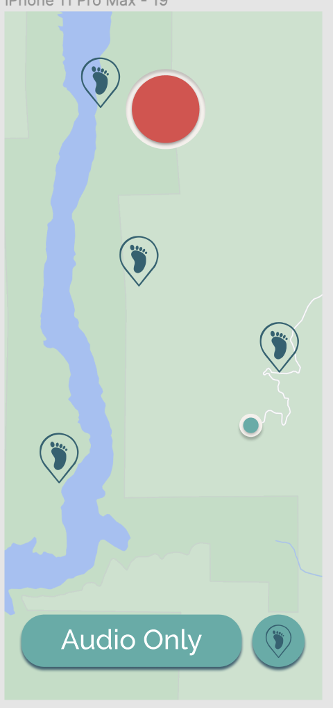
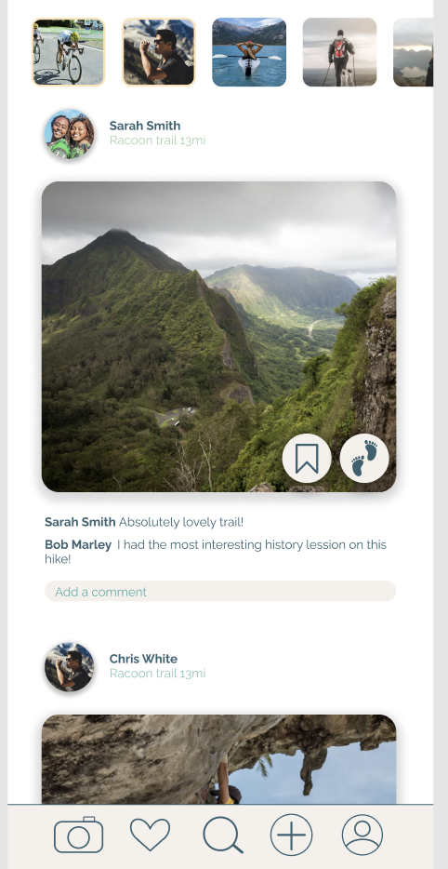
Explore page
Start recording trail page
Trail preview
Feed page
Navigate from either the explore or feed page!
Making following adventures easily accessible for all users

Slide 24
Simple: Follow previously published trails by other app users
Moderate: Explore and learn about nature in context

Slide 25

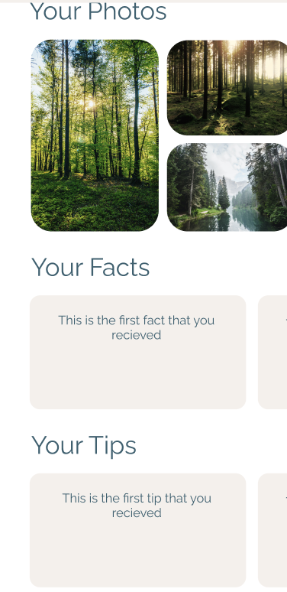
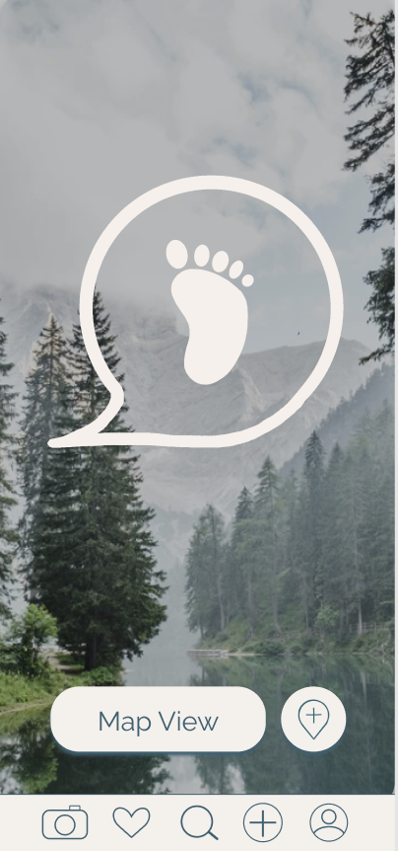
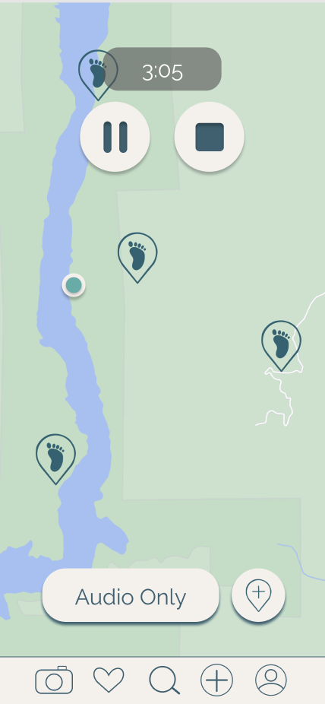
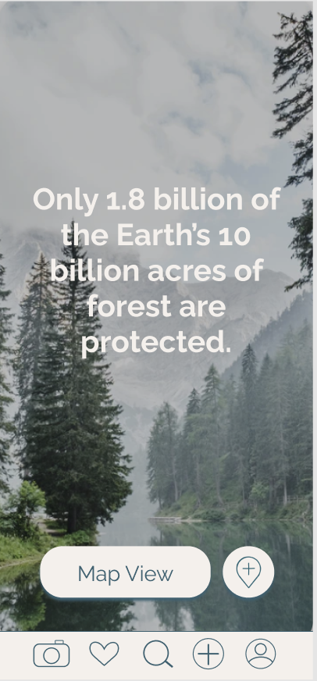
Giving people the feel of a “guided tour” through their surroundings
Start following a trail!
Finish and reflect on the journey!
Toggle to hands-free mode and listen to facts

Slide 26
Simple: Follow previously published trails by other app users
Moderate: Explore and learn about nature in context
Complex: Publish your own trail

Slide 27
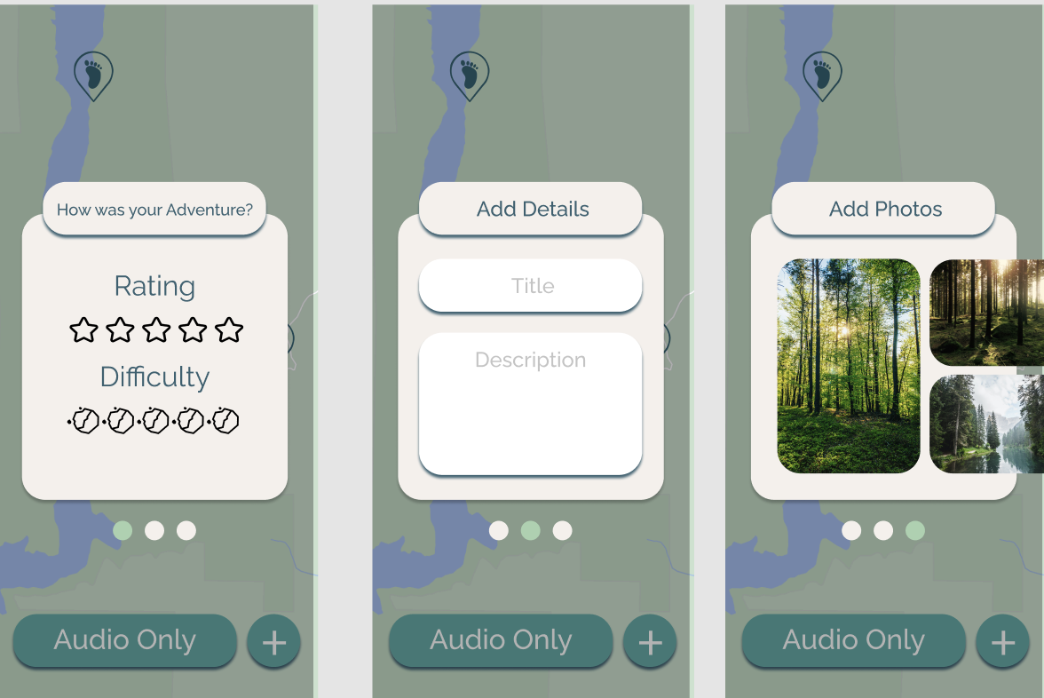
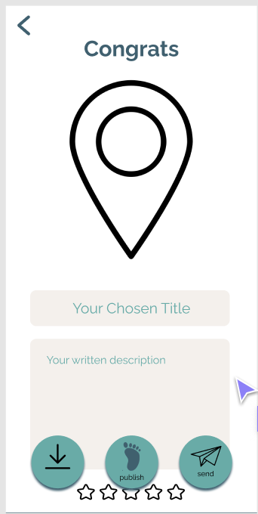
Easily add pictures, facts, and tags to your trail before sharing!
Enter create mode and record!
Share your newfound passions with others!

Slide 28
Simple: Follow previously published trails by other app users
Moderate: Explore and learn about nature in context
Complex: Publish your own trail
Moderate: Invite friends directly to follow your trail

Slide 29
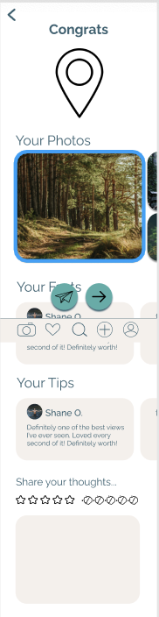
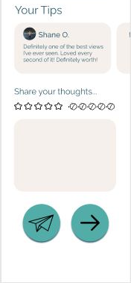
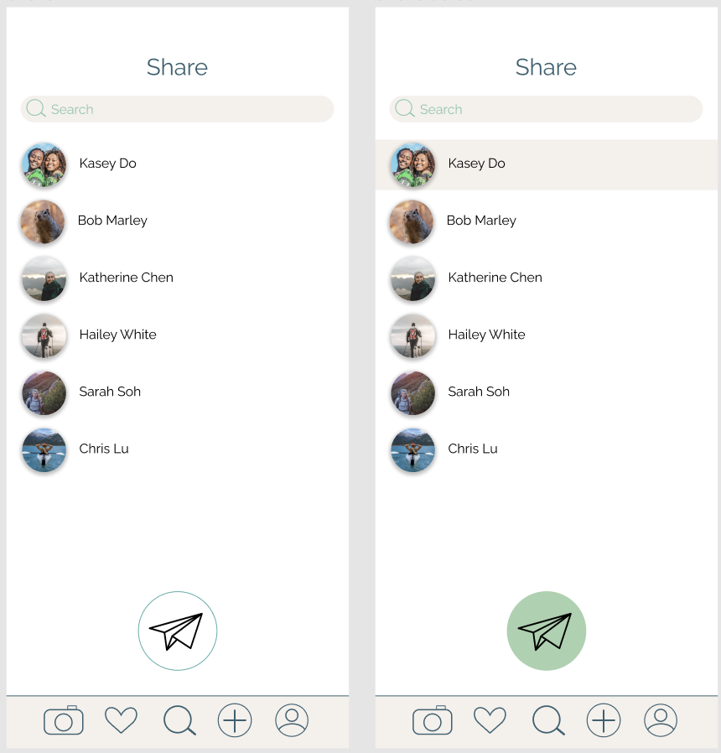
Spreading love for the outdoors with people who have yet to be reached
Finished trail page!
Select desired contacts
Two buttons: One to share and one to return to menu
Send trail directly!

Slide 30
Prototype Overview

Slide 31
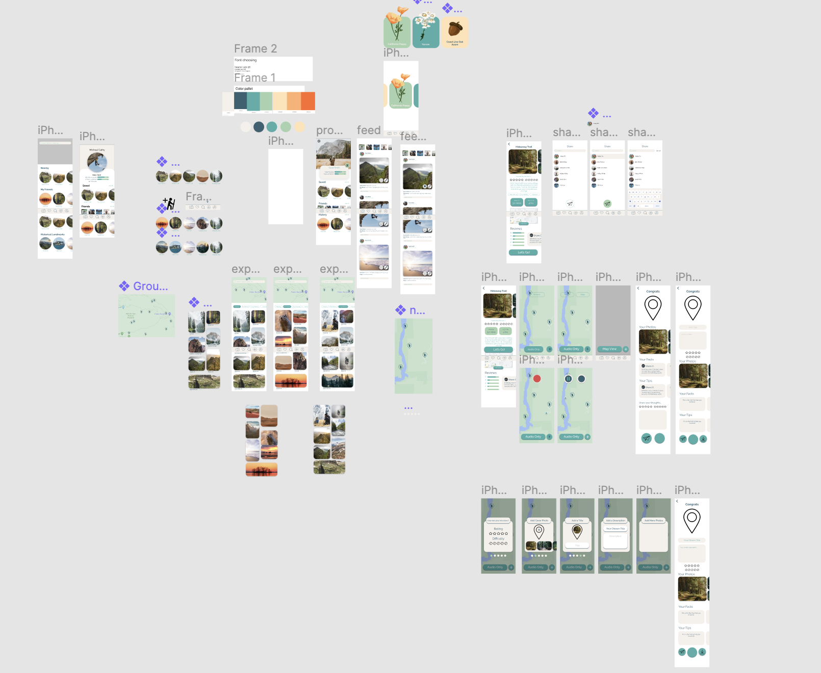
Interface
Medium-fi prototype made with Figma

Slide 32
Interface
Likes
Shared platform with real-time synced updates
Combination of design and prototyping
  Reusable components and styles
  Scrolling screens and overlays and popups
Dislikes
Individual wireframing: tedious
Many variations of the same screens
Prototyping became messy with all the connections
  Limited animations
Notes:
Menu ui clarity = issue with hamburger menu, & lack of

Slide 33
Limitations
Couldn’t store published trails in memory (including associated pictures, ratings, reviews, tags, etc.)
No access to location or camera functionality native to device
Viewing a specific friend’s posts and other profiles
No audio built in for education component
After publishing, no posting functionality
Notes:
Menu ui clarity = issue with hamburger menu, & lack of

Slide 34
Wizard of Oz
Upon starting a trail, facts would “pop up” based on the user’s location and movement
Upon sharing with a friend, the trail is assumed to be sent directly to the friend through the platform
For trail preview, app curates certain pictures for trail advertisement
Filter trail by category
Notes:
Menu ui clarity = issue with hamburger menu, & lack of

Slide 35
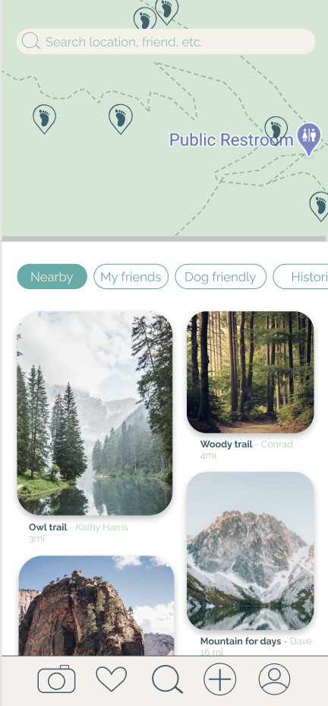
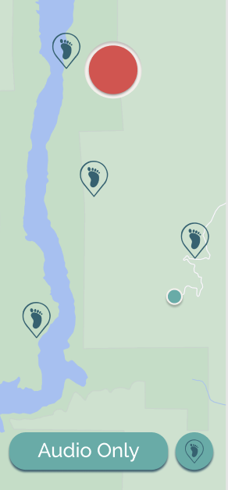
Hard-Coded Features
Landmarks and facts shown on map were hardcoded (because no access to location)
Trails shown in discover page, (should be based on location)
Initial profile info pre-loaded
Reviews pre-loaded
Map
Notes:
Menu ui clarity = issue with hamburger menu, & lack of

Slide 36
Appendix

Slide 37
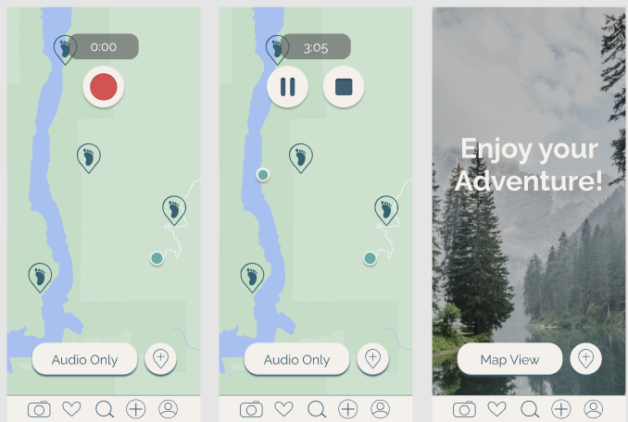

Slide 38
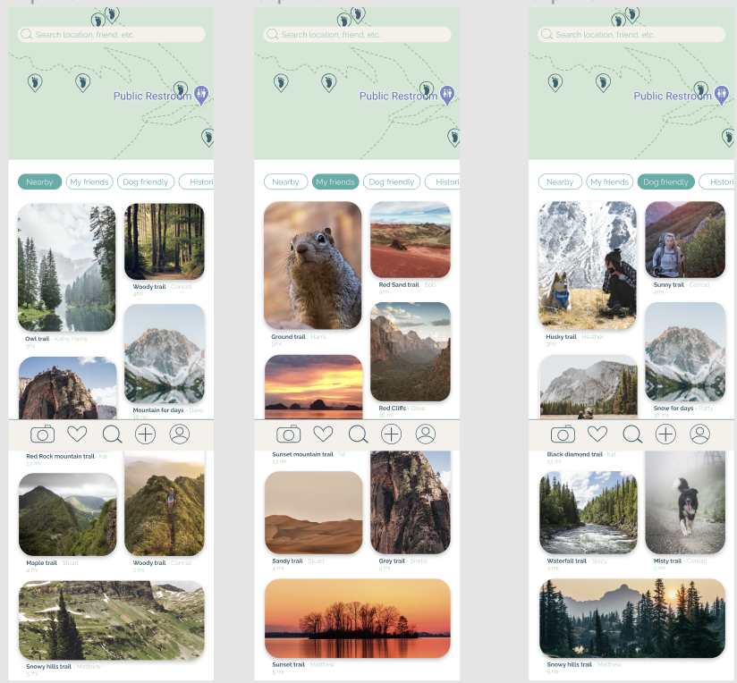

Slide 39
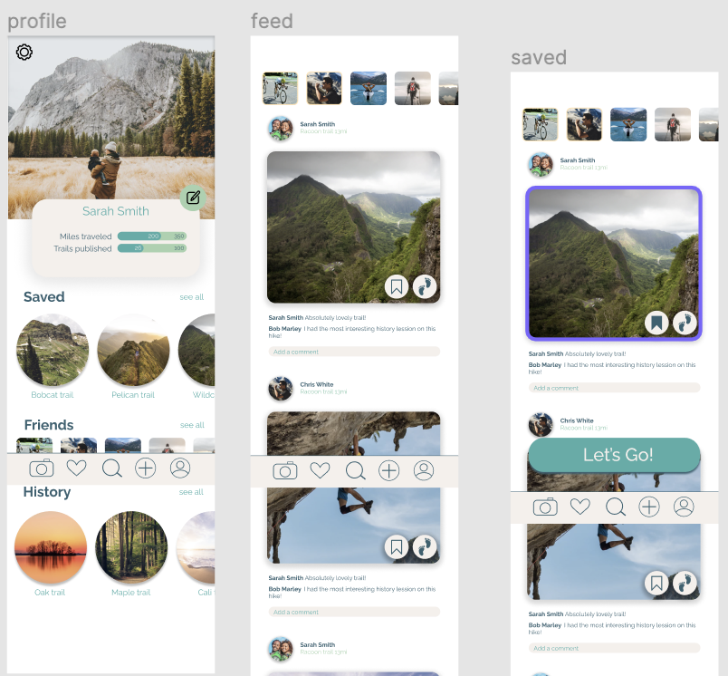

Slide 40
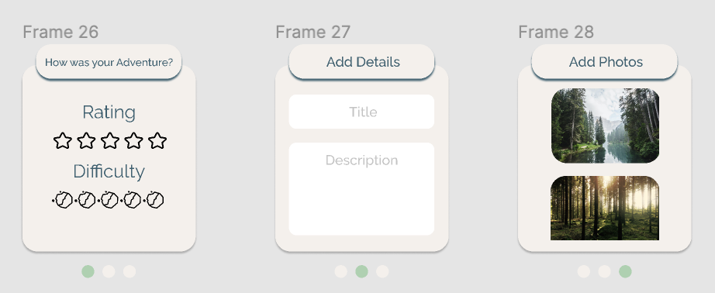
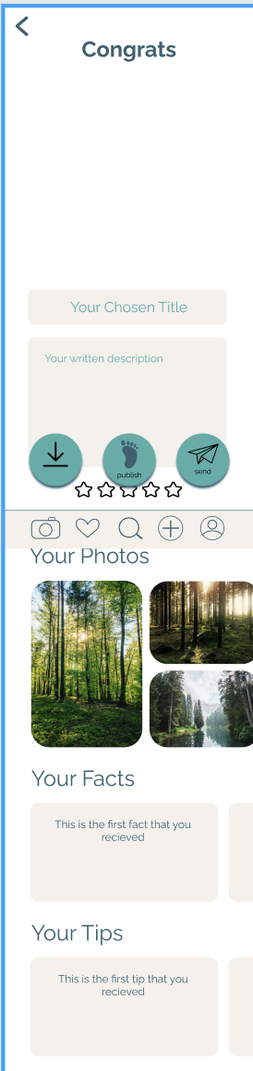

Slide 41
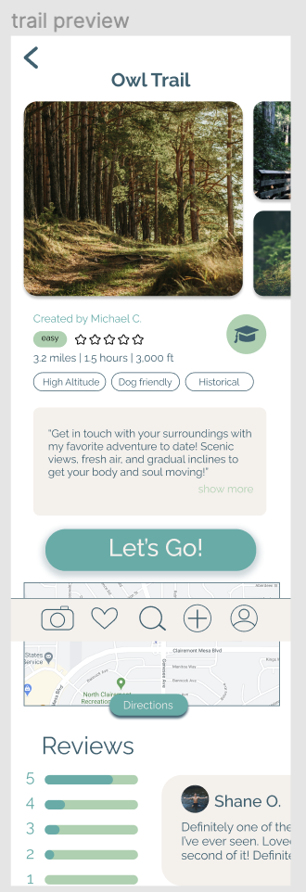

Slide 42
THE MENU BAR
Toggle between 5 different tabs
Camera
My feed
Explore
Create
Profile
RATIONALE:
For vertically oriented screens components should be stacked vertically
More accessible by thumb

Slide 43
The Pause button
More intuitive than just play and stop buttons

Slide 44
The Hiking Process
Landmarks visible on map to incentivize people to explore more
Ability to create landmarks
Added calories burned stat

Slide 45
Sharing Process
Creating a trail vs. following a trail
3 options:
Share to feed
Send directly
Save privately

Slide 46
Making it simple for people to share their newfound passions with others

Slide 47
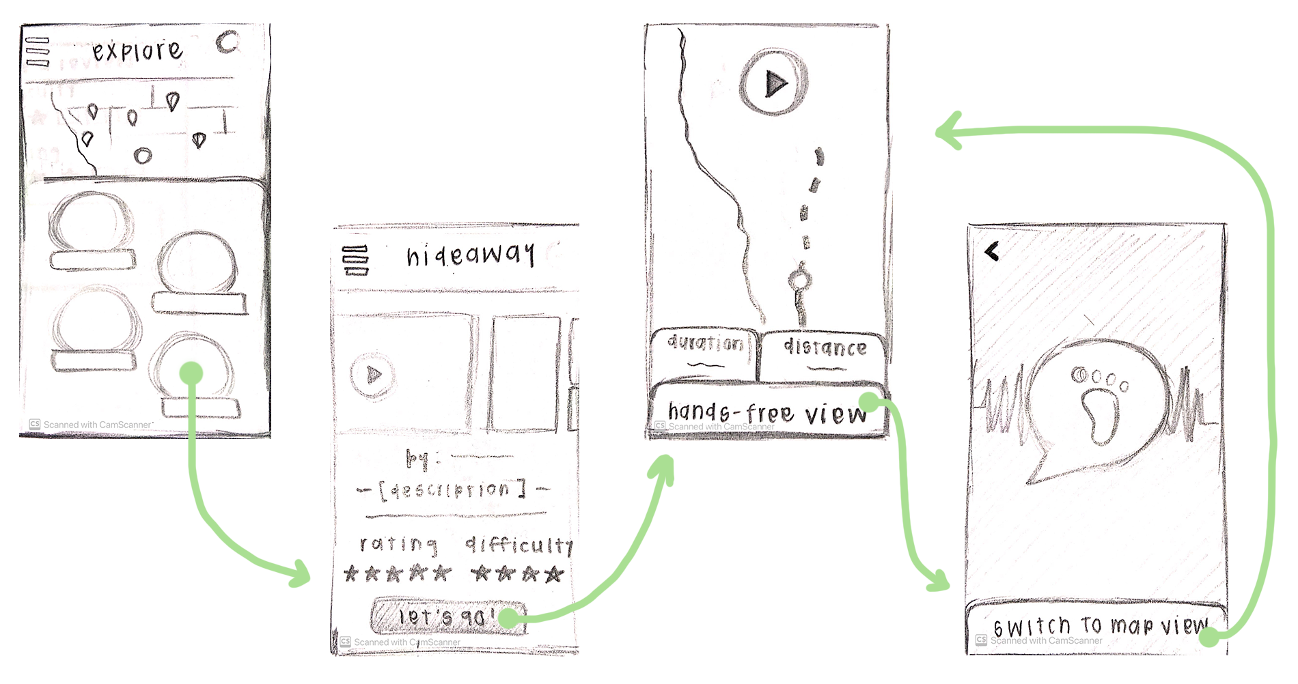
Giving people the feel of a “guided tour” through their surroundings

Slide 48
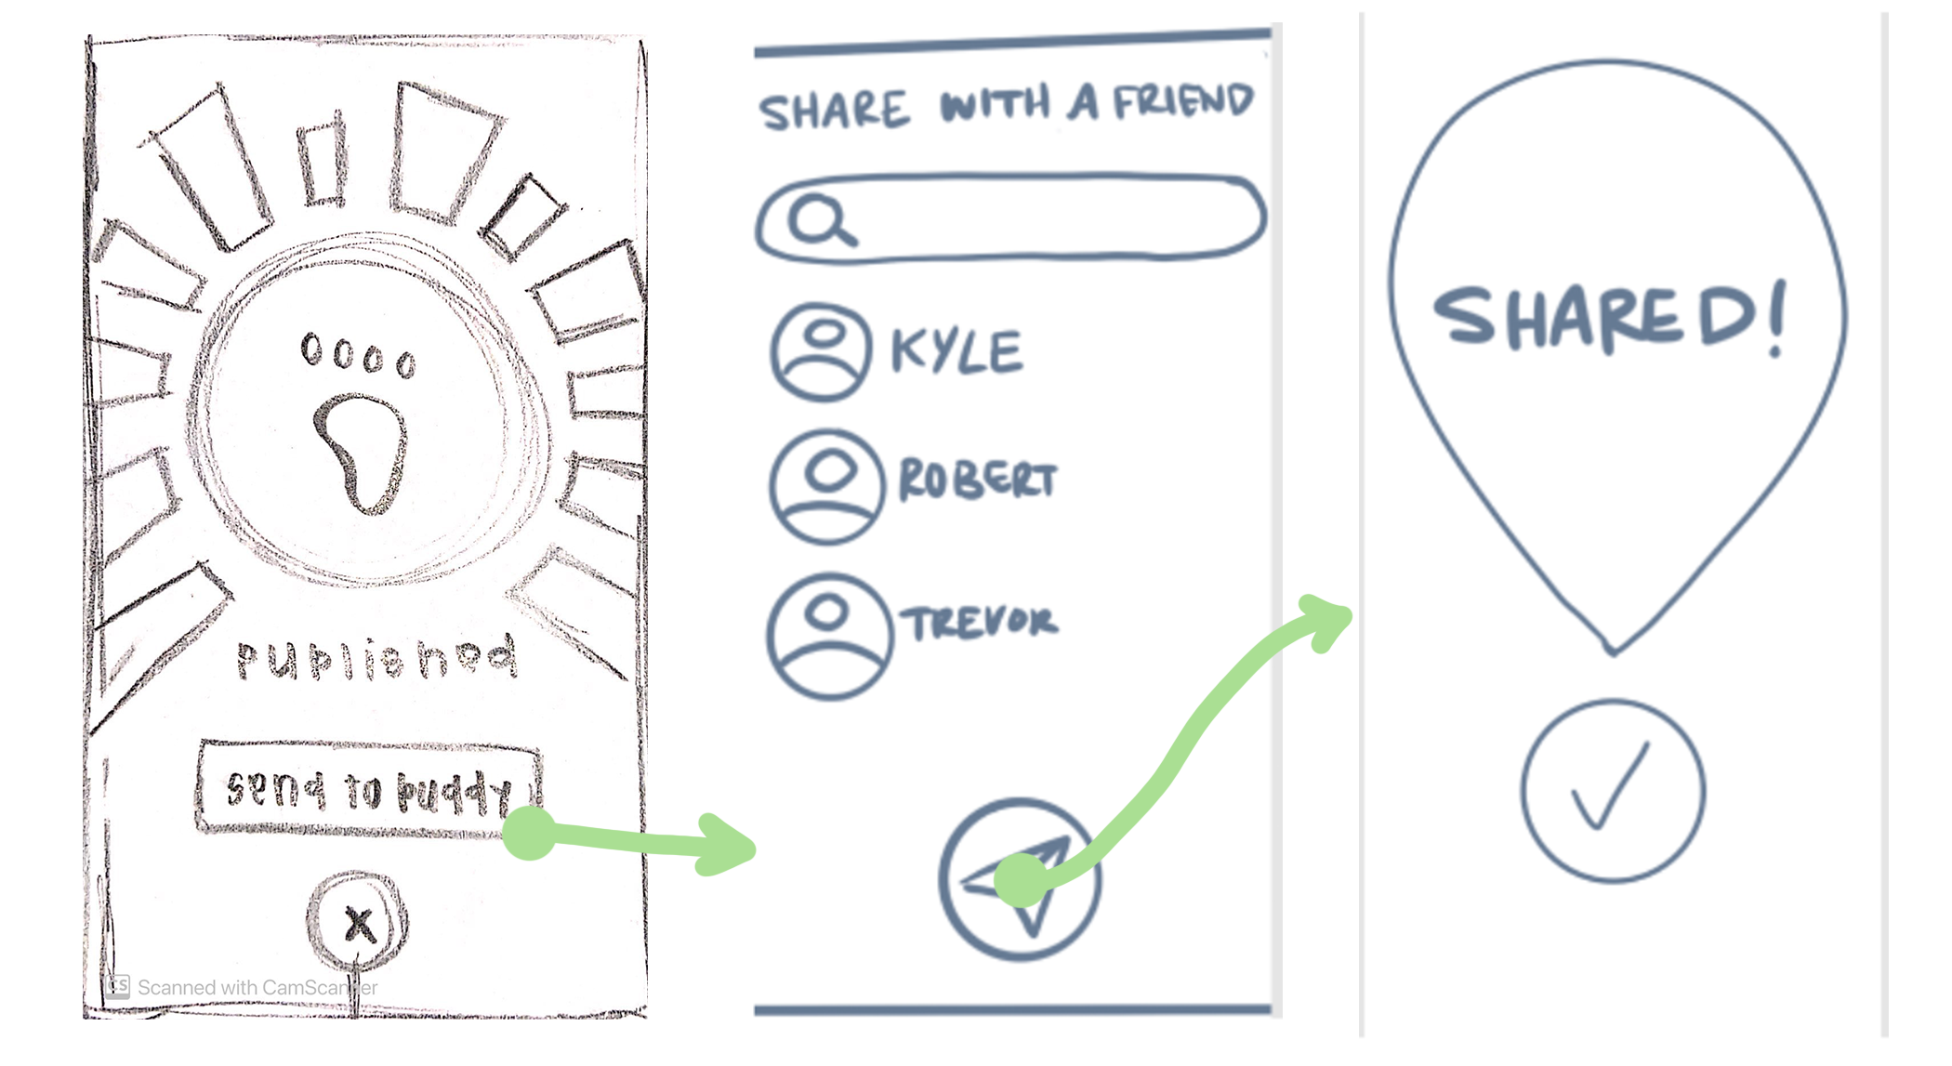
Spreading love for the outdoors with people who have yet to be reached

