Slide 1

barefoot
one step at a time
Notes:
The world is at your doorstep
We have a world to see
Meet the world
Where your journey begins
Walk the earth
One step at a time

Slide 2
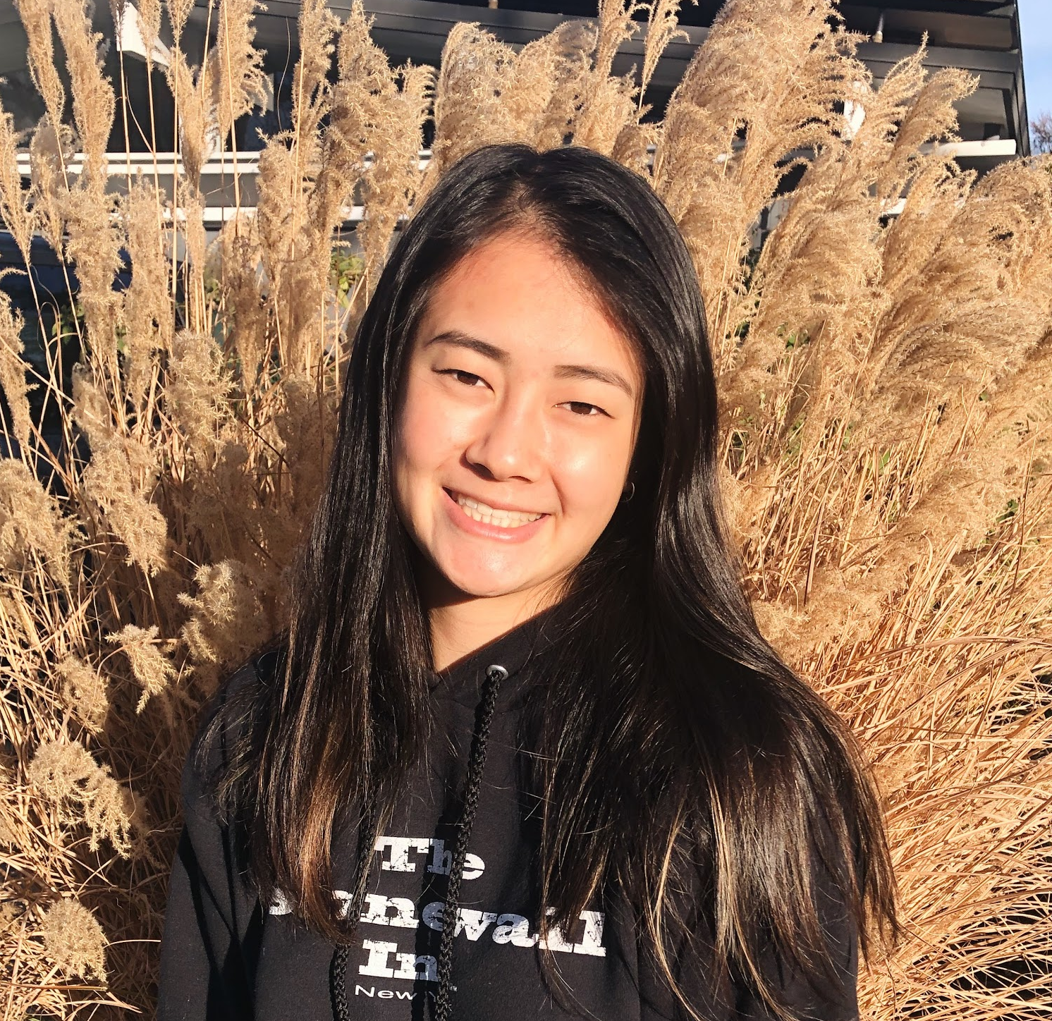
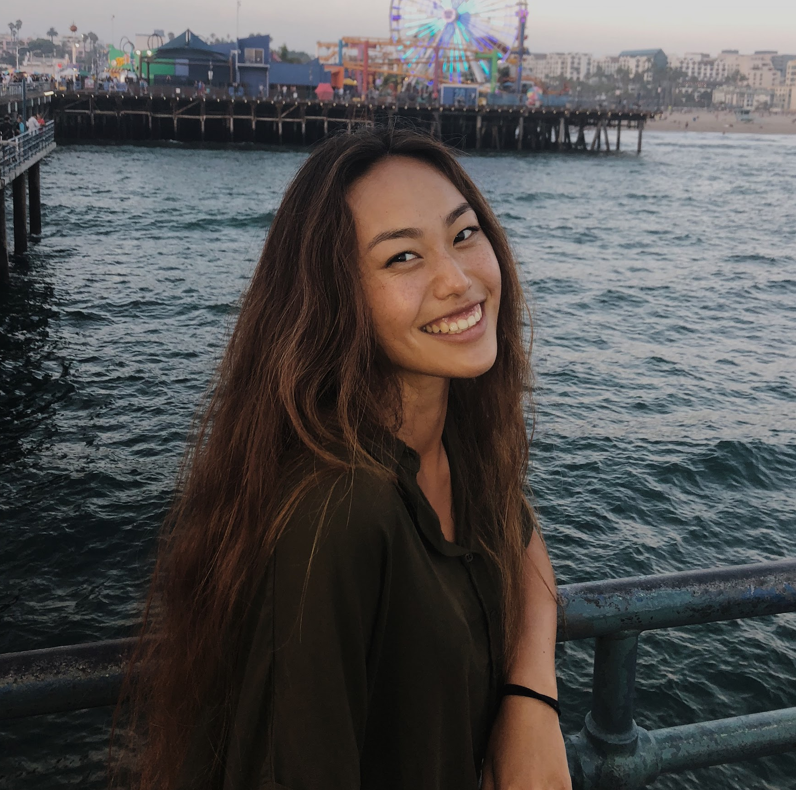
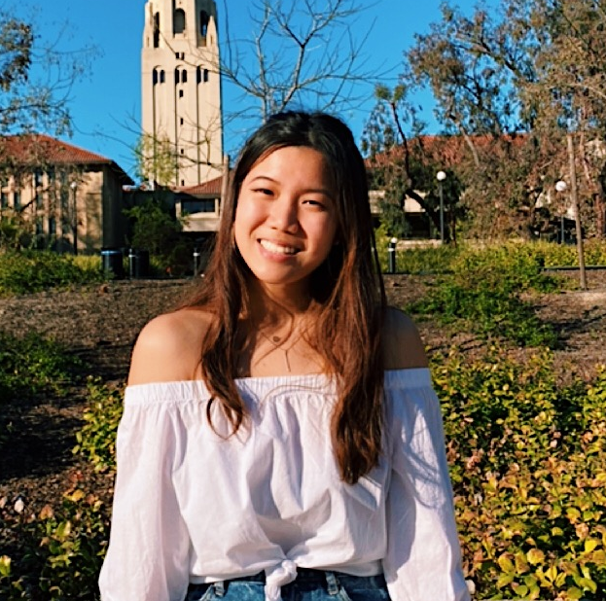
Katrina L
Rachel L
Grace Z
Anthony X

Slide 3
Overview
Notes:
We met Andrew
We were amazed to learn about how the school organizes walk to school days. Parents add their address to a map and coordinate walking to school with peers who live close by.
It would be game changing to broaden/ expand this to more than just elementary school children

Slide 4
SKETCHES +
STORYBOARDS
LOW-FI PROTOTYPE
TESTING + RESULTS
CHANGES + SUMMARY

Slide 5
Mission Statement
Notes:
We met Andrew
We were amazed to learn about how the school organizes walk to school days. Parents add their address to a map and coordinate walking to school with peers who live close by.
It would be game changing to broaden/ expand this to more than just elementary school children

Slide 6
Technology has made it incredibly easy to live a sedentary lifestyle and lose awareness of the environment around us.
This lack of environmental education and care towards nature makes it difficult for individuals to take action to live sustainably.

Slide 7
Technology has made it incredibly easy to live a sedentary lifestyle and lose awareness of the environment around us.
This lack of environmental education and care towards nature makes it difficult for individuals to take action to live sustainably.
...we hope barefoot can help people foster a deeper connection with the outdoors by immersing them in nature with contextual learning.

Slide 8
Initial Sketches
Notes:
We met Andrew
We were amazed to learn about how the school organizes walk to school days. Parents add their address to a map and coordinate walking to school with peers who live close by.
It would be game changing to broaden/ expand this to more than just elementary school children

Slide 9
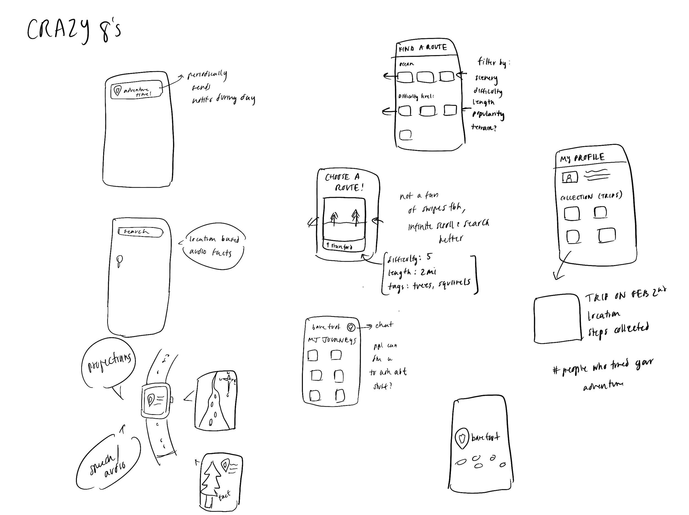
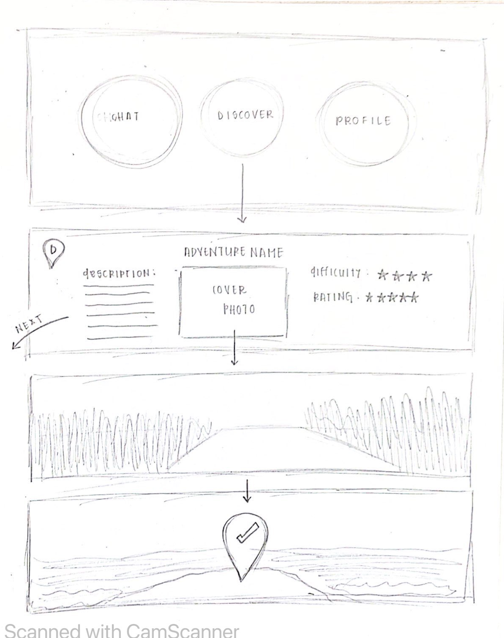
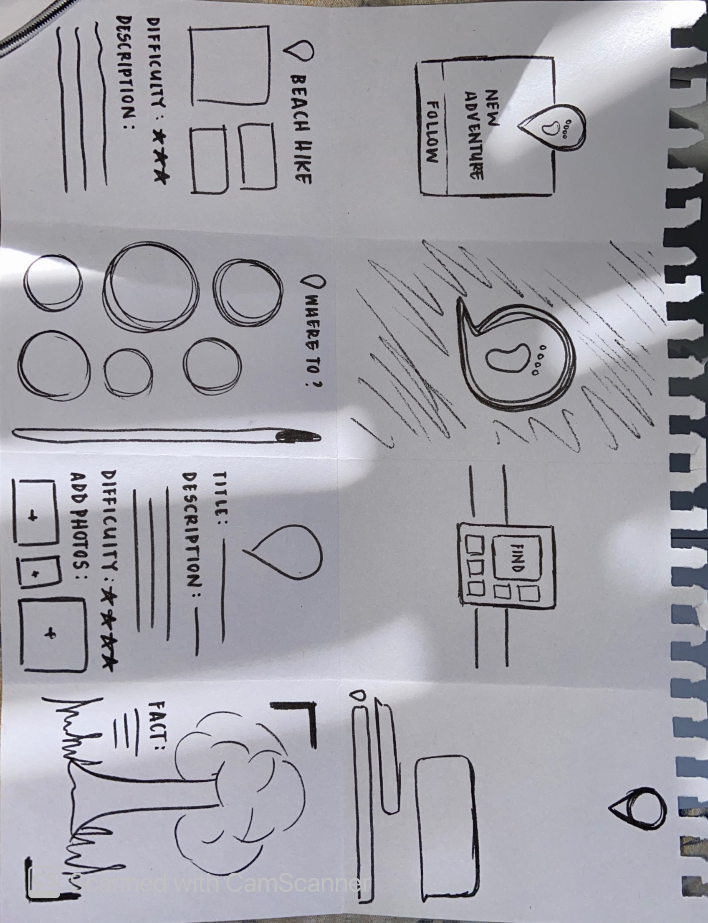
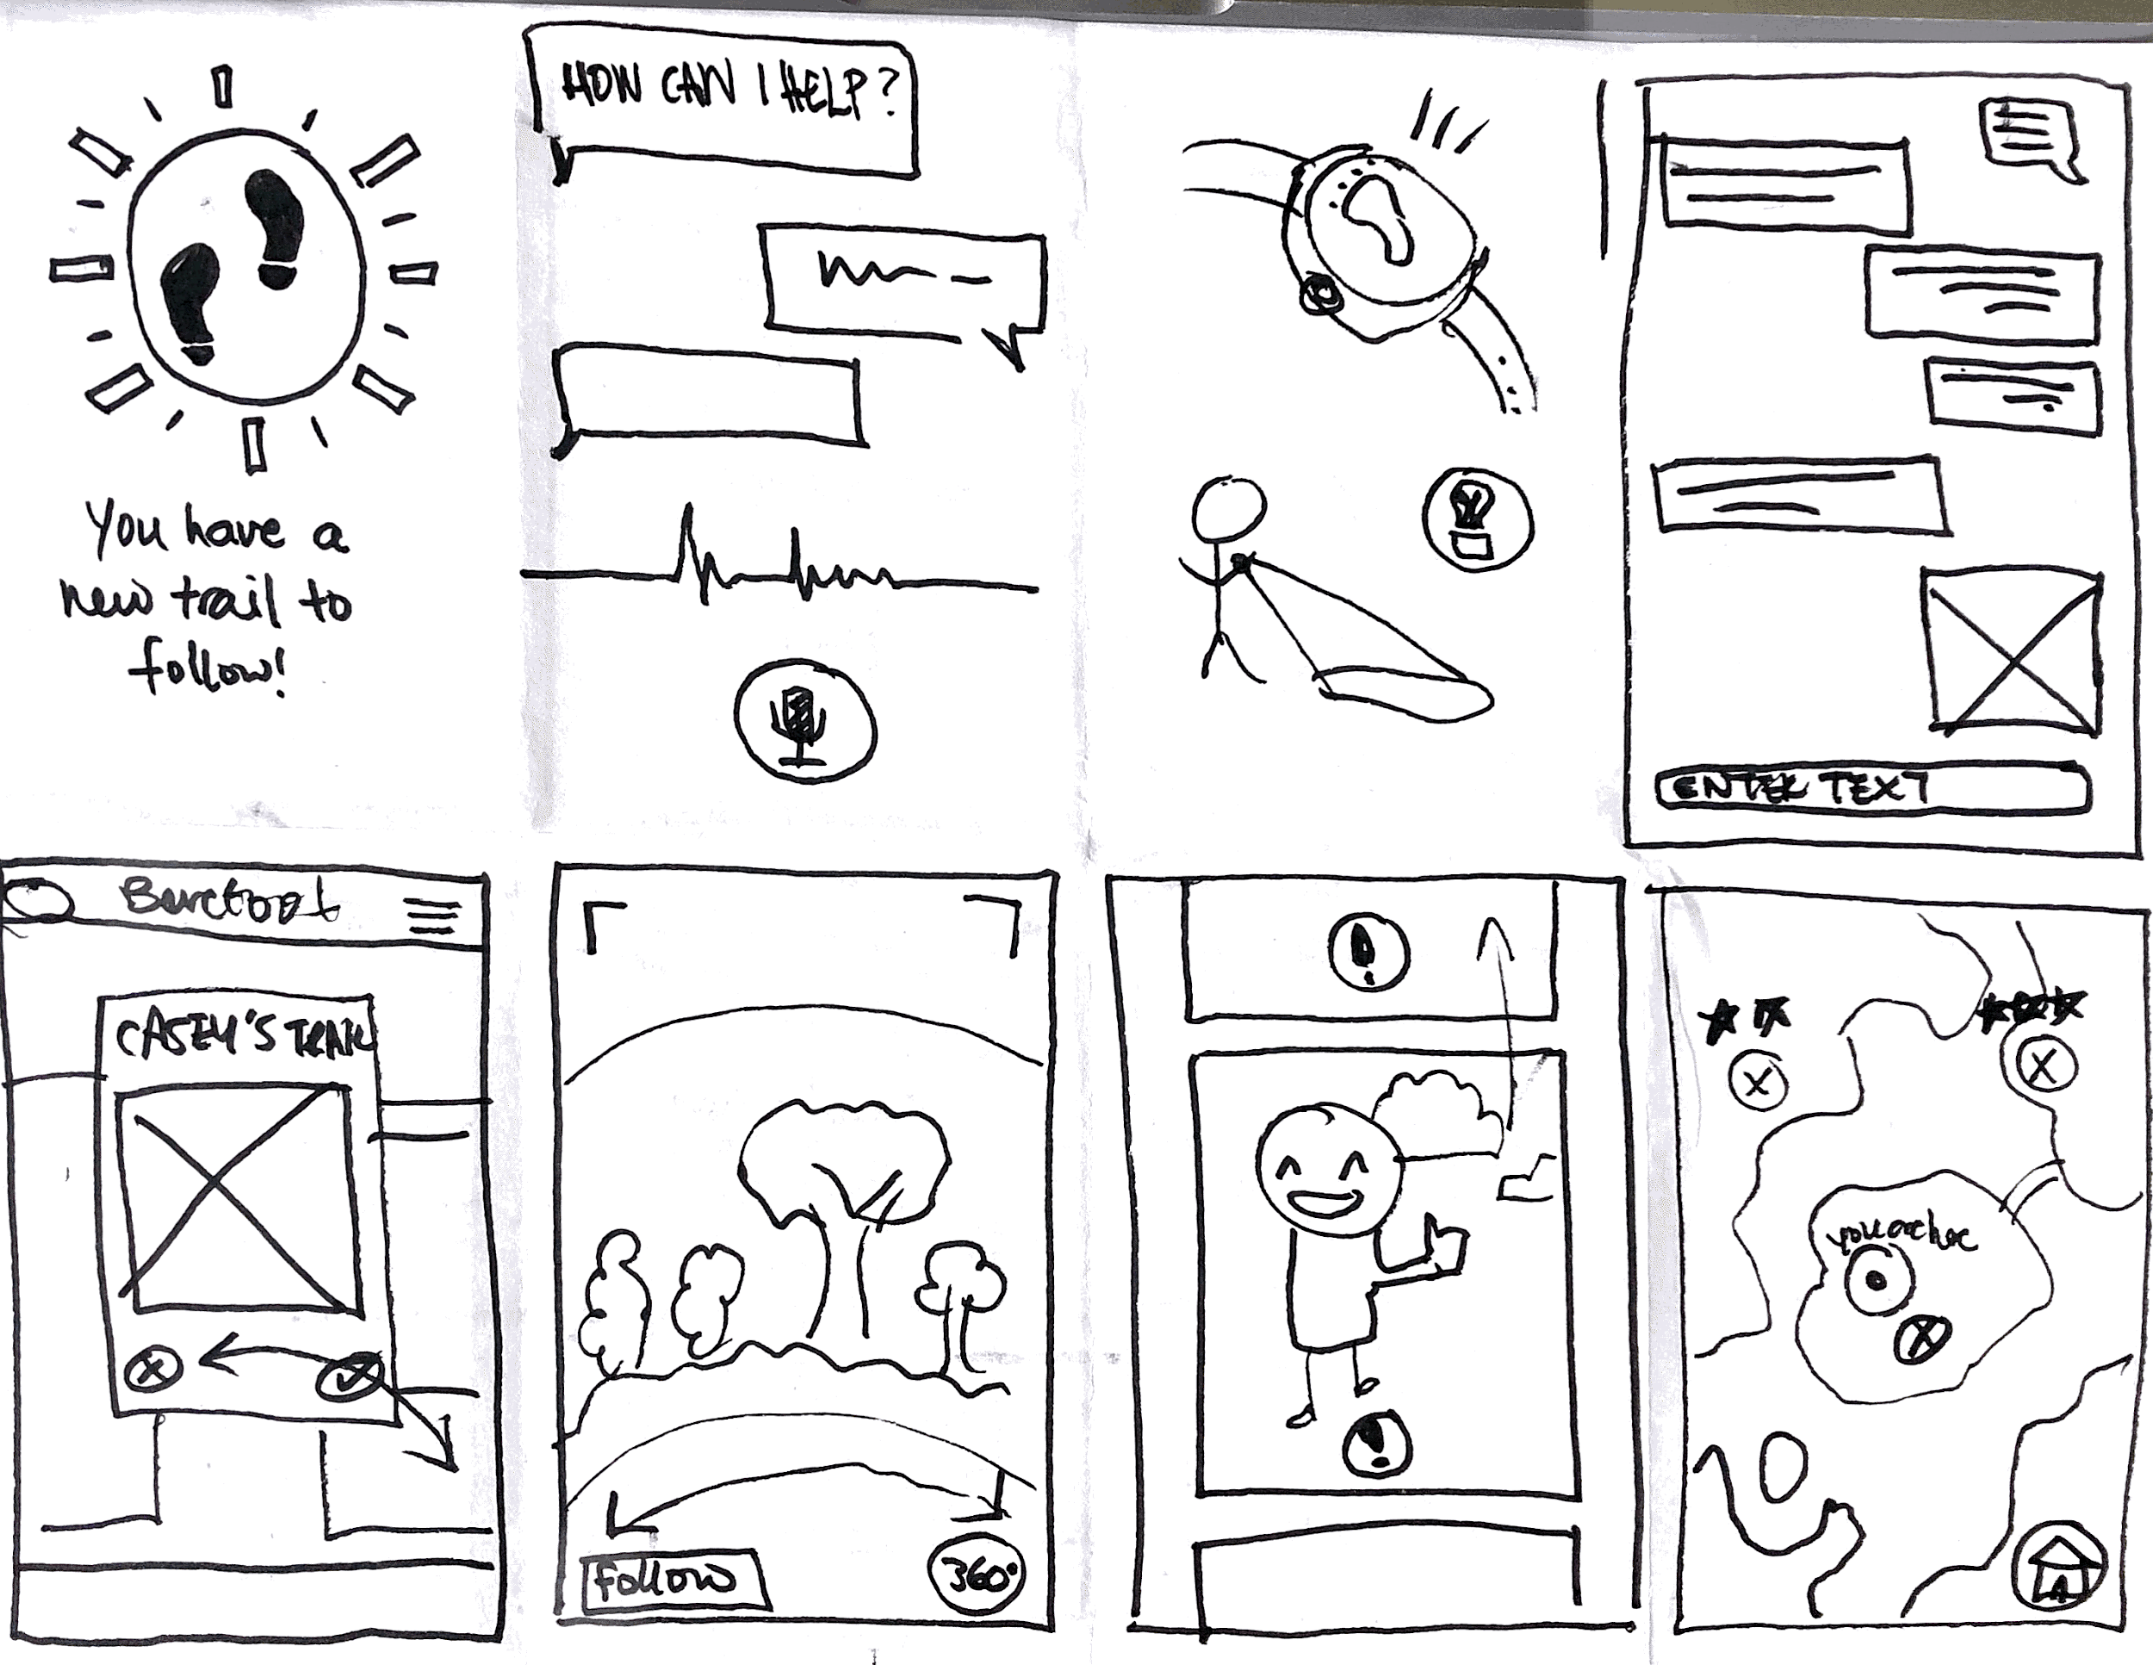
Mobile App
Virtual Reality

Slide 10
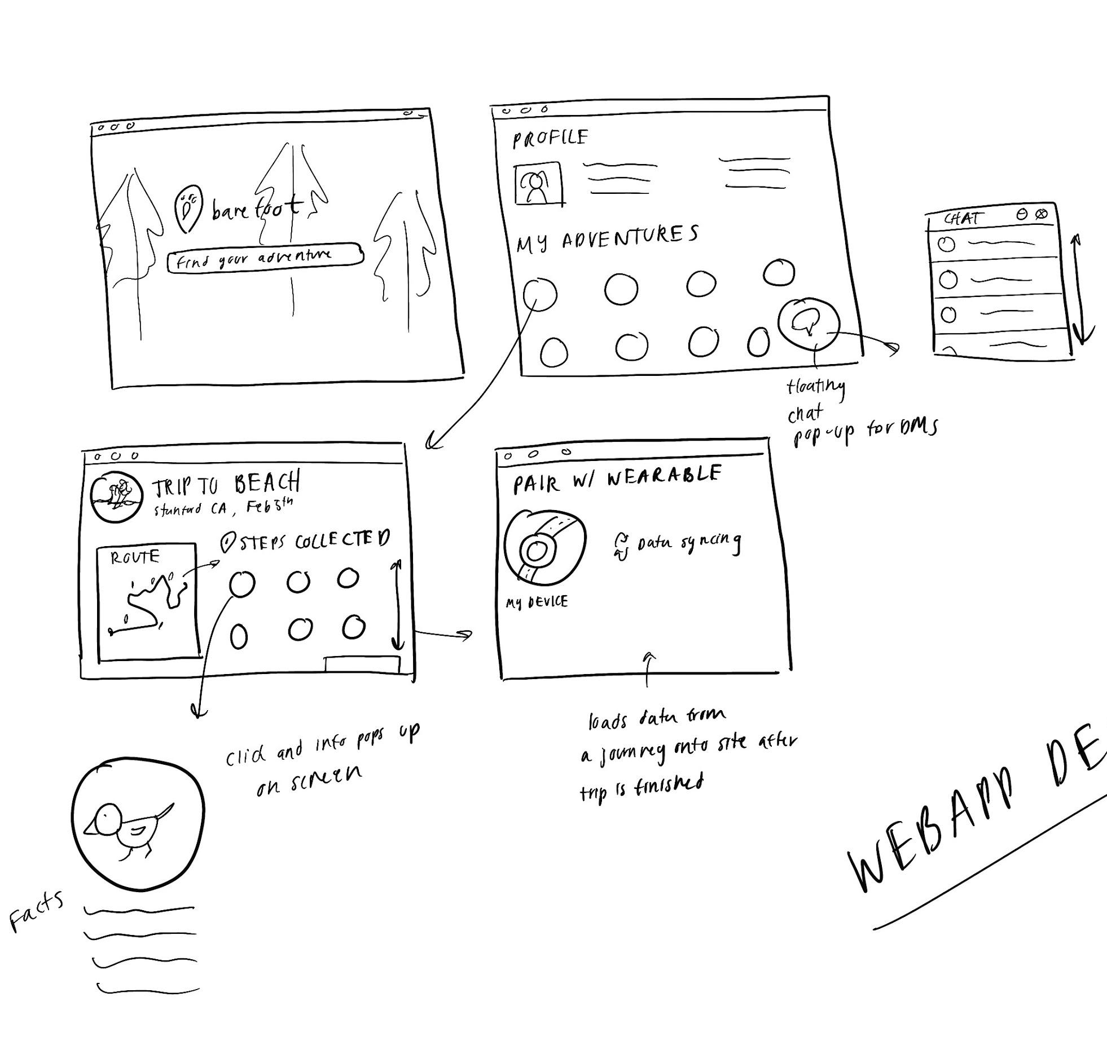
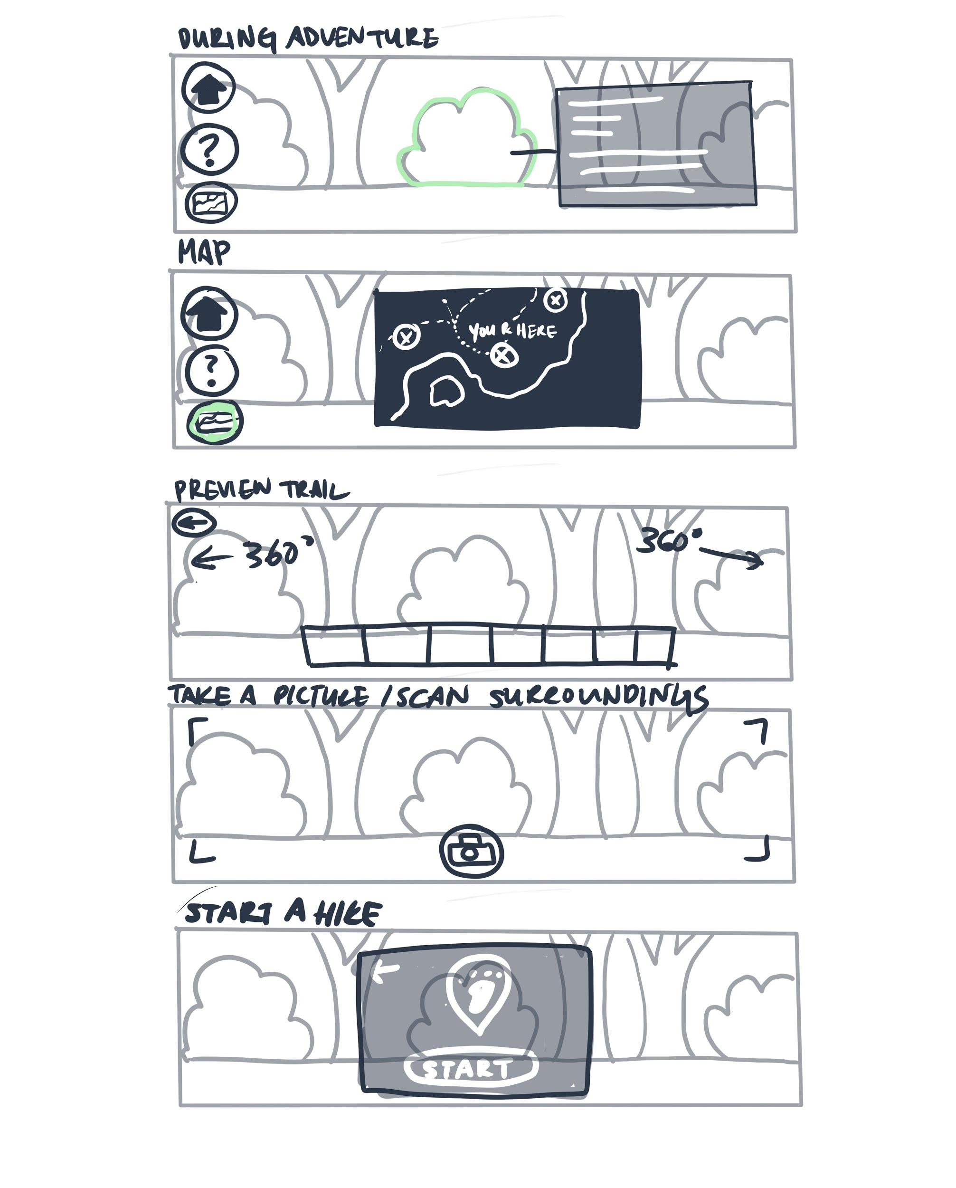
Web App
AR lens

Slide 11
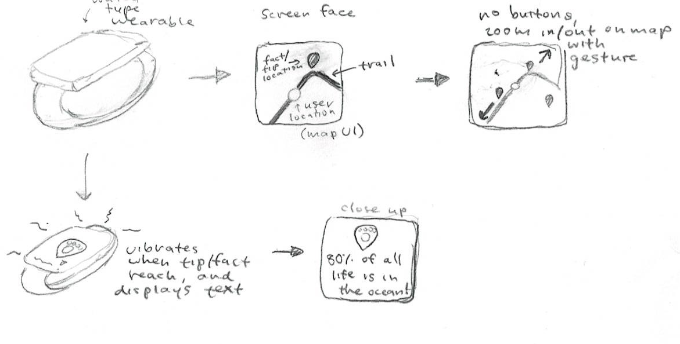
Wearable

Slide 12
Top 2 Interfaces
Notes:
We met Andrew
We were amazed to learn about how the school organizes walk to school days. Parents add their address to a map and coordinate walking to school with peers who live close by.
It would be game changing to broaden/ expand this to more than just elementary school children

Slide 13
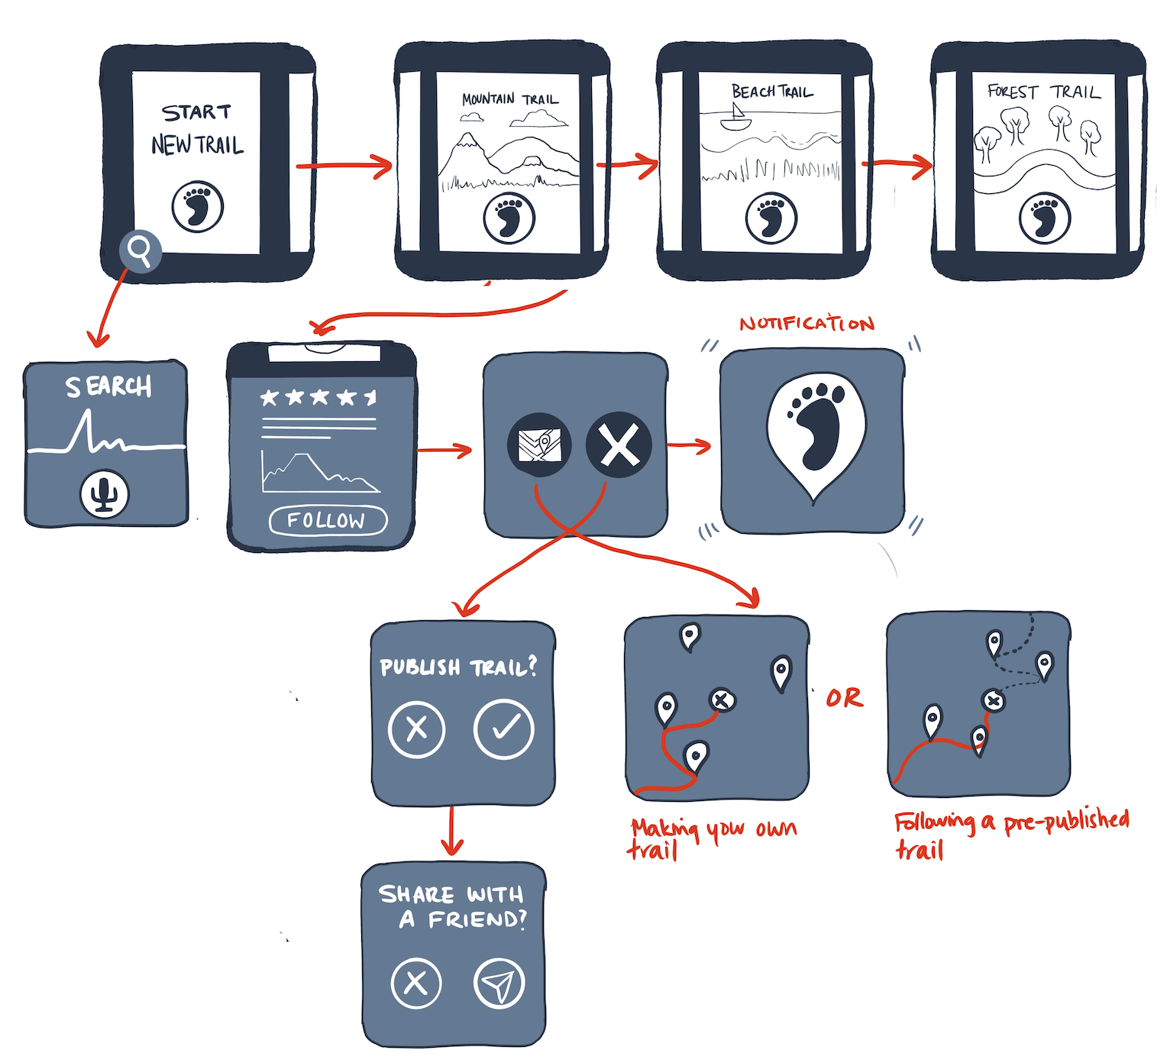
Wearable Watch
Pros:
Balance between immersion and having tech for guidance
Facts given in context
Primarily synchronous: focus is on the adventure
Cons:
Hard to navigate on such a small screen
Minimal asynchronous functionality outside hikes -- no interactivity or community or caching
Need to buy a smart watch

Slide 14
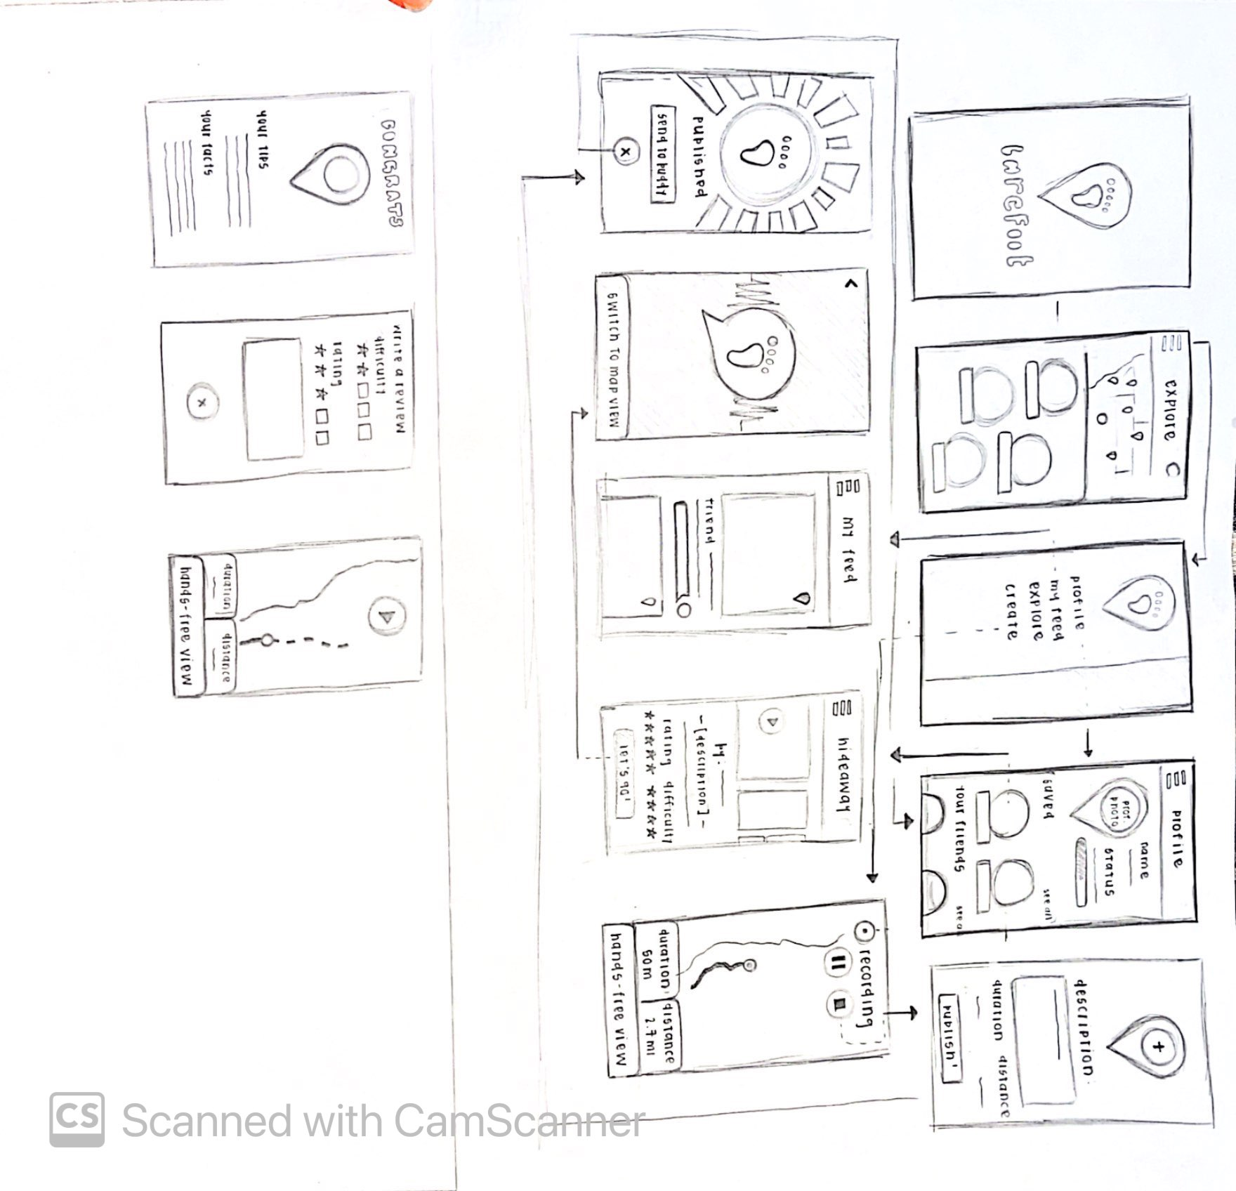
Mobile App
Pros:
Can be used anytime/anywhere
Facts given in context
Can view all other components of platform easily
Familiar interface accessible to anyone who has a smart phone
Better for long-term use
Cons:
Must actively be using app while on adventure to navigate/hear facts
Want to avoid becoming too “social-media-esque”

Slide 15
Lo-Fi Prototype

Slide 16
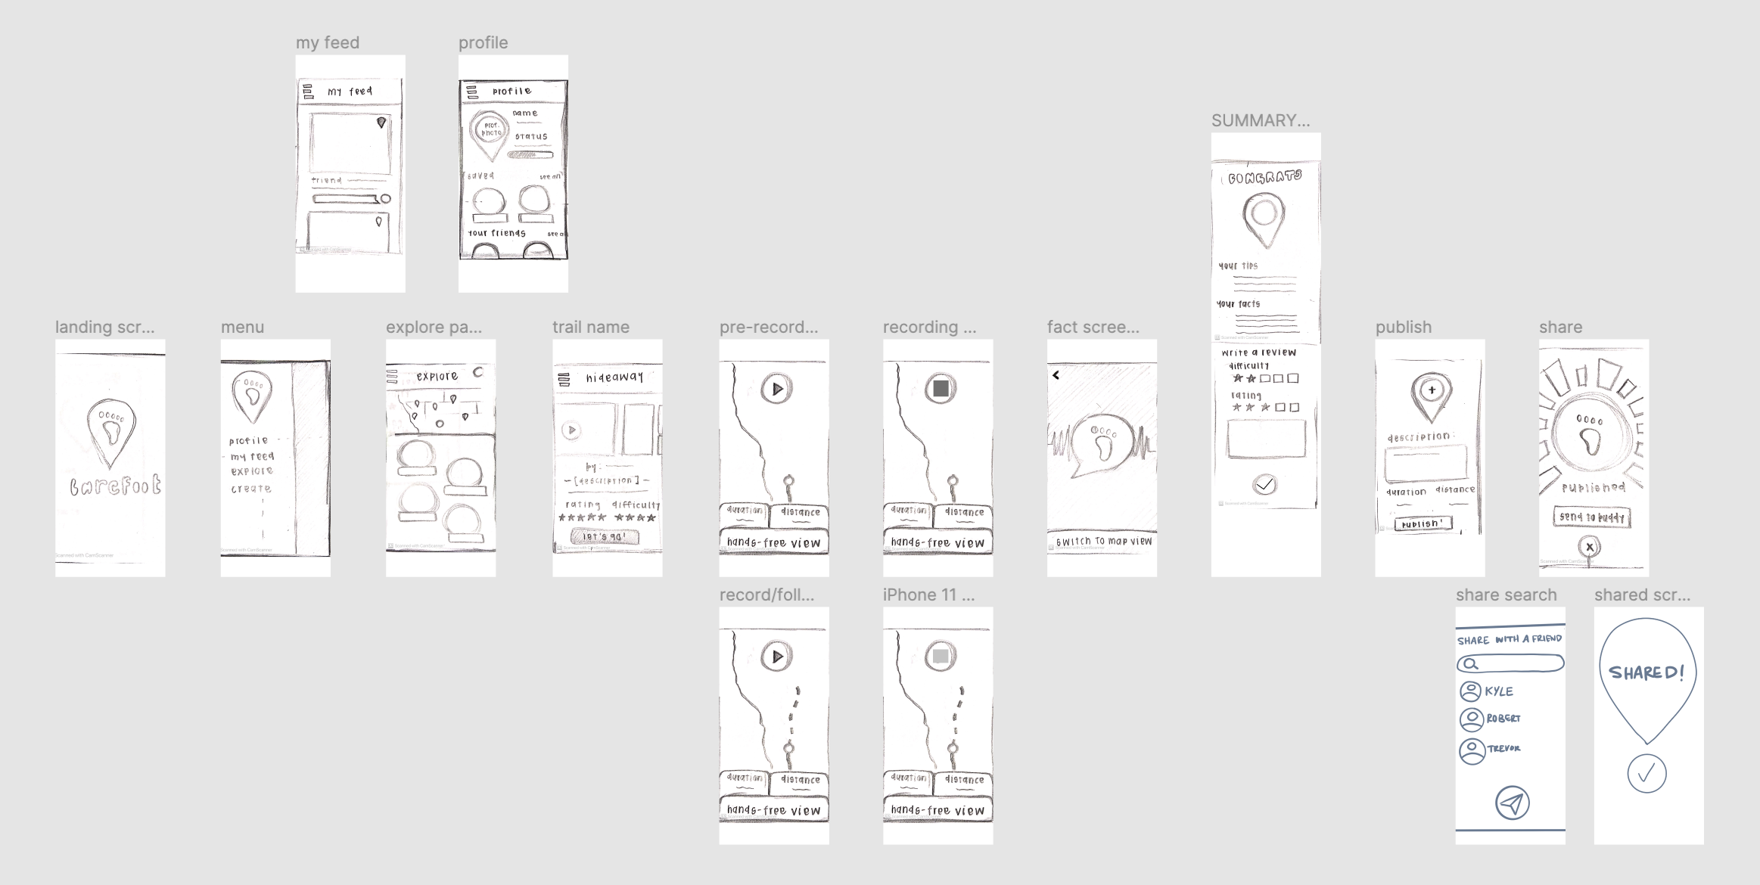

Slide 17
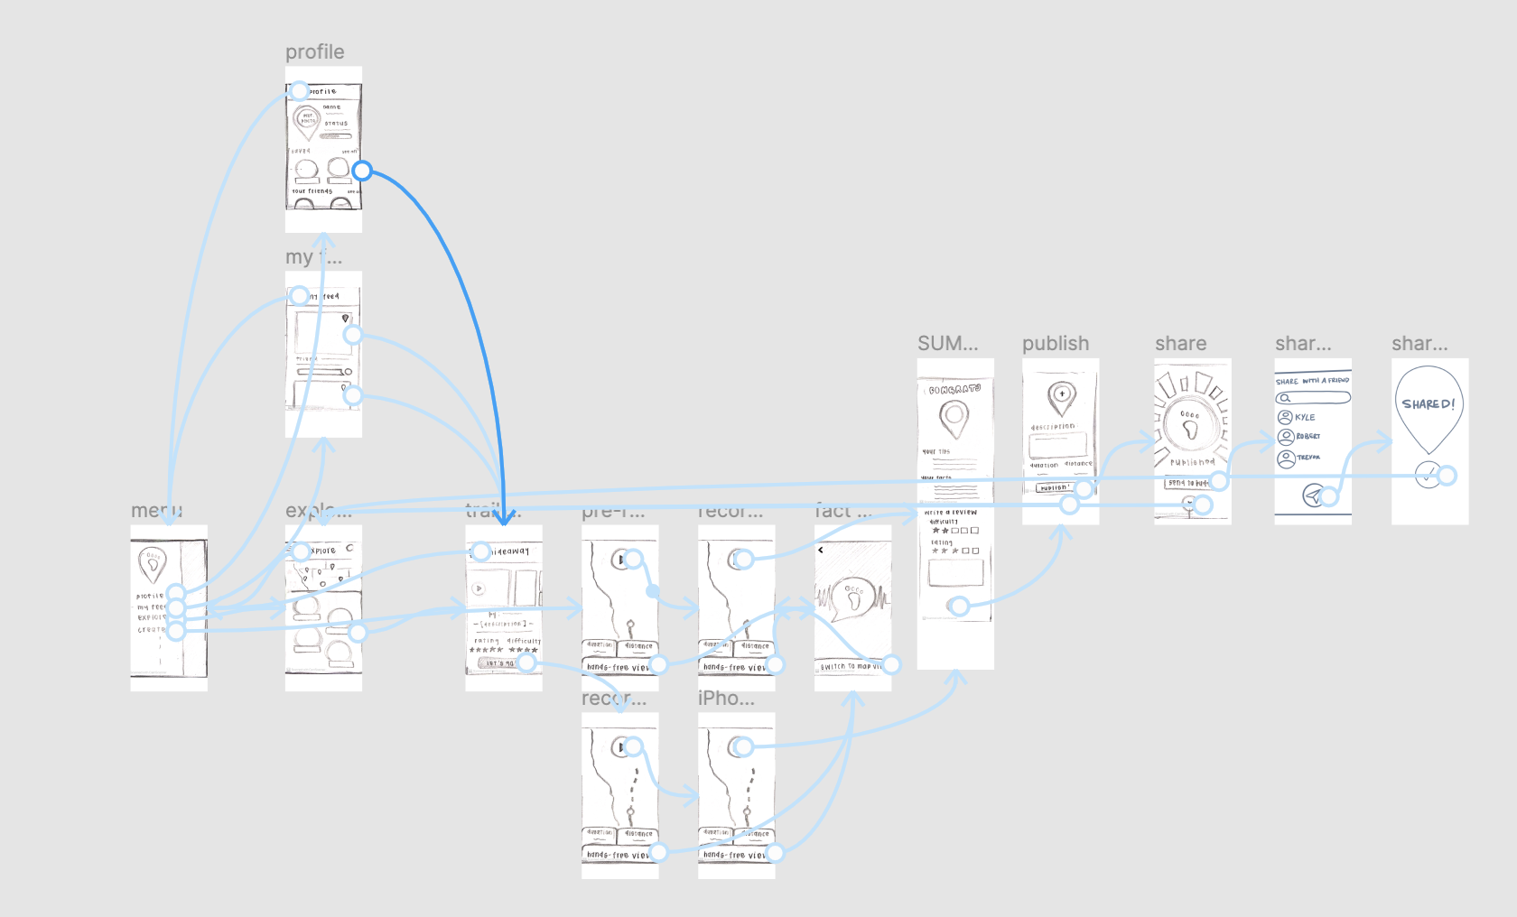

Slide 18
Task Flows
Notes:
We met Andrew
We were amazed to learn about how the school organizes walk to school days. Parents add their address to a map and coordinate walking to school with peers who live close by.
It would be game changing to broaden/ expand this to more than just elementary school children

Slide 19
Simple: Follow previously published trails by other app users

Slide 20
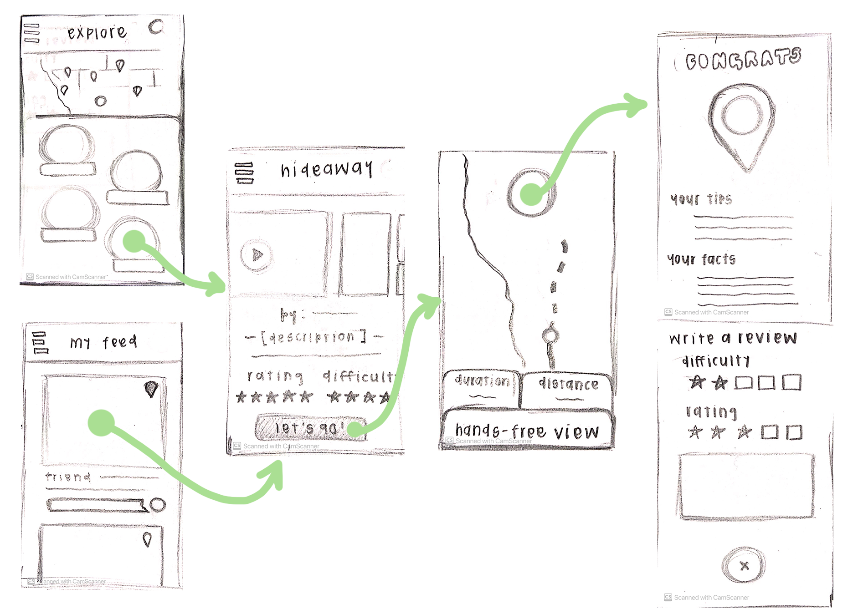
Making following adventures easily accessible for all users

Slide 21
Simple: Follow previously published trails by other app users
Moderate: Explore and learn about nature in context

Slide 22
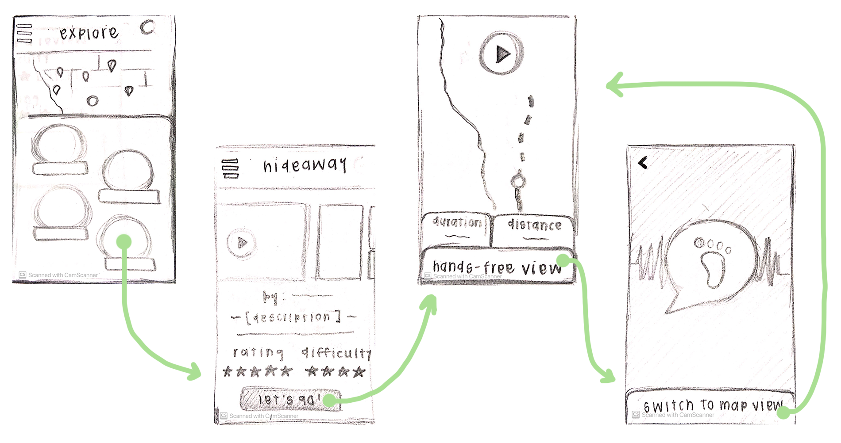
Giving people the feel of a “guided tour” through their surroundings

Slide 23
Simple: Follow previously published trails by other app users
Moderate: Explore and learn about nature in context
Complex: Publish your own trail

Slide 24
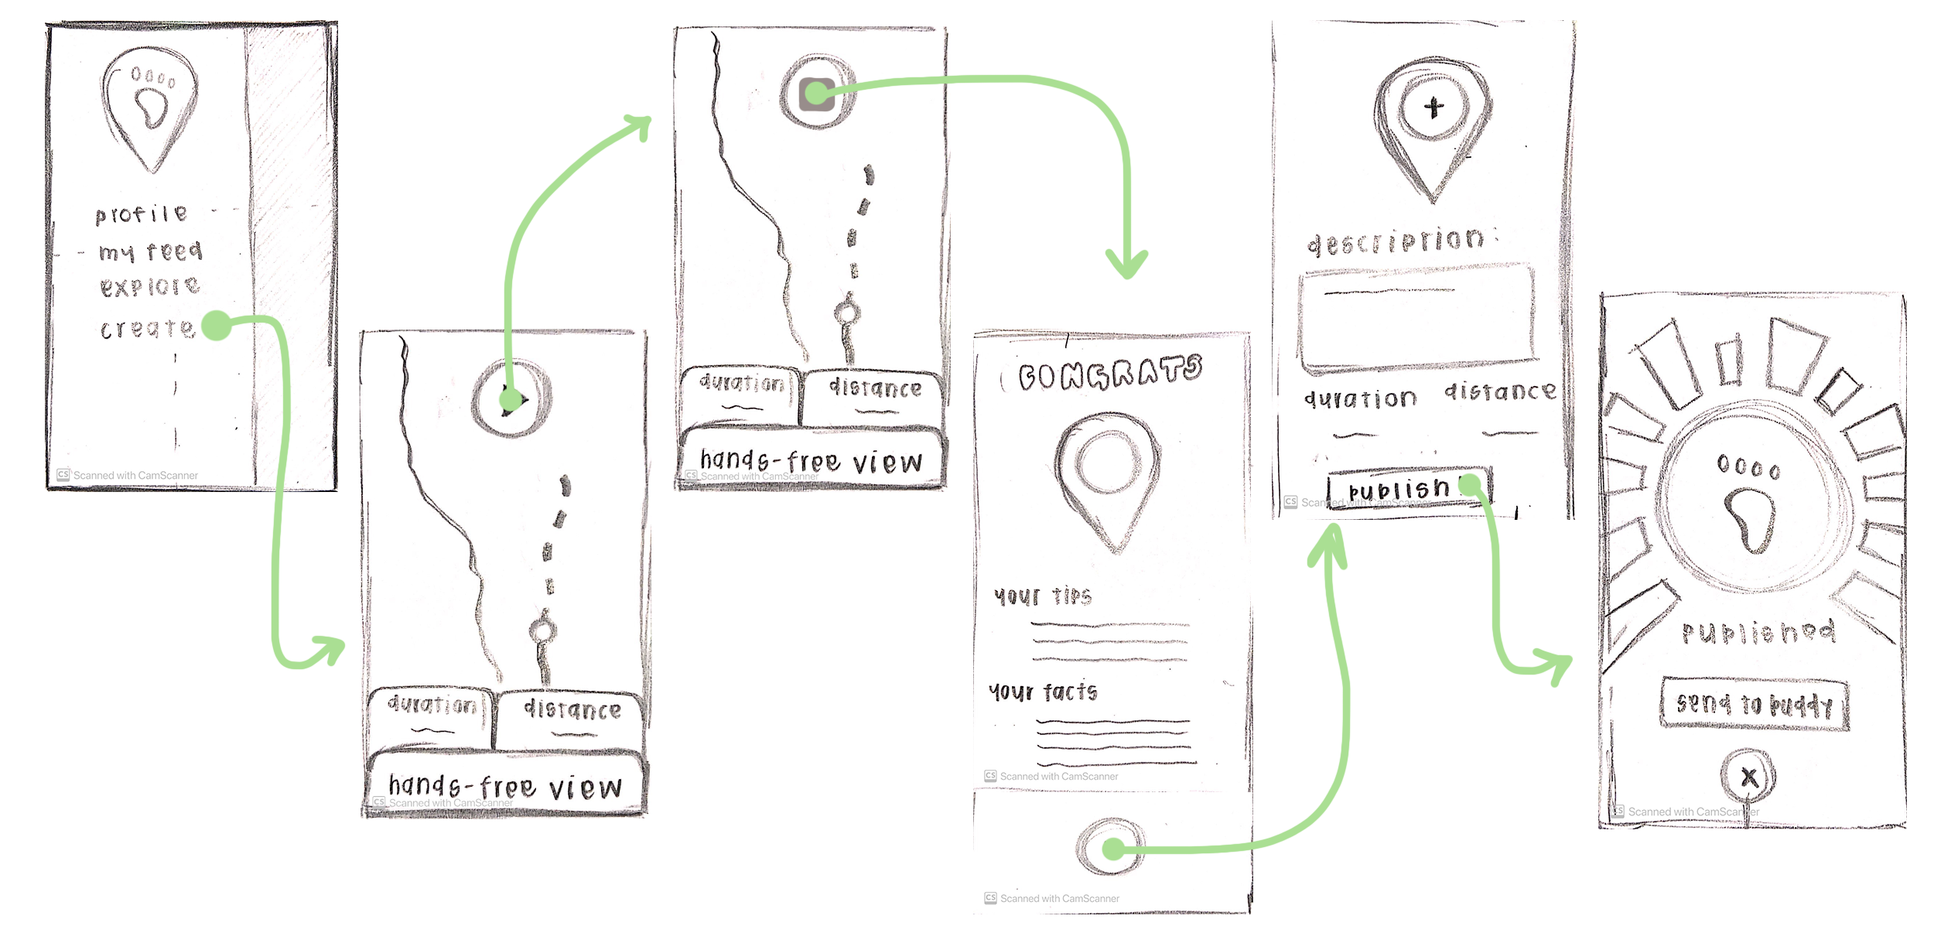
Making it simple for people to share their newfound passions with others

Slide 25
Simple: Follow previously published trails by other app users
Moderate: Explore and learn about nature in context
Complex: Publish your own trail
Moderate: Invite friends directly to follow your trail

Slide 26
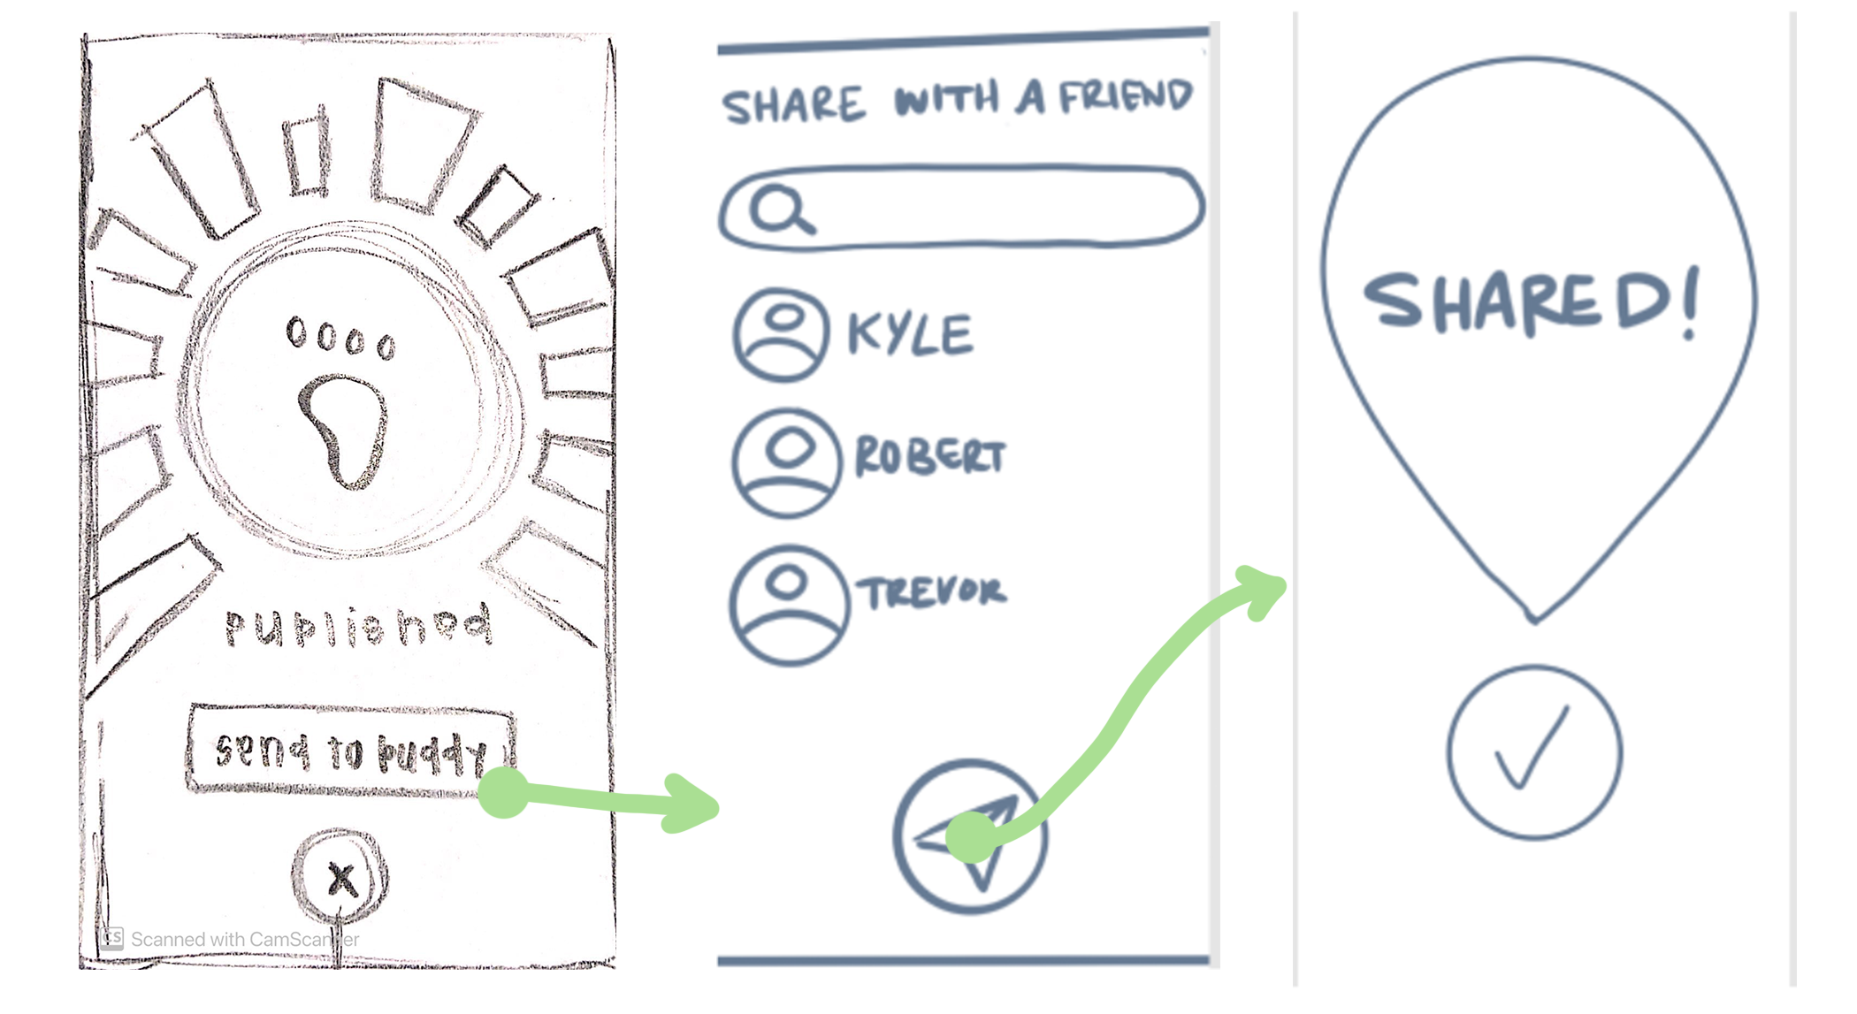
Spreading love for the outdoors with people who have yet to be reached

Slide 27
Testing & Results
Notes:
We met Andrew
We were amazed to learn about how the school organizes walk to school days. Parents add their address to a map and coordinate walking to school with peers who live close by.
It would be game changing to broaden/ expand this to more than just elementary school children

Slide 28
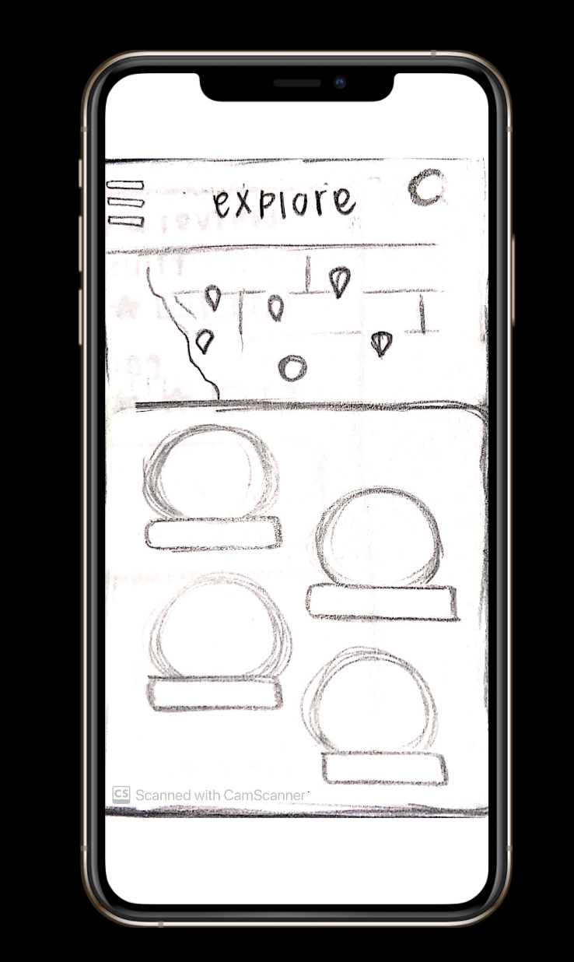
Testing Interface
Lo-fi prototype in Figma
Overview of app premise/function
Participant given remote control of interface
4 tasks given to participant
Observe/notes on successes, errors, points of confusion, and suggestions

Slide 29
Testing Participants
Brian
Stanford sophomore who enjoys hiking and exploring the outdoors
Alice
Middle aged mother who is passionate about sustainable living and outdoor activities
Cory
Introverted college senior who doesn’t go outside much or use social media
Hannah
Young woman with a love for exploration and the outdoors

Slide 30
Key Takeaways
Success
Familiarity with many features from previous experience
Trail-finding was intuitive
Enthusiasm towards the education component
Notes:
Menu ui clarity = issue with hamburger menu, & lack of

Slide 31
Key Takeaways
Success
Familiarity with many features from previous experience
Trail-finding was intuitive
Enthusiasm towards the education component
Error/Confusion Points
Not understanding the “hands-free view”
Menu UI clarity issues
Publishing/posting/sharing process raised questions
Notes:
Menu ui clarity = issue with hamburger menu, & lack of

Slide 32
FOR NEXT TIME...
Notes:
We met Andrew
We were amazed to learn about how the school organizes walk to school days. Parents add their address to a map and coordinate walking to school with peers who live close by.
It would be game changing to broaden/ expand this to more than just elementary school children

Slide 33
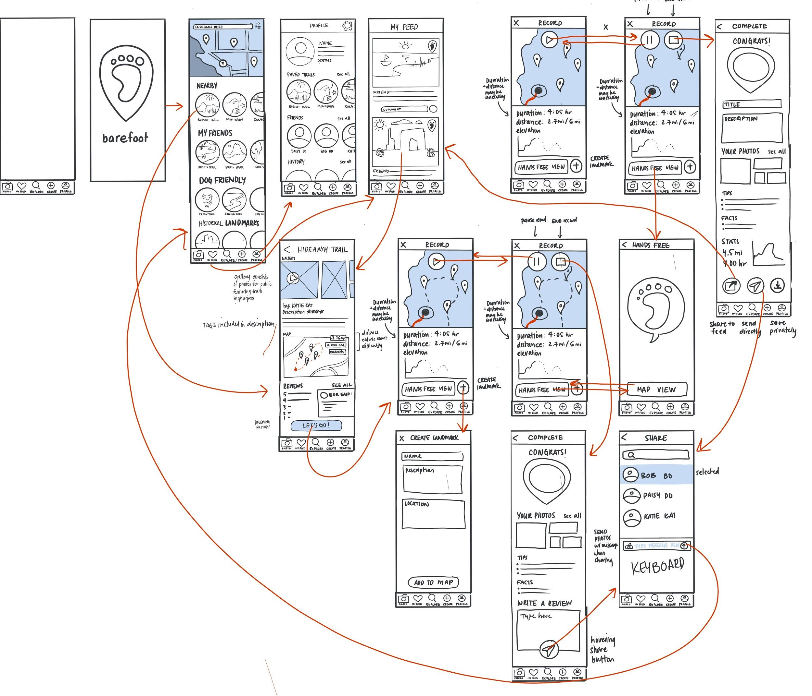
OUR NEW STORYBOARD

Slide 34
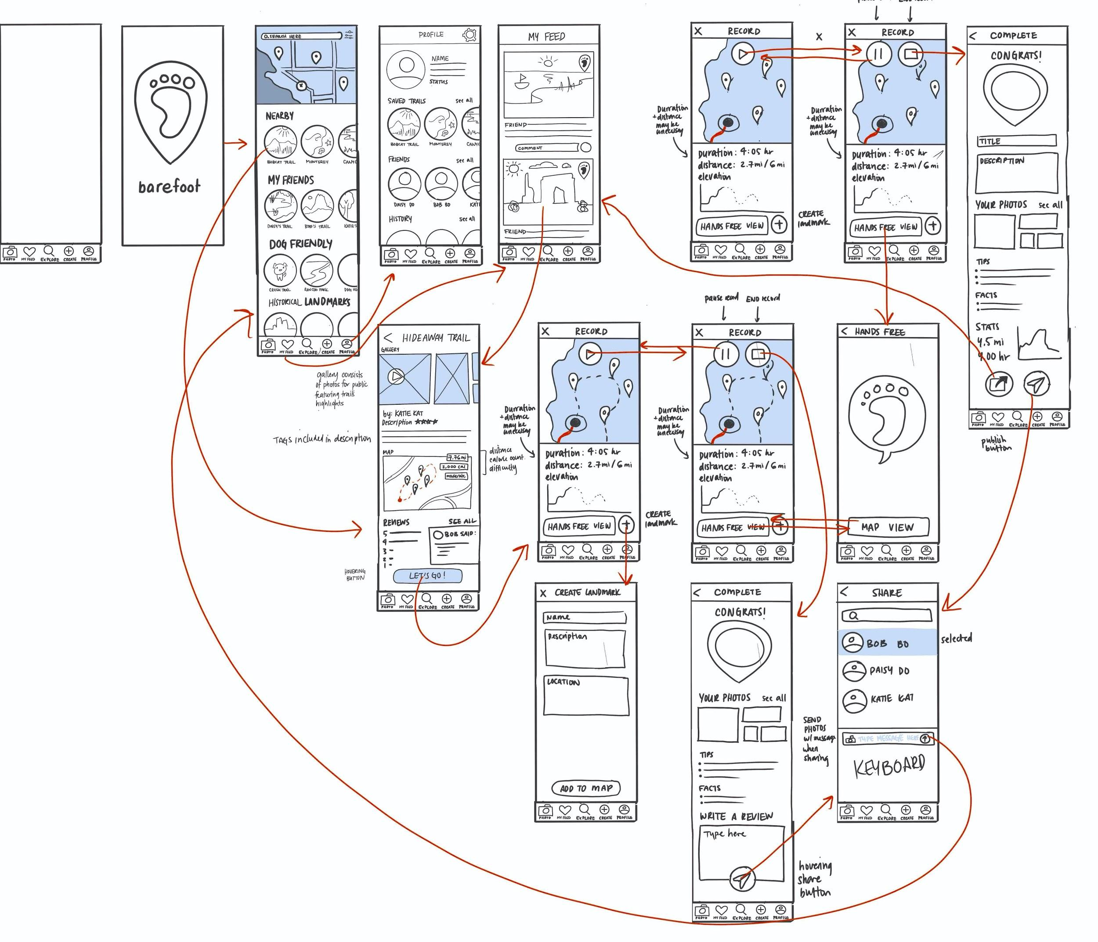
THE MENU BAR
Toggle between 5 different tabs
Camera
My feed
Explore
Create
Profile
RATIONALE:
For vertically oriented screens components should be stacked vertically
More accessible by thumb

Slide 35
The Pause button
More intuitive than just play and stop buttons

Slide 36
The Hiking Process
Landmarks visible on map to incentivize people to explore more
Ability to create landmarks
Added calories burned stat

Slide 37
Sharing Process
Creating a trail vs. following a trail
3 options:
Share to feed
Send directly
Save privately

Slide 38
Summary
Our users found familiarity with many aspects of the app, and expressed interest in the novel aspects.
Users had issues at certain points in navigating through our app(ie: going back to the menu)
Changes:
  Menu
  Hiking and sharing processes
  New additions such as tags and adding landmarks

