Slide 1
plum
Team 1: Grace Zhang, Katrina Liou, Rachel Leou, Anthony Xie

Slide 2
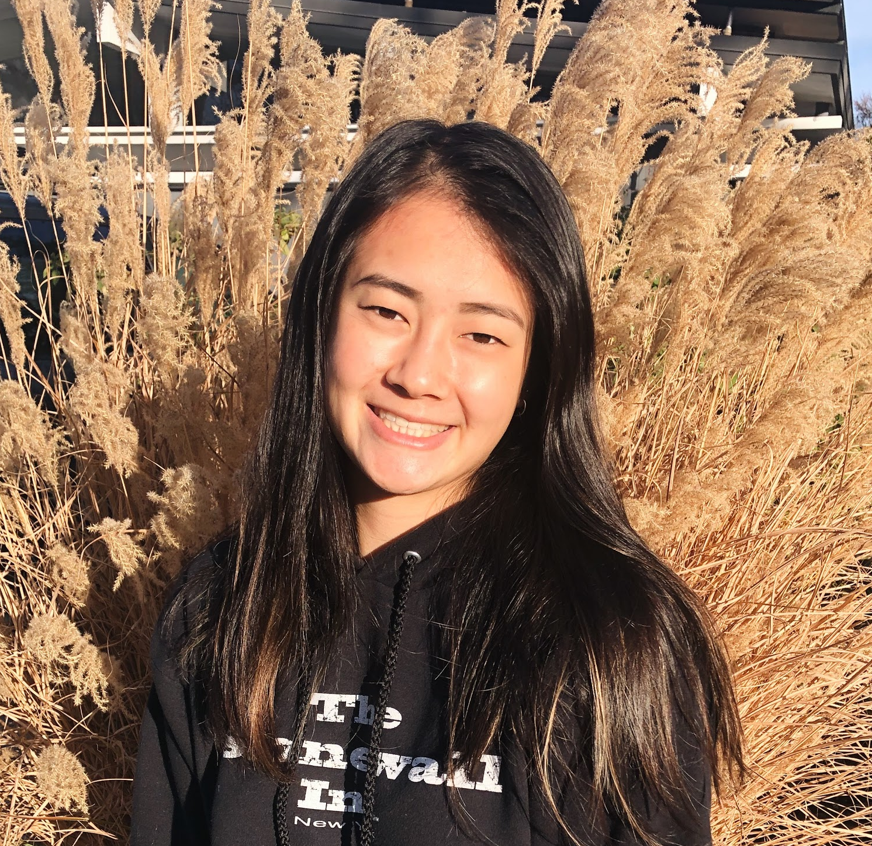

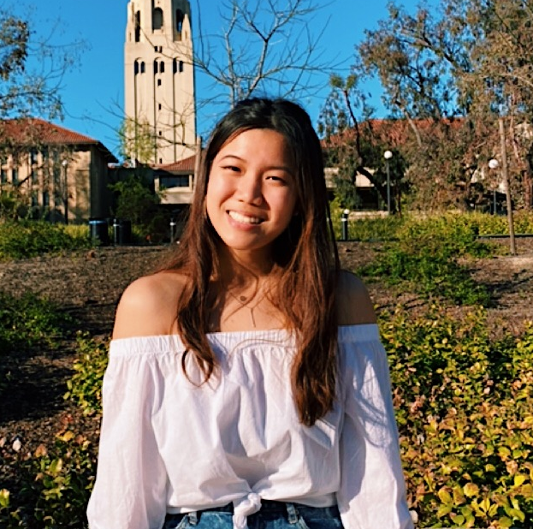
Katrina L
Rachel L
Grace Z
Anthony X

Slide 3
Initial POV
Notes:
We met Andrew
We were amazed to learn about how the school organizes walk to school days. Parents add their address to a map and coordinate walking to school with peers who live close by.
It would be game changing to broaden/ expand this to more than just elementary school children

Slide 4
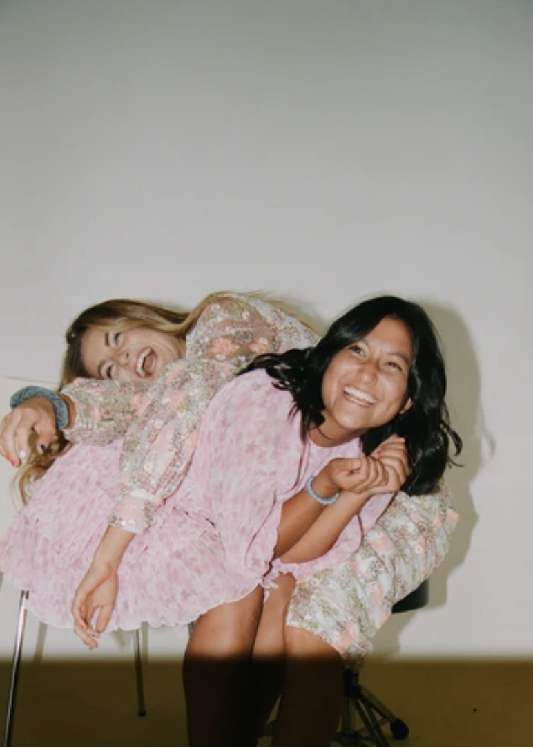
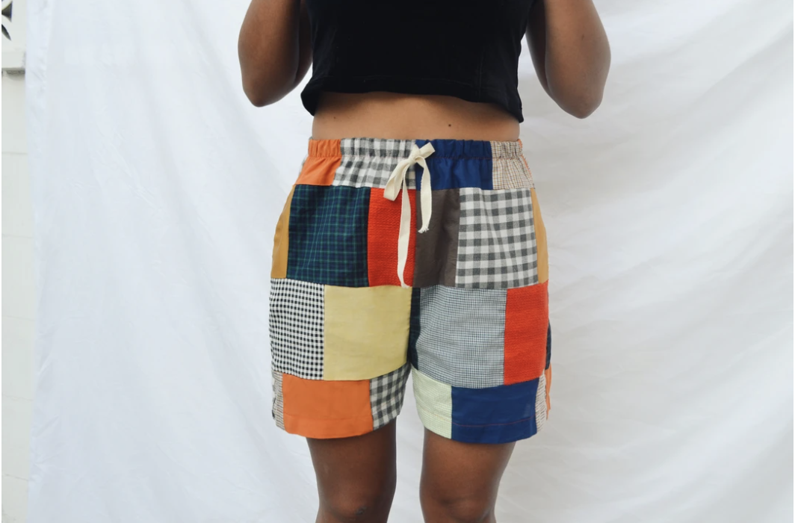
We met
Ellie
Nature-loving Stanford Product Design graduate; founder of Oddli Apparel, a sustainable fashion line

Slide 5
We were amazed to realize that the concept of collecting “high quality, long-lasting products” that you only buy once (like furniture) applied to clothing as well.
It would be game-changing to introduce the concept of “one-time-buy” products to younger children so that in the long run they can lead of more sustainable lifestyle

Slide 6
NEEDFINDING
POVs
HMWs
PROTOTYPES

Slide 7
Needfinding
Notes:
We met Andrew
We were amazed to learn about how the school organizes walk to school days. Parents add their address to a map and coordinate walking to school with peers who live close by.
It would be game changing to broaden/ expand this to more than just elementary school children

Slide 8
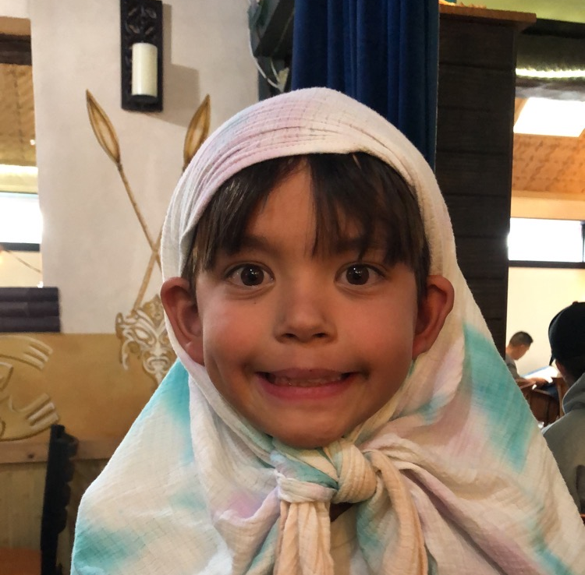
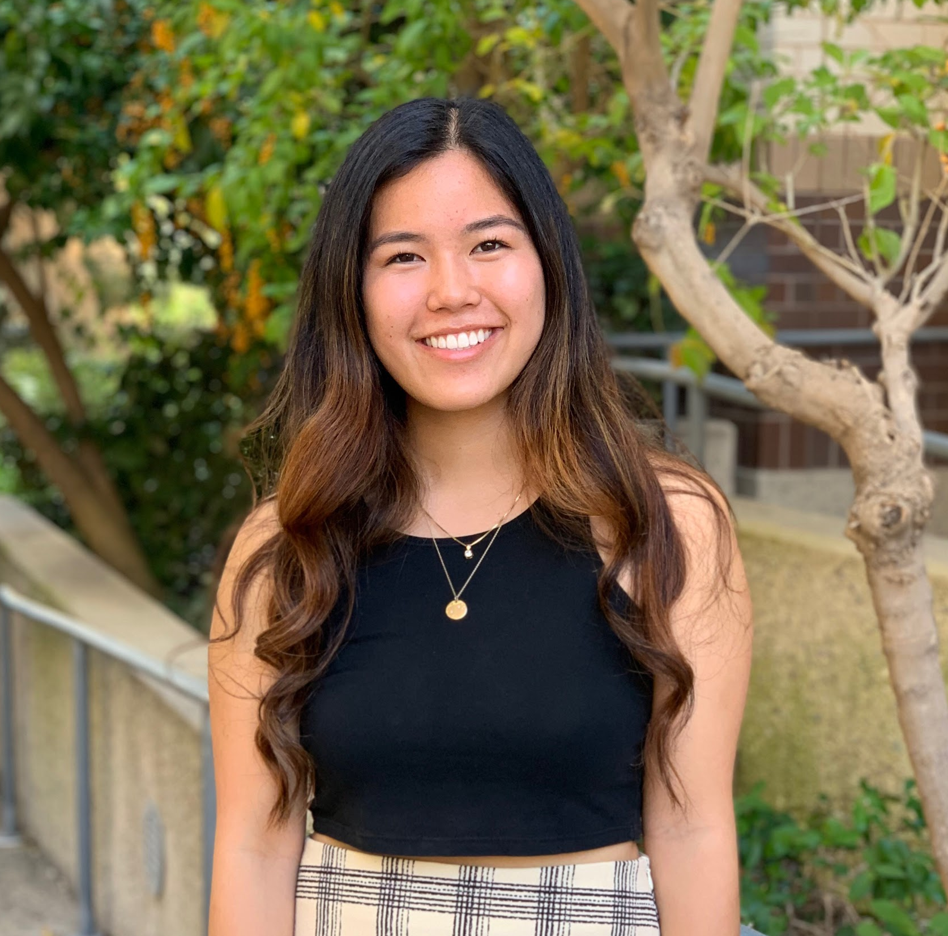
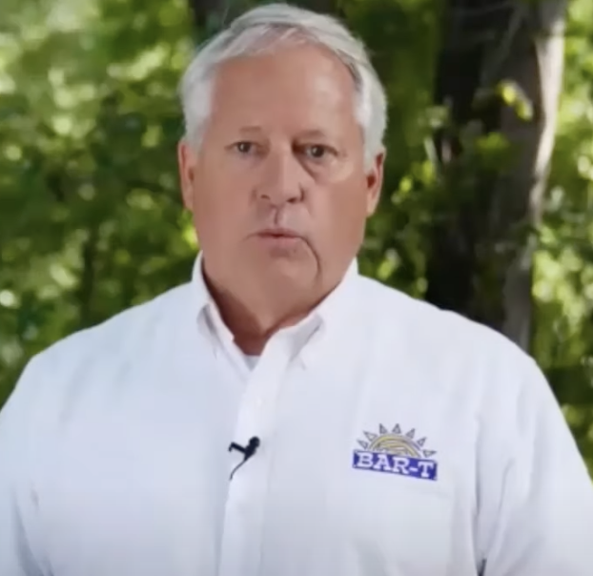

andrew
ellie
julia
joe

Slide 9
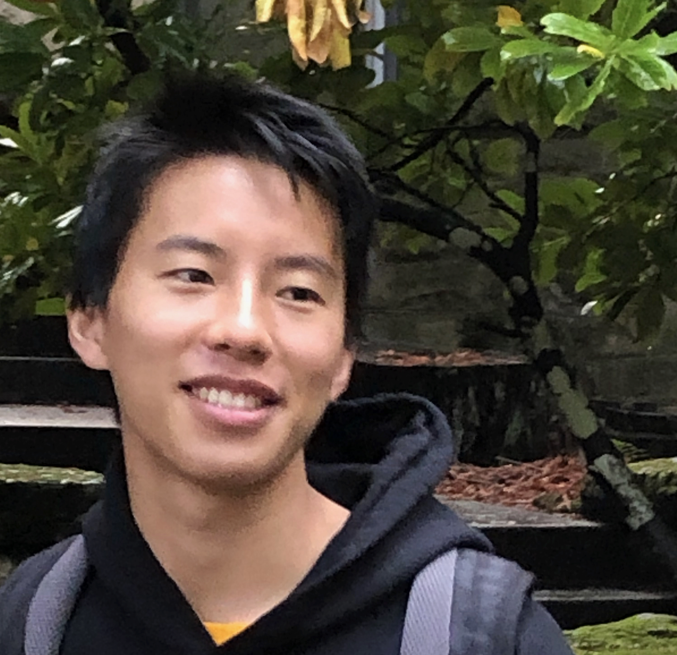
andrew
ellie
julia
joe
dennis

Slide 10
Dennis
What we learned:
Kids are super receptive, especially when engaging in games
Connections to nature are formed on a personal level through immersion and appreciation
“Kids are pretty observant, so it’s easy to lead by example.”
“I keep kids engaged primarily through games.”
“Experience is cumulative.”

Slide 11
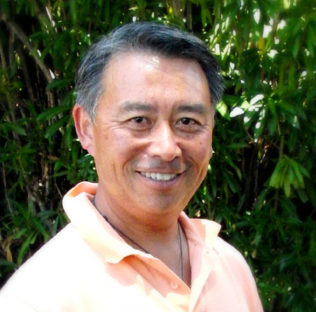
andrew
ellie
julia
joe
dennis
conrad

Slide 12
Conrad
What we learned:
New Zealand is sustainable due to its culture of learning from extended communities
There are many low-stakes opportunities for repurposing in daily life
“Growing up in NZ, we can see how other people live in ‘1st world countries’ -- we laugh at countries like America.”
“All our kitchen gray water is put back into the garden, instead of using the sprinkler system.”
“If you do educate younger kids, they’re the ones who will tell their parents.”
Notes:
“Most people have a clothesline outside, it’s pretty common in New Zealand”

Slide 13
Revised POV’s
Notes:
We met Andrew
We were amazed to learn about how the school organizes walk to school days. Parents add their address to a map and coordinate walking to school with peers who live close by.
It would be game changing to broaden/ expand this to more than just elementary school children

Slide 14
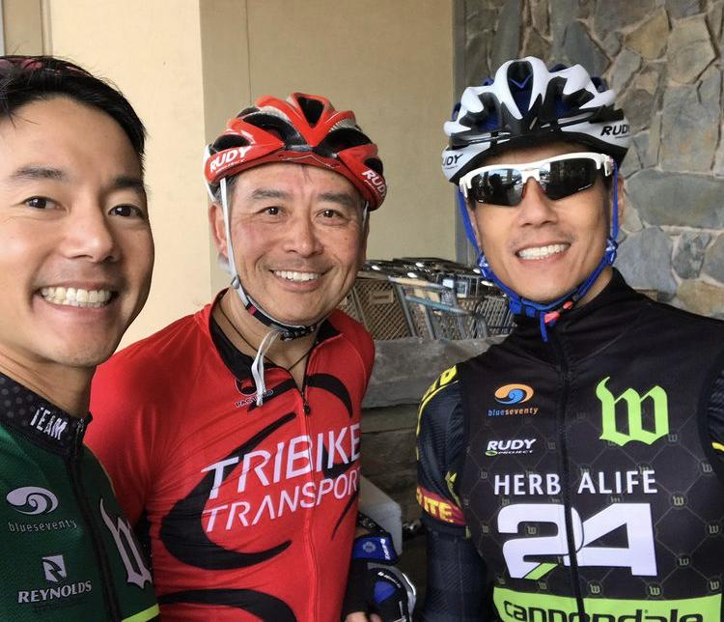
POV 1
We met
Conrad
a middle aged physical therapist and triathlete from New Zealand who now lives in the Bay Area.

Slide 15
POV 1
We were amazed to realize that Conrad uses kitchen graywater and biodegradable soap to water his garden and plants in order to save water and eliminate the need for sprinklers. He also doesn’t own a dryer because California weather is good enough to air dry clothes.

Slide 16
POV 1
We were amazed to realize that Conrad uses kitchen graywater and biodegradable soap to water his garden and plants in order to save water and eliminate the need for sprinklers. He also doesn’t own a dryer because California weather is good enough to air dry clothes.
It would be game-changing for people to recognize and address more avenues to repurpose and reduce our waste like Conrad

Slide 17
Change the way that people think about waste?
Show people how easy repurposing is?
Get people to integrate repurposing into their lives?
Find opportunities to repurpose?
Encourage people to reuse?
Create repurposing without extra effort?
HOW MIGHT WE…
Make sustainability appeal to lazy people?
Make repurposing sleek?
Shift away from “waste is gross”/make waste attractive?
Shift people’s mindsets to not view everything as waste?
Reinvent existing products to emphasize repurposing/reuse?
Notes:
change the way that people think about waste?
find opportunities to repurpose?
create repurposing without extra effort?
make repurposing sleek?
encourage people to reuse?
show people how easy repurposing is?
shift people’s mindsets to not view everything as waste?
shift away from “waste is gross”/make waste attractive?
reinvent existing products to emphasize repurposing/reuse?
Reinvent the way one uses existing products around the house to reduce the waste they produce ?
Shift people’s mindset to not view everything as waste
Make sustainability appeal to lazy people?

Slide 18
Change the way that people think about waste?
Show people how easy repurposing is?
Get people to integrate repurposing into their lives?
Find opportunities to repurpose?
Encourage people to reuse?
Create repurposing without extra effort?
HOW MIGHT WE…
Make sustainability appeal to lazy people?
Make repurposing sleek?
Shift away from “waste is gross”/make waste attractive?
Shift people’s mindsets to not view everything as waste?
Reinvent existing products to emphasize repurposing/reuse?

Slide 19
POV 2
We were amazed to realize that the culture surrounding sustainability in New Zealand is affected by their “village-like lifestyles” and encourages them to take more action, whereas American culture is limited by immediate family units

Slide 20
POV 2
We were amazed to realize that the culture surrounding sustainability in New Zealand is affected by their “village-like lifestyles” and encourages them to take more action, whereas American culture is limited by immediate family units
It would be game-changing to overcome the nuclear barriers of American culture and bring people together through sustainable living in a way which mimics a village-like community

Slide 21
Allow people to experience other cultures without having to leave their home?
Create “villages” in a culture that revolves around nuclear/ immediate families?
Create opportunities for people to explore different mindsets
Create online communities that take action in pandemic environments?
Change tradition?
Put people in others’ shoes to experience a different lifestyle pertaining to sustainability?
Encourage people to be open to different traditions
HOW MIGHT WE…
Persuade stubborn minds?
Build incentive through community/ build community through incentives
Increase individual, and therefore community, connections with nature and sustainability?
Encourage people to make new connections
Notes:
Put people in others’ shoes to experience a different lifestyle pertaining to sustainability?
create “villages” in a culture that revolves around nuclear/ immediate families?
allow people to experience other cultures without having to leave their home?
Change tradition?
Persuade stubborn minds?
Create online communities that take action in pandemic environments?
Encourage people to make new connections
Build incentive through community/ build community through incentives
Create opportunities for people to explore different mindsets
Encourage people to be open to different traditions
Expand existing communities (like book clubs, sports teams, etc)

Slide 22
Allow people to experience other cultures without having to leave their home?
Create “villages” in a culture that revolves around nuclear/ immediate families?
Create opportunities for people to explore different mindsets
Create online communities that take action in pandemic environments?
Change tradition?
Put people in others’ shoes to experience a different lifestyle pertaining to sustainability?
Encourage people to be open to different traditions
HOW MIGHT WE…
Persuade stubborn minds?
Build incentive through community/ build community through incentives
Increase individual, and therefore community, connections with nature and sustainability?
Encourage people to make new connections

Slide 23
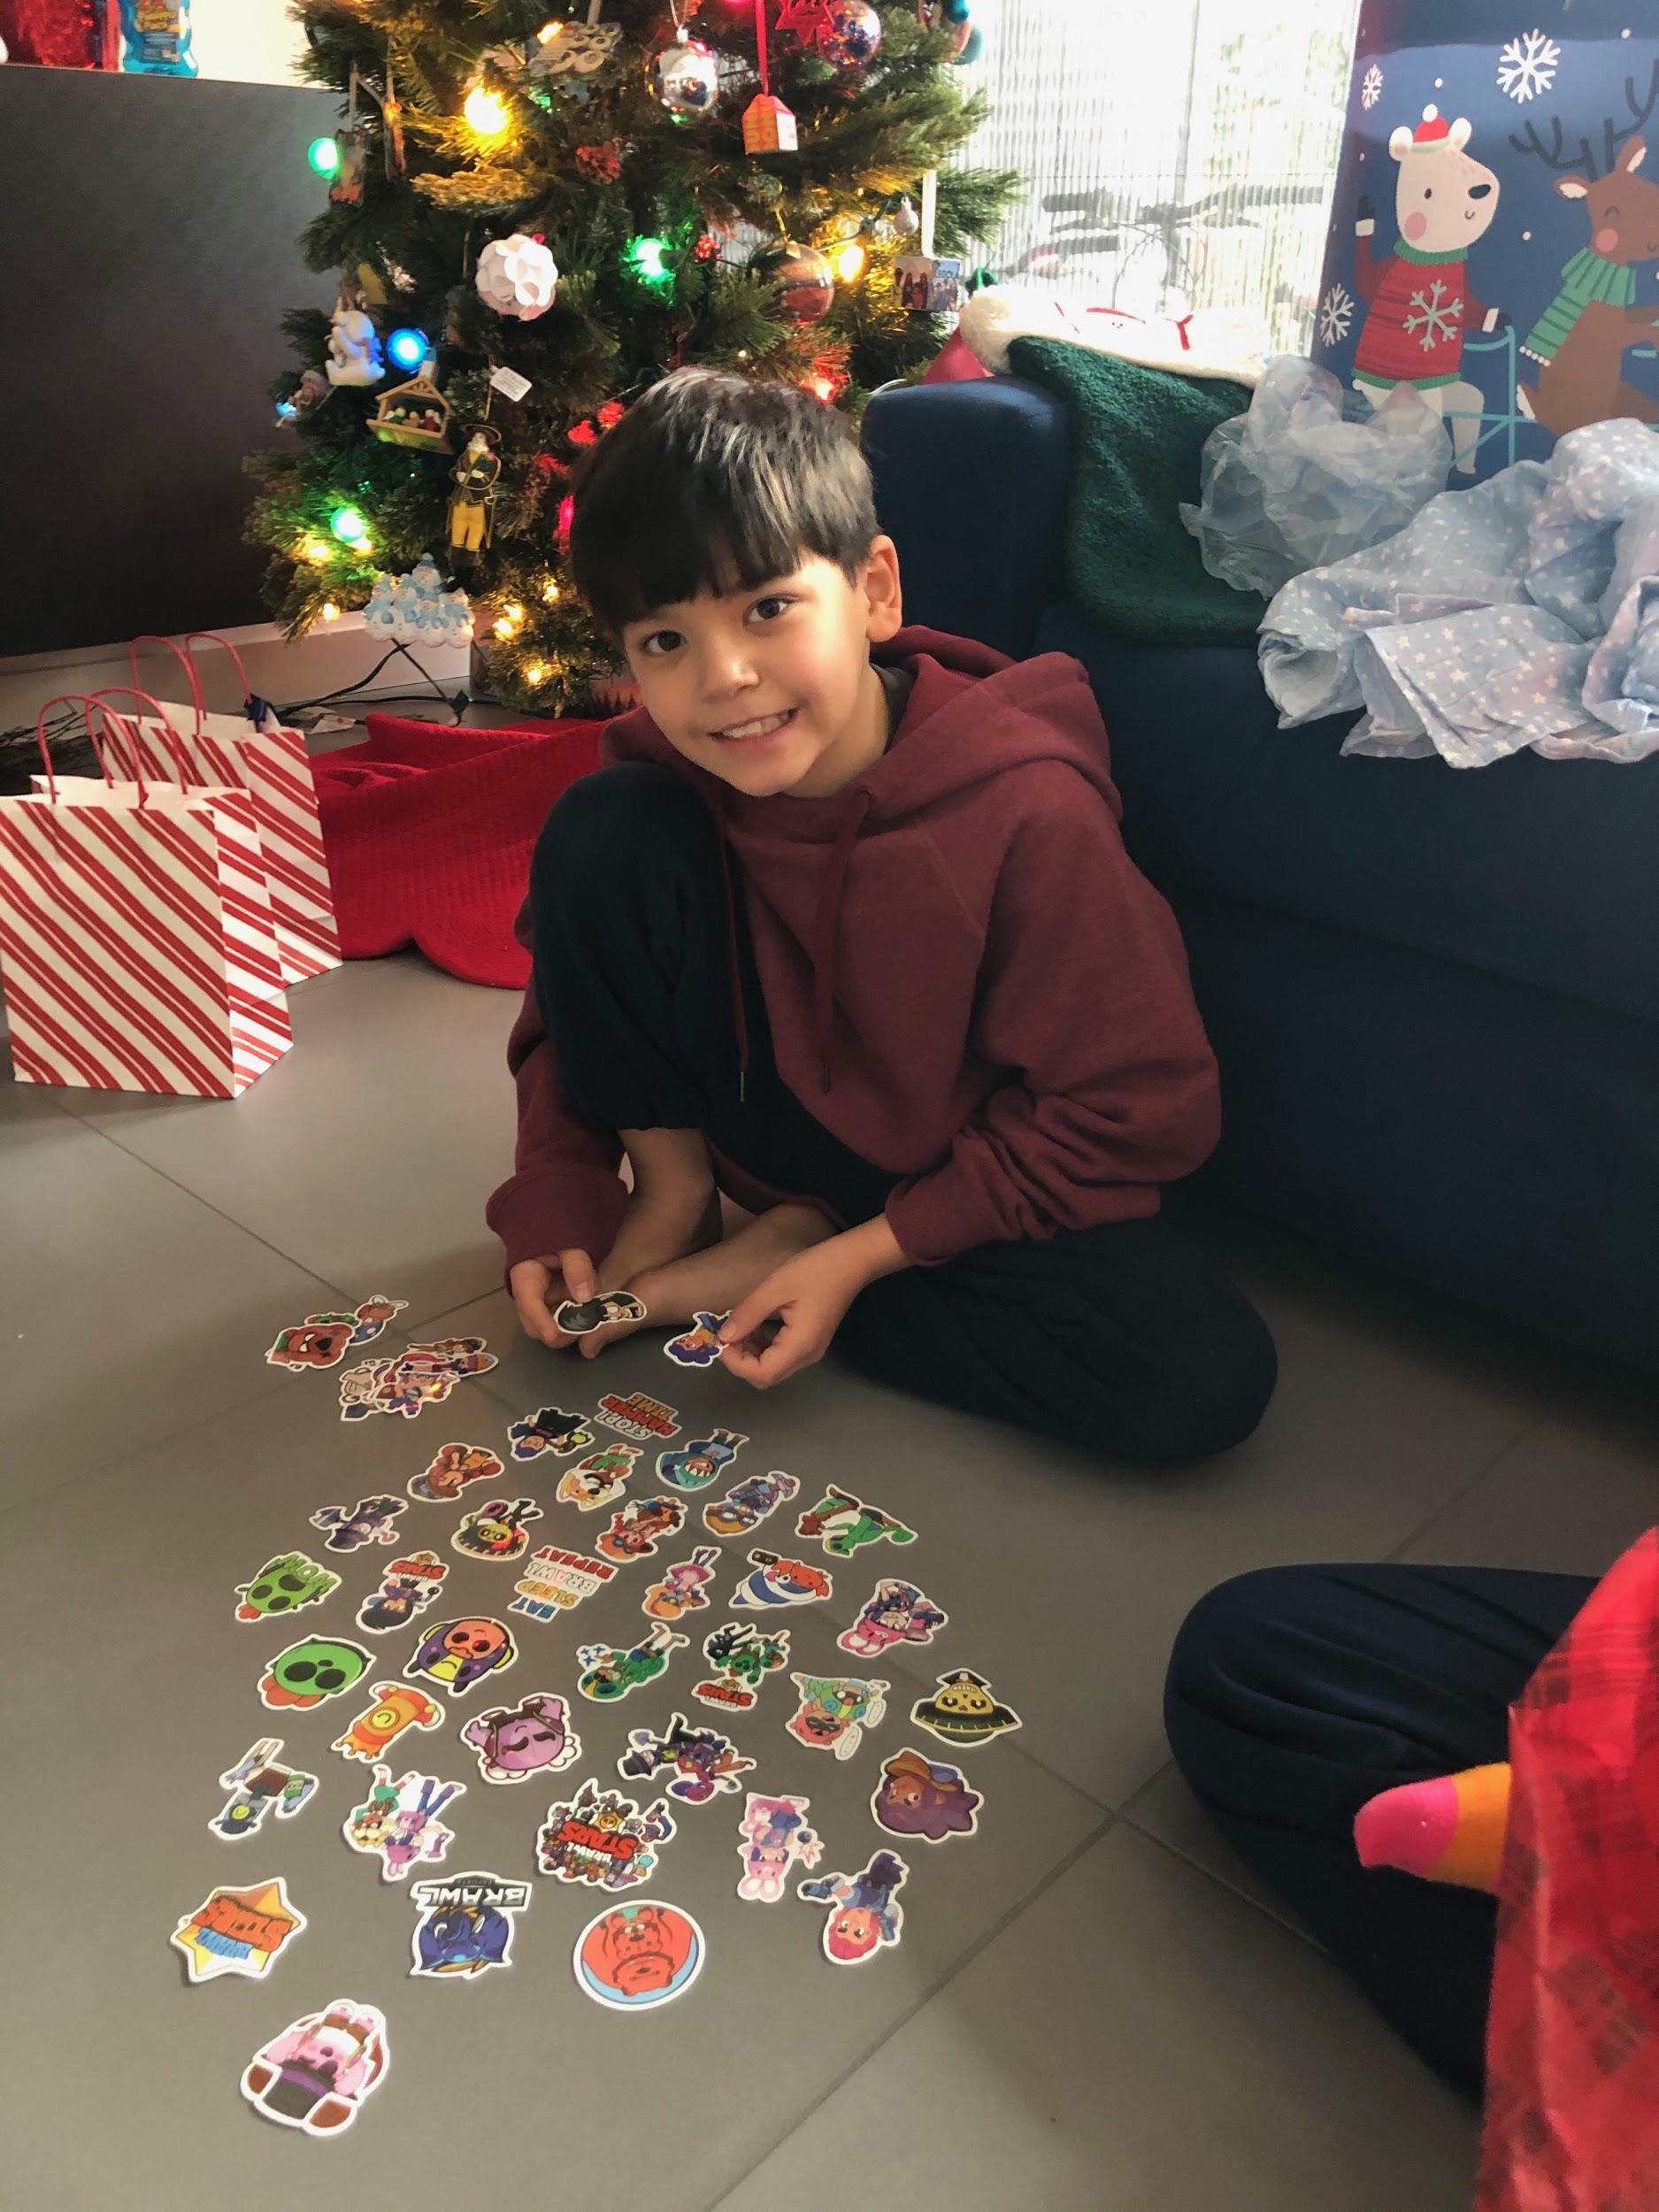
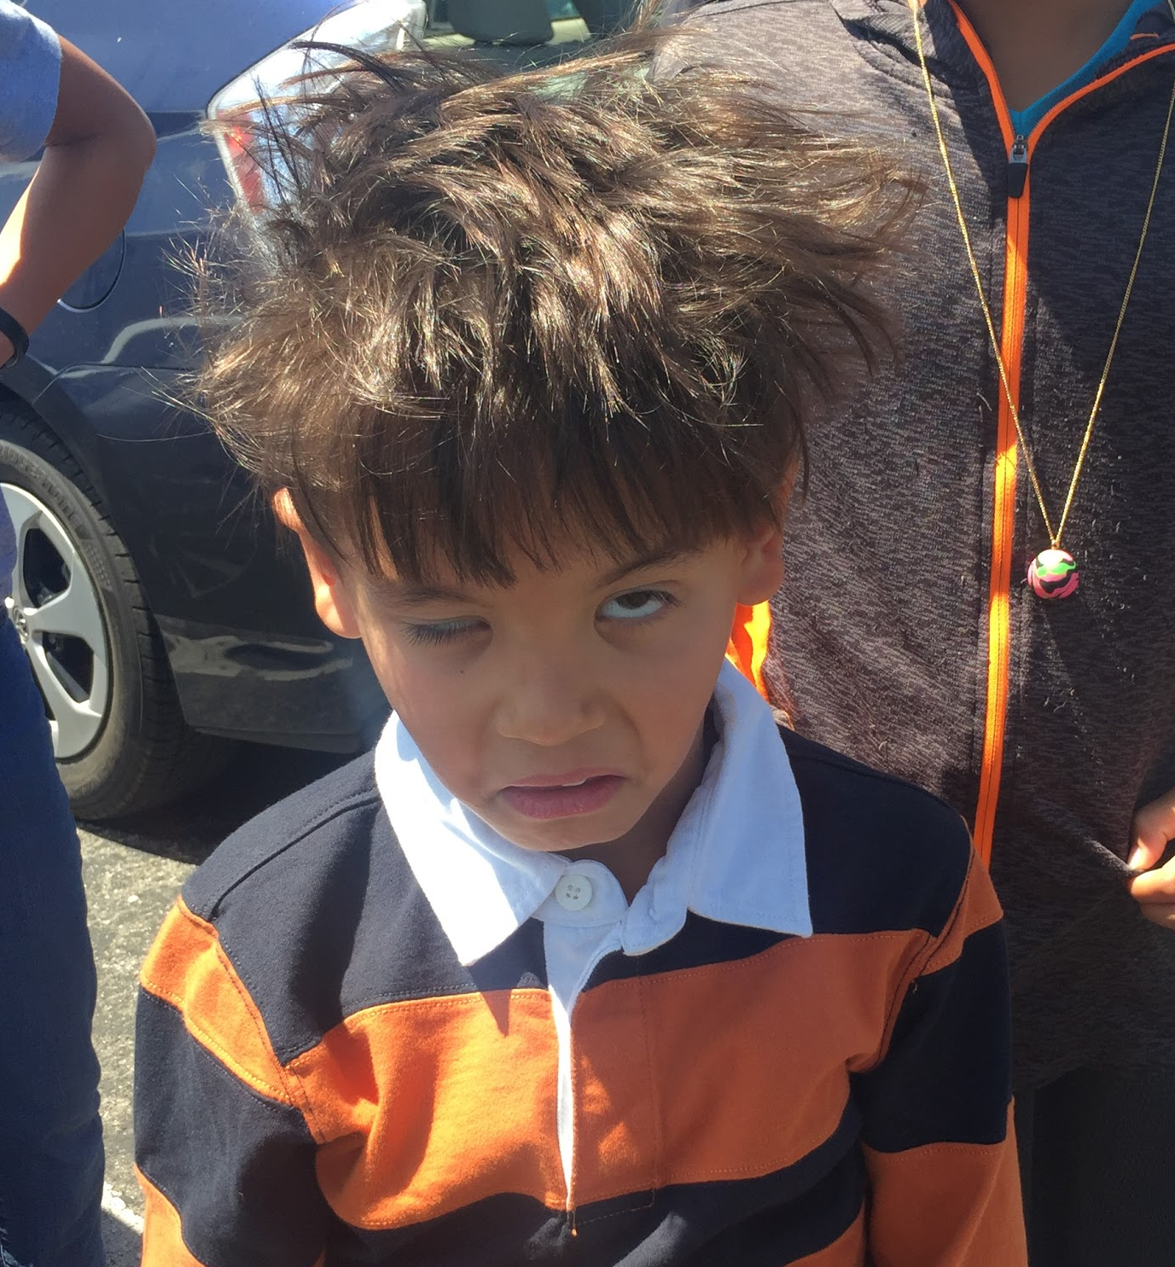
POV 3
We met
Andrew
a 4th grade male student living in the Bay Area

Slide 24
POV 3
We were amazed to realize that even though he didn’t know what “sustainability” was, he was eager to take action and share what he learned in school about renewable energy.

Slide 25
POV 3
We were amazed to realize that even though he didn’t know what “sustainability” was, he was eager to take action and share what he learned in school about renewable energy.
It would be game-changing to give children more of a voice when it comes to living sustainably in their home life. This could lead to a domino effect from the influence of an unsuspected age group.

Slide 26
Get adults to listen to kids
Make sustainability fun?
Encourage parents to be more aware of their children's’ actions in terms of sustainability?
Overcome generational stereotypes to bridge communication between kids and adults
Create compelling content so that kids listen and absorb
HOW MIGHT WE…
Give kids a platform they can communicate through/with
Connect kids of different ages to share their knowledge
Introduce sustainable behaviors into the lives of children, which is often controlled by their parents
Inspire kids to lead by example (while breaking the barrier between adults and kids)
Simplify sustainability so that kids can understand
Notes:
Get adults to listen to kids
Overcome generational stereotypes to bridge communication between kids and adults
Inspire kids to lead by example
Connect kids of different ages to share their knowledge
Break the barrier/ age gap between adults and kids (how might we get adults to see kids as their equals)
Simplify sustainability so that kids can understand
Introduce sustainable behaviors into the lives of children, which is often controlled by their parents
Give kids a platform they can communicate through/with
create compelling content so that kids listen and absorb
Encourage parents to be more aware of their childrens’ actions in terms of sustainability?

Slide 27
Get adults to listen to kids
Make sustainability fun?
Encourage parents to be more aware of their children's’ actions in terms of sustainability?
Overcome generational stereotypes to bridge communication between kids and adults
Create compelling content so that kids listen and absorb
HOW MIGHT WE…
Give kids a platform they can communicate through/with
Connect kids of different ages to share their knowledge
Introduce sustainable behaviors into the lives of children, which is often controlled by their parents
Inspire kids to lead by example (while breaking the barrier between adults and kids)
Simplify sustainability so that kids can understand

Slide 28

POV 4
We met
Dennis
a Stanford sophomore who cares deeply for animal life and was a camp counselor for many years

Slide 29
POV 4
We were amazed to realize how people are more engaged, receptive, and passionate about the subject they are learning about when they are immersed in interactive activities and in the environment.

Slide 30
POV 4
We were amazed to realize how people are more engaged, receptive, and passionate about the subject they are learning about when they are immersed in interactive activities and in the environment.
It would be game-changing to create more immersive opportunities for people to learn about sustainability through interactive activities

Slide 31
How Might We

Slide 32
How might we inspire kids to lead by example (while breaking the barrier between adults and kids)?

Slide 33
How might we increase individual and connections with nature and sustainability?
Notes:
Increase individual, and therefore community, connections with nature and sustainability?

Slide 34
How might we get people to integrate repurposing into their lives?

Slide 35
Prototypes
Notes:
We met Andrew
We were amazed to learn about how the school organizes walk to school days. Parents add their address to a map and coordinate walking to school with peers who live close by.
It would be game changing to broaden/ expand this to more than just elementary school children

Slide 36
How might we inspire kids to lead by example (while breaking the barrier between adults and kids)?

Slide 37
Solution 1
How might we inspire kids to lead by example (while breaking the barrier between adults and kids)?
Learning about sustainability through a game that incentivizes environmentally friendly living

Slide 38
Solution 1
Learning about sustainability through a game that incentivizes environmentally friendly living
Assumptions:
Users would apply knowledge learned from a game to real life
Users will be interested to learn and garden through an incentivized game

Slide 39
Experience Prototype #1
We wanted to see what kind of educational presentation would influence behavior in a game.

Slide 40
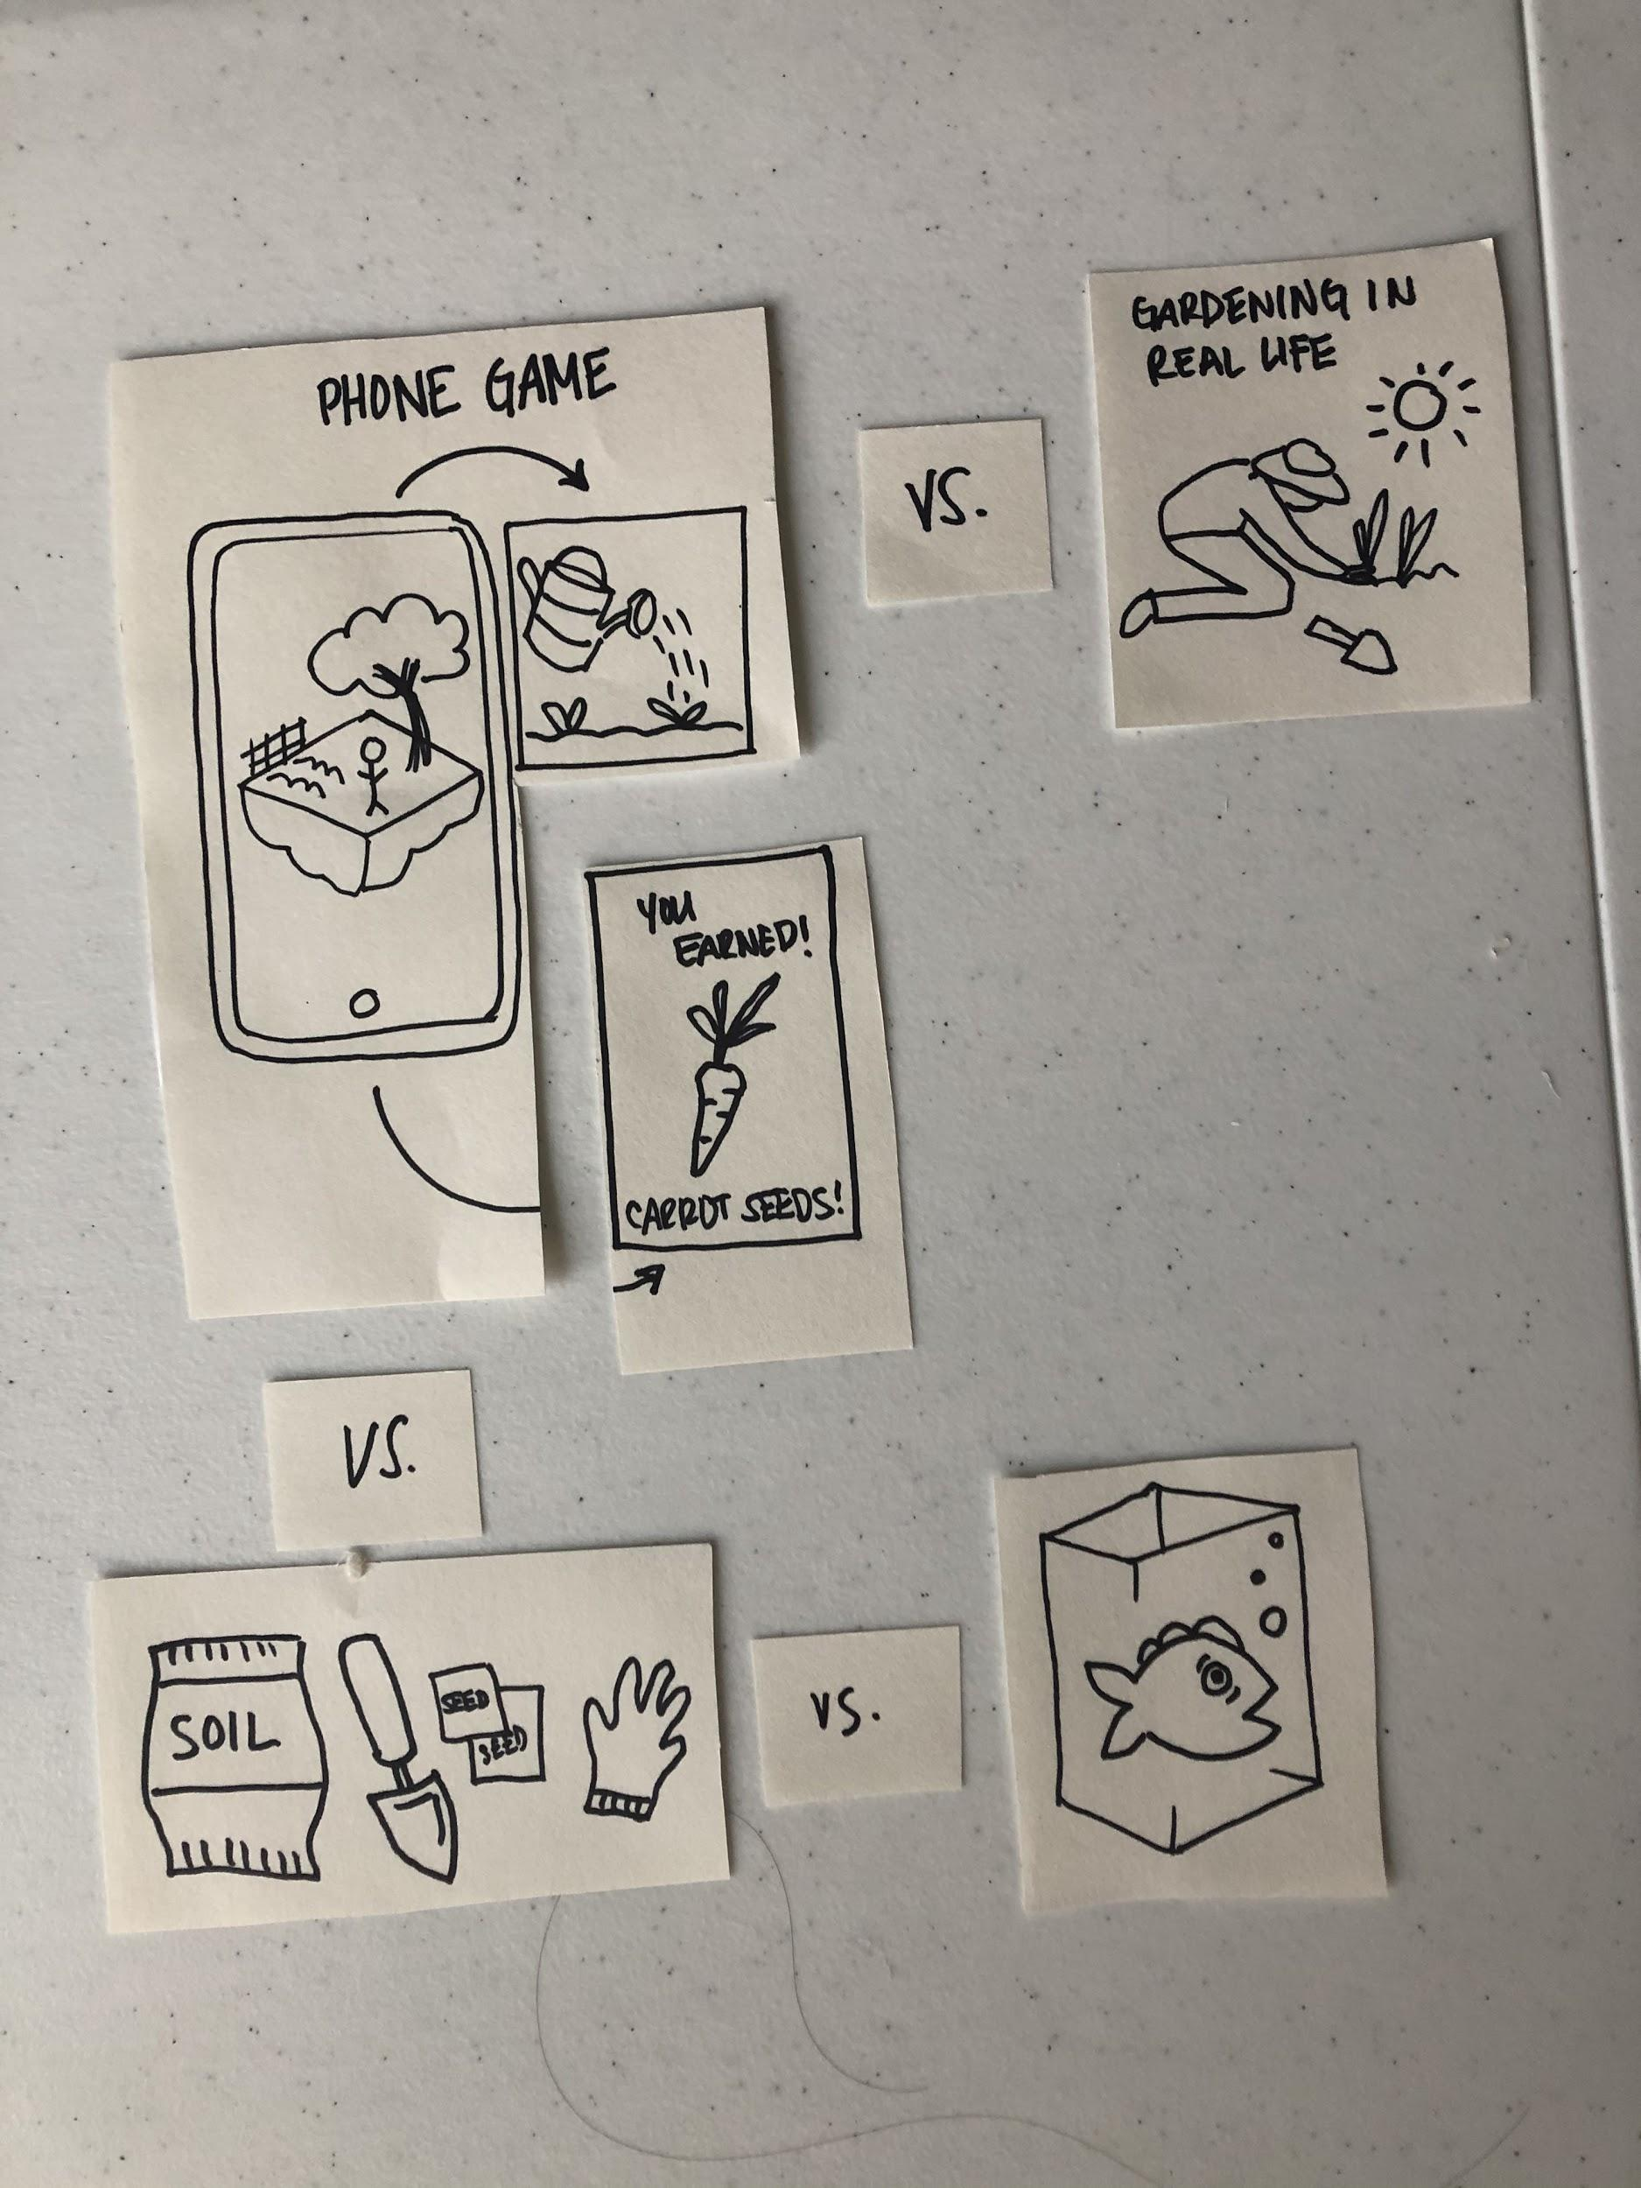
Experience Prototype #1
We wanted to see what kind of educational presentation would influence behavior in a game.
Presented hypothetical gardening game

Slide 41
Experience Prototype #1
We wanted to see what kind of educational presentation would influence behavior in a game.
Presented hypothetical gardening game
Non-personal fact about environment
vs.
Personal fact not about environment
vs.
Non-personal fact about homelife (no environment)

Slide 42
Experience Prototype #1
We wanted to see what kind of educational presentation would influence behavior in a game.
Presented hypothetical gardening game
Non-personal fact about environment
vs.
Personal fact not about environment
vs.
Non-personal fact about homelife (no environment)
Analyze reaction, response, and emotions

Slide 43
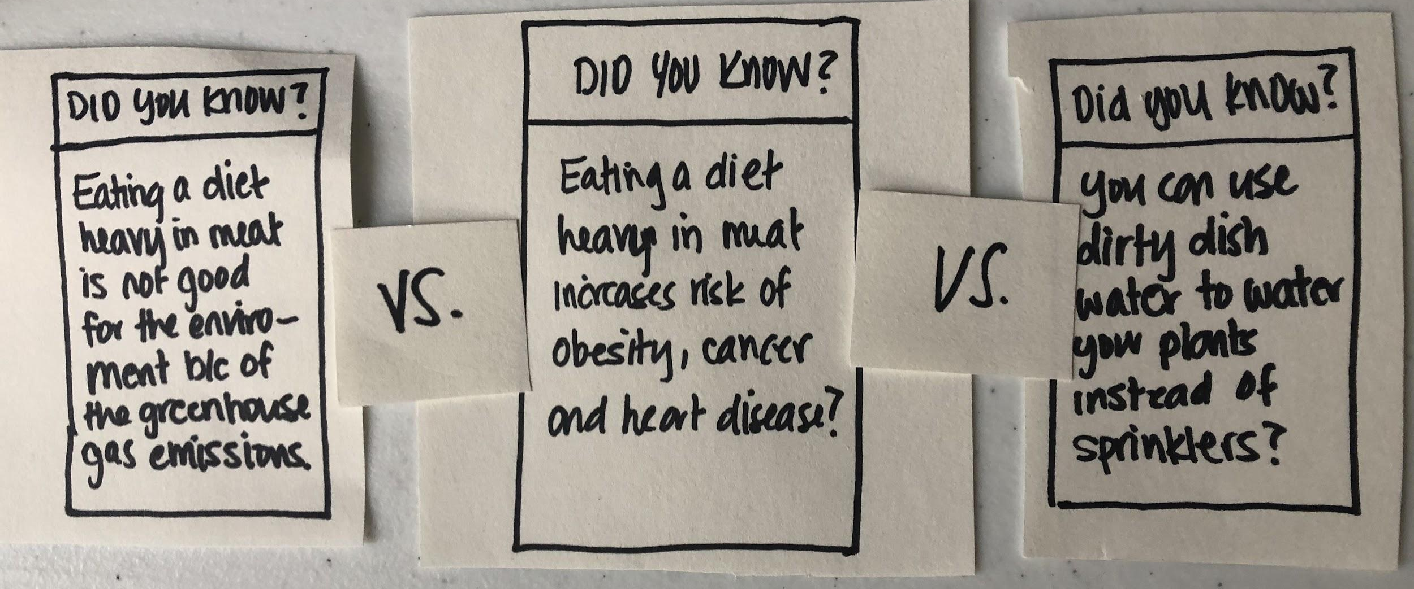
Which fact is most likely to change your behavior and why?
“It’s just a piece of information for you to know, it doesn’t heavily influence compared with everything here” (Cindy)

Slide 44
Gauging interest
Asked about:
Gardening phone game vs. gardening in real life
Incentivized phone game with physical gardening-at-home component
Gardening at home vs. community garden
Interest in gardening vs. aquaponics

Slide 45
Things that worked
Things that didn’t work
vs.
“I like how whatever I’ve invested time in virtually also has a real counterpart; it’d definitely make me want to garden more.” (Tianzhen)
“Will parents take their kids seriously if their kids are showing them something from a game?” (Tianzhen)
“I’m definitely not really looking to start fish and plant empire right here in my house” (Dylan)
“I’m not interested in gardening because I’m not good at it” (Cindy)
“For home growing, if it’s easy to grow, you feel like you are accomplishing things” (Cindy)

Slide 46
Surprises
“What if someone’s allergic to plants or fish, or some species don’t interact well together” (Tianzhen)
“Everyone knows what traditional gardening is [but not everyone knows about aquaponics.]” (Cindy)
“If the game benefits other people, then I’m more interested in the game.”
(Cindy)
Notes:
Increasing gamification potentially takes away from the value of learning about sustainability because people will find ways to cheat the system
Things that worked:
Dylan was excited at the prospect of exploration and potentially meeting new people.
Things that didn’t work:
Tianzhen questioned whether or not more screen time on your phone encourages more outdoor activity.
Surprises:
Concerned about people trashing environment during the
Dylan thought of ways to “cheat” the system.

Slide 47
How might we increase individual and community, connections with nature and sustainability?

Slide 48
Solution 2
How might we increase individual and community connections with nature and sustainability?
Incentivize exploration and discovery of the outdoors in order to foster individual relationships with nature
Notes:
Increase individual, and therefore community, connections with nature and sustainability?

Slide 49
Solution 2
Assumptions:
Incentivize exploration and discovery of the outdoors in order to foster individual relationships with nature
People can be incentivized to explore nature
Believe it’s safe enough to go explore in their area
Perceive value in establishing a connection with nature

Slide 50
Experience Prototype #2
We wanted to see if people can be incentivized to explore nature.

Slide 51
Experience Prototype #2
We wanted to see if people can be incentivized to explore nature.
Using Facebook’s maps, interviewee was sent a few possible locations to walk to

Slide 52
Experience Prototype #2
We wanted to see if people can be incentivized to explore nature.
Each location had different “points” assigned to it, which corresponded to a real life rewards
Using Facebook’s maps, interviewee was sent a few possible locations to walk to

Slide 53

Experience Prototype #2
We wanted to see if people can be incentivized to explore nature.
Each location had different “points” assigned to it, which corresponded to a real life rewards
Interviewee was left to walk for as long as or as short as they wanted
Using Facebook’s maps, interviewee was sent a few possible locations to walk to

Slide 54
Things that worked
Things that didn’t work
vs.
“I do take walks, but it’s always the same routes… It’s fun to have a reason to explore new places.” (Dylan)
“Are my movements being sold to some mega corporation company?” (Dylan)

Slide 55
Surprises
“I think it’s ironic that I’m going out in nature, but I’ll be looking at my phone the whole time still.” (Tianzhen)
“What if people start trashing the environments they’re exploring?” (Tianzhen)
“The first thing that I thought of was ‘how can I possibly get the most points as quickly as possible?” (Dylan)
Insight: We realized the contradiction between wanting to get people outdoors, while utilizing a medium that is inherently sedentary
Notes:
Increasing gamification potentially takes away from the value of learning about sustainability because people will find ways to cheat the system
Things that worked:
Dylan was excited at the prospect of exploration and potentially meeting new people.
Things that didn’t work:
Tianzhen questioned whether or not more screen time on your phone encourages more outdoor activity.
Surprises:
Concerned about people trashing environment during the
Dylan thought of ways to “cheat” the system.

Slide 56
How might we get people to integrate repurposing into their lives?

Slide 57
Solution 3
How might we get people to integrate repurposing into their lives?
A platform that makes repurposing old clothes an easy and fun activity

Slide 58
Solution 3
Assumptions:
People are interested in repurposing old/ thrifted clothes
People want to digitally visualize and plan the changes that they will be making
People have the time and artistic skills and dexterity to create wearable pieces
A platform that makes repurposing old clothes an easy and fun activity

Slide 59
Experience Prototype #3
We wanted to see if our service would incentivize people to steer away from the fast fashion industry

Slide 60
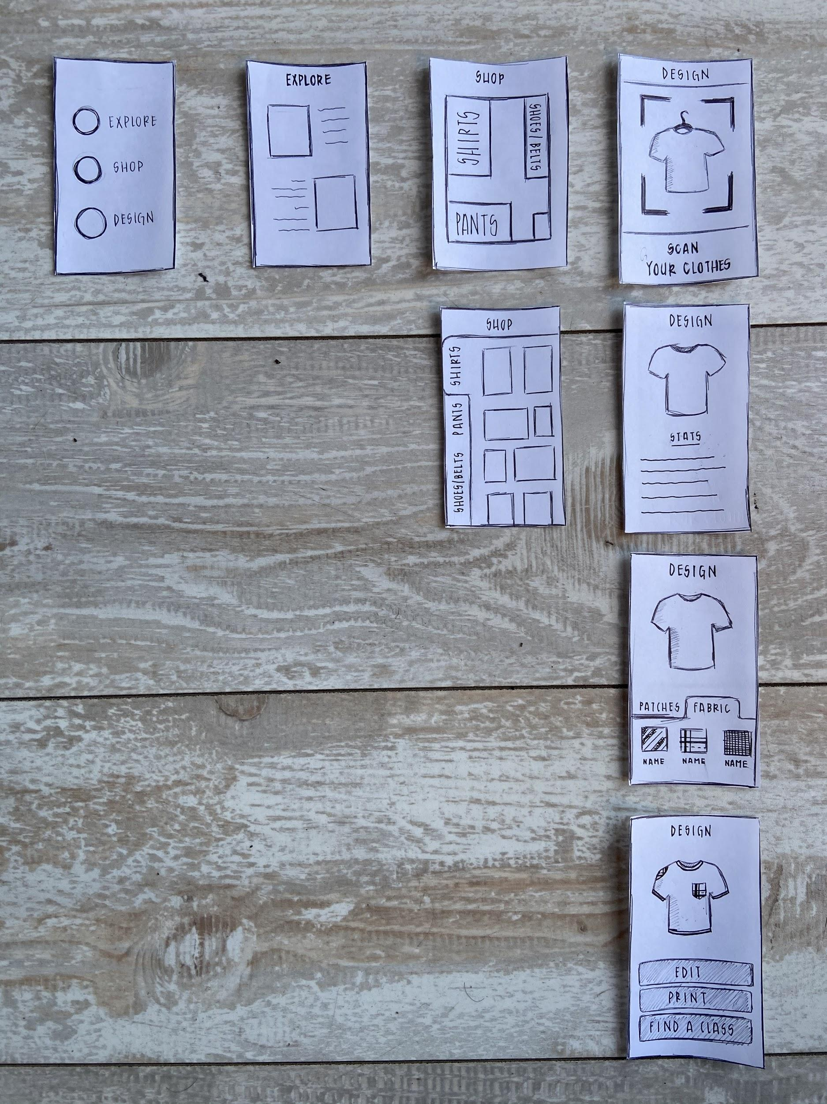
Experience Prototype #3
We wanted to see if our service would incentivize people to steer away from the fast fashion industry
Presented the concept of being able to upcycle old clothes into new pieces

Slide 61
Experience Prototype #3
We wanted to see if our service would incentivize people to steer away from the fast fashion industry
Gauged the interest and the effect it would have on shopping behavior.
Presented the concept of being able to upcycle old clothes into new pieces

Slide 62
Things that worked
Things that didn’t work
vs.
“Customers like being special. They love specialized experiences and showing up somewhere knowing that nobody’s gonna be wearing the same thing as you.” (Marlee)
“If I buy or have someone make something, you know, I want to be sure that it’s good quality.” (Dylan)
“I’d want to do all these cool things to my clothes, but I’d end up limiting myself because I know I don’t have the skills to do it for myself.” (Marlee)
“I like the component of getting to design everything beforehand and see how it’d look -- It would make me want to thrift more.” (Tianzhen)

Slide 63
Surprises
“I could see this bringing a community together with the core value being sustainability”
(Marlee)
“In theater, you have to reconstruct and repurpose costumes to adapt them for new shows fast”
(Marlee)
“In a dressing room and u cant have a second opinion” (Tianzhen)
Insight: We found that this service would be able to unite different audiences with one another, but would cater to a specific audience
Notes:
Increasing gamification potentially takes away from the value of learning about sustainability because people will find ways to cheat the system
Things that worked:
Dylan was excited at the prospect of exploration and potentially meeting new people.
Things that didn’t work:
Tianzhen questioned whether or not more screen time on your phone encourages more outdoor activity.
Surprises:
Concerned about people trashing environment during the
Dylan thought of ways to “cheat” the system.

Slide 64
Prototype 1
Prototype 2
Prototype 3
Most validated, but little interest in gardening aspect
Interest in combination of physical and virtual components
Direct forms of incentivization undermined original purpose
More interest in reward over immersion in nature
Also received positive feedback
Struggled with the feasibility of them being able to create themselves and trusting the final product
Moving forward, we want to continue testing incentivizing and exploring more virtual/physical combinations.

Slide 65
Prototype 1
Prototype 2
Prototype 3
Most validating prototype and received most and positive feedback, but expressed little interest towards gardening
Interest showed in a game that combined physical and virtual components of sustainability
We found that though incentivization may get people outdoors, it defeats the overall purpose.
People were more interested in the reward than the actual immersion in nature.
Liked the idea of creating unique pieces to add to their wardrobe
Struggled with the feasibility of them being able to create themselves and trusting the final product

