Slide 1

barefoot
one step at a time
Notes:
The world is at your doorstep
We have a world to see
Meet the world
Where your journey begins
Walk the earth
One step at a time

Slide 2
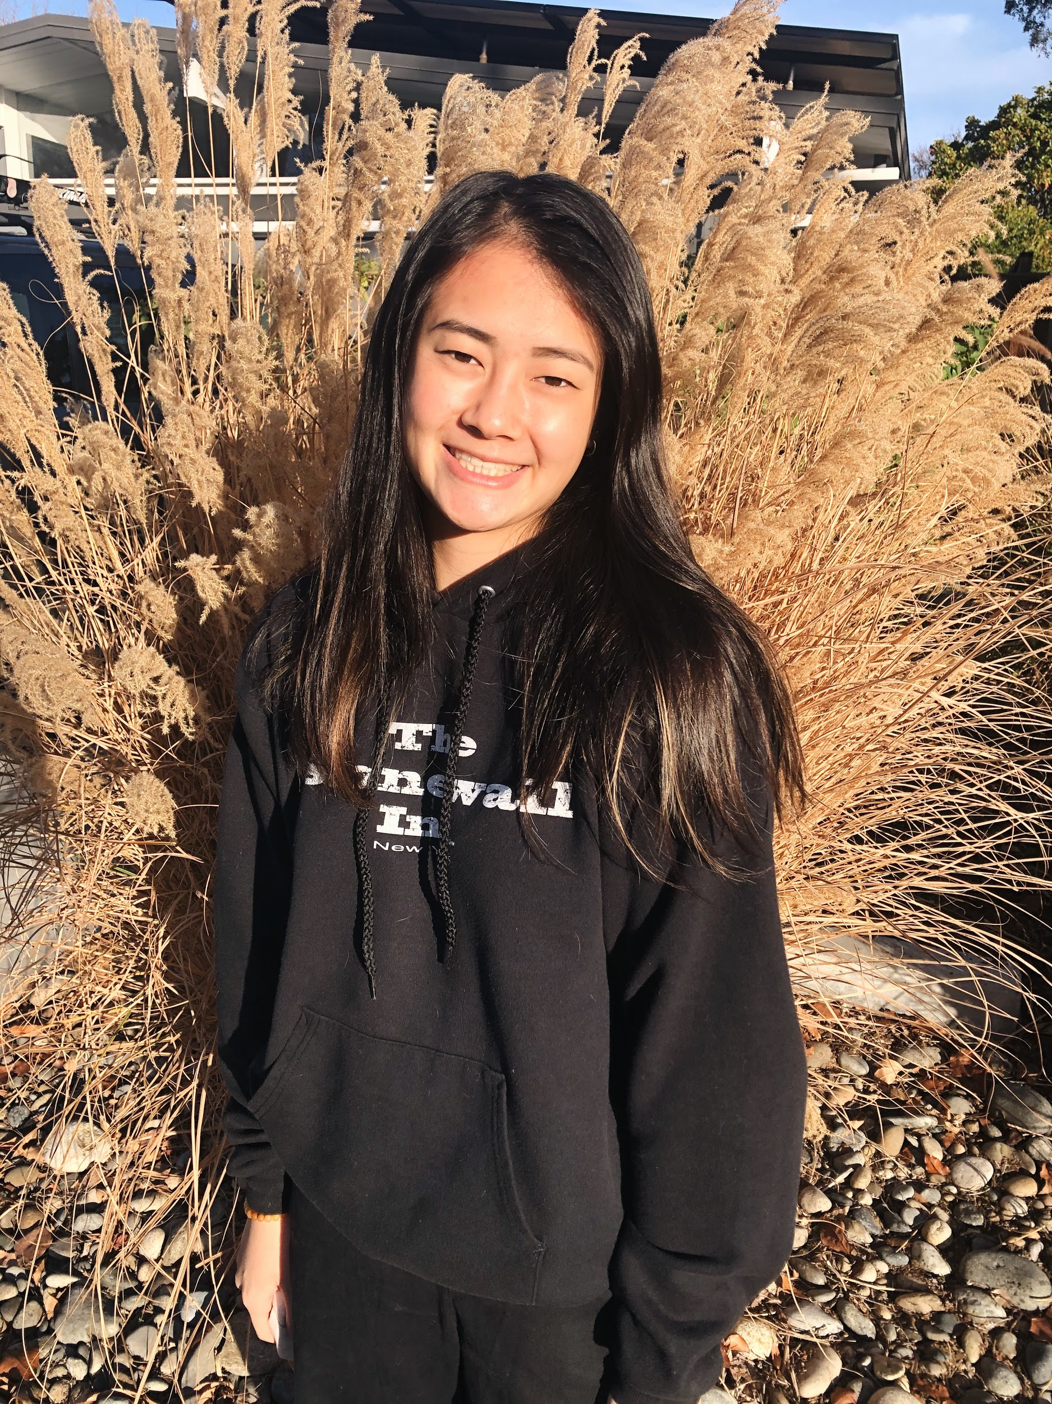


Grace Zhang
Anthony Xie
Rachel Leou
Katrina Liou

Slide 3
Value proposition
One step at a time
Problem
Technology has made it incredibly easy to live a sedentary lifestyle and lose awareness of the environment around us. This lack of environmental education and care towards nature makes it difficult for individuals to take action to live sustainably.
Solution
we hope barefoot can help people foster a deeper connection with the outdoors by immersing them in nature with contextual learning.

Slide 4
Overview
Heuristic evaluation + revised design

Slide 5
Overview
Heuristic evaluation + revised design
Prototype status

Slide 6

Overview
Demo!
Heuristic evaluation + revised design
Prototype status

Slide 7
Heuristic
Evaluation

Slide 8
Heuristic Eval Results
19 total 3-4 violations 9 changes
One left unchanged
36 total 1-2 violations 9+ changes
Most violated: H1: Visibility of Status , H4: Consistency & Standards , H2: Match between Sys & World

Slide 9
Design Revision Severity: 3-4
Problems (Related to med-fi limitations):
Creating landmark location is unclear
Unclear what feed content is
No option to not record trail
Recording doesn’t continue when accessing rest of app
Fix:
Hardcoded into application / intended to work in high-fidelity

Slide 10
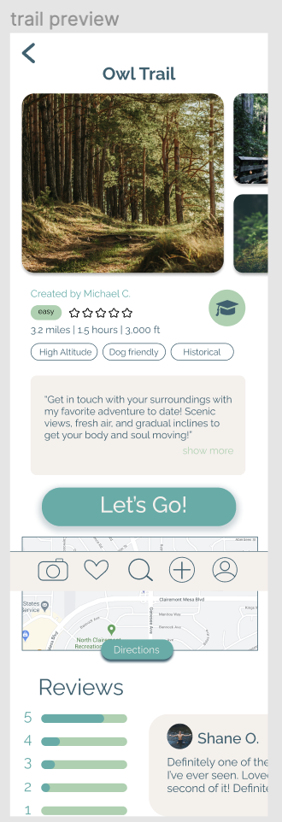
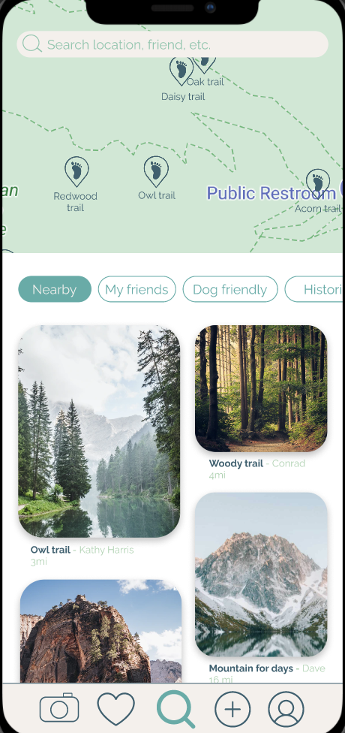
Design Revision Severity: 3-4
Problem 5:
Unclear which page of menu is currently selected
Fix:
Bold icons on current page!

Slide 11
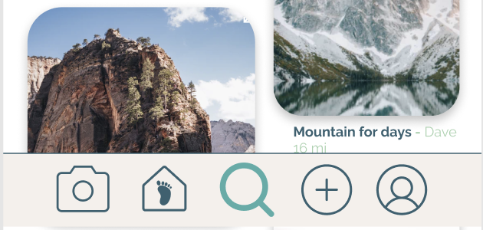
Design Revision Severity: 3-4
Problem 6:
Unclear function for heart icon on menu
Fix:
Changed icon to signify social media feed

Slide 12
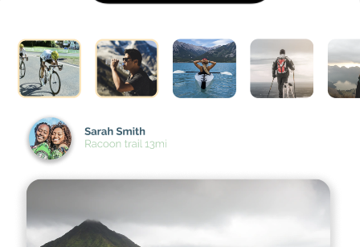
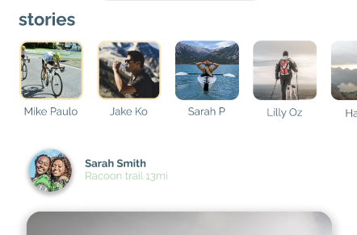
Design Revision Severity: 3-4
Problem 7:
Unclear what profile photos on top of feed are for
Fix:
Labeled stories with usernames!

Slide 13
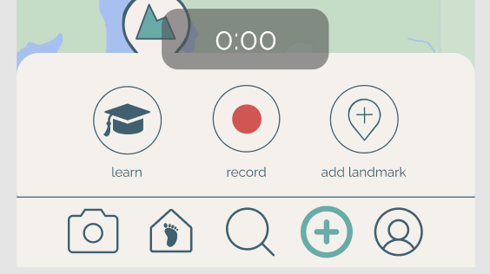
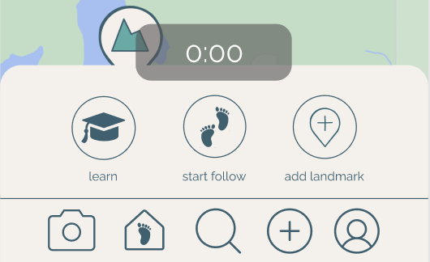
Design Revision Severity: 3-4
Problems:
8. Unclear what recording button is for
9. Unclear what pause and stop buttons are for
10. Confusion surrounding overall purpose of recording
11. Unclear if record button is the same as record for those who didn’t create the hike.
Fix:
Onboarding tutorial!
Reconfigure recording pages

Slide 14
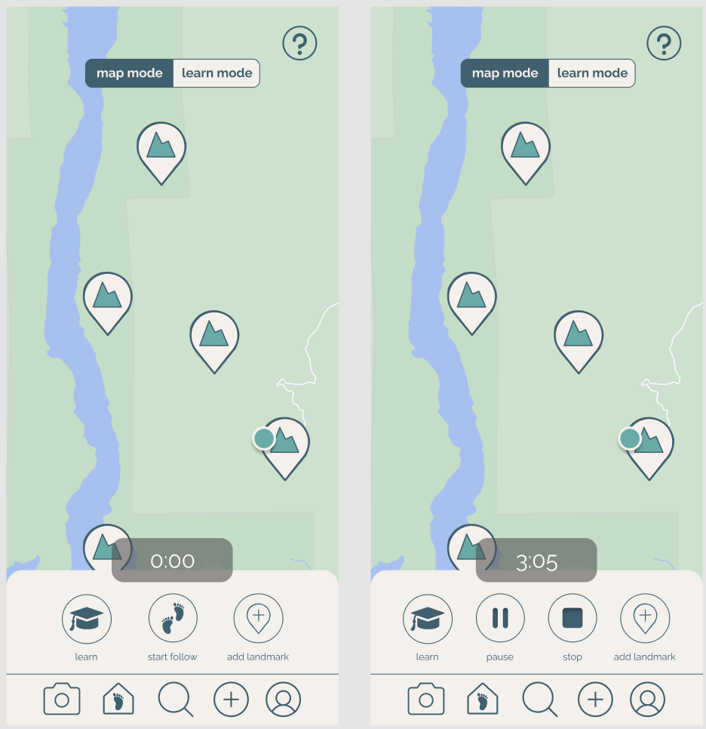
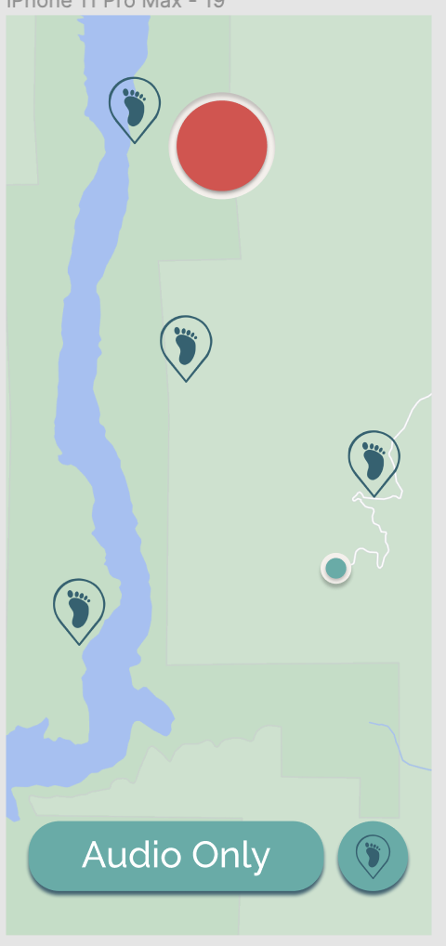
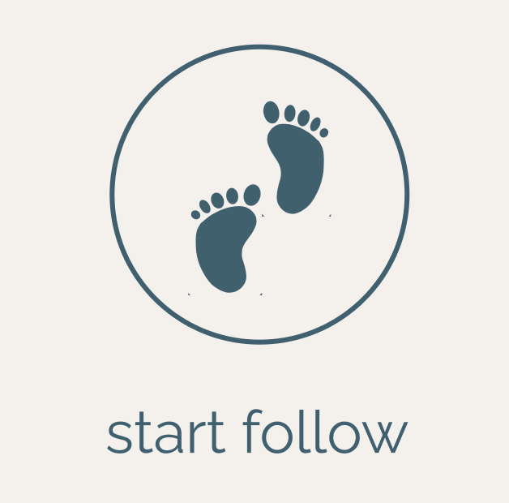
Before:
confusing recording buttons
After: onboarding process for follow trail and create trail

Slide 15
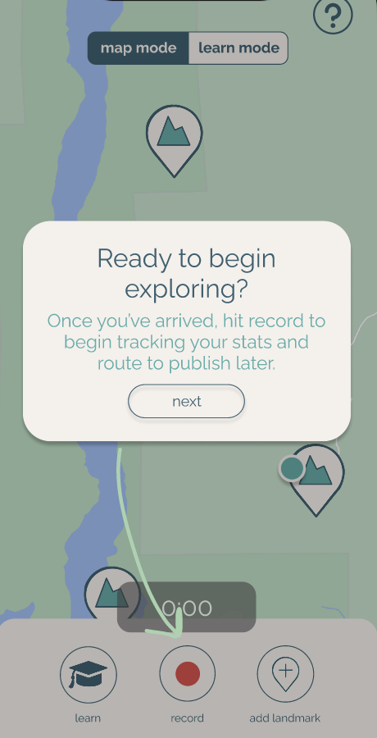
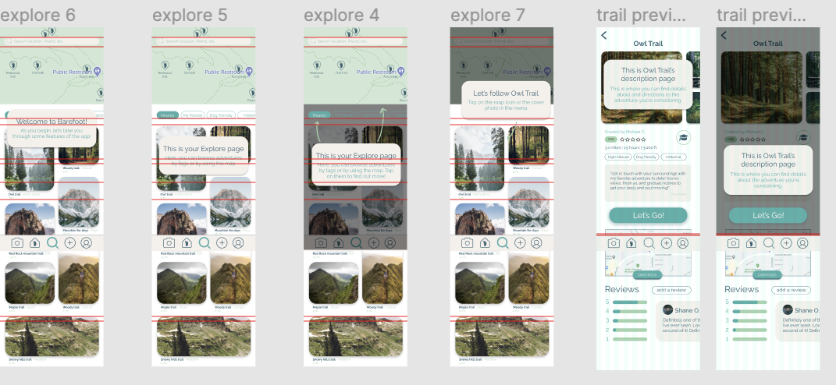
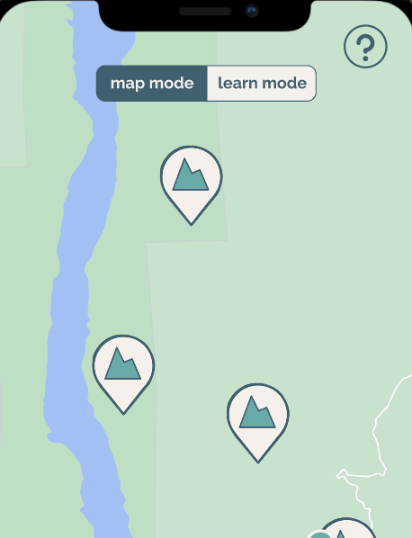
Before: no onboarding process
After: onboarding process for follow trail and create trail

Slide 16
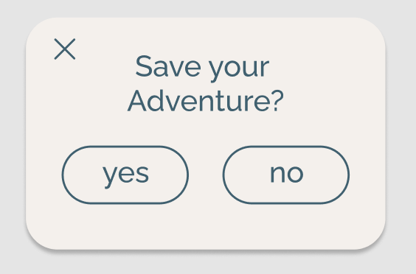
Design Revision Severity: 3-4
Problem 12:
No option to delete recording
Fix:
After ending hike, option
to delete or save
recording

Slide 17
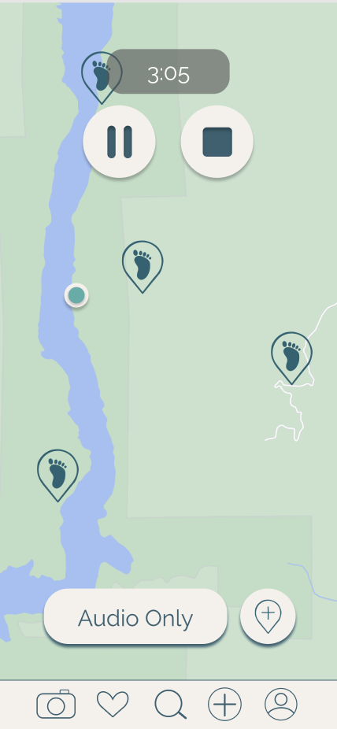
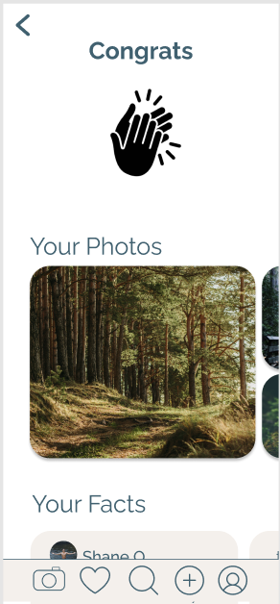
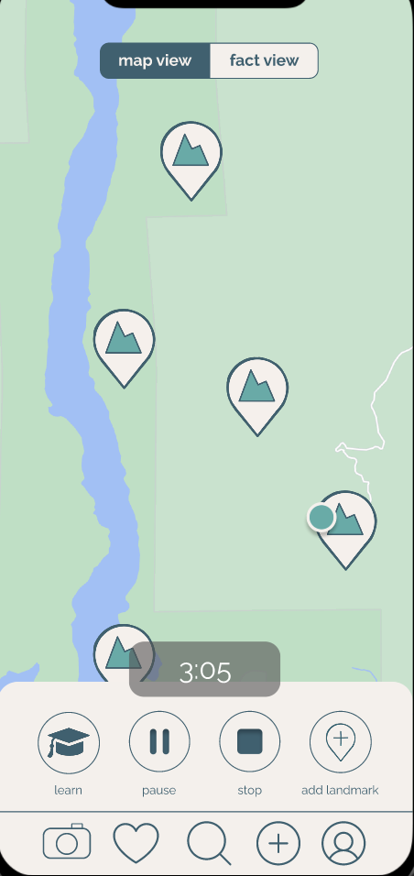
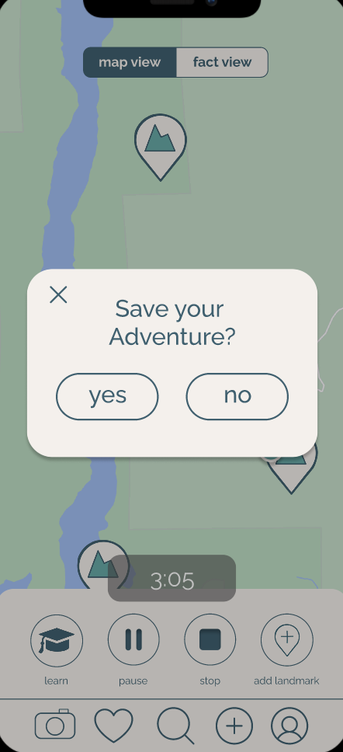
Before: straight to congrats page
After: Asks to save or delete adventure

Slide 18
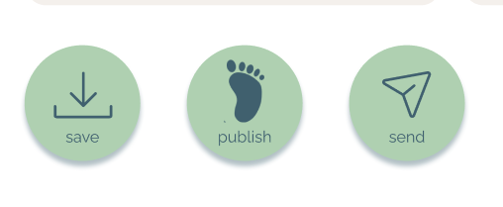
Design Revision Severity: 3-4
Problems:
13. Unclear what it means to share a hike vs. publish
14. What happens when you share?
Fix:
Label buttons and rename share to send

Slide 19
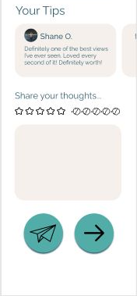
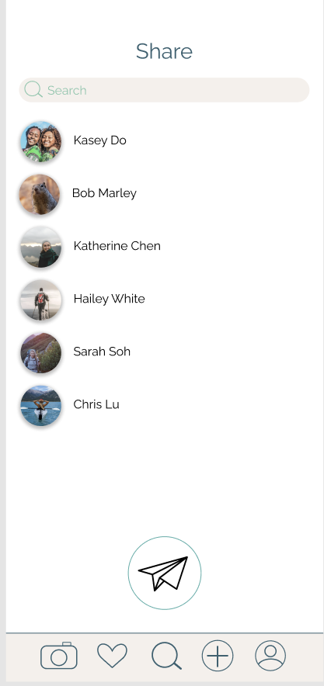
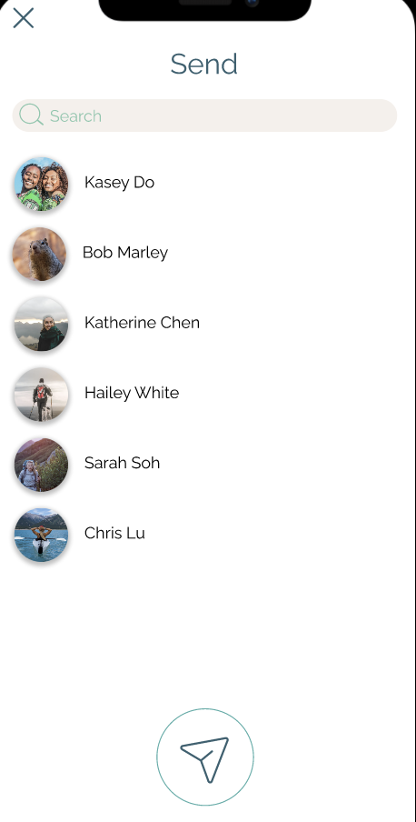
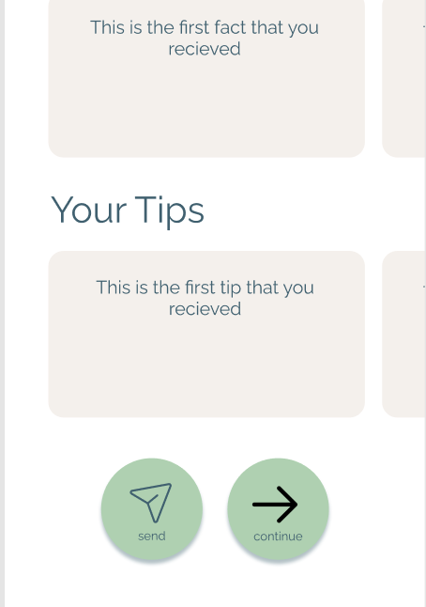
Before: buttons were not labeled and it was unclear what sharing would do
After: buttons are labeled and share was reworded to send

Slide 20
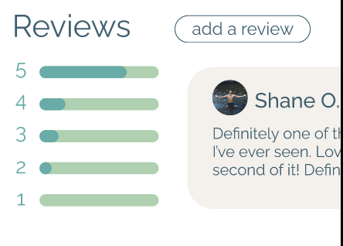
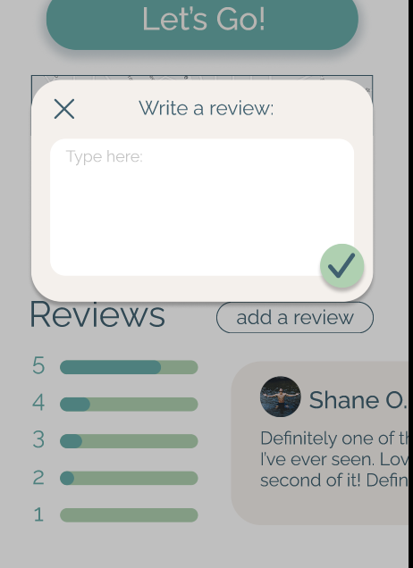
Design Revision Severity: 3-4
Problem 15:
User is only allowed to leave reviews after they finished hike
Fix:
Add “add review” option in trail detail page

Slide 21
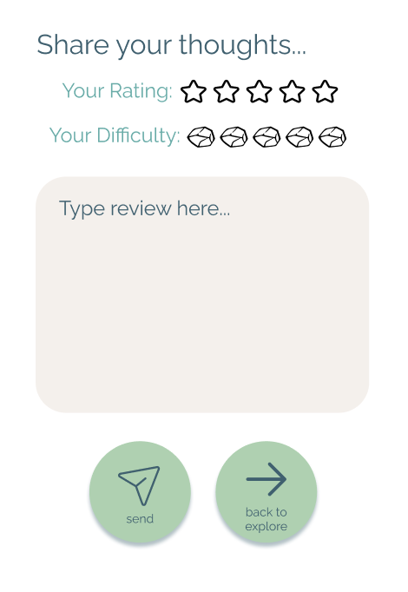
Before: only place to write a review was after hike. No option to add a review in the review section of the trail description
After: created option to add a review in the trail detail/ description page

Slide 22
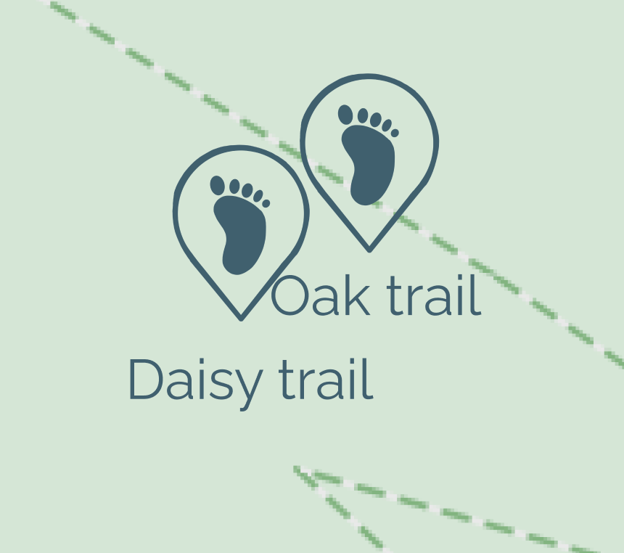
Design Revision Severity: 3-4
Problem 16:
Footprint icons on map did not signify which page you will be visiting
Fix:
Add trail name on map (similar to google maps)

Slide 23
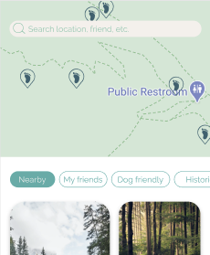
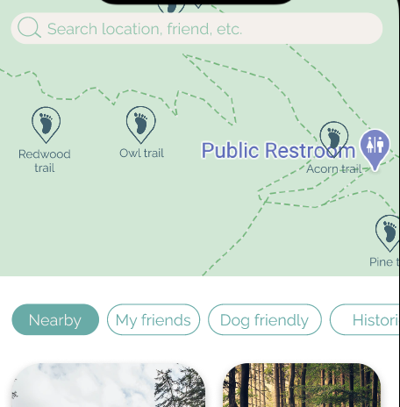
Before
After

Slide 24
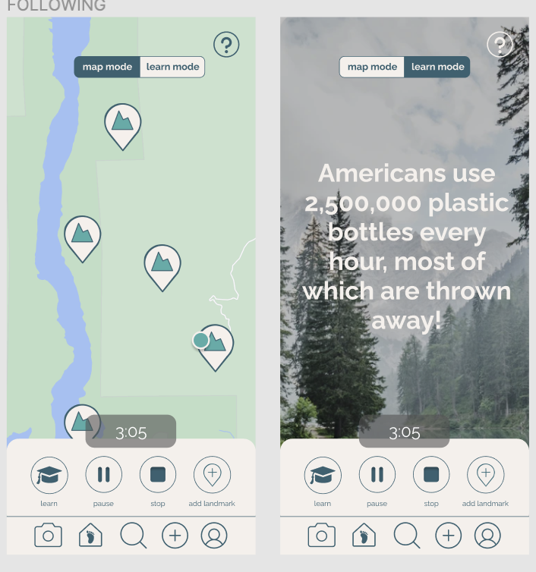
Design Revision Severity: 3-4
Problems:
17. Unclear function with audio only button
18. Audio only button label implies there is audio in map view
Fix:
Review audio only page and replace with learn mode

Slide 25
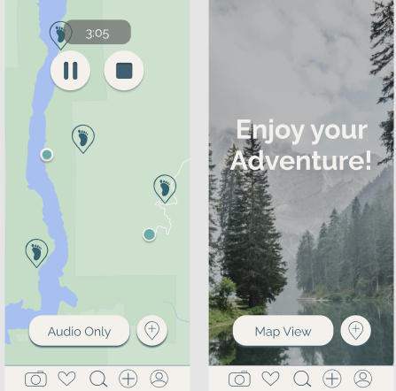
Before: audio only view button was confusing and function of audio only page was unclear
After: toggle between map mode and learn mode for 2 different ways of engaging with hike

Slide 26
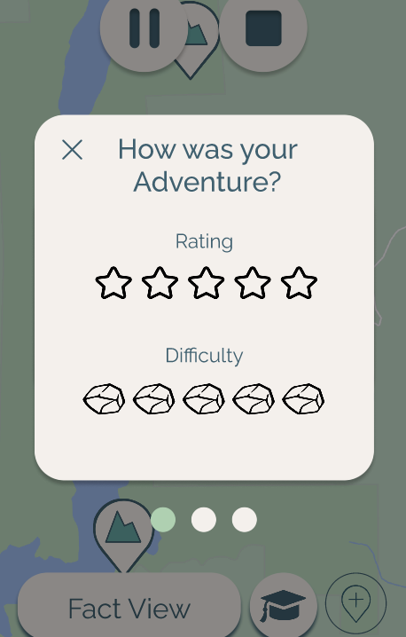
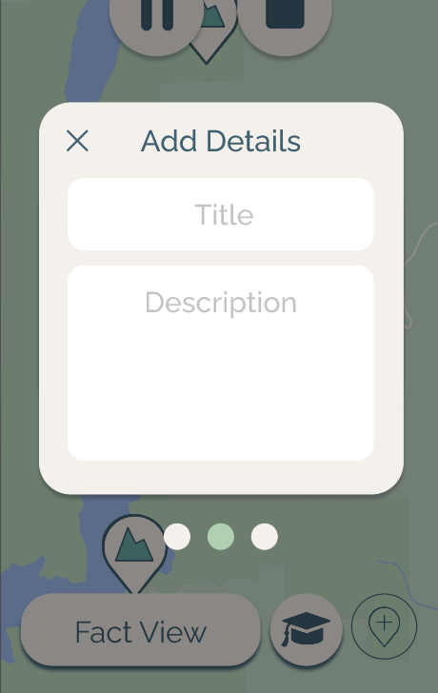
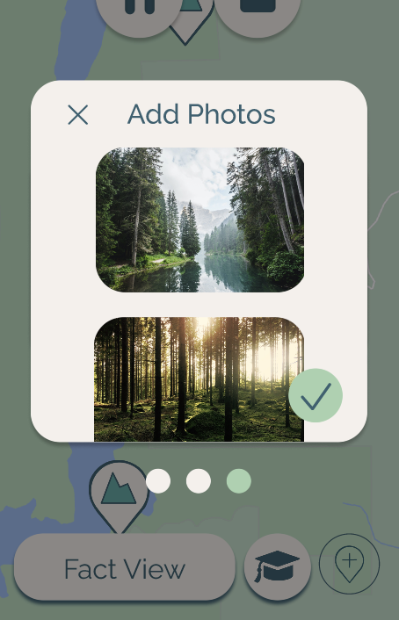
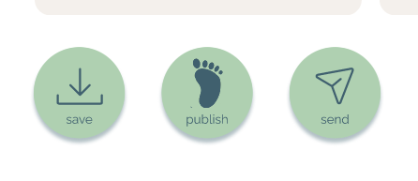
Design Revision Severity: 3-4
Unchanged Problem:
19. How do you prevent accidentally posting trail?
Already have a sequence that prevents accidentally posting a trail

Slide 27
Design revision severity: 1-2
Problem
“Watch out for” list is not accessible during hike
Landmark icons are unclear and the same as trail icons
Audio and map are not independent - can you listen while on map view?
Unclear what it means to create landmark does
No indication of what next arrow does after reviewing a hike
Unclear what saved is in profile
School/ learn button doesn’t look like a button
No indication on how to exit add landmark popup
Unclear back button on congrats page

Slide 28
Design Revision Severity: 1-2
Solutions:
“Watch out for” list is accessible during hike
Landmark icons are different than trail icons
Audio and map are not independent - can you listen while on map view?
Explain what creating a landmark does
Remove next arrow
Change saved in profile to bookmarked for clarification
Change learn button to look more like a button
Emergency exit on landmark popup
Fix back button on congrats page

Slide 29
Prototype Status

Slide 30

Tools Used
Mobile app built in React Native
Various React Native components/API
React Native Maps
Overlays and sliders

Slide 31
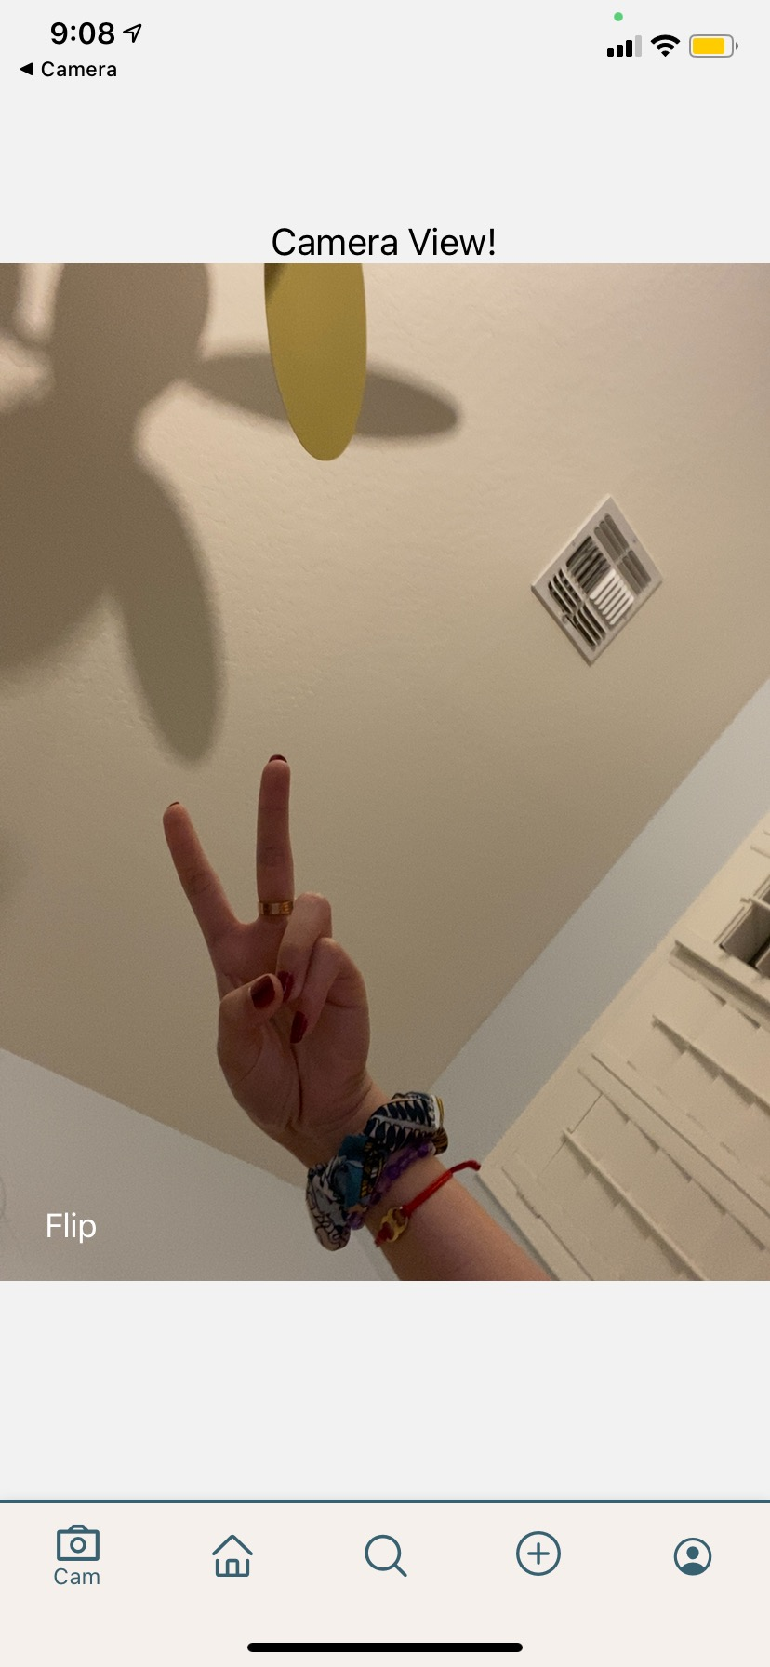
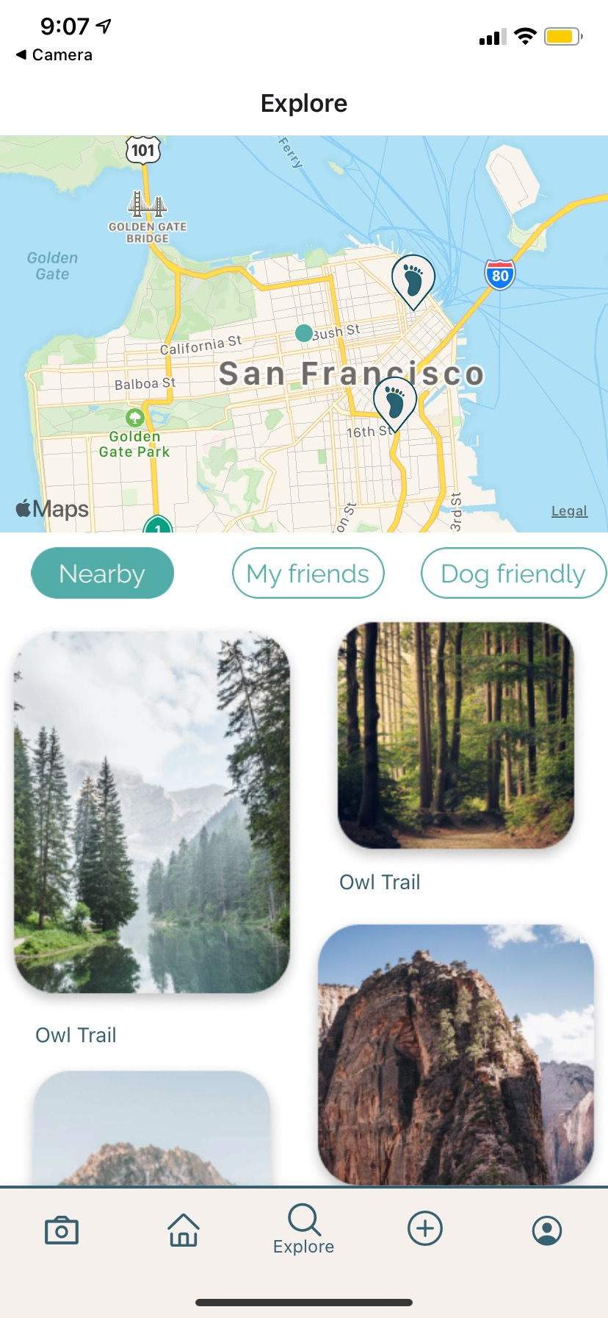
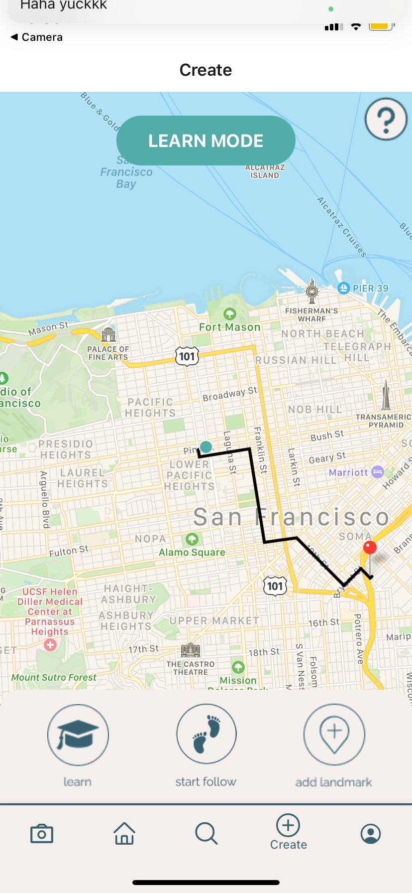
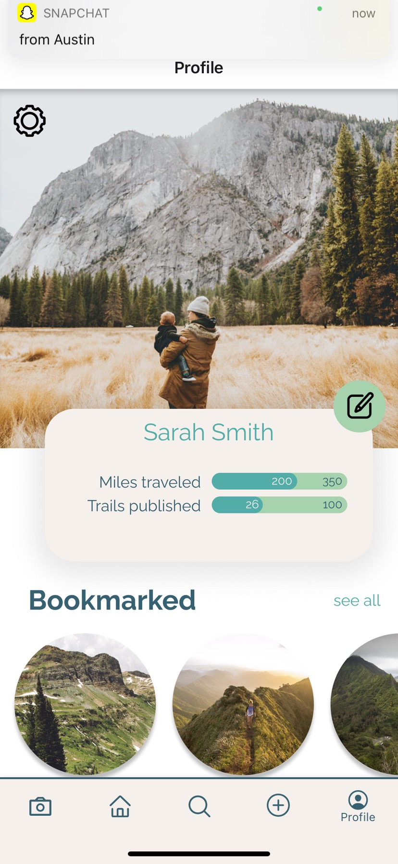
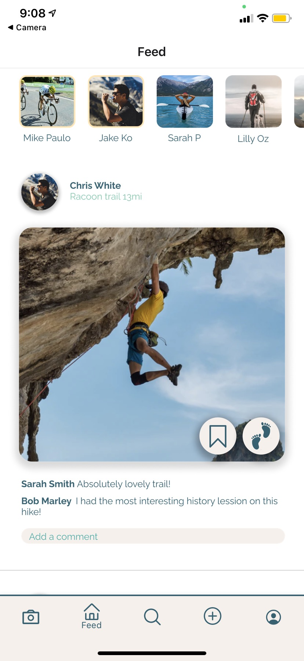
Implemented Features
Primary screens w/ nav bar

Slide 32
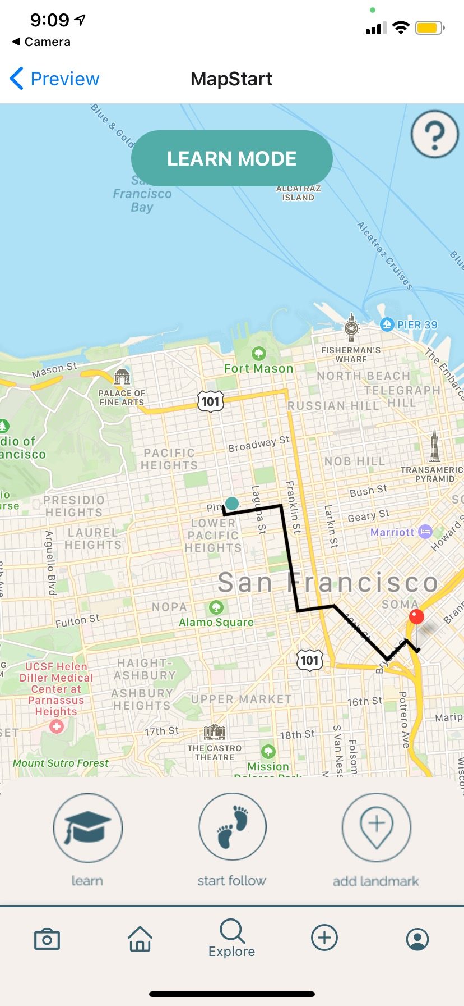
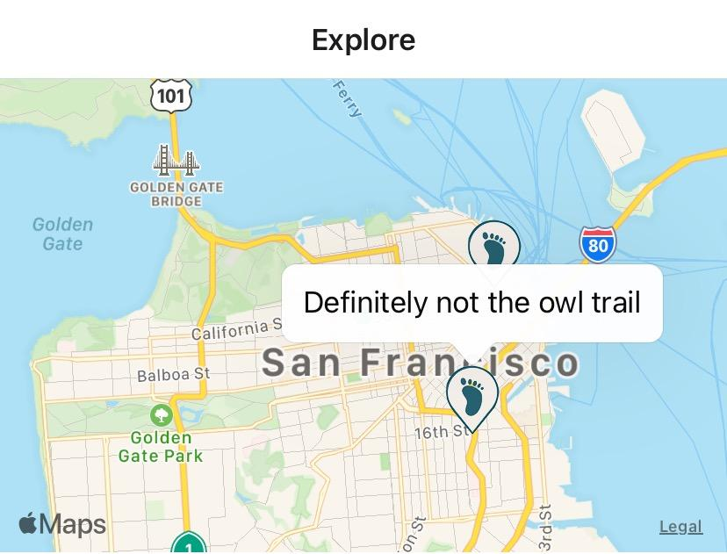
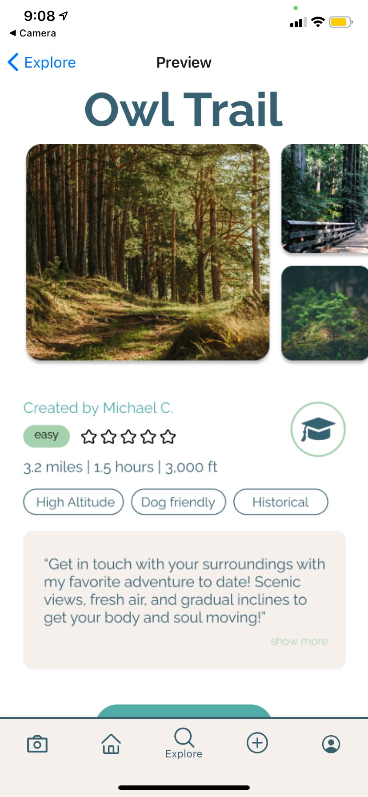
Implemented Features
Finding adventures through feed/explore
Interactive map w/ adventures

Slide 33
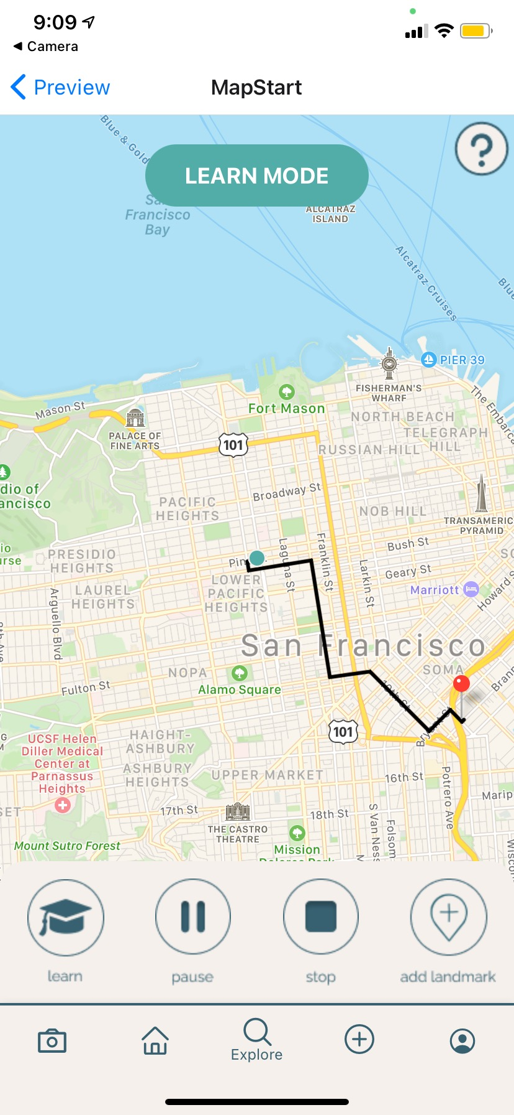
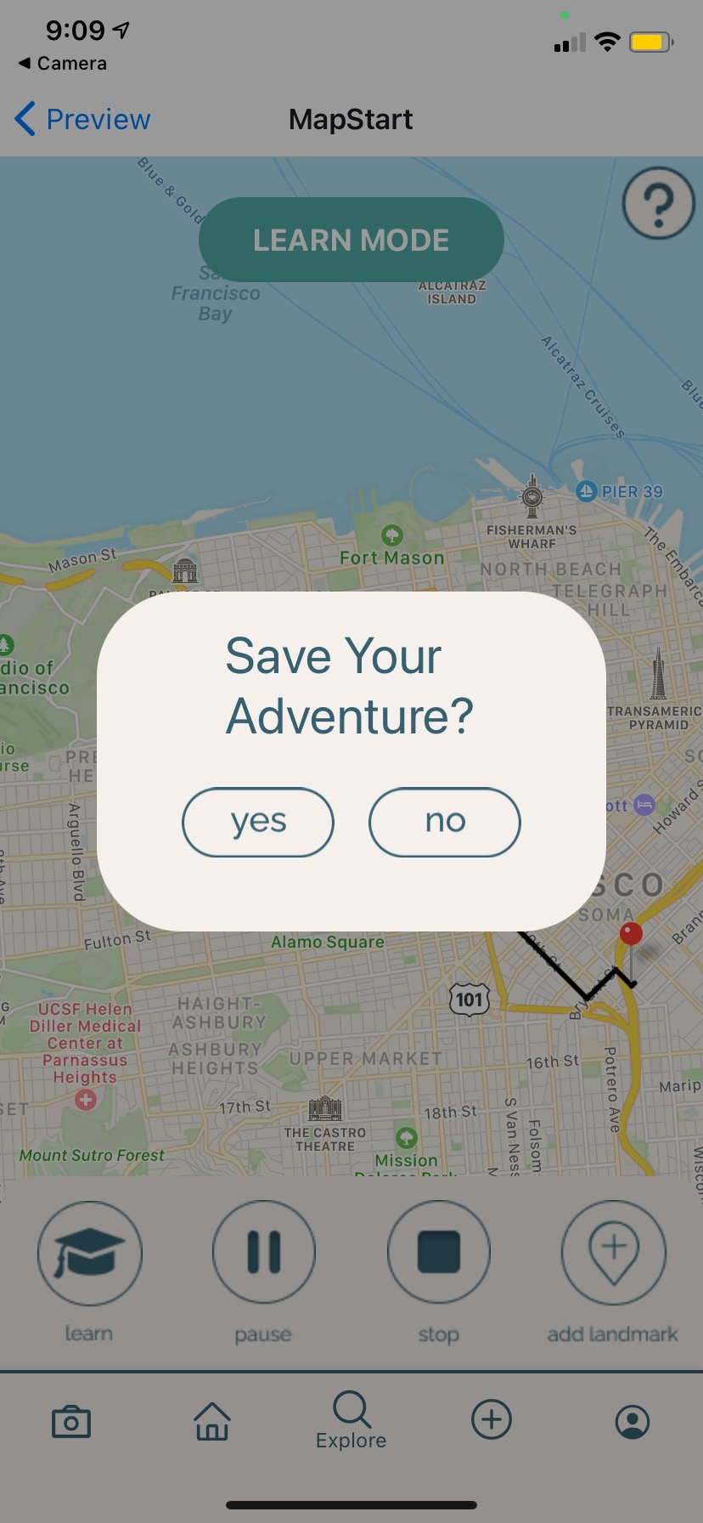
Implemented Features
Following & recording a pathway

Slide 34
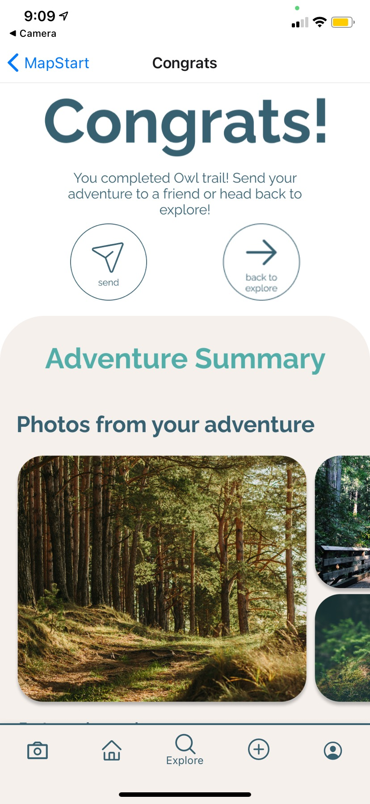
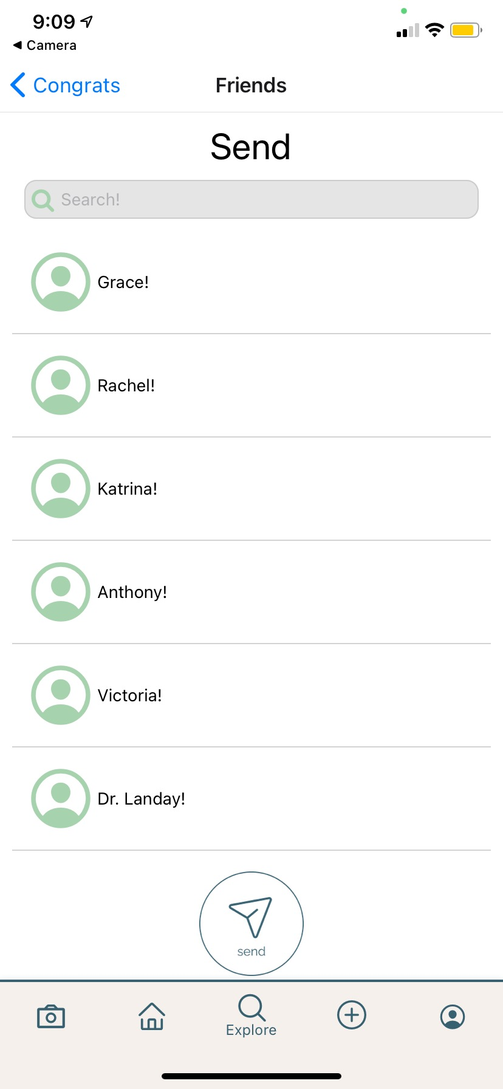
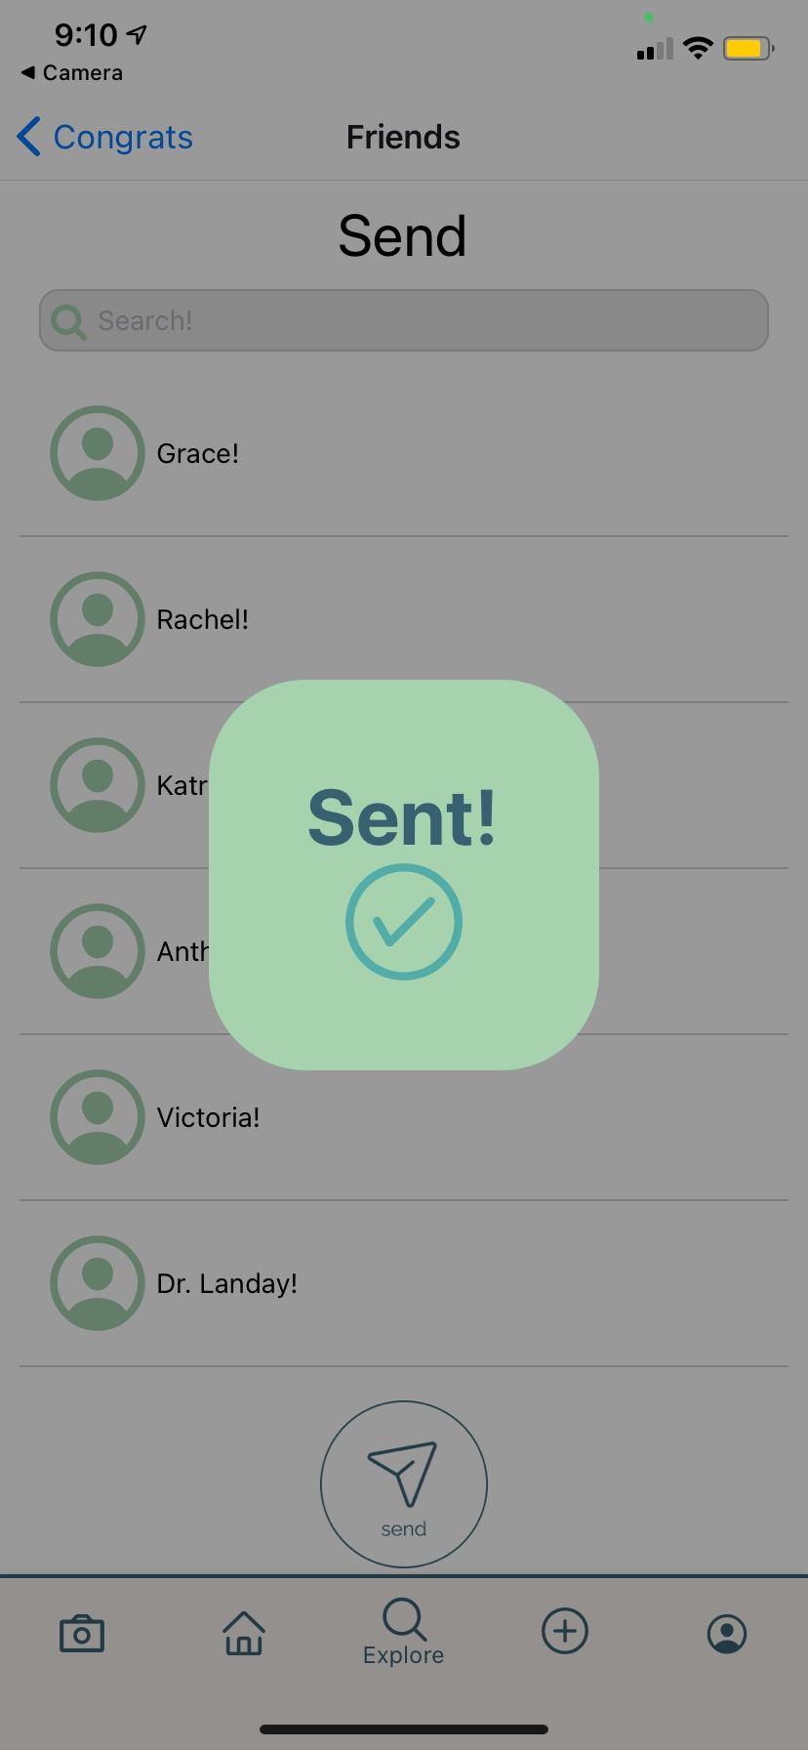
Implemented Features
Sharing adventures

Slide 35
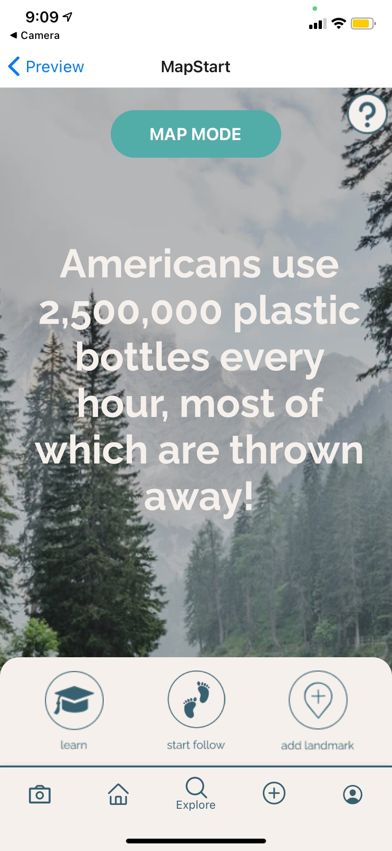
Implemented Features
“Learn” and “Map” Modes

Slide 36
Things to Complete
Refining various UI elements to match med-fi
Finishing trail creation task flow
Extra features (i.e, adding landmarks)
Help button overlay

Slide 37
Wizard of Oz
The “recording” function doesn’t actually record and “following” doesn’t track location
Trail path is auto generated using maps API
The provided fact is not based on location

Slide 38
Hardcoded Data
Fixed map location
Pre-defined trails
Contact list, profile, and feed

Slide 39
Issues/Questions
Unsure about specificity:
Should we display new post in feed once trail is published?
Should we track user location and movement?
(currently fixed in SF)

Slide 40
1
made 9 changes to address severity levels 3-4 and 9 minor changes for 1-2 severity
2
1 task fully completed for Hi Fi Prototype
summary
3
3 remaining tasks are 50% completed
4
on track to finish by our goal deadline!

Slide 41
Demo!

