Slide 1

Designing for ESL
Andrea Collins, Becky Weinstein,
Cathy Zhang, Kimberly Tran
Multimodal Interfaces to Broaden Access

Slide 2

POINTS OF VIEW
We met Thuy, who even after 10 years of speaking English is still uncomfortable with small talk.
We met Yuri, who finds that she is dependent on visual cues for verbal communication.
We met Alejandro, who feels burnt out from the burden of translating for his mother.

Slide 3

INTERVIEW INSIGHTS

Slide 4

ELSA
English/Spanish elementary school teacher from Panama, 70s
"Sometimes it's hard to translate from Spanish to English. Jokes in Spanish just don't make sense in English!"
Notes:
Elsa moved from Panama City in the 1960s when she was in her 20s with two children. She's always loved learning languages, and she learned English by completely surrounding herself in the language. After getting her bachelors and masters in ESL education in her 50s and working as a teacher, she still struggles with pronunciation and translating jokes/colloquialisms.

Slide 5

KAZUKI
Recent college graduate from Osaka, Japan, 20s
“When I first moved here I was so nervous, plus I am afraid to speak to Americans”
Notes:
Wasn't until he took a job at a welcome desk and started working as a mascot that he started feeling more comfortable learning English, still struggles with slang words, intimidating to speak up on a Zoom call

Slide 6
REVISED
POINTS OF VIEW

Slide 7
#1
We met Thuy, a mother who immigrated from Vietnam 10 years ago
We were amazed that after a decade of speaking English, Thuy is still uncomfortable with small talk
It would be game-changing to help her feel more comfortable in a variety of English-speaking situations
Notes:
HMWs:
...help Thuy be exposed to different types of conversations so she can practice her skills
...give Thuy a template for different small talk contexts
...remove Thuy from any situation which requires small talk
...help others engaging in small talk with Thuy better understand why she feels it difficult to engage with them
...make small talk a more fun experience for her
...empower the person at the other side of the dialogue to support her
...integrate small talk into her daily life through existing conversations
...connect Thuy with people she feels comfortable communicating with for practice
...teach Thuy conversational English in an impactful way
...assess the specific areas in conversational English that make Thuy uncomfortable
...give Thuy low pressure ways to practice small talk
...expand Thuy’s vocabulary in a low-commitment way

Slide 8
#2
We met Yuri, an international student from Japan who is still not completely comfortable with using English beyond the classroom
We were amazed how dependent she is on visual cues for verbal communication
It would be game-changing to help her to rely less on visual and physical cues
Notes:
HMWs:
...help Yuri understand words through masks
...make Yuri more comfortable with her ability to listen to words
...help Yuri practice picking up English words without visual cues
...develop Yuri’s confidence to engage in communications virtually despite visual limitations
...assess Yuri’s true comprehension of words (without visuals)
...help supplement visual cues that are not present during COVID
...help Yuri become more comfortable relying less on visual cues and more on actual words
...provide more visual and emotional cues for Yuri in online settings
...normalize providing visual cues to an ESL
...make social distance less of a barrier for translation
...use mobile devices to supplement in-person communication involving masks
...integrate features into existing video chat solutions to decrease the difficulty of understanding fast and/or hard-to-understand speaking

Slide 9
#3
We met Alejandro, who immigrated with his family as a child from Ecuador and often had to serve as his mother’s translator and communicator
We were amazed to learn that he is exhausted from having to constantly support his mother as a translator and communicator
It would be game-changing to provide Alejandro with a resource to enable him to alleviate his mother’s dependence
Notes:
HMWs:
...help Alejandro support his mother in a less extreme way
...connect Alejandro with other resources which can also help his mother
...automate or supplement Alejandro’s help to make his tasks less repetitive
...help Alejandro balance his commitments as a son and translator with his goals as a student
...help Alejandro’s mother communicate more easily without a third person translating
...increase the accessibility of resources for Alejandro’s mom
...make the translation process more fun and rewarding
...provide resources to his mother that make her feel more comfortable becoming proficient in English on her own
...mediate boundaries between Alejandro and his mom
...support Alejandro emotionally so he doesn’t feel frustrated helping his mother
...create more situations in which his mother doesn’t require a translator
...simplify the process for Alejandro’s mom to handle government language

Slide 10

HOW MIGHT WE…?

Slide 11
HOW MIGHT WE...
POV: Thuy
make engaging in small talk more accessible and fluid for adult ESL speakers in their daily lives?

Slide 12
HOW MIGHT WE...
POV: Thuy
expose adult ESL speakers to various English-speaking contexts in which they may feel uncomfortable?

Slide 13
HOW MIGHT WE...
POV: Yuri
decrease the difficulty of understanding fast and/or hard-to-understand speech for adult ESL speakers?

Slide 14

SOLUTIONS

Slide 15

App:
Fun Videos
To learn Culture & Conversational Skills
Source Videos to Understand Colloquialisms
How might we make engaging in small talk more accessible and fluid for adult ESL speakers in their daily lives?

Slide 16



Provide Visual Cues
During Conversation
How might we make engaging in small talk more accessible and fluid for adult ESL speakers in their daily lives?

Slide 17

Learn Conversational English Through a Game
How might we expose adult ESL speakers to various English-speaking contexts in which they may feel uncomfortable?

Slide 18
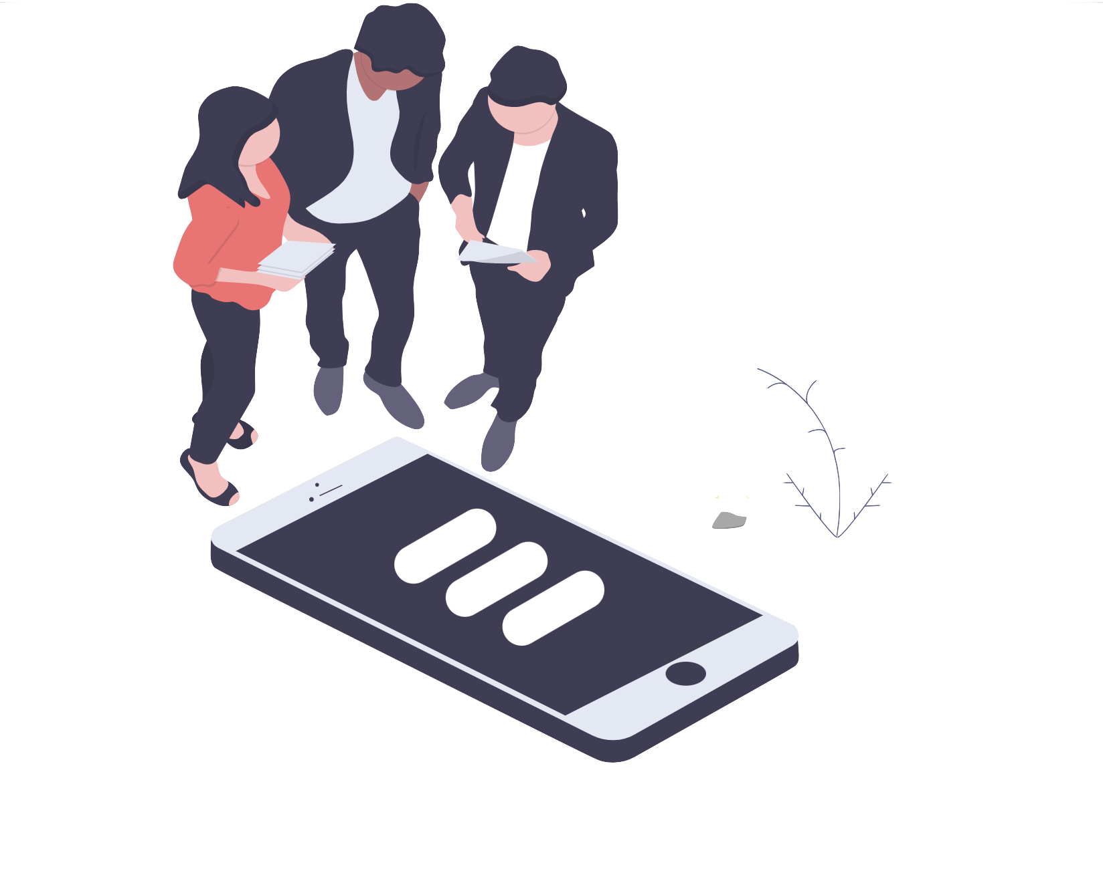
PROTOTYPES

Slide 19
PROTOTYPE #1
short videos to learn colloquial English

Slide 20
ASSUMPTIONS
People feel engaged while watching short videos
People can learn from watching short videos

Slide 21

DORA
Dermatologist who was born and raised in Israel, 50s
“I didn’t even know I was pronouncing it wrong”

Slide 22
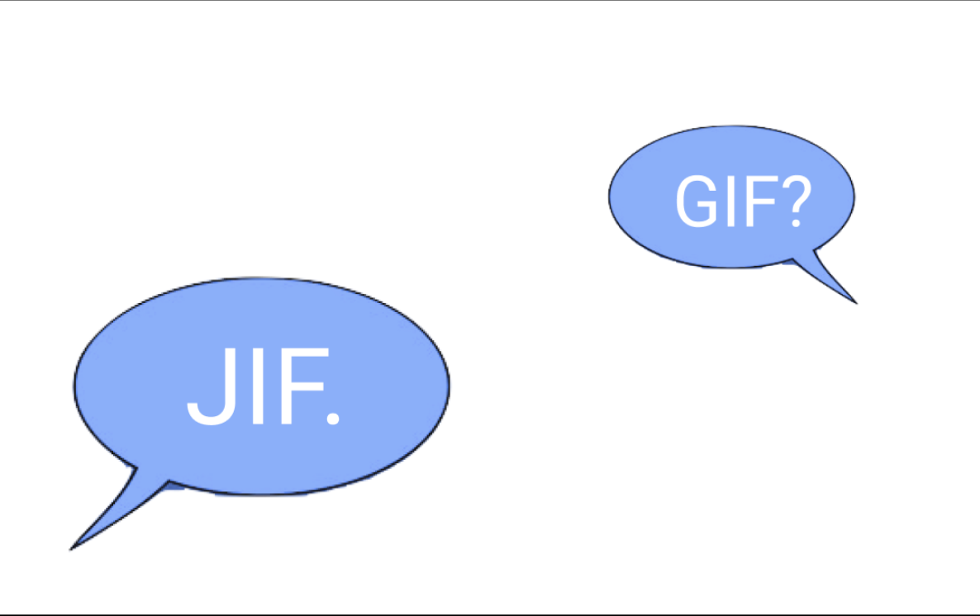
GIF
JIF
Place your screenshot here
Which is the correct pronunciation?

Slide 23
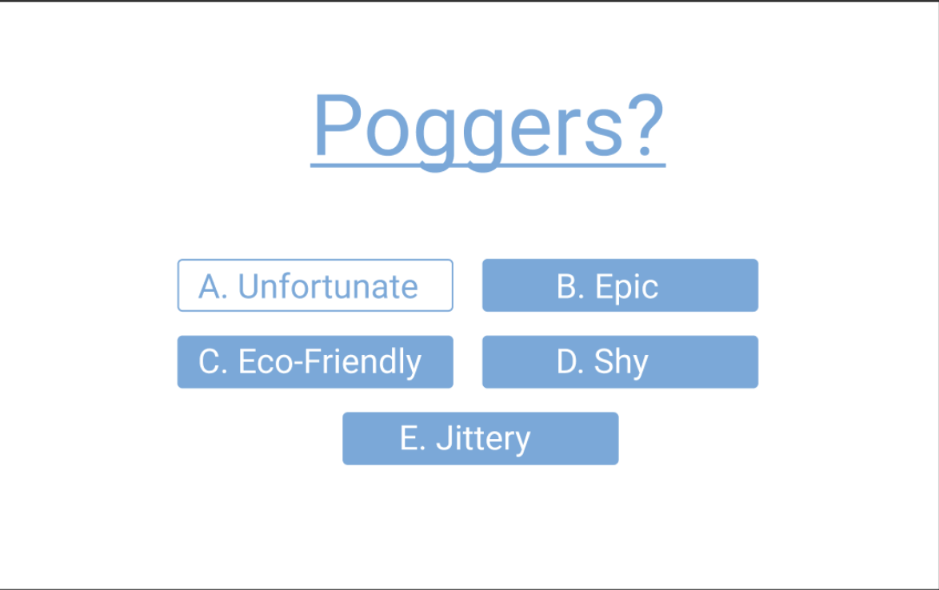
GIF
Place your screenshot here
Which is the correct meaning?

Slide 24
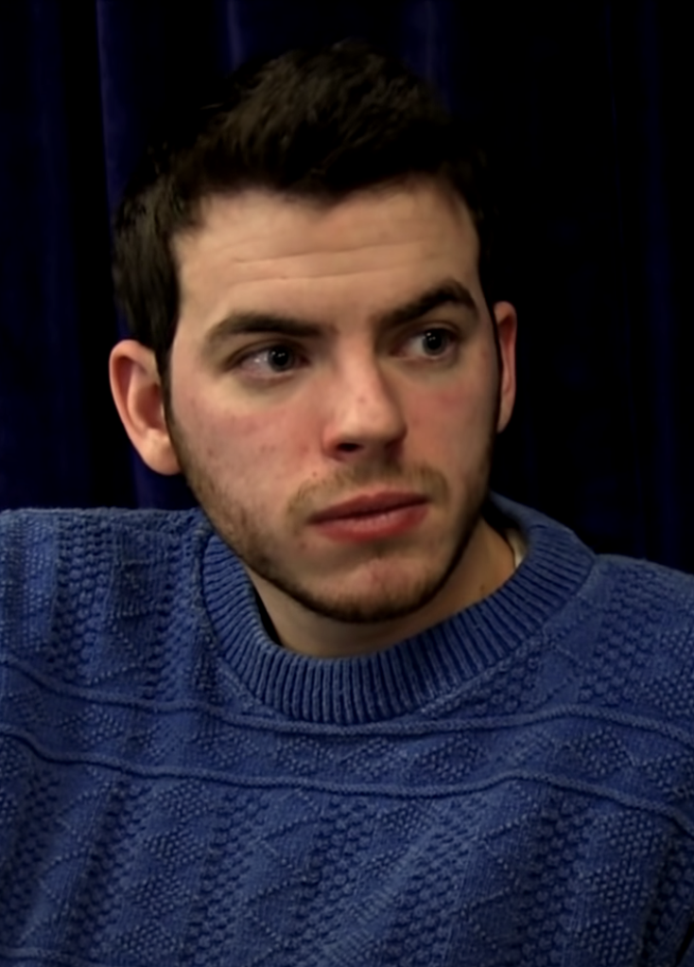
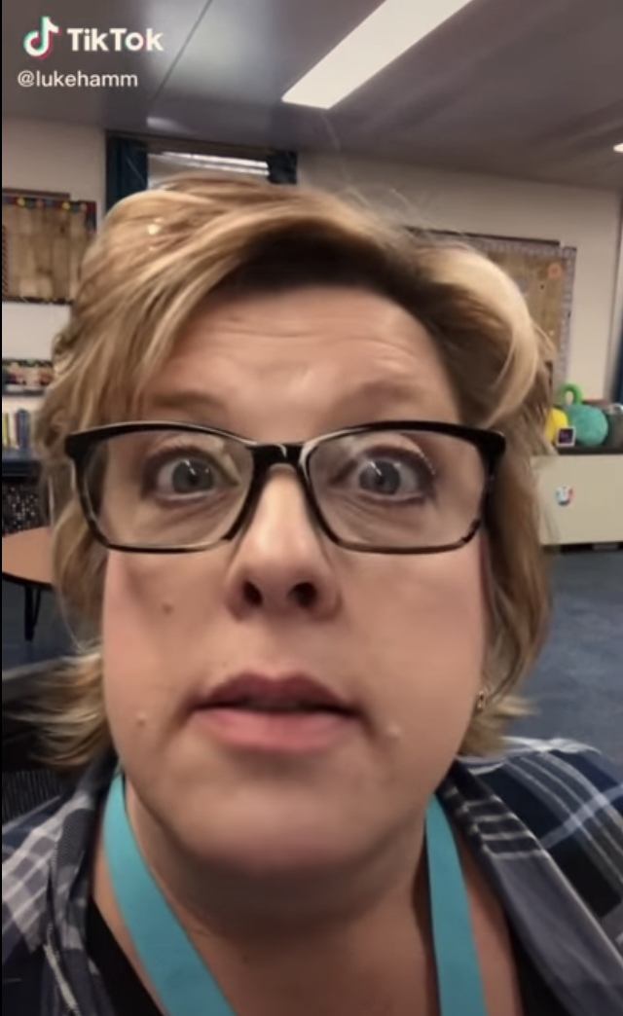
“It’s pronounced Gif”
“This is a totally epic, poggers moment”

Slide 25
Outcome
Initial Score: Final Score:
How likely are you to retain this information?
How much did you enjoy learning in this format?
0/2
2/2
1
5
1
5

Slide 26
TAKEAWAY
People can successfully engage with and learn from content in a short video format.

Slide 27
PROTOTYPE #2
providing visual cues during conversations

Slide 28
ASSUMPTIONS
Visual cues are helpful during a conversation.
Visual cues are not distracting or stressful during a conversation.

Slide 29
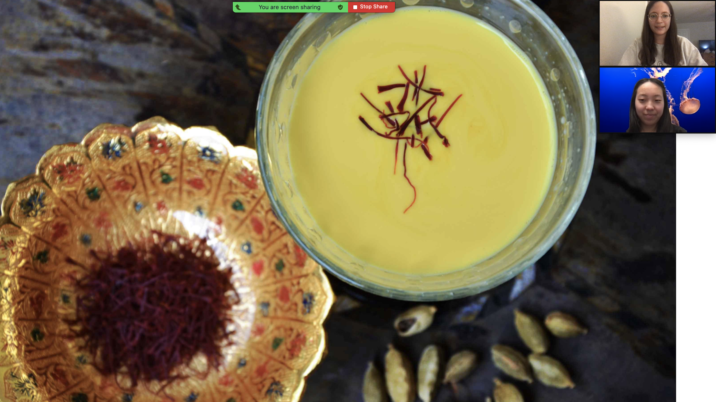
Prototype #3
Notes:
We tested these assumptions by holding two short conversations with each other while our tester listened in. During the first conversation, we shared a story about empanadas without any visuals. In the second conversation, we shared a story about another dish, chicken biryani, with visuals of Indian ingredients and emotions mentioned in the conversation. We asked our tester about her comprehension and experiences listening to our conversations.

Slide 30

JENNY
Engineer and immigrant from China of 25 years, 50s
"When I didn't understand, I could make a guess using the pictures."
Notes:
We tested our prototype with Jenny, a mother in her 50s who immigrated from China 20 years ago. Jenny, reported that she found the second conversation with visuals easier to understand and follow. When she didn't understand something, she could better infer the meaning from the visuals; this was particularly helpful for the Indian ingredients she was unfamiliar with. She also noted that the visuals helped her imagine the mood and emotions of the story, namely the warm family vibes that Andrea, the storyteller, was trying to convey. She reported that she would've liked detailed images of the progress of making empanadas, such as a picture of the different ingredients and the final product, during the first conversation to help her follow the conversation better.
"The image of the family enjoying the meal at the end made me feel warm and calm."

Slide 31
TAKEAWAY
Visuals during a conversation can assist with ESL speakers' comprehension.
Notes:
Visuals helped Jenny fill gaps in her understanding and imagine the right mood

Slide 32
PROTOTYPE #3
gamifying real world situations to learn English

Slide 33
ASSUMPTIONS
People will be engaged playing a game to learn English
Playing a game is an effective way to retain English

Slide 34

WILL
Refugee who immigrated from Vietnam, 60s
“We had a ‘monkey see, monkey do’ kind of philosophy to learn how to react in unfamiliar situations.”
Notes:
Will immigrated from Vietnam when he as a young adult. He primarily learned english through observing others around him and reading books which walked through various scenarios.

Slide 35


TESTING
Notes:
For this prototype, we created a google form that walked through various conversational scenarios. The user is asked to respond to a series of questions that they would encounter in real life scenarios. We even included “I don’t know” options that provide more context (either with more descriptions or visuals) to clarify and build better understanding of the options provided. Through this, the intent is to expose the user to vocabulary, phrases, and culture so that they can understand context and learn common responses in a variety of situations. For example, the diner scenario walks through an interaction one would have with a waiter at restaurant. This is inspired by Yuri’s story about being unsure about how to ask for water at a restaurant on her own when she first moved the the US.

Slide 36
TAKEAWAY
Exposure and repetition allow ESL populations to learn and retain English.
Notes:
This solution allows people to practice situations they are uncomfortable with or prepare for situations they might encounter in the future.

Slide 37
INSIGHTS
Visuals
Repetition
Relevance
Interactive
Notes:
Remember to cite which prototype tests support each insight

Slide 38

COMBINED SOLUTION
we want to create interactive, visual scenarios where users can practice English in everyday situations

Slide 39
SUMMARY
Pain Points - small talk, various contexts, difficult-to-understand speech
Quick Prototypes - videos, quizzes, slideshow, Google Form
Incorporate visuals, repetition, and interaction

Slide 40
NEXT STEPS
further develop the story around our solution via our concept video and continue testing our insights

Slide 42
How Might We...
Appendix
HMWs from POV 1
...help Thuy be exposed to different types of conversations so she can practice her skills
...give Thuy a template for different small talk contexts
...remove Thuy from any situation which requires small talk
...help others engaging in small talk with Thuy better understand why she feels it difficult to engage with them
...make small talk a more fun experience for her
...empower the person at the other side of the dialogue to support her
...integrate small talk into her daily life through existing conversations
...connect Thuy with people she feels comfortable communicating with for practice
...teach Thuy conversational English in an impactful way
...assess the specific areas in conversational English that make Thuy uncomfortable
...give Thuy low pressure ways to practice small talk
...expand Thuy’s vocabulary in a low-commitment way

Slide 43
How Might We...
Appendix
HMWs from POV 2
...help Yuri understand words through masks
...make Yuri more comfortable with her ability to listen to words
...help Yuri practice picking up English words without visual cues
...develop Yuri’s confidence to engage in communications virtually despite visual limitations
...assess Yuri’s true comprehension of words (without visuals)
...help supplement visual cues that are not present during COVID
...help Yuri become more comfortable relying less on visual cues and more on actual words
...provide more visual and emotional cues for Yuri in online settings
...normalize providing visual cues to an ESL
...make social distance less of a barrier for translation
...use mobile devices to supplement in-person communication involving masks
...integrate features into existing video chat solutions to decrease the difficulty of understanding fast and/or hard-to-understand speaking

Slide 44
How Might We...
Appendix
HMWs from POV 3
...help Alejandro support his mother in a less extreme way
...connect Alejandro with other resources which can also help his mother
...automate or supplement Alejandro’s help to make his tasks less repetitive
...help Alejandro balance his commitments as a son and translator with his goals as a student
...help Alejandro’s mother communicate more easily without a third person translating
...increase the accessibility of resources for Alejandro’s mom
...make the translation process more fun and rewarding
...provide resources to his mother that make her feel more comfortable becoming proficient in English on her own
...mediate boundaries between Alejandro and his mom
...support Alejandro emotionally so he doesn’t feel frustrated helping his mother
...create more situations in which his mother doesn’t require a translator
...simplify the process for Alejandro’s mom to handle government language

Slide 45
Appendix
Solutions from HMW 1
AI chatbot that generates various conversations where they engage in small talk to practice
App with fun video from pop culture/relevant interests that reflect various conversions
Short, fun conversational snippets for language learners
App that connects them with people to chat to practice
Pen pal app to connect them with someone to practice written conversation with
Set up conversation partners with people trying to learn their language
App that analyzes their messages and suggests other ways of phrasing things to diversify their vocabulary and conversation style
Goals tracker to track conversation goals
Give them phrase of the day to integrate into a conversation
Give them cues during her actual conversations
Have common phrases pop up as an extension during video calls
Give them templates at the beginning, middle, and end of day, personalized to their needs
Diary where they can write down things that happened, and then templates that help them convert these happenings into small talk
Practice small talk with people they're comfortable with (like family members)
Help them find low-stakes environments in their existing life to practice small talk
Special small language dictionary with common small talk phrases

Slide 46
Appendix
Solutions from HMW 2
Chatbot that adapts the conversation based on where there is confusion or to build diversity in conversation thorough thoughtful conversation flow
Sim-like game that integrates conversational scenarios that help us assess their comfort level (i.e. choose your story - we can assess which scenarios they avoid and find ways to integrate those more smoothly into the game for them to practice)
Diagnostic tool that gives common situations and asks user to rate their comfort, then generates personalized curriculum to address their needs
Something that generates various conversational videos that also ask for their feedback to gauge understanding (mini-quizzes to practice comprehension)
Set up meetings that imitate situations (ex. doctor’s office) and help user progress through levels of difficulty
Have user track / categorize the day’s conversations and rate them on comfort level to track their comfort over time / provide resources to address the areas of lower comfort
Journal app where they can record conversations and situations that made her uncomfortable
Interactive short videos of different contexts for conversational English
App that listens to their daily conversations and then assesses the parts they have difficulty with
Informational vocabulary tool with common terms in English but separated by situation and difficulty

Slide 47
Appendix
Solutions from HMW 3
Personalized voice profiles added to communications to improve accuracy of closed captions
Visual depictions of conversations as there are happening to give more visual context and understanding of conversation
sentiment analysis for sentences read online that produces an emoji to represent the emotion from the sentence/paragraph
AI that generates a flow chart of conversation, more specifically stories, to help track who is who and information grouping
Standards to provide enough clarity to normalize specific things like closed captions in educational and professional settings
Encouraging checkpoints to summarize last x minutes throughout the meeting
Visual AI that recognizes confusion and attempts to provide context to the user to clarify potential points of confusion
Annotations sent to attendees after meeting
Recap tool that helps meeting planners send agenda and recap before and after meetings
Highlight the meeting attendees who are being addressed at any given time
Integrate a deliverables tool into video chat to help attendees figure out what their job is after the meeting
Live keywords (and maybe person who said it so that you can check in individually with the person later)
An anonymous “someone in the meeting didn’t understand” button that anyone can click
Add more options to use emojis in video calls
Somehow incorporate ASL into conversations
Some sort of color scheme that changes color based on the sentiments expressed by the person at that time in meetings

