Slide 1
Visual Impairment & Technology
Assignment 1
Jung-Won, Haeli, Dani, and Sydney

Slide 2
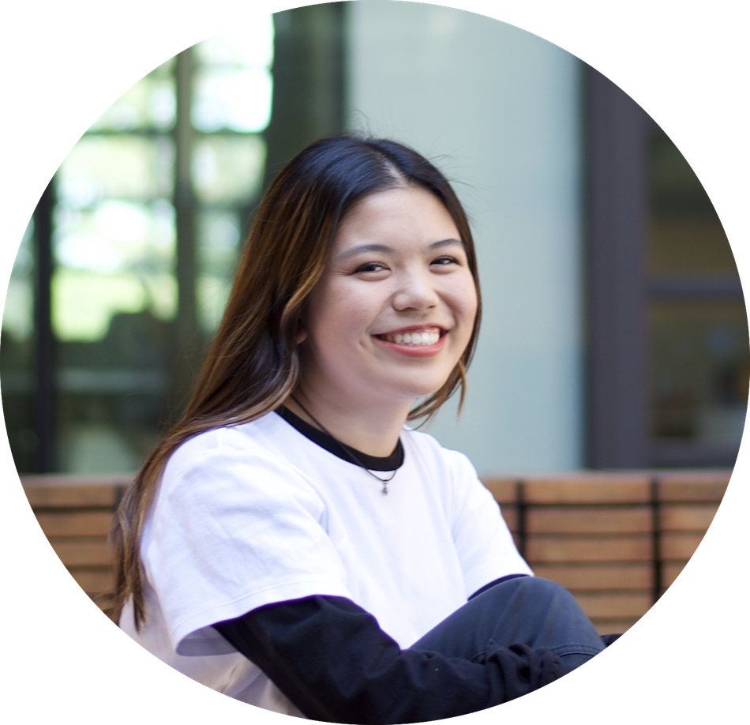
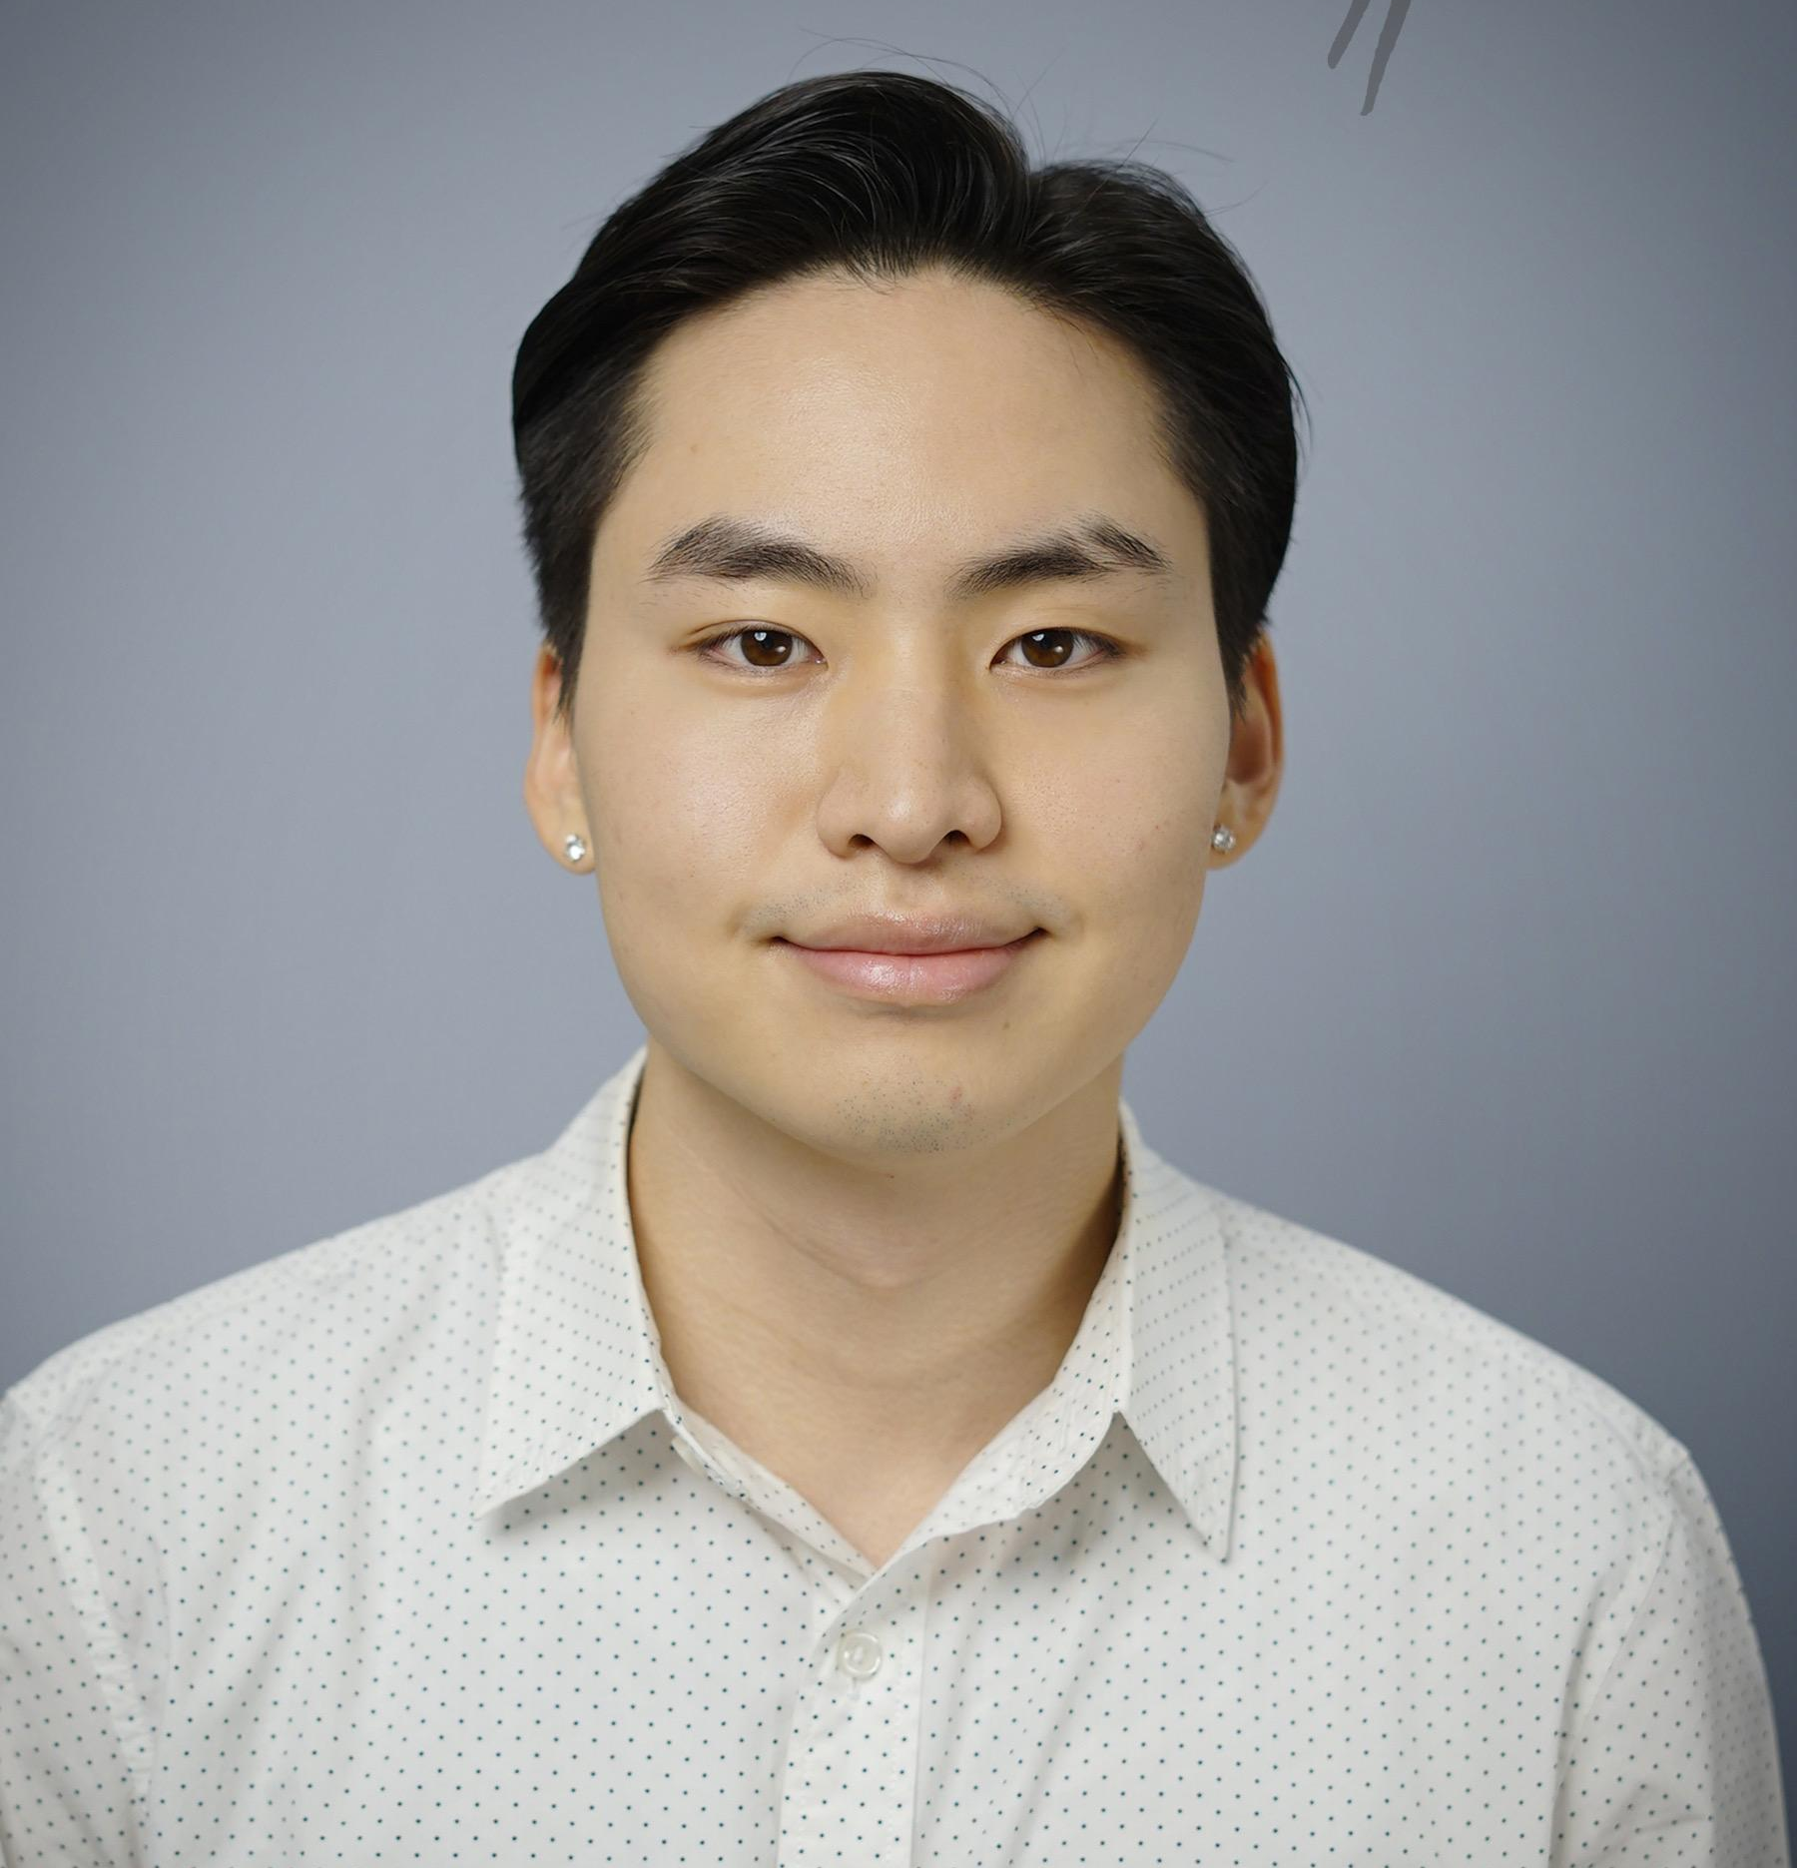
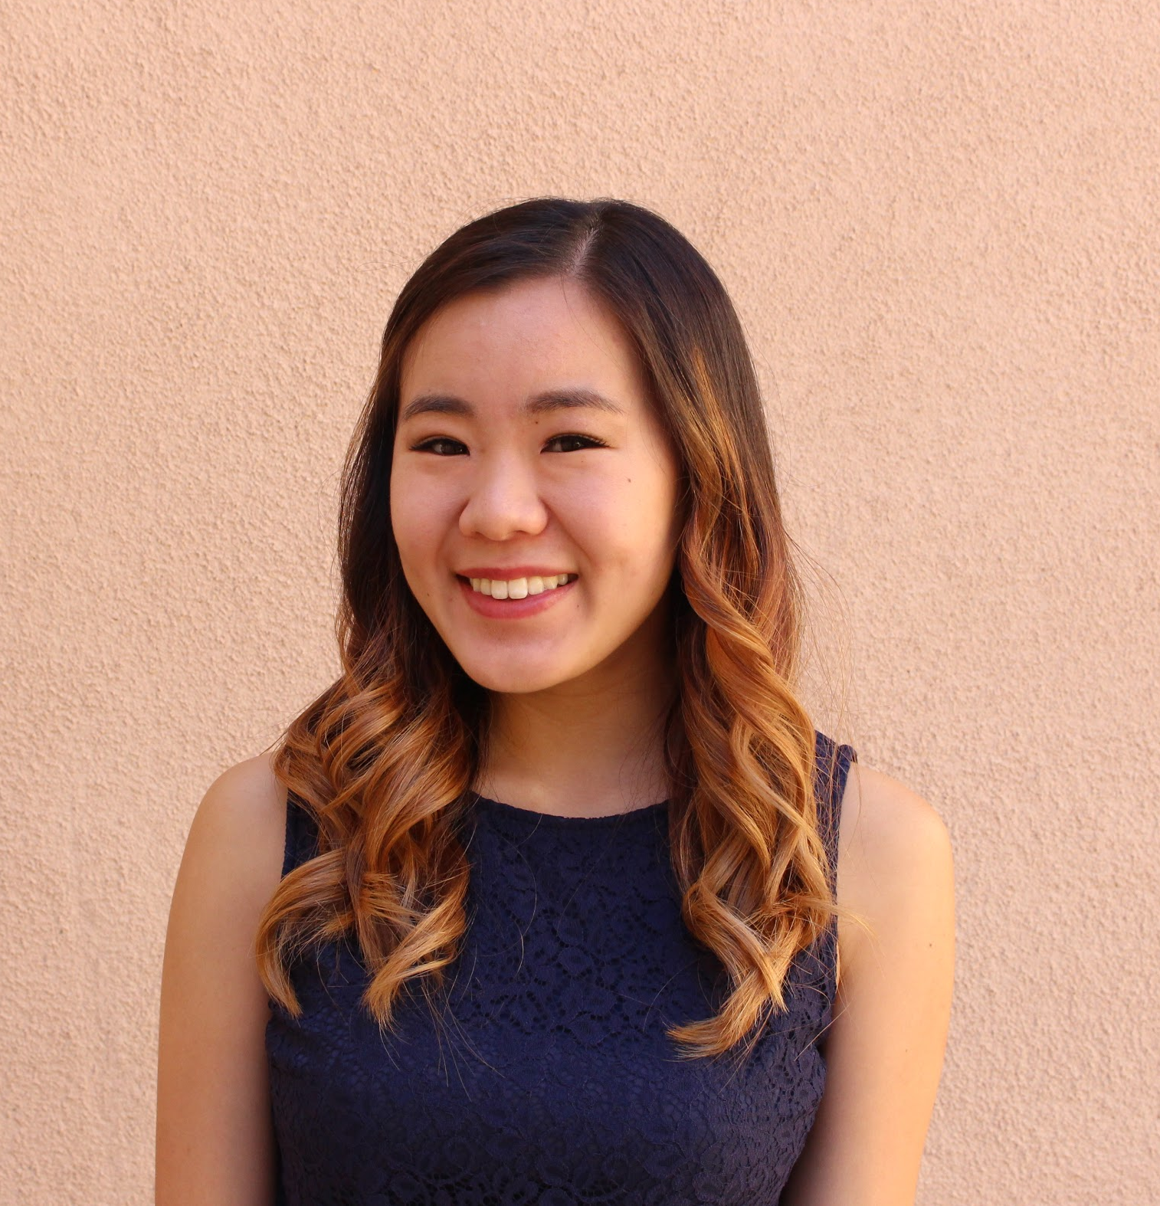
Meet Our Team
Sydney Jones
2021, Computer Science - HCI
Danielle Cruz
2021, Symbolic Systems - Learning
Jung-Won Ha
2021, Computer Science - AI
Haeli Baek
2021, Symbolic Systems - HCI

Slide 3
Project Domain
In what ways do visually impaired users interact with technology?
Notes:
Why we chose this domain - visually impaired people are forced to interact with technology in a multimodal way - cannot rely on screens only.

Slide 4
Interview 1
Adrian
Who
Stanford CS graduate (HCI), software engineer, nystagmus in one eye and blind in the other
Why
Perspective of a designer and developer with visual impairment, ample experience interacting with different devices and technologies
How
Emailed for 35-min Zoom chat, not compensated
Notes:
Nystagmus = “vision condition in which the eyes make repetitive, uncontrolled movements. These movements often result in reduced vision and depth perception and can affect balance and coordination.”

Slide 5
Interview 2
Michael
Who
Stanford lecturer in CS, visually impaired
Why
Perspective of a developer and engineer, legally blind, born with glaucoma
How
Emailed for a 45-min Zoom chat, not compensated
Notes:
Extreme user
Glaucoma is a group of eye conditions that damage the optic nerve

Slide 6
Interview 3
Patricia
Who
Sydney’s grandmother, 79 years old, LOVES emojis
Why
Perspective of older generation, non-technical background, vision loss with age (cataract surgery)
How
Messaged for a 30-min Zoom chat, not compensated
Notes:
Losing vision due to age. Positive experiences with tech. Our interviewees have a range of ages

Slide 7
Can you walk me through your typical day and your interactions with technology?
What about your FitBit made it confusing to use?
Tell me about a time when technology was really helpful
What Did We Ask?
Is there any technology you can’t use? Why?
Why do you prefer magnification to a screen reader?
Why do you say it’s unusual to pair Braille and magnification?
What are some frustrations in your daily life?
Notes:
Pink questions represent the probing questions specific to the person

Slide 8
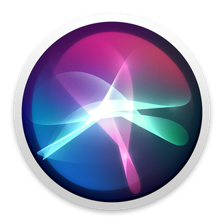
Siri is the worst voice assistant of all time.
Adrian
Notes:
Inaccuracies of Siri, e.g. if Siri misunderstands you, you get weird search results
Girlfriend uses it, despite subpar results
Prefers to type for own Google searches, or else it feels like you’re sacrificing quality of results
(Connects to insight #1:Even though voice assistants and screen readers can overcome visual boundaries, inaccuracies and losses of interaction can make them less preferable.)

Slide 9
I prefer magnification to a screen reader because I can still interact with images on the screen.
Michael
Notes:
Similarly, Michael prefers to use magnification to a screen reader because he can still interact with images on the screen
Don’t feel like you’re sacrificing quality
(Connects to insight #1:Even though voice assistants and screen readers can overcome visual boundaries, inaccuracies and losses of interaction can make them less preferable.)

Slide 10
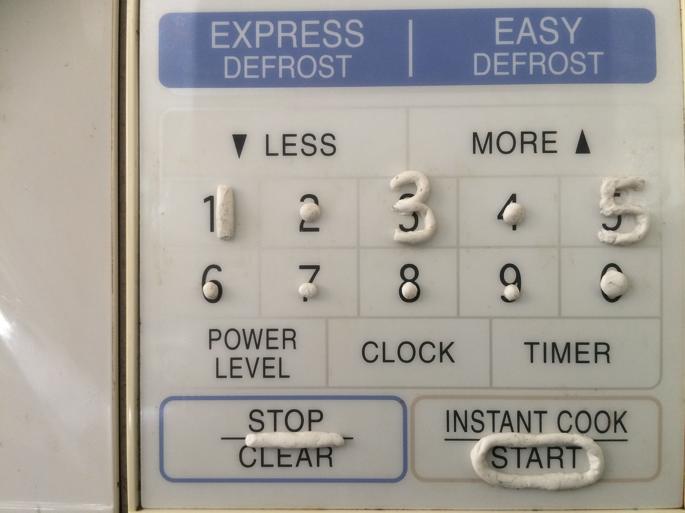
I don’t want a microwave that talks to me. I just want a way to know where the numbers are. I want to be able to use the same kind of microwave everyone else does.
Michael
Notes:
When things are set up in such a highly specialized way, the functionality can seem cut off from the rest of the world.
Prefers tactile methods rather than using audio for the microwav. Uses tapes
(Connects to insight #2: While each person has a different visual impairment and different things that work for them, highly specialized assistive tech can be frustrating in that it seems cut off from the rest of the world.)

Slide 11
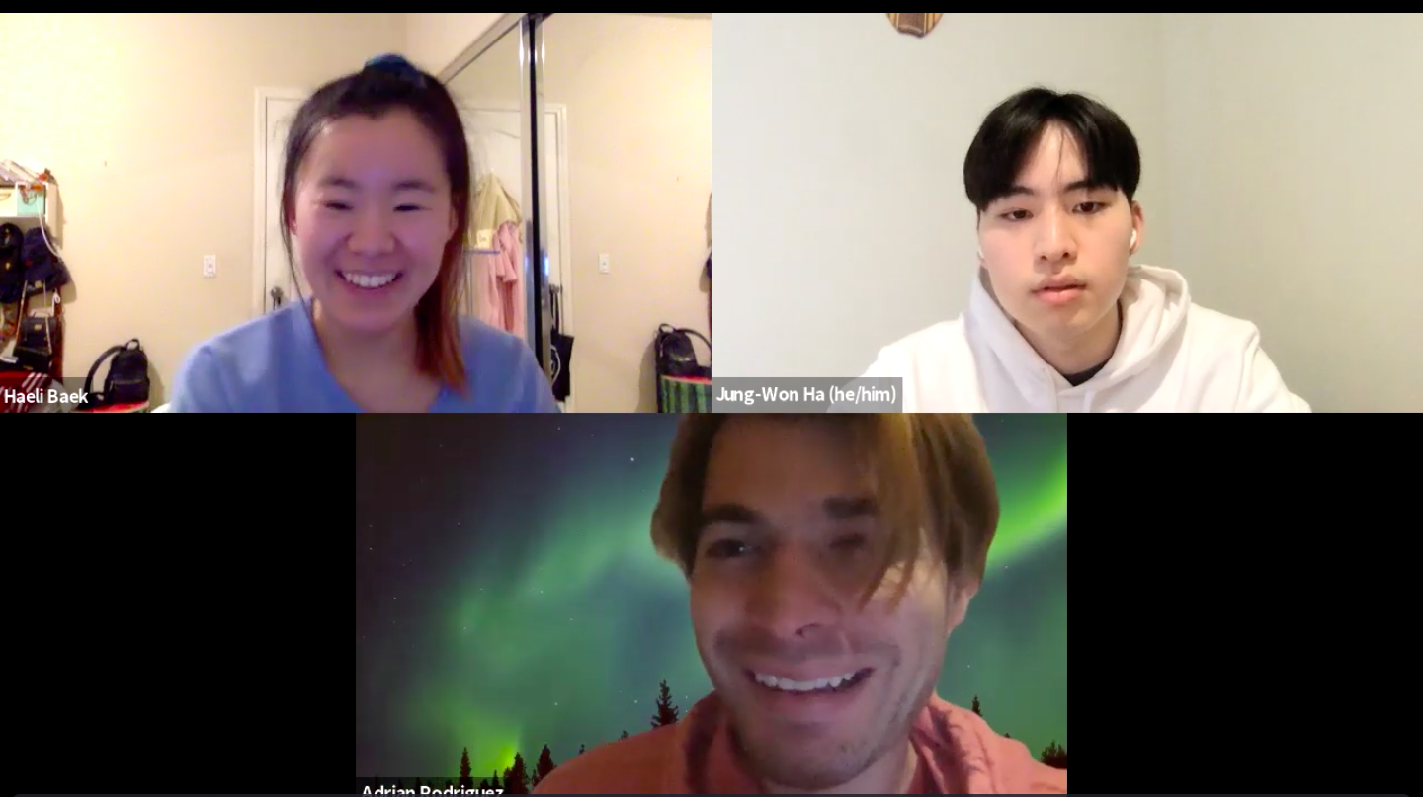
I want to build rapport. I want to engage and that’s very frustrating for me socially to not be able to, like, you know, greet people with confidence.
Adrian
Notes:
In the context of walking into a dimly lit room and not being able to tell the difference between looking at pillows on the couch or his friend.

Slide 12
Say
Can achieve ‘sweet spot’ with proper magnification and distance
Many technologies unnecessarily put users far away from the screen
Good graphic design makes a huge difference
Touch ID is more reliable than Face ID
Effective use of colors is essential
Intuitive design requires brain to do less work
Magnifier app on iOS is useful
Siri is the worst of all voice assistants
Tradeoff between location and accessibility when seeking apartments
Voice assistants can be very helpful for those visually impaired
Busy websites lead to mental cluttering
Inability to confidently perceive people hinders ability to build social rapport
Notes:
Jung-Won

Slide 13
Do
Uses Magnifier app on his phone to see things on his screen
Face was very close to the computer screen throughout interview
Utilizes Magnifier app for close and long distance vision (i.e. reading a menu + crosswalking)
Interviewee described having his chin directly above the touchpad of his laptop
Triple taps his phone screen to open the Magnifier app/Camera
Uses camera to take pictures of the menu at restaurants so he can zoom in later and read it
Constantly adjusting his relative distance and angle to the computer screen to gain focused vision
Manually types in iPhone password instead of using face ID because face ID won’t recognize his face close up
Body language was more engaged when talking about frustrations with lack of accessibility in everyday technologies
Notes:
Jung-Won

Slide 14
Think
Believes good graphic design is very important for increased accessibility
Utilizing color effectively is an essential, yet underappreciated tool
Voice assistants can overcome several visual boundaries with a single voice command
The social needs and desires of those visually impaired is not considered enough
Many websites could improve their designs and layouts to be more intuitive
Accessible design needs to become more widely accessible
Has to consider accessibility when looking for an apartment
The general population is unaware that there are various forms of visual impairment and needs differ accordingly
Accessible design has a lot of room for improvement
Many technologies unnecessarily put users far away from the screen
Magnifier app on iOS is a very useful, versatile tool
Notes:
Jung-Won

Slide 15
Feel
Feels frustrated for girlfriend who heavily relies on Siri
Thoroughly pleased by the new magnifier app on iOS
Annoyed by website designs that constantly require him to move back and forth from his screen to re-focus
Hopeful about the future of accessible design
Socially frustrating to not be able to greet people with confidence, hinders ability to build rapport
Feels disappointed that some video game sensors, such as the Wii, require you to be a certain distance away from the screen.
Feels disappointed in the Google Glass, as it wasn’t as user-friendly as he initially hoped
Thankful that we took the time to interview him about his unique relationship to technology and ux/ui design
Upset that specialized accessible technology is financially inaccessible
Notes:
Jung-Won

Slide 16
INSIGHT
Even though voice assistants and screen readers can overcome visual boundaries, inaccuracies and losses of interaction can make them less preferable.
NEED
It would be transformative for users to to experience visuals through other senses (e.g. speech) without sacrificing quality or interaction.
Notes:
Examples:
Adrian with Siri (weird search results that come up)
Michael with screen readers (doesn’t let him interact with images)
INSIGHT #1: SURPRISE, CONTRADICTIOIN
Even though voice assistants and screen readers can overcome visual boundaries, inaccuracies and losses of interaction can make them less preferable.
NEED
It would be transformative for users to to experience visuals through other senses (e.g. speech) without sacrificing quality or interaction.

Slide 17
INSIGHT
Devices that require people to be a certain distance away from the screen is very inaccessible, especially to those who can only see the screen up close.
NEED
It would be ground-breaking to help all people enjoy personal technologies regardless of their distance from the screen.
Notes:
Examples: Adrian with the Wii, exercise equipment, treadmill

Slide 18
INSIGHT
While each person has a different visual impairment and different things that work for them, highly specialized assistive tech can be frustrating in that it seems cut off from the rest of the world.
NEED
It would be game-changing to help users find individualized tools without disconnecting them from more universal, up-to-date technologies.
Notes:
Examples:
Michael’s thoughts about the microwave that talks
Michael’s Braille keyboard that only had Android 8
INSIGHT #2: SURPRISE, CONTRADICTION
While each person has a different visual impairment and different things that work for them, highly specialized assistive tech can be frustrating in that they seem cut off from the rest of the world.
A couple of us found this particularly surprising. Regarded it as a positive thing for assistive tech to be developed for specific users with certain disabilities, but we learned that might not always be the case.
Regarded it as a positive thing for assisti
ve tech to be developed for specific users with certain disabilities, but we learned that might not always be the case.
NEED
It would be game-changing to help users find individualized tools without disconnecting them from more popular, up-to-date technologies. INCLUSION

Slide 19
INSIGHT
A user’s relationship to assistive technology may change as their vision changes (e.g. improves with surgery, fades with age).
NEED
It would be revolutionary if there was a way for people’s relationships with assistive technology to adapt without having to learn entirely new methods or technologies.

Slide 20
INSIGHT
Not being able to detect the presence of others makes it hard to engage socially and build rapport.
NEED
It would be game-changing to provide a fast and easy way to detect the presence and identity of others in the same vicinity without having to visually see them.

Slide 21
Inferences and Questions
What proportion of visually impaired individuals don’t find voice assistance in technology helpful? Why?
Taking into consideration that everyone with visual impairments has different accommodations and preferences as to what is helpful to them, how do we design in a way that provides more accessibility rather than constraints?
It’s possible that devices that are set up and designed in such a highly specialized way are overdone and not as helpful as commonly perceived.

Slide 22
Summary
Magnification and color schemes are powerful tools
It’s important for devices to be flexible and allow users to be different distances from the screen.
Every visually-impaired person has different technological preferences about what works for them
Increasing the accessibility of technology that already exists could help with social connection and inclusion, instead of only designing tech specifically for the visually impaired

